Slide 1
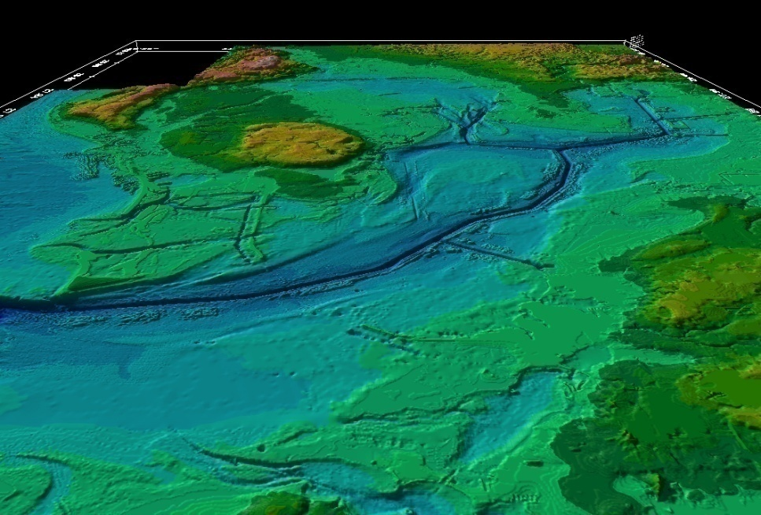
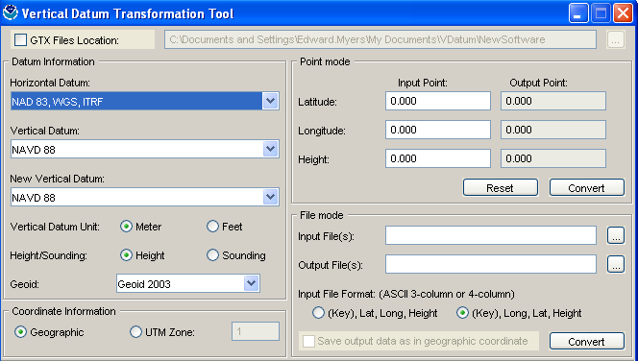
Development and Use of VDatum -
a Vertical Datum Transformation Tool
NOAA’s
National Geodetic Survey
Office of Coast Survey
Center for Operational Oceanographic Products & Services
Mapping the Land-Sea Interface
Notes:
Vertical Datum Transformation (VDatum) is a free software tool under development jointly by NOAA's National Geodetic Survey (NGS), Office of Coast Survey (OCS) and Center for Operational Oceanographic Products and Services (CO-OPS).
VDatum is designed to transform geospatial data among a variety of tidal, orthometric and ellipsoidal datums - allowing users to convert their data from different references to a common system ,
This helps to enable the fusion of a diversity of geospatial data onto a preferred vertical datum.

Slide 2
Tri-Office VDatum Team
CO-OPS
Manoj Samant – Operations Team Lead
Steve Gill (Development)
Jerry Hovis (Development & Operations)
Lijuan Huang (Operations)
David MacFarland (Operations)
Mike Michalski (Development & Operations)
Laura Rear-McLaughlin (Operations)
Hua Yang (Operations)
David Wolcott (Production)
James Taylor (Production)
NGS
Doug Brown- Program Manager
Eric Berkowitz (Development)
Steve Randall (Development & Operations)
Stephen White (Development)
Chris Parrish (Development)
Tom Soler (Development)
Bang Le (Development & Operations)
Joe Evjen (Operations)
Inseong Jeong (Development)
OCS
Maureen Kenny – Development Team Lead
Ed Myers (Development)
Kurt Hess (Development)
Corey Allen (Operations)
Julia Skory (Development)
Jiangtao Xu (Development)
Zizang Yang (Development)
Notes:
The slide shows the people from each office who are in some way involved in the VDatum Program (as of January 2011).

Slide 3
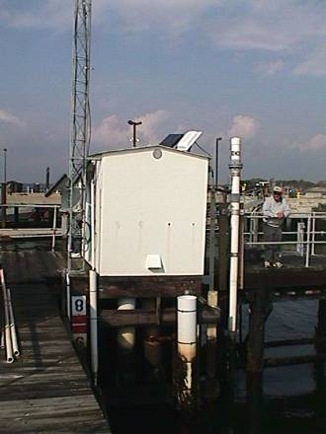
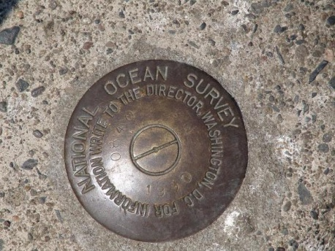
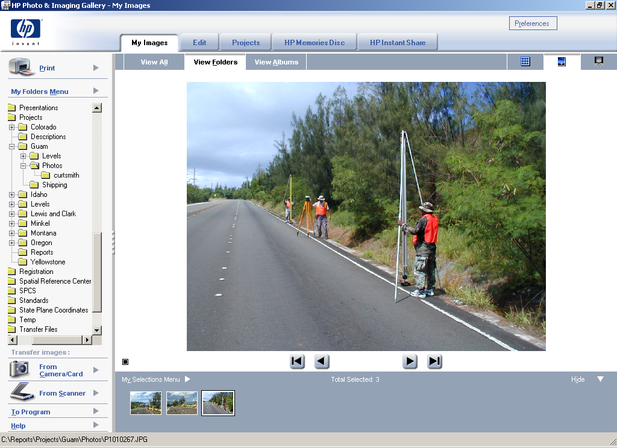
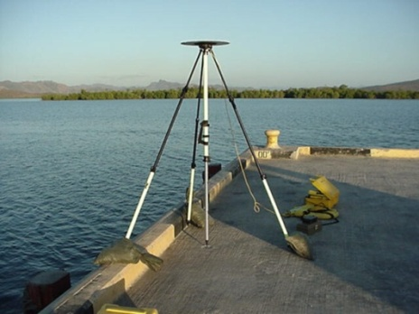
Vertical Datums - 3 height systems
A level surface to which elevations are referred.
Tidal Datums (Tide Stations)
  Defined by observation of tidal variations over a specified epoch of time
    Mean Lower Low Water (MLLW)
    Mean Sea Level (MSL)
Orthometric Datums (Leveling)
  Related to the Geoid model of the Earth
  Heights from differential leveling
    North American Vertical Datum 1988 (NAVD 88)
Ellipsoidal (3-D) Datums (GPS)
  Related to an ellipsoidal model of the Earth
  Heights directly from GPS
    North American Datum 1983 (NAD 83)
Notes:
This is the first of 6 slides that provide background on datum as a lead into a more detailed discussion of VDatum…
Most of the transformations offered by the VDatum tool are for vertical datums.
A vertical datum is a level surface to which elevations are referred, usually, MSL but may also include MLLW for charting purposes, MHW for shoreline delineation, or any arbitrary surface.
Tidal datums are defined by the observation of tides over a 19 year period. MLLW and MSL are tidal datums.
Orthometric datums are associated with the geoid model of the Earth and traditionally acquired by differential leveling. NAVD 88 is an orthometric datum.
Ellipsoidal datums are related to the ellipsoidal model of the Earth with heights derived from GPS. NAD 83 is an ellipsoidal datum.
The slide illustrates examples of each type of datum.

Slide 4

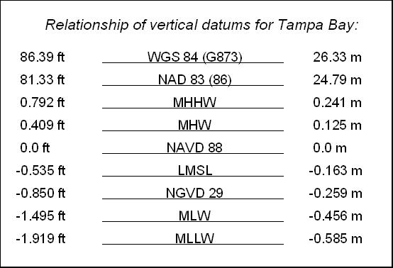
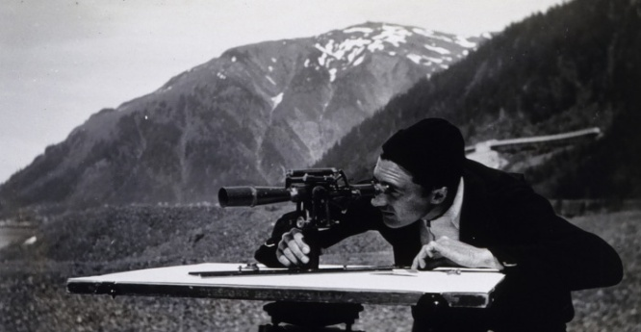
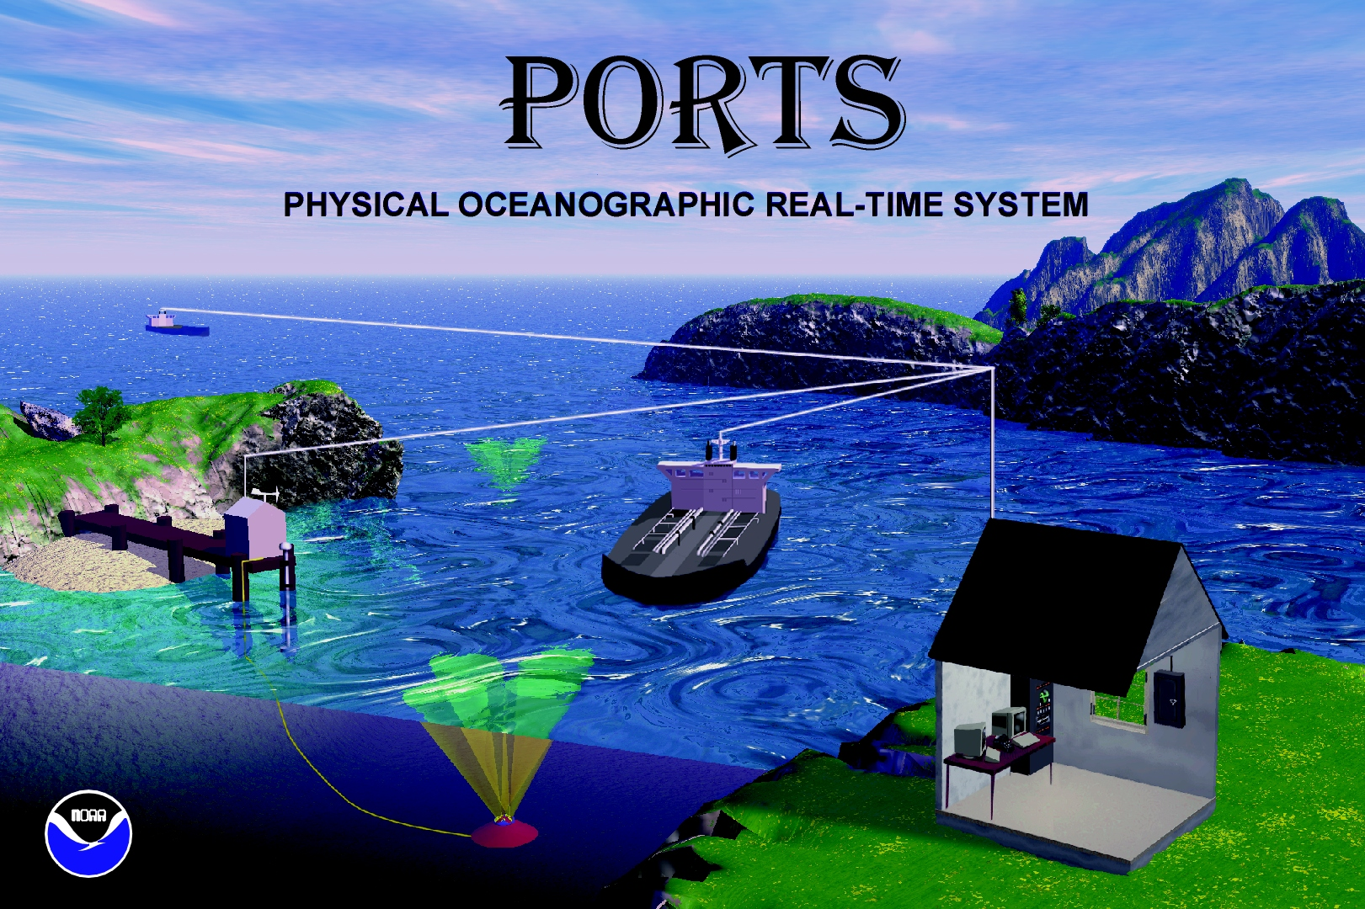
All elevation data is referenced to a vertical datum.
Ellipsoid Datums
BUT there are a many different vertical datums in use around the nation
WGS 84,
NAD 83 (NSRS)
+17 others
```
(CORS 96)
Orthometric Datums
(MSL)
NAVD 88, NGVD 29
Tidal Datums
For elevation data sets to be blended together they must be referenced to same vertical datum.
MHHW, MHW, MTL, DTL, LMSL, MLW, MLLW
Notes:
There are many different vertical datums in use around the Nation.
This slide illustrates in which of the three categories some of the major datums fall and the observing systems on which they are based (on the far right), and their vertical relationships with respect to NAVD 88 (down the center of the slide).

Slide 5
Heights
H = Orthometric Height (NAVD 88)
H = h - N
h = Ellipsoidal Height (NAD83)
N = Geoid Height (Geoid09)
Physical Earth
H
h
N
MLLW
GEOID 09
Geoid
Ellipsoid
GRS80
Notes:
The slide speaks to heights determined from different reference surfaces or datums.
VDatum transforms GPS-derived ellipsoid heights (and depths) to preferred datums for surveying, mapping, and charting.
As depicted in the slide, the geoid separation (“N”) is negative in value with respect to the ellipsoid, which means that the formula for determining the orthometric height shown is really the ellipsoid height PLUS the geoid height.

Slide 6
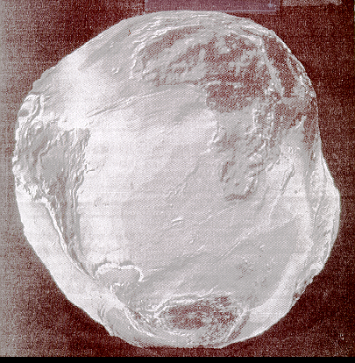
Why do we need an ellipsoid?
This image depicts the earth’s shape without water and clouds.
Calculation of geographic position on this irregular surface is very complex. A simpler model is needed.
This simplified mathematical surface is the ellipsoid.
Notes:
The ellipsoid (in red) is a simplified mathematical surface that helps in positioning, given the Earth’s irregular surface.
GPS positions are based on the ellipsoid.

Slide 7
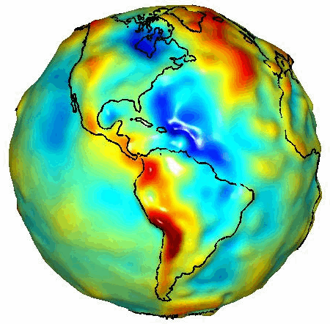

What is the Geoid?
Equipotential
Surface
of Gravity
GRACE Gravity Model 01
- Released July 2003
Notes:
The Geoid is an equipotential surface representing the effect of gravity around the globe.
In some places, the effect (or pull) of gravity is more than other places.
The effect of gravity is generally greater in mountain regions, but also an important factor in achieving VDatum model accuracy in coastal regions.
An accurate geoid is necessary in order to compute heights and depths that account for the effect of gravity.
NGS develops models of the Geoid on a continuing basis.

Slide 8

VERTICAL TIDAL DATUMS
Elevation only has meaning when referenced to some starting point.
LMSL Elevation
Mean Higher High Water
Mean High Water
Local Mean Sea Level
Mean Low Water
Mean Lower Low Water
Notes:
Elevation only has meaning when referenced to a starting point.
In this case, the starting point is LMSL for the elevation value at the top of the hill.

Slide 9
Vertical Datum Transformation “Roadmap”
Orthometric Datums
3D Datums
Tidal Datums
WGS 84 (G1150)
Calibrated Helmert Transformations
WGS 84 (G873)
NGVD 29
WGS 84 (G730)
Tide Models
MHHW
WGS 84 (orig.)
ITRF2000
VERTCON
MHW
ITRF97
ITRF96
NAD83 (CORS96)
NAVD 88
LMSL
MTL
ITRF94
ITRF93
DTL
ITRF92
ITRF91
MLW
ITRF90
GEOID99,
GEOID03,
GEOID09
MLLW
ITRF89
TSS
(Topography of the Sea Surface)
ITRF88
SIO/MIT 92
NEOS 90
PNEOS 90
Notes:
This is the VDatum “roadmap”, which illustrates how different datums are transformed from one to another.
Helmert Transformations are used to transform between 3D ellipsoidal datums.
A GEOID model is used to transform data on NAD83 to an orthometric datum like NAVD 88.
A model of the “Topography of the Sea Surface” is used to transform NAVD 88 to LMSL.
A corrected tide model is used to transform from LMSL to a variety of other tidal datums.

Slide 10
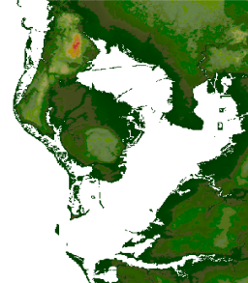
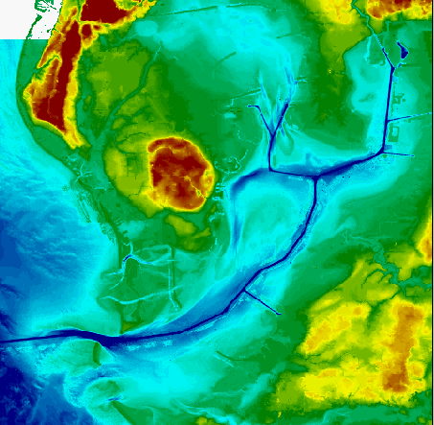
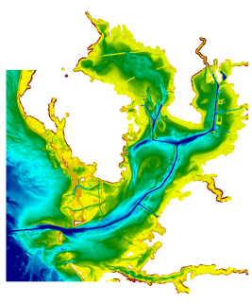
VDatum Used to Create Digital Elevation Models
Bathy/Topo
Digital Elevation Model
Topography
VDatum
Bathymetry
Applications for Seamless Bathy/Topo Datasets:
Inundation modeling from storm surge, tsunamis, and sea level rise.
Erosion, accretion, renourishment
Analyzing storm impacts
Determining setback lines
Determining local, state, and national boundaries
Navigation products and pervices
Habitat restoration
Shoreline change analysis
Analyzing environmental and natural resources
Permitting
Notes:
Merging data sets in coastal areas is important in a range of applications, which are shown at the bottom of the slide.
VDatum enables spatial information from different environmental sectors such as topographic and bathymetric data to be mapped onto one uniform surface.
This is why VDatum is considered an enabler of IOCM.

Slide 11
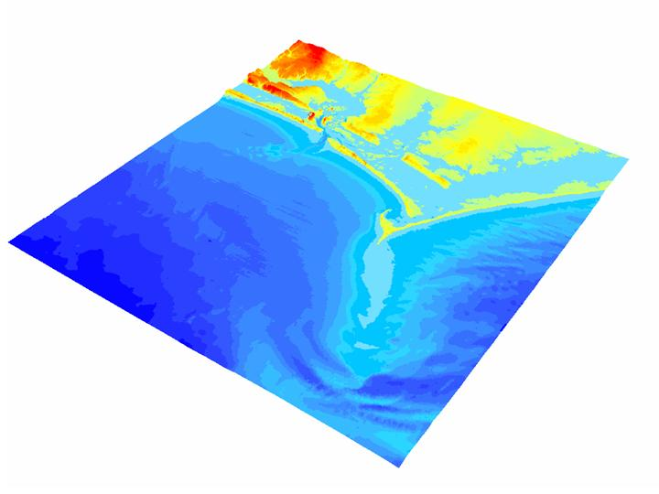
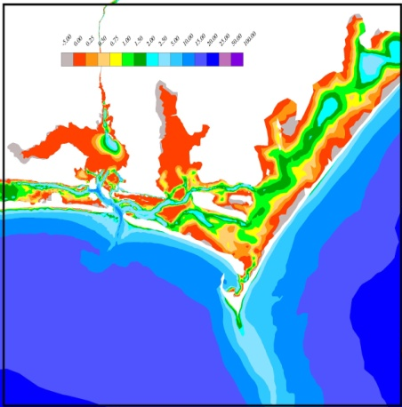
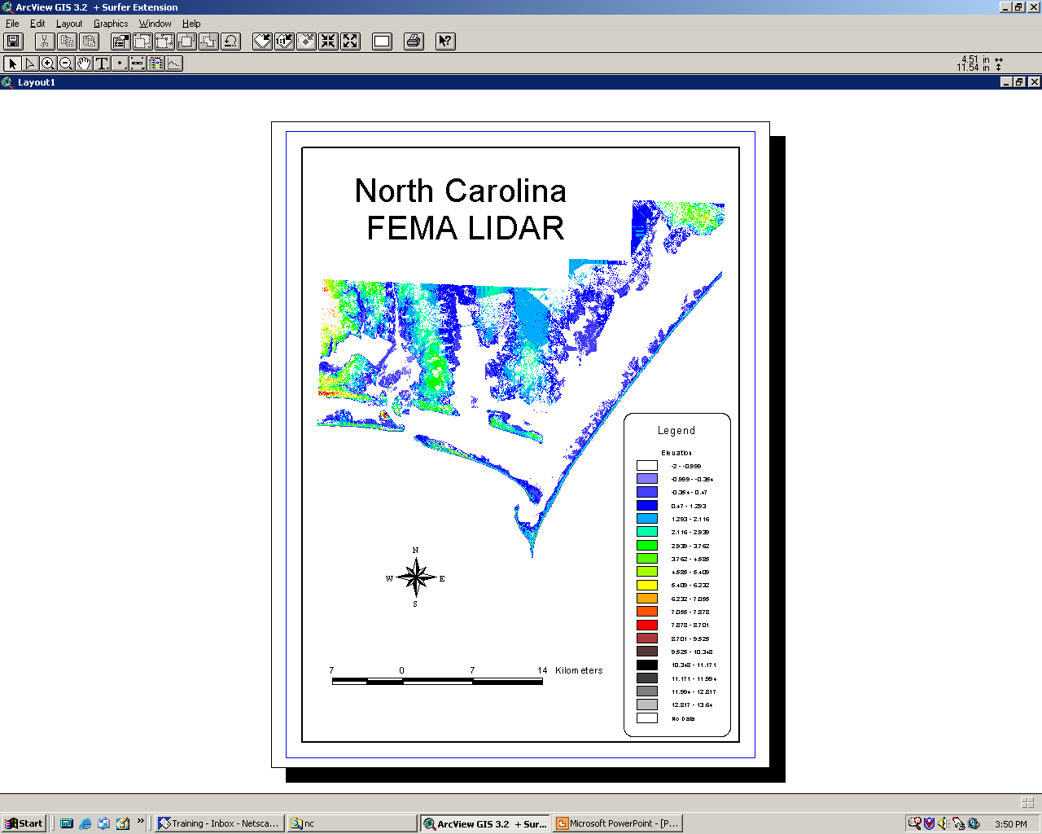
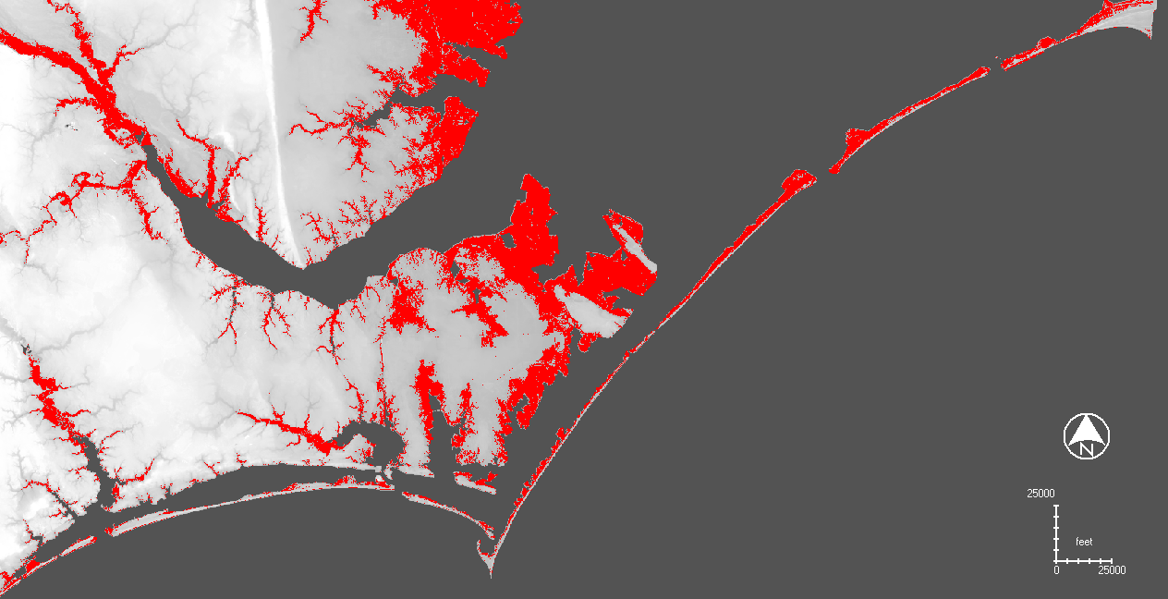
North Carolina Sea Level Rise Project –
a VDatum application
Create an integrated bathy/topo DEM
to assess sea level rise
NOAA
Bathymetry
Land
Elevations
Areas inundated
with a 1.0 m SLR
Notes:
This is an example of where VDatum was used to merge existing spatial datasets including NOAA bathymetry & FEMA Lidar along the NC coast.
The VDatum tool allowed the vertical datum issues to be resolved and for the creation of a seamless model of topography and bathymetry.
Using this model, sea level rise scenarios can be analyzed.

Slide 12
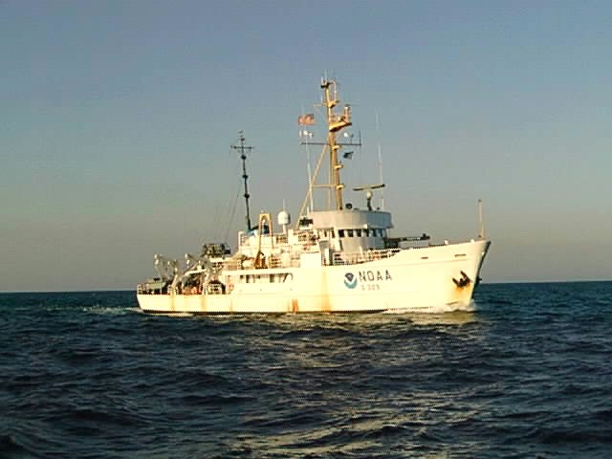
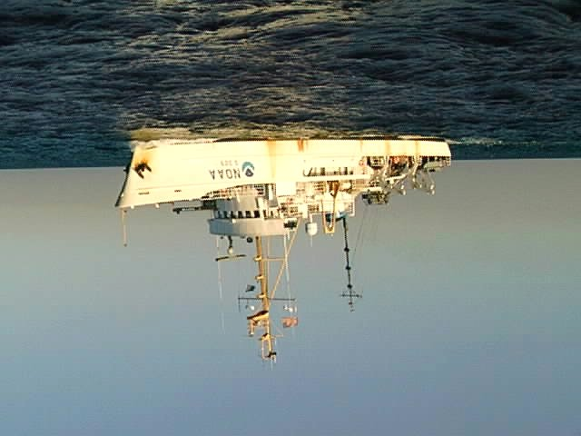

Surveying on the Ellipsoid
Advantages
  Eliminate labor intensive tidal zoning
  Reduce vertical uncertainty from heave, dynamic draft
Ellipsoid
MEASURED
KNOWN
using
VDatum
KNOWN
MLLW
COMPUTED
(depth MLLW)
MEASURED
Notes:
Surveying on the Ellipsoid is an important application of VDatum for NOAA, the Corps of Engineers and other hydro surveying organizations.
It holds the promise of acquiring hydrographic survey depths using kinematic GPS for vertical referencing.
In other words, it will allow hydrographic surveyors to determine the water depths related to a charted tidal datum directly from GPS observations, without having to determine the chart datum from measuring discrete tides.
By surveying on the ellipsoid, uncertainties resulting from vessel heave and dynamic draft can also be accounted for.

Slide 13
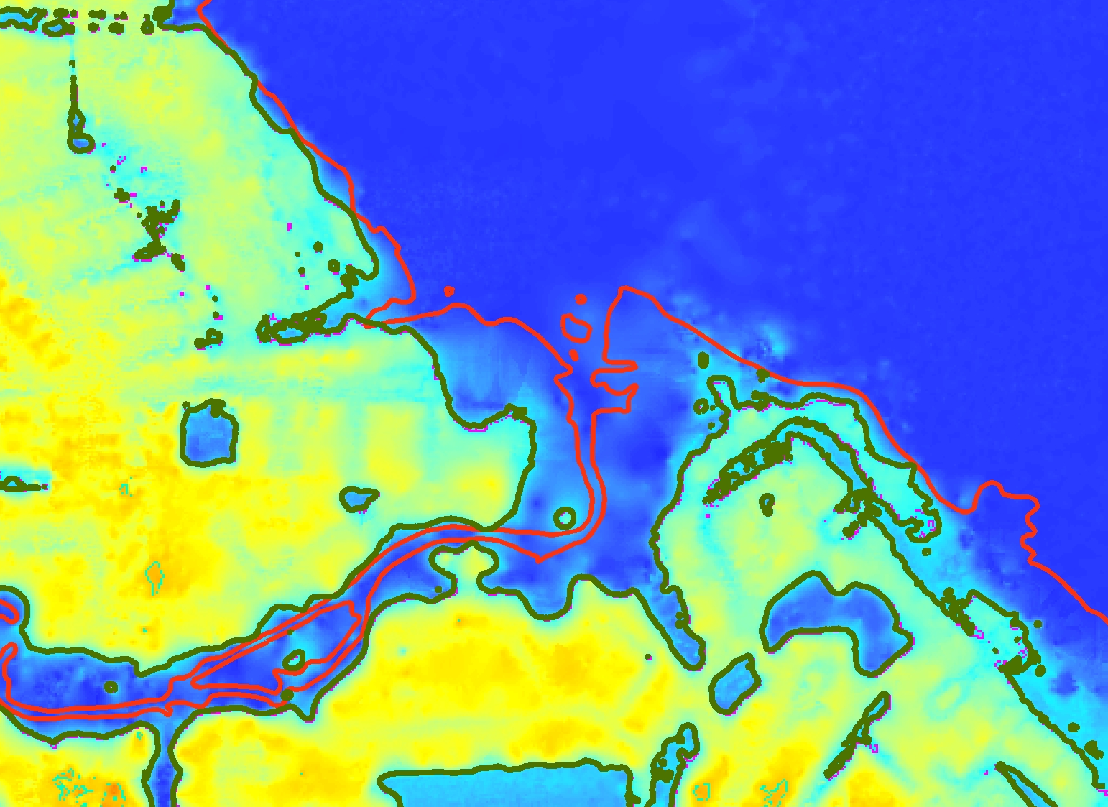
LIDAR can be used to Accurately Measure MHW and MLLW Shorelines
Consistent Shoreline
NOAA T-Sheet MHW shoreline (1977)
first true consistently-
defined MHW shoreline
can utilize topographic
LIDAR data from many
sources
can also measure MLLW
from bathymetric LIDAR
true interface between
bathymetry & topography
0 m contour is MHW shoreline (present)
Notes:
Another application of VDatum is with LiDAR imagery.
Since LiDAR imagery is based on GPS, VDatum can reconcile the imagery to a selected vertical datum.
In this case, the VDatum tool was used to establish the MHW line from present day topographic (or “dry”) LiDAR imagery;
It shows a significant difference from the MHW shoreline as charted on a NOAA Topographic Sheet dated 1977.
VDatum can also be used to determine a chart datum, such as MLLW, from bathymetric (or “wet”) LiDAR.

Slide 14
Maritime Boundaries
AL, AK, CA, CT, FL, GA, MD, MS, NJ, NY, NC, NH, OR, RI, SC, WA
Territorial Sea
Privately Owned
Uplands
State Owned
Tidelands
Contiguous Zone
US EEZ
(fisheries)
Exclusive Economic Zone (international)
State Submerged Lands
Outer Continental Shelf
3 n. mi.*
High Seas
12 n. mi.
MHHW
24 n. mi.
MHW
200 n. mi.
MLLW
Chart Datum
Privately
Owned
State
Owned
Privately
Owned
State
Owned
HI, LA, TX
* TX, the Gulf Coast of FL, and Puerto Rico claim submerged lands to 3 marine leagues or 9 n. mi
DE, MA, ME, PA, VA
Notes:
This slide summarizes the importance of determining tidal datums.
They are a reference for so many economic activities.
For example, most states consider submerged lands to start at the MHW and run seaward to the 3 mile limit.
Permitting of piers, docks, and other structures in submerged lands is an important source of revenue for states.

Slide 15
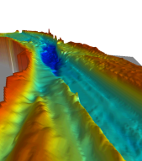
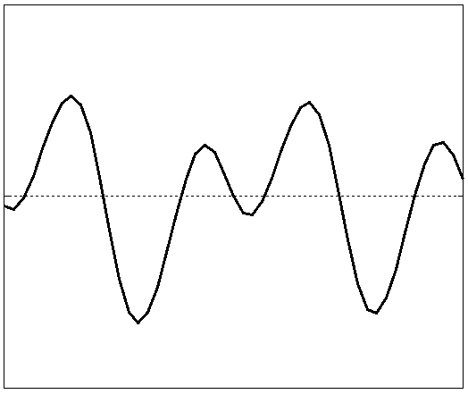
Steps to VDatum
Assess tidal & geodetic needs (CO-OPS)
Acquire base observational data (Tri-Office)
Model tidal datum variations across region (OCS)
Build topography of the sea surface (NGS)
Build grid of all transformations (OCS + NGS)
Determine uncertainty of model (OCS)
Notes:
This is the first of several slides devoted to production of a VDatum model…
Developing a VDatum model is NOT an easy process.
It starts with assessing the tidal and geodetic needs for developing a VDatum model of a specific region.
Based on the assessment, observational data are collected.
This includes tide guage data over a period of at least a month
… and GPS observations of BMs tied to the tide guages,
… and updates to the geoid model based on any GRAV-D data available.

Slide 16
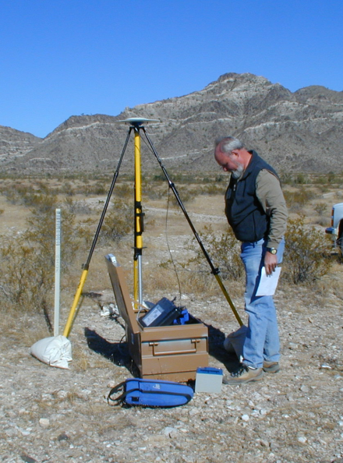

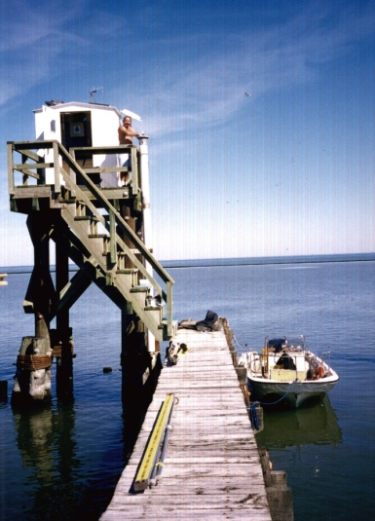
Base Observational Data
GPS observations
Leveling data
Gravity data
Water level data
Notes:
This illustrates the base observational data and the manner in which it is collected

Slide 17
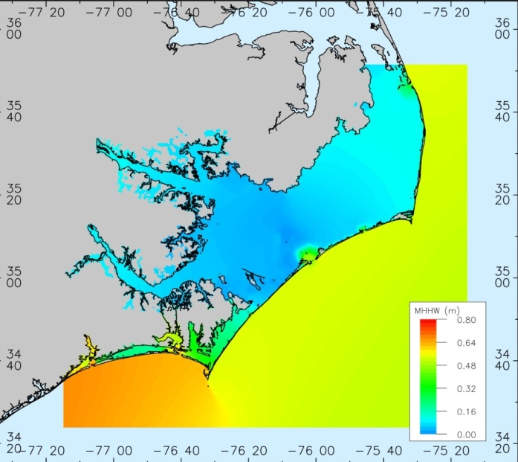
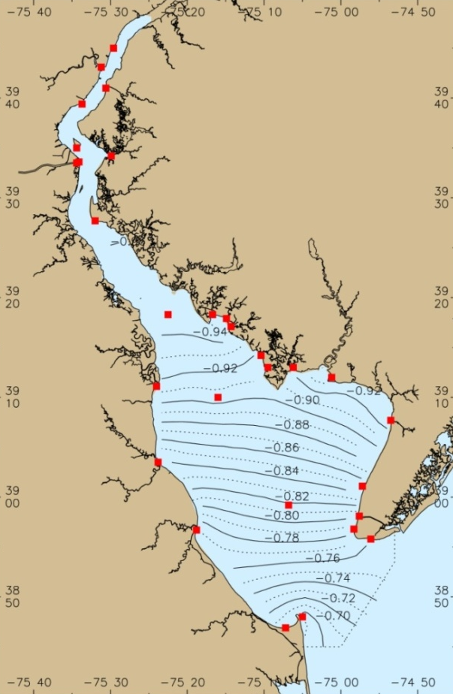
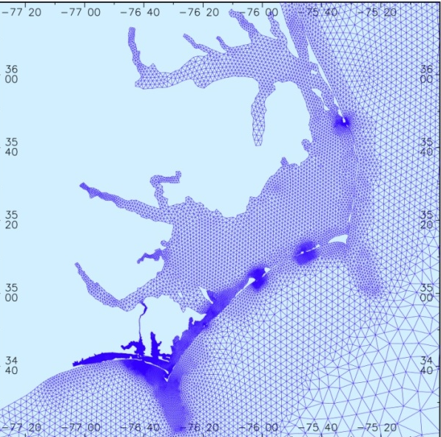
Computing Tidal Datum Variations
1. Hydrodynamic Model
2. TCARI: Tidal Constituent
And Residual Interpolation
MSL to MHHW
MSL to
MLLW
Solves dynamic equations of water flow - used when tide information is sparse (more accurate)
Spatial interpolation –
used when historical tide
information is dense
Notes:
The next step in the production process is computing tidal datum variations.
Tidal datum variations can be modeled using two basic approaches:
Using hydrodynamic models to simulate a time series of water levels from which high and low waters can be extracted.
Mean values of the highs and lows can then used to create a 2-dimensional field of any particular tidal datum.
Hydrodynamic models can be used across a wide variety of tidal ranges but are computationally intensive.
(2) The 2nd approach is using the Tidal Corrector Application software (TCARI) , which simply interpolates datums between locations of tide stations to create a 2-dimensional field.
TICARI works best in long, narrow embayments where there are many tide stations in the area, like Delaware Bay.

Slide 18
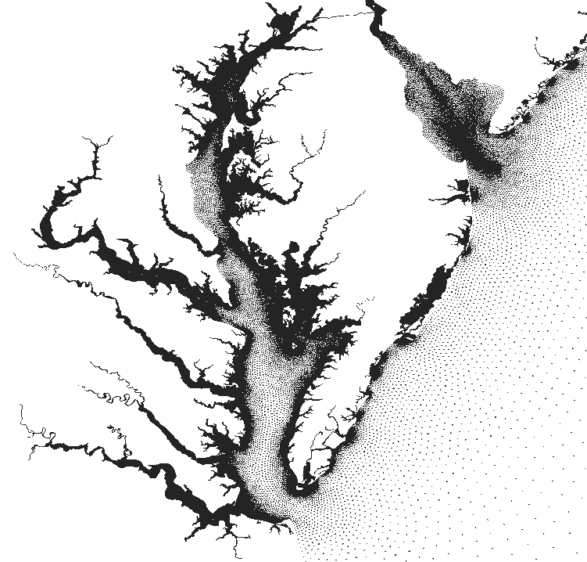
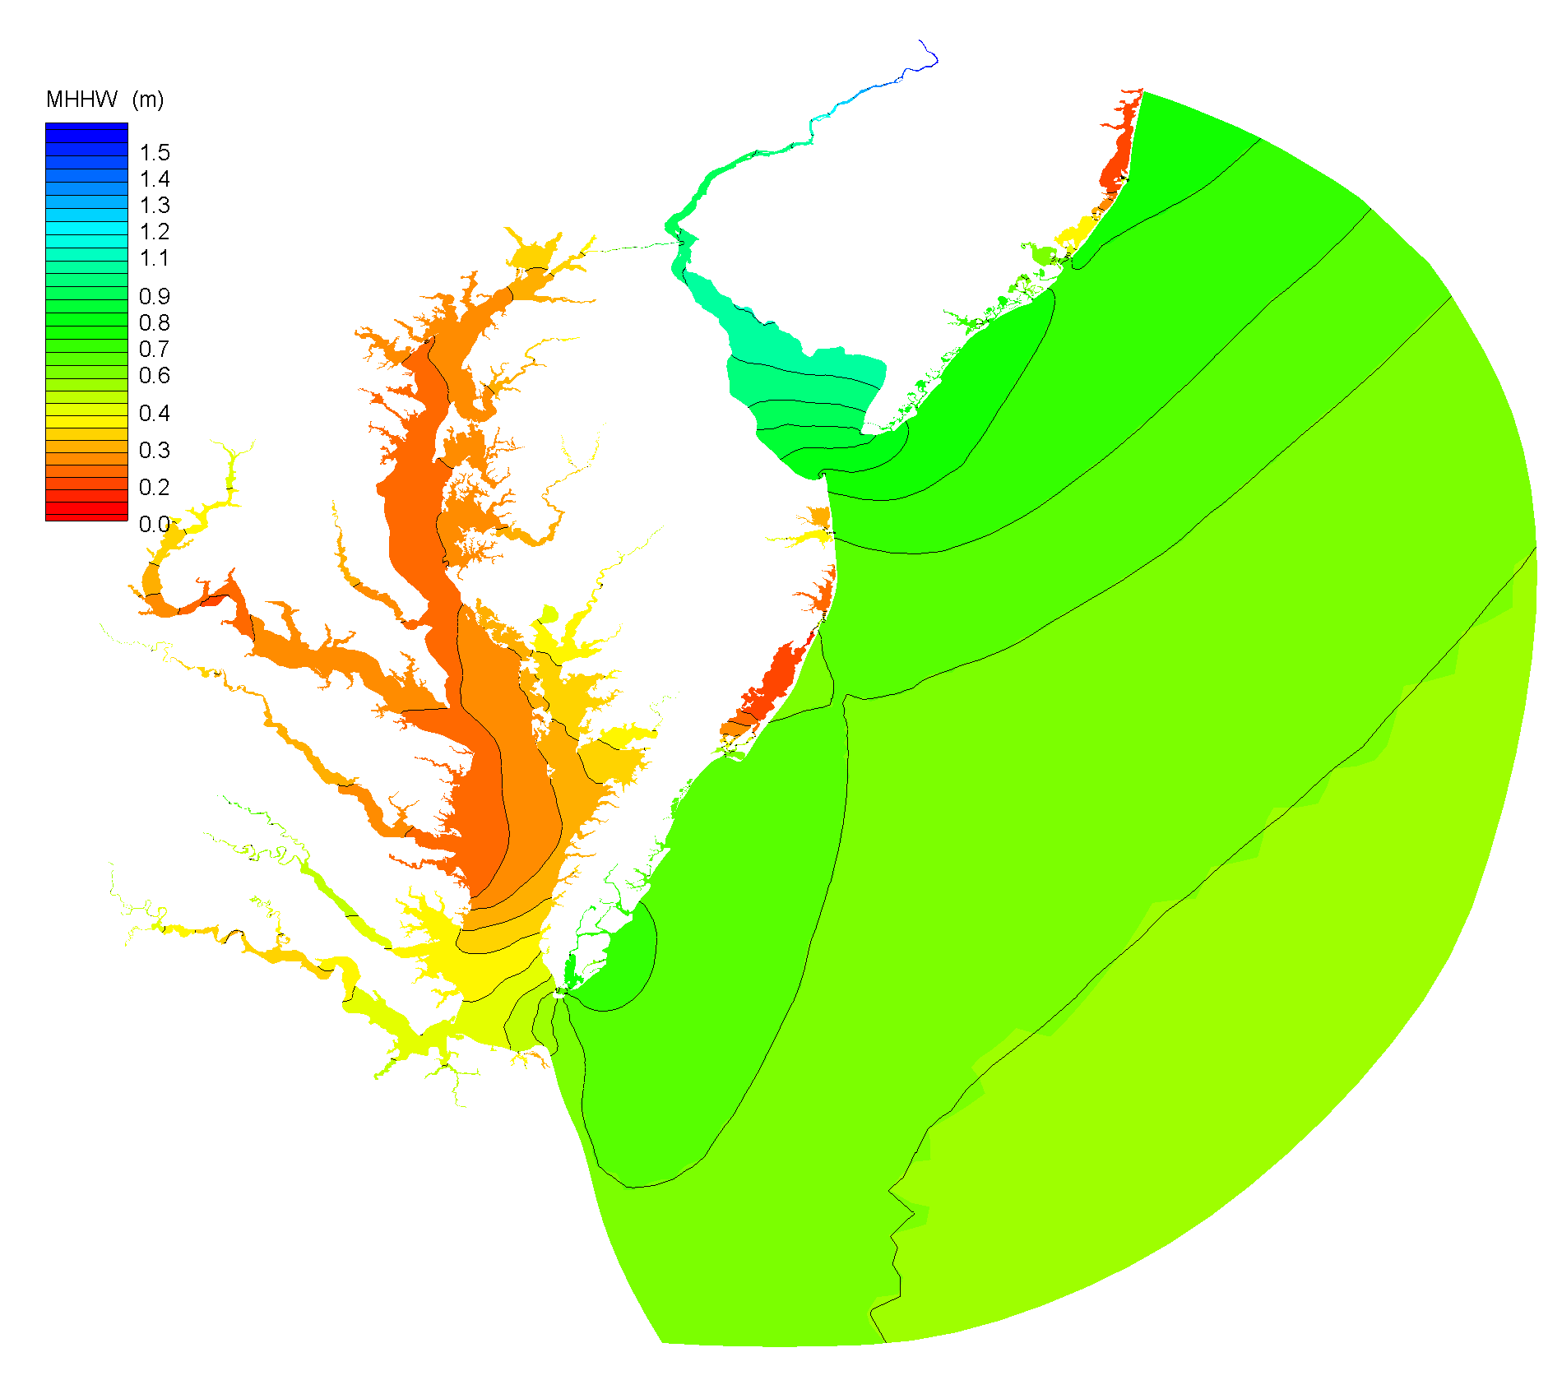
Generation of Tidal Datum Fields
ADCIRC model is used to generate time series of the tides at each grid point.
Final tidal datum fields are corrected to match observations at CO-OPS water level stations.
Corrections are made using TCARI, an interpolation tool based on solution of Laplace’s equation.
Higher High Water
Tidal datums are computed from the time series at each grid point.
High Water
Low Water
Lower Low Water
Notes:
The generation of the tidal datum fields (e.g., MHW, MLW, and MLLW) is currently
done through a blended approach, using a hydrodynamic model referred to as “ADCIRC”
and the TCARI program.
The ADCIRC model is used to generate a time series of the tides at each point in the field.
… and tidal datums are computed from the time series at each point.
Discrepancies between the model results and datums derived from CO-OPS tide guage
observations are interpolated with TCARI and applied to the model results to achieve
error corrected tidal datums.

Slide 19
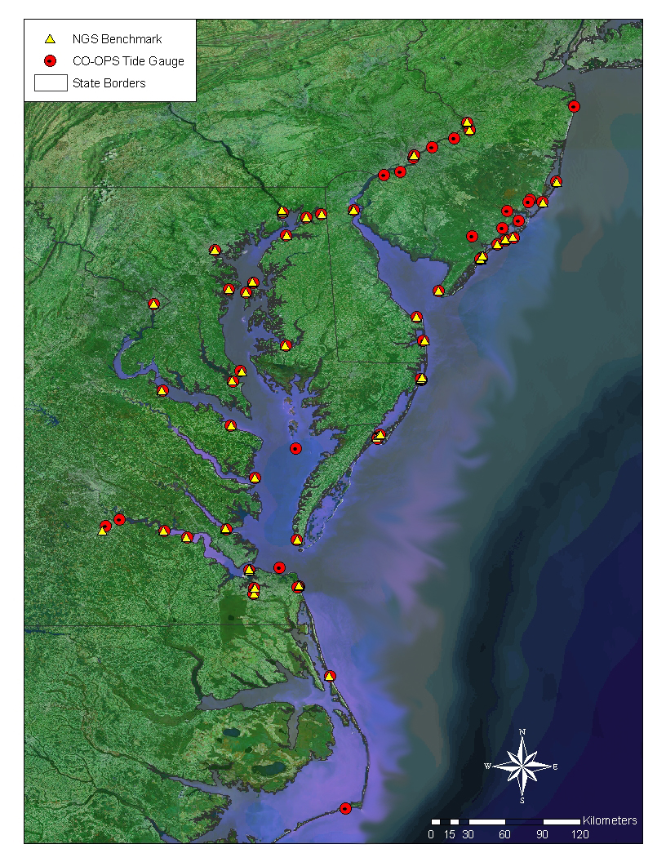
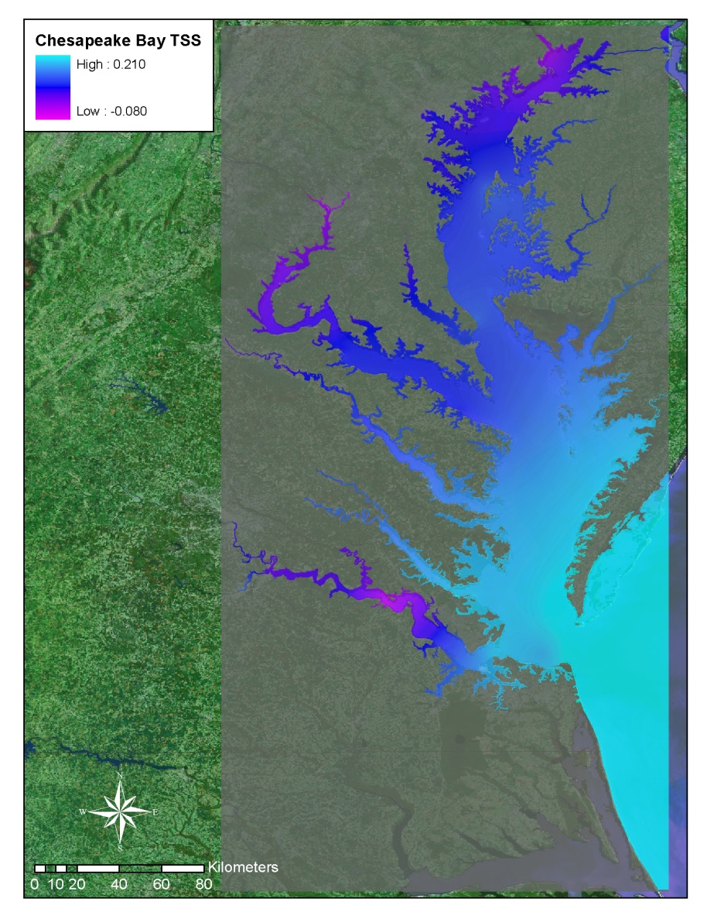
Topography of the Sea Surface
Defined as the difference between NAVD 88 and local mean sea level
Observed NAVD88-MSL differences at benchmark locations are spatially interpolated using a minimum curvature algorithm
Notes:
Developing the Topography of the Sea Surface (TSS) is the next step.
It is defined as the elevation of the North American Vertical Datum of 1988 (NAVD88) relative to local mean sea level (LMSL).
In the VDatum Road Map, this grid allows for the transformation of NAVD 88 based data to LMSL over the region.
A positive value specifies that the NAVD88 reference value is further from the center of the Earth than the local mean sea level surface.

Slide 20
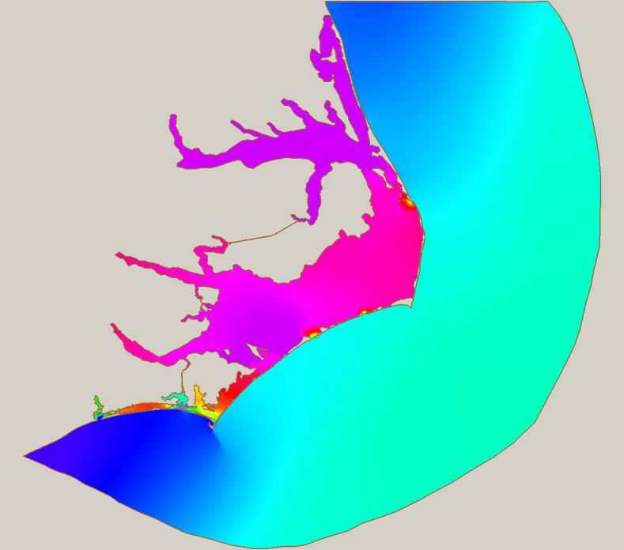
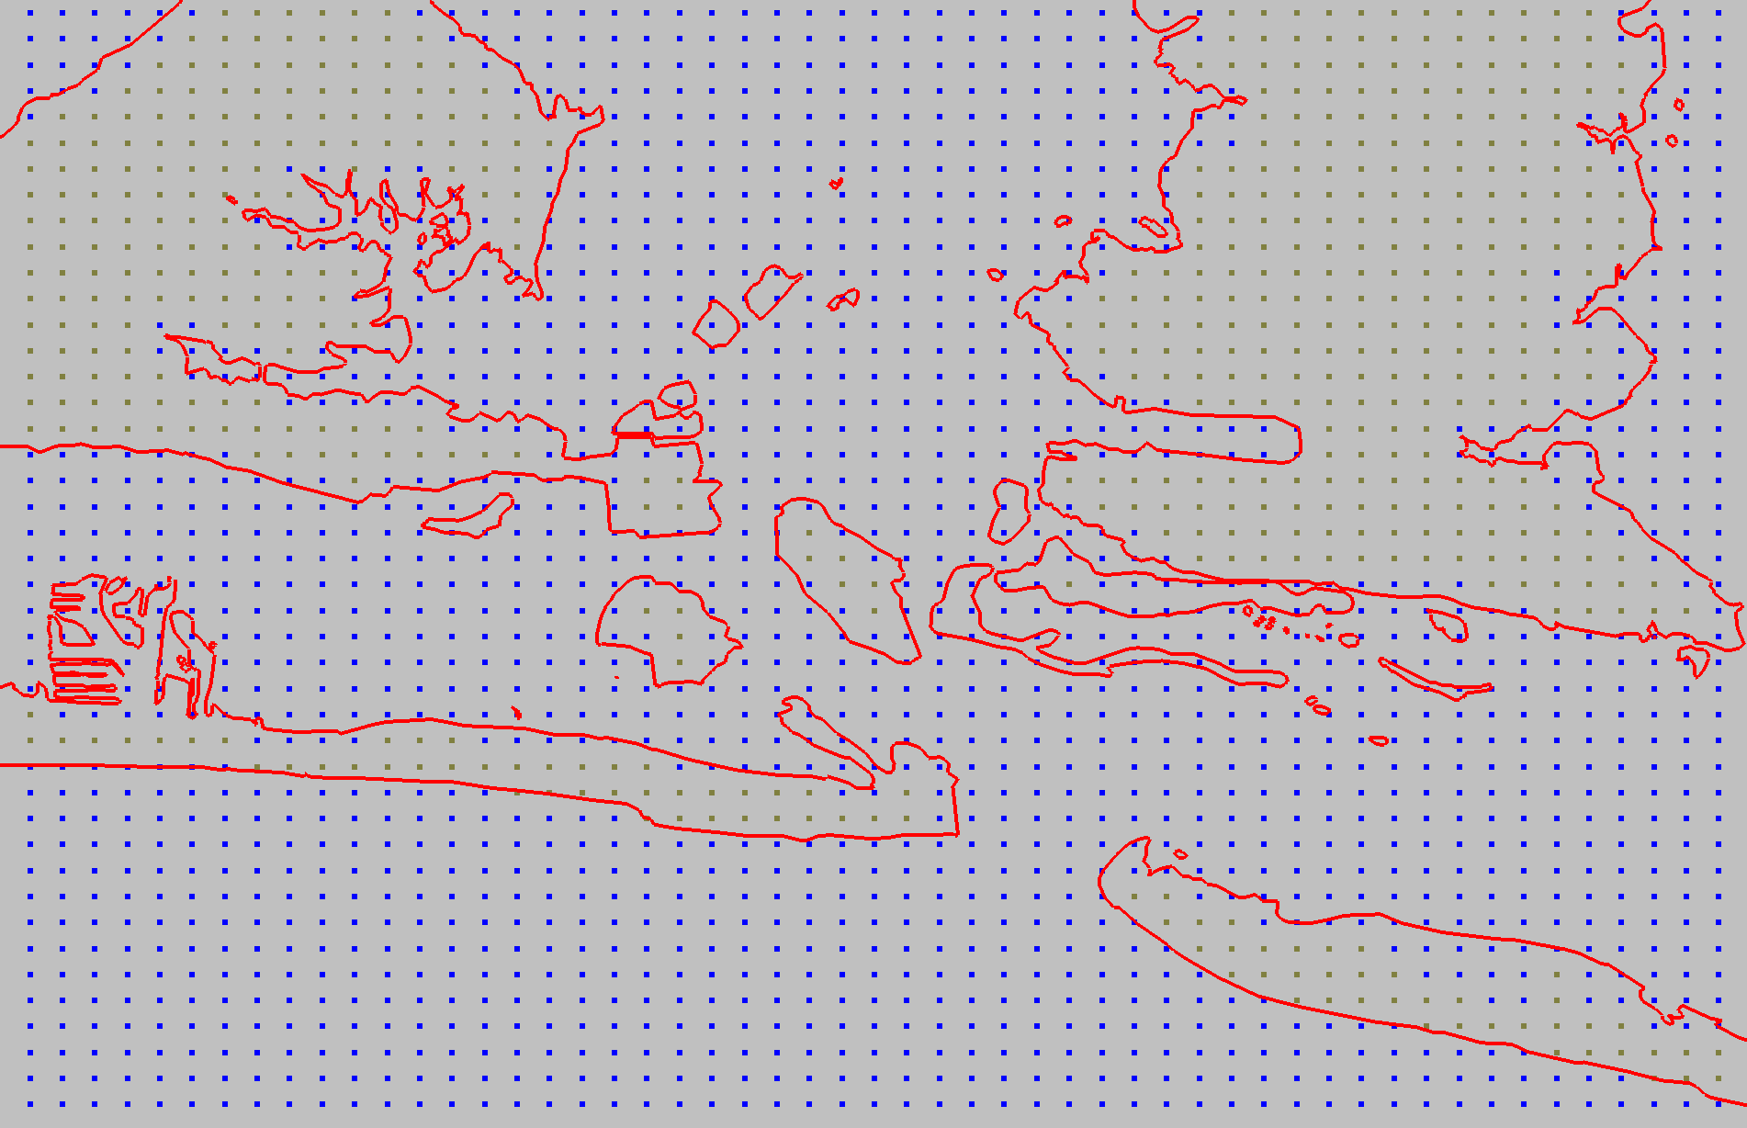
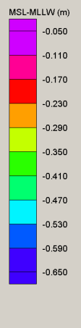
Building a grid of all transformations
Modeled Tidal Datum Fields
VDatum Marine Grid
Datum transformations provided on regularly structured grids to VDatum:
Modeled tidal datum fields
Topography of the Sea Surface (NAVD88 – to – LMSL field): spatially interpolated using benchmark data and a minimum curvature algorithm
VERTCON transformations between NAVD88 and NGVD29
GEOID models
NADCON horizontal datum transformations
Notes:
Referring back to the Road Map… everything except Helmert transformations (between ellipsoid 3-D reference systems) are put on a grid ->
The orthometric and tidal datums are transformed on regularly structured grids as illustrated by on the right.
The modeled tidal datums and TSS are placed on a marine grid or “null” mask. The null areas are where the land appears on the marine grid and used to denote where transformations of these datums are not allowed.

Slide 21
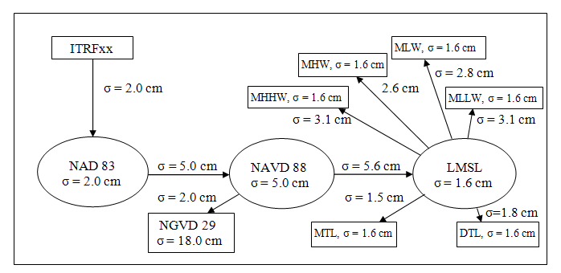
Uncertainty has been calculated for
transformations across the full process (at 1σ)
Chesapeake Bay Region
Ellipsoid
Orthometric
Tidal
Notes:
Users of VDatum must be aware of the uncertainties, or errors, in computed heights in the models.
Errors in VDatum may arise from inaccuracies in either the gridded fields used in the datum transformations, such as GEOID03 , or the MSL to MHHW tidal transformation,
… or inaccuracies may result from the source observational data used to create VDatum, such as the elevation of the tidal datums or the height of the North American Vertical Datum of 1988 (NAVD 88).
The standard deviation (Greek letter sigma) is used to quantify the uncertainty in both the vertical datums and the transformations between them. Standard deviation is a simple measure of the average size of the errors in a data set (when errors are normally distributed)

Slide 22
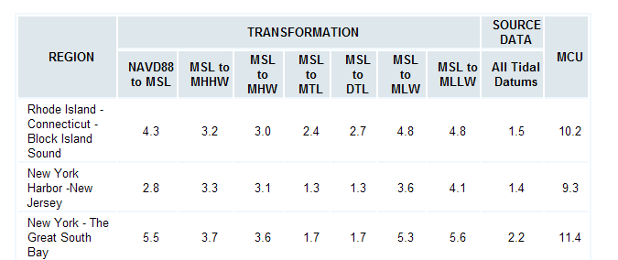
And combined to give
a maximum uncertainty
Evaluated at the water level stations only
Still need to define uncertainty away from stations (for example, in center of bay)
Notes:
And these uncertainties combined together amount to the Maximum Cumulative Uncertainty, or MCU, for converting data from the ellipsoidal to the tidal datum.
These uncertainty values are in centimeters.
And, very important, the uncertainties in the tidal transformations are based on data collected at the tide gauge only.
… Uncertainties away from the gauges are not accounted for. This is an task that is being undertaken this Fiscal Year.

Slide 23
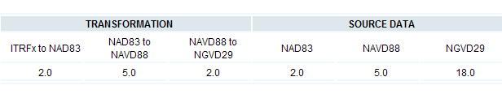
Uncertainties that are constant for all VDatum regions of the U.S.
Notes:
These are the uncertainty estimates that are constant and apply nationwide to all VDatum models.

Slide 24
Ellipsoid to MLW/MLLW Transformations
In VDatum, these transformations are made:
Issues to be aware of:
Ellipsoid to Geoid (Geoid model)
Geoid to local MSL (Topography of the Sea Surface)
Local MSL to MLLW (corrected tide model)
Accuracy of geoid model
Accuracy of TSS and tidal datum fields (dependent on data availability and characteristics of the tidal/TSS variations in a region)
H
h
N
MLLW
GEOID 09
Geoid
H = Orthometric Height (NAVD 88)
h = Ellipsoidal Height (NAD 83)
Ellipsoid
GRS80
N = Geoid Height (Geoid09)
H = h - N
Notes:
This slide summarized the issues to be aware of in transforming data from ellipsoidal reference to a chart datum such as MLLW.
With the introduction of a gravimetric-based geoid, it will further reduce uncertainties.

Slide 25
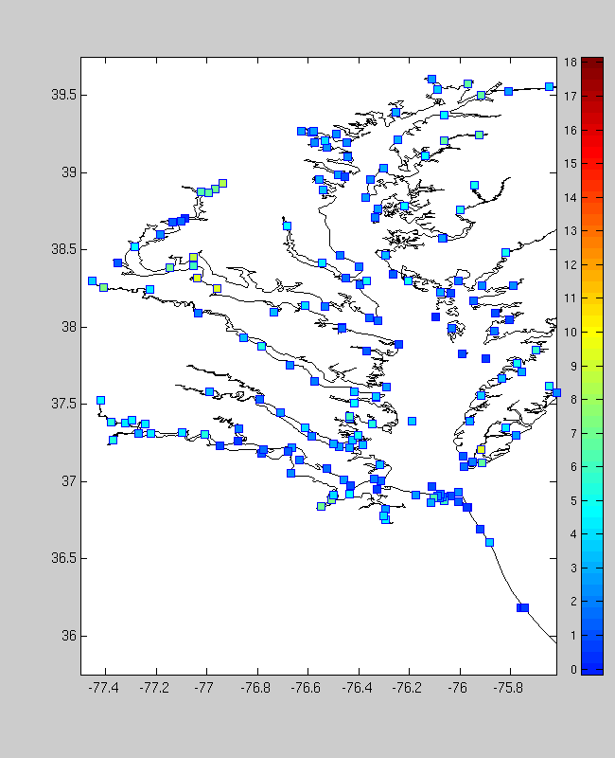
Uncertainty in the Tidal Datums
Issues about representing tidal datum variations:
Region 1: Interior location with sufficient density of surrounding tide gauges.
Region 2: Coastal area with tide gauge data gaps, as identified by CO-OPS.
Region 3: Marsh area, where results of the tide model may be less reliable.
Region 4: Tidally-influenced river region, upstream of the last NOAA tide gauge.
Notes:
There are other uncertainty estimates that are affected by regional variations.
In the case of Region 3 -- in purple -- there is no well defined boundary, the bathymetry data may be very old, and tide models in marshy area have complicated issues with friction, etc., which makes the model less reliable.
This illustrates the need for an understanding of the physical dynamics of a region through both models and data when developing a VDatum model.

Slide 26
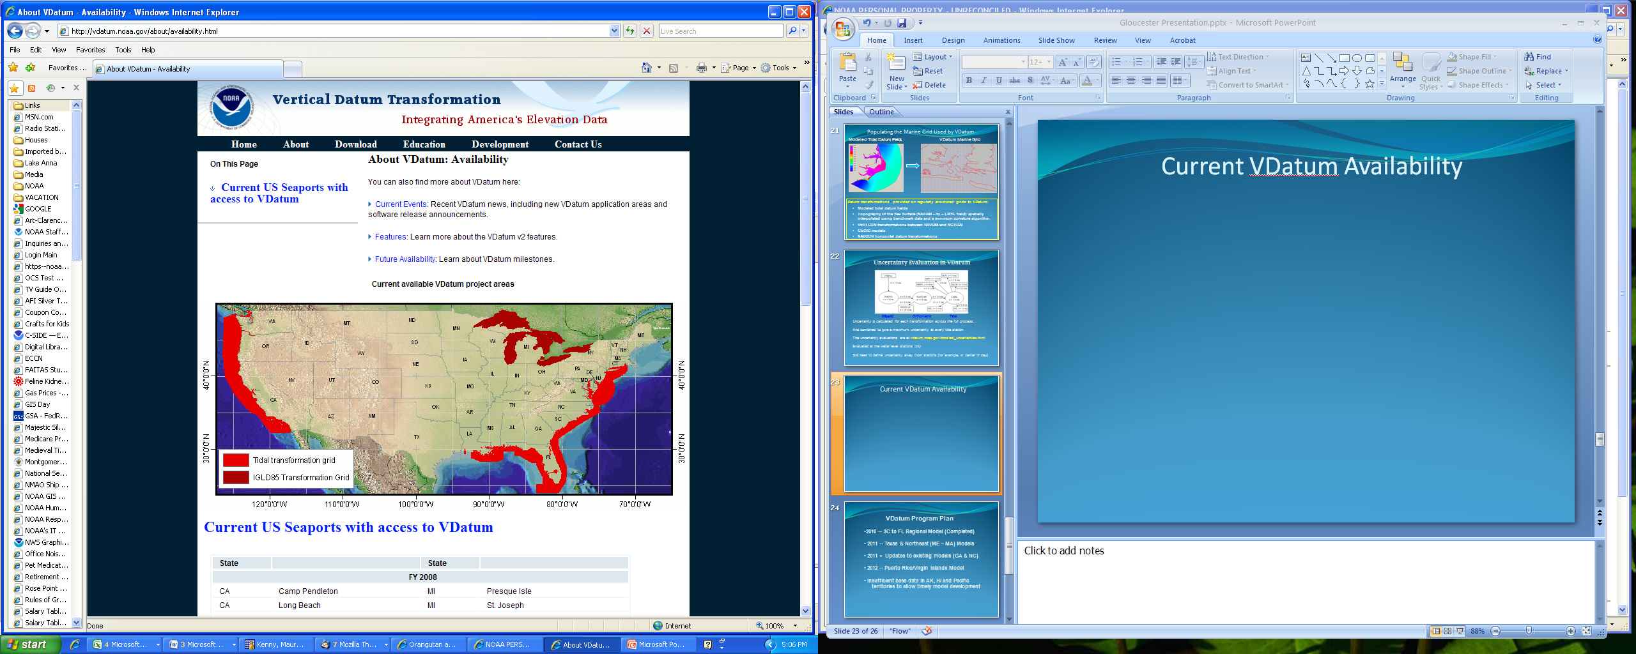
Current VDatum Availability
Notes:
This map illustrates where we have VDatum coverage at present.
The model of the Texas coast is scheduled for release not later than March.
The model for Northern New England is scheduled for release not later than June.
Another model that is in development will cover PR and VI, scheduled for release in the Q1 of FY12.
Transformations to IGLD 85 are available on the VDatum Website.

Slide 27
VDatum Program Plan
  2011 – Texas & New England (MA ME) Models
  2011 – Updates to existing models (GA & NC)
  2012 – Puerto Rico/Virgin Islands Model
  Requirements analysis to determine maintenance schedule
  Insufficient base data in AK & HI for model development
Notes:
This is the VDatum Model Development Schedule for the near future.
It includes some updates to existing models with GPS surveys of tidal bench marks in GA (completed) and NC. This new geodetic information will be “backfitted” into new versions of the models.
The VDatum Team is wrapping up a requirements analysis, and based on the results, it will determine the schedule for maintenance of models over the next 5 years and how soon we develop initial models for Alaska, HI and the Pacific territories.

Slide 28
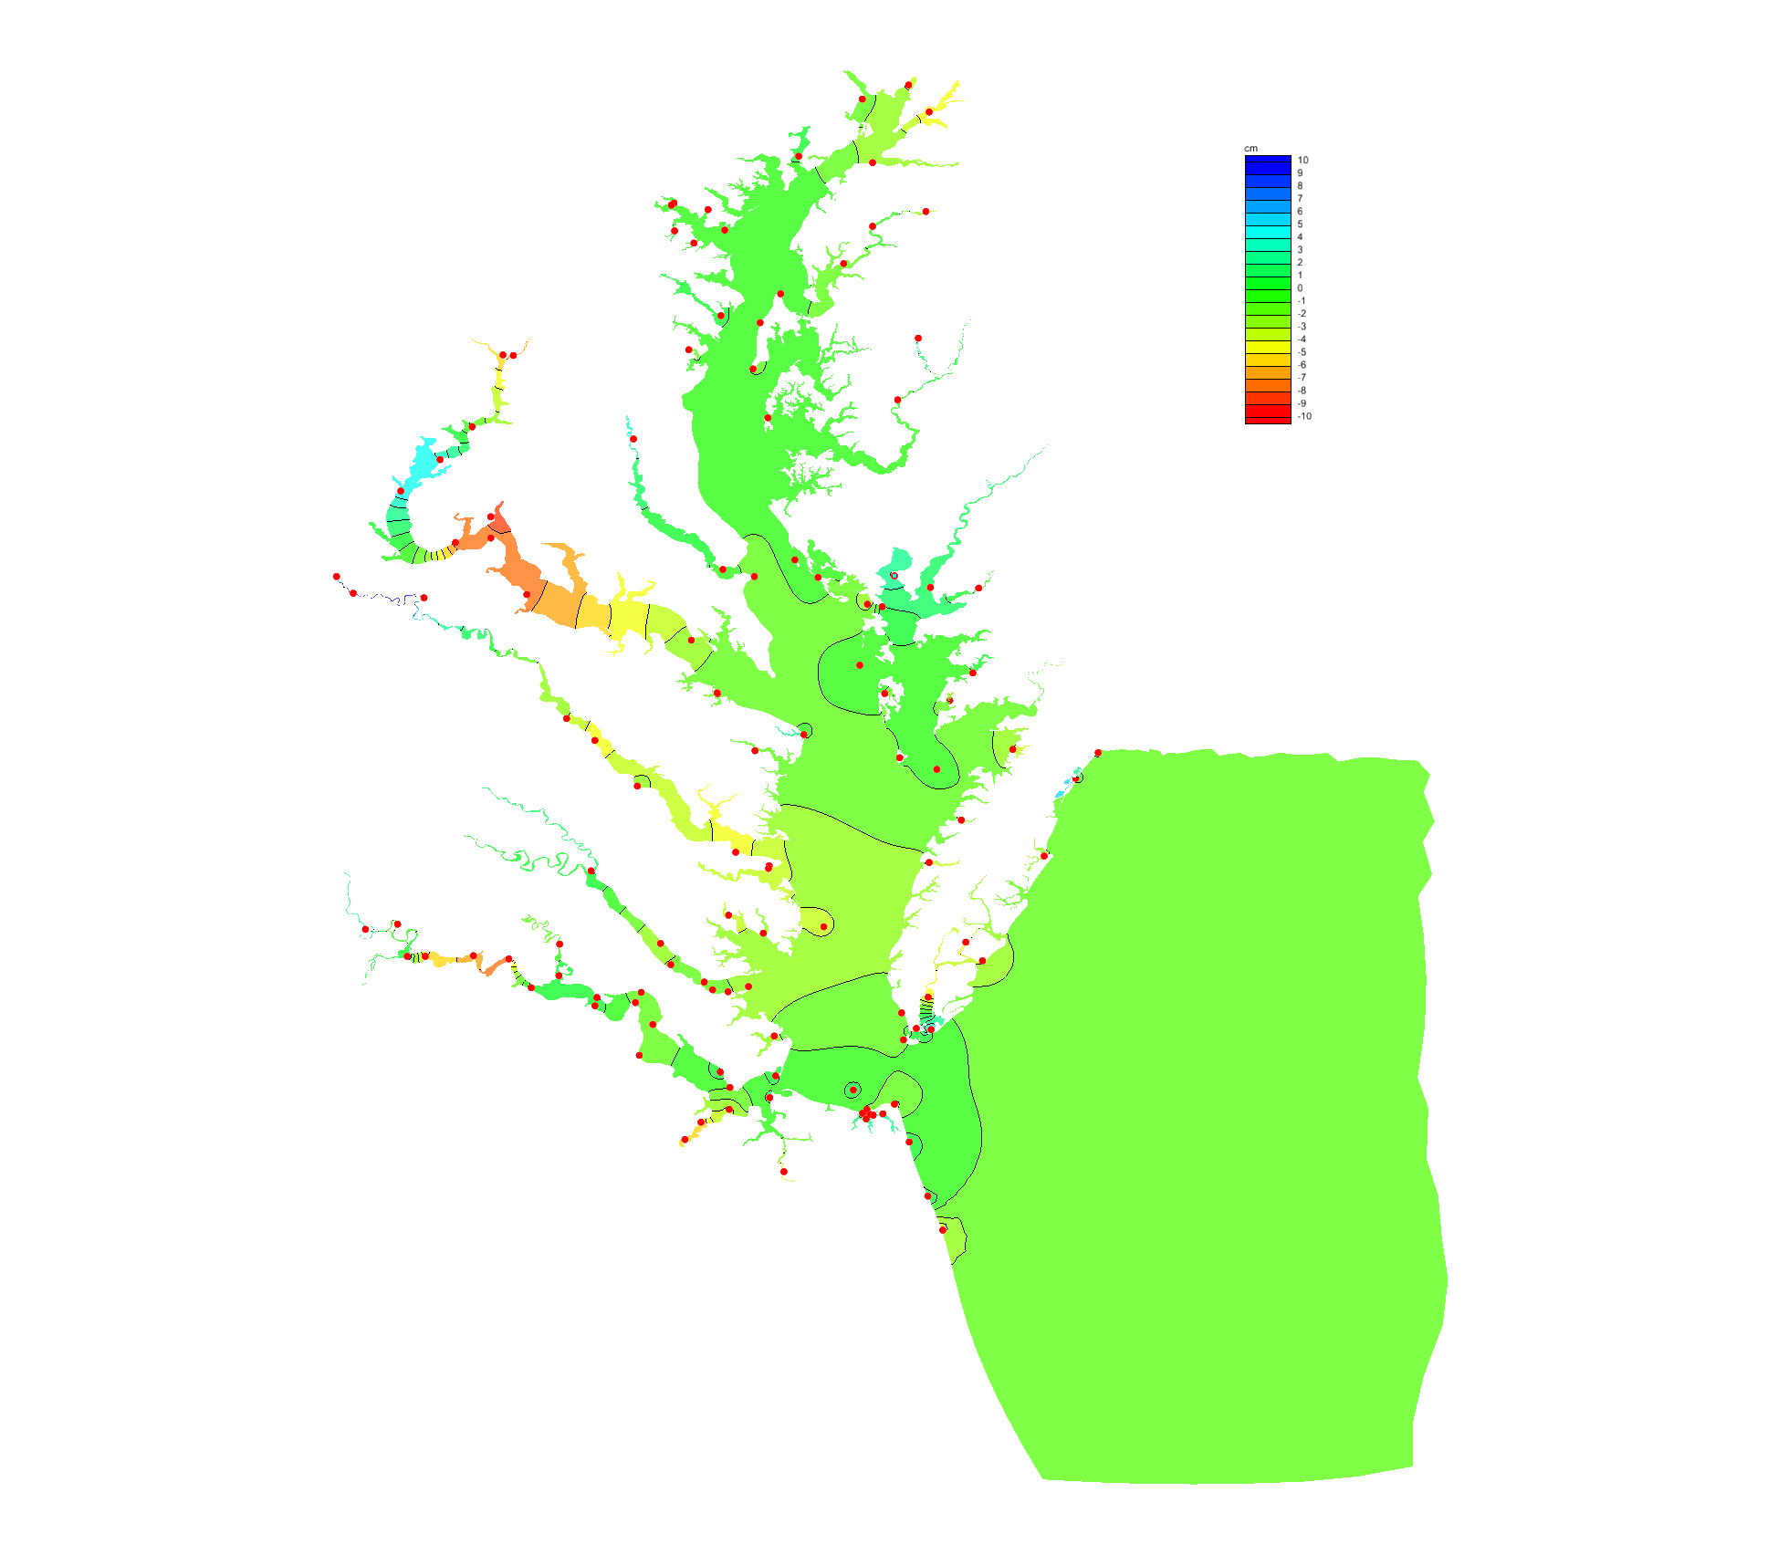
Improvements to VDatum
Currently in Development
Methods to validate VDatum uncertainties (e.g., GPS buoys)
Methods to extend uncertainty away from stations
Evaluating extending VDatum tidal datums further inland
Maintenance for tidal datum epoch; geoid and ellipsoid updates
Outreach and training (training ongoing with USACE)
Metadata
Future Developments
New web-based tools for interacting with VDatum results
Improvements to downloadable software
New gravimetric based geoid for North America
Notes:
These are some planned improvements toward making VDatum fully operational:
The first bullet is further evaluation of errors connected to transformations and to source data (e.g., NAVD 88) with GPS buoys as a platform for investigating these errors -- a focus during FY11.
The second bullet is to extend uncertainty estimates away from the tide stations. The idea being to provide users with standard deviations and methods to compute uncertainty for transformations in the offshore area of the model.
The third bullet is to consider extending VDatum tidal models further inland. A focus for FY12.
The next bullet is to develop maintenance procedures to ensure VDatum models are accurate and current.
Other improvements in the future include:
Developing GIS compatible output (with CSC assist),
Designing improved an Web interface
Implementing automatic QC measures
Incorporating the new GRAV-D derived gravimetric based geoid in all VDatum calculations

Slide 29
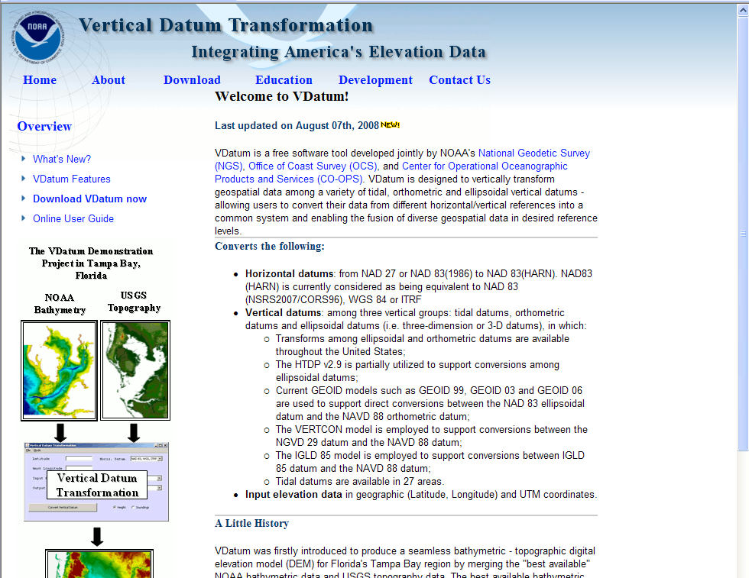
VDatum Website: vdatum.noaa.gov
Notes:
VDatum outreach is accomplished through a stand-alone Web site that has a link on each of the Tri-Office Web sites.
This is the look of the VDatum Home Page right now.

Slide 30
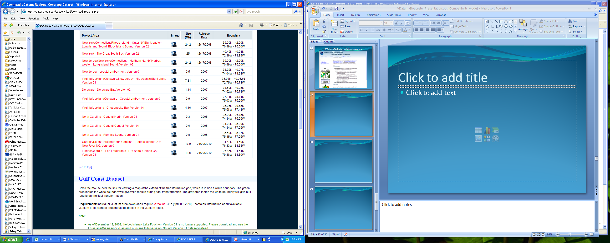
Notes:
This slide illustrates the East Coast Datasets that are available for download from the VDatum website.
Tidal transformation grids are available for each project area shown in red, together with an area information inset, which are shown on the next several slides.

Slide 31
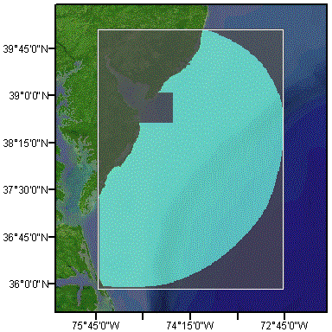
Notes:
This is the VDatum project area covering the Mid-Atlantic Bight shelf.

Slide 32
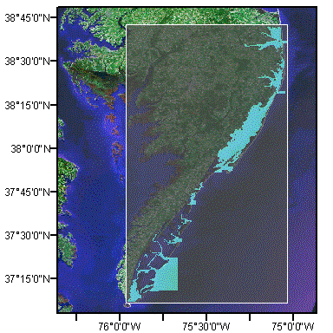
Notes:
This project area covers coastal embayments along the Atlantic side of the Delmarva Peninsula.

Slide 33
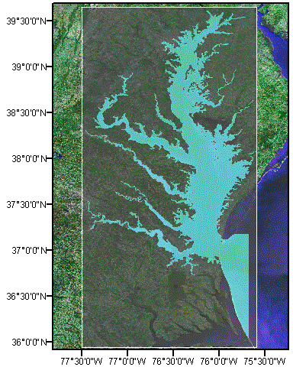
Notes:
This illustrates the VDatum project area for Chesapeake Bay.

Slide 34
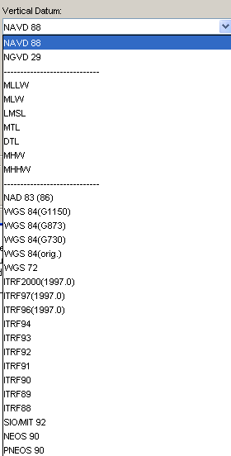
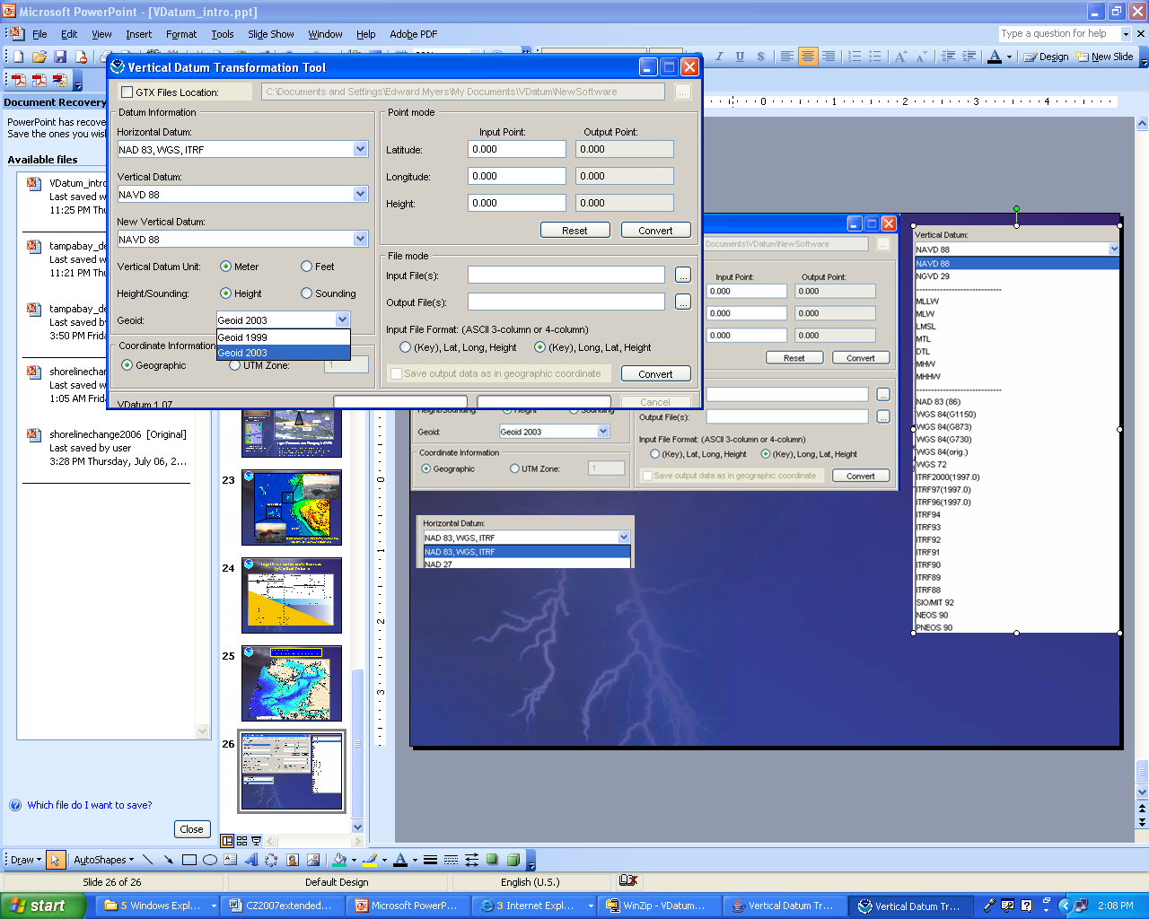
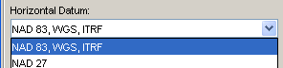
Choose input and output vertical datums:
Choose a geoid model
Choose a horizontal datum
Run as single point, batch, or insert into programming
Notes:
This is the user interface for doing transformations of data from one datum to another!
The user selects the horizontal datum, chooses a geoid model and then clicks on the input and output vertical datums.

Slide 35
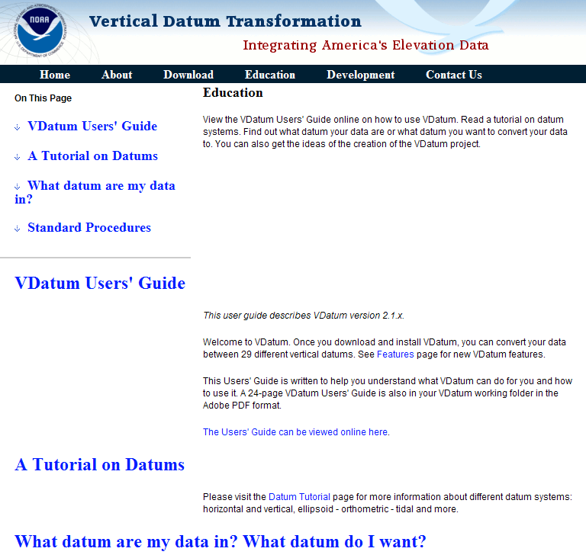
Notes:
The VDatum Users’ Guide is available online under the “Education” category of the Home Page.
It includes a tutorial on datum systems. With it, you can determine what datum your data are on, or what datum to convert the data to.

Slide 36
Questions?
…Discussion…

