Slide 1
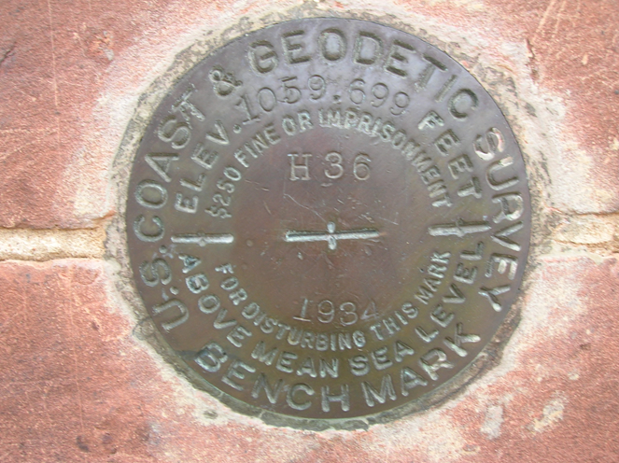


Project Planning
MARK SETTING and RECOVERY
Brian Ward
NOAA, National Geodetic Survey
Brian.Ward@noaa.gov
Notes:
Im Brian Ward, Central Plains Advisor, AR. KS, MO and TN. Worked for NGS 32 years. Field for 17, AR Advisor for 11 year Regional for 3 years.

Slide 2
Project Planning
Mark Setting
Line ties to the NSRS
Project Proposal
DSWorld
Windesc
Translev
Bluebooking
Notes:
I will try to demonstrate these programs.

Slide 3

Notes:
Everything I talk about is on our website.

Slide 4
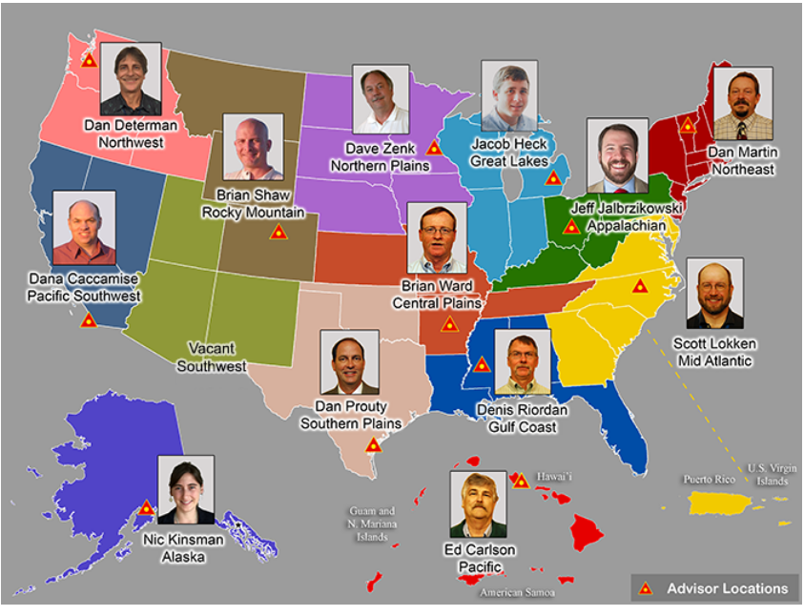
NGS Regional Advisor Program
Notes:
Regional geodetic advisors are located around the country for questions / support.
You can always call another Advisor if you cant get in touch with me. Lots of expertise in a varity of subjects related to geodesy in this group.

Slide 5
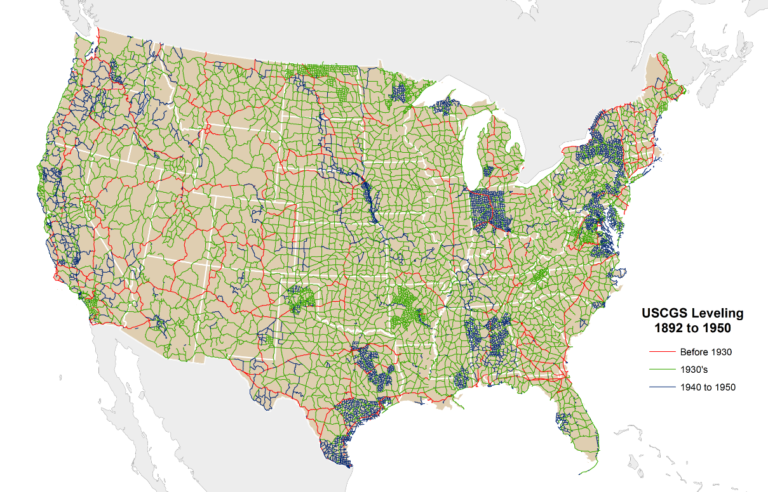
1892 to 1950
Notes:
Early Leveling in the USA

Slide 6
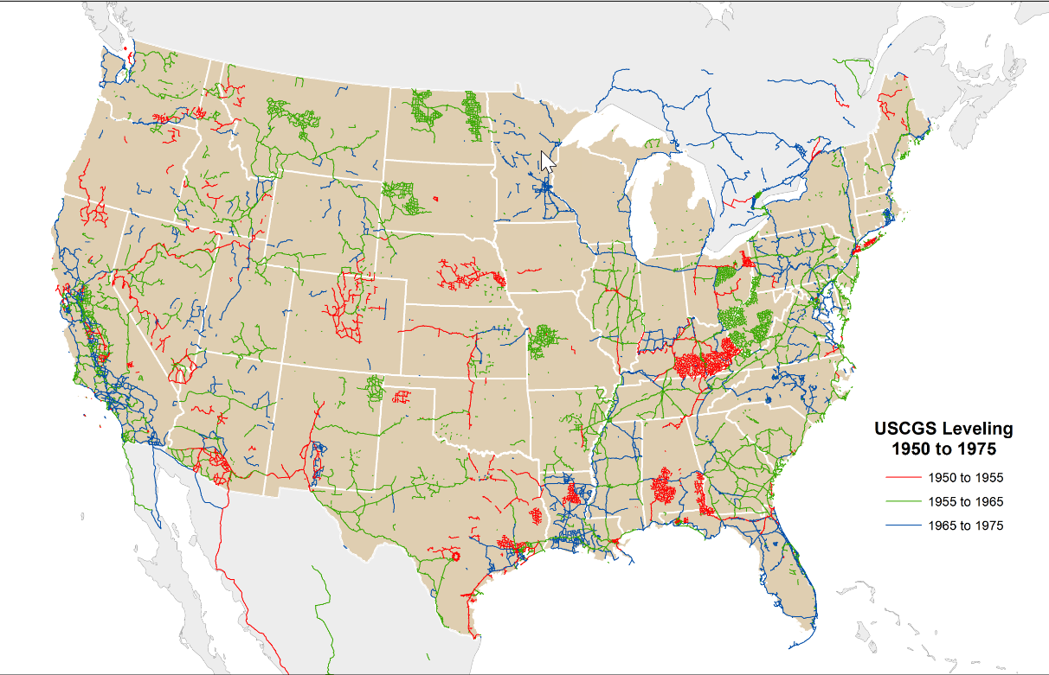
1950 to 1975

Slide 7
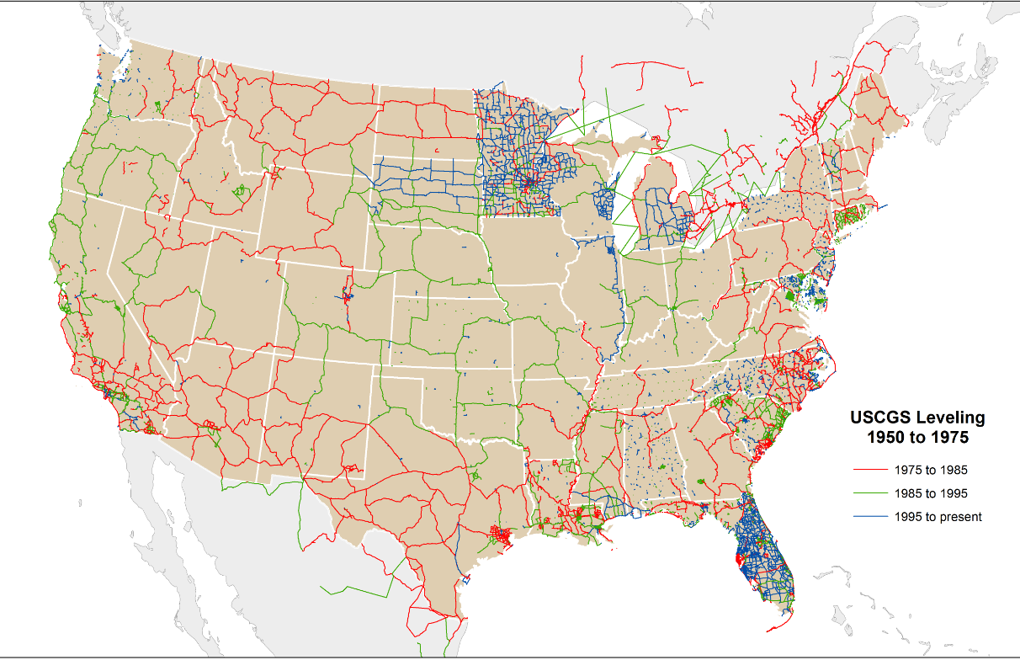
1975 to Present

Slide 8
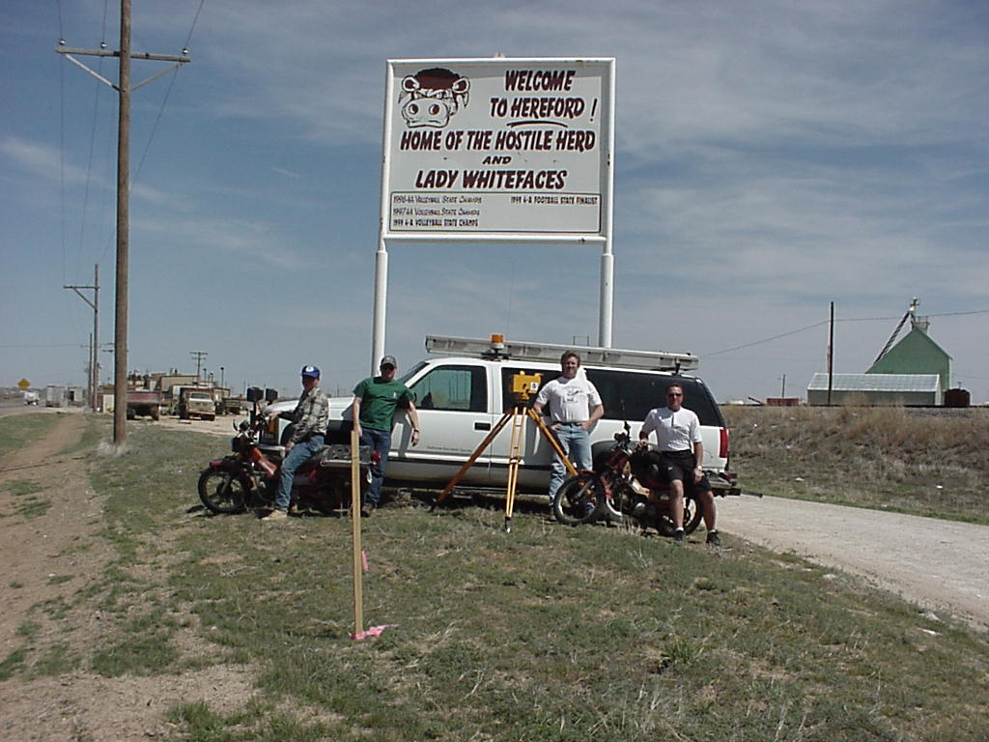
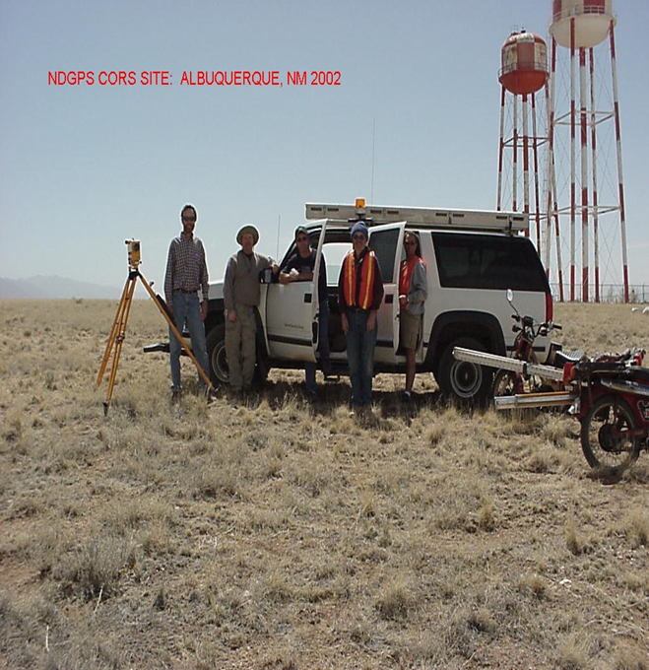
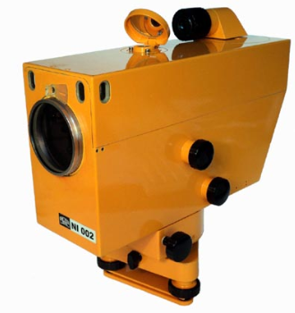
Geodetic 1st Order Levels
Notes:
Small All Terrain Cycles used to cover more ground.
Could level to 20 KM a day in flat terrain.
Zeiss NI002 had a swivel eye piece.
Phased in Digital Levels in early 2000. Using 1st order Digital Levels and Invar Bar Code Rods.

Slide 9
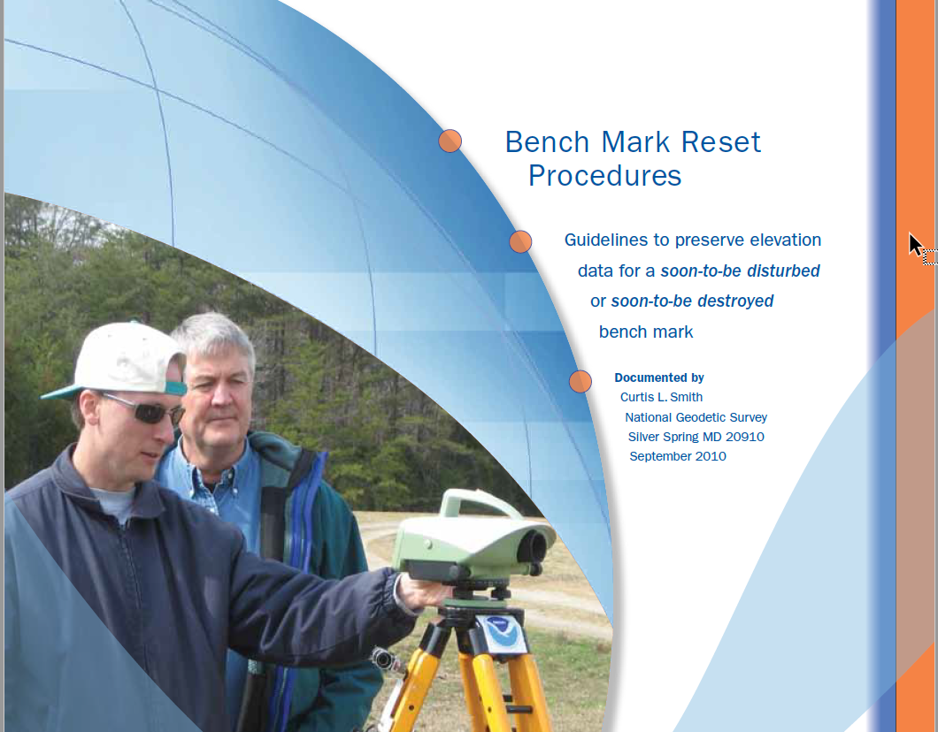
Bench Mark Reset Document
Notes:
Best source of information

Slide 10
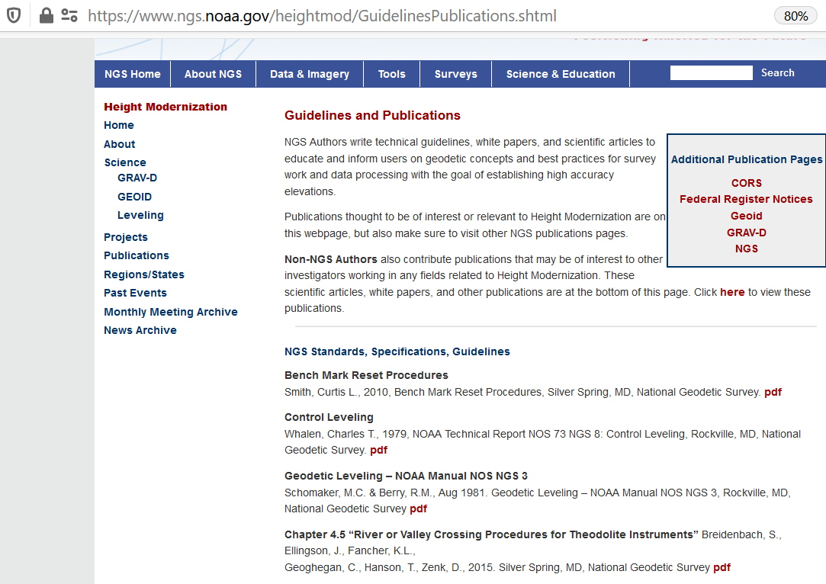
Mark Setting Information
Notes:
Best information is in the Benchmark Rest Manual

Slide 11
Stability Order
A = MOST RELIABLE AND EXPECTED TO HOLD POSITION/ELEVATION WELL
In a rock outcrop or ledge, exposed bedrock, large foundations on bedrock, rod drilled and cemented into bedrock...
the most reliable, are expected to hold well
B = PROBABLY HOLD POSITION/ELEVATION WELL
Deep driven stainless steel rod mark in +10’ Ft. in sleeve, massive structures and retaining walls, abutment of pier or large bridge..
will probably hold well.
C = MAY HOLD, BUT OF TYPE COMMONLY SUBJECT TO SURFACE MOTION
Concrete monument, footing of small or medium structures, retaining wall or concrete ledge.. may hold well, are commonly
subject to movement
D = MARK OF QUESTIONABLE OR UNKNOWN STABILITY
Light structures, prefabricated concrete post, sidewalk, curb..
of questionable or unknown reliability
Notes:
When setting marks, stability is always important. It all starts and ends with your mark setting.

Slide 12
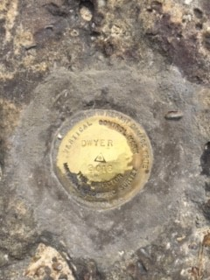
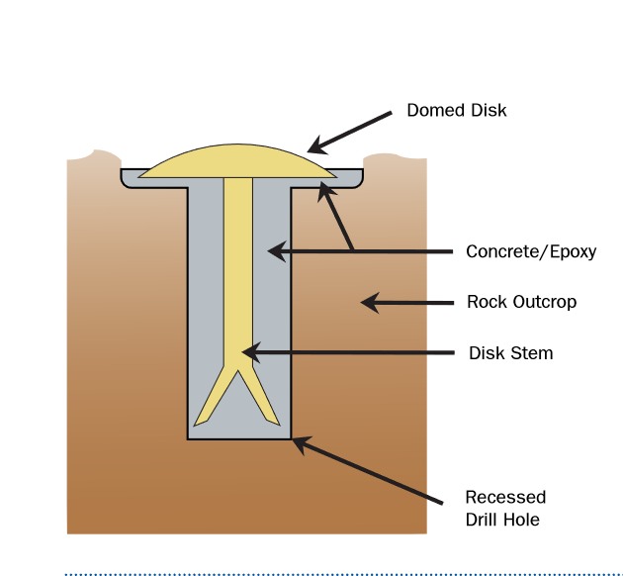
Bedrock Monuments
“A” Order Stability

Slide 13
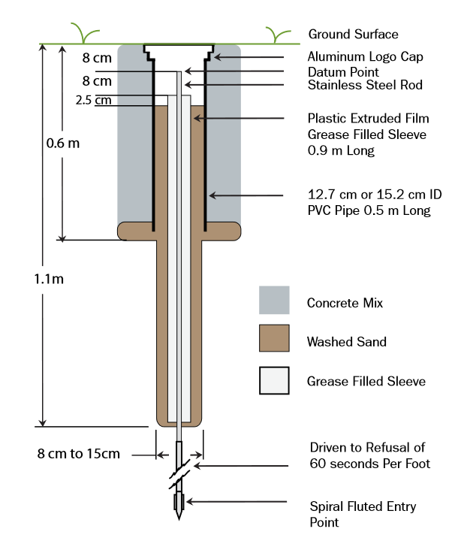
Deep Driven Rod Mark
“B” Order Stability

Slide 14
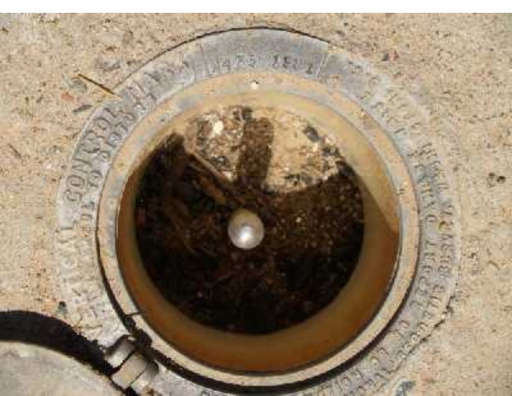
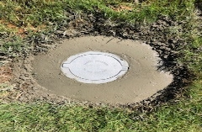
Access Cover to Datum Point

Slide 15
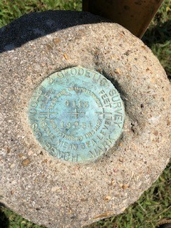
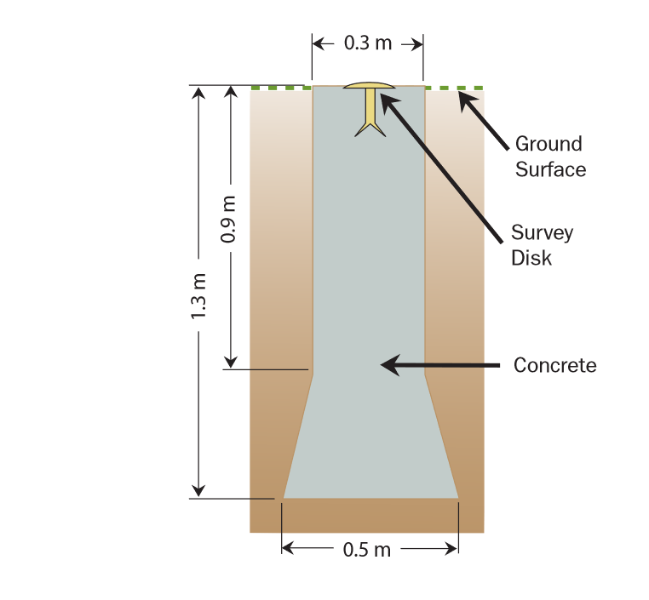
Concrete Monument
“C” Order Stability

Slide 16
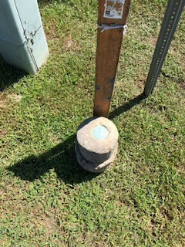
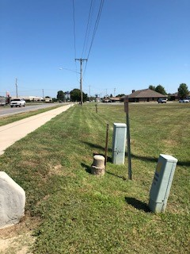
Concrete Monument

Slide 17
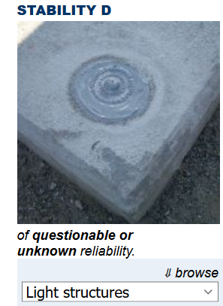
Unknown Stability

Slide 18
Project Planning
Preparation Before Setting Marks
Locate ties to the NSRS.
Decide route and number of marks to set.
Decide what type of marks to set.
Closely estimate distance of total line, including ties to NSRS.
Closely estimate distance between marks.
Design in DSWorld or other mapping app.
*Contact Utilities before you dig.
*All this information will be needed for Project Proposal.

Slide 19
Desk Top Recon
View Project Area
Selecting NSRS Tie Marks
Select approximate location of new marks
NSRS ties must be published, leveled and adjusted orthometric heights for Order & Class you are trying to achieve.

Slide 20
Mark Recovery Tools
DSWorld
NGS Data Explorer
Mark Recovery App

Slide 21
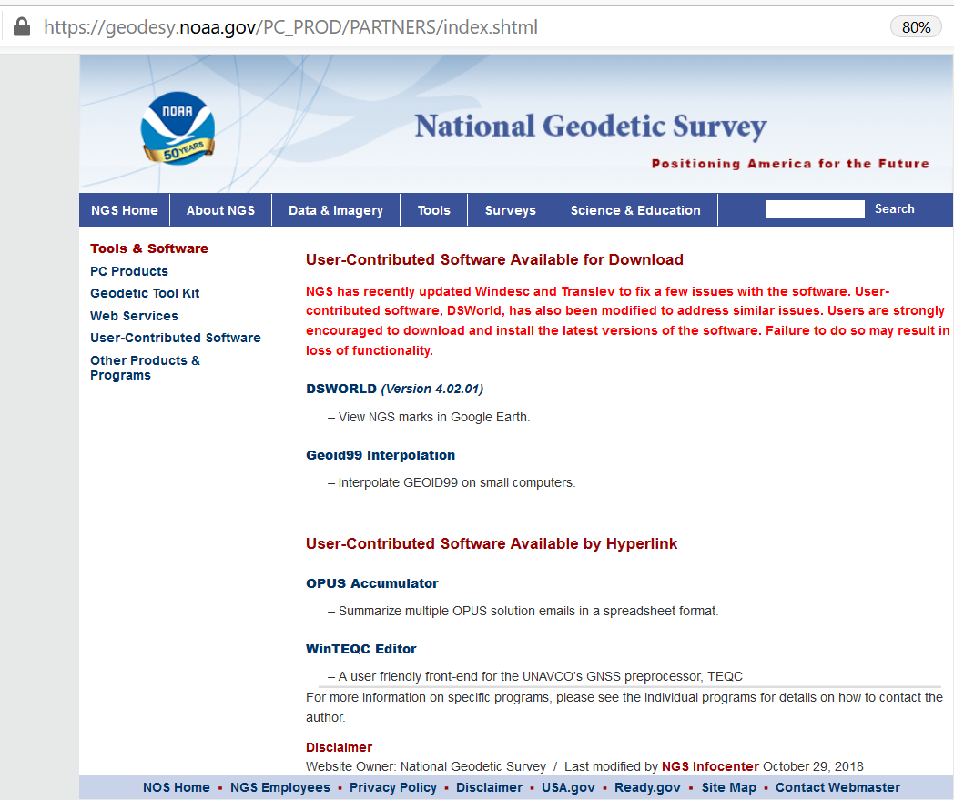
DSWORLD

Slide 22
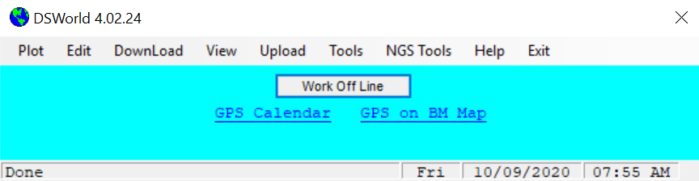

Slide 23
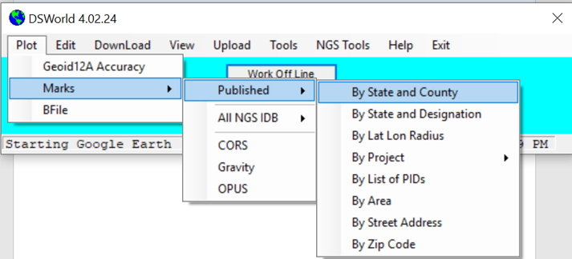
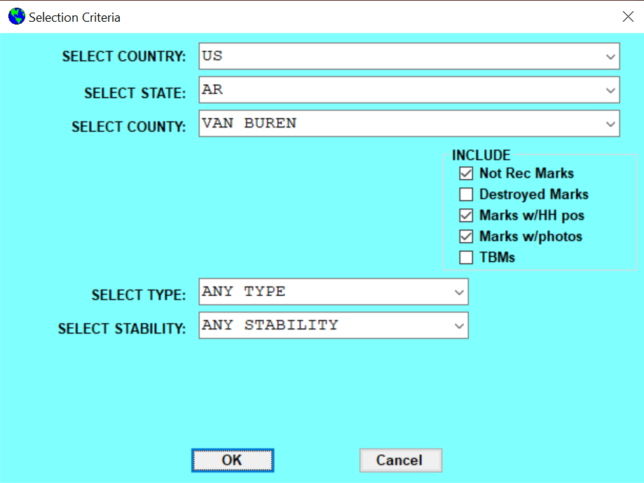
Notes:
We have tools to help find the marks. DSWorld is a good one.

Slide 24
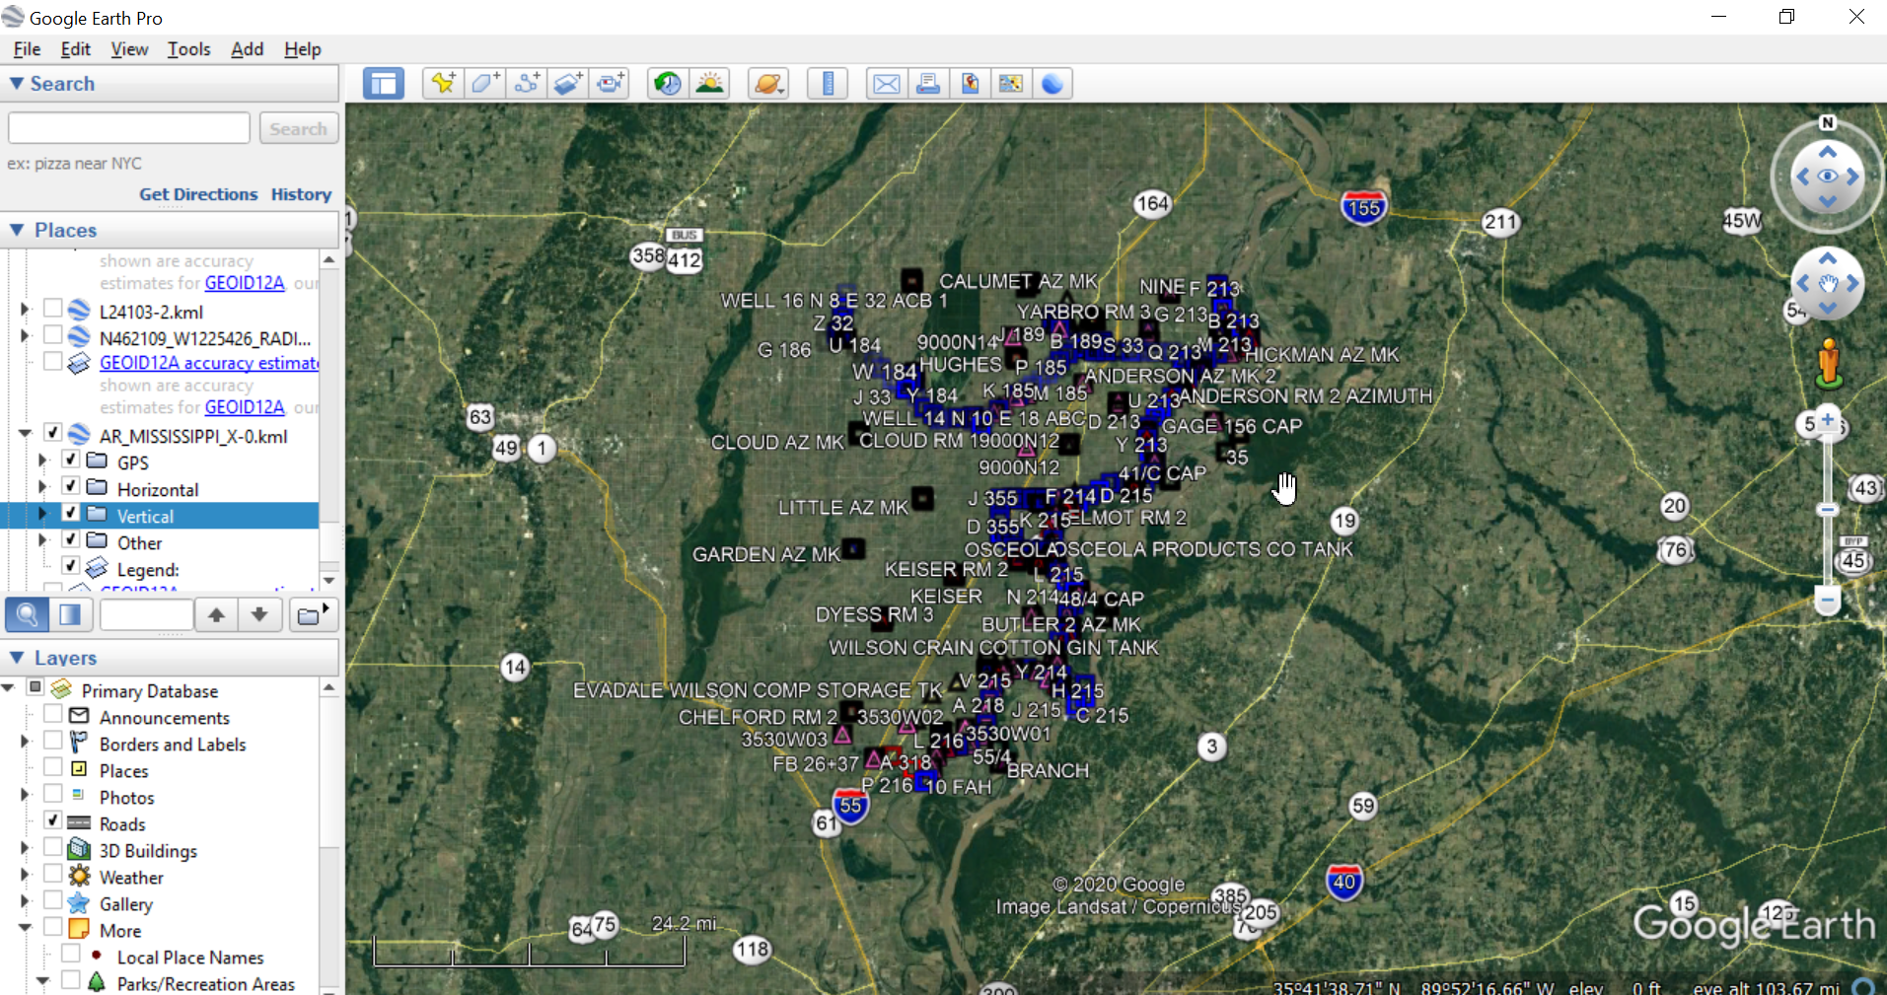
Notes:
This is crowded, but just wanted to show an example of what to look for

Slide 25
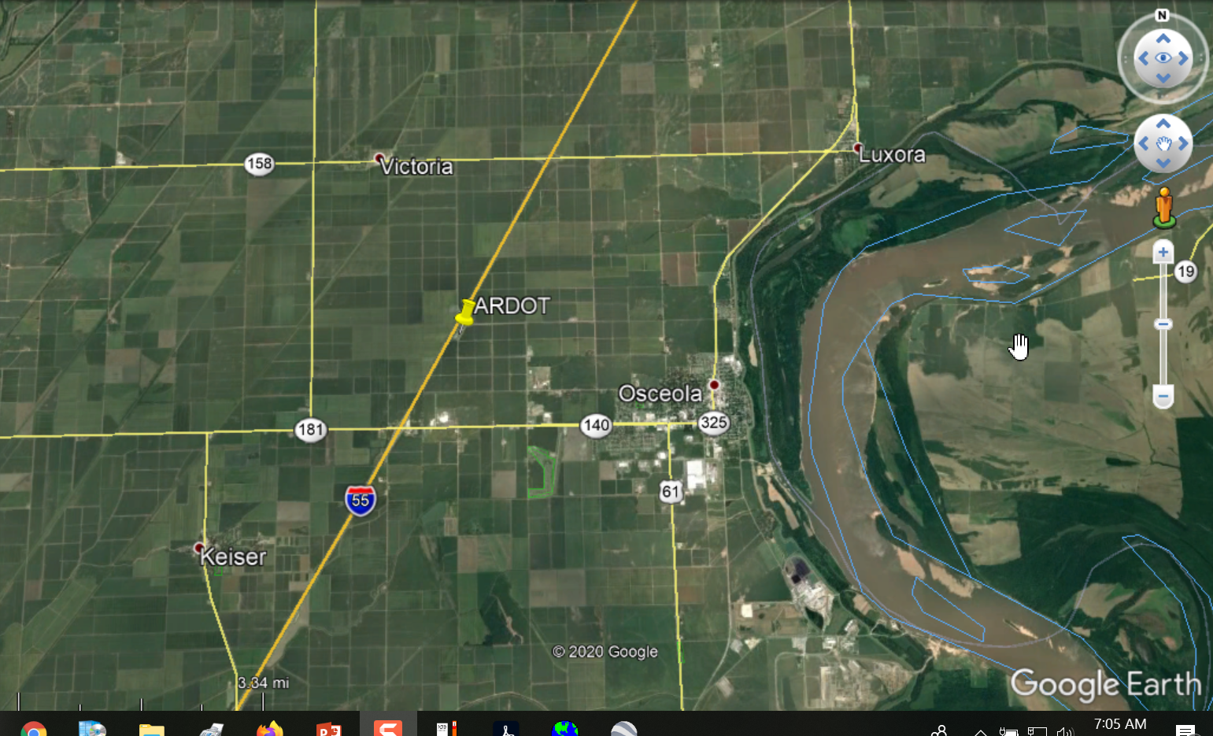
Notes:
Getting the line where you need it. No rules concerning specific routes.

Slide 26
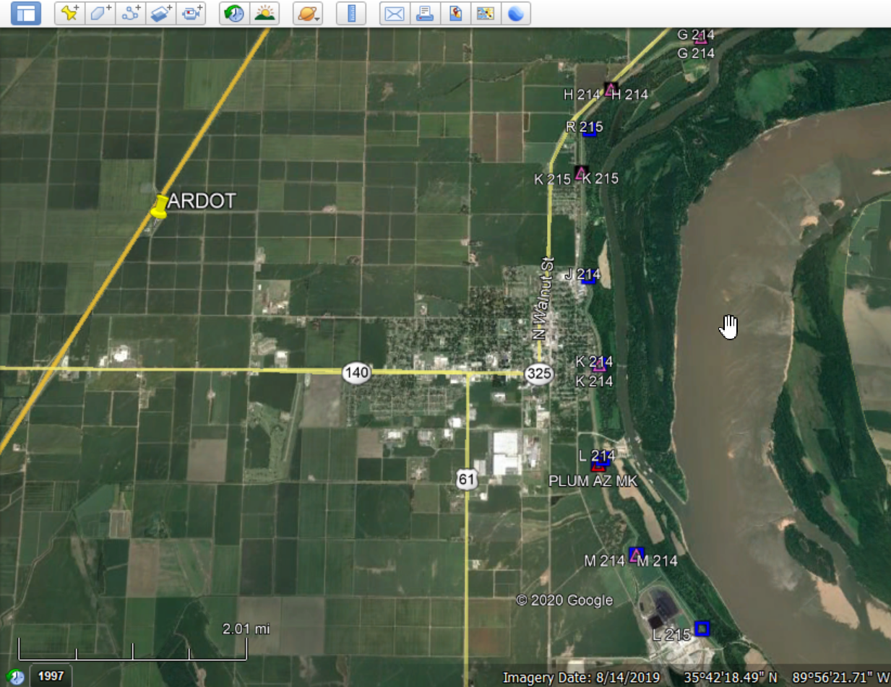
Notes:
Level line runs along the levee.

Slide 27
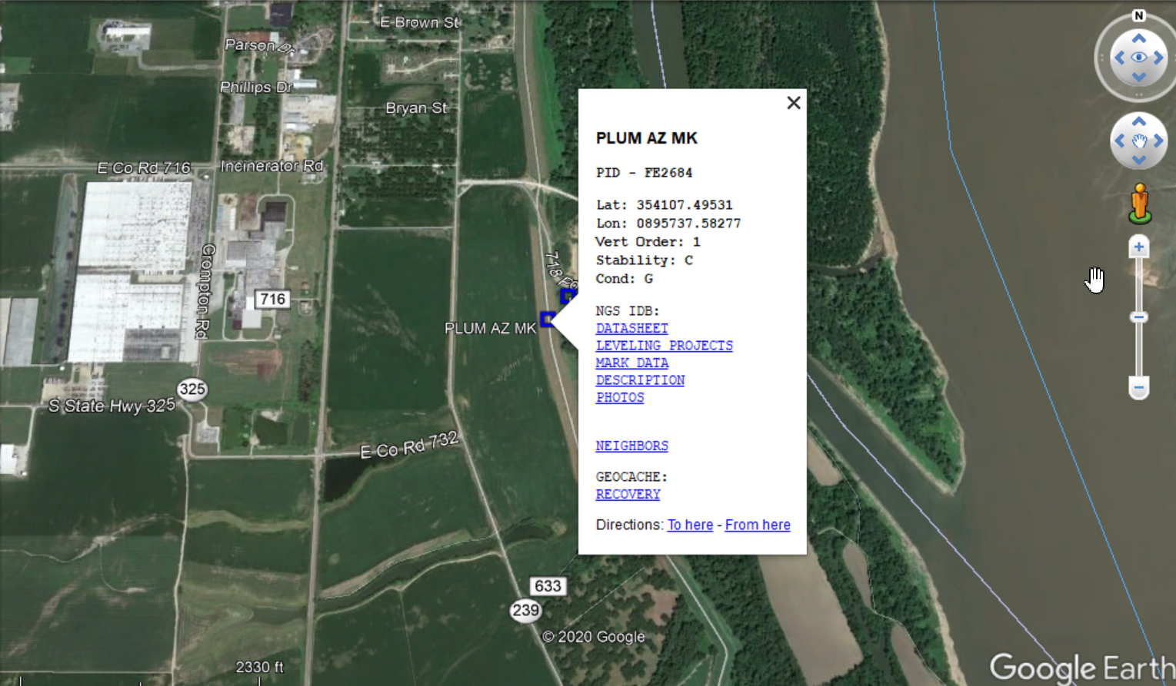

Slide 28
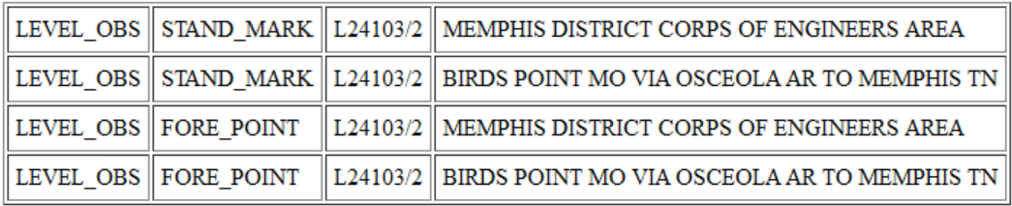

Slide 29
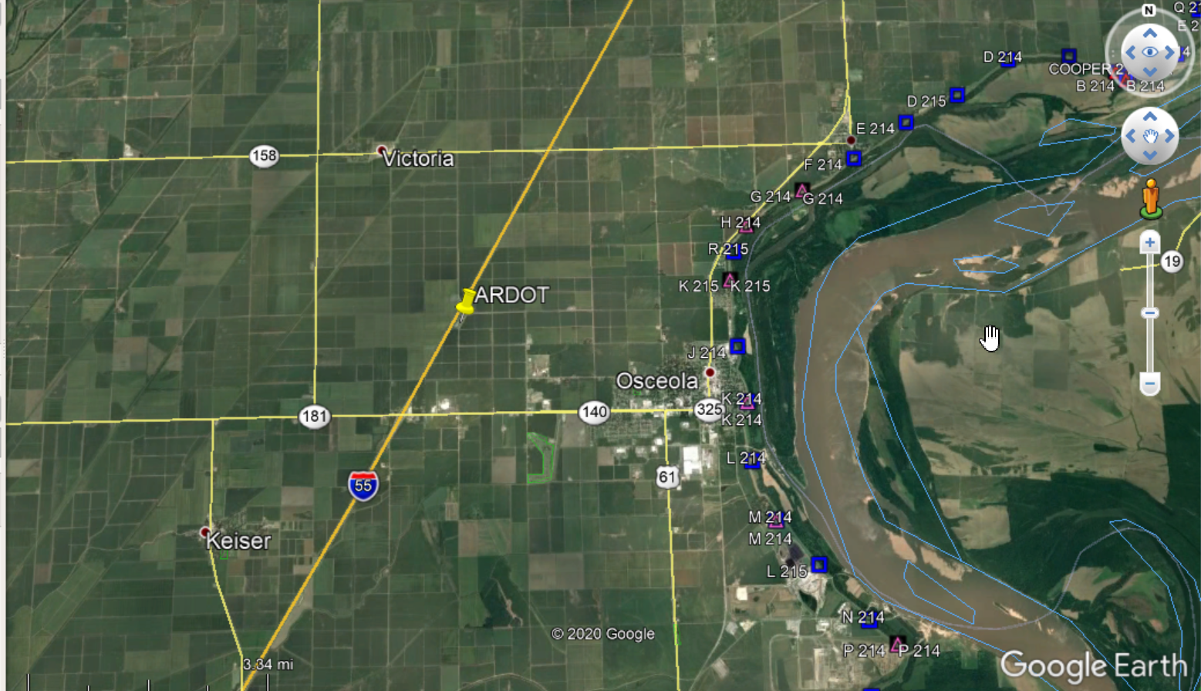
Notes:
You can see where the line needs to run. Recon old marks, locations for new marks, like bridges, rock outcrops, safe places in ROW.

Slide 30
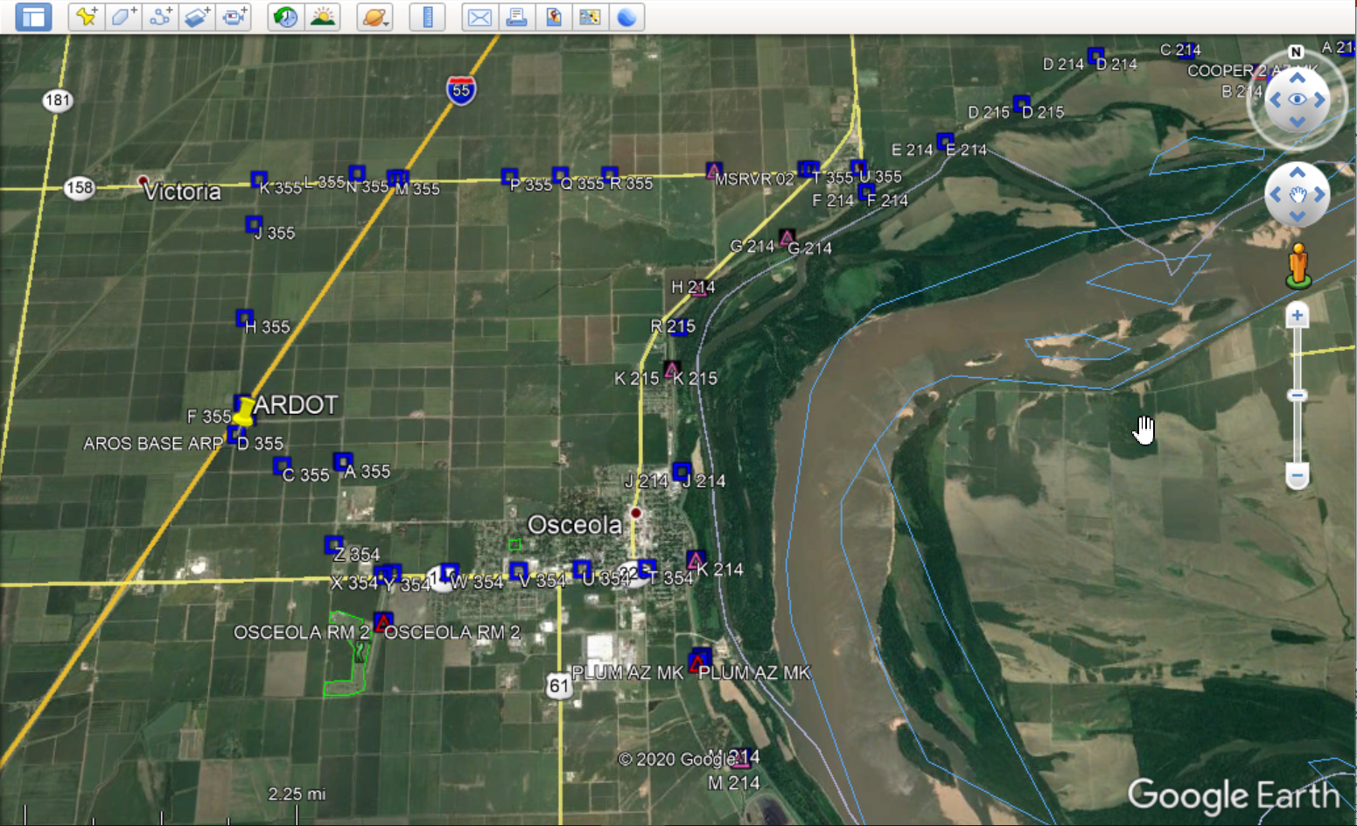
Notes:
Look for places to set marks like, bridges, sturdy foundations..etc Talk to land owners, mark places for new marks to have utilities marked

Slide 31
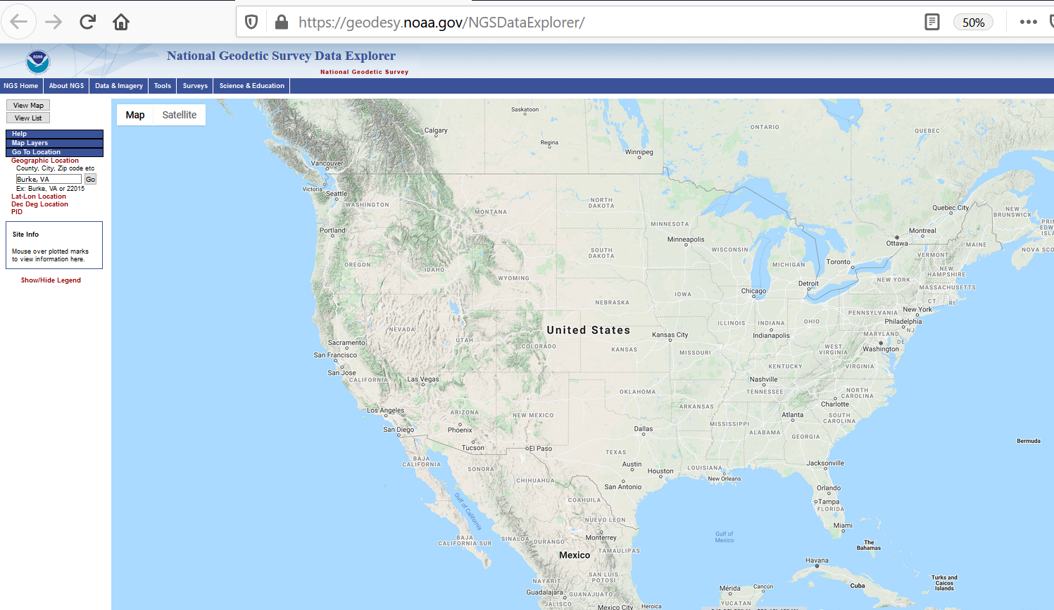
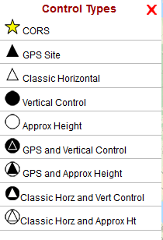
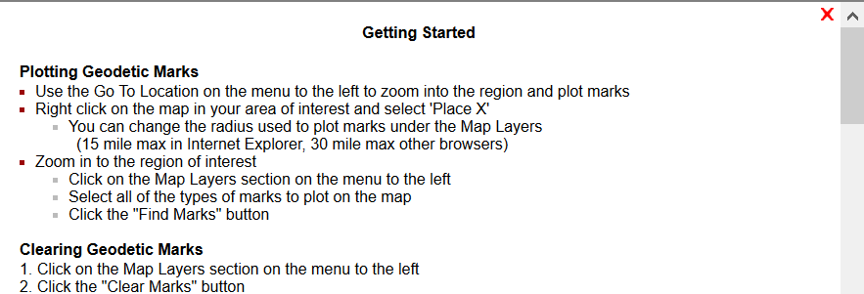
NGS DATA EXPLORER

Slide 32
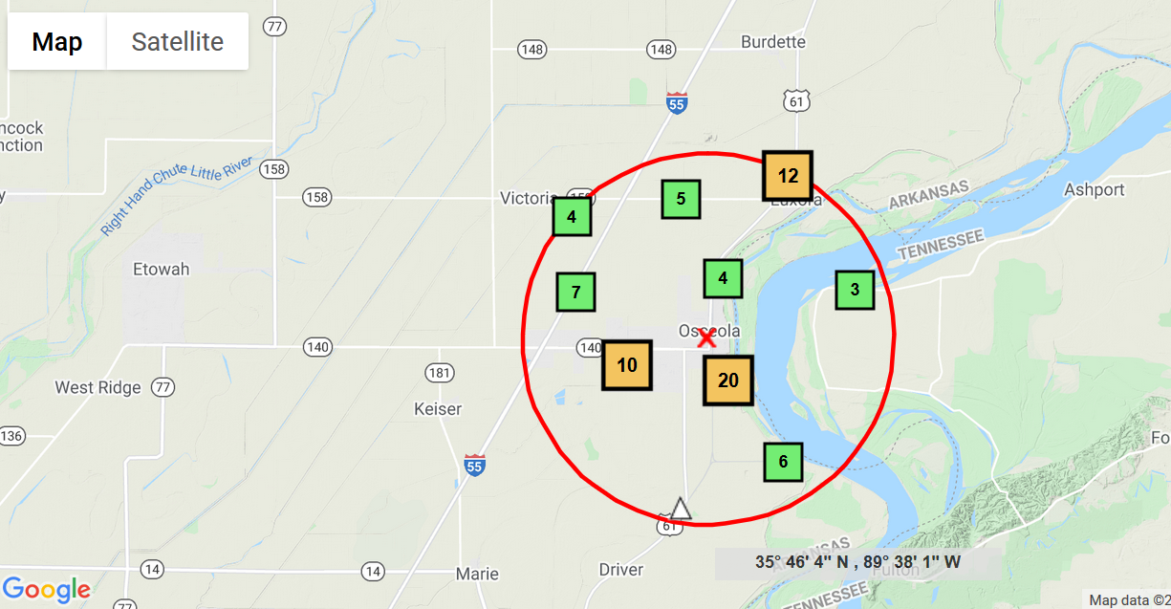
Notes:
Several features, you can expand radius

Slide 33
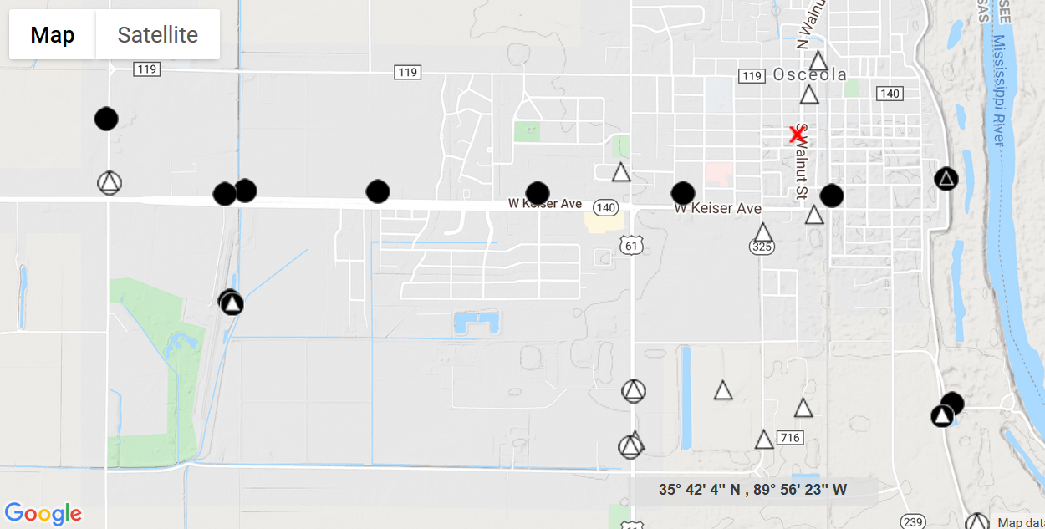

Slide 34
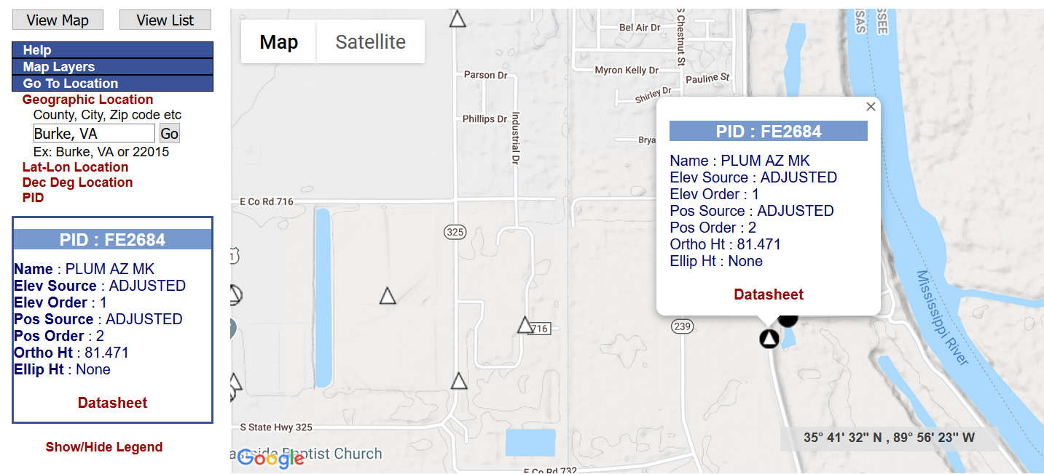
Notes:
Map View

Slide 35
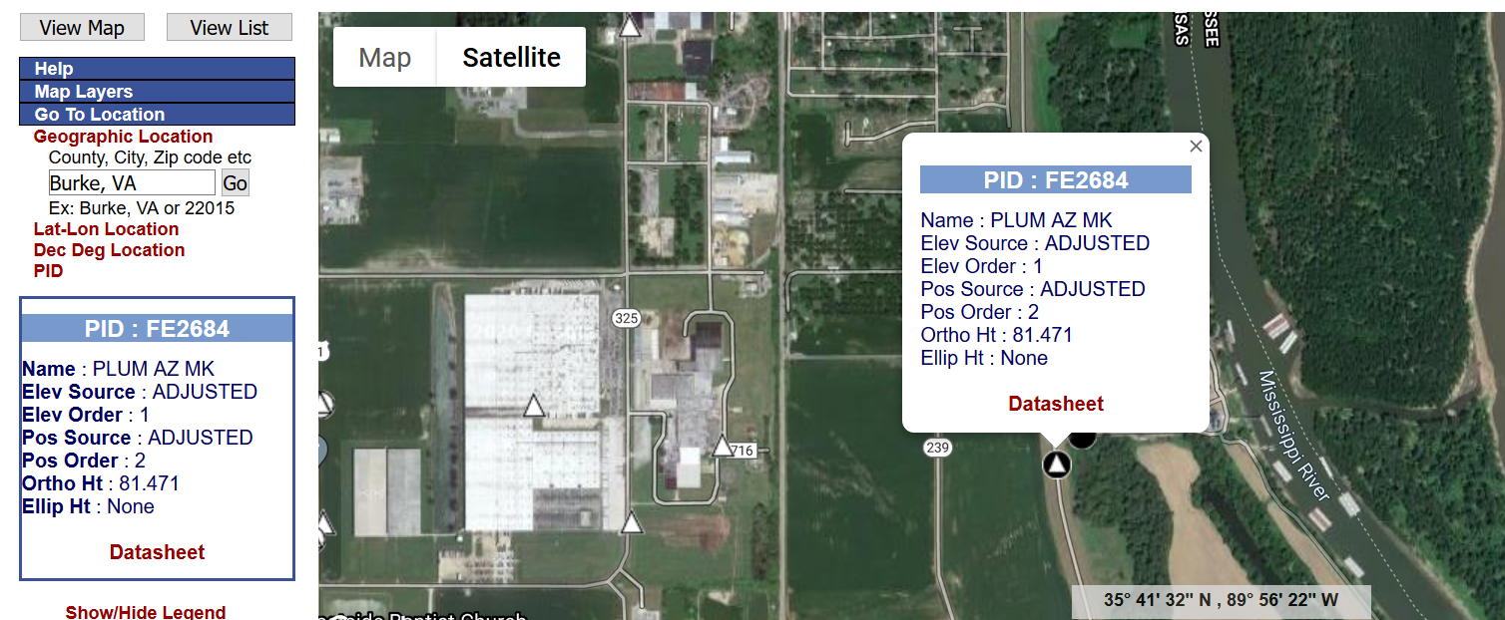
Notes:
Satellite View

Slide 36
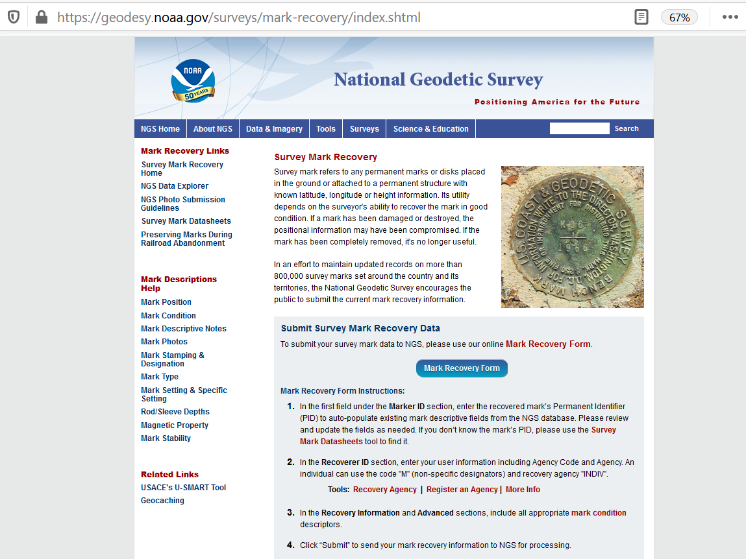
MARK RECOVERY FORM
Notes:
When you get in the field, you can use mark recovery form.

Slide 37
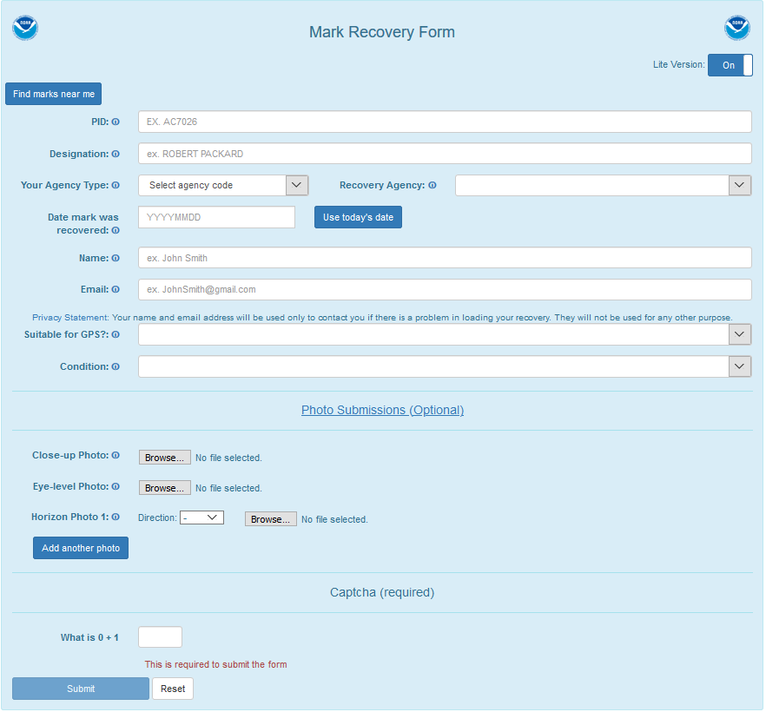
Notes:
Click on find marks near me

Slide 38
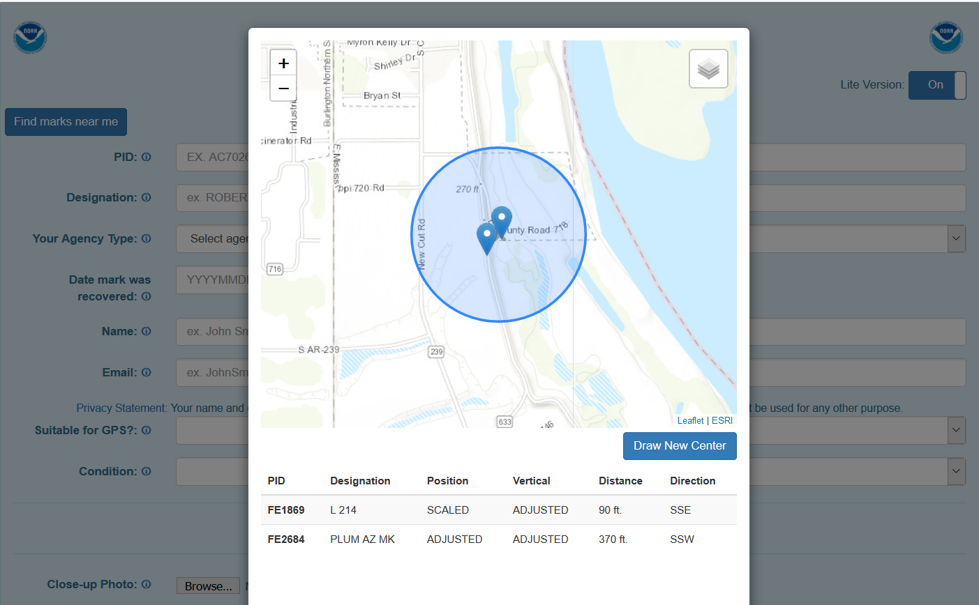
Notes:
Scroll map and draw new center.

Slide 39
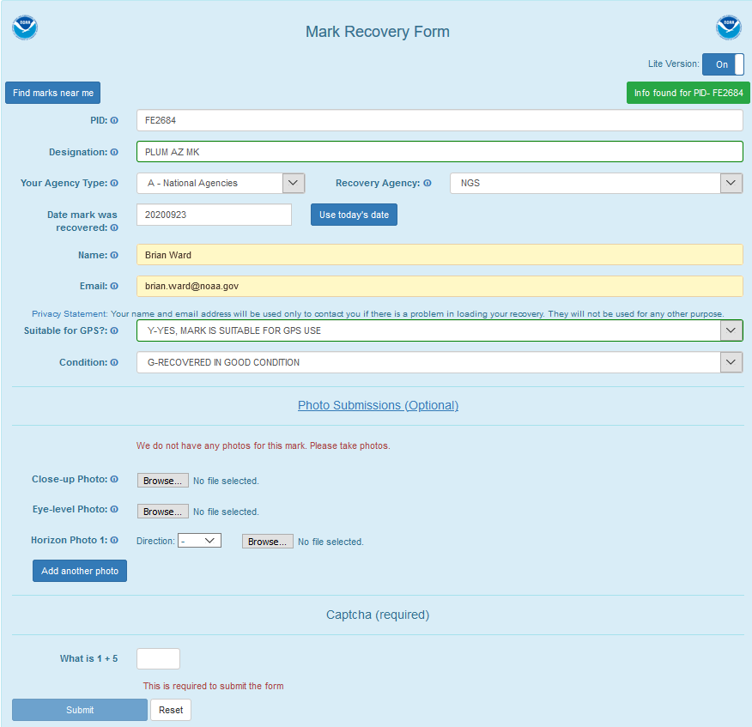
Notes:
This should be used for mapping only. Pictures and descriptive text will be entered in windesc.

Slide 40
Information you need to gather
https://www.ngs.noaa.gov/surveys/mark-recovery/index.shtml
Contact underground utilities with mark locations before digging.
Notes:
The following information will need to be gathered for later entry into windesc.

Slide 41
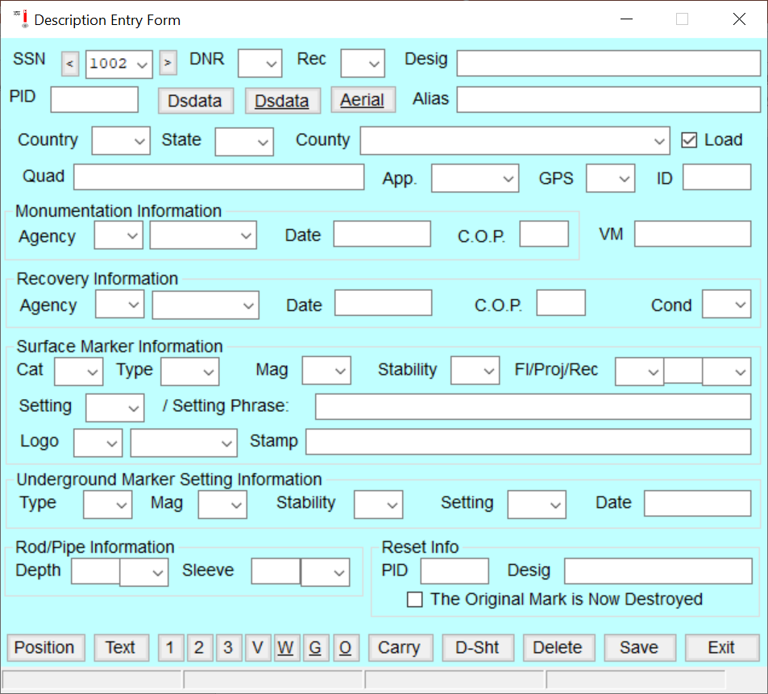
Windesc Information
Notes:
Information for new marks needs to be collected.

Slide 42
Mark Recovery https://geodesy.noaa.gov//surveys/mark-recovery/
Logbook or Notebook (computer, tablet or paper with pen or pencil)
Datasheets (paper or computer)
Tape measure (100m tape preferred) or EDM laser
Compass
Brush hook or Machete
Flagging (to help relocate the mark for future observation)
Spray Paint (can paint arrow and “BM” on road towards bench mark)
Probe (useful for finding benchmarks that might be buried with an inch or two of soil)
Camera/Phone (for mark recover pictures)
Survey grade or hand held GPS receiver or GPS enabled phone
Garden gloves
Shovel or Trowel
Paper towel, packaged wiping cloths, rags, napkins, or other such material to clean off disks
Flat blade screwdriver (for digging and for opening rod covers)
First aid kit
Metal detector
Notes:
Equipment for the field.

Slide 43
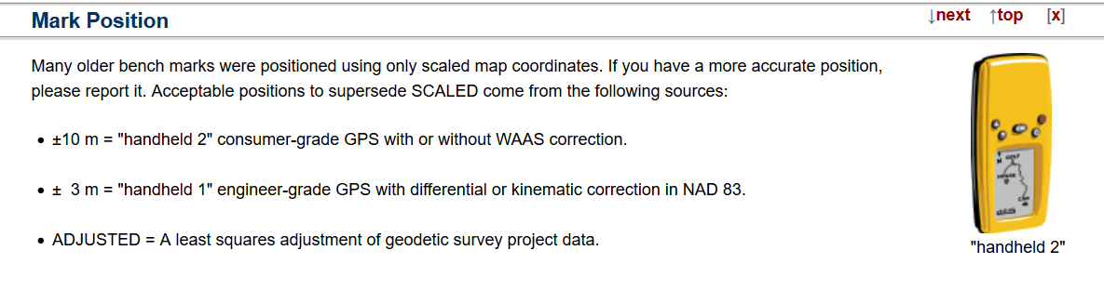
Mark Position

Slide 44
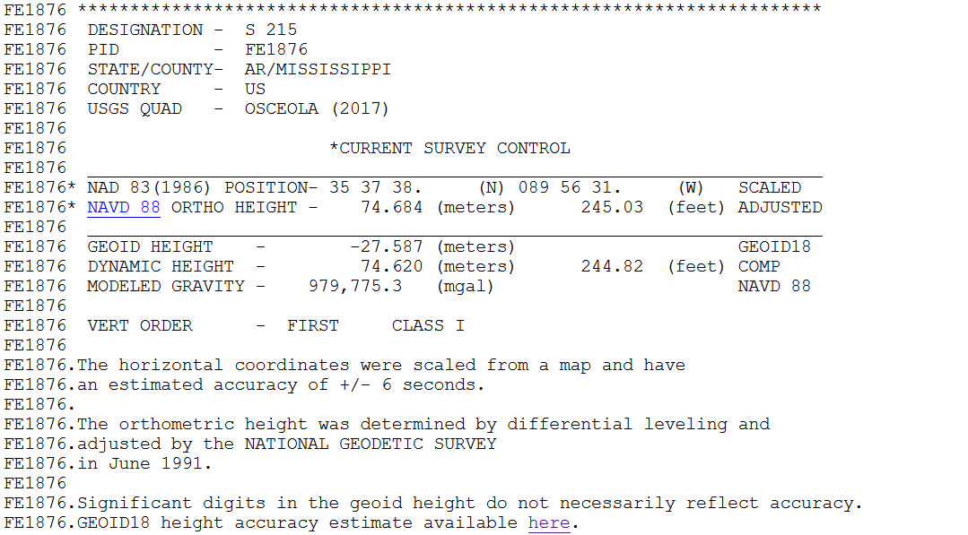
Scaled Position
Notes:
Scaled position needs update

Slide 45
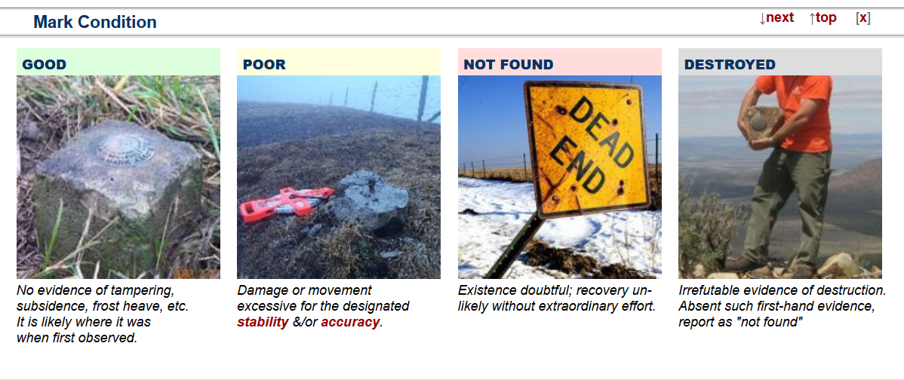
Mark Condition

Slide 46
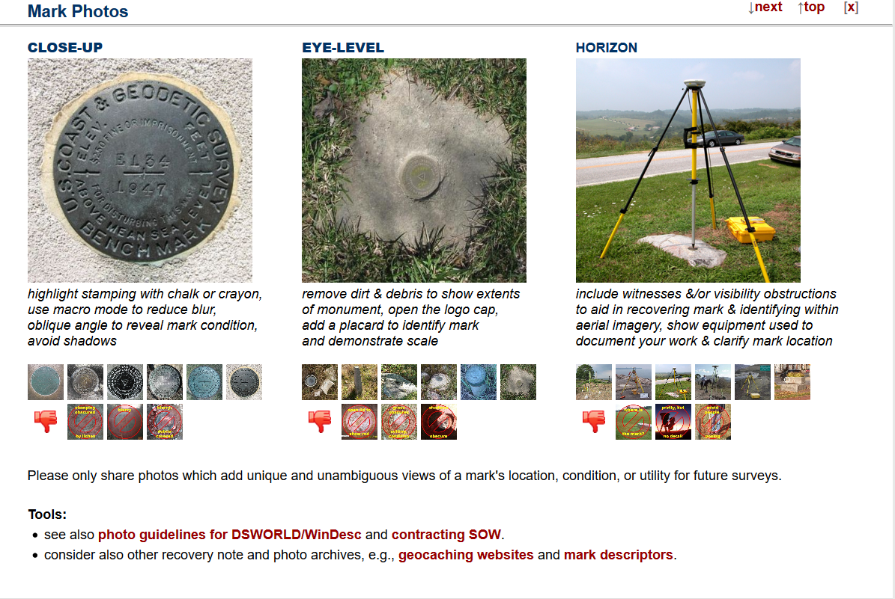
Mark Photos

Slide 47
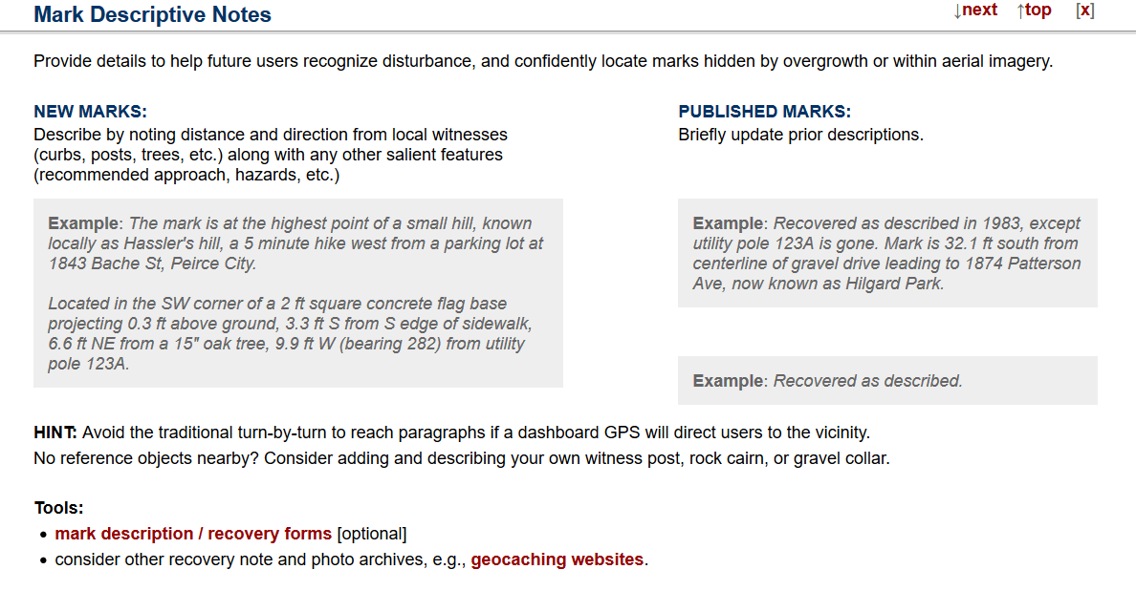
Mark Descriptive Notes

Slide 48
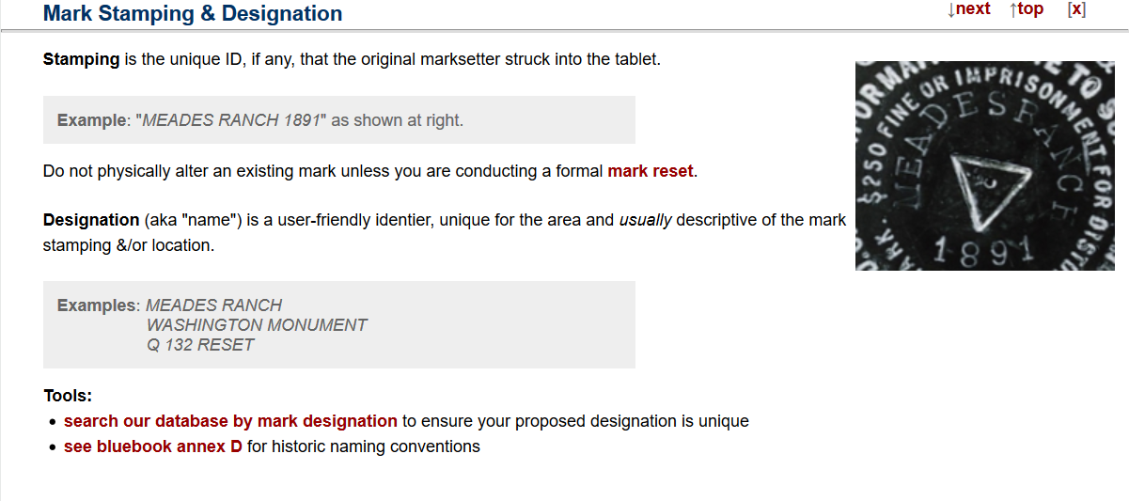
Mark Stamping & Designation

Slide 49
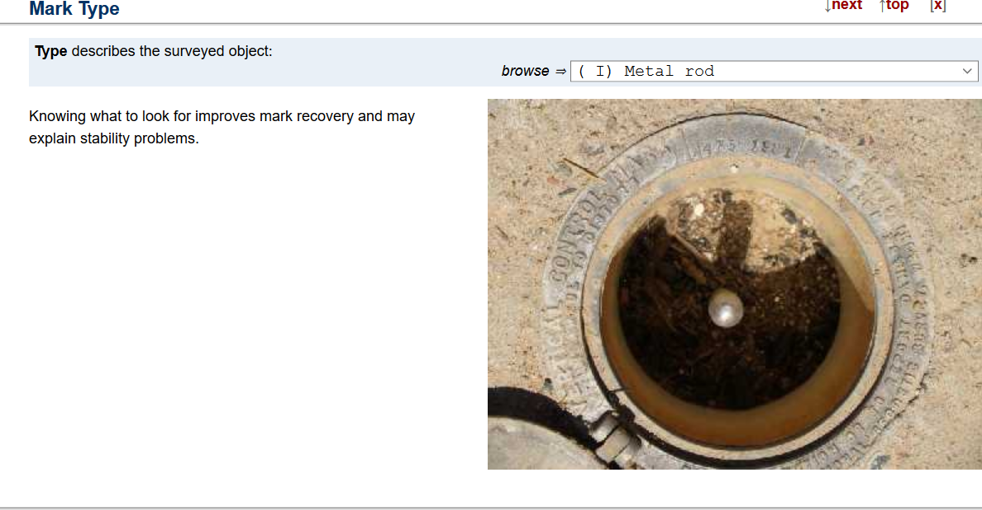
Mark Type

Slide 50

Mark Setting & Specific Setting

Slide 51

Special Application Marks

Slide 52

Magnetic Property

Slide 53

Mark Stability
Windesc will assign a stability code based on the “setting” selected.

Slide 54

Rod and Sleeve Depths

Slide 55
Project Proposal
Information Needed

Slide 56

Leveling Ties to the NSRS
First Order -Three mark tie required
Second Order-Two mark tie required
Notes:
All line ties must meet tolerance for order and class.

Slide 57
DSWORLD
Note Tie Marks-Pid’s & Take Pics of stamping
Note approximate number of new marks
Note type of marks to be set
Note distance of total run
Note route to be taken, start, finish, road names, State, County and Towns
Take a screen shot of project area

Slide 58
Submit Project Proposal
Project Title
Order and Class of leveling
Beginning and approximate end date
Contact information
Photos and Sketches
Notes:
Go through form

Slide 59


Project Proposal

Slide 60

L12345

Slide 62

Level Line Example

Slide 63
L12345
Line number should be used to name all files.
l12345.hgz, l12345.abs, l12345.nmo, l12345.des,,etc.
When you get your line number and sequence numbers, your project has been approved.
If an Advisor or other NGS person is assisting you, don’t hesitate to reach out.
Your ready to go!

Slide 64

LOCUS

Slide 65

LOCUS Results

Slide 67
LOCUS BM ADJUSTED
0 80.13865
1 77.41014
2 74.76259
3 81.95975
4 74.90121
5 76.33121
6 76.31088
7 76.78365
8 76.69923
9 74.46135
10 74.72267
11 96.39922
12 91.99580
13 81.49440
14 96.58920
*DK2866 L 321 80.139
*DK2867 M 321 77.410
DO7488 HOFFMAN 74.763
*DK2871 INN RESET 81.960
DO7489 HOLCOMB 74.901
DO7490 O MURRAY 76.331
DO7491 N MURRAY 76.311
DO7492 F MURRAY 76.784
DO7493 ARRON KING 76.699
DO7494 T 321 74.461
DO7495 S 321 74.723
DO7496 U 321 96.399
*EJ1665 H 290 91.996
*EJ1666 J 290 81.494
*EJ1667 K 290 96.589

Slide 68
Project Planning
Mark Setting
Line ties to the NSRS
Project Proposal
Demo!
DSWorld
Overview
County search
Project ID search
Windesc
Overview
Des.file
Translev
Overview
HGZ.file
Bluebook
Notes:
I will try to demonstrate these programs.

Slide 69

https://geodesy.noaa.gov/PC_PROD/index.shtml
DSWORLD

Slide 70
DSWORLD
DEMO

Slide 71
Digital Leveling
WINDESC
Preparing Descriptions for Passive Marks

Slide 72
Purpose of Writing Descriptions
To make geodetic data available to surveyors, engineers, cartographers and general public
To facilitate finding the mark
To correctly identify the mark
To use the mark for new surveys
To preserve the mark for future generations

Slide 73
Processing Sequence
Copy digital photos to photo directory
Create a new .des file and enter project info
Import description data from NGS
Renumber points if needed
Create or edit descriptions
Spell check all descriptions
Format all descriptions
Run neighbor and discrep

Slide 74
History
Hand-written/typed-different formats for horizontal and vertical control points
WDDProc-DOS-unified format-printed
WinDesc-Windows-D-File format-web

Slide 75

Project Header Information

Slide 76
The Description Header
Key fields: SSN, DNR code, Rec code
Enter from left to right from the top down
Some boxes populate subsequent boxes
Contains most mark attributes
Data must meet stringent NGS standards
Data will be loaded and stored in separate tables/fields in the NGS IDB
Used to generate the official NGS Datasheet

Slide 77


Slide 78
Descriptive Text
Must be easily readable
Use 3-paragraph format-location, to reach, reference distances/mark details
Go from the most general to the most specific
Use proper grammar
Check spelling
Avoid personal phone numbers
May contain special notes

Slide 79


Slide 80
Descriptive Text - Do
Get at least 4 reference distances
Format all descriptions
Spell check all descriptions
Use Windesc tools to help create descriptive text

Slide 81
Descriptive Text – Don’t
Don’t use slang
Don’t omit articles (a, an, the, etc.)
Don’t duplicate text
Don’t use the term ‘standard disk’
Don’t put positions in descriptive text

Slide 82
Positional Information
Latitude and Longitude to 0.1 seconds for bench marks via hand-held GPS measurement
Include horizontal datum
Include source, order and technique
May include other information for use with other geodetic software such as Translev
Used for geodetic computations and corrections
Used to plot mark in Google Earth and other plotting software

Slide 83


Slide 84


Slide 85


Slide 86
Wrap -up
Run through with Windesc

Slide 87
TRANSLEV

Slide 88
Digital Leveling
Translev
Bluebooking

Slide 89
Purpose
To insure leveling observations meet FGCS specifications and procedures
To reduce raw leveling data into standard .lvl format and finally to .hgz format for submission to NGS

Slide 90
Translev Program Overview
Program installation and configuration
File naming conventions
Processing leveling data
Tools
Web tools
Project submission

Slide 91
Program Installation
WindowsNT, Windows2000, WindowsXP Professional – Must have administrative privileges
Version numbering-current 5.03.02
Remove old version before installing the new
After installing, change permissions to read/write for all users

Slide 92
File Naming Conventions
Blue Book (.hgz)
Raw (.lev, .raw, .dat, .gsi)
Error Files (.err)
Abstracts (.abs)
Report (.rpt)
Lvl/Bok (.lvl, .bok)
New-minus-old (.nmo)
Statistics (.stt)

Slide 93

Flow Chart
FLOW
CHART

Slide 94

Notes:
Will ask for a DES.FILE

Slide 95

Notes:
HGZ.file

Slide 96
Translating Raw Files
Raw digital level formats - .gsi, .dat, .lev
Other formats-TDS, Digiloop, xml
Must have description file containing names, PIDs, elevations and geographic positions
Entering defaults
Rod/Instrument supporting files

Slide 97


Slide 98
The .lvl File
Editing the .lvl file
Checking the .lvl file
Fixing errors in the .lvl file
Importing the .lvl file to create the *40* series records in the .hgz file
Notes:
LVL Files

Slide 99

Notes:
Explain .lvl

Slide 100

Notes:
Import .lvl

Slide 101

Importing .lvl Files
Notes:
Importing .lvl

Slide 102

Notes:
HGZ File & 40 series records

Slide 103
Creating Abstracts
Date discontinuity errors
Rejections
Rod/Instrument data
Inverse-running length differences
Refraction corrections
The Neighbor File
The Segment File
Notes:
Abstracts

Slide 104


Notes:
Creating Abstract

Slide 105

Notes:
Explain Abstract

Slide 106
Notes:
HGZ File

Slide 107
Tools
Plotting
Creating statistical reports
Creating new-minus-old reports
Astronomic positions
Temperature profile prediction
Renumbering
Time zone calculator
Notes:
Tools in Windesc.

Slide 108
Creating a Plot

Slide 109


Slide 110
Creating a Statistical File

Slide 111


Slide 112
Creating the New-minus-old File

Slide 113


Slide 114



Slide 115


Slide 116


Slide 117
Web Tools
Aerial view (Google Earth)
Level projects
Updating files

Slide 118


Slide 119

Level Projects for Marks

Slide 120


Slide 121
Project Checklist
.hgz file created and checked
.lvl file(s) created, checked, combined
Abstract file created & checked
New-minus-old file created
Ties checked
Project report created

Slide 122
Files for Submittal
Description (.dsc) file
Combined raw (.gsi, .lev, or .dat) file
Combined (.bok) file
VERTOBS (.hgz) file
Abstract (.abs) file
Project report (.rpt) file
CD of photos

Slide 123
Run TRANSLEV

Slide 124
End of Line-24 K!!

