Slide 1
Section 9
Part II: The Modernized NSRS
Accessing the NSRS (3 slides)
The NOAA CORS Network (10 slides)
Notes:
Thank you for your interest in the Modernized National Spatial Reference System.
In this Section 9, we will discuss our plans for Accessing the . NSRS and the NOAA CORS Network.
I’m David Zenk, National Geodetic Survey Advisor for the Northern Plains Region.
I will be your narrator for this section of the presentation.

Slide 2
Part II: The Modernized NSRS
Guiding Principles
Documentation
Geometric Reference Frames
Geopotential Datum
Coordinates and Database
BREAK
Accessing the NSRS (3 slides)
The NOAA CORS Network (10 slides)
OPUS: The New Bluebooking
New Surveying Specifications
Transformations and Conversions
State Plane Coordinates
Addressing Known Concerns
NSRS Modernization Delay
Closing, Summary and Overview
Contact Information and Ways to Keep Up to Date
Notes:
Here’s where we are in the outline.

Slide 3
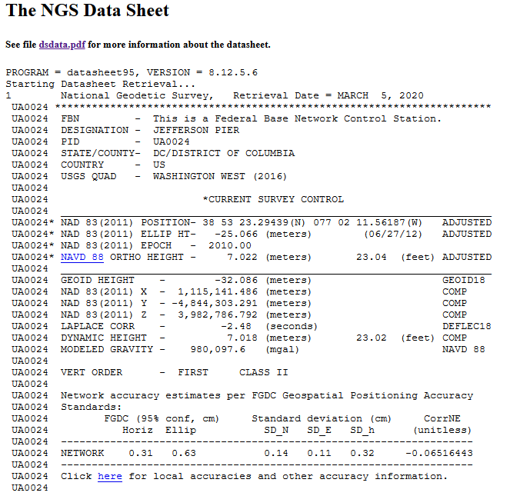
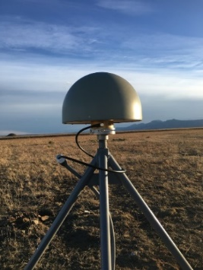
What “Access” to the NSRS Means
Until 1980, NGS offered “passive control” (Infrequently observed marks)
And one definitive coordinate set for each one of about 1.6 M marks
More recently, NGS provides data and coordinate functions with NOAA CORS Network
2000+ stations currently, most were not installed by NGS
And one definitive coordinate function for each one
And the software (PAGES / OPUS) to differentially position your GPS receiver to each station
Notes:
So, what does ACCESS mean?
Until 1980, NGS offered “passive control”* (meaning * Infrequently observed marks)
And one definitive coordinate set for each one of about 1.6 M marks
More recently, NGS provides data and coordinate functions with NOAA CORS Network
(most of which were not installed by NGS)
And one definitive coordinate function for each one
And the software (PAGES / OPUS) to differentially position your GPS receiver to each station
2000+ stations currently

Slide 4
What “Access” to the NSRS Will Mean
What will stay the same?
The NSRS will remain as “geodetic control” for you to “access”
Geospatial information and metadata about various points will still be available
Passive control will continue to exist…
But gone are the days of getting “the coordinate” on a point from a “datasheet”
Notes:
What will stay the same?
The NSRS will remain as “geodetic control” for you to “access”
Geospatial information and metadata about various points will still be available
And passive control will exist…
But gone are the days of getting “the coordinate” on a point from a “datasheet”

Slide 5
What “Access” to the NSRS Will Mean
What will be different?
Information: from the Data Delivery System (DDS)
Graphics (pictures, graphs, maps)
Computations: OPUS
Do-it-all tool (mark reporting, positioning, adjustments, etc)
Heavy emphasis on using GNSS to get to the NSRS
All GNSS constellations will be supported
More real time helpful CORS information (data availability & quality)
OPUS will use new GNSS observations and perhaps some “trusted” passive control
Otherwise, your OPUS coordinates may say “not tied to the NSRS”
Notes:
What will be different?
Information will come from the Data Delivery System (DDS)
With more graphics (such as pictures, graphs, and maps) than in the past
Computations will be performed in OPUS
Which will be a “Do-it-all” tool (for mark reporting, positioning, and adjustments)
There will be a heavy emphasis on using GNSS to access the NSRS
All GNSS constellations will be supported.
There will be more real-time helpful CORS information (such as data availability & quality).
OPUS will use new GNSS observations and perhaps some “trusted” passive control.
Otherwise, your OPUS coordinates may say “not tied to the NSRS”

Slide 6
Part II: The Modernized NSRS
Guiding Principles
Documentation
Geometric Reference Frames
Geopotential Datum
Coordinates and Database
BREAK
Accessing the NSRS
The NOAA CORS Network (10 slides)
OPUS: The New Bluebooking
New Surveying Specifications
Transformations and Conversions
State Plane Coordinates
Addressing Known Concerns
NSRS Modernization Delay
Closing, Summary and Overview
Contact Information and Ways to Keep Up to Date
Notes:
Let’s look at the NOAA CORS Network (or NCN)

Slide 7
Modernizing the NCN
Coordinate functions are the way to know the coordinates of a CORS at the time you are trying to position yourself relative to that CORS
These are discontinuous, piecewise linear functions
NGS is developing newer, faster ways to update them when any of these occur:
An earthquake
An obvious drift of the station’s daily-computed coordinates away from its own coordinate function
An obvious non-linear component to a station’s movement
Notes:
Coordinate functions are the way to know the coordinates of a CORS at the time you are trying to position yourself relative to that CORS.
These are discontinuous, piecewise linear functions.
NGS is developing newer, faster ways to update them when any of these occur:
An earthquake
An obvious drift of the station’s daily-computed coordinates away from its own coordinate function
An obvious non-linear component to a station’s movement

Slide 8
NCN Coordinate Functions
-2369510.583
X-coord
Date/time (T)
You saw this earlier. Note each piece is linear, but is offset from its neighboring piece. But at each unique time, there is one and only one “X” coordinate. This makes it a “function” by the strict mathematical definition.
Notes:
Here’s a chart of a NCN Coordinate Function
Note that each piece is linear, but is offset vertically from its neighboring piece.
But at each unique time, there is one and only one “X” coordinate.
This makes it a “function” by the strict mathematical definition.

Slide 9
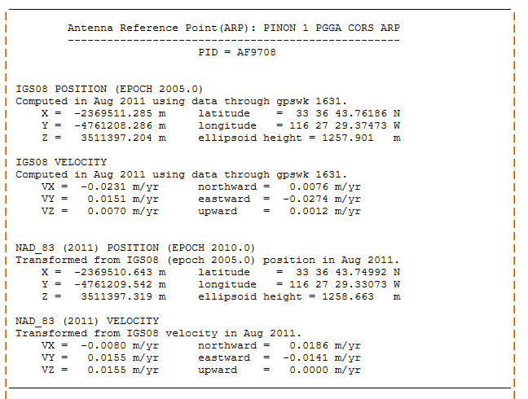
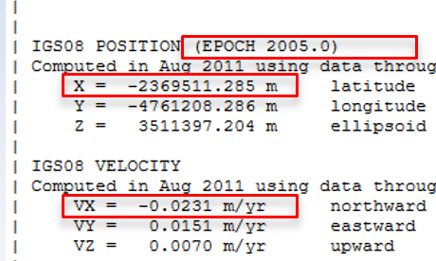
NCN Coordinate Functions
Today:
One coordinate, at one epoch, and one velocity…
Notes:
Today, NGS produces one coordinate, at one epoch, and one velocity.

Slide 10
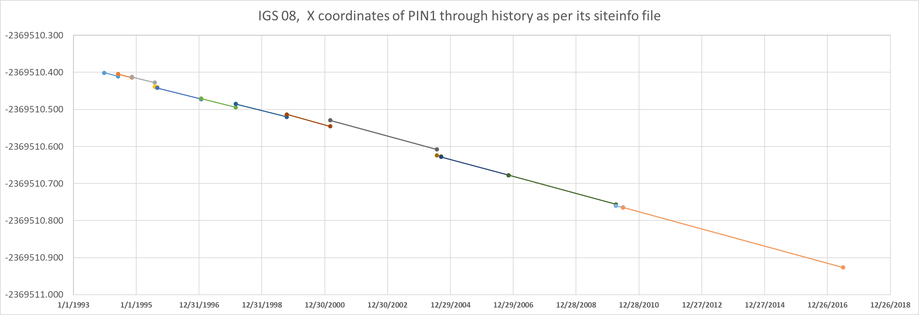
NCN Coordinate Functions
Modernized NSRS:
Every discontinuity shown
Vx = -0.0231m/y
Vx = -0.0213m/y
Vx = -0.0165m/y
But, in the modernized NSRS, NGS will produce a more detailed coordinate function which includes coordinate velocity trends.
Notes:
But, in the modernized NSRS, NGS will produce a more detailed coordinate function which includes coordinate velocity trends.

Slide 11
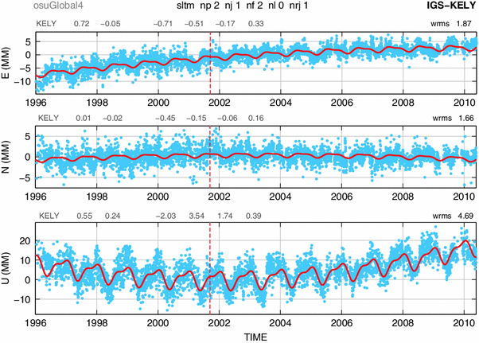
Examples of What Non-Linear CORS Coordinate Functions Might Look Like
Notes:
NGS is considering what non-linear coordinate functions to incorporate into the modernized NCN

Slide 12
Answers Being Developed…
The NCN will be the primary access to the modernized NSRS
This means every historic issue with the NCN to date must be, and will be, addressed
A list of such issues follows:
Notes:
The NCN will be the primary access to the modernized NSRS
This means every historic issue with the NCN to date must be, and will be, addressed
A list of such issues follows

Slide 13
The NCN of the Future Will…
Have a “CORS grading” system:
Quality and availability
To encourage use of “best” CORSs
Clarify the difference between the one GRP and the many ARPs at each station.
Remember that:
ARP: Comes and goes with every antenna
GRP: Permanent point on the station
Notes:
The NCN will have a “CORS grading” system:
Quality and availability
To encourage use of “best” CORSs
NGS will clarify the difference between the one GRP and the many ARPs at each station.
Remember that:
ARP: Comes and goes with every antenna
GRP: Permanent point on the station

Slide 14
The NCN of the Future Will…
Have a plan for maintaining accurate coordinate functions
As they drift away from daily solutions
As a station suffers an episodic movement
As they show evidence of non-linear features
Notes:
The NCN will have a plan for maintaining accurate coordinate functions
As they drift away from daily solutions
As a station suffers an episodic movement
As they show evidence of non-linear features

Slide 15
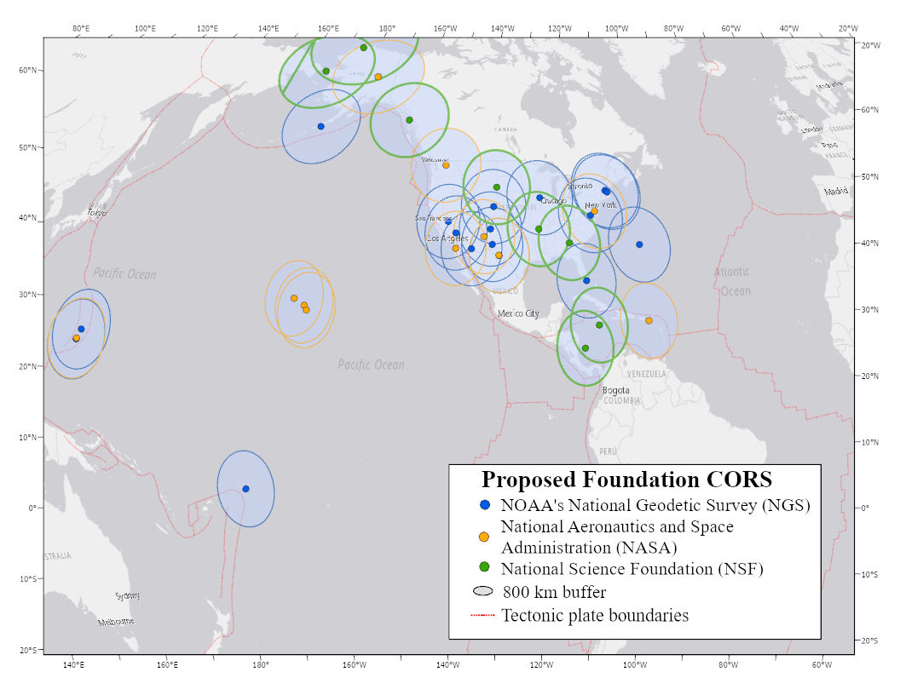
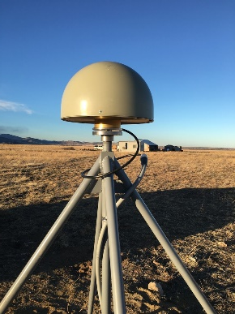
NOAA Foundation CORS Network
U.S. Federal Partners | GNSS Site ID | Location | Existing IGS or ITRF Site
National Science Foundation (NSF) Existing Sites Program: Network of the Americas (NOTA) | AB09 | Wales, AK
 | AB51 | Petersburg, AK
 | ATQK | Atqasuk, AK
 | P043 | New Castle, WY
 | P777 | Dennard, AR
 | P804 | The Rock, GA
NSF Existing Sites Program: COCONet | CN11 | Pedro Cay, Jamaica
 | SAN0 | San Andres Island, Colombia
National Aeronautics and Space Administration (NASA) Existing Sites Program: Global GNSS Network (GGN) | BREW | Brewster, WA | ITRF
 | CRO1 | St. Croix, VI | ITRF
 | FAIR/GCGO | Fairbanks, AK | IGS
 | GODE | Greenbelt, MD | IGS/ITRF
 | GUAM | Dededo, Guam | IGS
 | HAL1 | Haleakala, HI | IGS/ITRF
 | KOKB | Kauai, HI | IGS/ITRF
 | MDO1 | McDonald Observatory, TX | ITRF
 | MKEA | Mauna Kea, HI | IGS/ITRF
 | TBD | TBD California location | TBD
 | PIE1 | Pie Town, NM | IGS/ITRF
NOAA- National Geodetic Survey (NGS) Existing and New Sites Program: NOAA CORS Network | ASPA | Pago Pago, American Samoa | IGS
 | BRSG | St. George, Bermuda
 | CNMR | Saipan, Northern Mariana Islands | IGS
 | CORB | Woodford, VA
 | FLF1 | Richmond, FL | Proposed IGS/ITRF
 | GUUG | Mangilao, Guam | IGS/ITRF
 | TMG2 | Boulder, CO | Proposed IGS
 | WES2 | Westford, MA | IGS/ITRF
 | Future Station | Apache Point, NM | ITRF
 | Future Station | Fort Davis, TX | ITRF
 | Future Station | Fort Irwin, CA | ITRF
 | Future Station | Hancock, NH | ITRF
 | Future Station | Los Alamos, NM | ITRF
 | Future Station | Kitt Peak, AZ | ITRF
 | Future Station | Owens Valley, CA | ITRF
 | Future Station | Cold Bay, AK | ITRF
 | Future Station | North Liberty, IA | ITRF
26 in North America 4 in the Pacific 3 in the Caribbean 3 in the Marianas
A set of federally-operated, high quality, highly reliable stations with the longevity to guarantee citizens’ access to official National Spatial Reference System (NSRS) positions and support international positioning consistency efforts
Notes:
NGS will designate/create a superset of the NCN called the Foundation CORS Network.
It will be a set of federally-operated, high quality, highly reliable stations with the longevity to guarantee citizens’ access to official National Spatial Reference System (NSRS) positions and support international positioning consistency efforts
26 in North America,
4 in the Pacific,
3 in the Caribbean, and
3 in the Marianas
This is a Key Takeaway.

Slide 16
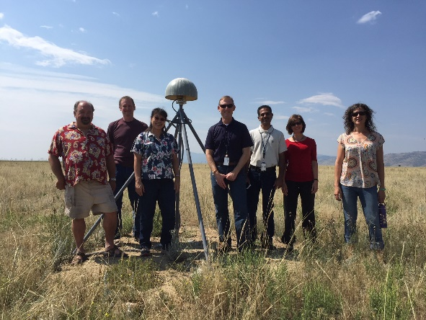
Three Ongoing Phases of Foundation CORS
Phase 1: Incorporate partner stations
Existing NASA and NSF stations brought into the Foundation CORS network.
[NASA Agreement signed 12/18/2019. Discussions ongoing with NSF.]
Phase 2: Upgrade existing NGS CORSs
Upgrades include fully-GNSS (“All in Sky”) capable equipment, RINEX3 support, and submission to IGS.
[RINEX3 creation, ingestion, and QC in development. 5 of 7 NGS Foundation CORS are fully-GNSS enabled]
Phase 3: Construct ~9 new stations
These NGS-owned stations will be co-located at sites with existing space geodetic techniques
Foundation CORS at NGS’ Table Mountain Geophysical Observatory in Boulder, CO, installed 2018 (ID: TMG2)
Notes:
NGS will follow a logical process in creating the Foundation CORS Network
Phase 1:
Incorporate partner stations such as NASA and NSF stations
Phase 2:
Upgrade existing NGS CORSs
Phase 3:
Construct about 9 new stations

Slide 17
End of Section 9
Notes:
This is the end of Section 9

