Slide 1
Section 10
Part II: The Modernized NSRS
OPUS: The New Bluebooking (7 slides)
New Surveying Specifications (4 slides)
Notes:
Thank you for your interest in the Modernized National Spatial Reference System.
In this Section 10, we will discuss our plans for OPUS and our dedication to surveying specifications.
I’m David Zenk, National Geodetic Survey Advisor for the Northern Plains Region.
I will be your narrator for this section of the presentation.

Slide 2
Part II: The Modernized NSRS
Guiding Principles
Documentation
Geometric Reference Frames
Geopotential Datum
Coordinates and Database
BREAK
Accessing the NSRS
The NOAA CORS Network
OPUS: The New Bluebooking (7 slides)
New Surveying Specifications (4 slides)
Transformations and Conversions
State Plane Coordinates
Addressing Known Concerns
NSRS Modernization Delay
Closing, Summary and Overview
Contact Information and Ways to Keep Up to Date
Notes:
As a reminder, here’s where we are in the outline.

Slide 3
OPUS
The Online Positioning User Service
NGS will phase-out the “hyphenated” terms
OPUS-Projects, OPUS-S, OPUS-RS, OPUS-Share, etc
Instead just plain “OPUS”
Using OPUS, NGS will replace
All internal versions of OPUS
All external (user) versions of OPUS
All forms of “Bluebooking” (data submission to NGS)
Analyzing, adjusting, submitting geodetic survey data to NGS
Mark Recovery and Reporting Tool
Some of these replacements are already being implemented.
Notes:
The Online Positioning User Service
NGS will phase-out the “hyphenated” terms
OPUS-Projects, OPUS-S, OPUS-RS, OPUS-Share, etc
Instead just plain “OPUS”
Using OPUS, NGS will replace
All internal versions of OPUS
All external (user) versions of OPUS
All forms of “Bluebooking” (data submission to NGS) which includes analyzing, adjusting, and submitting geodetic survey data to NGS
Mark Recovery and Reporting Tool
Some of these replacments are already being implemented.

Slide 4
OPUS
Available to everyone
Internal to NGS only
Plan projects, upload data, analyze, process and adjust data to any epoch with any constraints. Optional submit data to NGS
(For any survey project, with any mix of geodetic data types. Special support for special surveys like Airports and Calibration Baselines)
Find (NGS-known) passive control or report any found passive control. Upload to a project if so desired.
(For all survey marks, even ones not currently in NGS holdings)
Access ongoing user projects for customer service
Gather, analyze and adjust raw data files into survey epoch coordinates
(Every 4 weeks for GNSS*
Every year for Leveling*
Still deciding on gravity and other)
The RTN Alignment Service (RAS)
(For RTN operators to work with NGS and quantify the alignment of RTN-reported rover positions to the NSRS)
Upload 1 or more GNSS RINEX files to get OPUS coordinates
(For all constellations)
* These values are initial, but subject to change
Gather, analyze and adjust raw data files into reference epoch coordinates
(Every five years)
Data Delivery System
(Query the NSRS database for all publicly releasable data and metadata)
New CORS proposals
Notes:
There will be External OPUS Tools available to everyone,
and
There will be Internal OPUS functions available for internal use by NGS only.

Slide 5
NSRS Coordinates or Not?
No matter how you use OPUS, a user will always get coordinates with this label:
“These are OPUS coordinates…”
But depending on their choices for “control to use” and “epoch to adjust to”, they will get one of these two labels:
“These are OPUS coordinates and are tied to the NSRS”
“These are OPUS coordinates but are not tied to the NSRS”
Let’s look at why…
Notes:
No matter how you use OPUS, a user will always get coordinates with this label:
“These are OPUS coordinates …”
But depending on their choices for “control to use” and “epoch to adjust to”, they will get one of these two labels:
“These are OPUS coordinates … and are tied to the NSRS”
“These are OPUS coordinates … but are not tied to the NSRS”
Let’s look at why…

Slide 6
GNSS Is Key
Leveling can (and will) still tell you differential heights
But for OPUS to provide you absolute NSRS coordinates, you’ll need to “get into the datum”
Using trusted geodetic control:
Primarily: use new GNSS to get ellipsoid heights
Or “recently GNSS-surveyed” passive control
Then GEOID2022 to get orthometric heights
Then pick an “appropriate” epoch for your adjustment
Now you’re “in the datum”.
If you don’t follow NGS recommendations in OPUS – your results will be labeled as … not tied to the NSRS.
Notes:
Leveling can (and will) still tell you differential heights
But for OPUS to provide you absolute NSRS coordinates, you’ll need to “get into the datum”
You will need to use Trusted geodetic control:
Primarily: use new GNSS surveys to get current ellipsoid heights
or “recently GNSS-surveyed” passive control
Then apply GEOID2022 to get orthometric heights
Then pick an “appropriate” epoch for your adjustment
Now you’re “in the datum”.
If you don’t follow NGS recommendations in OPUS – your results will be labeled as not tied to the NSRS.
Similar arguments will apply for classical surveys (triangulation, trilateration, traverse).

Slide 7
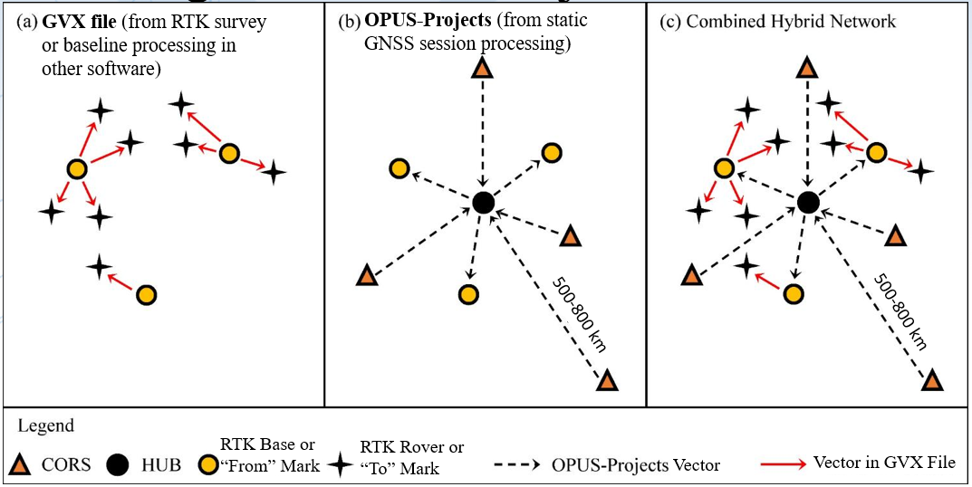
OPUS will soon take in RTK vectors!
OPUS-Projects for RTK Vectors and the GVX Format
April 9, 2020 | 2-3 pm, Eastern Time
Dan Gillins, National Geodetic Survey
Notes:
NGS anticipates that OPUS will soon take in RTK vectors.
Using the GVX format.
See the NGS webinar recording for more details.

Slide 8
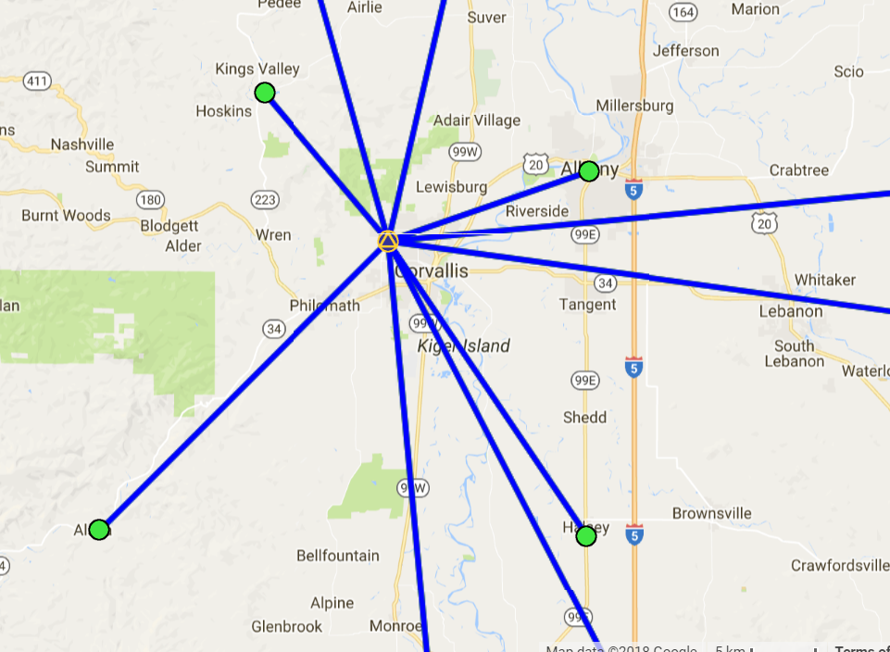
Example: Upload RTN Vectors to OPUS-Projects
LEGEND
CORS
User Mark
Processed Vector (OPUS-Projects)
Uploaded Vector
Upload Vectors
Notes:
RTK Vector inclusion will proceed along this path.
CLICK
Upload data files for Base Stations
Upload data files for Rover Marks
CLICK
Process vectors from CORS to Base Marks, then from Base Marks to Rover Marks
CLICK
Set up Adjustment
CLICK
Review and Submit to NGS

Slide 9
Leveling: NSRS coordinates or not?
Control used | Epoch of adjustment | Tied to the NSRS?
Passive control from the NSRS DB with RECs at the most recent reference epoch and/or SECs whose epoch falls after the most recent reference epoch | Any epoch from the most recent reference epoch (e.g. “2020.00”) until the midpoint epoch of the leveling campaign | Yes
Passive control from the NSRS DB without RECs at the most recent reference epoch and without SECs whose epoch falls after the most recent reference epoch | Any | No
Passive control where you have surveyed with GNSS using NGS’s latest GNSS w/ leveling specifications | Any epoch from the most recent reference epoch (e.g. “2020.00”) until the midpoint epoch of the leveling campaign | Yes
Passive control where you have surveyed with GNSS using NGS’s latest GNSS w/ leveling specifications | Any epoch before the most recent reference epoch | No
Anything else | Any other epoch | No
1
See Blueprint Part 3
2
Notes:
What this chart shows is that there are only two ways your “OPUS” coordinates will also get the “tied to the NSRS” label:
1 )Don’t do GNSS, but use marks with “recent” coordinates (either an REC or an SEC since the most recent RE) and adjust to some recent epoch (which can never be more then 7 years ago)
2) Do GNSS observations and adjust to some recent epoch (which can never be more then 7 years ago)
See Blueprint Part 3 for more details

Slide 10
Part II: The Modernized NSRS
Guiding Principles
Documentation
Geometric Reference Frames
Geopotential Datum
Coordinates and Database
BREAK
Accessing the NSRS
The NOAA CORS Network
OPUS: The New Bluebooking
New Surveying Specifications (4 slides)
Transformations and Conversions
State Plane Coordinates
Addressing Known Concerns
NSRS Modernization Delay
Closing, Summary and Overview
Contact Information and Ways to Keep Up to Date
Notes:
Now, let’s talk briefly about
new surveying specifications.

Slide 11
New Surveying Specifications
Focus 1: Modernized NSRS
Using GNSS to “enter the datum” when performing a leveling or classical project
POSSIBLY “trusted” passive control
Focus 2: Modern Technology
NGS has no “RTK” specifications, but guidelines
Leveling manual refers to 1981 update to 1948 manual
Large portions (“pack time,” “filling out paper bench mark descriptors”) can be excised, while modern tools (digital levels, online form-fillable PDFs, etc.) can be emphasized.
Notes:
NGS will develop new specifications to support modern survey methods.
NGS will provide specifications relating to Using the Modernized NSRS and update and formalize existing guidelines on technology.
Focus 1: Modernized NSRS
Using GNSS to “enter the datum” when performing a leveling or classical project
POSSIBLY “trusted” passive control
Focus 2: Modern Technology
NGS has no “RTK” specifications, but guidelines
Leveling manual refers to 1981 update to 1948 manual
Large portions (“pack time,” “filling out paper bench mark descriptors”) can be excised, while modern tools (digital levels, online form-fillable PDFs, etc.) can be emphasized.

Slide 12
New Leveling Specifications
For Differential Heights:
Leveling field work will look much the same as before.
But, for Absolute NSRS Heights coming from OPUS, you’ll need
1) Standard Leveling Field Work (See Above)
2) Then, to get “into the Datum”, you’ll also need either
preferred and supported: GNSS observations (including RTK) at time of leveling
or possibly: trusted “Passive Control”
3) Adjust to an Appropriate Epoch
Mid-point of leveling campaign or recent REC
Guidance Coming in Late 2020 (Blueprint Part 3)
Notes:
NGS will produce a new leveling specification.
For Differential Heights:
Leveling field work will look much the same as before.
But, for Absolute NSRS Heights coming from OPUS, you’ll need
1) Standard Leveling Field Work (See Above)
2) Then, to get “into the Datum”, you’ll also need either
- preferred and supported: GNSS observations (including RTK) at time of leveling
- or possibly: trusted “Passive Control”
3) Adjust to an Appropriate Epoch
Guidance Coming in Late 2020 (Blueprint Part 3)

Slide 13
Replace NGS-58
New “specifications” forthcoming based upon extensive
empirical evidence about achievable accuracies in the field.
Notes:
NOAA Technical Memorandum NOS NGS-58 will be replaced with a new “specification” based upon extensive empirical evidence about achievable accuracies in the field.

Slide 14
Surveying
Good surveying practice continues to be critical
Use GNSS to “get into the datum” even for leveling!
Follow specifications in the replacement for NGS-58
Process all survey types (GNSS, classical, leveling, gravity, etc.) in OPUS
SUBMIT TO NGS
Without your data, NGS cannot keep coordinates on passive control up to date!
Notes:
In summary,
Good surveying practice continues to be critical
Use GNSS to “get into the datum” even for leveling!
Follow specifications in the replacement for NGS-58
Process all survey types (GNSS, classical, leveling, gravity, etc.) in OPUS
SUBMIT TO NGS
Without your data, NGS cannot keep coordinates on passive control up to date

Slide 15
End of Section 10
Notes:
This is the end of Section 10

