Slide 1
Section 12
Part II: The Modernized NSRS
Addressing Known Concerns
NSRS Modernization Delay
Closing, Summary and Overview
Contact Information and Ways to Keep Up to Date
Notes:
Thank you for your interest in the Modernized National Spatial Reference System.
In this Section 12 we will conclude with
Known Concerns
NSRS Modernization Delay
Closing, Summary and Overview
and finally, Contact Information and Ways to Keep Up to Date
I’m David Zenk, National Geodetic Survey Advisor for the Northern Plains Region.
I will be your narrator for this section of the presentation.

Slide 2
Part II: The Modernized NSRS
Guiding Principles
Documentation
Geometric Reference Frames
Geopotential Datum
Coordinates and Database
BREAK
Accessing the NSRS
The NOAA CORS Network
OPUS: The New Bluebooking
New Surveying Specifications
Transformations and Conversions
State Plane Coordinates
Addressing Known Concerns
NSRS Modernization Delay
Closing, Summary and Overview
Contact Information and Ways to Keep Up to Date
Notes:
As a reminder, here’s where we are in the outline.

Slide 3
Known Concerns…
Closure of GPS/geoid/leveling
Differential Leveling is more precise over short distances than GPS+GEOID.
NGS is developing recommendations in Blueprint Part 3 to guide users.
TBDs in Blueprint Parts 1–3
Expect to have most TBDs determined before rollout, though some will require on-the-fly decisions through experimentation
I don’t have GPS…
I don’t have a good internet connection
OPUS relies upon internet….no downloadable version as there was with ADJUST/PAGES...
Notes:
There are several known concerns of which NGS is already aware.
Closure of GPS/geoid/leveling
Differential Leveling is more precise over short distances than GPS+GEOID.
NGS is developing recommendations in Blueprint Part 3 to guide users.
There are several TBDs in the Blueprints Parts 1,2 &3
NGS will be able to finalize these when the results of future data analysis is complete. For now, we have put forward our best estimate.
GPS – NGS expects to continue support for passive marks. The user community will submit data on existing and new marks.
Internet connections – OPUS and other future tools will rely more heavily on internet and browser delivery.
On the positive side, applications are up to date and no user-side installation is needed.
On the negative side, increasing bandwidth will be a local priority.

Slide 4
Part II: The Modernized NSRS
Guiding Principles
Documentation
Geometric Reference Frames
Geopotential Datum
Coordinates and Database
BREAK
Accessing the NSRS
The NOAA CORS Network
OPUS: The New Bluebooking
New Surveying Specifications
Transformations and Conversions
State Plane Coordinates
Addressing Known Concerns
NSRS Modernization Delay (3 slides)
Closing, Summary and Overview
Contact Information and Ways to Keep Up to Date
Notes:
Due to a variety of situations, NGS has had to delay the NSRS schedule.
Let’s look at a few of these impacts.

Slide 5
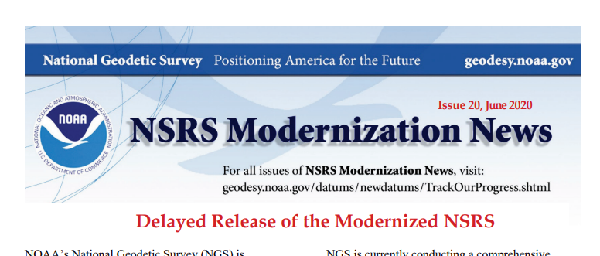
NSRS Modernization: DELAY
It’s official: we are delayed beyond 2022
On June 23, 2020, this message was rolled out:
NGS Web Page
NSRS Modernization News Special Issue
Granicus Announcement (email)
Notifications to NSPS, AAGS, FGDC/FGCS
Notes:
It’s official: we are delayed beyond 2022
On June 23, 2020, this message was rolled out via:
NGS Web Page
NSRS Modernization News Special Issue
Granicus Announcement (email)
Notifications to NSPS, AAGS, FGDC/FGCS

Slide 6
NSRS Modernization: DELAY
A list of FAQs is available. Some summary highlights:
Why are we delayed?
GRAV-D issues (COVID-19, airspace, unforeseen maintenance)
Personnel availability
How long is the delay?
Unknown. We hope only a few years. The future cannot be predicted.
Will names change?
No, “GEOID2022”, “NATRF2022”, etc. will remain the same
Notes:
A list of FAQs is available. Here are a few summary highlights:
Why are we delayed?
GRAV-D issues (COVID-19, airspace, unforeseen maintenance)
Personnel availability
How long is the delay?
Unknown. We hope only a few years. The future cannot be predicted.
Will names change?
No, “GEOID2022”, “NATRF2022”, etc. will remain the same

Slide 7
NSRS Modernization: DELAY
What now?
NGS is re-prioritizing all modernization tasks
Focusing efforts on getting tasks completed in a logical order that builds one upon the next
To allow us the choice, if we wish, to phase the modernization roll-out:
For example, rolling out NATRF2022 before NADCON exists
For example, rolling out NATRF2022 before NAPGD2022
BUT phased roll-out isn’t on the table yet
Notes:
So, what now?
NGS is re-prioritizing all modernization tasks :
Focusing efforts on getting tasks completed in a logical order that builds one upon the next
To allow us the choice, if we wish, to phase the modernization roll-out:
For example, rolling out NATRF2022 before NADCON exists
For example, rolling out NATRF2022 before NAPGD2022
BUT phased roll-out isn’t on the table yet

Slide 8
Part II: The Modernized NSRS
Guiding Principles
Documentation
Geometric Reference Frames
Geopotential Datum
Coordinates and Database
BREAK
Accessing the NSRS
The NOAA CORS Network
OPUS: The New Bluebooking
New Surveying Specifications
Transformations and Conversions
State Plane Coordinates
Addressing Known Concerns
NSRS Modernization Delay
Closing, Summary and Overview (6 slides)
Contact Information and Ways to Keep Up to Date

Slide 9
Summary
The NSRS of today is based on:
Pre-space-age geodetic technology
The concept of one unique coordinate assigned to a point, in perpetuity
The modernized NSRS will:
Leverage GNSS
Embrace the movements of points on Earth’s crust
Notes:
The NSRS of today is based on:
Pre-space-age geodetic technology
The concept of one unique coordinate assigned to a point, in perpetuity
The modernized NSRS will:
Leverage GNSS
Embrace the movements of points on Earth’s crust

Slide 10
Summary
Your NAD 83 coordinates may change by 2–4 meters
Your orthometric heights may change by up to 2 meters (or more)
Magnitude of change will vary with location:
NAD 83 will change by about 0.5 to 4 meters horizontally
Orthometric and NAD 83 ellipsoid heights will change by up to about 2 meters
And that just gets you to a “reference epoch”
Which continues to perpetuate the “one coordinate in perpetuity” myth
After that, real motions kick in and become part of the world of geodetic control
Notes:
Your NAD 83 coordinates may change by 2–4 meters
Your orthometric heights may change by up to 2 meters (or more)
Magnitude of change will vary with location:
NAD 83 will change by about 0.5 to 4 meters horizontally
Orthometric and NAD 83 ellipsoid heights will change by up to about 2 meters
And that just gets you to a “reference epoch”
Which continues to perpetuate the “one coordinate in perpetuity” myth
After that, real motions kick in and become part of the world of geodetic control

Slide 11
Summary
But it’s not all “change”…
You will still be able to:
Get a position using OPUS
Adjust your projects to some reference epoch
Look at a mark’s “datasheet”
Only now, there will be a lot more information and a lot more service provided
Notes:
But it’s not all “change”…
You will still be able to:
Get a position using OPUS
Adjust your projects to some reference epoch
Look at a mark’s “datasheet”
Only now, there will be a lot more information and a lot more service provided

Slide 12
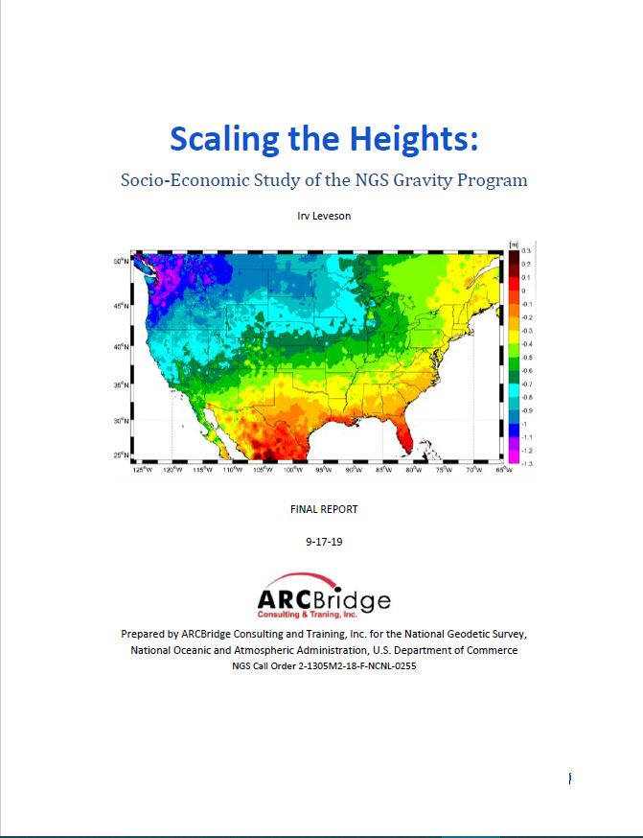
Summary
Socioecomic Benefit:
Value of the NGS gravity program—part of the NSRS modernization effort —was estimated in a 2019 study to be between $4.2 billion and $13.3 billion over ten years, with a middle scenario of $8.7 billion.
Notes:
Socioecomic Benefit:
Value of the NGS gravity program—part of the NSRS modernization effort —was estimated in a 2019 study to be between $4.2 billion and $13.3 billion over ten years, with a middle scenario of $8.7 billion.

Slide 13
Closing
Surveying will still be surveying
Just because NGS provides time-dependent information doesn’t mean everything you do has to be “time dependent”
NGS will provide tools to minimize its impact:
Plate fixed frames
Reference epoch coordinates
Notes:
Surveying will still be surveying
Just because NGS provides time-dependent information doesn’t mean everything you do has to be “time dependent”
NGS will provide tools to minimize its impact:
Plate fixed frames
Reference Epoch Coordinates

Slide 14
Closing
But if time-change is important (heights in coastal subsidence zones, anyone?) they are available
Survey epoch coordinates will show a mark’s coordinate history
The IFVM will be broadly useful for showing movement in the horizontal, but significantly less so in the vertical
Notes:
But if time-change is important (heights in coastal subsidence zones, anyone?) they are available
Survey epoch coordinates will show a mark’s coordinate history
The IFVM will be broadly useful for showing movement in the horizontal, but perhaps less so in the vertical

Slide 15
Part II: The Modernized NSRS
Guiding Principles
Documentation
Geometric Reference Frames
Geopotential Datum
Coordinates and Database
BREAK
Accessing the NSRS
The NOAA CORS Network
OPUS: The New Bluebooking
New Surveying Specifications
Transformations and Conversions
State Plane Coordinates
Addressing Known Concerns
NSRS Modernization Delay
Closing, Summary and Overview
Contact Information and Ways to Keep Up to Date
Notes:
Finally, I’d like to invite you to stay up-to-date with some contact information and NGS resources.

Slide 16
How to stay informed
Questions? ngs.infocenter@noaa.gov
NGS Regional Advisors:
https://geodesy.noaa.gov/ADVISORS/index.shtml
NSRS Modernization News
https://www.ngs.noaa.gov/datums/newdatums/index.shtml
Webinars:
https://www.ngs.noaa.gov/INFO/subscribe.shtml
Notes:
As always, your NGS Regional Advisor is available to help you.
Don’t forget to subscribe to the NGS Newsletters and Webinar Notifications

Slide 17
Thank You for your interest in the Modernized National Spatial Reference System
Notes:
Thank you for your interest in the Modernized National Spatial Reference System

Slide 18
End of Section 12
Notes:
This is the end of Section 12.

Slide 19
Questions?

