Slide 1
Section 8
Part II: The Modernized NSRS
Coordinates and Database (18 slides)
Notes:
Thank you for your interest in the Modernized National Spatial Reference System.
In this Section 8, we will discuss our plans for Coordinate Types and the Database.
I’m David Zenk, National Geodetic Survey Advisor for the Northern Plains Region.
I will be your narrator for this section of the presentation.

Slide 2
Part II: The Modernized NSRS
Guiding Principles
Documentation
Geometric Reference Frames
Geopotential Datum
Coordinates and Database (18 slides)
BREAK
Accessing the NSRS
The NOAA CORS Network
OPUS: The New Bluebooking
New Surveying Specifications
Transformations and Conversions
State Plane Coordinates
Addressing Known Concerns
NSRS Modernization Delay
Closing, Summary and Overview
Contact Information and Ways to Keep Up to Date
Notes:
As a reminder, here’s where we are in the outline.
If this is a live presentation, we’ll take a break after this topic.

Slide 3
New Types of Coordinates
NGS anticipates that 5 types of coordinates will be used in the NSRS. They are:
Reported Coordinates
OPUS Coordinates
Reference Epoch Coordinates (RECs)
Survey Epoch Coordinates (SECs)
Active Coordinates (ACs)
All are discussed in detail in Blueprint Part 3.
Notes:
NGS anticipates that 5 types of coordinates will be used in the NSRS.
These are
Reported Coordinates
OPUS Coordinates
Reference Epoch Coordinates (RECs)
Survey Epoch Coordinates (SECs)
Active Coordinates (ACs)
All are discussed in detail in Blueprint Part 3.
Which is a separate publication of the NGS.

Slide 4
New Types of Coordinates
Reported Coordinates
“These are from any source where the coordinate is directly reported to NGS without the data necessary for NGS to replicate the coordinate.”
Scaled from a map
Transformed using NCAT or VDatum
Smartphone
Reported directly from an RTK rover without data files
Notes:
Reported Coordinates
“These are from any source where the coordinate is directly reported to NGS without the data necessary for NGS to replicate the coordinate.”
They could be scaled from a map
Or, they might be transformed using NCAT or VDatum
Or, shown on a smartphone’s GPS
Or, perhaps reported directly from an RTK rover without data files.

Slide 5
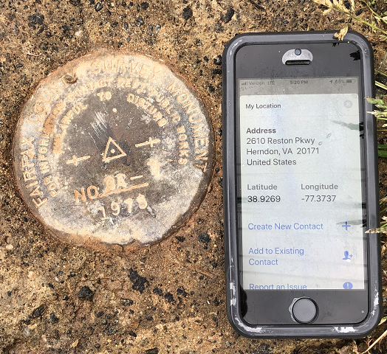
Reported Coordinates
reported coordinates
photo
Notes:
Reported Coordinates could be captured with a smartphone, perhaps with a photo, as part of a mark recovery.

Slide 6
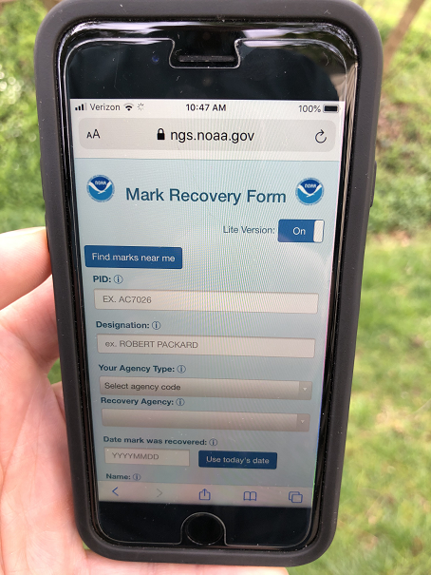
Speaking of Smartphones…
NGS has a new mobile-friendly mark recovery webpage. Please try it out!
https://www.ngs.noaa.gov/cgi-bin/mark_recovery_form.prl
Notes:
And … NGS has a new mobile-friendly mark recovery webpage.
Please try it out!

Slide 7
Buyer Beware!
Reported coordinates might be very wrong!
Reported using incorrect datum NAD 27, NAD 83, WGS84
Systematic Error: 2–100 meters
Scaled off of a USGS topographic map
Random Error: ± 600 meters
Smartphone
Random Error: ± 10–50 meters
NGS will show you reported coordinates
But their function is to get you “in the neighborhood” of a mark, not to use as geodetic control!
Notes:
Reported coordinates might be very wrong!
If they are reported using an incorrect datum NAD 27, NAD 83, WGS84
There could be Systematic Error: 2–100 meters
If they are scaled off of a USGS topographic map
Random Error: ± 600 meters
If they come from a smartphone GPS
Random Error: ± 10–50 meters
NGS data delivery system will show you reported coordinates
But their function is to get you “in the neighborhood” of a mark, not to use as geodetic control!

Slide 8
New Types of Coordinates
OPUS Coordinates
“These are coordinates that have been computed by the user in OPUS”.
These coordinates have not been evaluated by anyone at NGS
These are user-computed values, such as they might get today from either OPUS Static or OPUS Projects
“OPUS Coordinates” are the only coordinates a user will get directly from OPUS
Notes:
OPUS Coordinates are preliminary coordinates.
“These are coordinates the user wishes to use that have been computed by that user in OPUS.
These coordinates have not been evaluated by anyone at NGS.
These are user-computed values, such as they might get today from either OPUS-Static or OPUS-Projects.
“OPUS Coordinates” are the only coordinates a user will get directly from OPUS.

Slide 9
New Types of Coordinates
OPUS Coordinates may also come with the label: “tied to the NSRS”
But, only if a user restricts their computations to OPUS-recommended constraints.
Notes:
OPUS Coordinates may also come with the label:
“tied to the NSRS”
But, only if a user restricts their computations to OPUS-recommended constraints.

Slide 10
New Types of Coordinates
OPUS Coordinates may also come with the label: “not tied to the NSRS”.
Users who deviate from OPUS-recommended constraints can still perform computations and will get OPUS coordinates, but they will be labeled “not tied to the NSRS”.
Notes:
OPUS Coordinates may also come with the label:
“not tied to the NSRS”.
Users who deviate from OPUS-recommended constraints can still perform computations and will get OPUS coordinates, but they will be labeled
“not tied to the NSRS”.

Slide 11
New Types of Coordinates
However, in neither case will OPUS coordinates be considered “part of the NSRS”
That moniker is restricted to NGS-computed coordinates available from the NSRS database, such as: survey epoch coordinates (SECs),
reference epoch coordinates (RECs) and
active coordinates (ACs).
See next slides.
Notes:
However in neither case will OPUS coordinates be considered to be
“part of the NSRS”.
That moniker is restricted to NGS-computed coordinates available from the NSRS database, such as:
survey epoch coordinates (SECs),
reference epoch coordinates (RECs) and
active coordinates (ACs).
Let’s talk about those in the next slides..

Slide 12
New Types of Coordinates
Reference epoch coordinates (RECs)
“These are coordinates which have been estimated by NGS, from time-dependent age-limited historic survey data, CORS coordinate functions and an intra-frame velocity model, at an official NSRS reference epoch
NAD 83(2011) epoch 2010.00 (sort of) would’ve fallen under this category
Notes:
Reference Epoch Coordinates will be Time- and Age-limited:
NGS is considering limiting how far back we reach in order to compute RECs.
While horizontal motions are well known within many crustal motion models (like the IFVM2022 will be), the vertical motions are not.
And since NGS’s intent is to publish RECs only for trusted points, and only for as long as those points ARE trusted (in all 3 dimensions), a time-limit for how far back to reach is definitely one way to keep the coordinates trusted.

Slide 13
New Types of Coordinates
Reference epoch coordinates (RECs)
These will be computed by NGS every 5 years
On a schedule 2–3 years past the reference epoch
2020.00 coordinates would be computed in calendar year 2022, etc
The details of RECs are discussed in detail in Blueprint Part 3
Notes:
NGS currently plans for RECs to be computed on a 5 year cycle.
On a schedule 2–3 years past the reference epoch
2020.00 coordinates would be computed in calendar year 2022, etc
The details of this plan are discussed in detail in Blueprint Part 3.

Slide 14
New Types of Coordinates
Survey epoch coordinates (SECs)
“These are coordinates computed by NGS using submitted data and metadata, checked and adjusted and referenced to distinct epochs through time.”
These represent the best estimates NGS has of the time-dependent coordinates at any mark
Adjusting multiple surveys in timespans called “adjustment windows”, to a single epoch within that window.
Initial plan: 4 weeks for GNSS; 1 year for leveling
Notes:
Survey Epoch Coordinates
“These are coordinates computed by NGS using submitted data and metadata, checked and adjusted and referenced to distinct epochs through time.”
These represent the best estimates NGS has of the time-dependent coordinates at any mark.
SEC’s will be computed by adjusting multiple surveys in timespans called “adjustment windows”, to a single epoch within that window.
NGS’s initial plan: 4 weeks for GNSS; 1 year for leveling

Slide 15
Pros and Cons
 | Reference epoch (RECs) | Survey epoch (SECs)
Pros | Familiarity Large point count | Shows, rather than hides, time dependency at marks Easy to compute in a post-GPS era Very accurate
Cons | Hard to compute Requires an IFVM Perpetuates old way of using geodetic control Hides time dependency of marks Inaccuracies build up based upon the large number of assumptions used | Lack of familiarity by users Will require significant effort to compute pre-GPS era absolute values
Notes:
Comparing reference epoch coordinates and survey epoch coordinates reveals their unique characteristics.
CLICK
PROS for reference epoch
Familiarity
Large point count (because NGS can include legacy observations)
CLICK
PROS for survey epoch
Shows, rather than hides, time dependency at marks
Easy to compute
Very accurate
CLICK
CONS for Reference Epoch
Hard to compute
Requires an IFVM
Perpetuates old way of using geodetic control
Hides time dependency of marks
Inaccuracies build up based upon the large number of assumptions used
CLICK
CONS for survey epoch
Lack of familiarity by users
Will require significant effort to compute pre-GPS era absolute values

Slide 16
More on SECs and RECs
At passive control
SECs: adjusted to a midpoint epoch near the survey
(4 weeks for GNSS; 1 year for leveling; etc)
RECs: adjusted to a ref. epoch (2020.00, etc.)
REC adjustments will include:
Some age-limited span of data
If that age-limit were 10 years prior and 2 years post R.E….
Then 2020.00 RECs come from data spanning 2010.00 to 2021.99999
Exact age-limit won’t be known until we start experimenting in 2022 with the 2020.00 REC adjustments
Notes:
At passive control:
Survey Epoch Coordinates or SECs: are adjusted to a midpoint epoch near the survey
(4 weeks for GNSS; 1 year for leveling; etc)
Reference Epoch Coordinates or RECs: are adjusted to a ref. epoch (2020.00, etc.)
REC adjustments will include:
Some age-limited span of data
If that age-limit were 10 years prior and 2 years post R.E….
Then 2020.00 RECs come from data spanning 2010.00 to 2021.99999
Exact age-limit won’t be known until we start experimenting in 2022 with the 2020.00 REC adjustments

Slide 17
New Types of Coordinates
Active coordinates (ACs)
Not discrete, but rather a function through time assigned to some point
At a CORS GRP*, they will be the coordinate function
* Recall that the GRP is the physical point to which coordinates refer at a station like a CORS
Which will be generated by a “fit” to regularly computed coordinates on a TBD basis, perhaps daily, perhaps weekly
These daily or weekly coordinates will not generally be used as geodetic control by themselves
Notes:
Active Coordinates
These are not discrete, but rather a function through time assigned to some point
At a CORS GRP*, they will be the coordinate function
* Recall that a GRP is the physical point to which coordinates refer at a station like a CORS
The “coordinate function” be generated by a “fit” to regularly computed coordinates on a TBD basis, perhaps daily, perhaps weekly
These daily or weekly coordinates will not generally be used as geodetic control by themselves

Slide 18
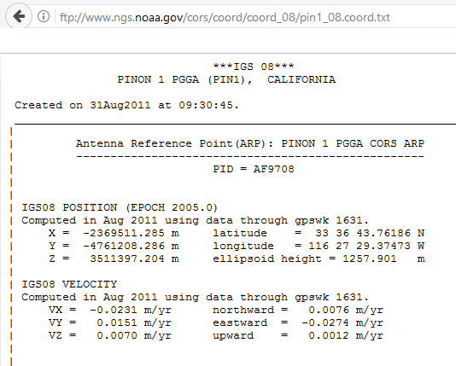
CORS Coordinate Functions… (AKA “Active coordinates”)
A typical “CORS coordinate file” available from NGS
Just one set of coordinates
and just one set of
velocities are given…
…while this is good and useful information, it hides the true nature of the coordinate function.
Notes:
CORS Coordinate Functions – also known as Active Coordinates.
A typical “CORS coordinate file” available from NGS
Shows just one set of coordinates and just one set of velocities.
…and while this is good and useful information, it hides the true nature of the coordinate function.

Slide 19
CORS Coordinate Functions (Incorrectly Inferred)
That single set of coordinates and set of velocities would lead a person to believe that the “coordinate function” or “final running coordinates” looks like a smooth linear function over time, but…
Notes:
That single set of coordinates and set of velocities would lead a person to believe that the “coordinate function” or “final running coordinates” looks like a smooth linear function over time….but…

Slide 20
CORS Coordinate Functions (True, but Hard to Find)
CORSs have complicated histories. This full history will be available in the CORS section of the new “data delivery system” (think “datasheets” - but better) as well as each CORS’s web page in the new NSRS database.
Notes:
In fact, for this particular site, there were 14 separate “pieces” (called “solutions”) when we assigned a “coordinate function” to it in the IGS08 frame.
This graph represents the *true* “active coordinates” (or coordinate function) for this particular CORS.
This broken set of lines represent the X Coordinate, in time, to which OPUS will differentially position a roving antenna.
The SITEINFO file contains detailed information on the coordinate function.
CORSs have complicated histories. This full history will be available in the CORS section of the new “data delivery system” (think “datasheets” - but better) as well as each CORS’s web page in the new NSRS database.

Slide 21
New Database
Currently: The NGS Integrated Database (IDB)
“Integrated” because it combined the previously separate horizontal and vertical databases
Future: The NSRS Database
Time-Dependent, Geospatial
Notes:
Currently: The NGS Integrated Database (IDB) is called
“Integrated” because it combined the old Horizontal and Vertical databases
In the future: The NSRS Database will be
Time-Dependent, and Geospatial

Slide 22
Coordinate Types
Five types:
Reported: Good for finding a point somewhere on Earth.
Not to be used as geodetic control
OPUS: Computed by you, and as accurate or inaccurate as the choices you make
Tied to the NSRS if you follow OPUS recommendations
Reference Epoch: Epoch-specific coordinates -
at 2020, 2025, 2030, etc.
Survey Epoch: Epoch-specific coordinates -
at time of survey
Active: Continuous coordinate functions at a CORS
Notes:
So, in summary there will be five coordinate types:
Reported Coordinates: These are good for finding a point somewhere on Earth.
but not to be used as geodetic control
OPUS Coordinates: which will be computed by you, and will be as accurate or inaccurate as the choices you make
and “Tied to the NSRS” if you follow OPUS recommendations
Reference Epoch Coordinates : Epoch-specific coordinates -
at 2020, 2025, 2030, etc.
Survey Epoch Coordinates: Epoch-specific coordinates -
at time of survey
Active: Coordinates Continuous coordinate functions at a CORS

Slide 23
End of Section 8
Notes:
This is the end of Section 8

