Slide 1
Section 2
Part I : History and Context
NGS and the NSRS
Geodetic Control Overview
Horizontal Datums and Reference Frames (4 Slides)
Vertical Datums
Historic Datums of the United States
Decision to Modernize
Notes:
Welcome to Section 2 of the Modernized National Spatial Reference System.
I’m David Zenk, National Geodetic Survey Advisor for the Northern Plains Region.
I will be your narrator for this section.
In this section, we’ll discuss:
Horizontal Datums and Reference Frames
Vertical Datums and
Historic Datums of the United States

Slide 2
Horizontal Datums / (Geometric) Reference Frames
What are they?
A coordinate system implied by points with coordinates
Parallels, meridians, and the geocenter are defined mathematically but don’t have a physical manifestation in the real world
So, what is the difference between “system, frame, and datum” ?
A reference system is a set of rules.
A reference frame or datum is a practical implementation of the rules.
There could be several implementations of a single set of rules.
Notes:
Let’s discuss a few terms now –
Reference System, Reference Frame, and Datum
They share characteristics, such as size, shape, and orientation of a coordinate system and its relationship to the Earth, but they differ in their specific meaning.
A reference system is a set of rules which define the basic parameters.
A reference frame or datum is the practical implementation of the rules.
Therefore, there could be several implementations of a single set of rules.

Slide 3
Horizontal Datums / (Geometric) Reference Frames
Realization is:
Realization is defined as the practical implementation of a concept
Coordinates are assigned to points in a way that best represents the mathematically abstract definition
Coordinates come from geodetic surveys of the highest accuracy
Coordinates could stand unchanged for decades (NAD 27, NGVD 29 being the best known examples)
Piecemeal updates from re-surveys
Realization – the process of making something real , such as implementing a reference system.
Notes:
A realization is defined as the practical process of implementing a concept
Coordinates are assigned to points in a way that best represents the mathematically abstract definition
Coordinates come from geodetic surveys of the highest accuracy
Coordinates could stand unchanged for decades (NAD 27, NGVD 29 being the best known examples)
And there were piecemeal updates from re-surveys
A “realization” should be time tagged, but that REALLY didn’t happen until the NAD 83(2011) epoch 2010.00 realization of the NAD 83 datum.
It was not possible to assign a specific date for earlier realizations.
Before “global reference frames”, a realization was usually constrained by other locally determinable physical measurements, such as astronomic latitude/longitude

Slide 4
Horizontal Datums / (Geometric) Reference Frames
Historic Definitions and Roles
National datums were adjusted from large networks
Often fixed to one or more points in the nation
USSD and NAD 27: Meades Ranch
This meant plate rotation was effectively cancelled out
Space Age / International Efforts
BIH (Bureau international de l'heure)
IERS (International Earth Rotation [and Reference System] Service)
Service of the International Association of Geodesy (IAG)
Arbiters of the International Terrestrial Reference Frame (ITRF)
Notes:
Historic Definitions and Roles
National datums were adjusted from large networks of observations
And were often fixed to one or more points in the nation
For the US Standard Datum (USSD) and NAD 27, that point was Meades Ranch
This meant plate rotation was effectively cancelled out
In the Space Age, International efforts and cooperation became important.
Several prominent agencies collectively define the ITRF
BIH (Bureau international de l'heure)
IERS (International Earth Rotation [and Reference System] Service)
Service of the International Association of Geodesy (IAG)
Arbiters of the International Terrestrial Reference Frame (ITRF)

Slide 5
Horizontal Datums / (Geometric) Reference Frames
Ideal Frames
ITRF
Combination of four frames (SLR, VLBI, GNSS, DORIS)
IGS
Post-ITRF frame
Most accurate GNSS orbits are in this frame
Currently the NSRS is mathematically defined:
Three NAD 83 frames: North America, Pacific, Mariana plates
All 3 defined with respect to ITRF94 (same as ITRF96)
All other ITRFs defined with transformations between ITRFs
Notes:
Ideal Frames
ITRF
Combination of four frames (SLR, VLBI, GNSS, DORIS)
IGS
Post-ITRF frame
Most accurate GNSS orbits are in this frame
Currently the NSRS is mathematically defined:
Three NAD 83 frames: North America, Pacific, Mariana plates
All 3 defined with respect to ITRF94 (same as ITRF96)
All other ITRFs defined with transformations between ITRFs

Slide 6
Part I : History and Context
NGS and the NSRS
Geodetic Control Overview
Horizontal Datums and Reference Frames
Vertical Datums (5 slides)
Historic Datums of the United States
Decision to Modernize
Notes:
Now, let’s discuss key concepts for vertical datums.

Slide 7
Vertical Datums
Like horizontal: “mathematical abstractions”
“The geoid” (surface of zero elevation) defined mathematically/geometrically but doesn’t have a physical manifestation in the real world. Though “global mean sea level” is pretty close
Which is why humans have used some level of water as a vertical datum for over 4000 years
But, the ocean is not a level surface.
Notes:
Like horizontal datums, vertical datums are “mathematical abstractions”
“The geoid” (the surface of zero elevation) is defined mathematically and geometrically, but doesn’t have a physical manifestation in the real world, though “global mean sea level” is pretty close.
Which is why humans have used some level of water as a vertical datum for over 4000 years.
Commonly “mean sea level” or some other water surface is chosen.
But, the ocean is not a level surface, due to variations in temperature, flow, current, and wind among other persistent physical effects.

Slide 8
Vertical Datums
Realization (much like horizontal):
Coordinates are assigned to points in a way that best represents the mathematically abstract definition
Coordinates come from geodetic surveys of the highest accuracy
Before national datums, they were usually constrained by other locally determinable physical measurements:
Sea level at tide gage(s)
Coordinates could stand unchanged for decades
Piecemeal updates from re-surveys
Notes:
Realization of a vertical datum (much like horizontal):
Coordinates (or heights) are assigned to points in a way that best represents the mathematically abstract definition
Coordinates come from geodetic surveys of the highest accuracy
Before national datums, they were usually constrained by other locally determinable physical measurements: such as sea level at tide gage(s)
Coordinates could stand unchanged for decades
And there were piecemeal updates from re-surveys

Slide 9
Vertical Datums
Historic definitions and roles (much like horizontal):
National datums were adjusted from large networks
Often fixed to one or more points in the nation
NGVD 29: 26 Tide gauges in North America
NAVD 88: Father Point in Rimouski, Canada
Space age / International Efforts
GPS surveys gave fast, accurate access to a previously obscure oddity called the “ellipsoid height”, which we’ll discuss more in later slides.
Notes:
Historic definitions and roles (much like horizontal):
National datums were adjusted from large networks and were often fixed to one or more points in the nation
NGVD 29: 26 Tide gauges in North America
NAVD 88: Father Point in Rimouski, Canada
Space age / International Efforts
GPS surveys gave fast, accurate access to a previously obscure oddity called the “ellipsoid height”, which we’ll discuss more in later slides.

Slide 10
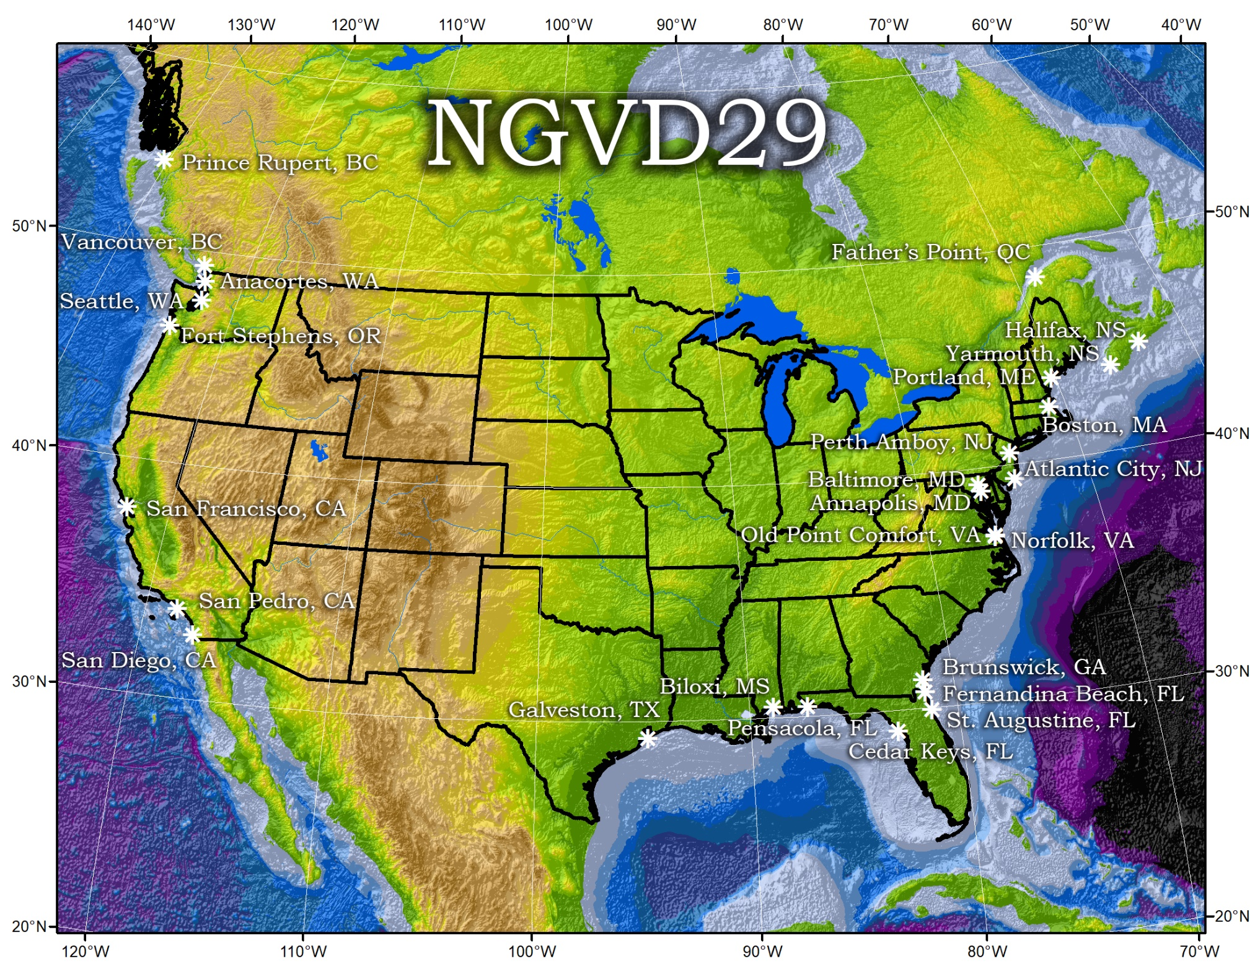
26 tide gages defining NGVD29
Notes:
Here’s a map showing the 26 tide gages defining NGVD29

Slide 11
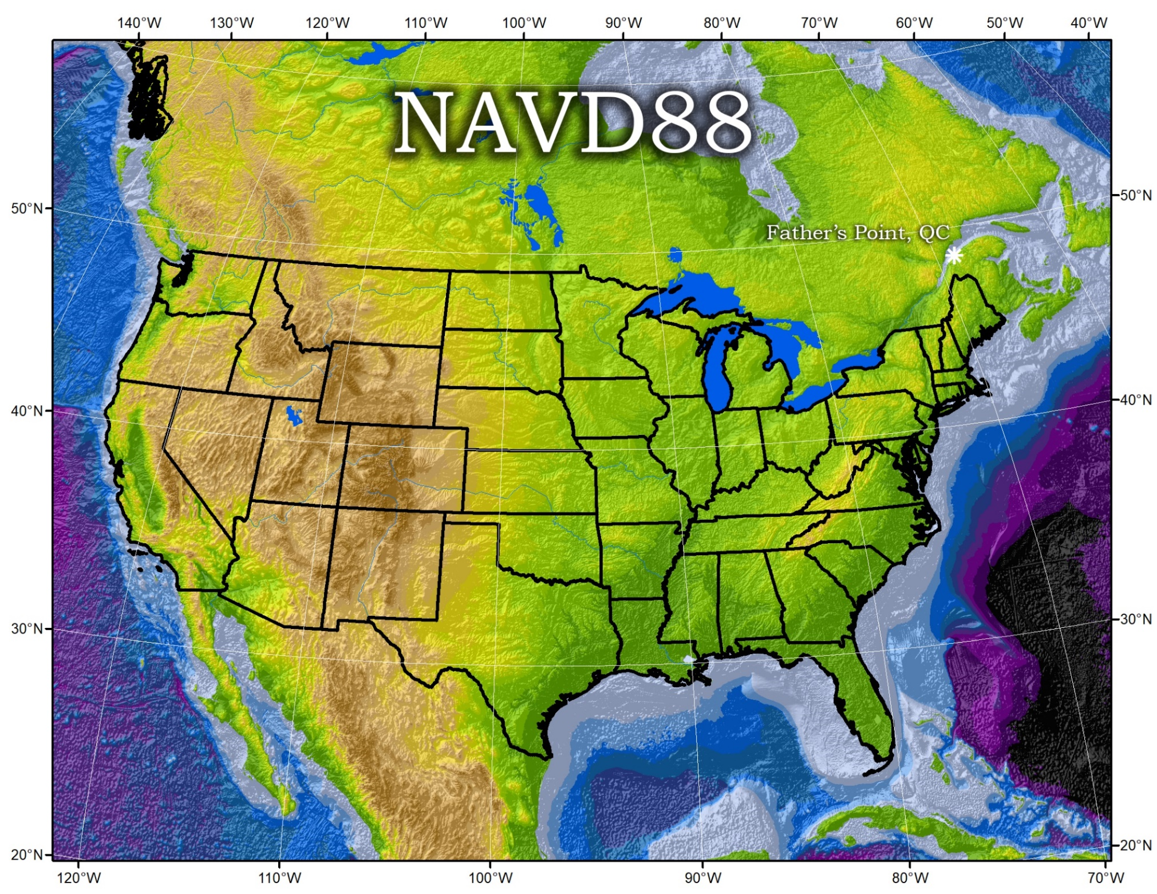
Single station defining NAVD88
Notes:
Here’s a map showingthe single station defining NAVD88

Slide 12
Vertical Datums
Space Age
Accurate access to the previously obscure “ellipsoid height” fueled increased research in the previously also-obscure field of “geoid modeling”
1960s: 1 meter of error in the geoid was “negligible”
1990s: Need for “1 cm accuracy” geoid grows quickly
Time-intensive geodetic leveling was expected to be replaced by “GPS + geoid” And it has been, to certain extents
Geodetic leveling continues to be the most accurate method of determining height differences over distances of 0 km to 20 km
Notes:
Space Age
Gave us an accurate wat to access the previously obscure “ellipsoid height” and fueled increased research in the previously also-obscure field of “geoid modeling”
1960s: 1 meter of error in the geoid was “negligible”
1990s: Need for “1 cm accuracy” geoid grows quickly
Time and labor intensive geodetic leveling was expected to be replaced by a more efficient “GPS + geoid” approach.
Indeed, it has been, to certain extents
Geodetic leveling continues to be the most accurate method of determining height differences over distances of 0 km to 20 km

Slide 13
Vertical Datums
International Efforts
Much less organized (and less needed) than global horizontal frames
Both the need for, and ability to solve the issue of, defining consistent heights across oceanic distances were somewhat sparse
Recent global geopotential models have allowed for a geoid-based attempt
International Height Reference System (IHRS)
Not yet the everyday term that ITRF has become
Notes:
International Efforts have been much less organized (and less needed) than global horizontal frames.
Both the need for, and ability to solve the issue of, defining consistent heights across oceanic distances were somewhat sparse
But, recent global geopotential models have allowed for a geoid-based attempt
Resulting in the International Height Reference System (IHRS)
Not yet the everyday term that ITRF has become

Slide 14
Part I : History and Context
NGS and the NSRS
Geodetic Control Overview
Horizontal Datums and Reference Frames
Vertical Datums
Historic Datums of the United States (4 slides)
Decision to Modernize
Notes:
Now. We’ll show the many historic datums and realizations for which NGS has been responsible and then examine the term “ellipsoid height” and how it can be used as a height reference.

Slide 15
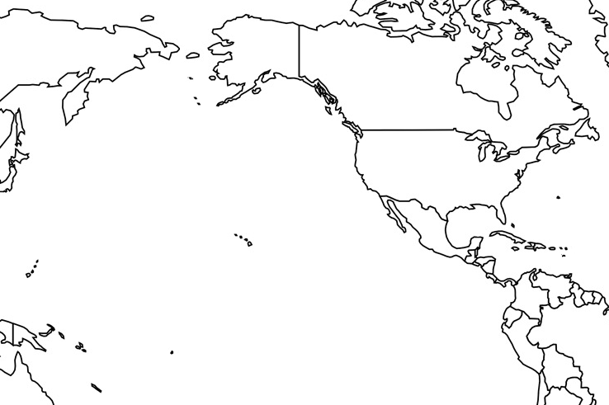
Horizontal Datums of the NSRS
St. Paul I.
St. Paul 1897
St. Paul 1952
NAD 83(1986)
NAD 83(2002:AK)
NAD 83(NSRS2007)
NAD 83(2011) epoch 2010.00
St. Lawrence I.
St. Lawrence 1952
NAD 83(1986)
NAD 83(2002:AK)
NAD 83(NSRS2007)
NAD 83(2011) epoch 2010.00
St. Matthew I.
St. Matthew 1952
Alaska
NAD 27
NAD 83(1986)
NAD 83(2002:AK)
NAD 83(NSRS2007)
NAD 83(2011) epoch 2010.00
St. George I.
St. George 1897
St. George 1952
NAD 83(1986)
NAD 83(2002:AK)
NAD 83(NSRS2007)
NAD 83(2011) epoch 2010.00
CONUS
U.S. Standard Datum
NAD 27
NAD 83(1986)
NAD 83(“HARN”)
NAD 83(“FBN”)
NAD 83(NSRS2007)
NAD 83(2011) epoch 2010.00
Hawaii
Old Hawaiian Datum
NAD 83(1986)
NAD 83(1993:HI)
NAD 83(PA11) epoch 2010.00
CNMI
Guam 1963
NAD 83(1993:GU)
NAD 83(2002:GU)
NAD 83(MA11) epoch 2010.00
Puerto Rico
Puerto Rico 1940
NAD 83(1986)
NAD 83(1993:PR)
NAD 83(1997:PR)
NAD 83(2002:PR)
NAD 83(NSRS2007)
NAD 83(2011) epoch 2010.00
U.S. Virgin Islands
Puerto Rico 1940
NAD 83(1986)
NAD 83(1993:PR)
NAD 83(1997:PR)
NAD 83(2002:PR)
NAD 83(NSRS2007)
NAD 83(2011) epoch 2010.00
Guam
Guam 1963
NAD 83(1993:GU)
NAD 83(2002:GU)
NAD 83(MA11) epoch 2010.00
American Samoa
American Samoa 1962
NAD 83(1993:AS)
NAD 83(2002:AS)
NAD 83(PA11) epoch 2010.00
Notes:
There have been about 60 datums and associated realizations over time.

Slide 16
Vertical Datums of the NSRS
St. Paul I.
- None -
St. Lawrence I.
- None -
St. Matthew I.
- None -
Alaska
NGVD 29
NAVD 88
St. George I.
- None -
CONUS
NGVD 29
NAVD 88
Hawaii
- None -
CNMI
NMVD 03
Puerto Rico
PRVD 09
U.S. Virgin Islands
VIVD 09
American Samoa
ASVD 02
Guam
GVD 63
GUVD 04
Notes:
There have been about 8 vertical datums and associated realizations over time.
Note that some locations have not had a formal datum, but were dependent on local definitions (mainly islands).
This is because it is impossible to extend traditional leveling across open water.

Slide 17
Reminder…
WGS 84 is not part of the NSRS
It is a military-controlled system
All civilian federal agencies are required to work in the NSRS (as per OMB A-16)
NAD 83 is part of the NSRS
NAD 83 ≠ WGS 84
(there is 2+ meters of systematic bias)
Many states and municipalities choose to work in the NSRS and they often legislate this use
Notes:
WGS 84 is not part of the NSRS
It is a military-controlled system
All civilian federal agencies are required to work in the NSRS (as per OMB A-16)
NAD 83 is part of the NSRS
But, NAD 83 ≠ WGS 84
There is 2+ meters of systematic bias)
Many states and municipalities choose to work in the NSRS and they often legislate this use

Slide 18
The Geoid, and Heights
h
= H
+ N
h: ellipsoid height
H: orthometric height
N: geoid undulation
Topography
h
H
The geoid
N
A chosen
ellipsoid
*The relationship between the ellipsoid and the geoid may be swapped in some locations
Notes:
Let’s review the geometry concepts of “ellipsoid height” (click through the animations and explain them)
Point of scientific clarity: The geoid is a surface that is always convex. Yes it has undulations, but geoid purists in the audience will point out to you that, measured at the scale of the Earth itself, the geoid always has a POSITIVE radius relative to the center of the Earth. But when we zoom in, just for illustrative purposes, it is nice to show an “undulating” geoid, to distinguish it from both the smooth ellipsoid and the not smooth topography.
Don’t worry that the plumb line (H) is curved.
Even at America’s largest known curved plumb line (Denali), this curvature is a SUB MILLIMETER effect.

Slide 19
End of Section 2
Next, we’ll discuss
Decision to Modernize (11 slides)
Notes:
This is the end of Section 2.
In the next section we’ll discuss the Decision to Modernize

