Slide 1
Section 3
Part I : History and Context
NGS and the NSRS
Geodetic Control Overview
Horizontal Datums and Reference Frames
Vertical Datums
Historic Datums of the United States
Decision to Modernize (11 slides)
Notes:
Welcome to Section 3 of the Modernized National Spatial Reference System.
I’m David Zenk, National Geodetic Survey Advisor for the Northern Plains Region.
I will be your narrator for this section.
In this section we’ll discuss the NGS’ Decision to Modernize.

Slide 2
Decision to Modernize
In 2007 NGS announced its decision to completely change how it approached its mission.
In a word, NGS chose to modernize the NSRS
Let’s look at the issues that drove that decision, and the direction NGS decided to go
Notes:
In 2007 NGS announced its decision to completely change how it approached its mission.
In a word, NGS chose to modernize the NSRS
Let’s look at the issues that drove that decision, and the direction NGS decided to go

Slide 3
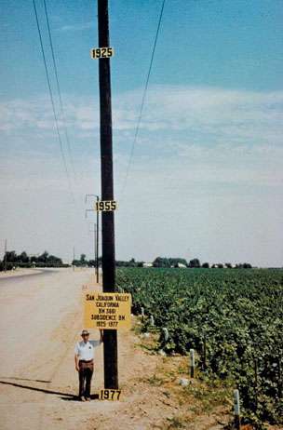
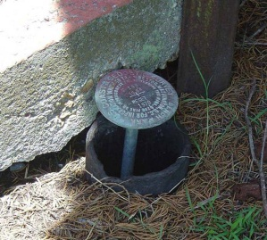
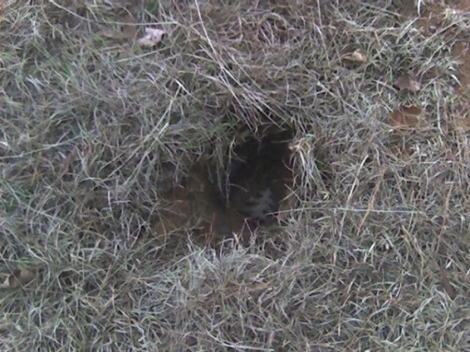
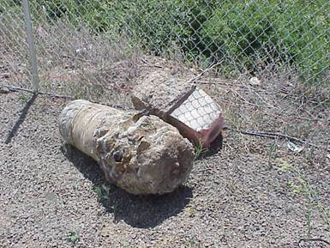
Issues
NAVD 88 suffers from use of passive control that:
Is almost never re-checked for movement
Disappears by the thousands every year
Is not funded for replacement
Is not necessarily in convenient places
Doesn’t exist in most of Alaska
Wasn’t adopted in Canada
Was determined by leveling from a single point, allowing the build up of cross-country error
PID: EZ0840
Notes:
NAVD 88 suffers from use of passive control that:
Is almost never re-checked for movement
Disappears by the thousands every year
Is not funded for replacement
Is not necessarily in convenient places
Doesn’t exist in most of Alaska
Wasn’t adopted in Canada
Was determined by leveling from a single point, allowing the build up of cross-country error

Slide 4
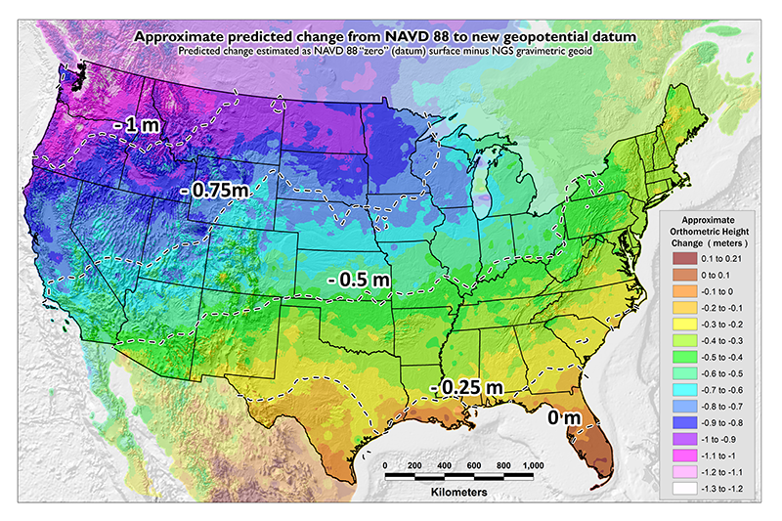
Issues
NAVD 88 suffers from a known bias (50 cm) and tilt (about 1 meter across CONUS) relative to the gravimetric geoid
Approximate level of geoid mismatch known to exist in the NAVD 88 zero surface
PID: EZ0840
Notes:
NAVD 88 suffers from a known bias (50 cm) and tilt (about 1 meter across CONUS) relative to the gravimetric geoid
The map shows the distribution of the approximate level of geoid mismatch known to exist relative to the NAVD 88 zero surface.

Slide 5
Issues
NAD 83 suffers from a 2+ meter non-geocentricity (which misaligns it with ITRF and all GNSS orbits)
Earth’s Surface
h_{ITRF}
h_{NAD83}
ITRF origin
~2.24 m
NAD 83 origin
Notes:
NAD 83 suffers from a 2+ meter non-geocentricity which misaligns it with ITRF and all GNSS orbits.
Remember this is why NAD83 is not equal to WGS84

Slide 6
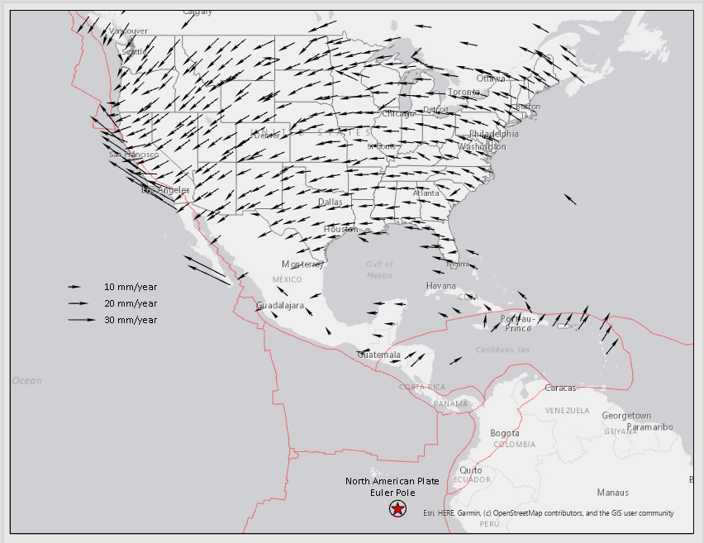
Issues
Geodetic control is usually affixed to a crust that is moving
Even so-called “plate fixed” frames are only as stable as:
The rigidity of a plate
The complete lack of subsidence or uplift
Notes:
Geodetic control is usually affixed to a crust that is moving
Even so-called “plate fixed” frames are only as stable as:
The rigidity of a plate and the lack of subsidence or uplift.
And we know that no plate is rigid – all exhibit internal and external deformations

Slide 7
Addressing Issues 2005-2007
Re-level the NAVD 88 network?
To correct decades of potential subsidence?
Wouldn’t fix issues of ongoing subsidence, mark loss and inconvenient locations
Best estimates: $200M to $2B
Decision: Impossible and impractical. A new way of defining, maintaining and providing access to a vertical datum was needed
Notes:
In the 2005-2007 timeframe, the NGS executive steering committee began a number of conversations about how to modernize. These were some of the topics:
Re-level the NAVD 88 network?
To correct decades of potential subsidence? The effort will take years to complete.
Wouldn’t fix issues of ongoing subsidence, mark loss, and inconvenient location of bench marks.
And it would be costly - best estimates: $200M to $2B
Decision: Impossible and impractical. A new way of defining, maintaining and providing access to a vertical datum was needed
of the topics covered…

Slide 8
Addressing Issues 2005-2007
Abandon passive control entirely?
This would substantially(!) reduce work at NGS
Decision: Change the role and importance of passive marks
NGS will provide surveying guidance that is:
“mark free” or at least “mark-reduced”
promotes an attitude that marks are “temporary coordinate holders” and not “permanent coordinate holders”
Notes:
Abandon passive control entirely?
This would substantially(!) reduce work at NGS
Decision: Change the role and importance of passive marks
NGS will provide surveying guidance that is:
“mark free” or at least “mark-reduced”
promotes an attitude that marks are “temporary coordinate holders” and not “permanent coordinate holders”

Slide 9
Addressing Issues 2005-2007
Just adopt the ITRF?
Could NGS abandon the USA-centric, plate-fixed approach?
This would mean embracing 2cm of lat/lon change annually in CONUS (and more elsewhere!)
This would moderately reduce work at NGS that some viewed as archaic and unnecessary
Decision: Embrace the pre-eminence of the ITRF and also provide “USA specific” frames only as an after-the-fact derivative product. Lead the way toward a purely ITRF-based surveying and mapping world.
Notes:
Just adopt the ITRF?
Could NGS abandon the USA-centric, plate-fixed approach?
This would mean embracing 2cm of lat/lon change annually in CONUS (and more elsewhere!)
This would moderately reduce work at NGS that some viewed as archaic and unnecessary
Decision: Embrace the pre-eminence of the ITRF and also provide “USA specific” frames only as an after-the-fact derivative product. Lead the way toward a purely ITRF-based surveying and mapping world.
This allows NGS to deliver the best blend of embracing global frames and yet delivering stable coordinates to the public.

Slide 10
General Direction
Future details would come, but in 2007 the general direction was:
Replace both NAD 83 and NAVD 88, at the same time
Transition to a geoid-based vertical datum
Leverage the rise of GNSS and RTNs
Completely re-invent “bluebooking”
Reduce complexity
Retain ability to standardize geodetic survey files
Notes:
Future details would come, but in 2007 the general direction was:
Replace both NAD 83 and NAVD 88, at the same time
Transition to a geoid-based vertical datum
Leverage the rise of GNSS and RTNs
Completely re-invent “bluebooking”
Reduce complexity
Retain ability to standardize geodetic survey files

Slide 11
Putting it out there…
Notes:
In 2007 and 2008, two policy documents were released. The GRAV-D project announced NGS’s intention to survey the entire nation using airborne gravimetry, as a foundational data set to improve the geoid to such a level that it could serve as a vertical datum.
The NGS Ten Year Plan for 2008-2018 announced NGS’s intention to replace NAD 83 and NAVD 88, among other improvements. It was optimistic and (in hindsight) short on details, but it drew a line in the sand and pointed NGS in the right direction. At the time, the finish date appeared to be around 2018.

Slide 12
History
The NSRS provides geospatial consistency across the government.
NGS is the steward of the NSRS.
The NSRS is millions of survey marks, thousands of active stations and tens of datums.
The last major update to the NSRS was in the 1990s.
Since then, numerous issues have been identified which drive the need for another major update.
NGS is working on modernizing the NSRS now!
Notes:
The NSRS provides geospatial consistency across the government
NGS is the steward of the NSRS
The NSRS is millions of survey marks, thousands of active stations and tens of datums
The last major update to the NSRS was in the 1990s
Since then, numerous issues have been identified which drive the need for another major update
NGS is working on modernizing the NSRS now

Slide 13
End of Section 3 & End of Part I
Notes:
This is the end of Section 3 and the
end of Part I of the
Modernized National Spatial Reference System.

