Slide 1
Section 6
Part II: The Modernized NSRS
Geometric Reference Frames – continued (28 slides)
Notes:
Thank you for your interest in the Modernized National Spatial Reference System.
In this Section 6, we will finish our discussion of the Geometric Reference Frames.
I’m David Zenk, National Geodetic Survey Advisor for the Northern Plains Region.
I will be your narrator for this section of the presentation.

Slide 2
Coordinates, Frames, Epochs, EPP2022 and IFVM2022
The next few slides will:
Highlight the interactions between the ITRF and the four frames of the modernized NSRS.
Show how changing the frame and/or the epoch will be done with EPP2022, IFVM2022 or both.
Notes:
The next few slides will:
highlight the interactions between the ITRF and the four frames of the modernized NSRS.
Show how changing the frame and/or the epoch will be done with EPP2022, IFVM2022 or both.

Slide 3
Symbols
EPP2022
Programming Code that applies the Euler Pole Parameters.
Changes the FRAME
IFVM2022
Programming Code that applies the Intra-Frame Velocity Models.
Changes the EPOCH
Programming Code that converts
XYZ to/from Lat/Lon/EllHt (PLH)
Latitude = ᶲ (phi)
Longitude = λ (lambda)
Changes neither EPOCH nor FRAME
XYZ2PLH
Notes:
Please note the following symbols will be used in many of the diagrams.
Each symbol indicates a software programming code that will perform a particular function.
EPP2022 applies the Euler Pole Parameters. This changes the FRAME.
IFVM2022 applies the Intra-Frame Velocity Models. This changes the EPOCH.
XYZ2PLH converts XYZ to/from Lat/Lon/EllHt (traditionally geodesists used Greek alphabet: phi (for latitude), lambda (for longitude)). This changes neither the EPOCH nor the FRAME. It changes only the coordinate system.

Slide 4
Definitive Implementation and Interaction of EPP2022 & IFVM2022
XYZ
PATRF2022
ep. 2028.048
EPP2022
XYZ
ITRF2020
ep. 2028.048
EPP2022
XYZ
NATRF2022
ep. 2028.048
XYZ2PLH
XYZ2PLH
XYZ2PLH
φλh
PATRF2022
ep. 2028.048
φλh
ITRF2020
ep. 2028.048
φλh
NATRF2022
ep. 2028.048
Remember,
EPP2022 changes the FRAME but not the EPOCH.
Working in a common epoch (2028.048)
Notes:
This version of the slide is animated to show how EPP2022 changes frames, without changing epochs.
Note that XYZ2PLH is a module within NCAT and VDatum.
CLICK
Take an XYZ coordinate in ITRF2020 epoch 2028.048.
CLICK
Apply XYZ2PLH to convert it to lat/lon/ht coordinate in ITRF2020 epoch 2028.048
CLICK
We could also apply EPP2022 (CLICK) to convert it to XYZ coordinate in NATRF2022 epoch 2028.048 and then apply XYZ2PLH to convert it to lat/lon/ht coordinate in NATRF2022 epoch 2028.048
CLICK
And, we could also apply EPP2022 (CLICK) to convert it to XYZ coordinate in PATRF2022 epoch 2028.048 and then apply XYZ2PLH to convert it to lat/lon/ht coordinate in PATRF2022 epoch 2028.048

Slide 5
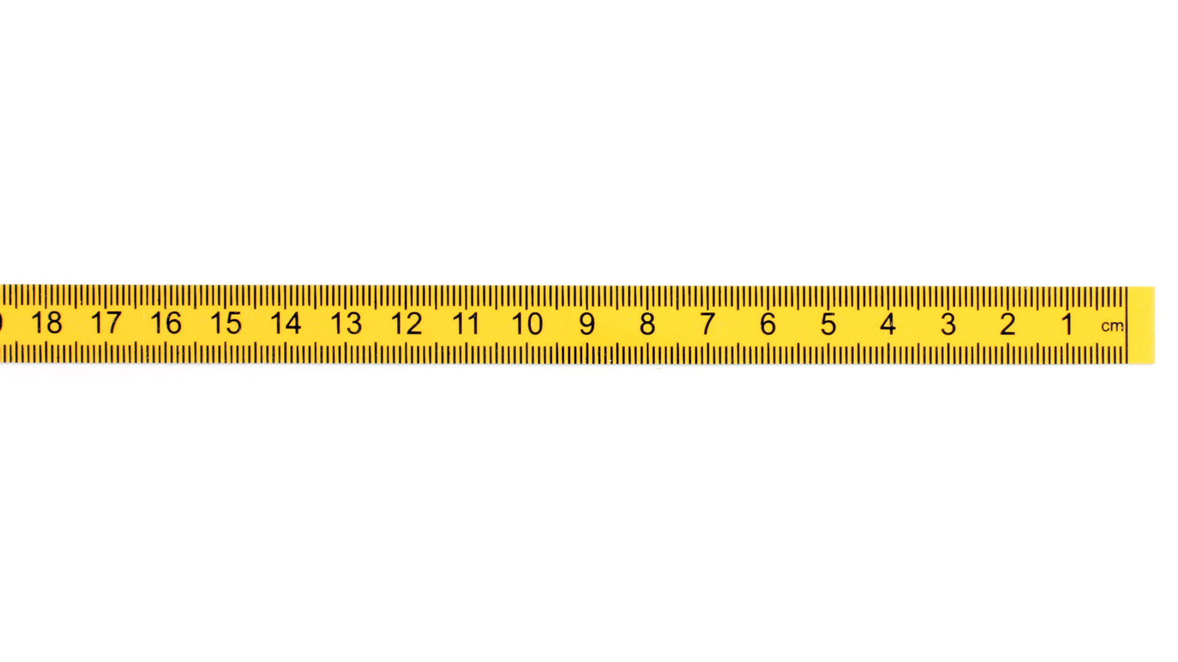
Coordinates, Frames, Epochs, EPP2022 and IFVM2022
A survey done Jan 1, 2023 and reported at epoch 2020.0
New Survey (same point) done Jan 1, 2030
Position of point in NATRF2022(2030)
Position of point in NATRF2022(2020)
If (rarely) IFVM = 0, then NATRF2022 (2030) = NATRF2022 (2020)
Remember,
EPP2022 changes the FRAME but not the EPOCH.
IFVM2022 changes the EPOCH, not the FRAME
Position from 2023 survey NATRF2022 (2020.0)
ITRF2020 (2020.0)
(V)
ITRF2020 (2030.0)
IFVM 2030-2020
NATRF2022
(2020.0)
fframe
fEpoch
EPP2022
NATRF2022 (2030)
(H)
Notes:
Let’s envision a simple application of the principles.
CLICK
1) At epoch 2020, ITRF2020 and NATRF2022 are identical.
CLICK
2) As time goes on the North American plate moves, a new survey is performed at the same point, resulting in new ITRF2020 coordinates at epoch (2030).
CLICK
3) If we remove 10 years of plate motion using EPP2022 it puts us back where NATRF used to be....EXCEPT, there has (probably) been regional and local motion.
That is why we call it the NATRF2022 (2030) position, because it is where NATRF IS in 2030.
CLICK
4) We now have to apply IFVM2022 to get back to epoch 2020, or any other date relative to NATRF.
The IFVM2022 models and accounts for the regional motions as revealed by surrounding CORS and InSAR.
CLICK
5) If IFVM2022 is not zero (as in most cases), then the newly computed NATRF2022(2020) positions will differ from its older NATRF2022(2020) position, thus revealing the local motion and survey errors of the point.
And, even if IFVM = 0, there might still be local motions and survey errors.
Remember - CLICK
* EPP2022 changes the FRAME
CLICK
* IFVM2022 changes the EPOCH
CLICK

Slide 6
Definitive Implementation and Interaction of EPP2022 & IFVM2022
Working in a common epoch (2039.704)
Remember,
EPP2022 changes the FRAME but not the EPOCH.
φλh
PATRF2022
ep. 2039.704
φλh
ITRF2020
ep. 2039.704
φλh
NATRF2022
ep. 2039.704
XYZ2PLH
XYZ2PLH
XYZ2PLH
XYZ
PATRF2022
ep. 2039.704
EPP2022
XYZ
ITRF2020
ep. 2039.704
EPP2022
XYZ
NATRF2022
ep. 2039.704
Notes:
This version of the slide is animated to show how EPP2022 changes frames, without changing epochs.
Note that XYZ2PLH is a module within NCAT and VDatum.
Take an XYZ coordinate in ITRF2020 epoch 2039.704.
CLICK
Apply XYZ2PLH to convert it to lat/lon/ht coordinate in ITRF2020 epoch 2039.704
CLICK
We could also apply EPP2022 (CLICK) to convert it to XYZ coordinate in NATRF2022 epoch 2039.704 and then apply XYZ2PLH to convert it to lat/lon/ht coordinate in NATRF2022 epoch 2039.704
CLICK
And, we could also apply EPP2022 (CLICK) to convert it to XYZ coordinate in PATRF2022 epoch 2039.704 and then apply XYZ2PLH to convert it to lat/lon/ht coordinate in PATRF2022 epoch 2039.704

Slide 7
XYZ
ITRF2020
ep. 2028.048
Working across epochs in the ITRF2020 frame
XYZ2PLH
φλh
ITRF2020
ep. 2028.048
Remember,
IFVM2022 changes the EPOCH, not the FRAME
IFVM2022
(master model)
φλh
ITRF2020
ep. 2039.704
XYZ2PLH
XYZ
ITRF2020
ep. 2039.704
Notes:
How do we work across EPOCHS within a FRAME?
This version of the slide is animated to show how IFVM2022 will change the EPOCH of ITRF2020 without changing the FRAME.
Since IFVM2022 works in Lat/Lon, we must first apply XYZ2PLH in each epoch.
CLICK
CLICK
Then apply IFVM2022 to move between EPOCHS
CLICK

Slide 8
XYZ
ITRF2020
ep. 2028.048
If “everything geometric is done in ITRF XYZ”, then why isn’t IFVM2022 built with this connection?
XYZ2PLH
Working across epochs in the ITRF2020 frame
?
φλh
ITRF2020
ep. 2028.048
IFVM2022
(master model)
Answer: Because the crustal movements in LAT/LON (φ, λ) are much different than h, and all models of crustal motion are divided that way.
φλh
ITRF2020
ep. 2039.704
?
XYZ2PLH
XYZ
ITRF2020
ep. 2039.704
Notes:
If everything geometric is done in ITRF2020 XYZ, why didn’t NGS propose the IFVM2022 be set up to work between XYZ rather than PLH? It is a good and reasonable question.
CLICK
CLICK
The answer is that the crust of the Earth moves in vastly different ways horizontally than vertically.
Horizontally things show consistent horizontal motions on the scale of hundreds of square kilometers up to continental scale.
On the vertical side, things can be very localized, even down to a square km or so.
Crustal movement studies commonly separate the signals by “horizontal” (lat, lon) and “vertical” (eht) due to their generally de-coupled nature.
If we were to build the IFVM in XYZ, that decoupling (and the simplicity and accuracy which comes with it) is lost.
Therefore NGS will break with their “everything geometric is done in XYZ” rule, specifically for IFVM2022.
And, in more human terms, it is easier to consider changes in a lat/lon/ht point of view (as that feels like a local coordinate system to most users), than to consider changes in the ECEF cartesian system position.

Slide 9
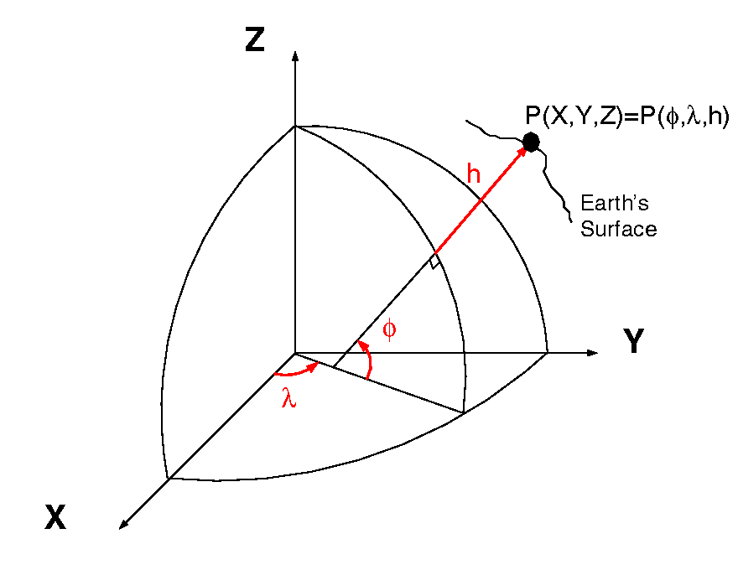
Point of View
Note that a point P that moves only in Ellipsoid Height (h) to P2 has large changes in X Y Z,
But no change in
LAT / LON:
Latitude = ᶲ (phi)
Longitude = λ (lambda)
P2
Z1
Z2
Y2
Y1
X2
X1
Notes:
Let’s consider a point P
CLICK
It has X1, Y1, and Z1 coordinates
Then, it moves only in ellipsoid height to P2
CLICK
CLICK
We see there are large changes in X, Y, and Z, but no change in LAT/LON.

Slide 10
Definitive Implementation and Interaction of EPP2022 & IFVM2022
XYZ
PATRF2022
ep. 2028.048
EPP2022
XYZ
ITRF2020
ep. 2028.048
EPP2022
XYZ
NATRF2022
ep. 2028.048
XYZ2PLH
XYZ2PLH
XYZ2PLH
φλh
PATRF2022
ep. 2028.048
φλh
ITRF2020
ep. 2028.048
φλh
NATRF2022
ep. 2028.048
Drats! A connection here
would be useful!
IFVM2022
(master model)
Drats! A connection here
would be useful!
φλh
PATRF2022
ep. 2039.704
φλh
ITRF2020
ep. 2039.704
φλh
NATRF2022
ep. 2039.704
XYZ2PLH
XYZ2PLH
XYZ2PLH
XYZ
PATRF2022
ep. 2039.704
XYZ
ITRF2020
ep. 2039.704
XYZ
NATRF2022
ep. 2039.704
EPP2022
EPP2022
Notes:
This version of the slide is animated to show the interaction of IFVM2022 and EPP2022, without the use of “virtual” grids.
CLICK
It takes the example of someone who prefers to work in lat/lon/eht NATRF2022, and did so in 2039.704, who then needs to compare their work against another surveyor’s work, on the same point
CLICK
where that other surveyor preferred to work in PATRF2022 and did so in 2028.048.
And, let’s say that our NATRF2022 user was given only the PATRF2022, ep. 2028.048 coordinates in lat/lon/eht, and the PATRF2022 surveyor saved no other information.
What NGS tools will allow for this comparison?
CLICK CLICK CLICK CLICK CLICK
Well, we can’t go that way!
13 CLICKS slowly
That’s a run of 7 different programs to go from NATRF2022 ep 2039.704 to PATRF2022 ep 2028.048.
Perhaps that’s to be expected, but what if it’s just a simple matter of changing epochs?...See next slide…

Slide 11
Definitive Implementation and Interaction of EPP2022 & IFVM2022
XYZ
ITRF2020
ep. 2028.048
EPP2022
XYZ
NATRF2022
ep. 2028.048
XYZ2PLH
XYZ2PLH
φλh
ITRF2020
ep. 2028.048
φλh
NATRF2022
ep. 2028.048
IFVM2022
(master model)
Drats! A connection here
would be useful!
φλh
ITRF2020
ep. 2039.704
φλh
NATRF2022
ep. 2039.704
XYZ2PLH
XYZ2PLH
XYZ
ITRF2020
ep. 2039.704
XYZ
NATRF2022
ep. 2039.704
EPP2022
Notes:
Say I just need to compare across epochs. For example: NATRF2022 lat/lon/eht given in two different survey epochs.
CLICK CLICK CLICK
We can’t go that way!
8 CLICKs slowly
That’s *7* programs to run just to change epochs.
Seems unnecessary!
Why the long path?

Slide 12
Why the long path?
Uniqueness
If there are two “paths” between input and output in our software, the potential for disagreeing answers will cause difficulties.
However, running 7 transformations solely to change the epoch, and not the frame, seems not only wasteful, but fixable without sacrificing uniqueness.
Notes:
Uniqueness!
If there are two “paths” between input and output in our software, the potential for disagreeing answers will cause difficulties.
However, running 7 transformations solely to change the epoch, and not the frame, seems not only wasteful, but fixable without sacrificing uniqueness.

Slide 13
Definitive Implementation and Interaction of EPP2022 & IFVM2022
XYZ
PATRF2022
ep. 2028.048
EPP2022
XYZ
ITRF2020
ep. 2028.048
EPP2022
XYZ
NATRF2022
ep. 2028.048
XYZ2PLH
XYZ2PLH
XYZ2PLH
φλh
PATRF2022
ep. 2028.048
φλh
ITRF2020
ep. 2028.048
φλh
NATRF2022
ep. 2028.048
Drats! A connection here
would be useful!
IFVM2022
(“subsidiary” PATRF2022 model)
IFVM2022
(master model)
Need
IFVM2022
(“subsidiary” NATRF2022 model)
Need
Drats! A connection here
would be useful!
φλh
PATRF2022
ep. 2039.704
φλh
ITRF2020
ep. 2039.704
φλh
NATRF2022
ep. 2039.704
XYZ2PLH
XYZ2PLH
XYZ2PLH
XYZ
PATRF2022
ep. 2039.704
XYZ
ITRF2020
ep. 2039.704
XYZ
NATRF2022
ep. 2039.704
EPP2022
EPP2022
Notes:
We’d like to find a way to change EPOCHS directly within a given FRAME
CLICK
without the long path through ITRF etc.
CLICK CLICK CLICK
We need this capability in NATRF, PATRF etc.
CLICK
We need to find a simpler way.

Slide 14
“Subsidiary” IFVM2022 Models?
The master IFVM2022 model will be made in ITRF2020
But without loss of accuracy, “subsidiary” models will be made for each of the four NSRS frames:
IFVM2022
ITRF “master” model
-
=
IFVM2022
“subsidiary” NATRF2022 model
EPP2022
ITRF to NATRF2022
All motion in ITRF
between two epochs
Δφ,Δλ,Δh
Plate rotational motion
of North American plate
between two epochs
Δφ,Δλ
Residual motion in ITRF,
or (equivalently)
All motion in NATRF2022,
between two epochs
Δφ,Δλ,Δh
Notes:
The Master IFVM2022 model will be made in ITRF2020
But without loss of accuracy, “subsidiary” models will be made for each of the four NSRS frames:
CLICK First, all motion in ITRF between two epochs will be captured in the Master IFVM2022 Model.
CLICK CLICK
Second, the EPP2022 rotation model will remove the systematic horizontal motions
CLICK CLICK
Third, Leaving all the vertical motions and the residual (small) horizontal motions in the “subsidiary” model(s)

Slide 15
IFVM2022 “Regions”
On release, IFVM2022 will only work in 6 regions, with these names and geographic borders:
Contrast this against NATRF2022, PATRF2022, CATRF2022 and MATRF2022 which are global frames, despite being built to minimize rotations of one particular tectonic plate.
Region | North | South | West | East
CONUS | 50° | 24° | 235° | 294°
Alaska | 73° | 50° | 172° | 232°
Hawaii | 23° | 18° | 199° | 206°
PR/VI | 19° | 17° | 291° | 296°
Guam/CNMI | 22° | 12° | 143° | 147°
Am. Samoa | -13° | -16° | 188° | 193°
Notes:
The lesson: if you’re using the modernized NSRS outside of the above 6 regions, you will only have access to the plate rotations embodied in EPP2022. You won’t have access to the detailed crustal motions of IFVM2022.

Slide 16
What will that look like?
Without the more complicated questions of:
Earthquakes
Velocities that change over time
Non-linear movements
Let’s look at what IFVM2022 velocities will look like in different frames and regions…
Notes:
Without discussing the more complicated questions of:
- Earthquakes
- Velocities that change over time
- Non-linear movements
Let’s look at what IFVM2022 velocities will look like in different frames and regions…

Slide 17
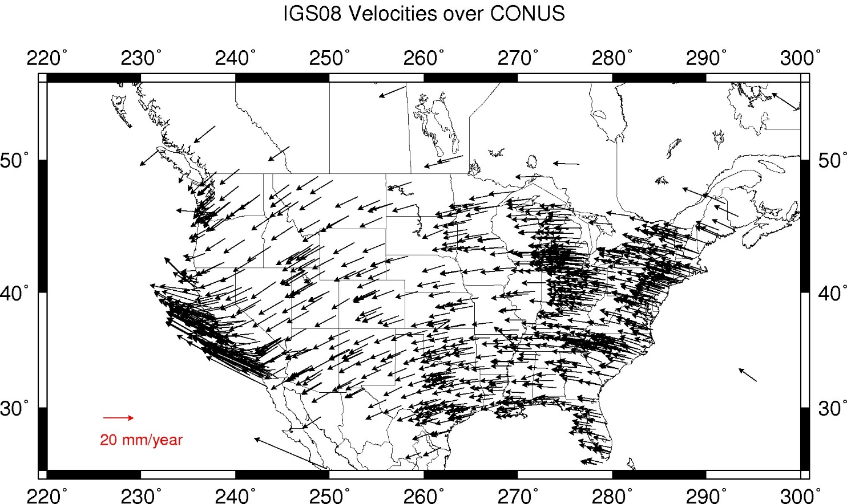
IFVM2022 Velocities – ITRF2020/CONUS
Notes:
This diagram of CONUS shows the IFVM2022 velocities expressed in the ITRF2020 Frame.
Note the arrows are about 20 mm/yr
It can generally be interpreted as “at what velocity are points in CONUS moving relative to the ITRF Frame?”

Slide 18
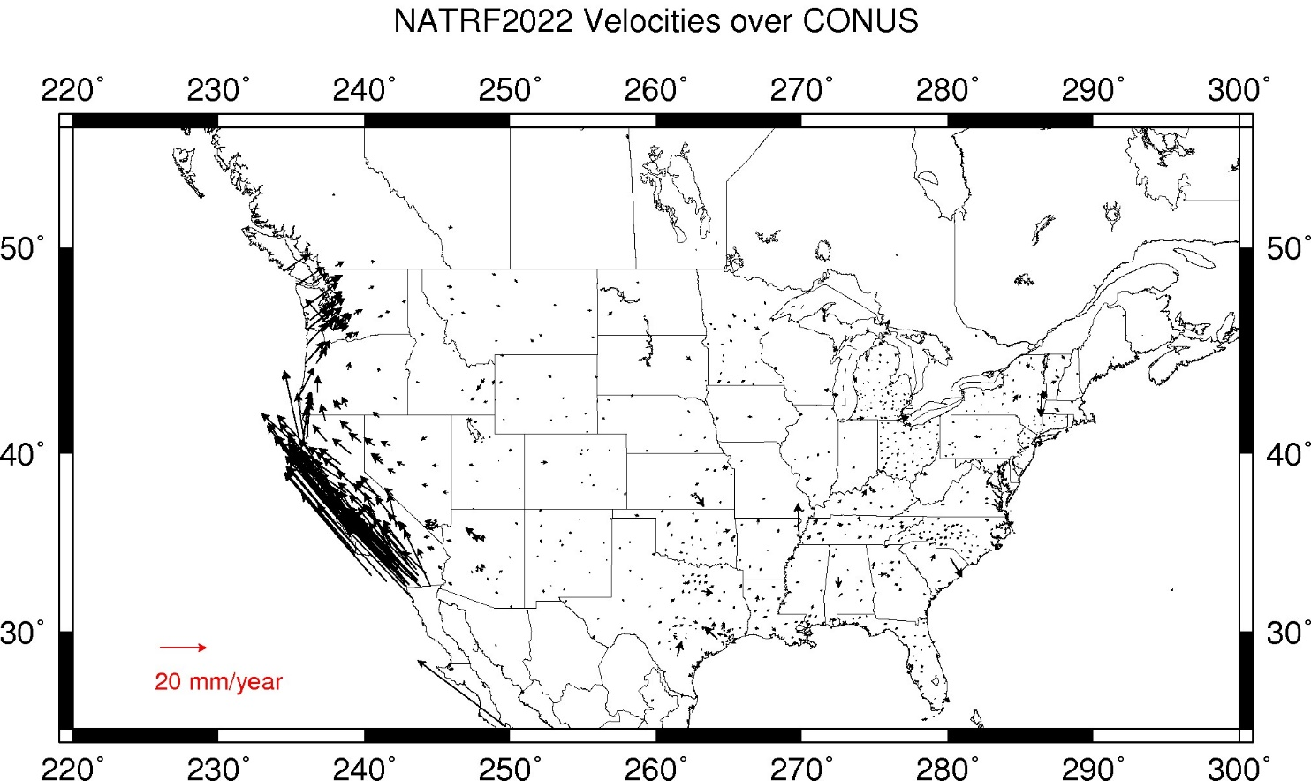
IFVM2022 Velocities – NATRF2022/CONUS
Notes:
This diagram of CONUS shows the IFVM2022 velocities expressed in the NATRF2022 Frame.
Note that even in “stable North America”, these velocities are not absolutely zero!
The IFVM2022 model will contain these tiny deviations from simple plate rotation!
It can generally be interpreted as “at what velocity are points in CONUS moving relative to the North American plate?”
It looks like California is moving northwesterly as viewed from the CONUS side.

Slide 19
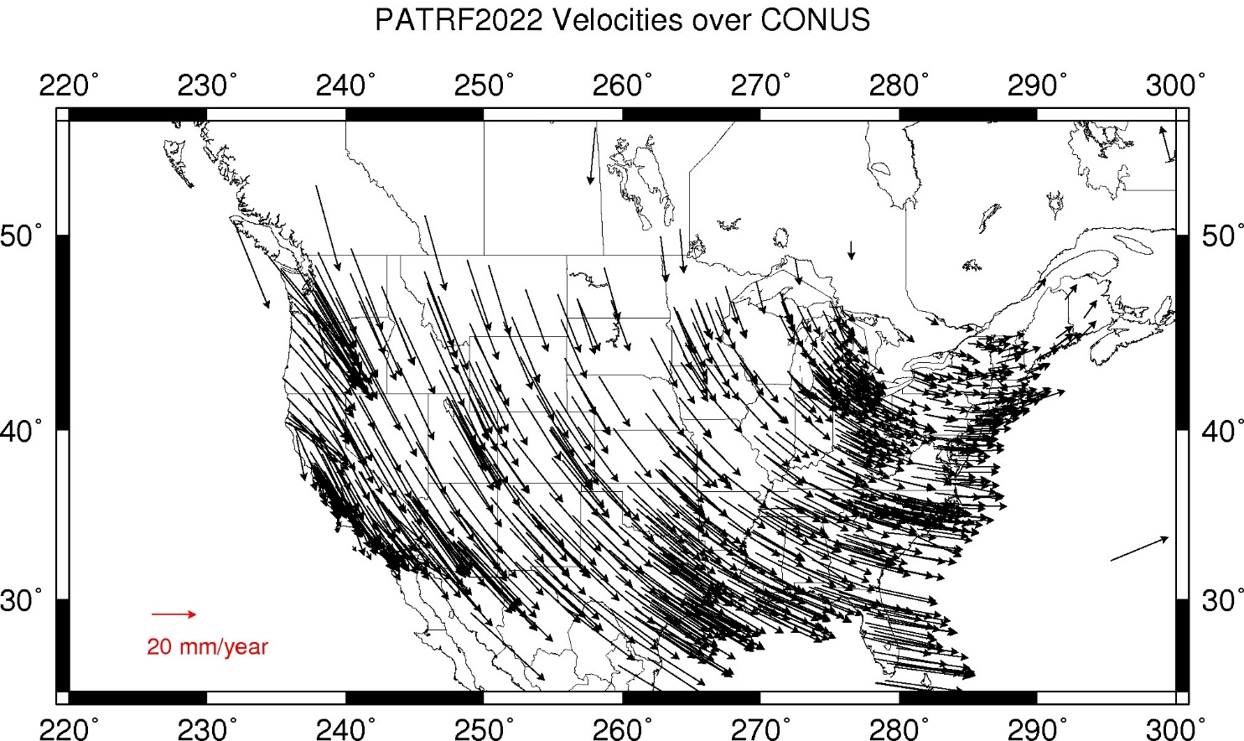
IFVM2022 Velocities – PATRF2022/CONUS
Notes:
This diagram of CONUS shows the IFVM2022 velocities expressed in the PATRF2022 Frame.
Not of much use, except note that we MAY just have done something useful in the Southern California region…(we’ll take a closer look later.)
It can generally be interpreted as “at what velocity are points in CONUS moving relative to the Pacific plate?
Or you can look at it this way, if California is moving northwesterly as viewed from CONUS, then couldn’t we think of CONUS as moving southeasterly as viewed from the California side?

Slide 20
And, for completeness…
Notes:
And, for completeness, the other 2 frames.

Slide 21
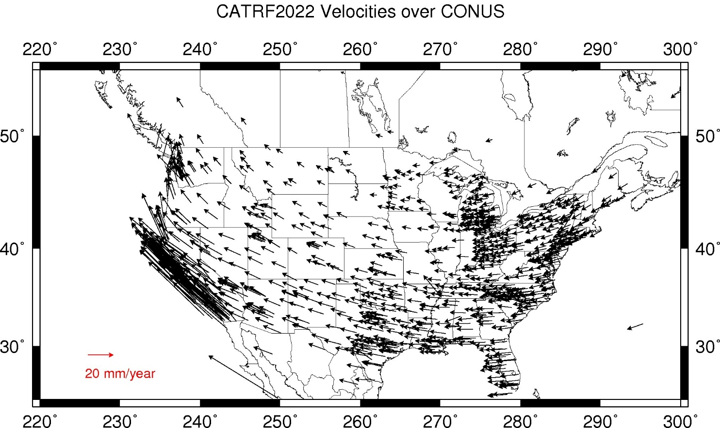
IFVM2022 Velocities – CATRF2022/CONUS
Notes:
This diagram of CONUS shows the IFVM2022 velocities expressed in the CATRF2022 Frame.
It can generally be interpreted as “at what velocity are points in CONUS moving relative to the Caribbean plate?”

Slide 22
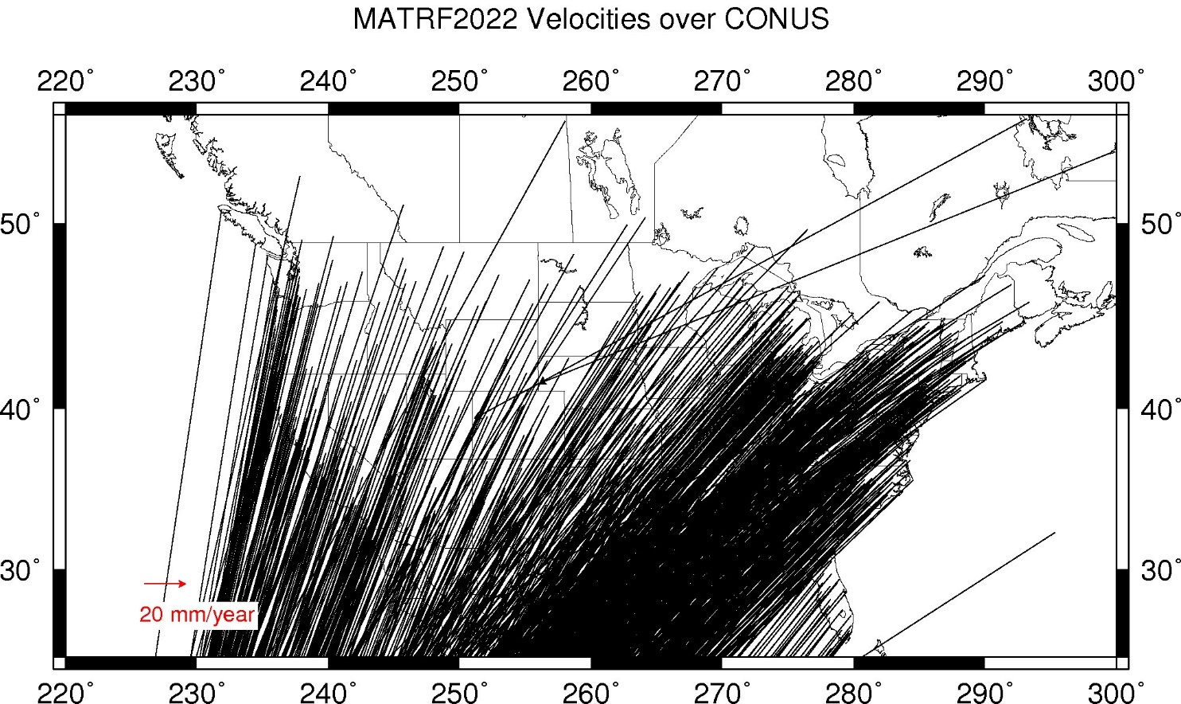
IFVM2022 Velocities – MATRF2022/CONUS
Notes:
This diagram of CONUS shows the IFVM2022 velocities expressed in the MATRF2022 Frame.
They can generally be interpreted as “at what velocity are points in CONUS moving relative to the Mariana plate?”

Slide 23
CONUS – Southern California Plates: Mostly NA, Some Pacific
Notes:
Let’s take a moment and zoom in on that Southern California region for further understanding…

Slide 24
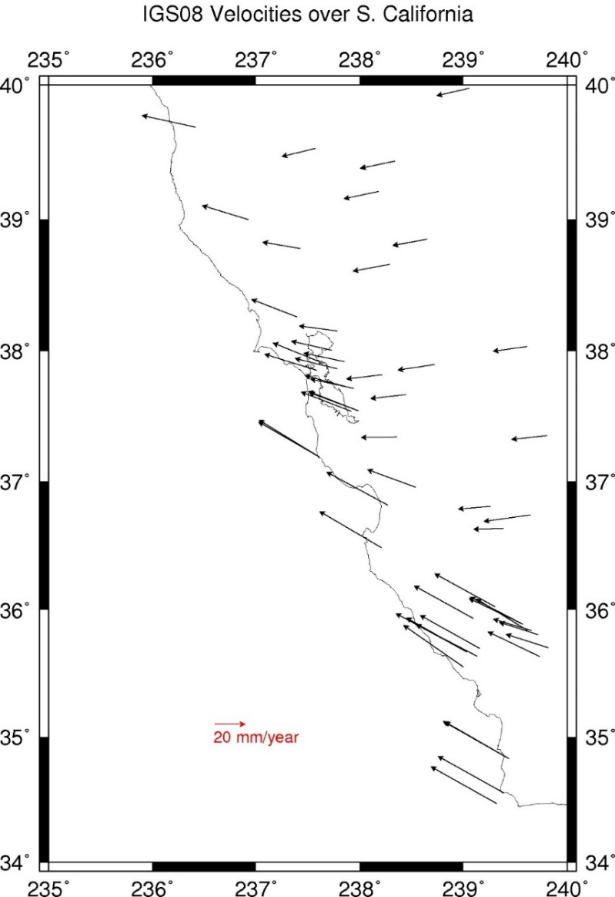
IFVM2022 Velocities – ITRF2020/CONUS
Note the slight agreement with North American Plate rotation…
…and the mixed signal here.
…and a strong agreement with the Pacific Plate rotation…
Notes:
The IFVM2022 velocities relative to the ITRF2020 Frame show 3 slightly differing “velocity fields” if you will.
CLICK
Note the slight agreement with North American Plate rotation…
CLICK
…and a strong agreement with the Pacific Plate rotation…
CLICK
…and the mixed signal here.

Slide 25
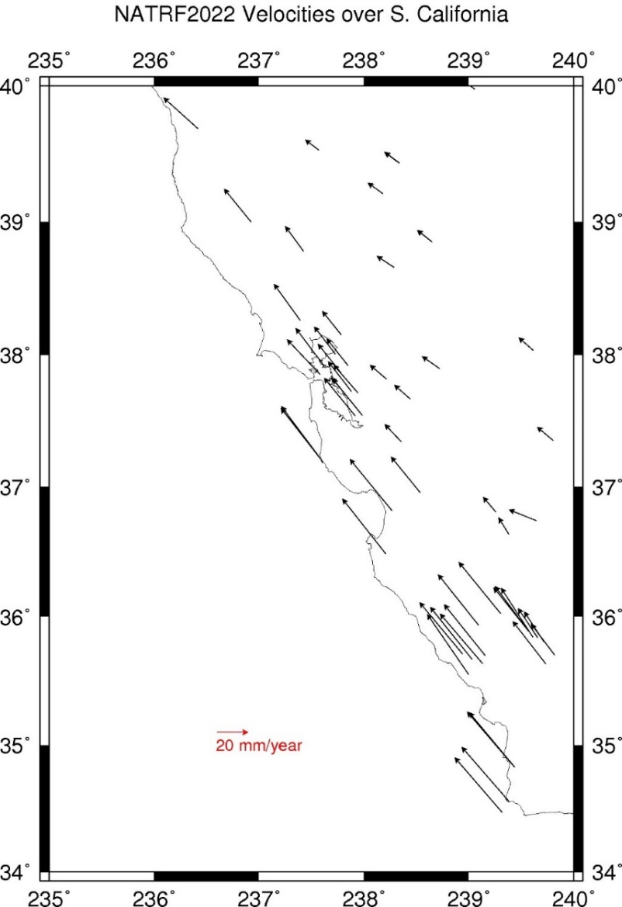
IFVM2022 Velocities – NATRF2022/CONUS
…and only partially helps here…
Obviously not a perfect agreement with the North American Plate rotation…
We now have “residual velocities in ITRF2020” (relative to the North American Plate) or, equivalently, “all velocities in NATRF2022”, as mentioned earlier.
And removing North American Plate rotation doesn’t do much to reduce signal for points moving like the Pacific Plate…
Notes:
Here are the IFVM2022 velocities expressed in the NATRF2022 frame.
CLICK
Obviously not a perfect agreement with the North American Plate rotation…
CLICK
And removing North American Plate rotation doesn’t do much to reduce signal for points moving like the Pacific Plate…
CLICK
…and only partially helps here…
CLICK
We now have “residual velocities in ITRF2020” (relative to the North American Plate) or, equivalently, “all velocities in NATRF2022”, as mentioned earlier.

Slide 26
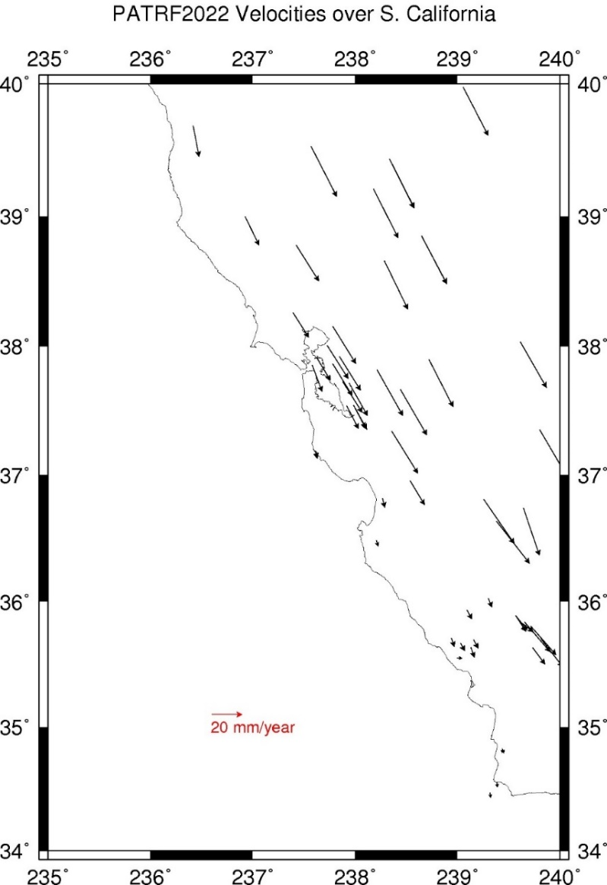
CORS Velocities – PATRF2022
…and (again) only partially helps here…
…while removing the Pacific Plate Rotation from points that move more like the North American Plate isn’t helping matters here…
We now have (again) “residual velocities in ITRF2020” (this time “residual” relative to the Pacific Plate) or, equivalently, “all velocities in PATRF2022”, as mentioned earlier.
Taking away the Pacific Plate Rotation has significantly reduced this signal…
Notes:
Here are the IFVM2022 velocities expressed in the PATRF2022 frame.
CLICK
Taking away the Pacific Plate Rotation has significantly reduced this signal…
CLICK
…while removing the Pacific Plate Rotation from points that move more like the North American Plate isn’t helping matters here…
CLICK
…and (again) only partially helps here…
CLICK
We now have (again) “residual velocities in ITRF2020” (this time “residual” relative to the Pacific Plate) or, equivalently, “all velocities in PATRF2022”, as mentioned earlier.
The takeaway: Most people will work in NATRF2022 in CONUS. Some RARE folks in southern California may find PATRF2022 yields stable coordinates. Most folks between southern California and the Rockies will find NEITHER frame provides satisfactory stability.

Slide 27
IFVM2022 Velocities — NATRF2022/CONUS
Notes:
The coastal regions of Oregon and Washington, while residing upon the North American Plate are being retarded in their westerly motion by the subduction of the Juan de Fuca Plate.
CLICK
Which in this diagram makes it look like Washington and Oregon are moving north-easterly.
CLICK
In reality, they are merely moving westerly at a slower rate than the bulk of North America.

Slide 28
Geometric Frames
In summary, there are 5 global frames
Use: ITRF: If you can accept annual change in latitude/longitude
Use: NATRF/PATRF/CATRF/MATRF2022 if you cannot
All are geocentric frames
EPP2022 connects all five frames
IFVM2022 connects epochs within each frame
Ellipsoid heights will always reflect uplift/subsidence
Notes:
There are 5 global frames
Use: ITRF: If you can accept annual change in latitude/longitude
Use: NATRF/PATRF/CATRF/MATRF2022 if you cannot
All are geocentric frames
EPP2022 connects all five frames
IFVM2022 connects epochs within each frame
Ellipsoid heights will always reflect uplift/subsidence

Slide 29
End of Section 6
Notes:
This is the end of section 6

