Slide 1
Part II: The Modernized NSRS
Notes:
Thank you for your interest in the Modernized National Spatial Reference System.
Part II of this presentation is of significant length due to the detailed content being discussed.
The presentation is therefore broken into smaller sections to fit flexible schedules for presentation and for viewing.
I’m David Zenk, National Geodetic Survey Advisor for the Northern Plains Region.
I will be your narrator for this series of presentations.

Slide 2
Part II: The Modernized NSRS
Guiding Principles (12 slides)
Documentation
Geometric Reference Frames
Geopotential Datum
Coordinates and Database
BREAK
Accessing the NSRS
The NOAA CORS Network
OPUS: The New Bluebooking
New Surveying Specifications
Transformations and Conversions
State Plane Coordinates
Addressing Known Concerns
NSRS Modernization Delay
Closing, Summary and Overview
Contact Information and Ways to Keep Up to Date
Notes:
If you are attending a live presentation, we will schedule breaks at comfortable intervals.
In Part I , we placed the Modernization into historical context.
Now, in Part II, we will discuss the details of the Modernization itself.

Slide 3
Section 4
Part II: The Modernized NSRS
Guiding Principles (12 slides)
Documentation
Notes:
In Section 4, we will discuss the Guiding Principles of the Modernization, and then show some of the publications you can consult for further details and reference.

Slide 4
Key Takeaways
Look for slides with this icon for important summaries!
Notes:
The KEY symbol indicates the important summaries.

Slide 5
Guiding Principles
Pre-eminence of the ITRF
Embrace Time-Dependencies
Access the NSRS through Trusted Geodetic Control (Preference: New GNSS Occupations)
Geoid-Based Vertical Datum
Support and Transition Customer Base
Revitalize the Importance of Standards
Document Everything
Notes:
Here are the NGS’ Guiding Principles for the Modernization:
The ITRF will be pre-eminent
We will embrace time-dependencies
Users will access the NSRS through Trusted Geodetic Control (with a preference for New GNSS Occupations)
NGS will adopt a Geoid-Based Vertical Datum
We will support and assist our Customer Base in transitioning to the new datums
We will Revitalize and Emphasize the Importance of Standards
And importantly, we will Document Everything

Slide 6
Pre-eminence of the ITRF
Decades as an ad-hoc international standard.
Recently adopted by the United Nations Committee of Experts on Global Geospatial Information Management (UN-GGIM) as the Global Geodetic Reference Frame. (https://ggim.un.org/)
All geometric computations will be done in ITRF / XYZ - then transformed into the NSRS.
Notes:
The ITRF has for decades acted as an ad-hoc international standard.
It was recently adopted by the United Nations Committee of Experts on Global Geospatial Information Management (or UN-GGIM) as the Global Geodetic Reference Frame.
All geometric computations will be done in ITRF / XYZ - then transformed into the NSRS.

Slide 7
Embrace Time-Dependencies
Coordinates Change
Even in so-called “plate fixed” frames
Associate Coordinates with their Survey Epoch
Active control: daily computed coordinates
Fit a simple function to them through time
Currently linear. Non-linear in the future.
Passive Control: Coordinates at epochs when the point was surveyed
BUT…
Notes:
NGS will embrace time dependency because Coordinates Change, even in so-called “plate fixed” frames.
We will associate Coordinates with their Survey Epoch.
For active control we will compute daily coordinates, then fit a simple coordinate function to them through time.
Currently a linear function. Non-linear functions will be studied for the future.
For Passive Control:, we will compute coordinates at epochs when the point was surveyed.
BUT…Showing Time Change Requires Re-surveys.

Slide 8
Showing Time Change Requires Re-surveys
Most of the 1.6 million marks in the NGS database were set for NAD 83 or NAVD 88
With nearly no overlap. Relatively few marks had BOTH horizontal and vertical positions!
Most have never been re-surveyed
But kudos to the recent GPS on Bench Mark surveyors!
You’re re-surveying marks that were leveled (for NAVD 88) but now seeing a GPS receiver, often for the first time!
Notes:
Most of the 1.6 million marks in the NGS database were set for NAD 83 or NAVD 88 with nearly no overlap.
Relatively few marks had BOTH horizontal and vertical positions!
Most have never been re-surveyed.
But kudos to the recent GPS on Bench Mark surveyors!
You’re re-surveying marks that were leveled (for NAVD 88) but which are now seeing a GPS receiver, often for the first time!

Slide 9
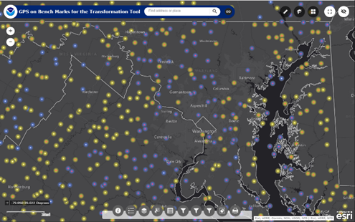
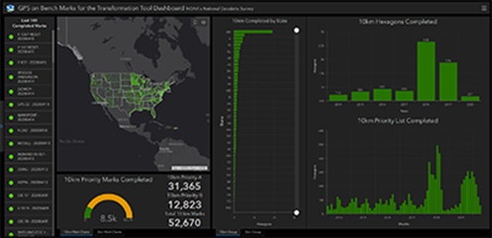
GPS on Bench Marks: Crowdsourcing Data for Better Models and Tools
NGS provides a prioritized list of marks where new data will most benefit the local accuracy of national scale models and tools such as GEOID18 and the 2022 Transformation Tool
Who: Federal and State government agencies, universities, and private sector firms
What: Mark Recovery Reports & Sharing GPS Observations
2022 Transformation Tool Campaign
National Coverage @ 10km spacing – ideal resolution for data to develop a national scale transformation tool
Local Densification @ 2km spacing – Allows partners to collect higher density data and increase local accuracy in areas they work
Priority Marks Web Map
Transformation Tool Campaign Progress Dashboard
GPS on BM Page:
https://geodesy.noaa.gov/GPSonBM/index.shtml
Notes:
The GPS on BM Campaign has been a great success.
Many surveyors contributed observations for the improvement of GEOID18 and have continued to do submit observations that will improve the NAD83 to NATRF2022 Transformation Tool .
Please view the GPS on BM Page to see how you can participate.

Slide 10
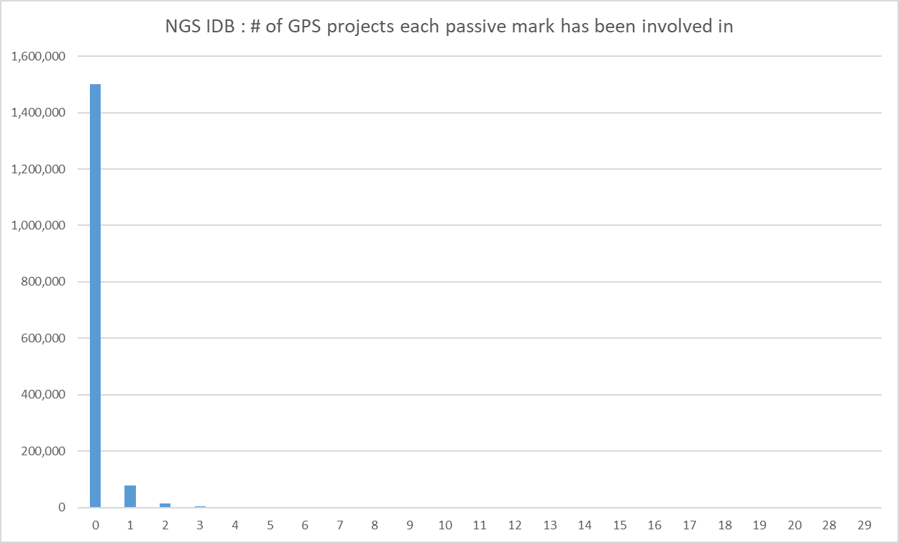
Does anyone really re-survey points?
Number of Marks versus GPS Observation Count
1,600,881 marks not at a CORS
1,500,750 have never seen a GPS receiver
Of those 100,131 remaining, only 22,000 or so have ever seen GPS 2 or more times.
Put another way - approximately:
93% have ZERO GPS occupations (1,500,750)
6.2% have 1 or more GPS occupation (100,131)
1.4% have TWO or more GPS occupations (22,412)
Notes:
It’s all well and good to say “we will show time dependency at passive control”.
But, considering how few are *re* surveyed, re-processing all of our historic data is a LOT of effort for minimal payoff.
Let’s look at some relevant statistical counts from the NGSIDB:
1,600,881 points total – not at a CORS
1,500,750 have never been GPS’d, thus only 100,131 have been in at least 1 GPS project
Put another way - approximately:
93% have ZERO GPS occupations (1,500,750)
6.2% have 1 or more GPS occupation (100,131)
- 1.4% have TWO or more GPS occupations (22,412)

Slide 11
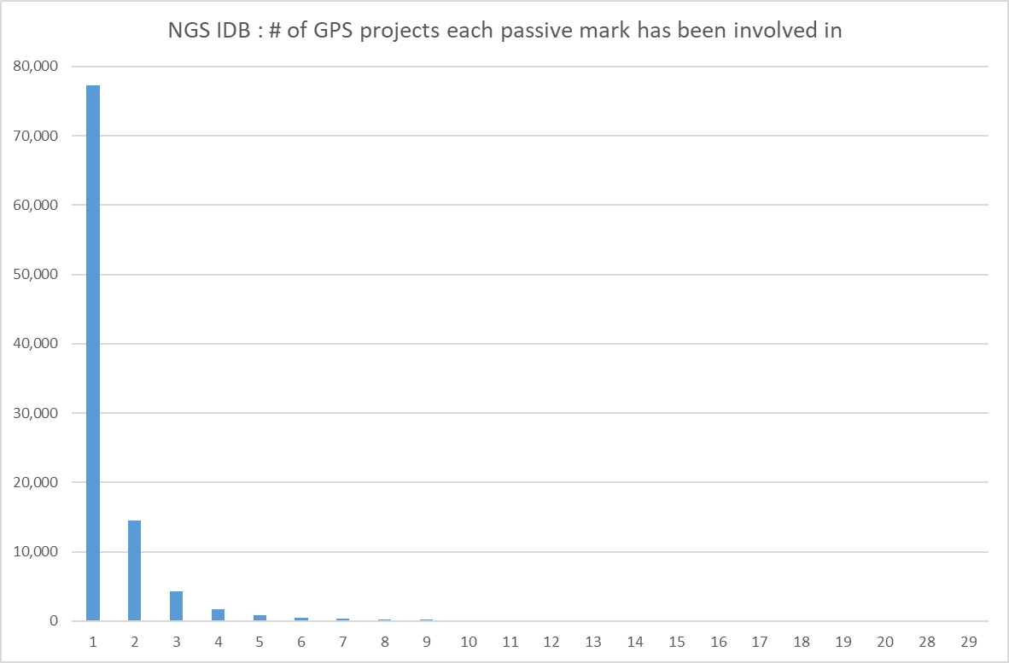
Does anyone really re-survey points?
Number of Marks versus GPS Project Count
Very few marks have participated in more than one GPS Project
Notes:
Very few marks have participated in more than one GPS Project

Slide 12
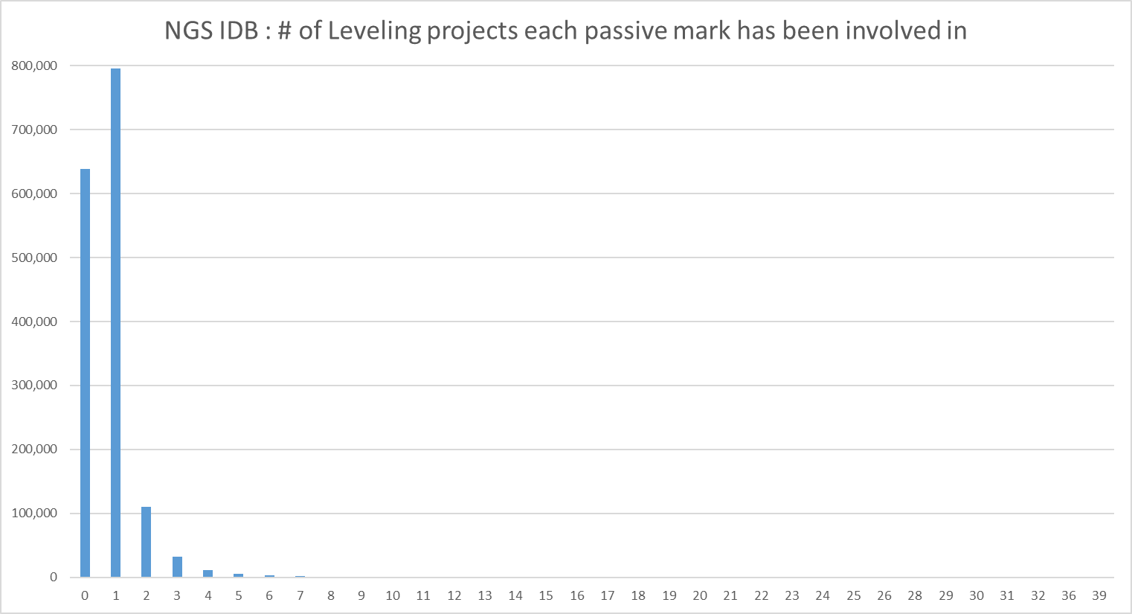
Does anyone really re-survey points?
Number of Marks versus Leveling Project Count
1,600,881 marks not at a CORS
680,000 have never been leveled
802,000 have been leveled only once
166,000 have been leveled 2 or more times.
Or to put it another way:
42% have ZERO Leveling (680,000)
50% have ONE Leveling occupation (802,000)
10% have TWO or more Leveling occupations (166,000)
All counts are approximate
Notes:
With respect to leveling
Of the 1,600,881 marks not at a CORS
680,000 have never been leveled
802,000 have been leveled only once
166,000 have been leveled 2 or more times.
Or to put it another way:
42% have ZERO Leveling (680,000)
50% have ONE Leveling occupation (802,000)
10% have TWO or more Leveling occupations (166,000)

Slide 13
Access the NSRS through Trusted Geodetic Control (Preference: New GNSS Occupations)
Meaning all classical and leveling surveys would require some GNSS for NGS to provide NSRS coordinates
Even if it’s a few 6 second RTN occupations
Notes:
We plan that users will access the NSRS through Trusted Geodetic Control (with preference for New GNSS Occupations)
This means that all classical and leveling surveys would require some GNSS for NGS to provide NSRS coordinates
Even if it’s a few 6 second RTN occupations!

Slide 14
Geoid-Based Vertical Datum
Criteria | Passive Control | Geoid-Based / GNSS accessed
Available everywhere? | No | Yes
Safe from being bulldozed? | No | Yes
Accurate to a few cm everywhere? | No | Yes
Differentially accurate to few mm < 50 km? | Yes | No
Differentially accurate to few mm 50-200 km? | Yes | Yes
Differentially accurate to few mm > 200 km? | No | Yes
Change to the way people do business? | No | Yes
Fast? | No | Yes
Notes:
Consider the advantages of a Geoid-based vertical datum versus a passive mark, leveling-defined vertical datum.
We see that leveling is still the best way to determine LOCAL height differences.
But, in other criteria comparisons, the geoid-based approach is superior.

Slide 15
GPS vs Leveling…
At <50 Km GPS remains steady over longer distances
Differential leveling
errors build
by distance
Differential GPS
errors are larger (at first), but
don’t change with distance
Notes:
This is a plot from GSVS 2 showing how Leveling errors are better than GPS errors at the 0 to 50 km level, but that GPS error remains steady over longer distances.
This is why we will keep pushing LEVELING as the most accurate way to do differential height determination at shorter (< 50 km) distances.

Slide 16
Support and Transition Customer Base
NGS is required to serve Federal agencies
But their largest customer base is state/local
NGS must provide the right instructions on the modernized NSRS
Standards and Specifications!
Notes:
NGS is required to serve Federal agencies
But our largest customer base is state/local
So, NGS must provide the right instructions on the modernized NSRS
That means a new commitment to Standards and Specifications!

Slide 17
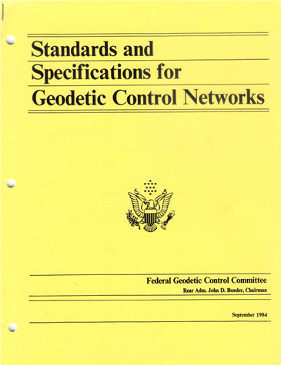
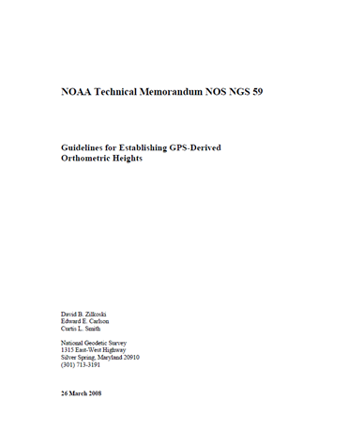
Revitalize the Importance of Standards
☺
☹
Notes:
“If you follow a specification, you have a statistically defined chance of meeting a standard”
“A guideline is a good idea, but without the weight of standard”
NGS will emphasize "standards" over "guidelines" in the modernized NSRS.

Slide 18
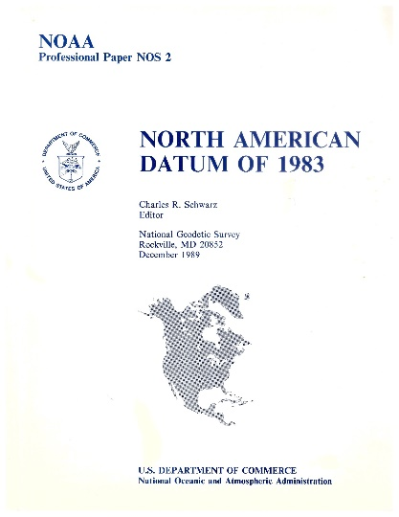
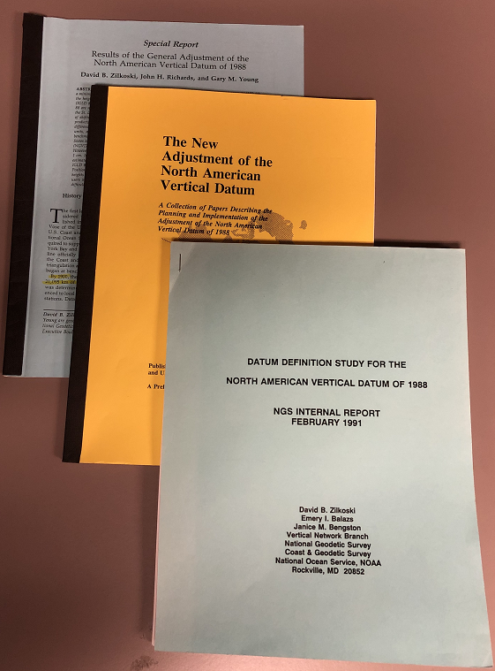
Document Everything
NGS has a mixed history of solid documentation, which we are committed to improving.
NAD 83
NAVD 88
HARNs
FBNs
VERTCON 1.0
VERTCON 2.0
NADCON 2.0
NADCON 4.2
Some web pages, some in-house documentation
☹
A 256 page stunning example of meticulous documentation.
160 pages across multiple reports.
☺
Notes:
NGS has a mixed history of solid documentation, which we are committed to improving.
The NAD83 Report was a stunning example of meticulous documentation.
The more recent HARN, FBN, and coordinate conversion tools had weaker documentation.

Slide 19
Part II: The Modernized NSRS
Guiding Principles
Documentation (4 slides)
Geometric Reference Frames
Geopotential Datum
Coordinates and Database
BREAK
Accessing the NSRS
The NOAA CORS Network
OPUS: The New Bluebooking
New Surveying Specifications
Transformations and Conversions
State Plane Coordinates
Addressing Known Concerns
NSRS Modernization Delay
Closing, Summary and Overview
Contact Information and Ways to Keep Up to Date
Notes:
Let’s move on to Documentation.

Slide 20
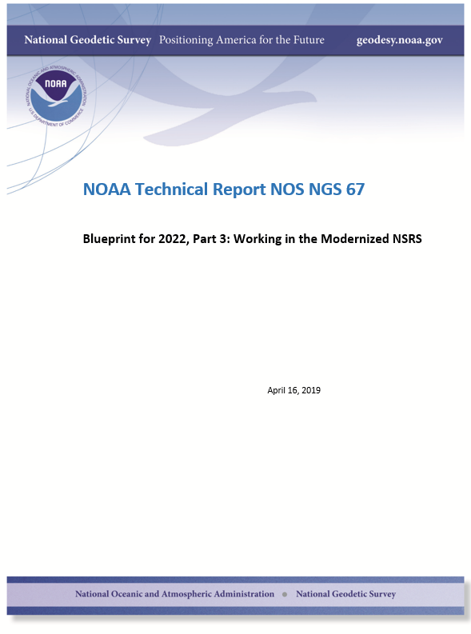
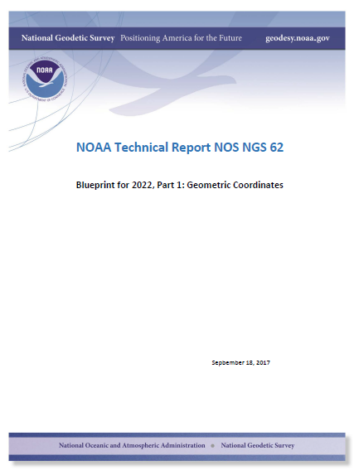
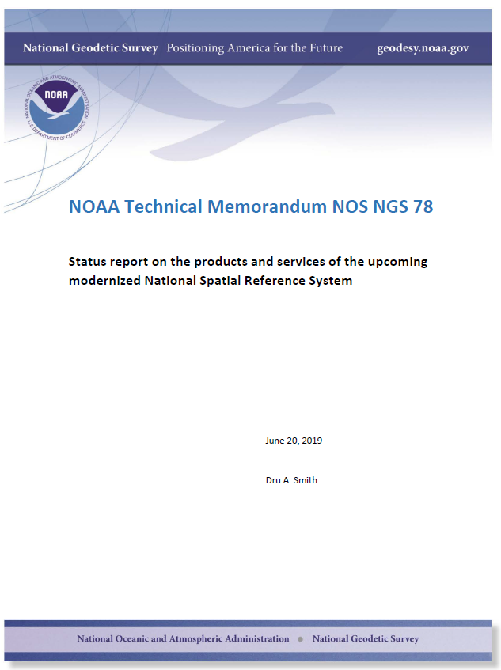
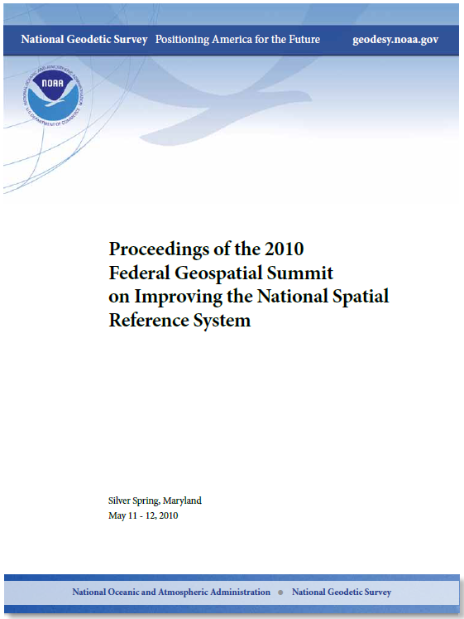
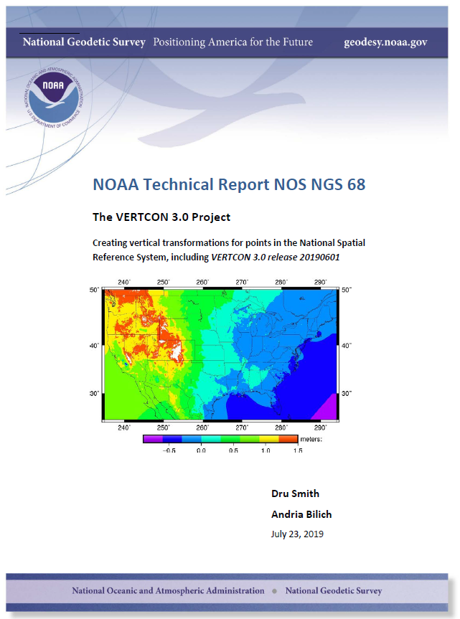
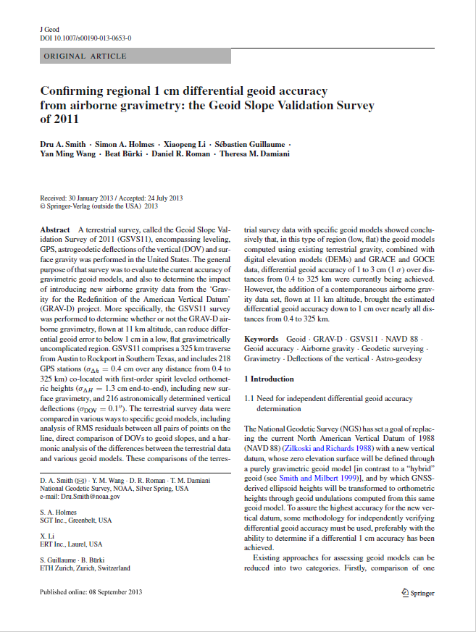
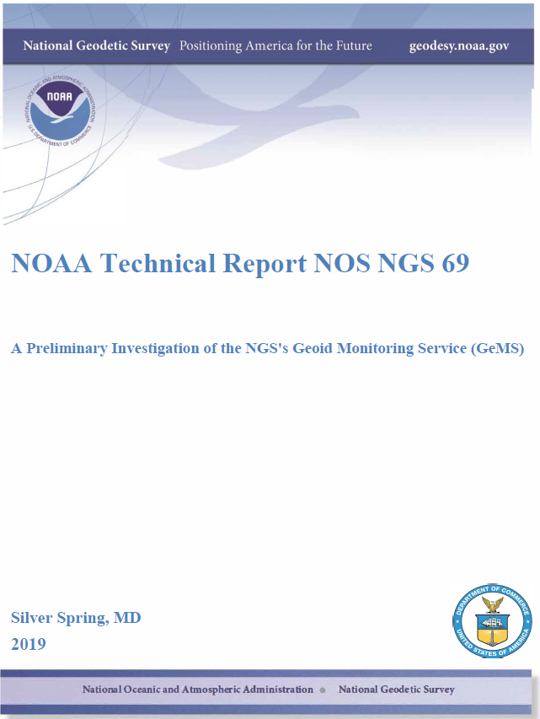
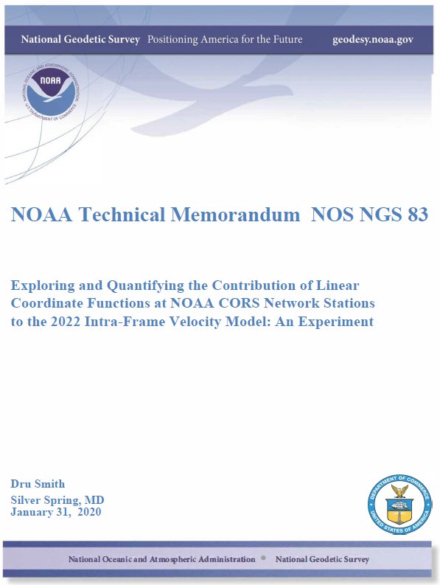
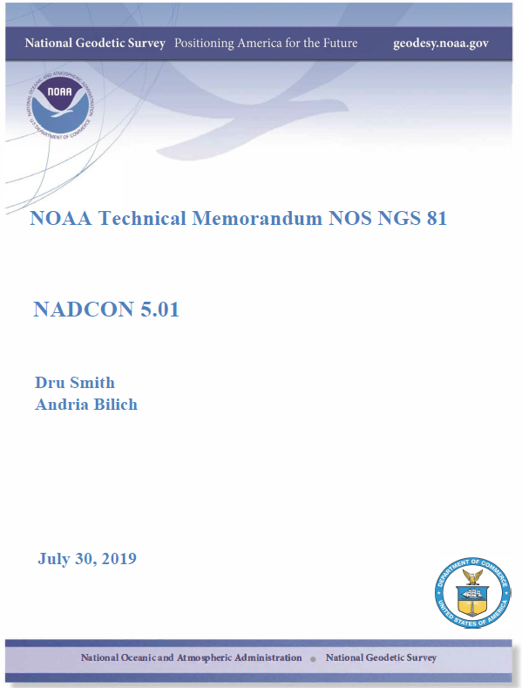
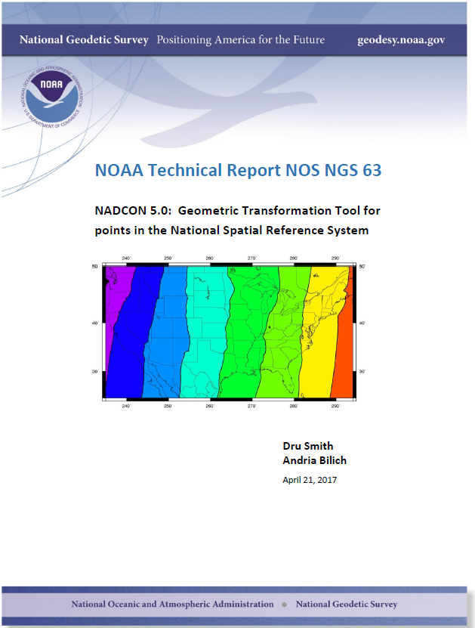
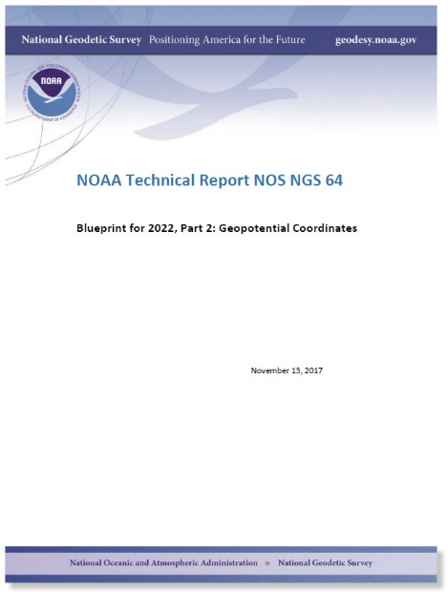
Recent Documentation
2010 – 156 pages
2019 – 121 pages
2011 – 41 pages
2013 – 23 pages
2017 – 41 pages
2019 – 112 pages
2017 – 32 pages
2019 – 20 pages
2020 – 52 pages
2017 – 240 pages
2019 – 77 pages
2018 – 27 pages
2019 – 11 pages
Pages total
947
897
156
197
220
252
293
533
560
633
644
664
776
Notes:
There have been at least 13 documents relating to the new datums.
And we expect more in the future.
Here are the most relevant.
I won’t attempt to read each title nor reference.
All these documents can be found on the NGS website.

Slide 21
Modernizing the NSRS
The “blueprint” documents: Your best source for information
All three documents are being updated and re-released in 2020!!
https://www.ngs.noaa.gov/datums/newdatums/policy.shtml
Geometric:
Sep 2017
NOAA TR NOS NGS 62
32 pages
Geopotential:
Nov 2017
NOAA TR NOS NGS 64
41 pages
Working in the
Modernized NSRS:
April 2019
NOAA TR NOS NGS 67
77 pages
Notes:
The most concise documents are the 3 Blueprints, formally titled
NOAA Technical Report NOS NGS 62
Blueprint for 2022, Part 1: Geometric Coordinates
NOAA Technical Report NOS NGS 64
Blueprint for 2022, Part 2: Geopotential Coordinates
NOAA Technical Report NOS NGS 67
Blueprint for 2022, Part 3: Working in the Modernized NSRS

Slide 22
Other Recent Documents on NSRS Modernization
Document | Year | Title
NOAA TM NOS NGS 83 | 2019 | Exploring and Quantifying the Contribution of Linear Coordinate Functions at NOAA CORS Network Stations to the 2022 Intra-Frame Velocity Model: An Experiment
NOAA TR NOS NGS 69 | 2019 | A Preliminary Investigation of the NGS's Geoid Monitoring Service (GeMS)
NOAA TR NOS NGS 68 | 2019 | The VERTCON 3.0 Project, Creating vertical transformations for points in the National Spatial Reference System, including VERTCON 3.0
NOAA TM NOS NGS 82 | 2019 | On the Use of Linear Units as a Companion to Horizontal Datum Transformations Performed on Curvilinear Coordinates
NOAA TM NOS NGS 81 | 2019 | NADCON 5.01
NOAA TM NOS NGS 78 | 2019 | Status Report on the Products and Services of the Upcoming Modernized National Spatial Reference System
NOAA TM NOS NGS 74 | 2018 | On Least-Squares Adjustments within the Variance Component Model with Stochastic Constraints
NOAA TR NOS NGS 63 | 2017 | NADCON 5.0: Geometric Transformation Tool for Points in the National Spatial Reference System
* Another document type id Special Publication (SP), used recently for State Plane documents
https://www.ngs.noaa.gov/library/
Notes:
Here’s a partial listing of other recent documents on the NSRS Modernization.
Note that
TM means Technical Memorandum (shorter topics)
TR means Technical Report (complete research papers)
SP means Special Publication
All these documents and many more can be found at
https://www.ngs.noaa.gov/library

Slide 23
Updates
The Blueprint documents contain some TBDs
They will be updated in 2020
Additional information can be found by:
Subscribing to the NSRS Modernization Newsletter
Subscribing to the NGS Email Newsletters
Excellent way to learn when about new TRs, TMs, and SPs.
https://www.ngs.noaa.gov/INFO/subscribe.shtml
Notes:
The Blueprint documents contain some TBDs, They will be updated in 2020.
Additional information can be found by:
Subscribing to the NSRS Modernization Newsletter
Subscribing to the NGS Email Newsletters
Excellent way to learn when about new TRs, TMs, and SPs.
The SUBSCRIBE link is located at the left edge of the NGS Home Page

Slide 24
End of Section 4

