Slide 1
Section 11
Part II: The Modernized NSRS
Transformations and Conversions (7 slides)
State Plane Coordinates (7 slides)
Notes:
Thank you for your interest in the Modernized National Spatial Reference System.
In this Section 11 we will discuss our plans for Transformations, Conversions, and State Plane Coordinates.
I’m David Zenk, National Geodetic Survey Advisor for the Northern Plains Region.
I will be your narrator for this section of the presentation.

Slide 2
Part II: The Modernized NSRS
Guiding Principles
Documentation
Geometric Reference Frames
Geopotential Datum
Coordinates and Database
BREAK
Accessing the NSRS
The NOAA CORS Network
OPUS: The New Bluebooking
New Surveying Specifications
Transformations and Conversions (7 slides)
State Plane Coordinates (7 slides)
Addressing Known Concerns
NSRS Modernization Delay
Closing, Summary and Overview
Contact Information and Ways to Keep Up to Date
Notes:
As a reminder, here’s where we are in the outline.

Slide 3
Improve the Toolkit
Old
“Tidal and Orthometric Elevations”
Magnetic Declination CORPSCON
Integrate into NSRS Database
or move to “exo-NGS”software page
VERTCON
NADCON
All Hybrid Geoid Models
All Gravimetric Geoid Models
All Hybrid DOV Models
All Gravimetric DOV Models
14 parameter transformations in HTDP
XYZWIN
UTMS
USNG
GGPCGP
SPC83
DYNAMIC_HT
IGLD85
Deprecate
Integrate into NCAT/VDatum
“Online Adjustment User Services”
GEOCON
GEOCON11
LVL_DH
ConvbinConvascii
ENHANCEMENTS
Gethvlist
INTERORB
TOLADD
Surface Gravity Prediction in the Conterminous USA
NAVD 88 Gravity Computations
Replace w/ GRAV2022
CALIBRATE
Translev
WinDESC
LOCUS
LOOP
MTEN4
Integrate into OPUS
New
HTDP (geodynamics)
Replace w/ IFVM2022
EPP2022
IFVM2022
SPCS2022
GEOID2022
GRAV2022
More…
INVERSE
FORWARD
INVERS3D
FORWRD3D
Integrate into new software
Notes:
NGS will improve the Toolkit. Here’s what we plan to do.
Some will be integrated into NCAT/VDatum
Some will be integrated into OPUS
Some will be integrated into new software
Some will be integrated into the NSRS Database or migrated outside of NGS
Some will be replaced with GRAV2022
Some will be replaced with IFVM2022
Some will be deprecated
And we will develop some new tools.

Slide 4
Conversion? Transformation?
Historically NGS has been inconsistent with these two words. Going forward, we will use them as:
Conversion: Changing the type of coordinate without changing the datum or frame
e.g. change NAD 83(1986) latitude and longitude to NAD 83(1986) State Plane Coordinates
Transformation: Changing the datum or frame, without changing the type of coordinate
e.g. changing an NAD 27 latitude & longitude to an NAD 83(1986) latitude & longitude
So, “NADCON” which transforms coordinates between datums really could have been called “NADTRAN.” C’est la vie.
Notes:
Historically NGS has been inconsistent with these two words.
Going forward, we will use them as:
Conversion: Meaning to change the type of coordinate without changing the datum or frame
e.g. change NAD 83(1986) latitude and longitude to NAD 83(1986) State Plane Coordinates
Transformation: Meaning to change the datum or frame, without changing the type of coordinate
e.g. changing an NAD 27 latitude & longitude to an NAD 83(1986) latitude & longitude
So, “NADCON” which transforms coordinates between datums could have been called “NADTRAN.” C’est la vie.

Slide 5
Conversions
NGS has had many stand-alone computer programs for coordinate conversions – shown in RED.
All of these are now integrated together inside NCAT (NGS Coordinate Conversion and Transformation Tool) – see later slides
No datum changes are shown here
φ, λ, h
xyz2plh
SPC83
X, Y, Z
SPC
USNG
UTMS
USNG
UTM
USNG
Notes:
NGS has had many stand-alone computer programs for coordinate conversions – shown in RED.
All of these are now integrated together inside NCAT (NGS Coordinate Conversion and Transformation Tool) – see later slides
No datum changes are shown here.
See next slide.

Slide 6
NCAT
Existing and Future Datums and Coordinate Systems will all be transformed and converted within NGS Coordinate Conversion and Transformation Tool (or NCAT)
Notes:
Existing and Future Datums and Coordinate Systems will all be transformed and converted within NGS Coordinate Conversion and Transformation Tool
Or just called NCAT

Slide 7
Region: CONUS
X, Y, Z
φ, λ, h
X, Y, Z
SPC
φ, λ, h
NATRF2022
epoch 2020.00
UTM
USSD
USNG
UTM
φ, λ, h
φ, λ, h
NAD 27
NAD 83 (2011)
epoch 2010.00
X, Y, Z
SPC
X, Y, Z
SPC
USNG
UTM
Existing NADCON connections in RED
USNG
UTM
NAD 83 (NSRS2007)
φ, λ, h
NAD 83 (1986)
φ, λ, h
NAD 83 (FBN)
NAD 83 (HARN)
φ, λ, h
X, Y, Z
SPC
X, Y, Z
SPC
φ, λ, h
USNG
UTM
USNG
UTM
X, Y, Z
SPC
X, Y, Z
SPC
USNG
UTM
USNG
UTM
Notes:
Existing Datums and Coordinate Systems will all be transformed and converted within NCAT
The RED connecting lines are “transformations”.
The BLACK connecting lines are “conversions”.
ALL are inside of NCAT.
CLICK
When it is released, NATRF2022 will be added to NCAT.

Slide 8
Transformations
NCAT/NADCON5
2D
3D
φ, λ, h
φ, λ
φ, λ
CONUS
UTM
SPCS
φ
λ
h
- Latitude
- Longitude
- Ellip. Height
UTM
SPCS
X, Y, Z
USNG
USNG
NAD 83
USSD
NAD 27
(1986)
(HARN)
(FBN)
(NSRS2007)
(2011)
NATRF2022
(No SPCS)
Notes:
NCAT incorporates many conversions and transformations, thus replacing former stand-alone tools in a more reliable and efficient interface.

Slide 9
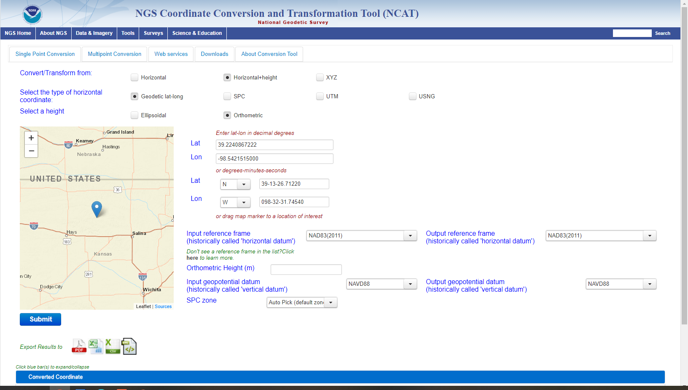
NCAT - with NADCON & VERTCON!
https://www.ngs.noaa.gov/NCAT/
Notes:
NCAT has now incorporated NADCON and VERTCON functions.

Slide 10
Ways to Use NCAT
Browser: Interactive, 1 point at a time
Browser: Upload a file / get a file back (text, xlsx)
As a Web Service
Download and run locally
Beware: This works, but NCAT is updated frequently, so the copy you have may be outdated, so always download the latest version
Notes:
There are several ways to use NCAT
Browser: Interactive, 1 point at a time
Browser: Upload a file / get a file back (text, xlsx)
As a Web Service
Download and run locally
Beware: This works, but NCAT is updated frequently, so the copy you have may be outdated, so always download the latest version

Slide 11
Part II: The Modernized NSRS
Guiding Principles
Documentation
Geometric Reference Frames
Geopotential Datum
Coordinates and Database
BREAK
Accessing the NSRS
The NOAA CORS Network
OPUS: The New Bluebooking
New Surveying Specifications
Transformations and Conversions
State Plane Coordinates (5 slides)
Addressing Known Concerns
NSRS Modernization Delay
Closing, Summary and Overview
Contact Information and Ways to Keep Up to Date
Notes:
Now, let’s discuss NGS plans for the State Plane Coordinate System of 2022.

Slide 12
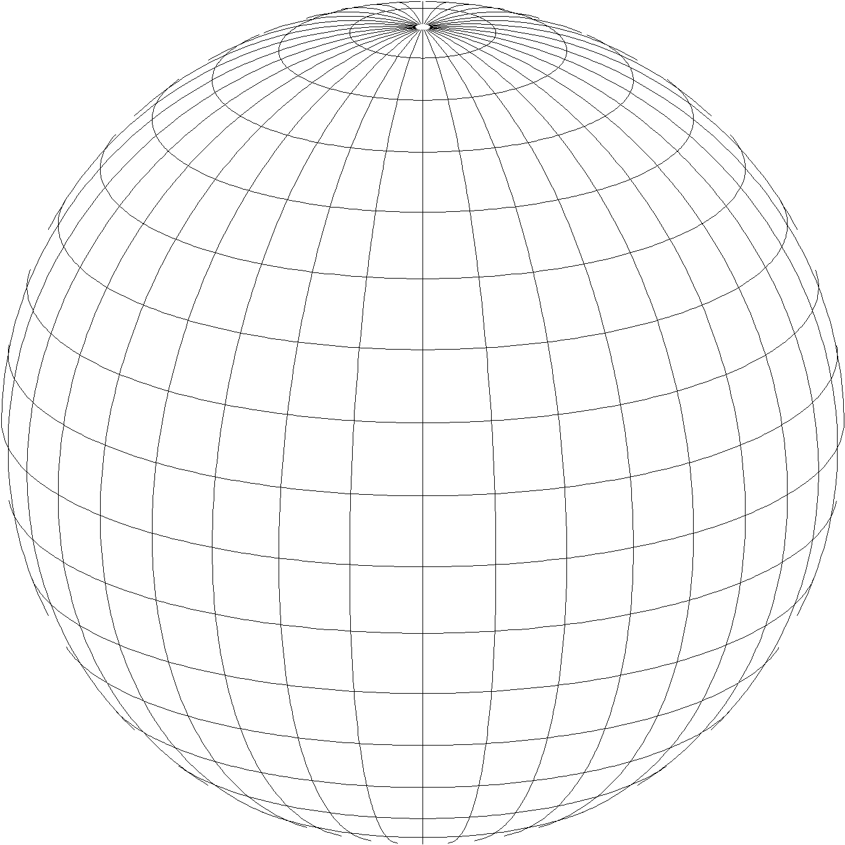
A New State Plane for 2022
State Plane Coordinate System of 2022 (SPCS2022)
Referenced to 2022 Terrestrial Reference Frames (TRFs)
Based on same reference ellipsoid as SPCS 83 (GRS 80)
Same 3 conformal projection types as SPCS 83 and 27:
Lambert Conformal Conic (LCC)
Transverse Mercator (TM)
Oblique Mercator (OM)
Notes:
The NGS new State Plane Coordinate Systems of 2022 (SPCS2022) will all be referenced to the 2022 Reference Frames.
They will continue to use the GRS80 Ellipsoid
And will use ONLY the 3 conformal projection types
Lambert Conformal Conic
Transverse Mercator and
Oblique Mercator.

Slide 13
Overall SPCS2022 characteristics
Minimize distortion at topo surface, not ellipsoid
NGS will design:
Statewide zone for every state
Default zones if no input from stakeholders (most with same zone extents and projection type as SPCS 83)
Max of up to 3 zone “layers” allowed
1 statewide plus 0, 1, or 2 multiple-zone layers
Most states will have total of 2 layers
Notes:
The main difference with SPCS 83 (and SPCS 27) is that SPCS2022 zones will be designed to minimize linear distortion at the topographic surface, rather than at the ellipsoid surface.
CLICK
NGS will design a statewide zone for every state.
CLICK
NGS will also design “default” zones for states if there is no consensus input from stakeholders requesting or proposing something different.
For nearly all states, a default zone has the same extents and projection type as SPCS 83. So they will “look” a lot like SPCS 83 zones, but with less linear distortion at the topographic surface. For states with a single SPCS 83 zone (e.g., North Carolina, Maryland, Vermont, etc.), the default zone is the same as the statewide zone.
CLICK
A state can have a maximum of 3 zone “layers”, with limitations.
For all states, one layer will be the statewide zone. A state can also have 0, 1, or 2 multiple-zone layers.
About a dozen states will have only 1 layer (a statewide zone).
Most states will have 2 layers (a statewide zone plus one multiple-zone layers).
A few states will also have an additional multiple zone layer with partial state coverage. This is intended for mountainous states, so that “low distortion” coverage can be achieved in areas where needed (e.g., valleys rather than mountain tops).
Within a multiple zone layer, none of the zones can overlap.
Only one multiple-zone layer can provide complete state coverage, and only one multiple-zone layer can provide partial state coverage.

Slide 14
Overall SPCS2022 characteristics
Stakeholders can request and propose preferences
Proposal and request deadline was March 31, 2020
Can still change/add/remove zones after 2022
See SPCS2022 policy and procedures for details https://geodesy.noaa.gov/SPCS/policy.shtml
Many states requested and proposed preferences
All zone designs will be finalized in 2021
Can change/add/remove zones after official rollout
Notes:
The deadline for state stakeholders to make requests and proposals is 3/31/2020 (which will likely have passed by the time this presentation is given).
However, after implementation of the 2022 NSRS Modernization (including SPCS2022), stakeholders can request or propose changes to SPCS2022
For more information on this (and other details about SPCS2022), refer to the SPCS2022 policy and procedures available on the NGS website.

Slide 15
SPCS2022 zones designed by NGS
Linear distortion design criterion
Parts per million (ppm), e.g., ±20 , ±50 , ±100 ppm, etc.
Criterion must satisfy all of following:
90% of population
75% of all cities and towns (by location only)
50% of entire zone area
Limitations for designs by NGS
Minimum design criterion ±50 ppm (1:20,000)
May be less for default zones if existing zone small
Low distortion projections (LDPs): < ±50 ppm
Must be designed by others
Notes:
NGS designs are based on a “linear distortion design criterion”
Criterion can initially be estimated by measuring the width of the zone perpendicular to the projection axis (central meridian for TM, central parallel for LCC, and skew axis for OM).
The value in parts per million (ppm) for the criterion are logical ranges of ±5, ±10, ±20, ±30, ±40, ±50, ±75, ±100, ±150, ±200, ±300, or ±400 ppm.
Standard values are used to facilitate design comparison and evaluation.
Gives indication of performance at topographic surface, where it is actually used.
Design criterion is the smallest standard range (listed above) that satisfies all three of the following minimum percentages:
90% of population (based on actual population distribution)
75% of cities and towns, based only on location, irrespective of population. Done to prevent excessive dominance by very large cities at expense of small communities.
50% of entire zone area. This value is set to accommodate mountainous zones; zones with minor topographic relief will usually get much higher percent coverage by area.
Zones design by NGS will use a minimum criterion of ±50 ppm (which is half the previous nominal ±100 ppm used for SPCS 83 and 27, with respect to the ellipsoid).
However, there are many states and existing zones within states that are small enough that a lower criterion will be used by NGS for default designs.
For new zones requested by stakeholders in multi-zone states, NGS will not design for less than ±50 ppm.
Low distortion projections (LDPs) must be designed by stakeholders if the criterion is less than ±50 ppm.

Slide 16
Bye, bye, U.S. survey foot…
In modernized NSRS, NGS will support only one definition of the “foot”
Previously called the “international foot”
Now, just the “foot”
1 foot = 0.3048 meter (exact)
However
Recommend using term “international foot” when there is potential for confusion with other foot
NGS will continue to support U.S. survey foot for legacy applications (e.g., SPCS 83 and 27)
The US Survey Foot will be deprecated after December 31, 2022
Notes:
In the modernized NSRS, NGS will support only one definition of the “foot”
Previously called the “international foot”
Now, just called the “foot”
1 foot = 0.3048 meter (exact)
However, NGS recommends using term “international foot” when there is potential for confusion with other foot
NGS will continue to support U.S. survey foot for legacy applications (e.g., SPCS 83 and 27)
The US Survey Foot will be deprecated after December 31, 2022.

Slide 17
Tools
NGS will release NADCON and VERTCON simultaneously with the new geometric frames and geopotential datum
Use NCAT and VDatum for all your conversions and transformations
State Plane Coordinates now support Low Distortion Projections
1 to 3 layers per state/territory/district
The U.S. Survey foot will not be supported going forward
But will continue to be available for historic transformations
Notes:
In summary, NGS will update and provide new coordinate management tools
NCAT - will replace NADCON and VERTCON
SPCS2022 - will support Low Distortion Projections (LDPs)
US Survey Foot – will not supported.

Slide 18
End of Section 11
Notes:
This is the end of Section 11

