Slide 1
Coordinate Functions
Rick Bennett and the NGS Analysis Center Team

Slide 2
Outline
What are coordinate functions?
Why do we need them?
Maintenance and binational coordination

Slide 3
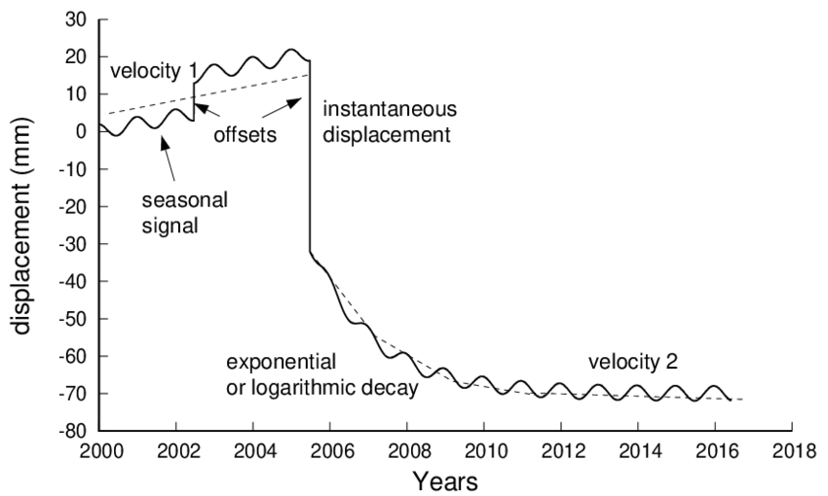
Describing station motion
Credit: Machiel Bos
Notes:
CFs are models that describe the motion of CORS stations. They generally include an offset at some specified epoch, a secular rate (velocity), seasonal motions, and sometimes decay terms. Large offsets due to earthquakes and equipment changes are also important. We will discuss those in the next slide.
An important point I want to make here is that the reference frame determines the coordinate function velocity, in other words the slope of the secular motion. Given a set of coordinate functions that share mutually consistent underlying reference fame, we may use the CFs to define a regional spatial reference system that shares the same frame of the coordinate functions.

Slide 4

Coordinate functions
Coordinate functions in general comprise both linear and nonlinear terms.
However:
Each breakpoint delimited segment of a CF has its own 2020.0 intercept reference epoch (not to be confused with the official REC).
These intercepts are determined exclusively from the linear portion of the CF for that segment.
x
v₁
v₂
v₀
Credit: P. McFarland
𝚫t₁
𝚫t₂
𝚫t
𝚫t = time since reference epoch
reference epoch (e.g., 2020.0)
Notes:
A note on coordinate function products: In the end, coordinate functions, whether they define the ITRF2020 frame, or the NSRS, are provided as sets of parameters delimited by breakpoints. The breakpoints usually occur at epochs of large magnitude earthquakes or antenna changes.
Each segment of a coordinate function is provided with its own intercept at the reference epoch, which is based on on a projection using the linear portion of the model. There are no explicit estimates of earthquake or antenna offsets, although these may be computed. This differentiates coordinate functions from geophysical trajectory models that generally have only one reference coordinate, and require earthquake and antenna offsets to compute the trajectory.

Slide 5
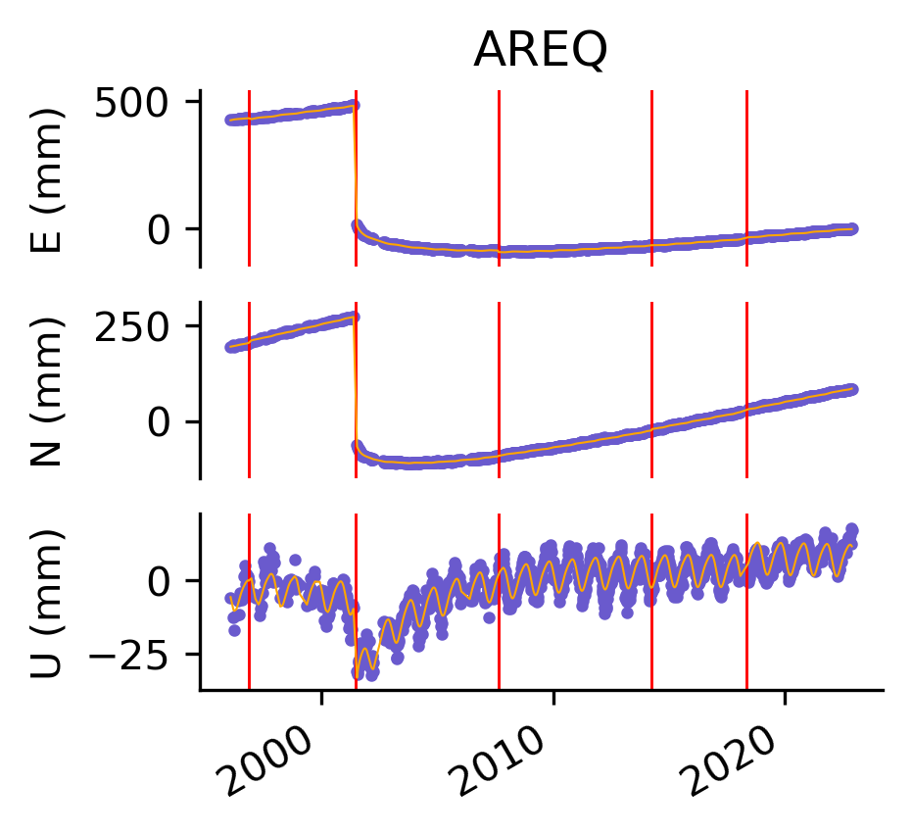
Extreme real world example: IGS station AREQ
SID X Y Z Vx Vy Vz Epoch Start Stop
AREQ_G2A 1942826.94674 -5804070.23434 -1796893.71605 0.01188 0.00064 0.01371 2015.00000 1996.02600 1996.86343
AREQ_G3A 1942826.94316 -5804070.23985 -1796893.71319 0.01188 0.00064 0.01371 2015.00000 1996.86343 2001.47410
AREQ_G5A 1942826.46086 -5804070.27126 -1796894.02929 0.01188 0.00064 0.01371 2015.00000 2001.47410 2007.61935
AREQ_G6A 1942826.45544 -5804070.27362 -1796894.02739 0.01188 0.00064 0.01371 2015.00000 2007.61935 2014.24675
AREQ_G7A 1942826.45550 -5804070.27470 -1796894.02401 0.01188 0.00064 0.01371 2015.00000 2014.24675 2018.32894
AREQ_G8A 1942826.46202 -5804070.27804 -1796894.02152 0.01188 0.00064 0.01371 2015.00000 2018.32894 2022.89450
Notes:
Note the large seasonal motion in the up component and the nonlinear decay starting in mid-2001.

Slide 6
Extreme real world example: IGS station AREQ
SID X Y Z Vx Vy Vz Epoch Start Stop
AREQ_G2A 1942826.94674 -5804070.23434 -1796893.71605 0.01188 0.00064 0.01371 2015.00000 1996.02600 1996.86343
AREQ_G3A 1942826.94316 -5804070.23985 -1796893.71319 0.01188 0.00064 0.01371 2015.00000 1996.86343 2001.47410
AREQ_G5A 1942826.46086 -5804070.27126 -1796894.02929 0.01188 0.00064 0.01371 2015.00000 2001.47410 2007.61935
AREQ_G6A 1942826.45544 -5804070.27362 -1796894.02739 0.01188 0.00064 0.01371 2015.00000 2007.61935 2014.24675
AREQ_G7A 1942826.45550 -5804070.27470 -1796894.02401 0.01188 0.00064 0.01371 2015.00000 2014.24675 2018.32894
AREQ_G8A 1942826.46202 -5804070.27804 -1796894.02152 0.01188 0.00064 0.01371 2015.00000 2018.32894 2022.89450
Linear portions only
Large diffs among intercepts @ the reference epoch

Slide 7
Extreme real world example: IGS station AREQ
SID X Y Z Vx Vy Vz Epoch Start Stop
AREQ_G2A 1942826.94674 -5804070.23434 -1796893.71605 0.01188 0.00064 0.01371 2015.00000 1996.02600 1996.86343
AREQ_G3A 1942826.94316 -5804070.23985 -1796893.71319 0.01188 0.00064 0.01371 2015.00000 1996.86343 2001.47410
AREQ_G5A 1942826.46086 -5804070.27126 -1796894.02929 0.01188 0.00064 0.01371 2015.00000 2001.47410 2007.61935
AREQ_G6A 1942826.45544 -5804070.27362 -1796894.02739 0.01188 0.00064 0.01371 2015.00000 2007.61935 2014.24675
AREQ_G7A 1942826.45550 -5804070.27470 -1796894.02401 0.01188 0.00064 0.01371 2015.00000 2014.24675 2018.32894
AREQ_G8A 1942826.46202 -5804070.27804 -1796894.02152 0.01188 0.00064 0.01371 2015.00000 2018.32894 2022.89450
Constant velocities for this case, but not in general
Non-linear motions accounted for by additional model components (not shown in the table, but apparent in the graph).
Linear portions only
Large diffs among intercepts @ the reference epoch
Notes:
Despite the occurrence of steps at breakpoints, it is common for the velocity to be constant across these breakpoints.

Slide 8
Why do we need coordinate functions?
now
future
3
All CORS move over time
Coordinate functions describe the motion
2
jump
i.e. earthquake
steady motion
i.e. velocity
1
N
past
E
Station motion - map view
Drawings modified from P. McFarland
Notes:
The key takeaway message about CFs is this: CFs are foundational to the U.S. and Canadian NSRS because they associate fiducial access points of the NSRS to the CORS stations as they move relative to the global reference frame of GNSS satellite systems. We can use them to determine the positions of any other points of interest using precise GNSS relative positioning techniques.

Slide 9
Why do we need coordinate functions?
now
future
solution 3 is best predictor of future position
3
Reference epoch
2
jump
i.e. earthquake
steady motion
i.e. velocity
1
N
past
E
Station motion - map view
Drawings modified from P. McFarland
Notes:
The simplest conceivable coordinate function is constant position at some reference epoch. What is the problem with such a coordinate function?

Slide 10
Why do we need coordinate functions?
now
future
current point of interest
jump
i.e. earthquake
steady motion
i.e. velocity
N
past
E
Station motion - map view
Drawings modified from P. McFarland
Notes:
Consider a point of interest, which we would like to locate in the NSRS.

Slide 11
Why do we need coordinate functions?
now
future
current point of interest
Precise Obs
Baseline Vector
large
positioning error
jump
i.e. earthquake
steady motion
i.e. velocity
estimate
N
past
E
Station motion - map view
Drawings modified from P. McFarland
Notes:
We can use GNSS to determine a very precise baseline vector between a CORS and our point of interest. Errors in the CORS’ reference coordinates would translate into errors in the position estimates for the point of interest. If we assume the reference coordinates are stationary, the positioning error would change over time. Thus, if you were trying to recover your buried treasure after some period of time, the errors in your position determination would be different at a later date. Your buried treasure might be lost forever.

Slide 12
Why do we need coordinate functions?
more accurate
coordinate of epoch
future
current point of interest
erroneous coord of epoch
Precise Obs
Baseline Vector
better point estimate
jump
i.e. earthquake
steady motion
i.e. velocity
estimate
N
past
E
Station motion - map view
Drawings modified from P. McFarland
Notes:
Now let’s imagine you have a slightly more sophisticated coordinate function that accurately characterizes offsets associated with earthquakes and other disturbances, as well as the steady state motion as viewed from the global frame of the satellites. Using the improved CF, you would be able to better locate your asset over time in the global frame.

Slide 13
Why do we need coordinate functions?
even more accurate
coordinate of epoch
future
current point of interest
computed station coordinate
periodic motion correction
periodic motion
jump
i.e. earthquake
Coordinate functions can include periodic motion models for better reference coordinate determination
steady motion
i.e. velocity
N
E
Station motion - map view
Drawings modified from P. McFarland
Notes:
Using a more complete coordinate function, for example one including a model for seasonal motions, we can improve our position estimates even more.

Slide 14
The MYCS3 Coordinate function model
x(t) = x_{R} + v_{x}(t - t_{R}) + A_{x}sin(2𝛑 t) +B_{x} cos(2𝛑 t) + C_{x}sin(4𝛑 t) +D_{x} cos(4𝛑 t) + g_{x}(t)
linear periodic (annual and semi-annual)
NGS only for now
Parameters
X, Y, Z, Vx, Vy, Vz, 3x(A, B, C, D)
Up to 18 (or 6) values per “solution”, i.e., model segment
Future enhancements
FY26? FY27?
Notes:
In summary, coordinate functions associate the locations of the CORS beacons to the reference frame of the GNSS satellites. They account for the motion of the CORS in the chosen reference frame, as well as other disturbances such as offsets due to large earthquakes. CFs are provided as collections of parameter estimates, that may be used to compute the current location of a CORS.

Slide 15
Maintenance and Binational Coordination
Updates may be required to account for earthquakes and as prediction errors accumulate.
CGS and NGS will continue to collaborate/coordinate to ensure consistency among coordinate functions
Future enhancements:
CGS to include periodic components
NGS to include post-seismic components
Notes:
Coordinate functions are not perfect and they occasionally need to be updated.
The next topic of discussion led by Ali will describe how to transform from the terrestrial reference frame to frames more suitable for geospatial analysis. The CORS coordinate functions play a central role in determining the transformations to these other frames.

