Slide 1

EPSG
– relationship to the ISO
Geodetic Register
– plans for NATRF2022
Roger Lott
IOGP Geodesy Subcommittee co-chair
NGS & CGS Bi-national Geospatial Software Developers Summit
April 2025

Slide 2
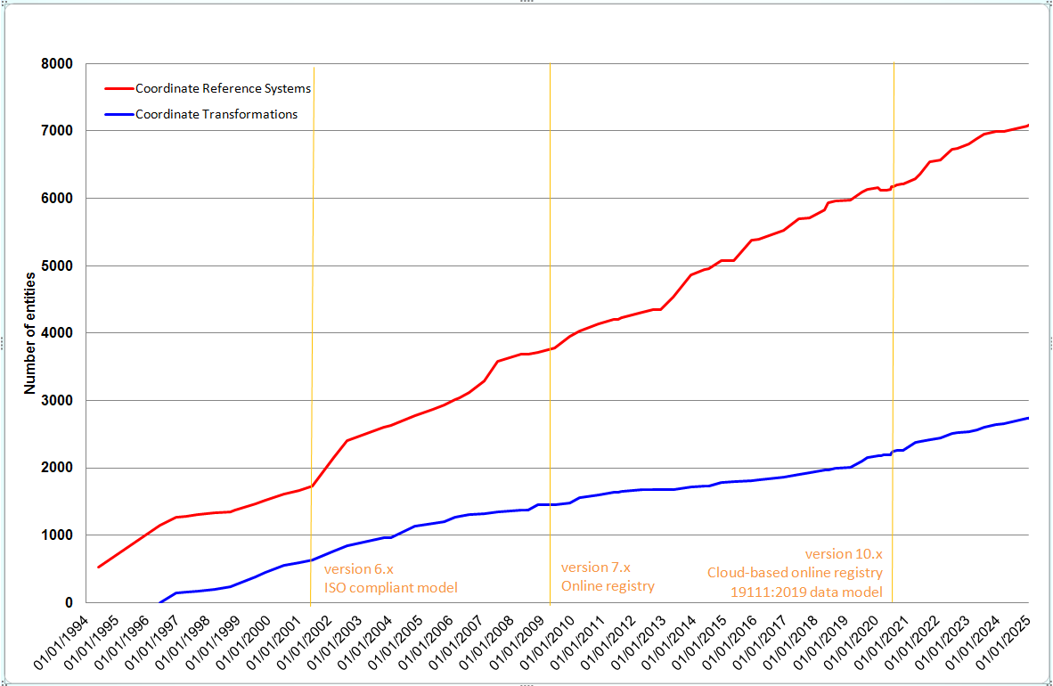
EPSG’s relationship to the ISO Geodetic Register
EPSG follows ISO 19111:2019 data model
Data maintained by the IOGP Geodesy Subcommittee
Subcommittee has ~20 members, 33% N America, 33% Europe, 33% ROW.
50% are geodesists, remainder are GIS experts, software developers, and surveyors
EPSG registry has GUI (epsg.org) and API
Dataset is fairly static – cache the definitions
ISOGR content is included in the EPSG Dataset
EPSG CRS and CT definitions include ISOGR identifier
Many EPSG support records adopted by ISOGR
EPSG content adopted by OGC
Requests for data changes to feedback@epsg.org
vetted against publicly-available information
>7000 CRSs
+12000 support records
>2500 CTs

Slide 3
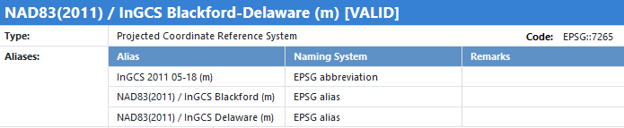
EPSG plans for adding NATRF2022 data
IOGP members wish to see NATRF2022 descriptions in EPSG as soon as practicable
Strategy:
We have had some dialogue with NGS (but not CGS)
NGS alpha data will not be included in EPSG
Information will be added after data is published in NGS beta (with metadata) or ISOGR, whichever is earliest
exception: EPSG Dataset will include projected CRSs for all relevant UTM zones even if not in NGS beta or ISOGR
SPCS2022
Unlike SPCS27 and SPCS83, EPSG codes for SPCS2022 will not be related to FIPS codes
Will include projection definitions and projected CRSs in both meters and feet. (unit included in name)
Axis order will be N,E (per NGS definition)
County zones with identical projection parameters
will have one record and one EPSG code,
aliases used for each county:
Test loading (of subset of alpha) has been successfully accomplished. Extent polygons identified as most difficult task
Notes:
Need to have parameter values in NGS beta – applications are not relevant to populating the EPSG Dataset.
Needs metadata esp. CT op accuracy.
SPCS county zones – eliminate overhead of redundant CTs.

Slide 4
EPSG strategy for adding NATRF2022 data
Strategy (continued):
For Canada MTM and 3TM zones, need information from CGS or provinces
Cannot do much without definition of reference frames / geodetic and vertical CRSs
needed before projected CRSs can be populated
needed before transformations can be populated
NAD83(2011) <> NATRF2022 CTs: file format NADCON5? GGXF? Both?
NAD83(CSRS) <> NATRF2022 CT(s): need information from CGS or ISOGR
geoid models (GEOID2022)
velocity grids (IFDM2022)
all transformations and point motion operations require nominal operation accuracy
relationship to ITRF (Euler pole rotations) not essential for populating above
Concern: NATRF2022-u2025 ... -u2030 … needs to be understood before first data load
Do end users want new projected CRS codes for each 5/10-year update?
NATRF2022(v1.0) / UTM zone 17N, NATRF2022(v1.1) / UTM zone 17N, NATRF2022(v1.2) / UTM zone 17N, …
NATRF2022 as a datum ensemble? If ensemble concept adopted, requires software to catch up.
Notes:
National atlas projCRSs?
Strategy for geoid models (static and dynamic and their relationship) not finalized.

Slide 5
Lucyna Kryla-Straszewska,
IOGP Principal Manager – Digital and Geomatics
lks@iogp.org
https://www.iogp.org/workstreams/engineering/geomatics/
https://epsg.org/

