Slide 1

Trimble Feedback on NSRS and CSRS Modernization
April 24, 2025
Presented By: Chris Pearson, Trimble
© 2025 Trimble, Inc - All Rights Reserved
Notes:
General cover slide

Slide 2
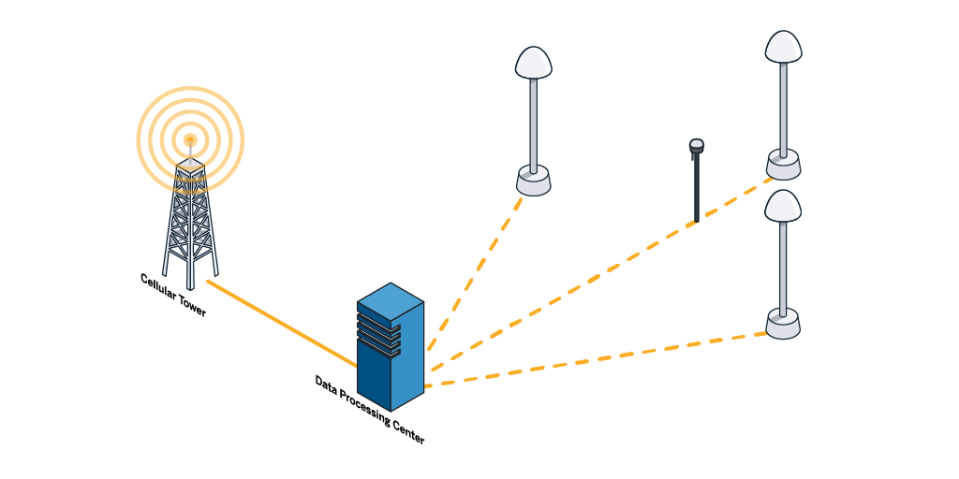
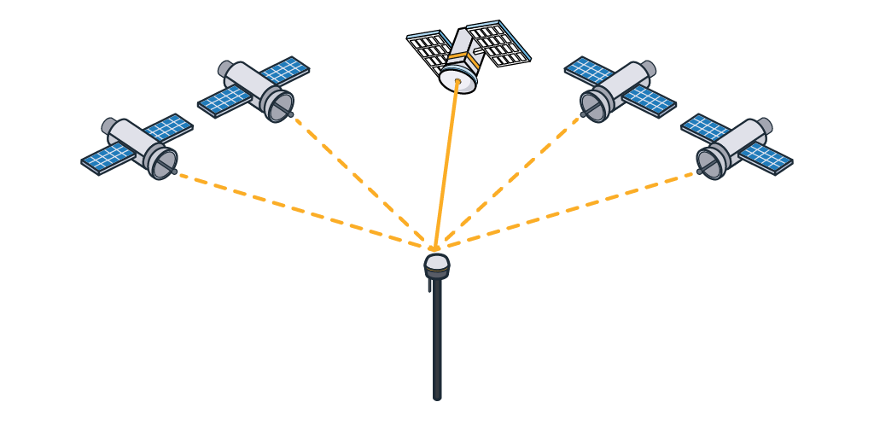
Trimble RTX & VRS today
VRS Now Corrections provided in
NAD 83 (2011)
RTX corrections provided in
ITRF2020 at EOM
Notes:
A good place to start is to show how our end-users work in different coordinate systems when using our products.
If they’re using RTX corrections, they receive corrections in ITRF2020 at the epoch of measurement.
If they’re using VRS Now corrections, they receive corrections in NAD83(2011) in a fixed epoch - we use 2010.0 for the US. We also provide NAD83(CRS) in Canada in various epochs.

Slide 3
NAD 83 (2011) California Zone3 + NAVD88
ITRS coordinate
(X_{ECEF}, Y_{ECEF}, Z_{ECEF})
ITRF2020 epoch 2025.31
(RTX Measurement)
GLOBAL coordinate
(X_{ECEF}, Y_{ECEF}, Z_{ECEF})
NAD 83 (2011) epoch 2010.0
(VRS Measurement)
LOCAL coordinate
(Latitude, Longitude, Height)
NAD 83 (2011)
(Measured or Control Position)
GRID coordinate
(Easting, Northing, Elevation)
California Zone 3 + NAVD88
(Computed or Control Position)
Time Dependent Transformation
Fourteen parameter
+ Deformation Models (HTDP)
Datum
Transformations
Null Transformation
Molodensky
Seven Parameter
Multiple Regression
Datum Grid
RTCM Datum
Projection
& Site Calibration
Standard Projections
or Projection Grid
or Snake Grid
+ Geoid Models
+ Ground Coordinates
+ Horz.& Vert. adjustments
Notes:
This slide shows an example of working in California Zone3 in NAD83(2011) Epoch 2010.0 & NAVD88
If you’re starting with RTX in ITRF, a Time Dependent Transformation that includes the Deformation Model is done to get to NAD83(2011) Epoch 2010.0, and then a projection.
If you’re starting with VRS in NAD83(2011) Epoch 2010.0, then just a projection is needed.
Selecting legacy datum like NAD83(HARN), NADCON Grid Files will be used to convert between Global and Local coordinates

Slide 4
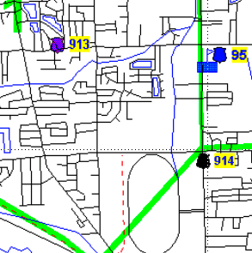
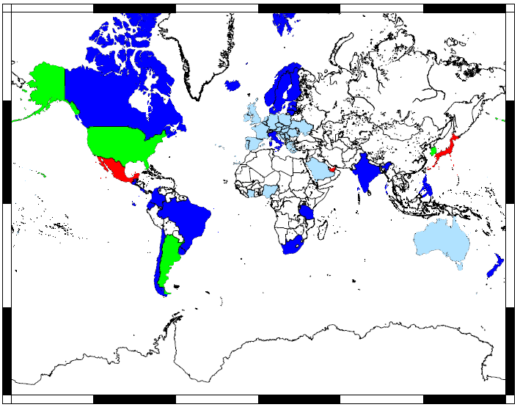
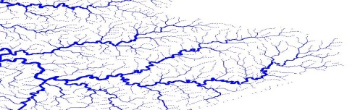
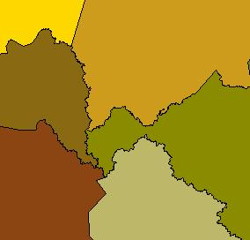
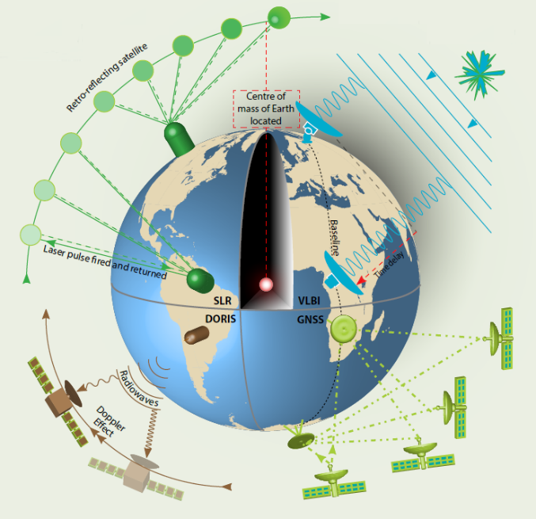
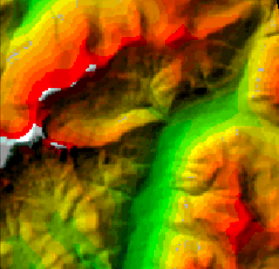
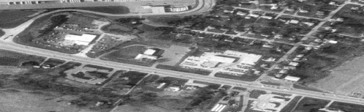
Time-dependent datum transformation
between ITRF & Global coordinates
Datum transformation 14 param
Displacement model
ITRF Measurement Techniques
Satellite Laser Ranging
Very Long Baseline Interferometry
Deformation model
National datum
at reference epoch
Euler Poles
DORIS: Doppler
GNSS (GPS)
ITRF
at epoch of measurement
Velocity grid
Velocity + EQ & PS patches
Distortion grid
Notes:
The Time Dependent datum transformations mentioned in the previous slides are required to convert between ITRF at the epoch of measurement to a Global coordinate at a reference epoch.
This requires 14-parameter transformations, and a local deformation model all over the world.

Slide 5
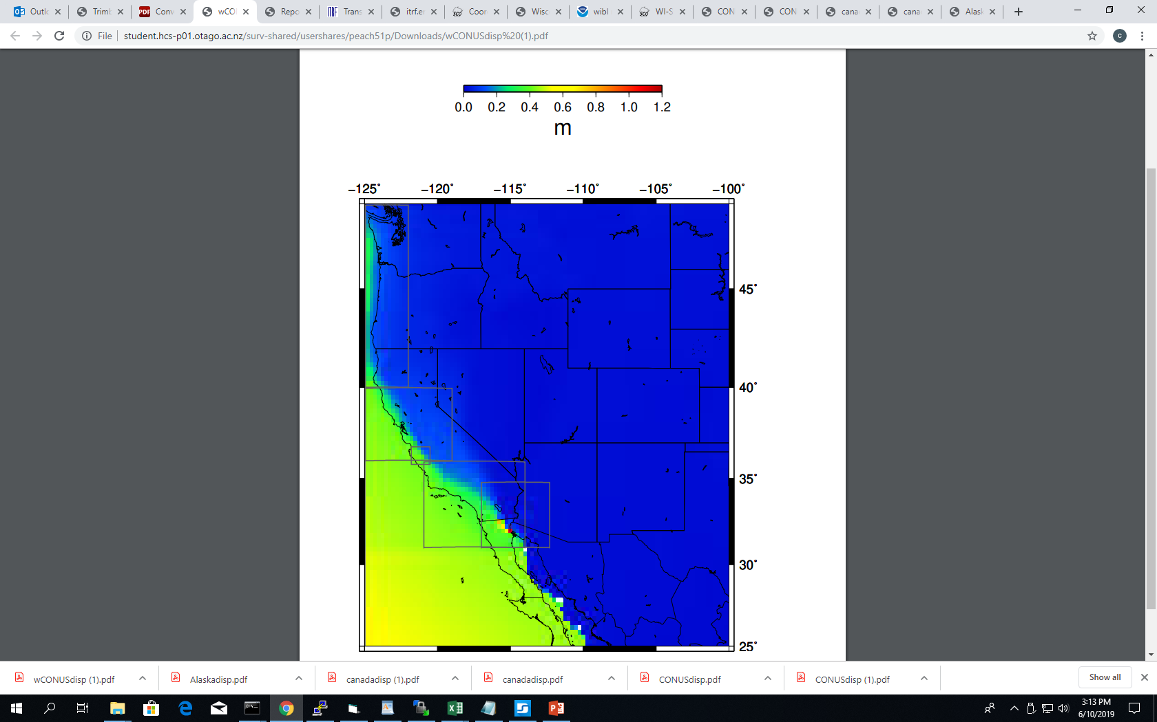
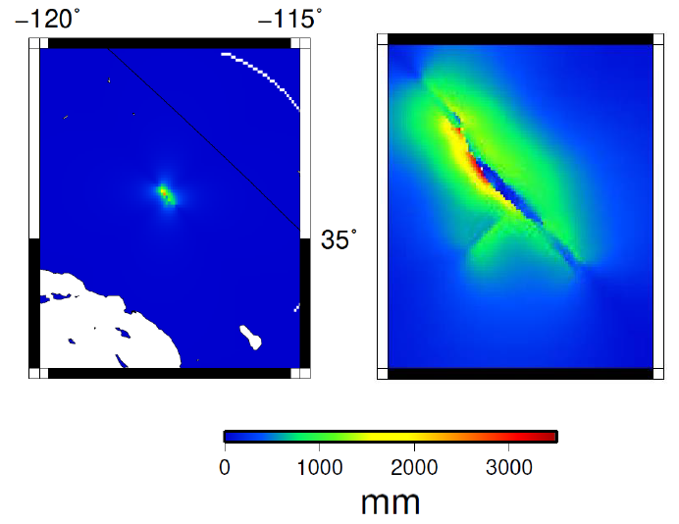
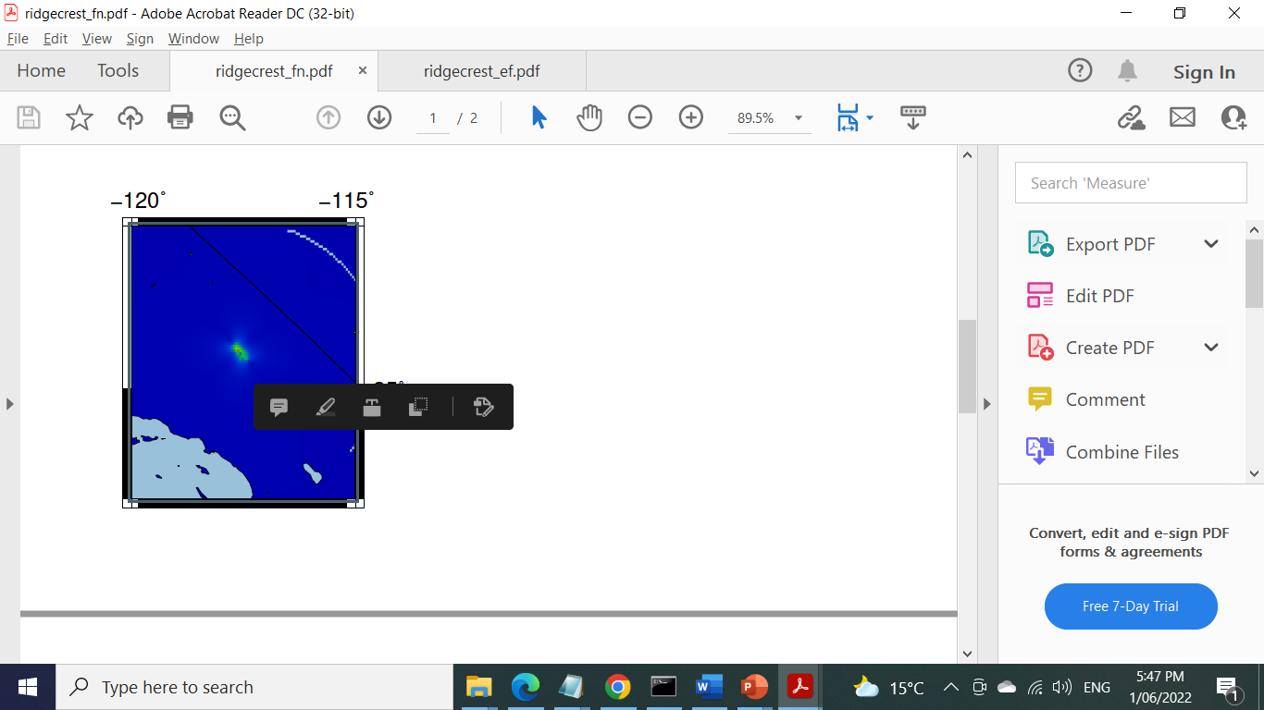
NAD83 (2011) CONUS
Trimble’s support for modernized NSRS & CSRS will be similar to NAD83(2011)
  Includes 4 new Euler Poles (NATRF2022, PATRF2022, CATRF2022 and MATRF2022)
  New velocity models for both the US and Canada
  For the US, the earthquake catalogue will include all required earthquakes
Low resolution vel grid
(4 pt / °)
High resolution vel grid
(16 pt / °)
Ridgecrest
EQ patch
ultra high res vel grid for SA fault
(100 pt / °)
SEM
EQ patch
Notes:
Trimble is supporting NAD83(2011) successfully, and has implemented the deformation model provided by HTDP.
We will need new deformation model IFDM2022 for accurate coordinates transformation between
ITRF at epoch of measurement and NSRS2022 at reference epoch in the US & Canada

Slide 6
Trimble RTX & VRS tomorrow
VRS Now Corrections provided in
NAD 83 (2011)
&
NATRF2022
RTX corrections provided in
ITRF2020 at EOM
Notes:
What’s going to change with NSRS 2022?
RTX will continue to be provided in ITRF2020 at the EOM
VRS will be provided in NATRF2022 AND we will continue to provide mountpoints in NAD83(2011)
We are also going to support the identification of CRS and/or mountpoint
- Supporting RTCM 3.4 CRS messages
- No standard equivalent for NTRIP, but we do provide reference frame meta-data in the "misc" field of Trimble-managed VRSNow networks.

Slide 7
NATRF2022 California Zone3 + NAPGD2022
ITRS coordinate
(X_{ECEF}, Y_{ECEF}, Z_{ECEF})
ITRF2020 epoch 2025.31
(RTX Measurement)
GLOBAL coordinate
(X_{ECEF}, Y_{ECEF}, Z_{ECEF})
NATRF2022 epoch 2020.0
(VRS Measurement)
LOCAL coordinate
(Latitude, Longitude, Height)
NATRF2022
(Measured or Control Position)
GRID coordinate
(Easting, Northing, Elevation)
California Zone 3 + NAPGD2022
(Computed or Control Position)
Time Dependent Transformation
Fourteen parameter
+ Deformation Models (IFDM2022)
Datum
Transformations
Null Transformation
Molodensky
Seven Parameter
Multiple Regression
Datum Grid
RTCM Datum
Projection
& Site Calibration
Standard Projections
or Projection Grid
or Snake Grid
+ Geoid Models
+ Ground Coordinates
+ Horz.& Vert. adjustments
Notes:
This slide is showing the same example as before, of California Zone3, but in NATRF2022 & NAPGD2022
If you’re starting with RTX in ITRF, a Time Dependent Transformation that includes the Deformation Model is done to get to NATRF2022 Epoch 2020.0, and then a projection.
If you’re starting with VRS in NATRF2022 Epoch 2020.0, then just a projection is needed.

Slide 8
Benefits & Challenges
Benefits
  Removal of the 2 m offset of the origin of NAD83 vs the true geocenter will help all GNSS users.
  New geoid based vertical is a big step.
Challenges
  Large increase in the number of zones (SPCS83 125 ZONES to SPCS2022 965 ZONES)
  Selection, use of correct zones, and merging of data from multiple zones
  Deprecation of US Survey Foot
  Identifying the CRS
Notes:
Trimble software support existing State Plane Coordinate Systems of 1983,
as well as low distortion county systems used in several states, including
Iowa (IaRCS), Illinois (ICS83), Indiana (InGCS), Minnesota, Ohio (OCCS), Wisconsin and soon Oregon
Could be hard for users to navigate to the appropriate zone on in a list
We have:
reorganized the selection lists to present users the relevant choices first
Applied polygons to each zone so that the users location can be used to suggest zones

Slide 9
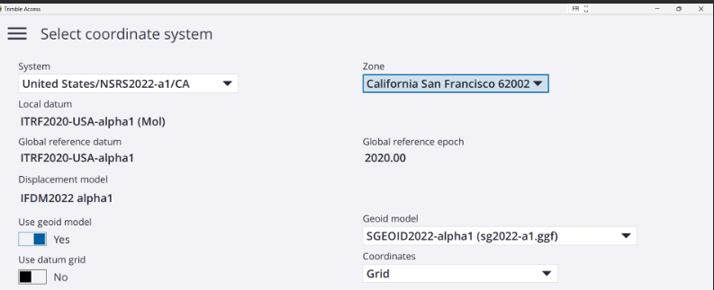
Alpha Preliminary Products
Notes:
Several customers requested Alpha Preliminary Products for test purposes
They are now available in Trimble Software

Slide 10
Conclusion
Questions from NGS
  Have you implemented and tested dynamic / time dependent reference systems in your software? Yes
  Where do you or will you get authoritative information on transformations now and once adopted (e.g. parameters, grids, etc)? We expect information from NGS and NRCan
  How do you advise clients on how to correctly transform between frames and epochs?
  We try to this automatically so the customer does not have to manage
  For RTK providers: what needs to happen on your RTK controllers to support NAD83 and NATRF (firmware updates)? How will you manage your mountpoints?
  We will provide two mountpoints for new and legacy datums
  What challenges are your users anticipating?
  State plane selection, units, merging datasets, identify coordinate reference system
  What are the major benefits of the new system that you anticipate for your customers? Removing 2m offset from geo center, and GEOID based vertical system
  What specific questions, suggestions, or concerns do you have for NGS and/or CGS?
  Deformation model for US and Canada - Grid Files in GGXF and ASCII formats

