Slide 1
CGS transformation tools and workflows in the modernized CSRS
Brian Donahue
Geodetic Services Manager
Canadian Geodetic Survey, Natural Resources Canada
Second Binational Geospatial Software Developers Summit
April 23 – 24, 2025

Slide 2
Presentation outline
Canadian Geodetic Survey (CGS) transformation tools
  Geometric transformations
  Height conversions
Use case: CSRS-PPP positioning service
Important takeaways

Slide 3



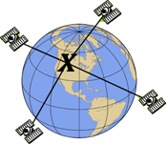
Canadian Geodetic Survey (CGS) Tools
TRX - coordinate transformation and conversion tool
GPS·H – height conversion tool
NTv2 – coordinate transformation for legacy datums (low accuracy)
CSRS-PPP – GNSS positioning service

Slide 4
CGS Tools: Overview
No significant changes are being made to CGS tool functionality to support CSRS modernization
CGS geodetic grids will be made available in GGXF (for exchange), but tools will continue to support legacy grid formats:
  BYN for GEOID, DEFLEC, and GRAV
  GVB for crustal deformation (velocity) model
  GSB (NTv2 format) for gridshift transformations from legacy datums
Grid Interpolation: bi-quadratic for BYN, bi-linear for GVB/GSB
Tools can be accessed via web, API, or installed and run on local Windows PC

Slide 5
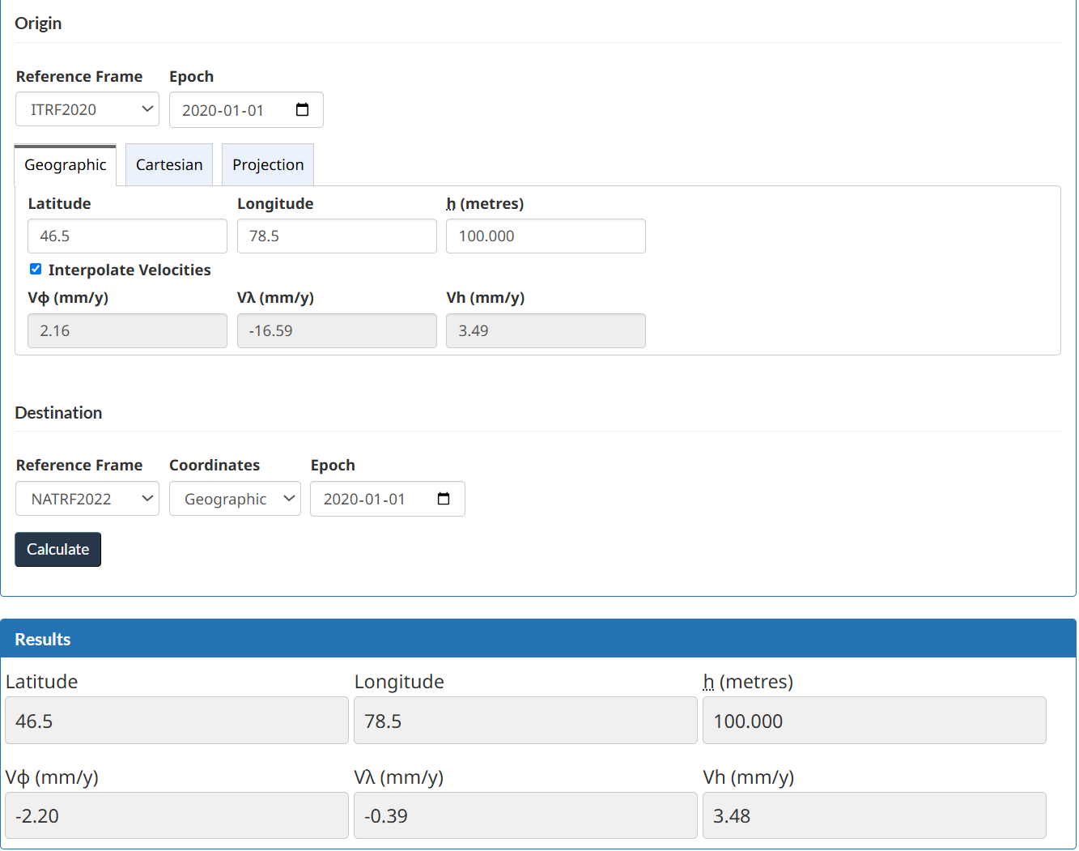
CGS Tools: TRX
Transform between NATRF2022, NAD83(CSRS) and ITRF realizations
Transform coordinates between epochs using the predicted motions from the Canadian IFDM2022
Convert coordinates between geographic, Cartesian, and mapping projections (UTM, MTM, stereographic)
Supports batch mode (CSV, GeoLab, GHOST formats)

Slide 6
CGS Tools: Geometric Transformations
NNR-NUVEL-1A
rotations for
epoch t
Adopted 7
parameter ITRF96-NAD83 transformation
ITRF96 aligned
to NA plate @ epoch t
ITRF96 @ epoch t
NAD83(CSRS) v8 @ epoch t
IGS
NAD83v8VG propagation from epoch t to 2010
ITRF97 @ epoch t
IERS
Published
ITRF2020-NAD83(CSRS) v8
Transformation @ epoch t
ITRF2000 @ epoch t
IERS
NAD83(CSRS) v8 @ 2010
Incremental ITRF Transformations. (from IERS)
ITRF2005 @ epoch t
IERS
NATRF2022 @ epoch 2020
ITRF2008 @ epoch t
IFDM2022 propagation from epoch t to 2020
IERS
ITRF2014 @ epoch t
Published
ITRF2020-NATRF2022
transformation @ epoch t
IERS
ITRF2020 @ epoch t
NATRF2022 @ epoch t
EPP2022 rotations for epoch t

Slide 7
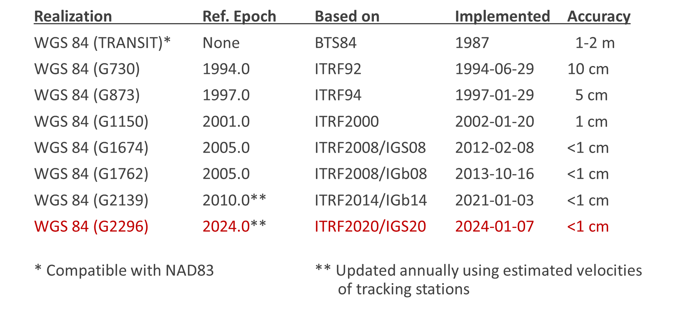
Geometric Transformations: Notes
14 parameter Helmert transformations between NATRF2022, ITRFxxxx, NAD83(CSRS)
  Transformation parameters change in time, but note that this doesn’t change the epoch
  Epoch transformations are done by applying IFDM2022 in the destination frame
ITRF versions can have NULL transformation WGS 84 and/or IGS versions

Slide 8
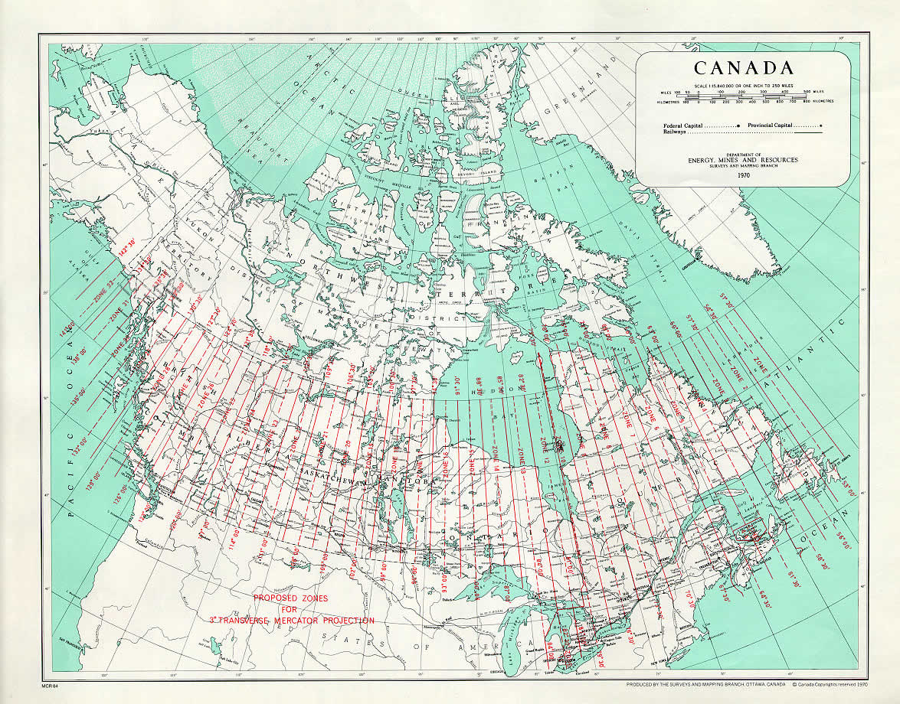
Canadian Map Projections
Map projections supported by CGS include UTM, MTM, double stereographic, and LCC
Some provinces support additional non-standard MTM zones (e.g., Alberta 10TM)
No plans for significant changes to existing map projections but some provinces will likely add new MTM versions for NATRF2022 with updated false eastings
Full list of supported projections available from: https://webapp.csrs-scrs.nrcan-rncan.gc.ca/CSRS/tools/TRX/projections
Projections need to be added to ISOGR
Canadian MTM Zones
Notes:
No plans to add any additional mapping projections in modernized CSRS

Slide 9
Vertical datum update in Canada
The currently adopted vertical datum is CGVD2013 (CGG2013a)
We plan to keep the name CGVD2013 but update the realization with SGEOID2022
At that point we will are considering following the proposed CGS/NGS versioning where:
Current Versioning | Modernized CGS Versioning | NGS Compatible Datum
CGVD2013 (CGG2013) | CGVD2013 v0 | N/A
CGVD2013 (CGG2013a) | CGVD2013 v0.a | N/A
CGVD2013 (SGEOID2022) | CGVD2013 v1 | NAPGD2022 v1

Slide 10
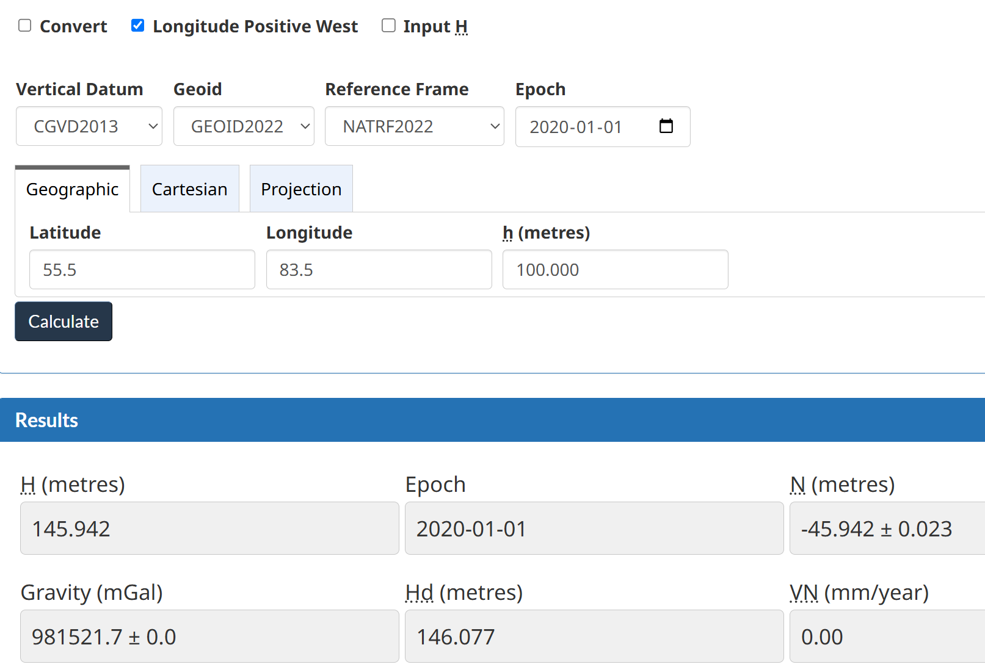
CGS Tools: GPS-H
Convert ellipsoid heights to orthometric heights and vice-versa
Supports dynamic heights when working in CGVD2013
Convert between vertical datums and versions (e.g.,):
  CGVD28 and CGVD2013
  (CGG2013a - HTv2.0)
  CGVD2013 v0 and CGVD2013 v1 (SGEOID2022 – CGG2013a)
Official adoption: CGVD2013 v1 (SGEOID2022 only)
Scientific support: NAPGD2022 v1 (SGEOID2022 + DGEOID2022)
Official Canadian adoption will consider only SGEOID2022 and will consider it static in NATRF2022 (TBD)

Slide 11
Vertical datum conversion workflows
CGS provides a grid representing the approximate separation between CGVD28 and CGVD2013
  Conversion grid from the difference between HTv2.0 (approximate representation of CGVD28) and CGG2013a (CGVD2013 v0)
  Will also provide a conversion grid from the difference between CGG2013a (CGVD2013 v0) and GEOID2022 (CGVD2013 v1)
For users migrating from CGVD28 to CGVD2013, the more precise technique is to conduct a geodetic quality GNSS survey directly on benchmarks having published heights in the levelling-based CGVD28 datum
Geoid models and conversion grids are available from: https://webapp.csrs-scrs.nrcan-rncan.gc.ca/geod/data-donnees/geoid.php

Slide 12
Heights: Metadata
N
Type of height: Orthometric (H), dynamic (H^{d}), normal (H^{n}), ellipsoidal (h), geoid (N)
Height Reference System: NATRF2022, ITRF2020, CGVD28, CGVD2013, NAVD 88, IGLD85
Height Reference Frame: Specific realization (i.e., version number)
Accuracy (e.g., ± 0.05 m)
Epoch (e.g., 2020.0)
Units m, ft
Geoid Height: -10.354 m
Accuracy: ± 0.015 m
Epoch: 2025.2
Model: SGEOID2022 v1
Frame: NATRF2022 v1.a
N = -10.354 ± 0.015 m CGG2013, NAD83(CSRS)
H
h
Height: 91.256 m
Accuracy: ± 0.007 m
Epoch: 2025.2
Type of height: Ellipsoidal (geodetic)
Height system: NATRF2022
Height frame: v1.a
h = 23.126 ± 0.007 m NATRF2022 v1.a Epoch 2025.2
Height: 101.61 m
Accuracy: ± 0.01 m
Epoch: 2025.2
Type of height: Orthometric
Height system: CGVD2013
Height frame: v0
H = 23.126 ± 0.007 m CGVD2013 v0 Epoch 2013.2
*NAPGD2022/NATRF2022 versioning to be finalized and published
Notes:
NAPGD2022/NATRF2022 versioning needs to be finalized and published

Slide 13
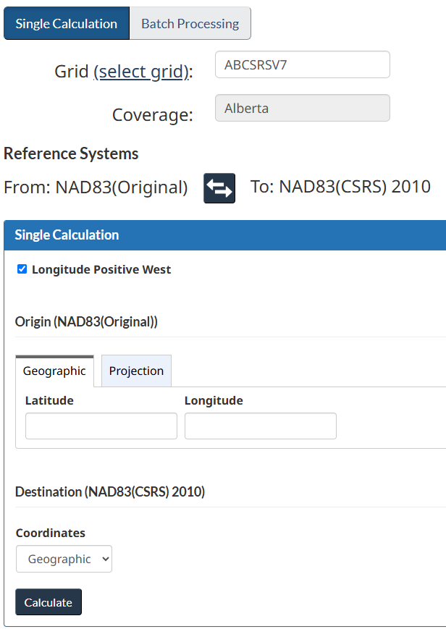
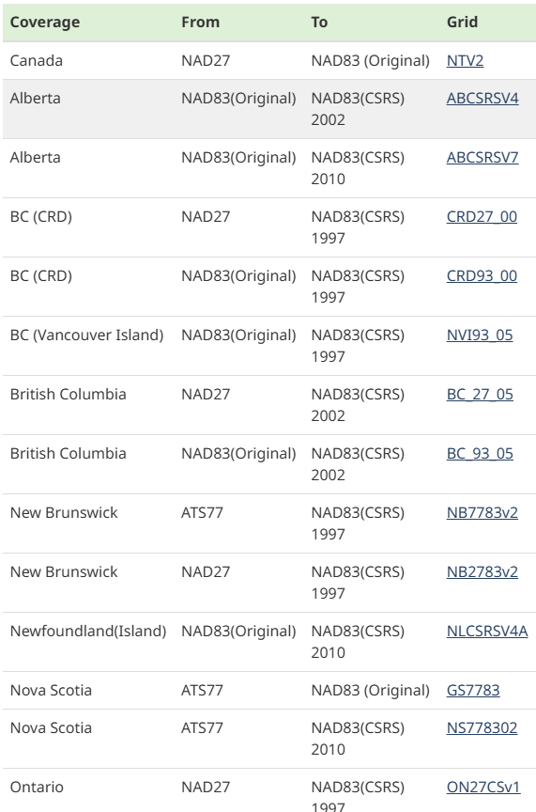
CGS Tools: NTv2
NTv2 is a tool to apply a horizontal distortion model in GSB grid format
National grid (NTv2) to transform from NAD27 to NAD83(Original)
Provincial grids to transform between legacy datums and various versions of NAD83(CSRS)
Some provinces are considering updating their distortion models to support NATRF2022 for lower accuracy datasets
Selection of existing NTv2 grids

Slide 14
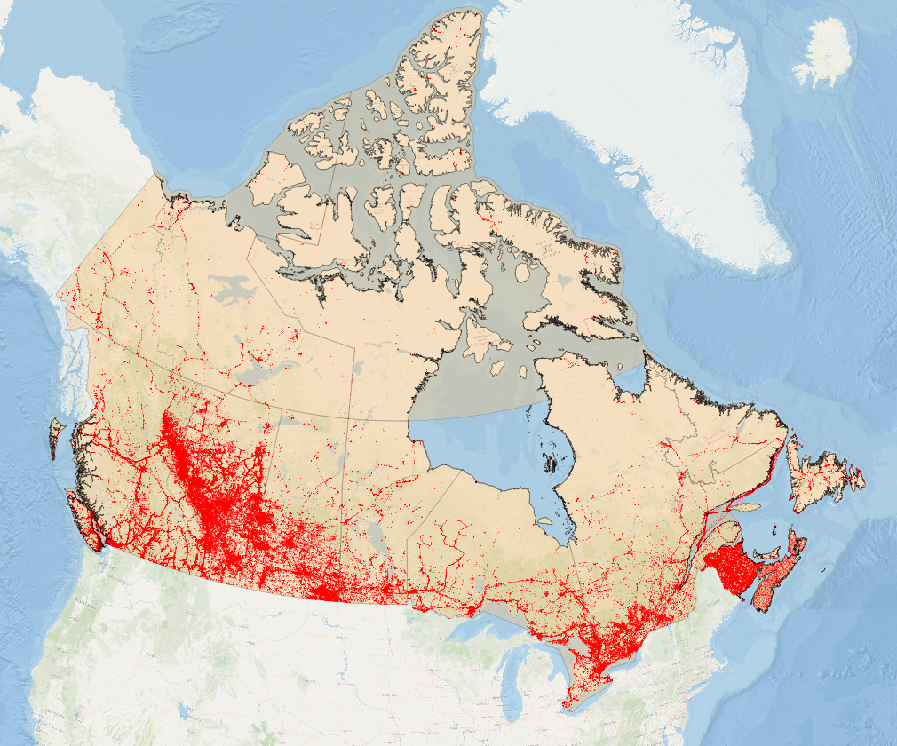
CGS Tools: CSRS-PPP
Used extensively, particularly in remote areas where passive control does not exist, or where passive control is not maintained
Shares a geodetic library with our coordinate transformation and height conversion tools (same workflow)
Geometric positions provided in:
  ITRF2020/IGS20/IGb20 at epoch of observations
  NATRF2022 at any epoch
  NAD83(CSRS) at any epoch
Supports Cartesian, geodetic, and projected coordinates
Supports CGVD28 and CGVD2013 v0/v1
Locations of Canadian CSRS-PPP datasets
1.2 million files processed 2014 - 2023

Slide 15
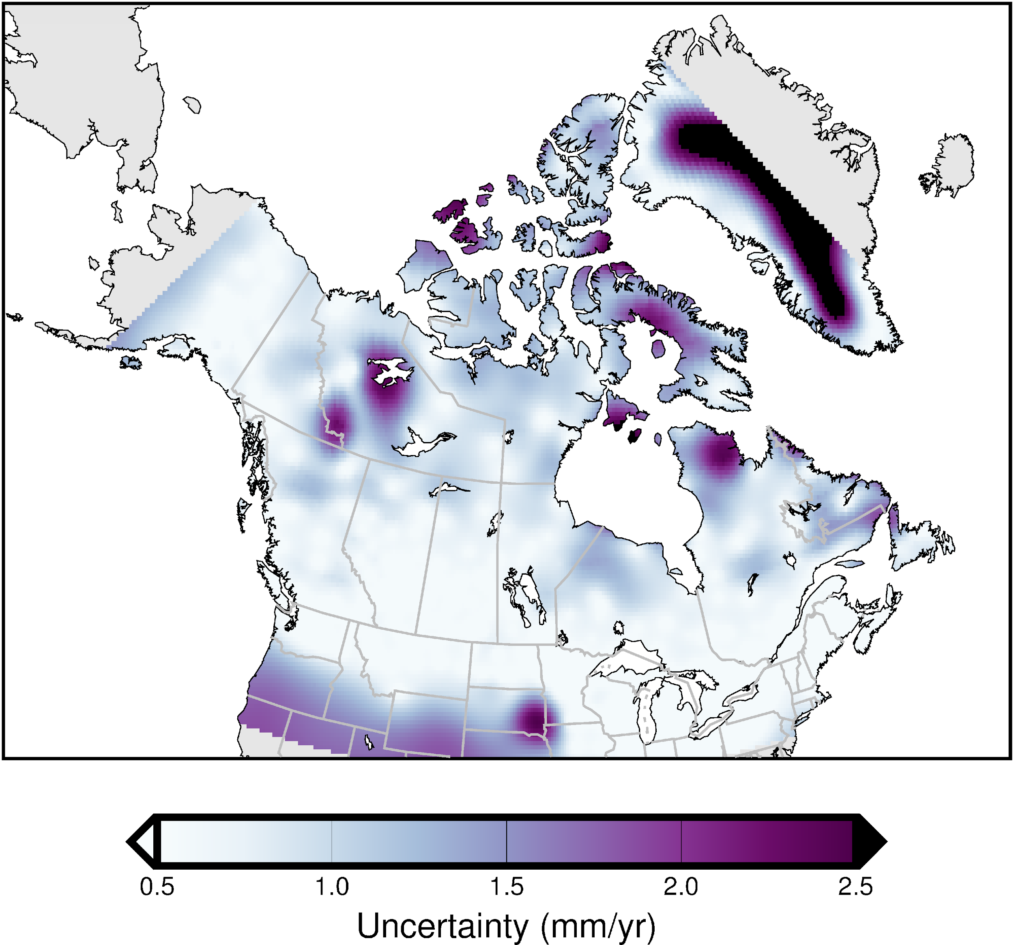
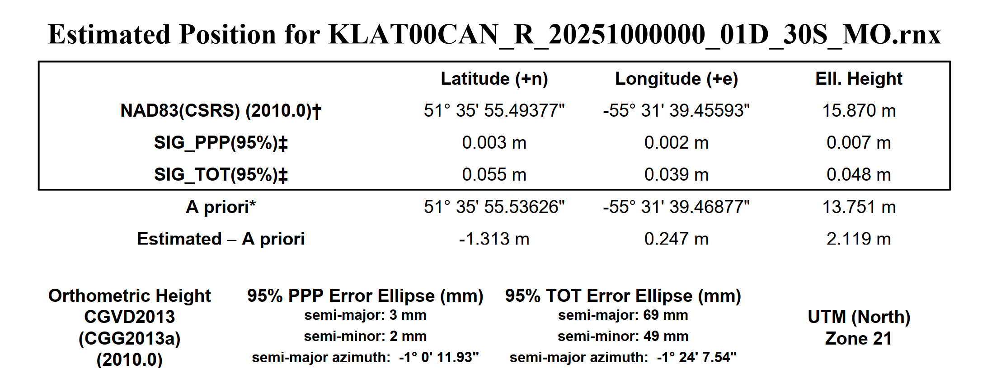
CGS Tools: CSRS-PPP
For users working in NATRF2022 or NAD83(CSRS) and requesting positions at an epoch other than the epoch of observations the uncertainty in the deformation (velocity) model is included in the total uncertainty
NAD83v80VG Vertical Uncertainty

Slide 16
Important takeaways
Core modernization products will be available and implemented in CGS tools by 2026
There will be no significant changes to CGS tool functionality in the modernized CSRS
CGS will continue support for NAD83(CSRS) and legacy geodetic grid formats for some time
Tools, models, and standards will be provided to transform between ITRF, NATRF2022, and NAD83(CSRS); as well as between different vertical datums
Modernized CSRS Questions: geodeticinformation-informationgeodesique@nrcan-rncan.gc.ca

