Slide 1
CGS Update
Catherine Robin
Section Chief / CSRS Modernization Implementation Manager
Canadian Geodetic Survey (CGS)
Natural Resources Canada (NRCan)
2nd Binational Geospatial Software Developers Summit
April 23, 2025

Slide 2

Presentation outline
CSRS* plans and products
Reference frame unification plans and timelines
Current challenges (throughout)
* Canadian Spatial Reference System

Slide 3
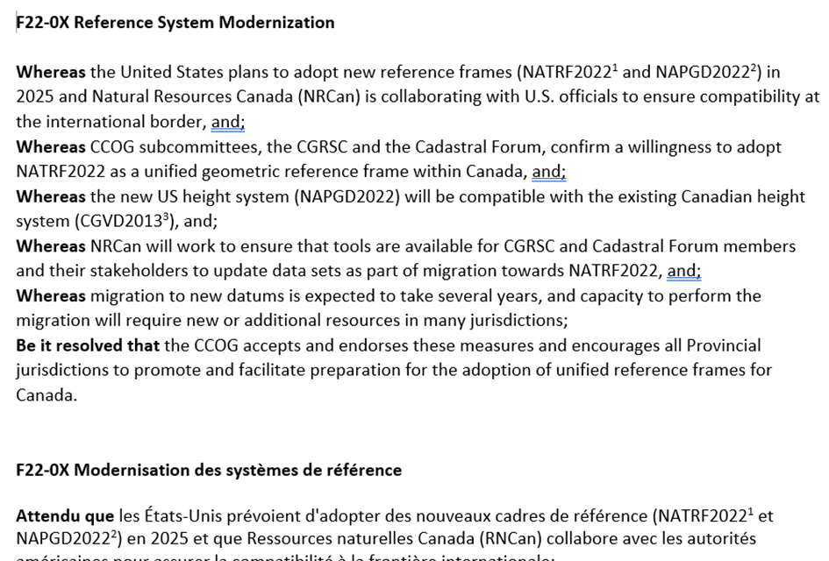
Plans and Timelines
NRCan will adopt NATRF2022 and update CGVD2013 in 2026,
in parallel with the US
2022 Canadian Council on Geomatics (CCOG) Resolution on planned adoption
    Canadian Geodetic Reference System Committee (CGRSC)
    CCOG Cadastral Forum

Slide 4
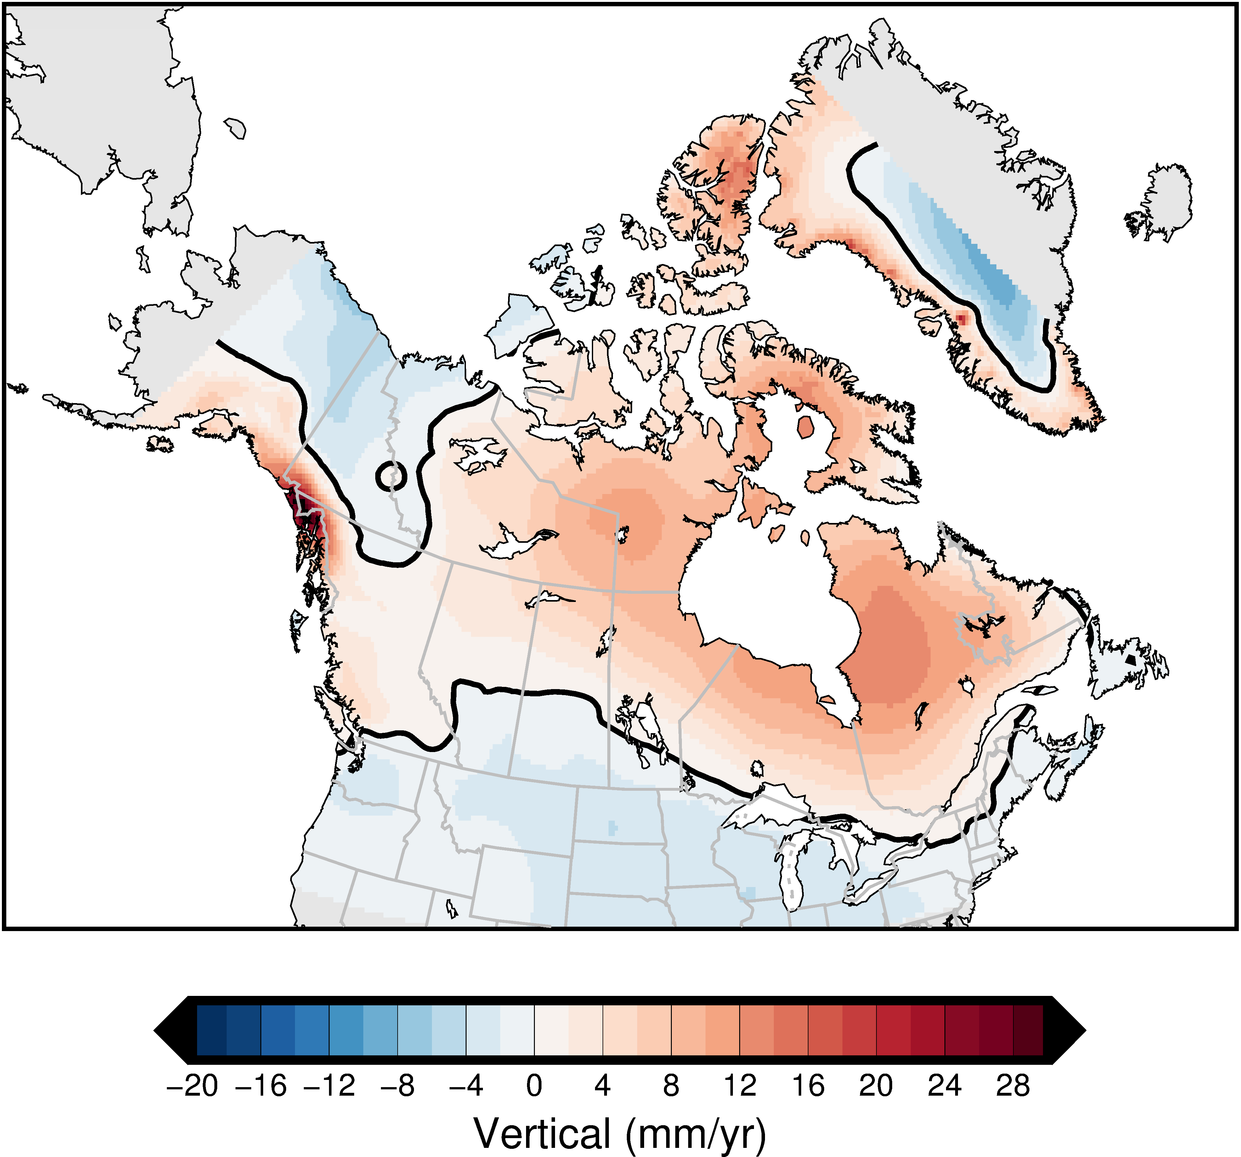
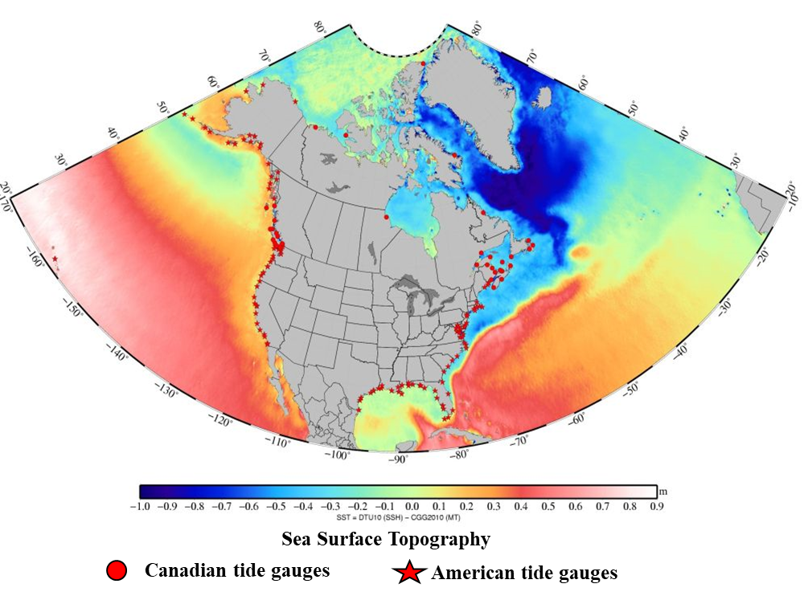
CSRS Frames
 | Current | Future
Reference Frames | NAD83(CSRS) v.8 | NATRF2022
Coordinate epochs | 2010 | 2020
Geopotential/Vertical datums | CGVD2013(CGG2013a) | CGVD2013(SGEOID2022)
Coordinate epochs | Static in NAD83(CSRS) | Static in NATRF2022

Slide 5
CSRS Tools
 | Current | Future
Geometric datum coordinate transformations and conversions | TRX* | TRX**
Height conversion | GPS-H* | GPS-H**
Positioning service | CSRS-PPP* | CSRS-PPP**
Legacy datum transformations | NTv2 | NTv2
* Current epoch transformations are linear (using station coordination functions and the velocity model)
**More complex functions and models for epoch transformations will be introduced after 2026

Slide 6

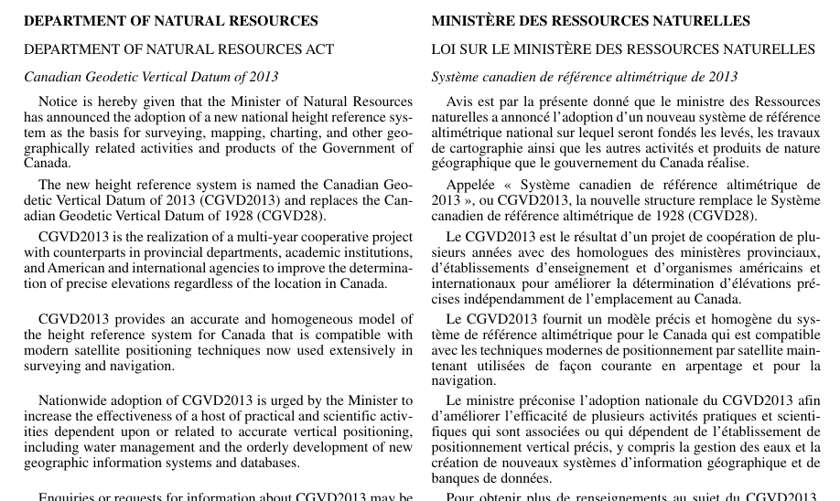
CSRS Modernization - Adoption
NRCan will adopt NATRF2022 and update CGVD2013 in 2026, in parallel with the US
Adoption Process:
Second set of CCOG resolutions
Announcements in the Canadian Gazette
No authority to enforce adoption by other federal departments or jurisdictions

Slide 7
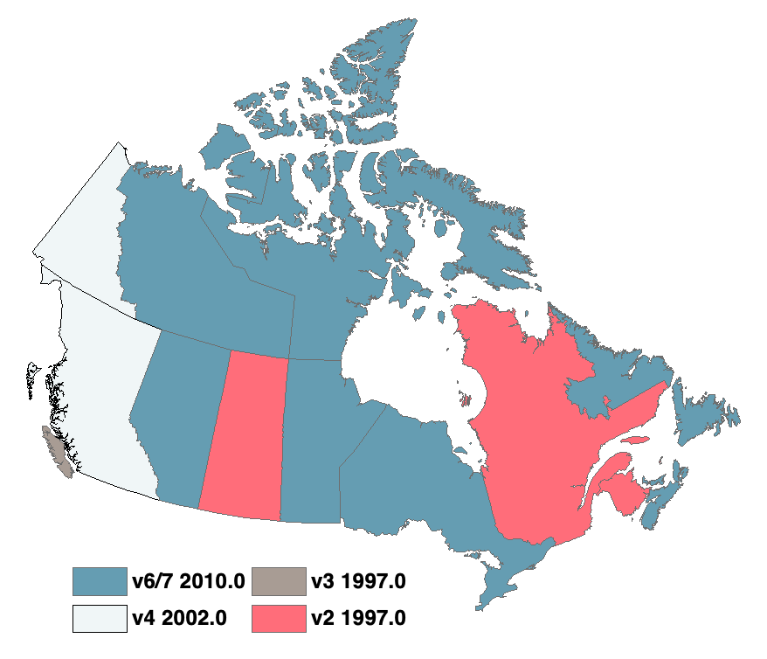
Reference Frame Unification
Geometric
Provincial adopted frames
Municipalities even more complex
Varying degrees and types of regulatory dependencies
  2022 National Survey:
    Provincial legislation
    Municipal by-law
    Standards & Policies
    Contract specifications
      legal surveys
      engineering
      hydrology & hydrography
      natural resources
      aviation & airspace
      other

Slide 8
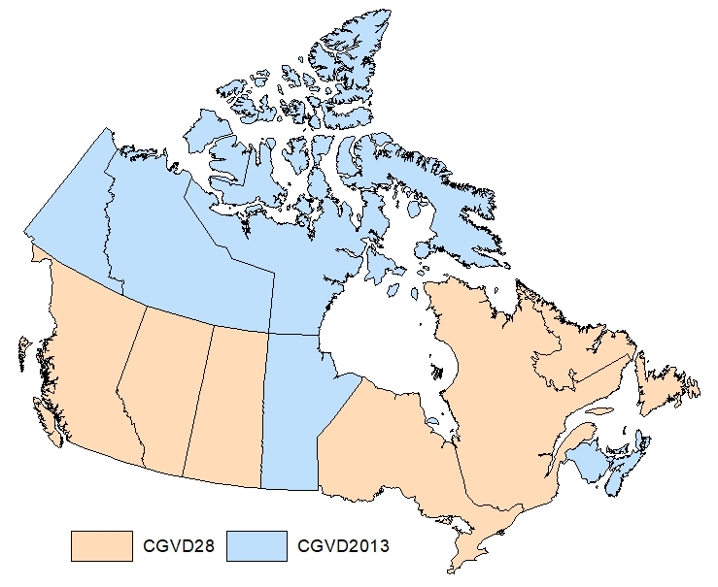

Reference Frame Unification
Heights
Provincial adopted frames
Municipalities even more complex
Varying degrees and types of regulatory dependencies
  2022 National Survey:
    Provincial legislation
    Municipal by-law
    Standards & Policies
    Contract specifications
      legal surveys
      engineering
      hydrology & hydrography
      natural resources
      aviation & airspace
      other

Slide 9
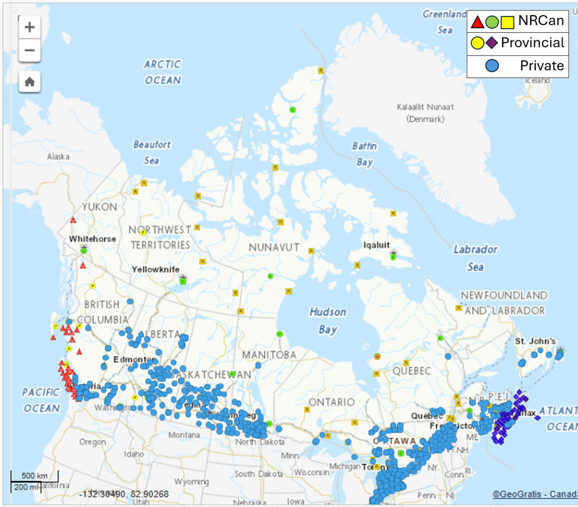
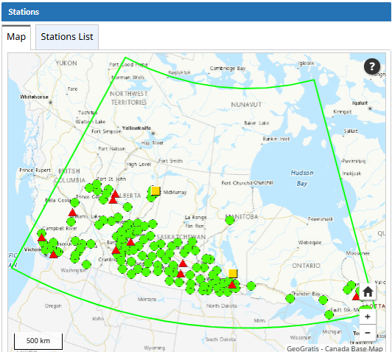
Public and Commercial RTK services
  Located primarily in populated areas
  Cross-jurisdiction datum challenges
  RTK Compliance program – growing!
  (Challenge: Federal Election April 28)

Slide 10
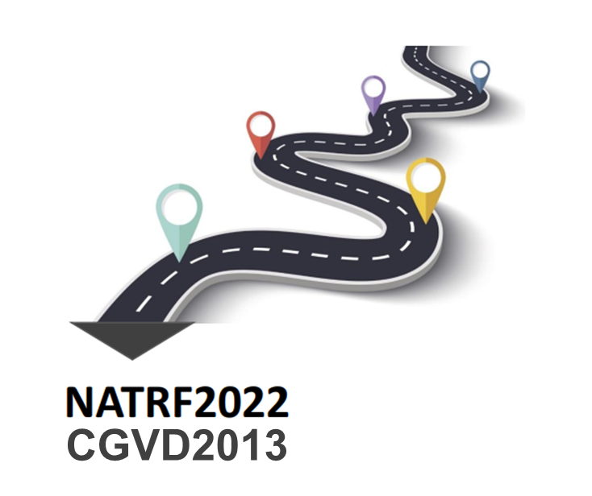
Reference Frame Unification - Provincial
NATRF2022 Discussion with provinces since 2018, primarily through the CGRSC (Provinces, OGDs, NGS)
Most provinces updating geodetic control by 2030
    Transformations
    Re-adjustments of passive networks
    Re-observation / expansion of high-precision networks
    ACS network expansion
    Non-geodetic: distortion modeling for legacy datum updates
Regulatory updates
Outreach with other provincial dept’s & municipalities (geodetic control & data layers)

Slide 11
Reference Frame Unification - federal
Federal groups actively planning modernization with GIS:
  NRCan - Mapping and Earth Observation (Lidar, DEMs)
  NRCan – Surveyor General (Canada lands, including territories)
  DFO - Canadian Hydrographic Service (seamless hydrographic datum, bathymetry)
  (ECCC – Water Surveys)
  …..

Slide 12
Thank you!
Questions?

Slide 13
Challenge:
NAD83 versions in use

Slide 14
NAD83 Adoption History
 | 1997 | 1998 | 1999 | 2000 | 2001 | 2002 | 2003 | 2004 | 2005 | 2006 | 2007 | 2008 | 2009 | 2010 | 2011 | 2012 | 2013 | 2014 | 2015 | 2016 | 2017 | 2018 | 2019 | 2020 | 2021
CA
BC*
AB
SK
MB
ON
QC
NB
PE
NS
NL
NAD27 | ATS77 | NAD83 Original | NAD83 v2 1997 | NAD83 v3 1997 | NAD83 v4 2002 | NAD83 v5 2006 | NAD83 v6 2010 | NAD83 v7 2010

Slide 15
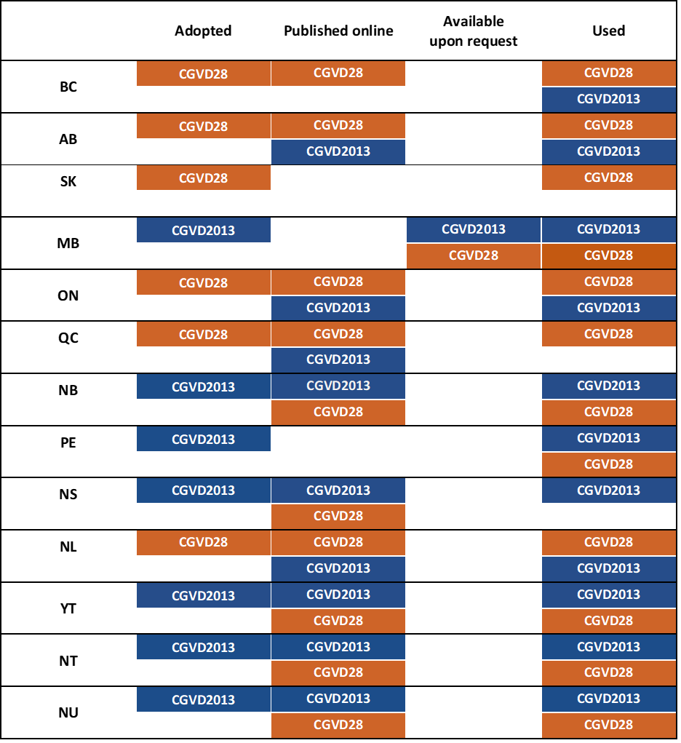
Challenge:
CGVD versions in use

