Slide 1

Gridded Geodetic data eXchange Format (GGXF)
Dr. Daniel R. Roman,
Senior Advisor for Geodesy
US rep to ISO TC 211 AG12/OGC CRS SWG

Slide 2
Agenda
Show MOU => why are we talking about this?
OGC’s GGXF standard
Relationship of standards
Discussion Points
GGXF Implementation for NGS products

Slide 3
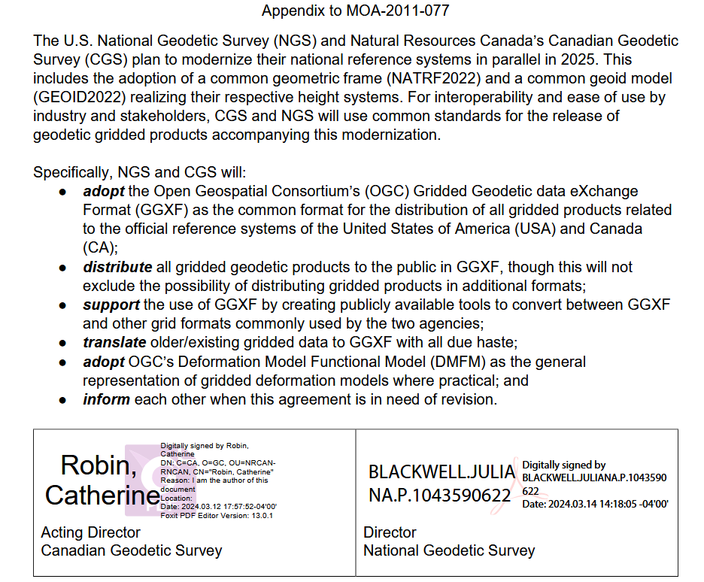
MEMORANDUM OF UNDERSTANDING
NOAA-NRCan MOU (NGS-CGS)
Agreement Codes:
MOA-2011-077/AGR-23064
Signed 2013/Amended 2023
Annex 2 (2024) Cooperative activities for Geodesy and Geodetic Applications
Appendix (2024) on adoption of GGXF for geodetic grids
Notes:
Border agreement (MOU) covers many aspects including cooperative activities (Annex 2) and specifically how to provide gridded data (Appendix 2).

Slide 4
Grid Formats
Hierarchical Data Format (HDF)
GGXF vs. NetCDF
More robust metadata about CRS
Explicit support for nested grids
Other geodetic data types (velocity/deformation)
Time functions associated with grids
Cannot handle irregular data (TIN)
Not as broadly adopted as NetCDF
Network Common Data Form (netCDF)
Gridded Geodetic data eXchange Format (GGXF)

Slide 5
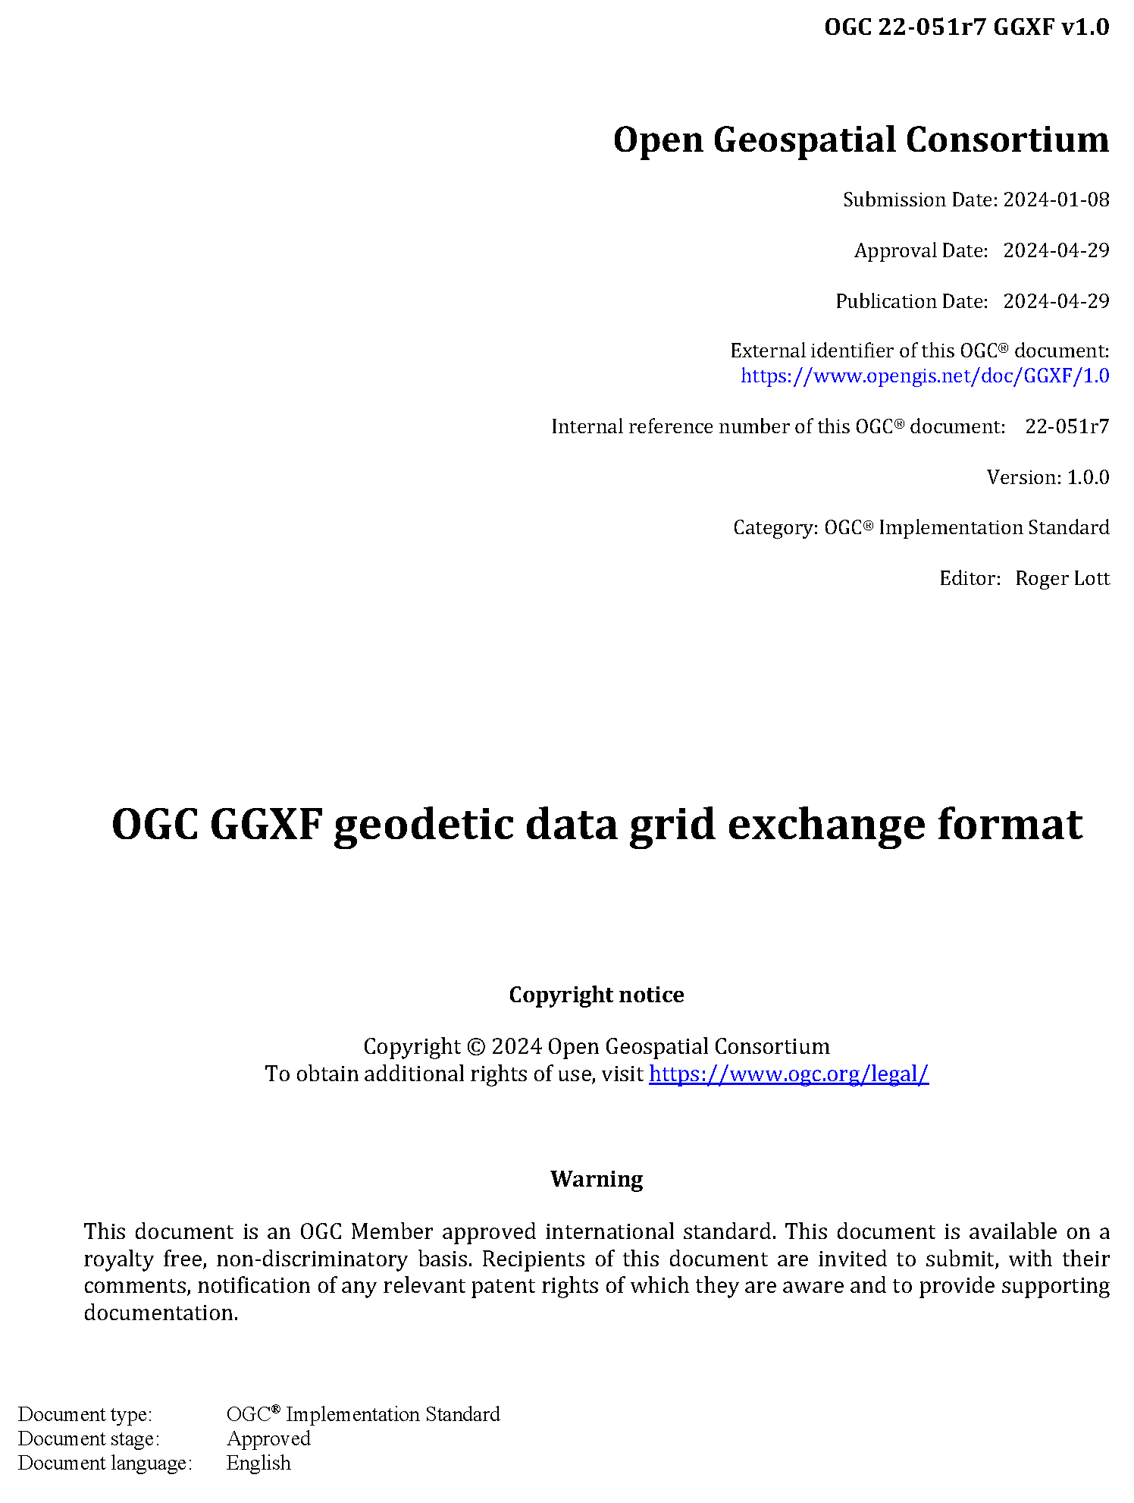
OGC’s GGXF
The GGXF Standard File Format for Gridded Geodetic Data
IAG Symposia paper – online 2024
Chris Crook, Kevin M. Kelly, Roger Lott & Richard Stanaway
Features
Complete and Informative Header in a Single File
User Definable Content
Flexible
Multi-dimensional
Hierarchical
Multi-resolution
Recent international standard
Interpolation
Efficient
Easy to Use
Recognizable
Notes:
Complete and Informative Header in a Single File GGXF
allows and encourages a full description of the data contained
in the file, including but not limited to its provenance. Most
existing grid format headers provide little or no information
about what the gridded data represents. A user must rely on
external documentation for this description; if it is missing or
unavailable the grid data is rendered meaningless.
User Definable Content
GGXF allows producers to define
the type of data represented by the grid. A predefined list
of well known geodetic data types is part of the format
specification. Users are able to propose additions to this list
which can readily be added to the specification.
Flexible
GGXF permits grids to carry any number of
parameters at grid nodes. Most existing geodetic grid formats
permit only pre-defined parameters at each grid node. The
GGXF format allows producers to define a set or tuple of
numeric data at each grid node, (d1 ,d2 , ..., di) where di is the
ith data value in the tuple. For example, three-dimensional
velocity data could be defined at each grid node as the
sequential set (VX ,VY ,VZ ) in an Earth-Centered, Earth-Fixed
Cartesian reference frame such as ITRF2014 or equivalently
in ellipsoidal geodetic coordinates as (V®,V,Vh) where ®,,h
are geodetic latitude, geodetic longitude and ellipsoidal
height. In both cases accuracy data may also be included in a
number of parameterisations, for example as standard error
values (X ,Y ,Z , or ®, ,h, respectively).
Multi-dimensional
A survey of current implementations
showed that the grid carrying the parameters (the
interpolation coordinate reference system) is spatially two-
dimensional. GGXF is capable of handling grids in two or
more dimensions. In addition GGXF provides the ability to
describe changes with time.
Hierarchical
GGXF permits overlapping grids and when
grids overlap it allows the definition of priority of use.
Multi-resolution
GGXF permits multiple levels of data resolution using
sub-grids in an analogous way to the Canadian
NTv2 format.
Interpolation
GGXF allows for the specification of the
required or recommended interpolation method, e.g. bilinear,
bicubic, etc. This facilitates application software applying
the interpolation algorithm intended by the grid producer.
C. Crook et al.
Efficient
GGXF supports a platform independent binary file
providing a compact encoding that can be used efficient
direct computation of the encoded geodetic parameters. It
permits fast access to any part of very large files.
Easy to Use
The GGXF project team strived to ensure that
the format is straightforward for grid producers to create and
easy and efficient for application developers to implement.
A well documented description, complete with examples
and an open-source reference implementation for developers
accompanies the format. The file format and metadata syntax
is published and versioned.
Recognizable
The GGXF file format is identified by file
name extension as well as by identifiers within the file.

Slide 6
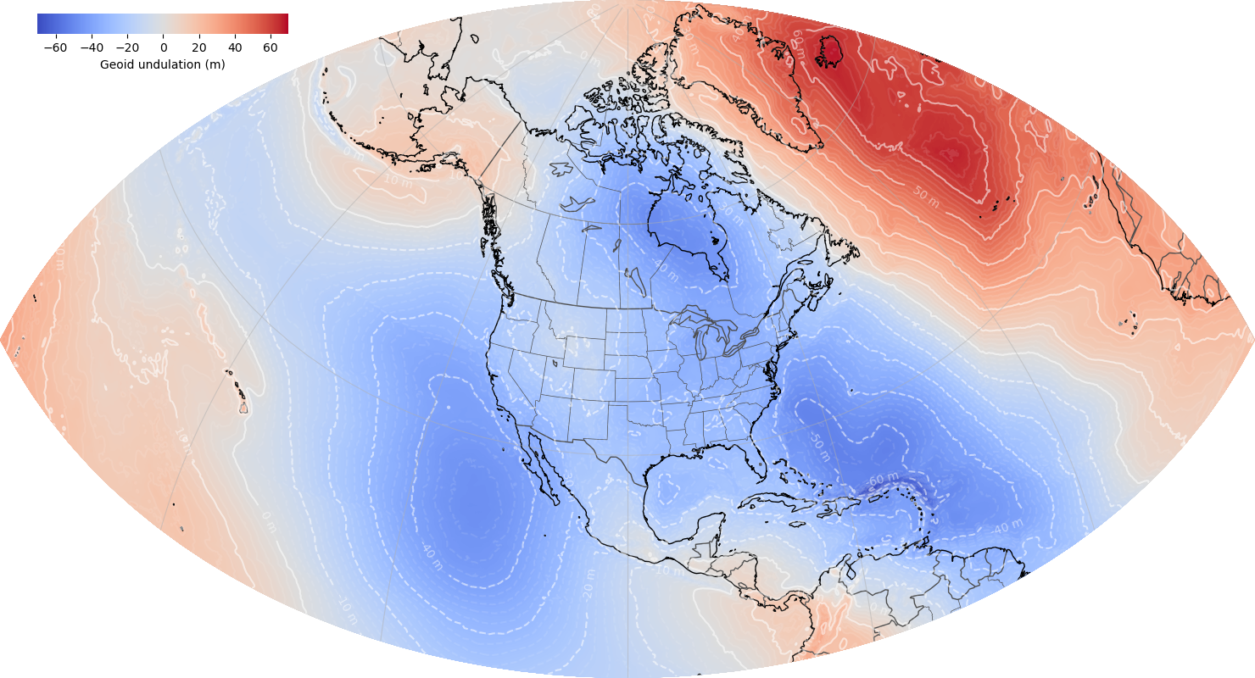
Planned GGXF Implementation
Published four source layers
Geoid Undulation (GEOID2022)
Deflection of the Vertical (DEFLEC2022)
Global Elevation model (DEM2022)
Surface gravity (GRAV2022)
Sample input/output files
Will also publish headers in NumPy array for Python coders
GGXF will be implemented on gridded data for exchange only
Internal software remains
No public support for NGS native formats (*.b & & *.bin)

Slide 7

Thanks for your attention!
Dr. Daniel Roman, Senior Advisor for Geodesy
Dan.Roman@noaa.gov
FMSDI Pilot: Integrating Land-Sea Geospatial Data

