Slide 1




North American-Pacific Geopotential Datum of 2022 (NAPGD2022)
Kevin Ahlgren, Ph.D. (kevin.ahlgren@noaa.gov)
Jianliang Huang, Ph.D. (jianliang.huang@nrcan-rncan.gc.ca)
Geoid Team(s): K Ahlgren¹, YM Wang¹, X Li¹, R Hardy¹, J Huang², I Foroughi², M Véronneau², D Avalos-Naranjo³
¹National Geodetic Survey – National Oceanic and Atmospheric Administration
²Canadian Geodetic Survey – Natural Resources Canada
³National Institute of Statistics and Geography, Mexico (INEGI)
https://alpha.ngs.noaa.gov/NAPGD2022/
 | Industry Workshop | 4/23/25

Slide 2
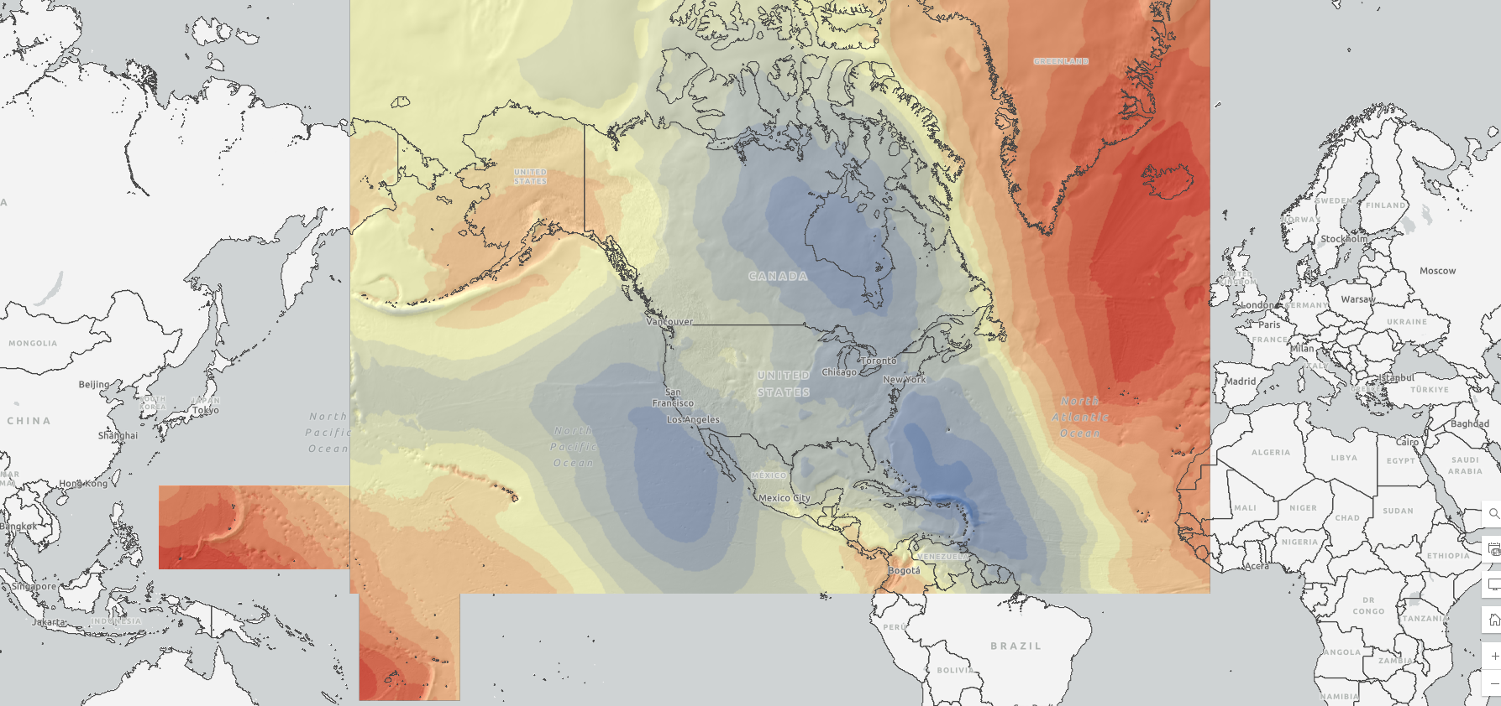
North American-Pacific Geopotential Datum of 2022
Definitions: | Value and realization:
W₀ | 62,636,856 m²s⁻²
GM | 3.986004415x10¹⁴ m³s⁻²
Realization | GEOID2022
Geometric RF | ITRF2020
Height (type) | Orthometric: H(t) = h(t) – N(t)
Tide system | Tide Free
Velocity of geoid height | Linear
Reference epoch | 2020.0
Notes:
The static geoid model (SGEOID2022) has been agreed upon with geoid teams. This combined model is a simple average of 1 CGS model, 1 NGS model, and 1 INEGI model. Since INEGI computes their model over a more limited area, the INEGI contribution is limited to the Mexico land mass. So, outside of Mexico, the model is a 50/50 split of CGS and NGS models.
This update is going to be released on the NGS ALPHA website as a Major Alpha Update, after evaluation by the NGS Product and Services Committee. This update will also incorporate the deflection and gravity models that have not previously been released on ALPHA.
We plan to release all the grids in the GGXF format for this release.
There are a number of components that still need to be resolved for a BETA release, which NGS will be working towards in the next quarter.
For outreach, NGS and CGS each have an oral presentation at AGU in December; and NGS will be giving a webinar in our Webinar Series in January.

Slide 3
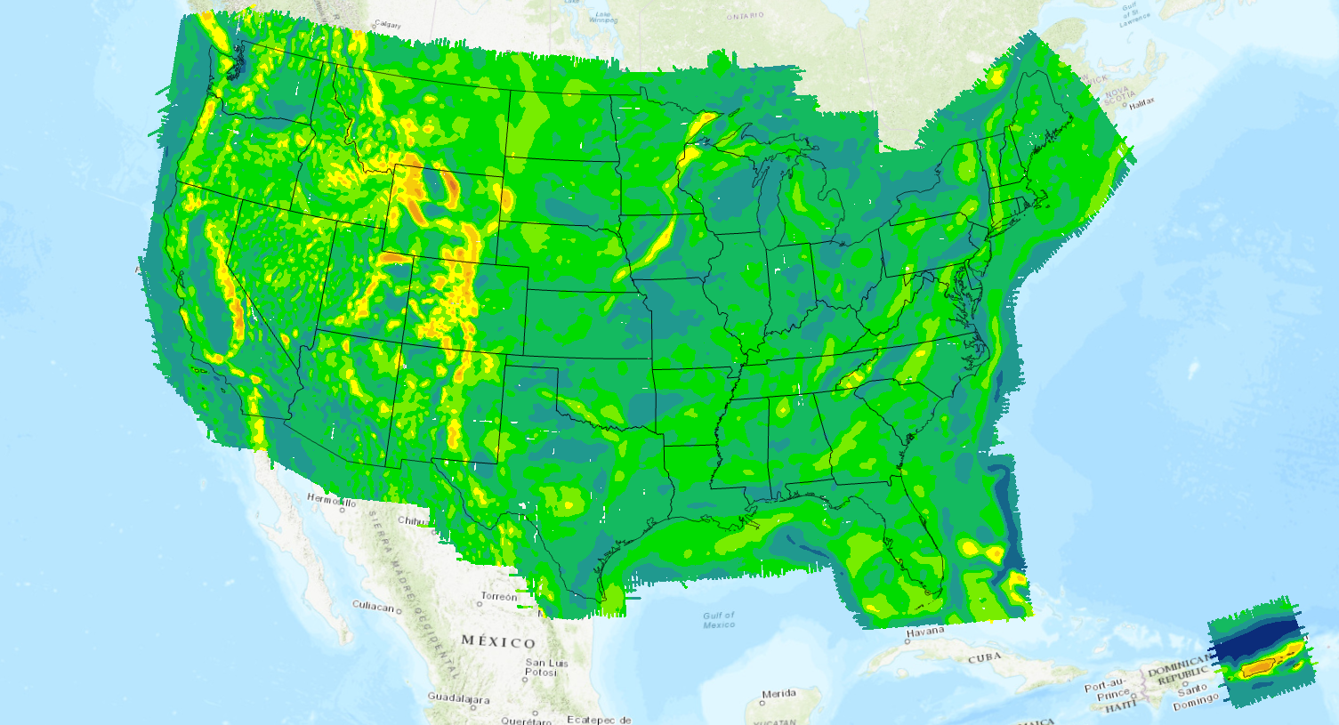
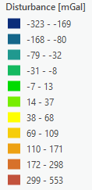
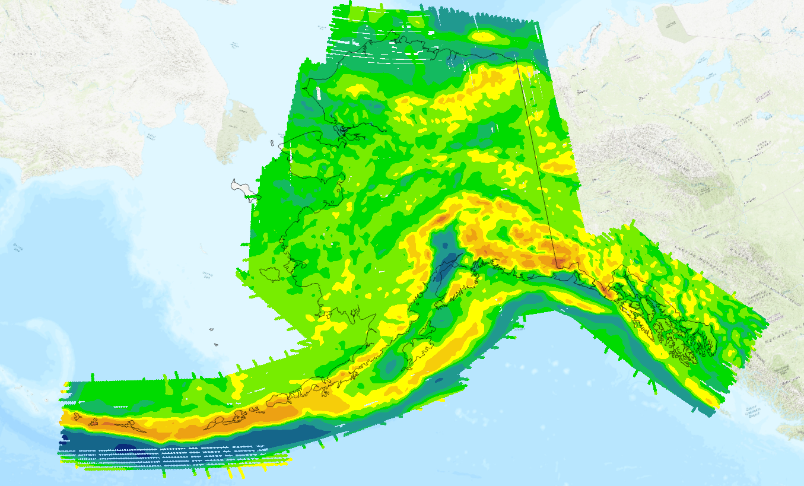
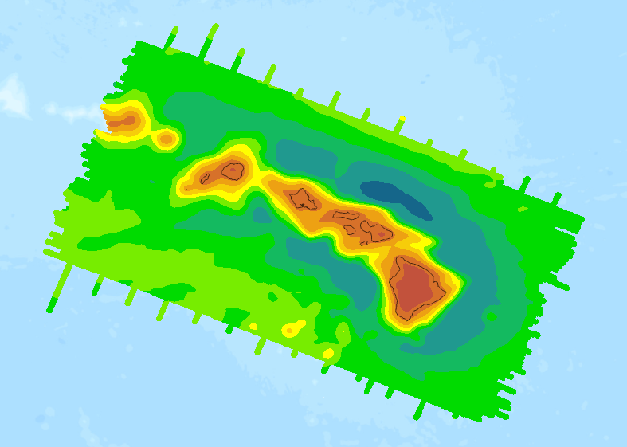
Background: Data used in GEOID2022
Terrestrial gravity data
Altimetric gravity (DTU21) in 1’x1’ grid
DEM2022 (3′′, a combination of TanDEM-X, NED, and MERIT)
ArcGPv2020 in 3’x3’ grids from NGA
Ice thickness data sets over Greenland
Airborne gravity data (GRAV-D) (shown)
GRAV-D data coverage
Alaska
Hawaii

Slide 4
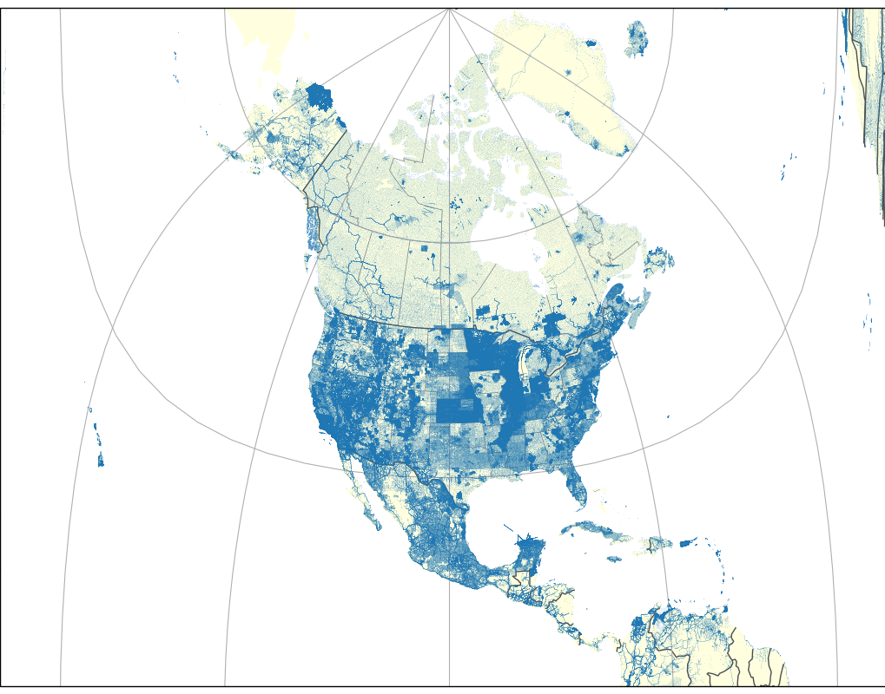
Background: Density of terrestrial gravity data
2.1 million gravity observations throughout North America
Data included from Canada, Mexico, and USA
  Various other regions
Quality is variable – most data were from many decades ago
Spacing is variable
Density of terrestrial gravity

Slide 5
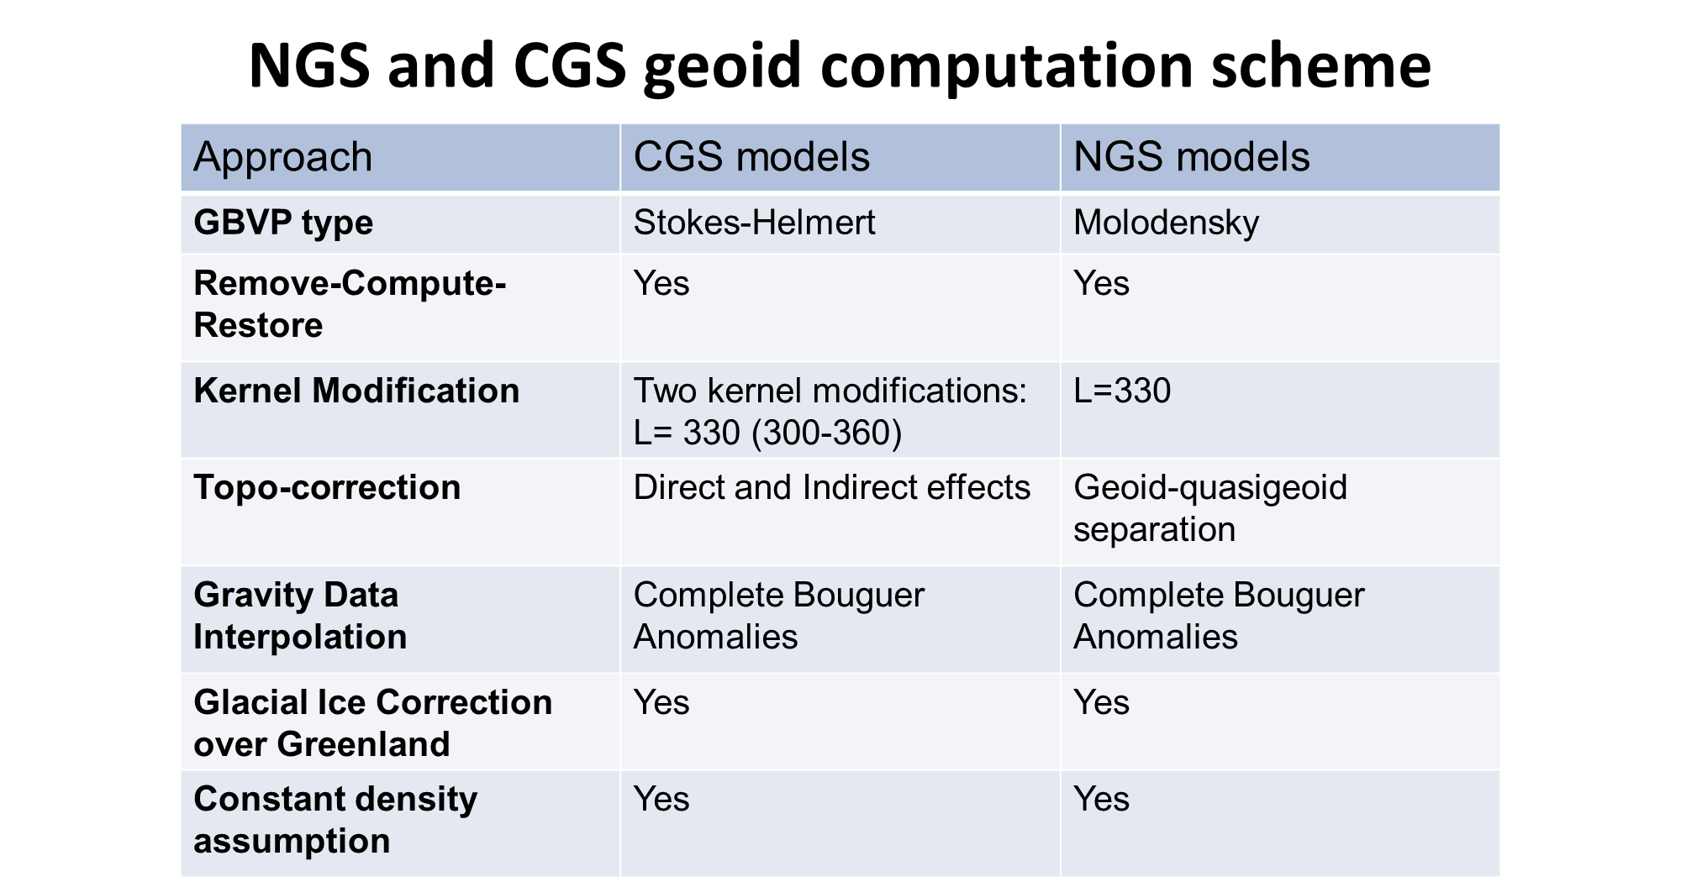

Slide 6
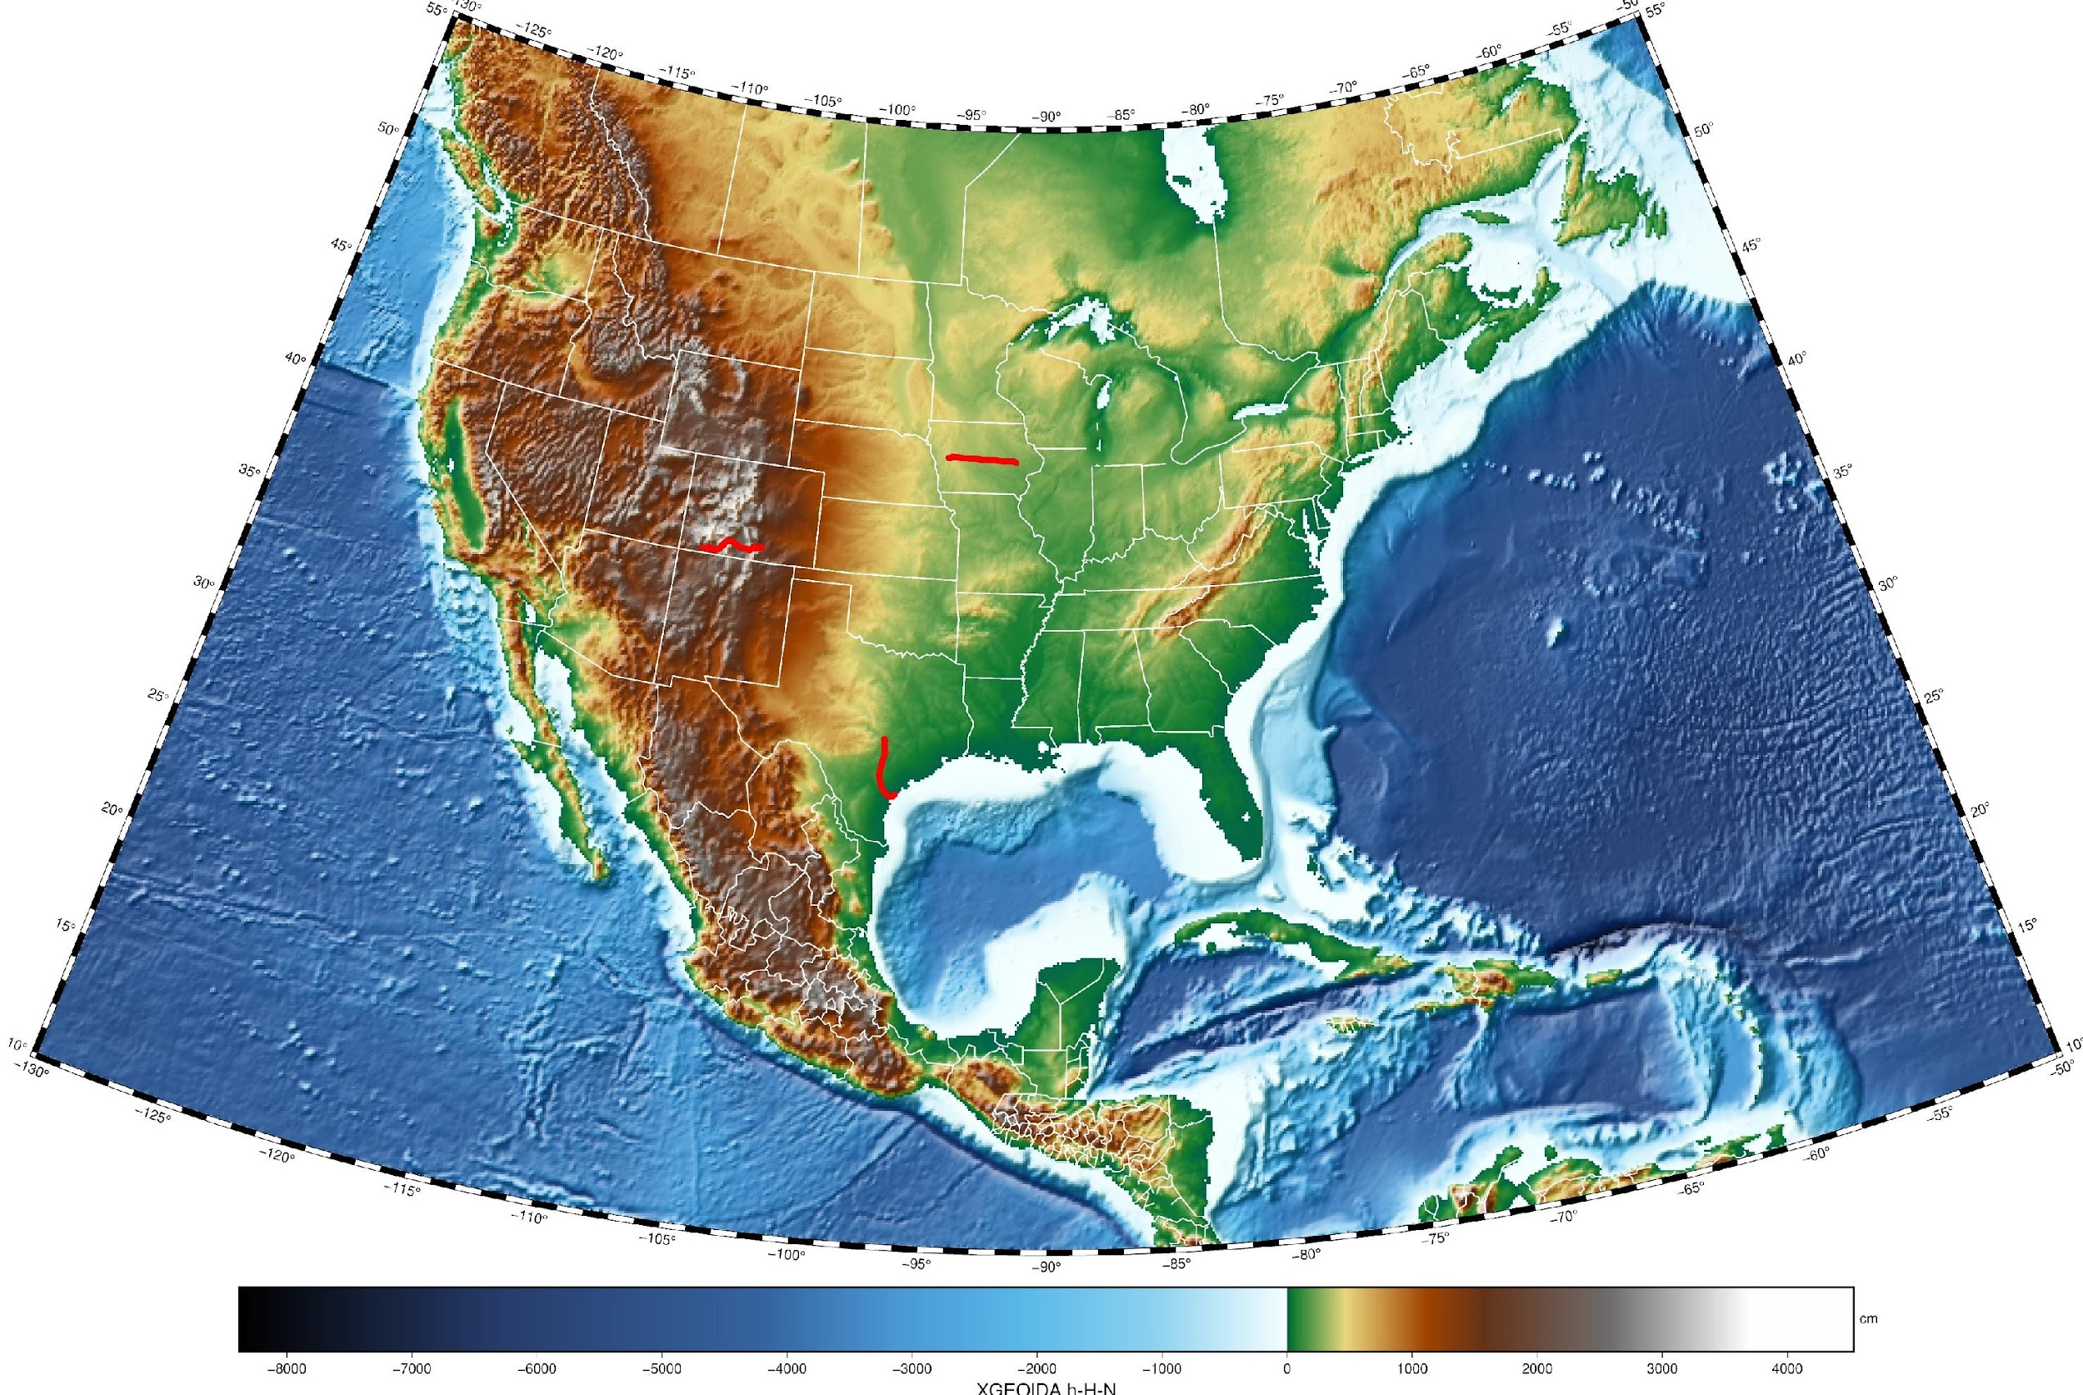
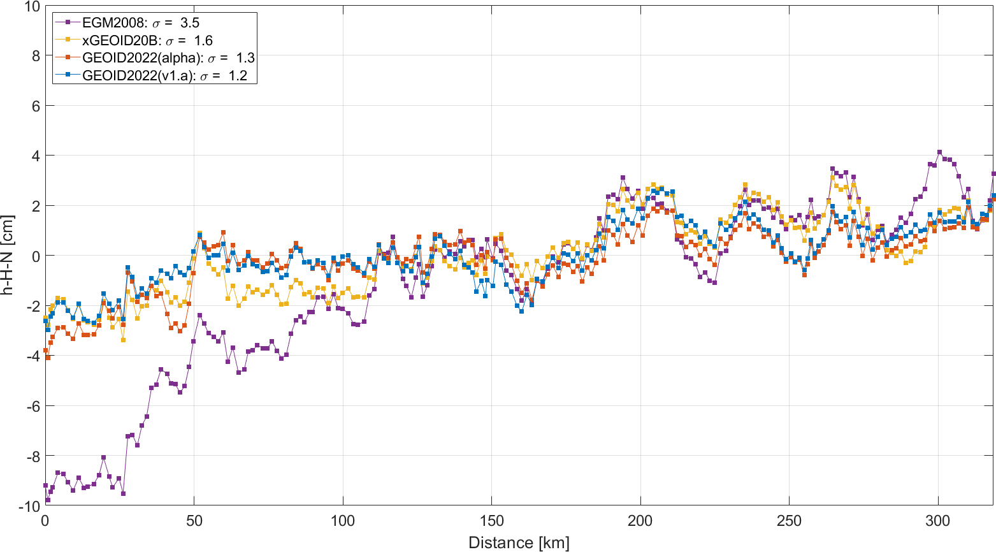
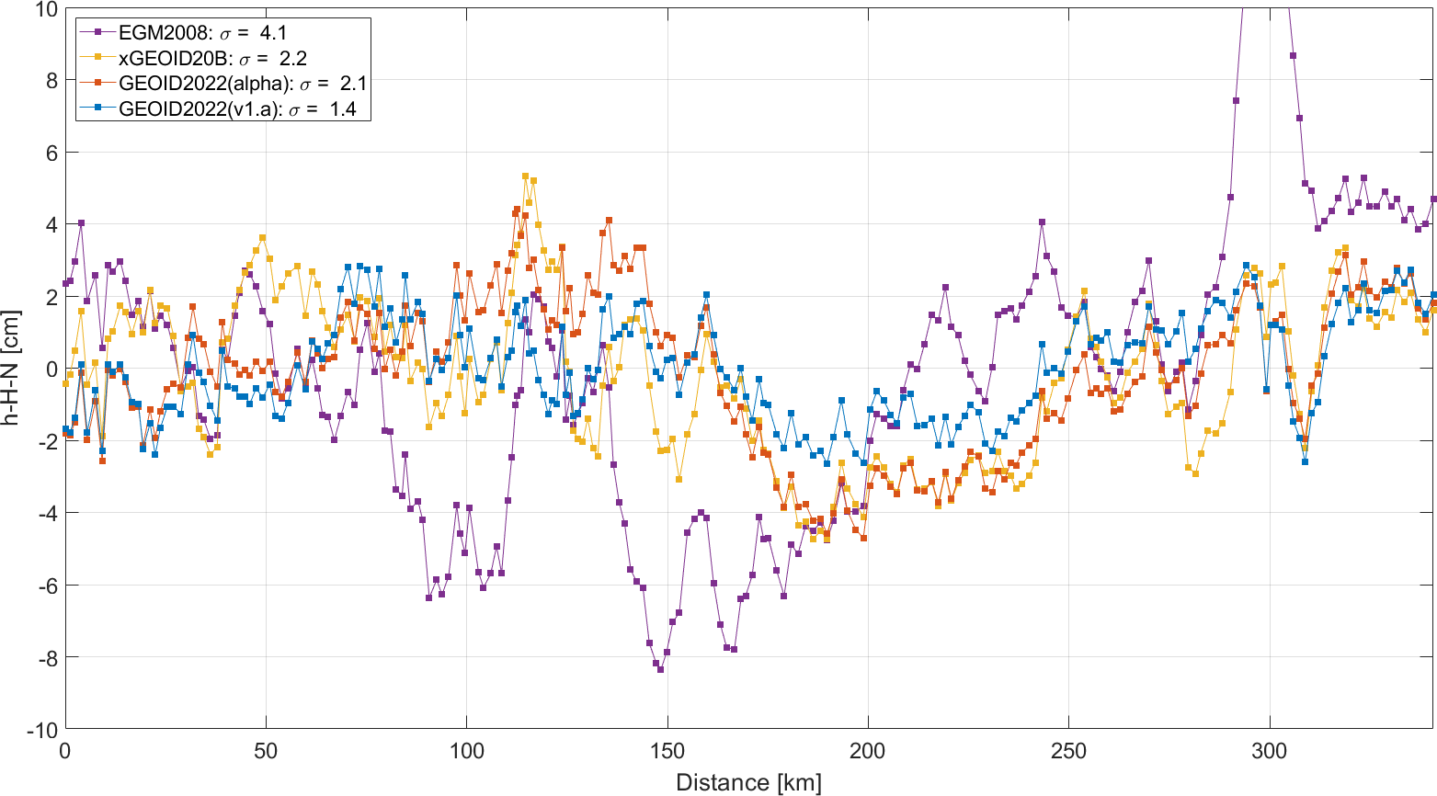
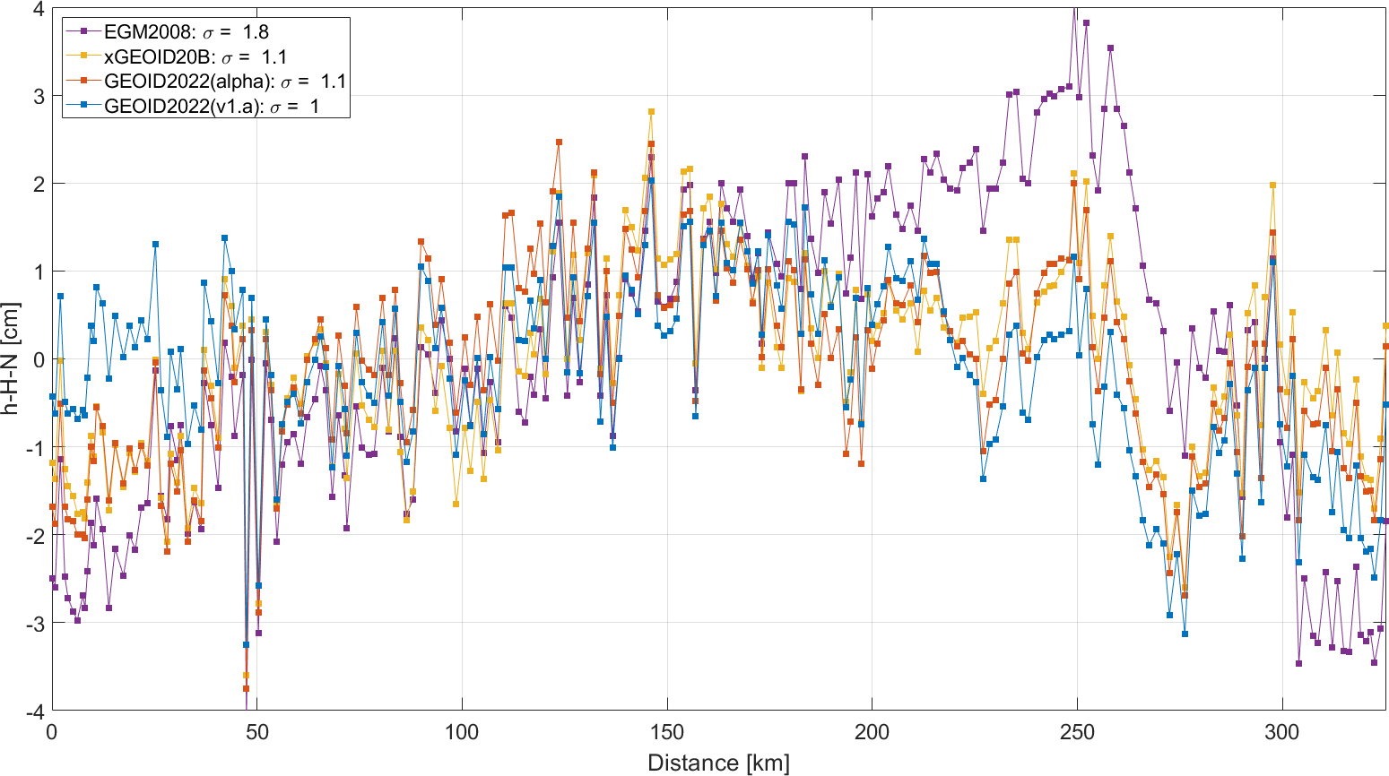
Residual geoid along three GSVS lines
Background: Geoid Slope Validation Surveys (GSVS)
1.2 cm
1.4 cm
1.0 cm

Slide 7
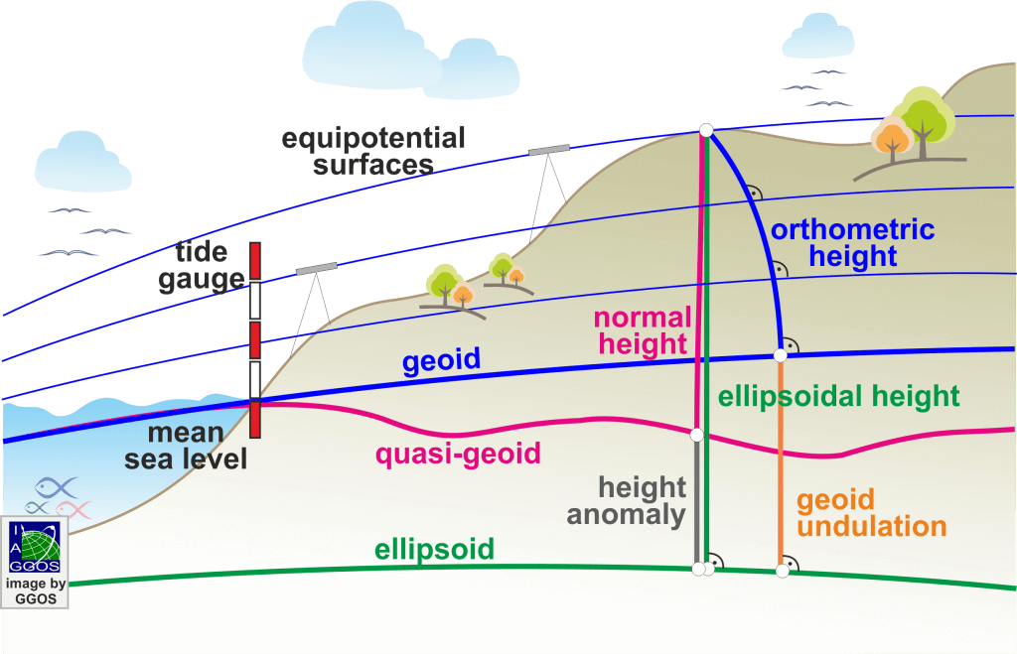


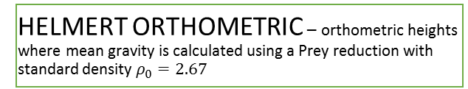
Background: Height System Relationship
PHYSICAL
GEOMETRICAL
ORTHOMETRIC (H^{O}) – distance from geoid to point, measured along the plumb line (with known real gravity g inside the masses, along the plumb line)
ELLIPSOIDAL (h)– distance from reference ellipsoid to point, measured along the normal to ellipsoid
NORMAL ORTHOMETRIC – orthometric heights computed with same density around the point and with using mean normal gravity (this is NOT a normal heights)
NORMAL (H^{N}) – distance from quasi-geoid to point, measured along the normal plumb line (with known normal gravity γ, associated with reference ellipsoid)
DYNAMIC – distance from geoid to point, measured along the plumb line (with constant normal gravity γ⁴⁵at 45°,associated with reference ellipsoid, have no geometrical meaning)
https://ggos.org/item/height-systems/#learn-this

Slide 8
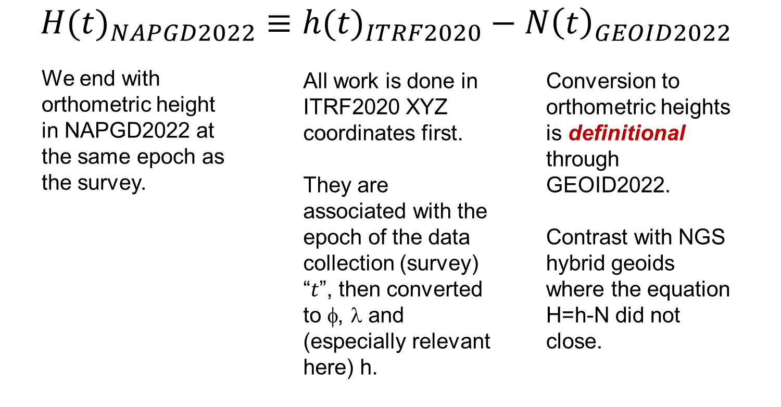
Definitional Relationship

Slide 9
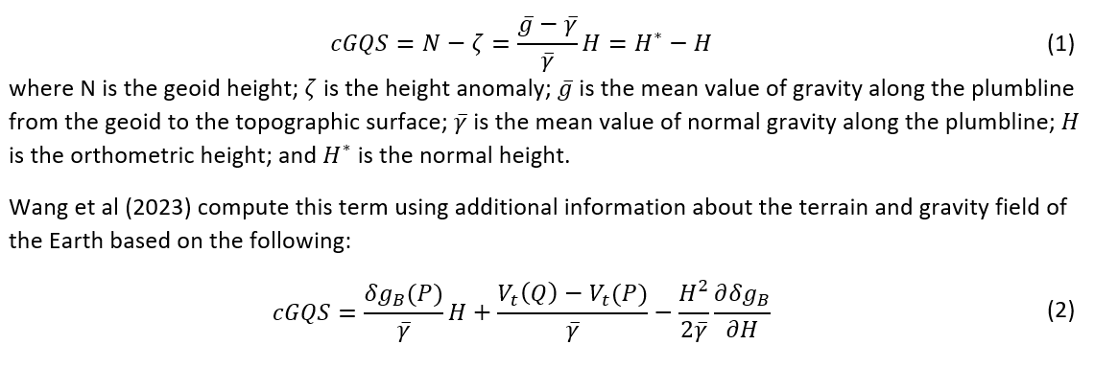
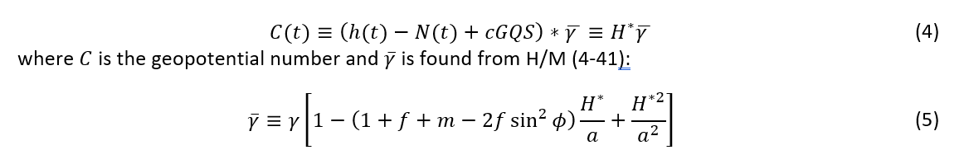
New method to compute dynamic heights:
Utilize the normal height definition and exact formulas:
Geoid – Quasigeoid Separation Term
Observed
Products
Easy Implementation with additional grid already computed in geoid model

Slide 10
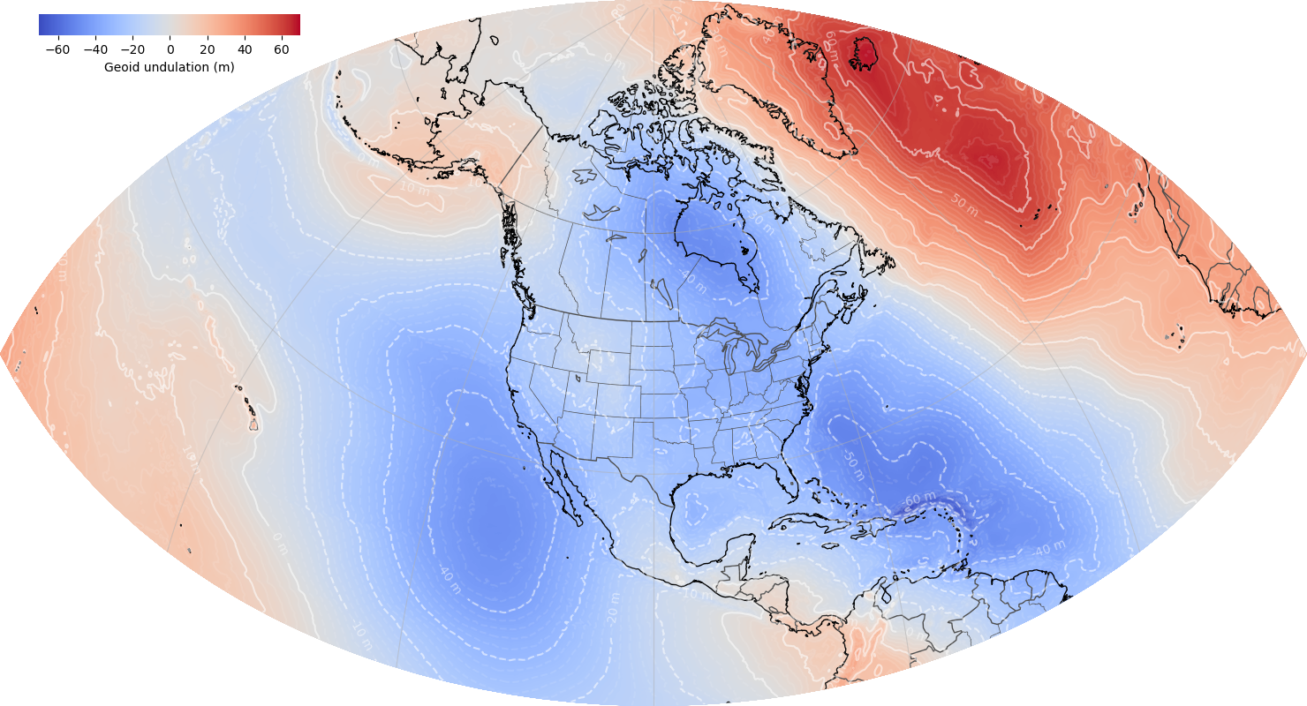
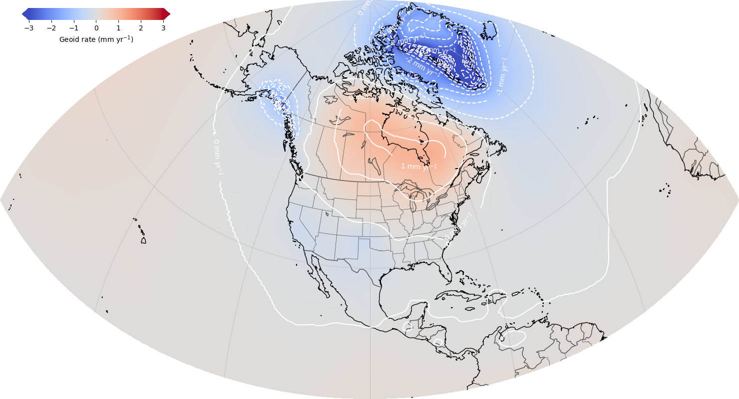
North American-Pacific Geopotential Datum of 2022
Alpha Release: GEOID2022 / DEFLEC2022 / GRAV2022 / GM2022
GEOID2022: Combined model (CGS+NGS+INEGI)
¼ Earth’s Surface
GEOID2022: Static Component Dynamic Component

Slide 11
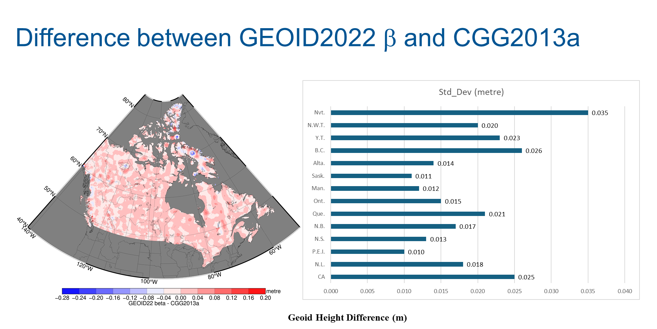
Notes:
Explanation:
Left: Full range of the differences between GEOID22 beta and CGG2013a over the land part of Canada.
Right: bar graph showing standard deviations of the differences with each province and territory.
Note: The differences are caused by the update of DEMs, new satellite gravity model, the use of NGS’s airborne GRAV-D data along the borders, marine gravity data along the coast, to a less extent by land gravity data and the method difference between CGS and NGS.

Slide 12
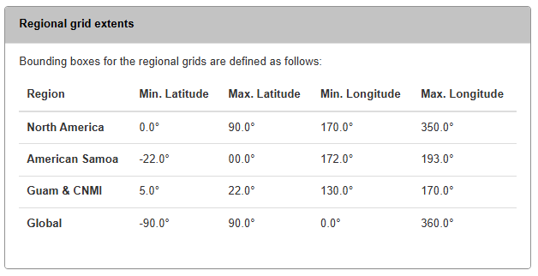
New Features on alpha site:
New products: GEOID2022, DEFLEC2022, DEM2022, GRAV2022, GM2022
  including uncertainties
  including regional models
Notes:
29 individual grids (GEOID – 6), (DEFLEC – 10), DEM (3), GRAV (9), GGM (1)

Slide 13
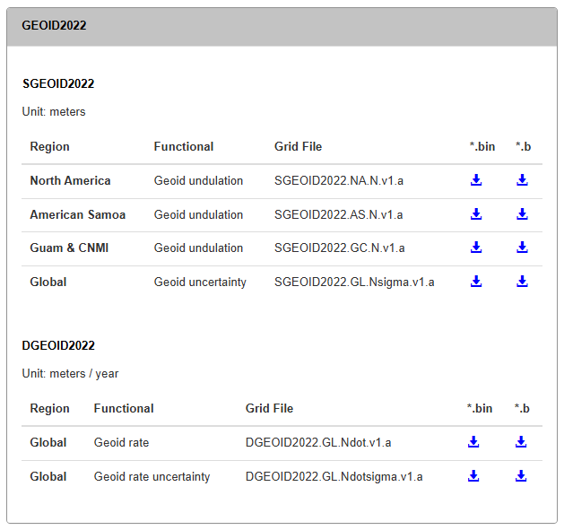
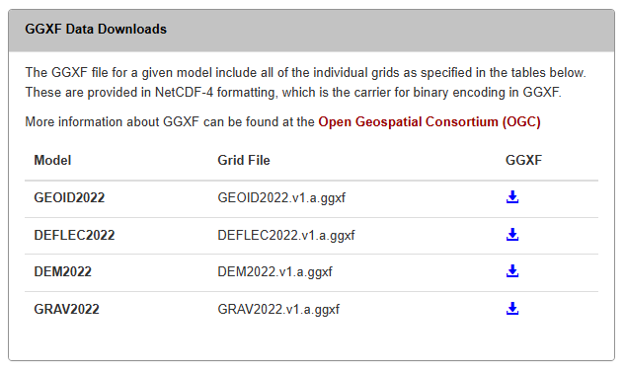
New Features on alpha site:
Grid formats: GGXF, legacy NGS format (*.bin and *.b)

Slide 14
New Features on alpha site:
Test cases (csv file):
  file with sample input, expected values, etc.
  87 examples representing major cities, model extrema values, and island regions.
Name | Category | Latitude | Longitude |  | SGEOID2022
Center | Grid | 45 | 260 |  | -22.554
New York | US Metro | 40.71296814 | -74.01361774 |  | -32.781
Los Angeles | US Metro | 34.05875104 | -118.27851290 |  | -35.252
Toronto | Metro | 43.64258362 | -79.38715210 |  | -37.195

Slide 15
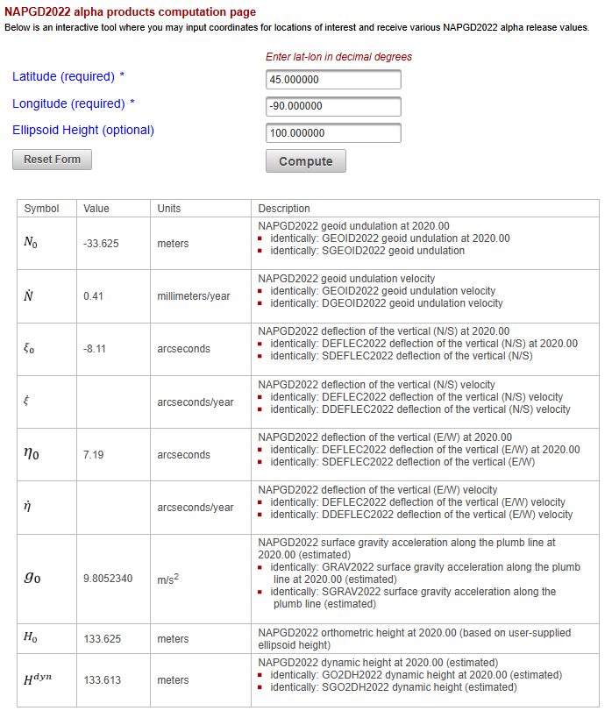
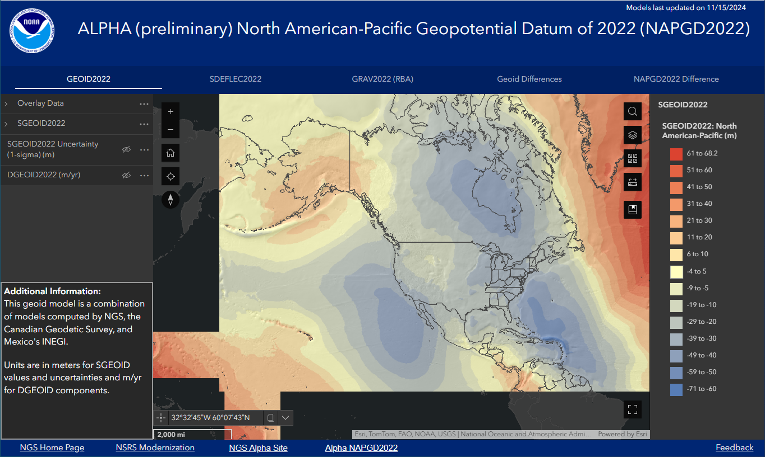
New Features on alpha site:
ArcGIS Experience for visualization that includes grids for geoid, deflections, gravity, geoid differences, datum differences, and their uncertainties
Computation tool for individual point input and exact values of NAPGD2022 quantities

Slide 16
Upcoming Changes: Released as beta – ~June 2025
Updated SGEOID2022 model – changes limited to Mexico
SGEOID uncertainty – 1’ resolution – grid provided only over regional extents
Improved support for GGXF
Additional APIs
Online computation tool moved to NCAT
Change log
**Versioning will remain the same**
PID: EZ0840

Slide 17
ngs.feedback@noaa.gov
Kevin Ahlgren
kevin.ahlgren@noaa.gov
NOAA’s National Geodetic Survey
https://alpha.ngs.noaa.gov/NAPGD2022

Slide 18
Backup Slides:
PID: EZ0840

Slide 19
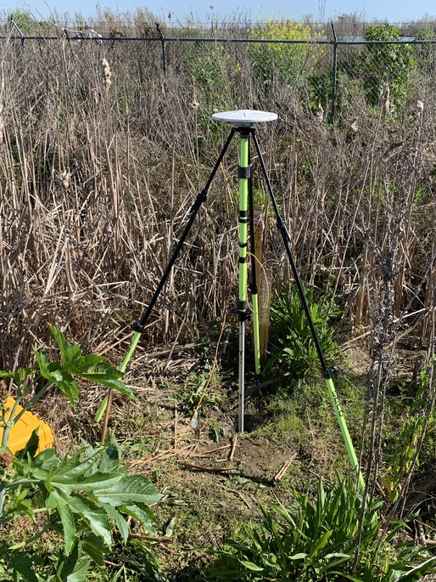
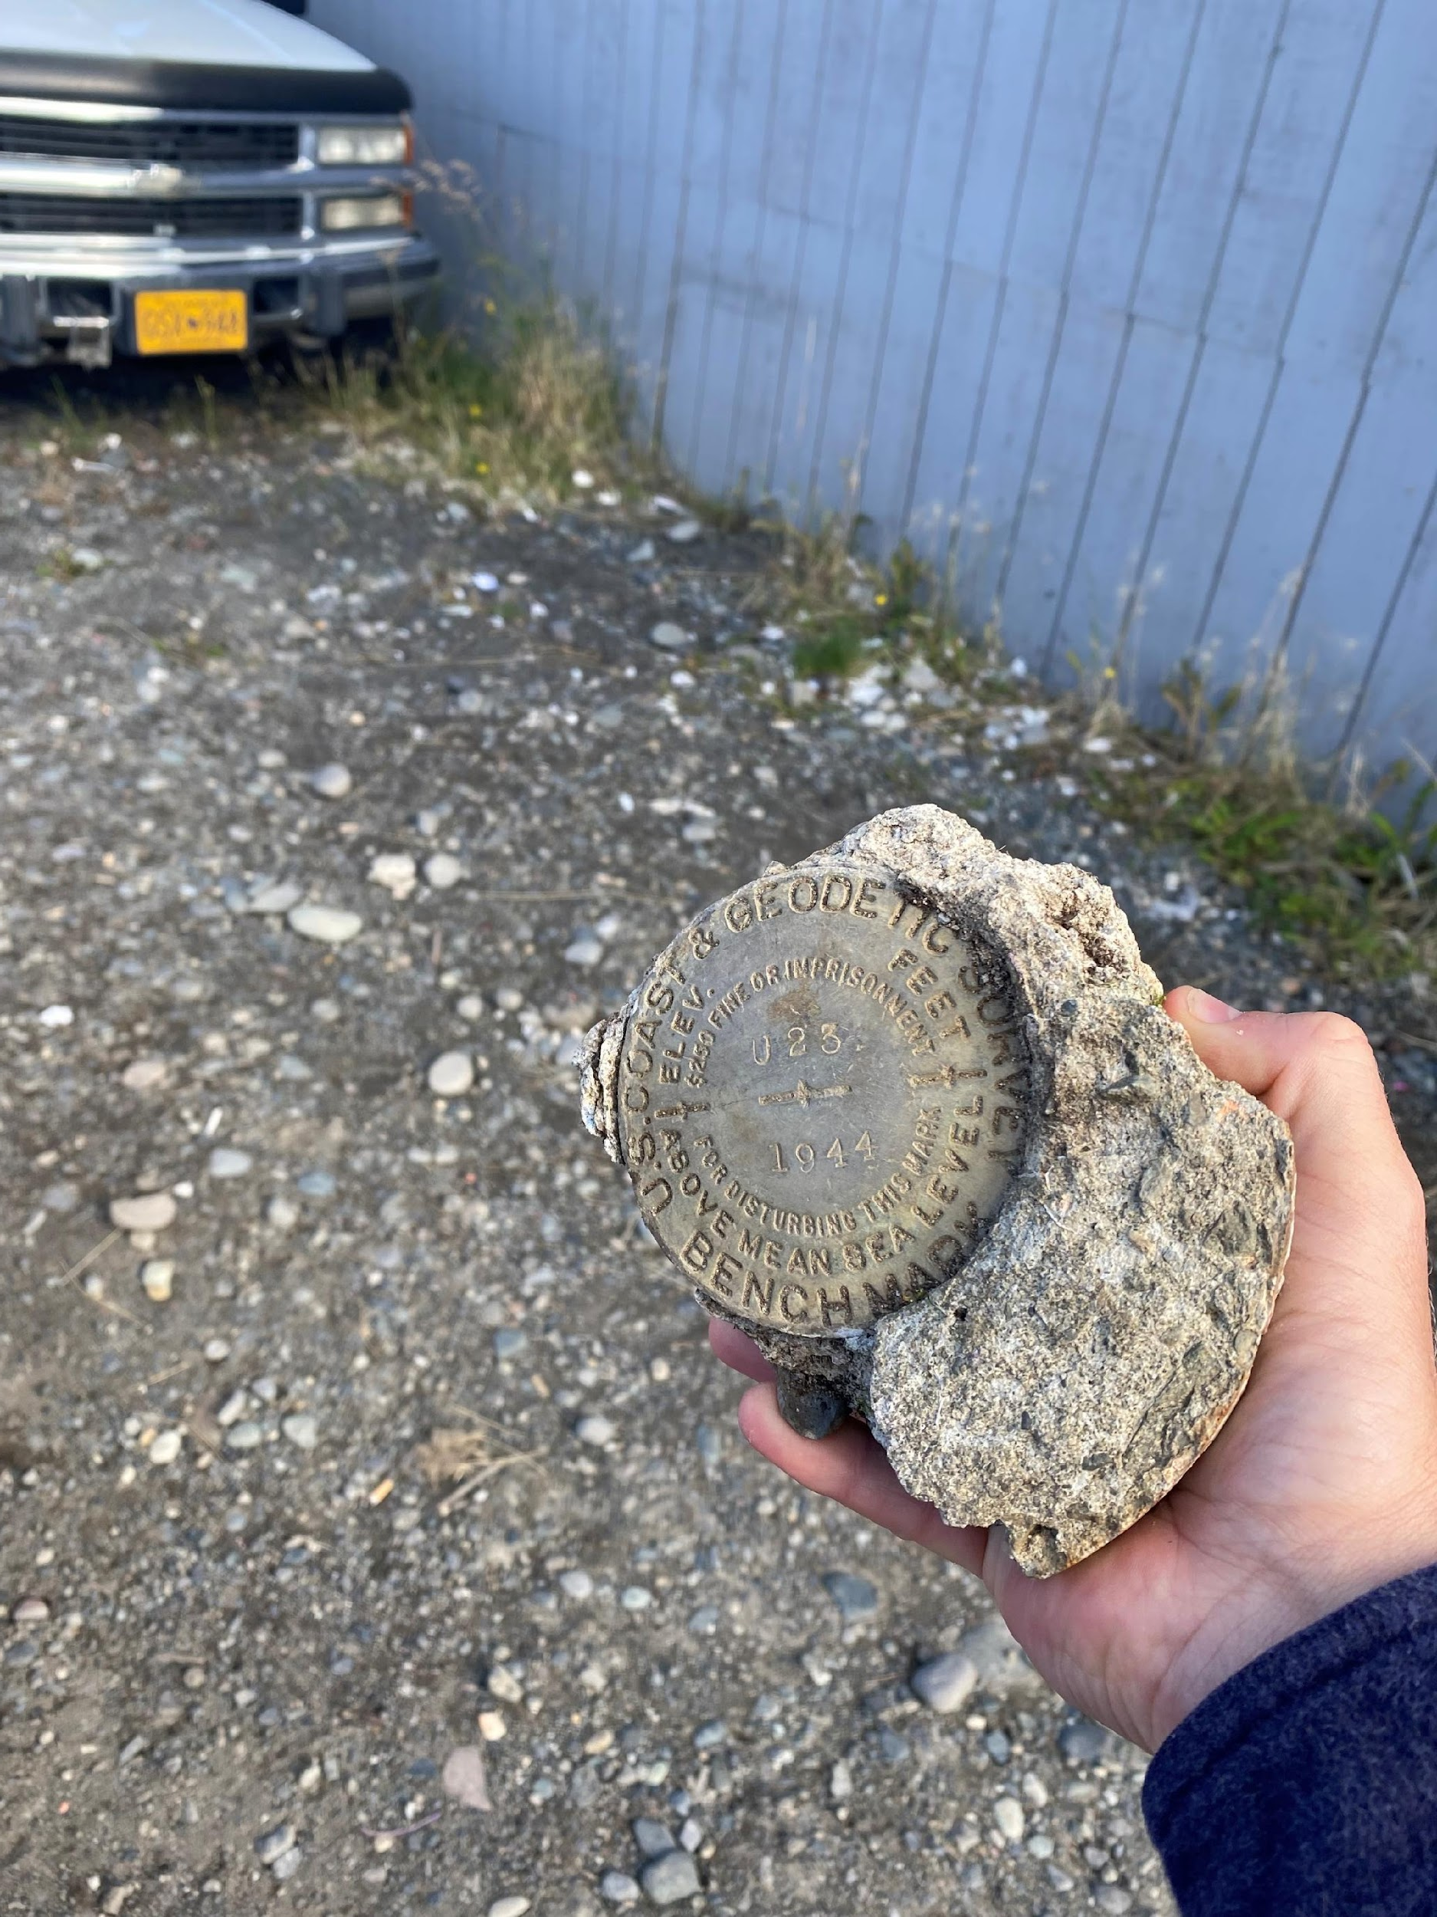
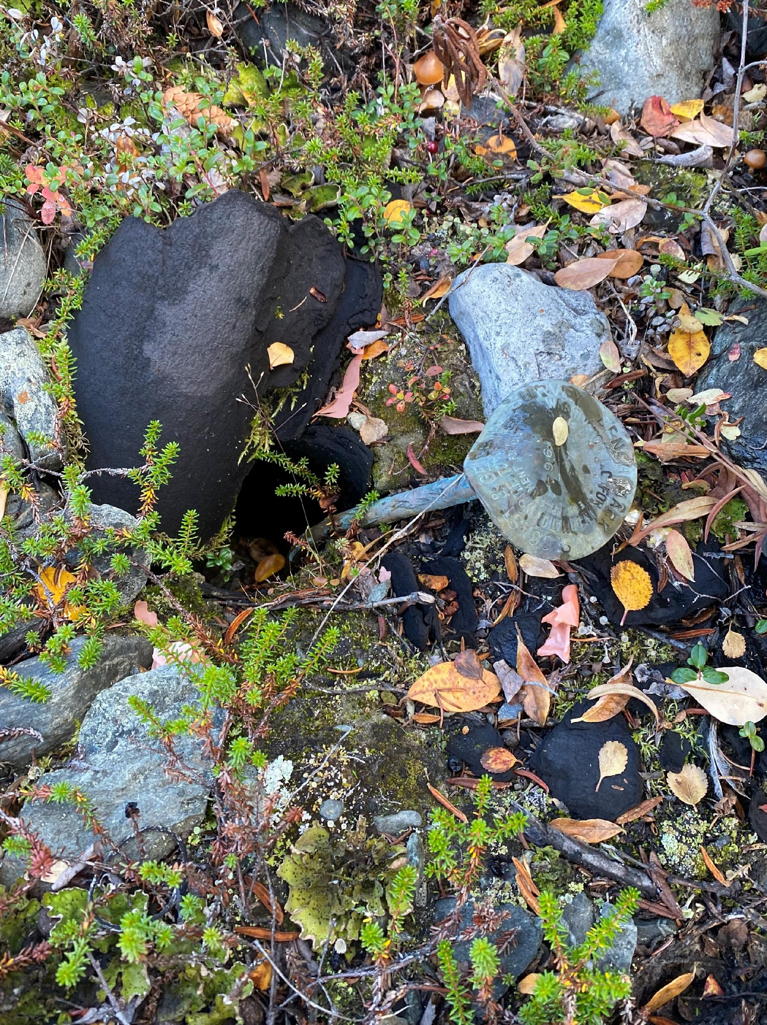
Issues with passive geodetic control
PID: EZ0840
Destroyed
Mutilated
Uplifted/Subsided

Slide 20
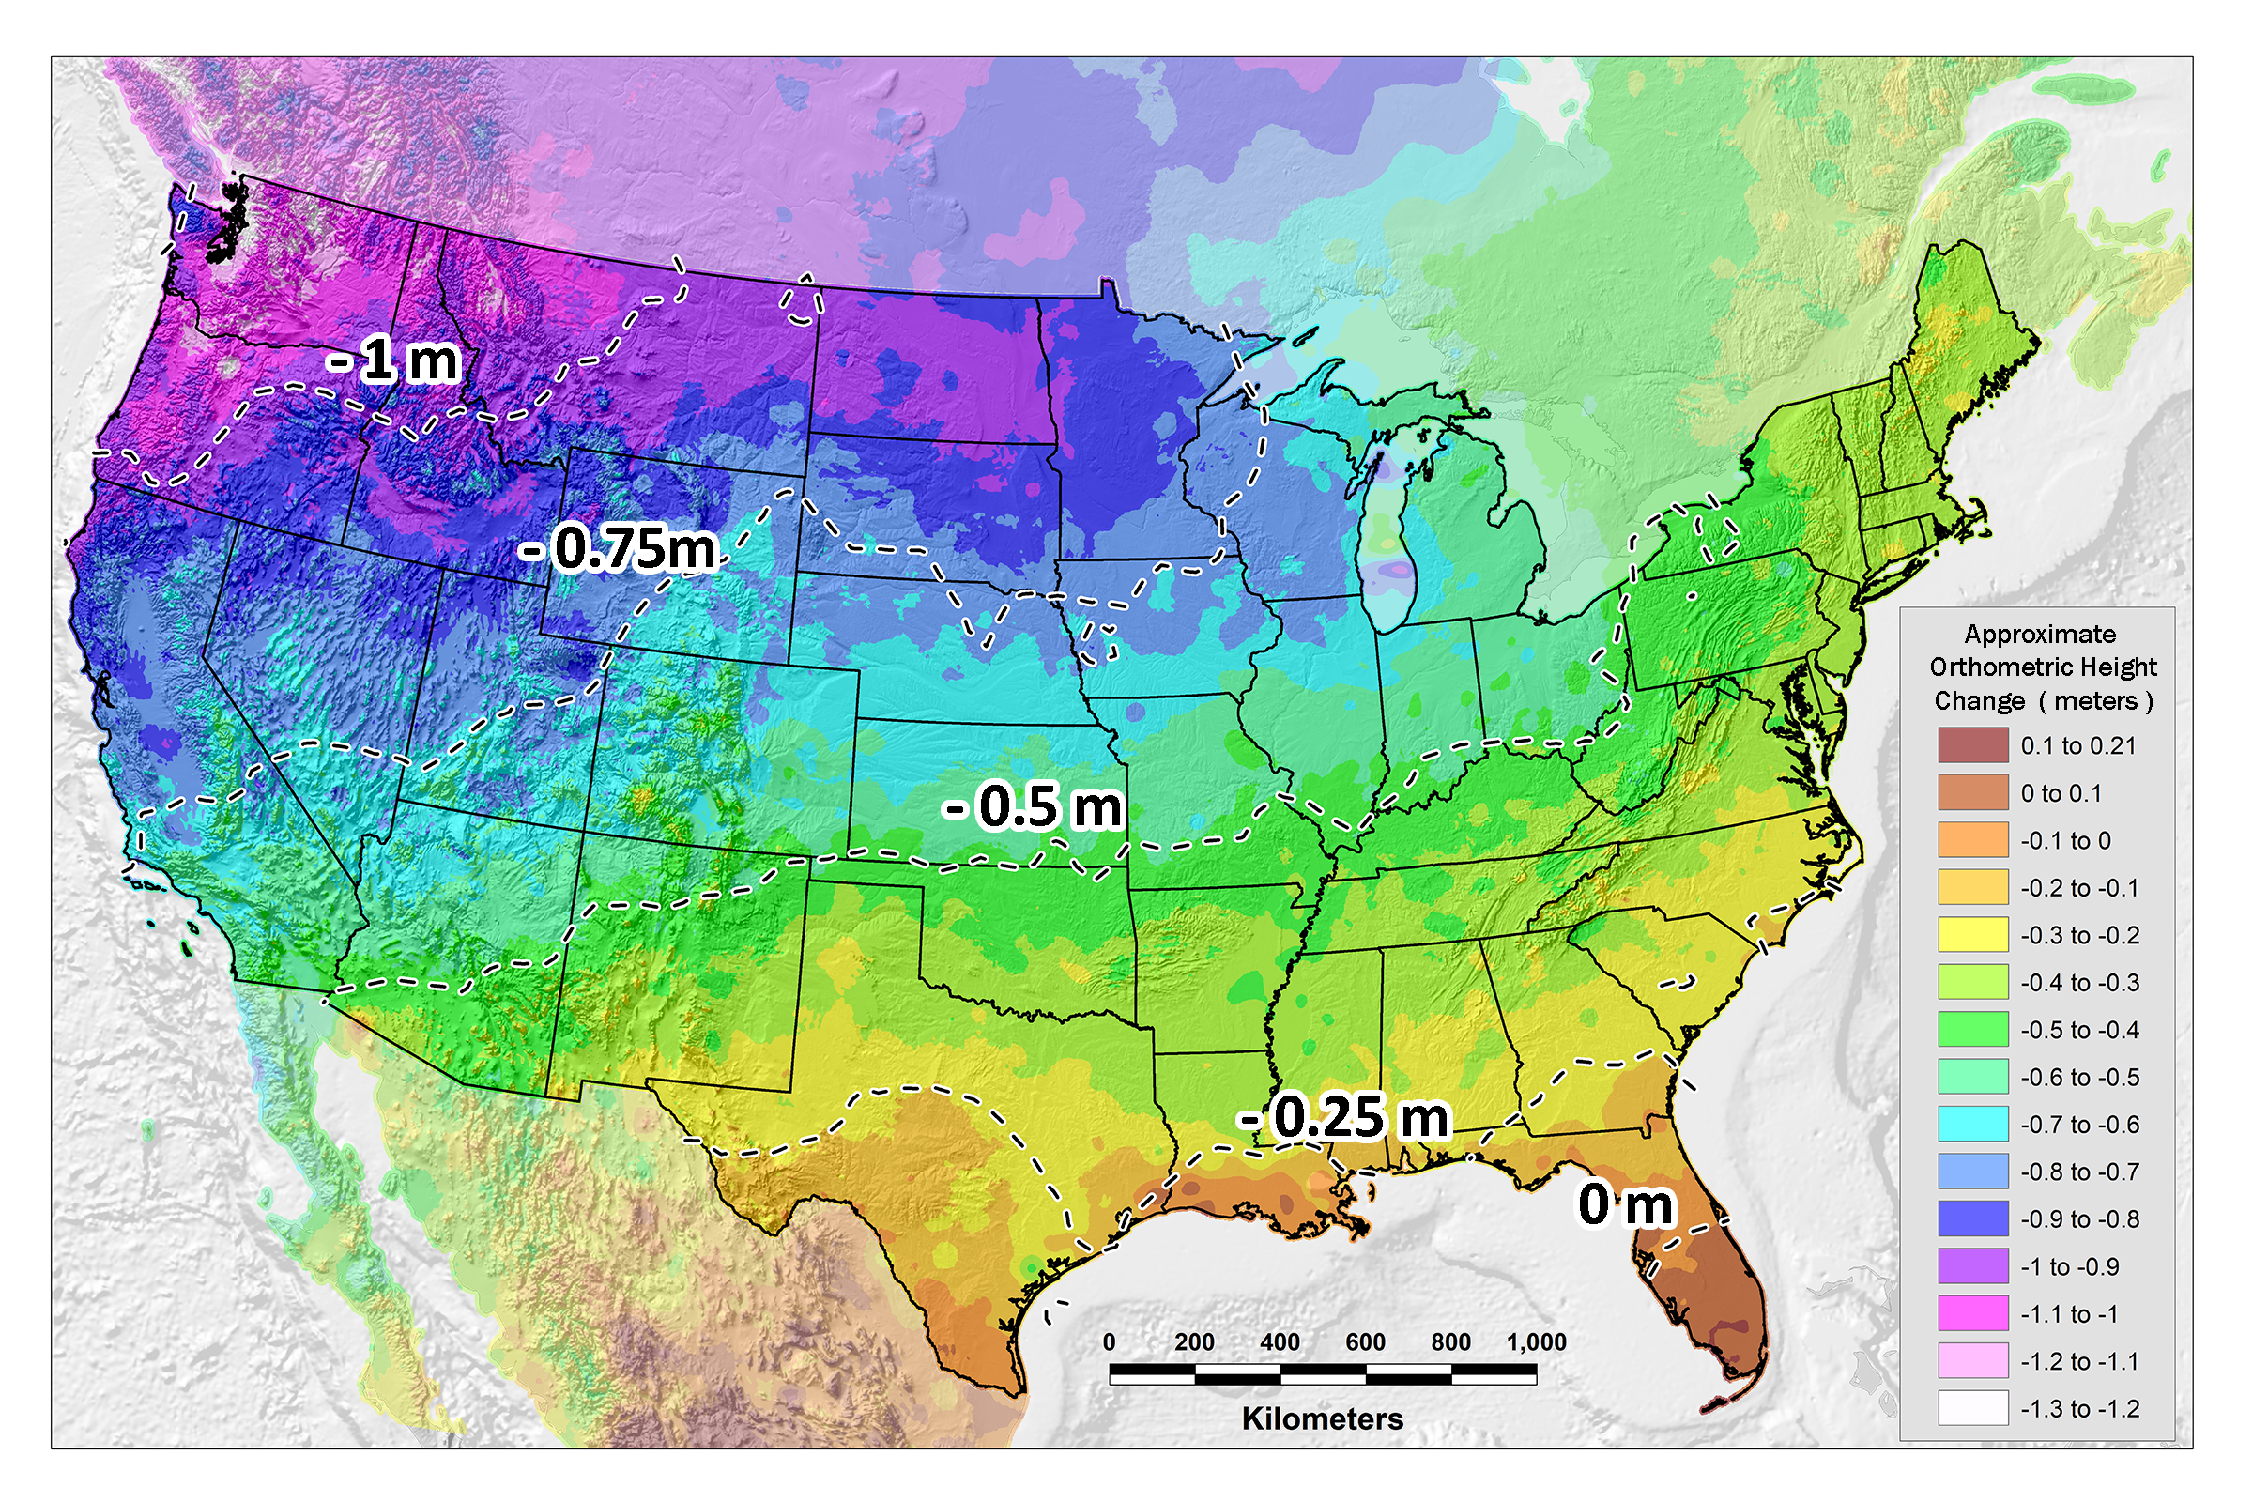
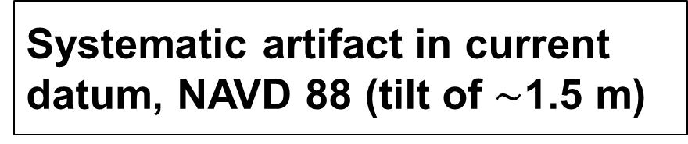
PID: EZ0840

