Slide 1
Components of the Modernized NSRS Geometric Frame
Intra-Frame Deformation Model of 2022 (IFDM2022)
Reference and Survey Epoch Coordinates (RECs and SECs)
State Plane Coordinate System of 2022 (SPCS2022)
National Geodetic Survey and Canadian Geodetic Binational Geospatial Software Developers Summit
Michael Dennis, PhD, PE, PLS
April 23, 2025

Slide 2
Intra-Frame Deformation Model of 2022
Purpose
  Model horizontal mark motion not captured by Euler Pole Parameters (EPPs)
  Model all vertical mark motion
  Used for time projection of geodetic observations, constraints, and cofactor matrices
Single set of velocity grids over entire Earth
  Resolution 0.1 degree (6 arc-minutes)
  Defined as 6 layers (“bands”) for each velocity and standard deviation component
  Velocities and standard deviations as east, north, up (mm/year)
  Exists as NetCDF, compatible with GGXF (currently only available internally at NGS)
Earthquakes models: 32 local grids in western CONUS and Alaska
Spatial reference: ITRF2020

Slide 3
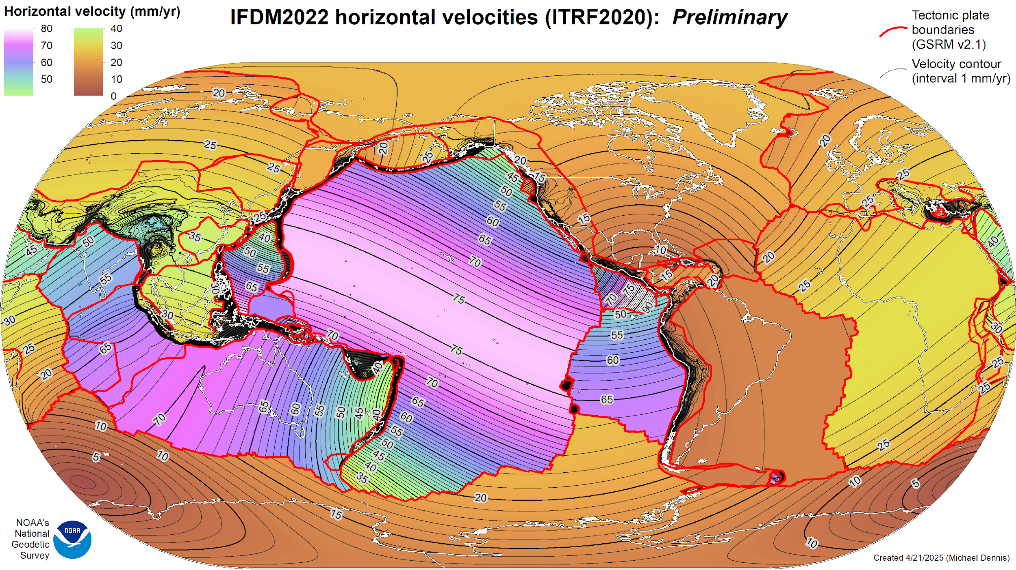
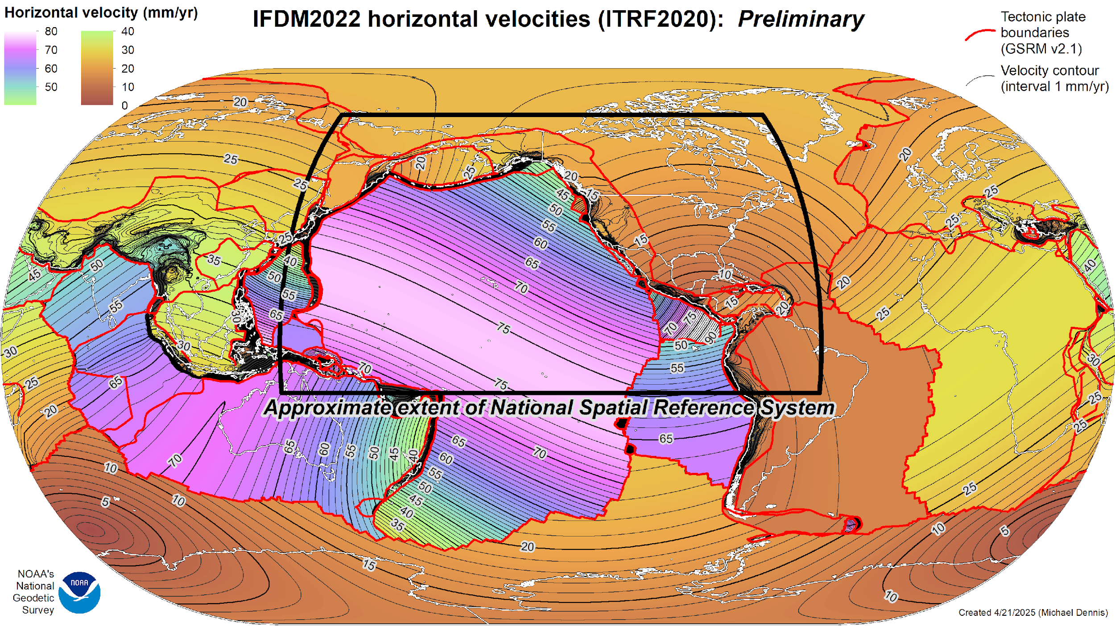

Slide 4
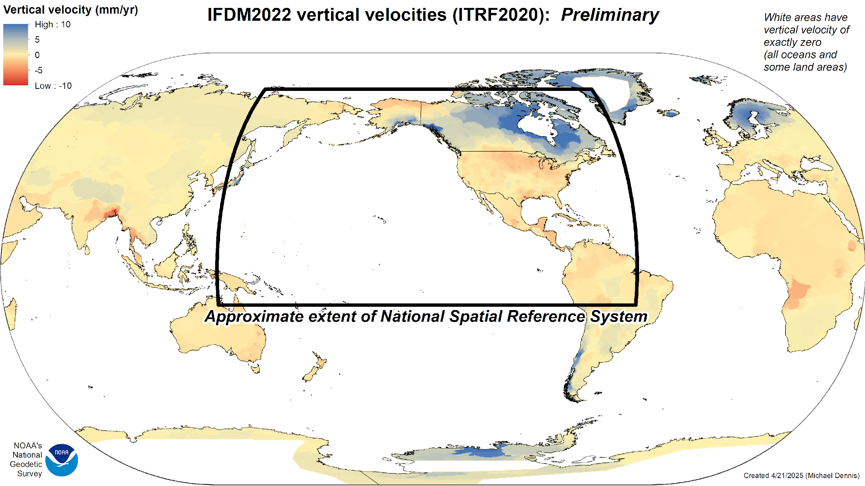

Slide 5
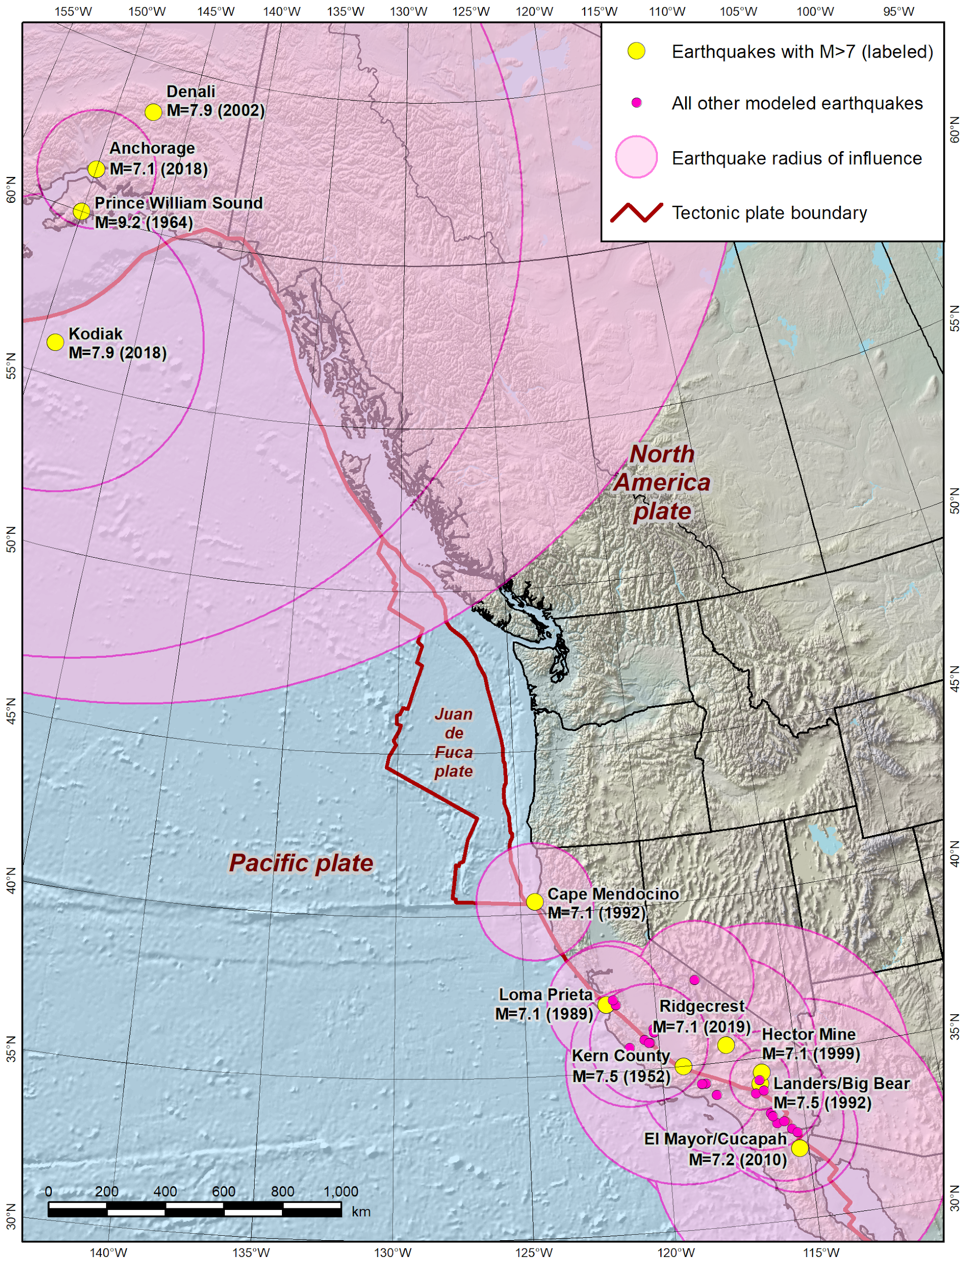
Earthquake models
32 models (1934 – 2019)
  Western CONUS and Alaska
  Same earthquakes as in NGS software HTDP (Horizontal Time-Dependent Positioning)
Each modeled as high-resolution grid
  Compatible with new Functional Model for Crustal Deformation (FMCD) standard
  Based on Okada continuous dislocation models in HTDP

Slide 6
Characteristics of IFDM2022
Data sources
  Global Strain Rate Model v2.1 (Kreemer et al, 2014) for all horizontal velocities
  Global Vertical Land Motion Model (Hammond et al, 2015) for most vertical velocities
  Augmented by Trans4D, MYCS3, and NGS study of Mariana plate motion
How it will be used
  Transformation and time projection performed by SPROCCET
    Software for PRojecting Observations, Constraints and Cofactor matrices/Errors through Time)
    Uses IFDM2022 velocity and earthquake grids
    Uses 14H software to perform 14-parameter Helmert transformations
    Purpose is to support network adjustments of geodetic observations at a common epoch
  Transformation and projection of coordinates a secondary function (more on this later)
Replaces NGS Horizontal Time-Dependent Positioning (HTDP) software

Slide 7
IFDM2022 versus HTDP
Characteristic | IFDM2022 | HTDP
What is it? | Models only – not a program | Program plus models
Includes vertical motion | Yes | Only for earthquake models
Includes uncertainties | Yes | No
Extent of velocity grids | Global | Only CONUS and Alaska
Uses rigid plate rotation models | No (only as boundary conditions to create model) | Everywhere outside of CONUS and Alaska velocity grids
Earthquake models | High-resolution grids | Continuous dislocation models
Helmert transformations | Computed separately (in 14H) | Built into program
Spatial reference | ITRF2020 | ITRF2008 (velocity grids)

Slide 8
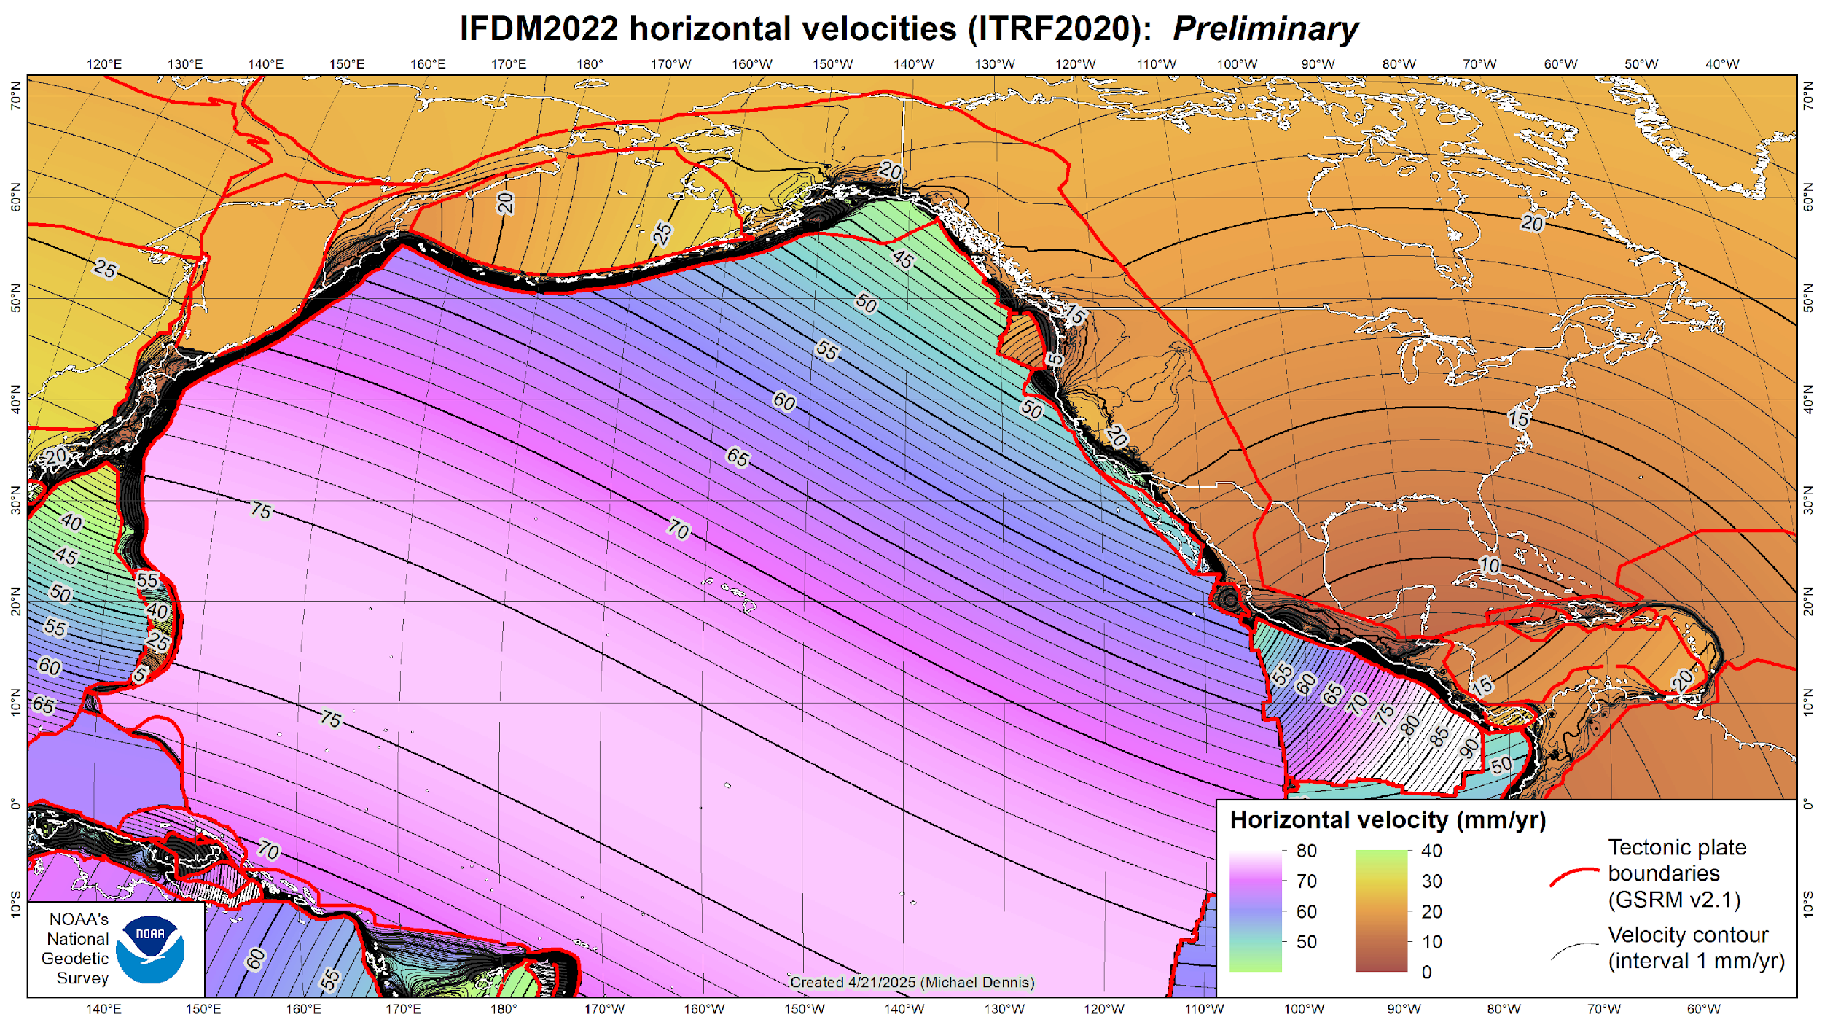
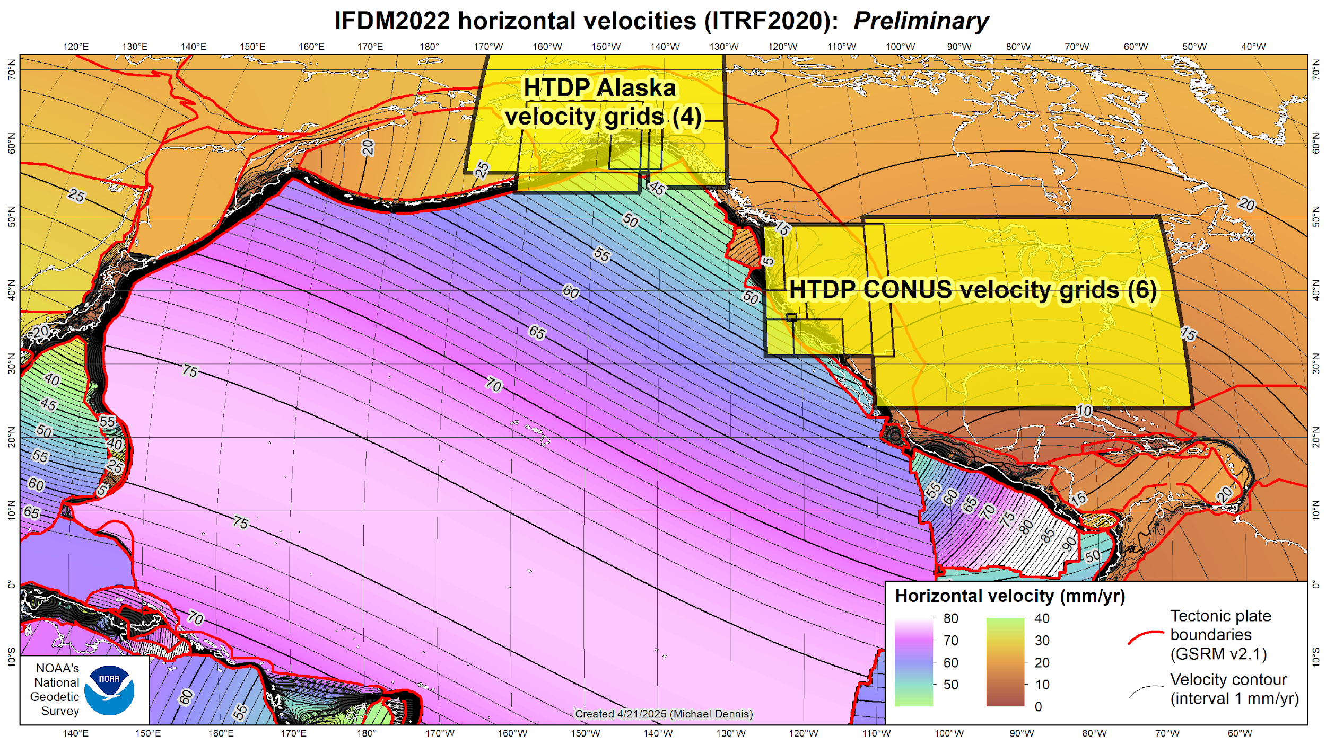

Slide 9
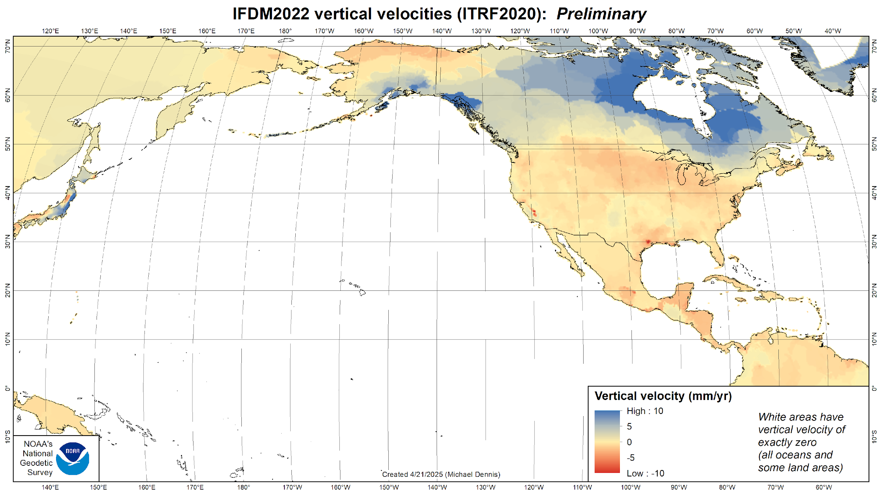

Slide 10
Things to note about IFDM2022
A set of models only
  Unlike HTDP, IFDM2022 is not a computer program
  Used to project observations, constraints, and cofactor matrices through time
Not definitional part of Modernized NSRS
  IFDM2022 model alone not considered accurate enough for geodetic control
  Main purpose: support projection of observations using SPROCCET for adjustments
  Secondary: non-definitive estimation of coordinate change through time
What time-related components of Modernized NSRS are definitional?
  EPPs: define relationship of four 2022 terrestrial reference frames to ITRF2020
  National CORS Network coordinate functions

Slide 11
New types of coordinates
Reference Epoch Coordinates (RECs)
Temporal “snapshot” of entire network
Similar to NAD 83 (2011/PA11/MA11) epoch 2010.00
Initial epoch 2020.00
Every 5 or 10 years (TBD)
Survey Epoch Coordinates
(SECs)
Time-dependent!
Gives coordinates at time of observation
Multiple SECs can indicate changes over time
Likely not included in initial rollout of Modernized NSRS

Slide 12
National adjustments to create RECs and SECs
National adjustments: geometric and orthometric
Geometric: determine geocentric XYZ of passive marks
  Converted to latitude, longitude, ellipsoidal height
  Constrained to CORS coordinate functions in ITRF2020 at epoch 2020.0
  Mostly GNSS solutions represented as “vectors” between marks
    Total of ~850,000 vectors connecting ~150,000 marks (passive and CORSs)
    ~600,000 vectors in NGS Integrated Data Base plus ~250,000 reprocessed OPUS-Share solutions
    Dataset spans from 1983 to present (over 40 years)
  Some classical observations included for limited cases (e.g., IERS site surveys)
  Combined with GEOID2022 to serve as constraints to orthometric adjustment
  Results of adjustment used to create new NADCON grids
  Passive marks RECs available as geodetic control through NGS Data Delivery System

Slide 13
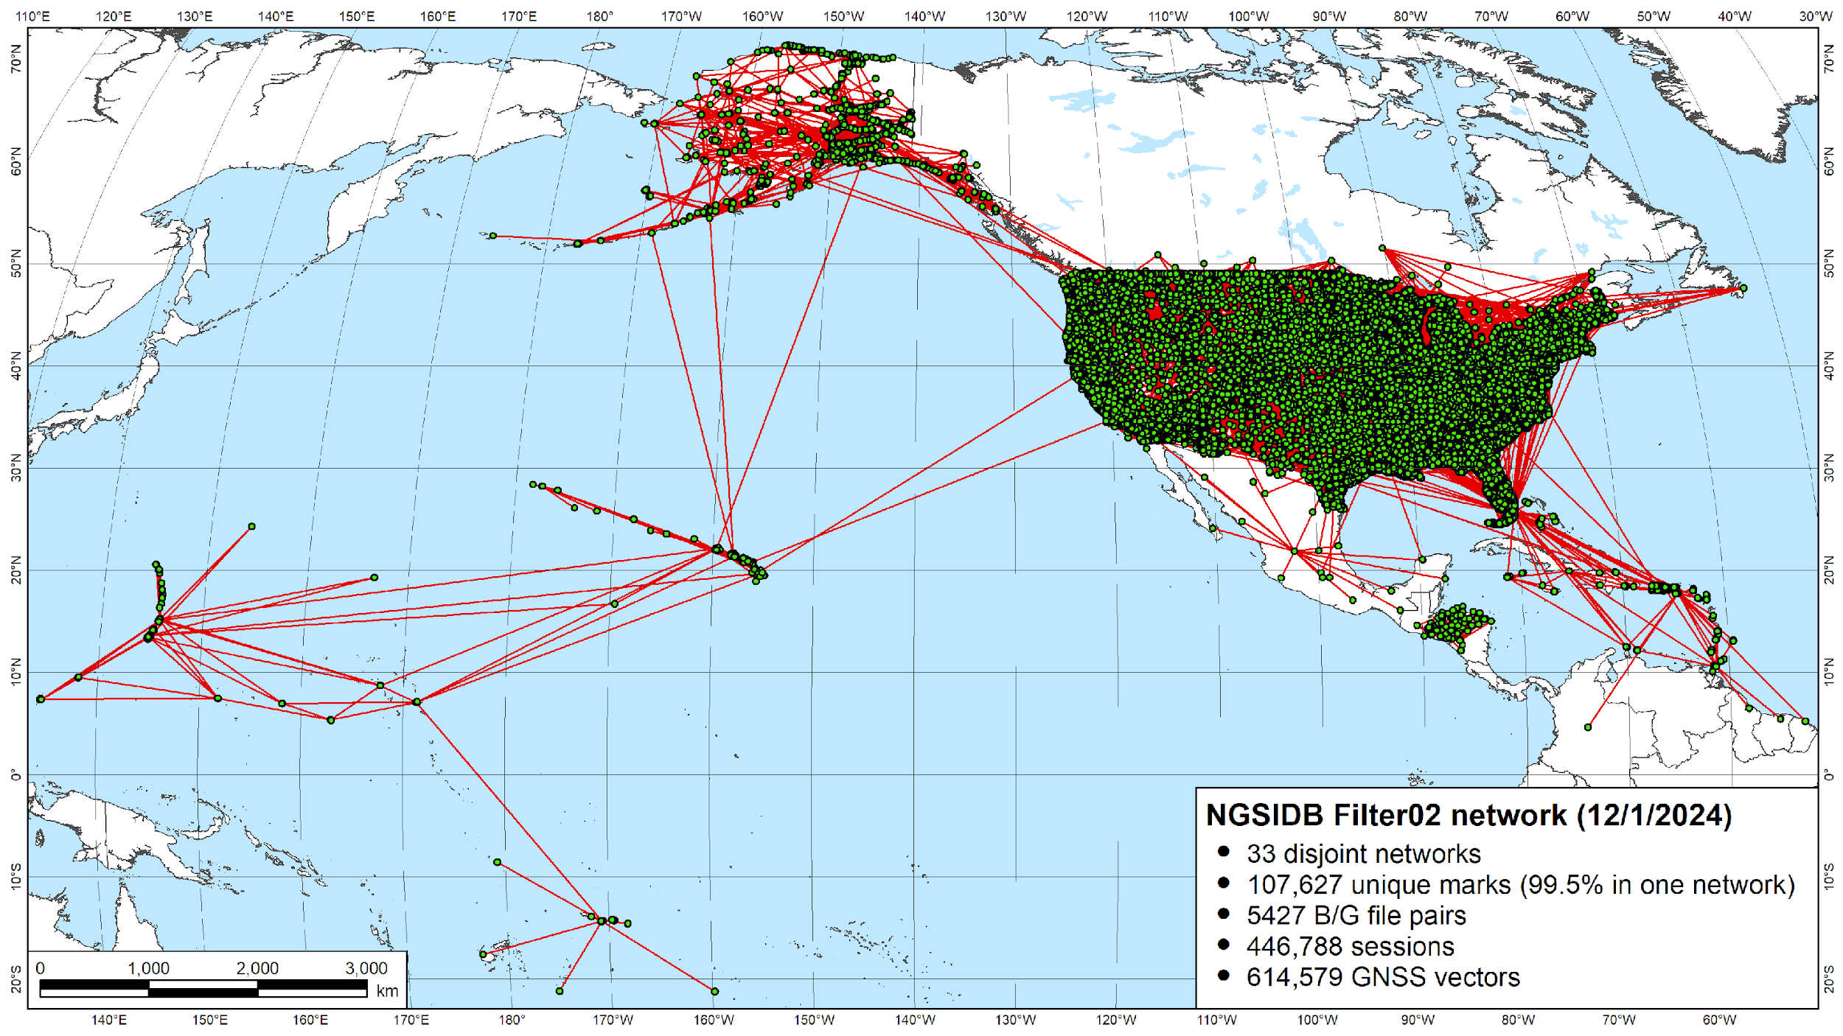

Slide 14
CRSs and transformations for RECs and SECs
Coordinate reference systems
  Five reference frames: ITRF2020, NATRF2022, CATRF2022, PATRF2022, MATRF2022
  RECs defined in 5 static (dynamic “snapshot”) CRSs at epoch 2020.0
  SECs defined in 5 dynamic CRSs at observation epoch
  Important: 5 “snapshot” CRSs will be created for each official reference epoch
    Official reference epochs will be on 5- or 10-year intervals (TBD)
Transformations
  RECs from national adjustment used to create new NADCON grid
  Transforms between NAD 83 epoch 2010.0 and N/C/P/MATRF2022 epoch 2020.0

Slide 15
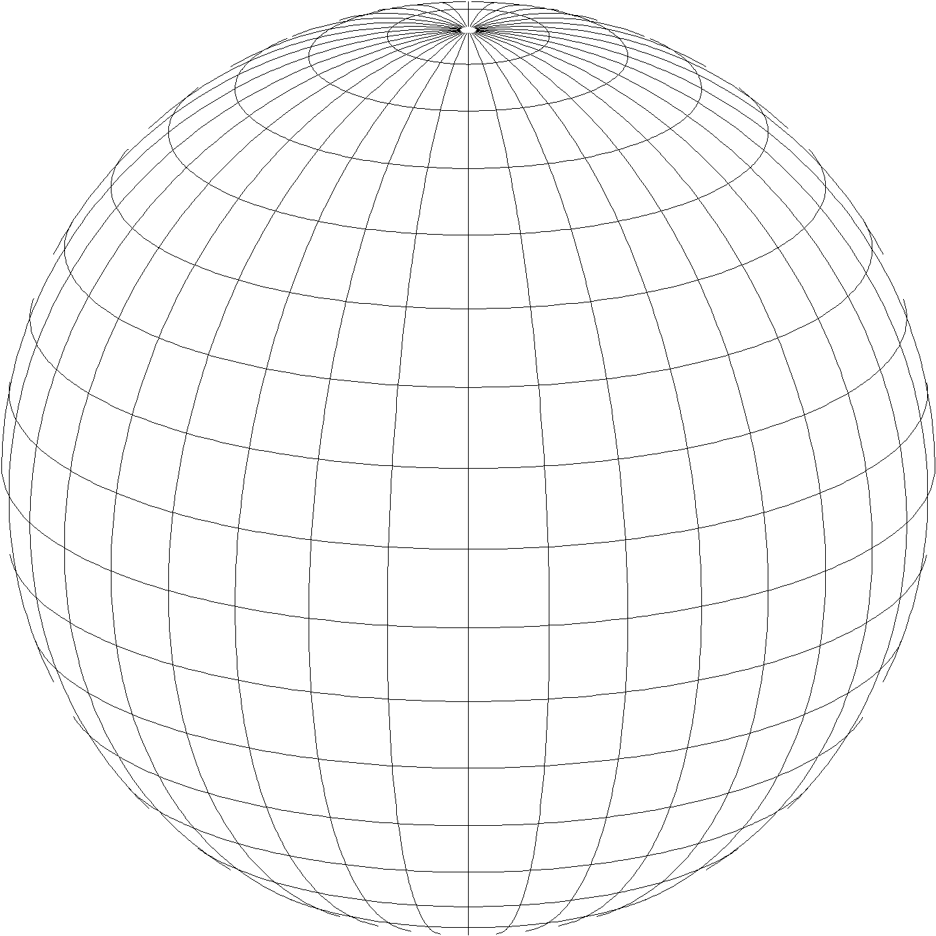
State Plane Coordinate System of 2022 (SPCS2022)
Third generation of State Plane
  First in 1930s (SPCS 27), second in 1980s (SPCS 83)
  Widely used in surveying, engineering, and GIS
  Same 3 map projection types
  Same reference ellipsoid as SPCS 83 (GRS80)
Same as existing State Plane, but different…
  Based on new terrestrial reference frames instead of NAD 83
  More zones, most designed by state stakeholders
  Designed to reduce linear distortion at topographic surface
  (i.e., reduce difference between “grid” and “ground” distances)
Lambert Conformal Conic
Transverse Mercator
Hotine Oblique Mercator

Slide 16
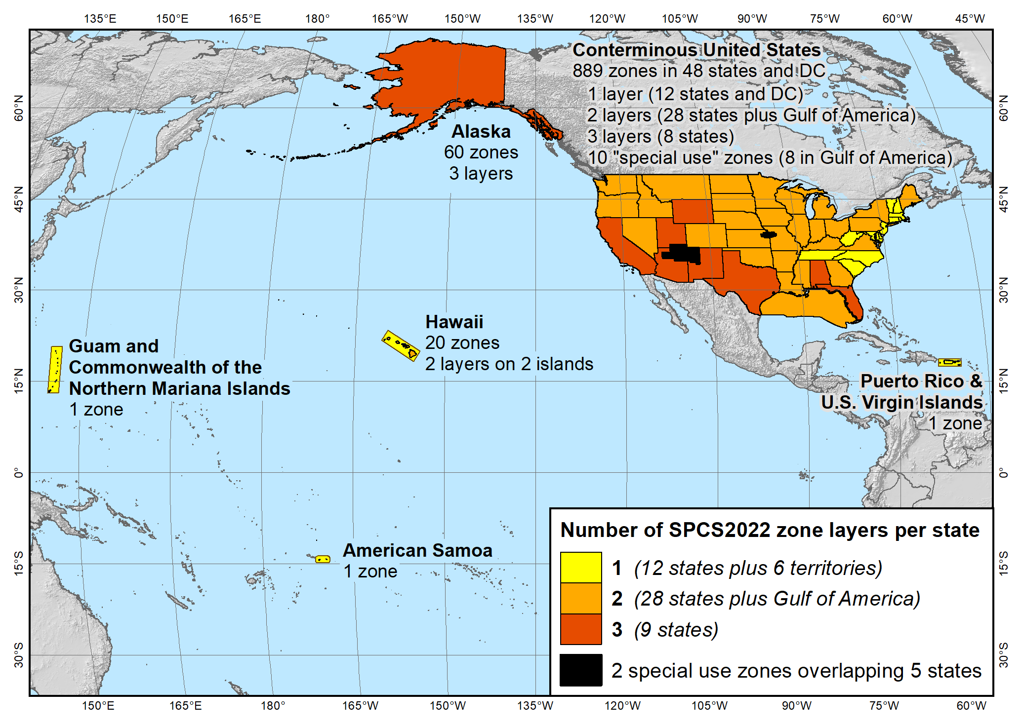
SPCS2022 zone layers
1 layer: 12 states plus 6 territories
2 layers: 28 states plus Gulf of America
3 layers: 9 states
Plus 10 special use zones (2 zones overlap 5 states)
Every state and territory has a statewide zone layer

Slide 17
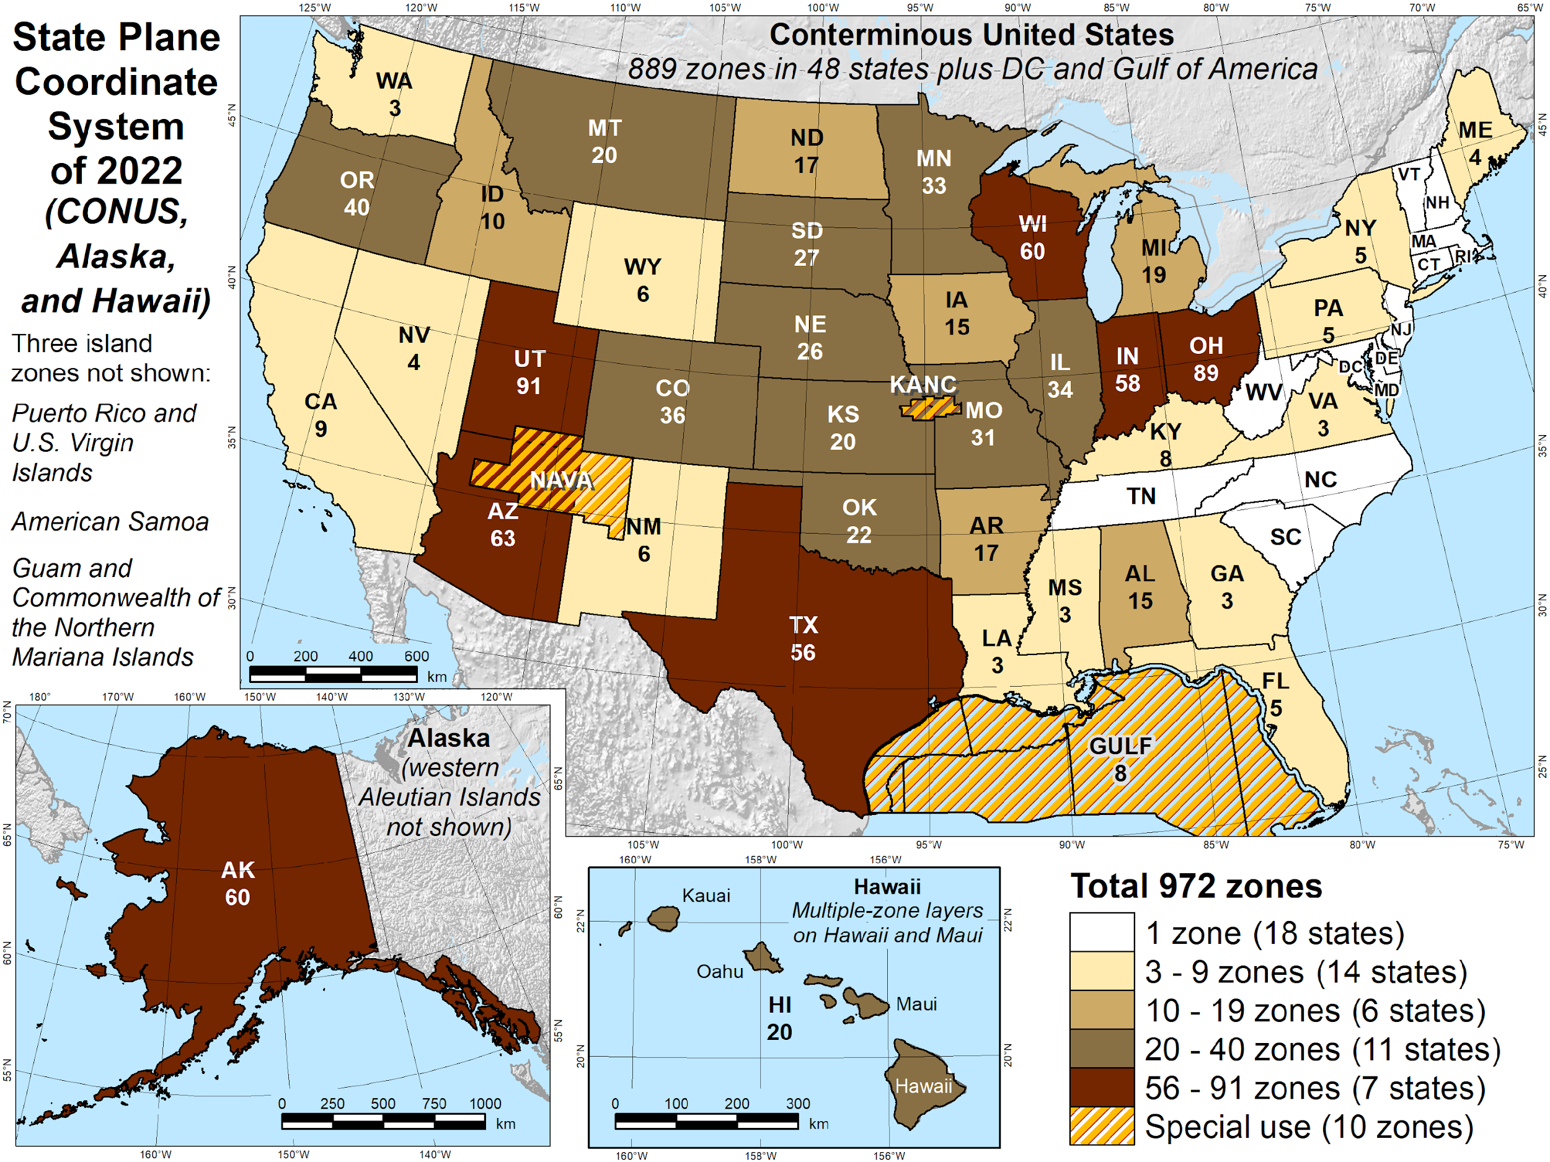
Number of SPCS2022 zones (preliminary)
Designs by NGS
  172 zones
  Includes 54 statewide zones…
  …and 10 “special use” zones
  (in more than one state or no state at all)
Designs by state stakeholders
  800 zones in 27 states
Total = 972 zones
for 56 states
and territories
Compare to 125
zones in existing
State Plane (SPCS 83)

Slide 18
SPCS2022 projected coordinate reference systems
Reference frames (datums) and epoch
  Each zone referenced to one of the four plate-fixed terrestrial reference frames
  Initial reference epoch 2020.0
Linear units: meters and international feet (no U.S. survey feet)
Will result in large number of projected CRS definitions
  Meters and feet: 2 × 972 zones = 1944 PCRS identifiers at epoch 2020.0
  Each reference epoch will increase that number by 1944
  If “dynamic datum” version used, will increase it by another 1944
  Allowing frame substitutions (e.g., ITRF2020) will further increase the number
  And more SPCS2022 zones may be added in the future
  Seems there ought to be a better way to handle this situation…

Slide 19
How will NGS provide SPCS2022 defintions?
Preference is by working directly with registries
  ISO Geodetic Registry
  EPSG Geodetic Parameter Dataset
Downloadable datasets?
  Well Known Text format
  Other formats?
  But would need to keep multiple datasets synchronized
Other ways?
  Open to suggestions, but resources are limited

Slide 20
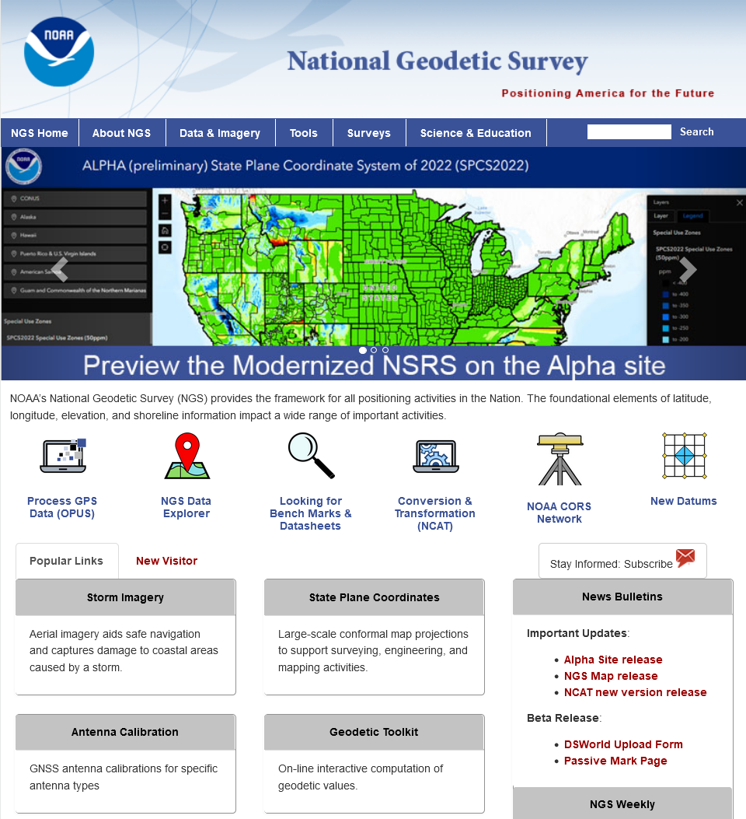


Where to learn more…
geodesy.noaa.gov
Thank you!

