Slide 1

Transformation work flows in the USA
Dru Smith
NSRS Modernization Manager
NOAA’s National Geodetic Survey

Slide 2
Outline
Commonalities
USA approaches

Slide 3
Commonalities
GGXF file distribution
Biquadratic interpolation

Slide 4
USA
Use NCAT or VDatum
They draw from the same code base

Slide 5
NCAT
Input and output data requirements:
2-D or 3-D
And then which type
Datum
Epoch (possibly. Depends on the datum)
Limitations:
Can go 3-D to 2-D but not the reverse
Only certain datums will trigger a request for “epoch”

Slide 6
Data types
2-D
Lat/Lon
SPCS(27, 83, 2022)
UTM
USNG
3-D
Any 2-D + h
Any 2-D + H
X, Y, Z

Slide 7
NCAT new functionality
Allowable datums now include all ITRFs and WGS84s
Heights can be converted from h to H and back
This will not require hybrid geoids
14 parameter Helmert transformations
This never changes an epoch, just a frame (subset of datums)
Maintains geodetic control
Deformation model
This never changes a frame, just an epoch but with mixed accuracy (Danger!)
Loses geodetic control
Singular paths will be defined
By opening up frame and epoch changes, multiple paths to the same answer may exist
But only one is “NGS recommended” and will be the default
Notes:
Some clever interactions between NADCON, VERTCON and GEOID2022 allow the conversion of h in any datum to H in any datum without needing hybrid geoids.

Slide 8
WGS72 (130)
WGS84_ORIG (140)
PNEOS90 (150)
NEOS9125 (160)
NEOS90 (170)
3
4
5
6
7
ITRF88 (100)
1
ITRF89 (110)
2
ITRF90 (120)
8
ITRF91 (180)
11
ITRF92 (210)
12
ITRF93 (220)
WGS84_G873 (240)
An ITRF
9
10
13
A 14 parameter Helmert transformation
14
Null transformations
SIO_MIT92 (190)
WGS84_G730 (200)
ITRF94 (230)
17
Two versions exist.
NAD83_NA (260)
Defined/Additive direction of stored transformation
15
Datum Code (Datum Number)
IGB08 (400)
16
WGS72 (130)
WGS84_G1150 (370)
ITRF96 (250)
IGS20 (470)
IGB20 (480)
IGS08 (380)
WGS84_G1674 (390)
17
IGS97 (280)
28
29
18
IGS14 (430)
IGB14 (440)
30
ITRF97 (270)
38
WGS84_G1762 (410)
37
27
33
34
31
19
NAD83_MA (330)
ITRF2020 (460)
36
ITRF2014 (420)
32
ITRF2008 (360)
26
ITRF2005 (340)
24
ITRF2000 (290)
23
39
22
42
25
20
NATRF2022 (490)
40
41
35
21
NAD83_PA (320)
PATRF2022 (500)
CATRF2022 (510)
MATRF2022 (520)
WGS84_G2139 (450)
IGS05 (350)
IGS00 (300)
IGB00 (310)

Slide 9
All NGS frames, ITRFs and WGS84s
Connected by 14-parameter Helmert transformations
Epoch 2010.00
Epoch: Any
Note that all coordinates in this box are XYZ.
For a generic epoch, program 14H, within NCAT/VDatum will perform all of these transformations.
There is no way to exit this box, without either:
Specifying an epoch and using NADCON, or
Introducing a mark motion model, such as IFDM2022.
However, since IFDM2022 is a model, and does not define coordinates in the NSRS, NGS will be very cautious about its use, and particularly its misuse.
ITRF88 (100)
NAD83_NA (260)
Etc.
16
ITRF96 (250)
NAD83_MA (330)
Etc.
23
ITRF2000 (290)
22
Etc.
NAD83_PA (320)
ITRF2020 (460)
39
NATRF2022 (490)
40
PATRF2022 (500)
IFDM2022
41
42
CATRF2022 (510)
Non-definitive NATRF2022 coordinates at a different epoch
Etc.
MATRF2022 (520)

Slide 10
All NGS frames, ITRFs and WGS84s
Connected by 14-parameter Helmert transformations
Epoch 2010.00
Epoch: 2010.00
For epoch 2010.00, NADCON provides a path in/out of this box, since frame NAD83_NA is definitionally equivalent to NAD83_2011.
NCAT will know that NAD83_NA (XYZ, 2010.00) is equivalent to NAD 83(2011) epoch 2010.00 XYZ values.
It can then convert to other forms, especially φ, λ, h…
…which then allows for either further conversions within the same datum…
…or allows for NADCON connections out of the frame.
ITRF88 (100)
NAD83_NA (260)
Etc.
16
ITRF96 (250)
Equivalent!!
NAD83_MA (330)
Etc.
23
ITRF2000 (290)
22
Etc.
Etc.
NAD83_PA (320)
φ, λ, h
φ, λ, h
φ, λ, h
6A,6B,6C
39
7A,7B,7C
ITRF2020 (460)
X, Y, Z
SPC
X, Y, Z
SPC
X, Y, Z
SPC
NATRF2022 (490)
USNG
UTM
40
USNG
UTM
USNG
UTM
PATRF2022 (500)
There is no connection
here. Different epochs!
But if IFDM is allowed to “define” coordinates, a connection can be made here. But that generally is not going to be allowed.
41
NAD83_2011
(255)
NAD83_NSRS2007
(245)
42
NATRF2022_2020
(801)
CATRF2022 (510)
Etc.
MATRF2022 (520)

Slide 11
All NGS frames, ITRFs and WGS84s
Connected by 14-parameter Helmert transformations
Epoch 2010.00
Epoch: 2010.00
For epoch 2010.00, NADCON provides a path in/out of this box, since frame NAD83_PA is definitionally equivalent to NAD83_PA11.
NCAT will know that NAD83_PA (XYZ, 2010.00) is equivalent to NAD 83(PA11) epoch 2010.00 XYZ values.
It can then convert to other forms, especially φ, λ, h…
…which then allows for either further conversions within the same datum…
…or allows for NADCON connections out of the frame.
ITRF88 (100)
NAD83_NA (260)
Etc.
16
ITRF96 (250)
NAD83_MA (330)
Etc.
23
ITRF2000 (290)
22
Etc.
Etc.
NAD83_PA (320)
Equivalent!!
φ, λ, h
φ, λ, h
φ, λ, h
10A,10B,10C
39
11A,11B,11C
ITRF2020 (460)
X, Y, Z
SPC
X, Y, Z
SPC
X, Y, Z
SPC
NATRF2022 (490)
USNG
UTM
40
USNG
UTM
USNG
UTM
PATRF2022 (500)
There is no connection
here. Different epochs!
But if IFDM is allowed to “define” coordinates, a connection can be made here. But that generally is not going to be allowed.
41
NAD83_PA11
(296)
NAD83_1993_HI
(286)
42
PATRF2022_2020
(831)
CATRF2022 (510)
Etc.
MATRF2022 (520)

Slide 12
We can do something similar with 2020.00
The frames NATRF2022, PATRF2022, CATRF2022 and MATRF2022 will always be defined as a simple mathematical connection to ITRF2020, across any epoch
Reference epoch coordinates (RECs) will represent “snapshot” frames, starting at 2020.00
Next one? Maybe 2025.00? Maybe 2030.00?
Let’s look at the previous slides, but from the standpoint of a 2020.00 epoch
NATRF2022 example only shown. Can extrapolate to the other three.

Slide 13
All NGS frames, ITRFs and WGS84s
Connected by 14-parameter Helmert transformations
Epoch 2010.00
Epoch: 2020.00
For epoch 2020.00, NADCON provides a path in/out of this box, since frame NATRF2022 is definitionally equivalent to NATRF2022_2020.
Which allows for NADCON connections out of the frame.
There is no connection
here. Different epochs!
But if IFDM is allowed to “define” coordinates, a connection can be made here. But that generally is not going to be allowed.
ITRF88 (100)
NAD83_NA (260)
Etc.
16
ITRF96 (250)
NAD83_MA (330)
Etc.
23
ITRF2000 (290)
22
Etc.
Etc.
NAD83_PA (320)
φ, λ, h
φ, λ, h
φ, λ, h
6A,6B,6C
39
7A,7B,7C
ITRF2020 (460)
Equivalent!!
X, Y, Z
SPC
X, Y, Z
SPC
X, Y, Z
SPC
NATRF2022 (490)
USNG
UTM
40
USNG
UTM
USNG
UTM
PATRF2022 (500)
41
NAD83_2011
(255)
NAD83_NSRS2007
(245)
42
NATRF2022_2020
(801)
CATRF2022 (510)
Etc.
MATRF2022 (520)

Slide 14
Doesn’t all this lead to multiple paths?
It may seem so, but not really…
Consider this example:
Given φλh in NAD83_NSRS2007
Want: φλh in ITRF88

Slide 15
All NGS frames, ITRFs and WGS84s
Connected by 14-parameter Helmert transformations
Epoch 2010.00
For NAD83_NSRS2007, there is no epoch.
NCAT can use NADCON to get to NAD83_2011…
Or press on to NATRF2022_2020…
If NAD83_NSRS2007 had epoch 2010.00, we might make this connection…
But it doesn’t.
If NAD83_NSRS2007 had epoch 2020.00, we might make this connection…
But it doesn’t.
As such, there is no way to fulfill this request.
Epoch: Unknown
Given φλh in NAD83_NSRS2007
Region: CONUS
Want: φλh in ITRF88
ITRF88 (100)
NAD83_NA (260)
Etc.
16
ITRF96 (250)
NAD83_MA (330)
Etc.
23
ITRF2000 (290)
22
Etc.
NAD83_PA (320)
φ, λ, h
φ, λ, h
φ, λ, h
6A,6B,6C
39
7A,7B,7C
ITRF2020 (460)
X, Y, Z
SPC
X, Y, Z
SPC
X, Y, Z
SPC
NATRF2022 (490)
USNG
UTM
40
USNG
UTM
USNG
UTM
PATRF2022 (500)
41
NAD83_2011
(255)
NAD83_NSRS2007
(245)
42
NATRF2022_2020
(801)
CATRF2022 (510)
Etc.
MATRF2022 (520)

Slide 16
What about the h to H conversion?
No hybrid geoids
All such conversions will run through GEOID2022

Slide 17
Given: h in NAD83_NSRS2007
Region: CONUS
Want: H in NGVD29
Here’s the basic NADCON connections we’ve already seen
Let’s reduce that down to just the heights, for ease of reading
Etc.
φ, λ, h
φ, λ, h
φ, λ, h
6A,6B,6C
7A,7B,7C
X, Y, Z
SPC
X, Y, Z
SPC
X, Y, Z
SPC
USNG
UTM
USNG
UTM
USNG
UTM
NAD83_2011
(255)
NAD83_NSRS2007
(245)
NATRF2022_2020
(801)

Slide 18
Given: h in NAD83_NSRS2007
Region: CONUS
Want: H in NGVD29
NGVD29
(1050)
NAVD88
(1060)
NAPGD2022_2020
(3020)
H
H
H
And here are the basic VERTCON connections that are/will exist in NCAT/VDatum
1001
1002
GEOID2022 epoch 2020.00
Etc.
h
h
h
6C
7C
NAD83_NSRS2007
(245)
NATRF2022_2020
(801)
NAD83_2011
(255)
By definition, H(NAPGD2022, epoch “t”) =
h(N/P/C/MATRF2022, epoch “t”)
– GEOID2022(epoch “t”)
We could draw a “hybrid geoid” connection here, but won’t:
Provides non-uniqueness of path
Raises question of “which one?” : GEOID99? GEOID03? GEOID06?

Slide 19
So what about IFDM2022?
Danger!
IFDM2022 is a Mark Motion Model
It is not a crustal motion model.
It uses crustal motions to estimate mark motions
Its sole use in a geodetic agency like ours is to estimate mark motions
If you want crustal motion models, look to agencies like USGS whose mission is the crust, not the geodetic marks upon the crust
Notes:
In the parlance of the multi-epoch least-squares adjustment (ME-LSA) problem, IFDM2022 is a “geodetic value change model” or GVCM because it is stored as changes (either linear velocities or instantaneous displacements) to the geodetic values of northing, easting and up. This is in contrast to a model of changes to parameter values (MCPV), which is derived from the GVCM, and is a representation the total linear changes, from one epoch (observation or constraint) to another epoch (the adjustment epoch), to the parameters of the ME-LSA, namely geocentric coordinates in X, Y and Z.

Slide 20
So what about IFDM2022?
Danger!
For example, let’s say a user is interested in NATRF2022 epoch 2026.3057 coordinates on a mark
If an SEC exists, great, they can see it
If not, there is no way to compute such a coordinate using NGS-sanctioned methods within NGS created tools
However, we are considering allowing users to compute such coordinates using IFDM2022
We don’t recommend it
We don’t like it
We will only implement this with significant limitations, caveats and warnings
Notes:
We call SPROCCET a “LASER pre-processor”

Slide 21
NADCON and VERTCON
Updating both NADCON and VERTCON has begun!
Some initial national adjustments, yielding initial RECs have allowed a quick-and-dirty look at the upcoming transformation grids

Slide 22
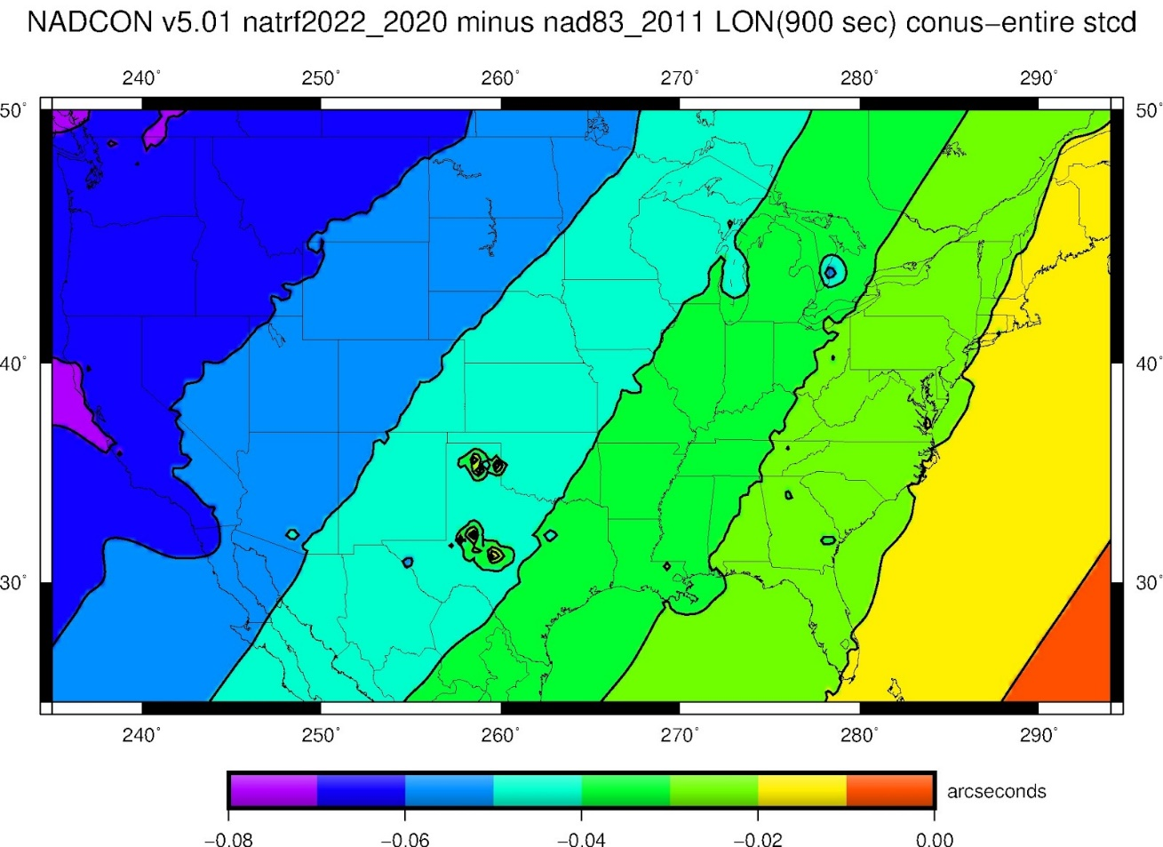
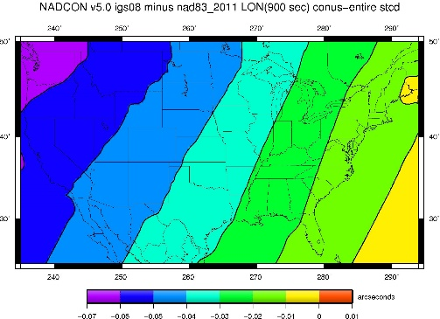
NADCON (longitude)
What we’ve been predicting
What our first iteration looks like

Slide 23
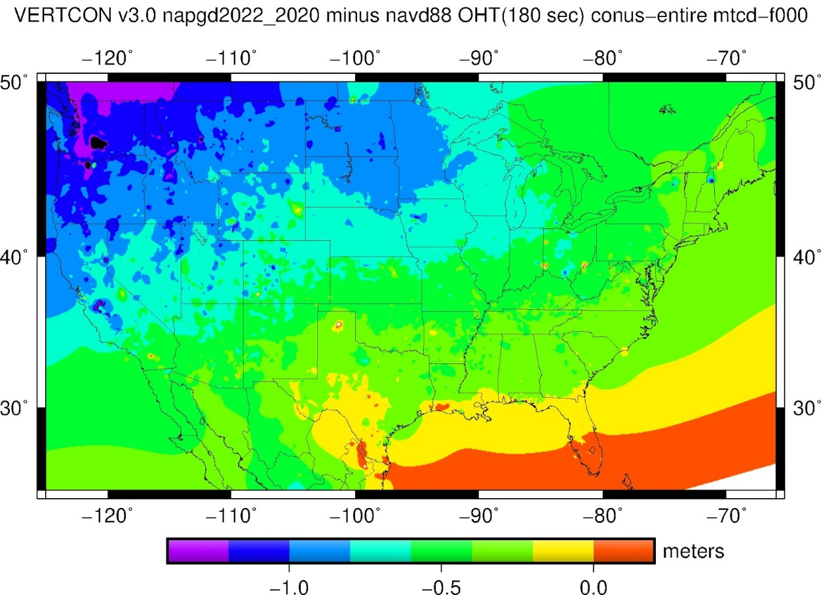
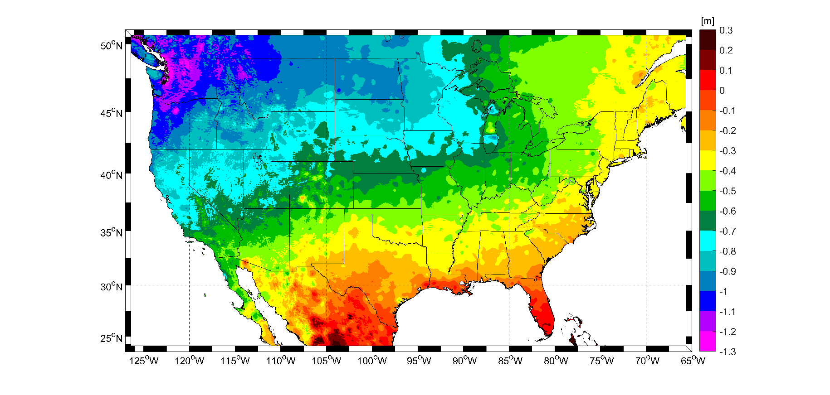
VERTCON
What we’ve been predicting
What our first iteration looks like

Slide 24
Thank you

Slide 25
Questions?

Slide 26
Extra Slides

Slide 27
So what about IFDM2022?
Danger!
Our current version of IFDM2022 is a global model of linear velocities on a 0.1 arc degree grid, plus a series of regional displacement grids on various spacings, one for each Earthquake back to 1934.
It is lacking in significant ways:
Poor horizontal resolution near fault lines
Poor vertical resolution in general
Lack of input data in oceanic/island regions
Notes:
In the parlance of the multi-epoch least-squares adjustment (ME-LSA) problem, IFDM2022 is a “geodetic value change model” or GVCM because it is stored as changes (either linear velocities or instantaneous displacements) to the geodetic values of northing, easting and up. This is in contrast to a model of changes to parameter values (MCPV), which is derived from the GVCM, and is a representation the total linear changes, from one epoch (observation or constraint) to another epoch (the adjustment epoch), to the parameters of the ME-LSA, namely geocentric coordinates in X, Y and Z.

Slide 28
So what about IFDM2022?
Danger!
The sole use of IFDM2022 is as an input model to SPROCCET
SPROCCET’s sole use at NGS is as a pre-processor to least-squares adjustments.
It projects through time observations, constraints and cofactor matrices from some epoch to the adjustment epoch
Failure to take the next step (performing a constrained least-squares adjustment upon those projected data) will mean suffering unknown and possibly unknowable errors on observations and constraints.
Notes:
We call SPROCCET a “LASER pre-processor”

Slide 29
So what about IFDM2022?
Danger!
Unless a coordinate is an observation (such as from PPP) or is serving as a constraint in a least-squares adjustment, SPROCCET was not built to deal with it.
SPROCCET does not project general coordinates through time.
It could be forced to do so, but we don’t like it.
Notes:
We call SPROCCET a “LASER pre-processor”

Slide 30
So what about IFDM2022?
Danger!
NGS’s mission is geodetic control
We define that control in two and only two ways:
CORS coordinate functions
Reference epoch coordinates (RECs)
As an additional scientific add-on to our mission, we will compute survey epoch coordinates (SECs) if and only if observations exist at the survey epoch to compute said SECs
These are useful for showing discrete coordinates in time, and thus to infer motion through time
Inferred velocities are not definitive
SECs are not geodetic control
Notes:
We call SPROCCET a “LASER pre-processor”

Slide 31
All NGS frames, ITRFs and WGS84s
Connected by 14-parameter Helmert transformations
Epoch 2010.00
Epoch: 2010.00
For epoch 2010.00, NADCON provides a path in/out of this box, since frame NAD83_MA is definitionally equivalent to NAD83_MA11.
NCAT will know that NAD83_MA (XYZ, 2010.00) is equivalent to NAD 83(MA11) epoch 2010.00 XYZ values.
It can then convert to other forms, especially φ, λ, h…
…which then allows for either further conversions within the same datum…
…or allows for NADCON connections out of the frame.
ITRF88 (100)
NAD83_NA (260)
Etc.
16
ITRF96 (250)
NAD83_MA (330)
Etc.
Equivalent!!
23
ITRF2000 (290)
22
Etc.
Etc.
NAD83_PA (320)
φ, λ, h
φ, λ, h
φ, λ, h
30A,30B,30C
39
31A,31B,31C
ITRF2020 (460)
X, Y, Z
SPC
X, Y, Z
SPC
X, Y, Z
SPC
NATRF2022 (490)
USNG
UTM
40
There is no connection
here. Different epochs!
But if IFDM is allowed to “define” coordinates, a connection can be made here. But that generally is not going to be allowed.
USNG
UTM
USNG
UTM
PATRF2022 (500)
41
NAD83_MA11
(308)
NAD83_2002_GC
(299)
42
MATRF2022_2020
(891)
CATRF2022 (510)
Etc.
MATRF2022 (520)

Slide 32
What about the Caribbean?
In the current NSRS, the NAD 83(2011) epoch 2010.00 (and NAD 83(NSRS2007)) coordinates were computed as if they were on the North American plate
That will change with the modernized NSRS
Thus the next slide needs careful consideration

Slide 33
All NGS frames, ITRFs and WGS84s
Connected by 14-parameter Helmert transformations
Epoch 2010.00
Epoch: 2010.00
For epoch 2010.00, NADCON provides a path in/out of this box, since frame NAD83_NA is definitionally equivalent to NAD83_2011, whether on the North American Plate or the Caribbean plate!
NCAT will know that NAD83_NA (XYZ, 2010.00) is equivalent to NAD 83(2011) epoch 2010.00 XYZ values on the Caribbean plate.
It can then convert to other forms, especially φ, λ, h…
…which then allows for either further conversions within the same datum…
…or allows for NADCON connections out of the frame, on the Caribbean plate.
ITRF88 (100)
NAD83_NA (260)
Etc.
16
ITRF96 (250)
Equivalent!!
NAD83_MA (330)
Etc.
23
ITRF2000 (290)
22
Etc.
Etc.
NAD83_PA (320)
φ, λ, h
φ, λ, h
φ, λ, h
22A,22B,22C
39
23A,23B,23C
ITRF2020 (460)
X, Y, Z
SPC
X, Y, Z
SPC
X, Y, Z
SPC
NATRF2022 (490)
USNG
UTM
40
USNG
UTM
USNG
UTM
PATRF2022 (500)
There is no connection
here. Different epochs!
But if IFDM is allowed to “define” coordinates, a connection can be made here. But that generally is not going to be allowed.
41
NAD83_2011
(255)
NAD83_NSRS2007
(245)
42
CATRF2022_2020
(861)
CATRF2022 (510)
Etc.
For region “CONUS” the NAD 83(NSRS2007) to NAD 83(2011) epoch 2010.00 NADCON transformations are 6A, 6B and 6C. Here, in the PRVI region, they are 22A, 22B, 22C
MATRF2022 (520)

