Slide 1

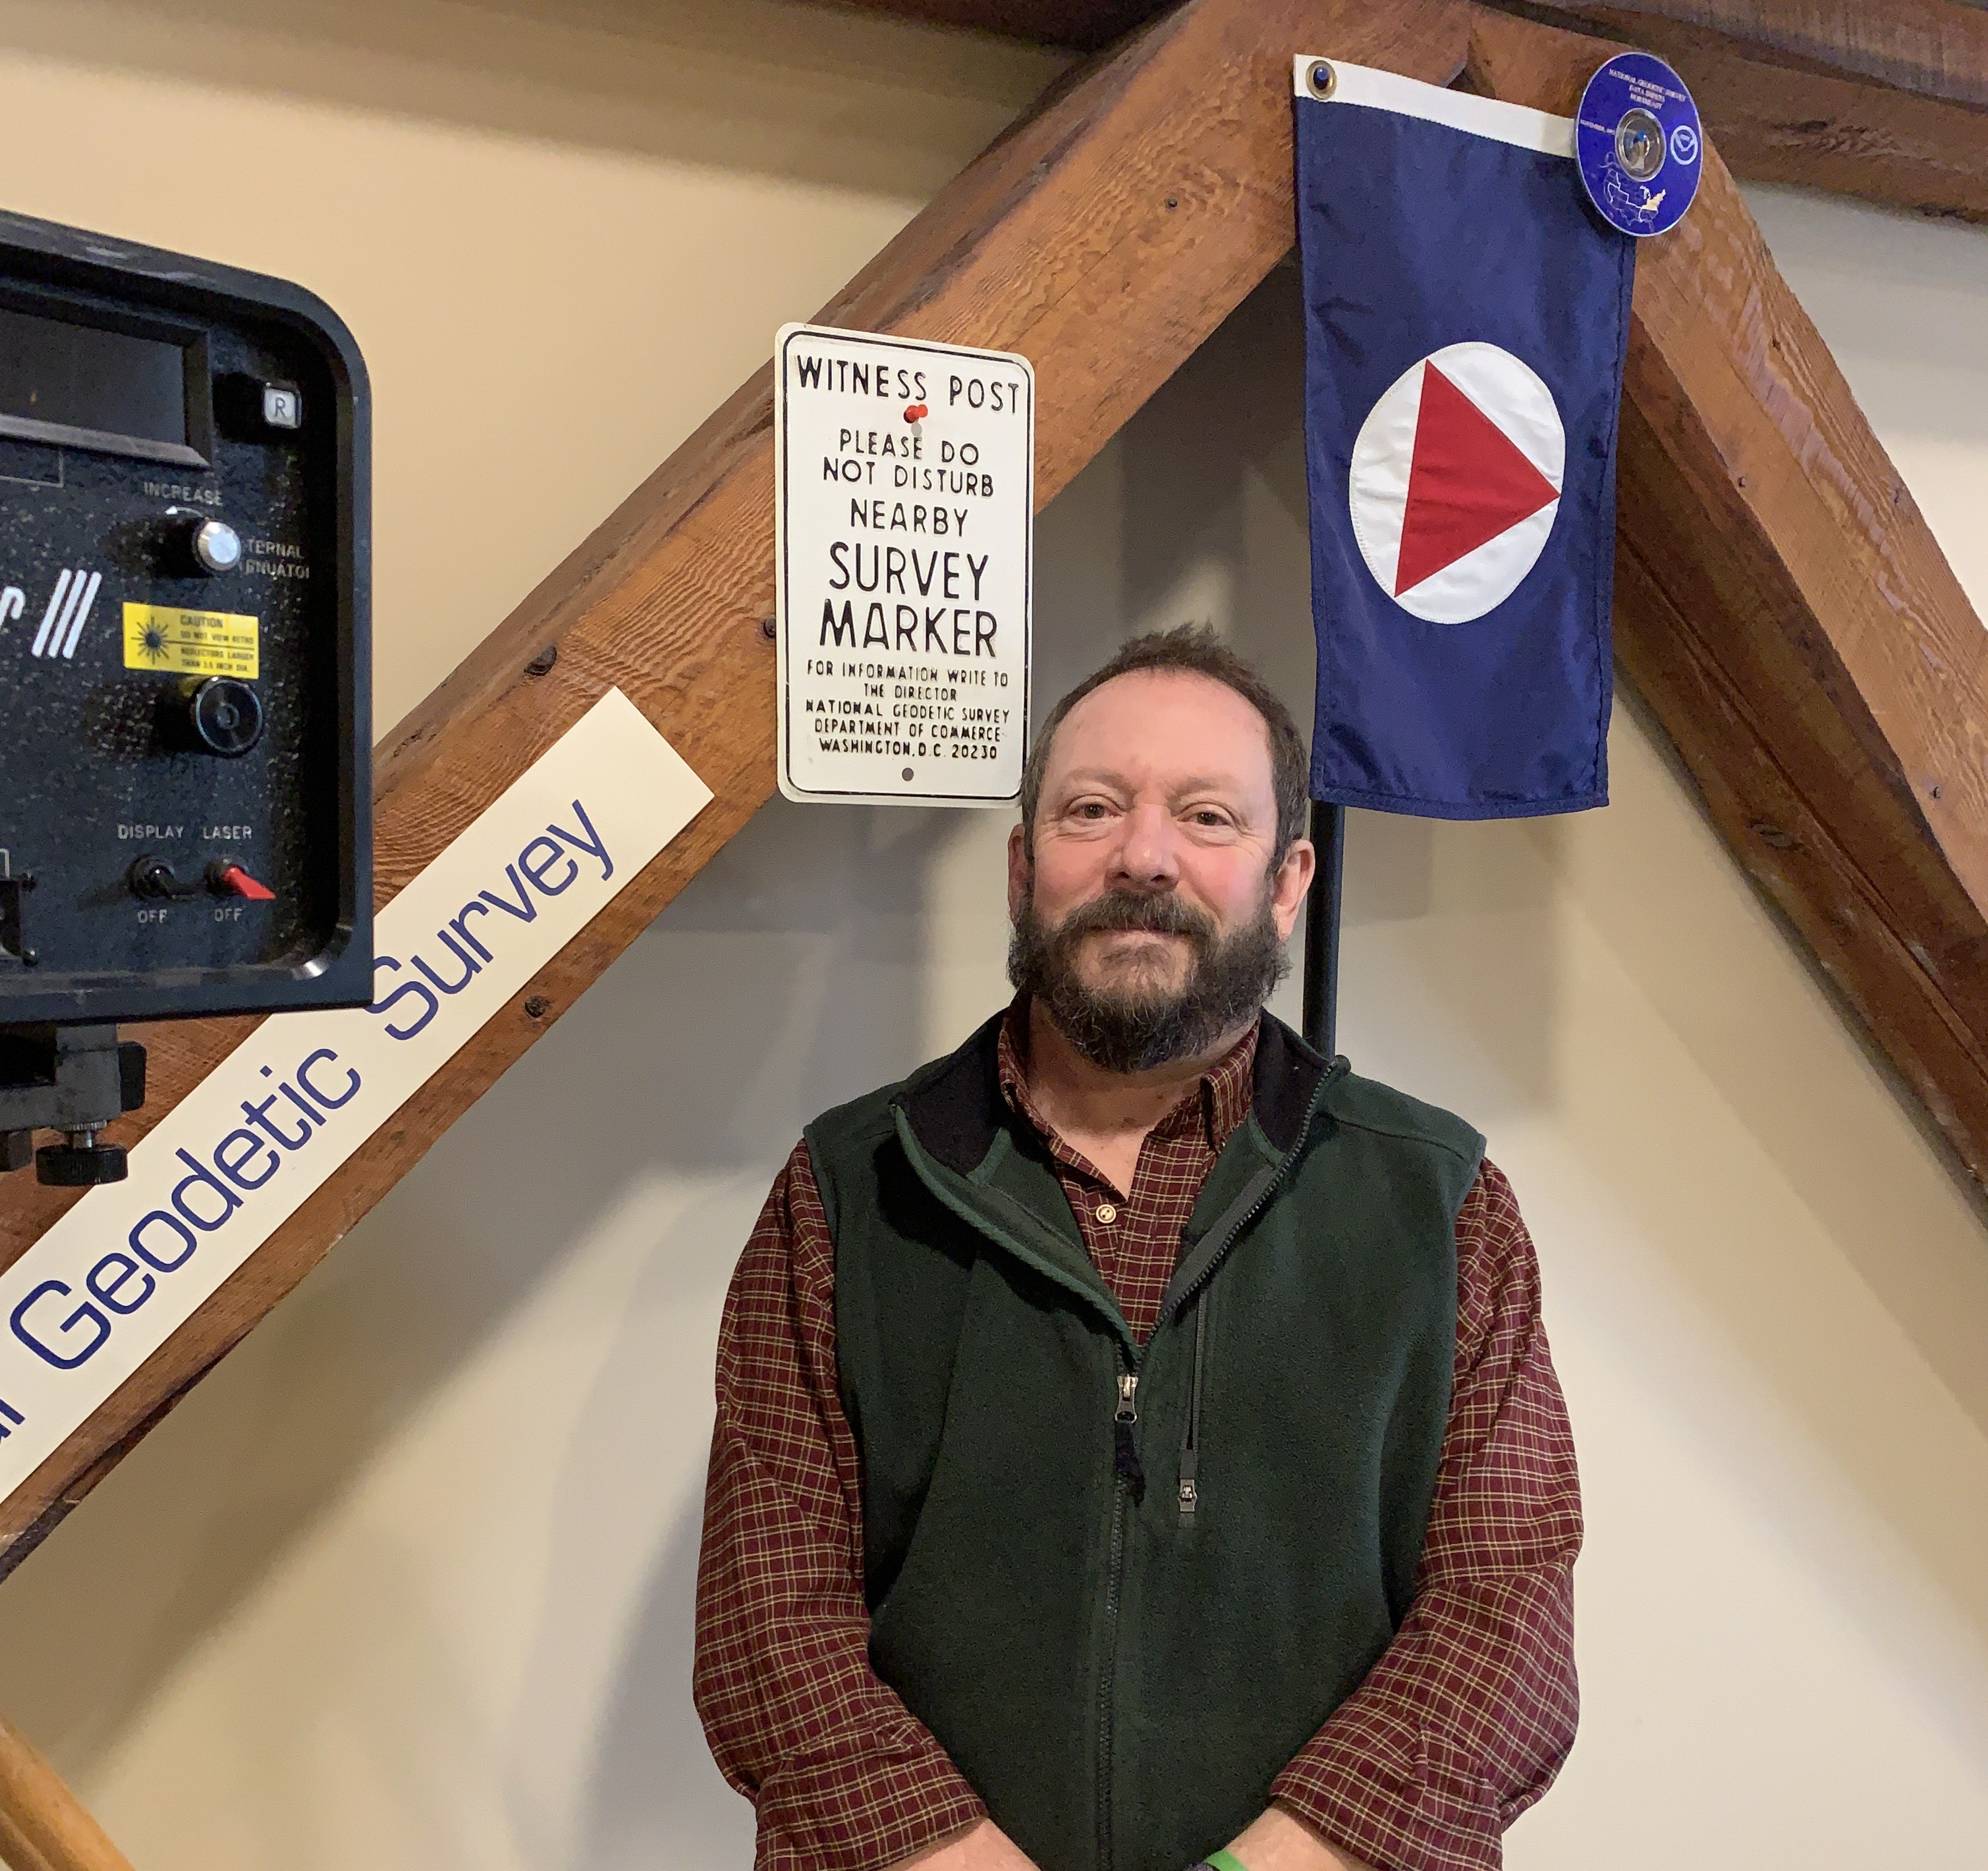
The National Spatial Reference System: the Common Foundation of Surveying and GIS
NY State Geospatial Advisory Committee
March 12, 2025
Dan Martin
Northeast Regional Geodetic Advisor
Dan.martin@noaa.gov
240-676-4762

Slide 2
National Spatial Reference System
(NSRS)
NGS Mission: To define, maintain & provide access to the National Spatial Reference System (NSRS) to meet our Nation’s economic, social & environmental needs
Consistent National Coordinate System
Latitude/Northing
Longitude/Easting
Height
Scale
Gravity
Orientation
& how these values change with time

Slide 3
Bottom Line Up Front
If you do geospatial work in the USA…
and you work in the National Spatial Reference System..
every product you’ve ever made…
  every survey…
  every map…
  every lidar point cloud…
  every image…
  every DEM…
  WILL have outdated coordinates on it in the next couple of years.
  Let’s talk about what this means, why it is happening, and how it will affect things going forward

Slide 4
GEODETIC DATUMS
  HORIZONTAL
  2 D (Latitude and Longitude) (e.g. NAD 27, NAD 83 (1986))
  VERTICAL
  1 D (Orthometric Height) (e.g. NGVD 29, NAVD 88, Local Tidal)
  GEOMETRIC
  3 D (Latitude, Longitude and Ellipsoid Height)
  Fixed and Stable - Coordinates seldom change
  (e.g. NAD 83 (1996), NAD 83 (2007), NAD 83 (CORS96) NAD 83 (2011))
  also
  4 D (Latitude, Longitude, Ellipsoid Height, Velocities) Coordinates change with time
  (e.g. ITRF00, ITRF08, ITRF14, ITRF20 etc…)

Slide 5
Horizontal Datums/Coordinates…What do we (you) use in your state?
NAD 27
NAD 83 (Lat-Lon) SPC
  Which one???
    NAD 83 (1986)
    NAD 83 (19xx) - HARN
    NAD 83 (1996) - FBN
    NAD 83 CORS96(2002)
    NAD 83 (NSRS2007)
    NAD 83 (2011) epoch 2010.00
WGS 84
  Which one???
    WGS 84 (1987)
    WGS 84 (G730)
    WGS 84 (G873)
    WGS 84 (G1150)
    WGS 84 (G1674)
    WGS 84 (G1762)
    WGS 84 (G2296)
ITRFxx (epoch xxxx)
IGSxx (epoch xxxx)

Slide 6
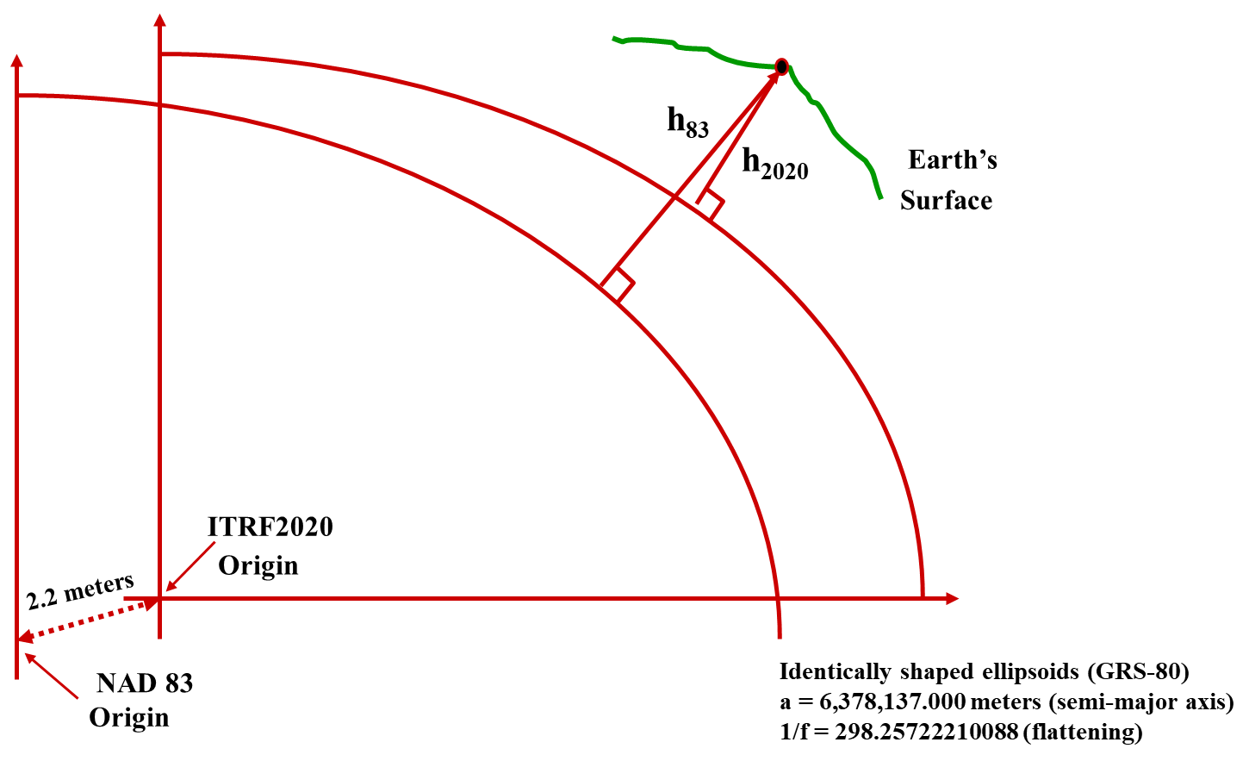

Why Modernize the NSRS?
NAD 83 is not as geocentric as it could be (approx. 2 m)
  Positioning Professionals don’t see this - Yet
NAD 83 is not well defined with positional velocities
NAVD 88 is realized by passive control (bench marks) most of which have not been re-leveled in at least 40 years.
NAVD 88 does not account for local vertical velocities (subsidence and uplift)
  Post glacial isostatic readjustment (uplift)
  Subsurface fluid withdrawal (subsidence)
  Sediment loading (subsidence)
  Sea level rise (up to 2 ft per 100 years) in CONUS

Slide 7

Main Benefits of Modernized NSRS
Fast, Accurate, Consistent Elevations Everywhere
Improved Public Safety
  Flood Plain Maps
  Emergency Route Planning
Accurate Positioning
  Autonomous vehicles, BIMs, Smart Cities
Notes:
NSRS Modernization News
https://geodesy.noaa.gov/datums/newdatums/TrackOurProgress.shtml

Slide 8
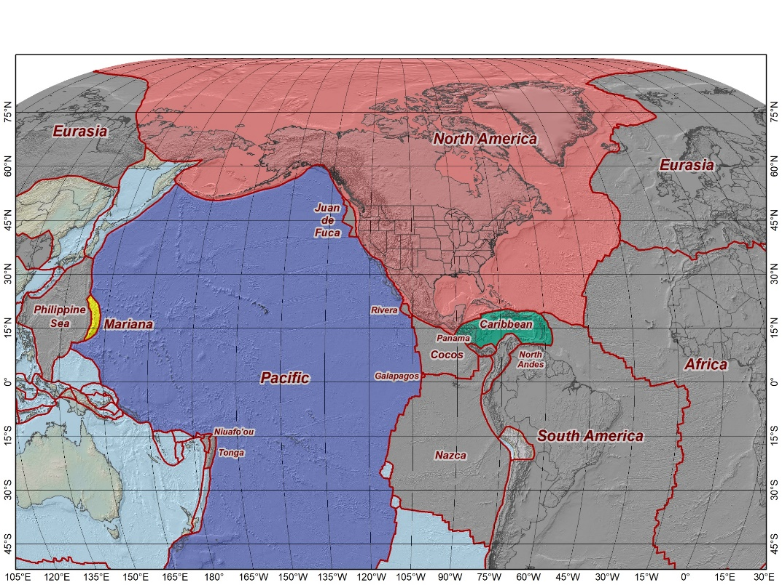
The Future Geometric Frames
The tectonic plates “fixed” for the
2022 Terrestrial Reference Frames
Tectonic Plate based
Each Plate is based on the same
densified ITRF model
North America NATRF
Caribbean CATRF
Pacific PATRF
Mariana MATRF
NATRF2022
MATRF2022
PATRF2022
CATRF2022
Notes:
NSRS Modernization Naming Conventions https://geodesy.noaa.gov/datums/newdatums/naming-convention.shtml

Slide 9
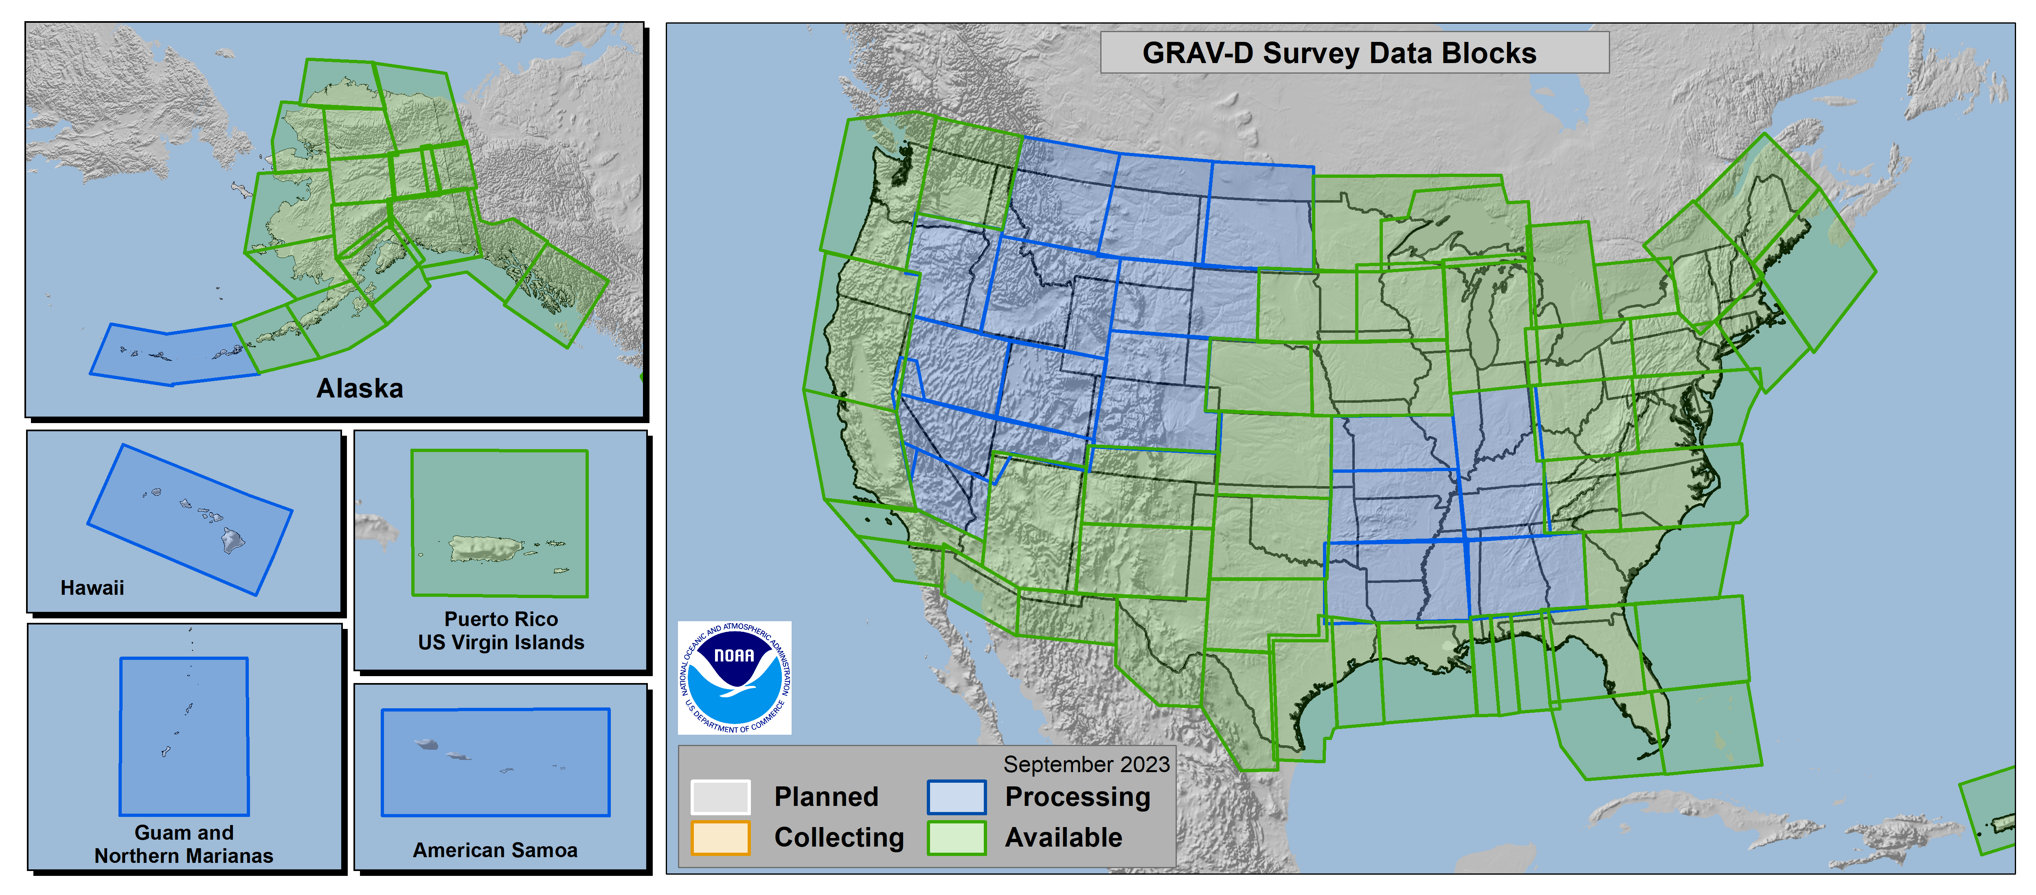
Gravity of the Redefinition of the American Vertical Datum
GRAV-D
100% Complete (2/05/2023)
Notes:
More information on GRAV-D
https://geodesy.noaa.gov/GRAV-D/
Data Download for GRAV-D blocks
https://geodesy.noaa.gov/GRAV-D/data_products.shtml

Slide 10


Slide 11
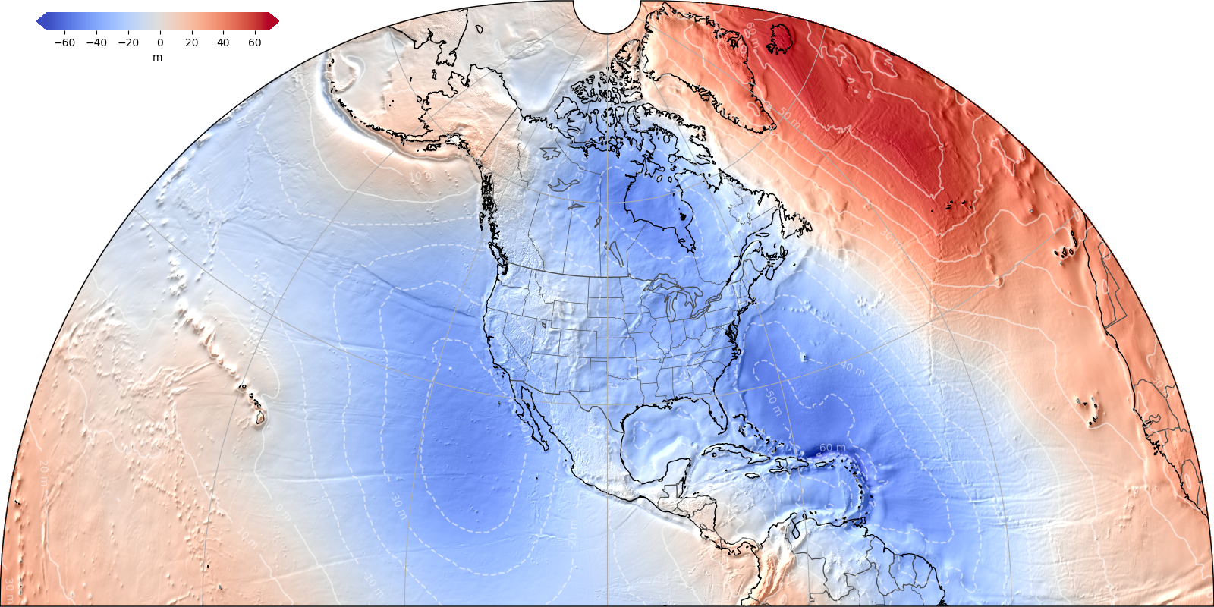
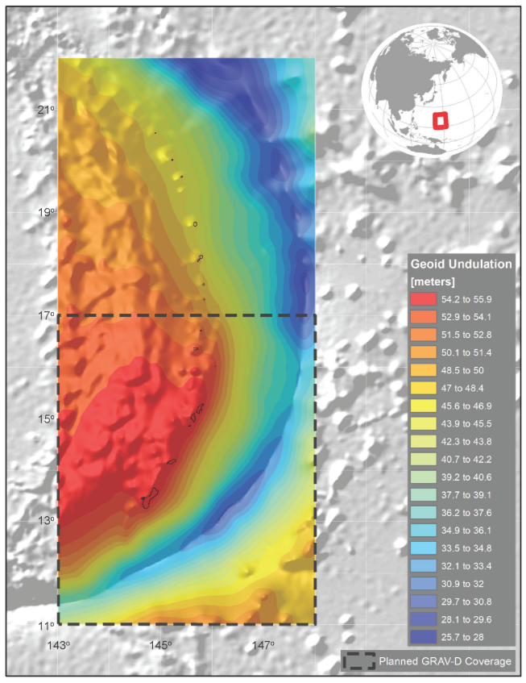
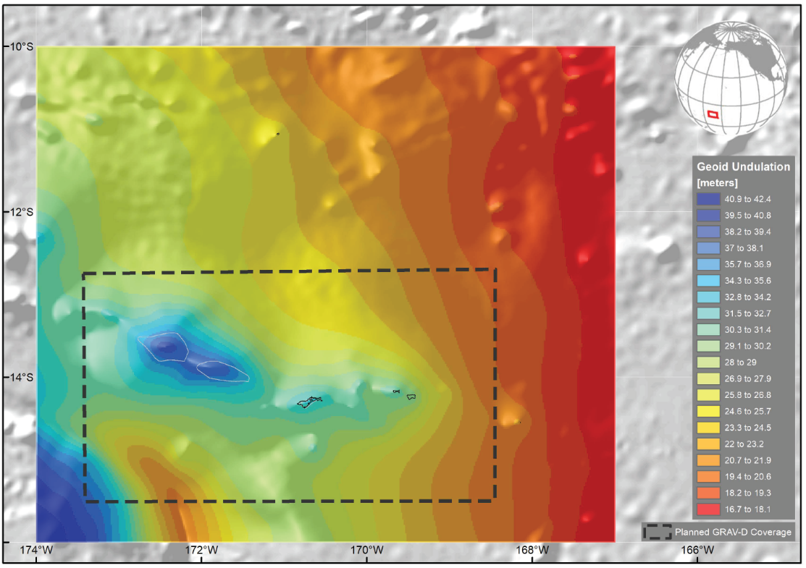
NAPGD2022 Geopotential Datum
North American-Pacific Geopotential Datum of 2022
Not a vertical datum, it is more than just heights.
Models included: Geopotential Deflection Gravity
Geoid
Alpha Geoid2022
¼ Earth’s Surface
Guam/CNMI
American Samoa
Notes:
NSRS Modernization News
https://geodesy.noaa.gov/datums/newdatums/TrackOurProgress.shtml
Experimental Geoid Models
https://beta.ngs.noaa.gov/GEOID/xGEOID20/
As noted in the Blueprint 2 document
https://geodesy.noaa.gov/library/pdfs/NOAA_TR_NOS_NGS_0064.pdf
NAPGD2022 will include all of the following
Geopotential Model of 2022 (GM2022) will include:
Static Geopotential model of 2022 (SGM2022)
Dynamic Geopotential model of 2022 (DGM2022)
GEOID2022 will include:
Static Geoid model of 2022 (SGEOID2022)
Dynamic Geoid model of 2022 (DGEOID2022)
DEFLEC2022 will include:
Static Deflection of the Vertical model of 2022 (SDEFLEC2022)
Dynamic Deflection of the Vertical model of 2022 (DDEFLEC2022)
GRAV2022
Static Gravity model of 2022 (SGRAV2022)

Slide 12
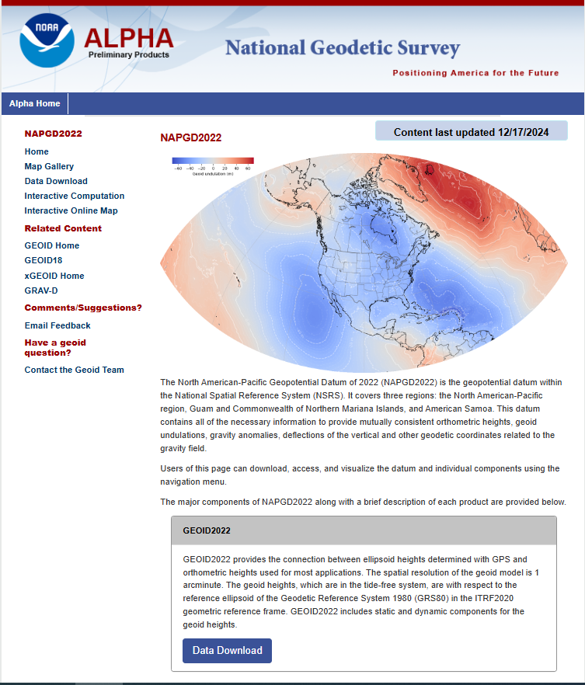
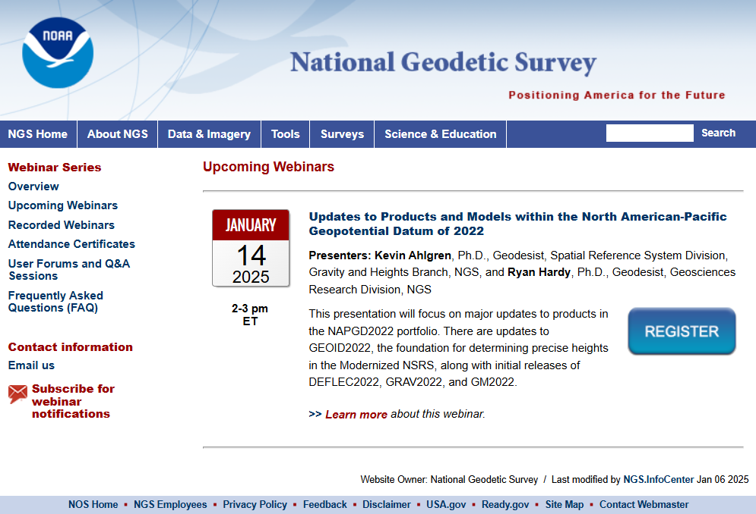
NAPGD2022 ALPHA
Jan 14, 2025 Webinar Algren,
https://alpha.ngs.noaa.gov/NAPGD2022/

Slide 13
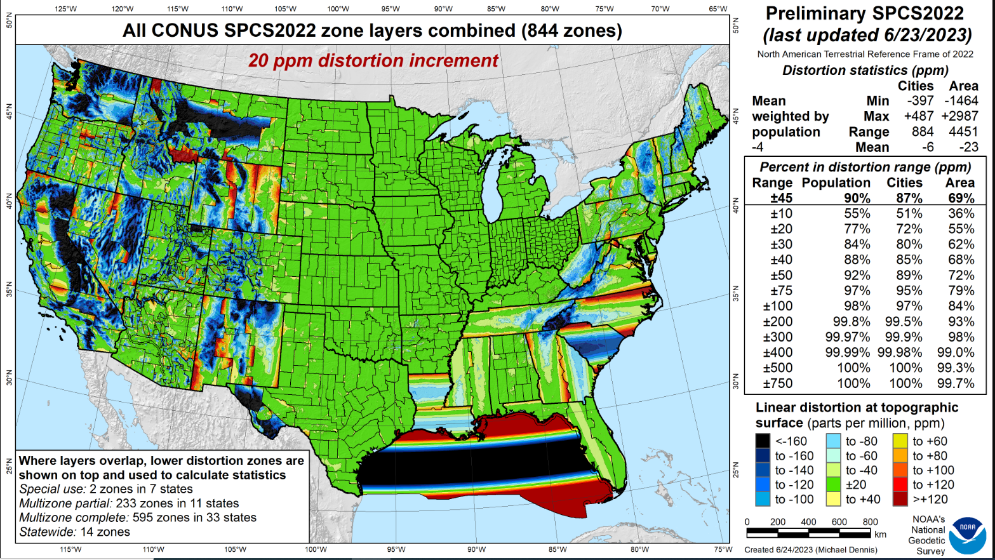
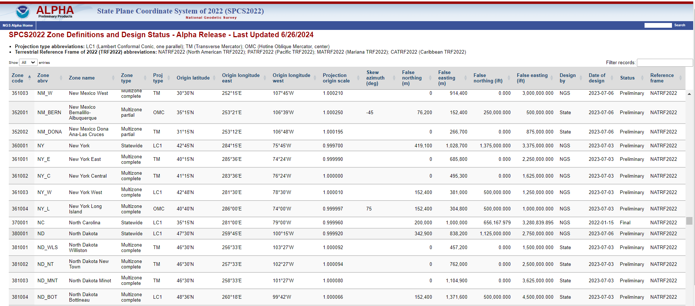

Slide 14

Replacing NAD 83
Develop four "plate-fixed" reference frames
Remove non-geocentricity of NAD 83 (Shift)
Align to ITRF2020 at epoch 2020.00
Remove most of tectonic plate rotation from ITRF2020 via Euler Pole Parameters
(pronounced: “oiler”) (Drift)
Shift and Drift…
Notes:
We’ll talk about that ‘plate fixed’ later.
Now wait a minute Jeff, what is the IGS? You just explained the ITRF and told us about that!!
IGS Reference Frame is pretty much equivalent to the ITRF, created by the Intl. GNSS Service, of which NGS is a contributing partner.
The Intl. GNSS Service, let’s take a look at their website for a minute.
-pronounced “oiler” poles

Slide 15
Shift and Drift
A sudden shift
  Horizontal change: 0.5 to 4 m (1.5 to 13 ft)
  Ellipsoid height change: ±2 m (±6 ft)
  Elevation change: -0.5 to +2 m (-1.5 to +6 ft)
A continuous drift
  Coordinates associated with specific dates
Two components of drift:
  Tectonic plate rotation (easy to model, 2D only)
  All other residual motion (hard to model, 3D)
Notes:
NSRS Modernization News
https://geodesy.noaa.gov/datums/newdatums/TrackOurProgress.shtml

Slide 16
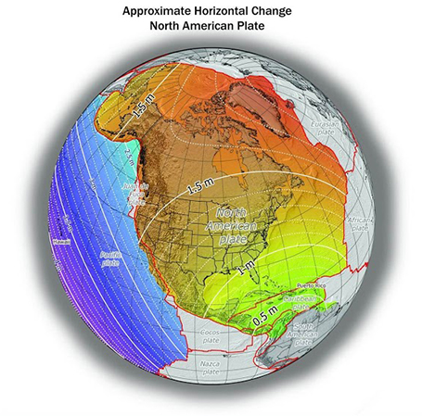
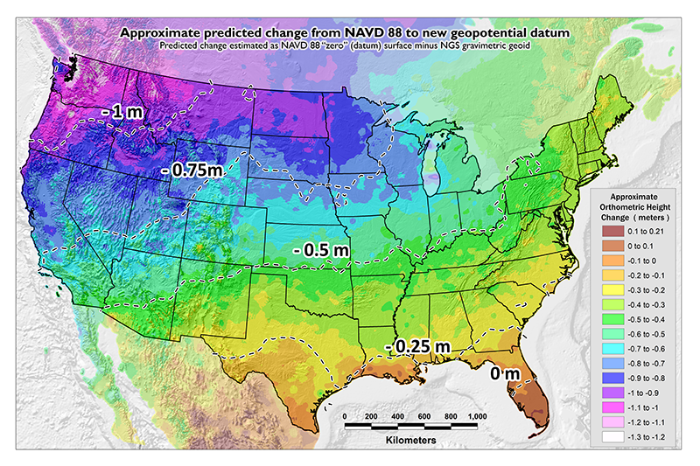
Shift: datum changes
~1 to 1.5 meters North America
~2.5 to 4 meters in Pacific
0 to 1.3 meters CONUS
Notes:
New Datums What to expect https://geodesy.noaa.gov/datums/newdatums/WhatToExpect.shtml
NGS is not shifting the land, merely shifting the reference surfaces to which we reference the geospatial data to.

Slide 17
Euler Poles and “Plate-Fixed”
ITRF
Frame = constant
NA Plate = rotating
NATRF
Frame = rotating
(relative to ITRF)
NA Plate = constant
(relative to NATRF2022)
Notes:
We say “NATRF2022” is “fixed” to the N.A. Plate, making it a “plate fixed” frame
-the frame is constant to itself, but rotating within ITRF, and moving in a different direction than the other 3 frames

Slide 18
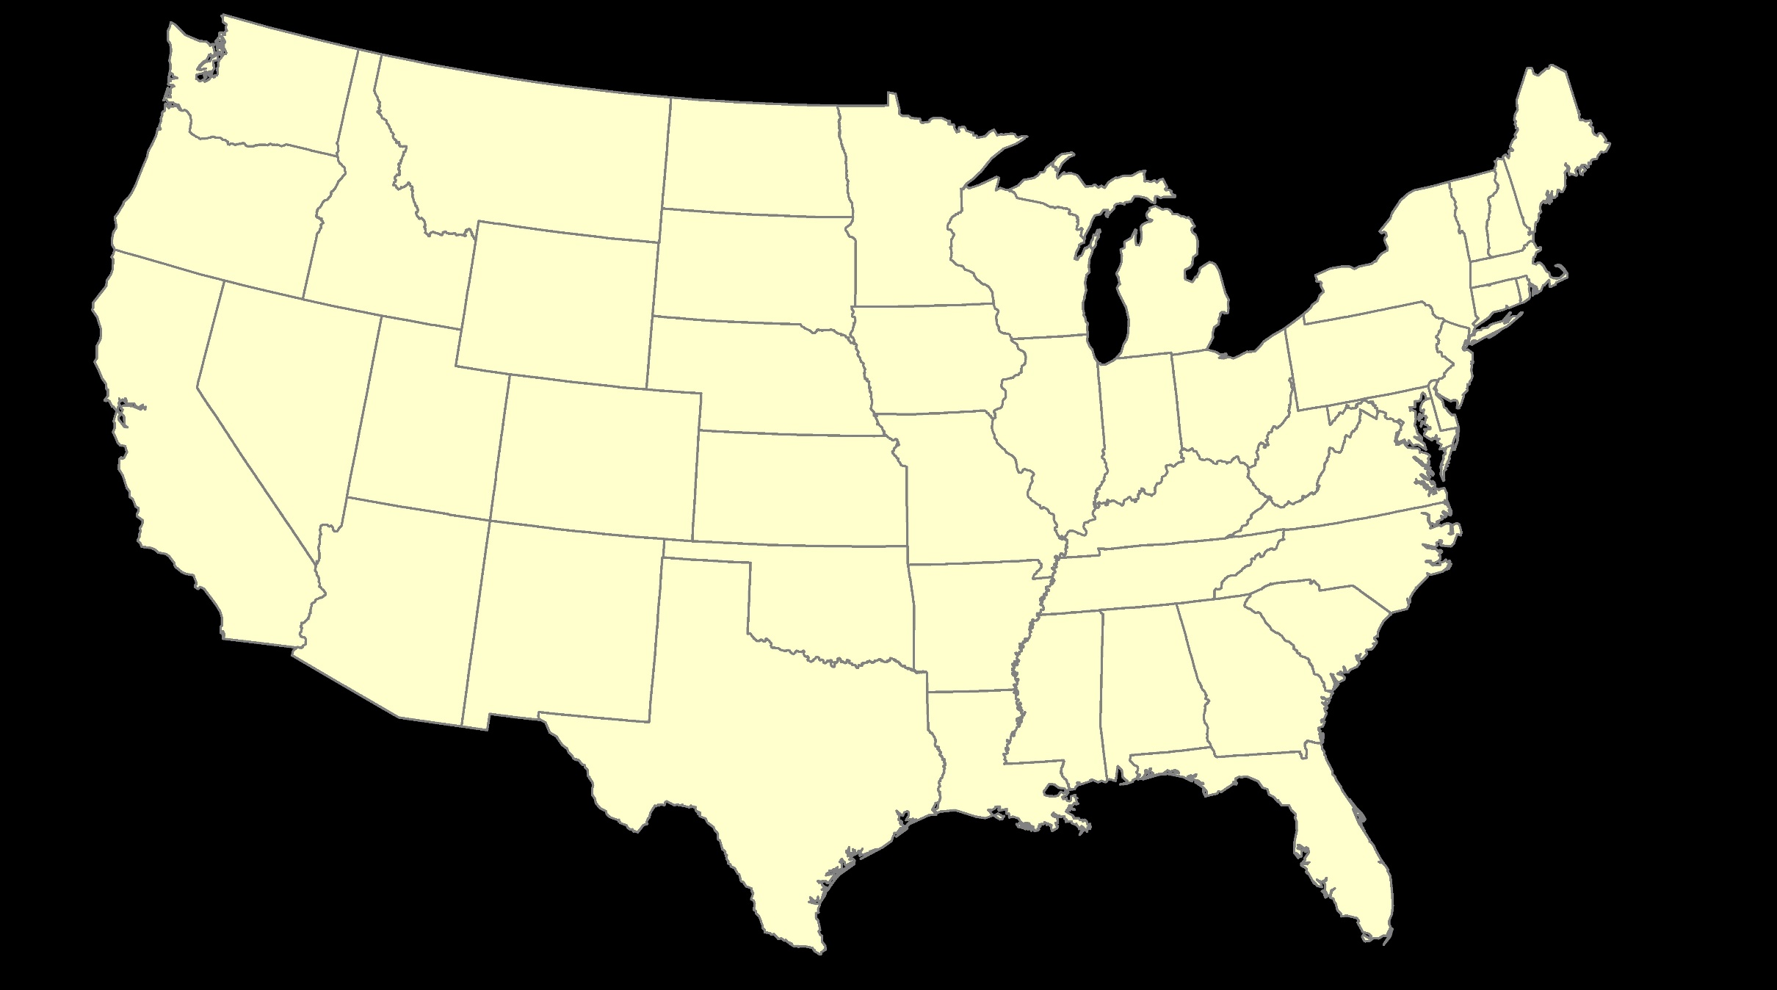
ITRF – constant frame, rotating plate

Slide 19
“Plate-Fixed”
NATRF – rotating frame, constant with plate

Slide 20
ITRF or NATRF – your choice, just use EPP

Slide 21
Shift and Drift: Summary
Shift
Drift
When?
Why?
How much?
Who?
Once, at rollout
Correcting systematic errors in the current datums
Decimeters-to-meters of one-time immediate coordinate changes
Will affect everyone
Impact will grow as time goes on
Embracing the dynamic planet upon which we live
Centimeters of persistent annual coordinate changes (plus potential meter-level jumps from earthquakes)
Can mostly be ignored or mitigated through NGS’s creation of plate-fixed frames and reference epoch coordinates

Slide 22
EPP2022 – Euler Pole Parameters – Simple Rotation
  Three parameters: lat, lon, rotation speed
  Horizontal only: just latitude and longitude
  Changes the frame: ITRF2020 + EPP2022 = NATRF2022
  Does not change the epoch
IFDM2022 – Intra-Frame Deformation Model - Complex
  Complex set of parameters
  Residual horizontal motion: all the motion leftover after Euler Pole rotation plus any local/regional motions
  All vertical motion: localized subsidence or uplift
  Changes the epoch
  Does not change the frame: “intra” = on the inside; within

Slide 23
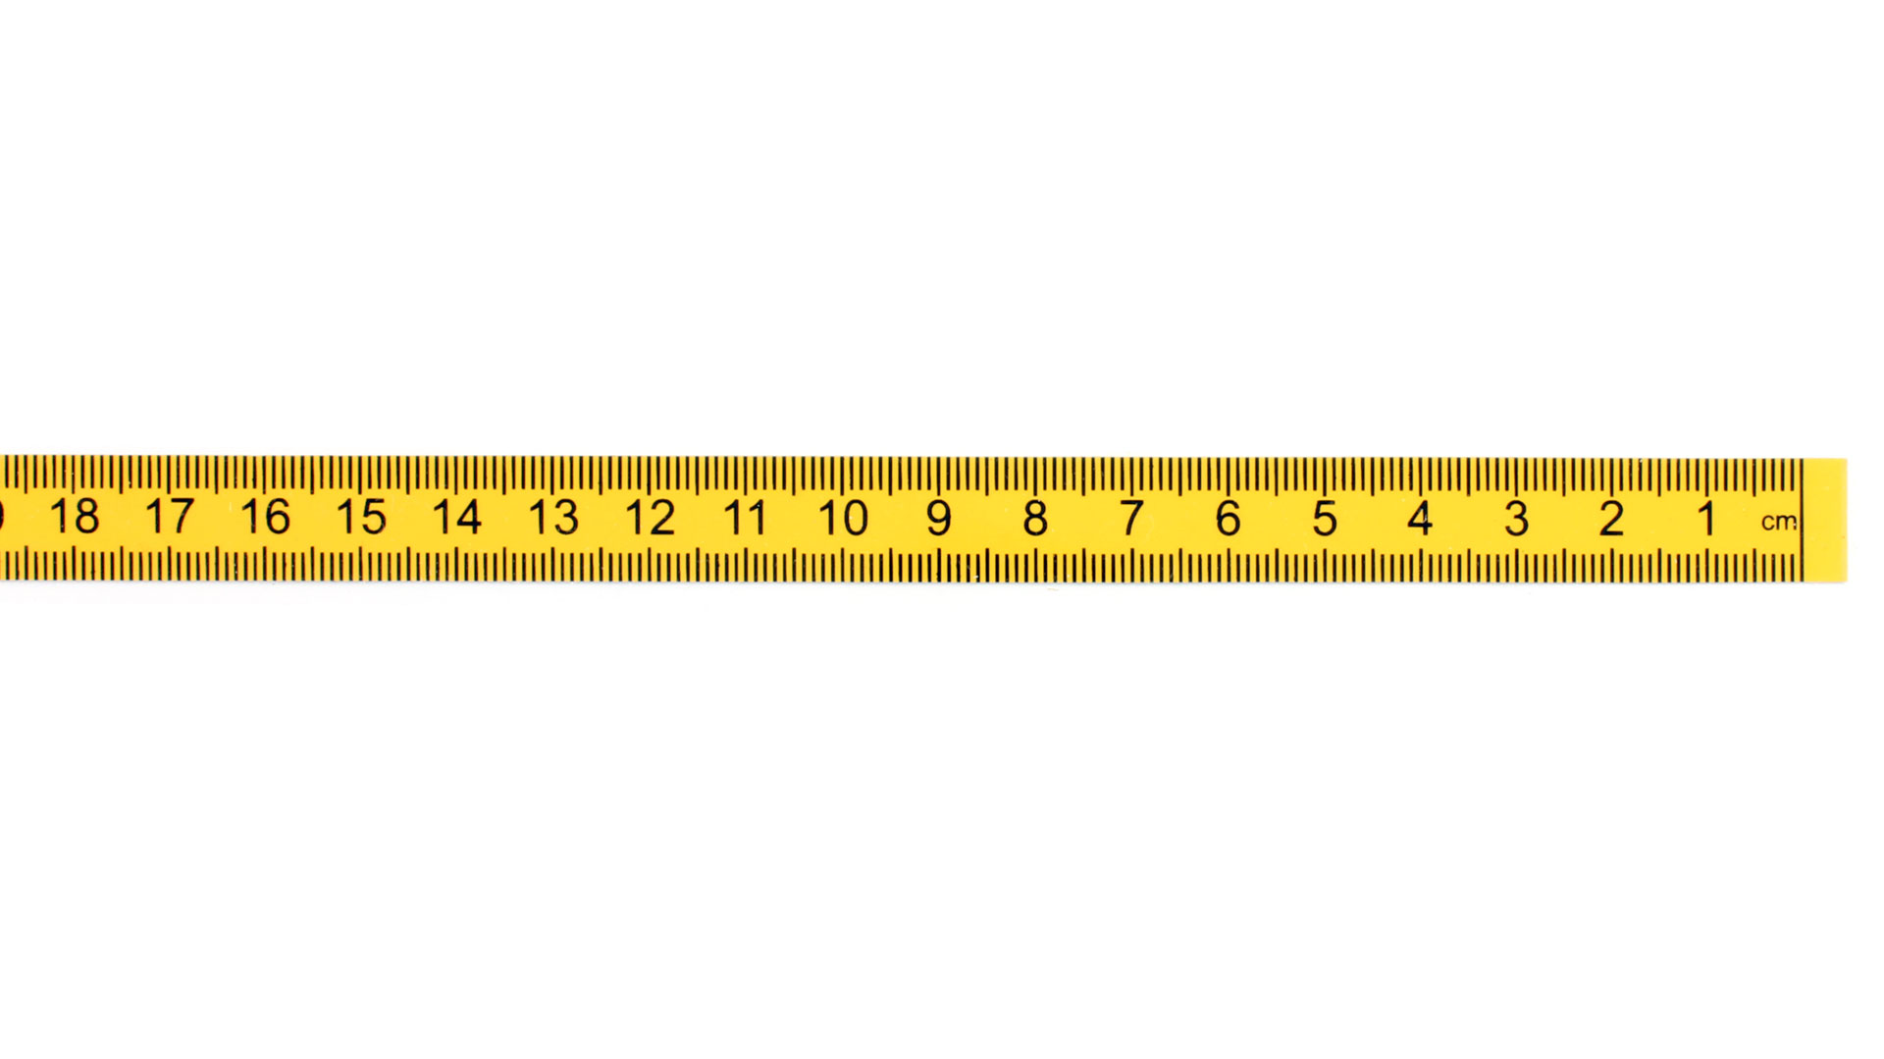


A survey done Jan 1, 2020
New Survey (same point) done Jan 1, 2030
Position of point in NATRF2022(2030)
Position of point in NATRF2022(2020)
If IFDM = 0, then NATRF2022 (2030) = NATRF2022 (2020)
Position from 2020 survey NATRF2022 (2020)
ITRF2020 (2020)
ITRF2020 (2030)
IFDM 2030-2020
NATRF2022
(2020.0)
Epp2022
fframe
NATRF2022 (2030)
(V)
fEpoch
(H)
Notes:
At 2020, ITRF and NATRF are identical. As time goes on the North American plate moves, resulting in new ITRF coordinates at epoch (say 2030) for the same point. If I remove 10 years of plate motion (ITRF velocity) it puts me back where NATRF used to be....EXCEPT, there has been local motion. That is why we call the it NATRF epoch 2030, because it is where NATRF IS in 2030. We now have to apply IFDM to get back to 2020, or any other date relative to NATRF.

Slide 24
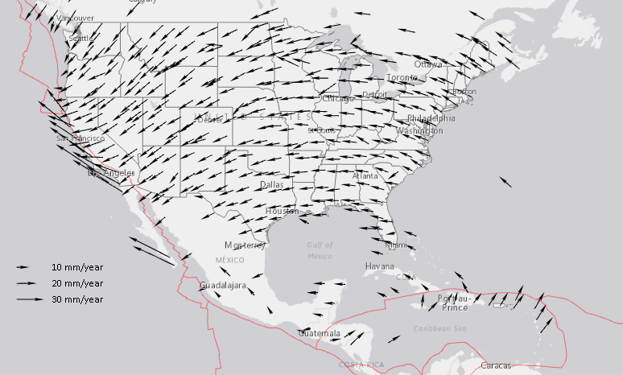
Drift: Plate Tectonics and Velocities
Annual changes to
ITRF2014 coordinates
Notes:
All plates are moving and through the constant collection of GNSS data using CORS we can now model where the land is moving. In the center of tectonic plates there is generally motion that can be measured but where plates converge can be thought of as a crunch zone and the modeling has much more uncertainty due to geophysical phenomena.

Slide 25
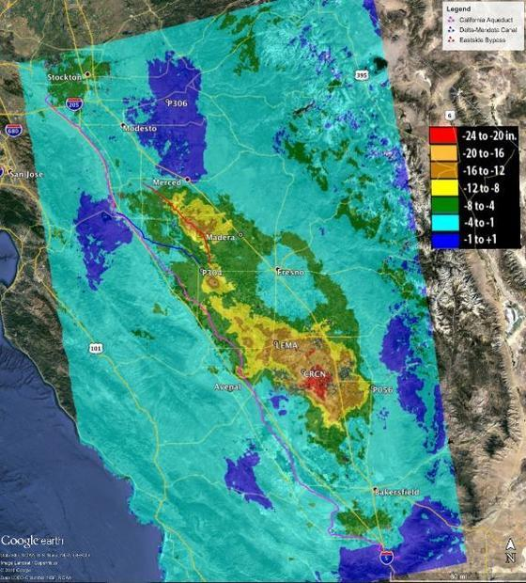
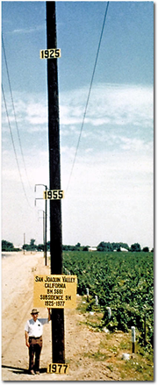
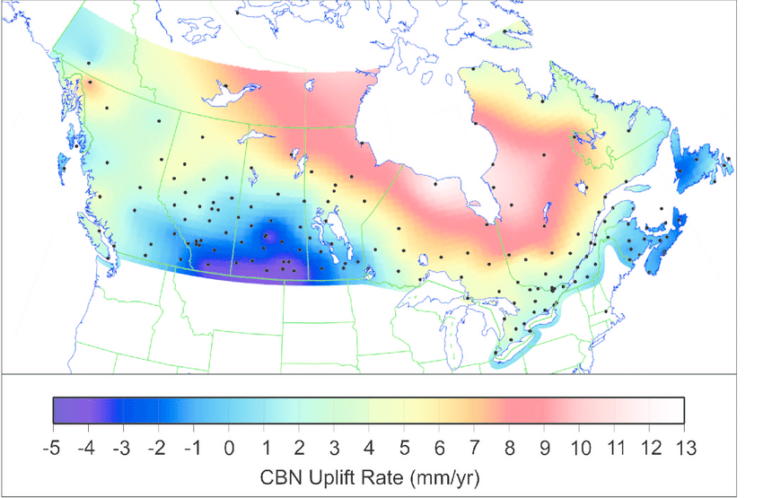
Vertical Motion
8.5 meters
50 years
May 2015
to
Sept 2016
Hudson Bay Uplifting
8 -13 mm/year
San Joaquin Subsiding
20-24” in 16 months
Notes:
San Joaquin Subsidence article
http://www.digitaljournal.com/tech-and-science/technology/sinking-san-joaquin-valley-of-california-seen-from-space/article/487393
Hudson Bay Uplift article (GIA)
https://www.researchgate.net/figure/Contour-map-of-observed-CBN-vertical-rates-Preliminary-results-from-the-combination-of_fig3_286867540
Photo of San Joaquin Valley Subsidence to 1977
https://lh4.googleusercontent.com/ymKsoXwZEP4rk4F4GqPD5S9FyMO4d0mrfL2GiLI0mXe7djBwYH3t0-OwncYltY8OJNmYk0DKh4pOLqS9DGItCHK3i23maqpjdDDISQH5ux0uqDVbrEnWTnFLPb7Woe2cka61EXC6

Slide 26
Modernization Timeline
Rollout, Testing, Replacement
NGS will roll out components of the modernized NSRS over time (2025-2026)
As each component is rolled out, it can be tested
Once the final component (likely VERTCON) is rolled out (likely late 2025), testing will continue for at least 6 months
Once enough testing is done, and all modernized NSRS components seem stable and correct, the FGCS will vote (likely 2026)
If affirmative, the modernized NSRS will replace the current NSRS

Slide 27
Best ways to determine coordinates in Modernized NSRS
Resurvey: Return to the field and collect new observations, relying upon geodetic control that has coordinates in the new datum
Readjust: Using existing observations, re-compute new coordinates based upon geodetic control (CORS) that has been defined in the new datum
Transform: Take finished products which have coordinates in the old datum and use transformation software to estimate coordinates in the new datum

Slide 28
How Can You Prepare
Metadata is essential
    Improves reliability and accuracy of data
    Increases value and usefulness
Transform and collect data in current datums
    NAD 83 (2011), NAVD 88
Make sure to note Geoid Models used for GNSS data

Slide 29
How to Prepare
Do an inventory of your data
Do you have documents, manuals, contracts, etc…that include language re: datums?
Do you have clients, subcontractors, in-house staff other than survey that need to be educated about the new datums?
Are you going to have to support projects in old datums for a while? What is the plan for that?
Store Data…not just coordinates!
  If you have your original data, it can always be reprocessed later
    Maintains the integrity of your survey
    Better than a transformation

Slide 30

NGS Resources
NGS Training Center
  https://geodesy.noaa.gov/web/science_edu/training/
Educational Videos
  https://geodesy.noaa.gov/datums/newdatums/WatchVideos.shtml
NGS Webinar Series
  https://geodesy.noaa.gov/web/science_edu/webinar_series/
Geospatial Summit (2021, 2019 recorded sessions)
  https://geodesy.noaa.gov/geospatial-summit/
Presentation Library
  https://geodesy.noaa.gov/web/science_edu/presentations_library/

Slide 31
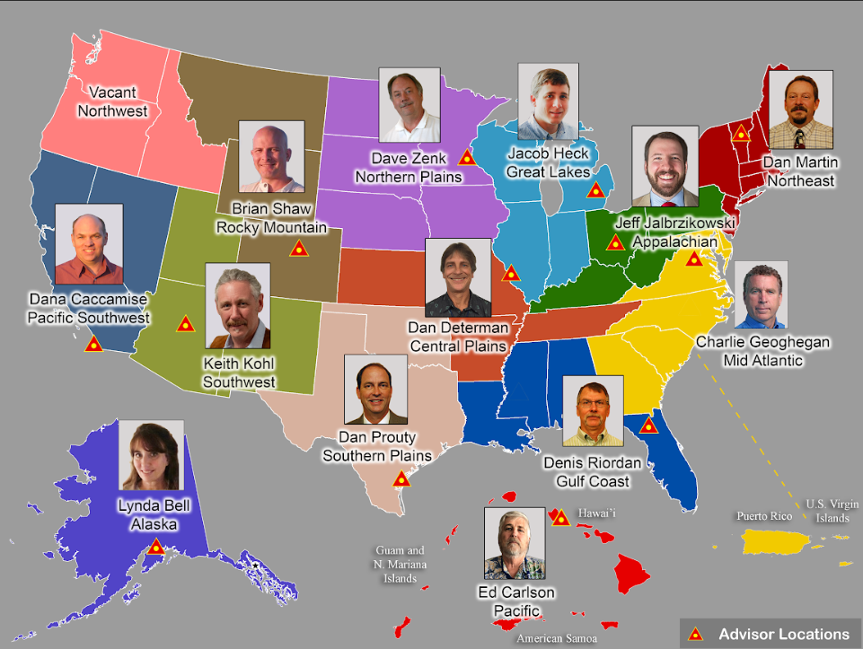
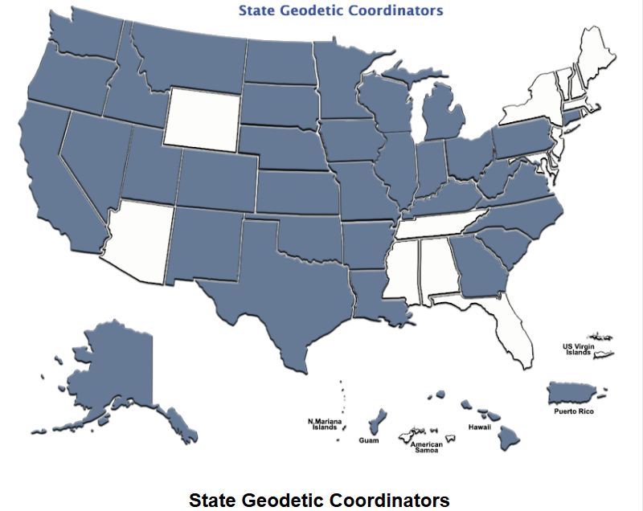
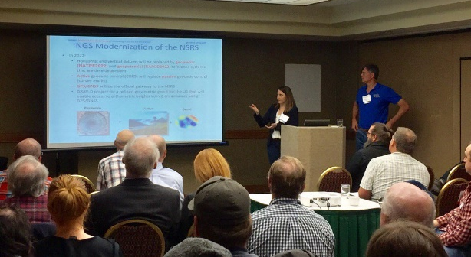
Importance of Coordination
14 Advisors
43 Coordinators
Notes:
NGS Regional Geodetic Advisors
https://geodesy.noaa.gov/ADVISORS/
State Geodetic Coordinators
https://geodesy.noaa.gov/ADVISORS/state-geodetic-coordinators.shtml

Slide 32
Questions?
Dan Martin
Northeast Regional Geodetic Advisor
ME, NH, VT, MA, CT, RI, NY, NJ
Dan.martin@noaa.gov
240-676-4762

