Slide 1
Why OPUS Projects’ Hub Processing Strategy is not a Radial Survey
An OPUS User Forum Webinar
January 16, 2025
Dan Martin
Northeast Regional Geodetic Advisor
Dan.martin@noaa.gov
240-676-4762

Slide 2
What we will cover
What do we picture when we think about a network?
Good design, bad design?
Different types of GNSS Vectors
Different types processing techniques

Slide 3
What we will cover
Planning observations
What is the Hub Processing Strategy and what are the benefits?
Control Networks – A new Paradigm, Optical vs GNSS Surveys, Different characteristics, different approaches

Slide 4
Geodetic Networks
BAD
GOOD

Slide 5
OPUS
OPUS
Session
Adjustment
CORS3
CORS5
CORS2
CORS1
CORS4
solution HATFIELD
solution MCCOY

Slide 6
OPUS Projects
OPUS
Session
Adjustment
CORS3
CORS5
CORS2
CORS1
CORS4
solution HATFIELD
solution MCCOY
session 001

Slide 7
Why do we want that “connection”?
Implies that the points are connected by a “measurement”
Implies they must have been occupied at the same time
Bottom line… It is how Surveyors picture “measurements” and it allows us to compute relative (local) accuracies between them

Slide 8
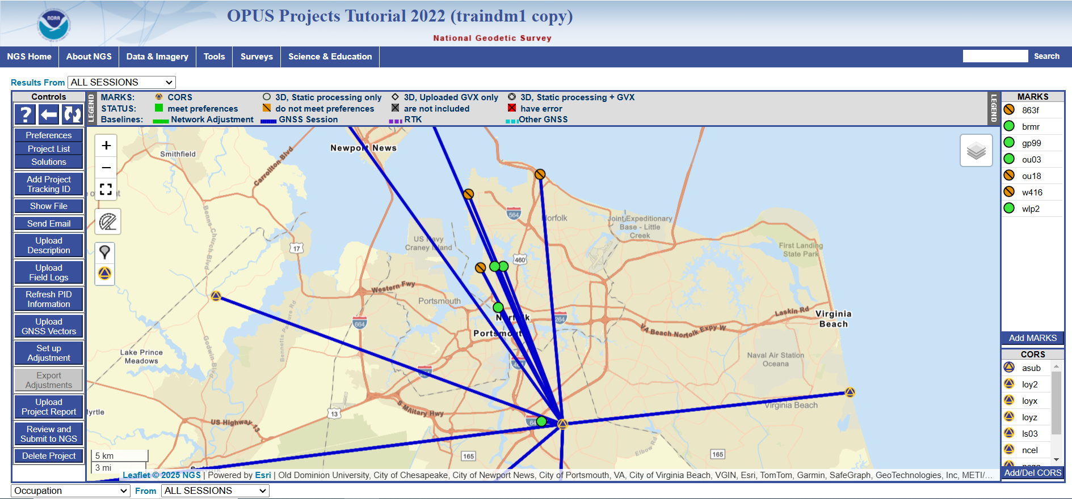
So why does my project look like this? Where are the baselines between my points?
Great Question!!

Slide 9
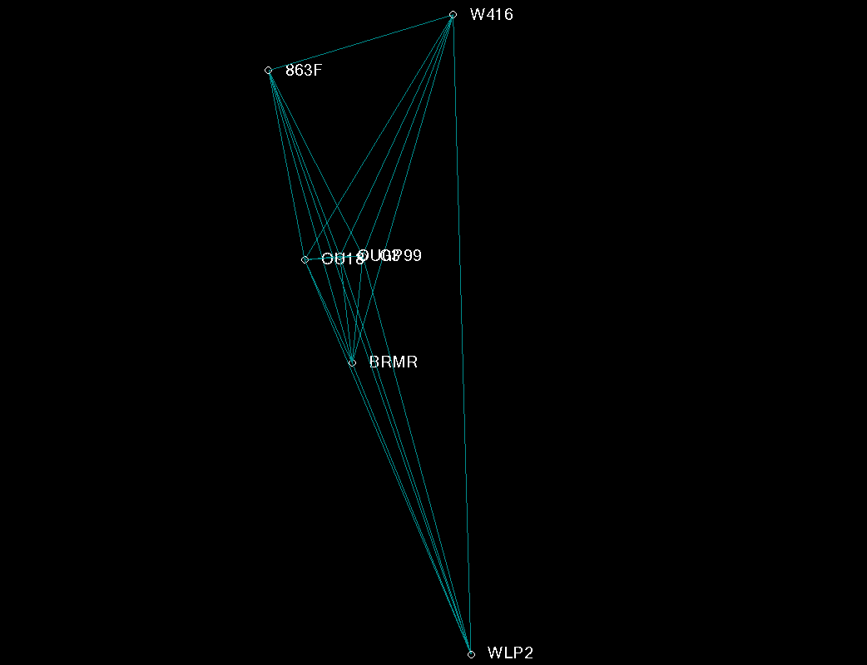
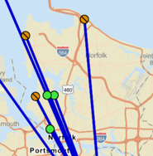
Compare to Vendor Software (Same set of observations)

Slide 10
Vector vs Baseline
A vector is a the result of a single instance of a measurement
A Baseline can be thought of as a single line between two points, that represents the existence of one, or maybe many vectors.

Slide 11
Types of Vectors (The Great Debate)
Vector (Craymer uses “Baseline”)
Coordinate vector resulting from any [simultaneously observed] station pair.
You do not really “measure” between points with GPS.
Independent (NoN-trivial) Vector
A set of vectors where no individual vector is a linear combination of any others.
Dependent (Trivial) Vectors
Vectors which are linear combinations of others.
Craymer and Beck; Proceedings of ION GPS-92

Slide 12
Independent vs Dependent Vectors
or
Number of independent (non-trivial) vectors = n-1
Independent (non-trivial)
Total number of vectors = n(n-1)/2
Dependent (trivial)
Notes:
Slide 6 - It is important to understand how PAGES, which is the baseline processing engine in OPUS Projects, works compared to commercial vendor processing software with which you may be familiar.
(click)
Let's consider creating a session using 4 receivers that develops three independent or non-trivial baselines, shown here as solid blue lines.
That would be equal to the number of receivers minus one (n-1).
(click)
Using PAGES, there are other correlations that exist, shown here as dashed red lines. PAGES computes and provides that information.
But if you went out and observed three independent baselines with your vendor software, you would not have the correlations between all the marks.
With PAGES and the fact that we suggest using the HUB type strategy, you will have those correlations.
(click)
There are different combination of "independent" vectors that one could choose to process and then you'd get a different set of correlations.
(click)

Slide 13
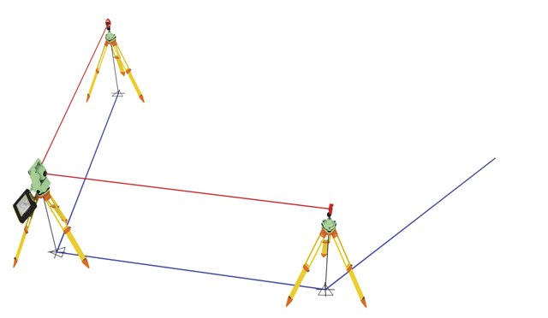
Example of Linear Dependence
Is this an observation?
Initial image Credit: billboyheritagesurvey

Slide 14
Types of Vector Processing
Simultaneous (Session) Processing
Solution from simultaneous processing of all independent vectors with mathematical correlations between simultaneously observed vectors
Includes only the independent vectors = (n-1)
Ready for combining into network adjustments
The PAGES processor inside OPUS Projects is a session processor.

Slide 15
Types of Vector Processing
Sequential (Baseline) Processing
One vector at a time
Can include all independent and dependent vectors for each session = (n) x (n-1) / 2*
Ignores mathematical correlations between baselines observed in the same session.
Must be properly scaled before combining sessions into network adjustment**
*Could include any number up to (n)x(n-1)/2
** If more than (n-1) baselines are processed

Slide 16
So What?
Dependent vectors are not additional observations!
But they do offer useful information if treated properly
When added to the adjustment, they are treated like additional independent observations. This inflates the degree of freedom, and the resulting error estimates are overly optimistic.
If n(n-1)/2 vectors are processed, then resulting coordinates may essentially be the same as in session processing, but statistics will be overly optimistic and misleading.

Slide 17
So What Cont.
If n(n-1)/2 vectors are processed, then one needs to appropriately scale uncertainties to account for the false redundancy
This is possible, but tricky, especially if only some of the dependent vectors are included, i.e., something between n-1 and n(n-1)/2 and/or if n is not the same for all sessions in a project

Slide 18
How Quickly Artificial Redundancy Grows
n | Independent | dependent | Total
2 | 1 | 0 | 1
3 | 2 | 1 | 3
4 | 3 | 3 | 6
5 | 4 | 6 | 10
6 | 5 | 10 | 15
7 | 6 | 15 | 21
8 | 7 | 21 | 28
This indicates that we have two times the information that is needed to solve for all the unknowns
This indicates that we have four times the information that is needed to solve for all the unknowns

Slide 19
Which Vectors to Create? (non-OPUS Projects)

Slide 20
Network - Independent Vectors (sequential)
Emphasis is on creating the baselines established in the network plan
Note that vectors from at least two different sessions are needed to close any loop
Notes:
Slide 9 – In order to build that with four receivers, (click) we would process these three independent vectors in the first session.
(click)
And then in the second session, we’d process these three, and so on picking up three independent vectors in each session until we've completed the figure that we intended to survey, 6 sessions in all.
(clicks)

Slide 21
Processing Independent Vectors
The previous network could be processed using either processing technique.
OPUS Projects currently allows the user “some” control over the selection of which independent vectors to process, but defaults to the “Hub Strategy” .. More on that in a minute.

Slide 22
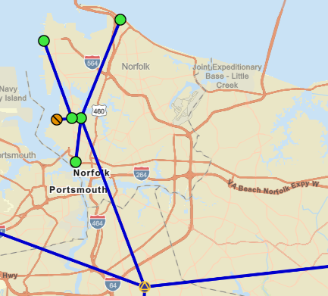
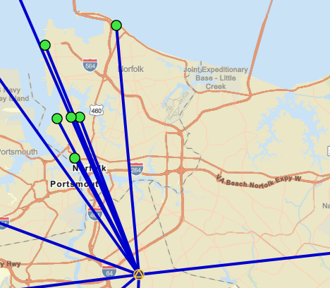
Different sets of Independent Vectors
Minimal Spanning Tree (MST)
Single Hub Processing Strategy

Slide 23
Network – Session Processing
Emphasis is on which marks to include in a session, not necessarily which vectors are created
Notes:
Slide 10 - But in OPUS Projects, we don't think about the individual vectors between the stations, instead we focus more on which stations are we are observing simultaneously.
(click)
Because we know that if we observe those simultaneously we’re going to get all the connections, either directly through a vector, or through the correlations.
(clicks)

Slide 24
OPUS Projects uses the “Hub” Session Processing Strategy
By default, independent vectors for each session are created from user marks to a single “Hub”
Think of the hub and spokes of a wheel
By default, OPUS Projects will select the most central CORS within a session/project and designate it as the Hub
Notes:
Slide 11 - By default, OPUS Projects will create independent baselines for each session from a single hub, like spokes in a wheel
Generally speaking, OPUS Projects will select the most central CORS with respect to the local project area, and designate it as a hub.
The relationship between all of the (non-hub) marks are going to be represented by the mathematical correlations.
Those are the other connections that you don't see on the map, but which exist.
And again, this has some benefits in the way that the data is processed.

Slide 25
OPUS Projects Session Processing cont.
The relationship between all (non-HUB) marks (dependent vectors) are represented by mathematical correlations.
The Hub processing strategy has some significant benefits, and will be discussed shortly.

Slide 26
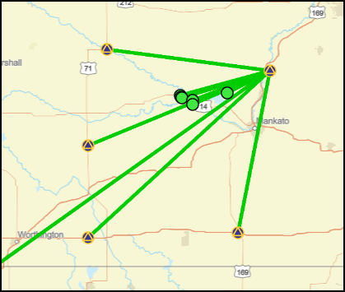
Sample OPUS Projects Session
Notes:
Slide 12 - Let’s look at our example using OPUS Projects (PAGES) approach.
With our Hub in the middle of our project,
(click) I know that if we observe these four stations in the first session,
(click) these are the three independent vectors that we’re getting (the solid blue lines).
(click) and we’re getting these correlations also (the dashed blue lines).
(click) In the second session, these are the marks being observed,
(click) these are the independent vectors that are being produced,
(click) and these are the correlations.
(continue to click to close the figure)
and so on through all 6 sessions.
The mark-to-mark relationship information that you want is being generated, even though you don't see that on the screen.
See the Sample OPUS Projects Session inset.
It is important for you to know what you're getting so that you can plan your project and observations correctly.

Slide 27
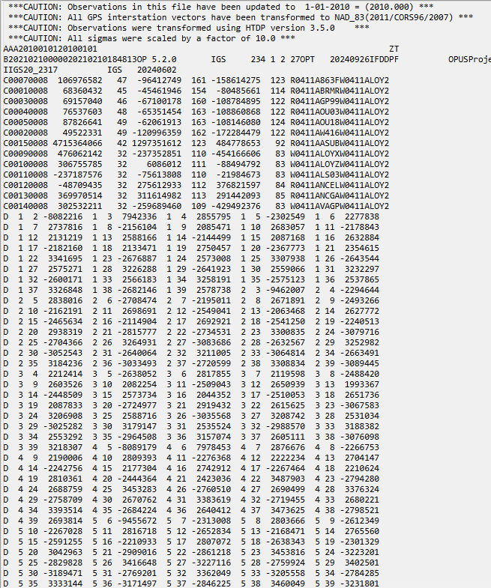
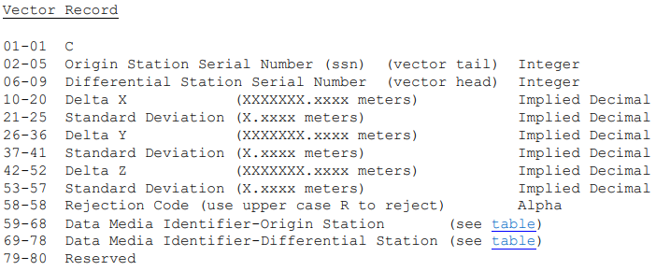
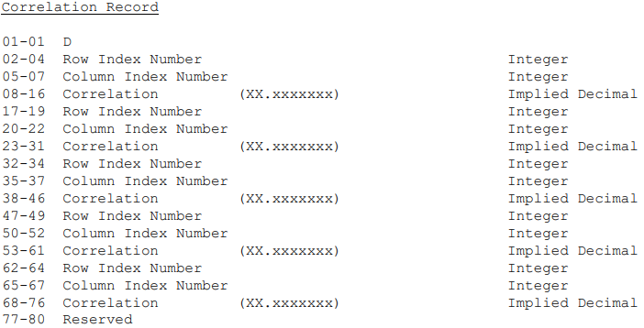
The Gfile

Slide 28
Which marks to observe together?
Marks that are intervisible, e.g., a mark and it’s azimuth mark
Any group of marks for which relative “Local Accuracies” are desired
Points that will control the beginning and end of a future traverse
Any place where you want to maximize the internal precision between points
Existing Passive Control (especially vertical) and their nearest neighbors

Slide 29
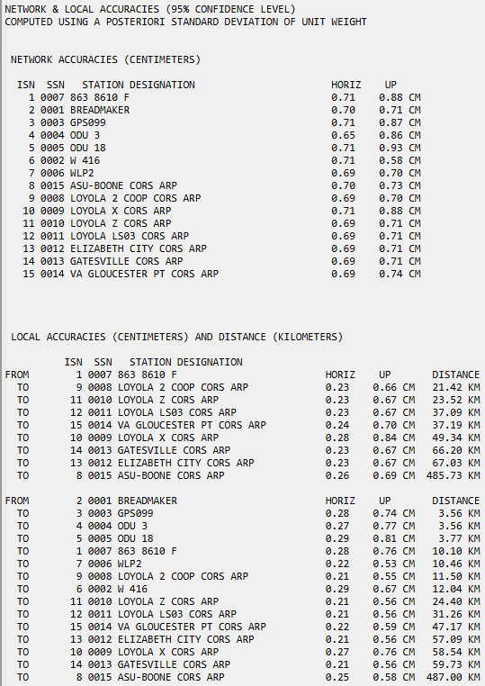
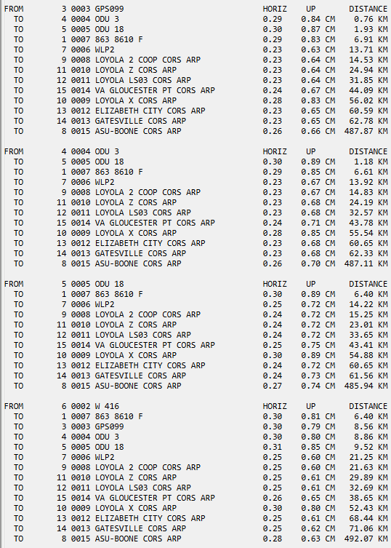

Slide 30
Hub Selection
Take advantage of their continuous data collection by using a NOAA CORS as Hub (Default)
Use the same Hub for all sessions
If there are no CORS within 100 km of your project then you can use a project mark as a Hub……But

Slide 31
Hub Selection - But
Do not use a project mark with just a few hours of data as a Hub
Too few mutual observations between it and the distant CORS
If you need to use a project mark as a Hub, then make sure it is observing all day 8+hours, Ideally continuous for the duration of the project

Slide 32
Relative Positioning - Precision
Project marks share common Hub
This minimizes common-mode errors.
Easier analysis as constraints do not contribute to coordinate discrepancy
If there is a coordinate discrepancy, then it must be from the data or user inputs.
Errors do not propagate throughout the network

Slide 33
A New Paradigm
GNSS projects have inherent characteristics that are very different from those of optically measured geodetic networks
These differences provide an opportunity to rethink how projects should be designed and processed

Slide 34
Optical Surveys
In a survey done with conventional optical survey tools, a total station for example, the marks of the network are connected by direct measurement of angles and distances.
These measurements are inseparable from the marks they connect.
This creates vectors free to float in space until constrained to control.
An error at any network node will propagate through network.

Slide 35
GNSS Surveys
GNSS measurements of the same network are not connected to each other.
GNSS measurements are independent.
There are no inherent connections between project marks as in optical surveying.
Computing the position of each mark relative to the same reference is optimal.
Although possible, artificially creating “chains” of dependencies among project marks is not optimal.

Slide 36
Errors Propagate through network?
Setup Error here
Using a Single Hub (CORS), errors only affect station where error occurred
Error at one stations affect coordinates at other stations
Notes:
Slide 6 - It is important to understand how PAGES, which is the baseline processing engine in OPUS Projects, works compared to commercial vendor processing software with which you may be familiar.
(click)
Let's consider creating a session using 4 receivers that develops three independent or non-trivial baselines, shown here as solid blue lines.
That would be equal to the number of receivers minus one (n-1).
(click)
Using PAGES, there are other correlations that exist, shown here as dashed red lines. PAGES computes and provides that information.
But if you went out and observed three independent baselines with your vendor software, you would not have the correlations between all the marks.
With PAGES and the fact that we suggest using the HUB type strategy, you will have those correlations.
(click)
There are different combination of "independent" vectors that one could choose to process and then you'd get a different set of correlations.
(click)

Slide 37
Final Thought
Thinking about how the data will be processed will inform you of how best to collect the data.

Slide 38
Closing Philosophical Thoughts
What you see is not necessarily what you get
What you get is not necessarily what you want
And, in the words of the celebrated philosopher
Sir Michael Philip Jagger…
♫ You can’t always get what you want, but if you try sometimes, you just might find…you get what you need!
“Rolling Stones, You Can't Always Get What You Want, November 1969”

Slide 39
Questions?
Presentation will be available at:
https://www.ngs.noaa.gov/web/science_edu/presentations_library/
Dan Martin
Northeast Regional Geodetic Advisor
ME, NH, VT, MA, CT, RI, NY, NJ
Dan.martin@noaa.gov
240-676-4762

