Slide 1
Recent Research at
The National Geodetic Survey
Dru Smith
Chief Geodesist, NGS

Slide 2
Outline
Overview of NGS and NOAA
Primer on Physical Geodesy
Recent Research
  Geoid Slope Validation Survey of 2011

Slide 3
President
Department of Commerce
NOAA
National Ocean Service
National Geodetic Survey

Slide 4

NOAA

Slide 5
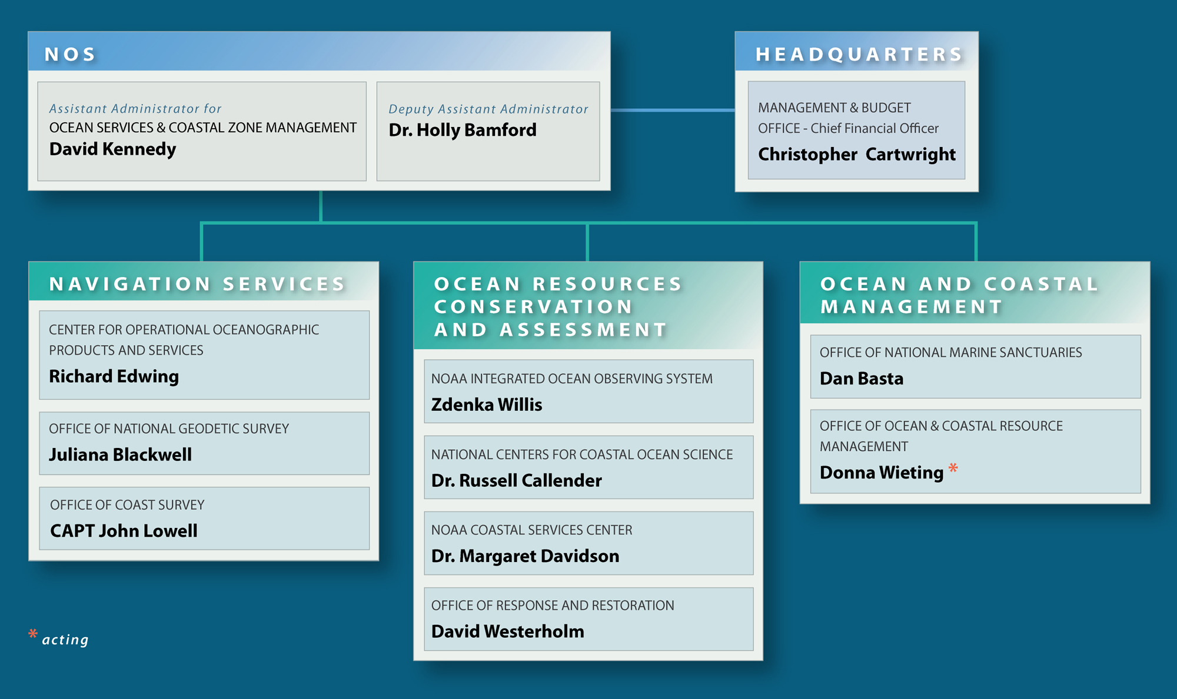

NOS Organization
*

Slide 6
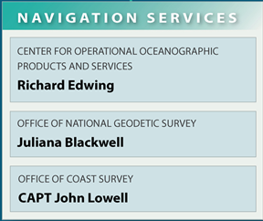
Navigation Services of NOS
Tides and Currents
Sea Level Datums (MLLW, MSL, MHW, etc)
Water Levels (Great Lakes, etc)
National Spatial Reference System
Terrestrial Datums
Coordinates
Shoreline Definition
Imagery
Gravity
Geodesy
Nautical Charts
Hydrodynamic Models

Slide 7
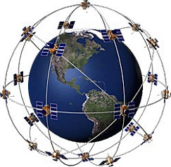
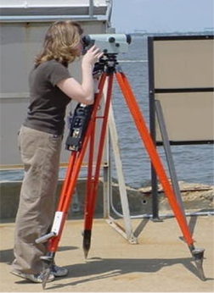
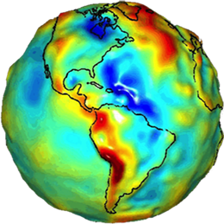
NGS Mission Statement
To define, maintain and provide access to the National Spatial Reference System (NSRS) to meet our nation’s economic, social, and environmental needs.
The NSRS is a consistent coordinate system that defines latitude, longitude, height, scale, gravity, and orientation throughout the United States.

Slide 8
Geodesy

Slide 9
What is Geodesy?
The scientific study of
  the size and shape of the Earth,
  its gravity field,
  the precise determination of positions on the Earth’s surface and
  the measurement of geodynamic phenomena
    such as the motion of the magnetic poles,
    tides and
    tectonic plate motion.

Slide 10
“Physical” Geodesy
Gravity
Heights
Geoid
Vertical Datum

Slide 11
Defining “Height”
Isn’t it intuitive? Don’t we already “know” what it means?
  Generally…yes
  Specifically…no (and it’s important!)
These statements keep geodesists awake at night:
  What is the height of __________?
  How accurately can we know a height?
  Where will water flow if this region is flooded?
  How fast are heights changing?

Slide 12
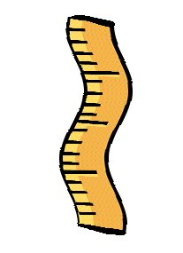
Defining “Height”
Height is…
Some length
(usually)*
along some path
between two points
in some specified “up” direction.
?
B
A
* = More on this later

Slide 13
Dominant Height Systems in use in the USA
Orthometric
  Colloquially, but incorrectly, called “height above mean sea level”
  On most topographic maps
  Is a >99% successful method to tell which way water will flow
Ellipsoid
  Almost exclusively from GPS
  Poor at determining water flow anywhere “non mountainous”
Dynamic
  Directly proportional to potential energy : always tells which way water will flow
  Dynamic heights are not lengths!
  Used primarily in describing water levels in the Great Lakes

Slide 14
Orthometric Height (H)
The distance along the plumb line from the geoid up to the point of interest
H
“The Geoid”

Slide 15
Ellipsoid Height (h)
The distance along the ellipsoidal normal from some ellipsoid up to the point of interest
h
h
h

Slide 16
Some definitions are required…
“the geoid”
  is the one equipotential surface surrounding the Earth which best fits to global mean sea level in a least squares sense.

Slide 17
Orthometric Height (H)
The distance along the plumb line from the geoid up to the point of interest
W=W₃=Constant
H
W=W₂=Constant
W=W₁=Constant
W=W₄=Constant
The geoid. Its gravity potential energy (W) is constant at all points on itself. That is W = W₀ = Constant. There are an infinitude of such surfaces where W=Constant…

Slide 18
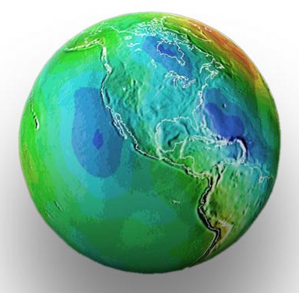
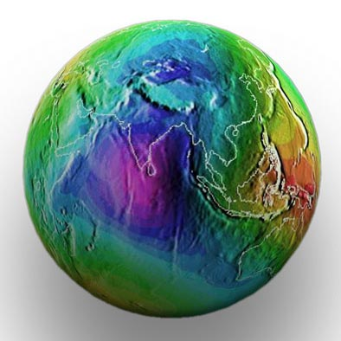
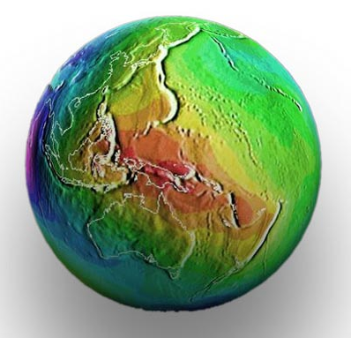
Figure of the Earth – The geoid
…and it “swells” away from
the center of the Earth near
New Guinea*
Yes, the ocean surface does
“dip” toward the center of the
Earth in the Indian Ocean*
* Relative to an ellipsoid. To be formal, the geoid is
entirely convex, not “star shaped”

Slide 19
Earth’s Surface
So…which one is the geoid?
C…correct! Why?
W=W_{A}
W=W_{B}
Mean Sea Level
W=W_{C}
W=W_{D}
W=W_{E}
W=W_{F}
Identifying “The geoid”

Slide 20
Earth’s Surface
Let’s take a closer look at what happens right
at the coastline…
Mean Sea Level
W=W_{C}

Slide 21
Q = Reference point for a tide gage
Earth’s Surface
η_{Q} = Distance above Local Mean Sea Level (LMSL)
H_{Q} = Orthometric Height
Q
H_{Q}
η_{Q}
The Geoid
e_{Q}
Mean Sea Level
e_{Q} = Error in assuming MSL = geoid at this tide gage

Slide 22
Geoid Undulation (N)
The distance along the ellipsoidal normal from some ellipsoid up to the geoid
H ≈ h-N
h
H
The Geoid
N
A chosen Ellipsoid

Slide 23
Stokes Integral
Just because a really complicated equation had to be in here somewhere
In English: if we measure gravity all over the Earth, we can know the geoid undulation at any location on Earth

Slide 24
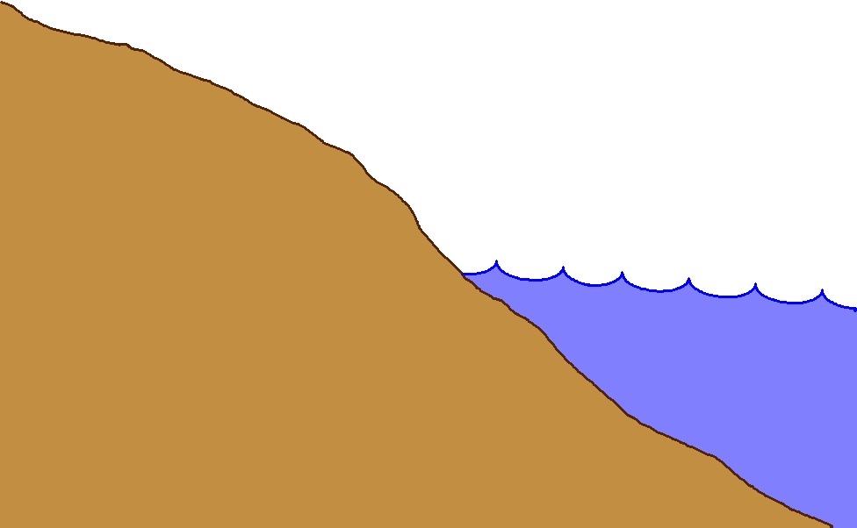
Gravity measurements help answer two big questions…
How “high above
‘sea level’ ” am I?
(FEMA, USACE,
Surveying and
Mapping)
How large are near-shore
hydrodynamic processes?
(Coast Survey, CSC,
CZM)
Earth’s
Surface
Geoid
Coast
Ocean
Surface
Ellipsoid
From
Gravity
From
GPS
From
Satellite Altimetry
Notes:
This slide is an idealized situation demonstrating the usefulness of near-shore gravity, specifically the use of such gravity to accurately compute a gravimetric geoid model. (The geoid is the one unique equipotential surface of the Earth’s gravity field which best fits, in a least-squares sense, global mean sea level).
On land, the use of the Global Positioning System (GPS) for fast, accurate surveying is well documented. However the height determined by GPS refers to a highly idealized, mathematically simple surface known as the ellipsoid. Thus GPS heights are “ellipsoid heights”. Unfortunately, ellipsoid heights are non-intuitive in many ways. First, they can be dozens of meters different from heights above the geoid (known as orthometric heights, or more colloquially, but less correctly as “heights above sea level”). Secondly, ellipsoid heights do not give an accurate portrayal of how water will flow, due to their complete disconnect from the gravity field of the Earth. If one has an accurate model of geoid undulations (the separation between the geoid and ellipsoid), then one can take the GPS-derived ellipsoid heights, remove the geoid undulation, and arrive at your orthometric height (a.k.a. “height above sea level”). This is a significantly faster method of determining orthometric heights compared to traditional surveying methods of spirit leveling.
On the ocean, satellite altimetry is used to monitor sea level. However, because the satellite orbits are known relative to the ellipsoid, and the altimetric measurement is from satellite to sea surface, the resulting information is the height of the sea surface above the ellipsoid, often called the “sea surface height” or SSH. If one is interested, however, in the impact of winds, heating, currents and other phenomena on the ocean surface, then one must remove the gravitational impact on the ocean surface. That is, one must know the separation between the ellipsoid and the geoid over the ocean in order to remove this signal, and arrive at the residual value. This residual, the distance from the geoid up to the sea surface, is known by many names, the most common being “sea surface topography” (SST) or “dynamic ocean topography”.
Coastal areas prone to flooding would benefit both by knowing accurate land elevations (to aid in construction planning, floodplain mapping, etc) as well as knowing accurately how the near shore ocean processes work (to better model responses to hurricanes and other dynamic ocean phenomena). It is an unfortunate fact that the largest areas missing accurate gravity measurements are those areas immediately offshore. This is because ships with gravimeters can not get into these shallows, altimetrically derived gravity models are unreliable due to the inability to accurately compute near-shore tides, and terrestrial gravimeters can not measure in the water. The only practical option to collecting the near-shore ocean gravity data is through airborne based technologies.
Dr. Dru A. Smith
Chief Geodesist
NOAA, National Geodetic Survey
Dru.Smith@noaa.gov
1/11/2006

Slide 25
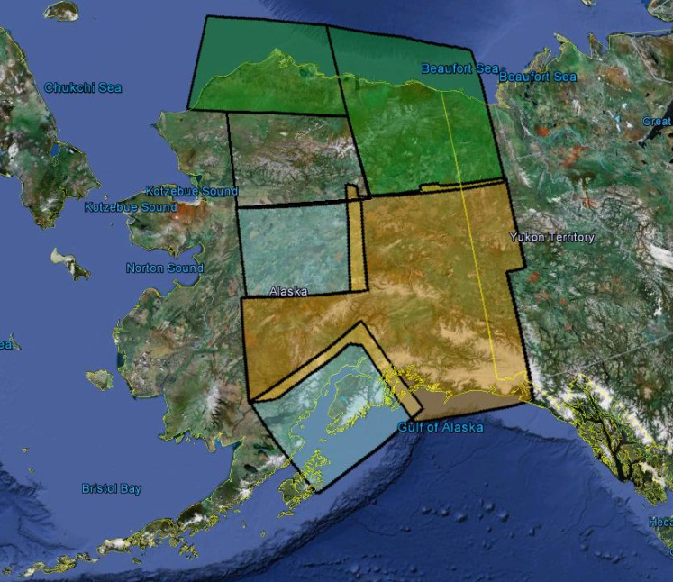
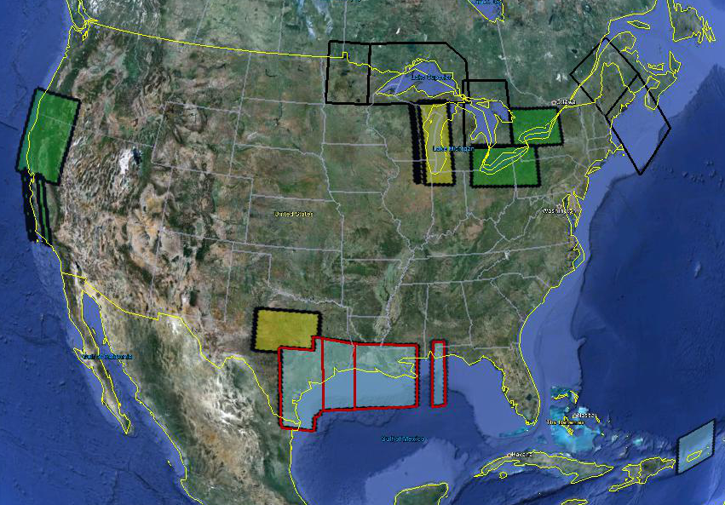
GRAV-D
In FY12 airborne surveys have been conducted in the Great Lakes and Texas
16.23% of the country is completed
Subsequent FY12 surveys will focus on the Great Lakes, Maine, and Alaska
All Gulf of Mexico data released publicly, more coming soon
Data and metadata at: http://www.ngs.noaa.gov/GRAV-D/data_products.shtml
Planned FY 2012
FY 2012
FY 2011
FY 2010
Pre-FY 2010
Data Released

Slide 26
H ≈ h-N
Good to sub-mm over most of the world
Good to < 1 cm anywhere in the USA
If determining N were fast (it is) and accurate (well…) then H can be determined from GPS!
That brings us to…

Slide 27
The Geoid Slope Validation
Survey of 2011

Slide 28
Goal of the survey
Observe geoid shape (slope) using multiple independent terrestrial survey methods
  GPS + Leveling
  Deflections of the Vertical
Compare observed slopes (from terrestrial surveys) to modeled slopes (from gravimetry or satellites)
  With / Without new GRAV-D airborne gravity
Notes:
Although a geoid slope validation survey won’t validate the absolute accuracy of the geoid model, it will help point out weakness in data and theory. The accuracy of the terrestrial surveys will be the best achievable, and formal accuracy estimates will be used to bound allowable disagreements with modeled geoid slopes.

Slide 29
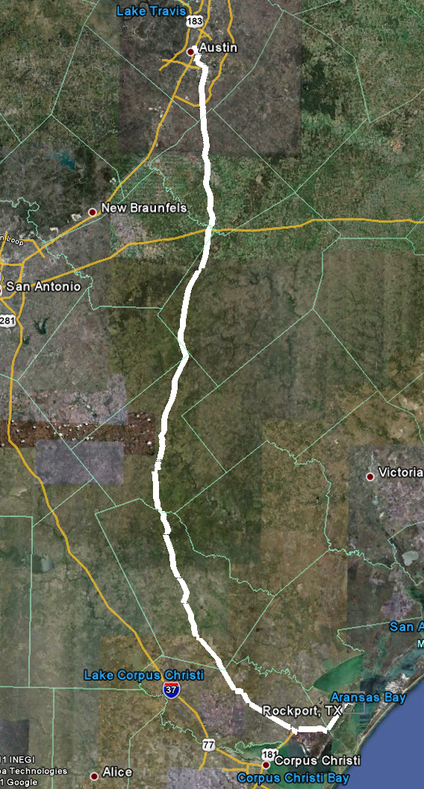
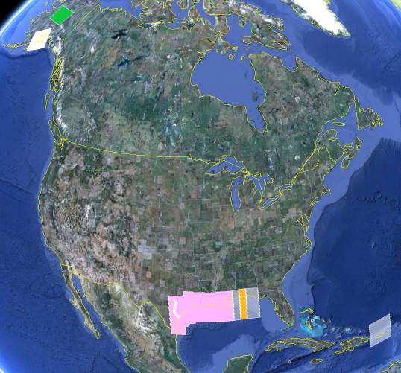
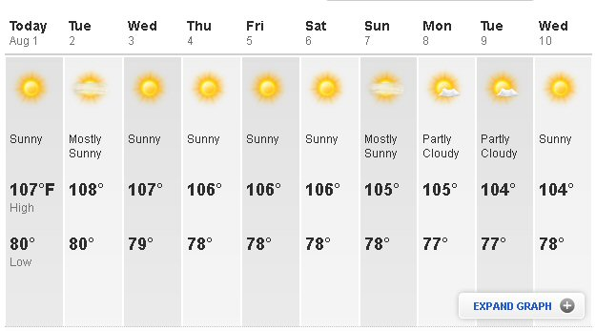
The Chosen Line
325 km
218 points
1.5 km spacing
South Texas
July-October, 2011
hot…Hot…HOT!
Notes:
The final line was a 325 km stretch from downtown Austin, Texas (North end) to Rockport, Texas (South end). There were 218 official survey points along the line, with an average spacing of 1.5 km between them. The shaded areas in the above picture were the existing GRAV-D data at the time of planning GSVS11 (since expanded). Although the weather report looks extreme, most surveying was done in the milder times of day.

Slide 30
Surveys Performed
GPS: 20 identical. units, 10/day leapfrog, 40 hrs ea.
Leveling: 1st order, class II, digital barcode leveling
Gravity: FG-5 and A-10 anchors, 4 L/R in 2 teams
DoV: ETH Zurich DIADEM GPS & camera system
LIDAR: Riegl Q680i-D, 2 pt/m² spacing, 0.5 km width
Imagery: Applanix 439 RGB DualCam, 5000’ AGL
Other:
  RTN, short-session GPS, extra gravity marks around Austin, gravity gradients

Slide 31
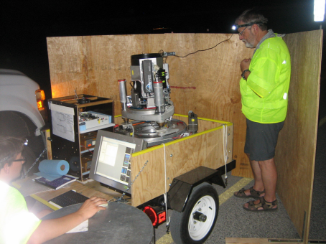
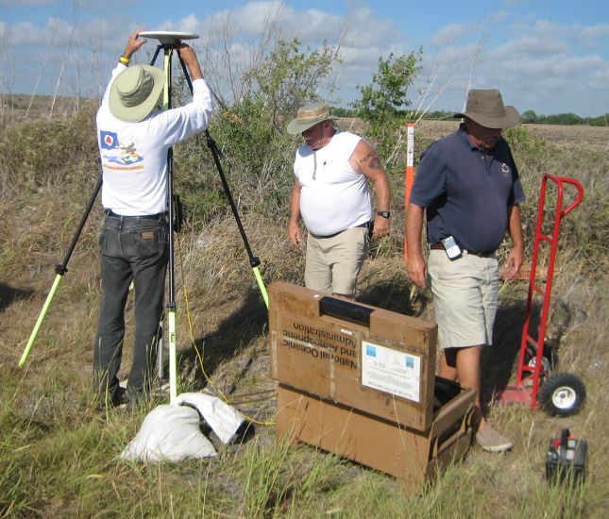
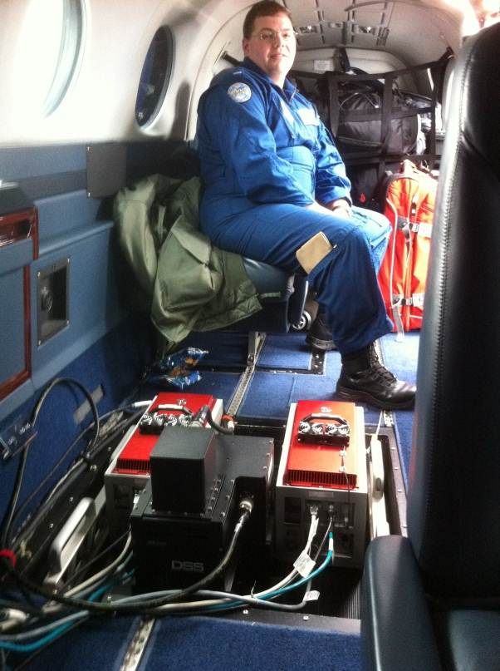
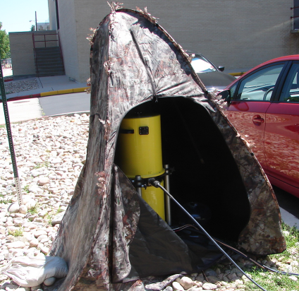
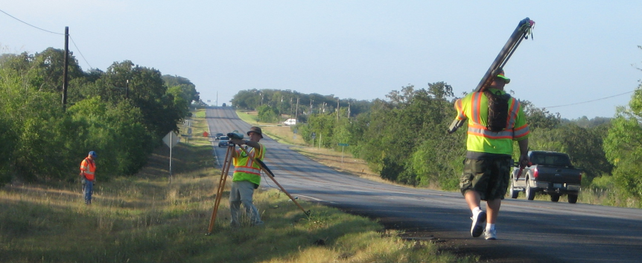
GPS
LIDAR/
Imagery
DoV
Gravity
Leveling
Notes:
These are just a small sampling of the field crews in action. Not shown are the RTN, FG-5, short-session GPS, relative gravity, gravity gradients and mark setting crews.

Slide 32
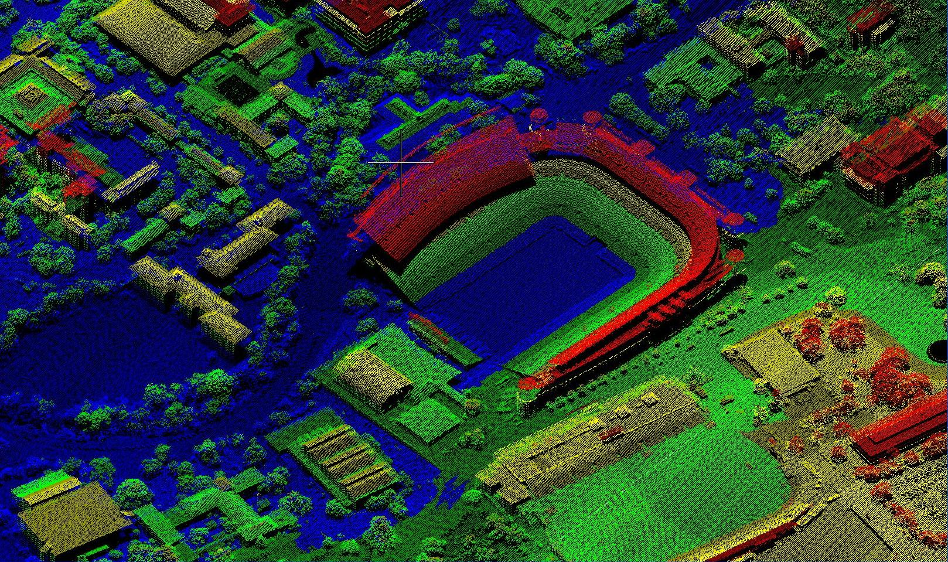
LIDAR

Slide 33
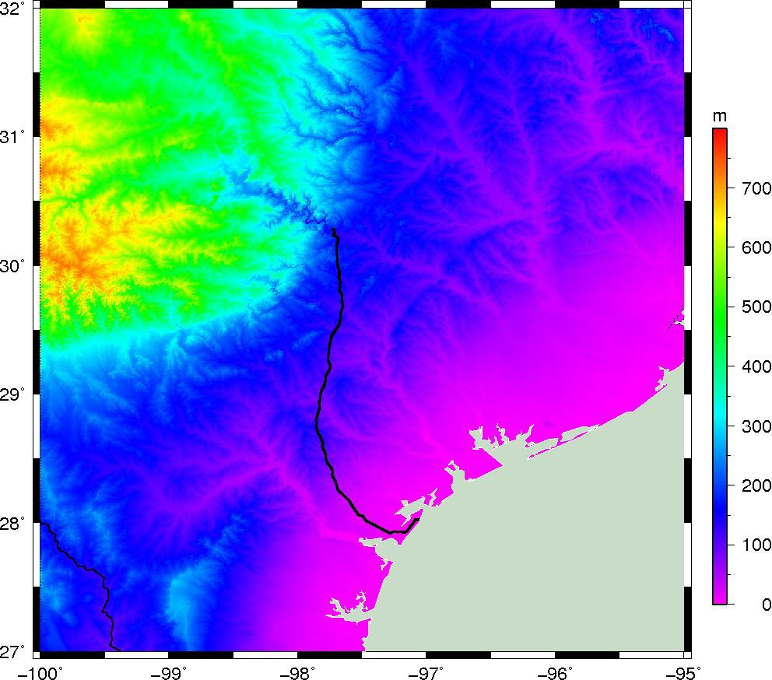
Blended LIDAR with NED

Slide 34

Empirical Error Estimates
σ_{Δh} (OPUS-S) : 2 - 6 cm
  GPSCOM combination: ~ 4 mm
  (no significant baseline dependency)
=> 16 mm RMS over GSVS11
σ_{ξ} , σ_{η} : 0.06 arcseconds
  ~ 0.43 mm / 1.5 km => 6.6 mm RMS over GSVS11
Notes:
These values are empirical estimates coming from various sources.
For the differential ellipsoid height accuracies, these come from either the OPUS-S runs, showing peak-to-peak error, or else
from a least squares adjustment of all the data, showing a baseline-length-independent ~4mm (give or take 2 mm) error
between any two of the 218 points.
For the differential orthometric height accuracy, the value quoted is the 1st Order, Class II relative maximum
elevation difference accuracy is 0.7 mm per (sq.rt. km) based on Table 2.2 of FGCC Standards and Specifications
for Geodetic Control Networks.
For the Deflections of the Vertical, the expected error for the DIADEM camera was 0.1 arc seconds, but the
empirically determined accuracy estimates from the data itself were 0.06 arcseconds. This corresponds to about 0.43 mm over 1.5 km, which, added in an RMS sense over 218 points yields a highly optimistic 6.6 mm of RMS over the entire line.

Slide 35
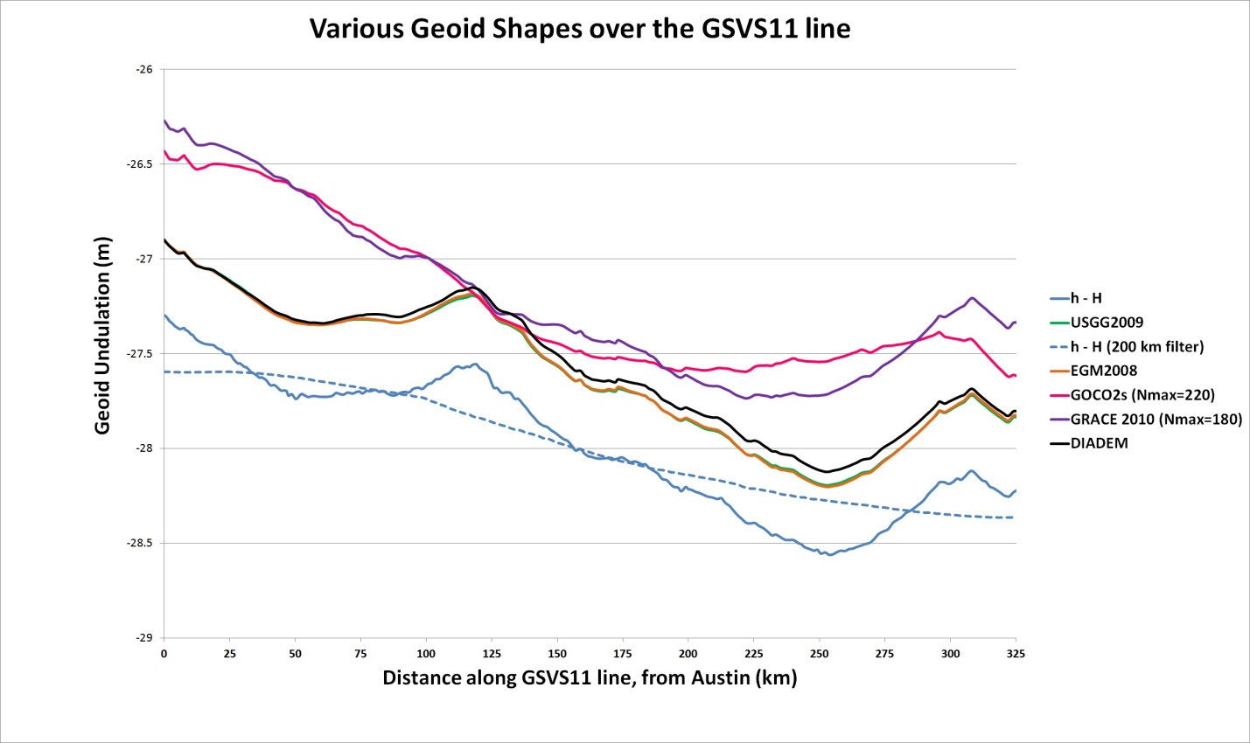
Existing Geoids vs GSVS11
Austin
(North end)
Rockport
(South end)
Notes:
The shapes in this plot are various forms of the geoid shape over the GSVS11 line. Of primary interest is the blue line (h-H) which represents the very best differential ellipsoid heights and differential orthometric heights from the new GPS and leveling of GSVS11. The blue dashed line is a smoothed (200 km filter) version of this. Note that this survey was about geoid slopes, so the absolute offsets seen here are immaterial to the goal of this survey.
The green and orange lines almost on top of each other are the latest gravimetric geoid from NGS (USGG2009) and EGM2008. Note how closely they appear to follow the h-H blue line.
The purple and pink lines are SHMs ITG-GRACE2010s and GOCO02s. Note their general inability to track even the largest details (except the more or less upward slope from Rockport to Austin) of the geoid. One would presume this is from omission error, but the failure to match the filtered h-H values (blue dashed line) calls into question whether there is commission, not omission error going on here. If EGM2008 were only given to maximum degree 220, it follows closely to these two models.

Slide 36
Notes:
This slide shows the RMS error (disagreement) between h, H and N for the USGG2009 geoid model as compared to the best GPS and leveling on GSVS11. The data are in “distance bins”, representing how far apart any two points in the survey were. There were 218 points, yielding 23,871 possible *pairs* of points, separated by distances ranging from 0.4 km (the closest any two points were to one another) to 325 km (the distance between the first and last points in the survey). Each “distance bin” contains about 2,000 pairs of points, separated by a distance which puts them in that particular bin.
As this is a *total* RMS error chart, it is worth nothing that in this fairly uncomplicated, and low-elevation area that even with the combined errors of GPS, leveling and a gravimetric geoid model, the total error barely reaches 3 cm over medium distances (wavelengths).

Slide 37
EGM2008 is better here
USGG2009 is
better here
Notes:
This slide builds upon the previous one, now showing EGM2008’s performance alongside of USGG2009. Since these two geoid models have almost identical input terrestrial gravity data, it is not surprising that they behave in very similar ways when compared to the GSVS11 GPS/leveling data. Differences between the two models can be attributed to the different modeling approaches, plus slight differences in input data.

Slide 38
Adding GOCO2s makes
things better here
Adding GOCO2s makes things worse here
Notes:
This slide builds upon the previous two, now showing a new experimental EGM (xEGM) created at NGS which blends EGM2008 and GOCO2s (called xEGM-G). The geoid model remains 5’ x 5’, like EGM2008. This blending of GOCO2s was shown to have a CONUS-wide overall improvement to the geoid, but in this particular area it is obvious that GOCO2s only improves the geoid at certain wavelengths, and actually degrades them over short wave lengths.

Slide 39
Airborne Gravity Improves the
Geoid across ALL DISTANCES
Notes:
This slide builds upon the previous three. The significant change now is that airborne gravity data, from the GRAV-D project, has been added over this region, and blended into an experimental EGM (xEGM). The blending combines EGM2008, GOCO2s and GRAV-D, and the experimental EGM is called “xEGM-GA” (“GA” meaning “with GOCO2s and with Airborne”). The geoid model built upon that data has a significant improvement in comparison to the GSVS11 GPS/leveling data.
The take-away message of this slide is that the contemporary, consistent airborne gravity data is the key to improving geoid accuracy. The previous three models (USGG2009, EGM2008 and xEGM-G) all relied upon / massaged the same terrestrial gravity data, but none of that improved the geoid significantly, whereas the airborne gravity data, being new, contemporary and consistent showed significant improvement over the other geoids.

Slide 40
New software makes
things worse here
New software
Makes things
better here
Notes:
This slide builds upon the previous four. NGS has been experimenting with more rigorous ways to account for topography and perform kernal truncations. The most recent iteration was used to create an experimental high resolution gravimetric geoid model (xUSGG), using upon the xEGM-GA model, plus high resolution gravimetry and topography. As can be seen, this gives a slight degradation to the model at short wavelengths, but has a noticeable improvement to the model at medium to long wavelengths.

Slide 41
Let’s remove this
from all of the other
bars to leave
geoid-only RMSE
Notes:
This slide builds upon the previous five. This time a new set of bars in green are added which are NOT the combined errors of GPS, Leveling and a geoid model, but are instead *only* GPS & Leveling errors. They are displayed to show the magnitude of these errors in comparison with the combined GPS/leveling/geoid errors.

Slide 42
The “1 cm
geoid”
Notes:
This slide is a companion to the previous one, but the h-H errors have been removed, in an RMS sense, from the total h-H-N errors, leaving gravimetric geoid model errors only.
As seen previously, the geoids based on airborne gravity data are the best performers, and the very slight degradation using new high resolution software at short wavelengths is noticeably offset by the significant improvement at medium wavelengths.
In fact, as a general statement, it could be said that adding airborne gravity data to the gravimetric geoid model has yielded about 1 cm differential geoid undulation accuracy across all distances, in the region of GSVS11, and that this can be further improved by continued improvement to the high resolution modeling software.

Slide 43
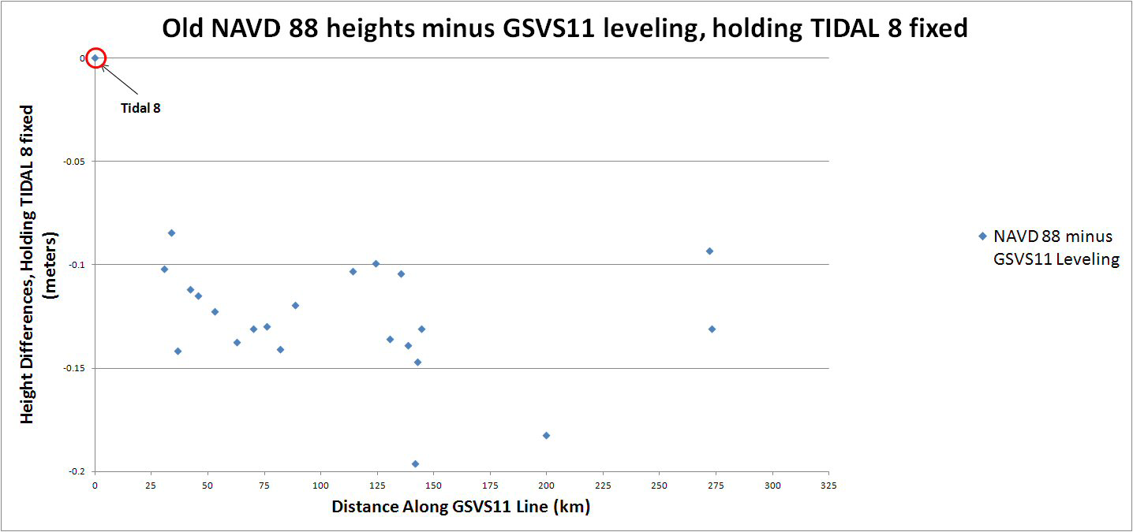
Old minus new leveling
South
(Rockport)
North
(Austin)
Notes:
Holding the official NAVD 88 height of “TIDAL 8” (Rockport, final official point on GSVS11) fixed, compare the existing (published from the IDB on datasheets) NAVD 88 heights to
those heights implied by the new leveling of GSVS11. Obviously this is only good for those marks that have existing NAVD 88 heights (= 23 marks).
Note the approximately 12 cm offset between TIDAL 8 and the mean of the other points. This implies that TIDAL 8 has likely subsided about 12 cm since it was last
leveled to. Note also the scatter, which is enormous, indicating much regional local motion. Finally, note the final two points, which are at opposite ends of
a runway. Their official height differential disagrees with the new leveling by 4 cm, indicating that (as one possibility) one of them has likely moved vertically 4 cm while the other
has remained stable. Note however that these two points were on the “Bad BM” list during the “7 good, 7 bad” test during the LIDAR flights!!

Slide 44
Conclusions
For GSVS11, adding airborne gravity data improves geoid slope accuracy at nearly all distances <325 km

Slide 45
Conclusions
A “1 cm” geoid is achievable in coastal areas
  With good GPS, this means “2 cm” differential orthometric heights for all distances between 0 and 300 km (at least)
  An acceptable replacement for leveling over “long” (> 150 km) lines
  Leveling remains the most precise local differential height tool

Slide 46
Future Work
Dozens of studies, comparing all of the terrestrial positioning techniques of GSVS11
GSVS13: IOWA!!!
  Higher elevation, more complicated geoid, additional measurements (borehole gravimetry?)

Slide 47
Questions/Comments?
Dru.Smith@noaa.gov
http://www.ngs.noaa.gov/GEOID/GSVS11/index.shtml

Slide 48
Extra Slides

Slide 49
Orthometric versus Dynamic Heights
Orthometric Height = Physical Length along Plumb Line from Geoid to Surface
Dynamic Height = (W₀-W₁) / γ₄₅ : Has no geometrical meaning
Dynamic Heights are directly related to water levels!!
Ortho = 500 m
Dynam = 498 m
Ortho = 501 m
Dynam = 498 m
Ortho = 503 m
Dynam = 498 m
Ortho = 502 m
Dynam = 498 m
Some Equipotential
Surface
(W = constant = W₁)
Plumb Lines
The Geoid
(W = constant = W₀)
Equipotential : Having constant
gravity potential energy (W)
[Not the same as “constant gravity (g)”]
γ₄₅ = A constant arbitrary gravity value
At the Geoid: Ortho. = Dynamic = 0
As ortho Height increases, so does
the potential discrepancy between
orthometric and dynamic height
Notes:
This slide is an idealized situation demonstrating the difference between Orthometric Heights and Dynamic Heights. In the United States most floodplain maps, and in fact most maps in general, use Orthometric Heights (though sometimes mistakenly labeled “Mean Sea Level Heights”). The reason for this is predominantly historic, and the Orthometric height system is something which most people understand (though, again, often under the mistaken label of “Height above Mean Sea Level”).
Strictly speaking, however, Orthometric heights do not show how water will flow. (To be fair, 99.9% of the time water will flow “downhill” in an Orthometric height system. But not always). Water will always, under the influence of gravity, and in the absence of other forces (winds, current, heating, friction, etc) “fill up” any basin (a puddle, a bathtub, a floodplain, a lake, and ocean, etc, etc) such that its top surface lies along an equipotential surface (a surface of equal gravity potential). There are an infinite number of such surfaces, like the layers of an onion, making up the gravity field of the Earth. (The shape of each surface is determined by the mass distribution and spin of the Earth). Dynamic heights are directly proportional to the values of gravity potential on an equipotential surface, and as such the dynamic height of all points on any given equipotential surface will all be identical to one another. Thus Dynamic heights will always determine the direction of water flow.
To exemplify this point – notice the heights on 4 points distributed along the top of a lake in the above figure. If we were to use Orthometric heights to tell us about water flow we would expect the water in the lake to re-distribute from the Ortho = 503 m point into the “lower” points, but we would be incorrect. Examining the Dynamic height system, however, we see that the all four points have the same height and therefore we correctly conclude that the water in the lake will not re-distribute itself from what is shown. (Remember, this is in the absence of other forces, including rivers feeding the lake, etc).
Because Dynamic heights and Orthometric heights converge to very similar values near the geoid, they can only diverge significantly at a significant elevation from the geoid. As such the most important place to consider the difference between these two height systems would be in any location of significant elevation where the land is very flat and there is a source of water nearby which may be prone to flooding. Such places might include the upper great plains near rivers and lakes.
Dr. Dru A. Smith
Chief Geodesist
NOAA, National Geodetic Survey
Dru.Smith@noaa.gov
1/9/2006

