Slide 1
Blueprint for 2022, Part 2:
Geopotential Coordinates
AKA “Replacing NAVD 88”
Dru Smith
NSRS Modernization Manager
NOAA’s National Geodetic Survey

Slide 2
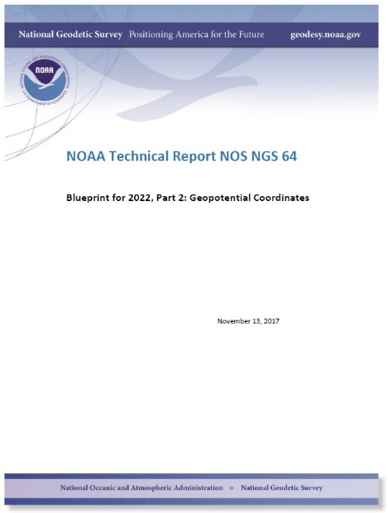

Slide 3
Overview
Quick topics:
How and Why (again)
Geodetic Control
Why not leveling?
Geoid modeling history
Geopotential
Deeper dives:
Time Dependency
Sea Level and the geoid (or not)
NAPGD2022
/nap-jee-dee-twen-tee-twen-tee-too/
Leveling? Yes!
Updates and Replacements
Summary

Slide 4
Why NGS wrote it…
2007 (1st Ten Year Plan) : “Replace NAVD 88”
2012 (2nd Ten Year Plan) : “Replace NAVD 88”
Details were lacking, and therefore outreach material couldn’t properly prepare the user community for 2022

Slide 5
How it came into being…
The idea of “blueprint” documents was fuzzy at first, but the need for details was clear
2014-2017: Driven mostly by the geometric side
Culminated in early 2017: Blueprint Part 1: Geometric Coordinates
Obvious follow-up was “Part 2, Geopotential Coordinates”

Slide 6
Content: Geodetic Control
Verbatim from Blueprint, Part 1
Additional words about vertical stability

Slide 7
Content: Why not leveling?
Wrong tool for a continental vertical datum on a dynamic planet
Geoid accuracy has improved by 2 orders of magnitude in the last 50 years
Including its dynamic component
GPS height accuracy has reached the cm level

Slide 8
Content: Geopotential
If you care about any of the following things…
Heights (orthometric, dynamic, normal)
Gravity
Deflections of the Vertical
Including their impact on azimuths
…then you should care about geopotential

Slide 9
So…what is “Geopotential”
Geo: Earth
Potential: Gravity Potential Energy
Geopotential: Gravity Potential Energy Field that surrounds the Earth.
Mass => Geopotential (including “the geoid”)
Mass Change => Geopotential Change (including “the geoid”)
More later, if time allows…

Slide 10
Time Dependency

Slide 11
Time and Mass
Mass quantity in the Earth system is effectively constant
Mass distributions in the Earth system are time dependent and some are large enough to be measurable
Secular
Shape change to every equipotential surface (like the geoid)
Size change to global mean sea level
Episodic
Periodic

Slide 12
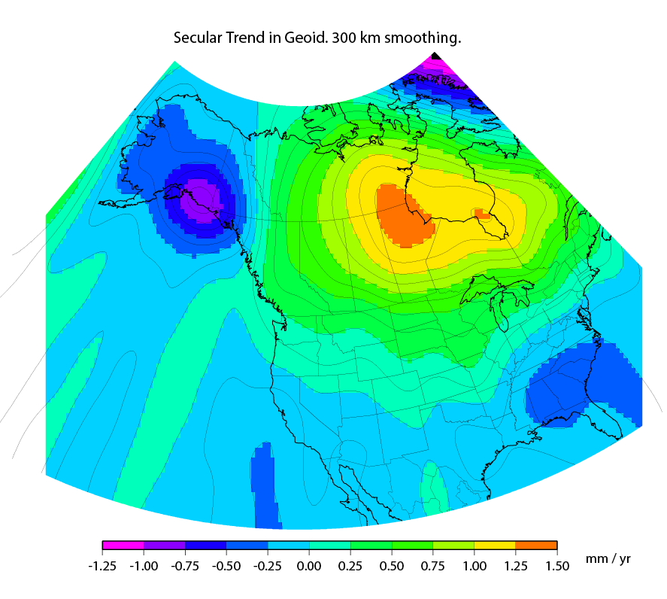
Secular Mass Movement
Mass is flowing in the mantle
to coalesce under Hudson
Bay, pushing the crust up.
GPS on the crust sees this
as one effect:
An increase in ellipsoid height
A gravimeter on the crust
sees two effects:
(small) decrease in gravity as the
gravimeter location gets
farther from the geocenter
(larger) increase in gravity as the
amount of mass below the
gravimeter pulls harder
This gravity change causes the
geoid to “swell” in the area
Notes:
There are two manifestations of the growing mass in the deep mantle under Hudson Bay:
Geometric – a GPS receiver will see the crust uplifting as the increase in mantle mass pushes the crust up in a displacement.
Geopotential – a gravimeter on the surface will sense the growing mass as an increase in the acceleration of gravity, BUT this will be slightly tempered by a reduction in gravity as well (because the gravimeter on the surface is getting farther from the Earth’s center). Still, the gain (from mass increase) is larger than the loss (from geometric movement) for a net gain. Because the net gain in gravity is not caused purely by being at a new crustal height, this translates into an increase in geoid undulations, or a “swelling” of the geoid in this region.
This is different than a purely geometric change caused by a compression of the crust. In that case, no significant mass is entering or leaving the region so, while GPS might sense a subsidence and a surface gravimeter might sense a slight increase as it moves closer to the Earth’s center, the geoid would not actually change.

Slide 13
Episodic Mass Movement
Notes:
Rare, but worth monitoring, large earthquakes or volcanic eruptions can move enough mass locally to cause the geoid to make a permanent local shift.

Slide 14
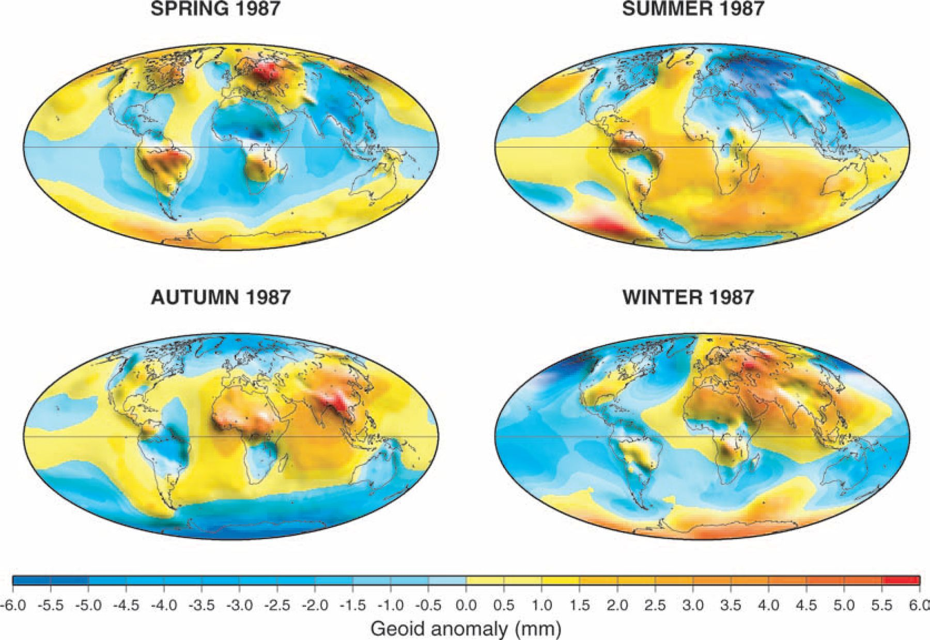
Periodic Mass Movement
Ramillien G et al. Geophys. J. Int. 2004;158:813-826
© 2004 RAS
Notes:
Seasonal variations of the synthetic geoids for 1987 computed using global model forecasts for the same period: atmosphere from ECMWF; oceans from POCM; total land water plus snow from LaD.
NGS sees this as a signal to be modelled and removed so users are not worried about “seasonal heights”.

Slide 15
Geoid Monitoring Service (GeMS)
Goal: Track all changes to the geoid which would prevent 1 cm accuracy
Aspects included:
Shape, Secular: e.g. Hudson Bay
Shape, Episodic: e.g. Massive Earthquakes
W0, Secular: Global Sea Level Change (see next slides)
Examples of things excluded:
Size, Secular: Mass quantity of Earth is effectively static
Shape, Periodic: Seasonal glacier cycle

Slide 16
Sea Level and The Geoid

Slide 17
Secular Sea Level Change
Special geoid-definition problem…
Consider only the mechanics of sea-level change:
Mass is moving about (geopotential change)
Land ice melts and joins the ocean, re-distributing mass around the globe
Global mean sea level is rising (geometric change)
By long standing tradition, the geoid is the one equipotential surface that fits global mean sea level

Slide 18
Scenario 1: Geoid Definition remains tied to GMSL
Time Passes
H
2
H
Sea Level Rises
1
Geoid
GMSL
Geoid
GMSL
As Global Mean Sea Level rises, orthometric height gets smaller

Slide 19
Scenario 2: Geoid Definition decoupled from GMSL
Time Passes
H
Sea Level Rises
H
1
2
GMSL
Geoid
GMSL
Geoid
As Global Mean Sea Level rises, orthometric height remains constant

Slide 20
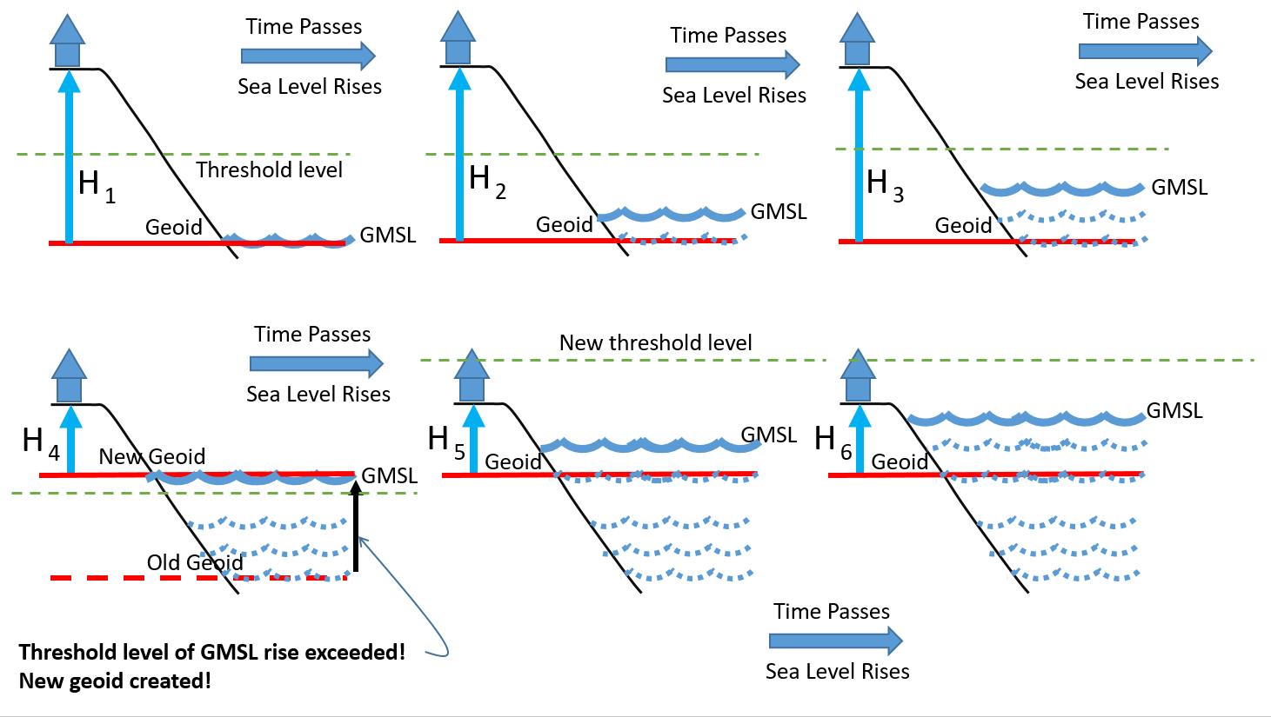
Choosing a new geoid as GMSL changes

Slide 21
NAPGD2022

Slide 22
Replacing NAVD 88
The Old:
NAVD 88
PRVD 02
VIVD09
ASVD02
NMVD03
GUVD04
IGLD 85
IGSN71
GEOID12B
DEFLEC12B
Orthometric
Heights
The New:
The North American-Pacific Geopotential Datum of 2022 (NAPGD2022)
- Will include:
GEOID2022
DEFLEC2022
GRAV2022
DEM2022
Normal
Orthometric
Heights
Dynamic
Heights
Gravity
Geoid
Undulations
Deflections of
the Vertical

Slide 23
NAPGD2022
“North American-Pacific…”
Because the gridded components (geoid, DoV, gravity, DEM) will cover all major USA populated territories, and these happen to fall in the general regions of “North America” and “The Pacific Ocean”
However, the foundation of the gridded components will be a global geopotential model

Slide 24
NAPGD2022
“…Geopotential…”
Because it isn’t just about heights, but rather about all geodetic coordinates related to Earth’s geopotential field (geoid, deflections, etc)

Slide 25
NAPGD2022
“…Datum…”
Because a “geopotential reference frame” was, frankly, an unwieldy term that had no precedence in geodetic literature.
“Reference Frame” only carries a geometric connotation in geodesy
It is replacing, and expanding upon, the idea of a “vertical datum”

Slide 26
NAPGD2022
“…2022”
Because that is our target release date

Slide 27
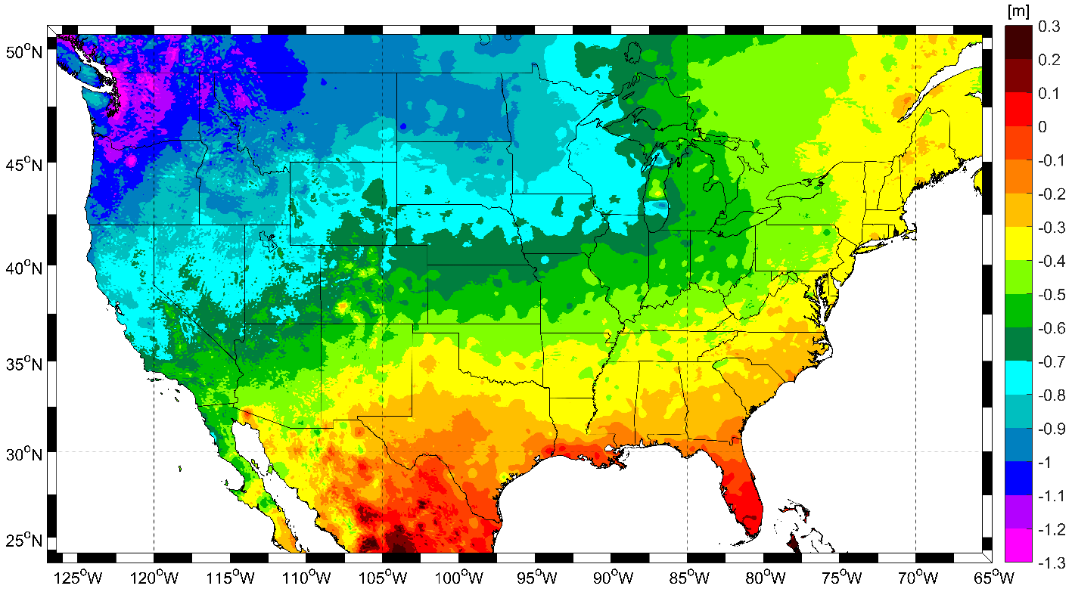
Expected changes to orthometric heights

Slide 28
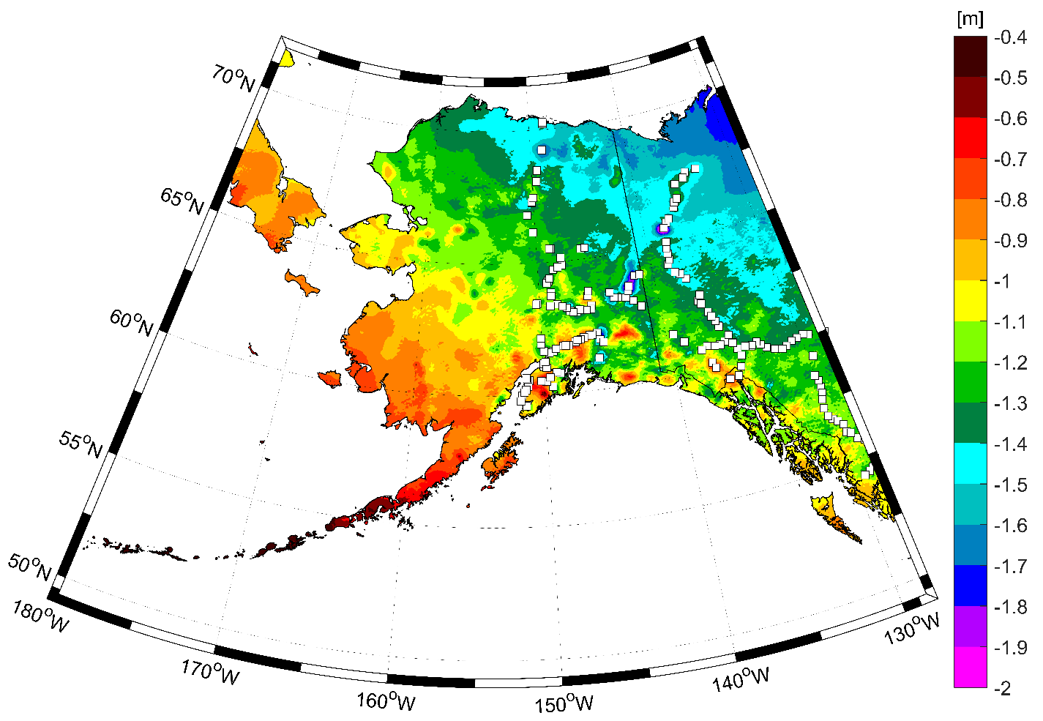
Expected changes to orthometric heights

Slide 29
Definitional Relationship
$H_{NAPGD2022}(t)≡h_{∗TRF2022}(t)−N_{GEOID2022}(t)$
Time-dependencies of ellipsoid heights
come from OPUS, where time-dependent
CORS coordinates serve as control for
your time-dependent GNSS survey.
Time-dependencies of geoid undulations
are captured in the dynamic component
of GEOID2022 (“DGEOID2022”), which
will come from the geoid monitoring
service, or GeMS.

Slide 30
High resolution products
All will be 1 x 1 arcminute grids
All will cover three finite regions of the globe
All will have a static and dynamic component
Dynamic surface gravity not expected to be ready by 2022
GEOID2022
Official converter of *TRF2022 ellipsoid heights into NAPGD2022 orthometric heights
DEFLEC2022
Surface deflections of the vertical in N/S and E/W
GRAV2022
Surface acceleration of gravity

Slide 31
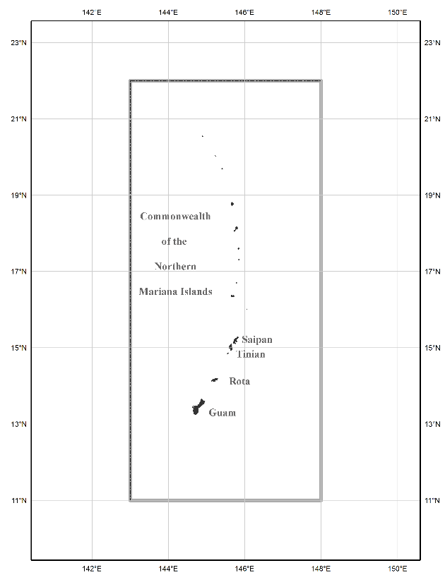
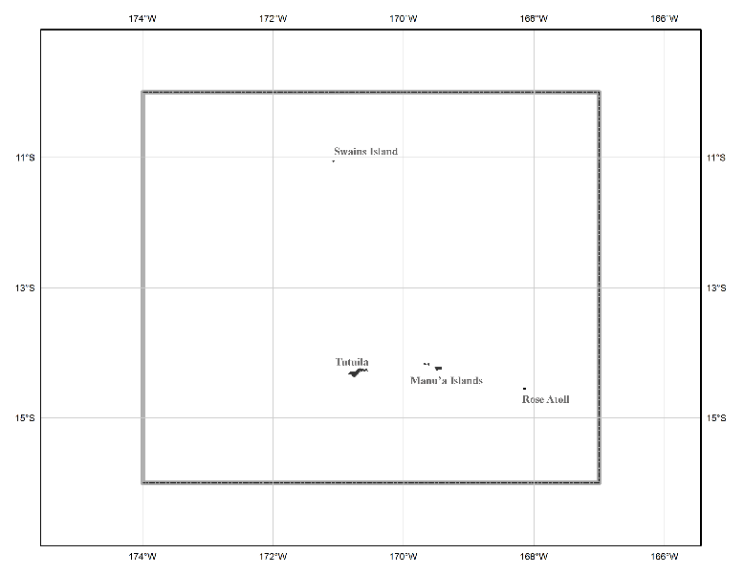
The three gridded regions
“North American region”
¼ of the Earth
“American Samoa region”
“Guam/CNMI region”

Slide 32
Leveling? Yes!

Slide 33
Leveling? Yes!
Leveling yields differential heights
If you want absolute heights, you need one or more known heights
Previously this was about finding a benchmark with a published NAVD 88 height
Does published mean “known”?
Does it mean “trusted”?
Does it mean “current”?

Slide 34
When was this point last leveled?
It’s in Louisiana where
accurate heights are
very important…
Has an “adjusted”
NAVD 88 height to
a millimeter…
It was monumented in
1968 (ignore the glitch),
and was last known to be
in good condition in 2002…
Savvy datasheet snoopers
may recognize this text as
meaning “it was adjusted
as part of the original roll-
out of NAVD 88…
It’s a trick question.
You can’t figure it out
from anything on here.
But the answer is:
Just once: 1968.

Slide 35
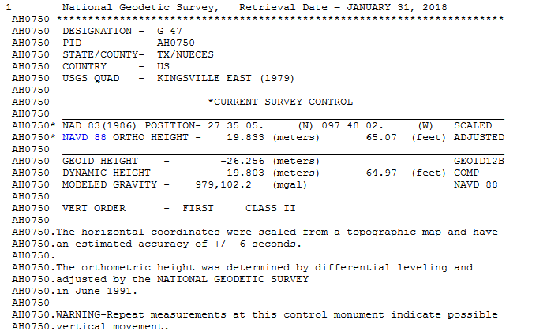
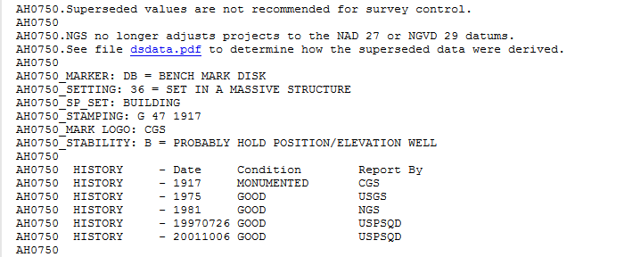
When was this point leveled?
You wouldn’t know it, but it was
leveled in:
1917, 1942, 1942 (again), 1945,
1951, 1981
The 1981 data went into
the NAVD 88 height
Q: But what about 64
years and 6 occupations?
A: You get a “warning” about vertical
movement, but no estimate of the rate.
Less than ¼ mile away is AH1055,
leveled once in 1981, with NO
warnings.

Slide 36
Leveling - Control
In NAPGD2022, “known” heights for a leveling survey:
Primary: Perform your own GPS survey
Yields starting orthometric heights using GEOID2022
RTK may be perfectly acceptable!
Secondary: Find a “not stale” passive mark
“Staleness” depends on the mark
Tertiary: Use VERTCON 3 on an NAVD 88 height
Please don’t do this

Slide 37
Updates and Replacements
NAPGD2022 will come with a version number
Updates will change the version
Bug fixes, new data, new theories, minor improvements
Replacements will change the name
When GMSL has changed by some threshold (20 cm)
About 50-70 years

Slide 38
Summary
NAPGD2022
Mutual consistency of heights, gravity, etc
Time dependent coordinates
Geoid definition decoupled from GMSL
Orthometric heights defined by GPS & geoid

Slide 39
Thank you!

Slide 40
Questions?

Slide 41
Extra Slides

Slide 42
Content: Geoid Modeling History
Provides context as to why “sea level” has been a perpetual human choice for “surface of zero height”
Attempts to model the sea level go back to the 1800s
Knowledge of currents and global sea level change have complicated the matter in the last 30 years or so
“Height above sea level” is too vague.
Which “sea level” and on what date?

Slide 43
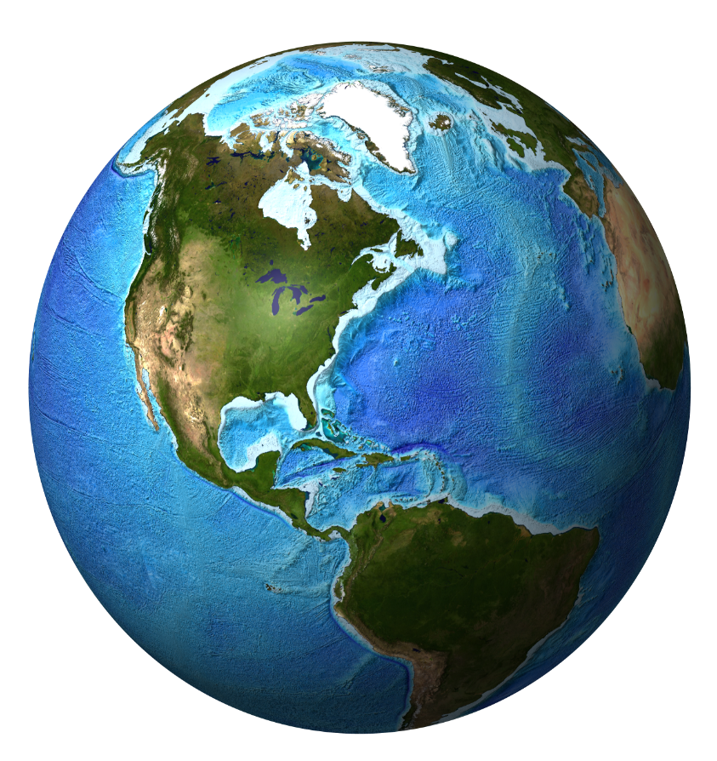
Earth’s Geopotential Field
Surface of equal gravity potential energy
(W=62,636,856 m^2 / s^2 = W )
The “Holy Grail”…
“THE” geoid…
0
Surface of equal gravity potential energy
(W=62,610,000 m^2 / s^2)
Surface of equal gravity potential energy
(W=62,620,000 m^2 / s^2)
Surface of equal gravity potential energy
(W=62,630,000 m^2 / s^2)
Surface of equal gravity potential energy
(W=62,640,000 m^2 / s^2)
Surface of equal gravity potential energy
(W=62,650,000 m^2 / s^2)
Surface of equal gravity potential energy
(W=62,660,000 m^2 / s^2)
Notes:
The derivative of potential relative to radial distance from the Earth (dW/dr) is being treated as negative here. The sense of the sign is convention, and differs based on which textbook and in which field (geodesy or physics) is being consulted.

Slide 44
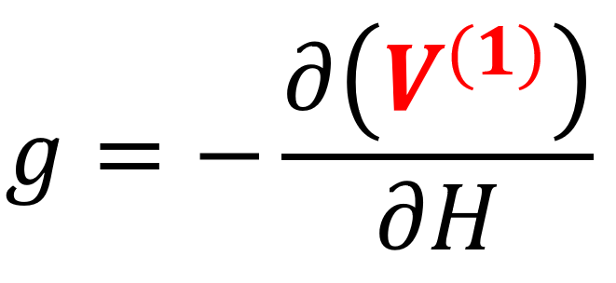
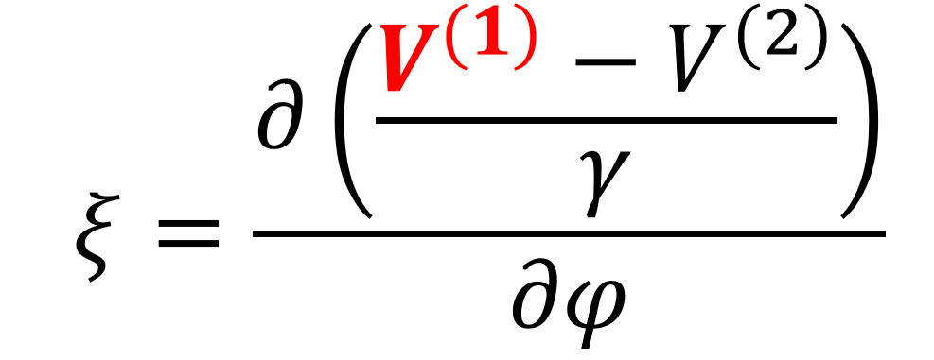
Geopotential Field
…as a function of
geocentric co-latitude,
geocentric longitude
radial distance from the center of the Earth…
Gravity Potential
Energy…
…can become…
Geoid Undulations…
Acceleration of Gravity…
Deflection of the Vertical…
Etc., ad nauseum.

