Slide 1

GPS on Bench Marks:
Summer 2021 Update
NGS Webinar Series
June 10th, 2021
NOAA’s National Geodetic Survey
GPSonBM Team:
Dr. Kevin Ahlgren, Geodesist & Geoid Modeler
Galen Scott, NGS Constituent Resources Manager
Brian Shaw, Rocky Mountain Regional Geodetic Advisor

Slide 2
Topics
GPS on Bench Marks: Past, Present, Future
Geoid explanation –
  Hybrid (GEOID12B/GEOID18) – NAVD 88
  Gravimetric (xGEOIDs) – NAPGD2022
Machine Learning to improve
GPS on Bench Mark Status Update for Transformation Tool
Update timing of data submissions and product updates

Slide 3

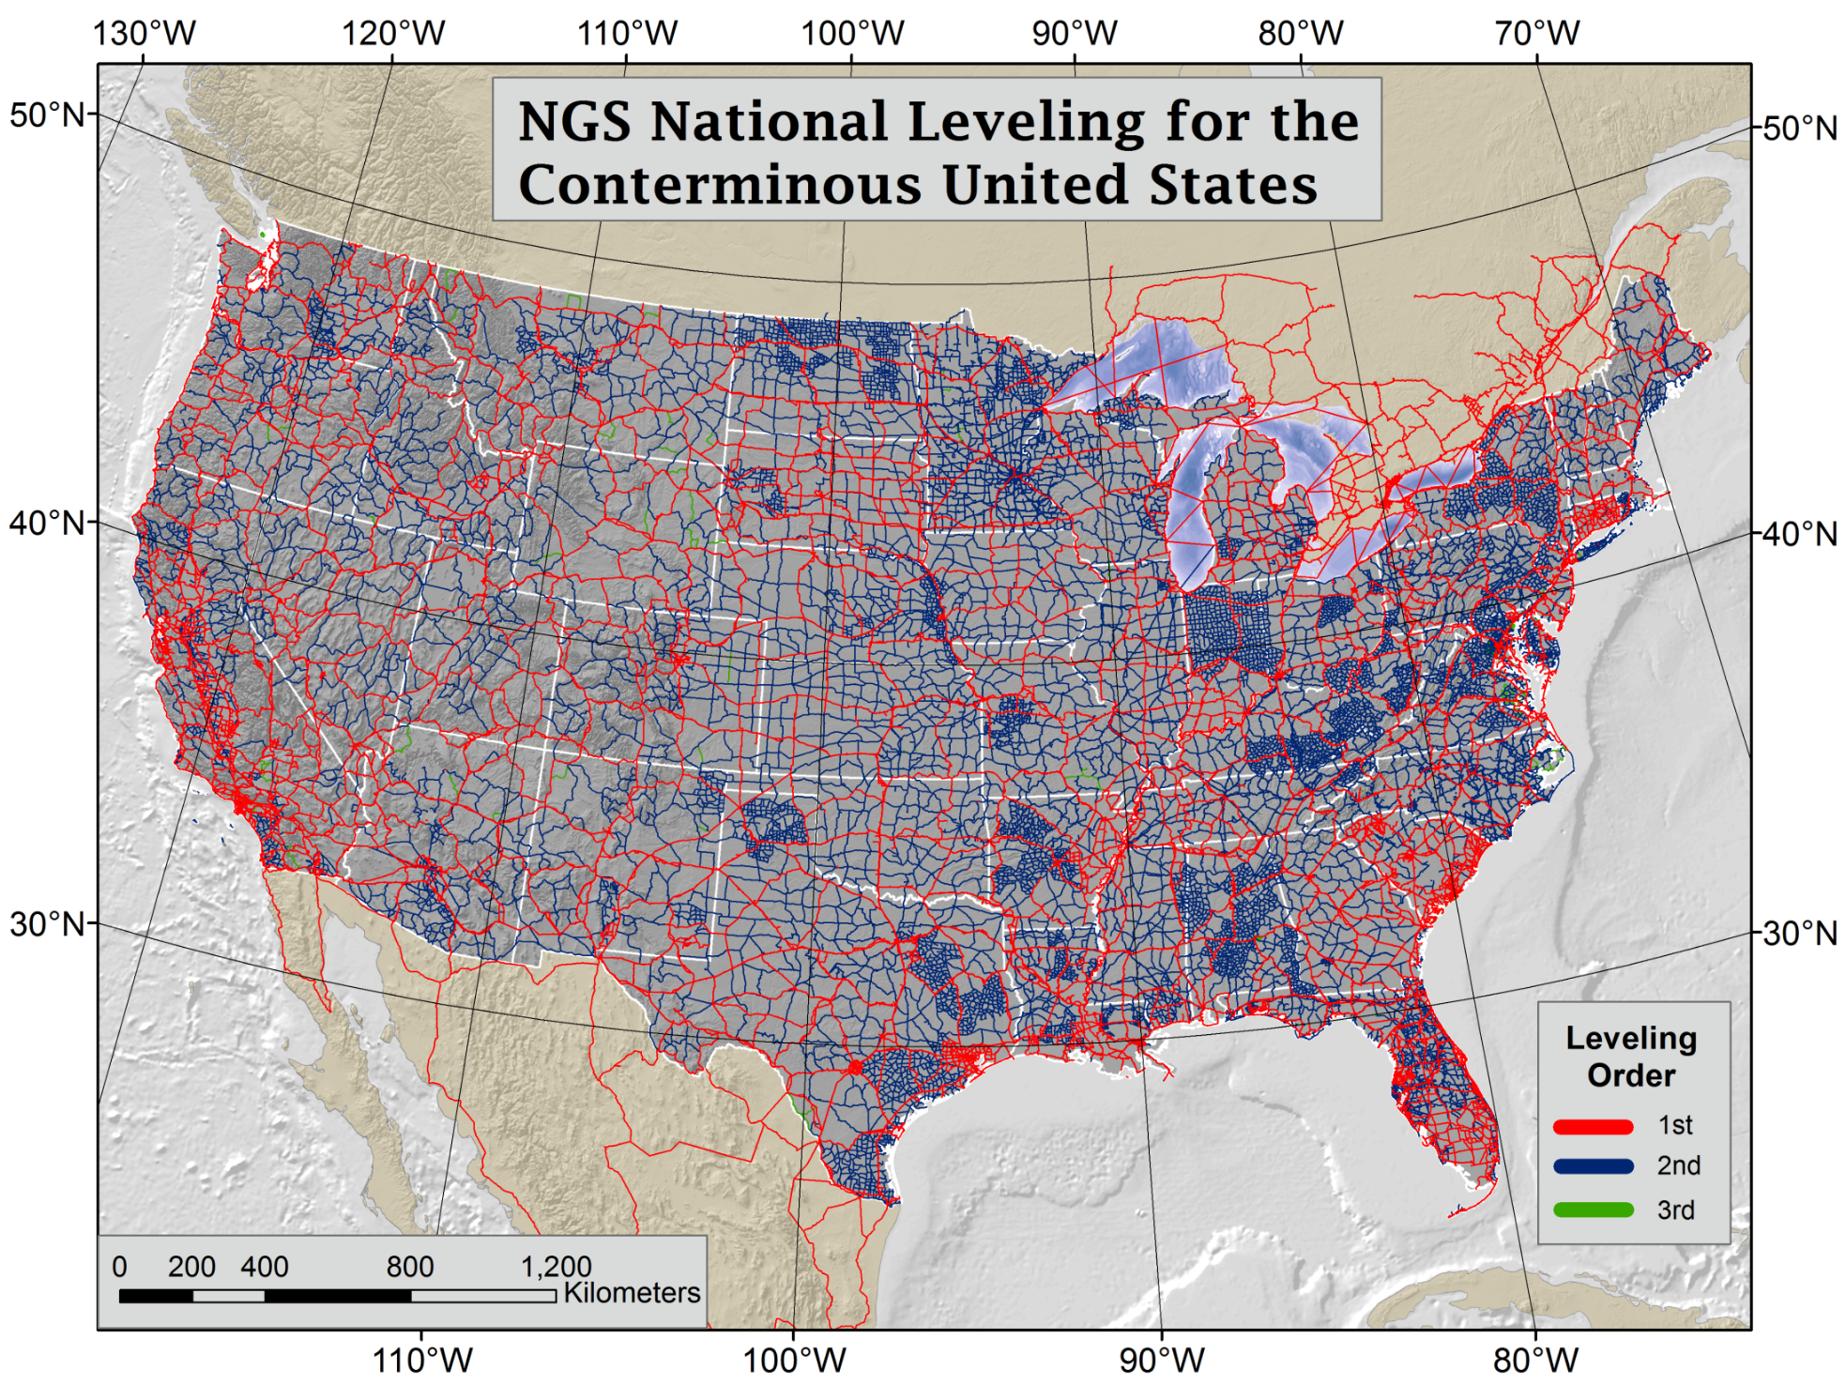
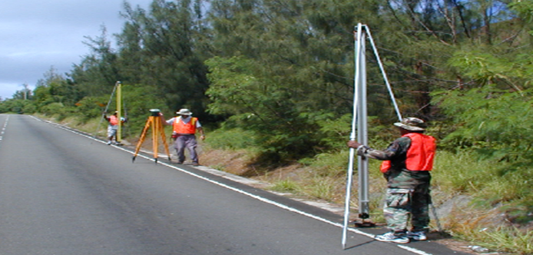
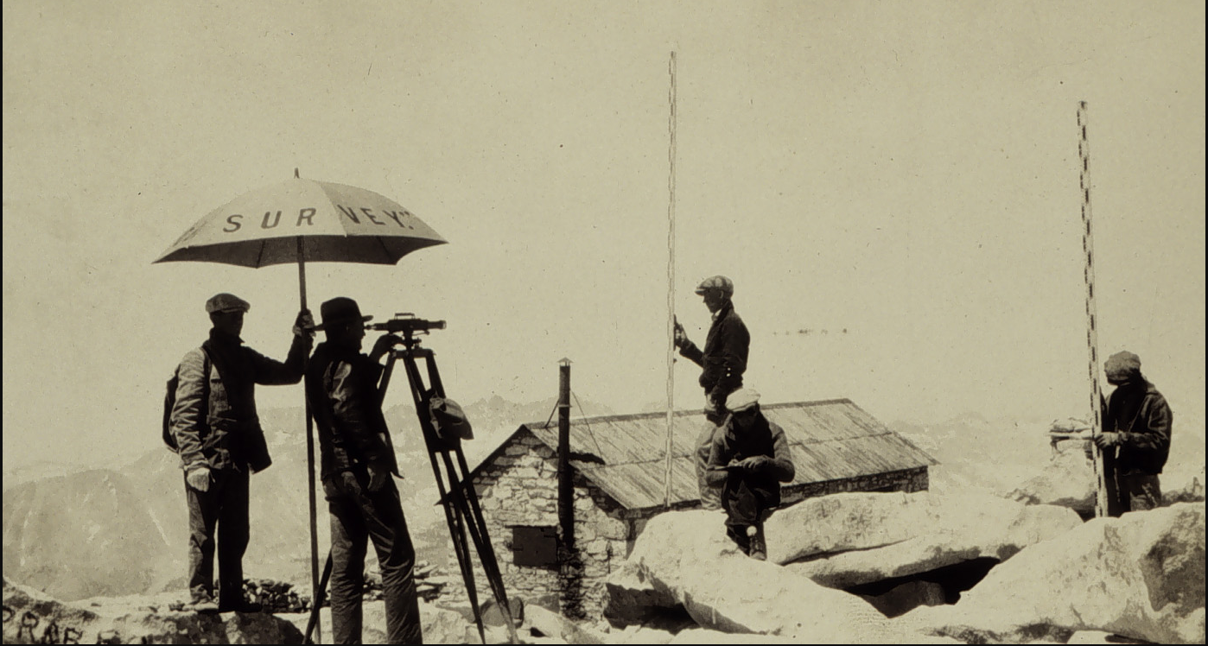
NAVD 88 is Based on
Continental Scale Geodetic Leveling
Current Vertical Datums:
NAVD88
CONUS & AK
PRVD02
Puerto Rico
VIVD09
US Virgin Islands
GUVD04
Guam
NMVD03
Commonwealth of the Northern Marianas
NAVD 88 consists of about 800,000 bench marks connected by about 2.2M km of leveling conducted over 80+ years
Notes:
NAVD 88 consists of about 800,000 bench marks and ~2.2M km of leveling. Data was collecting over many decades by roving bands of surveyors who walked across the country multiple times over the years, east to west, north to south and back again. It is currently the official vertical datum of the US and is required for federal mapping projects.
GPS data on those leveled marks will be used to create GEOID18 – the model used to derive NAVD88 heights from GPS ellipsoid heights, as well as the transformation tools that will be released with NAPGD2022.
GPS data on those leveled marks will be used to create the transformation tools that will be released with NAPGD2022.
Incredible effort – best tech at the time
BUT:
ACCESS!
Leveling is time intensive and expensive
Access has historically been through passive control, bench marks that you must find
Accuracy!
Distance dependent errors can build up, making the overall network less reliable
Bench mark can move over time , Only as reliable as the last observation
Consistency!
Modernized NSRS will eliminate systematic errors in current datums
Aligned with global reference frames
Integrated system for both positions and heights (“elevations”)
But, long time period during which things were moving that we could not adequately account for
New reference frames will give coordinates at specific reference epochs and the IFVM will move coordinates through time from the survey epoch to the reference epoch.

Slide 4

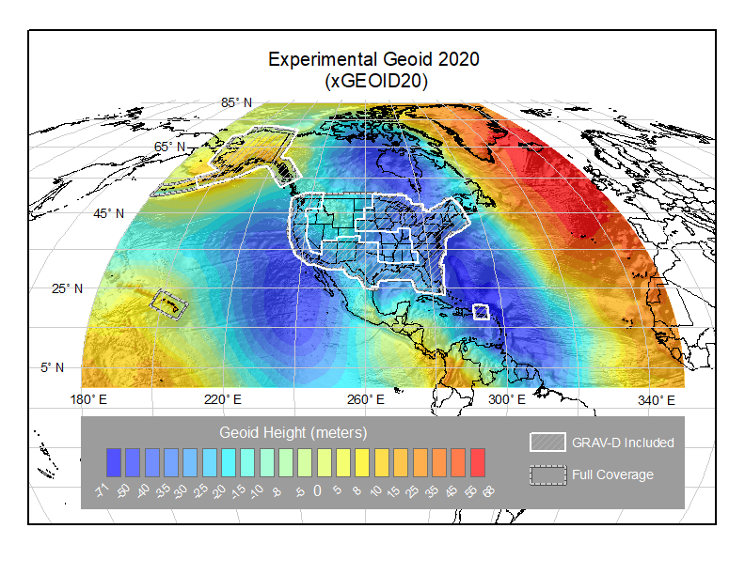
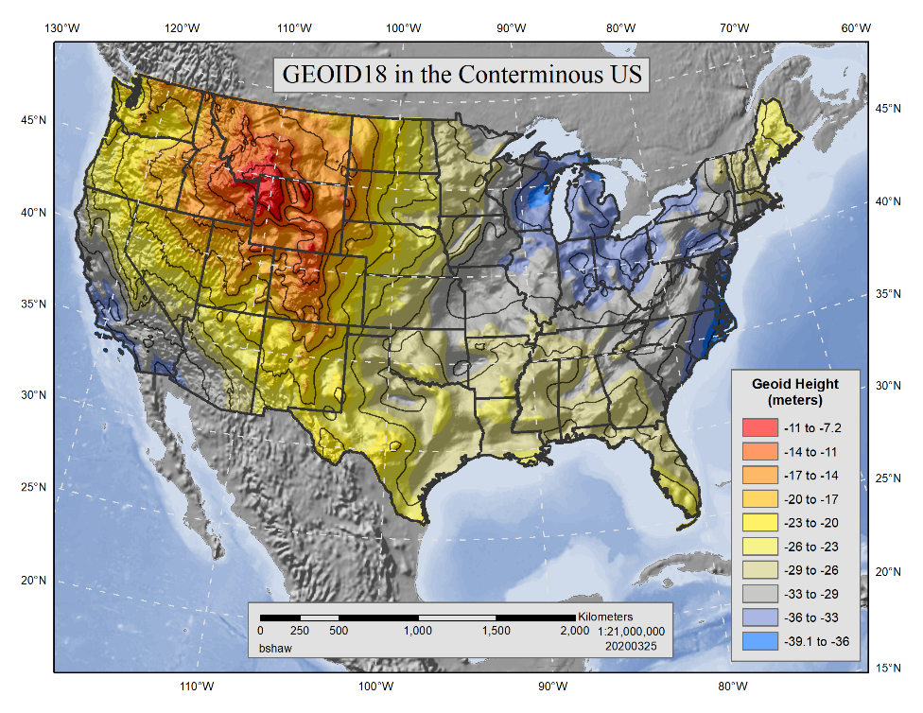
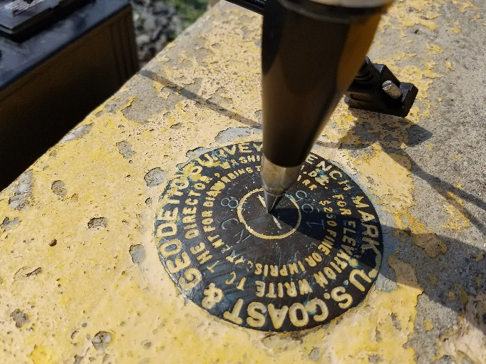
Building on the Past to Prepare for the Future
GPS on Bench Marks is about building the Transformation Tool to connect the past and future Datums and preparing the country and our communities to take full advantage of the benefits of the Modernized NSRS
Benefits of Participating in GPSonBM:
Improve local results of NAVD 88 – NAPGD2022 Transformation Tools
2020.0 Reference Epoch Coordinates (REC’s) with initial release of Modernized system
Go 4D - Track changes over time with Survey Epoch Coordinates (SEC’s)
GEOID18
Update Passive Control Status
Check your RTN results
What is GPSonBM? New GPS / GNSS data on existing NGS marks with published NAVD 88 orthometric heights
Notes:
Historically used to create the hybrid geoid models used to provide GPS derived NAVD 88 orthometric heights (GEOID99 – GEOID18)
Evaluate the experimental gravimetric geoid models (xGEOIDs) as team iterates toward GEOID2022, the foundation for NAPGD2022
Create transformation tools between NAVD88 and NAPGD2022
Gathering data to generate 2020.0 Reference Epoch Coordinates and (eventually) a series of Survey Epoch Coordinates

Slide 5



GPSonBM Helps You Prepare for the Modernized NSRS
Resurvey: Return to the field and collect new observations to compute REC’s
Readjust: Using existing observations, re-compute new coordinates based upon geodetic control with published REC’s
Transform: Take finished products which have coordinates in the old datum and use transformation software to estimate coordinates in the new datum
Working in the modernized NSRS:
April 2019
Revised February 2021
NOAA TR NOS NGS 67
Notes:
Listed in decreasing order of accuracy, but also in decreasing order of cost and increasing order of simplicity

Slide 6
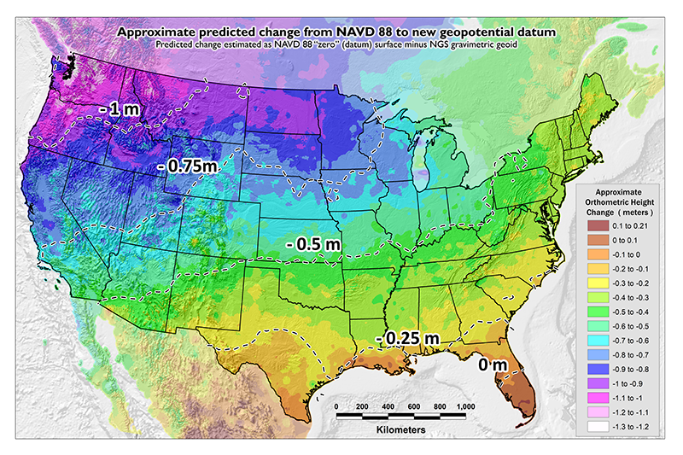
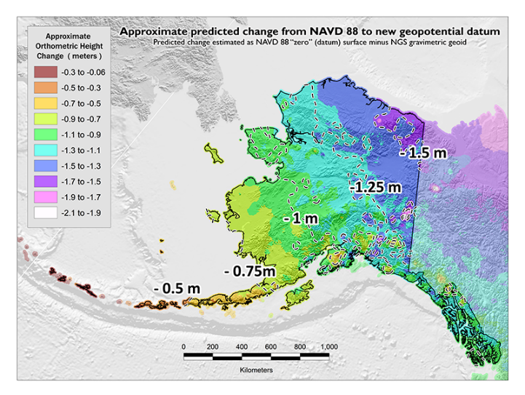
GPSonBM Measurements Connect
Current and Future Datums
Because the relationships between the old and new datums vary by location, the accuracy of the transformations in any particular place is directly related to the density of GPSonBM data available in that area.
  In moving from NAVD 88 to NAPGD2022, there will be a Shift: A one-time jump in the 0 to 2 meter range (orthometric height)
    From fixing biases and/or tilts in NAVD 88
PID: EZ0840
GPSonBM data is used to measure the Shift

Slide 7
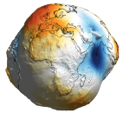

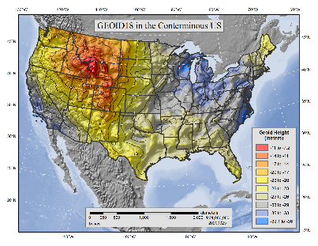
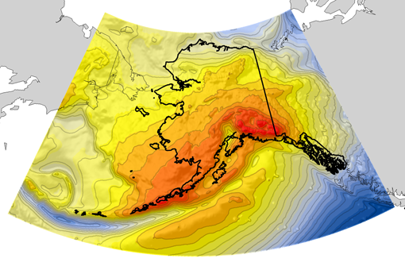
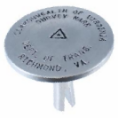
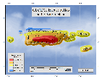
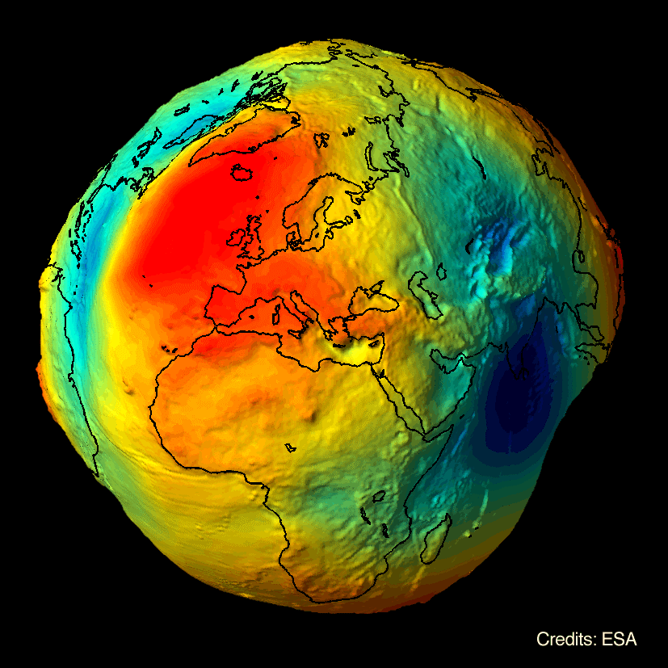

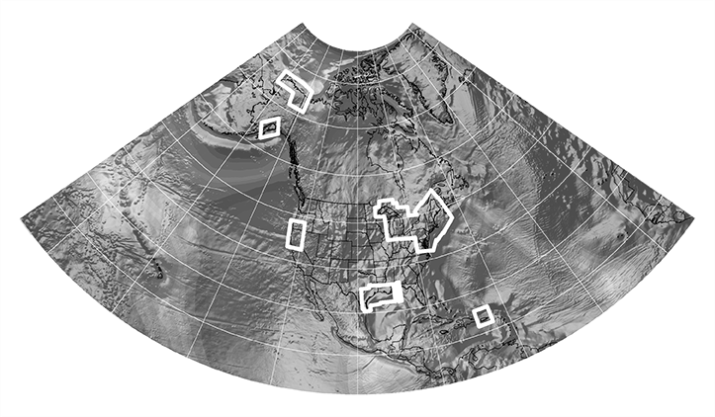
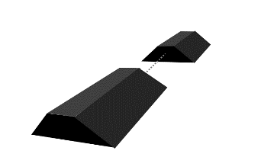
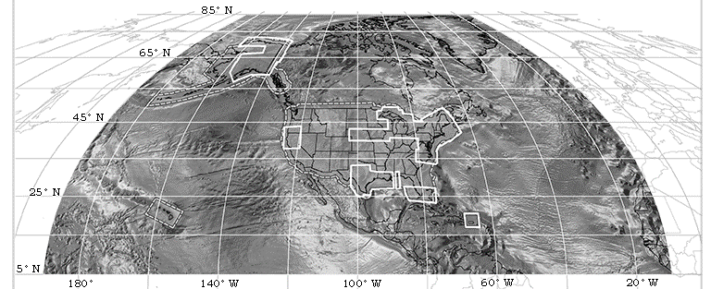

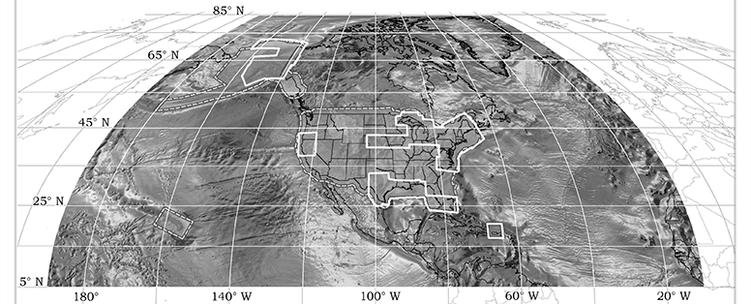

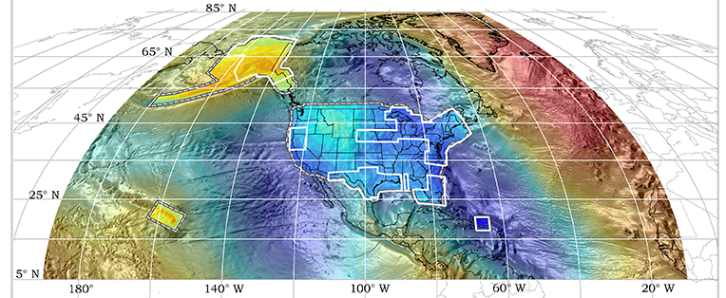
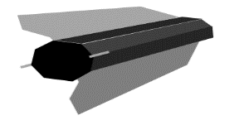

Evolution of Recent NGS Geoid Models
EGM2008
GEOID18
USGG2012
GEOID12A/B
GRAV-D
2008
2012
2014
2015
2017, … , 2020
GOCO05s
GOCO06S
2016
xGEOID14B
xGEOID15B
GRACE
GRACE FO
xGEOID16B
xGEOID20B
GEOID2022
+
GOCE
Notes:
Hybrids: NGS created hybrid geoid models to convert NAD83 ellipsoid heights from GPS observations to NAVD 88 orthometric heights.
Series of models released 1996 to 2019
Covering all US States and territories
Used GPSonBM data to constrain models to NAVD 88 heights
Current official model is GEOID18
Gravimetric Models …
Combine terrestrial, airborne, and satellite based gravity measurements with DEM, Math, & Physics
GEOID2022 will define NAPGD2022 in Modernized NSRS
Current prototype is xGEOID20

Slide 8
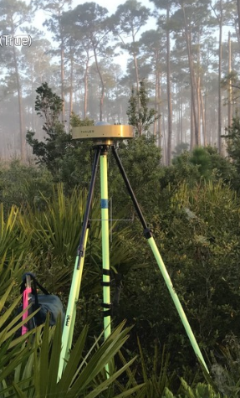
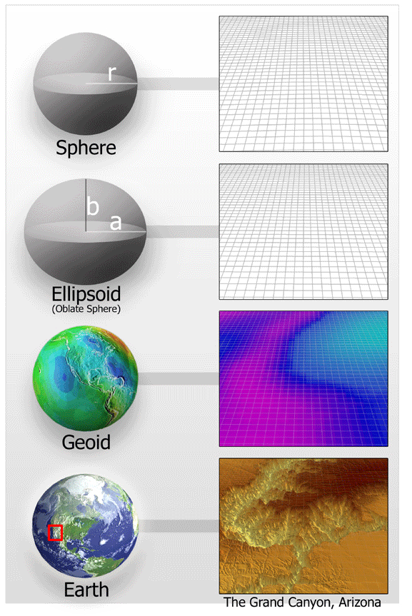
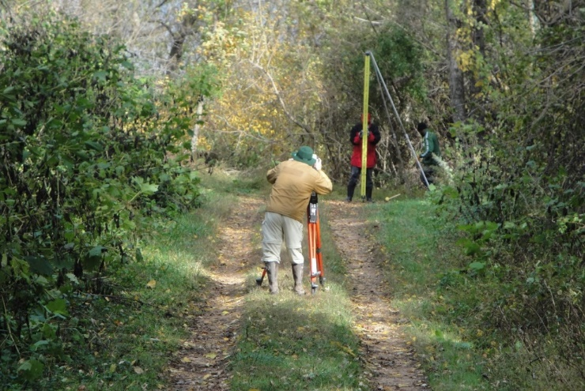
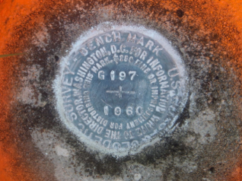
The Geoid, and Heights
h
= H
+ N
H: Orthometric height from Leveling – water flow
h: Ellipsoid height measured using GPS
Topography
h
H
The geoid
N
A chosen
ellipsoid
N: Geoid undulation from a geoid model: gravimetric or hybrid
*The relationship between the ellipsoid and the geoid may be swapped in some locations
Theoretically, the difference between these three values should be zero. In practice, using actual observations gives a residual, or measure of the misfit between the three. We use the residual to evaluate and quality control the observations. In the Modernized System the GEOID 2022 model will DEFINE the height rather than estimate it as done with the hybrid geoid models.
Notes:
How exactly are these two surfaces related?
Point of scientific clarity: The geoid is a surface that is always convex. Yes it has undulations, but geoid purists in the audience will point out to you that, measured at the scale of the Earth itself, the geoid always has a POSITIVE radius relative to the center of the Earth. But when we zoom in, just for illustrative purposes, it is nice to show an “undulating” geoid, to distinguish it from both the smooth ellipsoid and the not smooth topography.
Additionally, don’t even bother showing that the plumb line (H) is curved. For purists, fine, but even at America’s largest known curved plumb line (Den
If we get two observations that agree to within 5 cm, we use the data, if they don’t agree then we ask for a third. This process helps us evaluate which of the datasets is correct, and which may be wrong. New GPS observations are much less expensive that new leveling.
Process of comparing independent data sources allows us to make a decision about which observation are correct.
Because NAVD 88 is a leveling based datum, NGS has used hybrid geoid models for the last 2 decades to provide NAVD 88 orthometric heights from GPS derived NAD 83 ellipsoid heights. These hybrid geoid were made by warping a gravimetric geoid model to the NAVD 88 surface using the GPS observations on levelled NAVD 88 marks. GEOID18 was the last hybrid geoid model that NGS will release before moving to the Modernized NSRS which will use a purely gravimetric geoid model (GEOID2022) as the foundation for NAPGD2022.
ali), this curvature is a SUB MILLIMETER effect.
Photo credit for GPS picture: by Rudolphe Konou, Florida Dept of Environmental Protection

Slide 9


Cross Validation with independent data:
Residual = h - H - N
-
-
h is ellipsoid height measured using GPS
H is an NAVD 88 Orthometric Height from Leveling
N is from a geoid model
Theoretically, the difference between these three values should be zero. In practice, using actual observations gives a residual, or measure of the misfit between the three. NGS uses the residual to evaluate the observations in slightly different ways.
Notes:
In the future –this question will close by definition.

Slide 10
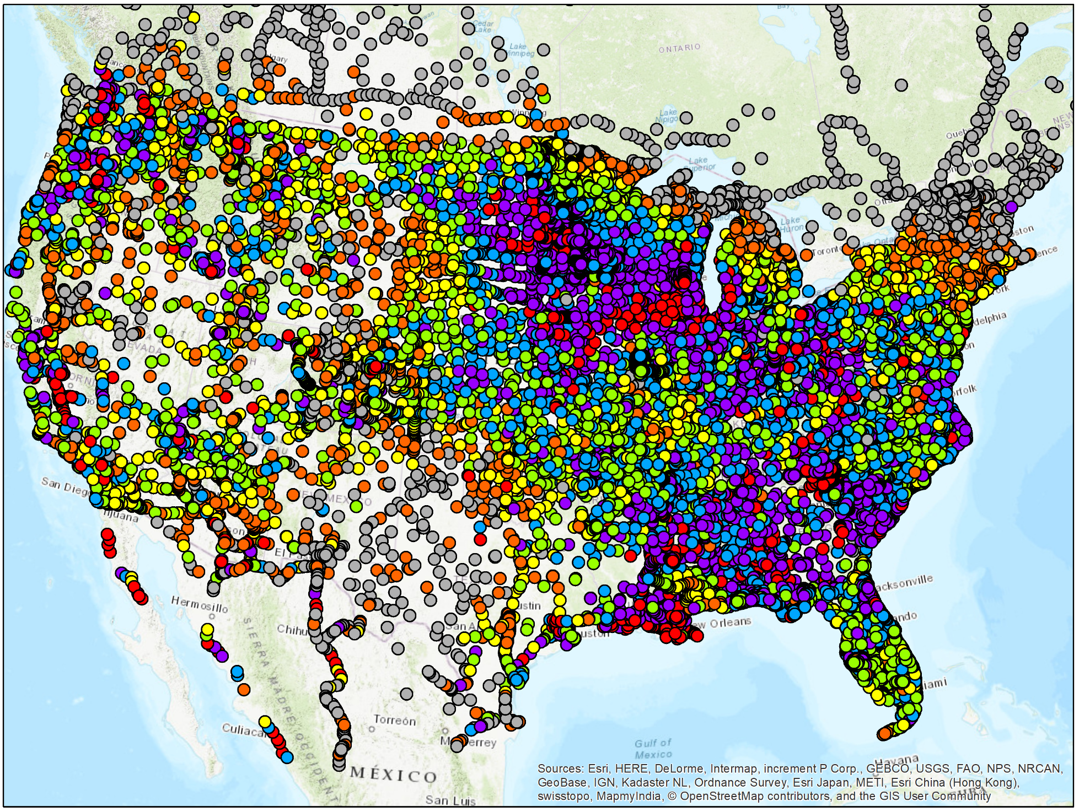
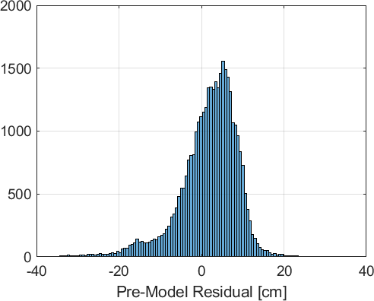
Residual from gravimetric geoid
Used in future Transformation Tool
Used in evaluating xGEOID quality

Slide 11
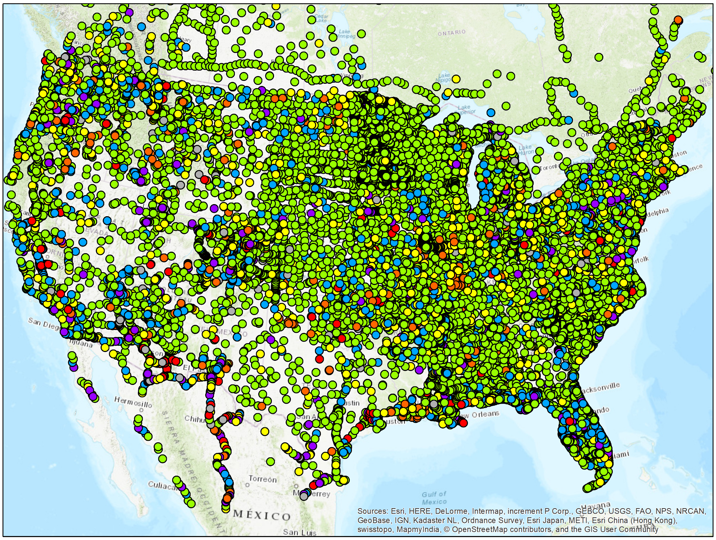
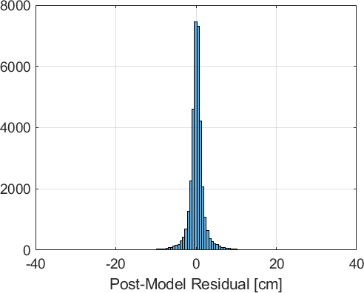
Residual from hybrid geoid
After constraining geoid to benchmarks
Notes:
After the OPUS Share info to show improvement

Slide 12


Hybrid GEOID18 and NAVD 88 Heights
GPS on Bench Marks
Benchmarks with Leveled NAVD 88 heights
H_{NAVD88} =
h
- N_{GEOID18}
Topography
h
H_{NAVD88}
GEOID18
Hybrid geoid
Gravimetric geoid
GEOID18
N_{GEOID18}
xGEOID19
A chosen
ellipsoid
*The relationship between the ellipsoid and the geoid may be swapped in some locations
Notes:
Point of scientific clarity: The geoid is a surface that is always convex. Yes it has undulations, but geoid purists in the audience will point out to you that, measured at the scale of the Earth itself, the geoid always has a POSITIVE radius relative to the center of the Earth. But when we zoom in, just for illustrative purposes, it is nice to show an “undulating” geoid, to distinguish it from both the smooth ellipsoid and the not smooth topography.
Additionally, don’t even bother showing that the plumb line (H) is curved. For purists, fine, but even at America’s largest known curved plumb line (Den
If we get two observations that agree to within 5 cm, we use the data, if they don’t agree then we ask for a third. This process helps us evaluate which of the datasets is correct, and which may be wrong. New GPS observations are much less expensive that new leveling.
Process of comparing independent data sources allows us to make a decision about which observation are correct.
Because NAVD 88 is a leveling based datum, NGS has used hybrid geoid models for the last 2 decades to provide NAVD 88 orthometric heights from GPS derived NAD 83 ellipsoid heights. These hybrid geoid were made by warping a gravimetric geoid model to the NAVD 88 surface using the GPS observations on levelled NAVD 88 marks. GEOID18 was the last hybrid geoid model that NGS will release before moving to the Modernized NSRS which will use a purely gravimetric geoid model (GEOID2022) as the foundation for NAPGD2022.
ali), this curvature is a SUB MILLIMETER effect.
Photo credit for GPS picture: by Rudolphe Konou, Florida Dept of Environmental Protection

Slide 13
GEOID2022 will define NAPGD2022 Heights
H_{NAPGD2022} =
h
- N_{GEOID2022}
H: Orthometric height – which way water flows
h: Ellipsoid height measured using GPS
Topography
h
H_{NAPGD2022}
GEOID2022
N_{GEOID2022}
A chosen
ellipsoid
N: Geoid undulation from a gravimetric geoid model
*The relationship between the ellipsoid and the geoid may be swapped in some locations
Theoretically, the difference between these three values should be zero. In practice, using actual observations gives a residual, or measure of the misfit between the three. We use the residual to evaluate and quality control the observations. In the Modernized System the GEOID 2022 model will DEFINE the height rather than estimate it as done with the hybrid geoid models.
Notes:
Point of scientific clarity: The geoid is a surface that is always convex. Yes it has undulations, but geoid purists in the audience will point out to you that, measured at the scale of the Earth itself, the geoid always has a POSITIVE radius relative to the center of the Earth. But when we zoom in, just for illustrative purposes, it is nice to show an “undulating” geoid, to distinguish it from both the smooth ellipsoid and the not smooth topography.
Additionally, don’t even bother showing that the plumb line (H) is curved. For purists, fine, but even at America’s largest known curved plumb line (Den
If we get two observations that agree to within 5 cm, we use the data, if they don’t agree then we ask for a third. This process helps us evaluate which of the datasets is correct, and which may be wrong. New GPS observations are much less expensive that new leveling.
Process of comparing independent data sources allows us to make a decision about which observation are correct.
Because NAVD 88 is a leveling based datum, NGS has used hybrid geoid models for the last 2 decades to provide NAVD 88 orthometric heights from GPS derived NAD 83 ellipsoid heights. These hybrid geoid were made by warping a gravimetric geoid model to the NAVD 88 surface using the GPS observations on levelled NAVD 88 marks. GEOID18 was the last hybrid geoid model that NGS will release before moving to the Modernized NSRS which will use a purely gravimetric geoid model (GEOID2022) as the foundation for NAPGD2022.
ali), this curvature is a SUB MILLIMETER effect.
Photo credit for GPS picture: by Rudolphe Konou, Florida Dept of Environmental Protection

Slide 14

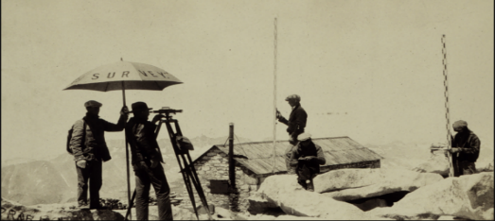
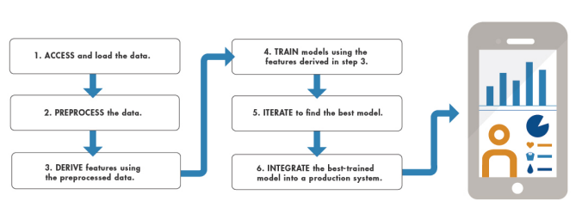

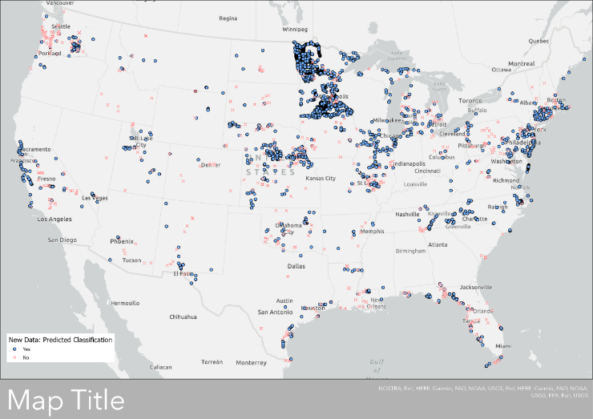
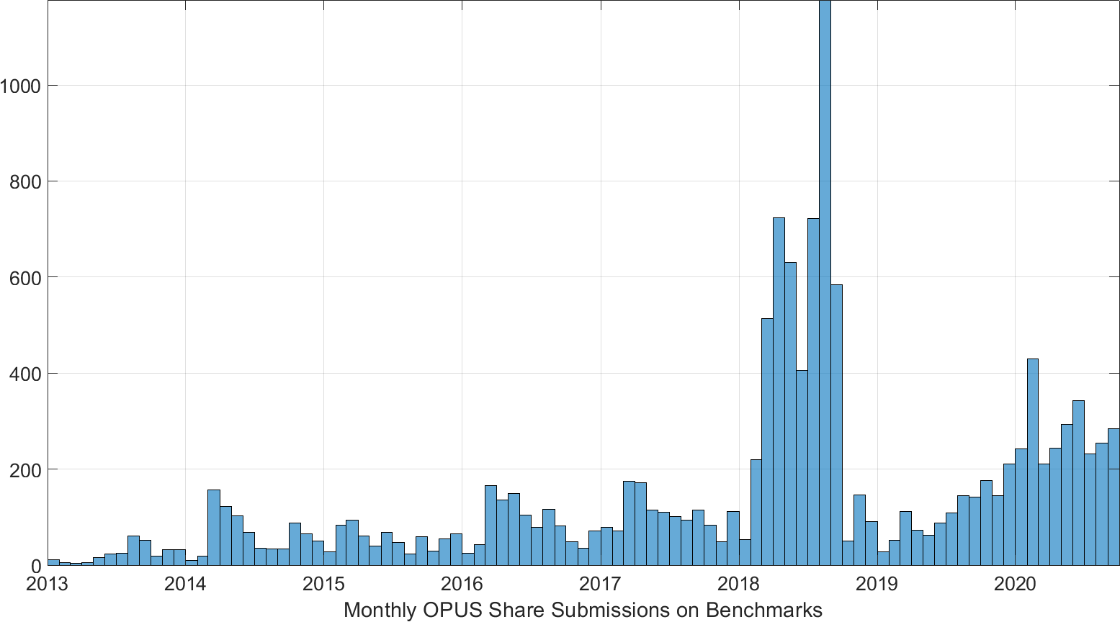
Automatic Evaluation of New GPS on Bench Mark data with Machine Learning
Use results from GEOID18 to ‘train’ a model
  “Supervised Classification” - based on previous manual editing/cleaning process
  Binary Class: ‘Use/Yes’ or ‘Not Use/No’
Use model on new data going forward
  Automate evaluation of ~250 new submissions on benchmarks each month
  Reduce need for human review
Notes:
GPS/leveling (GPS on benchmarks)
Applications: geoid model validation
Imperfect dataset: GNSS, leveling
Lots of observations/classes
Cleaning: Hybrid Geoid Models (GEOID18)
Machine Learning
Use results from GEOID18 to ‘train’ a model
“Supervised Classification” with MATLAB R2020a
Binary Class: ‘Use/Yes’ or ‘Not Use/No’
Use model on new data going forward
Have ~250 new submissions on bench marks each month
Avoid going back through manual editing/cleaning process
Our goal in this application though is to separate the good and the bad observational benchmarks using machine learning. In this machine learning model, we rely on a set of pre-determined classifications to train the model. So, what we have in this case is a set of 35,000 GPS on benchmarks that were evaluated for use in NGS’s latest hybrid geoid model, GEOID18, which have already been given Yes/No designations. We are using MATLAB software to perform the machine learning with a SUPERVISED CLASSIFICATION framework.
Ultimately, the goal is to then take an appropriately trained and accurate machine learning model – and apply it to new dataset that it hasn’t seen before.

Slide 15

GPSonBM is Driving a Surge in Shared OPUS Solutions
Modernized NSRS will be Realized through Shared GNSS Data
2021 NSRS Mod Campaign
2018 GEOID18 Campaign
2020 Transformation Tool Campaign
2019 Transformation Tool Campaign Launch
Notes:
GPSonBM History overview:
2007- Launched OPUS Database / Sharing
2014 -2017 – Outreach event for National Surveyor’s Week – People asked for specific target marks – started with static lists
2018 – GEOID 18 Campaign – Priority marks & 30km spacing goal
2019 – 2021 – Transformation Tool Campaign – 10km goal
2021 and on – NSRS Modernization Preparation –REC’s & SEC’s

Slide 16
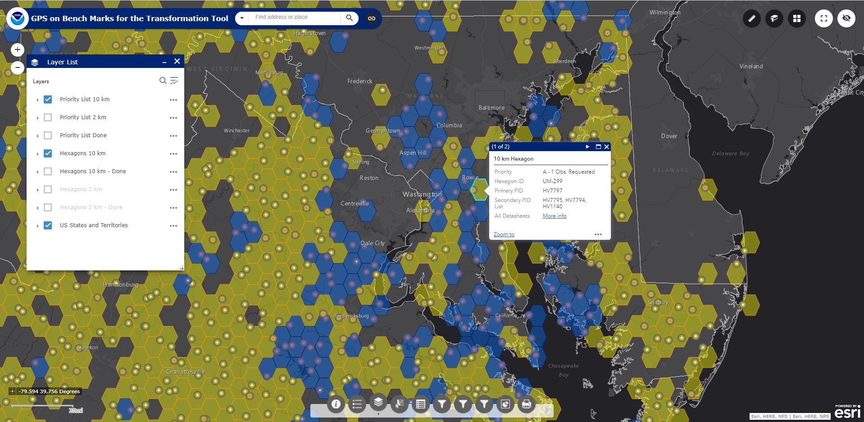
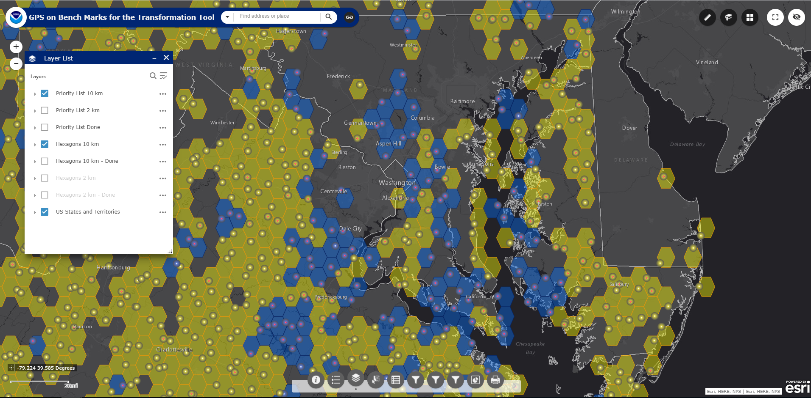
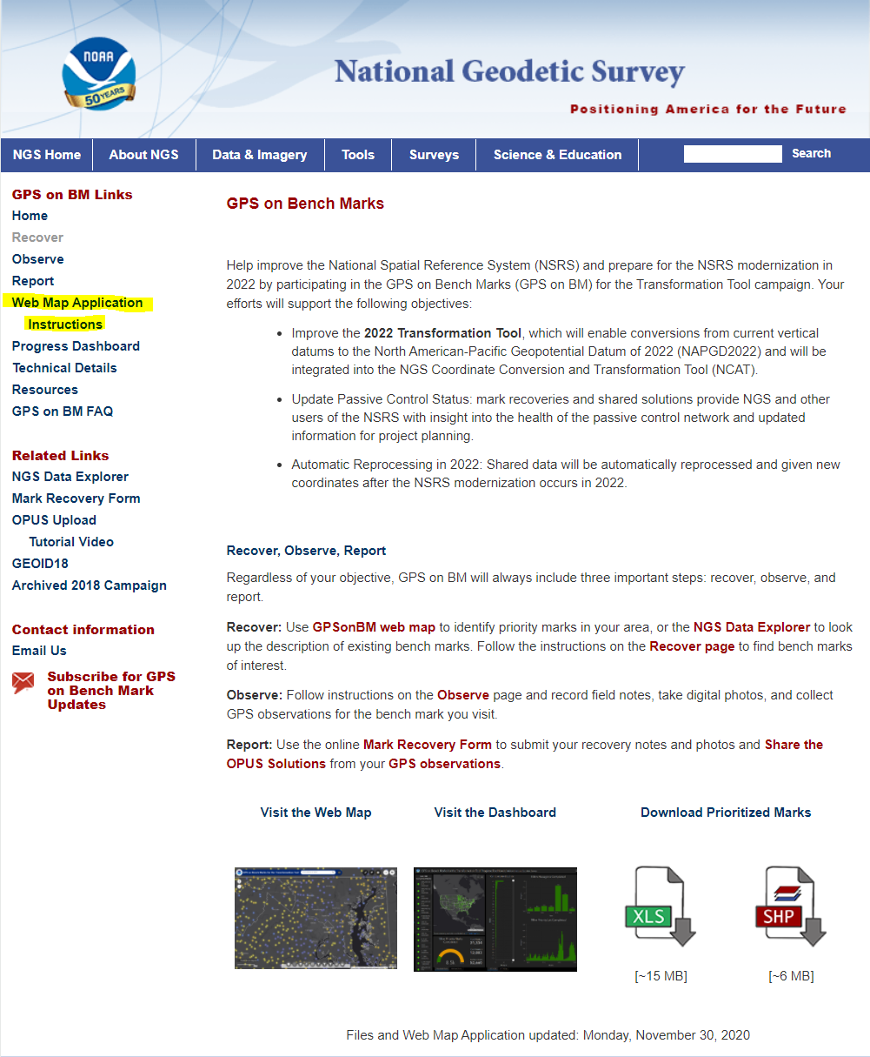
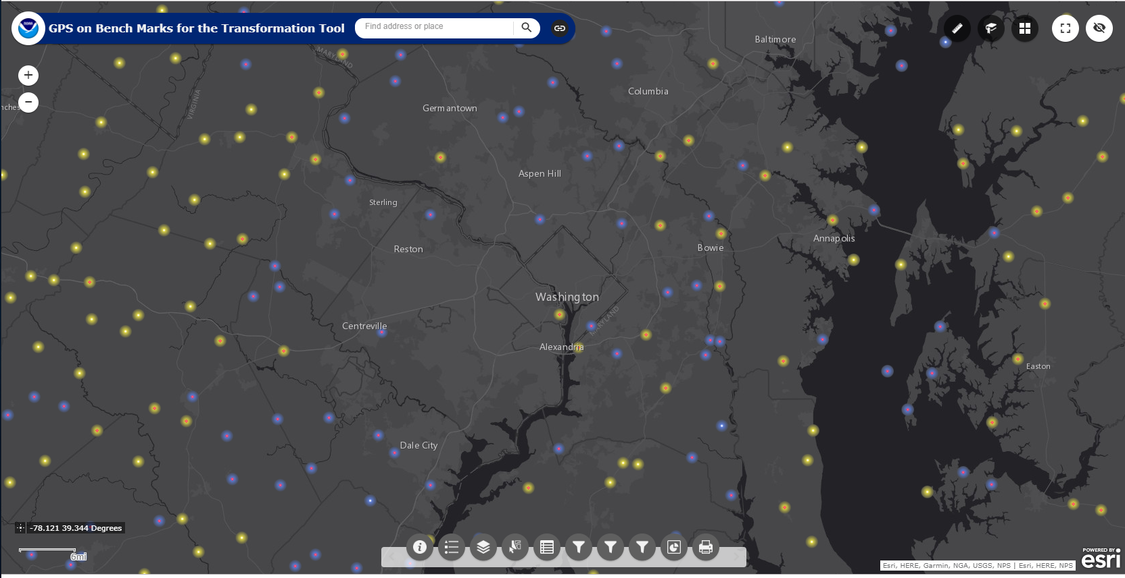
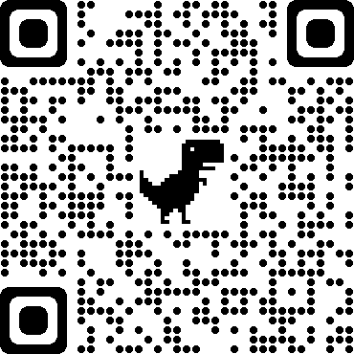
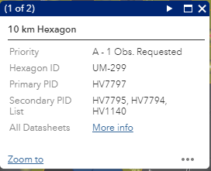
Transformation Tool Campaign Priority List and Web Map
Layer List
The web map has several functions that allow users to search, explore, filter, and export the data
Check out the GPSonBM webpage:
www.ngs.noaa.gov/GPSonBM/

Slide 17
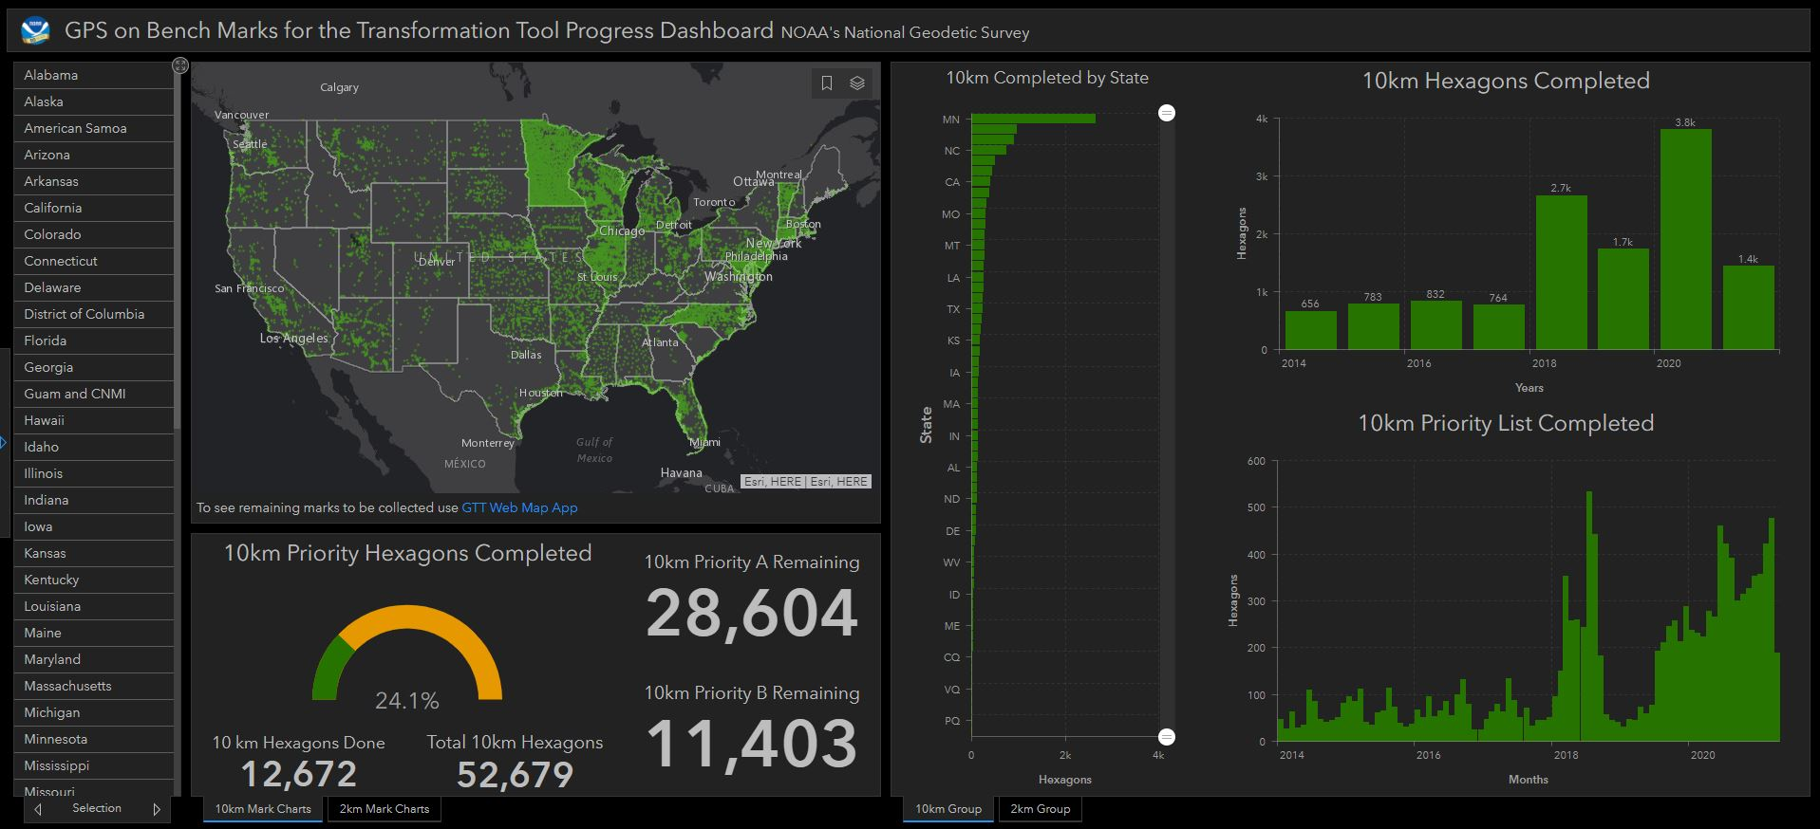
GPSonBM Transformation Tool Campaign: Progress Dashboard
Notes:
States that have submitted very little GPSonBM data so far:
AL
NM
NV
WV
PR
KY
ID
NH
ME
GA
HI
RI

Slide 18
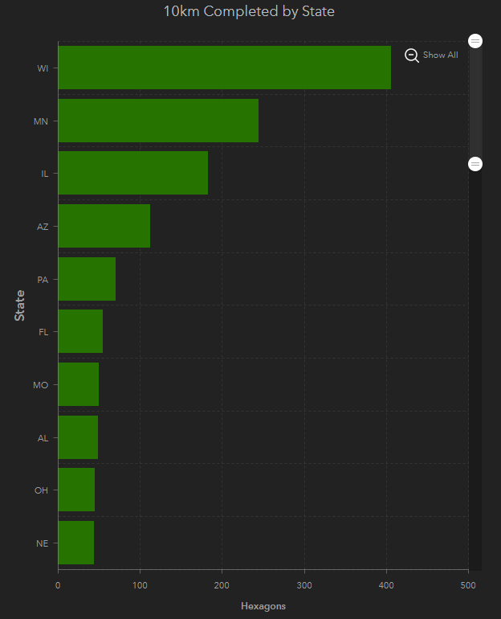
GPSonBM Transformation Tool Campaign: Progress Dashboard
2021 Top 10 List
10 km Hexagons Closed in 2021
Rank | State
1 | WI
2 | MN
3 | IL
4 | AZ
5 | PA
6 | FL
7 | MO
8 | AL
9 | OH
10 | NE
Notes:
States that have submitted very little GPSonBM data so far:
AL
NM
NV
WV
PR
KY
ID
NH
ME
GA
HI
RI

Slide 19
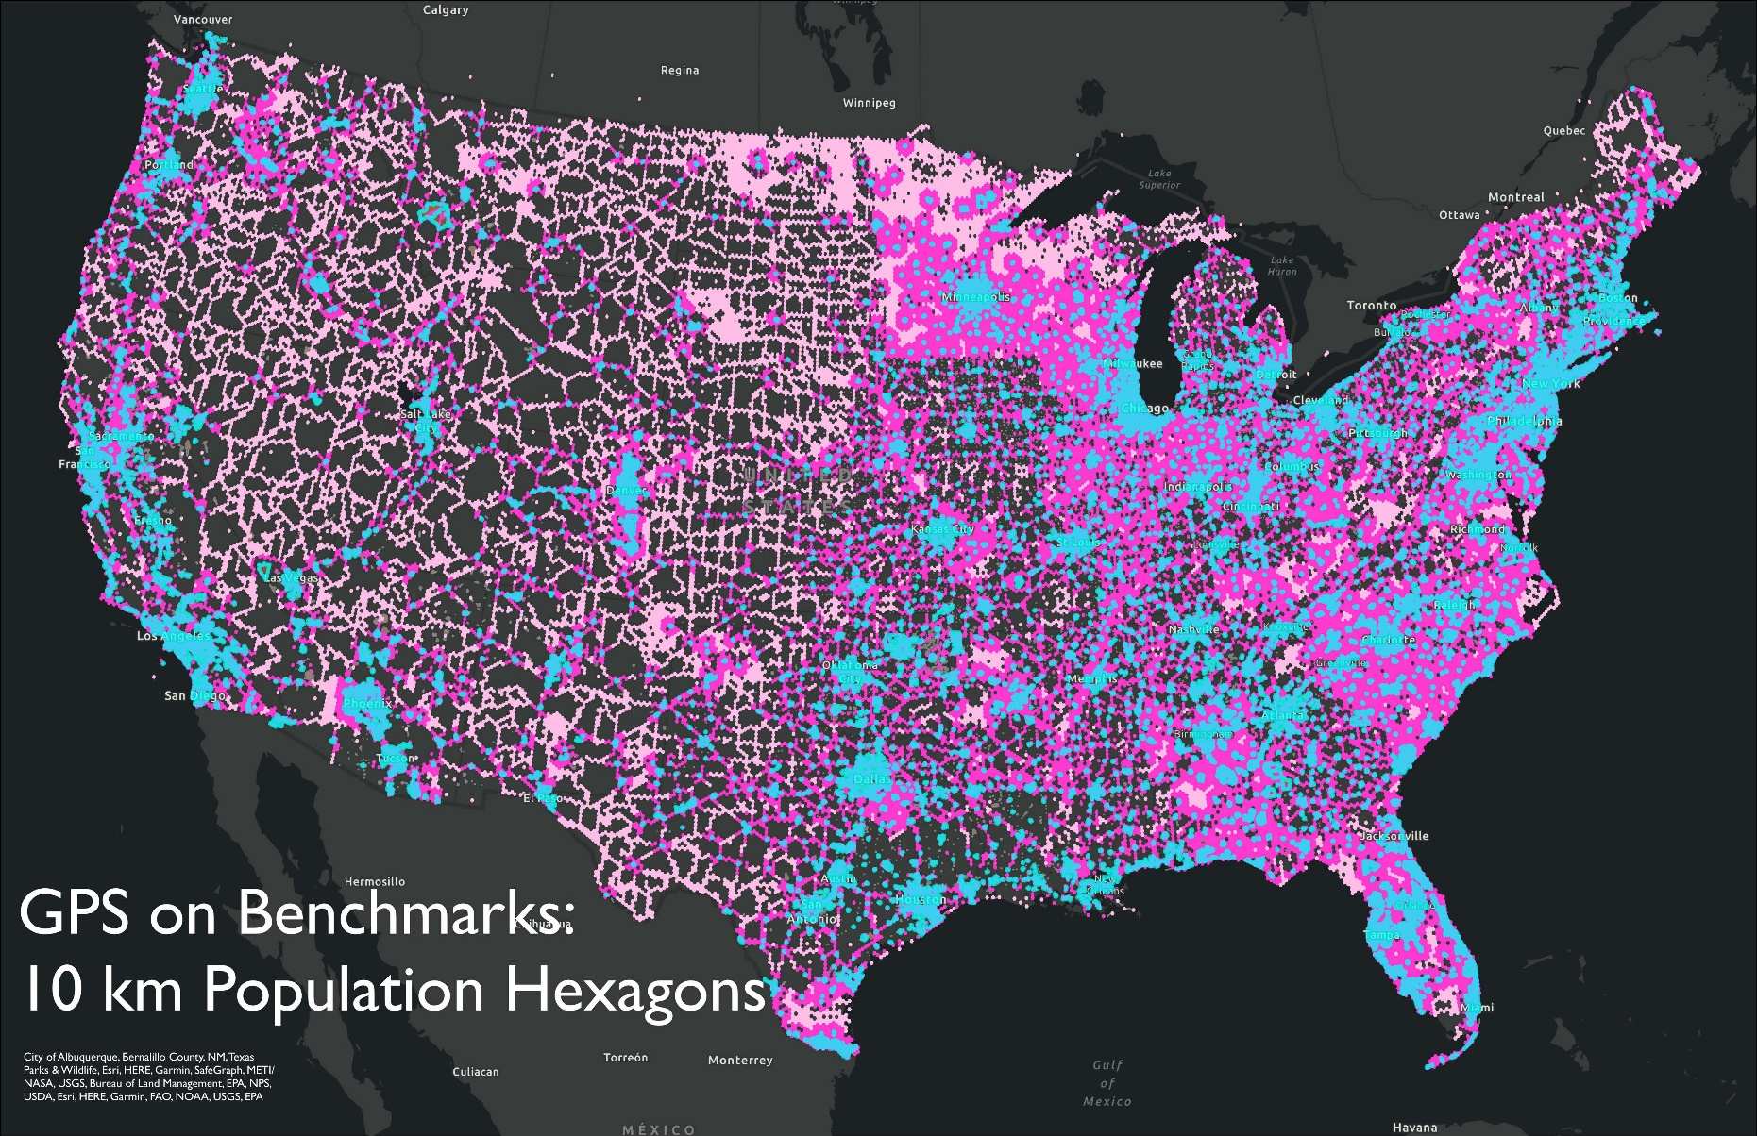
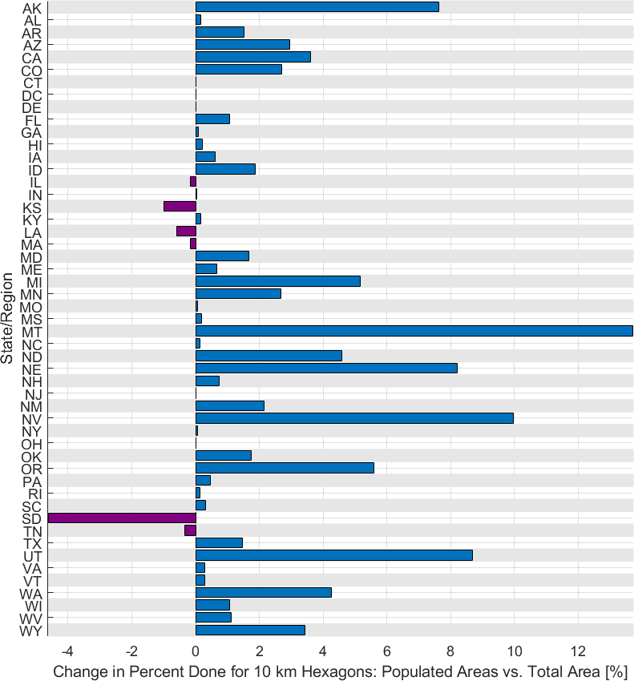
Tracking Progress in Populated Areas
Blue represents populated areas (>2,500). Dark Pink are the 10 km hexagons within 20 km of the populated areas. Light Pink are those outside the 20 km areas, away from populated areas.

Slide 20
Data Submission Route Comparison
Shared OPUS Solution
Bluebooking through OPUS 4.0 & 5.0
Individual Observation – not for use as geodetic control
Will NOT update NGS Datasheet
Will be harvested for inclusion in adjustment and receive 2020.0 REC to be released with modernized NSRS
Will be used to create transformation tool, only if mark has published NAVD 88 height (not suppressed heights)
Redundant observations and network adjustment of coordinates
Will provide new NAVD 88 heights published on NGS Datasheets
Will be harvested for inclusion in adjustment and receive 2020.0 REC’s to be released with modernized NSRS
Will be used to create transformation tool
5.0 - Will allow import of RTK vectors

Slide 21
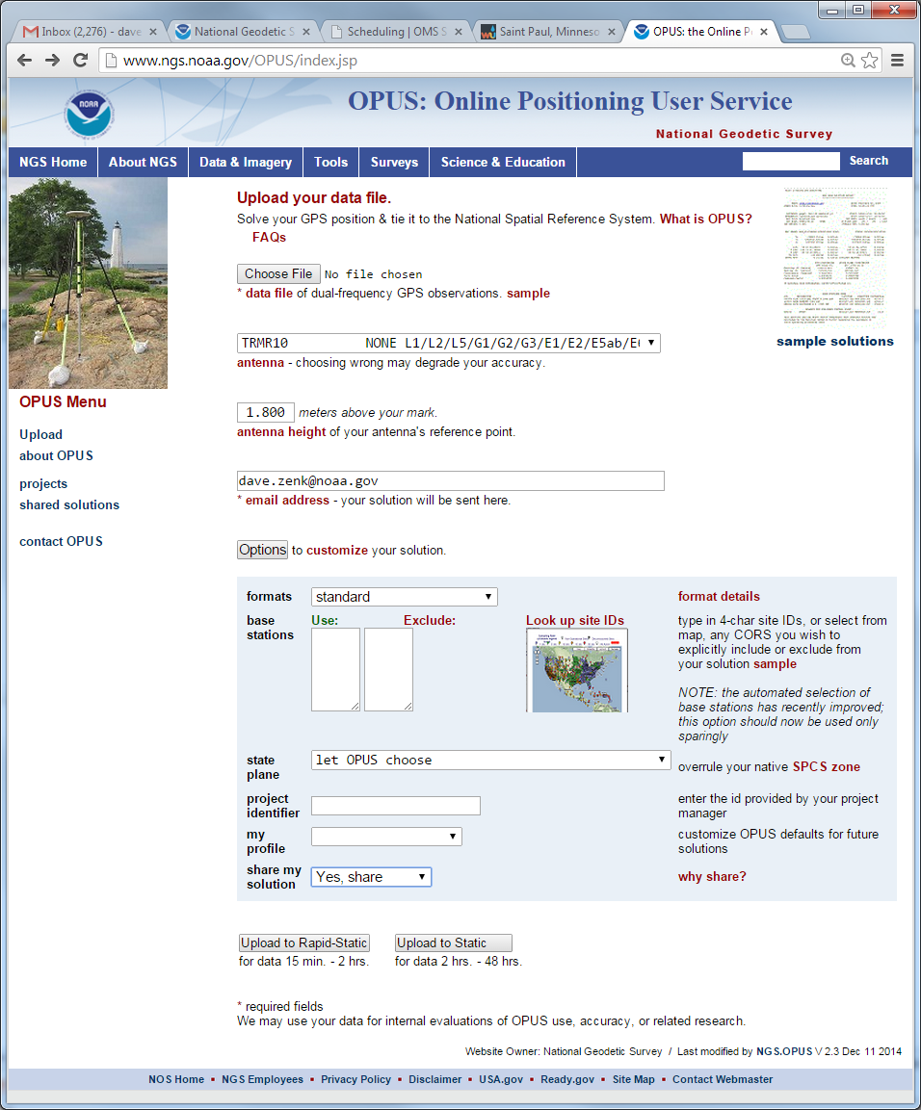
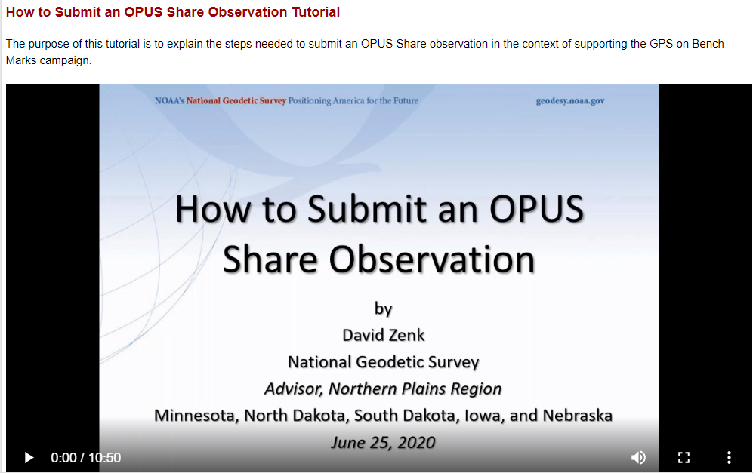
Share GPS Observations through OPUS
Upload 4+hour GPS observation file
Provide antenna type, antenna height, and email address
Click “Options” & Select “Yes, Share”
Identify the Mark by PID
Write a “To Reach” description
Attach 2 photos:
  close-up (avoid dark/blurry/dirt-covered)
  horizon (show equipment in use)
Respond to confirmation email
geodesy.noaa.gov/corbin/class_description/opus-share-tutorial/

Slide 22
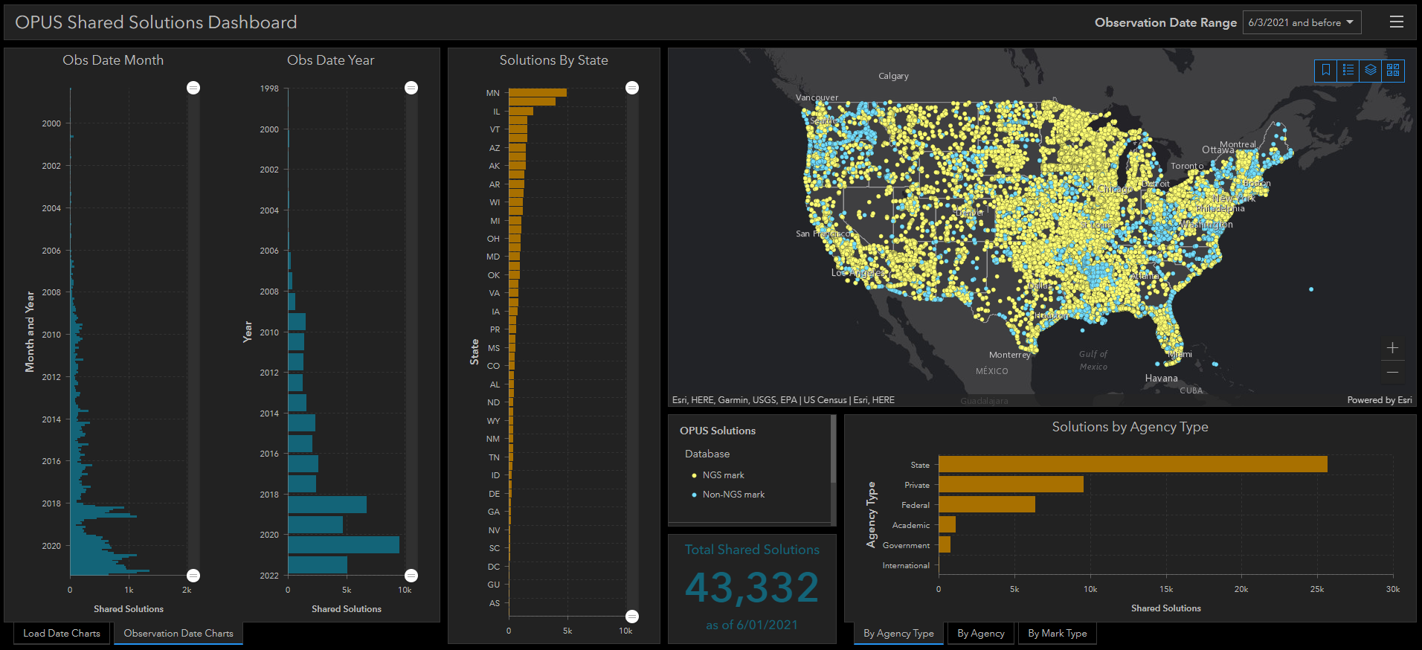
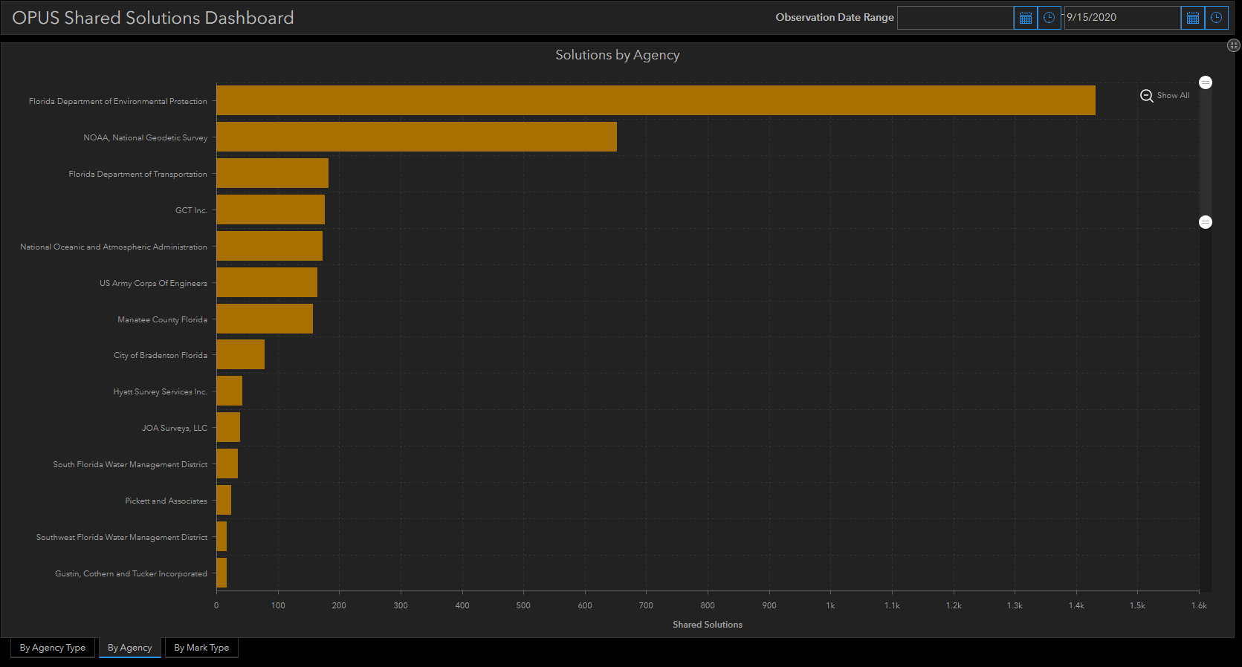
OPUS Shared Solutions Dashboard
Dashboard enables sorting and visualization of Shared Solutions by Month & Year, State, Agency Type, and Submitting Agency
Agency type | # Shared Solutions on NGS marks
State | ~21,700
Private Sector | ~4,600
Federal | ~3,100
Academic | ~890
Note the impact of GPSonBM Campaigns

Slide 23
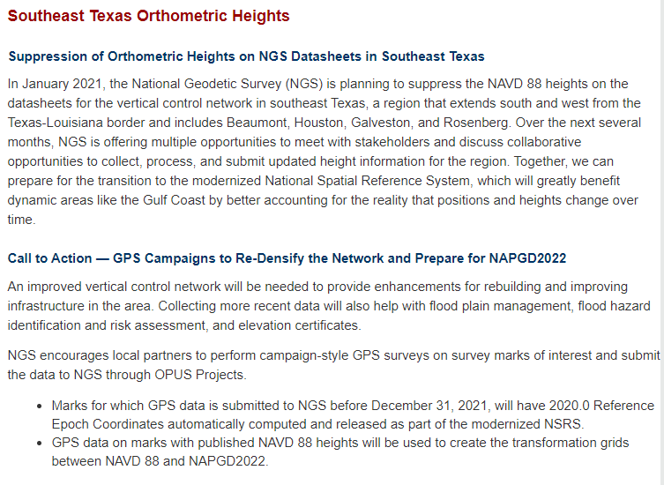
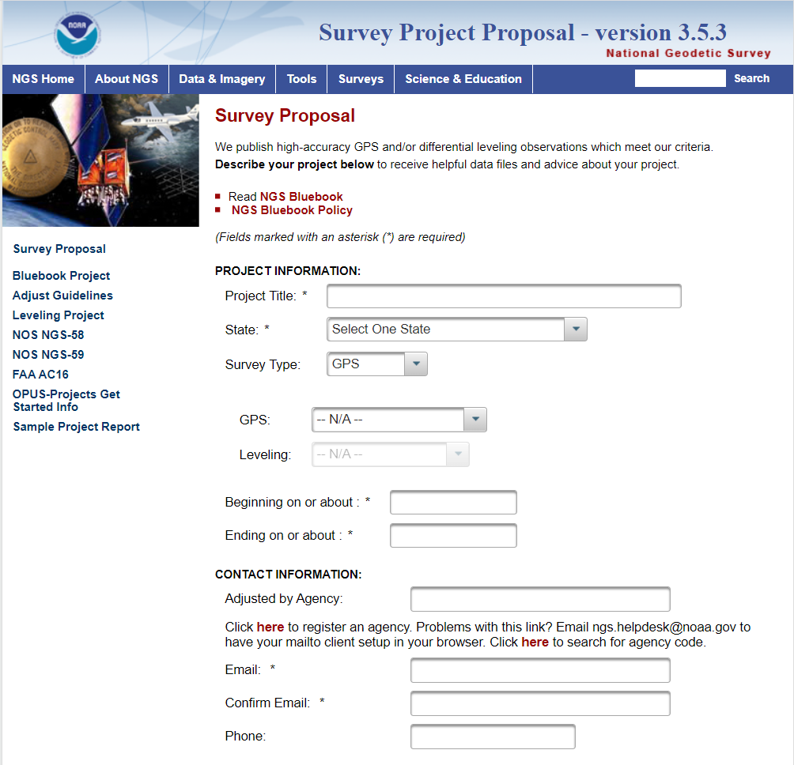

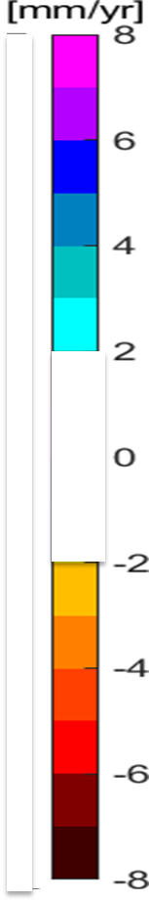
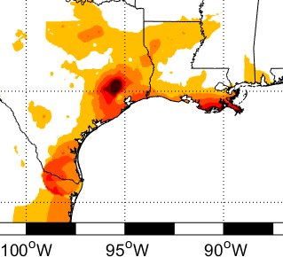
Campaign-Style Bluebooked Surveys
For Areas of Motion & Getting your Local Network into the NSRS
Update NAVD 88 heights on NGS datasheets in areas where the heights have been suppressed or the data is out of date.
Get new current NAVD 88 heights, 2020.0 REC’s, accurate transformation grid and baseline for time series
Notes:
Single Shared OPUS solutions currently provide coordinates tied to the NSRS, including a “No-Check” NAVD 88 height using GEOID18.
For the initial release of the Modernized NSRS, individual Shared solutions will be will be processed together with other observations submitted by December 31st, 2021 to compute the 2020.0 Reference Epoch Coordinates
Eventually, a series of Survey Epoch Coordinates (SEC’s) will also be computed from observations within a series of “adjustment windows” (TBD, but ~ 4 weeks) which is how the Modernized NSRS will provide the time-varying component of coordinates
Areas where the NAVD 88 is old and out of date or has been suppressed should go through Bluebook process to update the heights so they can be used

Slide 24




NGS Mark Recovery Webpage and Dashboard
Crowd sourced mark recoveries help update the GPSonBM map, let NGS and others know if the mark is still usable, and pictures make it easier to find.
www.ngs.noaa.gov/surveys/mark-recovery
Now with Find Marks Near Me!
Maintain you local control network: Submit a Recovery Note for each mark you find (up to once per year)
Did you find it?
Is it GPSable?
Got new photos?
Notes:
Using our online Mark Recovery Form, anyone can search for, find, and file a recovery report for our benchmarks. We update our priority list and maps when people report that the marks on our list have been damaged, destroyed, or are not suitable for GPS observations.

Slide 25
Timelines for GPSonBM data
Mark Recovery Submission
Update GPSonBM Priority Map (~1week)
Update NGS Datasheet
(~3 months)
Data submitted to OPUS and Share confirmation approved by user
OPUS Solution Shared (~1 day after confirmation email)
Update GPSonBM Priority Map
(~1-2 weeks)
Depends on Day of the week submitted
Data submitted to NGS to be Bluebooked through OPUS Projects
Results published on NGS Datasheets - depends on size and complexity of survey ( ~2 – 4 weeks)
Update GPSonBM Priority Map
(~1-2 weeks)

Slide 26





Traversing the Path Toward NSRS Modernization
Collect and Submit GPSonBM data before December 31st, 2021
Find Marks near you and send in Mark Recoveries
Stay in the Loop – Subscribe to NGS News & GPSonBM Updates
Get ahead of the curve with online lessons, videos, & tutorials

Slide 27
The future is already here —
it's just not very evenly distributed.
- William Gibson
Contact the GPSonBM team:
ngs.gpsonbm@noaa.gov
Provide Feedback:
ngs.feedback@noaa.gov
GPS on BenchMarks Page: geodesy.noaa.gov/GPSonBM/
Mark Recovery: geodesy.noaa.gov/surveys/mark-recovery/
GEOID18: geodesy.noaa.gov/GEOID/GEOID18/
OPUS: geodesy.noaa.gov/OPUS/

