Slide 1

The modernized NSRS: Coming in 2025
Dru Smith
NSRS Modernization Manager
NOAA’s National Geodetic Survey

Slide 2
Outline
Brief overview
  New Reference Frames / Datum
  New Types of Coordinates
  OPUS 6
Recent progress
Re-prioritization: a “data first” approach
Timeline
Sneak peak

Slide 3
Brief overview:
4 New Reference Frames &
1 New Geopotential Datum

Slide 4
Replacing NAD 83
The Old:
NAD 83(2011)
NAD 83(PA11)
NAD 83(MA11)
The New:
The North American Terrestrial Reference Frame of 2022
(NATRF2022)
The Caribbean Terrestrial Reference Frame of 2022
(CATRF2022)
The Pacific Terrestrial Reference Frame of 2022
(PATRF2022)
The Mariana Terrestrial Reference Frame of 2022
(MATRF2022)

Slide 5
Replacing NAVD 88
  The Old:
  NAVD 88
  PRVD 02
  VIVD09
  ASVD02
  NMVD03
  GUVD04
  IGLD 85
  IGSN71
  GEOID12B
  DEFLEC12B
  The New:
  The North American-Pacific Geopotential Datum of 2022 (NAPGD2022)
  Will include:
  GEOID2022
  DEFLEC2022
  GRAV2022
  DEM2022
  More
Orthometric
Heights
Normal
Orthometric
Heights
A HUGE component of this
effort is GRAV-D:
Gravity for the Redefinition of
the American Vertical Datum
Dynamic
Heights
Gravity
Geoid
Undulations
Deflections of
the Vertical

Slide 6
New types of Coordinates
Reference Epoch Coordinates
Survey Epoch Coordinates
An estimated “snapshot” of entire network
Every 5 or 10 years
Similar to NAD 83(2011) epoch 2010.00
Time-dependent!
Reflects coordinates at time of observation
Multiple SECs can show changes over time

Slide 7
Recent Progress

Slide 8
A rotation model for the Mariana Plate
A rotation model for the Mariana plate released
  Uses all available active & passive control data
  Relative to ITRF2014
    Will need to be updated to ITRF2020 to define MATRF2022
  NOAA Technical Report NOS NGS 74

Slide 9
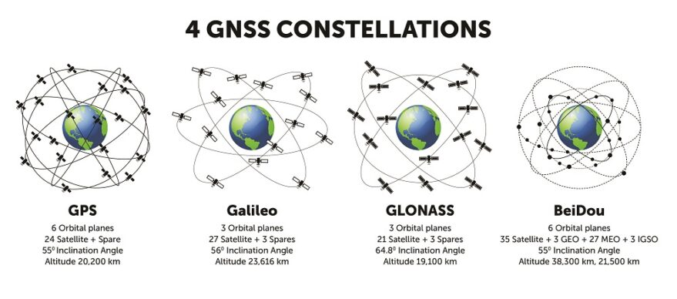
M-PAGES for multi-GNSS
M-PAGES can now process data from all existing constellations
  Still under development
  Has been integrated into OPUS-S for testing

Slide 10
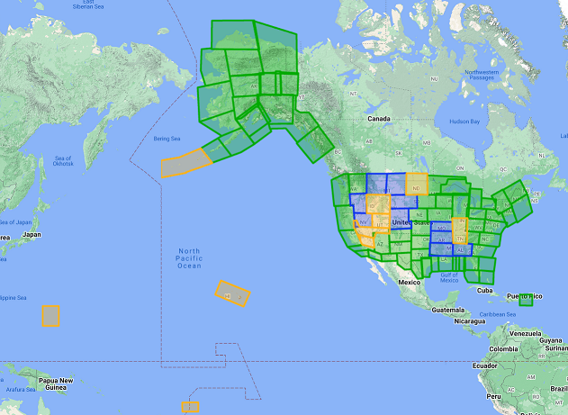
GRAV-D
Flying since 2007
96.8% complete
No blocks have zero data
100% by end of 2023
Available data and metadata
Data being processed
Data collection underway
Planned for data collection

Slide 11
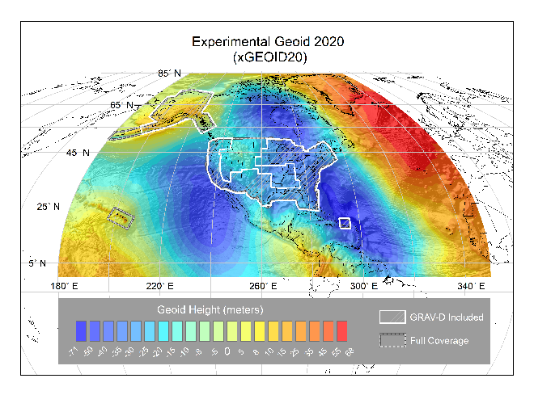
Geoid modeling
NGS, Canada and Mexico released the first ever joint geoid model between our countries
  xGEOID20
  The final GEOID2022 model will also be a joint model

Slide 12
OPUS
NGS’s flagship GNSS product
GVX (GNSS Vector Exchange) 1.0 format released
  Being adopted by industry
    Scheduled to be replaced by GDX in early 2023
OPUS-Projects 5.1.2 current official version
  Will be moved soon to https://www.ngs.noaa.gov/OPUS-Projects/OpusProjects.shtml
  Works with the current NSRS
  Supports upload of GNSS vectors in GVX format

Slide 13
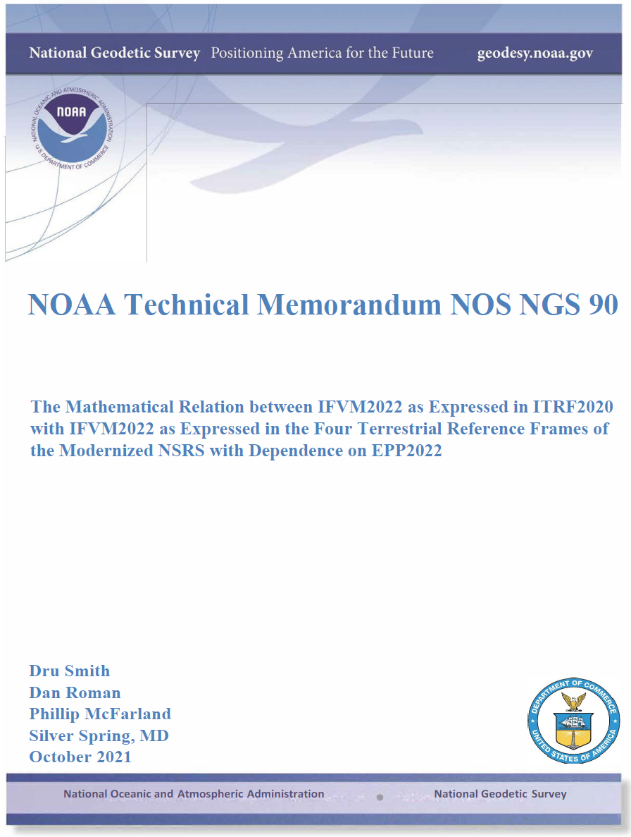
Science
Nine science papers in the last 2 years
  More coming this year
  https://geodesy.noaa.gov/library/

Slide 14
Least-squares adjustments
NGS has decided to replace all LSA software with a single suite
LASER (replaces ADJUST, et al.)
  Least squares Adjustments: Statistics, Estimates and Residuals
  Replicated the 2011 national adjustment in 2 hours on a modern laptop
  Without “Helmert Blocking”
  Currently supports geometic (GNSS, classical) and orthometric (leveling) adjustments
Coming soon:
  Relative gravity, CBLs

Slide 15
Re-prioritization: a “data first” approach

Slide 16
Re-prioritization
There are 33 active projects within NGS explicitly dedicated to NSRS modernization
  In an agency of ~200 people….resources are spread thin
Meanwhile the current NSRS slowly deteriorates
  Marks subside without checking
  CORSs drift away from their published coordinate functions
  The passive control network deviates from active control

Slide 17
Re-prioritization
NGS has recently decided to release all of the modernized NSRS data before we have fully completed all support tools
If we do not take this approach, we are not likely to see the modernized NSRS defined and released until 2030

Slide 18
Data
Upon release, the modernized NSRS will consist of this data:
  The NOAA CORS Network (NCN) operating on ITRF2020
  NATRF2022, PATRF2022, MATRF2022, CATRF2022 defined relative to ITRF2020
  NAPGD2022, including:
    GM2022, GEOID2022, DEFLEC2022, GRAV2022
  Geometric (XYZ / φλh) and orthometric (H) reference epoch coordinates (RECs) at 2020.00 at those passive control with the observations to support such coordinates
  Geometric (XYZ / φλh) and orthometric (H) survey epoch coordinates (SECs) at survey epochs between about 1994 and 2020 at those passive control with the observations to support such coordinates
  State Plane Coordinates of 2022 (SPCS2022), plus UTM and USNG
  NADCON
    Connecting NAD 83(2011/MA11/PA11) epoch 2010.00 to N/P/M/CATRF2022 epoch 2020.00
  VERTCON
    Connecting NAVD 88, PRVD02, ASVD02, NMVD03, GUVD04 and VIVD09 to NAPGD2022 epoch 2020.00

Slide 19
Tools
At a minimum, NGS is targeting these tools upon release:
  A Data Delivery System capable of yielding:
    RECs on some kind of datasheet
    Information on CORSs
A downloadable version of LASER
A browser-based online multi-GNSS service:
  Like OPUS-S
  Like OPUS-Projects 5.x
NCAT and Vdatum capable of invoking NADCON, VERTCON and SPCS2022

Slide 20
What will come after
Work will continue to and through the rollout of the modernized NSRS. Tools released after the initial release of the modernized NSRS include:
  Integrating leveling, classical data and gravity into OPUS
  Full integration of all old tools into NCAT and Vdatum
  SECs for pre-1994 (AKA “pre-NCN”) years, plus SECs for post-2020

Slide 21
Timeline

Slide 22
Timeline
Resources are being diverted from tool building to the assurance of quality data first and foremost
As such, based on this new approach, NGS anticipates the release of all data, and limited tools, by the middle of 2025.
Work on additional tools will continue in the out-years

Slide 23
Sneak Peak

Slide 24
What’s on deck?
NOW: Use OPUS-Projects 5.1.2 on beta.ngs.noaa.gov to mix static GNSS with RTK/RTN
Early 2023: Check out multi-GNSS with M-PAGES in OPUS-S
Early 2023: Look for GDX to replace GVX
Early 2023: The first (“alpha”) set of RECs in N/P/C/MATRF2022 on 100,000+ marks
Early 2023: The release of the State Plane Coordinate System of 2022
End of 2023: ITRF2020 coordinate functions on all NOAA CORS Network stations
End of 2023: First (“alpha”) release of GEOID2022
Mid 2024-Mid 2025: One year roll-out of products, “domino style”, on the beta website
Mid 2025: Official announcement of the modernized NSRS

Slide 25
Thank you!

Slide 26
Questions?

