Slide 1
NGS Programs and Geodetic Tools, Part II
Marti Ikehara
California Geodetic Advisor
Marti.ikehara@noaa.gov
Sacramento, CA
ftp://ftp.ngs.noaa.gov/pub/marti
CLSA/NALS Conference, Las Vegas, NV; March 2011

Slide 2
Order of Topics
March 19, NSPS-sponsored Surveying USA
Researching geodetic control
HTDP (deci-year! option)
VDATUM
Datasheets, understanding the metadata

Slide 3
NSPSMO.org: Surveying USA, 3/19 could support NGS geoid modeling
Notes:
Give public an opportunity to observe surveyors in action and to learn about one of the world’s oldest professions.

Slide 4
“ OPUS : Acceptance of OPUS Results for Publishing
OPUS solutions meeting certain criteria and accompanied by metadata describing the site may be eligible for publication. Users submitting solutions must be registered with NGS to receive a user ID and password and agree to the terms of this publication.
The numerical criteria for an OPUS solution
to be accepted for publication are:
NGS calibrated GPS antenna
minimum 4 hour data span
minimum 70% observations used
minimum 70% fixed ambiguities
maximum 0.04m horizontal peak-to-peak
maximum 0.08m vertical peak-to-peak

Slide 5
NSPS Surveying USA NGS can use 4 hours DF at an ‘88 BM
Dual-frequency GPS for 4.25 hours
Where? Not at same nor rejected locations, unless ‘h’ is shown as reason (Col V)
Review map (CA) and xls file that are on my ftp site
Looking for GPS ellipsoid height data at a BM that has a leveled NAVD88 height AND is not likely to have subsided since 1988
Data submitted to OPUS-DB can contribute to next iteration of NGS geoid model

Slide 6
GEOID09 published in Sept 09
In California, GEOID03 considered 567 bench marks with GPS data (ellipsoid heights), and kept 549
In GEOID09, there were 833 considered; 738 were included, a 36% increase from Geoid03

Slide 7
GEOID09 compared to GEOID03
09: teal, good; yellow: State advisor-rejected;
red: analysis-rejected (subsidence/tectonics
or bad ellipsoid height)
03 (underlying dots): dk blue, good; orange: rejected
Notes:
New points for 09 include data from Height Modernization projects: Leveling/GPS from BMs to CGPS in southern CA;
GPS data on BMs in San Joaquin Valley and northern CA. Yellow dots represent those HPGN marks that were leveled to from NGVD29 but which were improperly coded as NAVD88 in the database. Their use in G03 probably contributed to the errors in the model in the central valley that were seen.

Slide 8
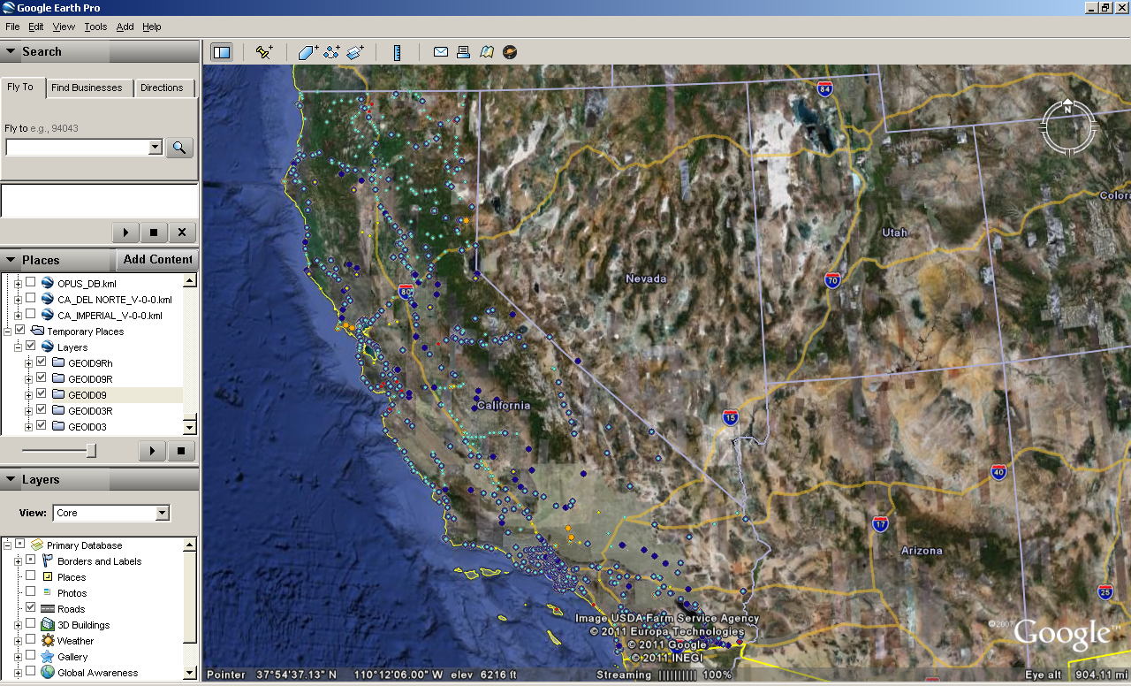

Slide 9
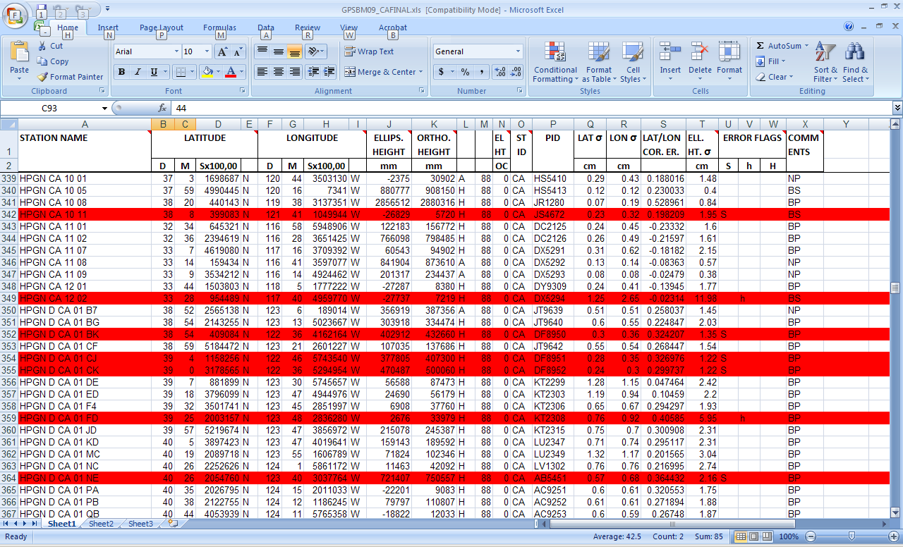
Notes:
Red are rejected; in this case, these were NOT NAVD88 level ties.

Slide 10
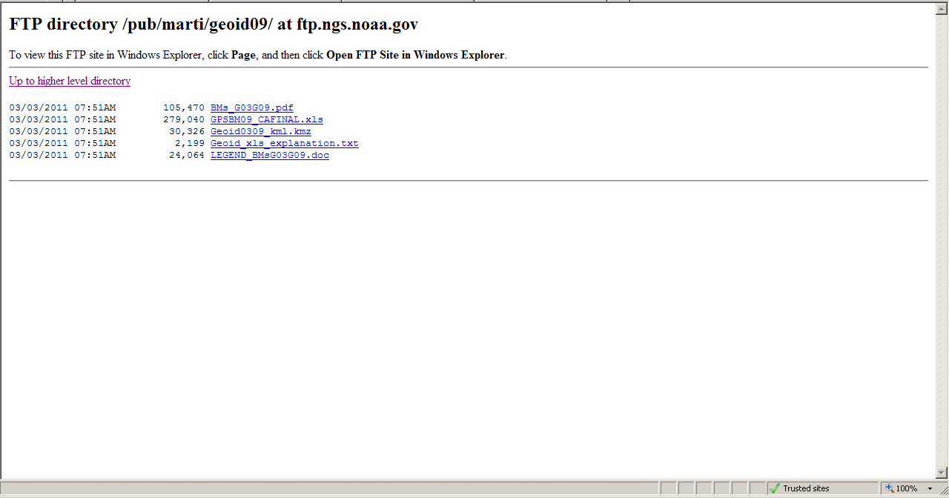
ftp://ftp.ngs.noaa.gov/ pub/marti/geoid09

Slide 11
Researching Geodetic Control
NGS Sources
NGS Datasheets
MAP-based:
CGAR (CA Geodetic Advisor Resources) webpages
DSWorld, application with Google Earth
OPUS-DB
CSRC Height Mod project (Central Coast)
PBO CGPS

Slide 12
Visualization of NGS Geodetic Control
CA Geodetic advisor Resources (CGAR) website, hosted by CT Office of Land Surveys webpage
http://www.dot.ca.gov/hq/row/landsurveys/geodetic
Google Earth kmls
Google Maps online
Shapefiles
DSWorld, NGS partner software

Slide 13
http://www.dot.ca.gov/hq/row/landsurveys/geodetic/geodetic_control.html
Notes:
Shown on the state are the 12 Caltrans districts; the counties are arranged by which CT District they are in.

Slide 14
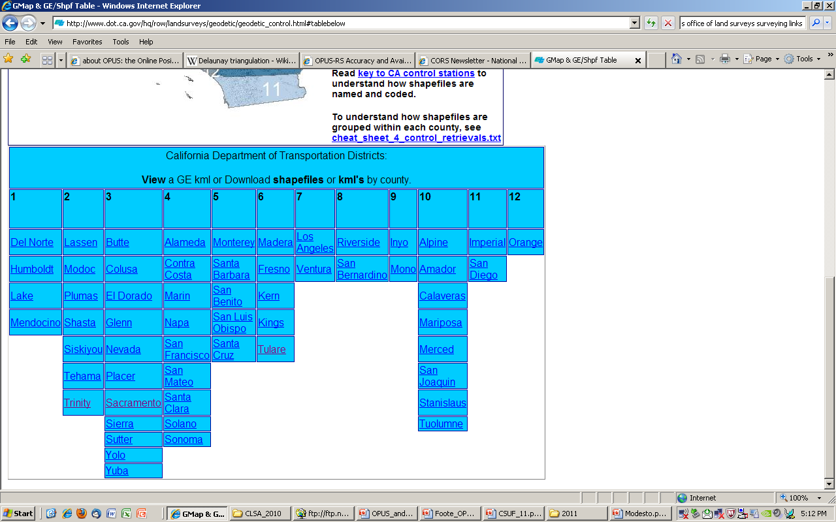

Slide 15
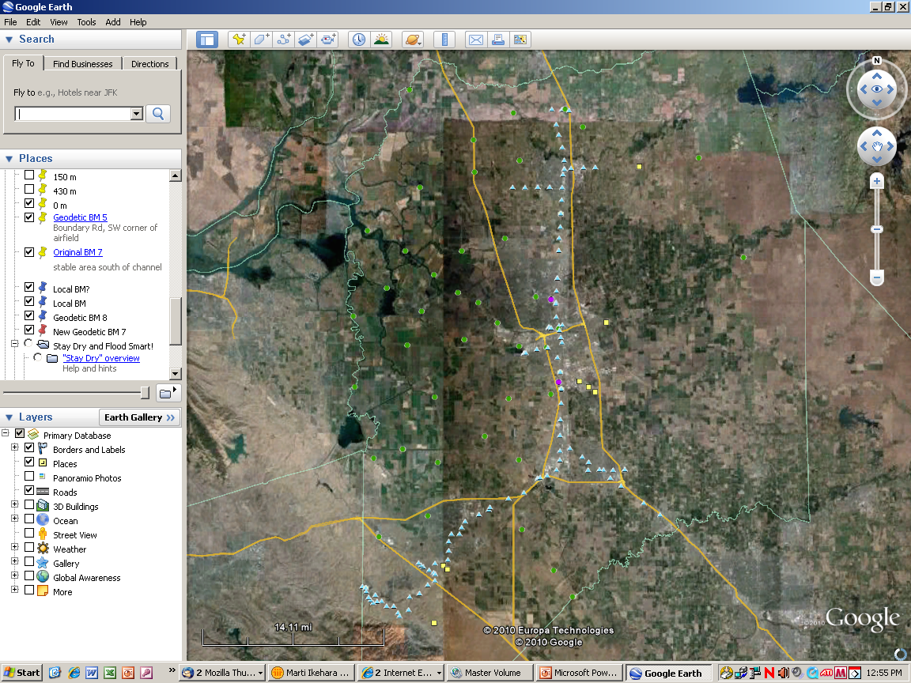

Slide 16
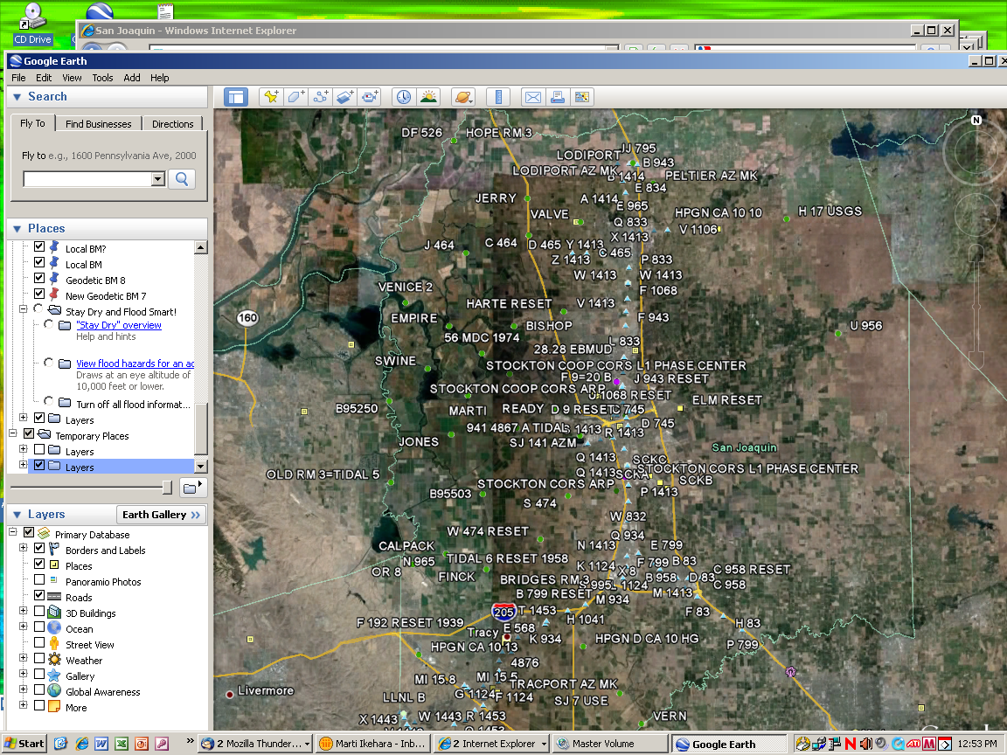
Notes:
If it’s too crowded, you can expand the layers and show only those that you want.
Blue triangles are leveled NAVD88, green hexagons are Ht Mod, yellow squares are HARN (not HM), beigey-green pentagons are leveled HARNs, purple circles are CGPS.

Slide 18
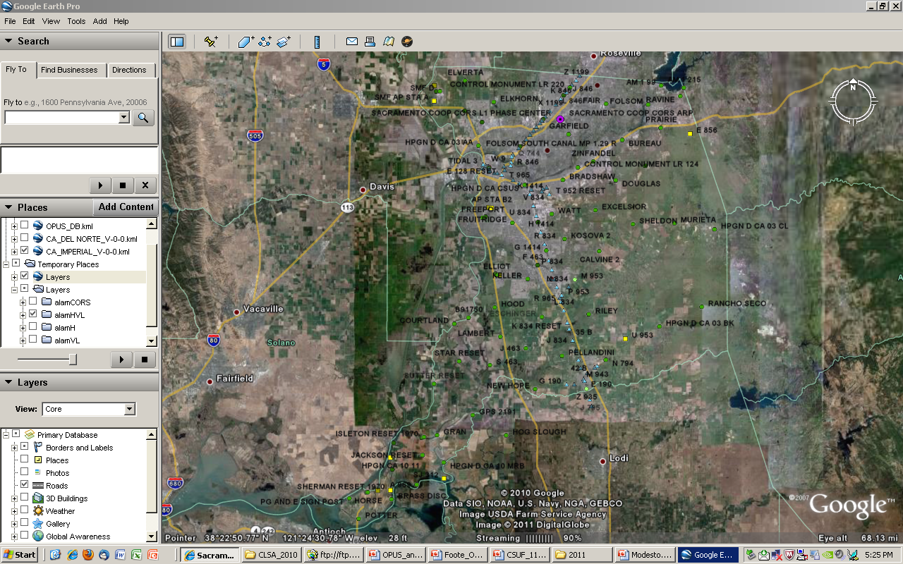

Slide 19
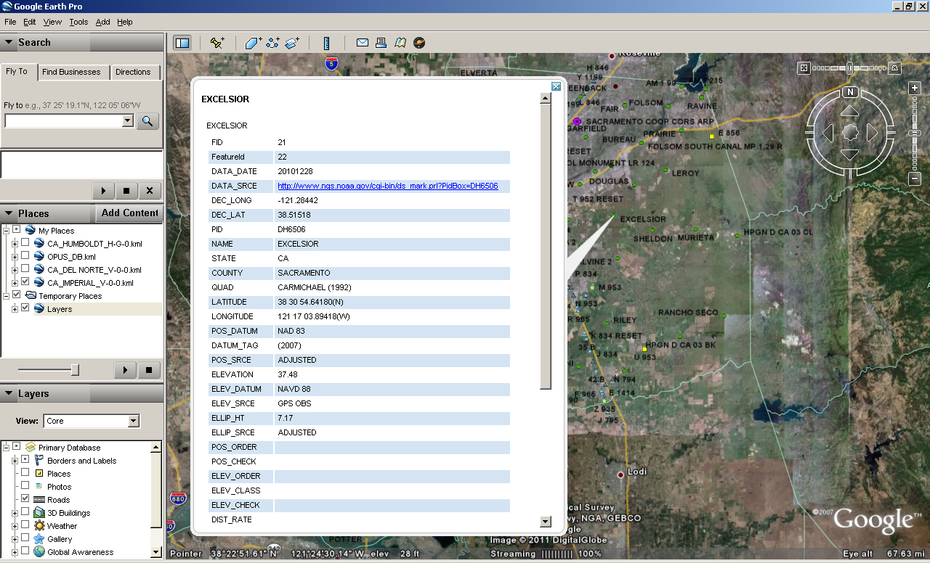

Slide 20
http://www.dot.ca.gov/hq/row/landsurveys/geodetic/geodetic_control.html

Slide 21
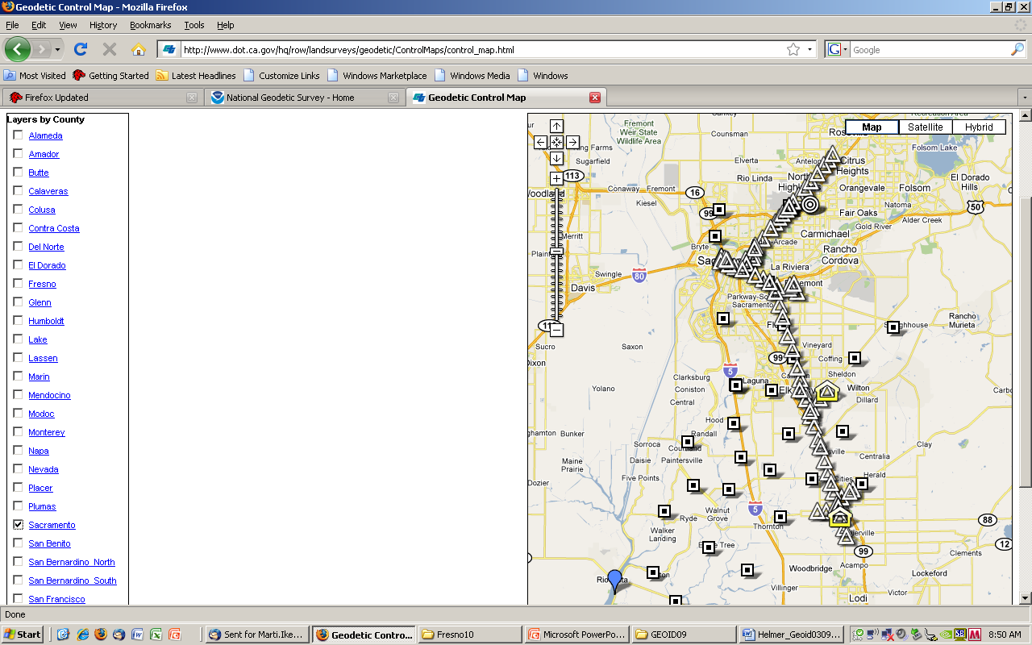
Notes:
To better spread out and make easier accesss to vertical control, NGS started an initiative in the mid-1990’s called Height Modernization, whereby GPS data was observed in networks often at the scale of a county. This shows Sac County before the Sac Valley HM project was loaded in mid- 2010. Because conversion fr GE to GM is not working (can someone help?), these are not the most current.

Slide 22
Using NGS DSWORLD software and Google Earth to get any vintage geodetic data from NGSIDB
Start by downloading “Google earth” at: http://earth.google.com/download-earth.html
Click here

Slide 23
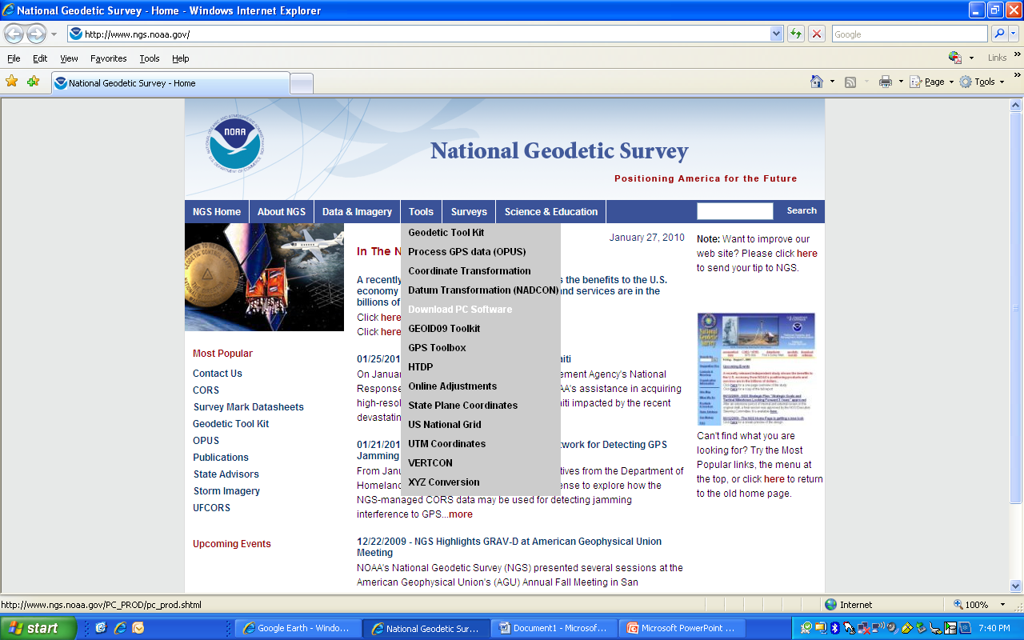
Open the NGS main page at www.ngs.noaa.gov
Mouse-over the
“TOOLS” button
Click on
“DOWNLOAD PC SOFTWARE”

Slide 24
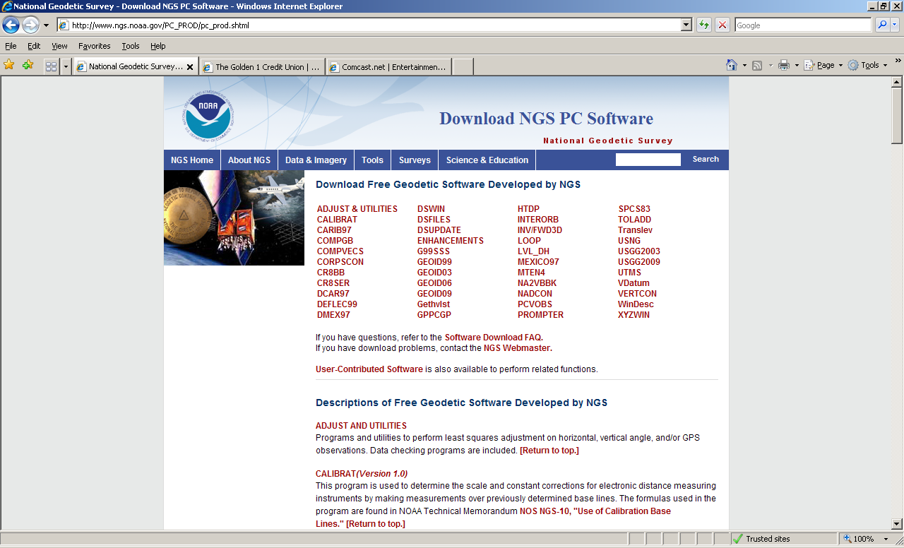
Click here

Slide 25
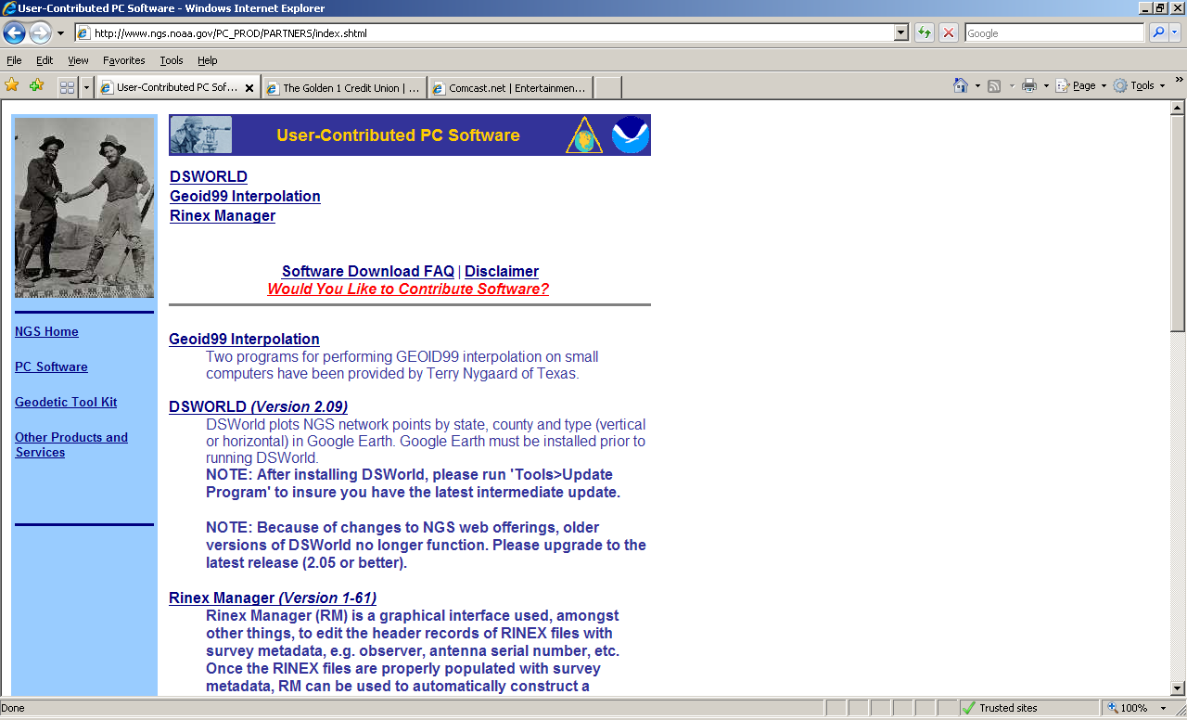
Next, click on the DSWORLD (Version *.**) link. A “file download” window will appear. Choose to save the file where you can easily find it. It will be a zip file, so you will need to unzip it and then double click on the setup.exe file. That will install the program for you.

Slide 28
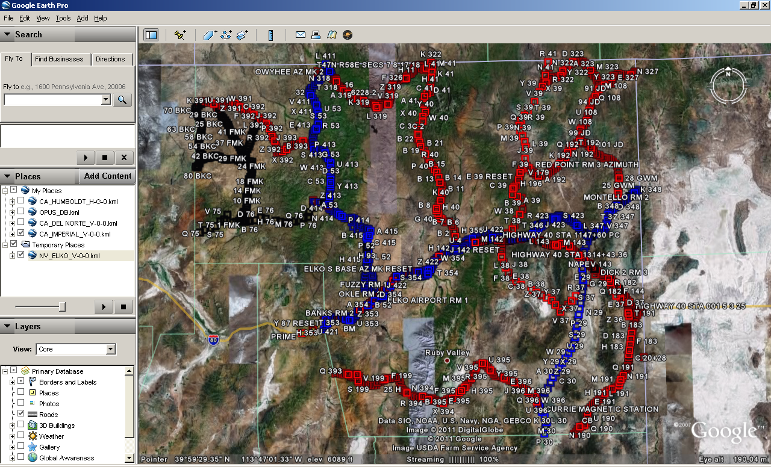

Slide 29
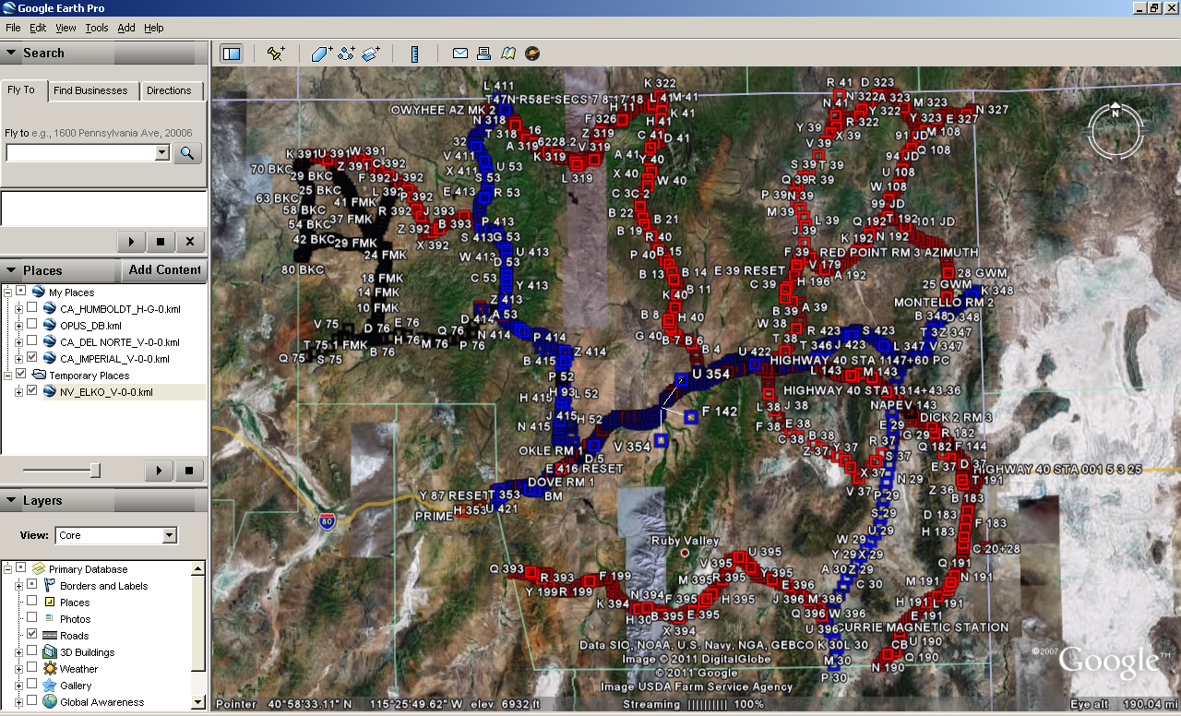

Slide 30
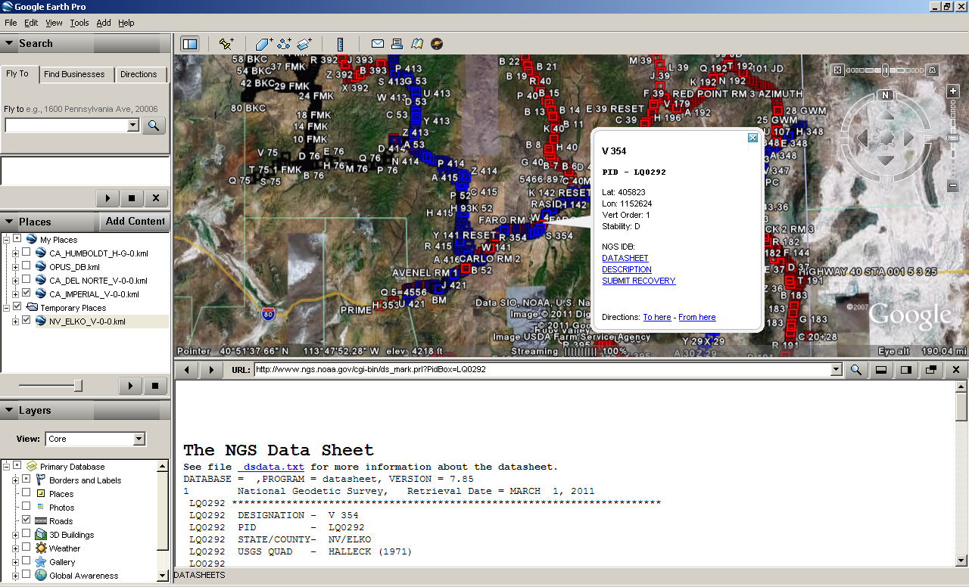
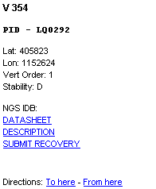

Slide 32
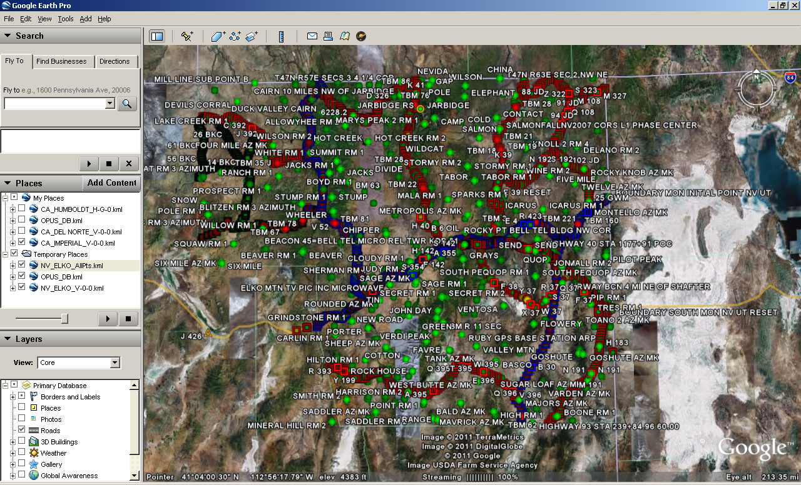

Slide 33
DSWorld Legend
Blue: First order leveled
Red: Second order leveled
Black: Other, eg, third, posted, readjusted
Lt Green: Horizontal control
Yellow: Not Found
Gold: OPUS-DB

Slide 35
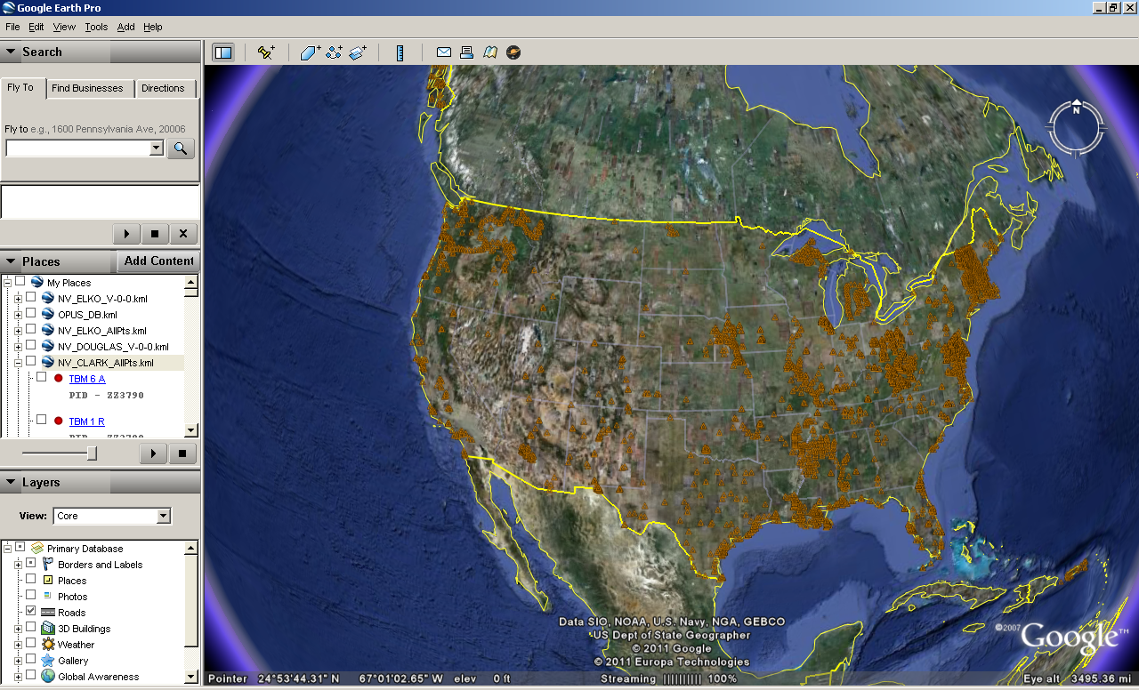

Slide 36
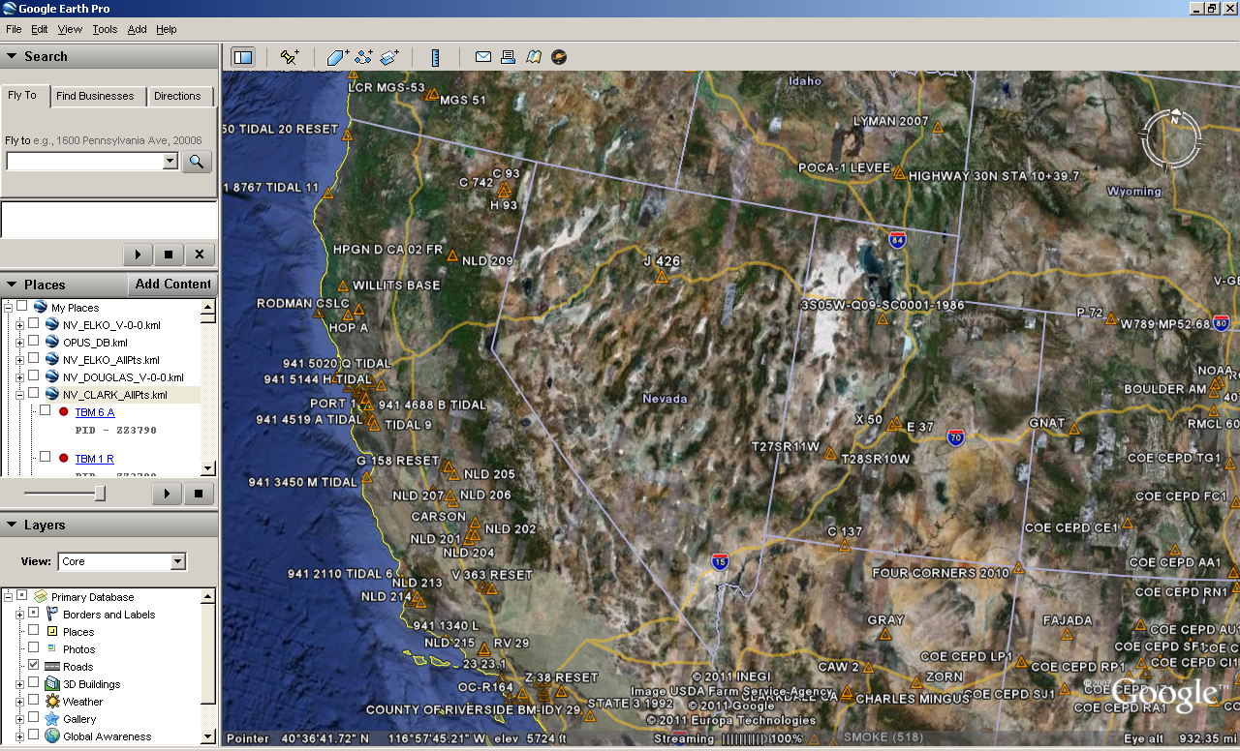

Slide 37
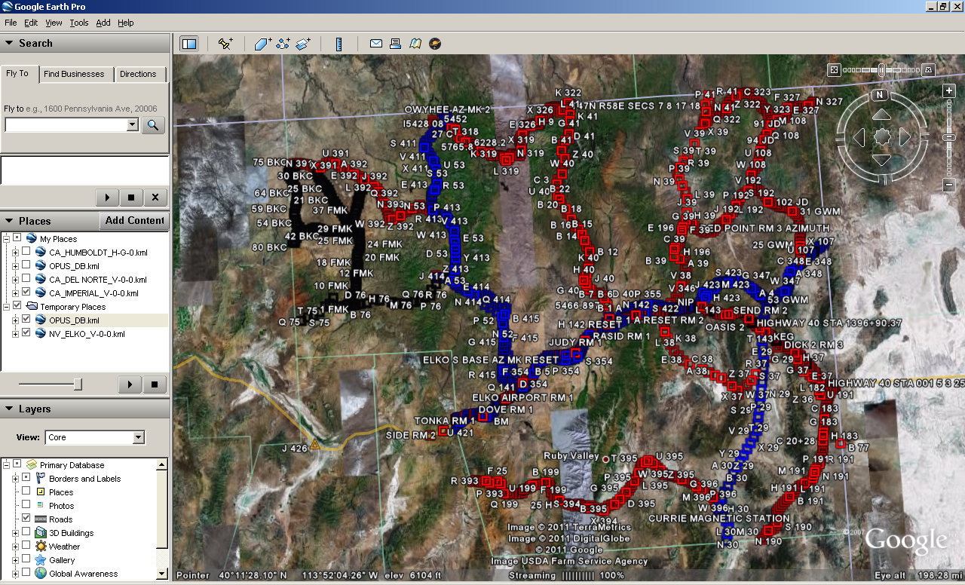
Notes:
Gold is OPUS-DB. Remember the orders that the colors represent?

Slide 38
Caution: Could be VERTCON orders! Douglas County Vertical is all VERTCON

Slide 39
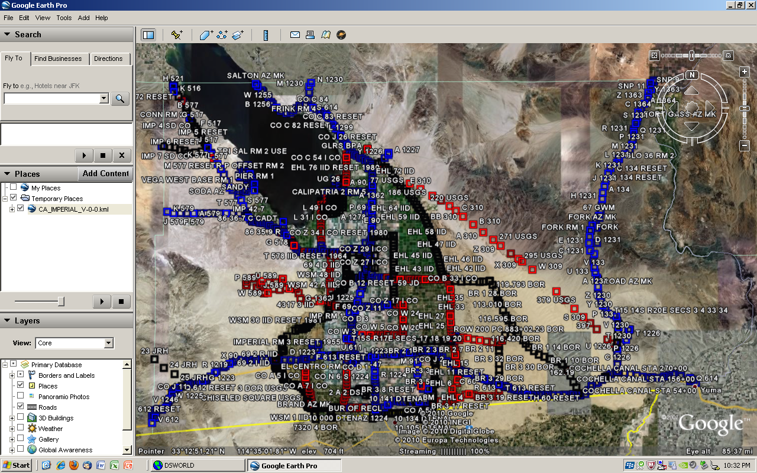
Notes:
Does not distinguish between VERTCON and other NAVD88. Blue-first order, Red-second order, Black-other, eg, third or readjusted or posted

Slide 40
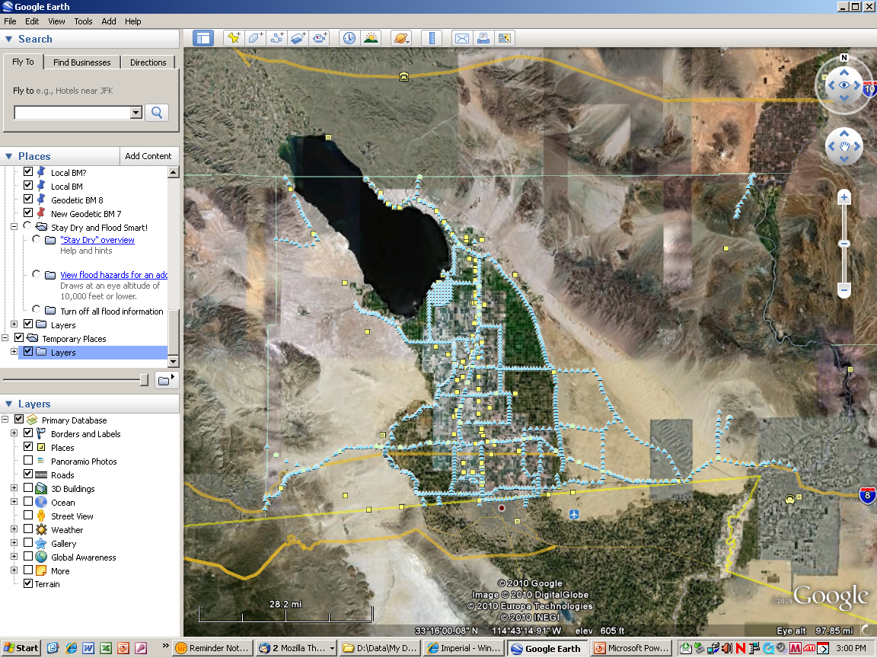

Slide 41
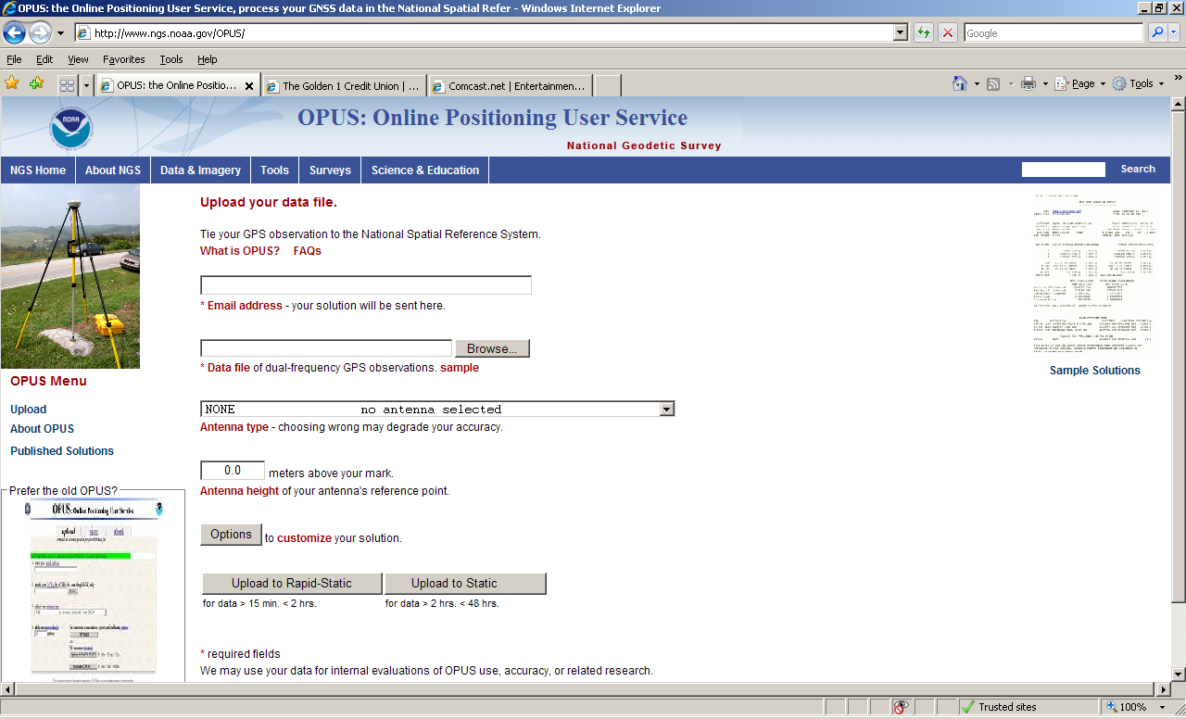

Slide 42
Notes:
Old webpage

Slide 43
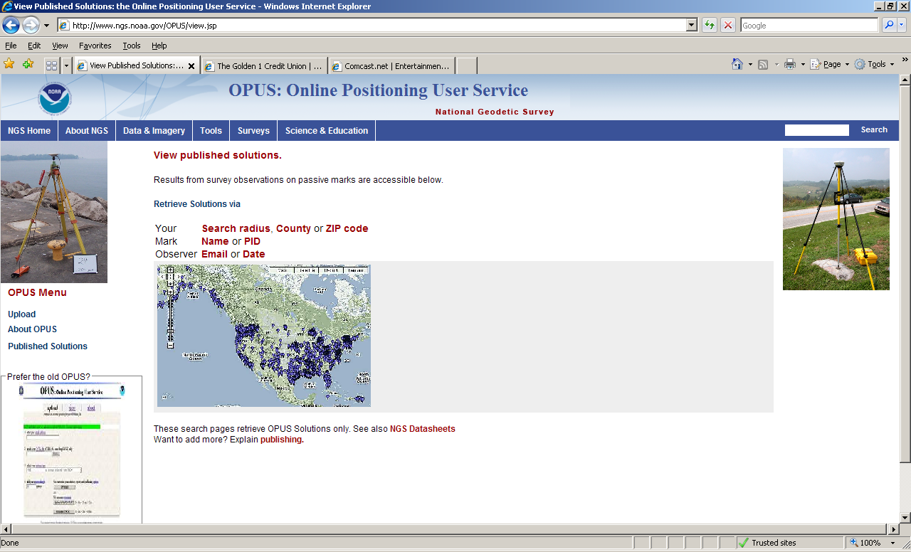

Slide 44
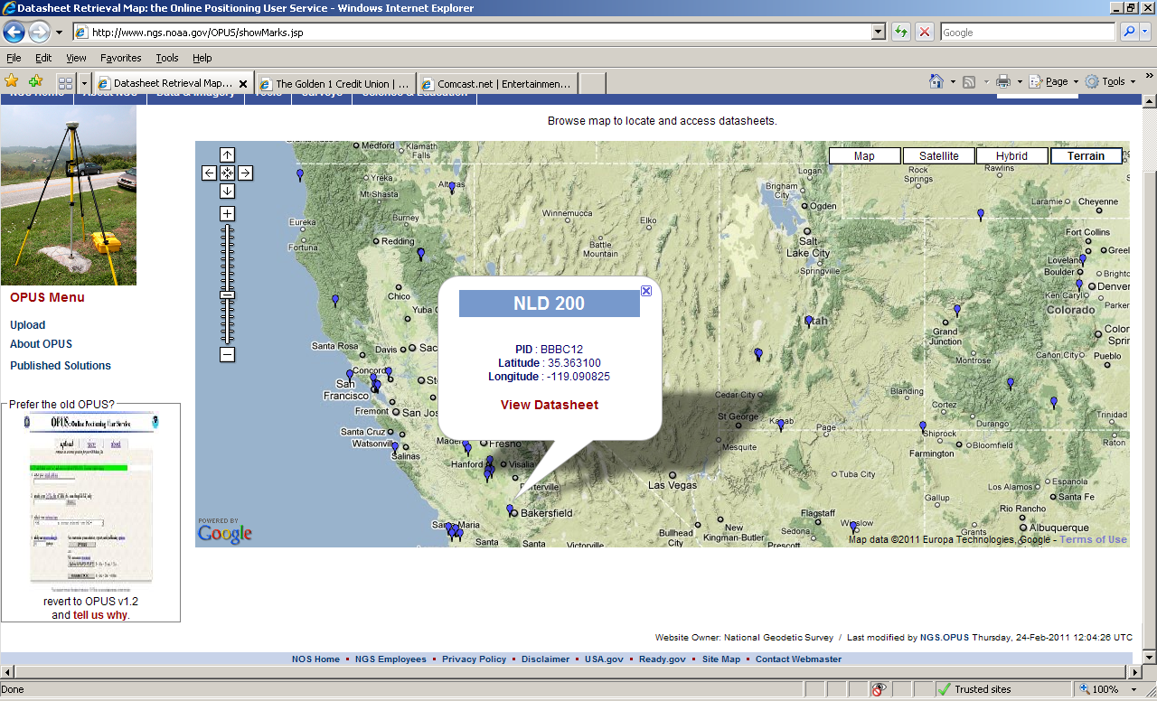

Slide 45
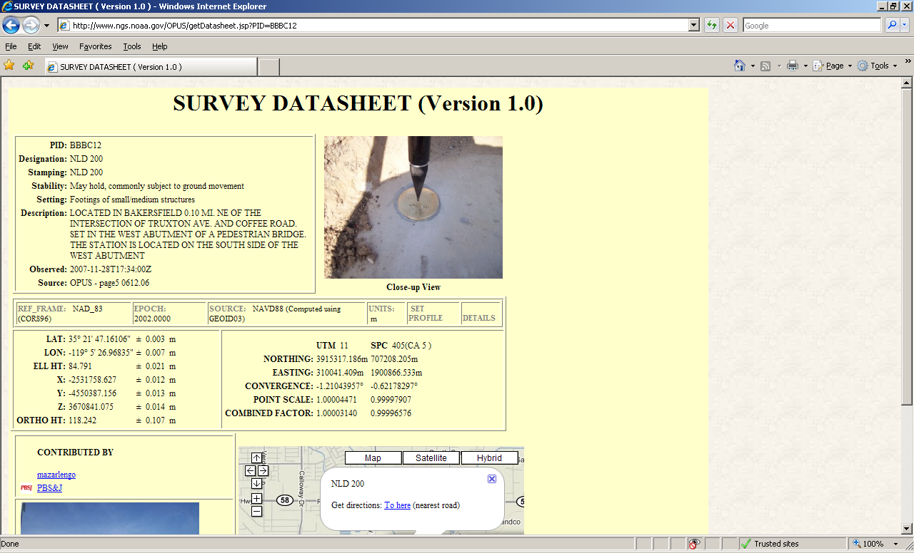

Slide 46
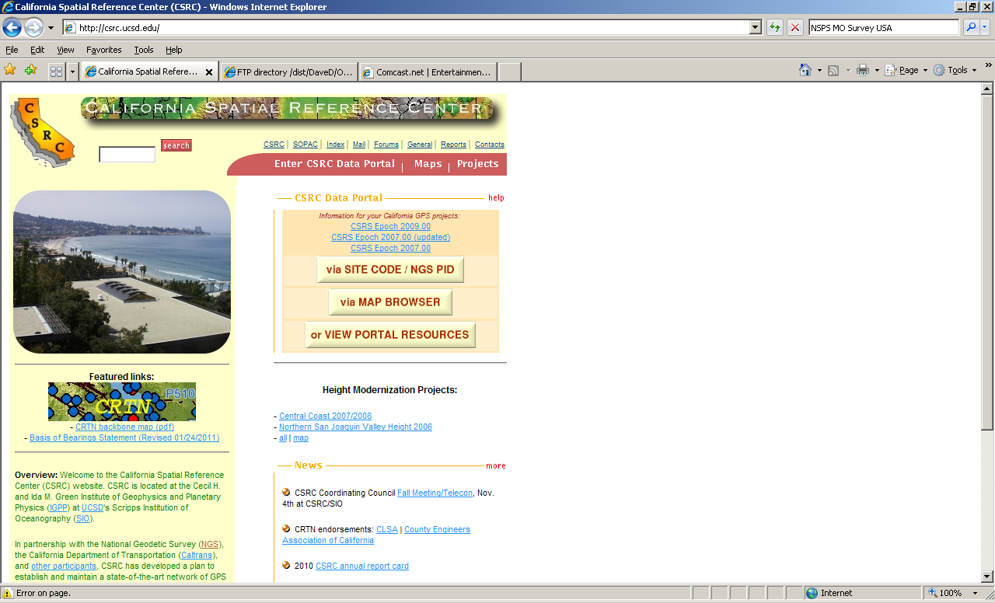
http://csrc.ucsd.edu [NO www] Central Coast Ht Mod project

Slide 47
Pbo.unavco.org CGPS—continuous GPS stations
Plate Boundary Organization
Installation of ~1100 CGPS, mostly in West
Network Information or Station health

Slide 48
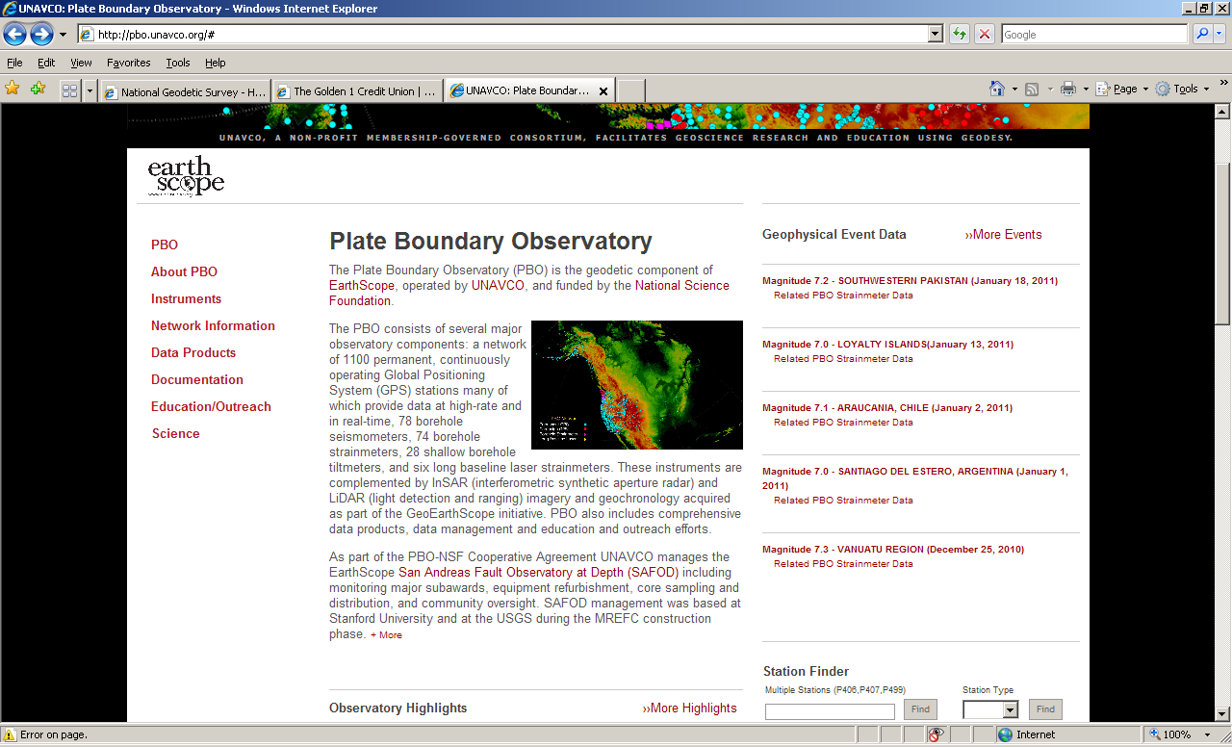

Slide 49
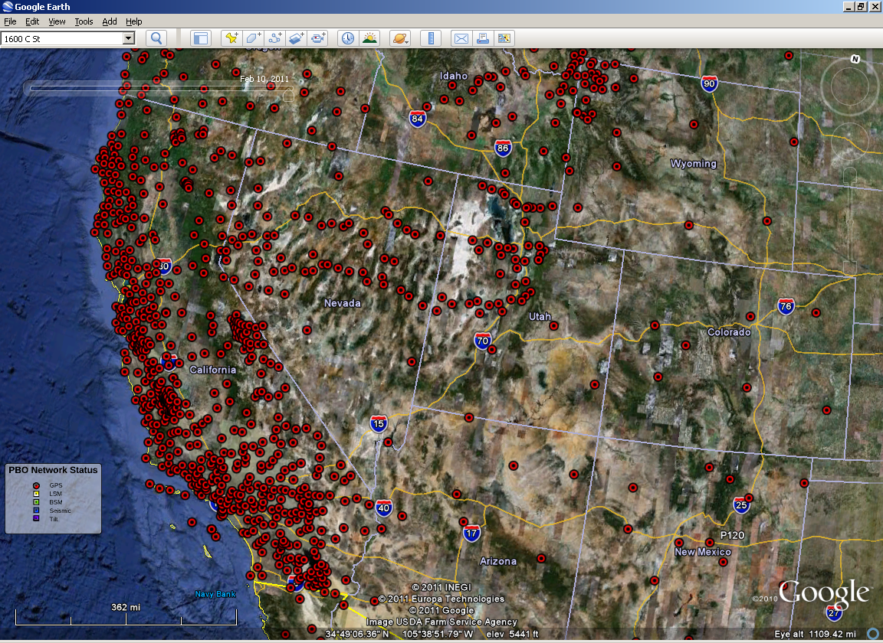

Slide 50
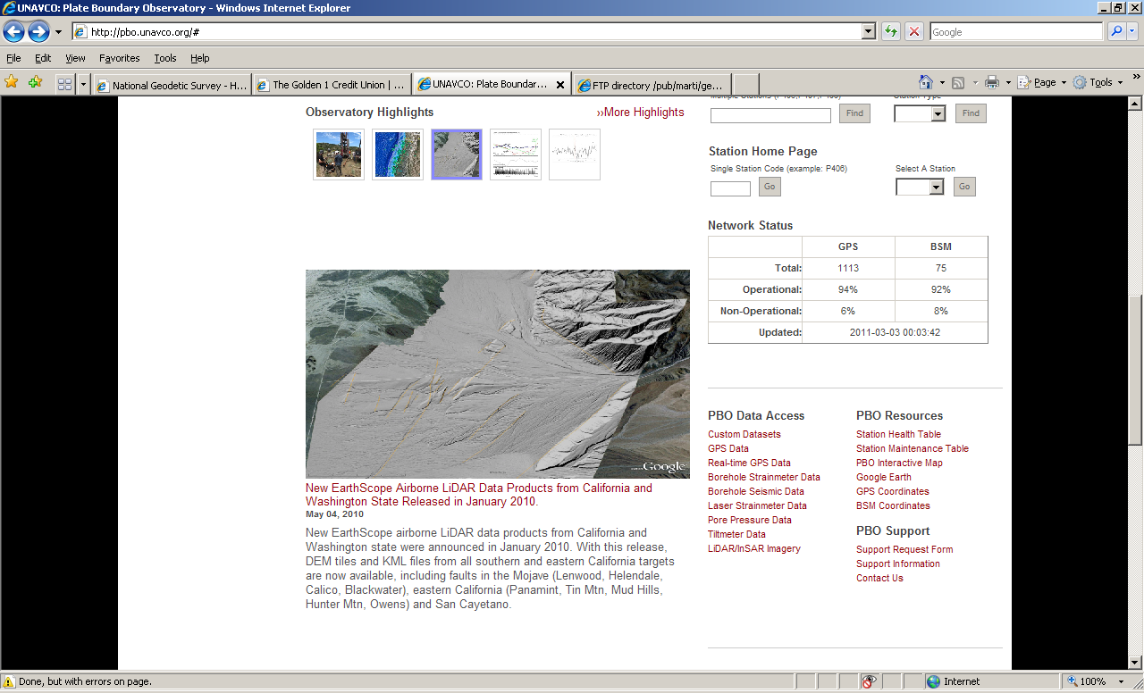
Notes:
Segue: CGPS are providing excellent velocities. Because of these, NGS is poised to compute new coordinates for our CGPS.

Slide 51
HTDP Horizontal Time Dependent Positioning

Slide 52
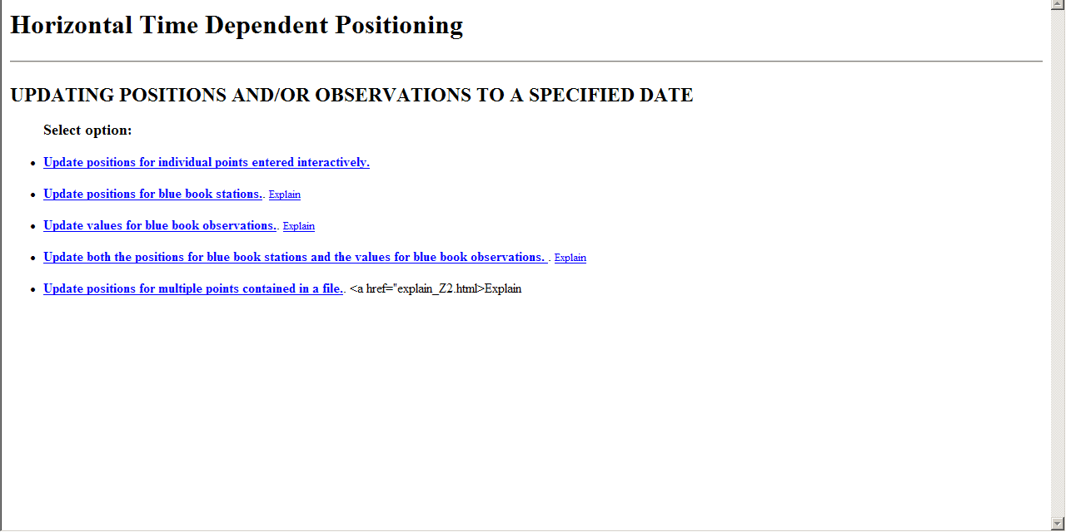

Slide 53
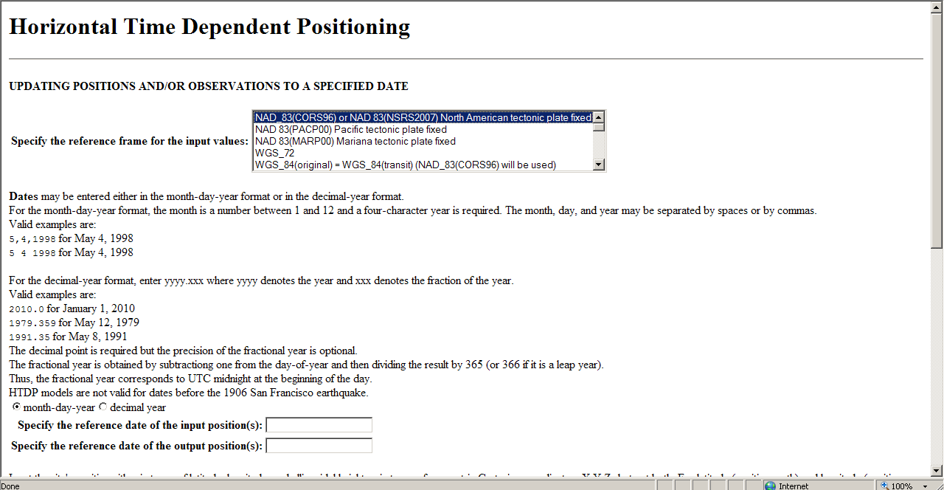
HTDP 3.1 BETA version

Slide 54
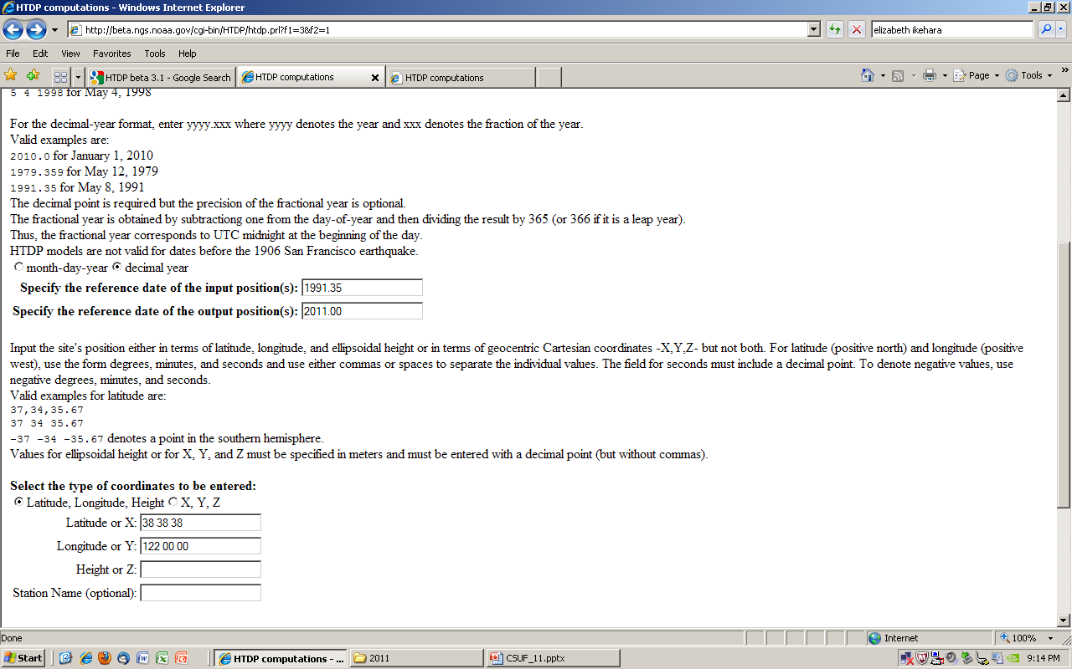
Just north of Winters, west of Davis

Slide 55
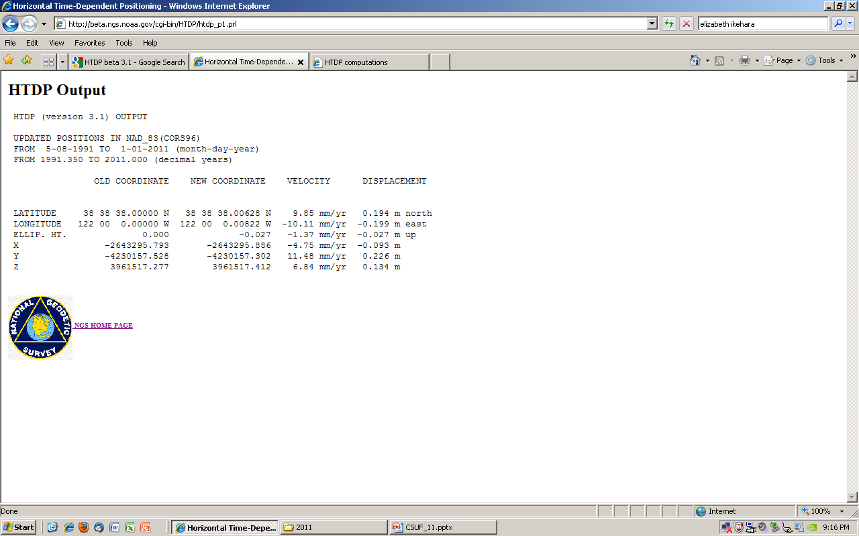
0.2 meter for both N and E in 20 years

Slide 56
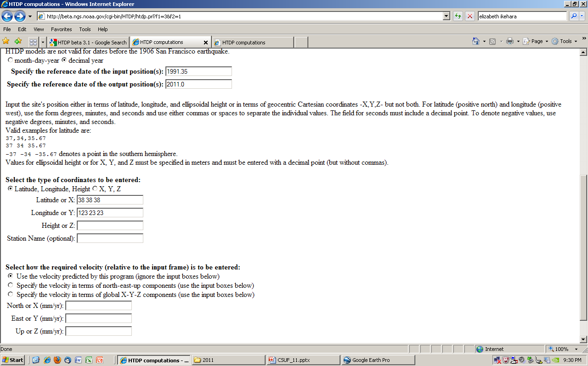
In Mendocino County, on the coast near Stewart’s Point; San Andreas Fault Zone is offshore

Slide 57
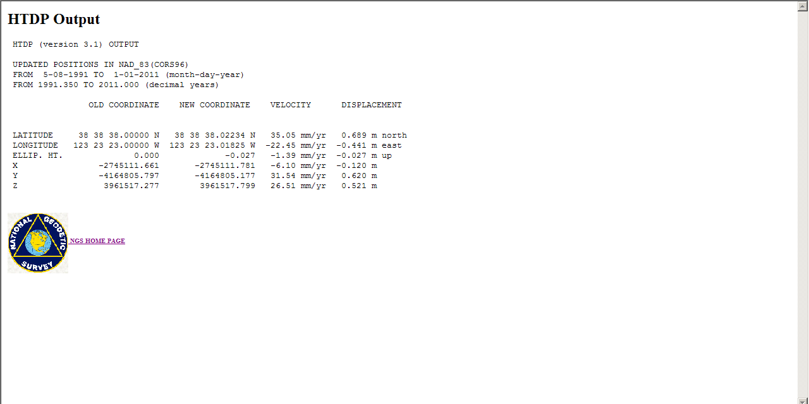
Almost 0.7m N and -0.5m E in 20 years
You MUST incorporate/apply horizontal velocities to ‘published’ coordinates to do geodetic surveying

Slide 58
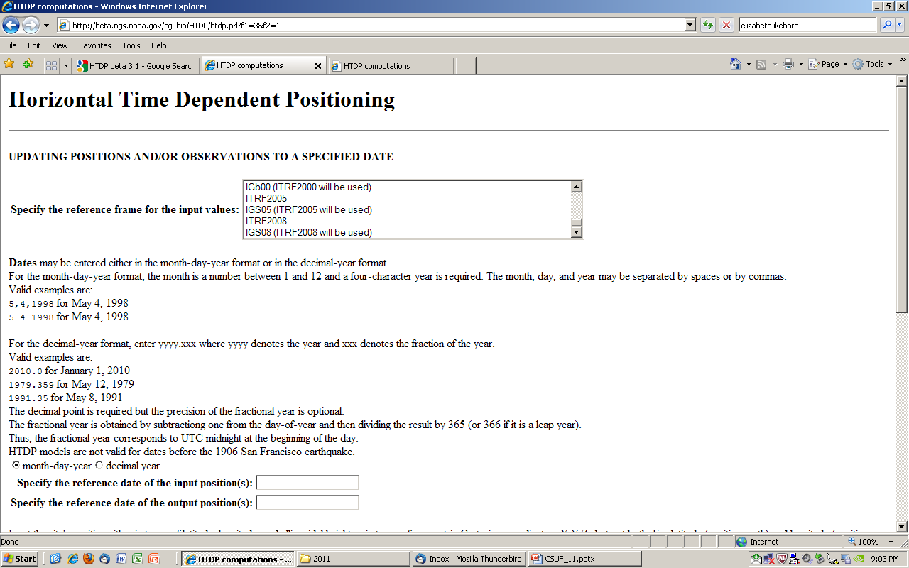
New reference frames, ITRF2008 and IGS08

Slide 59
VDATUM
How do you relate the geodetic datum (elevation) to a tidal datum water level?
Leveling from tidal bench marks OR
Use VDATUM software, a NOAA product that incorporates tide gage and NGS BM data
INTEGRATING AMERICA’S ELEVATION DATA

Slide 60
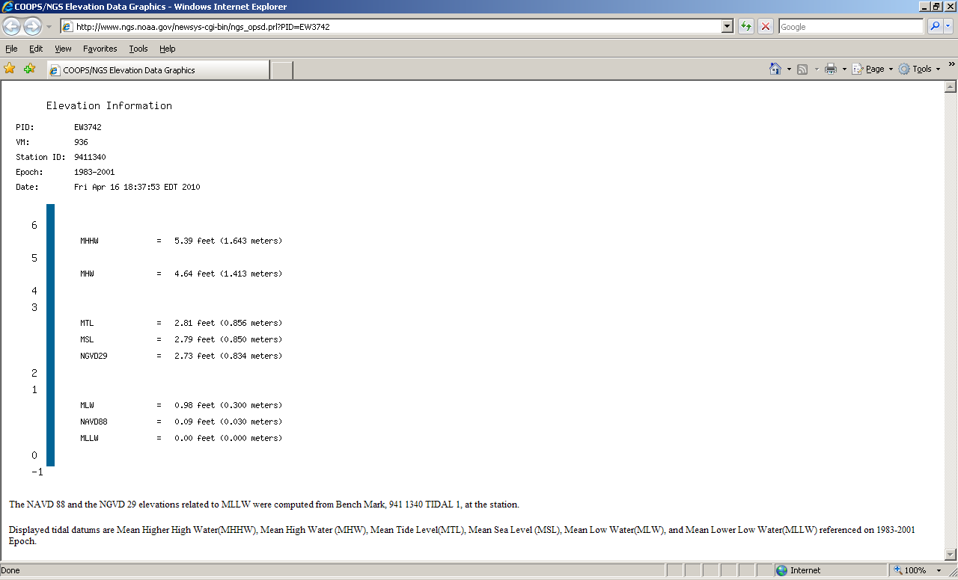

Slide 61
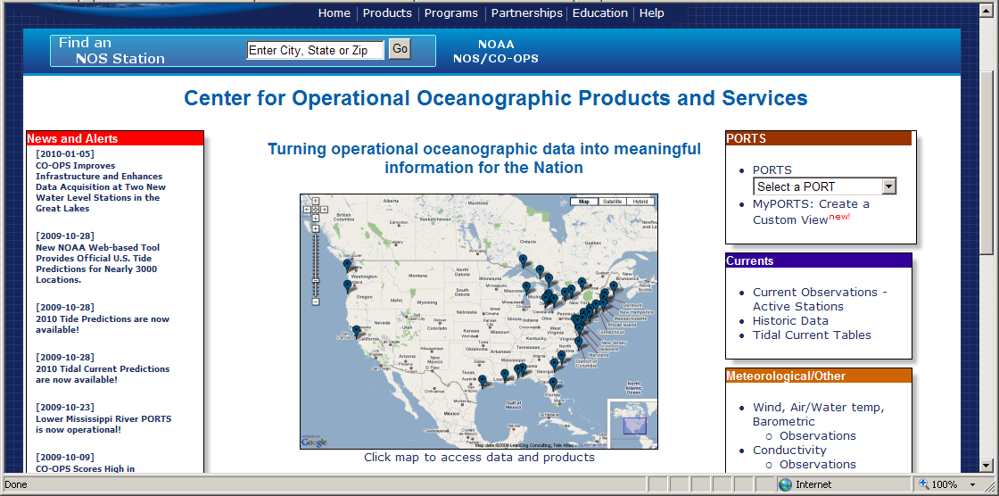
www.tidesandcurrents.noaa.gov

Slide 62
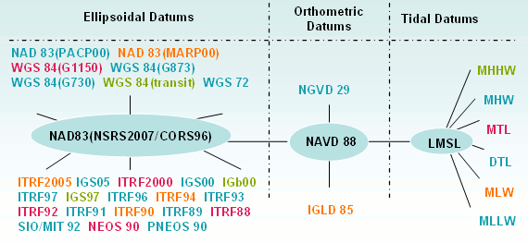
Datums available in VDATUM
Notes:
The most common datums are highlighted

Slide 64
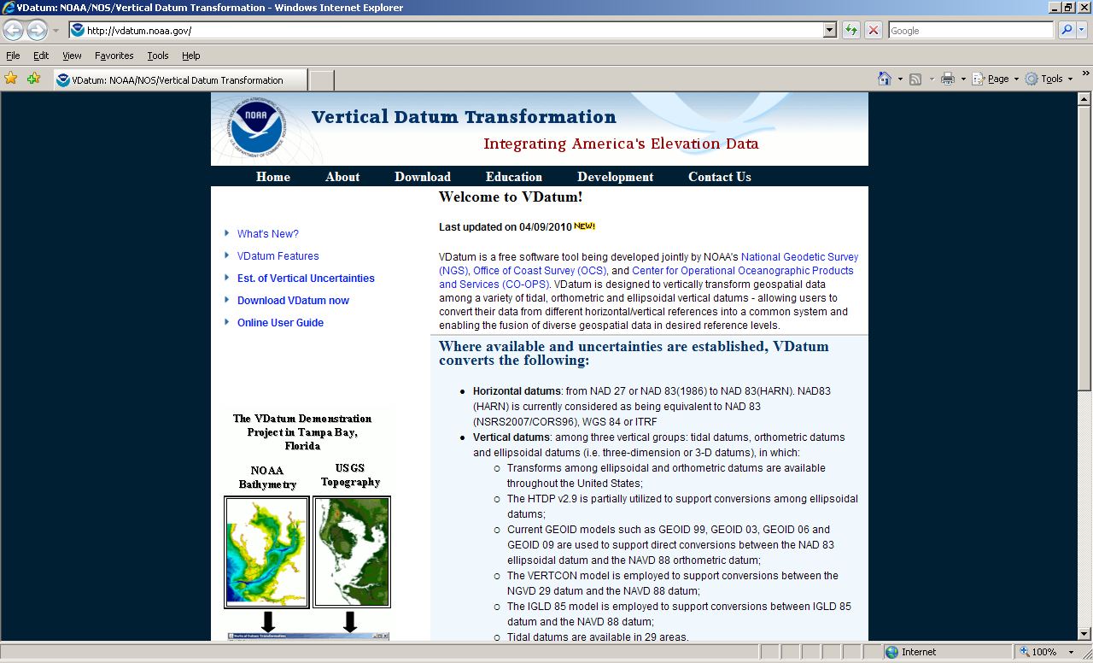

Slide 65
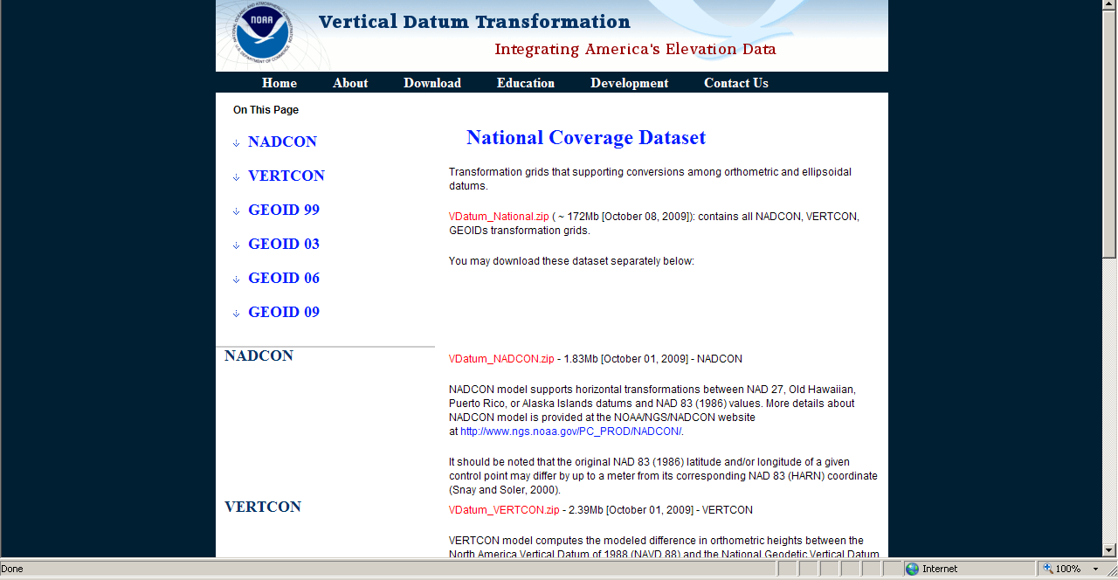

Slide 66
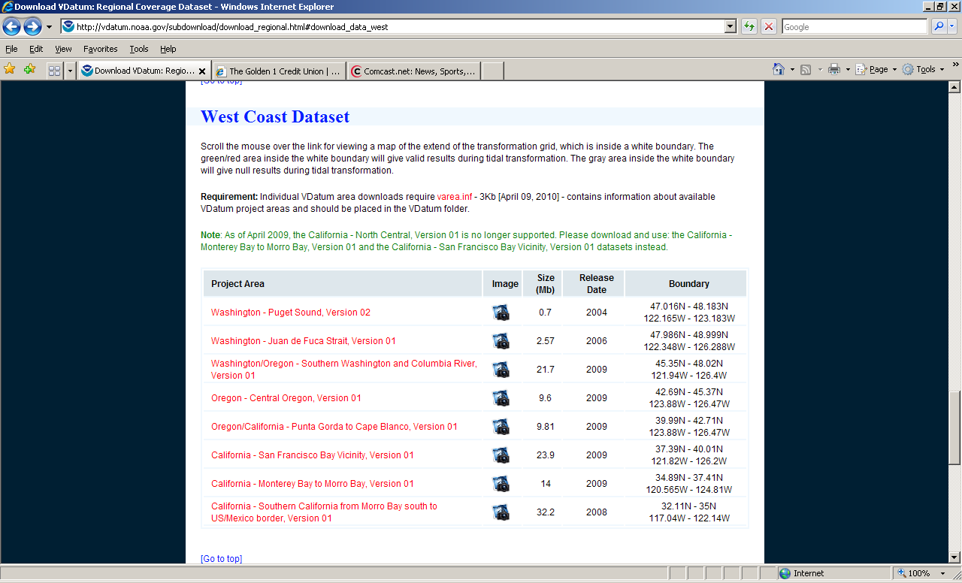

Slide 67
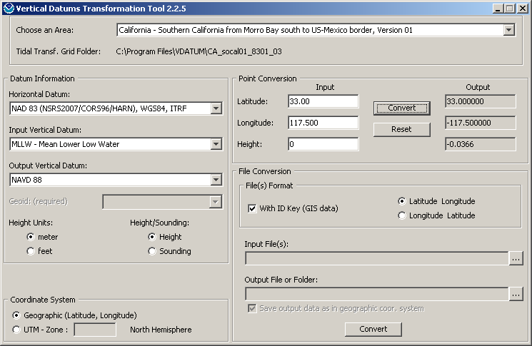

Slide 69
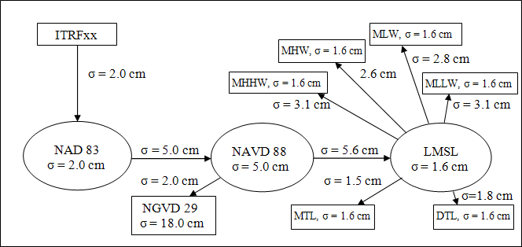
Errors from source data and transformations
Notes:
Error in source data (eg, NAD83=2 cm) AND in transformations (eg going fr 83 to 88 = 5cm

Slide 70
Datasheets
Orthometric height, leveled hts (Re-sort)
Geoid model STATEMENT
History/Recovery Note

Slide 71
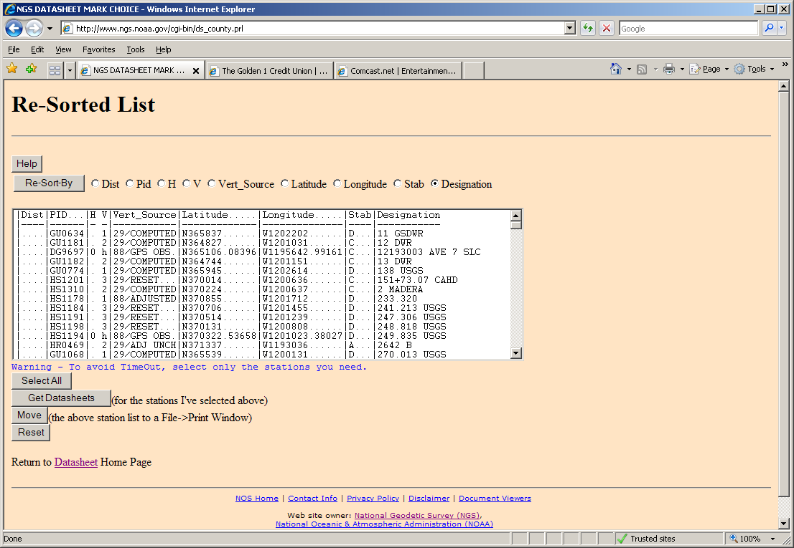

Slide 72
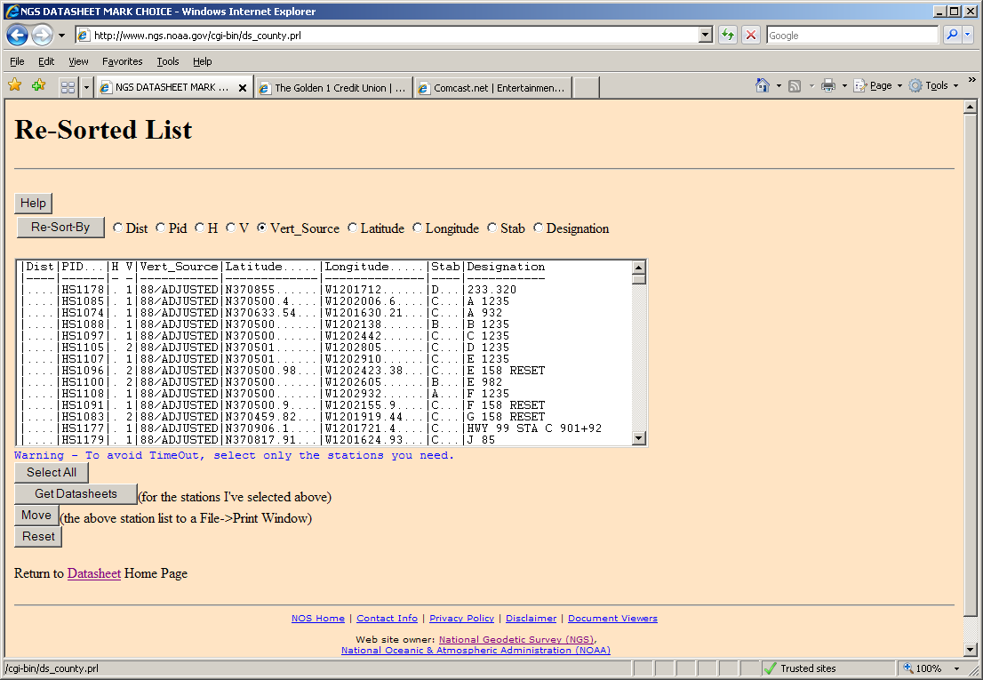

Slide 73
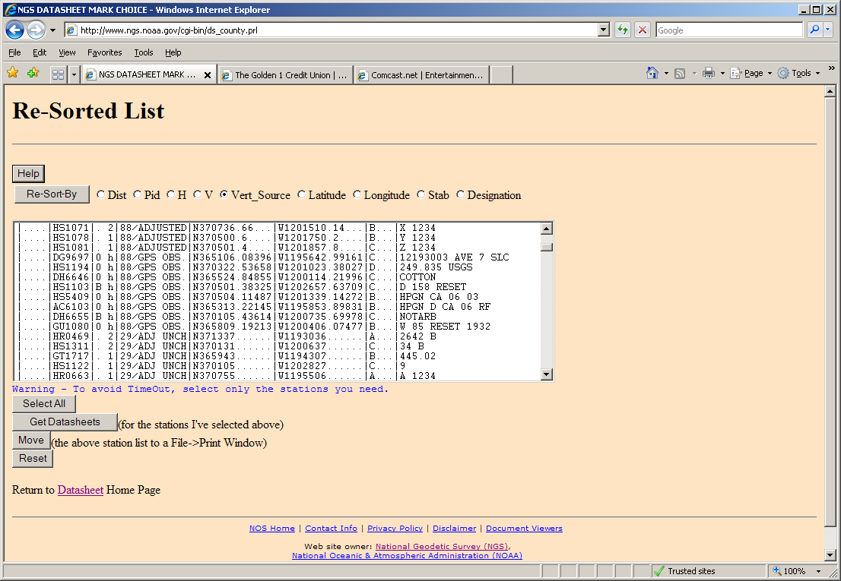
Notes:
8/adjusted, followed by 88/GPS Obs, then 29/adjusted, etc
0 in H column indicates 2007 NRA; B (or other) indicates subsequently submitted project

Slide 74
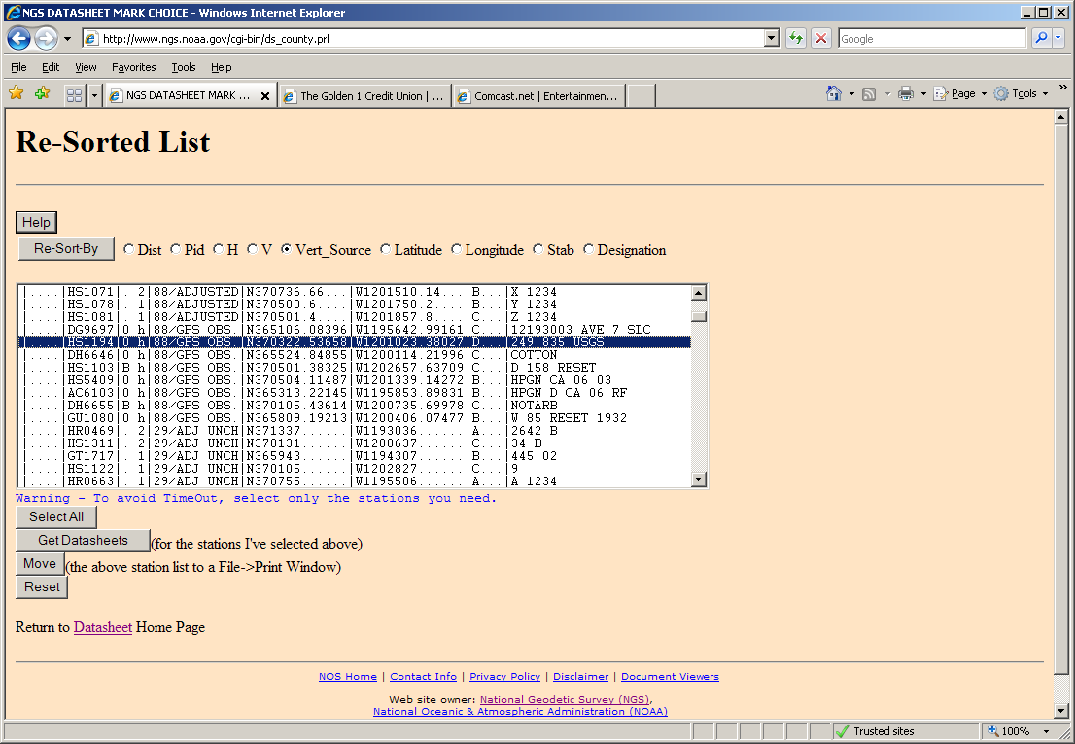

Slide 75
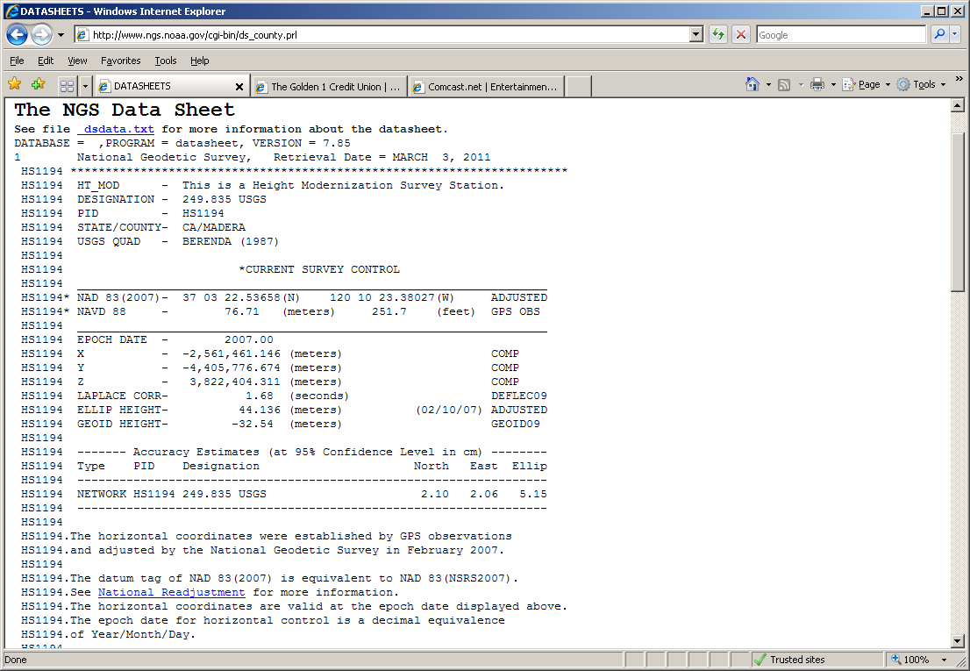
Notes:
Ortho height not computed by arithmetic, eg, Oht=eHt –(geoid height) and
.

Slide 76
Notes:
Note datum tags and epoch dates and adjustment date. Geoid height factual statement.

Slide 77
Notes:
Says that “a” model was used in the adjustment, doesn’t say anywhere that GEOID09 was used. And doesn’t show a date of the adjustment. This one happens to be 2010 (post G09 publication).

Slide 80
Notes:
Geoid09 shows on datasheet, but in this case, it WAS used.
Adjustment date shows 2/10/07 because this station was fixed in the network that was submitted.
There is absolutely no indication which Geoid model was used; because history date is 2008, one might guess that it would be G03, but it was G09. If you retrieve the Project, NEW stations –ones whose el ht adjustment date is NOT 02/10/07—will show an adjustment date of 2010, after G09 was published.

Slide 81
Alternative Learning Options offered by NGS
geodesy.noaa.gov
Science & Education
Workshops/Training
Workshops (at Corbin)
Training (webinars)
Online Learning Resources= archived presentations: ppt and video or audio record
Sign up for Mailing List

Slide 82
ftp://ftp.ngs.noaa.gov/pub/marti/Presentations
Marti.ikehara@noaa.gov AND
William.stone@noaa.gov

