Slide 1
GPS on Bench Marks for
NSRS Modernization
NGS Webinar Series
December 10th, 2020
GPSonBM Team:
Galen Scott, NGS Constituent Resources Manager
Dr. Kevin Ahlgren, Geodesist & Geoid Modeler
Brian Shaw, Rocky Mountain Regional Geodetic Advisor (CO, MT, WY)

Slide 2
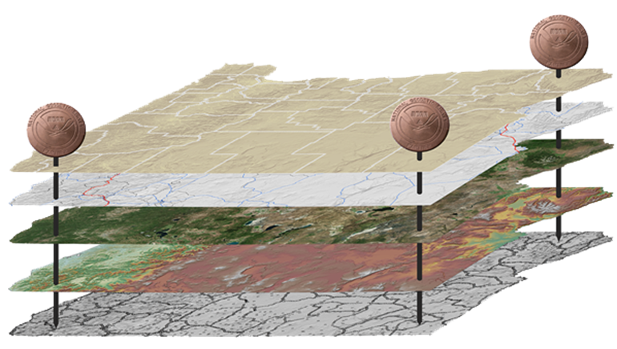
The National Spatial Reference System (NSRS)
NGS defines, maintains and provides access to the NSRS
North American Datum of 1983 (NAD 83)
North American Vertical Datum of 1988 (NAVD 88)
Latitude • Longitude • Elevation • Gravity • Shoreline Position
+ changes over time
Today’s NSRS
Notes:
The National Spatial Reference System is the United States’ geospatial infrastructure from which all positioning (with the exclusion of military/Department of Defense) is referenced to.
This system provides a consistent framework that allows people to use data in the same reference system to perform analysis and make meaningful comparisons and decisions from that analysis.
The National Spatial Reference System (NSRS) includes latitude, longitude and elevation in addition to the National Shoreline and geodetic control. You can think about geodetic control is the “base map” layer at the base of GIS applications that will get everything aligned.
Two datums that make up the backbone of the NSRS today are:
North American Datum of 1983 (NAD 83)
North American Vertical Datum of 1988 (NAVD 88)
In the future, there will be four Terrestrial Reference Frames, one per tectonic plate.
North American Terrestrial Reference Frame (NATREF 2022)
Caribbean Terrestrial Reference Frame (CATREF 2022)
Pacific Terrestrial Reference Frame (PATREF 2022)
Marianas Terrestrial Reference Frame (MATREF 2022)
And one gravimetric geoid model (GEOID2022) that will cover the entire north western Hemisphere of the Earth and serve as the foundation for the :
North America and Pacific Geopotential Datum (NAPGD 2022)

Slide 3
The National Spatial Reference System (NSRS)
NGS defines, maintains and provides access to the NSRS
Latitude • Longitude • Elevation • Gravity • Shoreline Position
+ changes over time
North American Terrestrial Reference Frame (NATREF 2022)
Caribbean Terrestrial Reference Frame (CATREF 2022)
Pacific Terrestrial Reference Frame (PATREF 2022)
Marianas Terrestrial Reference Frame (MATREF 2022)
North America and Pacific Geopotential Datum (NAPGD 2022)
Tomorrow’s NSRS
Notes:
The National Spatial Reference System is the United States’ geospatial infrastructure from which all positioning (with the exclusion of military/Department of Defense) is referenced to.
This system provides a consistent framework that allows people to use data in the same reference system to perform analysis and make meaningful comparisons and decisions from that analysis.
The National Spatial Reference System (NSRS) includes latitude, longitude and elevation in addition to the National Shoreline and geodetic control. You can think about geodetic control is the “base map” layer at the base of GIS applications that will get everything aligned.
Two datums that make up the backbone of the NSRS today are:
North American Datum of 1983 (NAD 83)
North American Vertical Datum of 1988 (NAVD 88)
In the future, there will be four Terrestrial Reference Frames, one per tectonic plate.
North American Terrestrial Reference Frame (NATREF 2022)
Caribbean Terrestrial Reference Frame (CATREF 2022)
Pacific Terrestrial Reference Frame (PATREF 2022)
Marianas Terrestrial Reference Frame (MATREF 2022)
And one gravimetric geoid model (GEOID2022) that will cover the entire north western Hemisphere of the Earth and serve as the foundation for the :
North America and Pacific Geopotential Datum (NAPGD 2022)

Slide 4
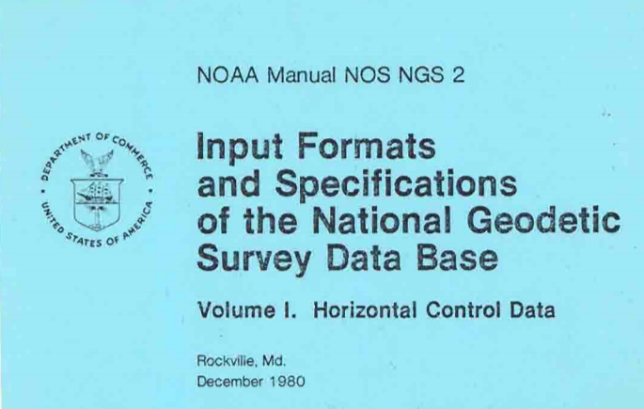
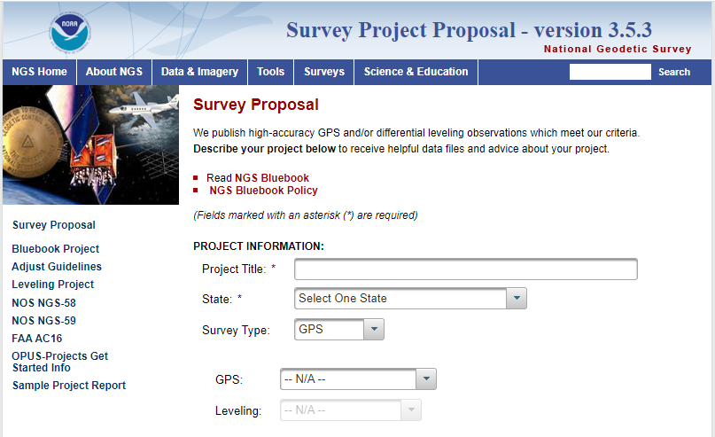
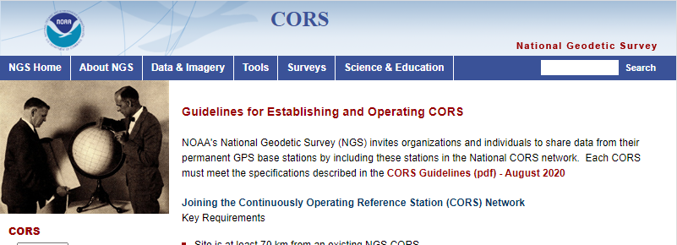
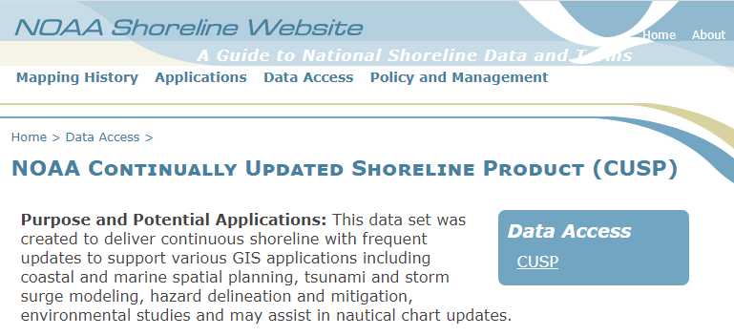
NGS’ Long History of Crowd Sourcing Data
In February 2020, NGS celebrated 40 years of crowd sourced data collection since the first NGS Bluebook was released in 1980
Today, NGS continues to encourage data contributions for use in multiple applications:
CORS data
Shoreline - CUSP
GPS and Leveling surveys – Bluebook
GPSonBM
Mark Recovery
Notes:
NGS has crowdsourced our survey data collection almost entirely, beginning with agency-to-agency data rescue in the 1970’s.
We crowdsource data because we have to, we don’t have the budget or the field crews to collect data ourselves. This will help us to improve access to the NSRS and get the data we need to make informed decisions to do our job.

Slide 5
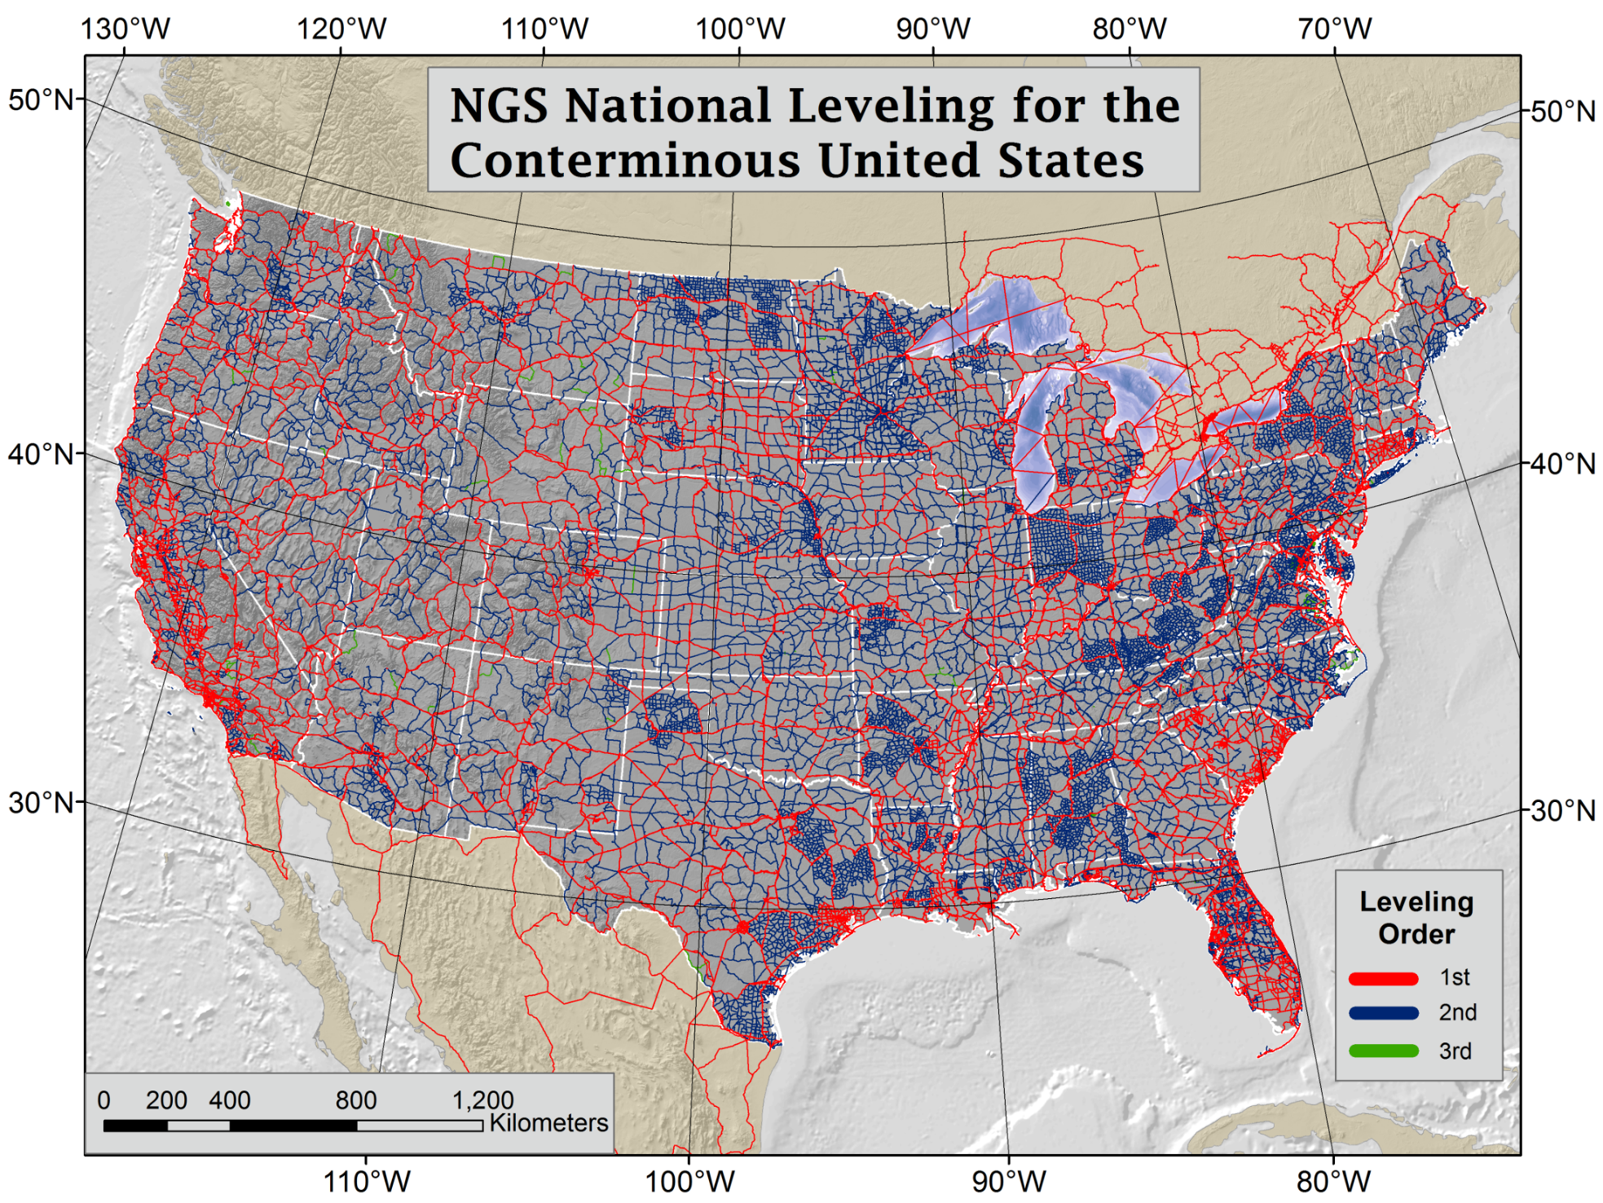
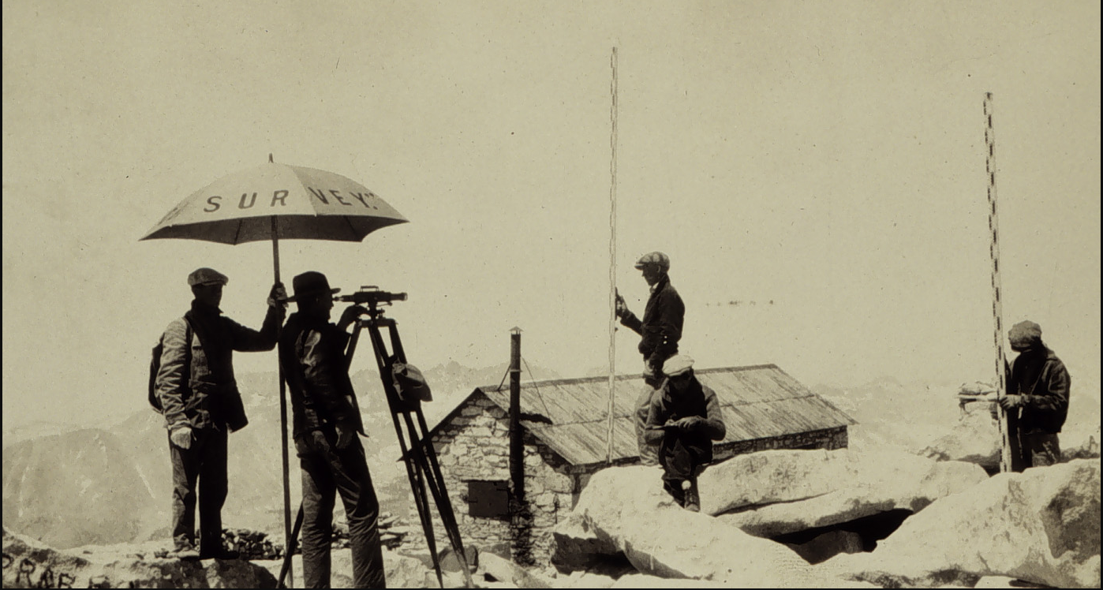
NAVD 88 is Based on Continental Scale
Geodetic Leveling
Current Vertical Datums:
NAVD88
CONUS & AK
PRVD02
Puerto Rico
VIVD09
US Virgin Islands
GUVD04
Guam
NMVD03
Commonwealth of the Northern Marianas
NAVD 88 consists of about 800,000 bench marks connected by
about 2.2M km of leveling
Notes:
NAVD 88 consists of about 800,000 bench marks and ~2.2M km of leveling. Data was collecting over many decades by roving bands of surveyors who walked across the country multiple times over the years, east to west, north to south and back again. It is currently the official vertical datum of the US and is required for federal mapping projects.
GPS data on those leveled marks will be used to create GEOID18 – the model used to derive NAVD88 heights from GPS ellipsoid heights, as well as the transformation tools that will be released with NAPGD2022.
GPS data on those leveled marks will be used to create the transformation tools that will be released with NAPGD2022.
Incredible effort – best tech at the time
BUT:
ACCESS!
Leveling is time intensive and expensive
Access has historically been through passive control, bench marks that you must find
Accuracy!
Distance dependent errors can build up, making the overall network less reliable
Bench mark can move over time , Only as reliable as the last observation
Consistency!
Modernized NSRS will eliminate systematic errors in current datums
Aligned with global reference frames
Integrated system for both positions and heights (“elevations”)
But, long time period during which things were moving that we could not adequately account for
New reference frames will give coordinates at specific reference epochs and the IFVM will move coordinates through time from the survey epoch to the reference epoch.

Slide 6
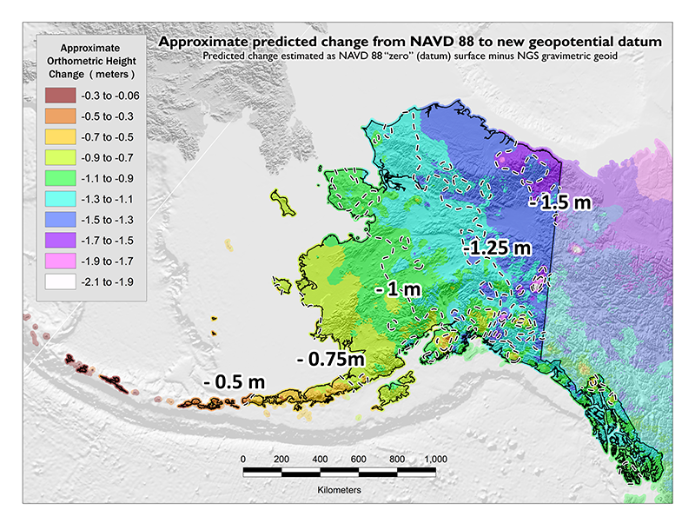
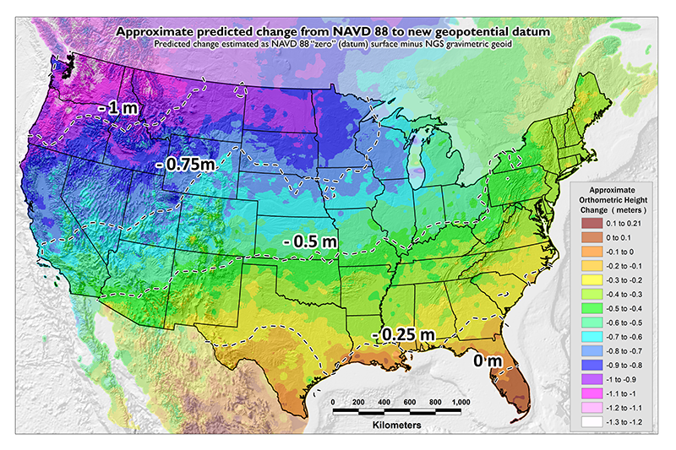
NAVD 88 Issues
NAVD 88 suffers from a known bias (50 cm) and tilt (about 1 meter across CONUS) relative to the gravimetric geoid
PID: EZ0840

Slide 7
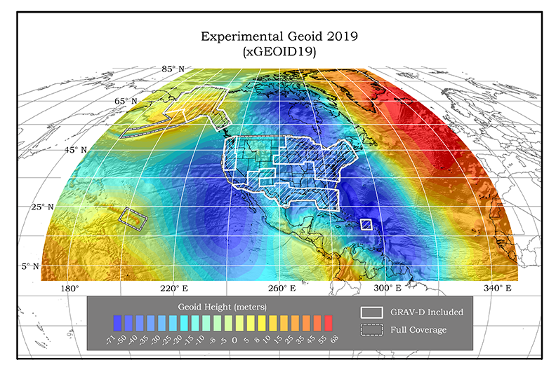
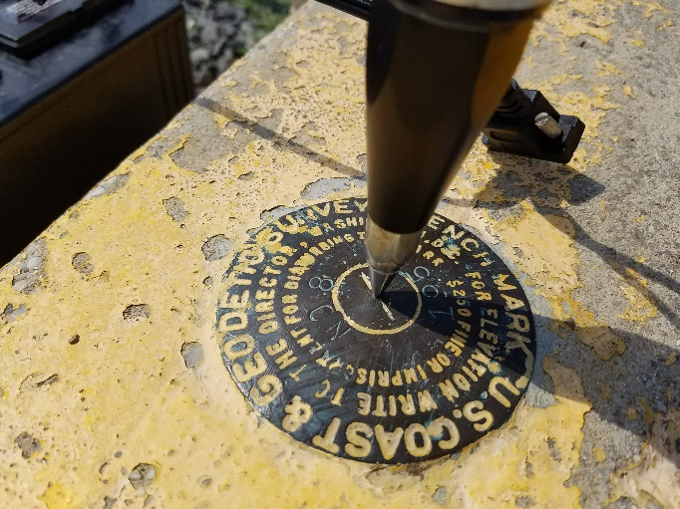
GPSonBM Measurements Connect
Old & New Datums
Because the relationships between the old and new datums vary by location, the accuracy of the transformations in any particular place is directly related to the density of GPSonBM data available in that area.

Slide 8
NAVD 88 Issues
NAVD 88 suffers from unknown movements before, during and after its original adjustment
By way of example…
1954: Leveling Performed to bench mark
House
House
House
BM
BM
BM
1991: Original 1954 leveling data is used to compute the NAVD 88 height which is then published for this BM
1954-1991: Subsidence
H₈₈(published)
H₈₈(true)
NAVD 88 zero height surface
Obviously the true height relative to the NAVD 88
zero surface is not the published NAVD 88 height
Notes:
Ability to do faster measurements in response to disaster and changes to floodplain

Slide 9
Showing Time Change Requires Re-surveys
Most of the 1.6 million marks in the NGS database were set for NAD 83 or NAVD 88
With nearly no overlap
Most have never been re-surveyed
But kudos to the recent GPS on Bench Mark surveyors!
You’re re-surveying marks that were leveled (for NAVD 88) but now seeing a GPS receiver, often for the first time!
Notes:
1,600,881 marks not at a CORS
1,500,750 have never seen a GPS receiver
Of those 100,131 remaining, only 22,000 or so have ever seen GPS 2 or more times.
Another way:
- 93% have ZERO GPS
- 1.4% have TWO or more GPS occupations

Slide 10
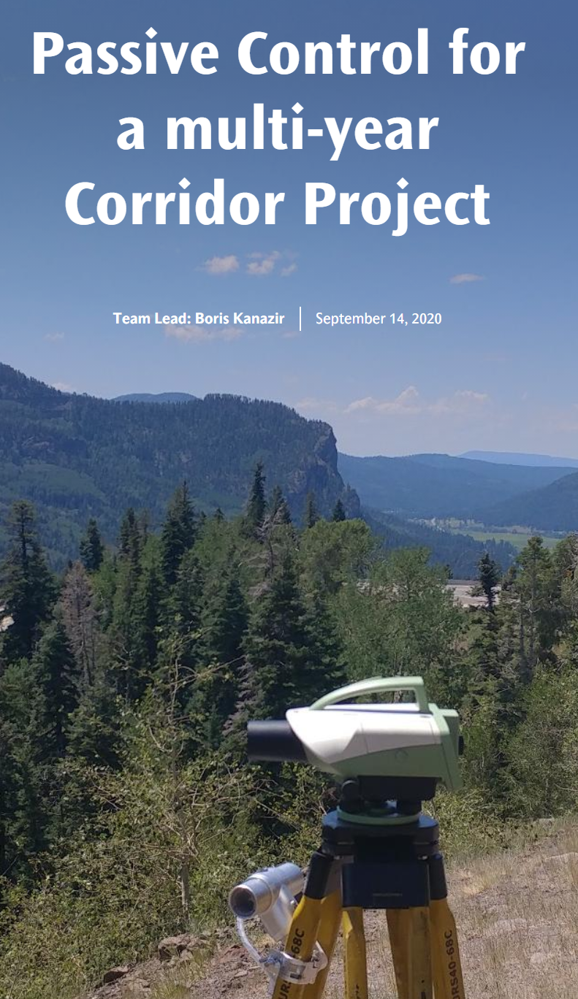
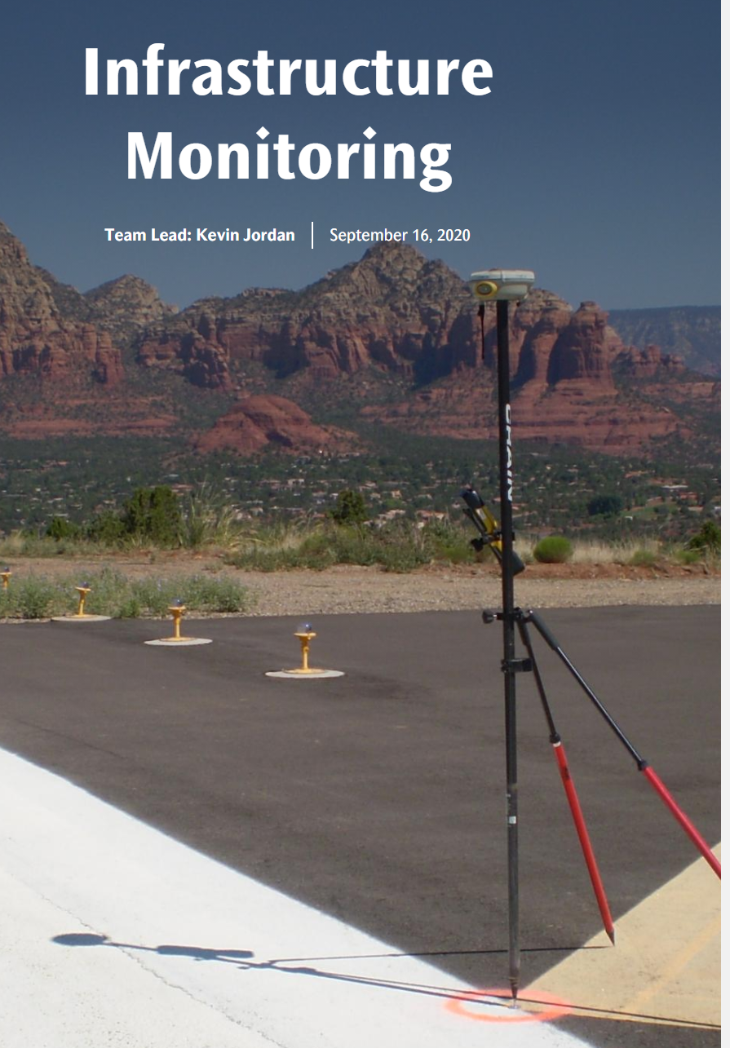
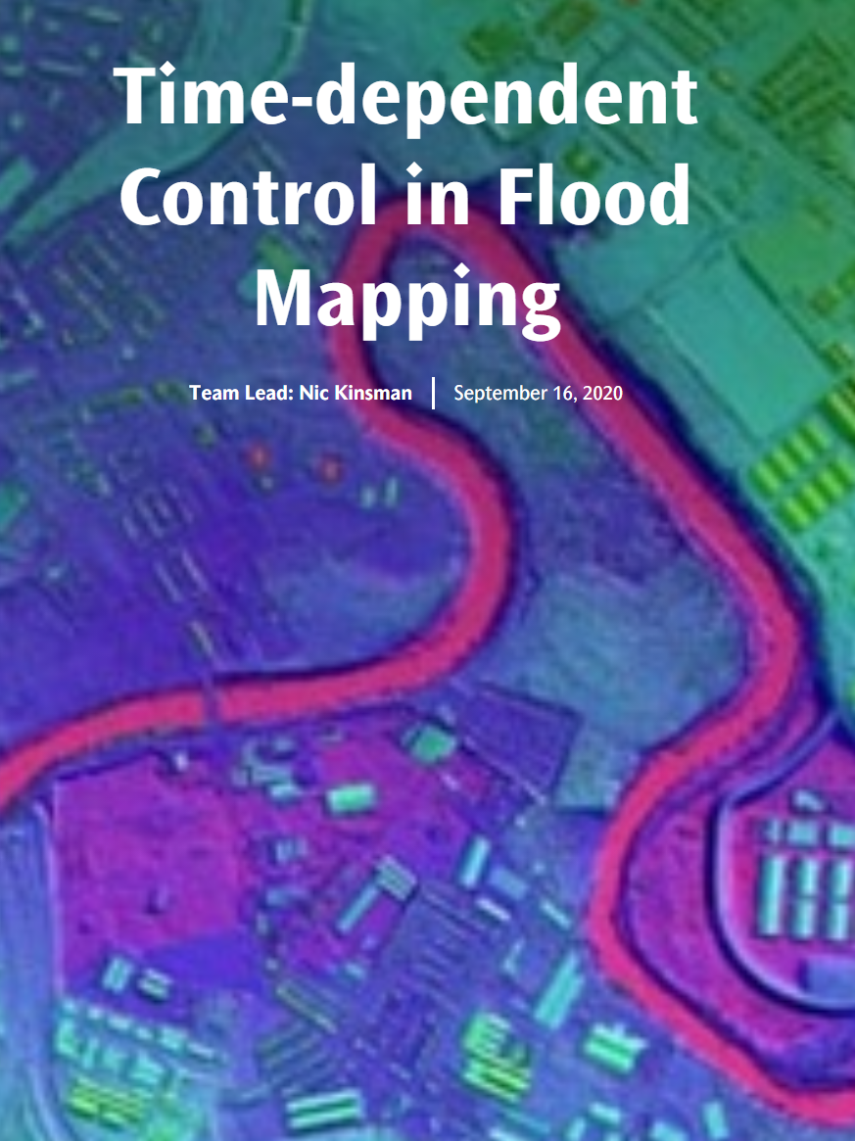
Blue Print 3: Working in the Modernized NSRS 2020 Updated Edition with Use Cases
Currently out for technical review.
March 2021 NGS Webinar Series Roll-out
Coming Soon
Working in the modernized NSRS:
April 2019
NOAA TR NOS NGS 67

Slide 11
Best ways to determine coordinates in Modernized NSRS
Resurvey: Return to the field and collect new observations, relying upon geodetic control that has coordinates in the new datum
Readjust: Using existing observations, re-compute new coordinates based upon geodetic control that has been defined in the new datum
Transform: Take finished products which have coordinates in the old datum and use transformation software to estimate coordinates in the new datum
Notes:
Listed in decreasing order of accuracy, but also in decreasing order of cost and increasing order of simplicity

Slide 12
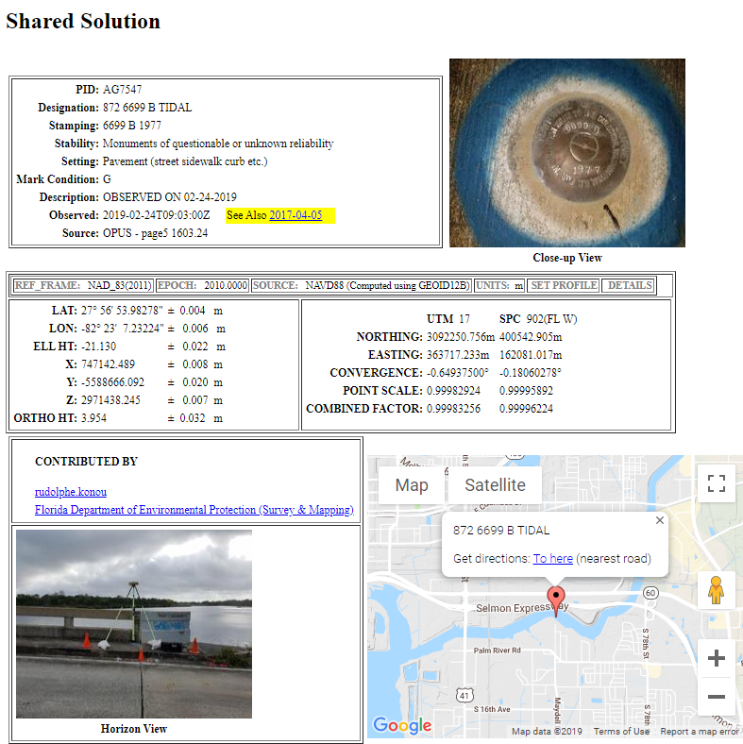
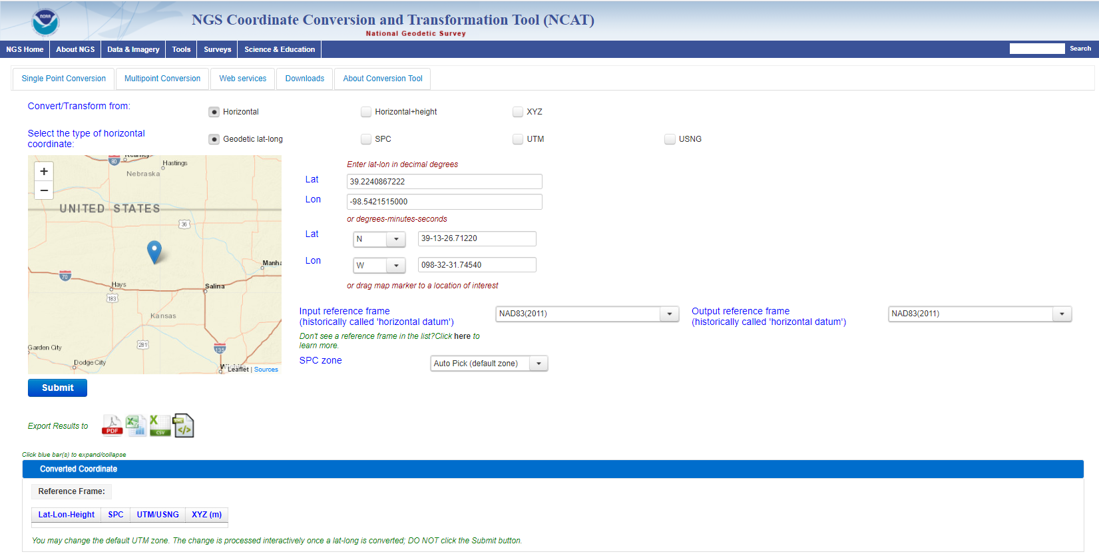
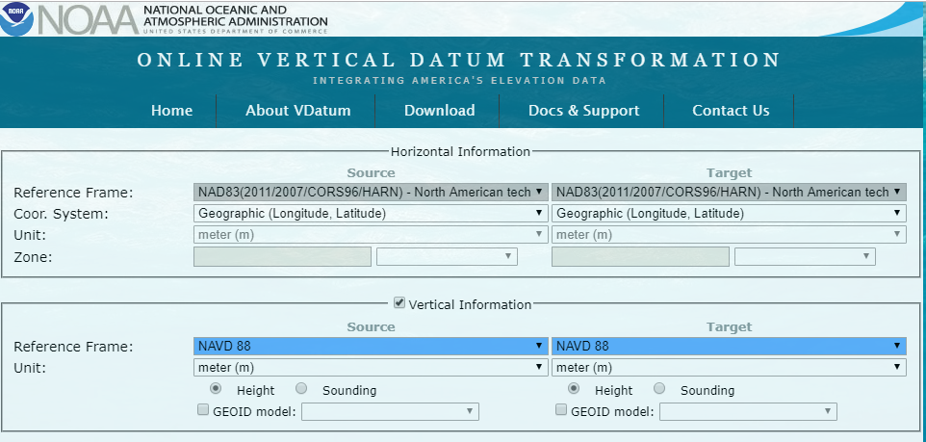
GPS on Bench Marks
GPS on Bench Marks is not only about building the Transformation Tool to connect the past and future Datums. It is about preparing the country and our communities to take full advantage of the benefits of the Modernized NSRS
GPSonBM Campaign Goals:
2020.0 Reference Epoch Coordinates (REC’s)
Data for NAVD 88 – NAPGD2022 Transformation Tools
Build time series of observations in areas of motion
Added benefits:
Update Passive Control Status
Check your RTN results
Identify marks suspected of movement
Notes:
NGS’ GPSonBM program is now requesting data to build the models that NCAT and VDatum will use to transform geospatial data from existing datums to the Modernized National Spatial Reference System.
These are the benefits that we derive that other countries could derive as well. The processes, tools, workflow, and technical specifications that we have developed can be applied in other places. We are keeping in house the definition of the NSRS, outsourcing the observations to realize the frames

Slide 13
A two-track approach to new coordinates
Reference Epoch Coordinates
Survey Epoch Coordinates
“These are coordinates which have been estimated by NGS, from time-dependent age-limited historic survey data, CORS coordinate functions and an intra-frame velocity model, at an official NSRS reference epoch
An estimated “snapshot” of entire network
Every 5 or 10 years
Similar to NAD 83(2011) epoch 2010.00
“These are coordinates computed by NGS using submitted data and metadata, checked and adjusted and referenced to distinct epochs through time.”
Answers: what were a mark’s coordinates when it was last surveyed?
NGS will adjust multiple surveys in timespans called “adjustment windows”, to a single epoch within that window.
Multiple SECs can show changes over time
Notes:
Initial plan for adjustment windows: 4 weeks for GNSS; 1 year for leveling
SECs represent the best estimates NGS has of the time-dependent coordinates at any mark
SEC were initially called Final Discrete Coordinates

Slide 14
Shift and Drift
When transitioning from NAVD 88 or another vertical datum, your coordinates will shift and drift:
Shift: A one-time jump somewhere in the 0 to 2 meter range (orthometric height)
From fixing biases and/or tilts in NAVD 88 and others
Drift: Coordinates are now time-dependent. The shift will take you to 2020.00. Working at any other epoch means you must account for the drift (velocity) of your coordinates
As well as any other motions over time
GPSonBM data is used to measure the Shift
Intraframe Velocity Model* will be used to compute the Drift
Notes:
When transitioning from NAVD 88 or another vertical datum, your coordinates will shift and drift:
Shift: A one-time jump somewhere in the 0 to 2 meter range (orthometric height)
from fixing biases and/or tilts in NAVD 88 and other causes.
IFVM may be called something else by the time we are done.
Drift: Coordinates are now time-dependent. The shift will take you to 2020.00. Working at any other epoch means you must account for the drift (velocity) of your coordinates
As well as any other motions over time

Slide 15
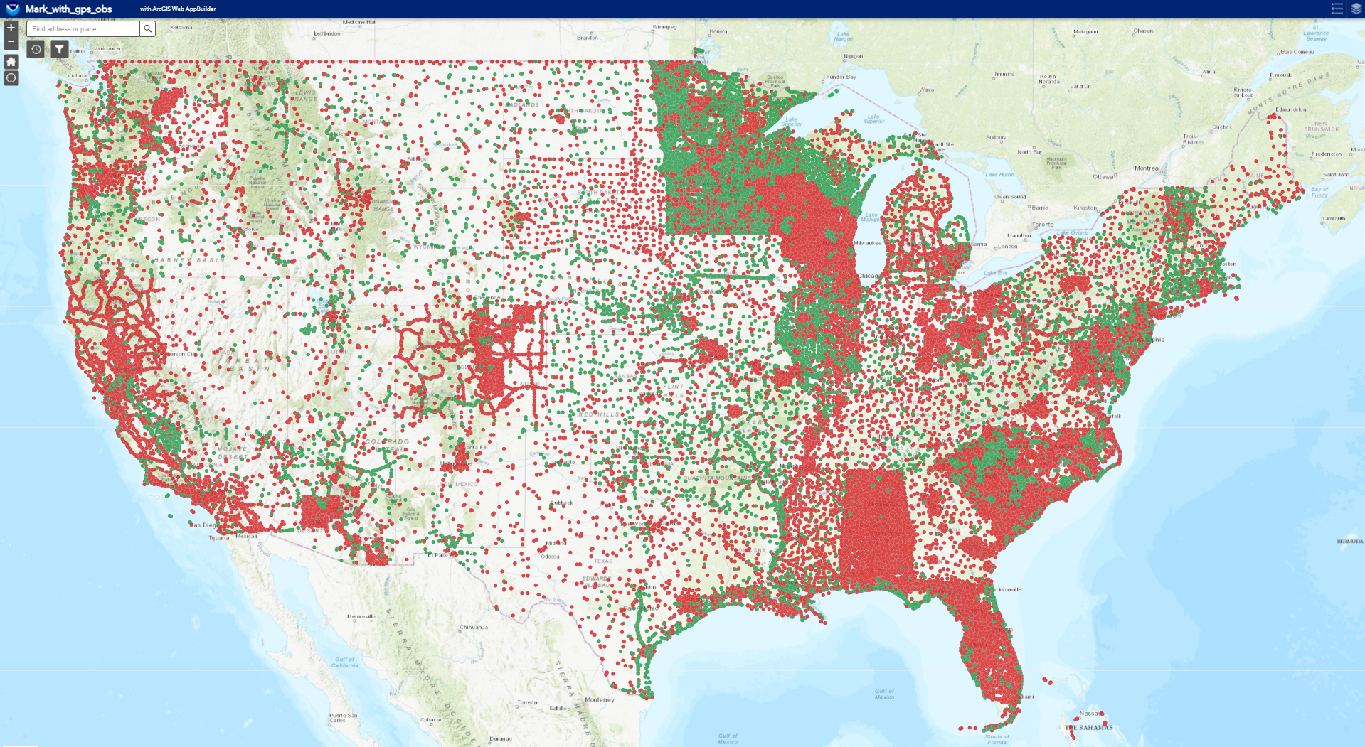
Evaluating Time Distribution of GPS Data
REC adjustments will include some age-limited span of data
Exact age-limit won’t be known until we start experimenting in 2022 with the 2020.00 REC adjustments
Before Jan 1, 2010
After Jan 1, 2010
Notes:
Time-limited: NGS is considering limiting how far back we reach in order to compute RECs. While horizontal motions are well known within many crustal motion models (like IFVM2022 will be), vertical motions are not. And since NGS’s intent is to put out RECs only for trusted points, and only for as long as those points ARE trusted (in all 3 dimensions), a time-limit for how far back to reach is definitely one way to keep the coordinates trusted.

Slide 16
Time Series of Observations in Areas of Motion
NGS is using Trans4D as the velocity model prototype.
People in areas of vertical motion of 2 mm/yr or greater should collect and submit data to develop a time series of observations to track changes over time
Snay, R. A., Freymueller, J. T., Craymer, M. R., Pearson, C. F., and Saleh, J. (2016), Modeling 3‐D crustal velocities in the United States and Canada, J. Geophys. Res. Solid Earth, 121, 5365– 5388, doi:10.1002/2016JB012884.
Notes:
Snay, R. A., Freymueller, J. T., Craymer, M. R., Pearson, C. F., and Saleh, J. (2016), Modeling 3‐D crustal velocities in the United States and Canada, J. Geophys. Res. Solid Earth, 121, 5365– 5388, doi:10.1002/2016JB012884.
Snay, R. A., Saleh, J., & Pearson, C. F. (2018). Improving TRANS4D’s model for vertical crustal velocities in Western CONUS. Journal of Applied Geodesy, 12(3), 209-227.

Slide 17
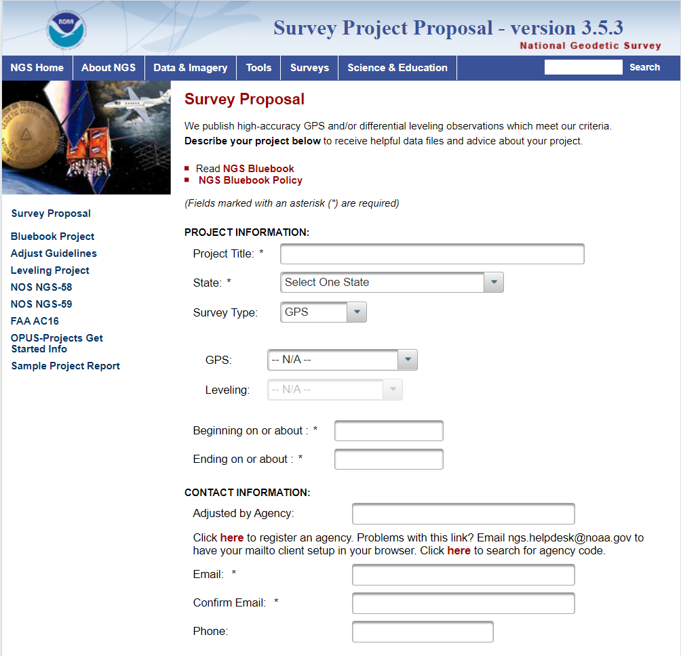
Campaign-Style Bluebooked Surveys Recommended in Areas of Motion
Update NAVD 88 heights on NGS datasheets in areas where the heights have been suppressed or the data is out of date.
Get new current NAVD 88 heights, 2020.0 REC’s, accurate transformation grid and baseline for time series
Notes:
Single Shared OPUS solutions currently provide coordinates tied to the NSRS, including a “No-Check” NAVD 88 height using GEOID18.
For the initial release of the Modernized NSRS, individual Shared solutions will be will be processed together with other observations submitted by December 31st, 2021 to compute the 2020.0 Reference Epoch Coordinates
Eventually, a series of Survey Epoch Coordinates (SEC’s) will also be computed from observations within a series of “adjustment windows” (TBD, but ~ 4 weeks) which is how the Modernized NSRS will provide the time-varying component of coordinates
Areas where the NAVD 88 is old and out of date or has been suppressed should go through Bluebook process to update the heights so they can be used

Slide 18
Coming February 2021: OPUS-Projects for RTK
NGS is developing a new Standardized GNSS Vector EXchange Format (GVX) that will be used to ingest vectors into OPUS Projects

Slide 19
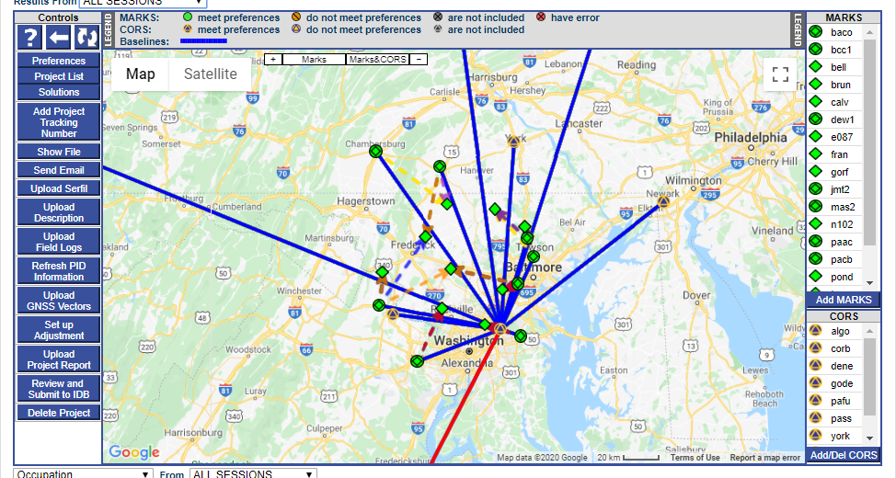
OPUS-Projects for RTK: Get Ready for Beta Testing
Tune in for OPUS-Projects for RTK Vectors and GVX Format
Webinar on February 11th^{th}, 2021
Notes:
GVX Contains:
Mark-to-mark ECEF vector components (dX, dY, dZ)
Standard deviations of vector components
Covariances of vector components
Reference frame
Start and stop time of observation
A-priori coordinates

Slide 20
GPSonBM is Driving a Surge in Shared OPUS Solutions
2020 Transformation Tool Campaign
2018 GEOID18 Campaign
2019 Transformation Tool Campaign Launch

Slide 21
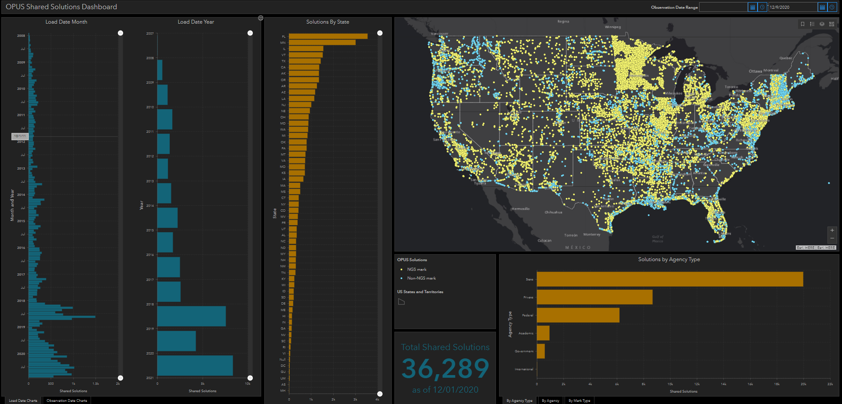
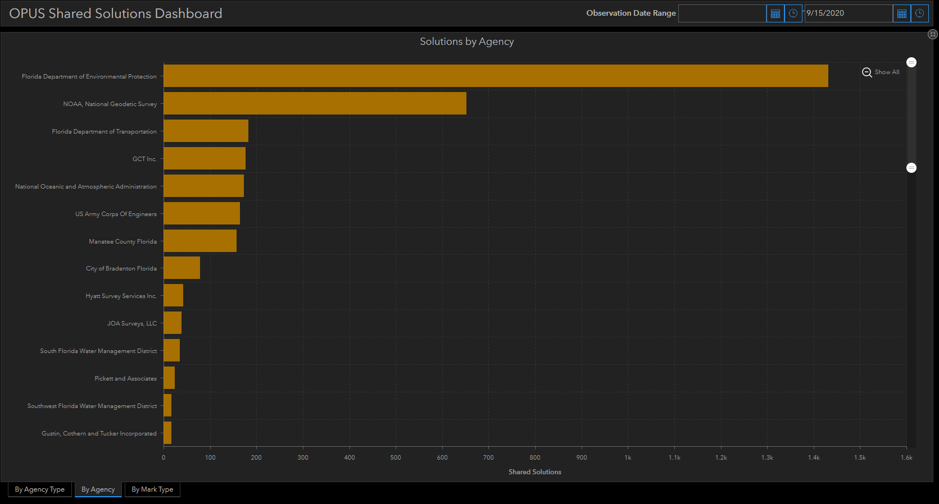
OPUS Shared Solutions Dashboard
Dashboard enables sorting and visualization of Shared Solutions by
Month & Year, State, Agency Type, and submitting agency
Agency type | # Shared Solutions on NGS marks
State | 16,500
Private Sector | 4,000
Federal | 3,000
Academic | 772
Local Gov’t | 580
Note the impact of GPSonBM Campaigns

Slide 22
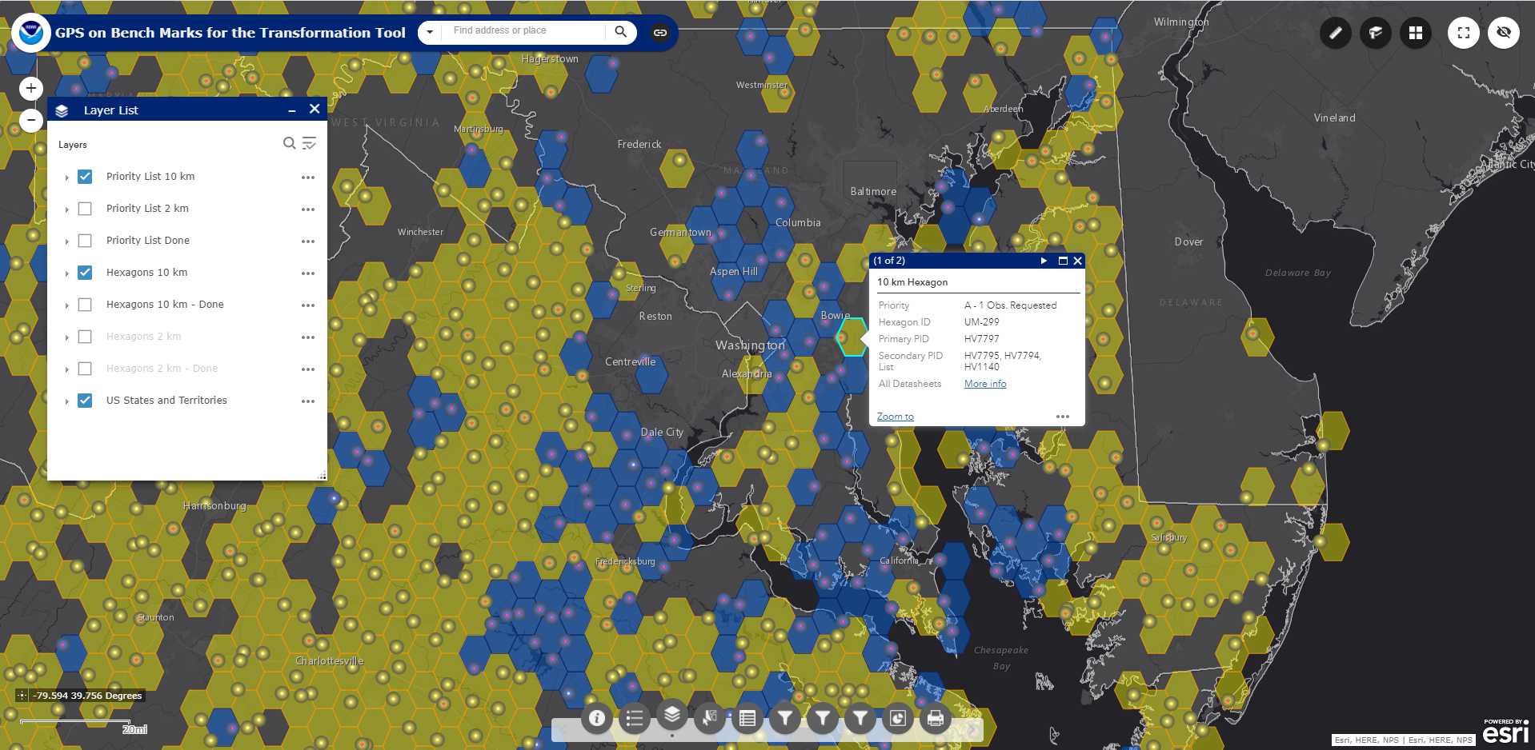
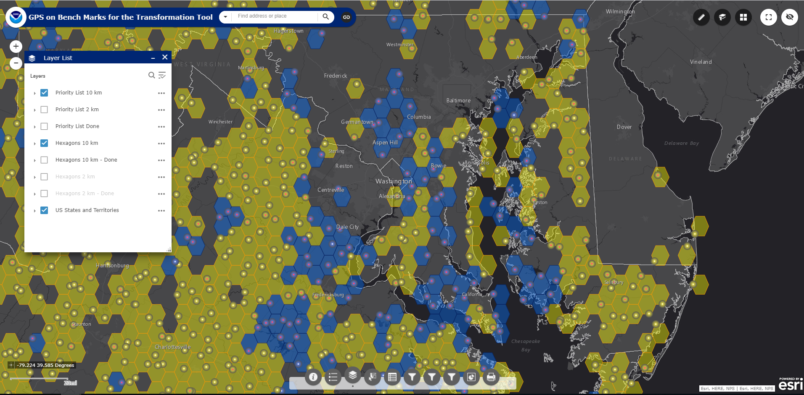
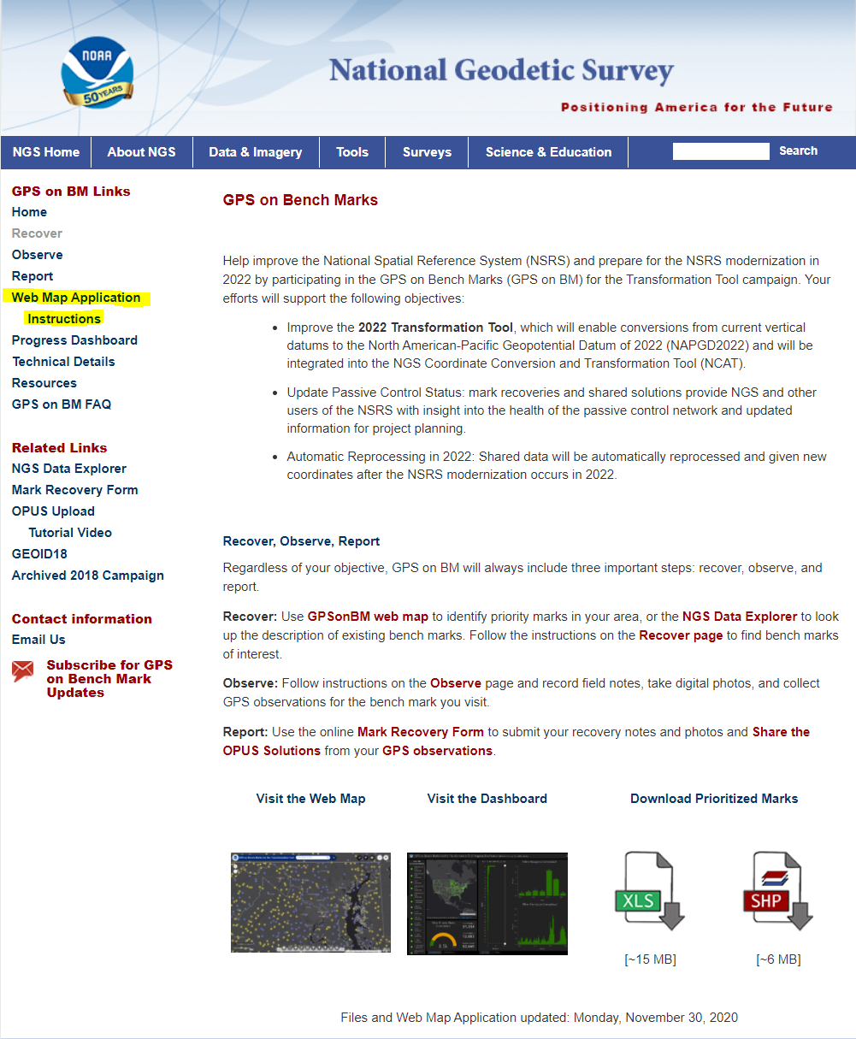
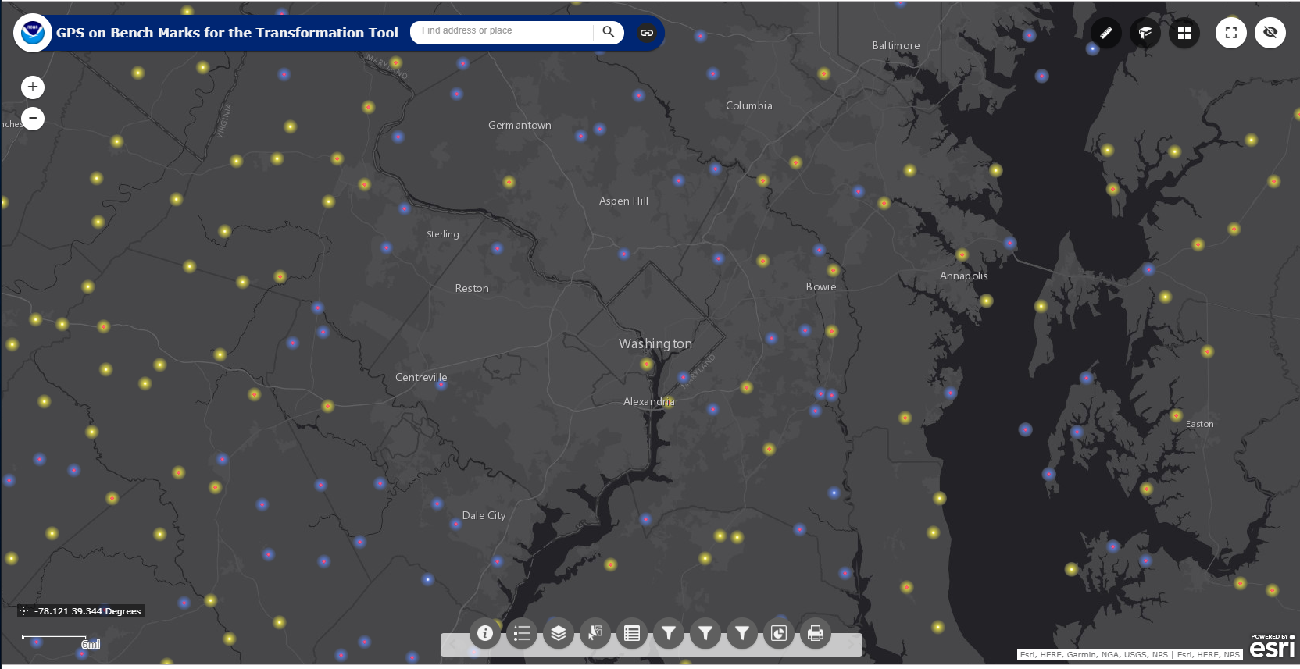
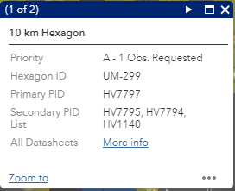
GPSonBM Priority List and Web Map
Layer List
The web map has several functions that allow users to search, explore, filter, and export the data
Check out the GPSonBM webpage:
www.ngs.noaa.gov/GPSonBM/

Slide 23
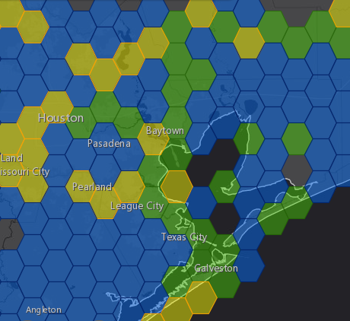
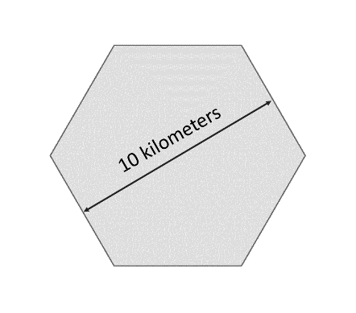
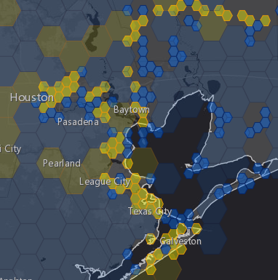
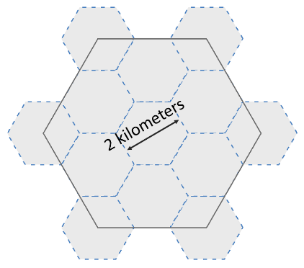
National Coverage and Local Densification
NGS has a National Coverage goal of 10 km spacing 10 km hexagons illustrate this coverage on the map
Priority marks within each hexagon are selected automatically based on their metadata
Once the 10 km goal is reached, the opportunity to densify the model and improve local results is unlocked. 2 km hexagons appear along with new priority marks within those hexagons
10 km
Priority A Hexagons are Gold
Hexagons where we have the data we need are marked Done and colored Green
Priority B hexagons are Blue
2 km

Slide 24
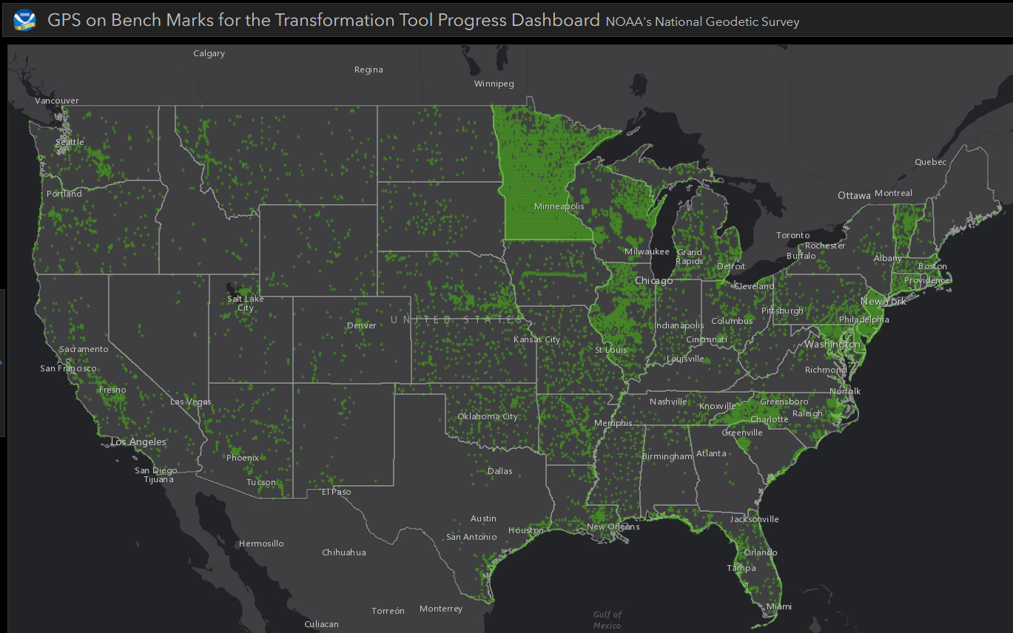
GPSonBM Data Distribution – Completed Hexagons

Slide 25
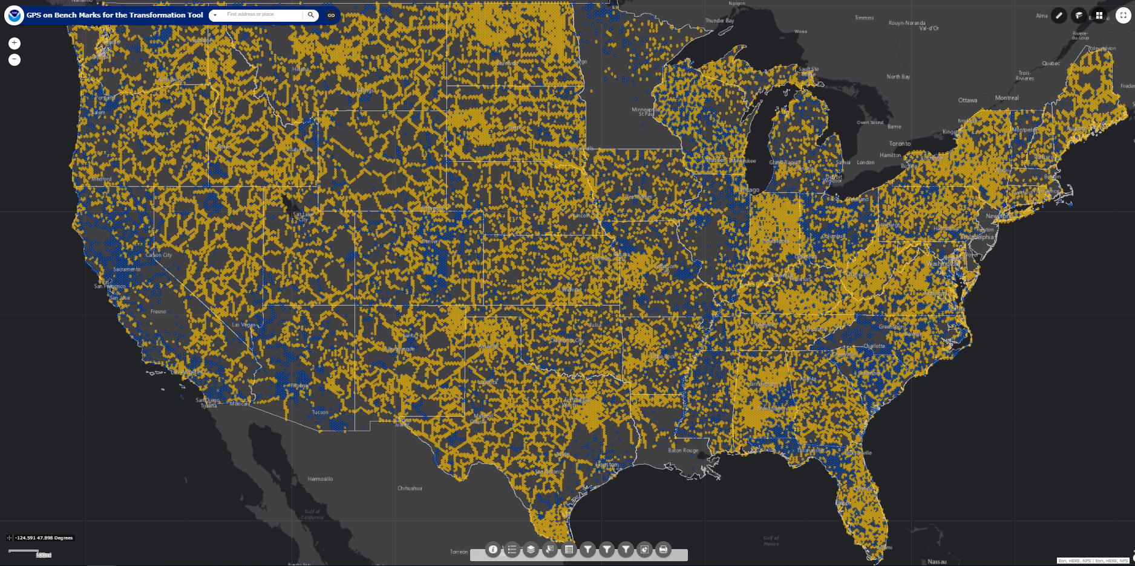
GPSonBM Data Distribution – Remaining Targets

Slide 26
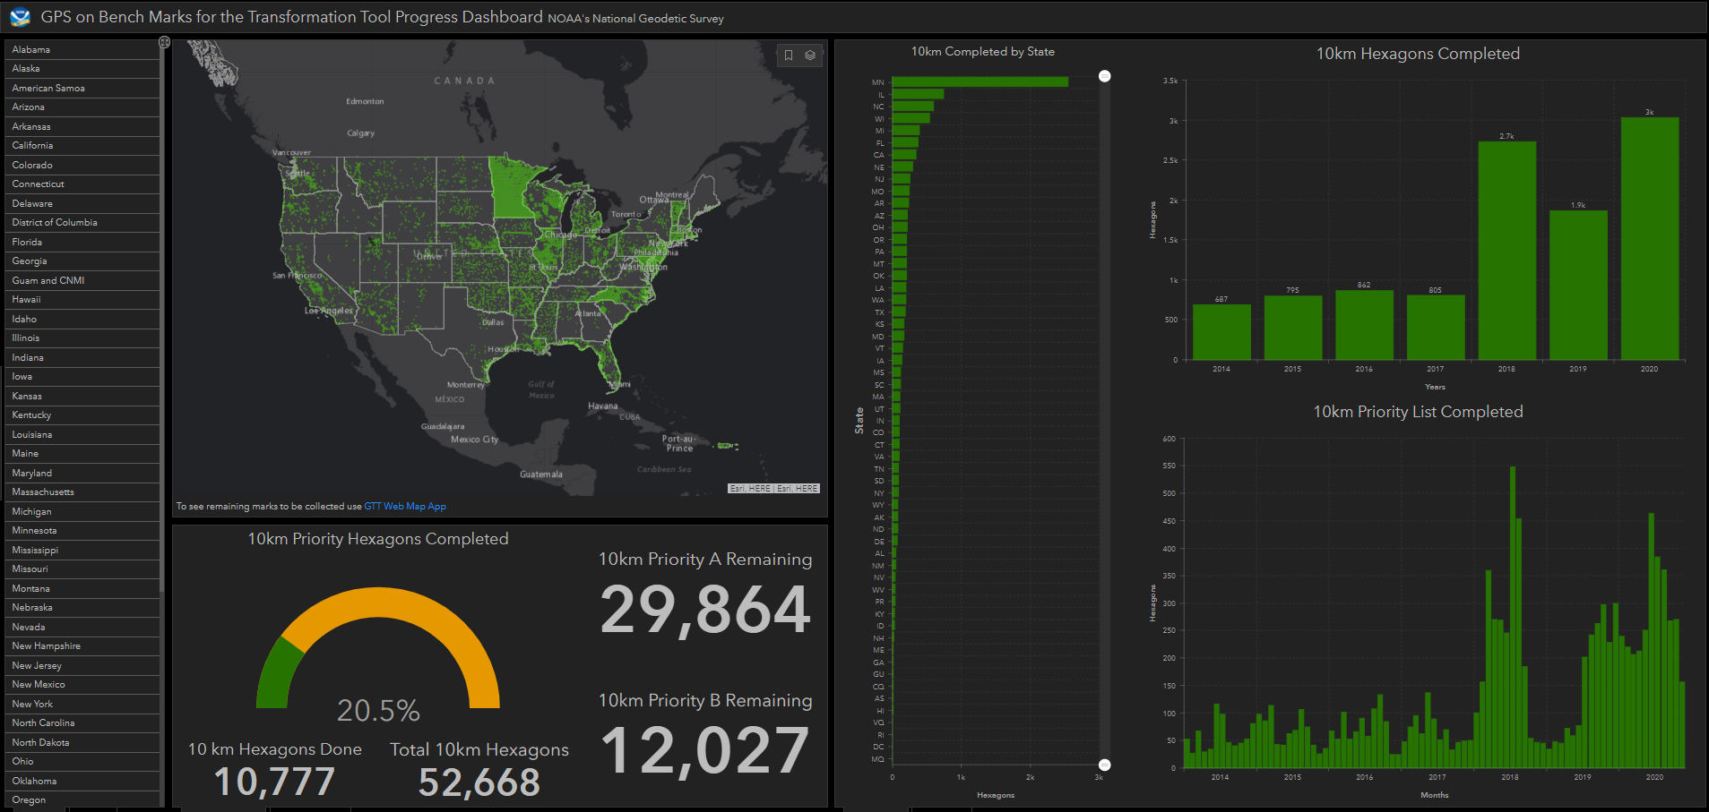
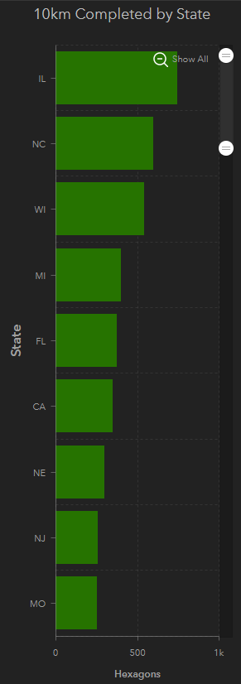
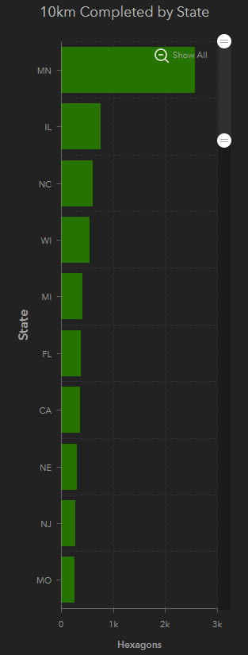
GPSonBM Transformation Tool Campaign: Progress Dashboard
Top 10
Rank | State
1 | MN
2 | IL
3 | NC
4 | WI
5 | MI
6 | FL
7 | CA
8 | NE
9 | NJ
10 | MO
Notes:
States that have submitted very little GPSonBM data so far:
AL
NM
NV
WV
PR
KY
ID
NH
ME
GA
HI
RI

Slide 27
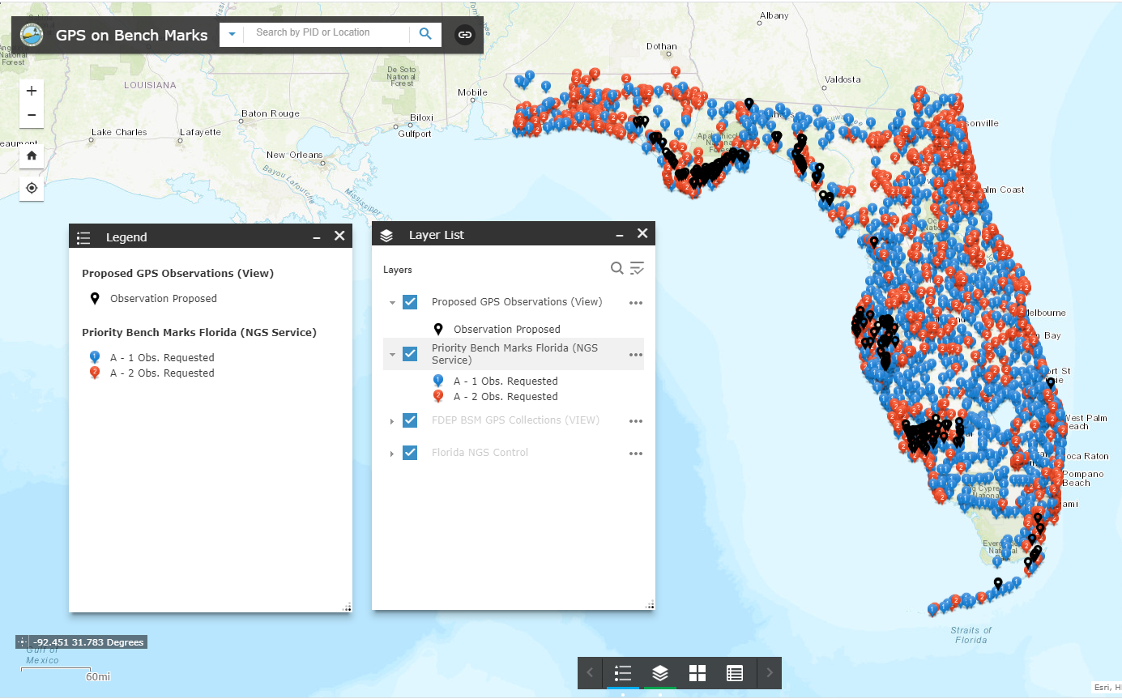
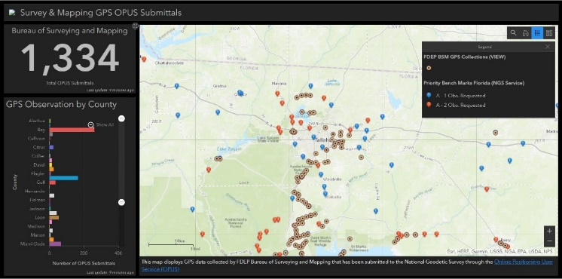
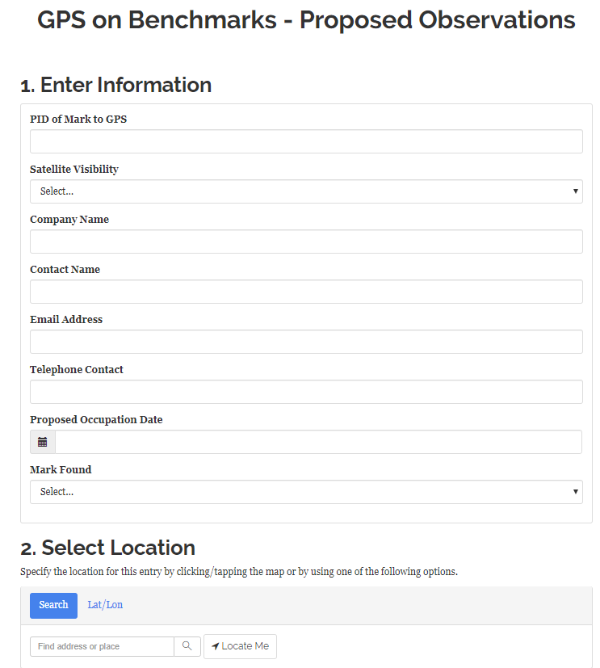
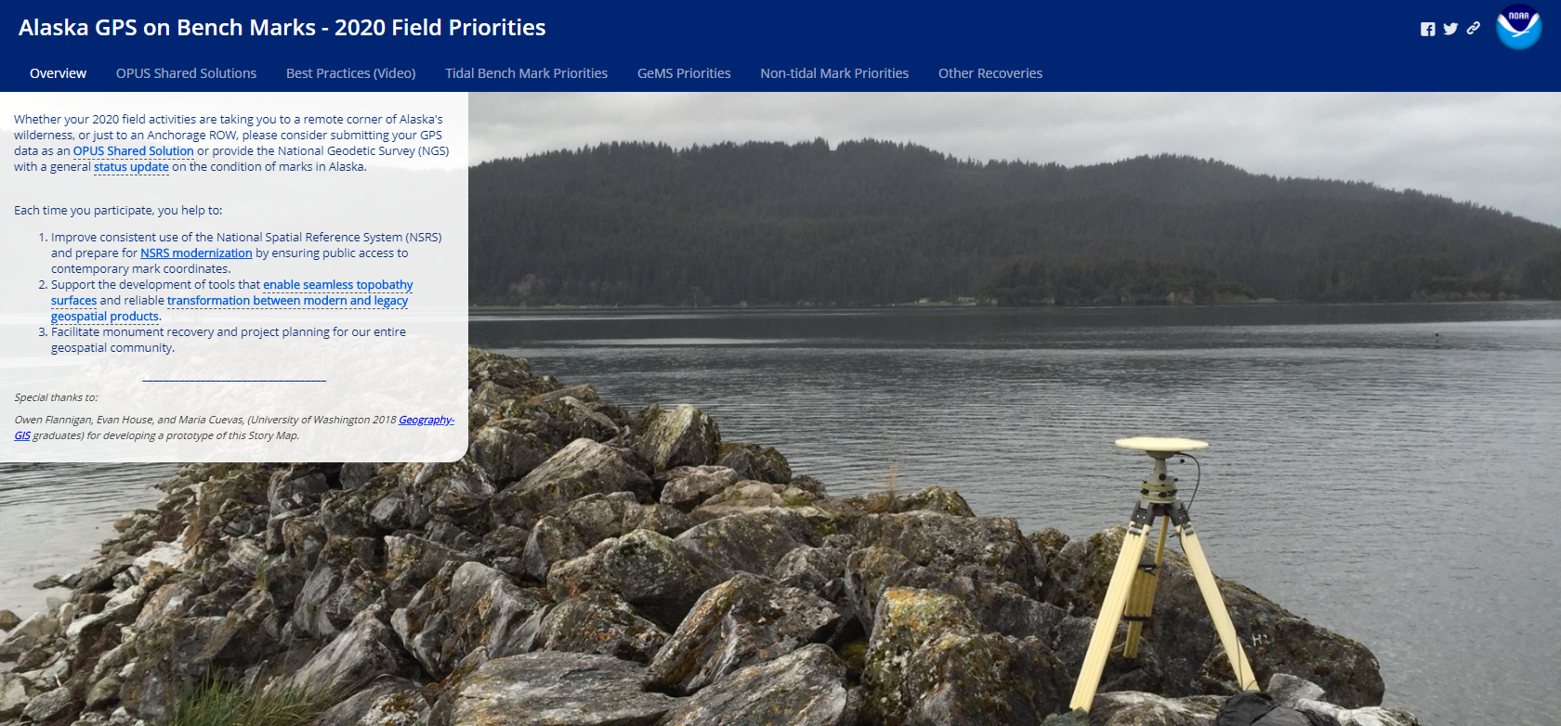
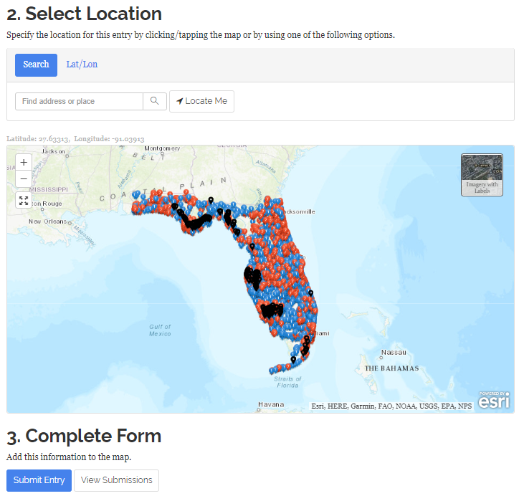
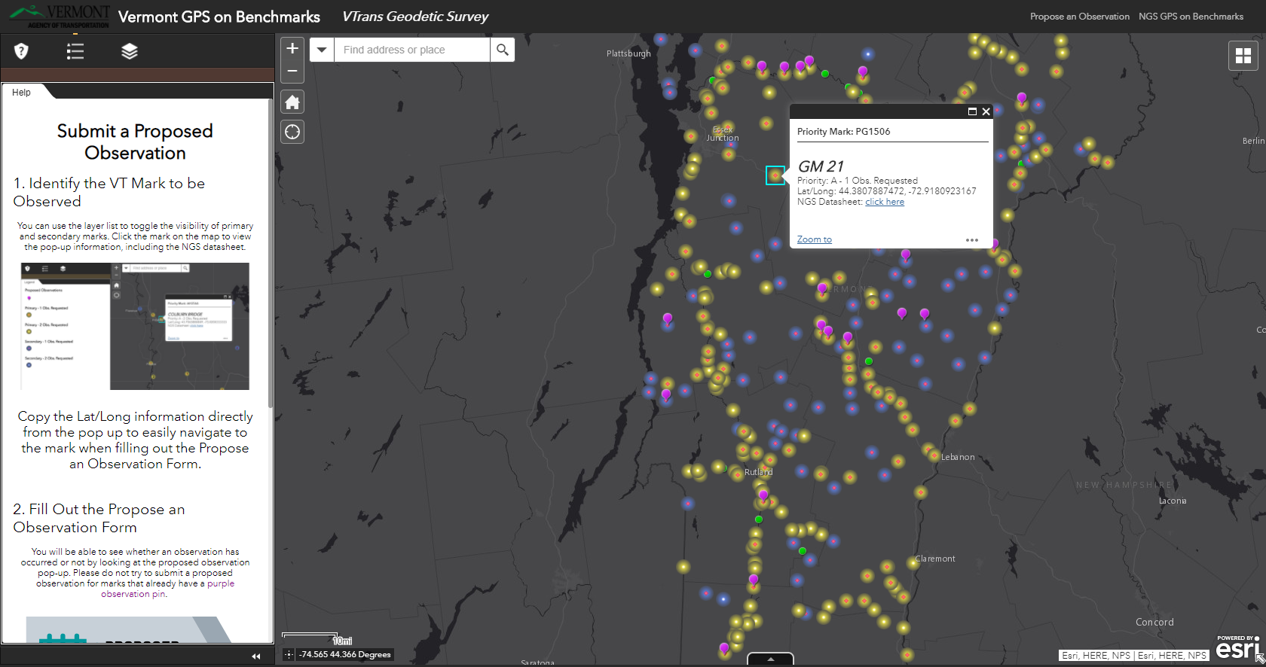
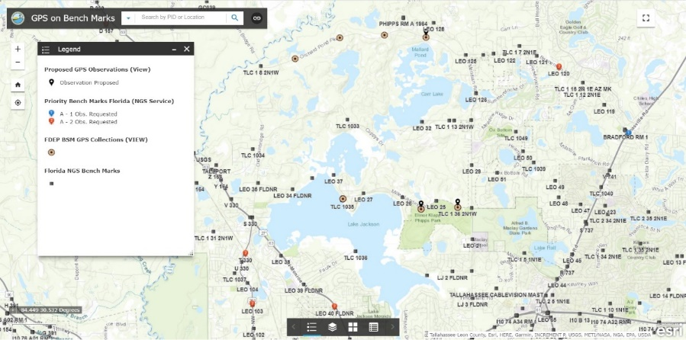
State Level Maps & Dashboards for Regional Coordination
Got your own maps, story maps, or dashboards?
Have a great picture or GPSonBM story?
Drop us a line and let us know at ngs.gpsonbm@noaa.gov
Notes:
NGS makes all of our GPSonBM data sets available online through the ArcGIS Online platform. Several States have created their own web maps and collaboration tools allowing them to coordinate with partners and plan together to decide who will observe which marks and when

Slide 28
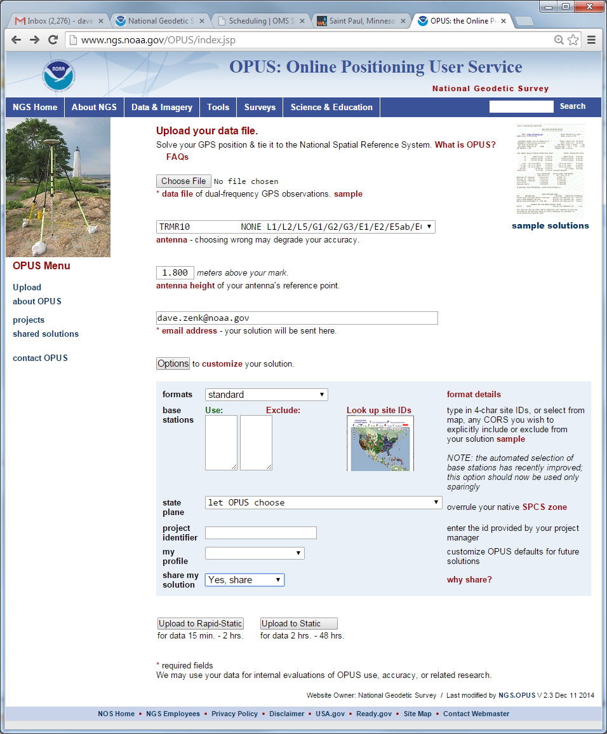
Share GPS observations through OPUS
Upload 4+hour GPS observation file
Provide antenna type, antenna height, and email address
Click “Options” & Select “Yes, Share”
Identify the Mark by PID
Write a “To Reach” description
Attach 2 photos: Close up & Horizon
Respond to confirmation email
geodesy.noaa.gov/corbin/class_description/opus-share-tutorial/

Slide 29
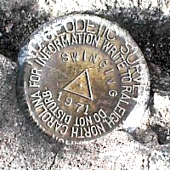
Minimal Data Requirements
GPS Observation: Collect 4+ hours of data on a bench mark
Description: Provide details of how to locate mark (To Reach)
Example: Located in the SW corner of a 2 ft square concrete pad projecting 0.3 ft above ground, 3.3 ft S from S edge of sidewalk...
Accurate antenna height and type values
2 photos:
close-up photo (avoid dark/blurry/dirt-covered)
horizon photo (show equipment in use)
Notes:
- We keep the minimum session time at 4 hours for OPUS share
- Longer sessions = better probability of fixing ambiguities and cancelling some errors in GNSS
Incorrect antenna height is often the cause of an inaccurate orthometric height
OPUS share requirements
https://geodesy.noaa.gov/OPUS/about.jsp#sharing
OPUS webinar from Dec 2016
https://geodesy.noaa.gov/web/science_edu/webinar_series/understanding-opus.shtml

Slide 30
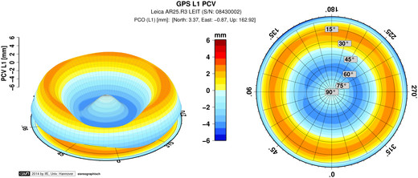
Antenna Type & Antenna Height are Crucial for Accurate Results
Rotate NRP to face true north
ARP
Each Antenna Type has unique biases
antenna height
mark
For antenna calibrations, photos, ARP and NRP diagrams, see geodesy.noaa.gov/ANTCAL/
JGE, 2015

Slide 31
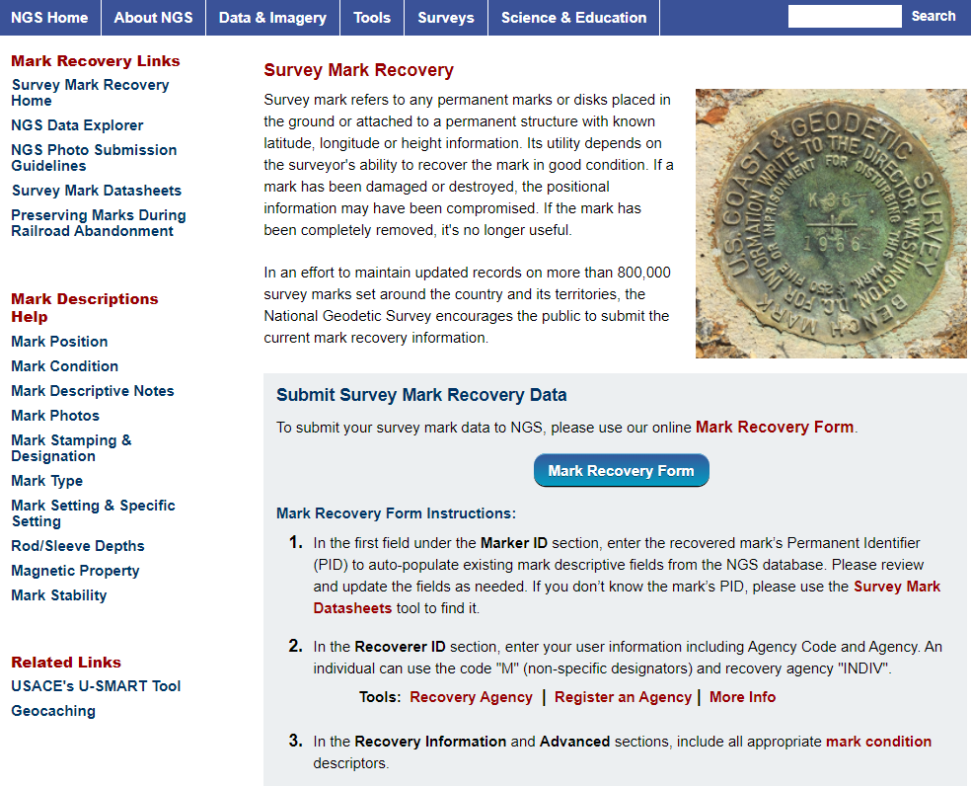
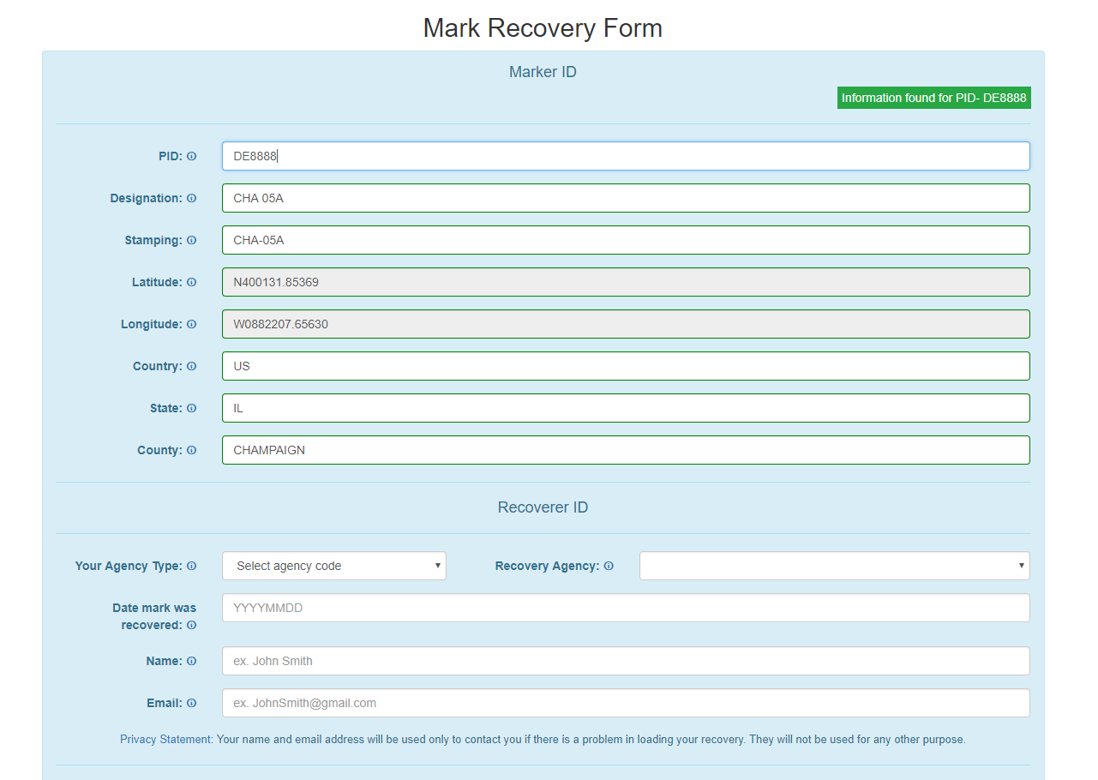
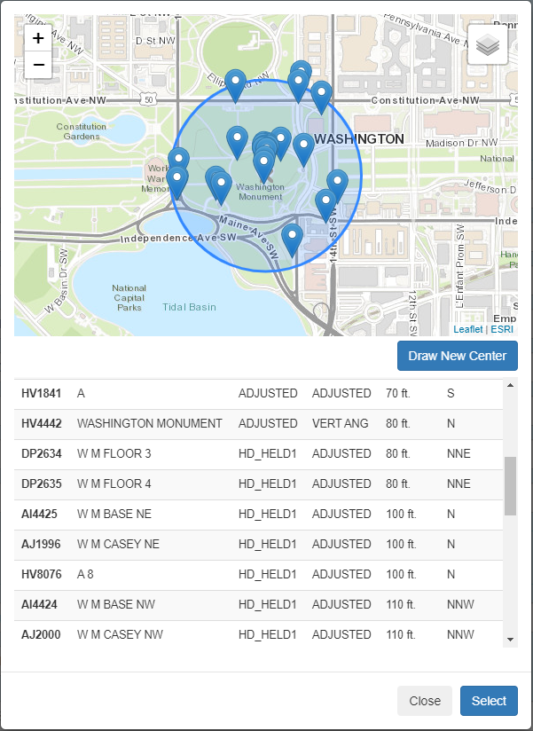
NGS Mark Recovery Webpage
Crowd sourced mark recoveries help update the GPSonBM map, let NGS and others know if the mark is still usable, and pictures make it easier to find.
www.ngs.noaa.gov/surveys/mark-recovery
Now with Find Marks Near Me!
Maintain you local control network: Submit a Recovery Note for each mark you find (up to once per year)
Did you find it?
Is it GPSable?
Got new photos?
Notes:
Using our online Mark Recovery Form, anyone can search for, find, and file a recovery report for our benchmarks. We update our priority list and maps when people report that the marks on our list have been damaged, destroyed, or are not suitable for GPS observations.

Slide 32
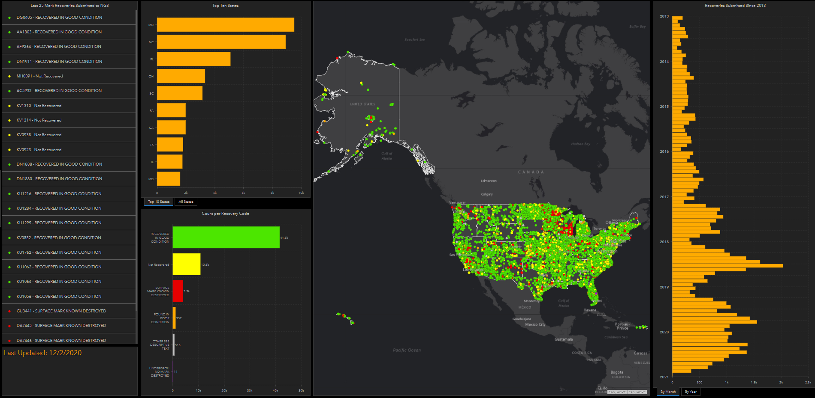
Mark Recovery Dashboard
https://www.ngs.noaa.gov/surveys/mark-recovery/index.shtml

Slide 33
GPSonBM at AGU on Dec 17th
G025-03: Improving the quality of NGS's GPS on Bench Marks with Machine Learning
Use results from GEOID18 to ‘train’ a model
“Supervised Classification”
Binary Class: ‘Use/Yes’ or ‘Not Use/No’
Use model on new data going forward
Have ~250 new submissions on bench marks each month
Avoid going back through manual editing/cleaning process
Notes:
GPS/leveling (GPS on benchmarks)
Applications: geoid model validation
Imperfect dataset: GNSS, leveling
Lots of observations/classes
Cleaning: Hybrid Geoid Models (GEOID18)
Machine Learning
Use results from GEOID18 to ‘train’ a model
“Supervised Classification” with MATLAB R2020a
Binary Class: ‘Use/Yes’ or ‘Not Use/No’
Use model on new data going forward
Have ~250 new submissions on bench marks each month
Avoid going back through manual editing/cleaning process

Slide 34
NGS Data Delivery System Prototypes
Try them out and tell us what you think at:
NGS.Feedback@noaa.gov
Beta Passive Mark Page
beta.ngs.noaa.gov/datasheets/passive-marks
Beta Leveling Projects Page
beta.ngs.noaa.gov/datasheets/leveling-projects
Beta Calibration Baseline Page
beta.ngs.noaa.gov/CBLINES/pages
Historic Geodetic Control Diagrams
beta.ngs.noaa.gov/gcd/
NOAA Shoreline Data Explorer
www.ngs.noaa.gov/CUSP/

Slide 35
Traversing the Path Toward NSRS Modernization
Collect and Submit GPSonBM data before December 31st, 2021
Send in mark recoveries for marks in your area
Try out our Beta Products and tell us what you think
Stay in the Loop – Subscribe to NGS News & Monthly Webinar Series
Get ahead of the curve with online lessons, videos, & tutorials

Slide 36
The future is already here —
it's just not very evenly distributed.
- William Gibson
Contact the GPSonBM team:
ngs.gpsonbm@noaa.gov
Provide Feedback:
ngs.feedback@noaa.gov

Slide 37
The Geoid, and Heights
h
= H
+ N
h: ellipsoid height
H: orthometric height
N: geoid undulation
Topography
h
H
The geoid
N
A chosen
ellipsoid
h is measured using GPS
*The relationship between the ellipsoid and the geoid may be swapped in some locations
Notes:
Point of scientific clarity: The geoid is a surface that is always convex. Yes it has undulations, but geoid purists in the audience will point out to you that, measured at the scale of the Earth itself, the geoid always has a POSITIVE radius relative to the center of the Earth. But when we zoom in, just for illustrative purposes, it is nice to show an “undulating” geoid, to distinguish it from both the smooth ellipsoid and the not smooth topography.
Additionally, don’t even bother showing that the plumb line (H) is curved. For purists, fine, but even at America’s largest known curved plumb line (Denali), this curvature is a SUB MILLIMETER effect.

Slide 38
Extensive Residual Analysis used to create a Prioritized List
Residual = h - H - N
-
-
N is from a geoid model: either gravimetric or hybrid
h is ellipsoid height measured using GPS
H is an NAVD 88 Orthometric Height from Leveling
Theoretically, the difference between these three values should be zero. In practice, using actual observations gives a residual, or measure of the misfit between the three. We use the residual to evaluate and quality control the observations.
Notes:
If we get two observations that agree to within 5 cm, we use the data, if they don’t agree then we ask for a third. This process helps us evaluate which of the datasets is correct, and which may be wrong. New GPS observations are much less expensive that new leveling.
Process of comparing independent data sources allows us to make a decision about which observation are correct.
Because NAVD 88 is a leveling based datum, NGS has used hybrid geoid models for the last 2 decades to provide NAVD 88 orthometric heights from GPS derived NAD 83 ellipsoid heights. These hybrid geoid were made by warping a gravimetric geoid model to the NAVD 88 surface using the GPS observations on levelled NAVD 88 marks. GEOID18 was the last hybrid geoid model that NGS will release before moving to the Modernized NSRS which will use a purely gravimetric geoid model (GEOID2022) as the foundation for NAPGD2022.

Slide 39
Definitional Relationship
$${H(t)}_{NAPGD2022}≡{h(t)}_{ITRF2020}−{N\left(t\right)}_{GEOID2022 }$$
We end with orthometric height in NAPGD2022 at the same epoch as the survey.
All work is done in ITRF2020 XYZ coordinates first.
They are associated with the epoch of the data collection (survey) “t”, then converted to φ, λ and (especially relevant here) h.
Conversion to orthometric heights is definitional through GEOID2022.
Contrast with NGS hybrid geoids where the equation H=h-N did not close.
Notes:
Let’s discuss this DEFINING RELATIONSHIP
CLICK CLICK
All work is done in ITRF2020 XYZ coordinates first.
CLICK
They are associated with the epoch of the data collection (the survey) “t”, then converted to f, l and (especially relevant here) h.
CLICK
Conversion to orthometric heights is definitional through GEOID2022.
CLICK
Contrast this with NGS hybrid geoids where the equation H=h-N did not close.
CLICK
We end with orthometric height in NAPGD2022 at the same epoch as the survey.

