Slide 1


Journey to
the Moving Center of the Earth
The Evolution of the National Spatial Reference System
NCEES Annual Meeting
August 24, 2016
Dan Martin
NOAA/National Geodetic Survey
Northeast Regional Geodetic Advisor
Dan.martin@noaa.gov
240-676-4762

Slide 2
Session description and objectives
In 2022, the National Geodetic Survey will be replacing the U.S. horizontal and vertical datums (NAD 83 and NAVD 88). We will discuss the history of these datums, their relationship to other reference frames, the reasons for the change, and how it affects surveyors and their access to these datums.
Objective…gain a fundamental understanding of:
  How and why our datums/reference frames have changed over time
  The need to further modernize the US reference frames
  How NGS will define new reference frames
  How users will access the new reference frames

Slide 3
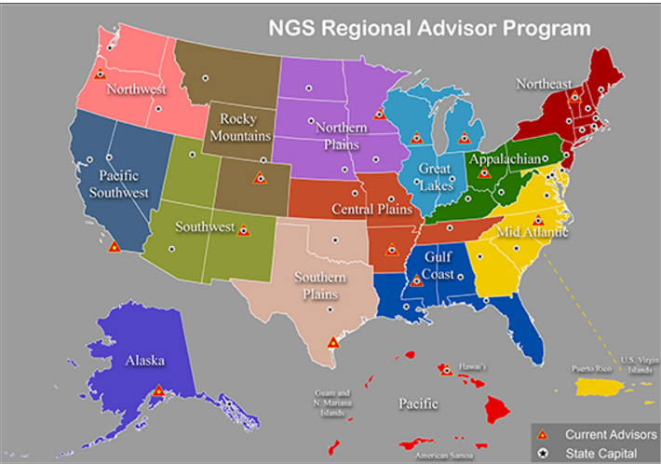

Slide 4
U.S. Department of Commerce
National Oceanic & Atmospheric Administration
National Geodetic Survey
Mission: To define, maintain & provide access to the
National Spatial Reference System (NSRS)
to meet our Nation’s economic, social & environmental needs
National Spatial Reference System
& their time variations
      Latitude
      Longitude
      Height
  Scale
  Gravity
  Orientation
Notes:
- NSRS benefit to the nation = $2.5B/year
est. 300K precision GPS users worldwide (2008); ¼ in US
- Very exciting to us at NGS to see how it has evolved over the years – now cm-accuracy capability / tracking with time

Slide 5






The National Spatial Reference System supports
Nautical charts, among many other geospatial applications
National Oceanic and Atmospheric Administration
Emergency Response Imagery,
Flood zones for the National Flood Insurance Program
Federal Emergency Management Agency
Levee Safety Program to determine levee heights & positions
United States Army Corps of Engineers
Topographic Maps and interior water data for the nation
United States Geological Survey
NSRS gravity data for the geospatial mission of NGA
National Geospatial-Intelligence Agency
Aeronautical Data Quality Assurance
Federal Aviation Administration

Slide 6
What is a Datum?
"A set of constants specifying the coordinate system used for geodetic control, i.e., for calculating the coordinates of points on the Earth."
"The datum, as defined above, together with the coordinate system and the set of all points and lines whose coordinates, lengths, and directions have been determined by measurement or calculation."
NGS has used the first definition for NAD83

Slide 7
Why change datums/realizations
NAD27 based on old observations and old system
NAD83(86) based on old observations and new system
NAD83(xx) based on new and old observations and same system (HARN)
NAD83(NSRS2007) based on new observations and same system. Removed regional distortions and made consistent with CORS
NAD83(2011) based on new observations and same system. Kept consistent with CORS

Slide 8
National Spatial Reference System (NSRS) Improvements over time
NETWORK TIME NETWORK LOCAL SHIFT
SPAN ACCURACY ACCURACY
NAD 27 1927-1986 10 meter s (1:100,000) 10-200 m
NAD83(86) 1986-1990 1 meter (1:100,000) 0.3-1.0 m
NAD83(199x)* 1990-2007 0.1 meter (1:1 million) 0.05 m
“HARN”, “FBN” (1:10 million)
NAD83(NSRS2007) 2007-2011 0.01 meter 0.01 meter 0.03 m
NAD83(2011) 2011- 0.01 meter 0.01 meter 0.01 m

Slide 9
Horizontal Datums/Coordinates…What do we (you) use in your state?
NAD 83 (Lat-Lon) SPC
  Which one???
    NAD 83 (1986)
    NAD 83 (1992)
    NAD 83 (1996)
    NAD 83 CORS96(2002)
    NAD 83 (NSRS2007)
    NAD 83 (2011)
NAD 27
WGS 84
  Which one???
    WGS 84 (1987)
    WGS 84 (G730)
    WGS 84 (G873)
    WGS 84 (G1150)
    WGS 84 (G1674)
    WGS 84 (G1762)
ITRF00 (epoch 97)
IGS08 (epoch 2005)

Slide 10
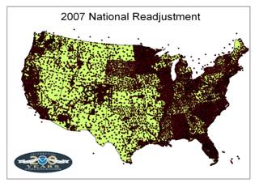

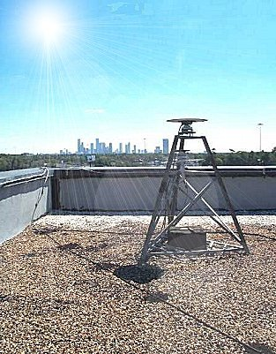
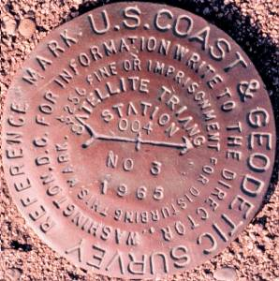
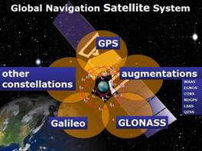
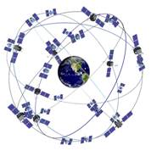
The NSRS has evolved
1 Million Monuments
(Separate Horizontal and Vertical Systems)
70,000
Passive Marks
(3-Dimensional)
→
Passive Marks
(Limited Knowledge of Stability)
≈ 2,000 GPS CORS
(Time Dependent System Possible;
4-Dimensional)
→
GPS CORS → GNSS CORS

Slide 11
ITRF2008
For the geodesy, geophysics and surveying communities, the best International Terrestrial Reference Frame is the “gold standard.”
The global community recently adopted an updated expression for the reference frame, the ITRF2008.
11

Slide 12
Simplified Concept of NAD 83 vs. ITRF08
h₈₃
h₀₈
Earth’s
Surface
ITRF 08
Origin
2.2 meters
NAD 83
Identically shaped ellipsoids (GRS-80)
a = 6,378,137.000 meters (semi-major axis)
1/f = 298.25722210088 (flattening)
Origin
Notes:
ITRF (International Terrestrial Reference Frame) just has an origin; take NAD83 shaped ellipsoid centered at the ITRF origin to derive ITRF97 ellipsoid heights.
Ellipsoid heights NAD83 vs. ITRF97 - Defined origins are best estimate of the center of mass; NAD83 is not geocentric. Move origin; move ellipsoid surface as illustrated.
Ellipsoid height differences reflect the non-geocentricity of NAD83.

Slide 13
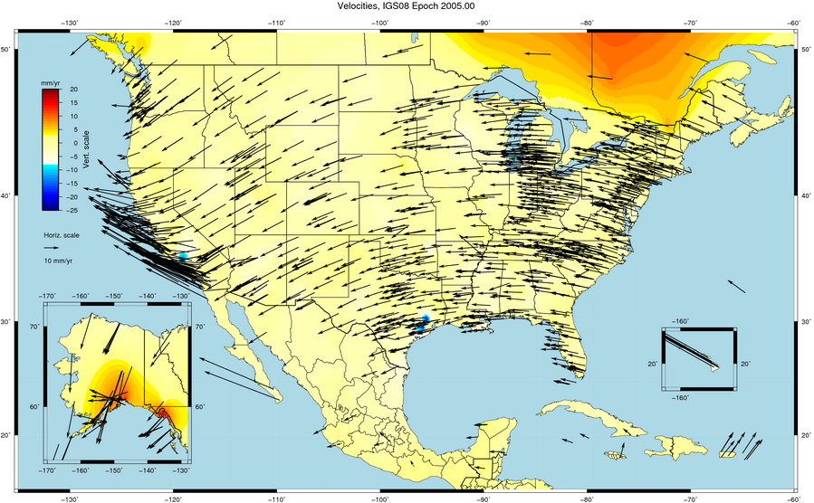

Slide 14
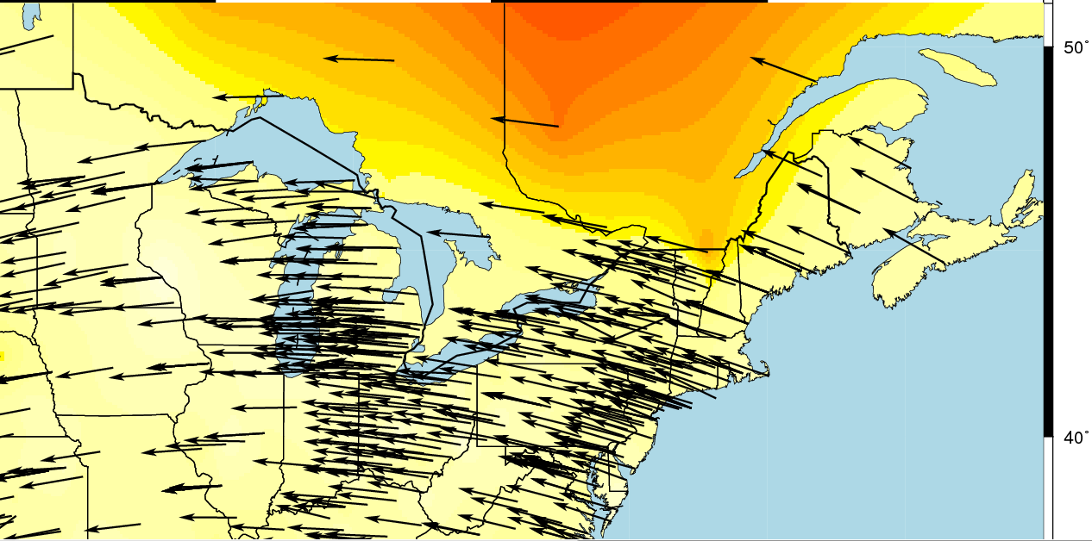
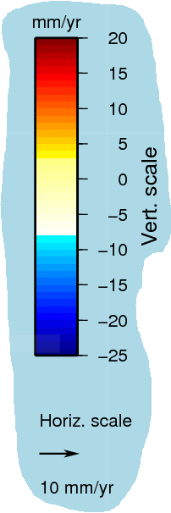

Slide 15
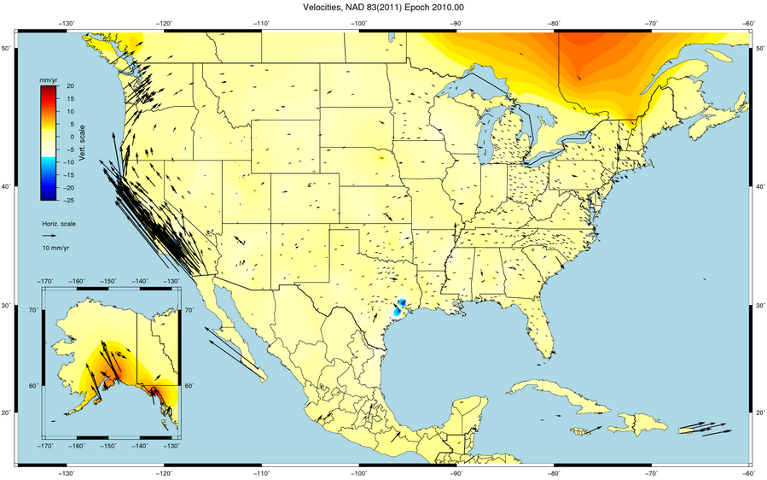

Slide 16
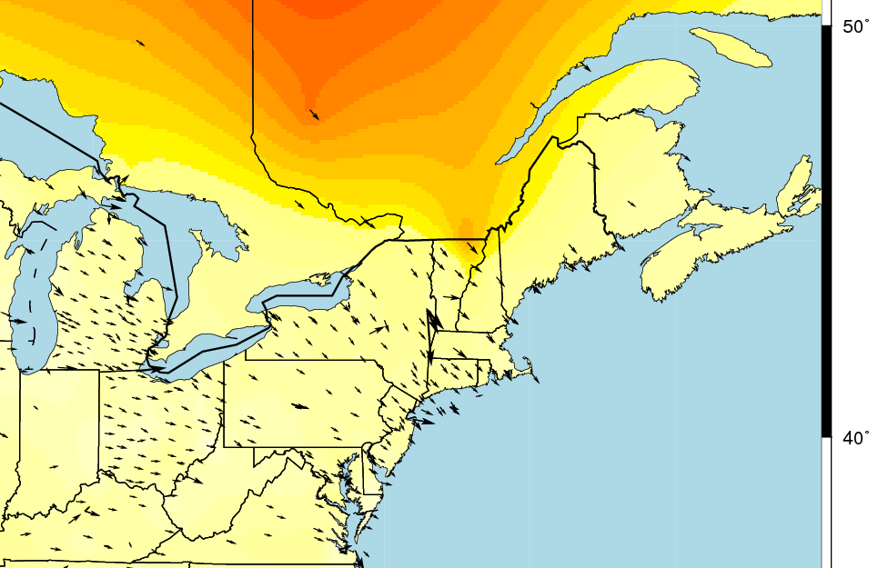
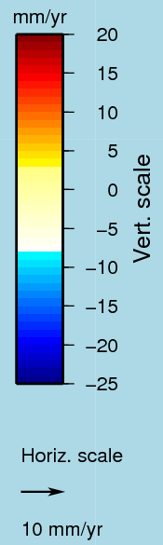

Slide 17

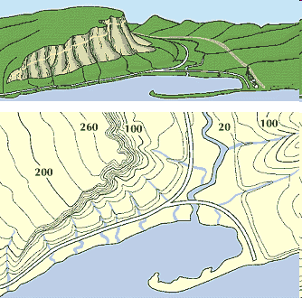
What is a Vertical Datum?
Strictly speaking, a vertical datum is a surface representing zero elevation
Traditionally, a vertical datum is a system for the determination of heights above a zero elevation surface
Vertical datum comprised of:
  Its definition: Parameters and other descriptors
  Its realization: Its physical method of accessibility
"topographic map." Online Art.
Britannica Student Encyclopædia.
17 Dec. 2008
<http://student.britannica.com/ebi/art-53199>

Slide 18
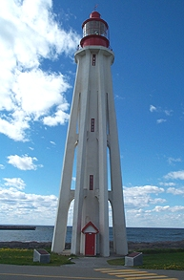
Current Vertical Datum in the USA
NAVD 88: North American Vertical Datum of 1988
Definition: The surface of equal gravity potential to which orthometric heights shall refer in North America*, and which is 6.271 meters (along the plumb line) below the geodetic mark at “Father Point/Rimouski” (NGSIDB PID TY5255).
Realization: Over 500,000 geodetic marks across North America with published Helmert orthometric heights, most of which were originally computed from a minimally constrained adjustment of leveling and gravity data, holding the geopotential value at “Father Point/Rimouski” fixed.
Father Point Lighthouse, Quebec
*Not adopted in Canada
Notes:
By fixing the geopotential value at the origin point, it was possible to ensure that the origins of IGLD 85 and NAVD 88 aligned.
*It should be pointed out that while the datum was defined in such a way as to be usable on the North American continent, it was never actually adopted in Canada. It can be used there, but it’s not their official civilian datum.
Note that the designation of the vertical control point at Father Point is “1250 G=NAVD 88 DATUM POINT” for PID# TY5255 and is not available from the publicly accessible NGSIDB.

Slide 19
History of vertical datums in the USA
NAVD 88
  North American Vertical Datum of 1988
  One height held fixed at “Father Point” (Rimouski, Canada)
  …height chosen was to minimize 1929/1988 differences on USGS topo maps in the eastern U.S.
  Thus, the “zero height surface” of NAVD 88 wasn’t chosen for its closeness to the geoid (but it was close…few decimeters)

Slide 20
Problems with NAD 83 and NAVD 88
NAD 83 is not as geocentric as it could be (approx. 2 m)
  Geospatial professionals don’t see this - Yet
NAD 83 is not well defined with positional velocities
NAVD 88 is realized by passive control (bench marks) most of which have not been re-leveled in at least 40 years.
NAVD 88 does not account for local vertical velocities (subsidence and uplift)
  Post glacial isostatic readjustment (uplift)
  Subsurface fluid withdrawal (subsidence)
  Sediment loading (subsidence)
  Sea level rise (0.70 ft – 3.00 ft per 100 years)
    Bar Harbor, ME 2.0 mm/yr (0.007 ft/yr) 1947-2006
    Miami Beach, FL 2.39 mm/yr (0.008 ft/yr) 1931-1981
    Grand Isle, LA – 9.05 mm/yr (0.030 ft/yr) 1947- 2015
    Seattle, WA– 2.0 mm/yr (.007 ft/yr) 1899-2015

Slide 21
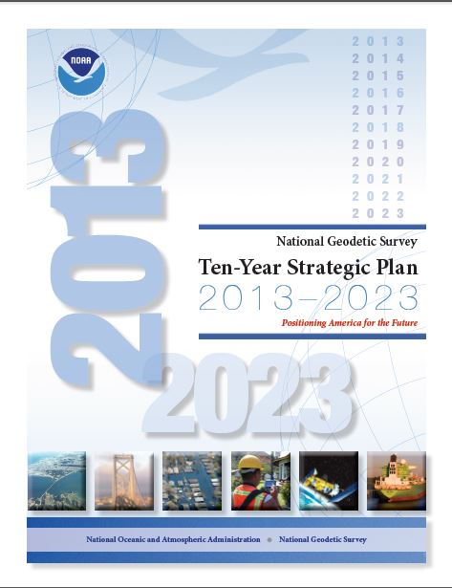
The National Geodetic Survey 10 year plan
Mission, Vision and Strategy
2008 – 2018, 2013-2023
http://www.ngs.noaa.gov/INFO/NGS10yearplan.pdf
Official NGS policy as of Jan 9, 2008
  Modernized agency
  Attention to accuracy
  Attention to time-changes
  Improved products and services
  Integration with other fed missions
2022 Targets:
  NAD 83 and NAVD 88 re-defined
  Cm-accuracy access to all coordinates
  Customer-focused agency
  Global scientific leadership
Notes:
Realization and unification of NAD83 in Canada and the U.S. via the ITRF.
http://www.geod.nrcan.gc.ca > Geodetic Survey Division > Publications > Papers

Slide 22
Terminology
Horizontal Datum
  Geometric Reference Frame
    Geocentric X, Y, Z
    Latitude, Longitude, Ellipsoid Height
Vertical Datum
  Geopotential Reference Frame
    Geoid undulation
    Orthometric height
    Gravity
    Deflection of the Vertical

Slide 23
Future Geometric Reference Frame
CORS-based, via GNSS
coordinates & velocities in ITRF and official US datum
(NAD83 replacement: plate-fixed or “ITRF-like”?) & relationship
replace NAD83 with new geometric reference frame – by 2022
passive control tied to new datum; not a component of new datum
address user needs of datum coordinate constancy vs. accuracy
lat / long / ellipsoid height of defining points accurate to 1 mm, anytime
CORS coordinates computed / published daily; track changes
support development of real-time networks

Slide 24
Future Geopotential Reference Frame
replace NAVD88 with new geopotential reference frame – by 2022
gravimetric geoid-based, in combination with GNSS
monitor time-varying nature of gravity field
develop transformation tools to relate to NAVD88
build most accurate ever continental gravimetric geoid model (GRAV-D)
determine gravity with accuracy of 10 microGals, anytime
support both orthometric and dynamic heights
Height Modernization is fully supported

Slide 25
Why New Reference Frames?
NAD 83
  non-geocentric, i.e. inconsistent with GNSS positioning
  difficult to maintain consistency between CORS & passive network NAD 83 coordinates
  lack of velocities, i.e. NAD 83 does not report station motion for passive marks
NAVD 88
  cross-country build up of errors (“tilt” or “slope”) from geodetic leveling
  passive marks inconveniently located and vulnerable to disturbance and destruction
  0.5 m bias in the NAVD 88 reference surface from the (best) geoid surface approximating global mean sea level
  subsidence, uplift, freeze/thaw, and other crustal motions invalidate heights of passive marks, and can make it difficult to detect such motions
  marks lacking adequate geophysical models - complicate sea level change detection
  changes to Earth’s gravity field cause changes in orthometric heights, but NAVD 88 does not account for those changes (NAVD88 based on a static gravity model)
  gravity model and modeling techniques used to determine NAVD 88 are not consistent with those currently used for geoid modeling

Slide 26
Why isn’t NAVD 88 good
enough anymore…continued
NAVD 88 suffers from use of bench marks that:
  Are almost never re-checked for movement
  Disappear by the thousands every year
  Are not funded for replacement
  Are not necessarily in convenient places
  Don’t exist in most of Alaska
  Weren’t adopted in Canada
  Were determined by leveling from a single point, allowing cross-country error build up
Notes:
Clarification on the word “convenient” – this is used to mean “there isn’t always a bench mark around when you need one – sometimes you have to find one far away and level from it to your site of interest”

Slide 27
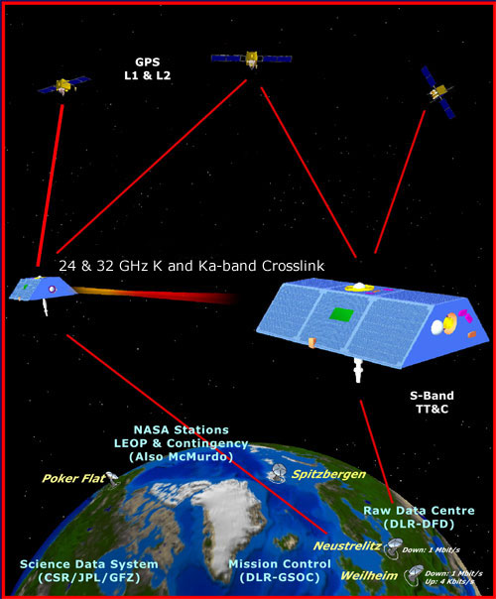
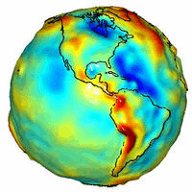
GRACE – Gravity Recovery
and Climate Experiment

Slide 28
Why isn’t NAVD 88 good
enough anymore? STILL continued…
NAVD 88 suffers from:
A zero height surface that:
  Has been proven to be ~50 cm biased from the latest, best geoid models (GRACE satellite)
  Has been proven to be ~ 1 meter tilted across CONUS (again, based on the independently computed geoid from the GRACE satellite)

Slide 29
Why isn’t NAVD 88 good
enough anymore?
Earth’s
Surface
H (NAVD 88)
H
NAVD 88 reference level
The Geoid
Errors in NAVD 88 : ~50 cm average,
100 cm CONUS tilt,
1-2 meters average in Alaska
Notes:
This slide shows what NGS now knows about the error in NAVD 88 itself. Using a continental geoid computed from the GRACE satellite, a bias and tilt in NAVD 88 has been computed using GPS derived ellipsoid heights on NAVD 88 bench marks. These are now known errors that exist in all NAVD 88 bench marks. This datum realization error, relative to the geoid, is over and above the errors from marks moving.

Slide 30
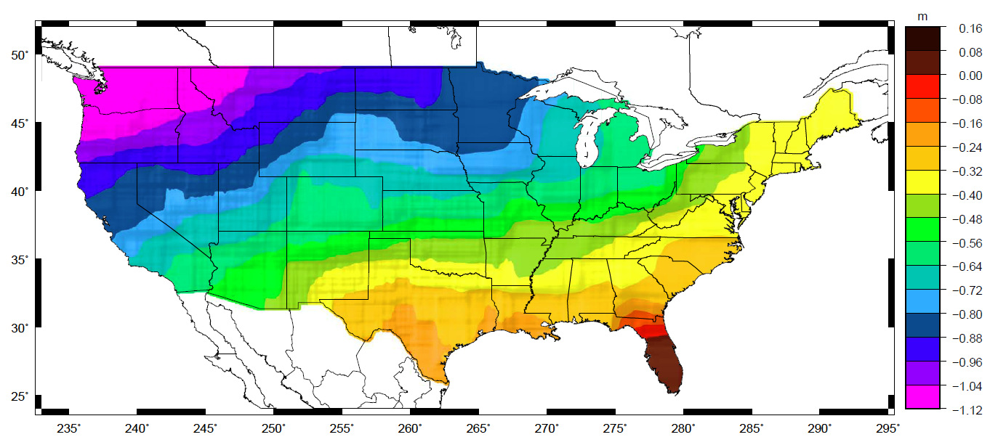
Why isn’t NAVD 88 good
enough anymore?
Approximate level of geoid mismatch known to exist in the NAVD 88 zero surface:
Notes:
This map reflects the sort of height changes that users could expect if NAVD 88 were replaced with a geoid-based vertical datum.
This is only a large scale approximation and should not be used as an absolute guide. Each benchmark might have its own level
Of mismatch, say from uplift or subsidence, not captured by this broad brush.
Also, this is the difference between the zero level of NAVD 88 and the actual geoid. The difference between NAD 83 ellipsoid heights and
ITRF/GRS-80 ellipsoid heights has NO influence on this graph and should not be part of the story.
Updated October 2010

Slide 31
Problems using traditional leveling (to define a National Vertical Datum)
Leveling the country can not be done again
  Too costly in time and money
  Leveling yields cross-country error build-up; problems in the mountains
Leveling requires leaving behind passive marks
  Bulldozers and crustal motion do their worst

Slide 32
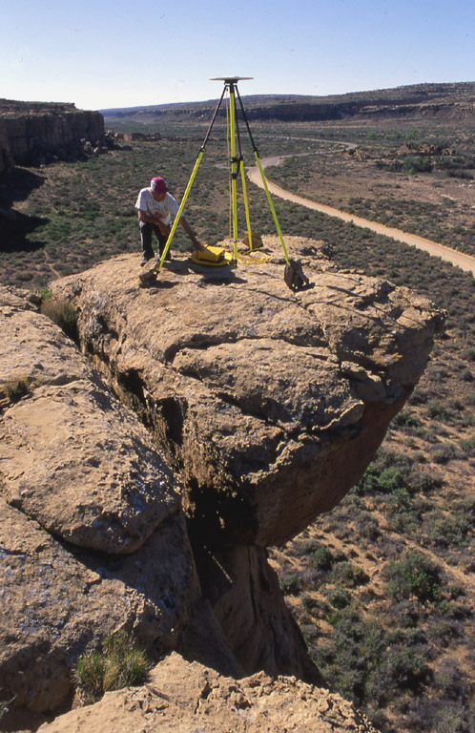
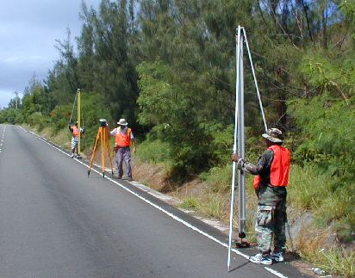
Height Modernization
Height
Modernization
-faster
-cheaper
Differential Leveling
GNSS + …

Slide 33
How Good Can I Do With OPUS Static?
OPUS Static reliably addresses the more historically conventional requirements for GPS data processing. It typically yields accuracies of:
1 – 2 cm horizontally
2 – 4 cm vertically
However, there is no guarantee that this stated accuracy will result from any given data set. Confirming the quality of the OPUS solution remains your responsibility. That’s the “price” for automated processing.
4-7 mm differential ellipsoid height accuracy in GSVS11
New ellipsoid height accuracy estimates will be included in a planned update to HTMOD guidelines for a number of GNSS techniques.

Slide 34
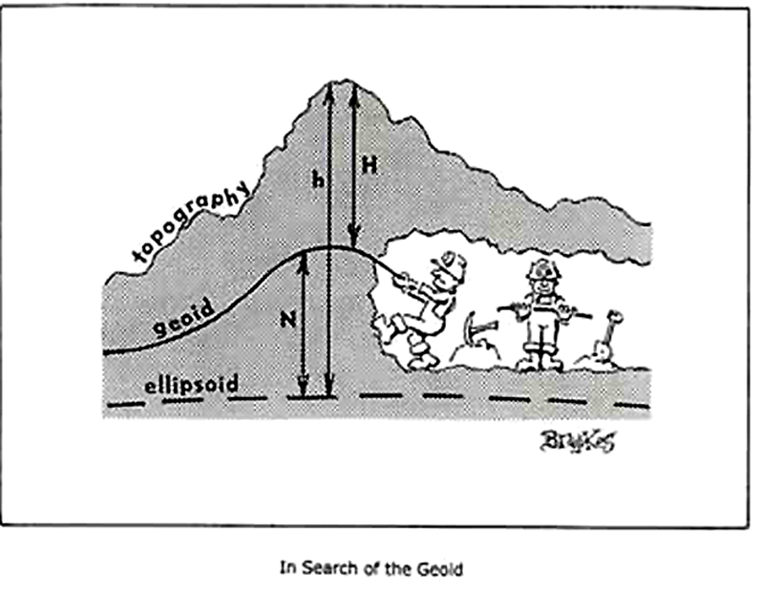

Slide 35
The ellipsoid, the geoid, and you
Deflection of the vertical
You are here
Earth surface
Ellipsoid height, h
Orthometric height, H
Alaska
Mean
sea level
Geoid height, N_{G}
Ellipsoid
Geoid
h ≈ H + N_{G}
h = H + N_{G}
Note: Geoid height is negative everywhere in the coterminous US
(but it is positive in most of Alaska)

Slide 36
Types Uses and History of Geoid Height Models
Gravimetric (or Gravity) Geoid Height Models
  Defined by gravity data crossing the geoid
  Refined by terrain models (DEM’s)
  Scientific and engineering applications
Composite (or Hybrid) Geoid Height Models
  Gravimetric geoid defines most regions
  Warped to fit available GPSBM control data
  Defined by legislated ellipsoid (NAD 83) and local vertical datum (NAVD 88, PRVD02, etc.)
  May be statutory for some surveying & mapping applications

Slide 37
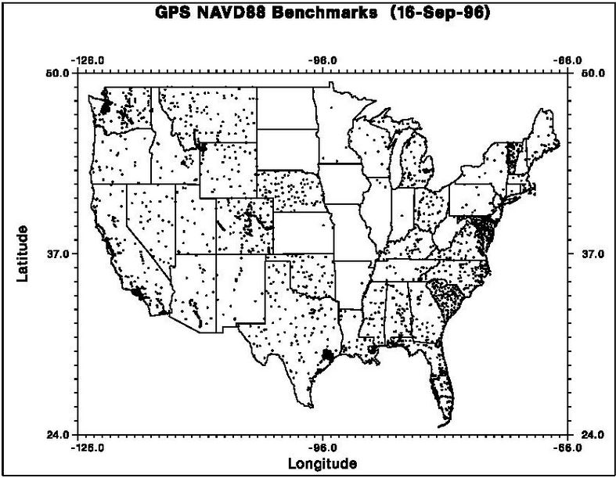
GPSBM1996: 2,951total 0 Canada STDEV ≈ 5 cm (2σ)

Slide 38

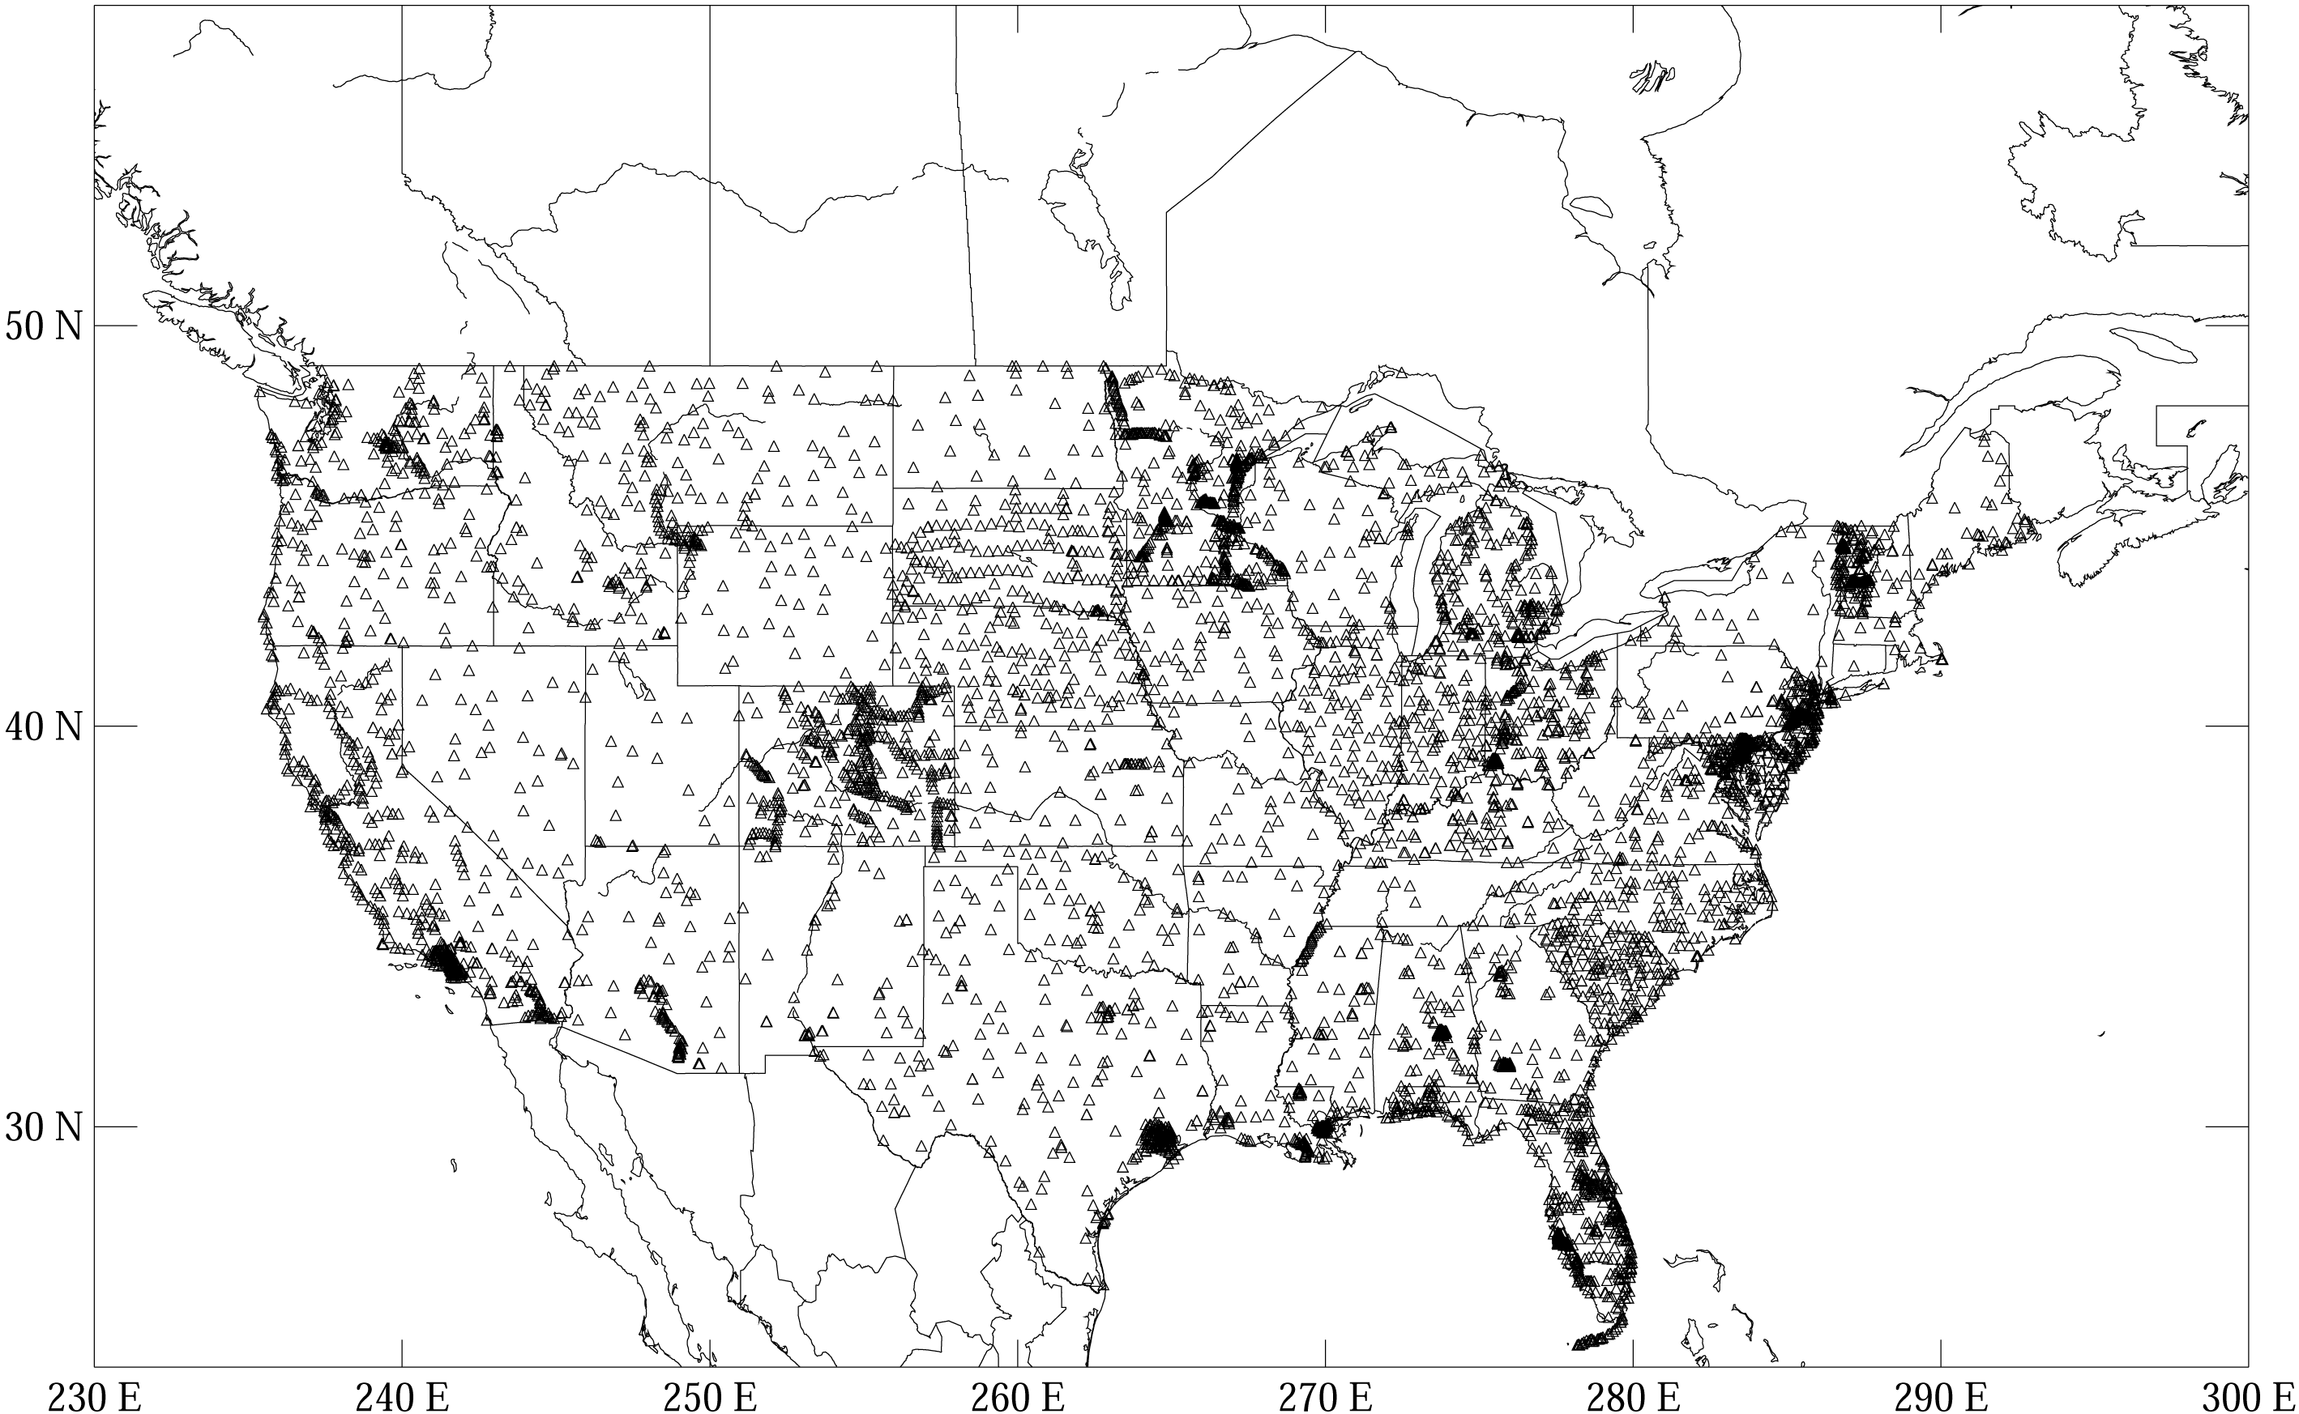
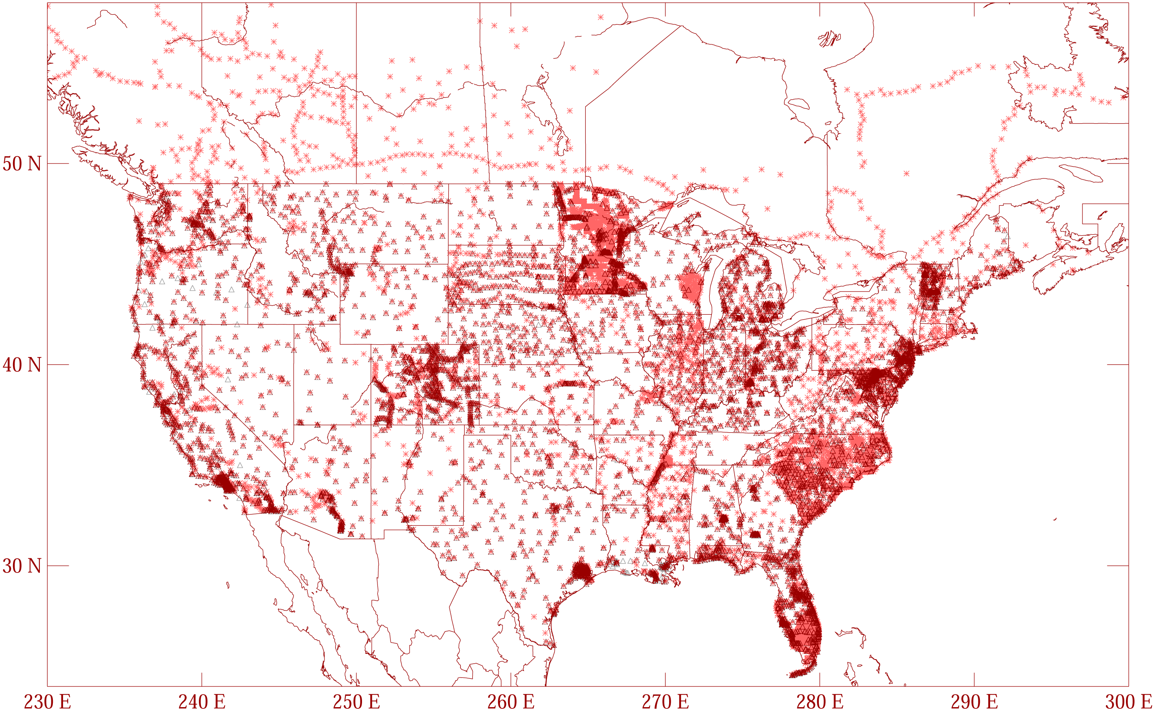
GPSBM1999: 6,169 total 0 Canada STDEV 9.2 cm (2σ)
GPSBM2003: 14,185 total 579 Canada STDEV 4.8 cm (2 σ)
Notes:
These are the control data used to make xGEOID06a, GEOID03 and GEOID99 (GPS on bench marks: GPSBM’s).
Improvements in Distribution are primarily due to obtaining data in Canada.
The bulk of the increase comes in one state: Minnesota (603 => 4161).
Note the inequitable distribution.
You could practically grid the GPSBM’s in South Carolina or Minnesota and get a good result.
Other places are not so fortunate…
Also note that this shows distribution but not quality of the points.
Some regions (e.g., Texas) have systematic quality problems (due to subsidence) that impact the GPSBM’s and the derived hybrid geoids.
Current techniques rely on creating models of the systematic effects at multiple wavelengths. If the spatial density doesn’t support the shorter wavelength models, then the quality of predictions will commensurately be reduced.
Note that a hyper-dense survey isn’t necessary to achieve optimal results. Later discussion on Minnesota will emphasize this.

Slide 39
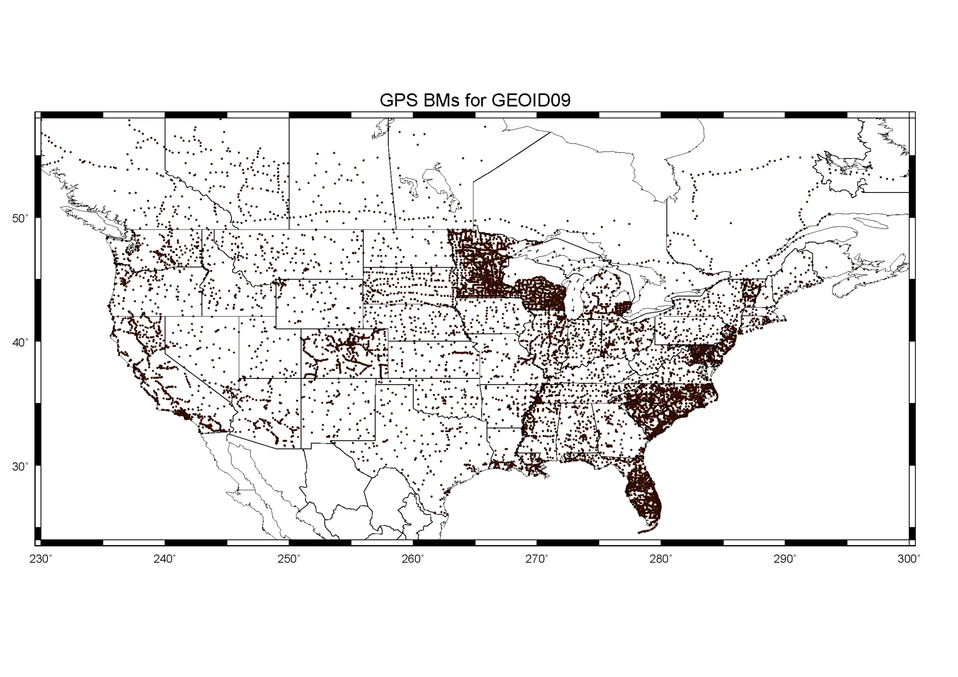
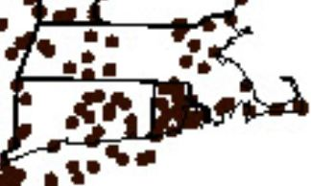
GPSBM2009: 18,398 STDEV 2.8 cm (2σ)

Slide 40
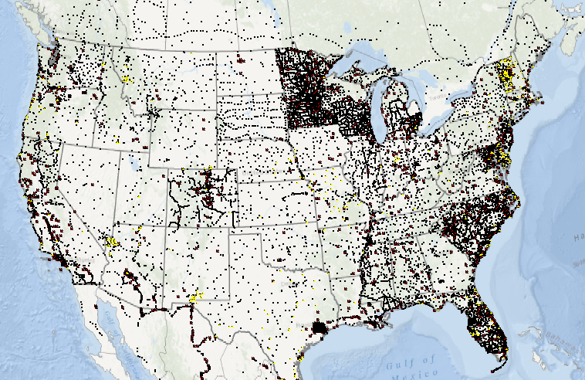
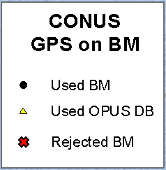
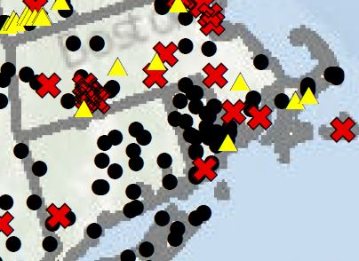
        GGPSBM2012A: 23,961 (CONUS) STDEV 3.4 cm (2σ) 499 (OPUS on BM)
        574 (Canada)
        177 (Mexico)

Slide 41
Which Geoid for Which NAD 83?
NAD 83(2011)
NAD 83(2007)
NAD 83(1996) & CORS96
Geoid12A/12B
Geoid09
Geoid06 (AK only)
Geoid03
Geoid99
Geoid96

Slide 42
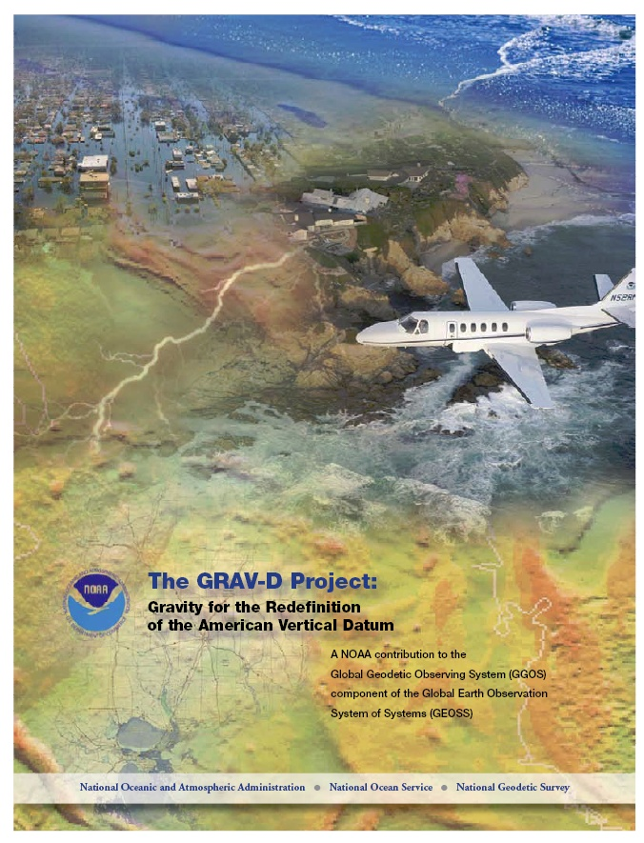
Gravity for the Redefinition of the American Vertical Datum (GRAV-D)
Replace the Vertical Datum of the USA by 2022 (at today’s funding) with a gravimetric geoid accurate to 1 cm
Orthometric heights accessed via GNSS accurate to 2 cm
Three thrusts of project:
  Airborne gravity survey of entire country and its holdings
  Long-term monitoring of geoid change
  Partnership surveys
Working to launch a collaborative effort with the USGS for simultaneous magnetic measurement
Gravity and Heights are
inseparably connected
Notes:
GRAV-D is the NGS project designed to replace NAVD88 with a vertical datum based upon a gravimetric geoid accurate to 1 cm. Heights above this datum will be accessed via GNSS measurements. Three thrusts of project. Launch USGS collaboration for simultaneous mag measurement.

Slide 43
What is GRAV-D?
GRAV-D will mean:
  As the H=0 surface, the geoid will be tracked over time to keep the datum up to date
  The reliance on passive marks will dwindle to:
    Secondary access to the datum
    Minimal NGS involvement
      Maintenance/checking in the hands of users
    Use at your own risk

Slide 44
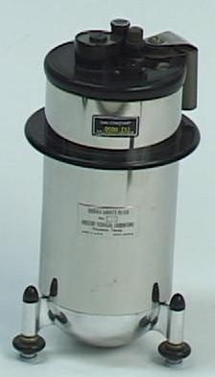
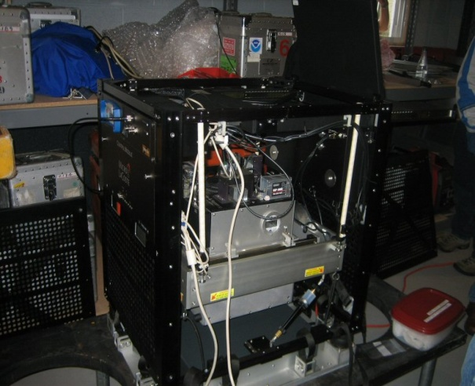
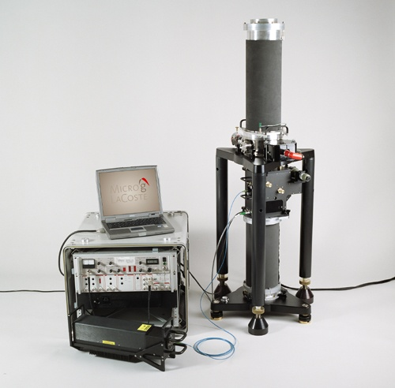
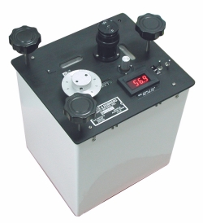
Gravity Survey Plan
National Scale Part 1
  Predominantly through airborne gravity
  With Absolute Gravity for ties and checks
  Relative Gravity for expanding local regions where airborne shows significant mismatch with existing terrestrial

Slide 45
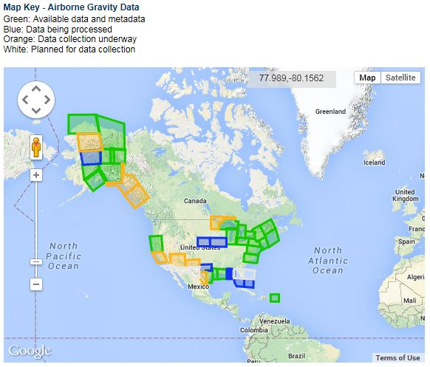
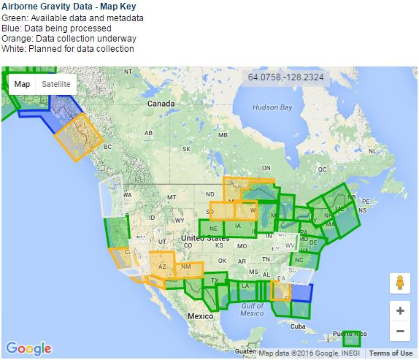
Airborne Gravity Current Coverage
Data Block Status
Complete
Processing
Collecting
Planned
As of July 20, 2016
http://www.ngs.noaa.gov/GRAV-D/data_products.shtml

Slide 46
GPRA* Performance Metric
For Airborne Surveys
FY09 Baseline | Targets vs Actual
 | FY10 | FY11 | FY12 | FY13 | FY14 | FY15 | FY16 | FY17 | FY18 | FY19 | FY20 | FY21 | FY22
6.14% | 7.5% | 12% | 20% | 28% | 36% | 45% | 53% | 60% | 68% | 76% | 84% | 92% | 100% and Implement
6.14 | 7.8 | 14.7 | 23.9 | 31.0 | 38.1 | 45.6 | 53.0
Oct. 2015 through June 2016
Measure: Percentage of the U.S. and its territories with GRAV-D data available
to support a 1 cm geoid supporting 2 cm orthometric heights.
*GPRA = Government Performance and Results Act of 1993
Notes:
We’ve set up a basic GIS GPRA monitoring in the War Room. We will report the coordinates of our survey monthly and they will calculate our percentages.

Slide 47
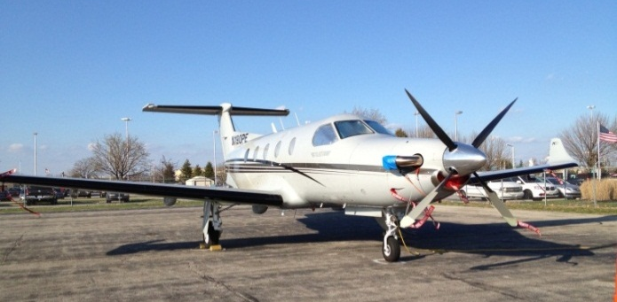

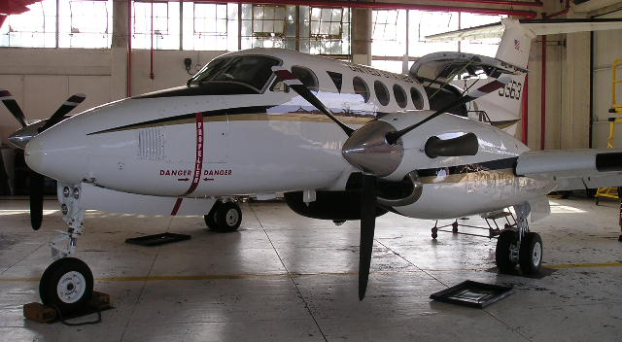

GRAV-D Aircraft
DOI Bureau of Land Management
  Pilatus PC-12
Fugro
  King Air E-90A
Naval Research Lab
  King Air RC-12
NOAA
  Gulfstream Jet Prop
  NOAA P-3 Hurricane Hunter
Pilatus PC-12
King Air E-90A
King Air RC-12
Notes:
GRAV-D surveys have been operating on a number of aircraft. In order to accomplish our objectives within budget, we utilize a “portfolio” of aircraft of both government and contract origin. We’ve used the NOAA Jet Prop and the P-3, although little opportunity exists for further use of these aircraft. We operate about five months/year aboard the BLM Pilatus PC-12 aircraft. This aircraft is used for fire-spotting during warmer weather months in AK and the western US. This year we began working with Fugro to provide us aircraft services. We plan also to work this year with the Naval Research Lab and the VXS-1 Navy Squadron aboard their RC-12 King Air aircraft.

Slide 48
Validating Geoid Accuracy
“...the gravimetric geoid used in defining
the future vertical datum of the United States should have an absolute accuracy of 1 centimeter at any place and at any time.”
-- The NGS 10 year plan (2008-2018)
Admirable!...Achievable?
Notes:
The above quote refers to one of many ambitious goals in the NGS 10 year plan. While admirable, its achievability remains an open question. In order to begin addressing the actual achievable accuracy of a gravimetric geoid model, NGS will engage in a variety of testing methods prior to the 2022 date when the gravimetric geoid will serve as the reference surface for a new vertical datum. The first such testing method took place in the summer of 2011 and is known as the Geoid Slope Validation Survey of 2011, or GSVS11. As its name implies, this survey tested the accuracy of differential geoid undulations between points ("geoid slopes") from NGS's gravimetric geoid models. The baseline for comparison will be independently computed geoid slopes from two methods, GPS and leveling as well as Deflections of the Vertical.

Slide 49
Validating Geoid Accuracy
NGS plans up to 3 surveys to validate the accuracy of the gravimetric geoid model
  GSVS11
    2011; Low/Flat/Simple: Texas; Done; Success!
  GSVS14
    2014; High/Flat/Complicated: Iowa; Field work Complete
  GSVS17
    2017; Very High/Rugged/Very Complicated: Colorado

Slide 50
Goal of the survey
Observe geoid shape (slope) using multiple independent terrestrial survey methods
  GPS + Leveling
  Deflections of the Vertical
Compare observed slopes (from terrestrial surveys) to modeled slopes (from gravimetry or satellites)
  With / Without new GRAV-D airborne gravity
Notes:
Although a geoid slope validation survey won’t validate the absolute accuracy of the geoid model, it will help point out weakness in data and theory. The accuracy of the terrestrial surveys will be best achievable, and formal accuracy estimates will be used to bound allowable disagreements with modeled geoid slopes.

Slide 51


Choosing the Place and Time for a New Survey
Criteria:
  Significantly exceed 100 km
  Under existing GRAV-D data
  Avoid trees and woods
  Along major roads
  Cloud-free nights
  No major bridges along the route
  Low elevations
  Significant geoid slope
  Inexpensive travel costs
Notes:
The reasons for the above are:
>100 km : to allow for direct comparison to GOCE and GRACE
Under GRAV-D : So that geoids with/without airborne gravity can be compared
Avoid woods: Better GPS visibility
Roads: Ease of accessibility
Cloud-Free Nights: For the DoV camera to see the stars
Bridges: To avoid “river crossings” in the geodetic leveling
Low Elevations: So the errors from correcting from surface data to the geoid are minimized
Geoid slope: To have an interesting signal to choose from
Travel costs: To minimize cost of survey

Slide 52
Surveys Performed
GPS: 20 identical units, 10/day leapfrog, 40 hrs ea.
Leveling: 1st order, class II, digital barcode leveling
Gravity: FG-5 and A-10 anchors, 4 L/R in 2 teams
DoV: ETH Zurich DIADEM GPS & camera system
LIDAR: Riegl Q680i-D, 2 pt/m² spacing, 0.5 km width (TX)
Imagery: Applanix 439 RGB DualCam, 5000’ AGL (TX)
Other: RTN, short-session GPS, extra gravity marks around Austin, gravity gradients

Slide 53
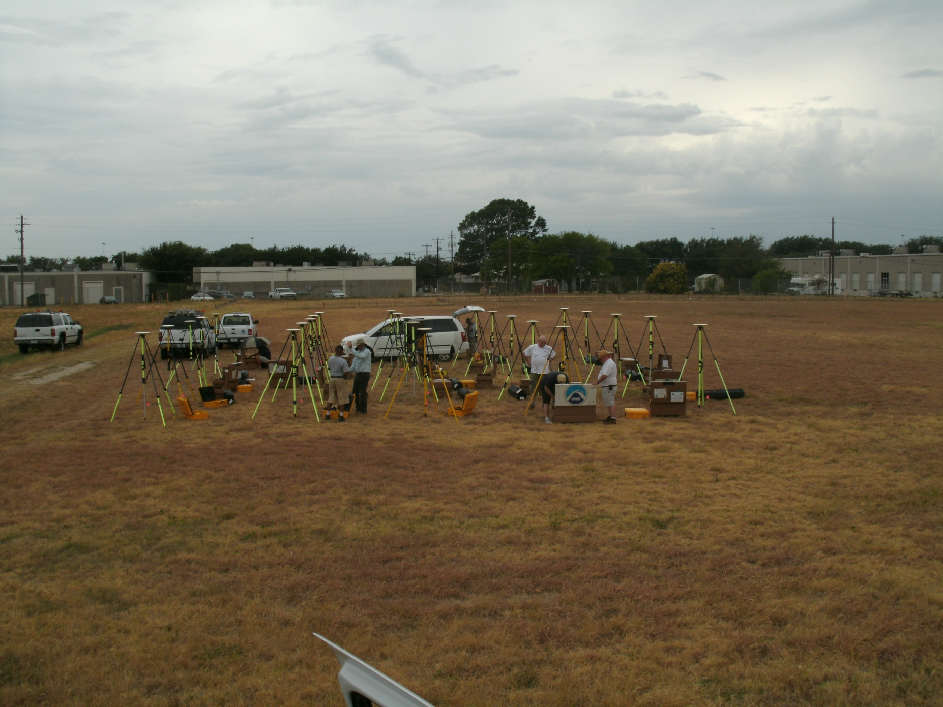
Campaign GPS

Slide 54
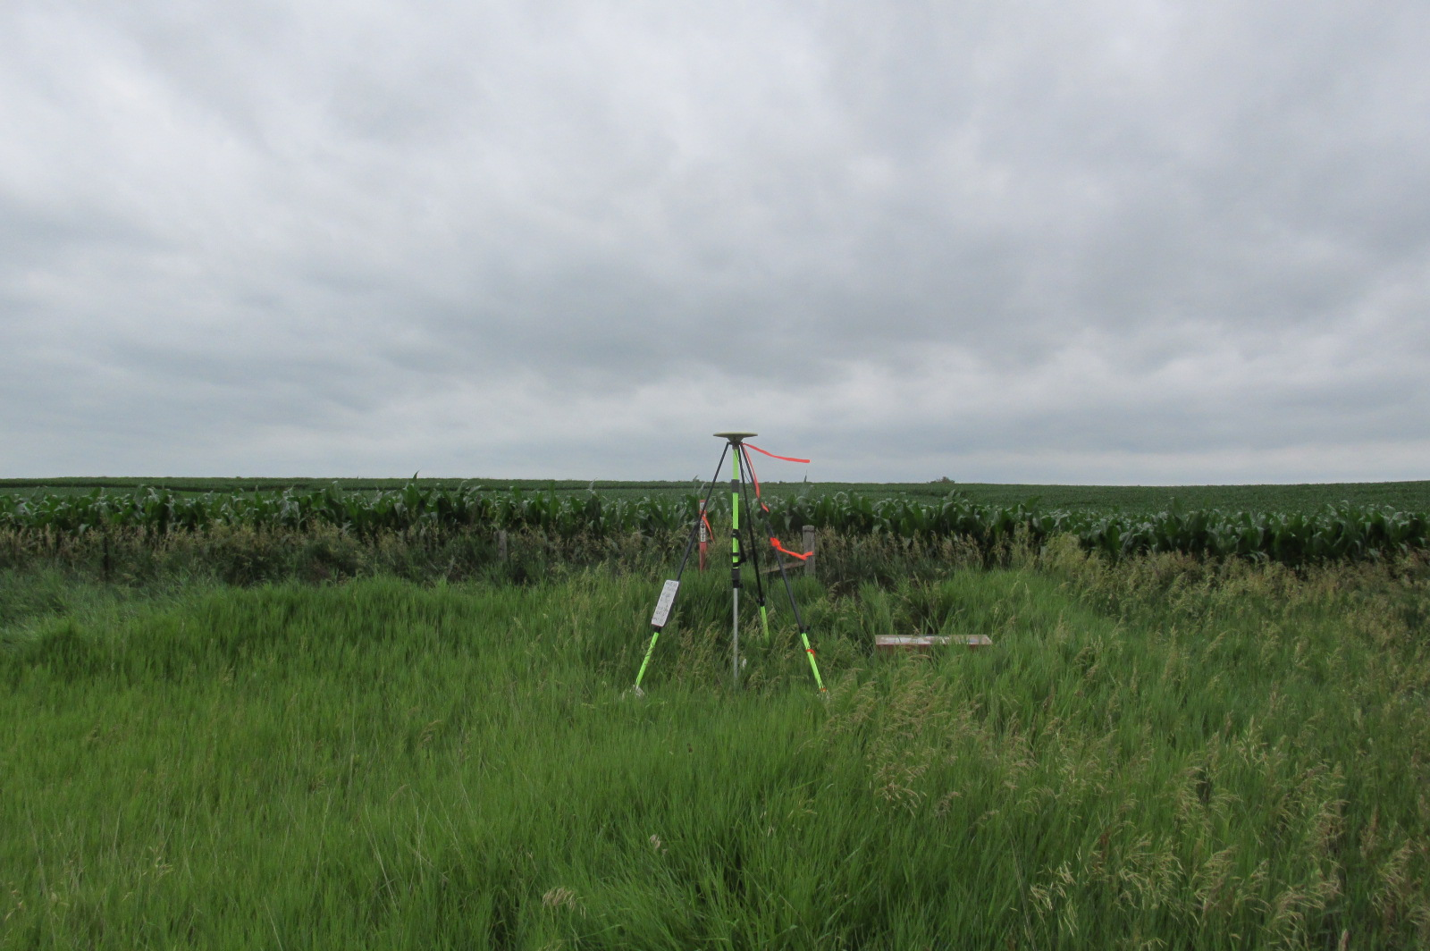
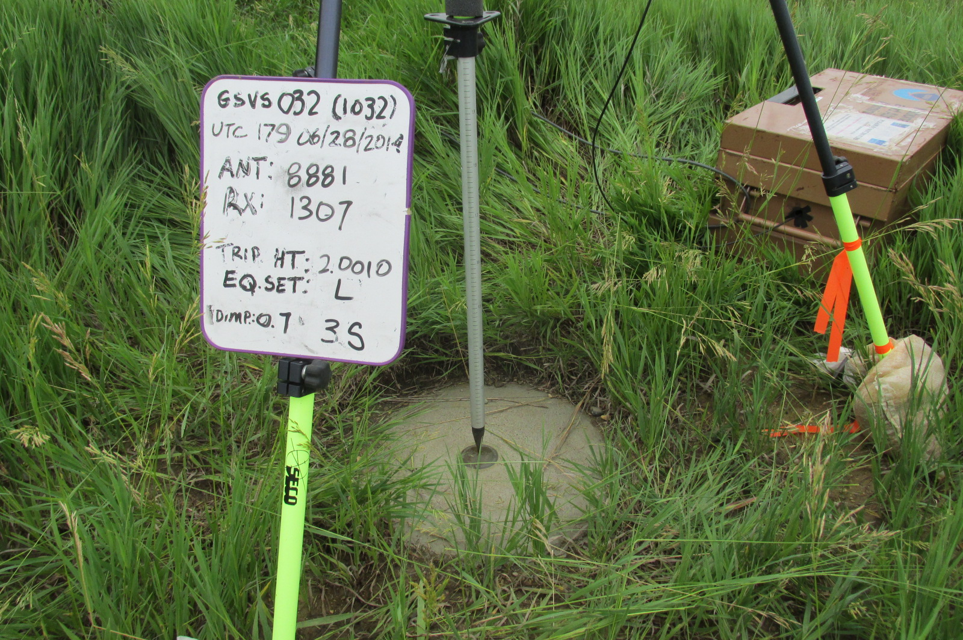
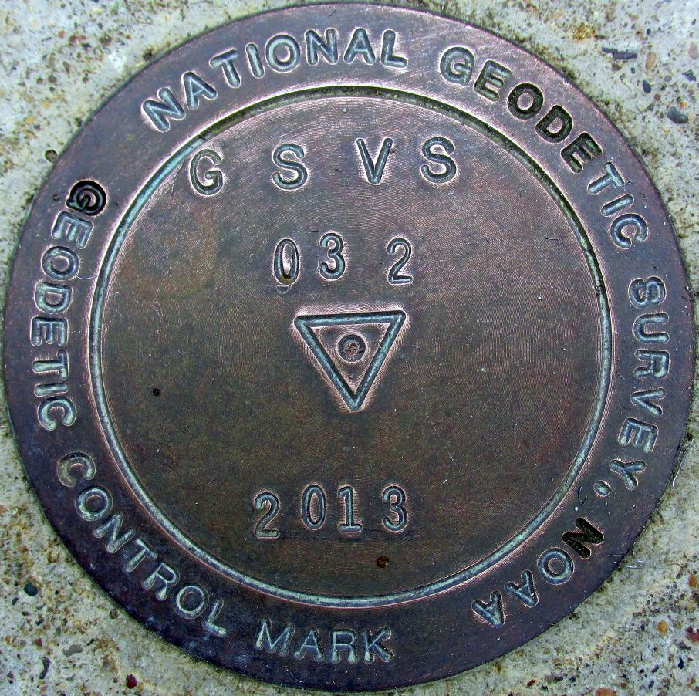
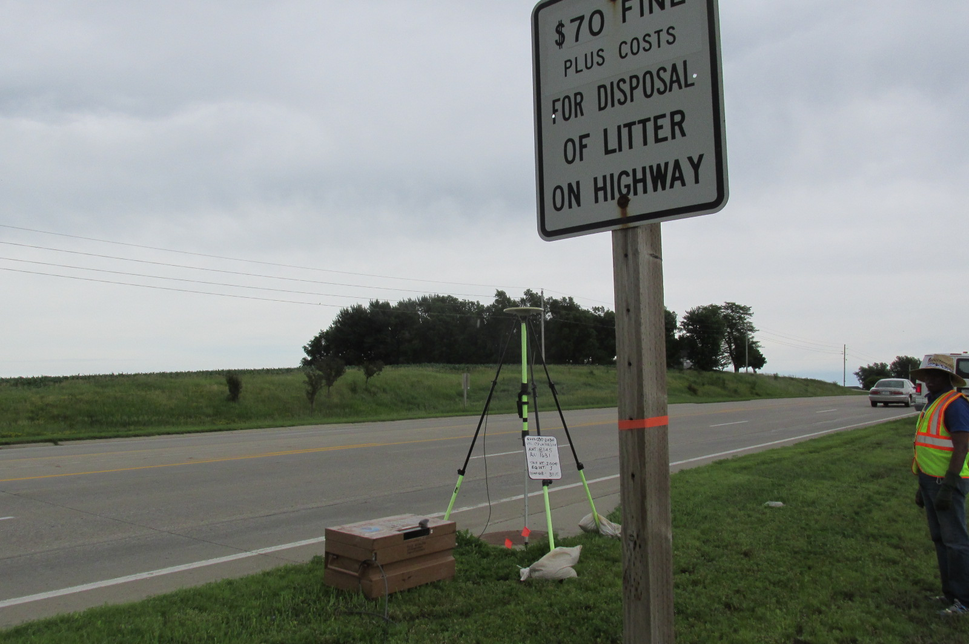

Slide 55
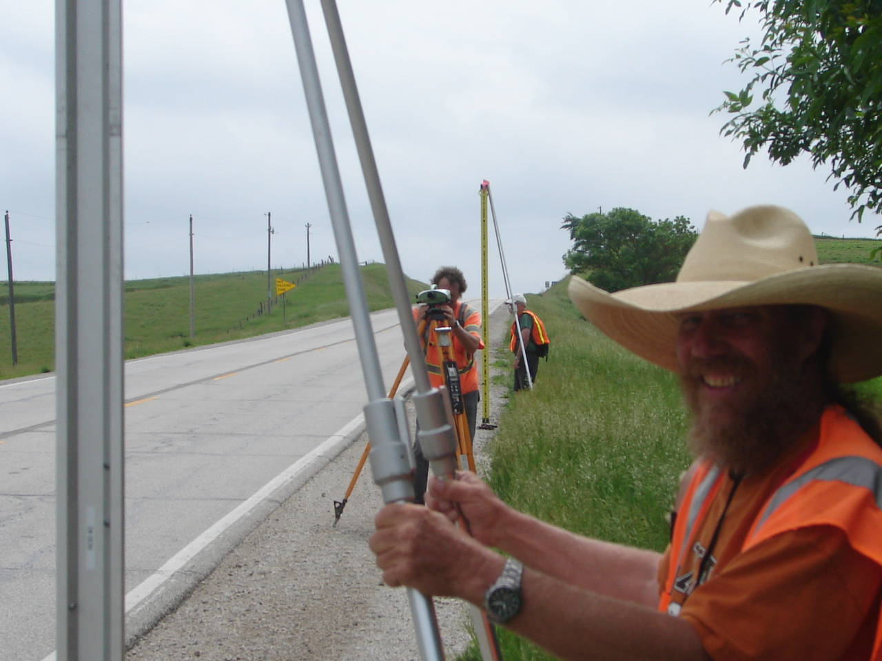
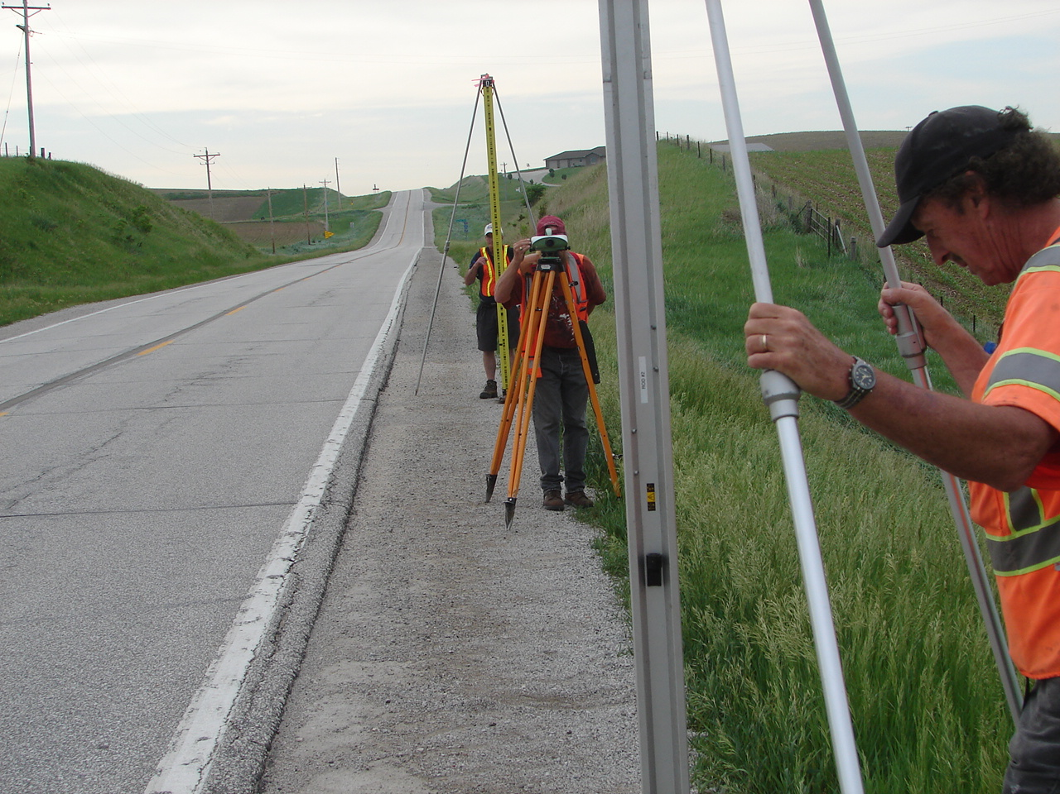
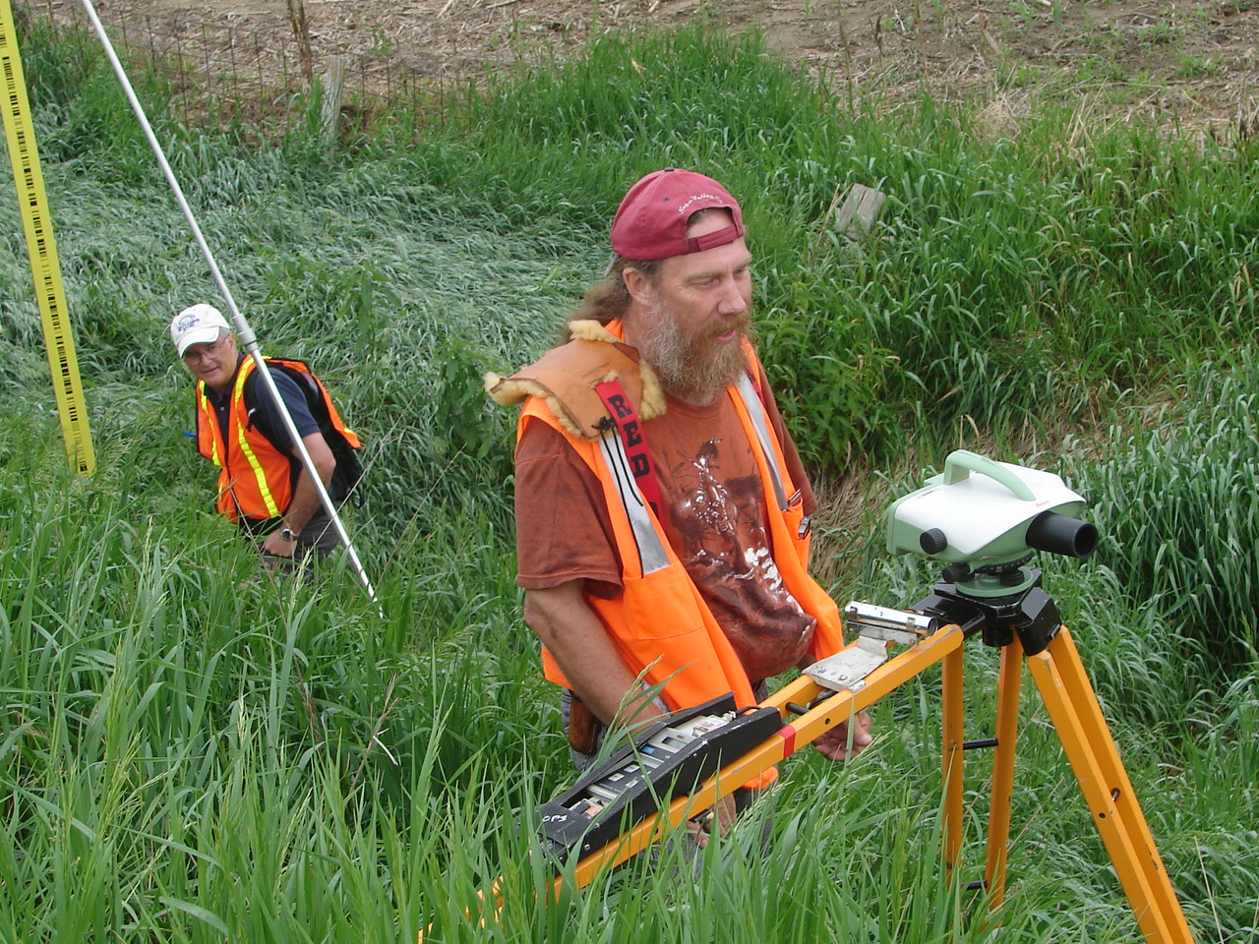
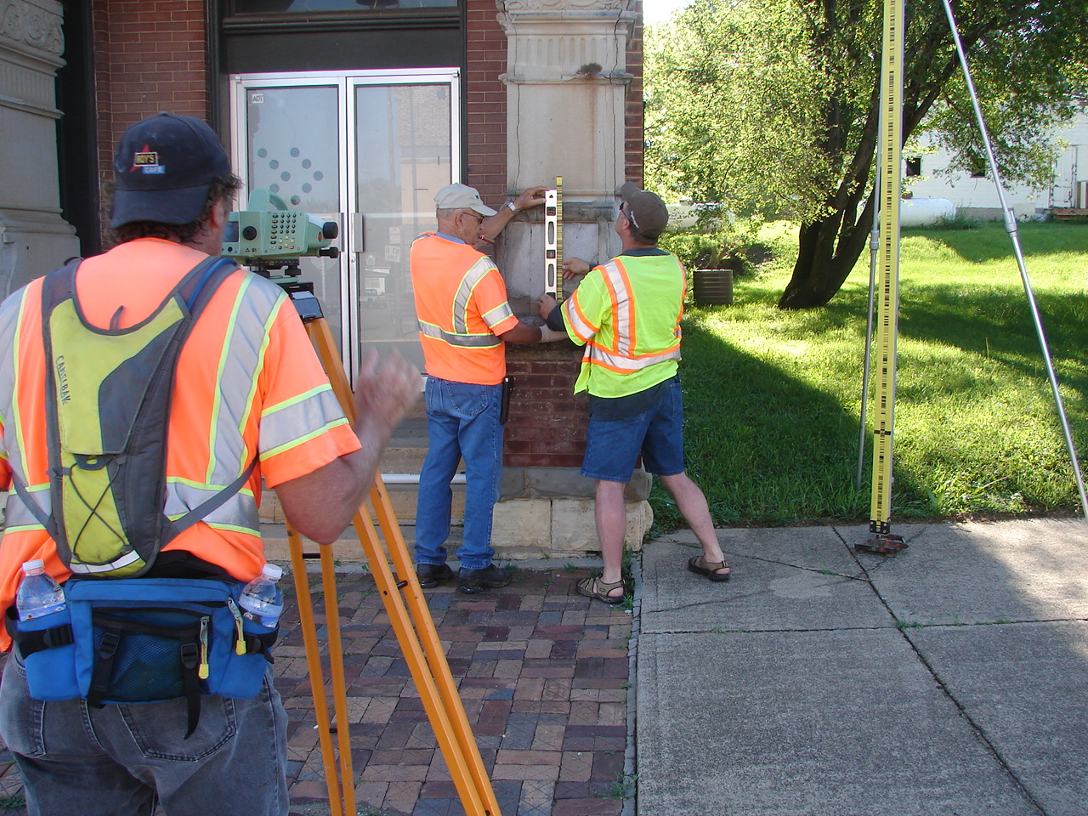
Geodetic Leveling

Slide 56
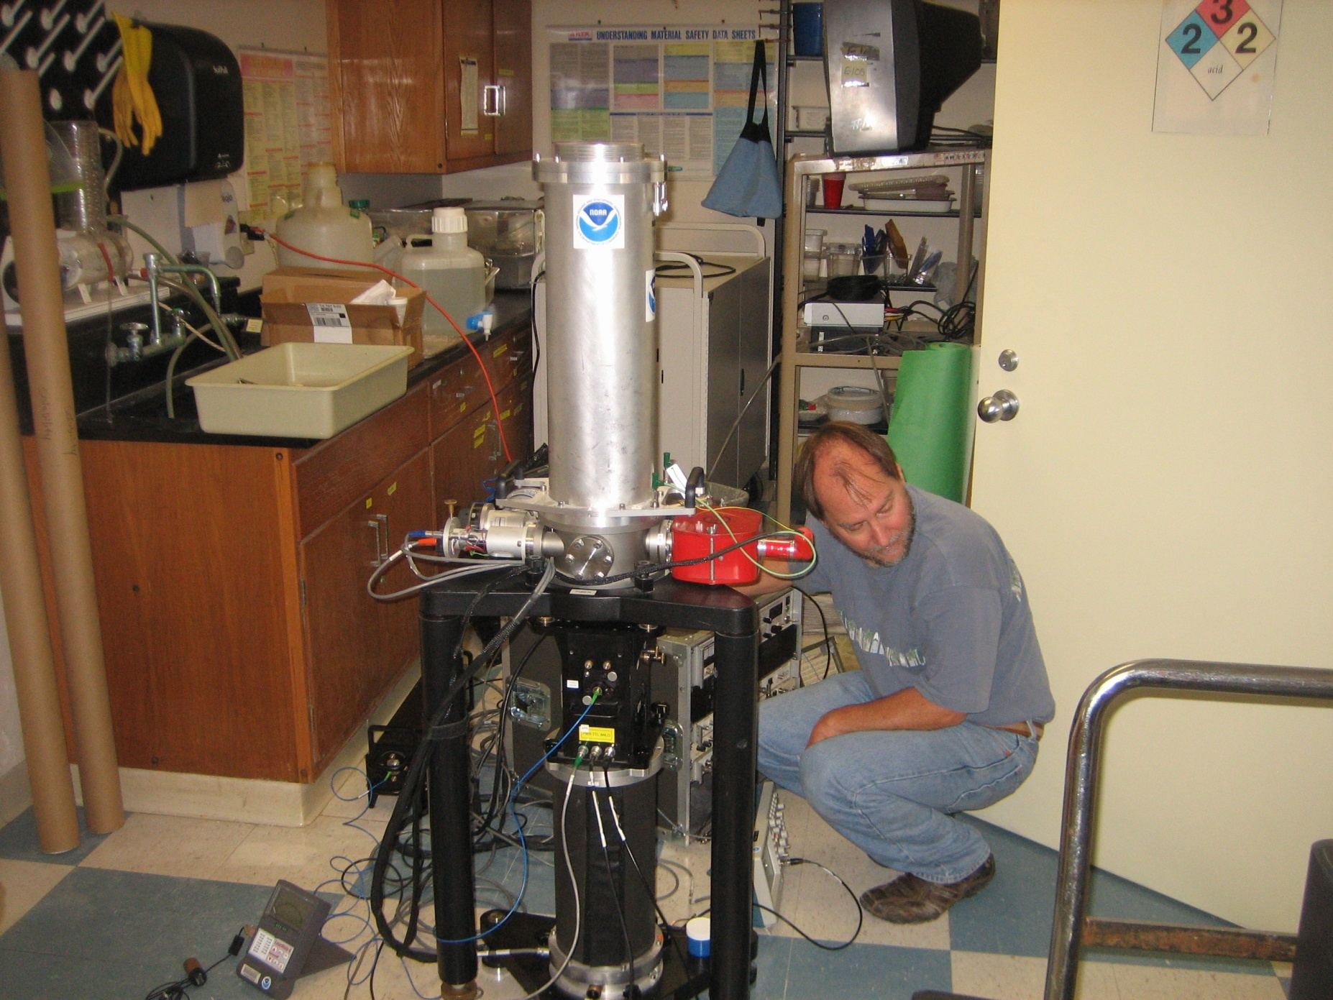
Gravity Observations

Slide 57
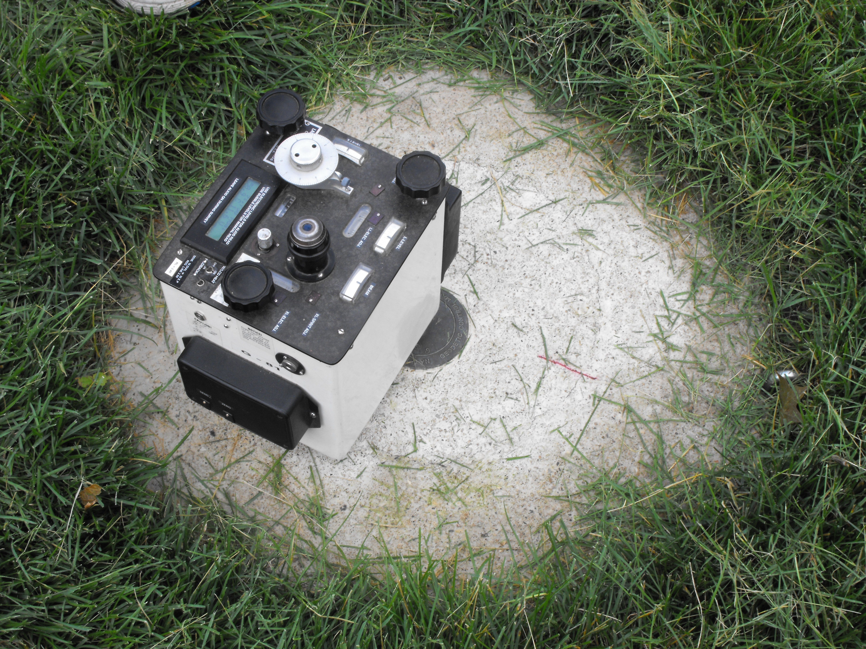

Slide 58
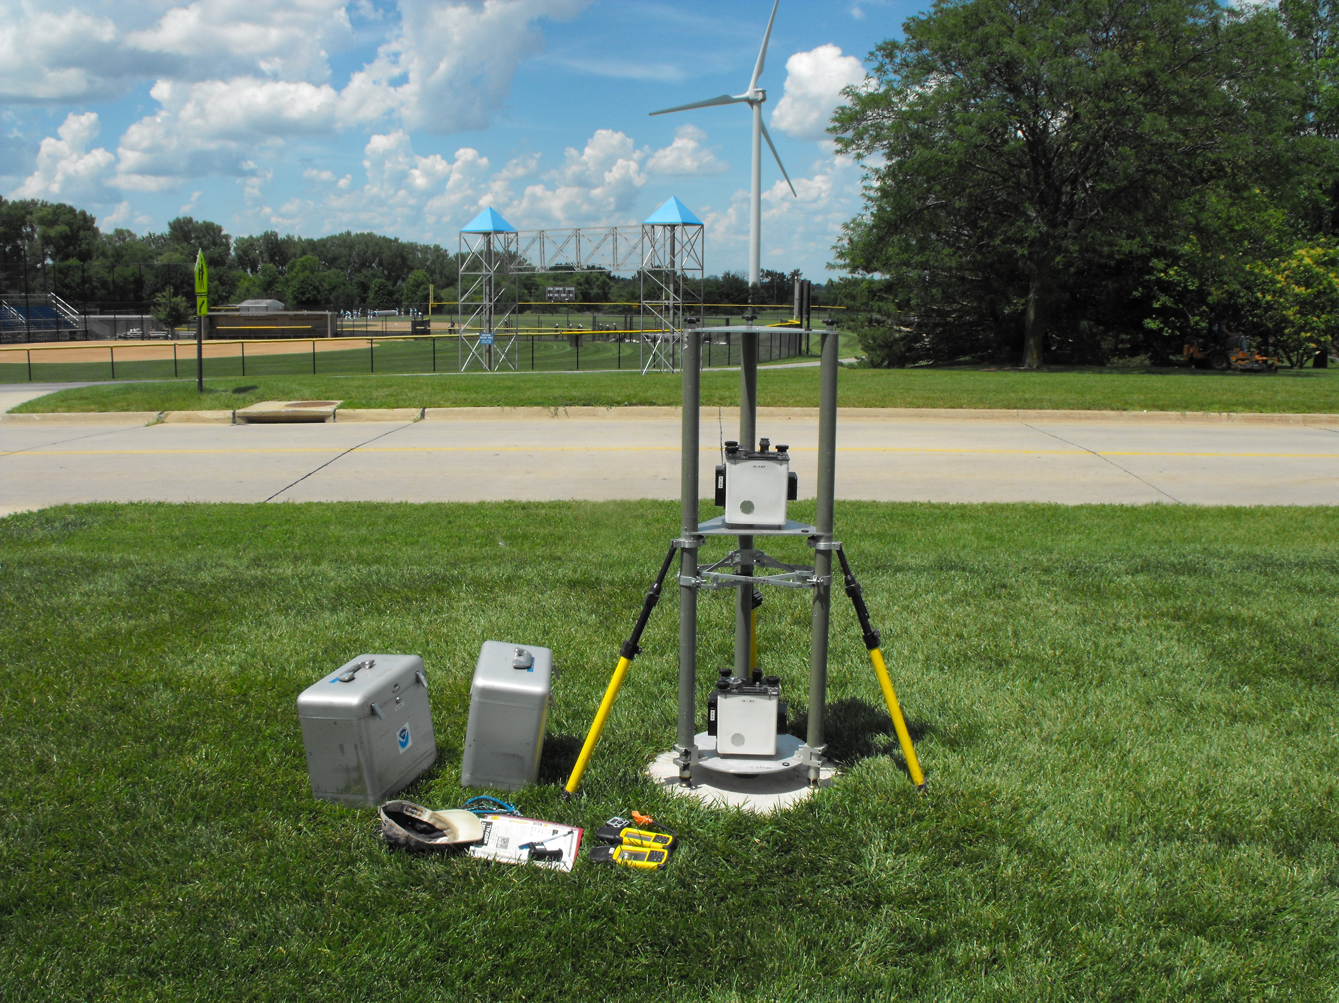

Slide 59

Astrogeodetic Deflecions of the Vertical (DoV)

Slide 60





Slide 61

Geoid Slope Validation Survey
Austin
Observe geoid shape (slope) using multiple independent terrestrial survey methods
  GPS + Leveling
  Deflections of the Vertical
Compare observed slopes (from terrestrial surveys) to modeled slopes (from gravimetry or satellites)
  With / Without new GRAV-D airborne gravity
325 km
218 points
1.5 km apart
Rockport
Notes:
But will this method produce a sufficiently accurate geoid?
This summer, we conducted an experiment to determine the accuracy of our geoid. We selected a line that extended 325 km from downtown Austin, Texas (North end) to Rockport, Texas (South end). There were 218 official survey points along the line, with an average spacing of 1.5 km between them. We compared the slope of the geoid along the line determined with GPS + leveling with deflections of the vertical as measured by the ETH Zurich DIADEM zenith camera. We also compared the observed geoid slope with slopes calculated from various geoid models to evaluate the their quality. As for NGS models, we tested geoids that both included and didn’t include new GRAV-D airborne gravity.

Slide 62

Geoid Slope Survey Conclusions
Including airborne gravity data improves geoid slope accuracy at nearly all distances <325 km
The NGS geoid in the TX survey meets the 1 cm accuracy objective only if airborne data are included
  No other model achieved 1 cm accuracy
Gravimetric geoid models and GPS are a viable alternative to long-line leveling
Notes:
The Survey verified that the inclusion of the GRAV-D airborne survey improved the geoid slope accuracies at all distances measured by the survey.

Slide 63

GSVS14 Line
Goal: Same as GSVS11
Region: Moderate terrain
More complex gravity
Data: Same as GSVS11
Timeline: Fiscal year 2014 field season
IA (Cedar Rapids to Denison)

Slide 64

The Chosen Line for 2017
30 July 2015
NGS-CDOT R5

Slide 65
Two Phases
Recon and Mark Setting
  August – November 2015 and July-August 2016
  Two person crew
Field Observations
  May – September 2017
  Single Team-Lead for each activity
    GPS, 1st Order Leveling, Absolute and Relative Gravity measurements, Deflection of Vertical
30 July 2015
NGS-CDOT R5

Slide 66

Accessing the New Vertical Datum
Primary access (NGS mission)
  Users with geodetic quality GNSS receivers will continue to use OPUS suite of tools
  Ellipsoid heights computed, and then a gravimetric geoid removed to provide orthometric heights in the new datum
  No passive marks needed
  But, could be used to position a passive mark
Secondary access (Use at own risk)
  Passive marks that have been tied to the new vertical datum
  NGS will provide a “data sharing” service for these points, but their accuracy (due to either the quality of the survey or the age of the data) will not be a responsibility of NGS
Continuously Operating Reference Station
Notes:
Multiple questions come up about using the new vertical datum. Two examples are given in the next few slides. The first is the example of how the new datum will address subsidence, say for floodplain mapping. The second example is about how the datum will be accessible when there aren’t bench marks in the immediate region of interest. Both examples rely on this simple formula:
Get an ellipsoid height (h) from GNSS in the latest geometric datum (the replacement for NAD 83)
Remove Subtract the NGS provided geoid model height (N)
The orthometric height in the new datum (H) is just H=h-N
NGS will eventually stop making the claim that we “know” the heights of bench marks as the method of providing access to the vertical datum. What NGS will do is provide the orthometric height to a user on the day of their survey (and with the disclaimer that this height should not be taken as “known” for very long, due to the dynamic nature of the Earth).

Slide 67
Accessing the New Vertical Datum
NAVD 88 conversion to new reference frame
  A conversion will be provided between NAVD 88 and the new datum
    Only where recent GNSS ellipsoid heights exist to provide modern heights in the new datum
Notes:
In areas where a brand new (relatively speaking) GNSS based ellipsoid height has been determined at an NAVD 88 bench mark, that data will allow for NGS to convert to the new datum.
The more of these points that can be determined right near the time of the new datum’s release, the better will be the conversion.

Slide 68


Slide 69
Predicted Positional Changes in 2022
Vicinity of Montpelier, VT.
(Computed for station MAY, pid AA9705)PG2656
HORIZONTAL = 1.25 m (4.1 ft)
ELLIPSOID HEIGHT = - 1.15 m (- 3.8 ft)
Predicted with HTDP
ORTHOMETRIC HEIGHT = - 0.37 m (- 1.2 ft)
Predicted with HTDP and xGEOID15B
HTDP
“Coping with Tectonic Motion”
R. Snay & C. Pearson
American Surveyor Magazine, December 2010
www.Ameriserv.com
Notes:
ACURRACY BUT NOT CONSISTENCY!!
To summarize: This slide shows how far we’ve come since 1986, really since 1927.
Unfortunately, --- Next slide ----

Slide 70


Additional Information
The NGS 10 year plan (2013-2023)
http://www.geodesy.noaa.gov/INFO/NGS10yearplan.pdf
The GRAV-D Project
http://www.geodesy.noaa.gov/GRAV-D
Socio-Economic Benefits of CORS and GRAV-D
http://www.geodesy.noaa.gov/PUBS_LIB/Socio-EconomicBenefitsofCORSandGRAV-D.pdf
Last Updated 02 Jan 2015 (DJM)
70

Slide 71

Predicted Positional Changes in 2022
Vicinity of Flatwoods, WV
(Computed for station L 278, pid HX1559)
HORIZONTAL = 1.15 m (3.8 ft)
ELLIPSOID HEIGHT = - 1.26 m (- 4.2ft)
Predicted with HTDP
ORTHOMETRIC HEIGHT = - 0.54 m (- 1.8 ft)
Predicted with HTDP and USGG2012
HTDP
“Coping with Tectonic Motion”
R. Snay & C. Pearson
American Surveyor Magazine, December 2010
www.Ameriserv.com
Notes:
ACURRACY BUT NOT CONSISTENCY!!
To summarize: This slide shows how far we’ve come since 1986, really since 1927.
Unfortunately, --- Next slide ----

Slide 72
State Plane Coordinates
Barring user-requested changes, NGS may use existing SPC projections, boundaries and equations, but with new false northings & eastings (to distinguish from NAD 27 and NAD 83)
User-provided plug-ins (pre-written code) for SPC or other projections may be possible

Slide 73
GOOD COORDINATION BEGINS WITH
GOOD COORDINATES
GEOGRAPHY WITHOUT GEODESY IS A FELONY

