Slide 1

Getting Ready for the Modernized
National Spatial Reference System (NSRS)
NOS Data Governance Board (DGB) Seminars, May 28, 2025, @ 11 a.m. (EST)
Daniel Roman
Dan.Roman@noaa.gov
Dana Caccamise
Dana.Caccamise@noaa.gov
NSRS2022 Datum Pre-Planning Brief
May 28, 2025
Notes:
Thank you for inviting me to present at your NOS Data Governance Board (DGB) Seminars.
Getting Ready for the Modernized National Spatial Reference System (NSRS)
We at NGS appreciate the opportunity to speak with you GeoSpatial leaders about the National Spatial Reference System and present our plans to modernize it, as well as how it'll affect you in the future.
So, the first question you might have is, what is the National Spatial reference system?

Slide 2
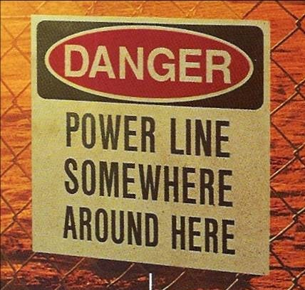
What is the National Spatial Reference System (NSRS)?
…and why should you care?
A set of consistent nationwide coordinate systems
Created in 1807 to support commerce and science
Defined and maintained by NOAA’s National Geodetic Survey
Geodesy:
the science of where things are
Notes:
The most concise description is that it is a consistent set of nationwide coordinate systems used for mapping and surveying in the U.S.
And it’s not new. It was created in 1807 by Thomas Jefferson to support commerce and science for the young United States.
Today, the NSRS is defined and maintained by NOAA’s National Geodetic Survey. We're that agency with that funny word in its name, “geodetic.” It’s derived from the word “geodesy,” the mathematical science that provides the basis for surveying, mapping, and navigation.
Well that's all very fascinating, but why should you care about the NSRS? Because geodesy is itself such an interesting and cool field?
No, not really. I think the real reason people care is this. They want to know where things are, not just an absolute sense, but where they are with respect to something else. We need that information, we always have, and we always will. In that sense maybe the best way to define geodesy is as “the science of where things are.”

Slide 3
What is the National Spatial Reference System (NSRS)?
…and why should you care?
Basis for positioning in the United States
  Where things are
  How high they are
  How far apart they are
  Direction between things
  Their accuracy
  …and how these things change with time
The need has existed since founding of NGS in 1807
…and that need has never been greater than it is today
NSRS defines where
“ ZERO” is and how to measure from zero
Notes:
Simply put, the NSRS is the basis for positioning for the civilians in the United States. It's about where things are, how high they are, how far apart they are, the direction between things and their spatial accuracy. And nowadays that includes how these things change with time.
There are a lot of ways to describe the NSRS, and different ways work for different people. One way that I hope helps is to say that the NSRS essentially defines where zero is. That is, zero for its coordinate systems (their origins), and how to measure from zero to find out where things are.
This need has existed ever since the founding of NGS in 1807. But with the huge proliferation of geospatial products and data, and the vital importance of accurate locations in modern society, that need has never been greater than it is today.

Slide 4
The NSRS is being “Modernized”
ALL NSRS coordinates will change
Modernized NSRS will be more accurate, efficient, and accessible
How do our customers and partners prepare?
  Evaluate geospatial workflows
  Assess dependencies on NGS products and services
  Proactively identify challenges and opportunities
  Address potential impacts early to reduce risks to operational efficiency
  Act now to minimize costs and complexity
  (and reduce more costly changes later)
Change is coming because Earth is dynamic
  NGS is working to make the transition as simple and painless as possible
Notes:
The NSRS has been around a long time, and from time-to-time it gets updated. This is currently happening, and we refer to it as “NSRS Modernization.”
What this means is that ALL of the coordinates in the NSRS will change. That is not just change for its own sake, but to to make the NSRS more accurate, efficient, and accessible.
The big question we're getting right now, including from your organization, is how do we, our customers, and partners prepare for Modernization?
There are a number of things you can do:
Evaluate your geospatial workflows to understand how the transition will impact data management operations and decision-making.
Assess dependencies on NGS products and services to ensure continued access and interoperability.
Proactively identify challenges and opportunities. NGS cannot do this for agencies since every agency has a unique situation; we need that information from you.
Address potential impacts early to reduce risk to operational efficiency. In other words, identify the weak points so they don’t catch you by surprise.
And a key thing is to act now. It’s essentially a pay-now-or-pay-later situation. Acting now will minimize costs and complexity going forward. It will be more expensive later.
These changes are coming because the earth is dynamic. Things are moving. That's just reality.
While that’s true, NGS’s goal isn't to make things more complicated. We want to make things easier. We're going to try to make the transition from the existing NSRS to the modernized NSRS as simple and painless as possible for everyone.

Slide 5
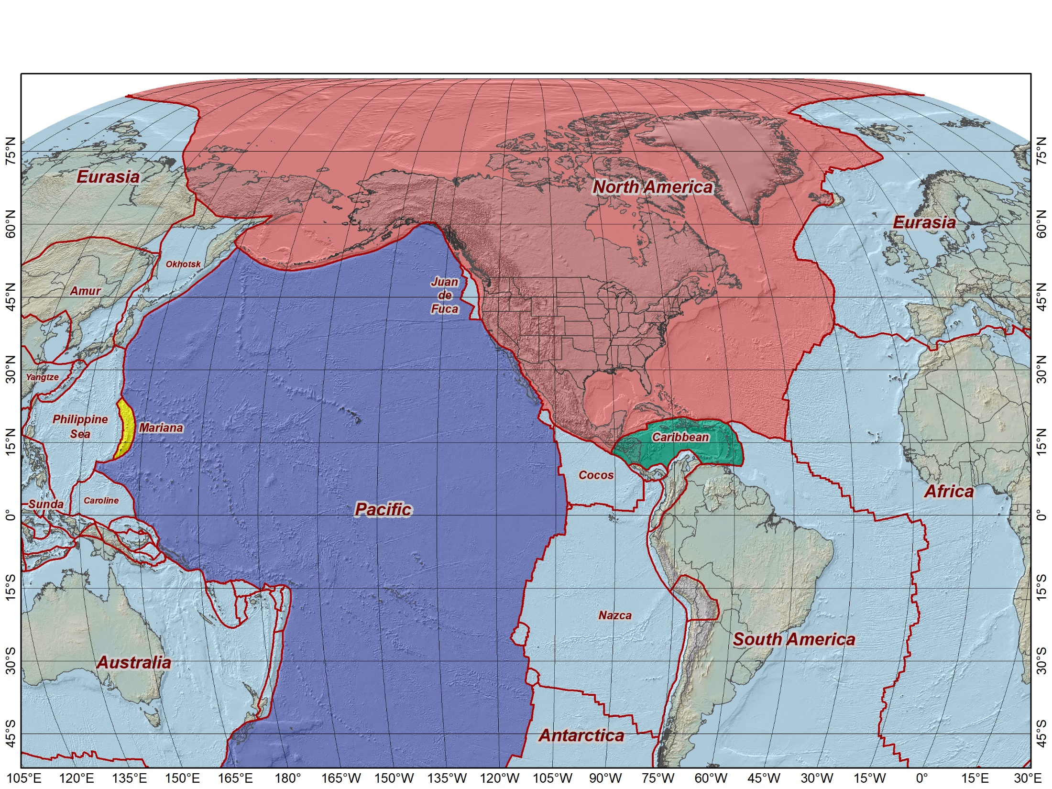
Why are we modernizing the NSRS?
Plate Tectonics!
~ Things are moving ~
Modernized NSRS accounts for crustal motion
              Tectonic plate rotation
        Local deformation
        Earthquakes
        Subsidence
        Earth Center is well known
        Reduces systematic errors
        Global rather than regional
            Compatible with international reference systems
Notes:
A natural question is why are we modernizing the NSRS? If I had to choose one thing, I would say “plate tectonics.” This map shows a large part of the Earth, including the entire NSRS and your operational areas. The Earth is divided into 50 or so tectonic plates, and they are all moving in different directions.
In other words, things are moving. And the Modernized NSRS accounts for this movement. That specifically includes coordinate systems for the four colored tectonic plates on this map (which includes the NSRS and your areas). We account for tectonic plate rotation, but also deformation at plate boundaries, earthquakes, subsidence, and other types of movement, everywhere on Earth (not just the four plates with NSRS coordinate systems).
We also know the location of the center of the Earth with much greater accuracy than ever before (at the cm level). This reduces systematic errors in the existing NSRS.
The Modernized NSRS is also global rather than regional. This means that everything is compatible with international reference systems, which helps a lot when interacting with our global neighbors or using datasets from other sources.

Slide 6
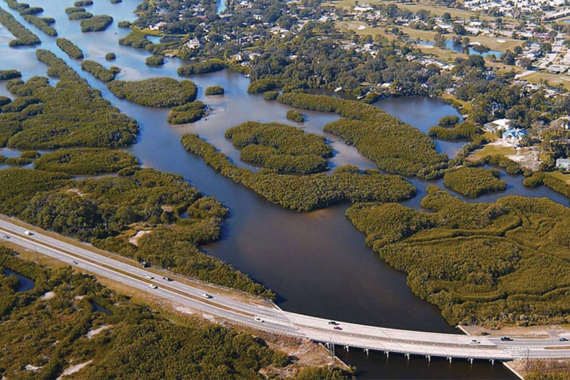
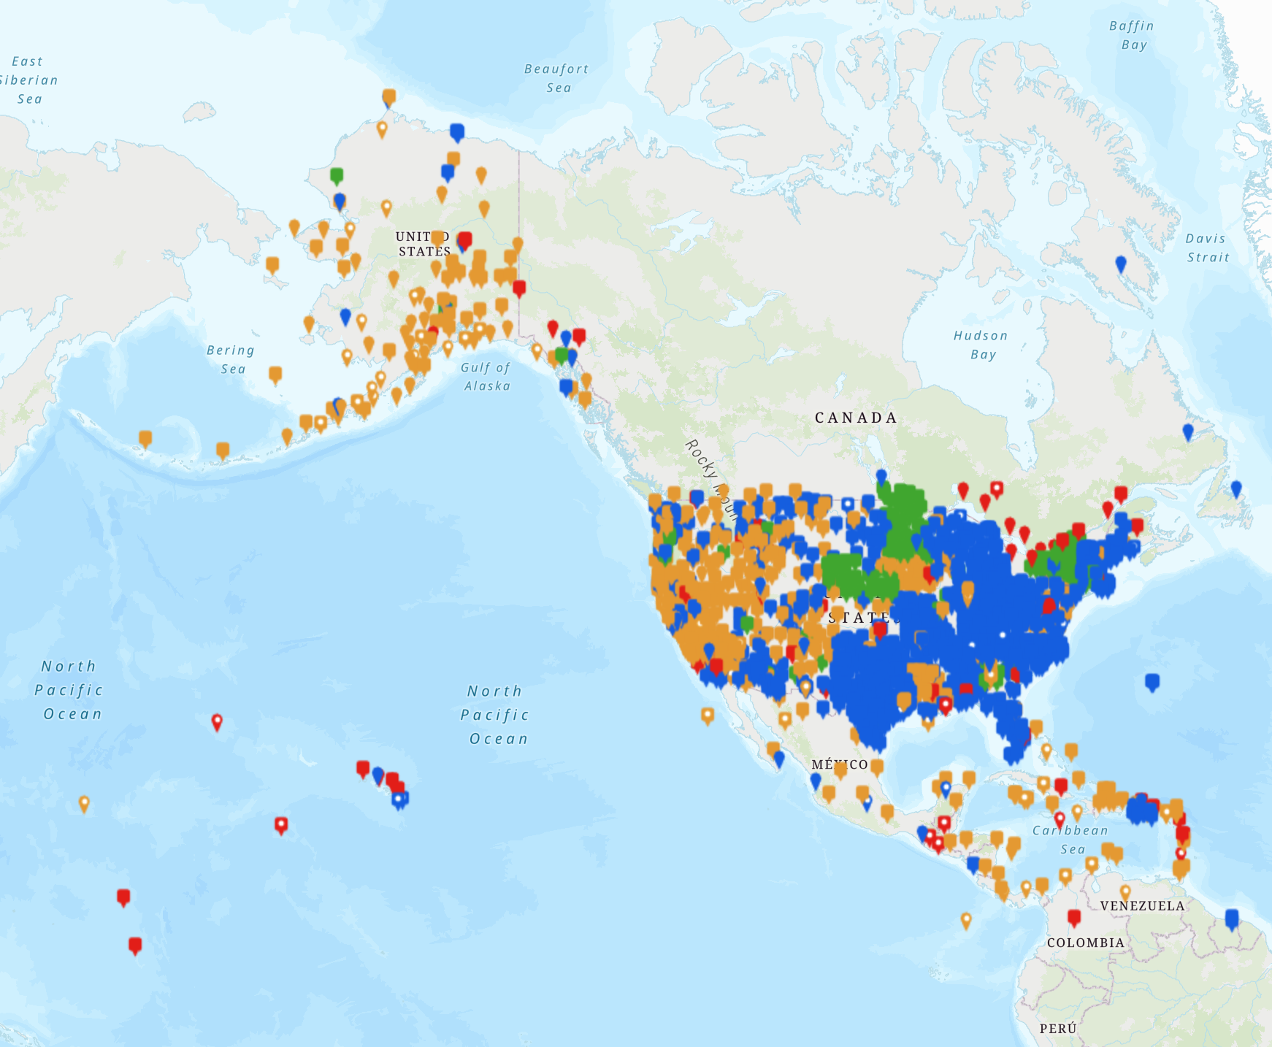


Current reference systems create challenges
Superseded in 1986
Lower accuracy and regional
Not compatible with GNSS
Based on U.S. survey foot
NAD 27 (1927)
Gulf of Mexico
NAD 83 (1986)
Alaska
Atlantic Coast
U.S. Virgin Islands / Puerto Rico
Pacific Coast
Gulf of Mexico (Offshore Texas and Louisiana)
Superseded in 1990s
Lower accuracy and regional
Not compatible with GNSS
Poorly defined
Low accuracy (2 m at best)
Combined multiple versions
Not directly accessible
Difficult to verify
Little to no documentation
Not part of the NSRS!
WGS 84 (ensemble)
Hawaii
Guam/CNMI
American Samoa
Uninhabited
Pacific Territories
Notes:
Challenges exist today for you when using the existing NSRS (and its predecessors). This maps shows the extent of your operational areas, and you can see they’re (mostly) on the four tectonic plates that are part of the modernized NSRS (but note that all plates are modeled, not just those four).
Today, our focus is becoming more regionalized and is likely using three reference systems (“datums”): NAD 27, NAD 83, and WGS 84. That in itself creates challenges for managing geospatial data. Some of the issues with these reference systems are shown in the boxes of red text appearing on the right. I don’t want to go through each off these things now; there are too many to cover in the time we have. But I want you to notice that there is a lot of red text, which means there are many things to deal with, and they represent challenges for you today.
An important thing to understand is that adopting the Modernized NSRS will resolve all of the issues listed here. That alone is a significant advantage of NSRS Modernization.

Slide 7
The solution:
Use the Modernized National Spatial Reference System
Official and best coordinate systems of the U.S. defined by NGS
The Federal Geodetic Control Subcommittee (FGCS) will provide oversight and approval as part of its responsibilities
  The subcommittee is open to all federal agencies and programs
Its use required for all civilian Federal Government agencies
  OMB A-16
  Geospatial Data Act of 2018
Widely used by state and local government agencies and private industry
Tied to regional and global networks, including maritime domain
Notes:
In a very real sense, using the Modernized NSRS is a solution to the challenges facing agencies now. And there is more to it than that.
The Modernized NSRS will be the set of official and best coordinate systems of the United States, defined by NGS. In terms of how it is justified, it will be approved by the Federal Geodetic Control Subcommittee (FGCS), part of the Federal Geographic Data Committee. The subcommittee includes representation from many federal agencies, including yours.
In addition, use of the NSRS is required for civilian federal government agencies, per the Office of Management and Budget Circular A-16. It is also (at least implicitly) required by the Geospatial Data Act of 2018.
Beyond those requirements for federal agencies, the NSRS is widely used by state and local governments as well as private industry. It is a highly used and popular system.
Lastly, the modernized NSRS is tied to the International Terrestrial Reference System, which is widely adopted by other Nations and is being incorporated into planning tools by IHO and efforts to develop a Federated Marine Spatial Data Infrastructure.

Slide 8
“Shift & Drift”
Sudden “SHIFT” to give coordinates on Jan 1, 2020
  Horizontal change of about 0.5 to 4 meters (1.5 to 12 feet)
  Elevation change of about ±2 meters (±6 feet)
Continuous “DRIFT” due to crustal motion
  Up to about 8 cm/yr (4 inches/yr) for tectonic plates
  Able to remove most by modeling crustal motion
Time is part of Modernized NSRS definitions
  Coordinates change with time, but reference system itself stays the same
  Change in coordinates can be minimized (most “drift” can be removed)
  Can determine coordinates at a specific time (to keep datasets consistent)
Modernized NSRS accounts for temporal changes...
…so you don’t have to!
Coordinates in Modernized
NSRS will always have a date
8
Notes:
I imagine you all have heard of “Shake & Bake.” At NGS, when we talk about the Modernized NSRS, we say “Shift & Drift.”
What that means is that there will be two components of movement. One is a sudden shift that will cause all coordinates to instantly to change from what they are now to their new values. That will be a change of about 1-1/2 to 12 feet horizontally and at least 6 feet vertically, depending on location.
The other is a slow continuous drift due mainly to tectonic plate rotation (punctuated occasionally in some places by earthquakes). The drift is up to about 4 inches per year (mainly in the Pacific). We will remove most of this effect by modeling crustal motion.
In the Modernized NSRS, coordinates will always have a date associated with them. When you provide or receive coordinates, you won’t simply say “here are my coordinates.” You will say “here are my coordinates at this date (or epoch).”
Time is part of the modernized NSRS definition. Coordinates will always have a date associated with them because they change with time, even though the reference system itself stays the same.
This may all sound complicated, but it’s actually a good thing. Things are moving, and our positioning capability today is so good that we can no longer ignore the movement. The Modernized NSRS is being developed with models and tools to account for such temporal change, so you don’t have to!

Slide 9
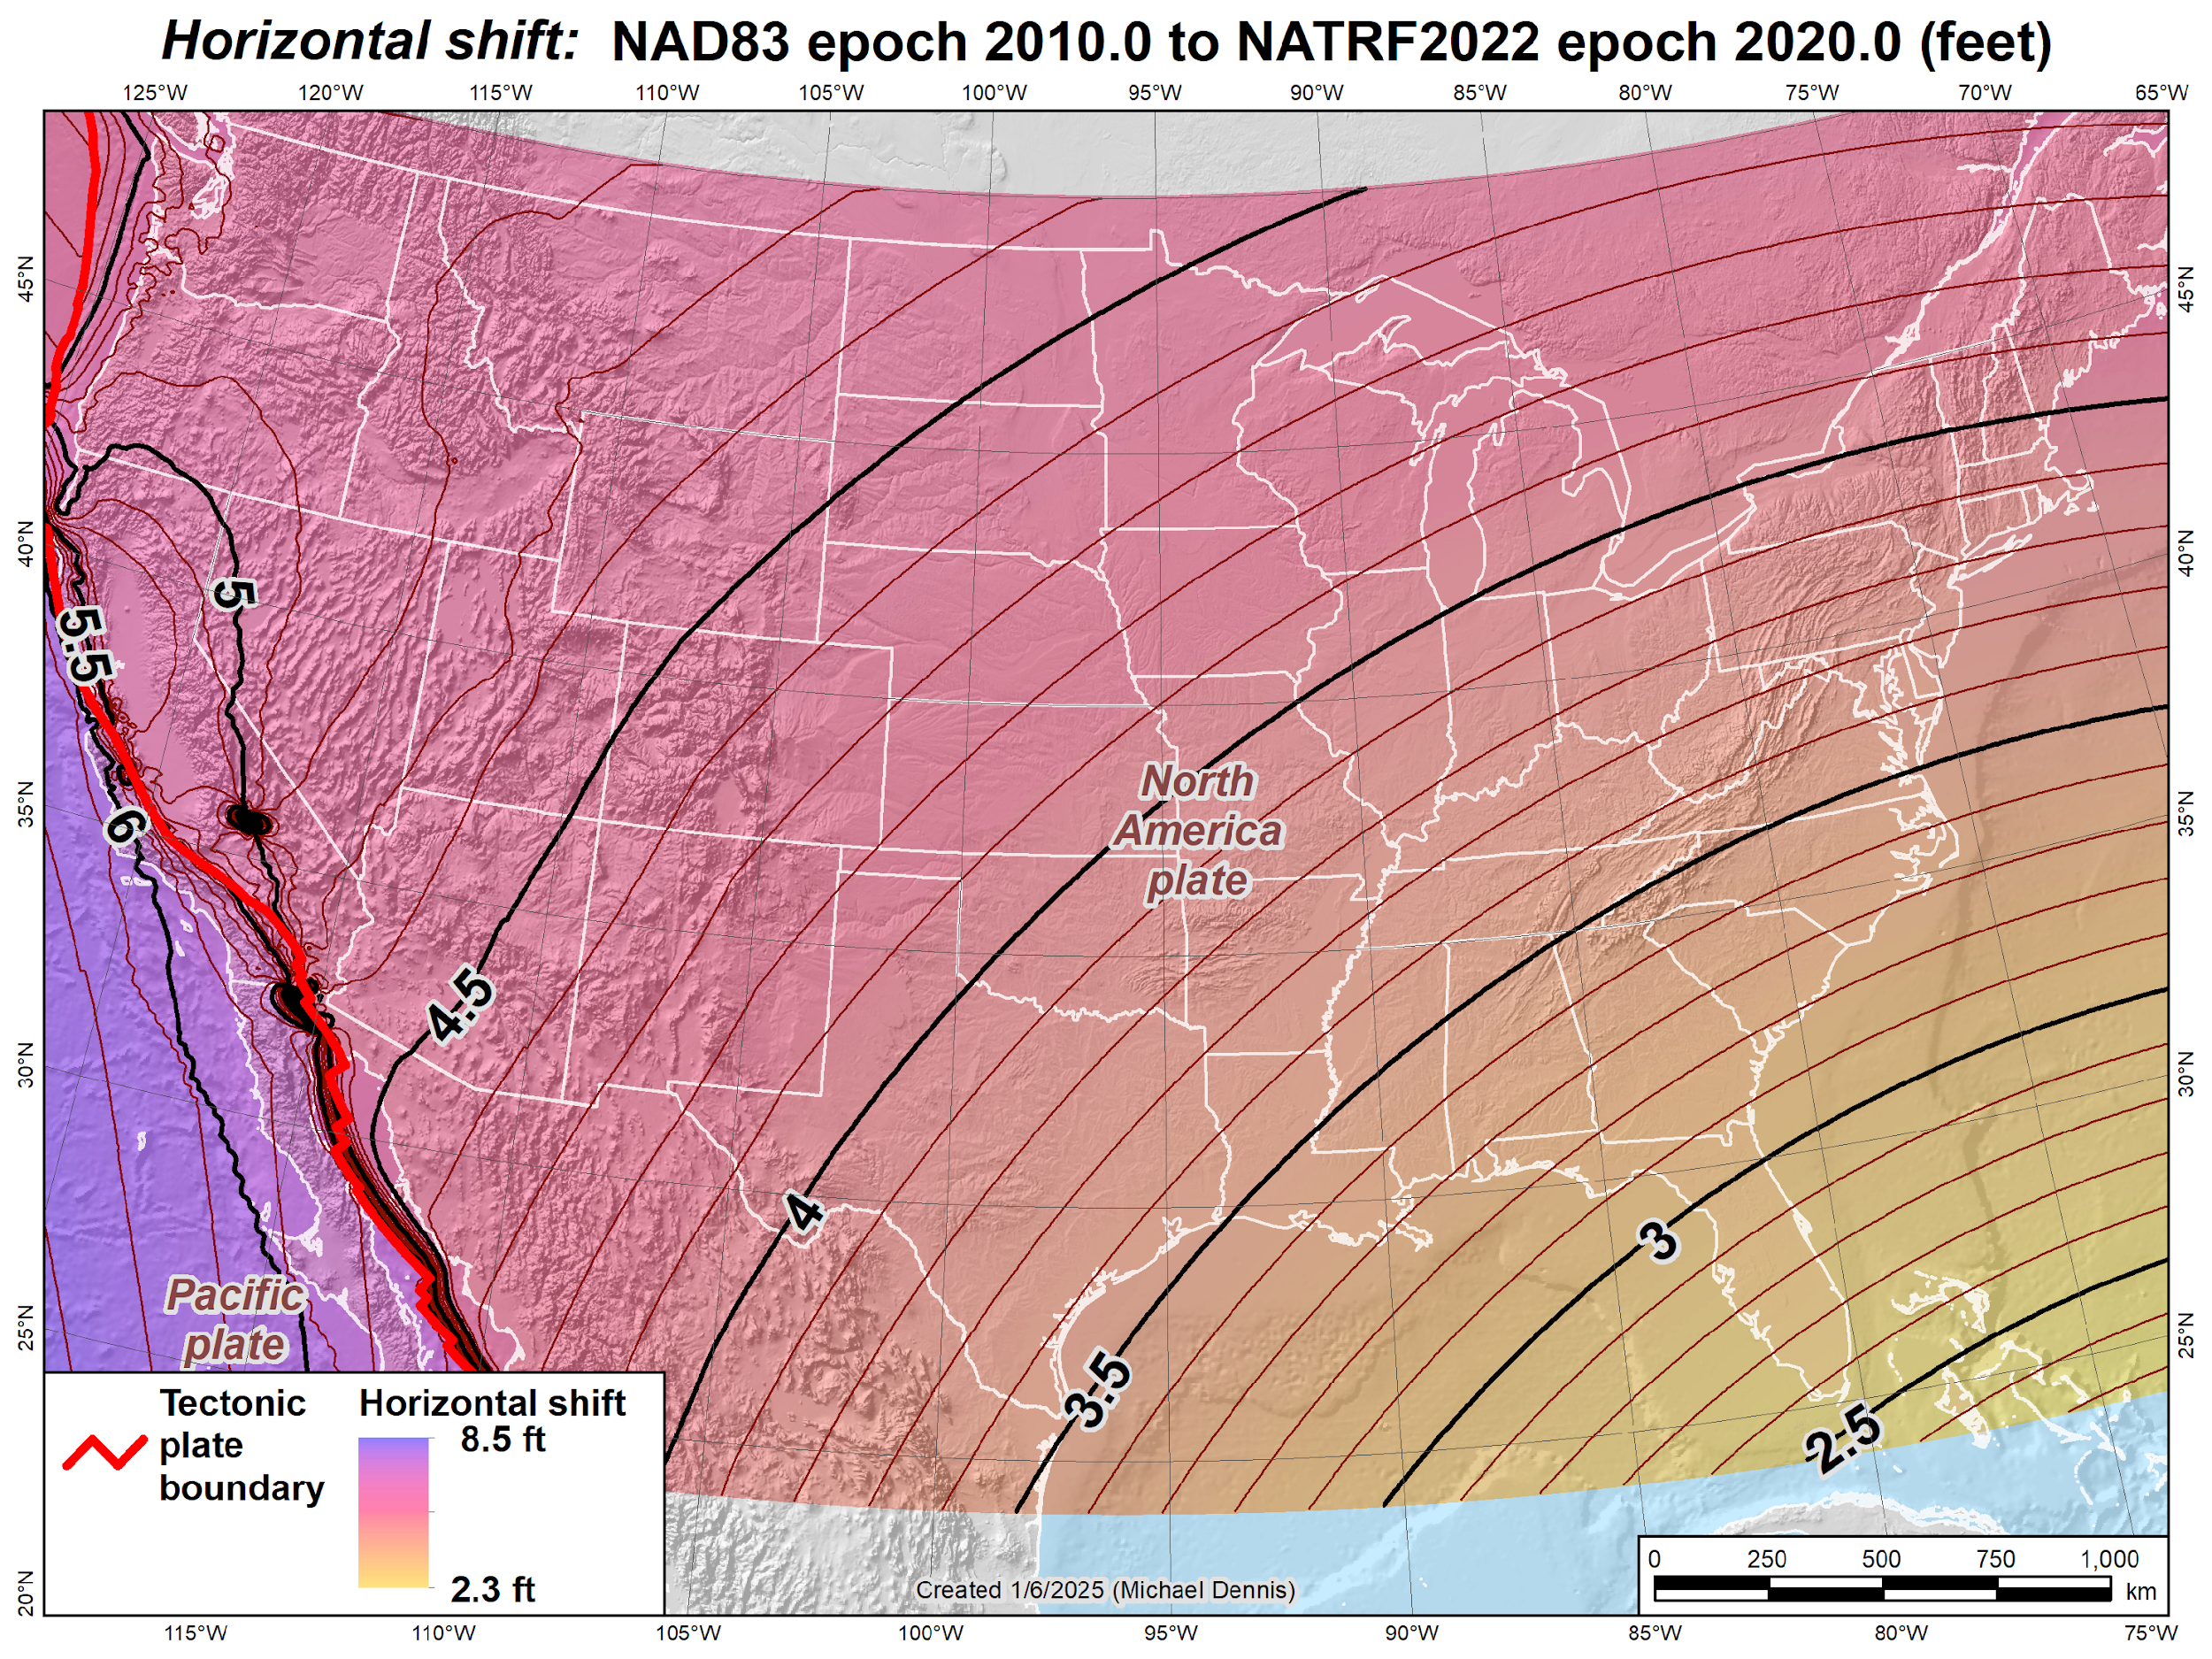
Estimated horizontal shifts (CONUS):
NAD 83 epoch 2010.0 to NATRF2022
epoch 2020.0 (feet)
Ridgecrest earthquake (July 2019)
El Mayor-Cucapah earthquake
(April 2010)
9
Notes:
This map illustrates the horizontal coordinate shifts (in feet) expected across CONUS with the transition from NAD 83 to the modernized National Spatial Reference System (NSRS). These shifts range from approximately 2.5 feet in southern Florida to more than 6 feet in California, with even larger displacements in areas affected by significant seismic events, such as Ridgecrest and El Mayor-Cucapah earthquakes. Shifts in the Pacific region are even more substantial—exceeding 12 feet in some locations.
It’s important to note that the future vertical datum, NAPGD2022, will be accessed through NATRF2022 and our other geometric reference frames. Accurate horizontal positioning in the modernized NSRS is critical to achieving proper alignment with tidal datums and sea level measurements.
This is especially significant because many satellite and airborne sensors use geometric coordinates. Post-processed data derived from these sources will provide the highest accuracy and will be closely tied to the modernized NSRS, supporting a range of applications from offshore mapping to coastal monitoring.

Slide 10
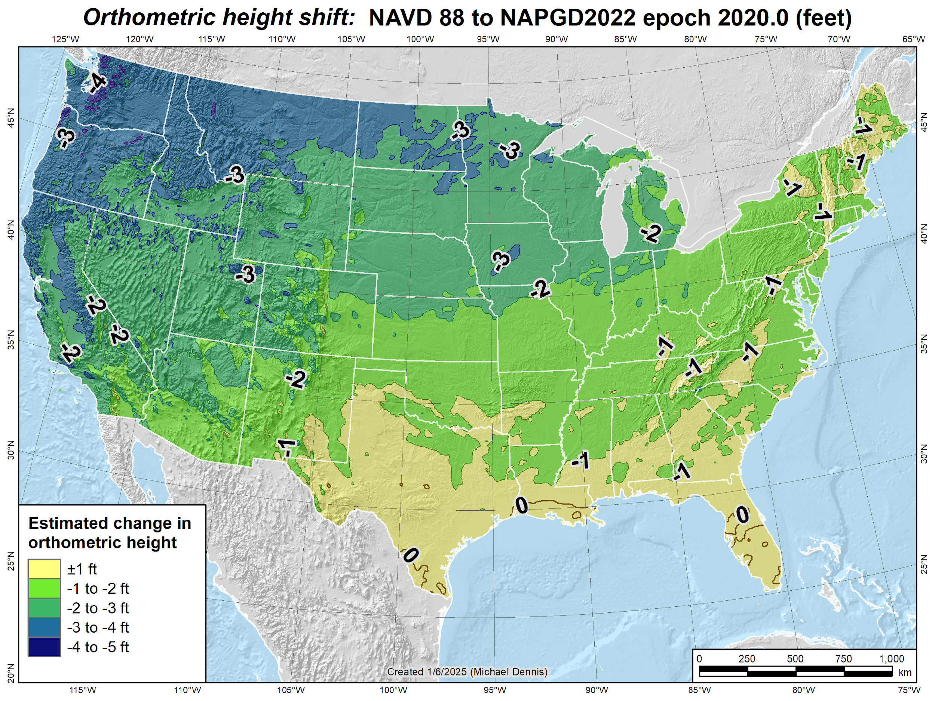
Estimated orthometric height shifts
(CONUS):
NAVD 88 to NAPGD2022
epoch 2020.0 (feet)
10
Notes:
This map shows the predicted elevation shift for CONUS, ranging from essentially zero in southern Florida to a decrease of more than 4 feet in the Pacific Northwest.
The new vertical datum—NAPGD2022—was defined using comparisons at over 200 tidal benchmarks across North America. These tide stations serve as the foundational link between sea level and land-based elevations, ensuring the datum reflects real ocean conditions. Ongoing maintenance of the datum will support the detection of vertical land motion, which is especially important for monitoring coastal change.
These updates are vital for improving consistency between coastal, offshore, and terrestrial applications. This alignment is crucial for NOAA’s work in areas such as hydrography, sea surface change, and coastal inundation modeling.
To access NAPGD2022, users must work through the corresponding geometric reference frames—such as NATRF2022. This ensures vertical positions are grounded in accurate, up-to-date, and physically meaningful coordinates tied to both land and sea.

Slide 11
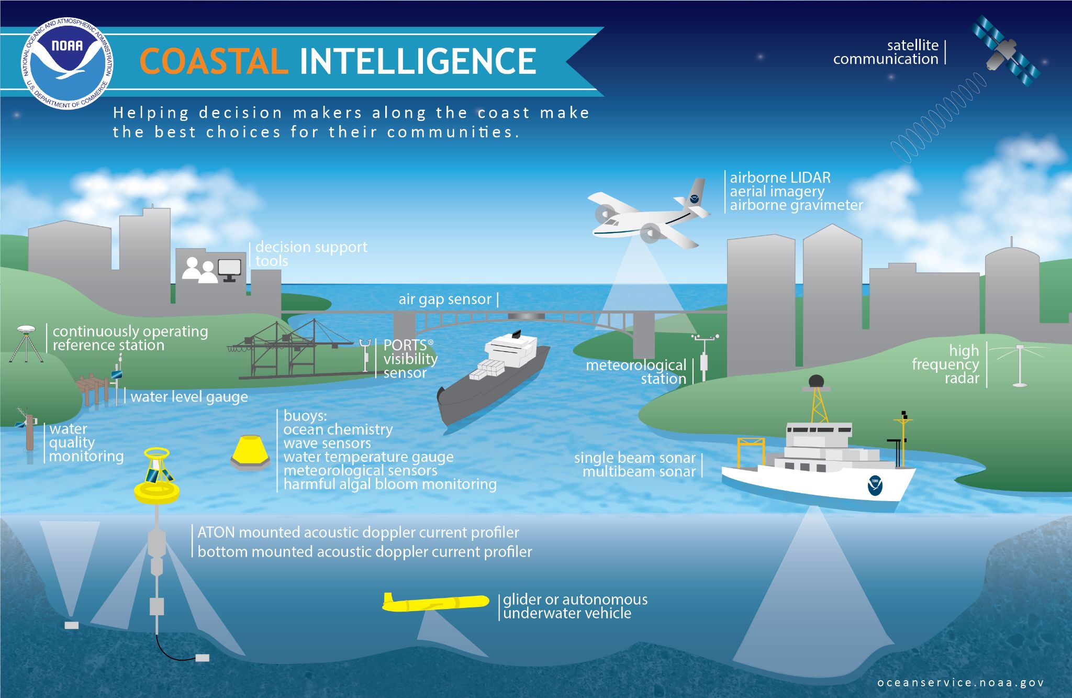
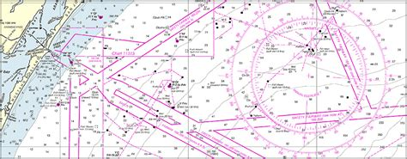
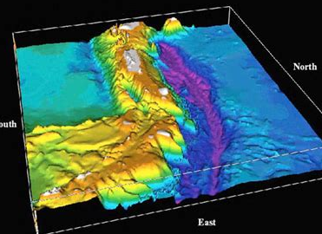
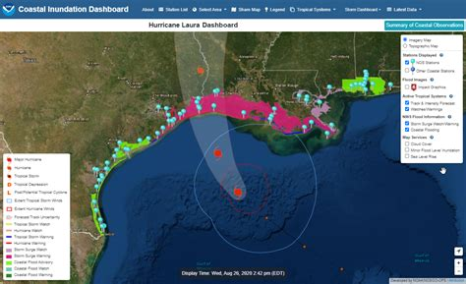
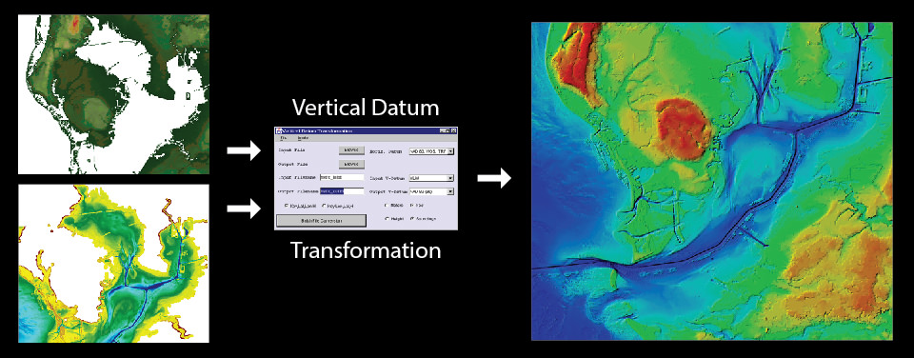
What types of data are affected?
Bathymetry
Charting
Coastal Intelligence
Coastal Inundation
VDatum - bringing land and sea together
Notes:
What kinds of data are affected at NOS? As you can see, a wide range of mission-critical datasets will be affected.
NOS delivers a suite of products and services that extend offshore and into the coastal zone—including charting, bathymetry, and inundation modeling. These must increasingly be integrated with land-based geospatial processes that support the broader Coastal Intelligence ecosystem.
For these services to be actionable, all geospatial data must be accurately referenced to the land. That’s where the modernized National Spatial Reference System (NSRS) becomes essential—it provides a consistent and precise framework for aligning offshore, coastal, and onshore data.
Perhaps the most significantly affected process will be VDatum, NOAA’s tool for transforming between vertical datums. VDatum relies on NGS’s geodetic models to integrate land and marine data into a unified spatial framework.
⚠️ However, it’s important to note that VDatum is not a one-size-fits-all solution. While powerful, it introduces some level of uncertainty and should be carefully evaluated for suitability in specific applications. Users must understand the underlying assumptions and data quality limitations—especially when high-precision or regulatory uses are involved.

Slide 12
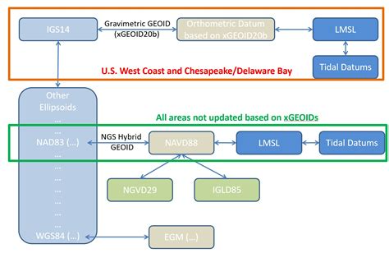
Inconsistency to Integration: VDatum in the Modernized NSRS
Replacing Regional Workflows
with
Globally Consistent Geodetic Models
Other geometric CRS
…
…
N/C/P/MATRF
…
NAD 83 (ens.)
…
…
NAD 27
GEOID2022
height model
NAPGD2022
TSS
Tidal
Datums
LMSL
NAVD 88
IGLD 2020
NGVD 29
IGLD 85
With the modernized NSRS, the Topography of the Sea Surface (TSS) will be defined using the Mean Sea Surface referenced to NAPGD2022—not NAVD 88
⚠️
Notes:
The current VDatum workflow varies by region, relying on different models that often yield inconsistent results. This variability can introduce confusion and limits the ability to integrate data across coastal and offshore applications seamlessly.
With the modernized NSRS, results will be consistent from the East Coast to the Gulf Coast to the Pacific.
NGS will continue to maintain decimeter-level accurate transformations to historical datums such as NAVD 88. However, for applications requiring centimeter- or inch-level precision, future work must be tied to the modernized NSRS.
At the heart of this system is the GEOID2022 model, which connects geometric reference frames (like NATRF2022) to the new vertical datum, NAPGD2022. This surface serves as the reference for determining the Topography of the Sea Surface (TSS) by comparing it to the Mean Sea Surface (MSS), enabling transformations to Local Mean Sea Level (LMSL).
To ensure the highest level of vertical accuracy—especially at coastal and Great Lakes sites—LMSL should be tied directly to NAPGD2022. This is particularly important as NOAA considers future updates to the National Tidal Datum Epoch (NTDE).
⚠️ Important note:
While tools like VDatum enable these transformations, they are not one-size-fits-all. Users should understand the models and assumptions behind VDatum and ensure its application is appropriate for the required level of accuracy.
Misuse can lead to significant errors in coastal modeling, planning, and policy decisions.

Slide 13
Benefits of adopting the Modernized NSRS
Provides greater accuracy and precision
Supports the F.A.I.R. principle for spatial data
  Findable. Accessible. Interoperable. Reusable.
Helps quantify spatial improvement
“Future proofs” data and workflows
Enables better coordination between federal agencies and external parties
Modernizing now prevents more costly adoption later
  Planning and being proactive will make for a smoother transition
  Coordinating adoption with other agencies facilitates data sharing and collaboration
Accuracy is telling the truth.
Precision is telling the same story over and over again…
Notes:
My hope is that NSRS Modernization is not simply viewed as a burden. There will be benefits.
One is that it provides greater accuracy and precision. Although these words are often used interchangeably, they are not the same thing. One way to think of it is that accuracy is telling the truth. But precision is telling the same story over and over again. That’s tory may be true, or it may be false, but the point is that it’s the same, repeated story. The ideal case for spatial data is that it is both accurate and precise, and that you know how accurate and precise it is.
Another is that it supports the important FAIR principle for spatial data: Findable. Accessible. Interoperable. Reusable.
As mentioned before, it can help identify issues with spatial data inherited from the past, such as those with NAD 27, NAD 83, WGS 84, deprecation of the U.S. survey foot. More than identify, it can help quantify the magnitude of the improvement in spatial data quality achieved through modernization.
It will also help future-proof your future data and workflows. The Modernized NSRS will be in use for decades, and, unlike prior versions, allowance for change will be built into it. This will improve its usability over time.
It also enables better coordination between federal agencies and external parties because everything is well defined and consistent.
And, as I said before, modernizing now prevents more costly adoption later.
Planning and being proactive will make for a smoother transition.
And outside, coordinating with other agencies helps facilitate data sharing and collaboration; it will help in doing things consistently during the change.

Slide 14
NSRS Modernization is nearly done!
Preliminary release in phases
  Initial release by mid-2025
  Final release by calendar year 2025
  These releases are for testing and evaluation only
Will replace current datums in 2026
  At least 6 months after final 2025 release
  After Federal Geodetic Control Subcommittee votes to approve in 2026
NGS will continue supporting current NSRS through the rollout and testing of the modernized NSRS
14
Notes:
As for NSRS Modernization itself, it’s nearly done! NGS started it in 2007, so it’s been going on for quite some time.
Preliminary release of the Modernized NSRS will being this year, and it will be done in phases, starting in mid-2025. We plan to release the last preliminary component of the Modernized NSRS by the end of calendar year 2025. Note that these preliminary releases are for testing and evaluation only; they are not final products.
The current existing datums will be replaced in 2026. This will occur at least 6 months after the last preliminary component is released. This will give time for our partners and customers to review the preliminary release and provide feedback. Near the end of this period, once the FGCS votes to approve the Modernized NSRS, it will replace all datums of the current NSRS. As an important side note, we’ve been engaged with FGCS for many years on Modernization. FGCS has been fully supportive and we expect a vote for approval.
Throughout this period of releasing, testing, and evaluating the Modernized NSRS, the current NSRS will be fully supported. It will not be replaced by the Modernized NSRS until that process is complete, including an FGCS vote.

Slide 15
Next steps for Modernization
Evaluate operational needs and avoid unnecessary changes
  Organizational impact and staff readiness
  Program and regional support
  Leasing requests (potentially)
  Interagency collaboration
  Leadership and communication
  Include plans to accommodate greater accuracy in the future
Lower-accuracy datasets may require no change at all (e.g., 10 ft)
NSRS modernization is more than a technical update
  An opportunity to enhance your agencies geospatial capabilities for the future
What does NGS need to help YOU?
  To clearly communicate what is needed with one voice
15
Notes:
Now for the next steps for Modernization, for YOU.
We recommend that your agency evaluate operational needs. An important part of that is to identify changes that are unnecessary. I'll get to that in more detail in a moment.
Other things to consider include:
Assess organizational impacts and staff readiness. Are you, or will you, be ready for Modernization?
How will existing program and regional support be impacted?
What parts of leasing requests will be affected, how will they be handled going forward?
Interagency collaboration, so that you can align shared data sets, reduce redundancy, and maximize efficiency.
Leadership and communication, including getting the word out throughout the organization, so that people understand what's going on.
Consider how Modernization can be used to plan for future improvements in spatial accuracy. Although you may not need such accuracy now, that may change in the future. After all, there is a continuous drive toward greater accuracy throughout the geospatial ecosystem.
An important thing to understand is that your lower accuracy data sets may require no change at all (other than the metadata associated with it). That’s likely around a spatial accuracy of about 10 feet. Data less accurate than that probably need not be changed at all (again, other than its metadata). So an important thing to do is identify such data—it could save a lot of work and time!
Keep in mind that NSRS Modernization is more than a technical update. It is an opportunity to enhance your geospatial capabilities for the future. It's going to help you resolve some of the issues you're facing right now.
Lastly, what does NGS needs from YOU so that we can best help you navigate adoption of the Modernized NSRS? Most importantly, it should be communication with one voice, to ensure NGS gets consistent input. For example, this could be a technical designee assigned to serve as a liaison between your potential internal work group(s) and NGS. That will make for better coordination with us so that we can better address your unique situation.

Slide 16
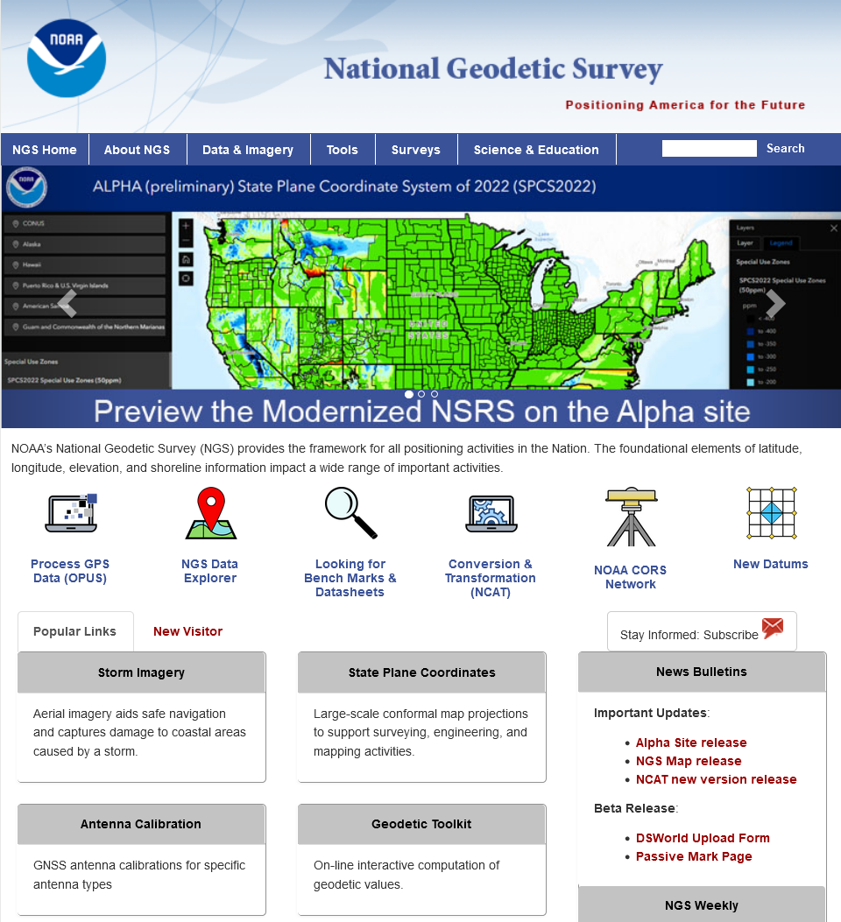


Find out more…
Thank You!
geodesy.noaa.gov
16
Notes:
In closing, I’ll end by providing a link to the NGS web site. Here is a URL and a QR code. Our site includes a wealth of information about NSRS Modernization.
Thank you very much for your attention! I welcome any questions you may have.

