Slide 1
Reaching New Heights
NYSAPLS First Friday Webinar
June 06, 2025
Dan Martin
Northeast Regional Geodetic Advisor
Dan.martin@noaa.gov
240-676-4762

Slide 2
NAPGD2022 a New Paradigm
Not based on passive marks but defined by
H22 = h22 – N22
Like NAVD88 Each point (unless connected by observation) has it’s own, uncorrelated Network Accuracy and no Local Accuracy relative to other marks, but unlike NAVD88, there is no point on the ground “Truth” for validation. The height you establish IS the truth.

Slide 3
Some New Scenarios
My version of the truth is not same as your version of the truth. Who’s telling the truth?
Maybe we both are.
There is no higher level of control (other than CORS) by which we can determine what the truth really is. Even then, the determination of that truth comes with essentially the same range of error.

Slide 4
Academic Exercise
The year is 2028, and you have been contacted to conduct a survey that will establish vertical control and produce an elevation certificate for flood insurance. Before giving a quote, or planning a survey, what information do you want/need to know?

Slide 5
Submit a few answers in the question box

Slide 6
Some Things to Consider
Mapping Datum?
Required Accuracy (relative to what)?
Closeness to zone height (How much wiggle room)
Geoid uncertainty
Transformation uncertainty
How accurate can you establish height relative to Mapping Datum?

Slide 7
More Things to Consider
Existing “defining” control in area
How was study conducted?
Any Known or suspected motion?

Slide 8
Academic Exercise
The year is 2028, and you have been contacted to conduct a survey that will establish vertical control and produce an elevation certificate for flood insurance. Here is what we know:
Structure is in Zone AE, EL 10 (NAVD 88)
A quick look at recent LiDAR puts Lowest Adjacent Grade at about 8’+/-
Site visit (street view), shows what looks to be about 1’ of frost wall/foundation above grade.

Slide 9
What we know cont.
Nearest NAVD 88 control points are about 1 mile and two miles away.
There are couple of old USGS marks with NGVD 29 heights a few hundred yards away.
You have GNSS equipment, and access to OPUS and RTN

Slide 10
What method do you want to use?
Pole Question 1

Slide 11
Errors Associated with GNSS Heights
Setup/Instrument Error (controllable)
Ellipsoid Height Error from GNSS (controllable with limits)
Depends on technique, duration, redundancy
Geoid Error
Not controllable
Vertical transformation(s) error if applicable (not controllable)

Slide 12
Setup Error
Fixed Height (verified), or good procedures for slant height measurements and use of correct antenna model if applicable
Plumbing/Centering Device in Adjustment
Field procedures designed to eliminate blunders
Avoiding obstructions and multipath

Slide 13
GSVS Equipment Calibration
Calibrated, fixed-height antennas, all identical models
In Texas 2011:
20 complete sets of equipment (2 parties, 10 sets each)
Each party observed 10 new stations each day
20 hours of observation each day
Project processed with OPUS Projects

Slide 14
Two-meter fixed height pole???
Full antenna recalibration check before survey
Each fixed height tripod height
measured before and after
20 complete sets of equipment -
2 parties (10 sets each)
Each party observe 5 new and 5
repeat stations each day
30 observation days
Project processed with OP
ID | before | after | a - b | avg.
A | 2.0028 | 2.0029 | 0.0001 | 2.0029
B | 2.0019 | 2.0018 | -0.0001 | 2.0018
C | 2.0005 | 2.0002 | -0.0003 | 2.0004
D | 2.0079 | 2.0079 | 0.0000 | 2.0079
E | 2.0011 | 2.0010 | -0.0001 | 2.0010
F | 1.9999 | 1.9998 | -0.0001 | 1.9998
G | 2.0006 | 2.0009 | 0.0003 | 2.0008
H | 2.0016 | 2.0017 | 0.0001 | 2.0017
I | 2.0020 | 2.0020 | 0.0000 | 2.0020
J | 2.0041 | 2.0041 | 0.0000 | 2.0041
K | 2.0003 | 2.0004 | 0.0001 | 2.0003
L | 2.0010 | 2.0007 | -0.0003 | 2.0008
M | 2.0000 | 2.0002 | 0.0002 | 2.0001
N | 1.9964 | 1.9963 | -0.0001 | 1.9963
O | 2.0005 | 2.0005 | 0.0000 | 2.0005
P | 2.0003 | 2.0002 | -0.0001 | 2.0002
Q | 2.0024 | 2.0029 | 0.0005 | 2.0027
R | 1.9999 | 1.9999 | 0.0000 | 1.9999
S | 2.0052 | 2.0052 | 0.0000 | 2.0052
T | 2.0026 | 2.0023 | -0.0003 | 2.0024
U | 2.0031 | 2.0031 | 0.0000 | 2.0031
V | 1.9995 | 1.9995 | 0.0000 | 1.9995
W | 2.0002 | 2.0003 | 0.0001 | 2.0003
X | 2.0020 | 2.0022 | 0.0002 | 2.0021
Y | 2.0053 | 2.0053 | 0.0000 | 2.0053
Z | 2.0016 | 2.0014 | -0.0002 | 2.0015

Slide 15
Ellipsoid Height Accuracy
Highly dependent on
Technique
OPUS, RTN/RTK, Post-Processed
Duration
Redundancy (3-hour offset?)

Slide 16
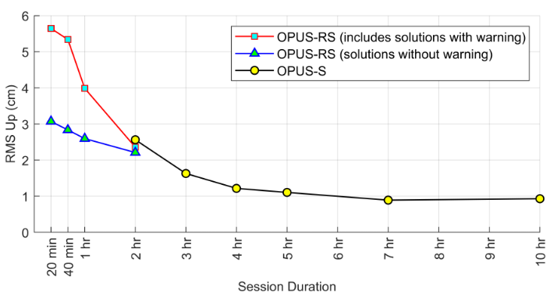
OPUS Accuracy (Datum)
Approximately 5 cm and 3 cm at 95% for 2 hours and four hours respectively

Slide 17
RT Accuracy (Datum)
95% Confidence
± 5.0 cm, vertical
± 2.5 cm, horizontal
Or similar to accuracy of a 2-h OPUS-S solution!
[Allahyari el al. 2018]

Slide 18
Summary on RT Accuracy
RTNs in Oregon and South Carolina produced similar results
NRTK is more accurate than SRTK, especially vertically
HRMSE = 1.0 to 1.8 cm for both NRTK and SRTK
VRMSE = 3.1 to 4.7 cm for SRTK
VRMSE = 2.0 to 2.7 cm for NRTK
VRMSE @ 95% = 3.9 to 5.3 cm
GPS+GLONASS is slightly more accurate than GPS-only
Accuracy hardly improves with session duration, especially after 5 minutes
T = 3 to 5 minutes appears optimal
Notes:
It seems that in real-time, it is readily possible to measure an ellipsoid height to less than 5 cm at 95% confidence using NRTK. This error could be further reduced by taking multiple repeat NRTK observations on the same mark.

Slide 19
Repeat Occupations
Accuracy improves even more by making repeat occupations on marks
[Gillins et al. 2019]
Notes:
Based on testing of 9 bench marks in Maryland

Slide 20
OPUS-Projects Accuracy (Datum)

Slide 21
Geoid Error
GEOID18
Dependent on location, quality, and quantity of data (GPSonBM)
GEOID2022
Dependent on location…………..

Slide 22
Estimate Errors Up Front

Slide 23
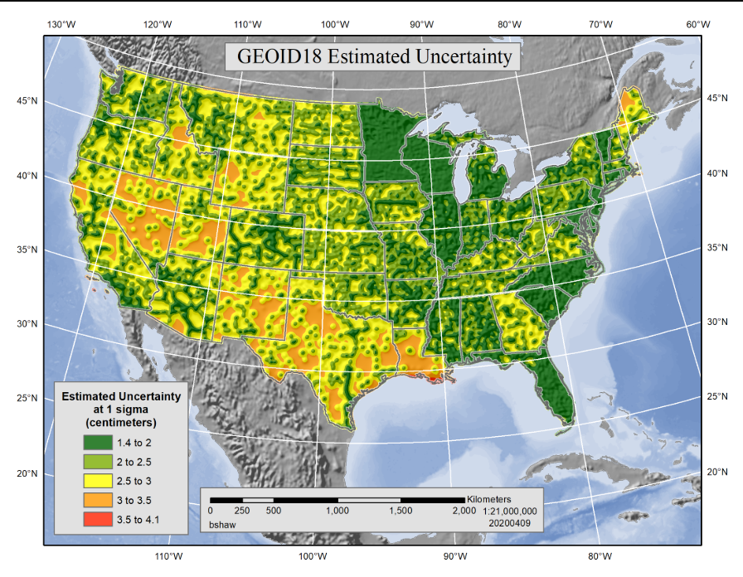

Slide 24
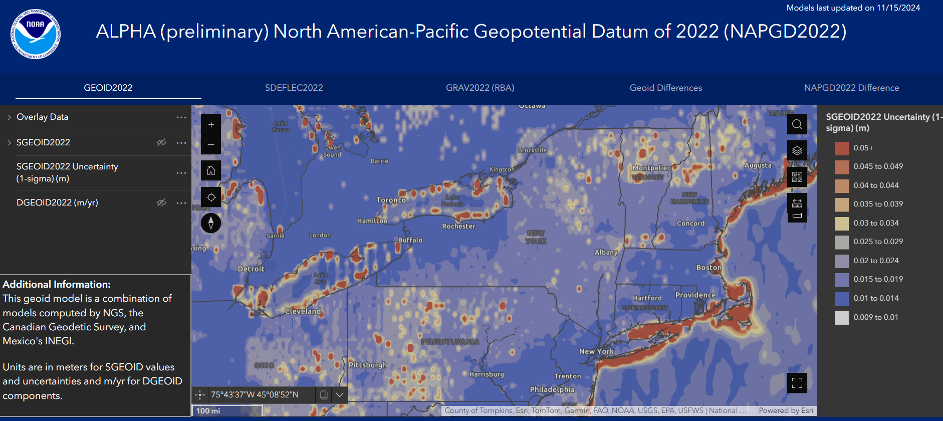

Slide 25
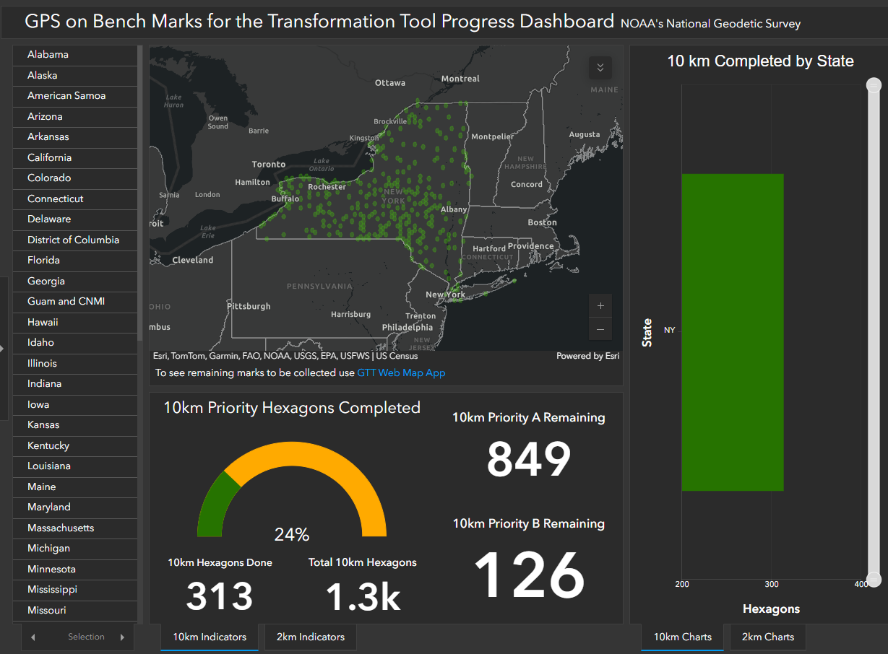
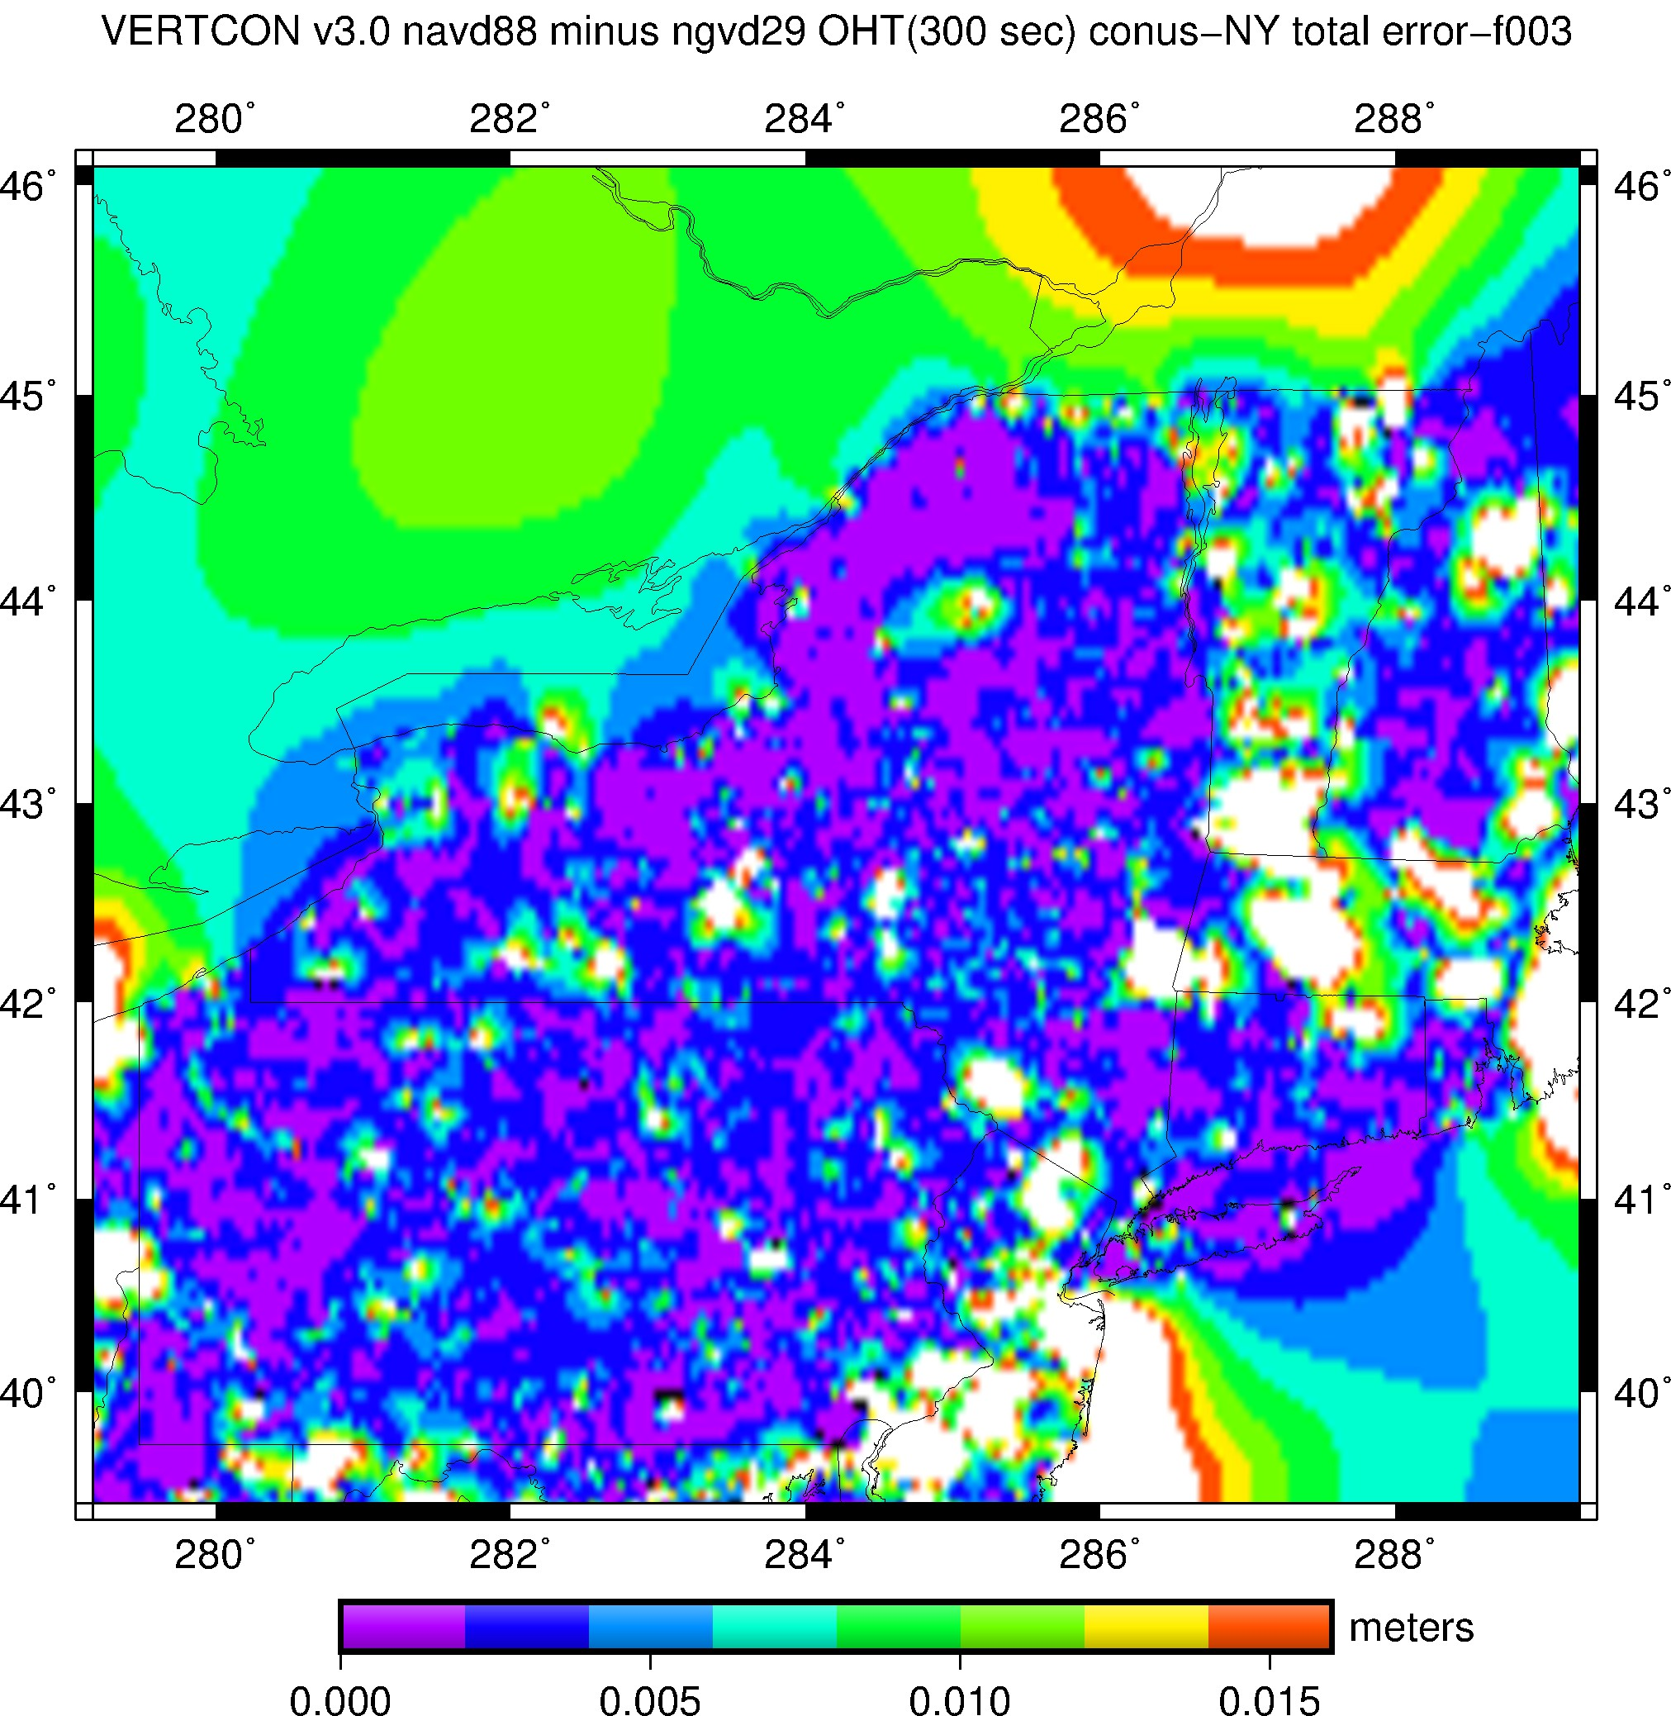
VERTCON4 Error NAVD88 to NAPGD2022
Dependent on GPSonBM Density

Slide 26
Height Options
Establish NAPGD 2022
Use Vertcon to transform to NAVD 88
Establish NATRF2022 h
Transform to NAD83(2011)
Apply Geoid18 > NAVD88
Find NAVD88 BM and level, etc…

Slide 27
Bottom Line
Decision relies on analysis of error budget vs accumulated error and Technique
Setup + Observation + Geoid + VERTCON
Duplicating the original method used to establish the original project datum is the best option (accuracy wise)

Slide 28
Questions?
Presentation will be available at:
https://www.ngs.noaa.gov/web/science_edu/presentations_library/
Dan Martin
Northeast Regional Geodetic Advisor
ME, NH, VT, MA, CT, RI, NY, NJ
Dan.martin@noaa.gov
240-676-4762

