Slide 1
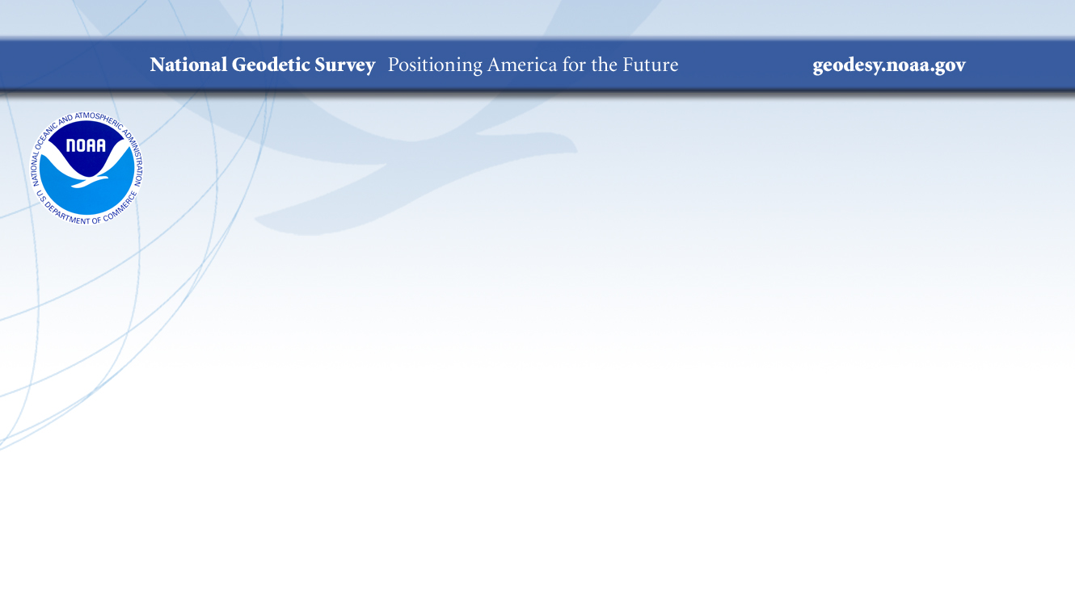
Modernization of the United States
National Spatial Reference System
Daniel R Roman
&
Dana J Caccamise II
NOAA's National Geodetic Survey (NGS)
dana.caccamise@noaa.gov & dan.roman@noaa.gov

Slide 2





The NSRS Supports:
National Oceanic and Atmospheric Administration
NSRS positioning data provides the reference for NOAA’s
nautical charts, among many other geospatial applications.
Federal Emergency Management Agency
FEMA uses NSRS elevations to determine flood zones
for the National Flood Insurance Program.
United States Army Corps of Engineers
USACE uses NSRS elevations to determine levee heights
and positions in their Levee Safety Program.
United States Geological Survey
USGS uses the NSRS to reference their Topographic Maps
and interior water data for the nation.
National Geospatial Intelligence Agency
NSRS gravity data contributes to NGA’s geospatial mission.

Slide 3
NSRS Modernization Delay
Operational, workforce retention, and other issues have delayed NSRS Modernization.
SPCS2022 zones should be finalized soon but will not be rolled out until all of the NSRS is modernized.
GPS on Bench Marks deadline extended
September 30, 2023
Find out
More:
https://geodesy.noaa.gov/datums/newdatums/delayed-release.shtml
https://geodesy.noaa.gov/datums/newdatums/FAQNewDatums.shtml

Slide 4
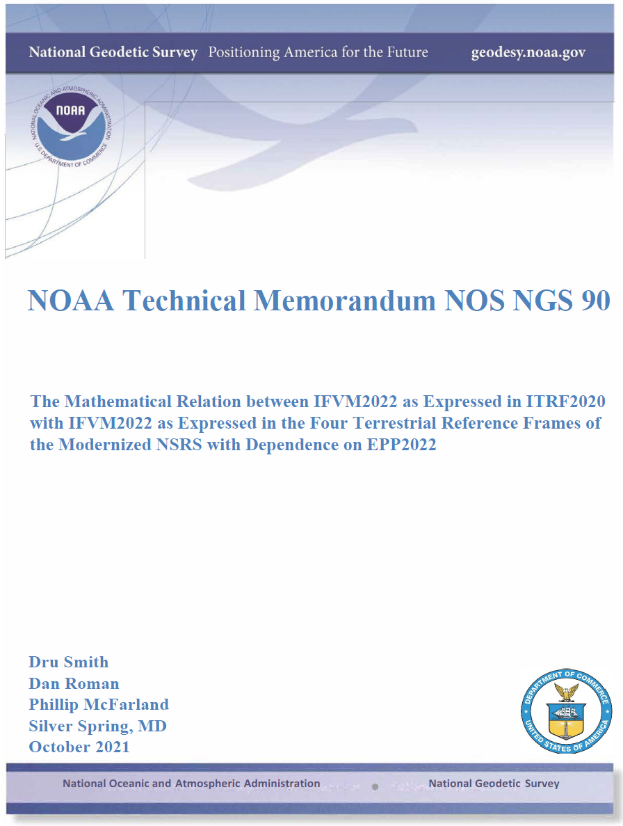
New and Updated Science
Nine science papers in the last two years
( I counted ten )
  More coming this year
  https://geodesy.noaa.gov/library/

Slide 5
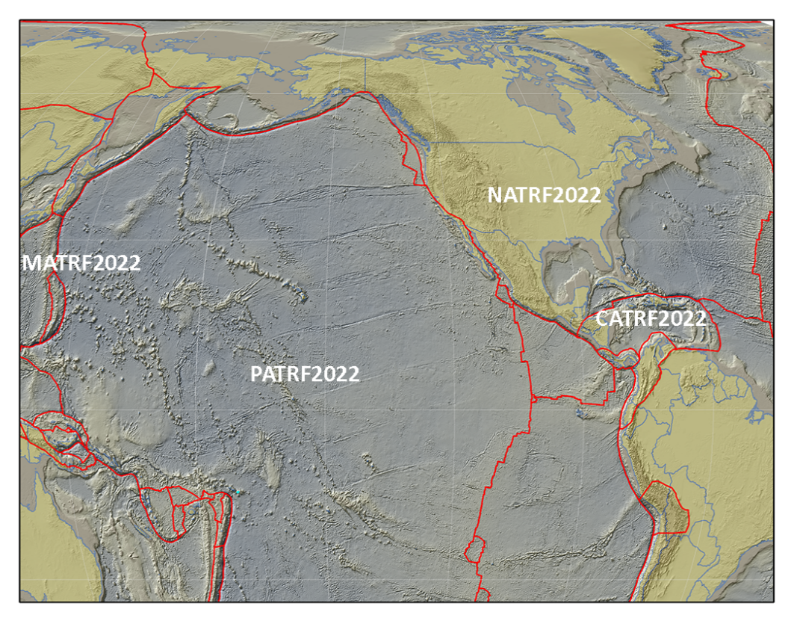
The Future Reference Frames
Will be based on a densified ITRF model (Eg. SIRGAS)
Tectonic Plate based
Each Plate is based on the same densified
ITRF model
North America
Caribbean
Pacific
Mariana
NATRF
CATRF
PATRF
MATRF
Notes:
ITRF fixed PLATE specific reference frame. 5th frame will be SIRGAS
NSRS Modernization Naming Conventions https://geodesy.noaa.gov/datums/newdatums/naming-convention.shtml

Slide 6
Replacing NAD 83
The Old:
NAD 83(2011)
NAD 83(PA11)
NAD 83(MA11)
The New:
The North American Terrestrial Reference Frame of 2022
(NATRF2022)
The Caribbean Terrestrial Reference Frame of 2022
(CATRF2022)
The Pacific Terrestrial Reference Frame of 2022
(PATRF2022)
The Mariana Terrestrial Reference Frame of 2022
(MATRF2022)

Slide 7
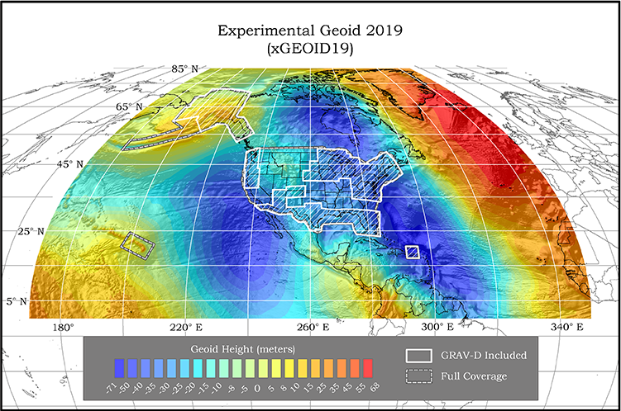
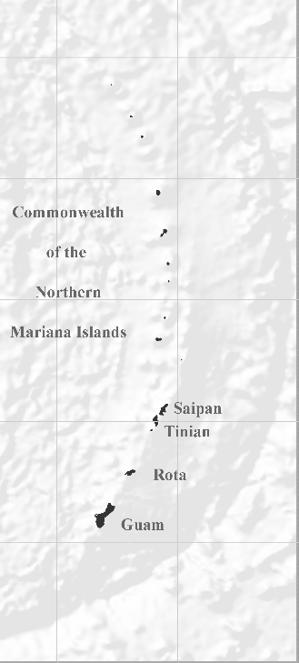
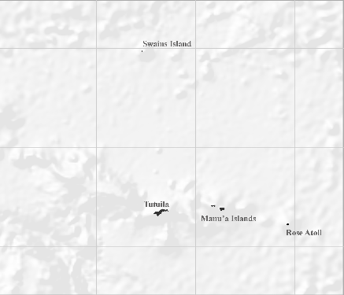
NAPGD2022 Geopotential Datum
Not just a vertical datum, it is more than just heights.
NGS, Canada, and Mexico released the first-ever joint geoid model
Models included:
Experimental Geoid 2020 (xGEOID20)
¼ Earth’s Surface
Geopotential, Geoid Deflection of Vertical,
& Gravity
Guam/CNMI
American Samoa
Notes:
NGS, Canada, and Mexico released the first-ever joint geoid model between our countries xGEOID20.
The final GEOID2022 model will also be a joint model.
As noted in the Blueprint 2 document
https://geodesy.noaa.gov/library/pdfs/NOAA_TR_NOS_NGS_0064.pdf
NAPGD2022 will include all of the following
Geopotential Model of 2022 (GM2022) will include:
Static Geopotential model of 2022 (SGM2022)
Dynamic Geopotential model of 2022 (DGM2022)
GEOID2022 will include:
Static Geoid model of 2022 (SGEOID2022)
Dynamic Geoid model of 2022 (DGEOID2022)
DEFLEC2022 will include:
Static Deflection of the Vertical model of 2022 (SDEFLEC2022)
Dynamic Deflection of the Vertical model of 2022 (DDEFLEC2022)
GRAV2022
Static Gravity model of 2022 (SGRAV2022)

Slide 8
Replacing NAVD 88
  The Old:
  NAVD 88
  PRVD 02
  VIVD09
  ASVD02
  NMVD03
  GUVD04
  IGLD 85
  IGSN71
  GEOID12B
  DEFLEC12B
  The New:
  The North American-Pacific Geopotential Datum of 2022 (NAPGD2022)
    Will include:
    GEOID2022
    DEFLEC2022
    GRAV2022
    DEM2022
    More
Orthometric
Heights
Normal
Orthometric
Heights
    A HUGE component
    of this effort is
    GRAV-D:
Gravity for the Redefinition of
the American Vertical Datum
Dynamic
Heights
Gravity
Geoid
Undulations
Deflections of
the Vertical

Slide 9
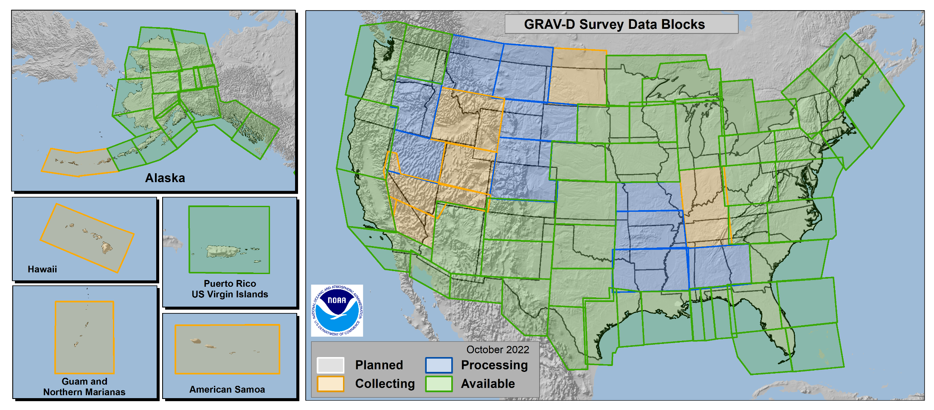
Gravity for the Redefinition of the
American Vertical Datum
GRAV-D
96.8% Complete
(11/21/2022)
Notes:
Flying since 2007
96.8% complete
No blocks have zero data
100% by end of 2023
10 km data lines
70 km cross lines
20,000 ft altitude
230 kt flight speed
More information on GRAV-D
https://geodesy.noaa.gov/GRAV-D/
Data Download for GRAV-D blocks
https://geodesy.noaa.gov/GRAV-D/data_products.shtml

Slide 10
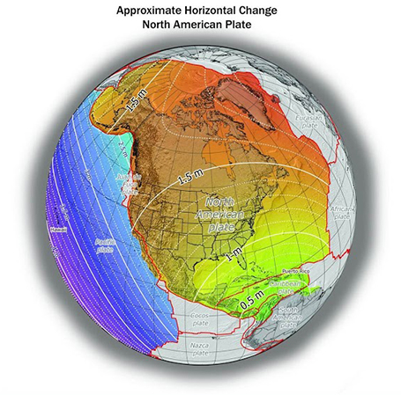
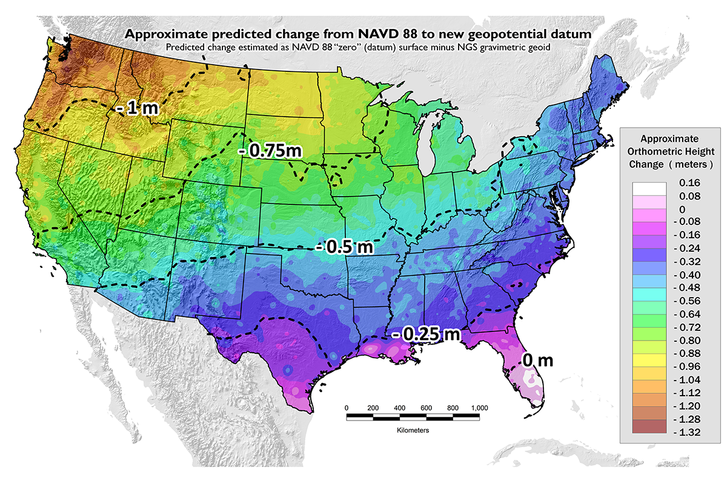
Once we get to 2022: What to Expect?
~1 to 1.5 meters North America
~2.5 to 4 meters in Pacific
0 to 1.3 meters CONUS
Notes:
New Datums What to expect https://geodesy.noaa.gov/datums/newdatums/WhatToExpect.shtml
NGS is not shifting the land, merely shifting the reference surfaces to which we reference the geospatial data to.

Slide 11
New types of Coordinates
Reference Epoch Coordinates
Survey Epoch Coordinates
An estimated “snapshot” of entire network
Every 5 or 10 years
Similar to NAD 83(2011) epoch 2010.00
Time-dependent!
Reflects coordinates at the time of observation
Multiple Survey Epoch Coordinates (SECs) can show changes over time

Slide 12
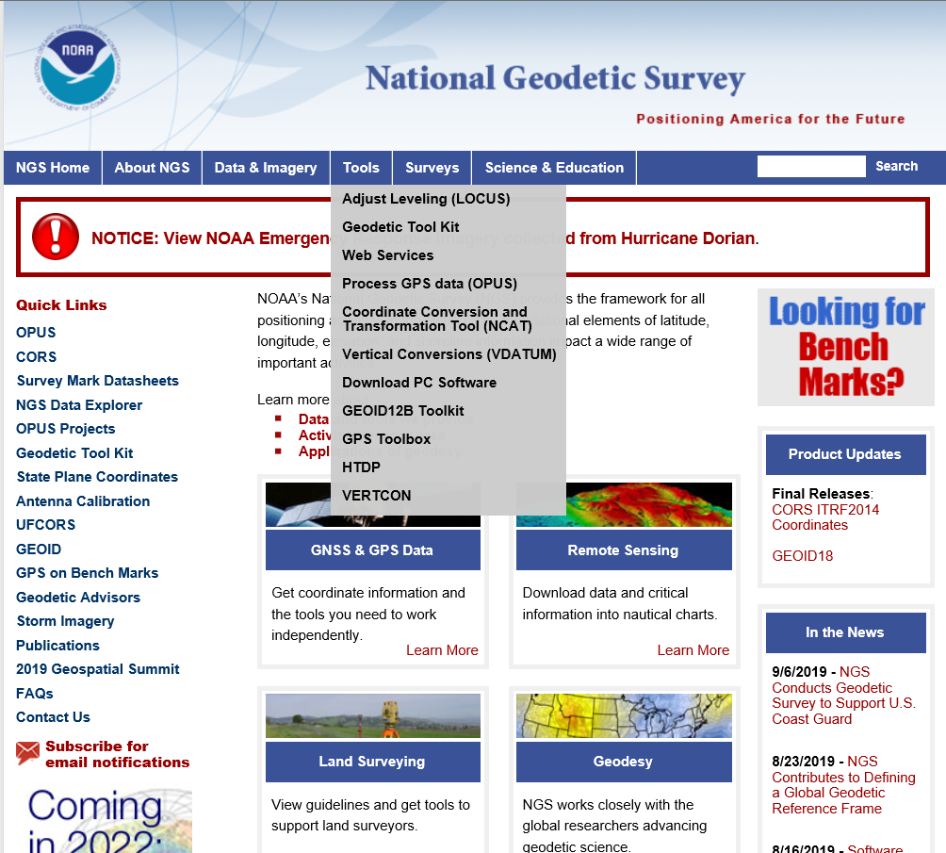
NGS Products Update - NCAT

Slide 13
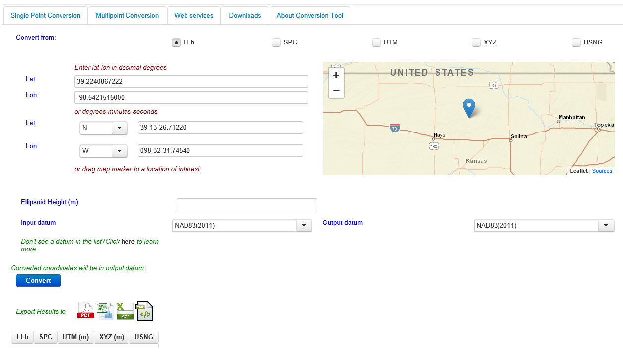
NGS Products Update - NCAT

Slide 14
X, Y, Z
φ, λ, h
Region: CONUS
SPC
UTM
φ, λ, h
USSD
2022
X, Y, Z
USNG
UTM
φ, λ, h
GEOCON 11
φ, λ, h
NAD 27
NAD 83 (2011)
X, Y, Z
SPC
X, Y, Z
SPC
USNG
UTM
NADCON
GEOCON
USNG
UTM
NAD 83 (NSRS2007)
φ, λ, h
NAD 83 (1986)
φ, λ, h
NAD 83 (FBN)
NAD 83 (HARN)
φ, λ, h
X, Y, Z
SPC
X, Y, Z
SPC
φ, λ, h
USNG
UTM
USNG
UTM
X, Y, Z
SPC
X, Y, Z
SPC
USNG
UTM
USNG
UTM

Slide 15
X, Y, Z
Region: CONUS
φ, λ, h
2022
SPC
UTM
φ, λ, h
USSD
X, Y, Z
USNG
UTM
φ, λ, h
φ, λ, h
NAD 27
NAD 83 (2011)
X, Y, Z
SPC
X, Y, Z
SPC
NCAT
USNG
UTM
USNG
UTM
NAD 83 (NSRS2007)
φ, λ, h
NAD 83 (1986)
φ, λ, h
NAD 83 (FBN)
NAD 83 (HARN)
φ, λ, h
X, Y, Z
SPC
X, Y, Z
SPC
φ, λ, h
USNG
UTM
USNG
UTM
X, Y, Z
SPC
X, Y, Z
SPC
USNG
UTM
USNG
UTM

Slide 16
NGS’ Recent Progress
Thoughts to keep in mind for the next few slides:
Re-processing of GNSS observations for any data is possible if you have
higher resolution requirements.
All our new models will be available on the NGS website and in the
ISO Geodetic Registry, including necessary transformations
between the new and the old and vice versus.
NGS is happy to work with you. To facilitate this, we need you to lay out your
geospatial data requirements so that we can understand and help you assess
the expected outcome using NGS’ conversions and transformations.
Notes:
If they are just centroid of builds - less of a problem. However, as you noted, this could still mean they get the wrong building depending on resolution.
Maybe re-processing GNSS observations for any data, if they have a need for higher resolution. Then they might use OPUS.
Emphasize that our new models will be available on our website and also in the ISO Geodetic Registry as well as necessary transformations between old and new.
We'll be happy to work with them if they can lay out what they have for geospatial data and the accuracy they need in any transformations.

Slide 17
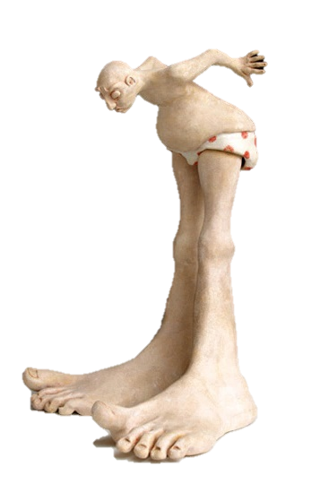
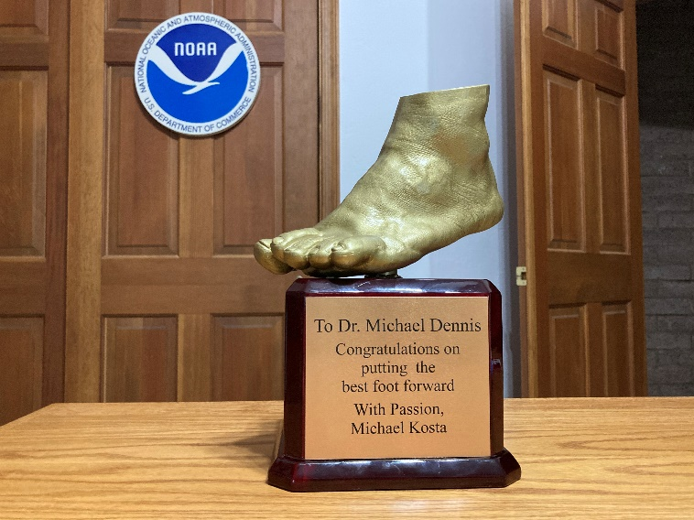
Deprecation of US Survey Foot
December 31, 2022
Will NOT impact current SPCS 83 coordinates. The US Survey Foot (sft) will
continue to be supported in the SPCS 83 system indefinitely.
The International Foot (ift) will be used in the Modernized NSRS and SPCS2022
Find out more:
Webinar
https://geodesy.noaa.gov/web/science_edu/webinar_series/ending-us-survey-foot.shtml
FRN
https://www.federalregister.gov/documents/2020/10/05/2020-21902/deprecation-of-the-united-states-us-survey-foot
Notes:
Links on the slide.

Slide 18
A rotation model for the
Mariana Plate
A rotation model for the Mariana plate released
  Uses all available active & passive control data
  Relative to ITRF2014
    Will need to be updated to ITRF2020 to define MATRF2022
  NOAA Technical Report NOS NGS 74

Slide 19
Least-squares adjustments
NGS has decided to replace all LSA software with a single suite
LASER (replaces ADJUST, et al.)
  Least squares Adjustments: Statistics, Estimates and Residuals
  Replicated the 2011 national adjustment in 2 hours on a modern laptop
  Without “Helmert Blocking”
  Currently supports geometic (GNSS, classical) and orthometric (leveling) adjustments
Coming soon:
  Relative gravity, CBLs

Slide 20
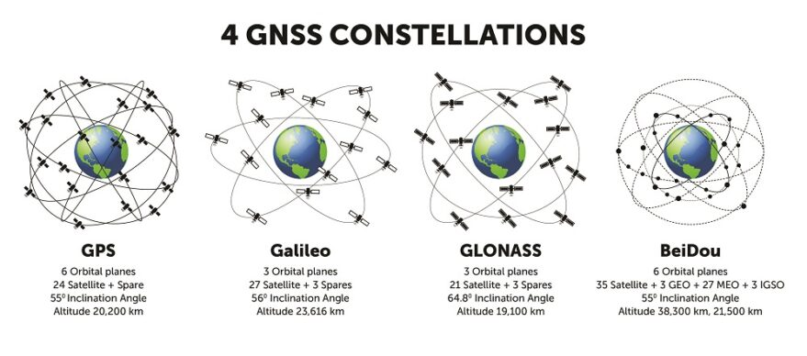
M-PAGES for multi-GNSS
M-PAGES can now process data from all existing constellations
  Still under development
  Has been integrated into OPUS-S for testing

Slide 21
OPUS
Online Positioning User Service
NGS’s flagship GNSS product
GVX (GNSS Vector Exchange) 1.0 format released
  Being adopted by industry
    Scheduled to be replaced by GDX in early 2023
OPUS-Projects 5.1.2 current official version
  Will be soon moved to
  https://www.ngs.noaa.gov/OPUS-Projects/OpusProjects.shtml
  Works with the current NSRS
  Supports upload of GNSS vectors in GVX format

Slide 22
Data includes
Upon release, the modernized NSRS will include these data:
  The NOAA CORS Network (NCN) operating on ITRF2020
  NATRF2022, PATRF2022, MATRF2022, CATRF2022 defined relative to ITRF2020
  NAPGD2022, including:
    GM2022, GEOID2022, DEFLEC2022, GRAV2022
  Geometric (XYZ / flh) and orthometric (H) reference epoch coordinates (RECs) at 2020.00 at those passive control with the observations to support such coordinates
  Geometric (XYZ / flh) and orthometric (H) survey epoch coordinates (SECs) at survey epochs between about 1994 and 2020 at those passive control with the observations to support such coordinates
  State Plane Coordinates of 2022 (SPCS2022), plus UTM and USNG
  NADCON
    Connecting NAD 83(2011/MA11/PA11) epoch 2010.00 to N/P/M/CATRF2022 epoch 2020.00
  VERTCON
    Connecting NAVD 88, PRVD02, ASVD02, NMVD03, GUVD04 and VIVD09 to NAPGD2022 epoch 2020.00

Slide 23
NSRS Tools upon release
At a minimum, NGS is targeting these tools upon release:
  A Data Delivery System capable of yielding:
    RECs on some kind of datasheet
    Information on CORSs
A downloadable version of LASER
A browser-based online multi-GNSS service:
  Like OPUS-S
  Like OPUS-Projects 5.x
NCAT and Vdatum capable of invoking NADCON, VERTCON and SPCS2022
Notes:
Reference Epoch Coordinates
Survey Epoch Coordinates

Slide 24
NGS’ work is ongoing
Work will continue to and through the rollout of the modernized NSRS. Tools released after the initial release of the modernized NSRS include:
  Integrating leveling, classical data and gravity into OPUS
  Full integration of all old tools into NCAT and Vdatum
  SECs for pre-1994 (AKA “pre-NCN”) years, plus SECs for post-2020

Slide 25
Thank You !
QUESTIONS?

Slide 26
Re-prioritization: a “data first” approach

Slide 27
Re-prioritization
There are 33 active projects within NGS explicitly dedicated to NSRS modernization
  In an agency of ~200 people….resources are spread thin
Meanwhile the current NSRS slowly deteriorates
  Marks subside without checking
  CORSs drift away from their published coordinate functions
  The passive control network deviates from active control

Slide 28
Re-prioritization
NGS has recently decided to release all of the modernized NSRS data before we have fully completed all support tools
If we do not take this approach, we are not likely to see the modernized NSRS defined and released until 2030

Slide 29
Timeline

Slide 30
Timeline
Resources are being diverted from tool building to the assurance of quality data first and foremost
As such, based on this new approach, NGS anticipates the release of all data, and limited tools, by the middle of 2025.
Work on additional tools will continue in the out-years

Slide 31
Sneak Peak

Slide 32
What’s on deck?
NOW: Use OPUS-Projects 5.1.2 on beta.ngs.noaa.gov to mix static GNSS with RTK/RTN
Early 2023: Check out multi-GNSS with M-PAGES in OPUS-S
Early 2023: Look for GDX to replace GVX
Early 2023: The first (“alpha”) set of RECs in N/P/C/MATRF2022 on 100,000+ marks
Early 2023: The release of the State Plane Coordinate System of 2022
End of 2023: ITRF2020 coordinate functions on all NOAA CORS Network stations
End of 2023: First (“alpha”) release of GEOID2022
Mid 2024-Mid 2025: One year roll-out of products, “domino style”, on the beta website
Mid 2025: Official announcement of the modernized NSRS

