Slide 1
NOAA Sentinel Site Program:
Sea Level Rise and Coastal Inundation
Virginia Association of Surveyors Fall Seminar:
Sea Level Rise and Subsidence
September 19th, 2014
Galen Scott
National Geodetic Survey

Slide 2
Quotes to Kickoff
"As relative sea level increases, it no longer takes a strong storm or a hurricane to cause flooding. Flooding now occurs with high tides in many locations due to climate-related sea level rise, land subsidence and the loss of natural barriers "
-Dr. William Sweet, NOAA Nusiance Flooding Study
“I don’t know many churches that have to put the tide chart on their Web site” - Rev. Jennifer Slade, Unitarian Church of Norfolk Washington Post 5/28/2014

Slide 3
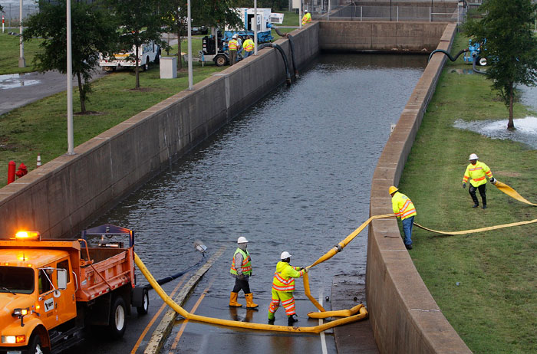
A quote of my own
“Sea level rise” or “recurrent flooding”, no matter what you call it, Hampton Roads is getting wet and understanding elevations and the relationships between tidal and geodetic datums is crucial for planning and adapting.
Hurricane Isabel – September 18th, 2003
Image From: www.hamptonroads.com

Slide 4

NGS Mission Statement
To define, maintain and provide access to the National Spatial Reference System (NSRS) to meet our nation’s economic, social, and environmental needs.
The NSRS is a consistent coordinate system that defines latitude, longitude, height, scale, gravity, and orientation throughout the United States - and how these values change with time.

Slide 5
National Spatial Reference System
(NSRS)
NSRS comprises a consistent, accurate, and up-to-date national shoreline; a network of continuously operating reference stations (CORS) which supports 3-dimensional positioning activities; a network of permanently marked points, and a set of accurate models describing dynamic, geophysical processes that affect spatial measurements.

Slide 6






The National Spatial Reference System supports
Nautical charts, among many other geospatial applications
National Oceanic and Atmospheric Administration
Emergency Response Imagery, Flood zones for the
National Flood Insurance Program
Federal Emergency Management Agency
Levee Safety Program to determine levee heights & positions
United States Army Corps of Engineers
Topographic Maps and interior water data for the nation
United States Geological Survey
NSRS gravity data for the geospatial mission of NGA
National Geospatial-Intelligence Agency
Aeronautical Data Quality Assurance
Federal Aviation Administration

Slide 7
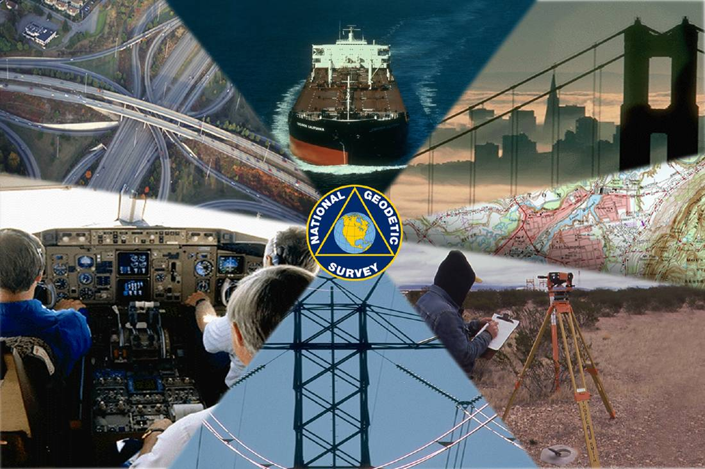

Notes:
Traditionally, Mapping and Charting functions within NOAA have served our Commerce and Transportation requirements.

Slide 8


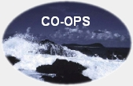
NOAA’s Navigation Services Offices
National Geodetic Survey
  NSRS
  National Shoreline
Office of Coast Survey
  Bathymetry
  Nautical Charts
Center for Operational Oceanographic Products and Services
  Tides & Currents

Slide 9
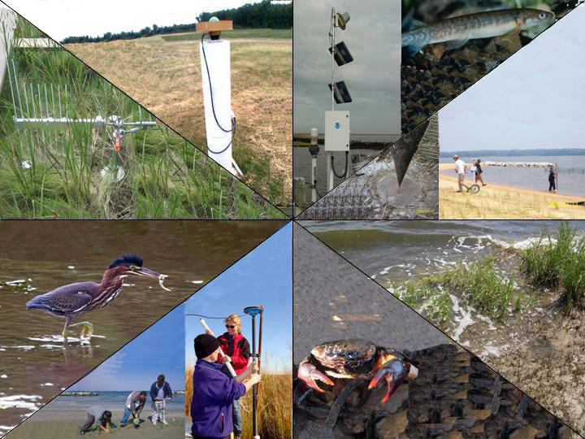
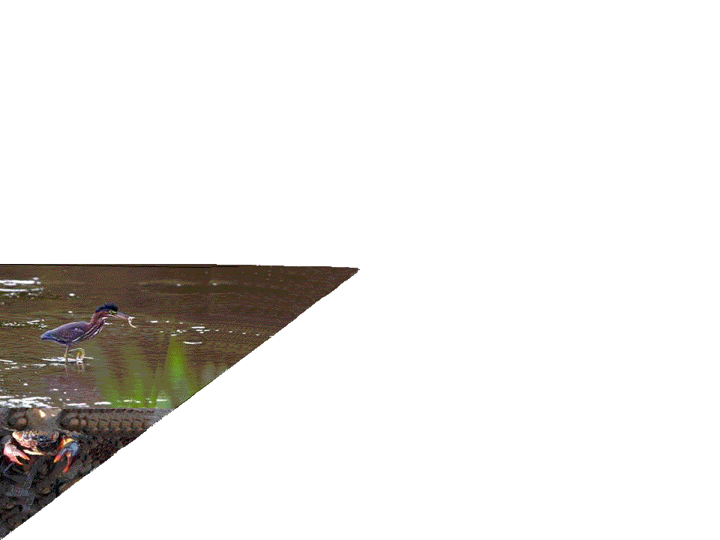
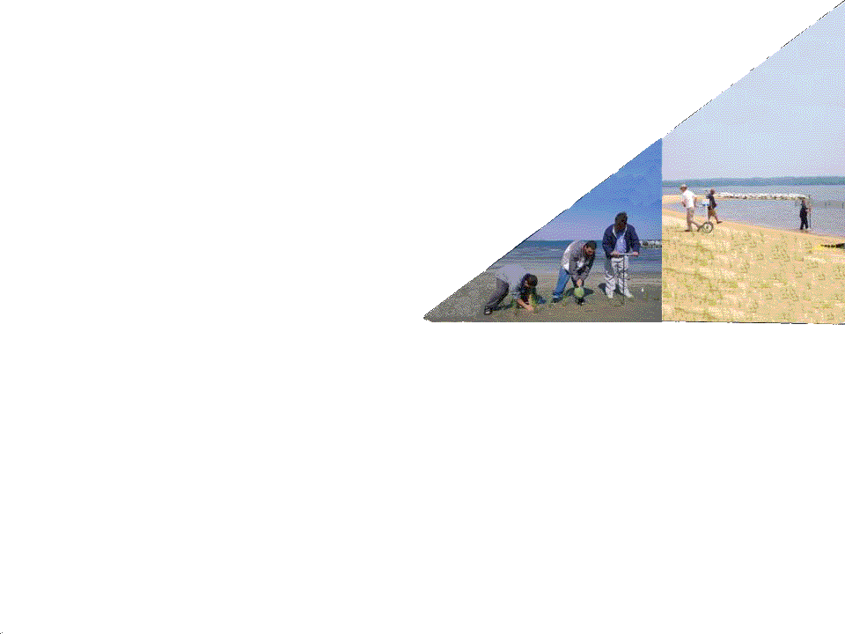
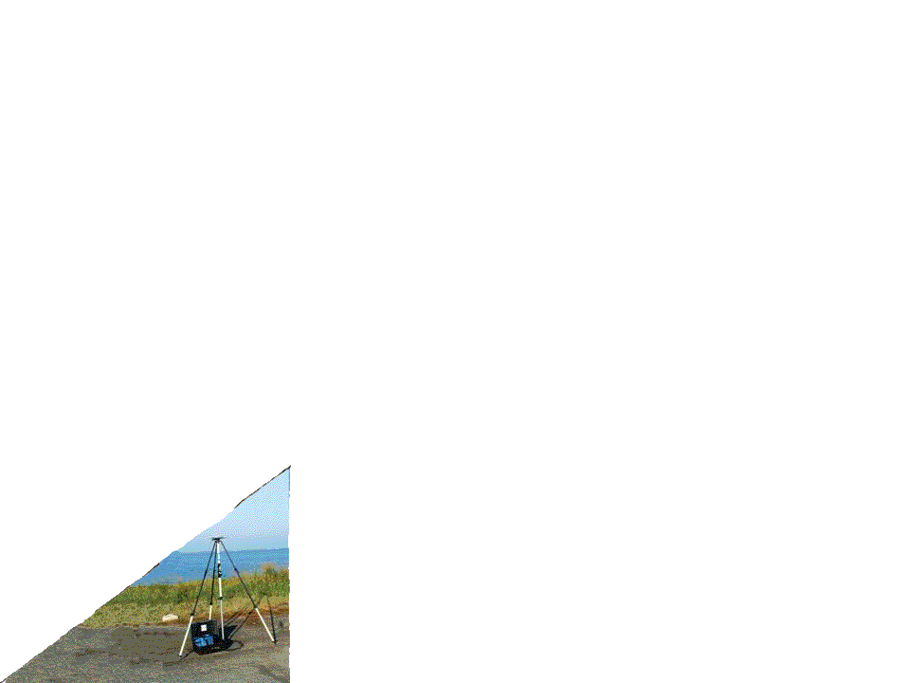
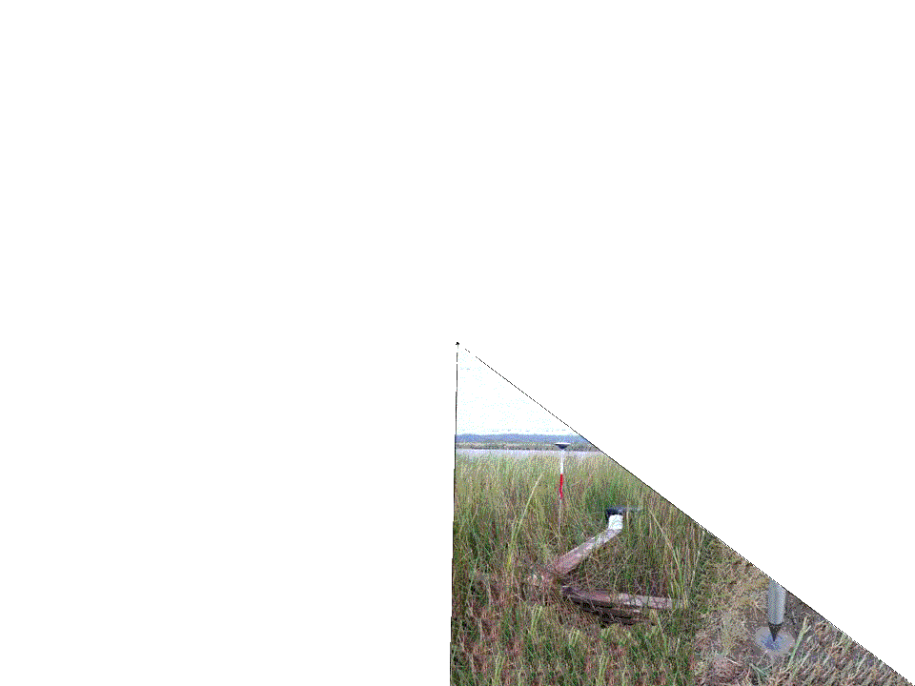
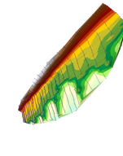
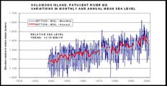
Notes:
The NGS Ecosystems and Climate Operations Team applies the science and expertise that have historically served our navigation responsibilities toward new non-traditional science and management applications in the coastal zone

Slide 10
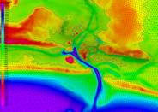
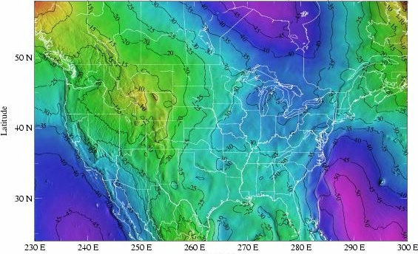
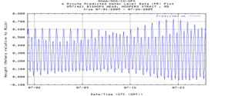
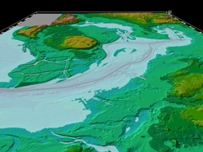
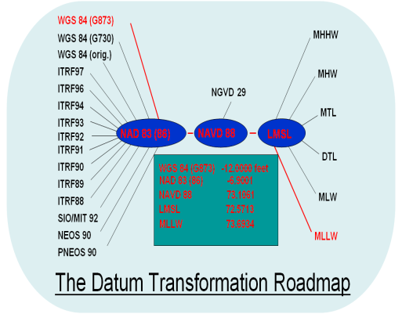
NOAA Data, Models, and Tools for Informing Adaptation Decisions
Water level data
Geodetic Data
Geophysical data
Models
Transformation programs
GIS applications
Subsidence/Crustal Movement

Slide 11
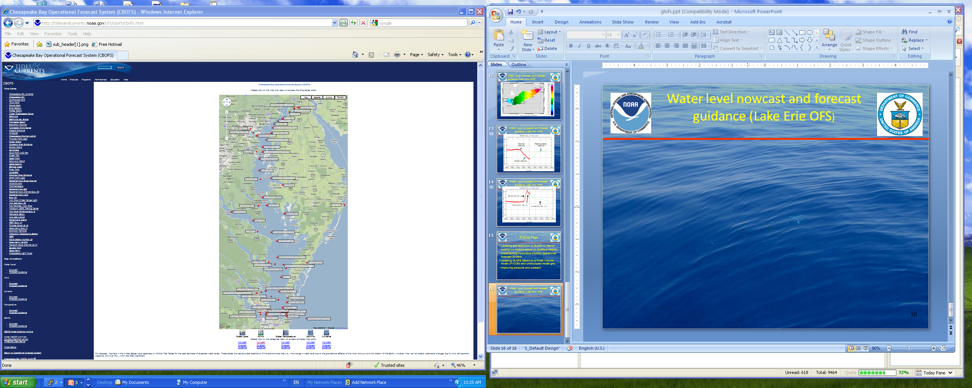
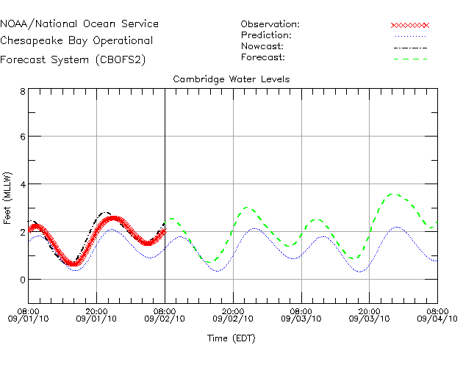
NOAA Coastal Operational Forecast System
Coastal ocean backbone to support navigation, hazards response, ecological
Web products used daily by coastal managers, maritime, navigation and emergency response communities.
Graphics on CO-OPS Web Site:
Water levels, currents, temperature, salinity, and surface winds at selected locations
Time series plots of selected locations, contour and vector map plots, animations
Notes:
Chesapeake Bay Operational Forecast System (CBOFS)
http://tidesandcurrents.noaa.gov/ofs/cbofs/cbofs.html

Slide 12
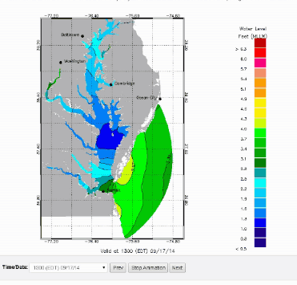
Chesapeake Bay Operational Forecast System – Water Levels
Notes:
Chesapeake Bay OFS Water Level Nowcast
http://tidesandcurrents.noaa.gov/ofs/ofs_animation.shtml?ofsregion=cb&subdomain=0&model_type=wl_nowcast

Slide 13
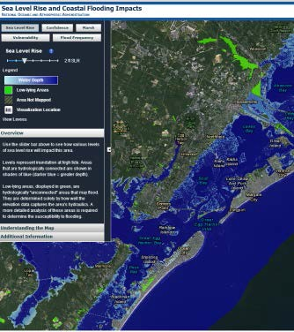
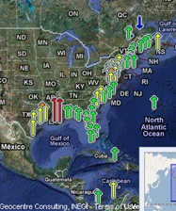
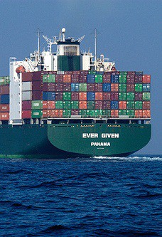
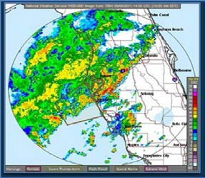
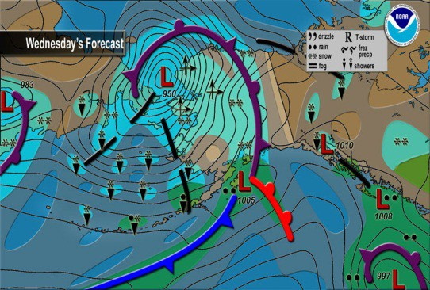
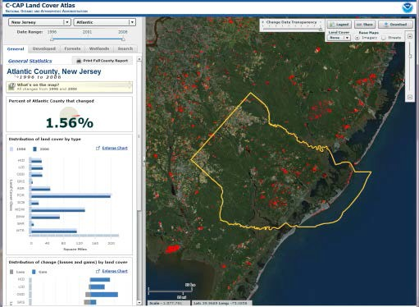
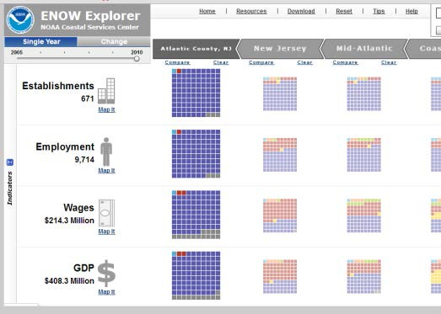
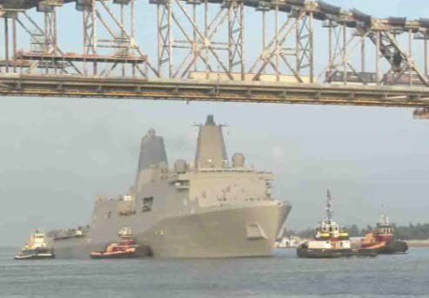
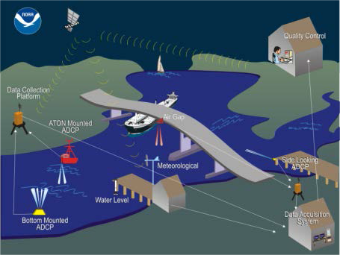
Coastal Intelligence
Planning for Long-Term Resilience
Promoting Resilience to Coastal Hazards and Climate Change
Building a Weather-Ready Nation
Supporting Community Livability
Ensuring Safe, Efficient, and Environmentally Sound Navigation
Notes:
http://oceanservice.noaa.gov/
Graphics (in order): Promoting Resilience to Hazards (SLR/Coastal Inundation Impact Assessments; Extreme Water Levels and Inundation Analysis; Foundational Data for Maritime Commerce, Transportation and Community Resilience). Weather Ready Nation-Marine Weather Forecasts (including Sea Ice Forecasts)). Community Livability (Coastal Change Analysis Program (C-CAP); Socio-Economics/ Social Science Analysis: E-NOW Application). Ensuring Safe, Efficient, Environmentally Sound Navigation (PORTS® System - The U.S. Navy LPD ship, the USS New York under the Huey P. Long Bridge just north of downtown New Orleans, Mississippi River, June ‘09); E-NAV and Electronic Chart Products; Shoreline/ Precise Positioning Services.

Slide 14
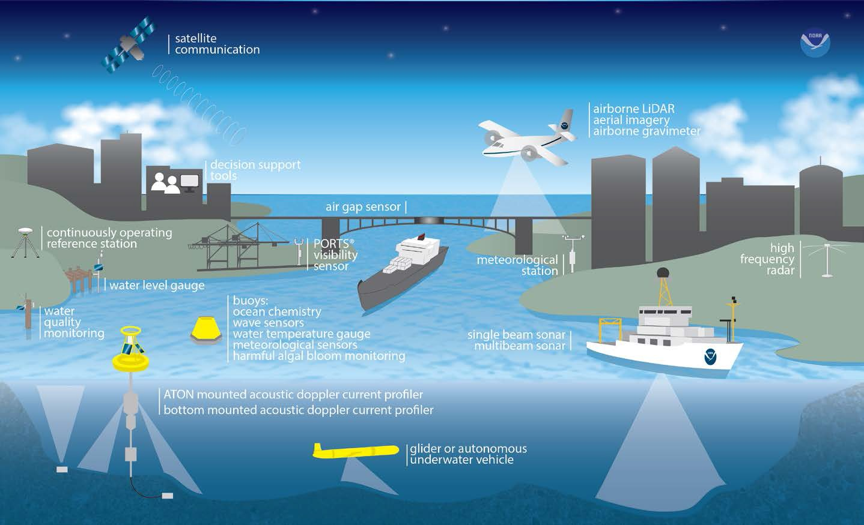
Coastal Intelligence: Foundational Data

Slide 15
Sea Levels, Subsidence, and Height Systems
Addressing issues of spatial and temporal scale and resolution

Slide 16
Sea Levels Overview
Sea Level is the mean level of the ocean’s surface.
Global sea level change is the spatial average over the entire ocean.
“Absolute” changes are due to actual water volume changes.
“Relative” changes are due to vertical land motion (subsidence) and hydrodynamic processes (currents)
Long-term variability is caused by climatic changes (glacial cycles), multi-year oceanic oscillations (i.e., ENSO), and from vertical land motion (i.e., subsidence and tectonic rebound)
Short-term variability is primarily from seasonal trends, atmospheric frontal activity and from the tides
Challenge: Assessing and Forecasting the Impacts of Relative Sea Level Rise on Coastal Communities and Ecosystems

Slide 17
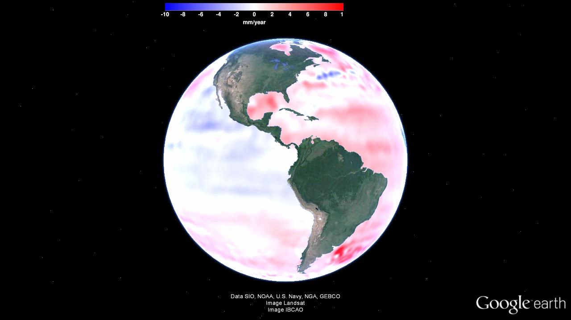
Global Sea Level Change

Slide 18
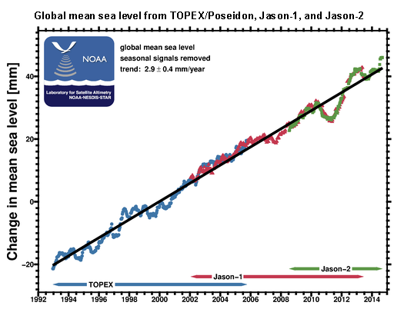
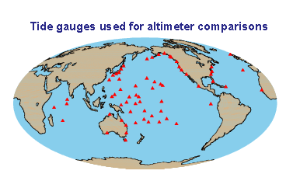

Satellite Altimetry Time Series

Slide 19
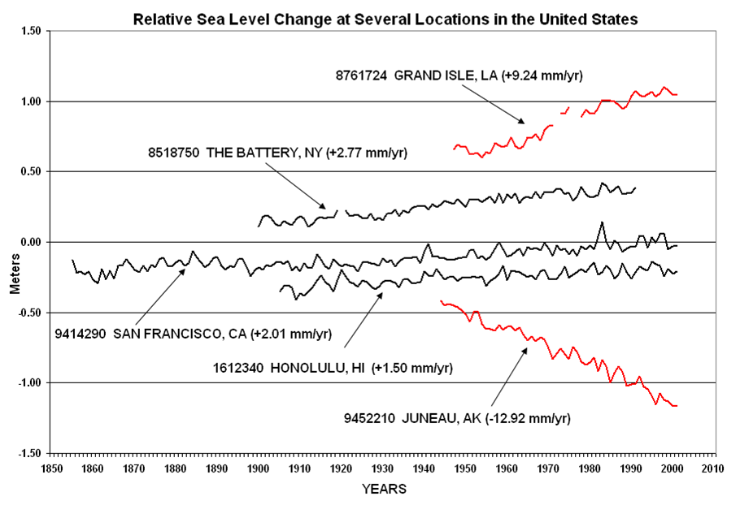
Highly variable relative sea level changes at tide stations

Slide 20
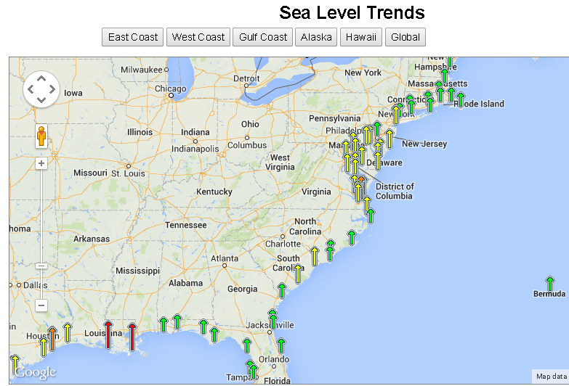
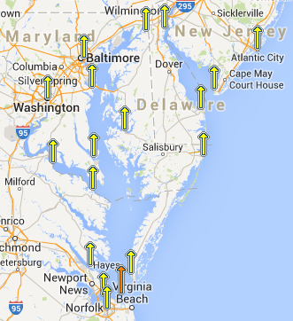
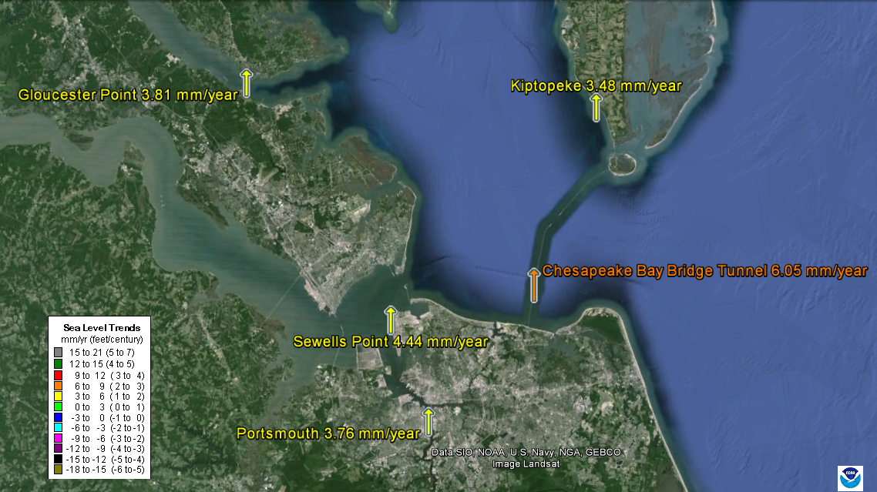
Regional Sea Level Trends
http://tidesandcurrents.noaa.gov/sltrends

Slide 21
Local Sea Level Trends
Station | Observation Length | SL Trend (mm/yr) | 95% Confidence (mm/yr)
Gloucester Point | 53 years | 3.81 | +/- 0.47
Sewell Point | 79 years | 4.44 | +/- 0.27
Portsmouth | 52 years | 3.76 | +/- 0.45
CBBT | 31 years | 6.05 | +/- 1.21
Kiptopeke | 55 years | 3.48 | +/- 0.42
–
Notes:
http://tidesandcurrents.noaa.gov/sltrends

Slide 22
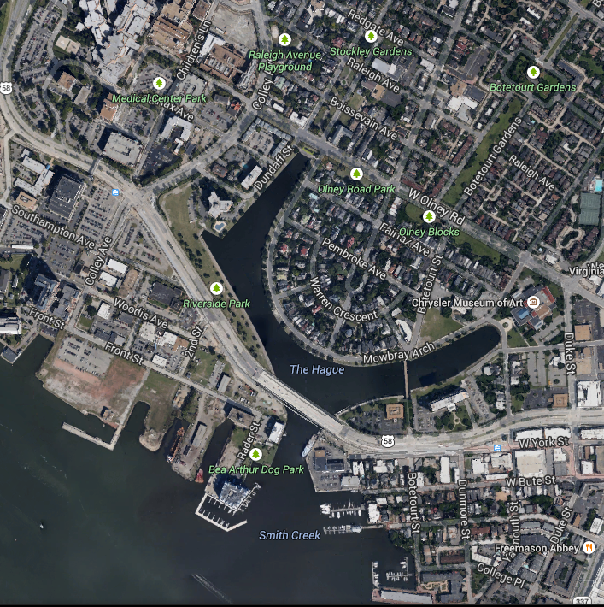
$318 million light-rail system –built at sea level
$318 million light-rail system — paid for primarily with federal funds -- was built at sea level
Before 1980, the Hague, had never flooded for more than 100 hours in a year. By 2009, it was routinely flooded for 200 hours/year.
from Washington Post 5/28/2014

Slide 23
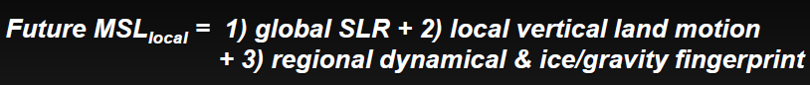
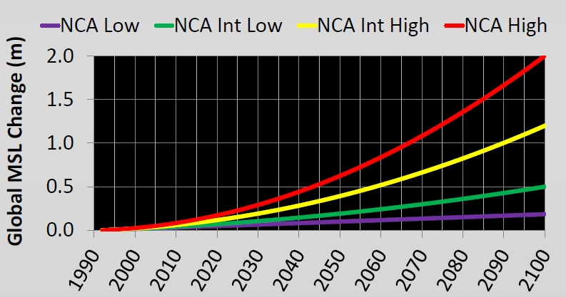
Tomorrow’s Concern: Accelerating SLR
2013 US National Climate Assessment (NCA) SLR Risk-framing Scenarios

Slide 24
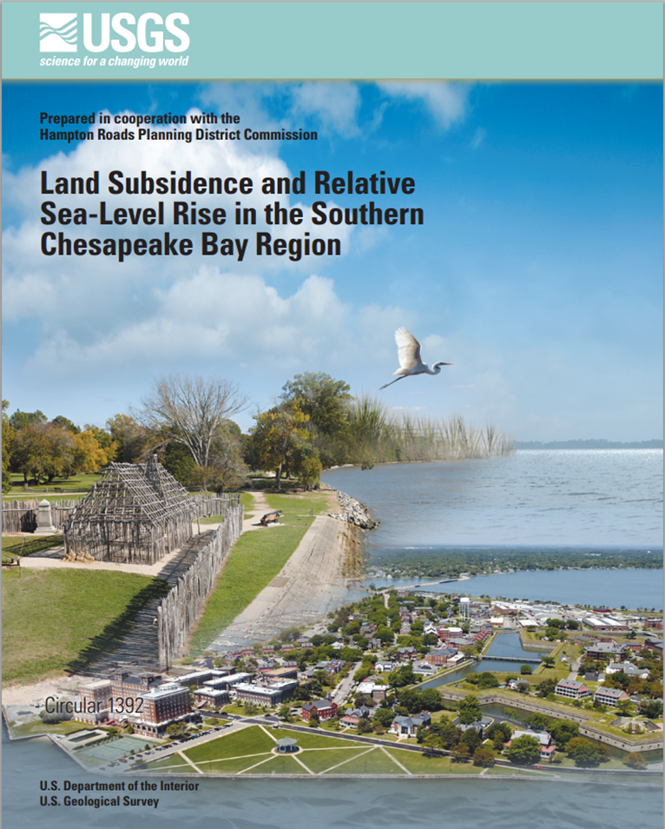
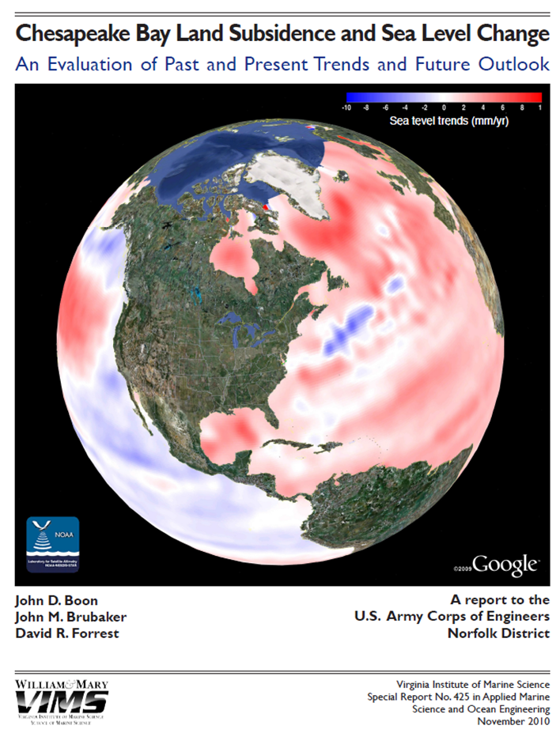
Recent Reports of Note
USGS Circular 1392 - 2013
VIMS - 2010

Slide 25
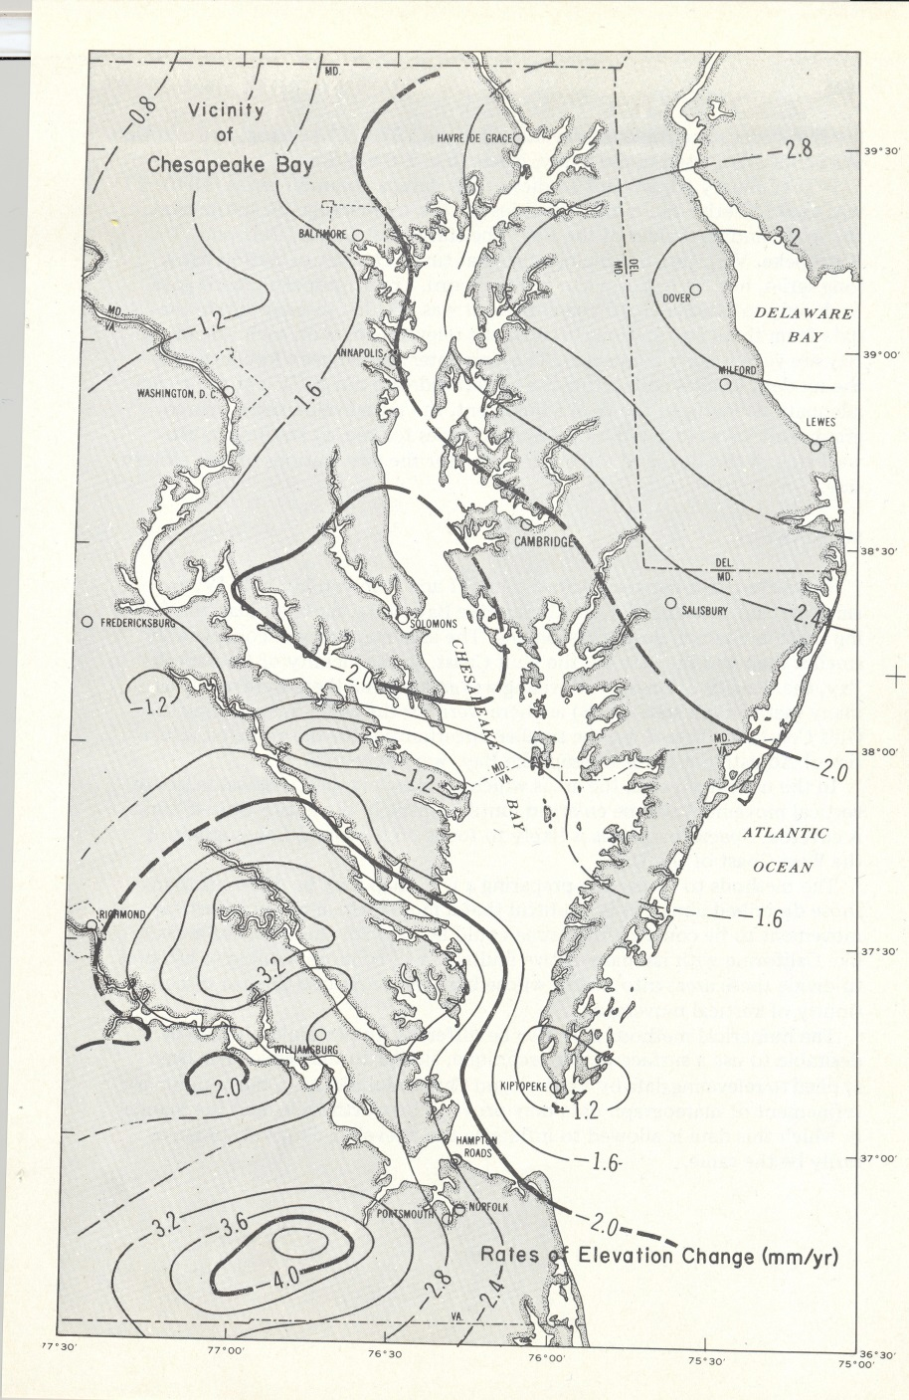
Subsidence in the area of Chesapeake Bay
1973 Report by S. Holdhal and N. Morrison
Rates of Elevation
Change (mm/yr)
IGS08
Vertical Velocity at Selected CORS
GAIT = - 0.0004
GODE = - 0.0011
BACO = - 0.0032*
CORB = - 0.0010
ANP6 = - 0.0016
VAGP = - 0.0027
HNPT = - 0.0024
VAWI = - 0.0043*
DRV6 = - 0.0033
VIMS = - 0.0034*
COVX = - 0.0016
* = Differs by more than 1 mm from
1973 estimates

Slide 26
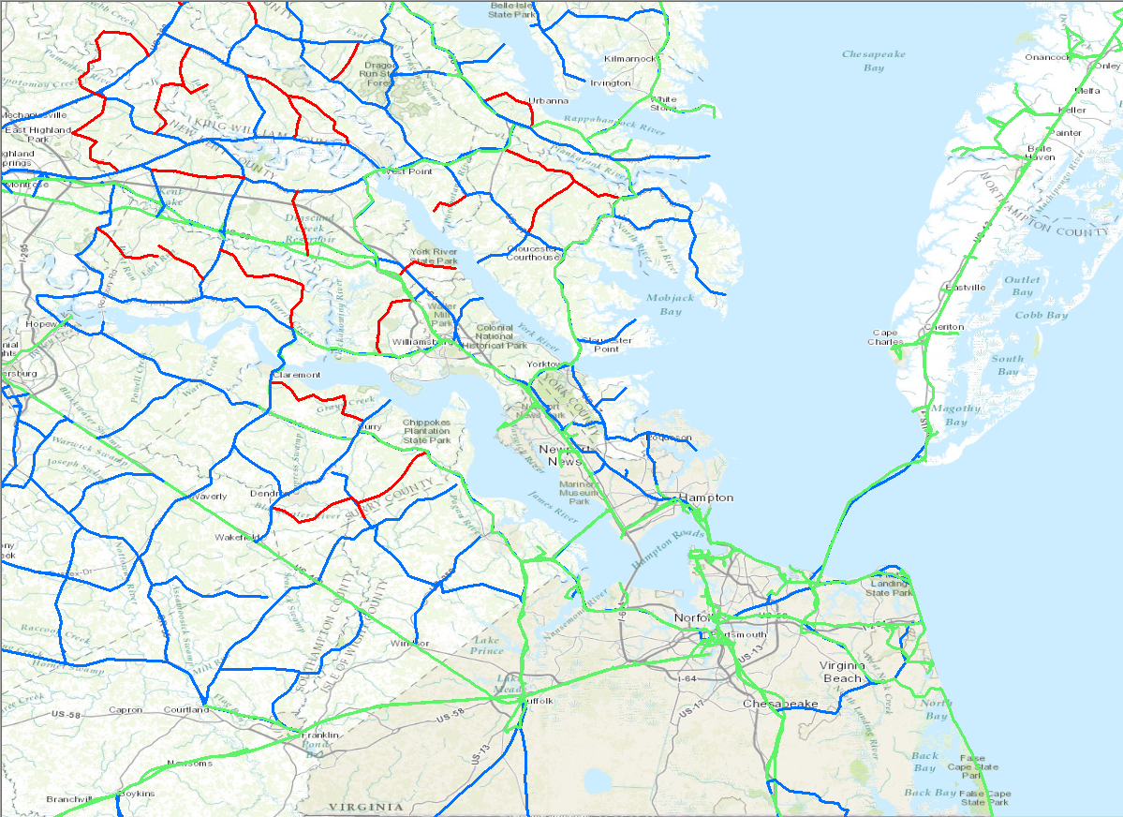

Level Lines in VA
Notes:
From NGS hgz files

Slide 27
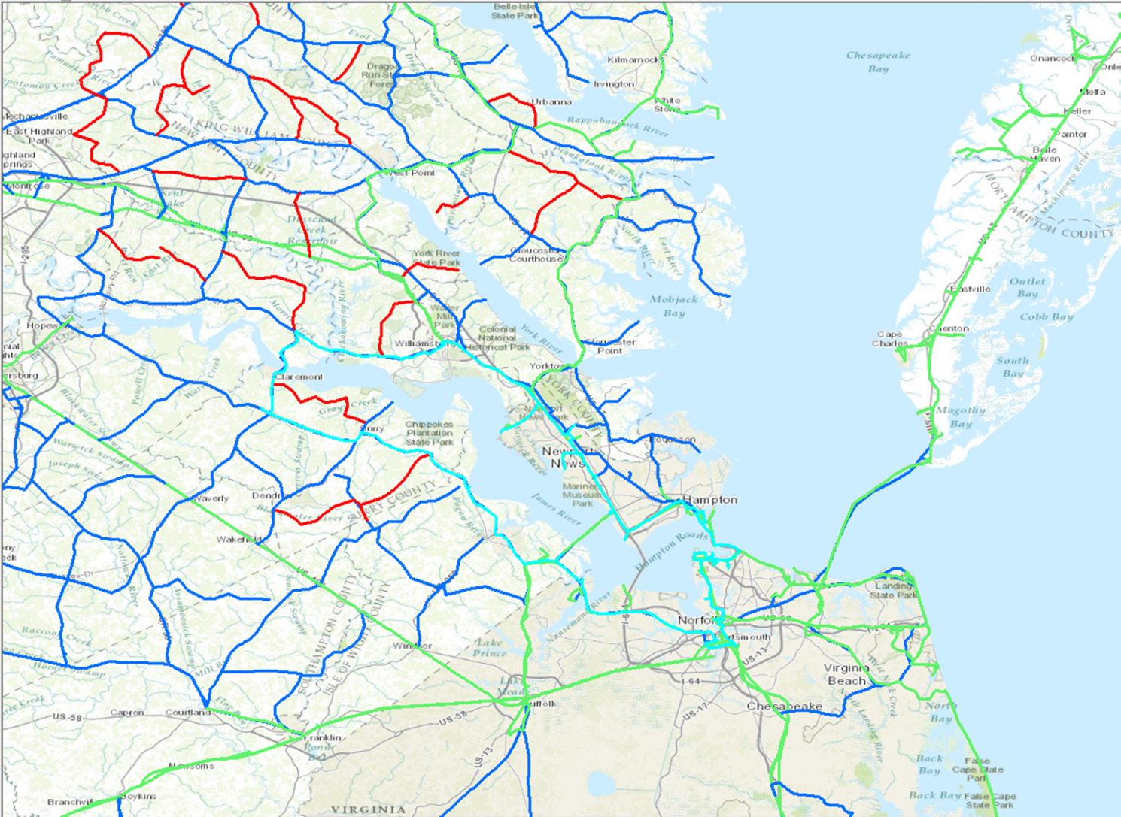
Level Lines in VA – L22443
James River Loop 1971

Slide 28
Subsidence and Bench Mark Height
1971: Leveling Performed
to bench mark
House
1971-1991: Subsidence
House
BM
BM
1991: Published NAVD 88 height for this BM is from 1971 leveling
H₈₈(published)
H₈₈(true)
NAVD 88 zero height surface
The published NAVD 88 height is no longer the true height for this BM-
2.8mm * 20 years = 5.6 cm (.183 feet) – NAVD88 published
2.8mm * 43 years = 12.4 cm (.406 feet) - Today
Notes:
2.8 mm/yr subsidence estimate from Hodahl and Morrison report 1973 (slide 25)

Slide 29
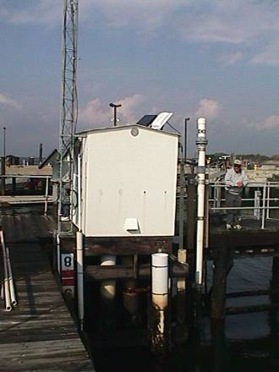
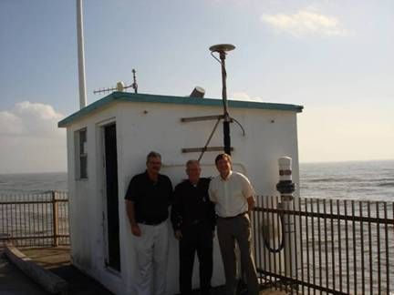
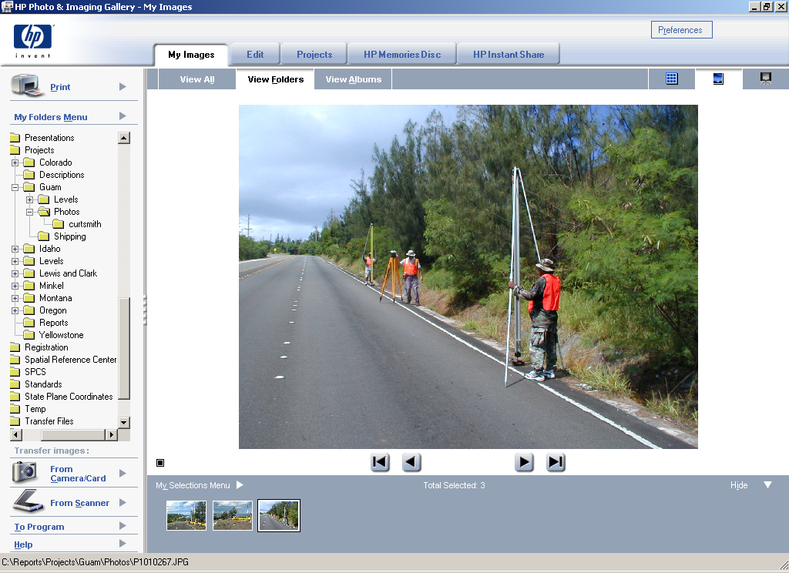
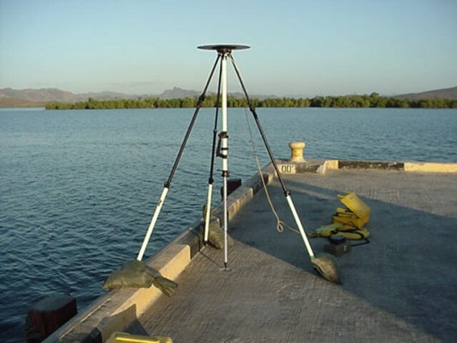
Vertical Datums - 3 Height Systems
A set of fundamental elevations to which other elevations are referred.
Tidal Datums (Tide Stations)
  Defined by observation of tidal variations over a specified epoch of time
    Mean Lower Low Water (MLLW)
    Mean Sea Level (MSL)
Orthometric Datums (Leveling)
  Related to the Geoid model of the Earth
  Heights from differential leveling
    North American Vertical Datum 1988 (NAVD 88)
Ellipsoidal (3-D) Datums (GPS)
  Related to an ellipsoidal model of the Earth
  Heights directly from GPS
    North American Datum 1983 (NAD 83)
    International Terrestrial Reference Frame (ITRF 08)
Notes:
NAVD 88 = Official Vertical Datum for US
The North American Vertical Datum 1988 (NAVD88) is that level surface that corresponds to mean sea level at Father’s Point, Quebec, Canada during the 1960 – 1978 National Tidal Datum Epoch
A Datum is Characterized by:
A set of physical monuments and published coordinates (horizontal and/or vertical) on the monuments

Slide 30
The ITRF
The International Earth Rotation and Reference Systems Service (IERS) is responsible for maintaining the International Terrestrial Reference Frame (ITRF).
Four Observing Systems are used to Compute ITRF:
Very Long Baseline Inteferometry (VLBI).
Satellite Laser Ranging (SLR).
Global Positioning System (GPS).
Doppler Orbitography Radiopositioning Integrated by Satellite (DORIS).

Slide 31
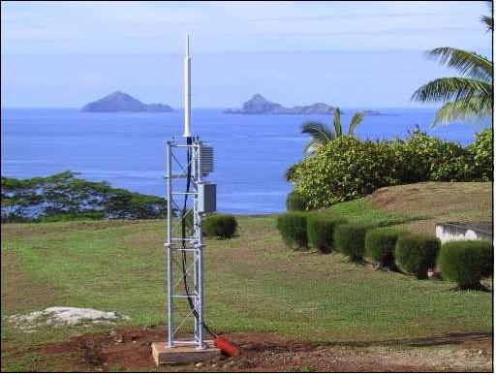
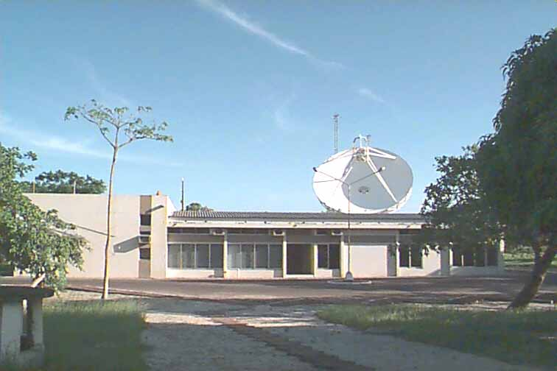
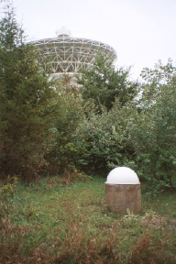


DORIS
VLBI
GPS
SLR

Slide 32
Sentinel sites

Slide 33


What are Sentinel Sites?
Selected locations in coastal and marine environments that have the operational capacity for intensive study and sustained observations to detect and understand changes in the ecosystems they represent.
Urban Sentinel Site??
The canaries in the coal mine…

Slide 34




Sentinel Stations
Sentinel Stations are discrete instruments and measurement platforms and sensors, within a consistent geospatial framework, that provide information and data which can be synthesized in order to provide an understanding of the ecological status and trends in physical (water level, surface elevation, etc.) and biological variables of interest, as well as knowledge of environmental state and past and present SLC impact indicators.

Slide 35




Goodwin Island “Sentinel Site”
Notes:
From Scott Lerberg – CBVA NERR
The Goodwin Islands are located at the mouth of the York River subestuary and are an archipelago of marsh islands surrounded by submerged aquatic vegetation (SAV) beds and shallow open estuarine waters. CBNERRVA with collaborators have developed the critical infrastructure and data analysis capacity to address both short-term, episodic impacts and longer-term trends in support of targeted habitat (e.g. submerged aquatic vegetation, emergent tidal marshes, and the marsh-forest ecotone) sentinel site designation; including:
• Emergent marsh and SAV transects to monitor changes in spatial distribution and community composition of vegetated habitats
• Surface Elevation Tables (SETs) co-located with vegetation transects to monitor surface elevation changes over time
• Groundwater monitoring to evaluate salt intrusion and water table and flooding dynamic
• NERRS System-Wide Monitoring Program (SWMP) water quality station tied through GPS techniques to tidal benchmarks of nearby NWLON Station
• A local geodetic control network tied to the National Spatial Reference System (NSRS and all monitoring components so measurements are collected on the same vertical datum
• Meteorological station
• Multi-decadal aerial image analysis of shoreline and vegetation community boundaries
• Local sea level and salt intrusion model
Increased understanding of physical conditions driving changes in habitat type and quality to support wetland inventories and develop strategies to increase adaptive capacity of vulnerable wetlands

Slide 36













Sentinel Site Program Vision
integrating multiple parallel efforts to promote resilient coastal communities and ecosystems in the face of climate change
Observe & Monitor
Spatial Analysis & Visualization
Management &
Decision Making
Applied Research
Education & Outreach
Models & Predictions
Information Transfer
Science
Service
Stewardship

Slide 37
Sentinel Site Program Mission
To improve understanding, long-range planning, and adaptation to climate change impacts focusing on sea level change and coastal inundation, in coastal communities through coordinated planning that involves NOAA trust resources such as the National Estuarine Research Reserves and National Marine Sanctuaries in partnership with federal, state and local partners within a scientifically relevant Sentinel Site Cooperative boundary.
Notes:
NOAA Sentinel Site Program Report
September 30th, 2011
http://oceanservice.noaa.gov/sentinelsites/pdf/Sentinel-Site-Program.pdf

Slide 38

Sentinel Site Cooperatives
The spatial extent for which the outputs, products, and services from all relevant Sentinel Sites and Sentinel Stations are both scientifically relevant and applicable to local management issues.
Notes:
NOAA Sentinel Site Program website:
http://oceanservice.noaa.gov/sentinelsites/

Slide 39
NOAA Sentinel Site Program (SSP):
Major Components
Community: socio-economic systems
Sentinel Site Cooperative: entire spatial extent
Sentinel Site: Managed, protected areas
Sentinel Station: Instrument and measurement platforms
Sentinel
Site #1
Sentinel
Site #2
Community:
People and Infrastructure
Sentinel
Site #3
Notes:
INTRODUCTION
In 2011, the National Oceanic and Atmospheric Administration (NOAA) initiated a Sentinel Site Program (SSP) to encourage federal, state and local partners to cooperatively address impacts of climate change using a place-based approach, with an initial emphasis on supporting resilience to sea level change and coastal inundation.
This program builds on the strengths of NOAA’s National Estuarine Research Reserve Systems (NERRS) Sentinel Site program.
It describes the Cooperative’s strategic and operational approach to engaging a continuum of capabilities from observations and research to application, management, and outreach to address local impacts of sea level change and inundation
Sentinel Station. Instruments and measurement stations (platforms and sensors) located within a geospatial framework, that provide information and data that can be synthesized to provide an understanding of the variables of interest.
Sentinel Site. Areas in coastal and marine environments that have the operational capacity for intensive study and sustained observations to detect and understand changes in the ecosystems they represent.
Sentinel Site Cooperative. Spatial extent for which the outputs, products, and services from all applicable Sentinel Sites are scientifically relevant and applicable to
local management issues. Cooperatives bound not only the physical and biological data, but also the socioeconomic information necessary to deliver useful products to coastal communities. Continuum from data collection and processing to outreach and management actions.

Slide 40

National Estuarine Research Reserve System (NERRS)
Notes:
28 Reserves , protecting > 1.3 million acres of coastal and estuarine habitats representing major biogeographical regions.
As of 2014, The NERRS Sentinel Sites include the majority of the east coast reserves, three in the Gulf of Mexico, two of the four west coast reserves, and one each in the Great Lakes and Alaska.

Slide 41

Notes:
Shows Sentinel Buildout at Waquoit Bay.

Slide 42





North Inlet Winyah Bay
Assess the effects of sea level on the physical and biological structure of intertidal marsh along an elevation gradient from creek bank to upland edge within the North Inlet estuary.
Forest edge & Juncus high marsh
Segment
A
SWMP site & NOAA tide gauge
Segment
B
Mixed meadow & Salicornia
mid-marsh
permanent plots
SETs
0.0
0.5
1.0 Km
Spartina low marsh
Notes:
Project goal: Assess the effects of sea level on the physical and biological structure of intertidal marsh along an elevation gradient from creek bank to upland edge within the North Inlet estuary.
→ Quantify horizontal & vertical rates of change in response to sea level variability.
→ Understand factors regulating plant community dynamics in relation to marsh migration and upland transgression.

Slide 43

CBSSC Sentinel Sites
Blackwater National Wildlife Refuge
Assateague Island National Seashore
Chesapeake Bay NERR (MD)
  Otter Point Creek
  Jug Bay
  Monie Bay
Chesapeake Bay NERR (VA)
  Sweet Hall Marsh
  Taskinas Creek
  Catlett Islands
  Goodwin Islands
Virginia Eastern Shore LTER
Notes:
Current locations identified as sentinel sites as part of the Chesapeake Bay Sentinel Site Implementation Plan. Long term monitoring efforts are present at each location.
http://oceanservice.noaa.gov/sentinelsites/chesapeake.html

Slide 44

Sweet Hall Marsh
Chesapeake Bay VA NERR
Four Components of Chesapeake Bay NERR in Virginia
Sweet Hall
Taskinas Creek
Catlett Island
Goodwin Islands
Notes:
In order to incorporate the diversity of habitats in the southern Chesapeake Bay subregion, CBVA NERR established a multi-component system along the salinity gradient of the York River estuary.
Reserve components include Sweet Hall Marsh, Taskinas Creek, Catlett Islands and the Goodwin Islands
44

Slide 45

Chesapeake Bay Sentinel Site Cooperative
 | Current Participants
Federal | NOAA, USGS, USFWS, NPS, EPA, USACE
State | MD DNR, VA DEQ
Academic | UMD, VIMS, ODU, VCU, CNU
NGO | MARACOOS, NWF, TNC, CBF
http://www.vims.edu/cbnerr/CBSSC/
Notes:
http://www.vims.edu/cbnerr/CBSSC/

Slide 46
Chesapeake Bay Sentinel Site Cooperative
GOAL 1: Governments, NGOs, and academic institutions have greater access to more reliable and integrated ecosystem and socio-economic data.
GOAL 2: Local governments and land and natural resource managers have decision support tools to effectively prepare for, respond to, and recover from current and anticipated sea level rise and other related climate change impacts.
GOAL 3: Coastal stakeholders and the general public understand and trust information on sea level change and coastal inundation hazards, and the severity of related impacts to Chesapeake Bay habitats, ecosystems, and built environments.
Notes:
Chesapeake Bay Sentinel Site Cooperative
Implementation Plan
FY13-FY18
http://www.vims.edu/cbnerr/ChesapeakeBay_SentinelSiteCooperative_IP_FY13FY17_FINAL.pdf

Slide 47






Chesapeake Bay VA NERR
Notes:
Geospatial Infrastructure Training at CBVA NERR

Slide 48
Surface Elevation Table (SET)
Bench Mark with Geodetic Control (NAVD88, etc.)
Tide Station
Surface Accretion
Initial Wetland Surface
Elevation Change
Upland
Subsided Wetland Surface
Rise
Sea Level
Marker Horizon
Depth of SET measurement integration
Shallow Subsidence
Deep Subsidence

Slide 49


NWLON
National Water Level Observation Network (NWLON)
A network of continuously operating tide stations that are the foundation for NOAA’s tide prediction products
The network provides:
water level
wind speed and direction
barometric pressure
air and water temperature
conductivity/temp
Notes:
http://tidesandcurrents.noaa.gov/nwlon.html

Slide 50



CORS Network
Continuously Operating Reference Stations (CORS)
A multi-purpose cooperative network providing
3-dimensional positioning
Will incorporate results from GRAV-D for increased accuracy of vertical positioning
Co-locating with other instruments increases overall knowledge
Built with partners in the public and private sectors, including state and local governments, universities, and private businesses
Notes:
http://geodesy.noaa.gov/CORS/

Slide 51


SET Technology
Surface Elevation Tables (SETs)
Portable leveling device to measure relative elevation of wetland sediments.
SETs monitor coastal land elevation relative to local sea level rise
Provides further understanding to processes leading to the formulation and maintenance of coastal elevation
Notes:
The SET is a device that has been developed over the past decade to measure incremental changes in wetland and shallow water surfaces over time with respect to a bench mark that is inserted into the sediment until refusal.
The SET was developed to understand processes leading to the formation & maintenance of coastal elevation.
Land loss is an incremental thing. Satellite imagery will tell you when the wetland is lost, not what it’s doing leading up to that loss. Elevation may be lost at rates on the order of millimeters per year - Being able to measure that loss requires precise measurements over time, and under different experimental conditions.
The Surface Elevation Table, or SET, was developed in the Mississippi Delta to support investigations into the processes leading to wetland loss.
SETs were developed to allow the investigator to monitor relative changes in coastal wetland elevation.
SETs also allow one to investigate the processes leading to changes in elevation.
SETs have also been used in experimental settings, testing the effect of different treatments such as fire or fertilization on wetland elevation.

Slide 52











CORS/SETs/Tide Stations /Benchmarks
Survey Control Monuments
Continuously Operating (GPS) Reference Stations (CORS)
Land Elevation Trend -1.1mm/yr
Local Sea-Level Rise 3.29 mm/yr
Surface Elevation Tables (SETs)
Wetland elevation dynamics
Long Term Tide Stations
Local Marsh Trajectory - 2.1mm/yr
Notes:
Three observing systems all tied to a local network of high-accuracy survey control monuments

Slide 53



OVERVIEW – Applications - Future
NOAA Shoreline Mapping Capability
RGB
Near-IR
LIDAR Point Cloud

Slide 54



Static GPS Differential Survey
Establish control network and monitor stability
Occupation Time: Two separate GPS constellations for 4-6 hrs each
Real Time Kinematic (RTK)
GPS Differential Survey
Positioning remote points; digital elevation models
• Occupation Time: 10-30 seconds
Geodetic Digital Leveling
Monitor network connections and stability
Time dependent on distance and resources
Notes:
Surveying techniques used for developing Sentinel Site Geospatial Infrastructure

Slide 55




Supporting Geospatial Infrastructure Components
Water Quality Stations
Monitoring Wells and
Transect Surface Elevations
Vegetation Plots
Erosion Pins
Notes:
Biogeophysical monitoring stations that can be tied to local vertical control network

Slide 56

Geospatial Infrastructure Guidelines
Notes:
Pending release in late 2014

Slide 57
NGS Tools & Updates

Slide 58

Historic T-sheets
1854 Entrance to Hampton Roads
Notes:
http://nosimagery.noaa.gov/images/shoreline_surveys/noaa_shoreline_surveys.kmz

Slide 59

Historic T-Sheets

Slide 60

Historic T-Sheets

Slide 61


OPUS Shared Solutions
Notes:
http://www.ngs.noaa.gov/OPUS/showMarks.jsp

Slide 62


OPUS-Projects
Officially operational Jan 2014
Enhancement to OPUS-Static
Network solution of GPS data from multiple receivers and occupations
Intuitive graphical user interface
Requires attending training to get access
Notes:
http://www.ngs.noaa.gov/OPUS-Projects/OpusProjects.shtml

Slide 63

LOCUS – Leveling Online Calculation Service
Provides tools for users to submit vertical control data, either from an optical or digital instrument, perform the necessary reductions, apply the needed constraints, and compute elevations through a standard least squares adjustment process.
Notes:
http://www.ngs.noaa.gov/CORS-Proxy/locus/

Slide 64

New Datums Coming in 2022
A new geometric and a new geopotential (vertical) datum will be released together in 2022
The realization of the new datums will be through GNSS receivers
NGS will provide tools to allow for easy transformation between the new and old datums
Notes:
Both datums will be released together in 2022
- NGS will provide tools to allow for easy transformation between the new and old datums
- The realization of the new datums will be through GNSS receivers
- We expect to assign values to all BMs that have GPS observations
- NGS will develop standards and specifications for how to best blend the controlled leveling survey with the new methods of accessing the datum

Slide 65





GRAV-D:
Gravity for the Redefinition of the American Vertical Datum
Nationwide airborne gravity collection essential for the definition of an improved national vertical reference system
Profound implications for GPS elevation accuracy:
national elevations with GPS to ~ 2cm
compared to as much as 2 meters today
Aerial Gravity Collection
for a new national
vertical datum
Notes:
Talking points:
Oct ’07 : NGS Acquires Airborne Gravimeter
Nov ’07 : NGS Releases Final Version of the GRAV-D plan
Nov ’07 : NGS Trains Airborne Gravimeter Operators
Jan/Feb ‘08 : NGS conducts successful test flights of gravimeter along Gulf Coast
NOAA’s National Geodetic Survey (NGS) conducted test flights in Mississippi and Alabama in January, 2008 using its recently acquired airborne gravimeter in support of the Gravity for the Redefinition of the American Vertical Datum (GRAV-D) program. GRAV-D is an effort to use gravity data to re-define the vertical datum of the United States by 2017. In support of these tests, NGS also performed ground based reconnaissance in a grid that is approximately 140k north-south and 250k east-west covering southern Alabama and Mississippi. Hundreds of grid points were observed using GPS and relative gravity meters. This information will be used to "truth" the data that is collected by the airborne gravimeter.
The GRAV-D program has profound implications for all activities (inside and outside of NOAA) which rely upon accurate heights.

Slide 66

GRAV-D:
Gravity for the Redefinition of the American Vertical Datum
Enabling coastal communities to:
improve flood protection infrastructure
plan evacuation routes
model storm surge
monitor sea-level rise
monitor levee subsidence
improve flood plain maps
Notes:
Talking points:
Oct ’07 : NGS Acquires Airborne Gravimeter
Nov ’07 : NGS Releases Final Version of the GRAV-D plan
Nov ’07 : NGS Trains Airborne Gravimeter Operators
Jan/Feb ‘08 : NGS conducts successful test flights of gravimeter along Gulf Coast
NOAA’s National Geodetic Survey (NGS) conducted test flights in Mississippi and Alabama in January, 2008 using its recently acquired airborne gravimeter in support of the Gravity for the Redefinition of the American Vertical Datum (GRAV-D) program. GRAV-D is an effort to use gravity data to re-define the vertical datum of the United States by 2017. In support of these tests, NGS also performed ground based reconnaissance in a grid that is approximately 140k north-south and 250k east-west covering southern Alabama and Mississippi. Hundreds of grid points were observed using GPS and relative gravity meters. This information will be used to "truth" the data that is collected by the airborne gravimeter.
The GRAV-D program has profound implications for all activities (inside and outside of NOAA) which rely upon accurate heights.

Slide 67

Geoid 12A Accuracy map
Notes:
http://www.ngs.noaa.gov/GEOID/

Slide 68

Notes:
GPS observations on Benchmarks used to create Geoid 12A

Slide 69


Geoid 12A in VA

Slide 70

Geoid Slope Validation Survey of 2014 (GSVS14)
Research toward new vertical datum
E-W line across Iowa
Observations began in May 2014
Includes:
  Differential leveling
  GPS
  Terrestrial gravity
  Aerial gravity
  Deflection of vertical
This is the second GSVS project
  First in 2011 in Texas (GSVS11)

Slide 71


NGS 58/59 update project
An update for guidelines on GNSS-derived ellipsoid and orthometric heights
Two phases
  Vertical precision (FL)
  GPS bench mark Height Mod (SC)
Fieldwork done Dec 2013
Analysis of data underway
Will be used for new guidelines to replace
NGS 58/59 documents

Slide 72
NOAA Resources

Slide 73

http://csc.noaa.gov/slr/viewer/

Slide 74


Shallow Flood Frequency

Slide 75
Coastal Inundation Landmark Project
Our Goal
Improve community resilience to coastal flooding by providing consistency across water level data and cultivating partnerships to successfully incorporate this data into community planning and response.
What is a Coastal Inundation Landmark?
Familiar community locations referenced to a single benchmark
These locations will be socially relevant to the community (statues, historic sites) and important to the planning process of local emergency managers and government (metro station, fire station).
Why are Coastal Inundation Landmarks Needed?
Better communication around the extent and impacts from flooding
Supporting storm surge forecasting by reporting on the ground impacts throughout a storm
Eliminating the confusion around referencing water height over ground in our storm forecasting efforts
What can this provide to our users?
Technical basis for more effective and accurate communication of water levels during nuisance flooding, storm surge inundation, and long-term sea level rise
Consistency of water level information
A frame of reference for historical events
Real-time water level data in relation to familiar locations

Slide 76


Notes:
http://tidesandcurrents.noaa.gov/publications/Technical_Report_NOS_CO-OPS_065.pdf
http://tidesandcurrents.noaa.gov/publications/NOAA_Technical_Report_NOS_COOPS_073.pdf

Slide 77

Notes:
From Dr. Billy Sweet, NOAA CO-OPS, presentation at TechSurge 2014
Available here: http://mtshamptonroads.org/mtshr/?page_id=419

Slide 78

Notes:
From Dr. Billy Sweet, NOAA CO-OPS, presentation at TechSurge 2014
Available here: http://mtshamptonroads.org/mtshr/?page_id=419

Slide 79

Notes:
From Dr. Billy Sweet, NOAA CO-OPS, presentation at TechSurge 2014
Available here: http://mtshamptonroads.org/mtshr/?page_id=419

Slide 80

GPS on bench marks campaign
Will help improve next hybrid geoid model and conversion to new 2022 vertical datum
Can provide a time series on specific marks of interest.
Notes:
Volunteers occupied leveled bench marks with GPS
Performed during GPS Week (Mar 16-22)
Record number of shared OPUS solutions

