Slide 1
Confirming 1 cm differential
geoid accuracy: The Geoid Slope Validation Survey of 2011
Dru Smith¹, Simon Holmes¹, Xiaopeng Li¹,
Sébastien Guillaume², Yan Wang¹,
Beat Bürki², Dan Roman¹, Mark Eckl¹
GGHS2012
Venice, Italy
1 = NOAA’s National Geodetic Survey
2 = Institute of Geodesy and Photogrammetry,
ETH Zurich, Switzerland
Notes:
This presentation was presented by Mark Eckl at GGHS 2012, in Venice, Italy.

Slide 2
Genesis of the survey
“...the gravimetric geoid used in defining
the future vertical datum of the United States should have an absolute accuracy of 1 centimeter at any place and at any time.”
-- The NGS 10 year plan (2008-2018)
Admirable!...Achievable?
Notes:
The above quote refers to one of many ambitious goals in the NGS 10 year plan. While admirable, its achievability remains an open question. In order to begin addressing the actual achievable accuracy of a gravimetric geoid model, NGS will engage in a variety of testing methods prior to the 2022 date when the gravimetric geoid will serve as the reference surface for a new vertical datum. The first such testing method took place in the summer of 2011 and is known as the Geoid Slope Validation Survey of 2011, or GSVS11. As its name implies, this survey tested the accuracy of differential geoid undulations between points ("geoid slopes") from NGS's gravimetric geoid models. The baseline for comparison will be independently computed geoid slopes from two methods, GPS and leveling as well as Deflections of the Vertical.

Slide 3
Goal of the survey
Observe geoid shape (slope) using multiple independent terrestrial survey methods
  GPS + Leveling
  Deflections of the Vertical
Compare observed slopes (from terrestrial surveys) to modeled slopes (from gravimetry or satellites)
  With / Without new GRAV-D airborne gravity
Notes:
Although a geoid slope validation survey won’t validate the absolute accuracy of the geoid model, it will help point out weakness in data and theory. The accuracy of the terrestrial surveys will be the best achievable, and formal accuracy estimates will be used to bound allowable disagreements with modeled geoid slopes.

Slide 4
Why not rely on existing surveys?
Most existing marks are not GPS or gravity friendly
Existing leveling is decades old
Existing leveling and GPS are tied to unmonitored passive control coordinates
Overlap of existing gravity, GPS or leveling is minimal in space and widely separated in time
Notes:
The standard method of validating gravimetric geoid models (and creating hybrid geoid models) is through a comparison with existing GPS-derived heights on benchmarks with leveling-derived orthometric heights. However such data has many disadvantages, listed here.

Slide 5

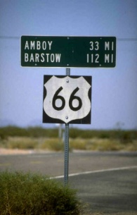



Choosing the Place and Time for a New Survey
Criteria:
  Significantly exceed 100 km
  Under existing GRAV-D data
  Avoid trees and woods
  Along major roads
  Cloud-free nights
  No major bridges along the route
  Low elevations
  Significant geoid slope
  Inexpensive travel costs
Notes:
The reasons for the above are:
>100 km : to allow for direct comparison to GOCE and GRACE
Under GRAV-D : So that geoids with/without airborne gravity can be compared
Avoid woods: Better GPS visibility
Roads: Ease of accessibility
Cloud-Free Nights: For the DoV camera to see the stars
Bridges: To avoid “river crossings” in the geodetic leveling
Low Elevations: So the errors from correcting from surface data to the geoid are minimized
Geoid slope: To have an interesting signal to choose from
Travel costs: To minimize cost of survey

Slide 6
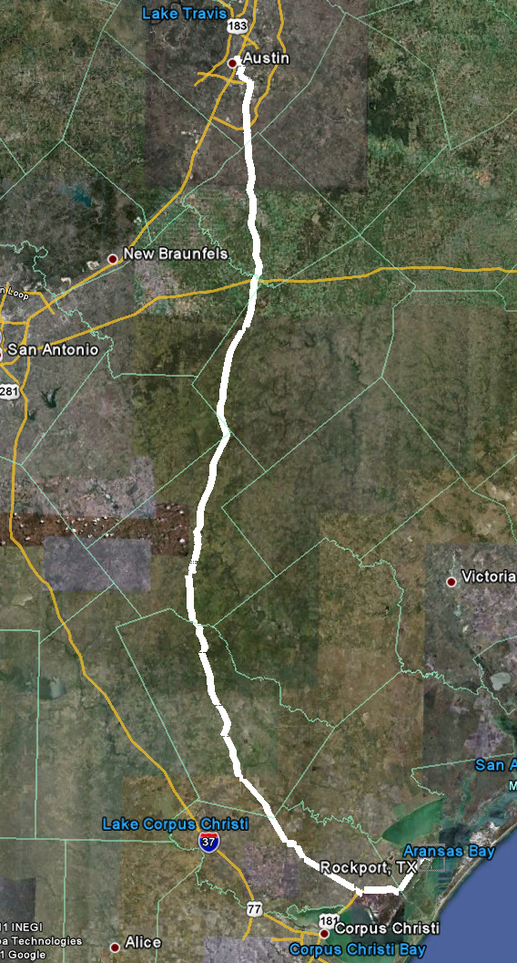
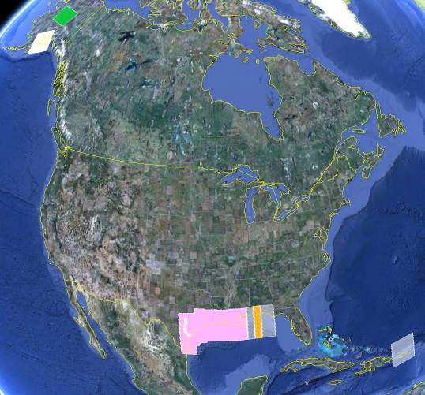
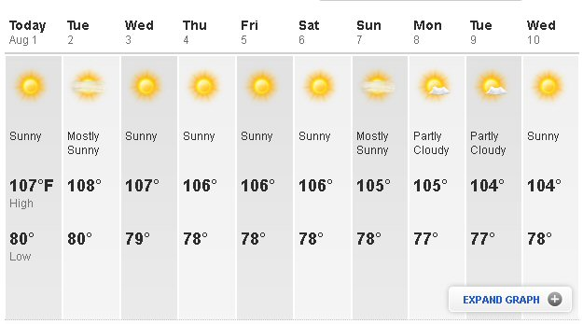
The Chosen Line
325 km
218 points
1.5 km spacing
South Texas
July-October, 2011
hot…Hot…HOT!
Notes:
The final line was a 325 km stretch from downtown Austin, Texas (North end) to Rockport, Texas (South end). There were 218 official survey points along the line, with an average spacing of 1.5 km between them. The shaded areas in the above picture were the existing GRAV-D data at the time of planning GSVS11 (since expanded). Although the weather report looks extreme, most surveying was done in the milder times of day.

Slide 7
Surveys Performed
GPS: 20 identical. units, 10/day leapfrog, 40 hrs ea.
Leveling: 1st order, class II, digital barcode leveling
Gravity: FG-5 and A-10 anchors, 4 L/R in 2 teams
DoV: ETH Zurich DIADEM GPS & camera system
LIDAR: Riegl Q680i-D, 2 pt/m² spacing, 0.5 km width
Imagery: Applanix 439 RGB DualCam, 5000’ AGL
Other:
  RTN, short-session GPS, extra gravity marks around Austin, gravity gradients

Slide 8
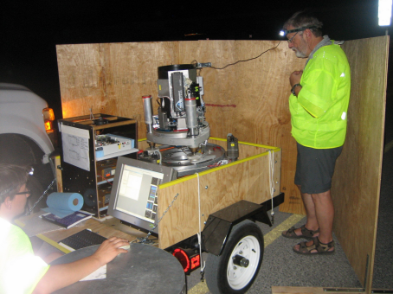
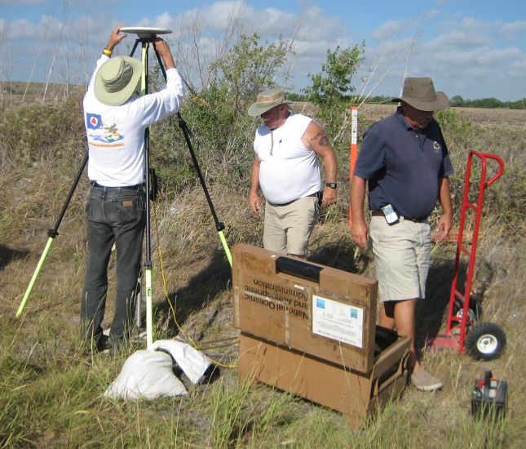
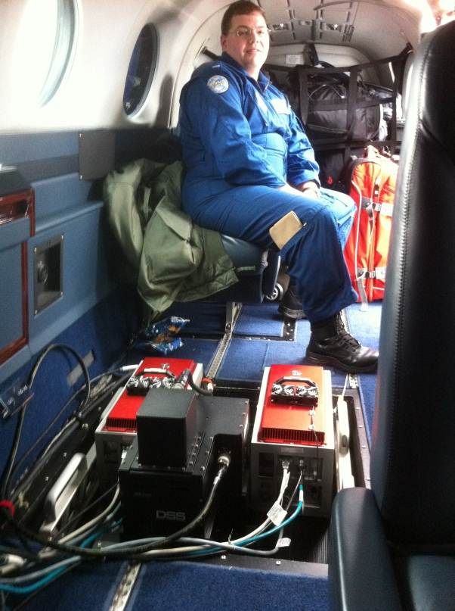
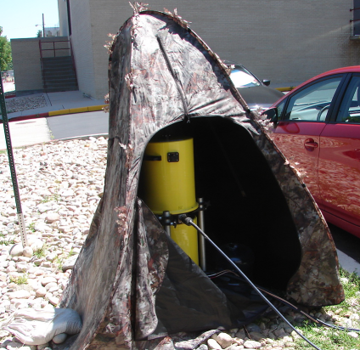
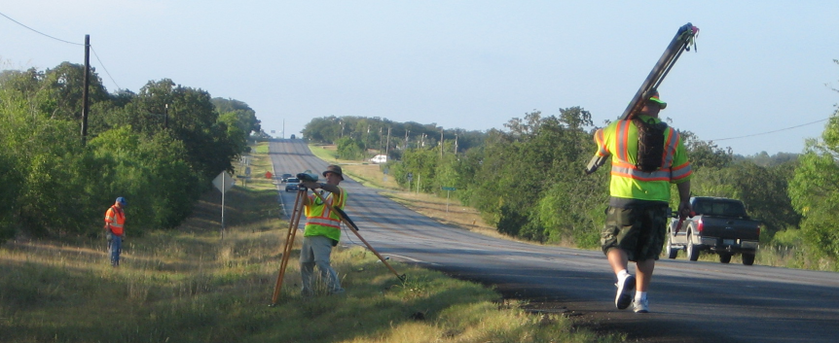
GPS
LIDAR/
Imagery
DoV
Gravity
Leveling
Notes:
These are just a small sampling of the field crews in action. Not shown are the RTN, FG-5, short-session GPS, relative gravity, gravity gradients and mark setting crews.

Slide 9

Empirical Error Estimates
σ_{Δh} (OPUS-S) : 2 - 6 cm
  GPSCOM combination: ~ 4 mm
  (no significant baseline dependency)
=> 16 mm RMS over GSVS11
σ_{ξ} , σ_{η} : 0.06 arcseconds
  ~ 0.43 mm / 1.5 km => 6.6 mm RMS over GSVS11
Notes:
These values are empirical estimates coming from various sources.
For the differential ellipsoid height accuracies, these come from either the OPUS-S runs, showing peak-to-peak error, or else
from a least squares adjustment of all the data, showing a baseline-length-independent ~4mm (give or take 2 mm) error
between any two of the 218 points.
For the differential orthometric height accuracy, the value quoted is the 1st Order, Class II relative maximum
elevation difference accuracy is 0.7 mm per (sq.rt. km) based on Table 2.2 of FGCC Standards and Specifications
for Geodetic Control Networks.
For the Deflections of the Vertical, the expected error for the DIADEM camera was 0.1 arc seconds, but the
empirically determined accuracy estimates from the data itself were 0.06 arcseconds. This corresponds to about 0.43 mm over 1.5 km, which, added in an RMS sense over 218 points yields a highly optimistic 6.6 mm of RMS over the entire line.

Slide 10
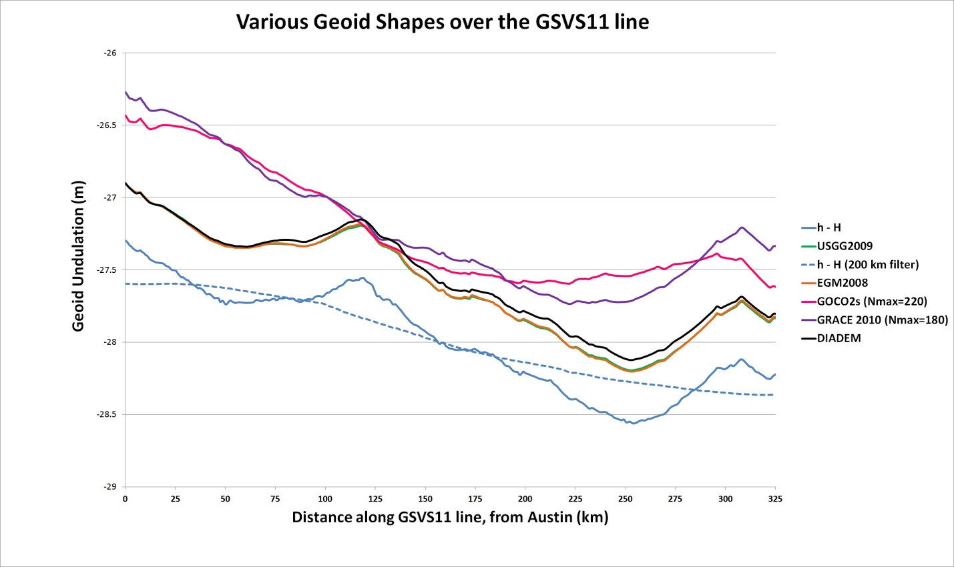
Existing Geoids vs GSVS11
Austin
(North end)
Rockport
(South end)
Notes:
The shapes in this plot are various forms of the geoid shape over the GSVS11 line. Of primary interest is the blue line (h-H) which represents the very best differential ellipsoid heights and differential orthometric heights from the new GPS and leveling of GSVS11. The blue dashed line is a smoothed (200 km filter) version of this. Note that this survey was about geoid slopes, so the absolute offsets seen here are immaterial to the goal of this survey.
The green and orange lines almost on top of each other are the latest gravimetric geoid from NGS (USGG2009) and EGM2008. Note how closely they appear to follow the h-H blue line.
The purple and pink lines are SHMs ITG-GRACE2010s and GOCO02s. Note their general inability to track even the largest details (except the more or less upward slope from Rockport to Austin) of the geoid. One would presume this is from omission error, but the failure to match the filtered h-H values (blue dashed line) calls into question whether there is commission, not omission error going on here. If EGM2008 were only given to maximum degree 220, it follows closely to these two models.

Slide 11
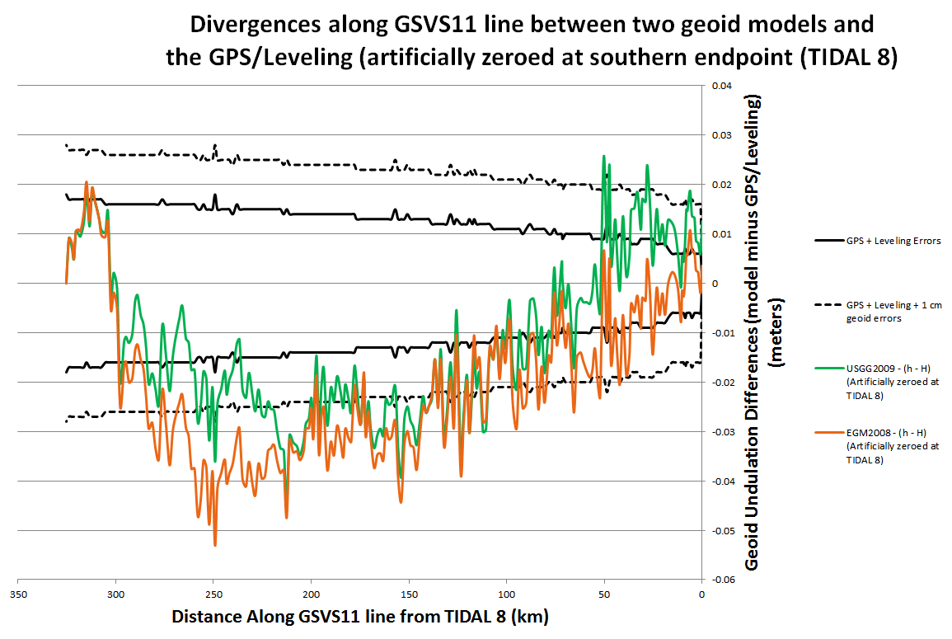
Existing Geoids vs GSVS11
Austin
(North end)
Rockport
(South end)
Notes:
The black bars show the expected growth of error from Rockport toward Austin along GSVS11. The dominant signal is the 0.7 km per sq km, but overlaying this are the empirical error estimates of GPS, with the only dependence being site specific, not baseline distance dependent.
Note that neither of the geoids yields agreement in these bars, yet the total disagreement is only a few cm out of bounds.

Slide 12
Notes:
This slide shows the RMS error (disagreement) between h, H and N for the USGG2009 geoid model as compared to the best GPS and leveling on GSVS11. The data are in “distance bins”, representing how far apart any two points in the survey were. There were 218 points, yielding 23,871 possible *pairs* of points, separated by distances ranging from 0.4 km (the closest any two points were to one another) to 325 km (the distance between the first and last points in the survey). Each “distance bin” contains about 2,000 pairs of points, separated by a distance which puts them in that particular bin.
As this is a *total* RMS error chart, it is worth nothing that in this fairly uncomplicated, and low-elevation area that even with the combined errors of GPS, leveling and a gravimetric geoid model, the total error barely reaches 3 cm over medium distances (wavelengths).

Slide 13
EGM2008 is better here
USGG2009 is
better here
Notes:
This slide builds upon the previous one, now showing EGM2008’s performance alongside of USGG2009. Since these two geoid models have almost identical input terrestrial gravity data, it is not surprising that they behave in very similar ways when compared to the GSVS11 GPS/leveling data. Differences between the two models can be attributed to the different modeling approaches, plus slight differences in input data.

Slide 14
Adding GOCO2s makes
things better here
Adding GOCO2s makes things worse here
Notes:
This slide builds upon the previous two, now showing a new experimental EGM (xEGM) created at NGS which blends EGM2008 and GOCO2s (called xEGM-G). The geoid model remains 5’ x 5’, like EGM2008. This blending of GOCO2s was shown to have a CONUS-wide overall improvement to the geoid, but in this particular area it is obvious that GOCO2s only improves the geoid at certain wavelengths, and actually degrades them over short wave lengths.

Slide 15
Airborne Gravity Improves the
Geoid across ALL DISTANCES
Notes:
This slide builds upon the previous three. The significant change now is that airborne gravity data, from the GRAV-D project, has been added over this region, and blended into an experimental EGM (xEGM). The blending combines EGM2008, GOCO2s and GRAV-D, and the experimental EGM is called “xEGM-GA” (“GA” meaning “with GOCO2s and with Airborne”). The geoid model built upon that data has a significant improvement in comparison to the GSVS11 GPS/leveling data.
The take-away message of this slide is that the contemporary, consistent airborne gravity data is the key to improving geoid accuracy. The previous three models (USGG2009, EGM2008 and xEGM-G) all relied upon / massaged the same terrestrial gravity data, but none of that improved the geoid significantly, whereas the airborne gravity data, being new, contemporary and consistent showed significant improvement over the other geoids.

Slide 16
New software makes
things worse here
New software
Makes things
better here
Notes:
This slide builds upon the previous four. NGS has been experimenting with more rigorous ways to account for topography and perform kernal truncations. The most recent iteration was used to create an experimental high resolution gravimetric geoid model (xUSGG), using upon the xEGM-GA model, plus high resolution gravimetry and topography. As can be seen, this gives a slight degradation to the model at short wavelengths, but has a noticeable improvement to the model at medium to long wavelengths.

Slide 17
Let’s remove this
from all of the other
bars to leave
geoid-only RMSE
Notes:
This slide builds upon the previous five. This time a new set of bars in green are added which are NOT the combined errors of GPS, Leveling and a geoid model, but are instead *only* GPS & Leveling errors. They are displayed to show the magnitude of these errors in comparison with the combined GPS/leveling/geoid errors.

Slide 18
The “1 cm
geoid”
Notes:
This slide is a companion to the previous one, but the h-H errors have been removed, in an RMS sense, from the total h-H-N errors, leaving gravimetric geoid model errors only.
As seen previously, the geoids based on airborne gravity data are the best performers, and the very slight degradation using new high resolution software at short wavelengths is noticeably offset by the significant improvement at medium wavelengths.
In fact, as a general statement, it could be said that adding airborne gravity data to the gravimetric geoid model has yielded about 1 cm differential geoid undulation accuracy across all distances, in the region of GSVS11, and that this can be further improved by continued improvement to the high resolution modeling software.

Slide 19
Agreement with DIADEM DoVs
(arcseconds)
Model | Mean | STD | Extreme Values
USGG09 | -0.02 | 0.19 | -0.59 / 0.53
EGM08 | -0.04 | 0.21 | -0.56 / 0.49
xEGM-GA (w/ Airborne) | -0.09 | 0.21 | -0.62 / 0.45
xUSGG-GA-R-K480 (w/ Airb & RTM) | -0.07 | 0.20 | -0.63 / 1.08
ξ
N/S
Model | Mean | STD | Extreme Values
USGG09 | -0.03 | 0.20 | -0.53 / 0.55
EGM08 | -0.04 | 0.23 | -0.58 / 0.47
xEGM-GA (w/ Airborne) | 0.01 | 0.18 | -0.42 / 0.51
xUSGG-GA-R-K480 (w/ Airb & RTM) | 0.02 | 0.17 | -0.54 / 0.51
η
E/W
Notes:
Note that the new software and airborne gravity data don’t have a significant improvement in the north south deflections, but do improve the east-west deflections. Whether this is due to the N/S nature of the flights, or the E/W nature of the RTM effects or some other factor has not yet been determined.

Slide 20
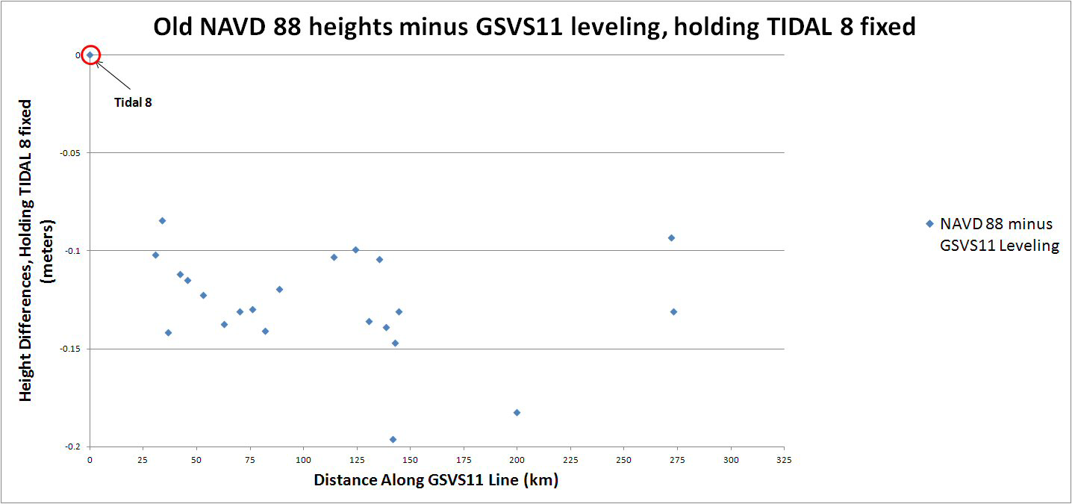
Old minus new leveling
South
(Rockport)
North
(Austin)
Notes:
Holding the official NAVD 88 height of “TIDAL 8” (Rockport, final official point on GSVS11) fixed, compare the existing (published from the IDB on datasheets) NAVD 88 heights to
those heights implied by the new leveling of GSVS11. Obviously this is only good for those marks that have existing NAVD 88 heights (= 23 marks).
Note the approximately 12 cm offset between TIDAL 8 and the mean of the other points. This implies that TIDAL 8 has likely subsided about 12 cm since it was last
leveled to. Note also the scatter, which is enormous, indicating much regional local motion. Finally, note the final two points, which are at opposite ends of
a runway. Their official height differential disagrees with the new leveling by 4 cm, indicating that (as one possibility) one of them has likely moved vertically 4 cm while the other
has remained stable. Note however that these two points were on the “Bad BM” list during the “7 good, 7 bad” test during the LIDAR flights!!

Slide 21
Conclusions
For GSVS11, adding airborne gravity data improves geoid slope accuracy at nearly all distances <325 km
  E/W deflections (“pointwise slopes”) improved, but not N/S deflections
Gravimetric geoid models and GPS are a viable alternative to long-line leveling
Improvements still being made to high resolution geoid modeling

Slide 22
Future Work
Dozens of studies, comparing all of the terrestrial positioning techniques of GSVS11
Dig deeper on GRACE / GOCO2s disagreements with GSVS11
GSVS13: IOWA!!!
  Higher elevation, more complicated geoid, additional measurements (borehole gravimetry?)

Slide 23
Questions/Comments?
Dru.Smith@noaa.gov
http://www.ngs.noaa.gov/GEOID/GSVS11/index.shtml

Slide 24
Extra Slides

Slide 25
How to read the next chart
Pick any 2 (of the 218) points (P_{i} and P_{j}) separated by a distance “d_{ij}”
  23,871 possible (i,j) pairs of points
  0.4km < d_{ij} < 325km
Compute residuals: Δ(h-H-N) over distance:
  Δ(h-H-N) = (h_{i}-H_{i})-(h_{j}-H_{j}) – (N_{i}-N_{j})
Accumulate statistics on residuals for all (i,j) pairs in a bin
Each d_{ij} bin contains ~2000 pairs of points

Slide 26
High Resolution Geoids
(vs GPS / Leveling; cm)
Bins of d_{ij}, km | h/H error budget | USGG2009 (1’x1’) | EGM2008 (5’x5’) | USGG2012x01 (1’x1’) New software | USGG2012x02 (1’x1’) New software + Airborne data
0.4 - 15 | 0.0 ± 0.4 | 0.0 ± 1.0 | -0.0+/-1.0 | -0.0+/-1.0 | -0.0+/-0.9
15-30 | 0.0 ± 0.5 | 0.0 ± 1.0 | 0.0+/-1.3 | -0.0+/-1.4 | -0.0+/-1.1
30-46 | 0.0 ± 0.6 | -0.1 ± 1.5 | 0.0+/-1.7 | -0.2+/-1.8 | -0.2+/-1.1
46-63 | 0.0 ± 0.6 | -0.3 ± 1.7 | -0.1+/-2.0 | -0.4+/-2.1 | -0.3+/-1.2
63-81 | 0.0 ± 0.7 | -0.4 ± 2.0 | -0.2+/-2.1 | -0.6+/-2.5 | -0.3+/-1.3
81-101 | 0.0 ± 0.8 | -0.6 ± 2.3 | -0.4+/-2.2 | -0.7+/-2.8 | -0.4+/-1.4
101-122 | 0.0 ± 0.8 | -0.7 ± 2.6 | -0.6+/-2.3 | -0.8+/-3.0 | -0.4+/-1.4
122-145 | 0.0 ± 0.9 | -0.9 ± 2.7 | -0.8+/-2.4 | -0.7+/-2.9 | -0.3+/-1.3
145-172 | 0.0 ± 1.0 | -1.0 ± 2.8 | -1.0+/-2.6 | -0.6+/-2.6 | -0.1+/-1.0
172-204 | 0.0 ± 1.0 | -1.2 ± 2.7 | -1.2+/-2.5 | -0.9+/-2.1 | -0.2+/-1.0
204-247 | 0.0 ± 1.1 | -1.4 ± 2.4 | -1.3+/-2.7 | -1.7+/-1.4 | -0.7+/-1.0
247-325 | 0.0 ± 1.4 | -1.0 ± 1.6 | -0.2+/-2.3 | -1.9+/-1.4 | -1.3+/-1.0
All separation distances
show improvement
with GSVS11 survey when
airborne gravity are
introduced.
New software shows modest improvement
at medium wavelengths
Notes:
This chart speaks to the ability of a gravimetric geoid model to be as accurate over distances as GPS and leveling combined. The basic messages here are that currently, gravimetric geoids aren’t as accurate as GPS and leveling, but they aren’t bad either. They are certainly cheaper than leveling! Furthermore, it shows that for this survey, at least, USGG2009 has some improvements to make to beat EGM2008. As such, NGS embarked on a rigorous re-examination of their geoid modeling methods. The new software will likely be complete later in 2012. But some new experimental geoids with the new software show an improvement over USGG2009, but still not quite as good as EGM2008. The real story of columns 3/4/5 can be summarized as follows: “No matter what software is used, massaging the same old, uncorrected terrestrial gravity data isn’t going to yield
However, when adding in airborne gravity from GRAV-D, these new geoids blow everything else away.

Slide 27
Tallies
Survey | Person-Weeks | Primary Equipment
Recon | 32 | Mark Setting Truck, Standard survey disks
Static GPS | 35 | Trimble Net R5, R7 ; Zephyr Geodetic Antenna TRM41249.00
Leveling | 120 | Leica DNA03 , Trimble DiNi11
DoV | 32 | DIADEM
Gravity | 30 | FG-5, A-10, L/R D and G meters
R-S GPS | 3 | Trimble R8_GNSS RTK
RTN | 3 | Trimble R8_GNSS RTK
LIDAR | 4 | Riegl Q680i-D, NOAA King Air
Imagery | 4 | Applanix 439 RGB DualCam, NOAA King Air

Slide 28
Tallies
Total persons involved: 46
  NOAA Employees: 43
    First time in the field: 6
Issues:
  Medical Emergencies: 4
  Flat tires: 3
  Inoperative equipment: 2

Slide 29
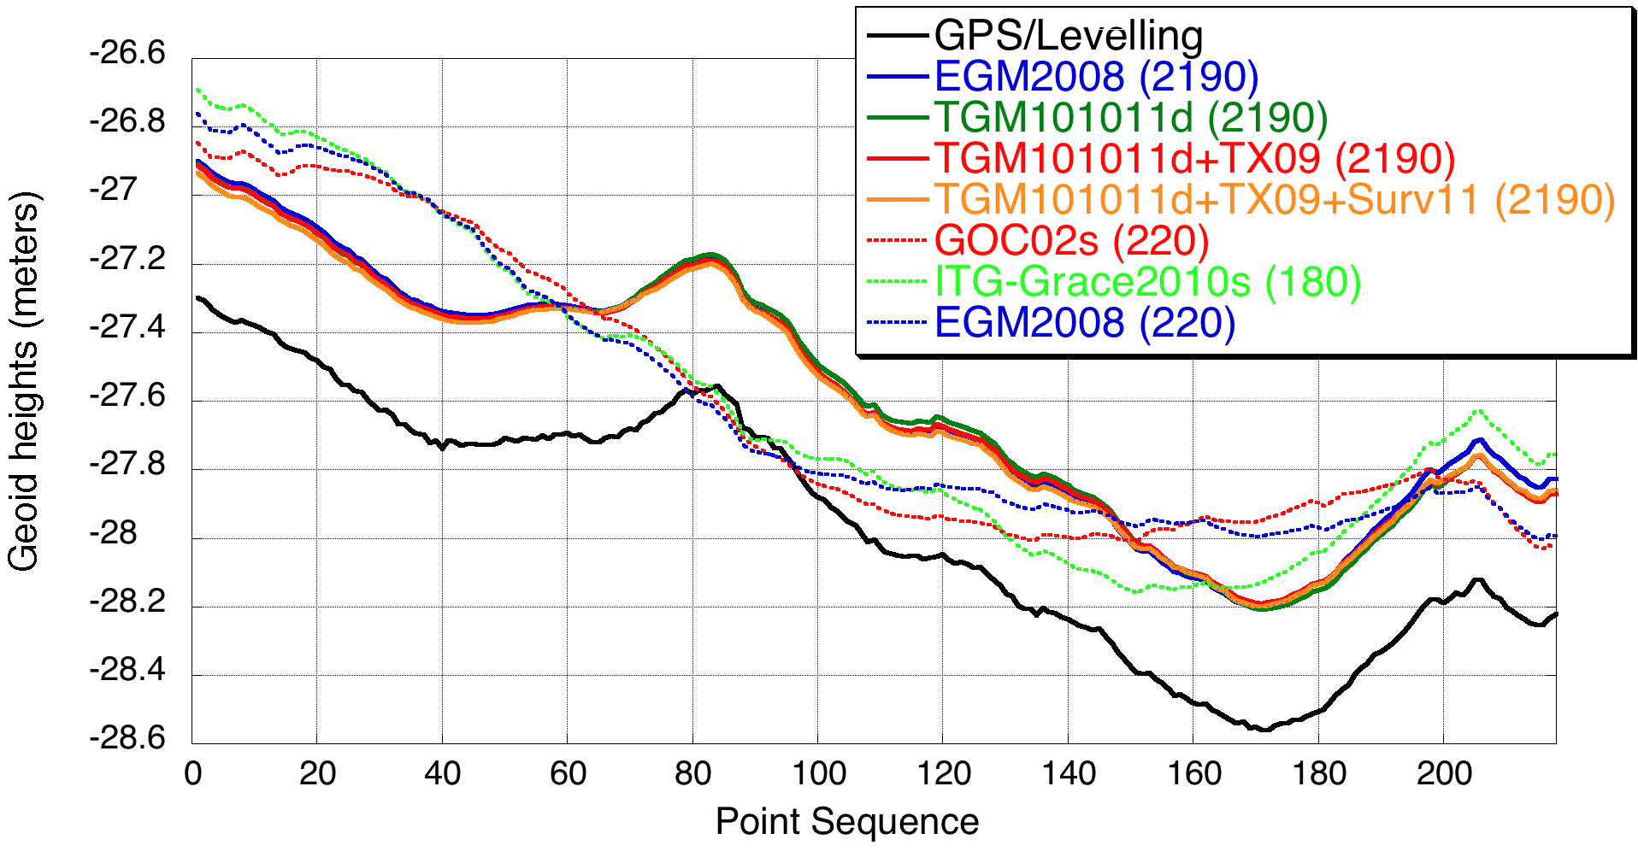
Note EGM08 2190 vs 220

Slide 30
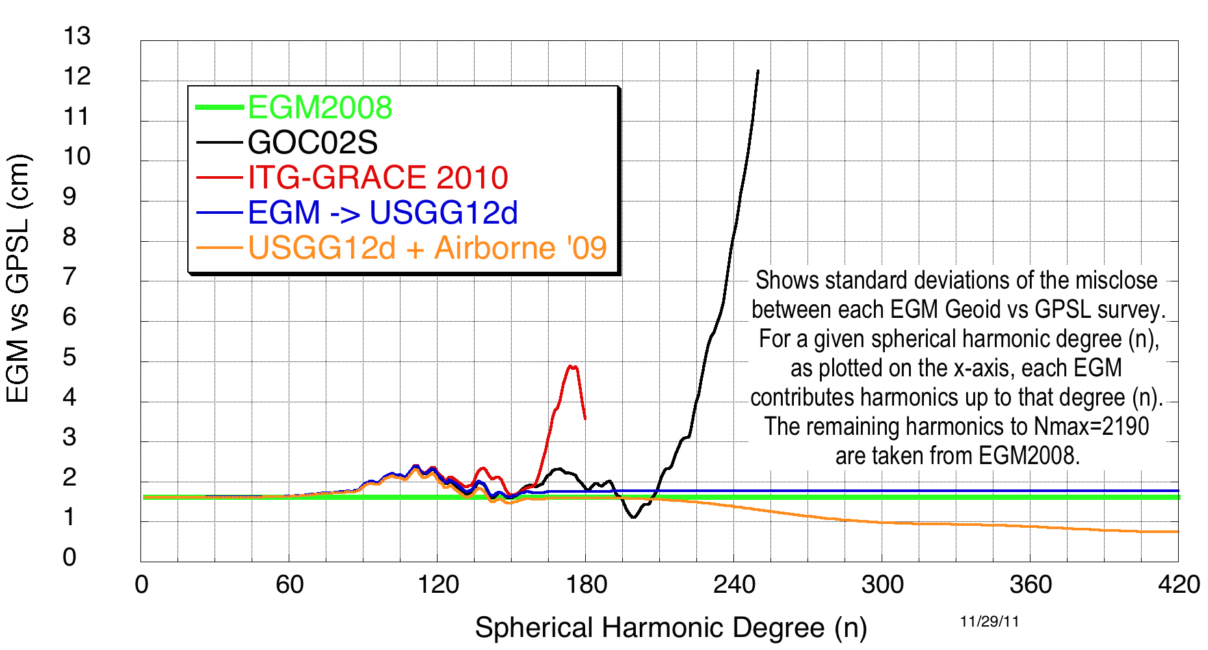
SHM representation of geoid agreement with GSVS11
Notes:
This plot shows what happens if you compare various spherical harmonic representations of the geoid against GSVS11. In each case, EGM2008 plays a role in higher degrees. Basically each point on each line is the disagreement if, at that spherical harmonic degree, you stopped using the given model and began using EGM2008. So a dot on the black line at SHD=180 means that if you use GOCO02s to degree 180 and let EGM2008 control from 181 to 2190, this is the disagreement you’ll see with GSVS11. Note that if you let the airborne data come in around degree 180 and replace EGM2008, you can drive the disagreements below 1 cm std.

Slide 31
Austin (North end)
Rockport (South End)
Notes:
Looking at the difference between ITG-GRACE 2010s, GOCO02s and h-H values over GSVS11 (USGG2009 divergences also provided to show what is achievable without significant omission or commission error). We won’t focus further on this disagreement, as it requires more detailed study to determine how, or if, such models will play a part in future terrestrial validation surveys. Failure of the two models to match the smoothed/filtered h-H data seems to point to commission, not omission error, but this has not been investigated in time for this presentation.

Slide 33
Experimental geoids and USGG2009 vs GSVS11 h-H
Kern. | 480 | 480 | 480 | 480 | 720 | 720 | 720 | 720 | USGG2009
Air? | N | N | Y | Y | N | N | Y | Y | N
RTM? | N | Y | N | Y | N | Y | N | Y | N/A
0-15 | -0.1+/-1.0 | -0.0+/-1.0 | -0.1+/-0.9 | -0.0+/-0.9 | -0.1+/-1.0 | -0.0+/-1.0 | -0.1+/-0.9 | -0.0+/-0.9 | 0.0 ± 1.0
15-30 | -0.1+/-1.4 | -0.0+/-1.4 | -0.1+/-1.0 | -0.0+/-1.1 | -0.1+/-1.4 | -0.1+/-1.4 | -0.2+/-1.0 | -0.1+/-1.0 | 0.0 ± 1.0
30-46 | -0.3+/-1.7 | -0.2+/-1.8 | -0.3+/-1.1 | -0.2+/-1.1 | -0.3+/-1.8 | -0.2+/-1.8 | -0.3+/-1.0 | -0.2+/-1.1 | -0.1 ± 1.5
46-63 | -0.5+/-2.1 | -0.4+/-2.1 | -0.4+/-1.2 | -0.3+/-1.2 | -0.5+/-2.2 | -0.4+/-2.3 | -0.3+/-1.1 | -0.2+/-1.2 | -0.3 ± 1.7
63-81 | -0.7+/-2.4 | -0.6+/-2.5 | -0.4+/-1.2 | -0.3+/-1.3 | -0.6+/-2.6 | -0.5+/-2.7 | -0.4+/-1.2 | -0.3+/-1.2 | -0.4 ± 2.0
81-101 | -0.8+/-2.7 | -0.7+/-2.8 | -0.5+/-1.3 | -0.4+/-1.4 | -0.8+/-2.9 | -0.6+/-3.0 | -0.5+/-1.2 | -0.3+/-1.3 | -0.6 ± 2.3
101-122 | -0.9+/-2.9 | -0.8+/-3.0 | -0.5+/-1.4 | -0.4+/-1.4 | -0.9+/-3.1 | -0.7+/-3.2 | -0.5+/-1.3 | -0.3+/-1.3 | -0.7 ± 2.6
122-145 | -0.9+/-2.8 | -0.7+/-2.9 | -0.5+/-1.2 | -0.3+/-1.3 | -0.9+/-3.1 | -0.7+/-3.2 | -0.4+/-1.2 | -0.2+/-1.3 | -0.9 ± 2.7
145-172 | -0.9+/-2.5 | -0.6+/-2.6 | -0.4+/-1.0 | -0.1+/-1.0 | -0.9+/-2.8 | -0.6+/-2.9 | -0.4+/-1.1 | -0.1+/-1.1 | -1.0 ± 2.8
172-204 | -1.2+/-1.9 | -0.9+/-2.1 | -0.5+/-1.0 | -0.2+/-1.0 | -1.2+/-2.1 | -0.9+/-2.3 | -0.5+/-1.0 | -0.2+/-1.1 | -1.2 ± 2.7
204-247 | -2.0+/-1.3 | -1.7+/-1.4 | -1.0+/-1.0 | -0.7+/-1.0 | -1.9+/-1.3 | -1.6+/-1.4 | -0.9+/-1.0 | -0.7+/-1.0 | -1.4 ± 2.4
247-325 | -2.4+/-1.4 | -1.9+/-1.4 | -1.8+/-1.0 | -1.3+/-1.0 | -2.2+/-1.6 | -1.7+/-1.5 | -1.6+/-1.0 | -1.1+/-0.9 | -1.0 ± 1.6

Slide 34


Slide 35
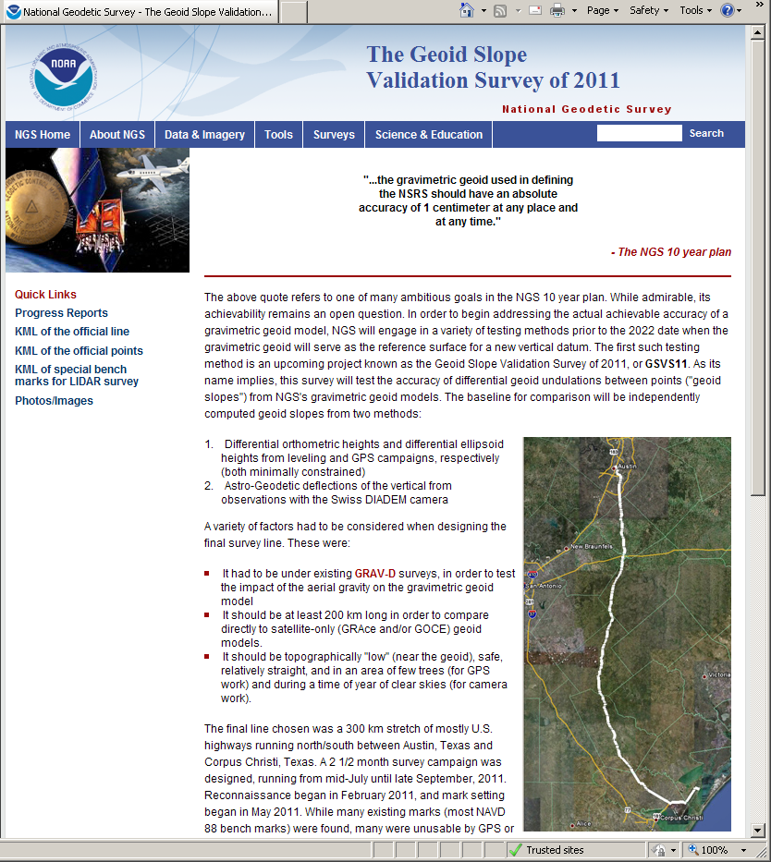
Weekly reports on a
crew-by-crew basis
from July 18 through
November 4

Slide 36
http://www.ngs.noaa.gov/GEOID/GSVS11

