Slide 1
Modernizing the National Spatial Reference System:
A 2017 update
Dru Smith
NSRS Modernization Manager
NOAA’s National Geodetic Survey

Slide 2
“Modernizing the NSRS” means…
Replacing NAD 83
Replacing NAVD 88
Re-inventing Bluebooking
Improving the Geodetic Toolkit
Better Surveying Methodologies
Notes:
There are actually 3 “NAD 83”s, NAD 83(2011), NAD 83(PA11) and NAD 83(MA11)
There are also many more vertical datums than NAVD 88 in the NSRS, each one for specific states or territories that have no line of sight to CONUS/Alaska

Slide 3
So…what’s new in 6 months?
NAMES!!

Slide 4
NSRS Modernization
The Old:
NAD 83(2011)
NAD 83(PA11)
NAD 83(MA11)
The New:
The North American Terrestrial Reference Frame of 2022
(NATRF2022)
The Caribbean Terrestrial Reference Frame of 2022
(CTRF2022)
The Pacific Terrestrial Reference Frame of 2022
(PTRF2022)
The Mariana Terrestrial Reference Frame of 2022
(MTRF2022)

Slide 5
NSRS Modernization
The Old:
NAVD 88
PRVD 02
VIVD09
ASVD02
NMVD03
GUVD04
IGLD 85
IGSN71
GEOID12B
DEFLEC12B
Orthometric
Heights
The New:
The North American-Pacific Geopotential Datum of 2022 (NAPGD2022)
- Will include GEOID2022
Normal
Orthometric
Heights
Dynamic
Heights
Gravity
Geoid
Undulations
Deflections of
the Vertical

Slide 6
So…what’s new in 6 months?
NAMES!!
Mathematical Decisions!!

Slide 7
Replacing the NAD 83’s
Three plate-(pseudo)fixed frames will be replaced with four plate-fixed reference frames
N. Amer., Pacific, Mariana, Caribbean(new!)
Remove long-standing non-geocentricity of NAD 83 frames
All four : identical to IGSxx at a TBD epoch
2020.00?
All four : differ from IGSxx by plate rotation only
Updated Euler Pole determination for rigid plate only

Slide 8
Each frame will get 3 parameters
Euler Pole Latitude
Euler Pole Longitude
Rotation rate (radians / year)
This will be used to compute
time-dependent TRF2022
coordinates from time-dependent
IGS coordinates.

Slide 9
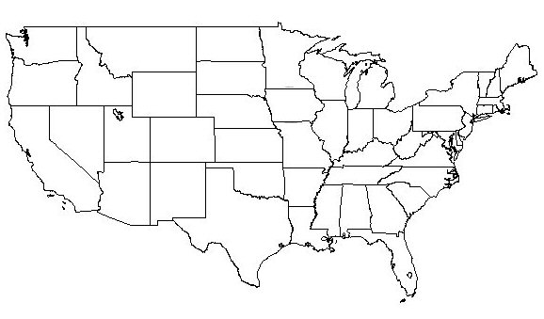
NATRF2022 frame is rigid and fixed to rigid part of the N.A. plate
Non-rigid part of the N.A. plate
(deformation)
area

Slide 10
NATRF2022 coordinates over time (Remember: The NATRF2022 frame is rigid)
Point on deforming part of plate
Point on rigid part of plate
λ
λ
t
t

Slide 11
NATRF2022 coordinates over time (Remember: The NATRF2022 frame is rigid)
Point on deforming part of plate
Point on rigid part of plate
λ
λ
t
t

Slide 12
NATRF2022 coordinates over time (Remember: The NATRF2022 frame is rigid)
Point on deforming part of plate
Point on rigid part of plate
λ
λ
t
t

Slide 13
NATRF2022 coordinates over time (Remember: The NATRF2022 frame is rigid)
Point on deforming part of plate
Point on rigid part of plate
λ
λ
t
t

Slide 14
Time-Dependencies as a service: NATRF2022 and actual survey epochs
NAD 83 forcibly combined data spanning many years (using HTDP with no vertical modeling) to compute and find one height at one epoch.
NATRF2022 will compute coordinates at survey epoch to show actual motion.
Even gridding surrounding CORS yields better subsidence rates than you have today.
NAD 83 best estimate of dh/dt: +2.8 mm / year
NATRF2022 best estimate of dh/dt: -4.2 mm / year
CORS best estimate of dh/dt: -2.2 mm / year
Notes:
Potential outline and speaker assignments; can be adjusted as needed.

Slide 15
Time Dependencies as a service: Intra-plate motions

Slide 16
So…what’s new in 6 months?
NAMES!!
Mathematical Decisions!!
NADCON 5.0!!

Slide 17
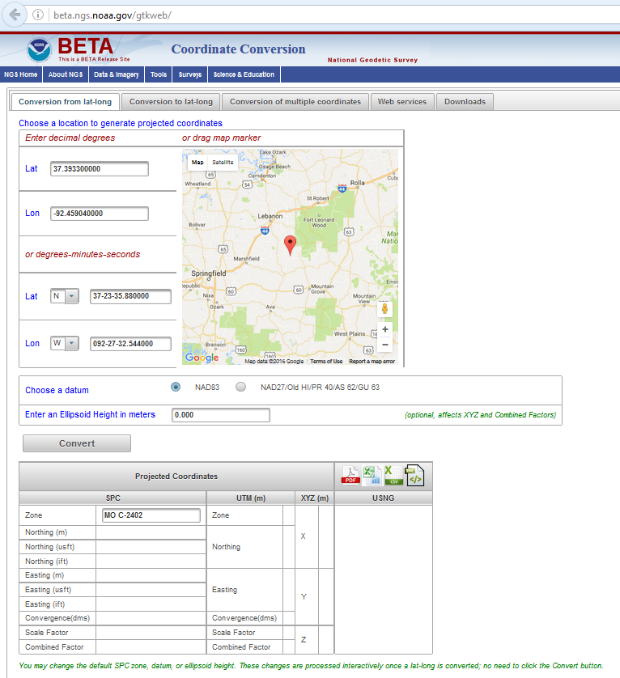
The new Geodetic Toolkit
https://beta.ngs.noaa.gov/gtkweb/

Slide 18
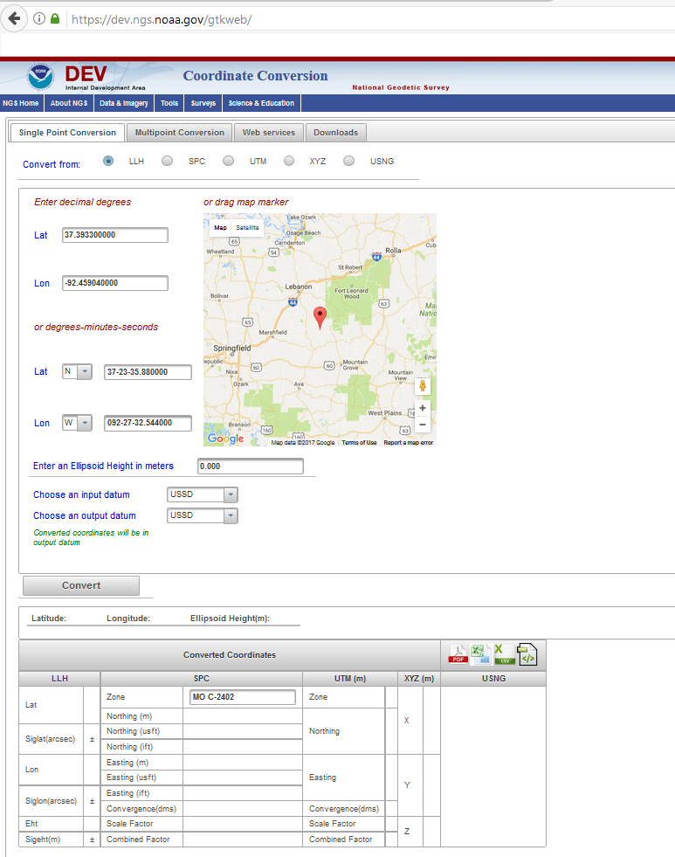
The new Geodetic Toolkit with NADCON 5.0
https://dev.ngs.noaa.gov/gtkweb/

Slide 19
NAD 83 (2011)
Allowable Regions:
CONUS
Alaska
Hawaii
PR/VI
AS
Guam/CNMI
St. Paul
St. George
St. Lawrence
Notes:
φ, λ, h
xyz2plh
plh2xyz
SPC83
a,f (GRS 80)
NAD 83
X, Y, Z
SPC
USNG
NAD 83
UTMS
a,f (GRS 80)
USNG
UTM
USNG
NAD 83

Slide 20
X, Y, Z
φ, λ, h
φ, λ, h
Region: CONUS
NADCON 5 connections in RED
2022
X, Y, Z
SPC
UTM
USSD
USNG
UTM
φ, λ, h
φ, λ, h
NAD 27
NAD 83 (2011)
X, Y, Z
SPC
X, Y, Z
SPC
USNG
UTM
USNG
UTM
NAD 83 (NSRS2007)
φ, λ, h
NAD 83 (1986)
φ, λ, h
NAD 83 (FBN)
NAD 83 (HARN)
φ, λ, h
X, Y, Z
SPC
X, Y, Z
SPC
φ, λ, h
USNG
UTM
USNG
UTM
X, Y, Z
SPC
X, Y, Z
SPC
USNG
UTM
USNG
UTM

Slide 21
Thank you!

Slide 22
Questions?

Slide 23
Plate-(pseudo)fixed frames
NAD 83(2011) minus NAD 83(NSRS2007)
NAD 83(NSRS2007)
Epoch 2002.0
NAD 83(2011)
Epoch 2010.0
If NAD 83 were truly “plate
fixed” then an 8 year
epoch change would not
yield the systematic
plate rotation seen here.
(*)TRF2022 will determine
a new Euler Pole rotation
for each of 4 plates.
(*)=NA, C, T or P

Slide 24
NAD 83’s non-geocentricity
Earth’s Surface
h_{NAD83}
φ_{NAD83} – φ_{IGSxx}
λ_{NAD83} – λ_{IGSxx}
h_{NAD83} – h_{IGSxx}
all vary
smoothly by latitude
and longitude
h_{IGSxx}
IGSxx origin
same
GRS-80
ellipsoid
~2.2 m
NAD 83 origin

Slide 25
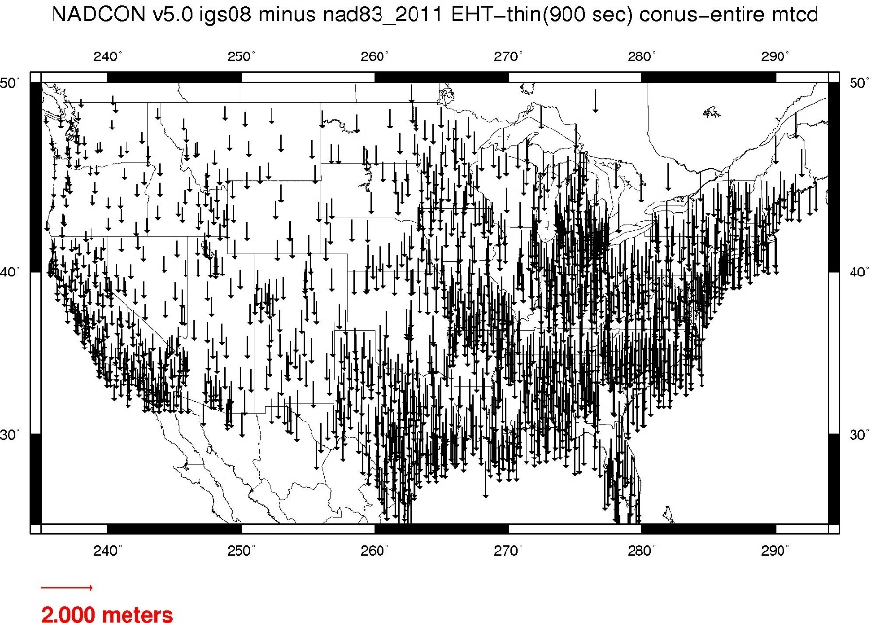
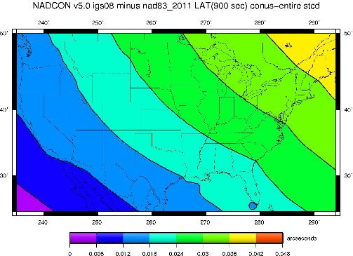
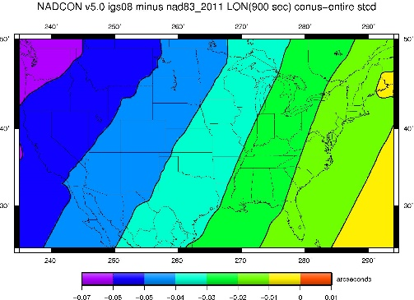
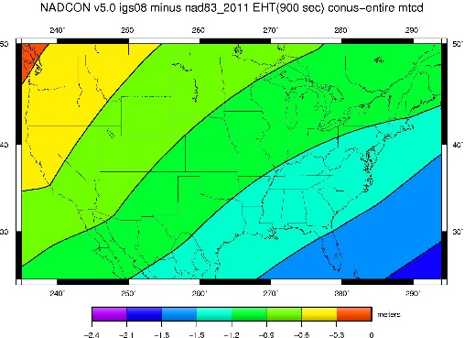
Fixed-Epoch Transformation NAD 83 to “2022”

