Slide 1
The
change
you
shape

Slide 3
What you need to know to prepare for the 2022 National Spatial Reference System (NSRS) Modernization
Dr. Dru Smith,
NSRS Modernization Manager
NOAA/National Geodetic Survey
13 June 2019

Slide 4
Outline
BLUF
What I’ll be skipping…
Refresher
Shift and Drift
Replace NAD 83
Replace NAVD 88
EPP2022 and IFVM2022
Reference Epoch Coordinates from Time-Dependent Coordinates
So much more…

Slide 5
Bottom Line, Up Front
If you do geospatial work in the USA…
and you work in the National Spatial Reference System..
every product you’ve ever made…
every survey…
every map…
every lidar point cloud…
every image…
every DEM…
WILL have the wrong coordinates on it in 3 years.
Let’s talk about what this means, why it is happening, and how it will affect things going forward

Slide 6
What I’ll be skipping…
This topic usually takes 2 hours to cover
Not included today:
What is…
NGS and its mission
The NSRS
Bluebooking
GRAV-D
ITRF
Why we are modernizing in 2022
All of these topics have been covered extensively in multiple forums in the last few years

Slide 7
Refresher

Slide 8
“Modernizing the NSRS” means…
Replacing NAD 83
Replacing NAVD 88
Re-inventing Bluebooking
Improving the Geodetic Toolkit
Better Surveying Methodologies
Blueprint for 2022, Part 1
Blueprint for 2022, Part 2
Blueprint for 2022, Part 3
Notes:
There are actually 3 “NAD 83”s, NAD 83(2011), NAD 83(PA11) and NAD 83(MA11)
There are also many more vertical datums than NAVD 88 in the NSRS, each one for specific states or territories that have no line of sight to CONUS/Alaska

Slide 9
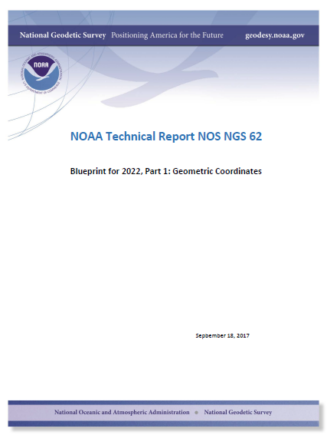
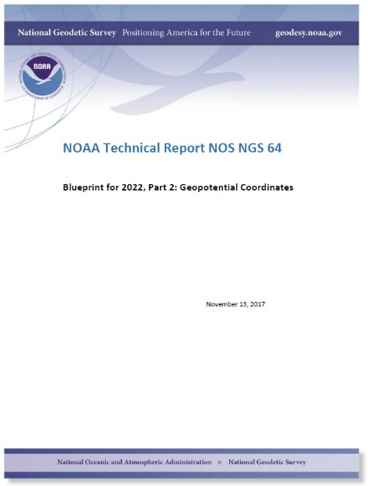
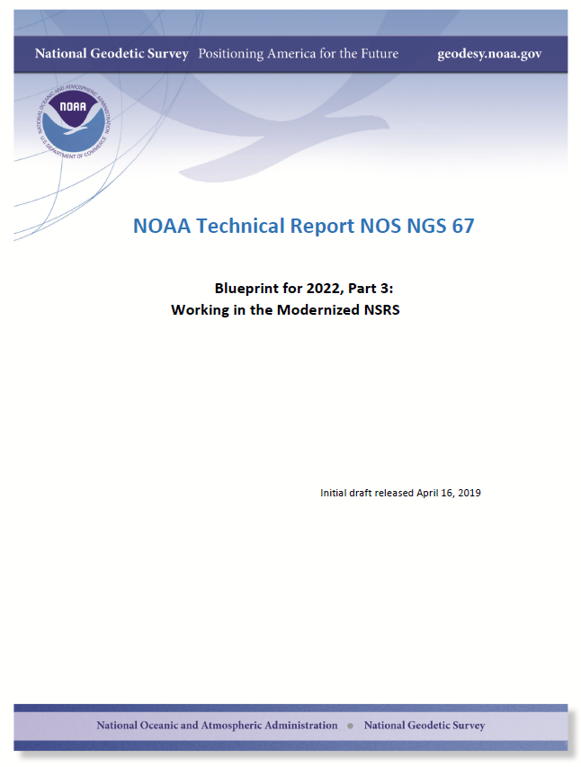
Modernizing the NSRS
The “blueprint” documents: Your best source for information
Geometric:
Sep 2017
NOAA TR NOS NGS 62
32 pages
Geopotential:
Nov 2017
NOAA TR NOS NGS 64
41 pages
Working in the modernized NSRS:
April 2019
NOAA TR NOS NGS 67
77 pages

Slide 10
Replacing NAD 83
The Old:
NAD 83(2011)
NAD 83(PA11)
NAD 83(MA11)
The New:
The North American Terrestrial Reference Frame of 2022
(NATRF2022)
The Caribbean Terrestrial Reference Frame of 2022
(CATRF2022)
The Pacific Terrestrial Reference Frame of 2022
(PATRF2022)
The Mariana Terrestrial Reference Frame of 2022
(MATRF2022)

Slide 11
Replacing NAVD 88
The Old:
NAVD 88
PRVD 02
VIVD09
ASVD02
NMVD03
GUVD04
IGLD 85
IGSN71
GEOID12B
DEFLEC12B
The New:
The North American-Pacific Geopotential Datum of 2022 (NAPGD2022)
Will include:
GEOID2022
DEFLEC2022
GRAV2022
DEM2022
More
Orthometric
Heights
Normal
Orthometric
Heights
Dynamic
Heights
Gravity
Geoid
Undulations
Deflections of
the Vertical

Slide 12
The preeminence of ITRF
Rotation of the
North American Plate
The North American Terrestrial Reference Frame of 2022
(NATRF2022)
The Caribbean Terrestrial Reference Frame of 2022
(CATRF2022)
The Pacific Terrestrial Reference Frame of 2022
(PATRF2022)
The Mariana Terrestrial Reference Frame of 2022
(MATRF2022)
Rotation of the
Caribbean Plate
ITRF2014
Rotation of the
Pacific Plate
Rotation of the
Mariana Plate
EPP2022
EPP for “Euler Pole Parameters”
(a way of describing a plate’s rotation)

Slide 13
Shift and Drift

Slide 14
Shift
One of the two major changes you’ll see in 2022 is a shift in coordinates
Latitude, Longitude, Ellipsoid Height: -2 to +4 meters
Non-geocentricity of NAD 83
Orthometric Height: -0.5 to +2.0 meters
Bias and tilt in NAVD 88
Other shifts will occur in non-CONUS, non-Alaska regions of the USA
There will be outliers!
“Old” unsurveyed points might be off by meters if they’ve moved!

Slide 15
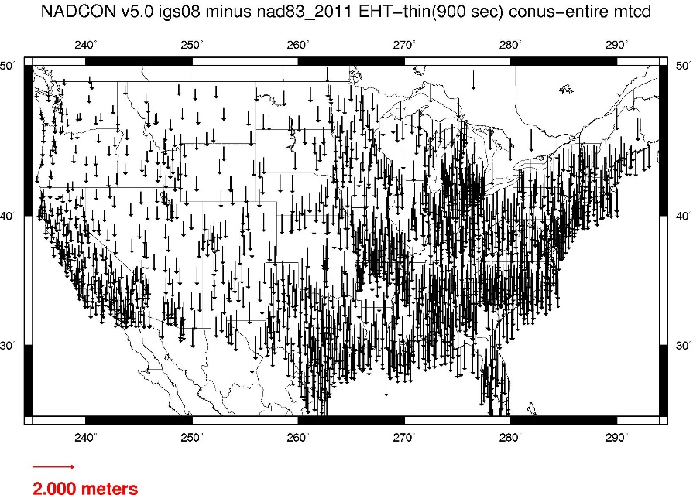
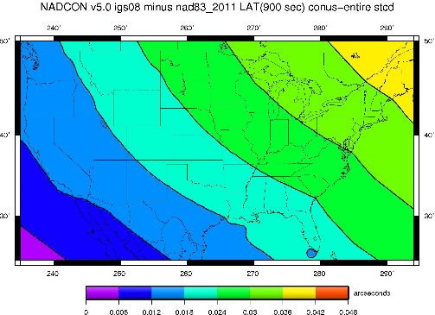
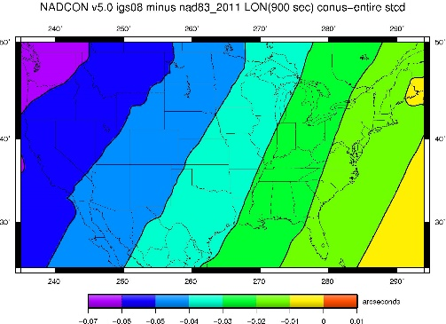
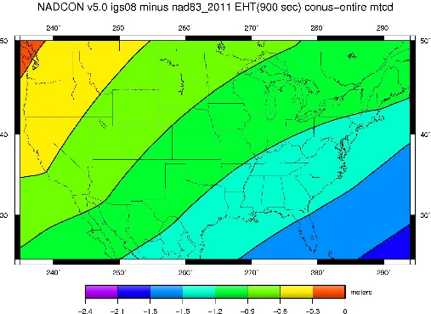
NAD 83(2011) epoch 2010.0 to NATRF2022 epoch 2020.00 (estimate)

Slide 16
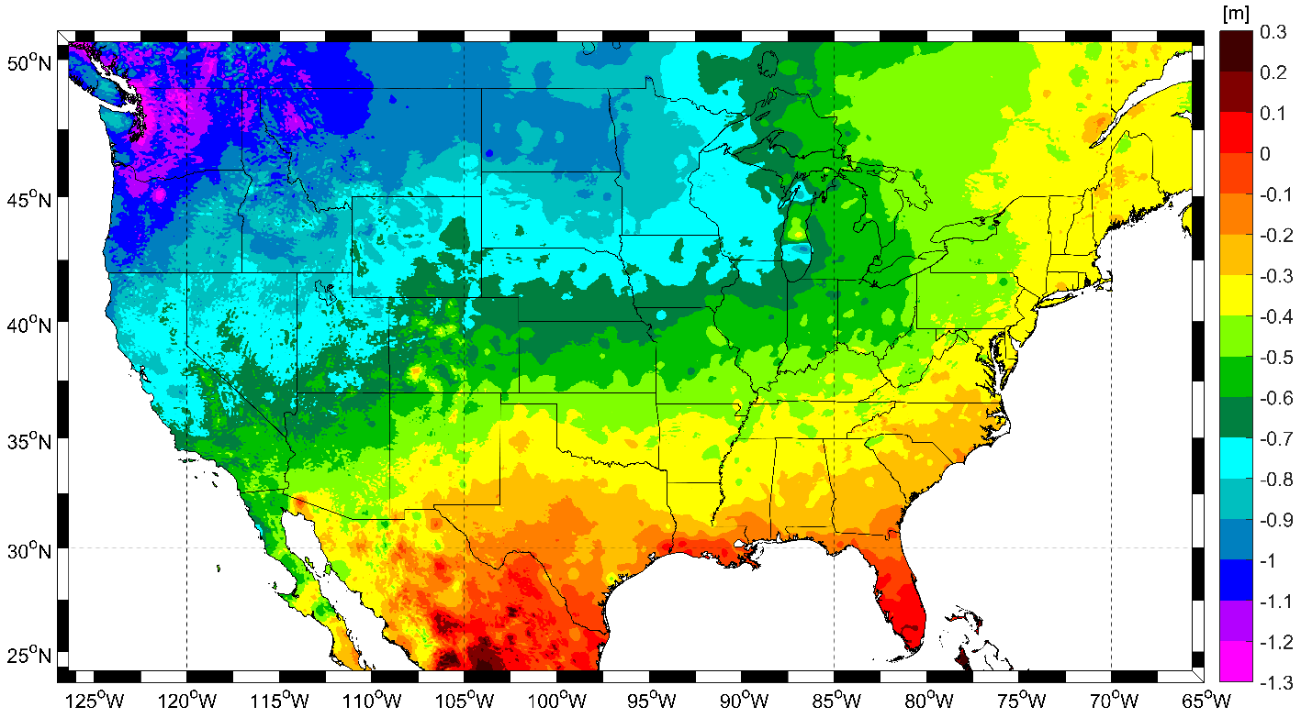
NAVD 88 to NAPGD2022 epoch 2020.00 (estimate)

Slide 17
Drift
The second major change you’ll see in 2022 is a drift in coordinates
Everything in the world moves
Coordinates will be associated with the actual date when the data was taken!

Slide 18
The wrong question, circa 2022:
“What is the latitude of that point?”
The right question, circa 2022:
“What is the latitude of that point, on some specific date?”

Slide 19
Drift
The second major change you’ll see in 2022 is a drift in coordinates
Everything in the world moves
Coordinates will be associated with the actual date when the data was taken!
Velocities at all marks can be estimated
Using a new tool, called the Intra-Frame Velocity Model (IFVM2022)
Two things will mitigate the pain of time-dependent coordinates:
“Plate Fixed” frames
“Reference Epoch” coordinates

Slide 20
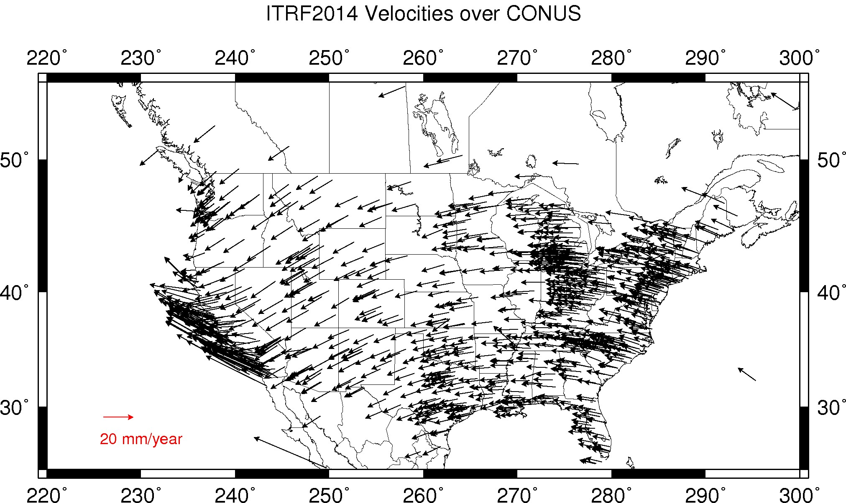
CORS Velocities – ITRF2014

Slide 21
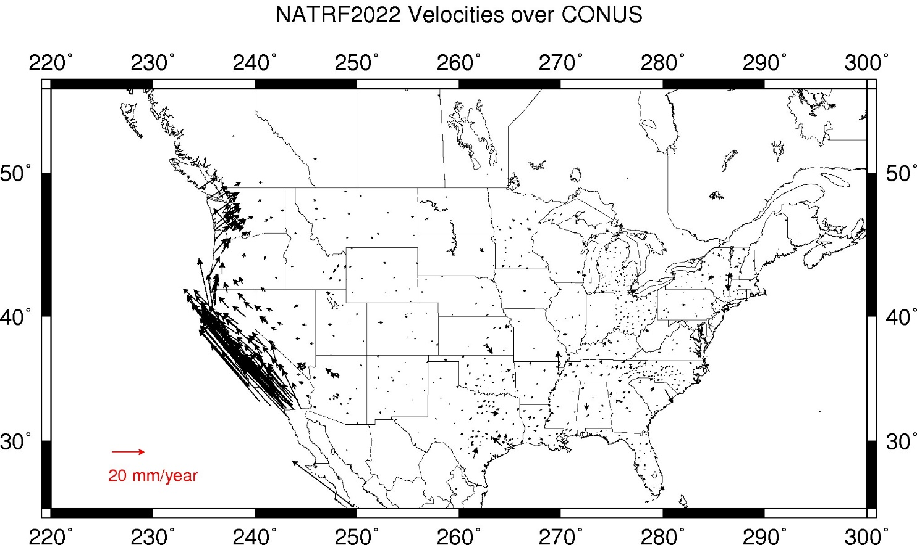
CORS Velocities – NATRF2022

Slide 22
EPP2022 and IFVM2022: The two tools that make time dependent geodetic control useable

Slide 23
There’s really two drifts
The plate rotation is simple (3 parameters per plate)
Captured in EPP2022
Horizontal (latitude/longitude) only
Changes the frame
ITRF2014 to NATRF2022, PATRF2022, CATRF2022 & MATRF2022
Doesn’t change the epoch
The residual motions (after removing plate rotation) are complex
Captured in IFVM2022
Residual horizontal motion
All vertical motion
Changes the epoch
Doesn’t change the frame
IFVM = “Intra-frame” velocity model

Slide 24
Example
It’s 2039 and you are working in San Diego using NATRF2022
You need to compare your work against a competitor’s survey
Done in 2028, using PATRF2022
PATRF2022
ep. 2028.048
EPP2022
ITRF2014
ep. 2028.048
EPP2022
NATRF2022
ep. 2028.048
IFVM2022
IFVM2022
PATRF2022
ep. 2039.704
EPP2022
ITRF2014
ep. 2039.704
EPP2022
NATRF2022
ep. 2039.704

Slide 25
Reference Epochs
It seems highly unlikely that surveyors will embrace coordinates with such diversity of epochs
To mitigate that, NGS will issue “snapshots” of the NSRS every five years (called “Reference Epochs”)
Estimates of coordinates at specific 5 year intervals, based on historic time-dependent coordinates and IFVM2022
Beginning with 2020.00
Each “snapshot” will be published 2-3 years after the reference epoch
Thus the 2020.00 Reference Epoch Coordinates get published by the end of calendar year 2022

Slide 26
Reference Epoch Coordinates from Time-Dependent Coordinates

Slide 27
Assume “h” was determined four different times:
1990: 2.100
1994: 2.110
2002: 2.190
2009: 2.180
2.250
2.200
h
2.150
2.100
2.050
2.000
1990
‘95
‘00
‘05
‘10
‘15
‘20
‘25
‘30
time

Slide 28
All measurements have error. Shown here are the same
values of “h”, but with their error estimates.
1990: 2.100 +/- 0.0375 (3.75 cm)
1994: 2.110 +/- 0.0250 (2.50 cm)
2002: 2.190 +/- 0.0200 (2.00 cm)
2009: 2.180 +/- 0.0250 (2.50 cm)
2.250
2.200
h
2.150
In the modernized NSRS these time-dependent
coordinates, estimated at the actual date when
the surveys took place, will be called
“Final Discrete Coordinates”
2.100
2.050
2.000
1990
‘95
‘00
‘05
‘10
‘15
‘20
‘25
‘30
time

Slide 29
In today’s NSRS, a height is held fixed until
replaced. So plotting the height as seen on a datasheet
over time would look like this:
2.250
2.200
h
2.150
2.100
2.050
2.000
1990
‘95
‘00
‘05
‘10
‘15
‘20
‘25
‘30
time

Slide 30
In the modernized NSRS we will also have an estimate of
crustal motion from IFVM2022
2.250
2.200
h
2.150
2.100
Combining Final Discrete Coordinates
with IFVM2022 allows
NGS to estimate Reference Epoch Coordinates
2.050
2.000
1990
‘95
‘00
‘05
‘10
‘15
‘20
‘25
‘30
time

Slide 31
2.250
2.200
h
2.150
2.100
The IFVM2022 model will match reference epoch coordinates
2.050
2.000
1990
‘95
‘00
‘05
‘10
‘15
‘20
‘25
‘30
time

Slide 32
2.250
2.200
h
2.150
2.100
In the absence of new survey data, error estimates will
grow through time.
2.050
2.000
1990
‘95
‘00
‘05
‘10
‘15
‘20
‘25
‘30
time

Slide 33
The (in)ability of current approach to
properly inform users of the height of
this mark can be seen in green below.
2.250
2.200
h
2.150
2.100
2.050
2.000
1990
‘95
‘00
‘05
‘10
‘15
‘20
‘25
‘30
time

Slide 34
Example (v2)
It’s 2039 and you are working in San Diego using NATRF2022 (epoch 2035.00)
You need to compare your work against a competitor’s survey
Done in 2028, using PATRF2022 (epoch 2025.00)
PATRF2022
ep. 2025.00
EPP2022
ITRF2014
ep. 2025.00
EPP2022
NATRF2022
ep. 2025.00
IFVM2022
IFVM2022
PATRF2022
ep. 2035.00
EPP2022
ITRF2014
ep. 2035.00
EPP2022
NATRF2022
ep. 2035.00

Slide 35
So much more…
New version of PAGES
GPS, Galileo, GLONASS, Beidou, QZSS, etc.
Target: 15 minute occupations
New version of OPUS
RTK/RTN: 2019
Leveling, Classical, Gravity: 2020-2025
Fully integrated (GPS projects with leveling and gravity? No problem!)
Ease of submission to NGS for inclusion in the NSRS
New Mark Recovery Tool
Smart-phone enabled. In beta now! beta.ngs.noaa.gov/cgi-bin/recvy_entry_www.prl
Fully integrated toolkit
NCAT and VDatum

Slide 36
Take the
session survey
Please complete your session survey on the HxGN LIVE Mobile App

Slide 37
Thank you

Slide 38
Questions?

Slide 39
Extra Slides

Slide 40
The “why”

Slide 41
Drivers of change
The current NSRS has issues:
Non-geocentricity of ellipsoid
Outdated geoid as the zero height surface
Does not account for time change
Significant dependence upon passive marks
More details available in Appendix A of the proceedings of the 2010 Geospatial Summit:
https://www.ngs.noaa.gov/library/pdfs/SP_NOS_NGS_10.pdf
Fixing these will cause a “shift”
Fixing this will cause a “drift”

Slide 42
NAD 83’s non-geocentricity
Earth’s Surface
h_{NAD83}
φ_{NAD83} – φ_{ITRF2014}
λ_{NAD83} – λ_{ITRF2014}
h_{NAD83} – h_{ITRF2014}
all vary smoothly by latitude and longitude
h_{ITRF2014}
ITRF2014 origin
same
GRS-80
ellipsoid
~2.2 m
NAD 83 origin

Slide 43
Outdated geoid (H=0) in NAVD 88
Earth’s
Surface
H (NAVD 88)
NAVD 88 H=0 reference level
(AKA “the geoid for NAVD 88”)
H
The Geoid*
*Current best
estimate from:
GRACE/GOCE satellites
GRAV-D airborne mission
Errors in NAVD 88 : ~50 cm average,
100 cm CONUS tilt,
1-2 meters average in Alaska
Notes:
This slide shows what NGS now knows about the error in NAVD 88 itself. Using a continental geoid computed from the GRACE satellite, a bias and tilt in NAVD 88 has been computed using GPS derived ellipsoid heights on NAVD 88 bench marks. These are now known errors that exist in all NAVD 88 bench marks. This datum realization error, relative to the geoid, is over and above the errors from marks moving.

Slide 44
Re-inventing Bluebooking
What? | The Old | The New
GPS campaigns | Bluebooking (PAGES, ADJUST, burden on user) | OPUS
Leveling campaigns | Bluebooking / Tied to passive control | OPUS ; GNSS requirements (time, spacing)
Relative Gravity campaigns | Dead bluebook procedure ; Processed separately; Not stored in IDB | OPUS
Absolute Gravity campaigns | Processed separately; Not stored in IDB | OPUS
Classical survey campaigns | Dead bluebook procedure ; Official policy is we don’t take them; Processed separately; Not stored in IDB | OPUS ; GNSS requirements (time, spacing)
GPS campaigns (redux) | OPUS-Projects w/o any way to submit to NGS | OPUS
Single GNSS occupations | OPUS-S or OPUS-RS w/o any way to submit to NGS | OPUS
Mark Recovery | Mark Recovery Page | OPUS ; Browser-based on a smart phone with GPS/Camera/Internet
CORS coordinate functions | Piecewise linear ; years long “repros” ; rare checks on persistent disagreements between daily positions and coordinate functions | Piecewise non-linear ; daily checks on persistent disagreements between daily positions and coordinate functions
RTN/K | No significant interaction with NSRS | RTN alignment service ; RTK/N vectors allowed in OPUS
Historic GPS data | Stored as vectors; occasionally re-adjusted | Raw data stored; massive re-processing possible
ITRF | An acknowledged, but minor role in NSRS | Dominates the NSRS; all values flow from ITRF2014
Coordinates | Time-independent; Occasional readjustment | Time dependent (primary) ; Adjusted to reference epochs every 5 years (secondary)
Geodynamics | HTDP (almost no vertical ; getting dated) | IFVM (3-D, time dependent, method TBD)
Least Squares Adjustments | ADJUST, NETSTAT, GPSCOM/LLSOLV, CALIBRATE, PAGES, Heart of Gold, INERT1, HOACOS, HAVAGO, others? | One common code library, rigorously derived and documented including parameter estimation and hypothesis testing?
Descriptions | WinDESC ; complicated | Possibly a position and photograph?

Slide 45
Improve the Toolkit
The Old:
VERTCON
NADCON
All Hybrid Geoid Models
All Gravimetric Geoid Models
All Hybrid DOV Models
All Gravimetric DOV Models
14 parameter transformations in HTDP
XYZWIN
UTMS
USNG
GGPCGP
SPC83
DYNAMIC_HT
IGLD85
CALIBRATE
Translev
WinDESC
LOCUS
LOOP
MTEN4
“Tidal and Orthometric Elevations”
INVERSE
FORWARD
INVERS3D
FORWRD3D
The Old:
“Online Adjustment User Services”
GEOCON
GEOCON11
LVL_DH
ConvbinConvascii
ENHANCEMENTS
Gethvlist
INTERORB
TOLADD
Surface Gravity Prediction in the Conterminous USA
NAVD 88 Gravity Computations
HTDP (geodynamics)
Magnetic Declination
CORPSCON
Integrate into
NCAT/VDatum
Deprecate
Replace
w/ GRAV2022
Integrate into
OPUS
Replace w/ IFVM2022
Move to “exo-NGS”
software page
Integrate into NSRS Database
The New:
EPP2022
IFVM2022
SPCS2022
GEOID2022
GRAV2022
More…
Integrate into one new piece of code

Slide 46
Everything 2022…
Definitional Constants
Definitional Data
Ellipsoid
W₀
EPP2022
CORS coordinate functions in ITRF2014
IFVM2022
GM2022
GEOID2022
DOV2022
GRAV2022
DEM2022
H^{dyn}(φ, λ, t)
Process/Submit software for users
OPUS Mark Recovery
OPUS for GNSS
OPUS for leveling
OPUS for relative gravity
OPUS for classical
OPUS for absolute gravity
Software for NGS
“alpha” version planned for 2019
NGS versions of OPUS to:
Check submissions
Cluster and process GNSS by “lune”, and load
Cluster and process all data for reference epoch coordinates, and load
Someplace to put that data…
…and a way to display it all
NSRS Database
Data delivery system

Slide 47
Terminology
The following terms (and more) are defined meticulously in BP3 in a coordinated effort within NGS and with the IERS:
Point, Mark, Station, Site, ARP, GRP, Site Marker, CORS, the NOAA CORS Network
GRP = Geometric Reference Point – the official point on a station to which all coordinates refer
As a direct fallout: NGS will no longer provide CORS coordinates at an ARP, only to a GRP
An antenna has an ARP.
A CORS only sometimes has an antenna.
Therefore a CORS only sometimes has an ARP.
But it always has a GRP.
The ARP and GRP are only sometimes coincident in space when the antenna is mounted at a CORS
The GRP gets a Permanent Identifier (PID)

Slide 48
Terminology
“CORS” is an acronym
It is singular (S means “Station”, not “Stations”)
It will no longer be used to describe the network of all such stations
That will, for now, be called the NOAA CORS Network, or NCN
Which has a subset of stations called the NOAA Foundation CORS Network, or NFCN
Its plural form is CORSs
No apostrophe, No “es” and no skipping the “s”
GODE is a CORS
Not “a CORS site”
And definitely NOT “a CORS Station”
That’s like “an ATM machine”
GODE and 1LSU are CORSs
GODE and 1LSU belong to the NOAA CORS Network
TMG2 is a NOAA Foundation CORS
TMG2 and FLF1 are NOAA Foundation CORSs
TMG2 and FLF1 belong to the NOAA Foundation CORS Network

Slide 49
Terminology
“OPUS”
Online Positioning User Service
Adopted as the general term for all of our online positioning software
Rather than “-Projects” , “-S” , etc
Basically “do it with OPUS” should be applicable to a wide variety of tasks
Recon, Mark Recovery, GPS, Leveling, Gravity, Classical

Slide 50
Terminology
“GPS Month”
A span of four consecutive GPS weeks, where the first GPS week in the GPS month is an integer multiple of 4
GPS Month 0 = GPS weeks 0, 1, 2 and 3
GPS Month 1 = GPS weeks 4, 5, 6 and 7
Etc.

Slide 51
New Types of Coordinates

Slide 52
New Types of Coordinates
Reported
“These are from any source where the coordinate is directly reported to NGS without the data necessary for NGS to replicate the coordinate.”
Scaled
From NCAT or Vdatum
NGS Coordinate Conversion and Transformation Tool (NCAT)
Hand Held / Smartphone
Reported directly from an RTK rover without data files

Slide 53
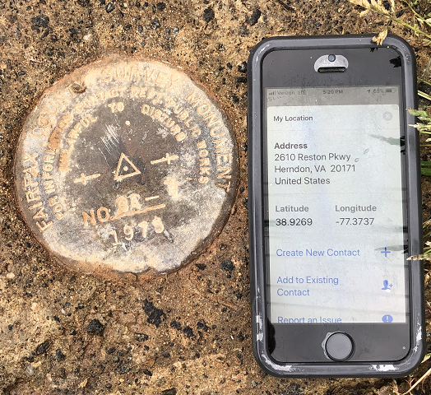
Reported Coordinates

Slide 54
New Types of Coordinates
Preliminary
“These are coordinates at survey epoch that have been computed from OPUS, but not yet quality checked and loaded into the National Spatial Reference System Database (NSRS DB).”
User-computed values, such as they might get today from either OPUS-S or OPUS-Projects
“Preliminary” coordinates are the only coordinates a user will get directly from OPUS

Slide 55
New Types of Coordinates
Reference Epoch
“These are coordinates which have been estimated by NGS, from time-dependent (final discrete and final running) coordinates, at an Official NSRS Reference Epoch (ONRE)”
NAD 83(2011) epoch 2010.00 (sort of) would’ve fallen under this category
These will be computed by NGS every 5 years
On a schedule 2-3 years past ONRE
2020.00 coordinates will be computed in CY 2022
2025.00 coordinates will be computed in CY 2027

Slide 56
New Types of Coordinates
Final Discrete
“These are coordinates computed by NGS using submitted data and metadata, checked and adjusted and referenced to one survey epoch.”
These represent the best estimates NGS has of the time-dependent coordinates at any mark
Could be a:
Daily solution on one CORS
The single adjusted value coming from one or more occupations on a passive mark within 1 GPS Month
*
*
More on that in a moment…

Slide 57
New Types of Coordinates
Final Running
“Of all types of coordinates on a mark, these are the only ones which will have a coordinate at any time.”
At a CORS GRP, they will be the coordinate function
Which will be generated by a “fit” to regularly computed Final Discrete Coordinates (FDCs) on a TBD basis, perhaps daily, perhaps weekly
On a passive mark, they will come from a mixture of Final Discrete Coordinates (FDCs) and the Intra-Frame Velocity Model (IFVM2022)
And possibly the time-dependent geoid, DGEOID2022

Slide 58
New Way of Operating the NOAA CORS Network (NCN)

Slide 59
New Way of Operating the NOAA CORS Network (NCN)
Each CORS will get a coordinate function
Actually three functions, X(t), Y(t), Z(t), in the ITRF2014 frame
In the strict mathematical definition of “function”
For any given “t”, there is one and only one X , Y and Z
We actually do this today, just that the functions are piecewise linear
We are NOT limiting our “modernized NSRS” discussions of CORS coordinate functions to linear functions only!
But have made no further decisions yet

Slide 60
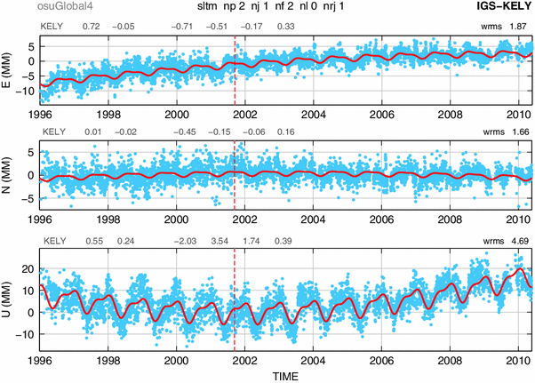
Examples of what non-linear CORS coordinate functions look like

Slide 61
New Way of Operating the NOAA CORS Network (NCN)
Philosophy:
The NOAA CORS Network (NCN) will be self-consistent, meaning:
The impact of a user’s CORS choices within their project will not exceed a small, statistically acceptable value:
Horizontal < 5 mm, Vertical < 10 mm
On a daily basis NGS must be able to detect, and react to, persistent disagreement between daily solutions and the current “coordinate function” assigned to any CORS in the NOAA CORS Network (NCN)

Slide 62
Persistent Disagreement
The point:
It’s not enough to say “each CORS is good to 1 cm in ellipsoid height”.
That phrase is vague, lacking what it means to be “good to 1 cm”.
NGS will define and publish “persistent disagreement”
Possible component: A persistent non-zero average disagreement
Possible component: A persistently deviating disagreement
And NGS will define what happens when a CORS exhibits “persistent disagreement”

Slide 63
New Way for USERS to Process GNSS Projects

Slide 64
GNSS: Time Span…
GNSS projects have no time limit.
(Leveling does. More on that later)
But they will be processed by NGS in GPS Months
*

Slide 65
GNSS: Processing by users in OPUS
GNSS projects, processed by users using OPUS, must always be processed by GPS month as a first step
Multiple occupations on a point within a GPS month will be adjusted together
Coordinate functions from the IGS network or the NOAA CORS Network are the only allowable control
These are effectively the identical steps NGS will use in-house to compute Final Discrete Coordinates (FDCs) from your data
Except NGS will merge your data with all other data in the nation during each GPS month
This process will be built into OPUS as the default, making it easy for users to quickly perform the adjustment
Afterwards, users may move on to a second step…
*

Slide 66
GNSS: Processing by users in OPUS
As a second step, a user may do many alternative things…
Adjust to some epoch that is convenient to them…
Hold any CORSs or passive control as constraints…
This two-step approach is a form of sequential adjustments and allows a win-win:
NGS gets to see the user-computed time-dependent “preliminary” coordinates, which have been computed by GPS Month
Which will be checked against “final discrete” coordinates computed by NGS
The user gets whatever adjustment and/or coordinates fulfill their contractual needs
Redundancy checks can occur both within a GPS month (at step 1, if multiple occupations occur in 1 GPS month) and across GPS months (at step 2, if occupations occur in different GPS months)

Slide 67
New Way of Processing Leveling Projects

Slide 68
Leveling: Time Span…
Leveling projects must not exceed 12 sequential months
Longer projects must be broken into sub-projects each spanning less than 12 sequential months
A compromise between:
Treating “1 GPS Month” as “simultaneous” in the GNSS arena, and
Acknowledging that leveling surveys often take weeks to months to conduct
Mixed with the reality that:
You can’t solve for time-dependent orthometric heights in most leveling projects

Slide 69
Leveling: GNSS required
For the immediate years following 2022, NGS will require that all leveling projects turned in have GNSS on primary control
Minimum of 3 points
Maximum spacing of 30 km
At least two occupations:
+/- 14 days of beginning of leveling
But also within the same GPS month
+/- 14 days of ending leveling
But also within the same GPS month
If leveling exceeds 6 months, must have a 3rd, middle occupation
A GNSS “occupation” can mean “RTK/N”!

Slide 70
Leveling: Step 1 Identify project marks

Slide 71
Leveling: Step 2 Identify primary control marks (PCM)
Each PCM is within 30 km of at least one other PCM
< 30 km
< 30 km
< 30 km
< 30 km

Slide 72
Leveling: Step 2 Identify primary control marks (PCM)
No point over 30 km from a PCM

Slide 73
Leveling: Step 3 Initial GNSS on all PCMs
All PCMs, required: within +/- 2 weeks of the start of leveling
Each PCM, required: 2+ occupations within the same GPS month
All PCMs, recommended: Use the same GPS month

Slide 74
Leveling: Step 4 Leveling
Finished in under 12 months
If greater than 6 months, need a mid-project GNSS set on PCMs

Slide 75
Leveling: Step 5 (if 6-12 months) Mid-project GNSS on all PCMs
All PCMs, recommended: Near midpoint of project
Each PCM, required: 2+ occupations within the same GPS month
All PCMs, recommended: Use the same GPS month

Slide 76
Leveling: Step 6 Final GNSS on all PCMs
All PCMs, required: within +/- 2 weeks of the end of leveling
Each PCM, required: 2+ occupations within the same GPS month
All PCMs, recommended: Use the same GPS month

Slide 77
Leveling: Processing
All GNSS data processed into GPS months, as per normal processing
These are then adjusted to a mean epoch of the entire leveling survey to yield “representative” orthometric heights that serve as control over the entire leveling project
Stochastic but no time dependency

Slide 78
Leveling: Processing
The pre-computed GNSS-based orthometric heights are held as stochastic constraints in the adjustment of leveling data
Use math model from NOAA TM NOS NGS 74
Separates out errors in GNSS from Leveling:
Absolute heights will have standard deviations that are “at GNSS accuracy levels”
Differential heights will have standard deviations that are “at leveling accuracy levels”

Slide 79
Leveling: Absolute errors
Consider this quote from a concerned user:
“In the old NSRS, I could pull the datasheet for a point in California and see that NGS trusted the NAVD 88 height to 1 millimeter. Now, you’re telling me to use RTN to establish orthometric heights in the same area, and I’m getting heights with 4 cm standard deviations! Why are your heights less accurate today than in the past?”

Slide 80
New Way for NGS to Process and store GNSS Data: Final Discrete Coordinates (FDCs)

Slide 81
GNSS: Monthly workflow…
Every GPS month (say the first Monday of that GPS month), NGS will “process the GPS month of 12-16 weeks ago” by doing the following:
Ensure that the “final” IGS orbits for the GPS month that spans 12-16 weeks prior are available
If not, hold off on this until they are
Create an in-house project named for that prior GPS month
Farm all data (collected during that GPS month) from all projects submitted to NGS, and put them all into the in-house project

Slide 82
Processing by GPS Month…
GPS Month 587
GPS Month 588
GPS Month 589
GPS Month 590
GPS Month 591
GPS Month 592
GPS Month 593
GPS Month 594
All GNSS data collected in this
GPS month…
…are processed in this GPS month…
…to create Final Discrete coordinates for
this GPS month….
…which are loaded into the
NSRS database in this GPS month.

Slide 83
Processing by GPS Month…
GPS Month 587
GPS Month 588
GPS Month 589
GPS Month 590
GPS Month 591
GPS Month 592
GPS Month 593
GPS Month 594
All GNSS data collected in this
GPS month…
…are processed in this GPS month…
…to create Final Discrete coordinates for
this GPS month….
…which are loaded into the
NSRS database in this GPS month.

Slide 84
GNSS: Monthly workflow…
Adjust all that data together
Take the results of this adjustment and load them into the NSRS database as “final discrete” coordinates

Slide 85
GNSS: Monthly workflow…
Q: What about users’ projects that span more than 12-16 weeks?
A: NGS will provide a way for a user to “allow NGS to farm my data as it is loaded to my ongoing project”
Thus NGS needn’t wait for them to finish their project and click “submit”.
Will require some sort of metadata validity statement from the user for each data file uploaded

Slide 86
GNSS: Monthly workflow…
Q: What if a user turns in data more than 12-16 weeks after it was collected?
A: NGS will have a “holding bin” for such data. Occasionally, but not more than 1/year, NGS will sweep up all data in the holding bin, and put that data into the proper in-house GPS-month-based projects, depending on the GPS month of that data.
Since those in-house projects have already been adjusted once before using data that WAS submitted within the 12-16 week limit, and “final discrete” coordinates were computed on those early-submitted data, NGS will hold the “final discrete” coordinates on that early-submitted data as “fixed”, and adjust the later-submitted data only.

Slide 87
New Way for NGS to Process and store GNSS Data: Reference Epoch Coordinates (RECs)

Slide 88
GNSS: Every five years…
Official NSRS Reference Epochs (ONREs) will happen every five years, beginning with 2020.00.
Every ONRE will have a project associated with it
To estimate the Reference Epoch Coordinates (RECs) at each ONRE
That project will begin 2 years after the ONRE and will end 3 years after it
Thus the project to create 2020.00 RECs will run January 1-December 31, 2022
Using data collected through the end of 2021
Error estimates in RECs will grow larger every five years for those points which are not regularly observed
Once computed, the REC at an ONRE for a point will stand forever, unless corrected for a blunder

Slide 89
The relation of five global reference
frames through time.
NATRF2022
MATRF2022
Rotations are not to scale
CATRF2022
Rotation of North American Plate
PATRF2022
Rotation of Pacific Plate
ITRF2014 frame
ITRF2014 frame through time
ITRF2014 frame
Rotation of Caribbean Plate
PATRF2022
CATRF2022
Rotation of Mariana Plate
NATRF2022
Time “t ” when
all four TRFs and
ITRF2014 are identical.
(2020.0)
MATRF2022
0
t=t - Δt
(“the past”)
t=t + Δt
(“the future”)
0
0

Slide 90
These are part of the NSRS
Hor Datums / Geometric Reference Frames | Vertical Datums | Great Lakes Datums | Geoid Models | Transformations / Conversions
USSD | NGVD 29 | IGLD55 | GEOID90 | NADCON
NAD 27 | NAVD 88 | IGLD85 | GEOID93 | VERTCON
NAD 83 | PRVD02 |  | ALASKA94
 | ASVD02 |  | GEOID96 | SPCS 27
 | NMVD03 |  | GEOID99 | SPCS 83
 | GUVD04 |  | GEOID03
 | VIVD09 |  | GEOID06
 |  |  | GEOID09
 |  |  | GEOID12(A,B)
These are select entries, not a complete list

Slide 91
These are not part of the NSRS
Hor Datums / Geometric Reference Frames | Vertical Datums | Great Lakes Datums | Geoid Models | Transformations / Conversions
WGS 84 | IHRS |  | OSU91A | CORPSCON
ITRF |  |  | EGM96 | Appendix B.6 of DMA TR 8350.2 (WGS 84)
IGS |  |  | EGM2008 | Oregon Coordinate Reference System
 |  |  |  | The Kansas Regional Coordinate System
These are select entries, not a complete list

Slide 92
Mixing NSRS and non-NSRS?
Just do it right
Right:
The Oregon CRS has a mathematically defined relationship to the NSRS
Wrong:
“WGS 84 is the same as NAD 83”
“WGS 84 is the same as the ITRF”
“Sub-meter accuracy is possible using WGS 84”
Such statements gloss over critical facts about history, accuracy and application

Slide 93
Accuracy
Consider your users’ accuracy needs
3 Meters?
Then WGS 84 is NAD 83
Global 14 parameter transformations will suffice
3 Decimeters?
Then NAD 83(2011) is NAD 83(NSRS2007)
But NAD 83(1986) is not the same as NAD 83(HARN)
NADCON will suffice as a transformation
3 Centimeters?
Every detail matters

Slide 94
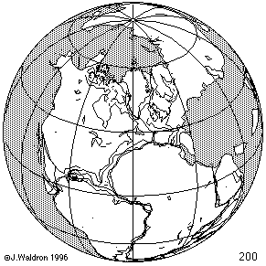
Time Changes - Horizontal
Watch the grid!

Slide 95
Time-Dependency
The IGS14 frame is not beholden to any tectonic plate
Thus the four plates with U.S. populations will have time-dependent latitudes/longitudes:
North America: 1-3 cm / year (CONUS, Alaska)
Pacific: 7-8 cm / year (Hawaii, AS)
Caribbean: 1-2 cm / year (PR, USVI)
Mariana: 1-4 cm / year (Guam, CNMI)

Slide 96
What does it mean to provide time-dependent coordinates in 5 frames?

Slide 97
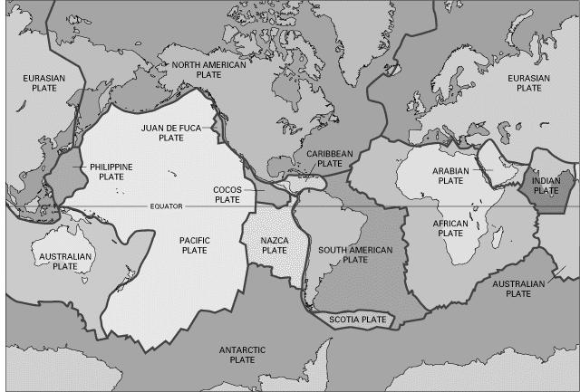
BSMK (North Dakota)

Slide 98
BSMK (North Dakota)
As per NGS policy decision circa 2018:
t₀ = 2020.0
NATRF2022 Latitude is CONSTANT over time

Slide 99
BSMK (North Dakota)
NATRF2022 Longitude is constant over time

Slide 100
BSMK (North Dakota)
No matter WHAT frame, the ellipsoid height is dropping over time

Slide 101
PIN1 (S. California)

Slide 102
PIN1 (S. California)
Latitude in NATRF2022 and PATRF2022 change over time

Slide 103
PIN1 (S. California)
Longitude in NATRF2022 and PATRF2022 change over time

Slide 104
PIN1 (S. California)
No matter WHAT frame, the ellipsoid height is rising over time

Slide 105
Definitional Relationship
$H_{NAPGD2022}(t)≡h_{∗TRF2022}(t)−N_{GEOID2022}(t)$
Time-dependent ellipsoid heights
come from time-dependent
CORS coordinates which serve as control for your time-dependent GNSS survey.
They will be modeled in the IFVM
Time-dependent geoid undulations
are modeled in the dynamic component of GEOID2022 (“DGEOID2022”), which will come from the geoid monitoring service, or GeMS.

Slide 106
X, Y, Z
φ, λ, h
φ, λ, h
Region: CONUS
NADCON 5 connections in RED
2022
X, Y, Z
SPC
UTM
USSD
USNG
UTM
φ, λ, h
φ, λ, h
NAD 27
NAD 83 (2011)
X, Y, Z
SPC
X, Y, Z
SPC
USNG
UTM
USNG
UTM
NAD 83 (NSRS2007)
φ, λ, h
NAD 83 (1986)
φ, λ, h
NAD 83 (FBN)
NAD 83 (HARN)
φ, λ, h
X, Y, Z
SPC
X, Y, Z
SPC
φ, λ, h
USNG
UTM
USNG
UTM
X, Y, Z
SPC
X, Y, Z
SPC
USNG
UTM
USNG
UTM

