Slide 1
The modernized NSRS
Dru Smith
NSRS Modernization Manager
NOAA’s National Geodetic Survey

Slide 2
Outline
Some answers up front
Why “2022”?
Brief overview
New Reference Frames / Datum
Expected Changes
Recent progress
Re-prioritization: a “data first” approach
Timeline

Slide 3
Answers …
What is changing?
All horizontal datums and vertical datums in the NSRS
NAD 83 , NAVD 88 , etc.
Thus every coordinate for everything in the USA is going to change by decimeters to meters
Why?
Predominantly to keep up with technology.
Global proliferation of real time cm-accuracy positioning (in the hands of people who have no understanding of geodesy, datums, plate tectonics, error sources or other subtleties) is rapidly approaching.
Many surveying, mapping and navigation professionals already enjoy this accuracy.
The current datums have systematic errors exceeding 1 meter.
When is it changing?
Mid 2025
Will it be an immediate or gradual change?
Immediate

Slide 4
Modernized NSRS and “2022”
Intent: release the modernized NSRS in 2022
Years ago, many yet-to-be-built components were given “2022” in their names:
GEOID2022, NATRF2022, NAPGD2022, etc.
“We are delayed” – announcement in June 2020
To avoid confusion with long-standing communications, NGS chose to leave “2022” in the names
When will we be done? Mid-2025

Slide 5
Federal Users of the NSRS
Notes:
Many of these users also sit on the Federal Geodetic Control Subcommittee, so there is a feedback loop between the providers of geodetic control (NGS) and the users of that control.

Slide 6
Brief overview: Four New Reference Frames and One New Geopotential Datum

Slide 7
Replacing NAD 83
The Old:
NAD 83(2011)
NAD 83(PA11)
NAD 83(MA11)
The New:
The North American Terrestrial Reference Frame of 2022
(NATRF2022)
The Caribbean Terrestrial Reference Frame of 2022
(CATRF2022)
The Pacific Terrestrial Reference Frame of 2022
(PATRF2022)
The Mariana Terrestrial Reference Frame of 2022
(MATRF2022)

Slide 8
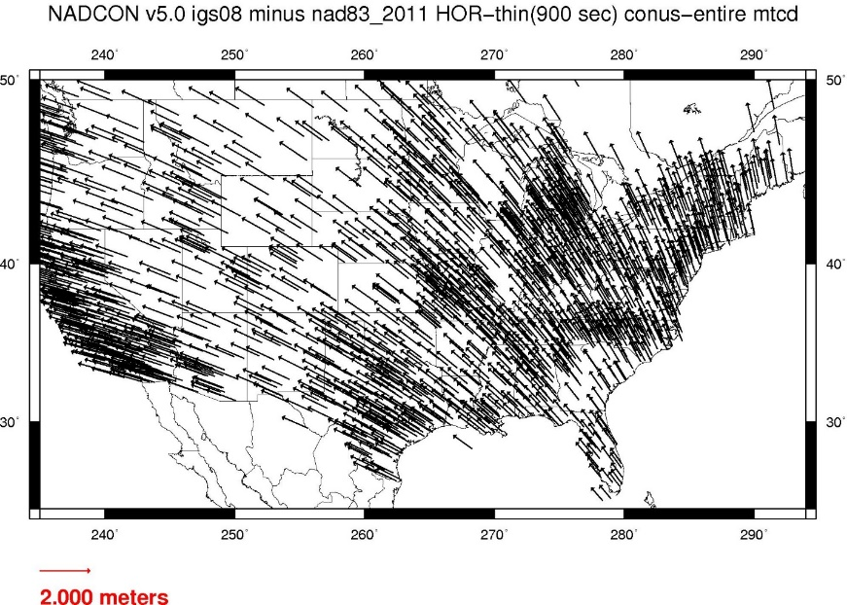
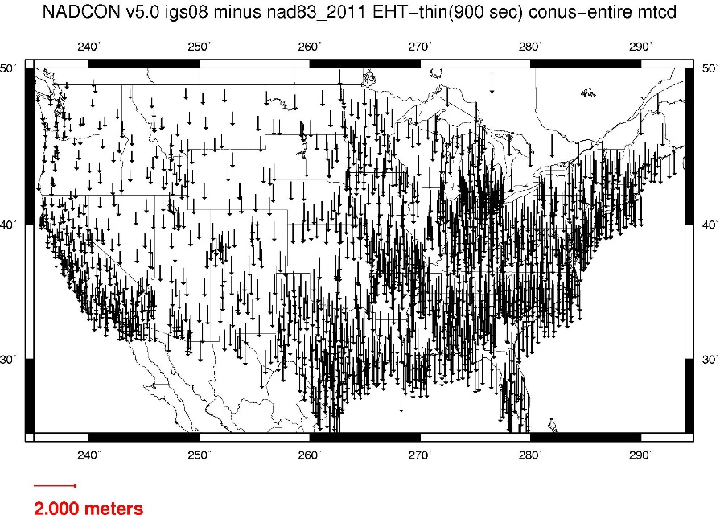
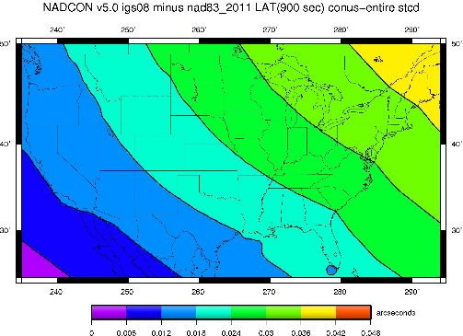
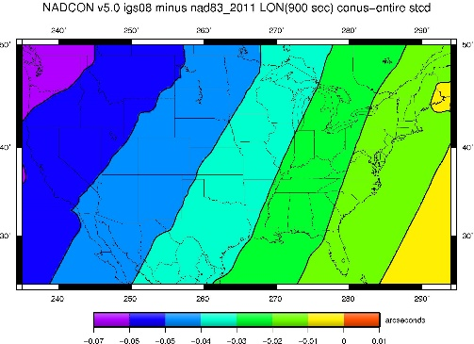
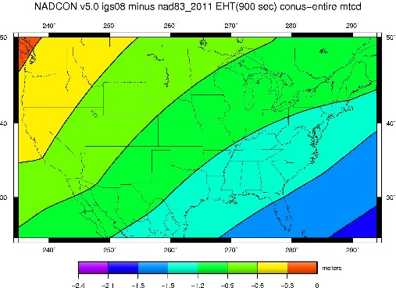
NAD 83(2011) epoch 2010.0 to NATRF2022 epoch 2020.00 (estimate)

Slide 9
Replacing NAVD 88
The Old:
NAVD 88
PRVD 02
VIVD09
ASVD02
NMVD03
GUVD04
IGLD 85
IGSN71
GEOID12B
DEFLEC12B
The New:
The North American-Pacific Geopotential Datum of 2022 (NAPGD2022)
Will include:
GEOID2022
DEFLEC2022
GRAV2022
DEM2022
More
Orthometric
Heights
Normal
Orthometric
Heights
A HUGE component of this
effort is GRAV-D:
Gravity for the Redefinition of
the American Vertical Datum
Dynamic
Heights
Gravity
Geoid
Undulations
Deflections of
the Vertical

Slide 10
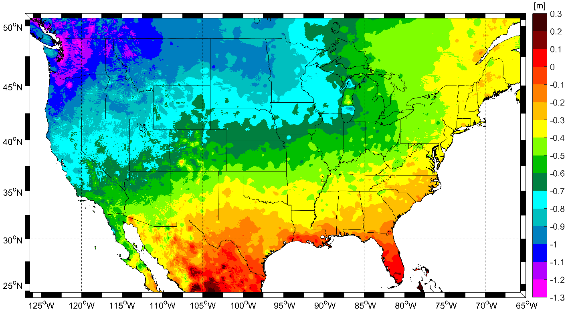
Expected changes to orthometric heights

Slide 11
Re-prioritization: a “data first” approach

Slide 12
Re-prioritization
NGS has recently decided to release all of the modernized NSRS data before we have fully completed all support tools
If we do not take this approach, we are not likely to see the modernized NSRS defined and released until 2030

Slide 13
Data
Upon release, the modernized NSRS will consist of this data:
The NOAA CORS Network (NCN) operating on ITRF2020
NATRF2022, PATRF2022, MATRF2022, CATRF2022 defined relative to ITRF2020
NAPGD2022, including:
GM2022, GEOID2022, DEFLEC2022, GRAV2022
Geometric (XYZ / φλh) and orthometric (H) reference epoch coordinates (RECs) at 2020.00 at those passive control with the observations to support such coordinates
Geometric (XYZ / φλh) and orthometric (H) survey epoch coordinates (SECs) at survey epochs between about 1994 and 2020 at those passive control with the observations to support such coordinates
State Plane Coordinates of 2022 (SPCS2022), plus UTM and USNG
NADCON
Connecting NAD 83(2011/MA11/PA11) epoch 2010.00 to N/P/M/CATRF2022 epoch 2020.00
VERTCON
Connecting NAVD 88, PRVD02, ASVD02, NMVD03, GUVD04 and VIVD09 to NAPGD2022 epoch 2020.00

Slide 14
Tools
At a minimum, NGS is targeting these tools upon release:
A Data Delivery System capable of yielding:
Coordinates on survey marks
Information on Continuously Operating GNSS Reference Stations
A downloadable version of LASER
NCAT and Vdatum capable of invoking NADCON, VERTCON and SPCS2022
A few more…

Slide 15
Timeline

Slide 16
Timeline
Resources are being diverted from tool building to the assurance of quality data first and foremost
As such, based on this new approach, NGS anticipates the release of all data, and limited tools, by the middle of 2025.
Work on additional tools will continue in the out-years

Slide 17
Thank you!

Slide 18
Questions?

