Slide 1

The Challenges of Change:
Future Changes in
the National Spatial Reference System &
the National Geodetic Survey Geodetic Advisor Program
William Stone
Southwest Region (NV, AZ, NM, UT) Geodetic Advisor
william.stone@noaa.gov
Marti Ikehara
California Geodetic Advisor
marti.ikehara@noaa.gov
NOAA’s National Geodetic Survey
geodesy.noaa.gov

Slide 2
Today’s Topics
Part 1 (Bill)
Continuously Operating Reference Stations (CORS)
Multi-Year CORS Solution (new CORS network coords/vels)
National Adjustment of 2011 (new passive network coords)
New Datums (NGS Ten-Year Plan)
Part 2 (Marti)
The Rest of the Story …
Notes:
This is a listing of the parts of subject matters to be covered. Cut out entire chapters if they are unimportant to your audience.

Slide 3
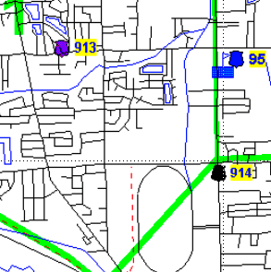
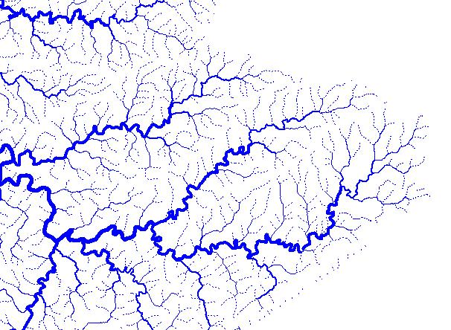
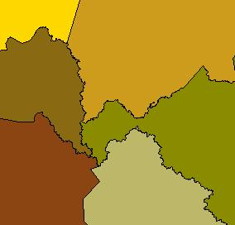
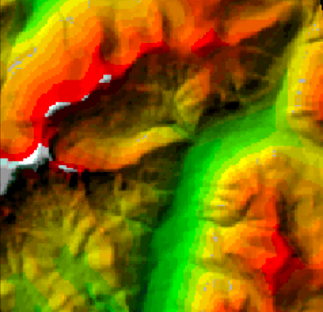
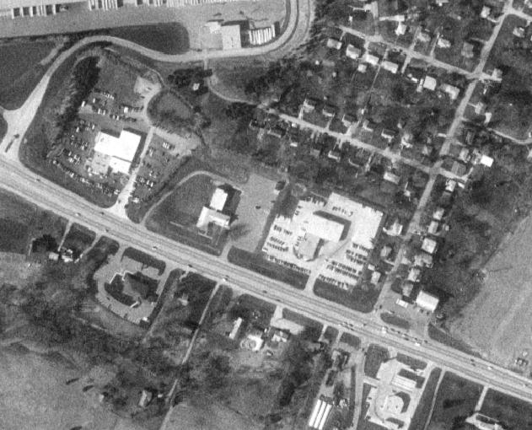
U.S. Department of Commerce
National Oceanic & Atmospheric Administration
National Geodetic Survey
Mission: To define, maintain & provide access to the
National Spatial Reference System (NSRS)
to meet our Nation’s economic, social & environmental needs
National Spatial Reference System
& their time variations
      Latitude
      Longitude
      Height
  Scale
  Gravity
  Orientation
Notes:
- NSRS benefit to the nation = $2.5B/year
est. 300K precision GPS users worldwide (2008); ¼ in US
- Very exciting to us at NGS to see how it has evolved over the years – now cm-accuracy capability / tracking with time

Slide 4
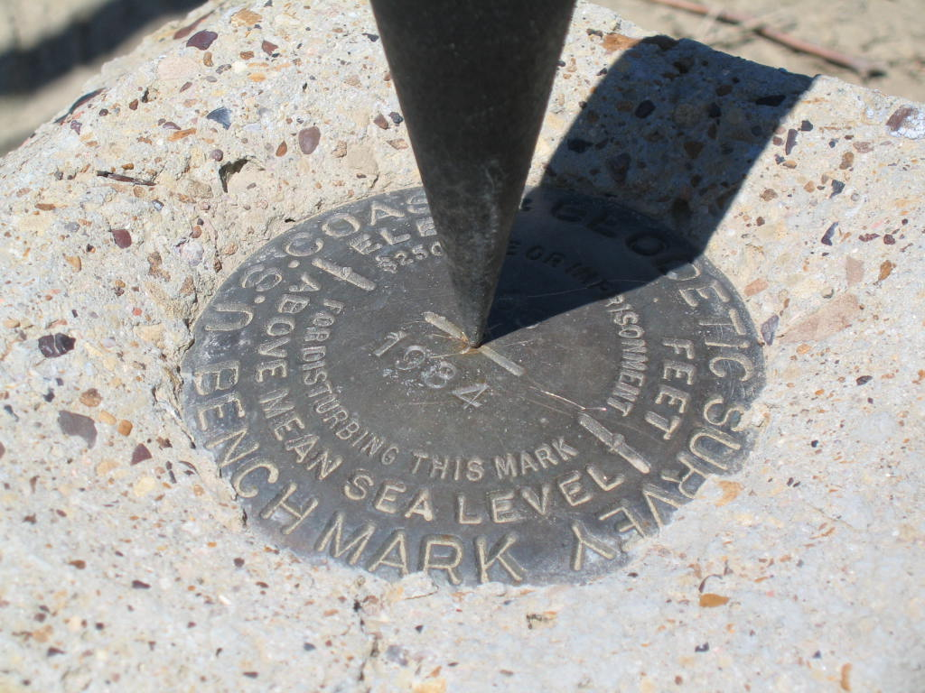
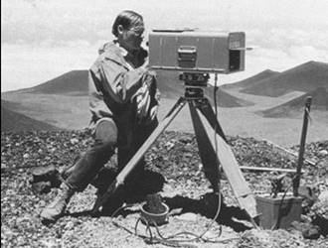
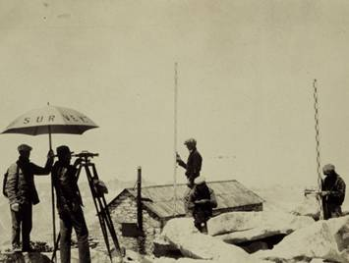
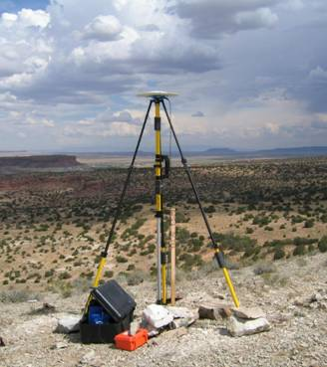
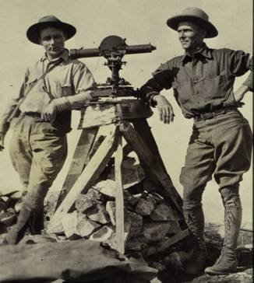
36 33 42.15986 N / 105 12 15.67754 W
1855.973 m
NAD83(2007) / NAVD88

Slide 5
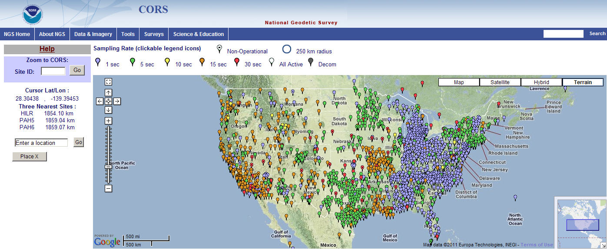
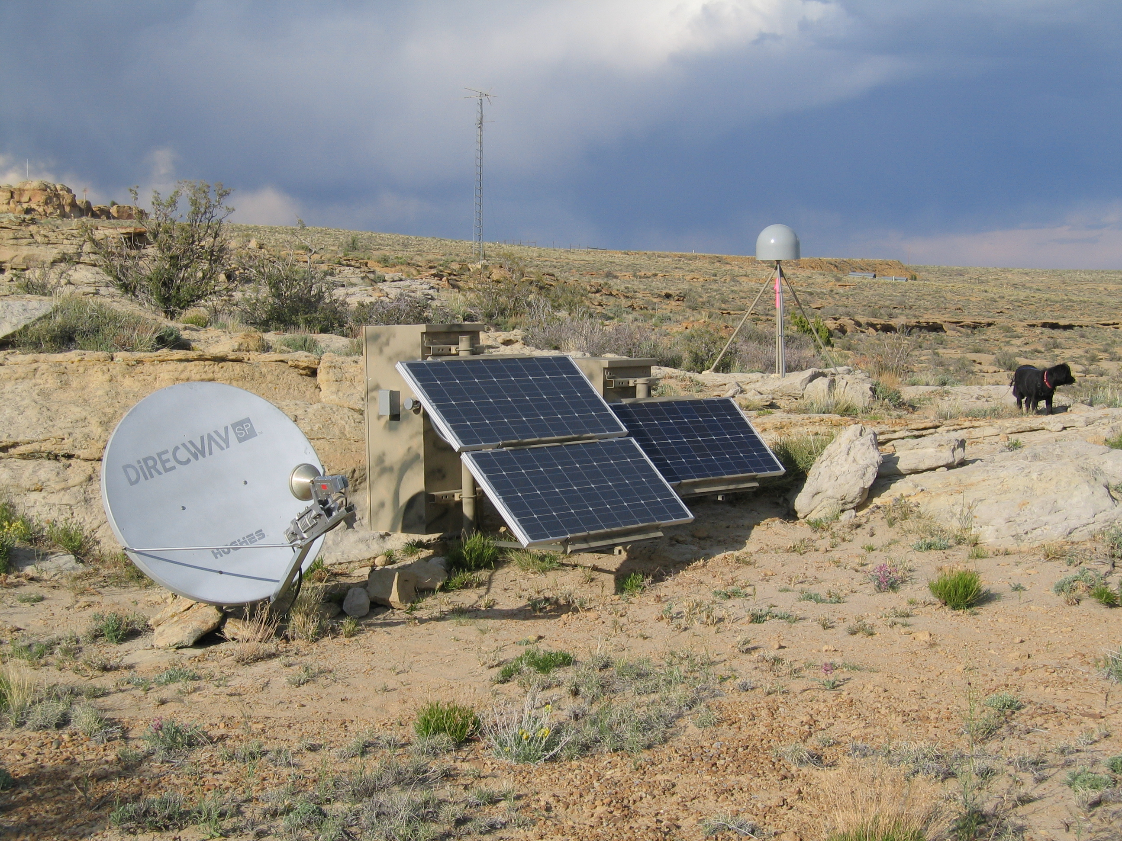
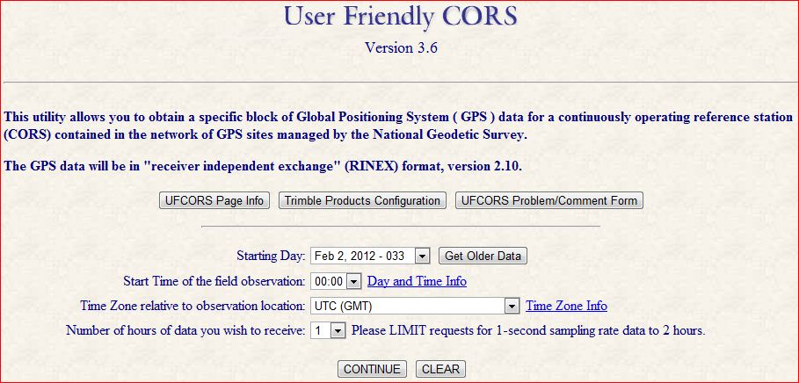
Continuously Operating Reference Stations (CORS)
1750+ GPS/GNSS sites
200 organizations

Slide 6
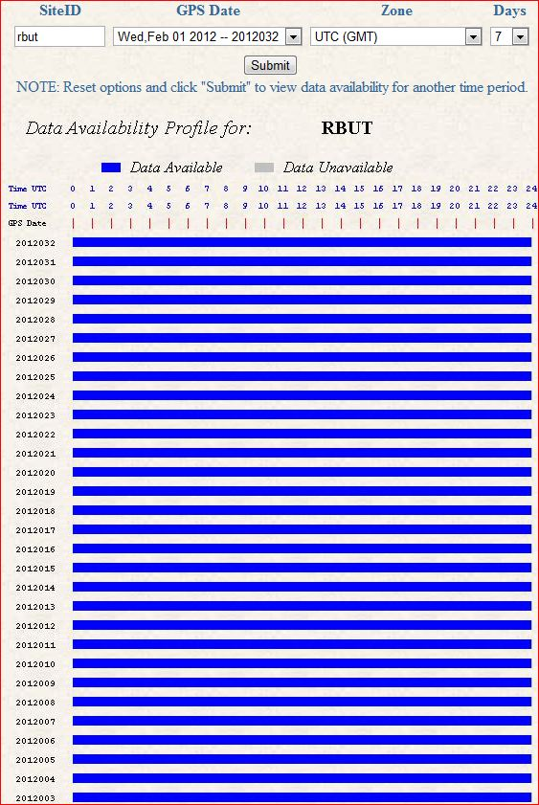
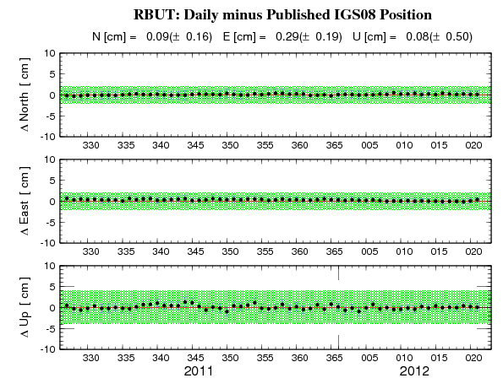
Red Butte (RBUT) CORS Plots
Data Availability
60-day Time Series

Slide 7
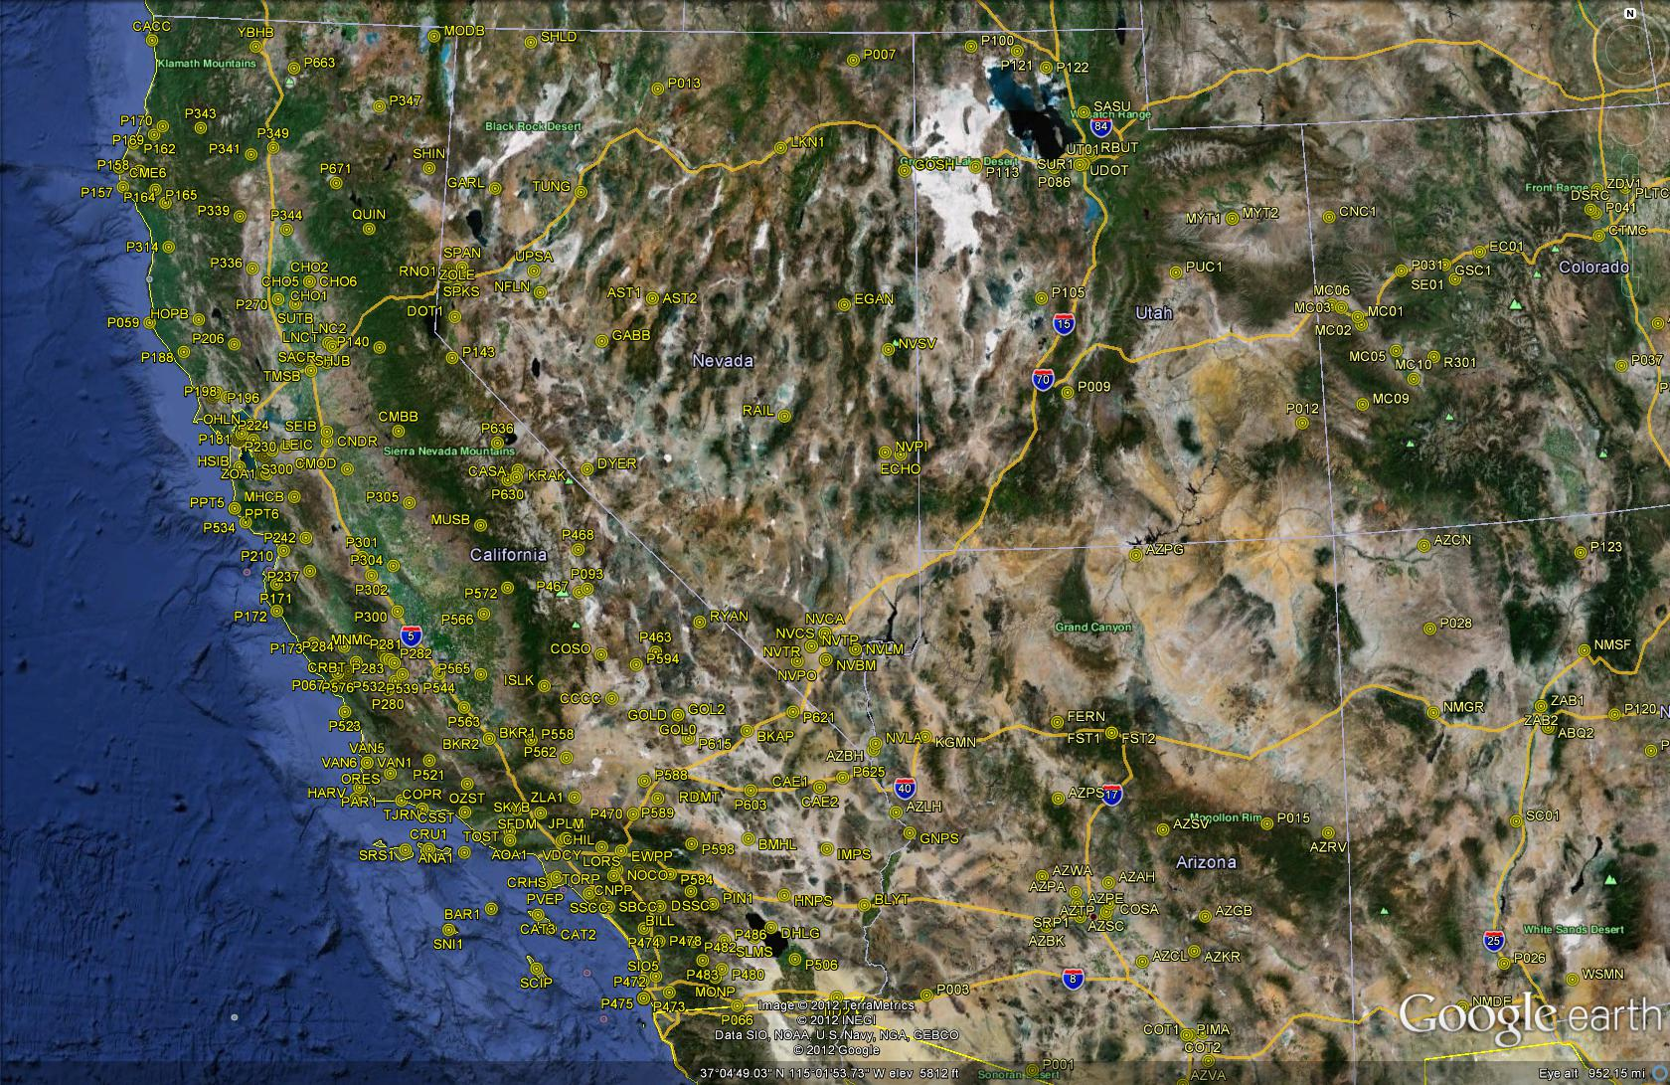
CORS in California, Nevada and Beyond

Slide 8
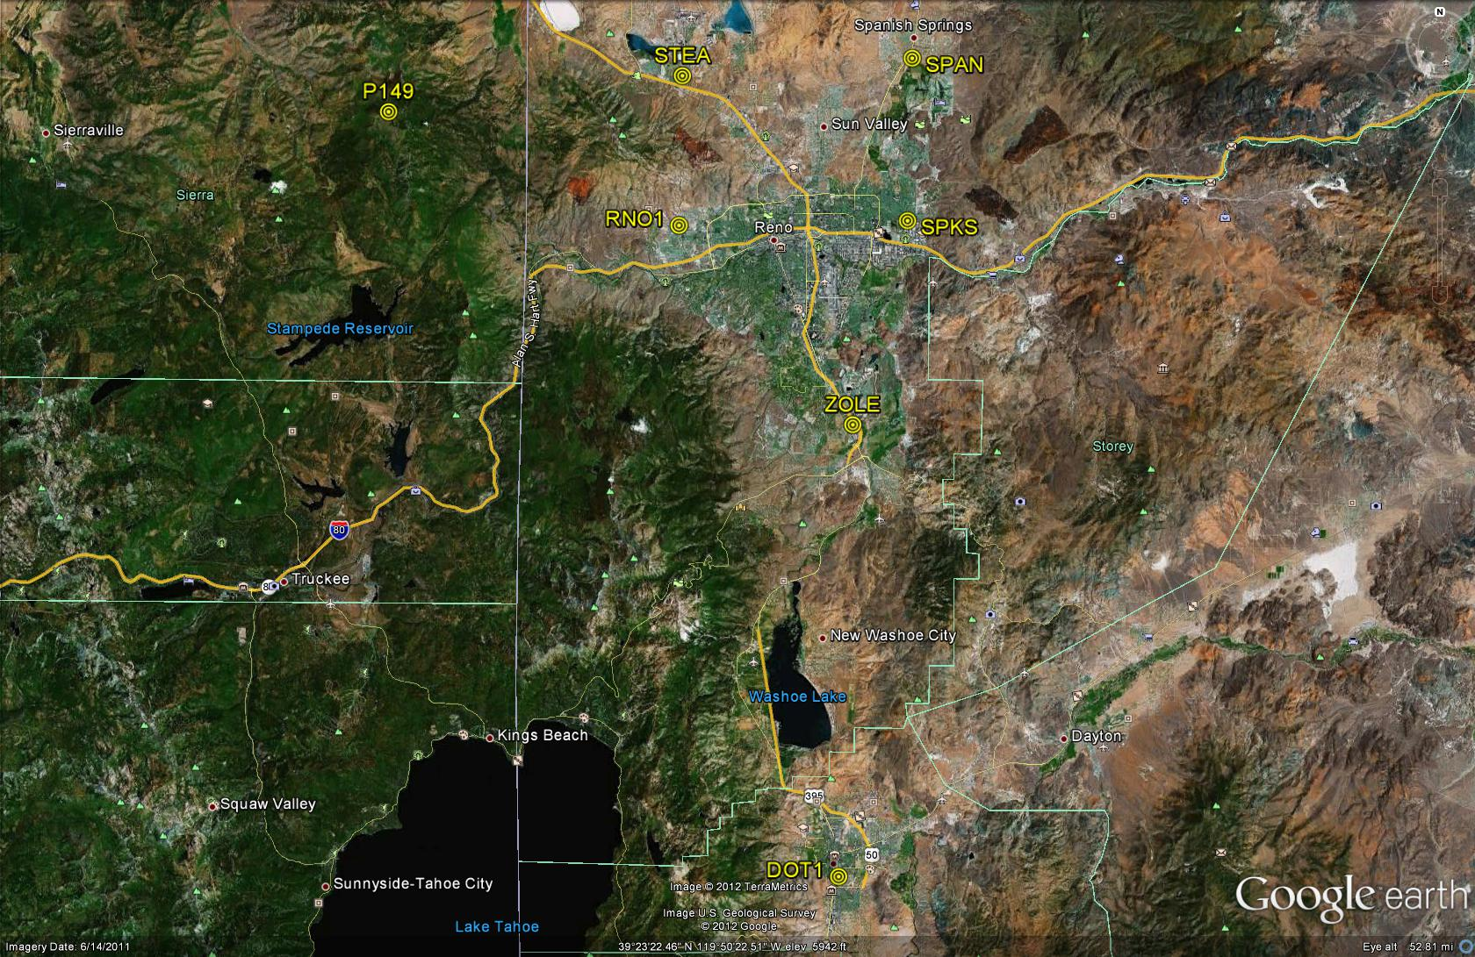
CORS in Greater Reno Area

Slide 9
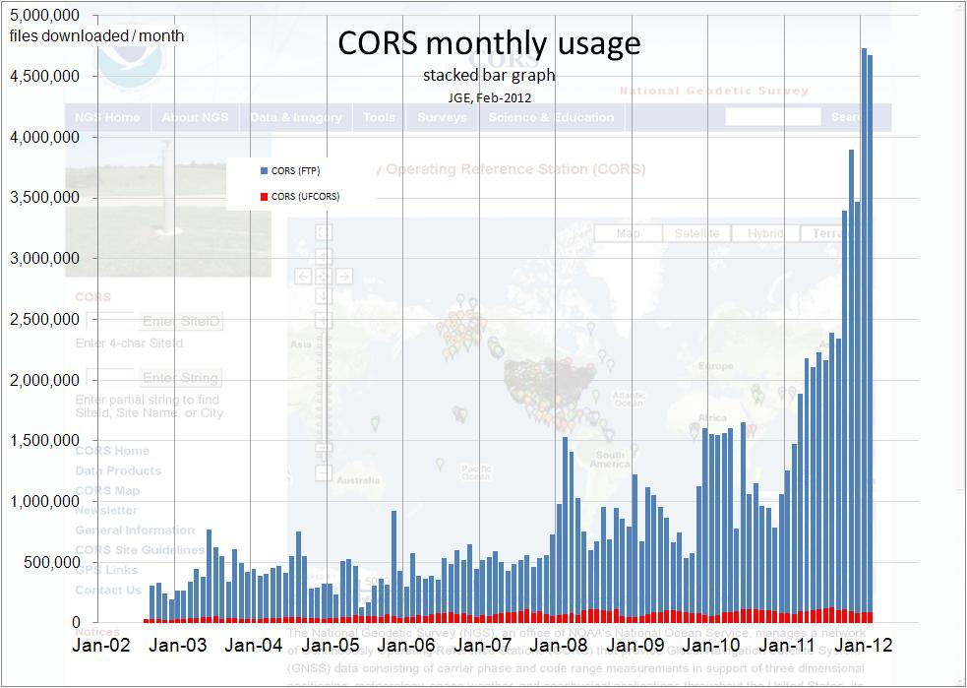

Slide 10

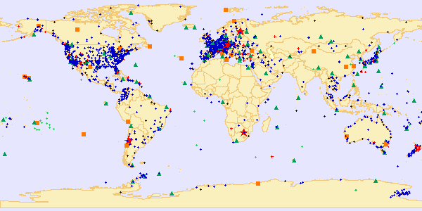
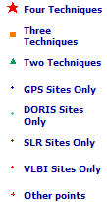
International Terrestrial Reference Frame (ITRF)
space-based techniques: VLBI, DORIS, SLR, GNSS
Current Realization: ITRF2008 (epoch 2005.0)
International Earth Rotation and Reference System Service(IERS)
(http://www.iers.org)

Slide 11
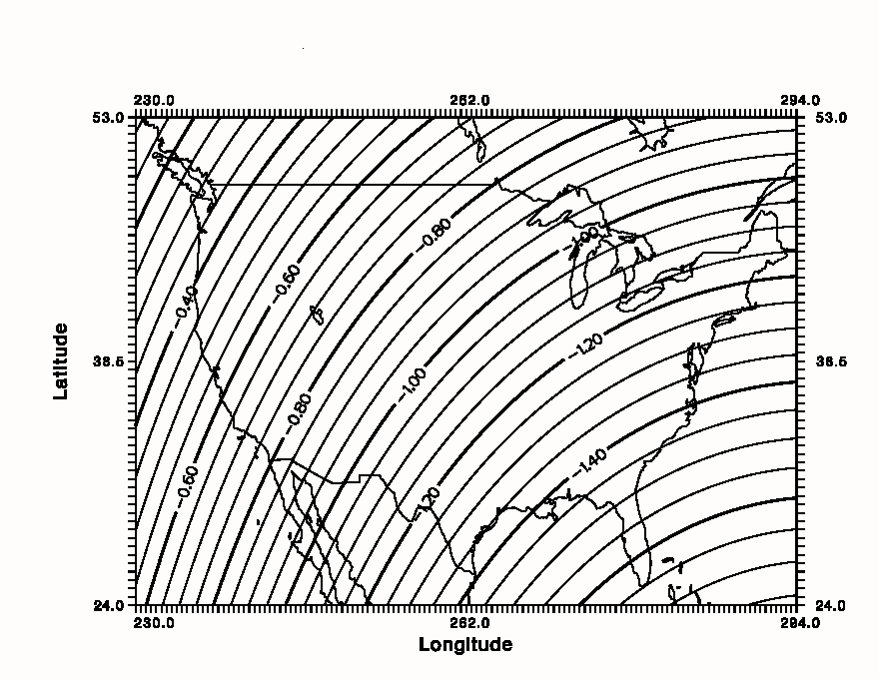
Simplified Concept of NAD 83 vs. ITRF
In Southwest US - NAD83 & ITRF
differ by
ABOUT 1 meter H & V
h_{NAD83}
h_{ITRF}
Earth’s
Surface
ITRF 00
Origin
2.2 meters
Ellipsoid for both NAD83 and ITRF:
Geodetic Reference System 1980 (GRS80)
a = 6,378,137.000 meters (semi-major axis)
1/f = 298.25722210088 (flattening)
NAD 83
Origin
WGS84 (G1150) ~ ITRF2000
Notes:
ITRF (International Terrestrial Reference Frame) just has an origin; take NAD83 shaped ellipsoid centered at the ITRF origin to derive ITRF97 ellipsoid heights.
Ellipsoid heights NAD83 vs. ITRF97 - Defined origins are best estimate of the center of mass; NAD83 is not geocentric. Move origin; move ellipsoid surface as illustrated.
Ellipsoid height differences reflect the non-geocentricity of NAD83.

Slide 12
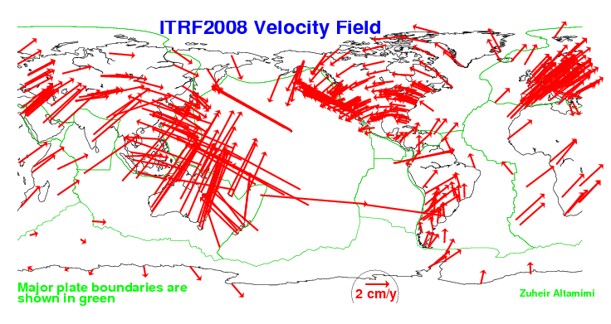
Global Velocity Field - ITRF2008
global condition of NO Net-Rotation

Slide 13
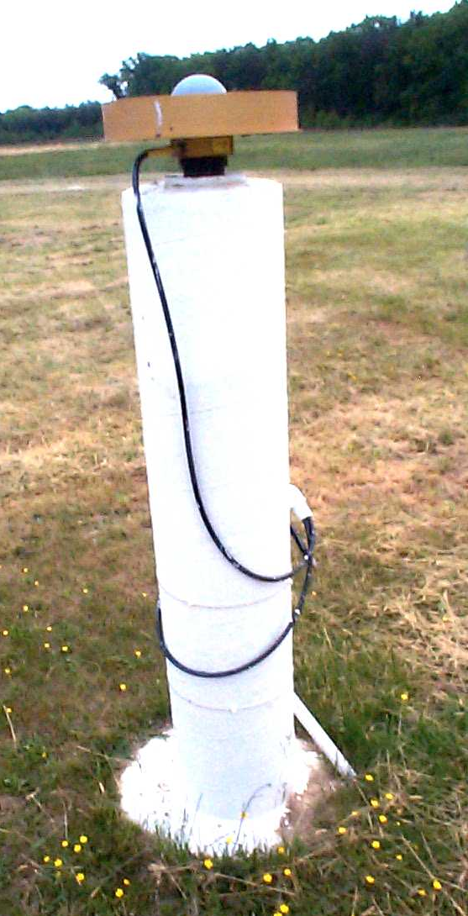
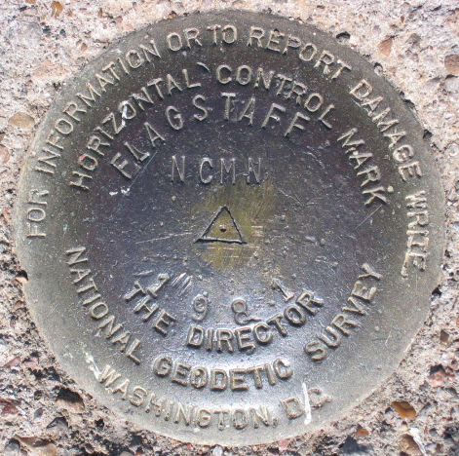
Introducing… NAD 83(2011) epoch 2010.00
1. Multi-Year CORS Solution (MYCS)
  Reprocessed all CORS GPS data Jan 1994-Apr 2011
  2264 CORS & global stations
  NAD 83 computed by transformation from ITRF08(IGS08)
  New set of published CORS coordinates & velocities
2. National Adjustment of 2011 (NA2011)
  New adjustment of GNSS-observed passive control stations
  GNSS vectors tied (and constrained) to CORS
  Approximately 80,000 stations; > 400,000 GNSS vectors
SAME Datum Realization for CORS and passive marks
This is NOT a new datum! (still NAD 83)
The name: NAD 83(2011) epoch 2010.00
  “2011” is datum tag → year adjustment complete
  “2010.00” is “epoch date” (January 1, 2010)
    Date associated with coordinates of control station
  Frame fixed to North American tectonic plate
    Includes CA, AK, Puerto Rico, US Virgin Islands

Slide 14
Why a Multi-Year CORS Solution?
Consistent coordinates and velocities from combined solution
  Previous solution mixture of station & velocity sources
  Limited ties to global reference frame
  Previous vertical velocities for most CORS = 0
Need for alignment with most recent realization of global frame (IGS08)
  IGS08 epoch 2005.0 (previously ITRF00 at epoch 1997.0)
  NAD 83 (2011) epoch 2010.00 (previously NAD83 (CORS96) at epoch 2002.0)
Major processing algorithm, modeling, metadata improvements
  Conformance with current international conventions (IERS)
Absolute phase center antenna calibrations
  Both ground (receiving) and satellite (transmitting) antennas
  Previous (NAD83(CORS96)) used relative calibrations (significant change)
RESULT: Highly accurate and consistent CORS coordinates and velocities
    determined using Best Available Methods
  CORS Network is Foundation of Nation’s Positioning Infrastructure

Slide 15
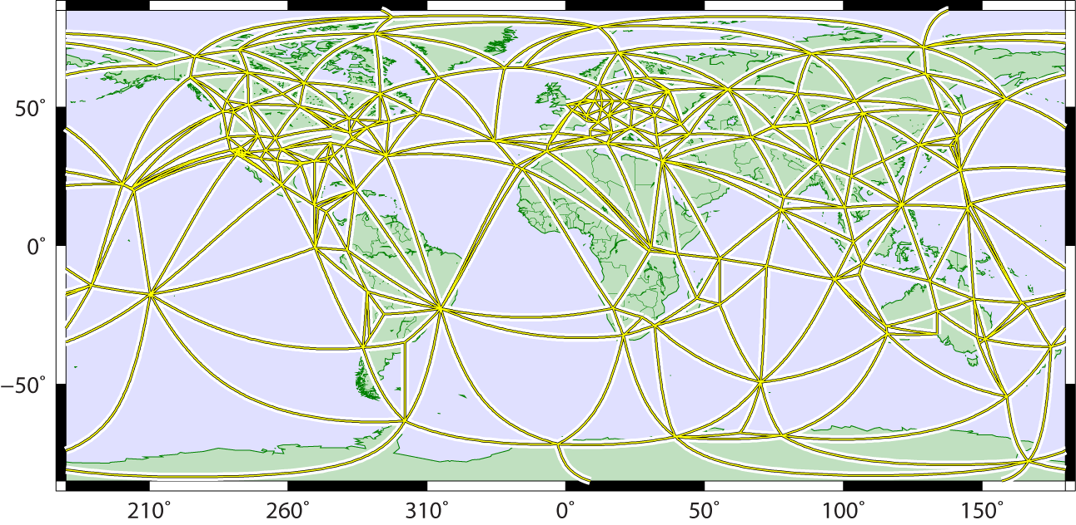
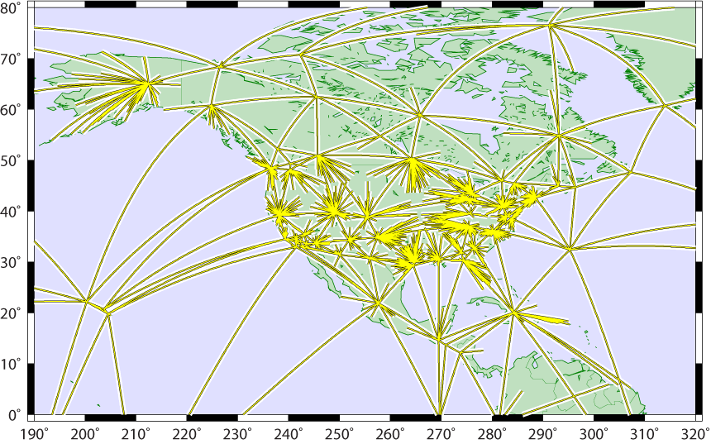
Maintaining Coordinate Accuracy - the Multi-Year CORS Solution
5 years in the making
global tracking network used for estimating:
  satellite orbits (15-min intervals)
  terrestrial framework
  Earth Orientation (EOPs)
  global station positions (weekly averages)
Global
U.S. CORS tied to global framework via single baselines radiating from global stations
  minimizes frame distortions from local effects in dense regional networks
1994-2010.5 tracking history
90 billion double-difference eqs.
switch to absolute antenna cals.
Global+CORS

Slide 16
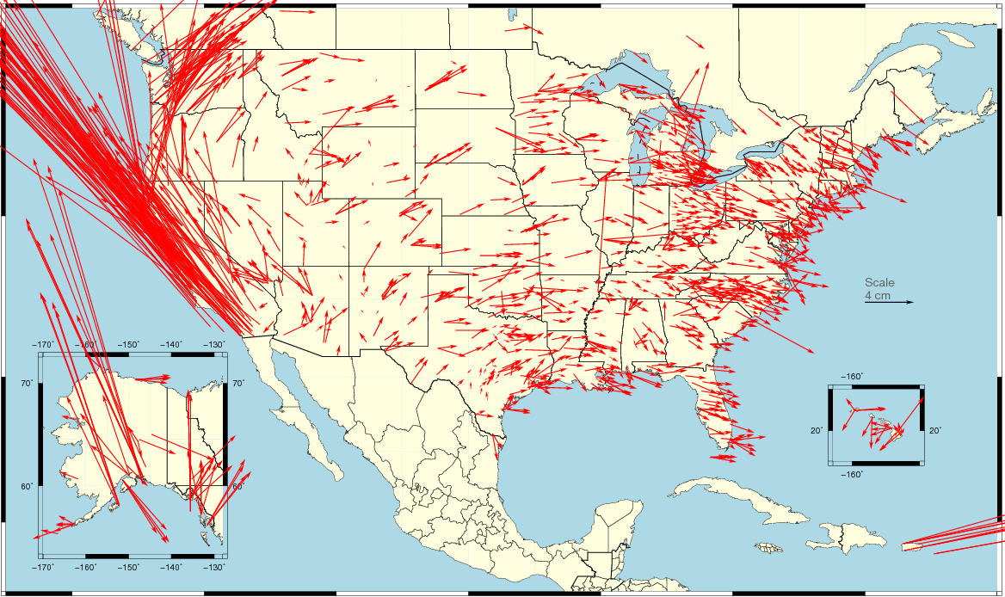
Change in NAD 83 Horizontal Position
NAD 83(2011) epoch 2010.00 – NAD 83(CORS96) epoch 2002.0
Average shift: ΔE = 0.05 cm ± 5.25 cm ΔN = 2.12 cm ±6.08 cm
  combination of position and velocity differences
  due mostly to updated velocities (including up to 8 more years of data)
  plate movement in far West
ID+MT+ND+SD+WY
1.7E / 0.5N cm
WA+OR
4.4E / 5N cm
East
1.4E / -0.2N cm
CA+NV
-10.8E / 14.4N cm
UT+CO+NM+AZ
0.5E /1.0N cm

Slide 17
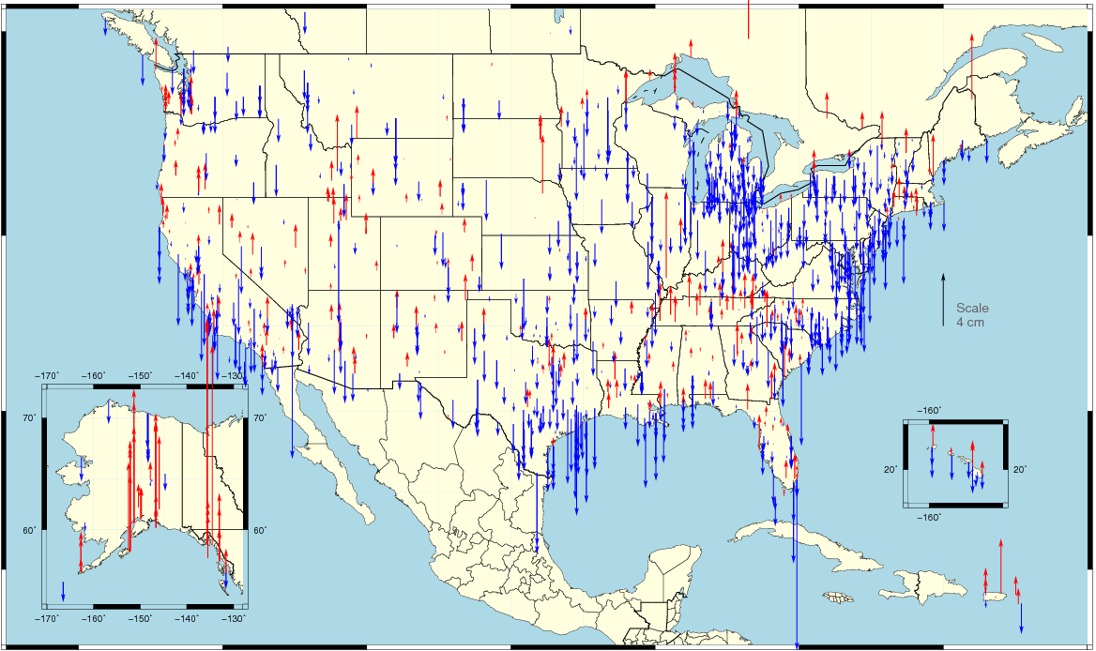
Change in NAD 83 Ellipsoid Height
NAD 83(2011) epoch 2010.00 – NAD 83(CORS96) epoch 2002.0
Avgerage shift: ΔU = -0.66 ± 2.24 cm
  combination of position and velocity differences from additional data, tectonics
  assuming vertical velocity ≈ 0.00 in NAD 83(CORS96)

Slide 18
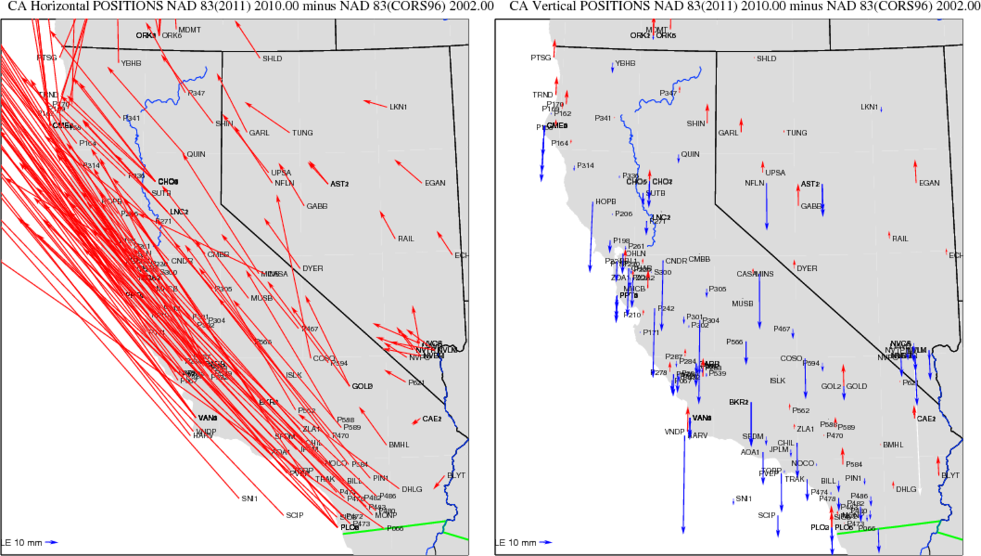
CA & NV NAD83(2011) epoch 2010.00 minus NAD83(CORS96) epoch 2002.0
Horizontal Vertical

Slide 19
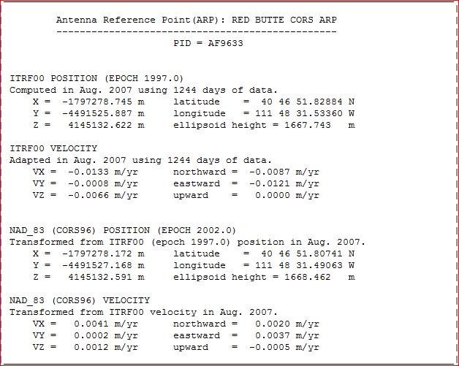
CORS Reference Frame Changes Due to MYCS –
new coordinates / velocities available now
> IGS08 epoch 2005.0
IGS08 = International GNSS Service 2008
(GPS-only realization of ITRF2008)
> NAD83 (2011) epoch 2010.00
NAD83 (2011) = North American Datum 1983
(2011 Realization)

Slide 20
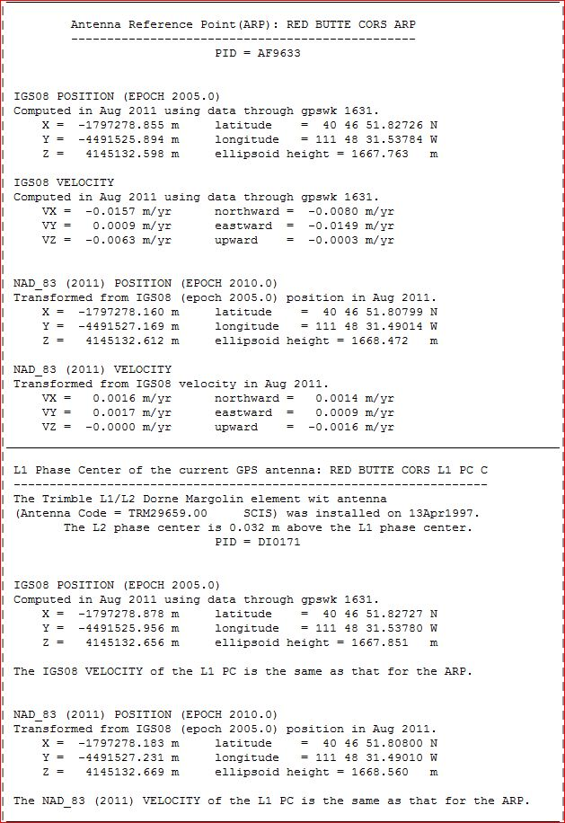
CORS Coordinates – New Reference Frames
IGS08 = International GNSS Service 2008
(GPS-only realization of ITRF2008)
NAD83 (2011) = North American Datum 1983
(2011 Realization)

Slide 21
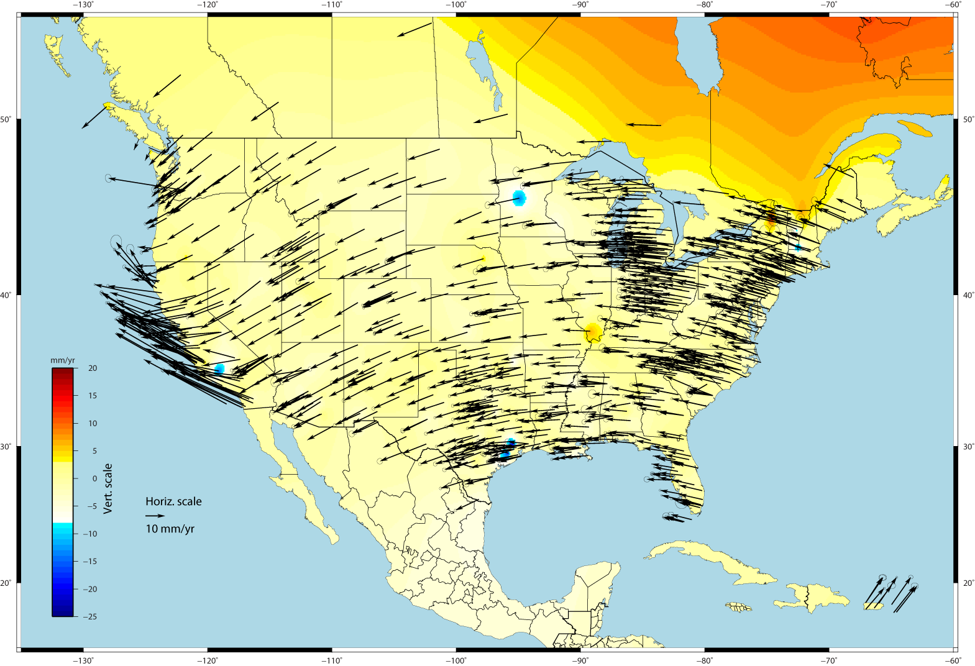
U.S. CORS Velocity Field – ITRF2008 (IGS08 epoch 2005.0)

Slide 22
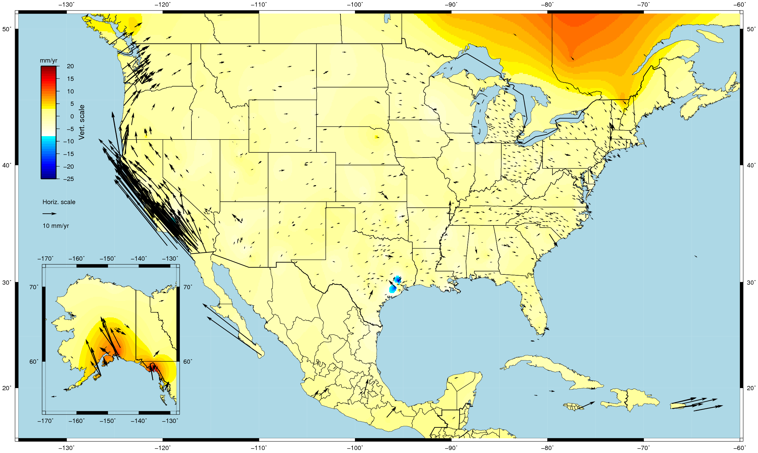
U.S. CORS Velocity Field - NAD83(2011) epoch 2010.00

Slide 23
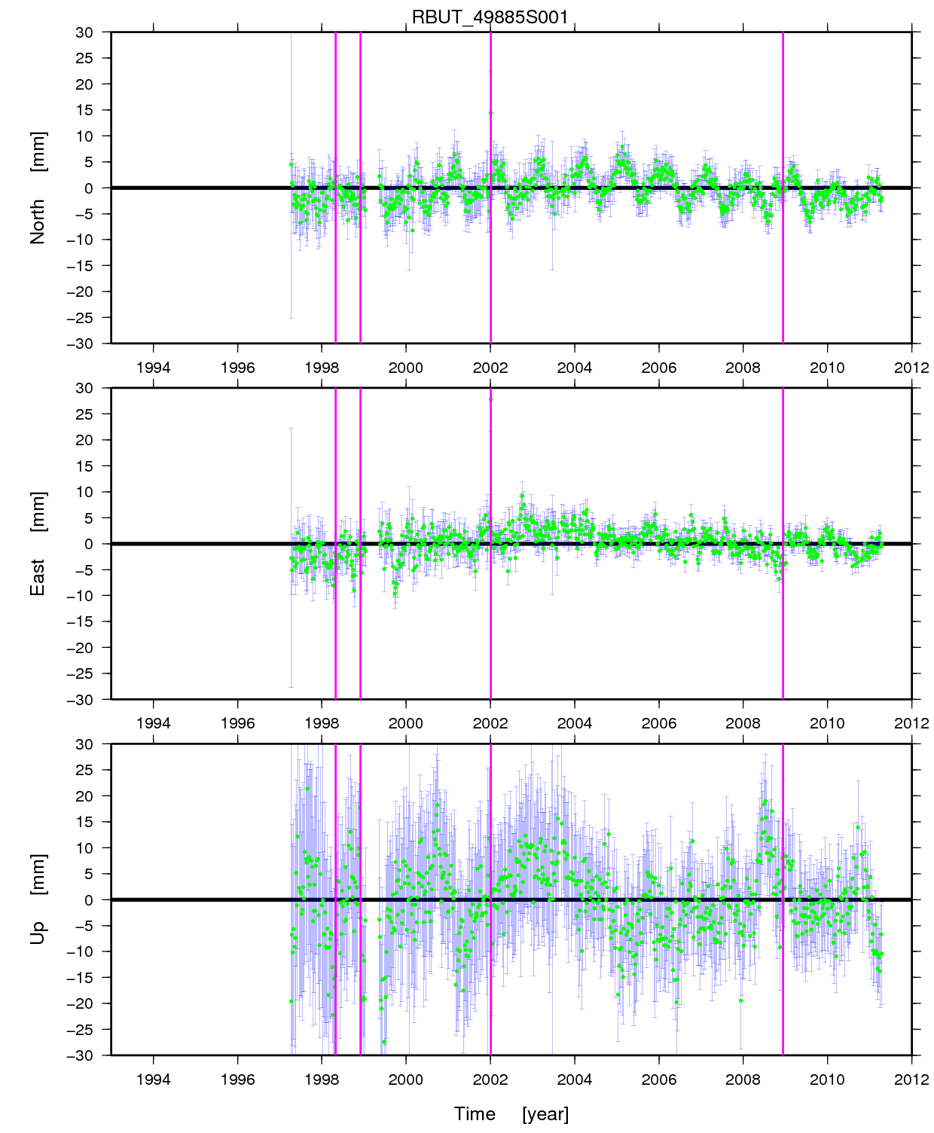
Red Butte (RBUT) CORS: 1997 - 2011

Slide 24
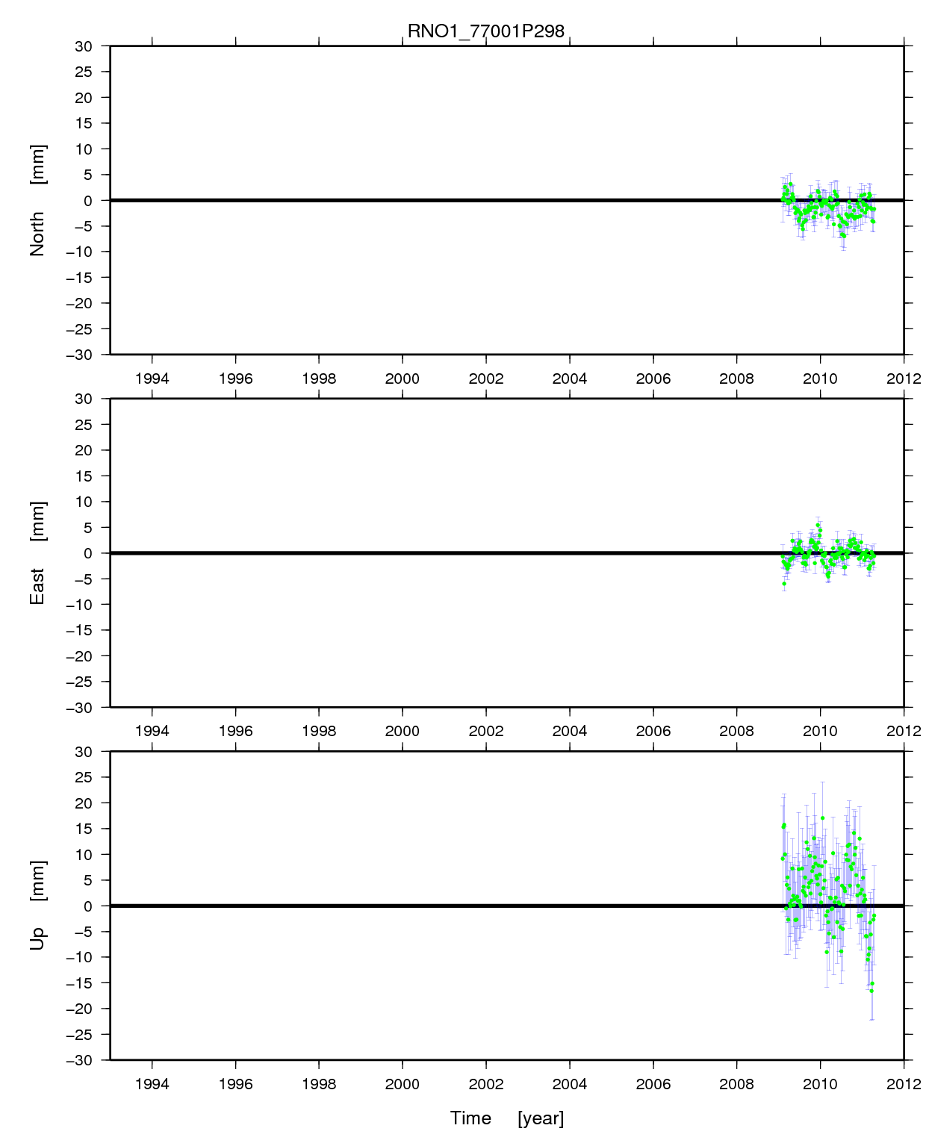
Reno (RNO1) CORS: 2009 - 2011

Slide 25
CORS Coordinates / Velocities –
Computed vs. Modeled
CORS coordinates / velocities now clearly identified/distinguished as:
“Computed”: >2.5 yrs of tracking history
  positions and velocities from stacked solution
  valid for “fixed” coordinates
  OR
“Modeled”: <2.5 yrs of tracking history
  positions from stacked solution
  velocities via Horizontal Time-Dependent Positioning (HTDP) model
Users encouraged to avoid CORS with modeled velocities
  when possible, wait (up to 3 years) until computed velocities are available
  especially important if fixing coordinates in a solution

Slide 26
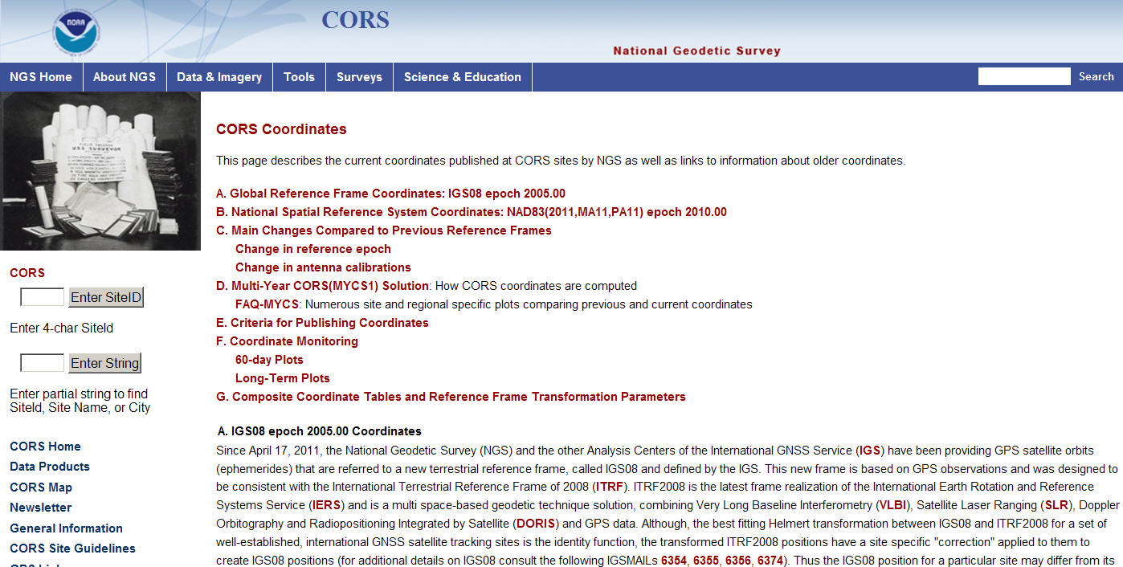
Info on New Coordinates
- see CORS Web site pages

Slide 27
Why a new passive network National Adjustment ?
- the National Adjusment of 2011 project
Optimally align passive control with new CORS
Added >1000 projects since NAD83(2007)
  + observations for Hawaii, other Pacific islands
Network and local accuracies on all stations
  Including future submitted projects
More consistent results in tectonically active areas
  More current data, better tectonic modeling
Better computations and analysis techniques
  improved outlier detection
  lessons learned previous national adjustment

Slide 28
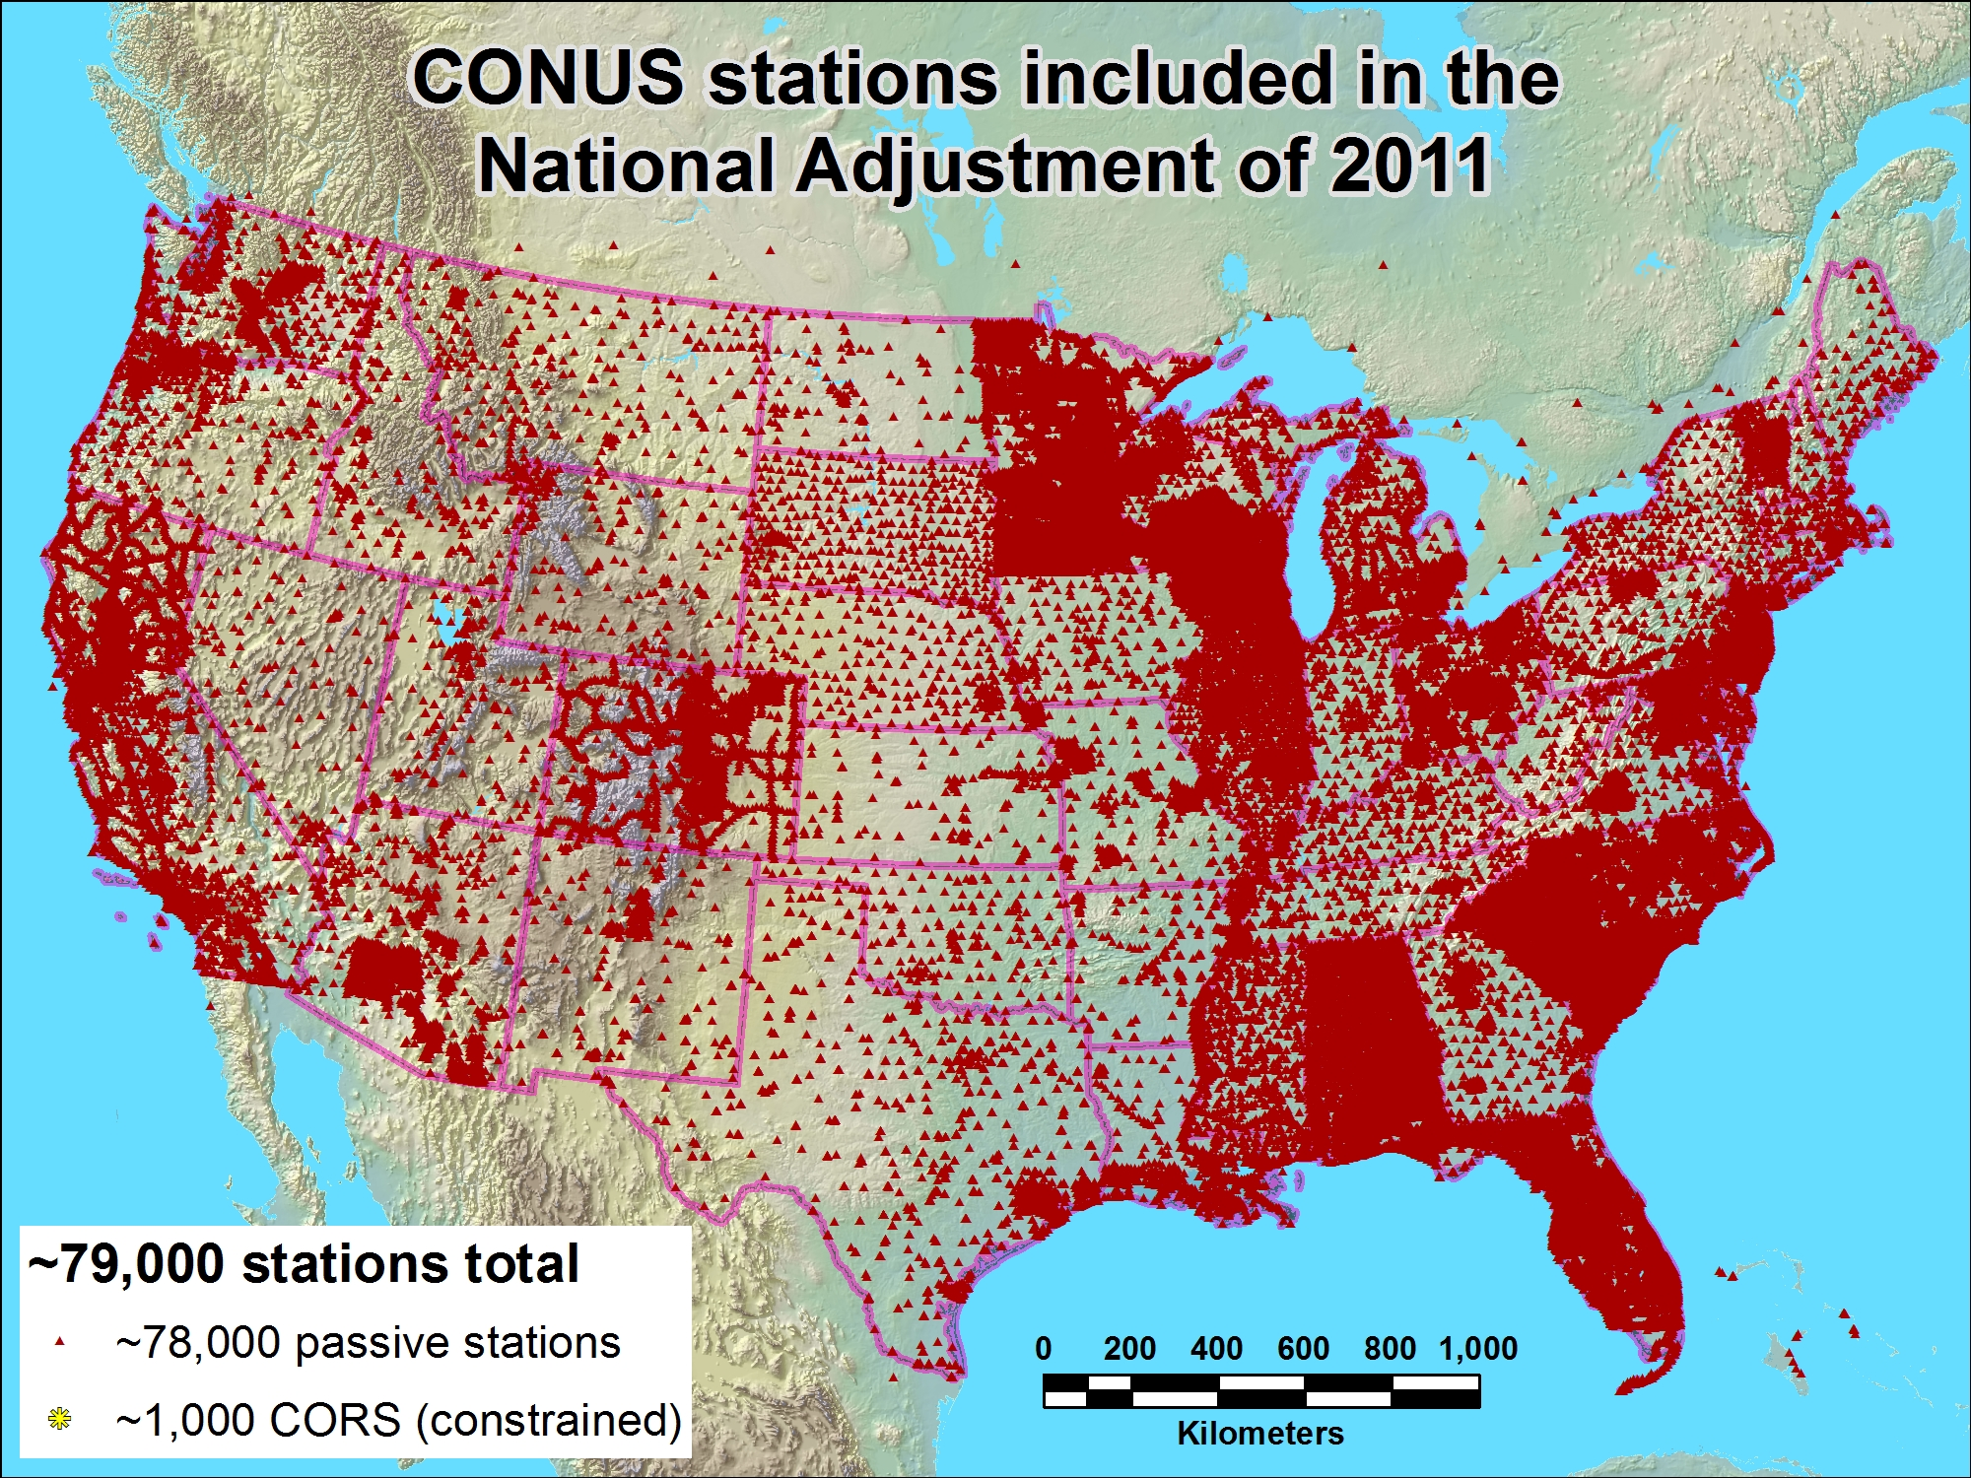
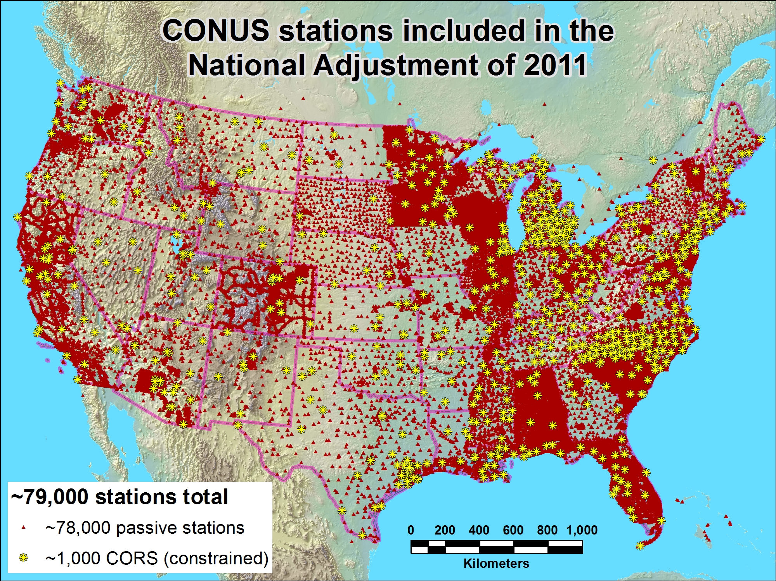

Slide 29
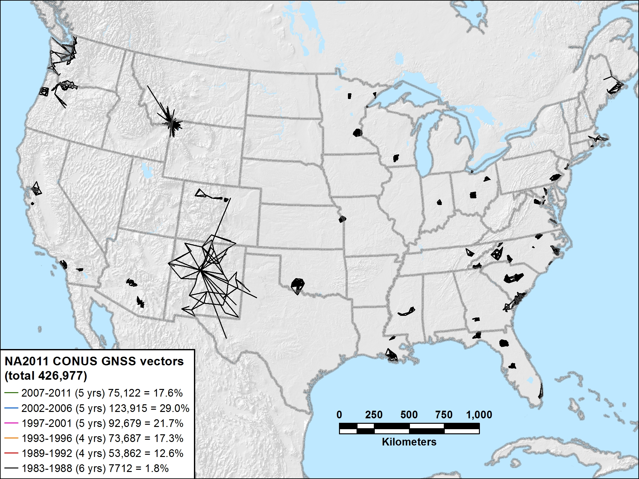
NA2011 CONUS 1983-1988 (6 yrs) 7712 vectors (1.8%)

Slide 30
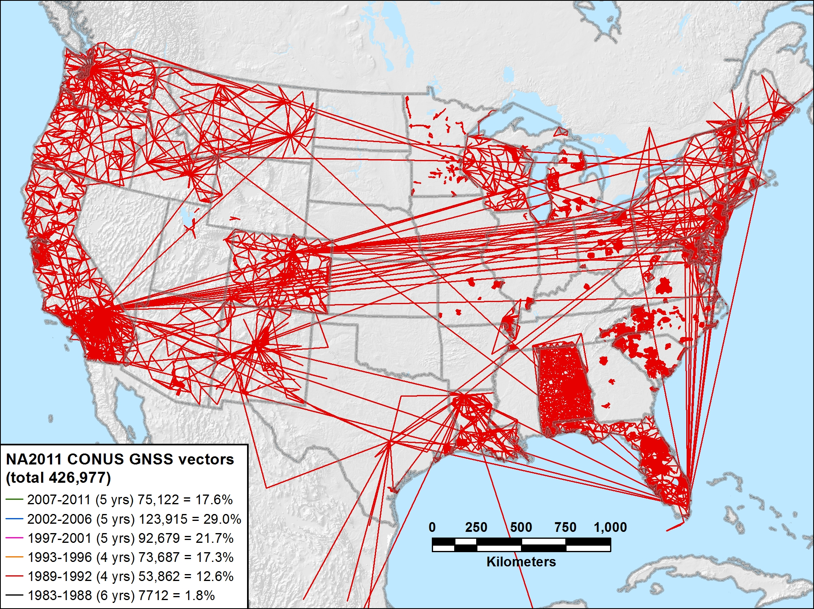
NA2011 CONUS 1989-1992 (4 yrs) 53,862 vectors (12.6%)

Slide 31
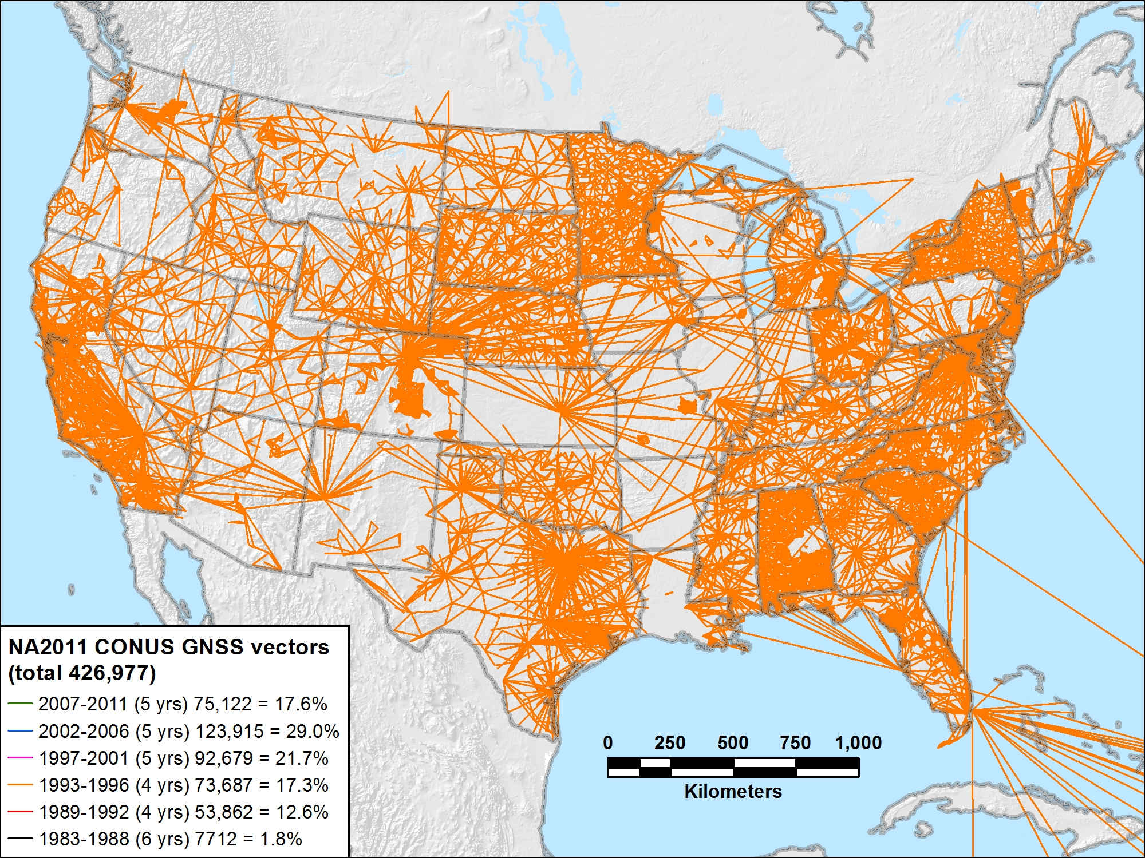
NA2011 CONUS 1993-1996 (4 yrs) 73,687 vectors (17.3%)

Slide 32
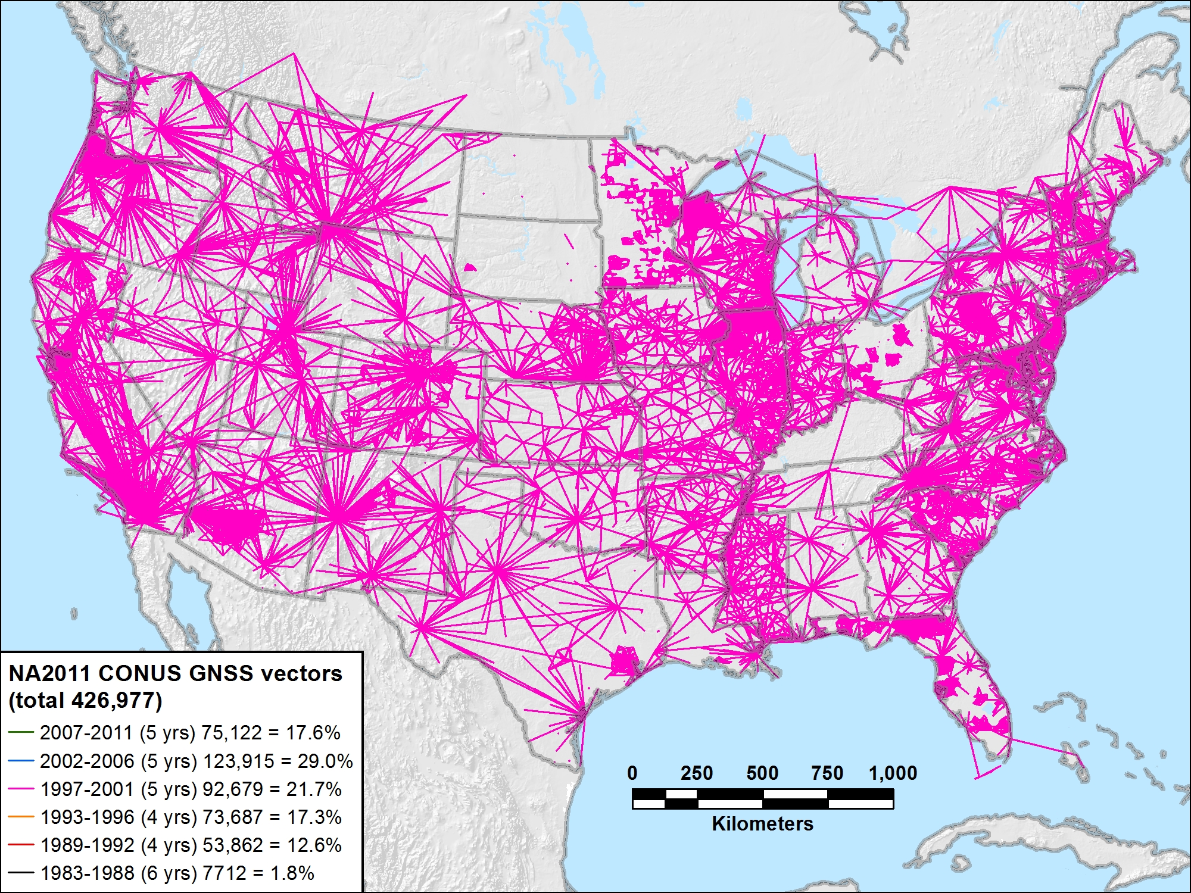
NA2011 CONUS 1997-2001 (5 yrs) 92,679 vectors (21.7%)

Slide 33
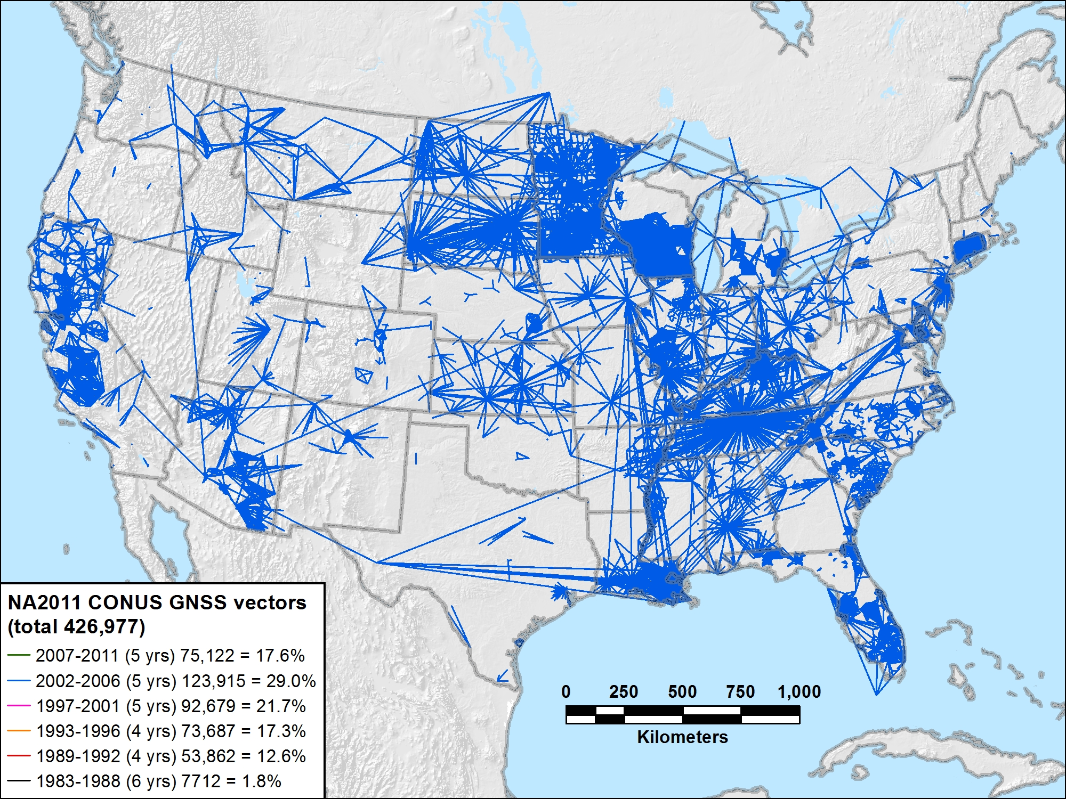
NA2011 CONUS 2002-2006 (5 yrs) 123,915 vectors (29.0%)

Slide 34
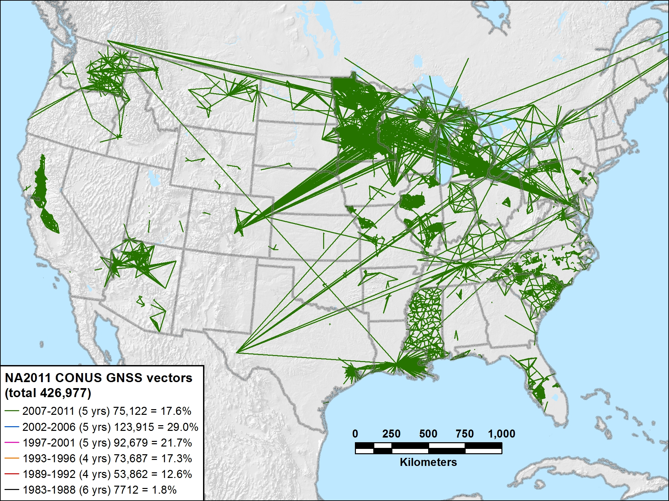
NA2011 CONUS 2007-2011 (5 yrs) 75,122 vectors (17.6%)

Slide 35
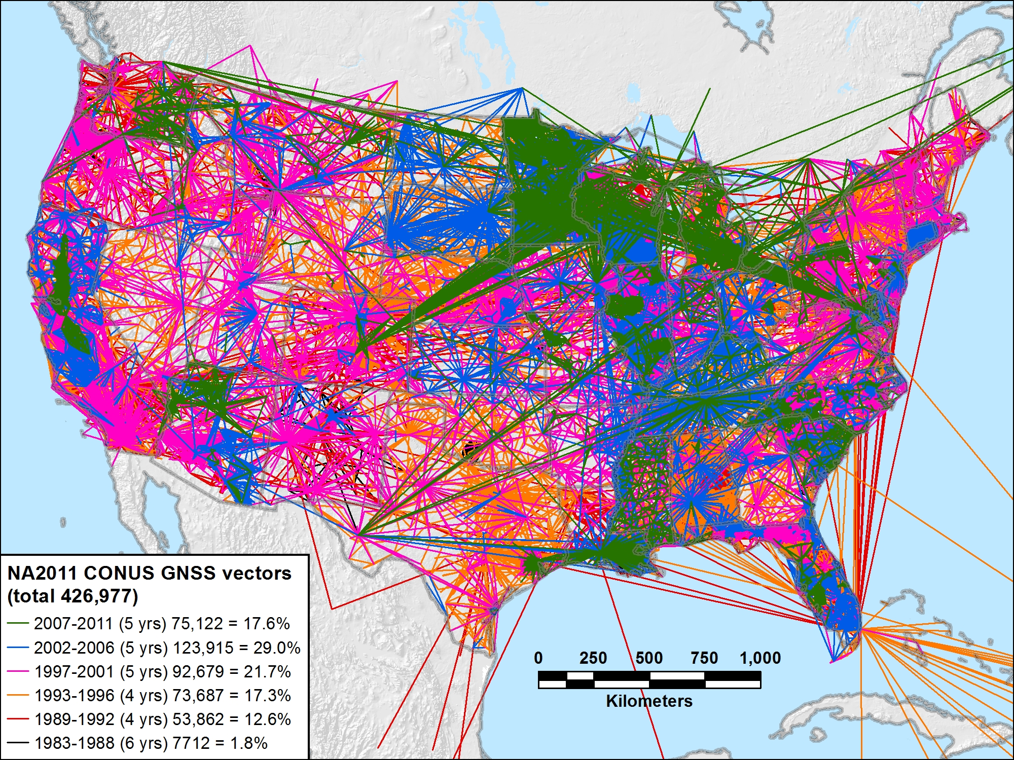
NA2011 CONUS 1983-2011 (29 yrs) 426,977 vectors (100.0%)

Slide 36
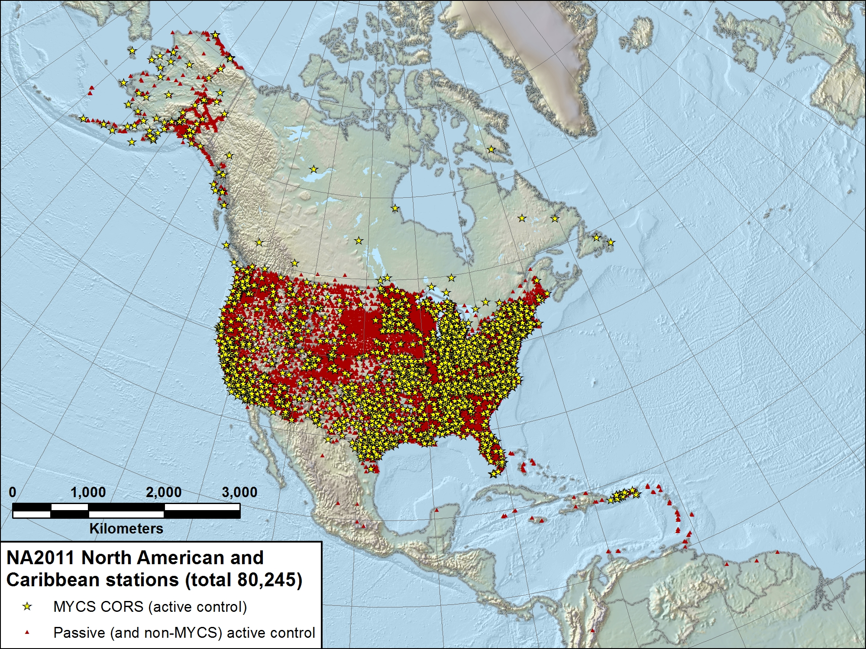
CONUS (+ AK & Caribbean)
4197 projects
80,245 stations
407,000 enabled vectors
referenced to North American tectonic plate

Slide 37
NA2011 Project Status
Expect overall coordinate change approx same as MYCS
  Horizontal: Mean ~2 cm (±8 cm), median ~0 cm
  Vertical: Mean ~ -1 cm (±2 cm), median ~ -1 cm
  This is for change in realization and reference epoch
    NAD 83(CORS96) epoch 2002.00 → NAD 83(2011) epoch 2010.00
New NAD 83 coordinate transformation tools
  NAD 83(HARN) ←→ (NAD83(2007)/CORS96) ←→ NAD83(2011)
  Conversion of horizontal coordinates AND ellipsoid heights
  Currently under study and development by NGS
    Prelim high res (1 arc-minute) grids completed for HARN / NSRS2007
    Includes error grid to give users estimate of accuracy

Slide 38
When will it all be done?
Multi-Year CORS Solution
  Coordinates/velocities released in September 2011
  Will publish in NGS database simultaneously with NA2011
National Adjustment of 2011
  Goal: publish in April 2012
  Final data added to NA2011 network mid-Dec 2011
OPUS (Online Positioning User Service)
  Dual solutions (CORS96 and MYCS) available until NA2011 complete
NAD 83(HARN)←→(NSRS2007/CORS96) coordinate transformation tool
  Expect completion soon
  Will create (NSRS2007/CORS96) ←→(2011) tool after NA2011 complete
New hybrid geoid model - GEOID12
  To relate NAD83(2011) ellipsoid height & NAVD88 orthometric height
  Uses NAD 83(2011) ellipsoid heights on leveled NAVD 88 benchmarks
  Plan release same time as NA2011
  Note: GEOID09 is NOT valid for use with NAD83(2011)

Slide 39

More information…
geodesy.noaa.gov

Slide 40

National Geodetic Survey Ten-Year Plan
Approved January, 2008
Refines mission, vision, & strategy for the future of NGS actions
Emphasis on outside capacity
  Modernize the Geometric (“Horizontal”) Datum
  Modernize the Geopotential (“Vertical”) Datum
  Migrate the Coastal Mapping Program >>> Integrated Ocean & Coastal Mapping
  Evolve Core Capabilities
  Increase Agency Visibility
Available at: geodesy.noaa.gov

Slide 41
Future Geometric (3-D) Datum
replace NAD83 with new geometric datum – by 2022
CORS-based, via GNSS
coordinates & velocities in ITRF and official US datum
  (NAD83 replacement: plate-fixed or “ITRF-like”?) & relationship
passive control tied to new datum; not a component of new datum
address user needs of datum coordinate constancy vs. accuracy
lat / long / ellipsoid height of defining points accurate to 1 mm, anytime
CORS coordinates computed / published daily; track changes
support development of real-time networks

Slide 42
Future Geopotential (Vertical) Datum
replace NAVD88 with new geopotential datum – by 2022
gravimetric geoid-based, in combination with GNSS
monitor time-varying nature of gravity field
develop transformation tools to relate to NAVD88
build most accurate ever continental gravimetric geoid model (GRAV-D)
determine gravity with accuracy of 10 microGals, anytime
support both orthometric and dynamic heights
Height Modernization is fully supported

Slide 43
Why New Datums?
NAD 83
  non-geocentric, i.e. inconsistent with GNSS positioning
  difficult to maintain consistency between CORS & passive network NAD 83 coordinates
  lack of velocities, i.e. NAD 83 does not report station motion for passive marks
NAVD 88
  cross-country build up of errors (“tilt” or “slope”) from geodetic leveling
  passive marks inconveniently located and vulnerable to disturbance and destruction
  0.5 m bias in the NAVD 88 reference surface from the (best) geoid surface approximating global mean sea level
  subsidence, uplift, freeze/thaw, and other crustal motions invalidate heights of passive marks, and can make it difficult to detect such motions
  marks lacking adequate geophysical models - complicate sea level change detection
  changes to Earth’s gravity field cause changes in orthometric heights, but NAVD 88 does not account for those changes (NAVD88 based on a static gravity model)
  gravity model and modeling techniques used to determine NAVD 88 are not consistent with those currently used for geoid modeling

Slide 44
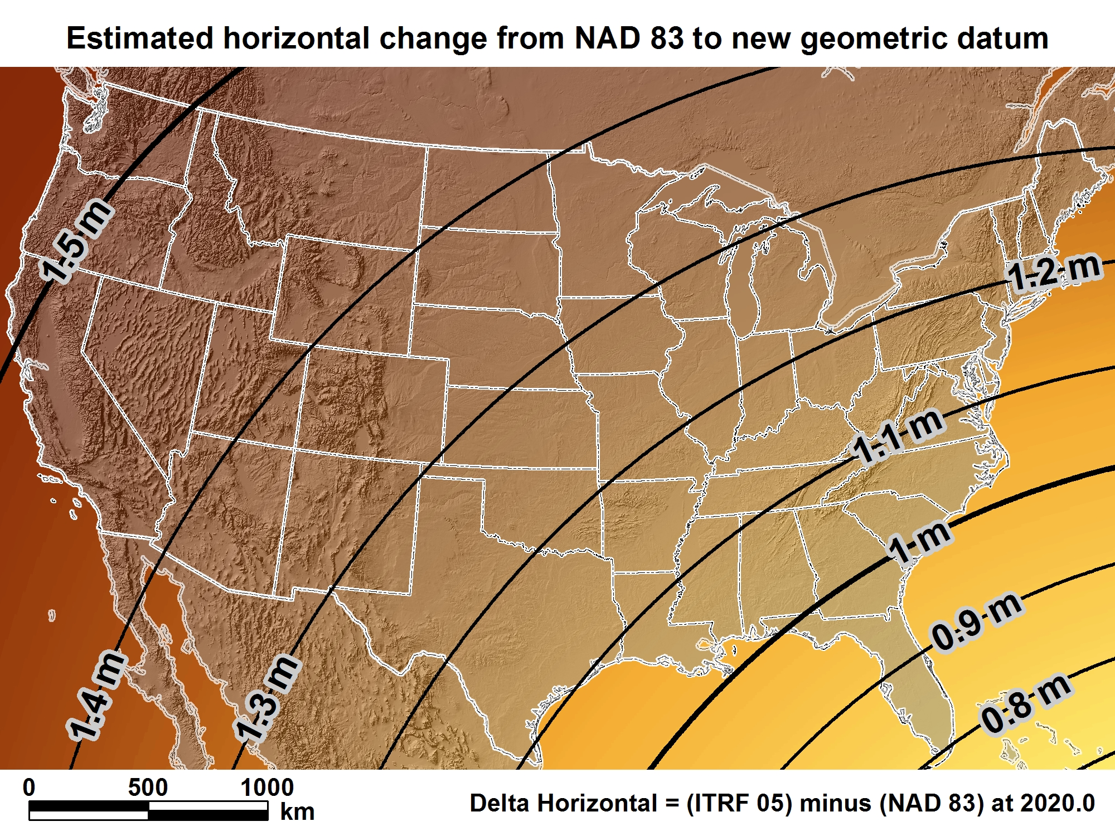
New geometric datum minus NAD 83 (horizontal)

Slide 45
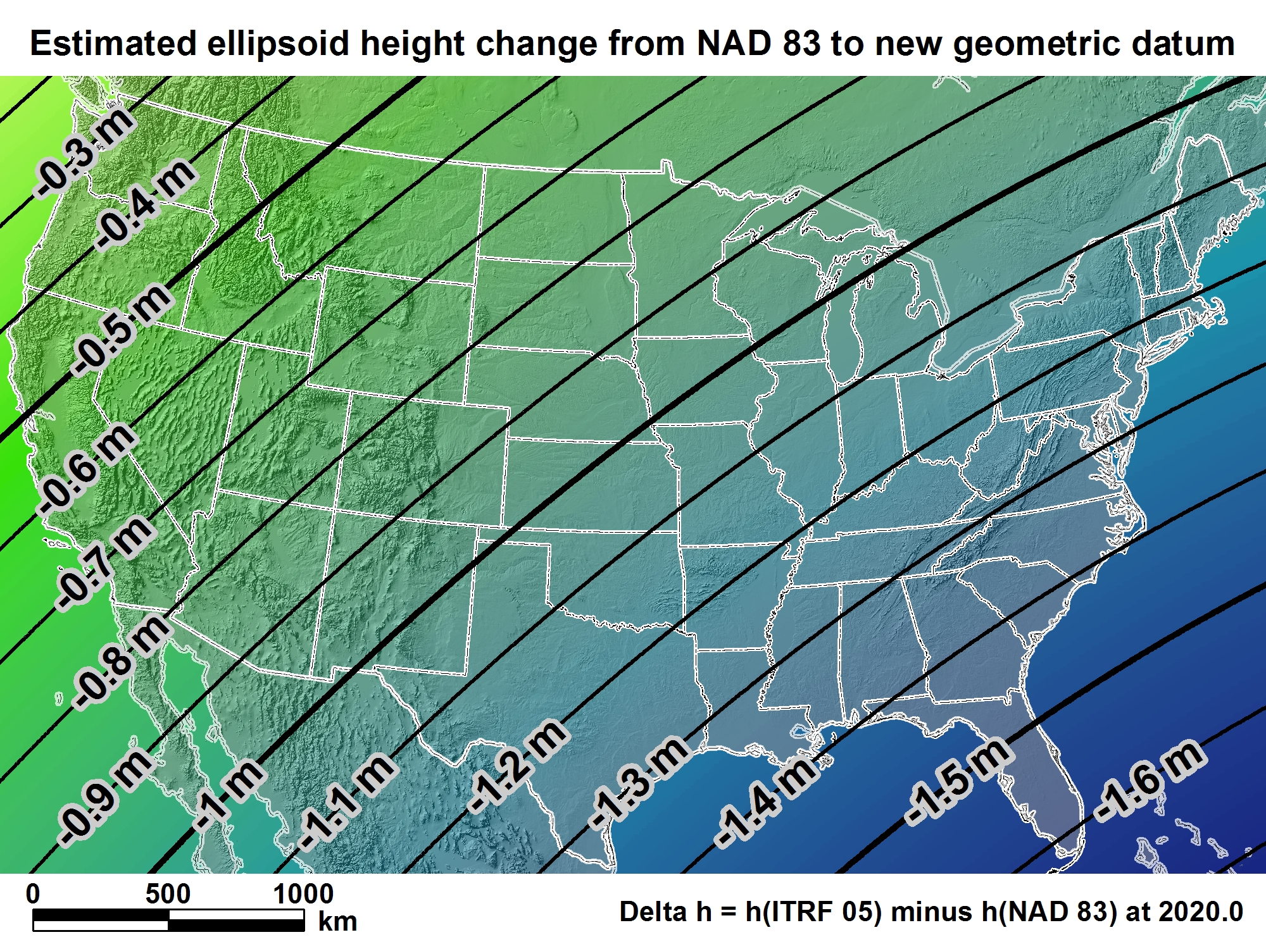
New geometric datum minus NAD 83
(ellipsoid height)

Slide 46
And now, the rest of the story...
Orthometric Heights
(a.k.a. NAVD 88 elevations)
“By 2018, a new geopotential datum (for orthometric and dynamic heights) is defined and realized through the combination of GNSS technology and gravity field modeling.”
In other words, orthometric heights will NOT be based on leveling data; they too will change.
2022

Slide 47

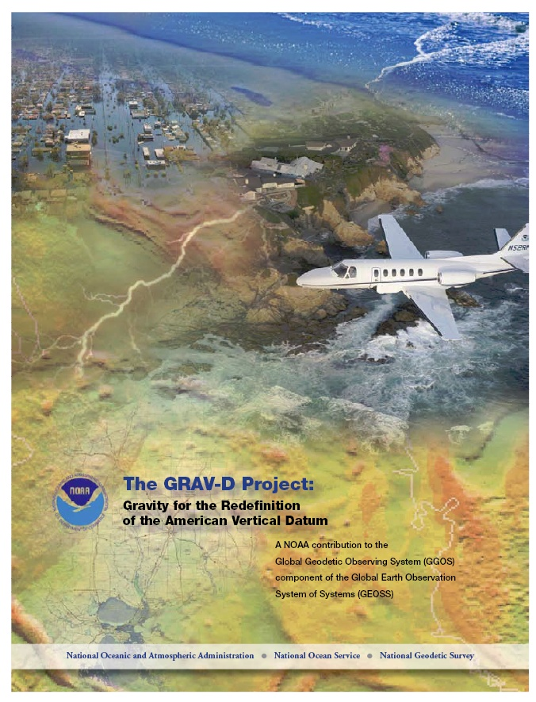
Gravity for the Redefinition of the American Vertical Datum (GRAV-D)
Replace the Vertical Datum of the USA by 2022 (at today’s funding) with a gravimetric geoid accurate to 1 cm
Orthometric heights accessed via GNSS accurate to 2 cm
Three thrusts of project:
  Airborne gravity survey of entire country and its holdings
  Long-term monitoring of geoid change
  Partnership surveys
Working to launch a collaborative effort with the USGS for simultaneous magnetic measurement
Gravity and Heights are
inseparably connected
Notes:
GRAV-D is the NGS project designed to replace NAVD88 with a vertical datum based upon a gravimetric geoid accurate to 1 cm. Heights above this datum will be accessed via GNSS measurements. Three thrusts of project. Launch USGS collaboration for simultaneous mag measurement.

Slide 48
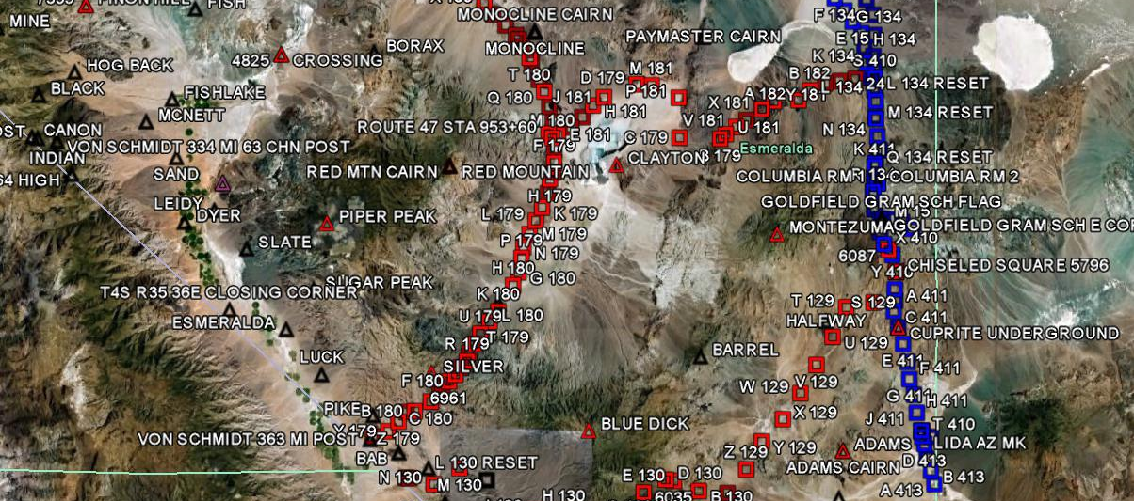
GRAV-D Goals
2 cm accuracy orthometric heights -
  from GNSS (1 cm) + geoid model (1 cm)
fast, accurate, consistent orthometric heights -
everywhere in the USA

Slide 49
How much will “elevation”
(orthometric height) change?
We don’t know with certainty … yet.
  Geopotential value for “zero” to be determined in consultation with our neighbors
  How the NAVD 88 slope will be “taken out” not yet determined
But, if we assume USGG09 is indicative of the GRAV-D-determined geoid model and
we use the same “zero” surface then…

Slide 50


Slide 51
How to Plan for the Future
Move to latest realization, i.e. NAD 83(2011) epoch 2010.00
  NAD 83(HARN) <-> NAD 83(NSRS2007) &
  NAD 83(NSRS2007) <-> NAD 83(2011) tools under development
Obtain precise ellipsoid heights on NAVD 88 bench marks (OPUS-DB, contact NGS Geodetic Advisor)
  Improves hybrid geoid models and provides “hard points” in new vertical datum
Move off NGVD 29 and onto NAVD 88
  Understand the accuracy of VERTCON in your area
Move away from passive marks to GNSS
Require/provide complete metadata for all mapping contracts
  How did they get the positions/heights? Document it!!

Slide 52



Slide 53

Estimated Positional Changes ~ 2022
Summit of Mount Whitney, CA
[NAD83(2007) / NAVD88 – NEW DATUMS]
HORIZONTAL: 1.78 m ( 5.8 ft)
ELLIPSOID HEIGHT: - 0.67 m (- 2.2 ft)
(Predicted with HTDP)
ORTHOMETRIC HEIGHT: - 0.81 m (- 2.7 ft)
(Predicted with USGG2009)
HTDP = Horizontal Time-Dependent Positioning (Model)
USGG2009 = US Gravimetric Geoid 2009

Slide 54


