Slide 1
Modernizing the NOAA CORS Network
Theresa Damiani, Ph.D.
Chief, Spatial Reference System Division
May 7, 2019 NGS Geospatial Summit

Slide 2
Outline
What is a CORS?
How many are there?
What are they for?
How valuable are they?
How accurate are they?
What is their future?

Slide 3
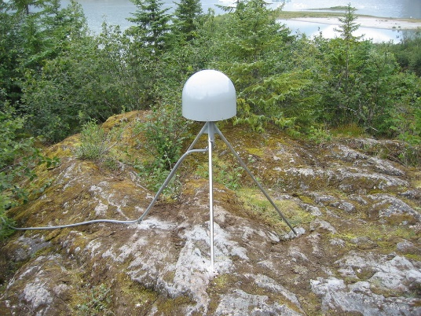
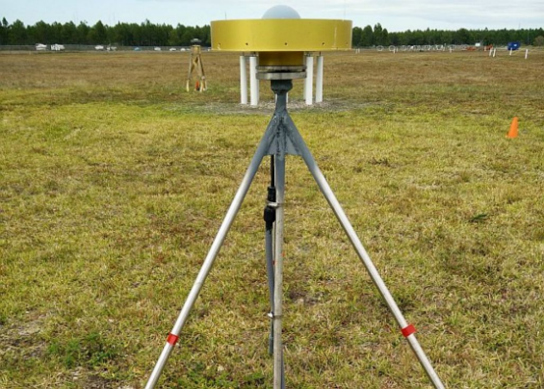
What is a CORS?
A Continuously Operating Reference Station (CORS)
Records signals of position and time from satellites in orbit
GPS (U.S. Global Positioning System)
Sometimes GNSS (Global Navigation Satellite Systems) owned by other countries
Located, monumented, and operated to provide geodetic-quality control
CORS managed by NGS are part of the NOAA CORS Network
Notes:
CORS is a method-agnostic term, but common useage applies it to GPS/GNSS stations.

Slide 4
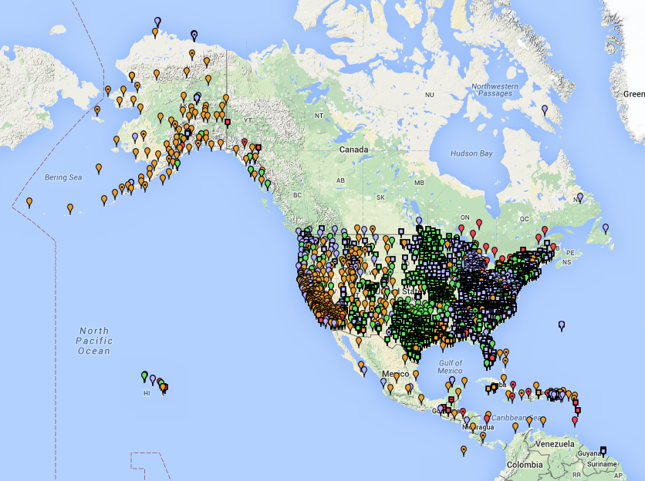
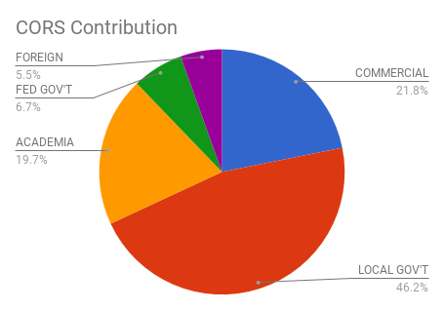
Snapshot of the NOAA CORS Network
~1900 GPS/GNSS CORS
Run by various agencies and research groups
Largest sector of contributors is state government (DOTs and geodetic offices)
Largest single contributor is the National Science Foundation
Founded in 1994
Celebrating 25 years!
Satellite Systems Observed | # of CORS
GPS (U.S.) only | 524
GPS + GLONASS (Russian) | 1075
GPS + GLONASS + Galileo (E.U.) | 169

Slide 5
Uses of the NOAA CORS Network
Define and provide access to the National Spatial Reference System
CORS quality: residual RMS < 2 cm horizontal, 4 cm vertical (~3/4”, 1.6”)
Monitoring tectonic plate motion, rotation
Provide active control for GPS positioning through OPUS
Control for the surveying and mapping industry
NOAA applications: nautical chart references, tide gauge references, space weather models
Other federal applications: FEMA floodplain maps, USGS topographic maps and interior water management

Slide 6
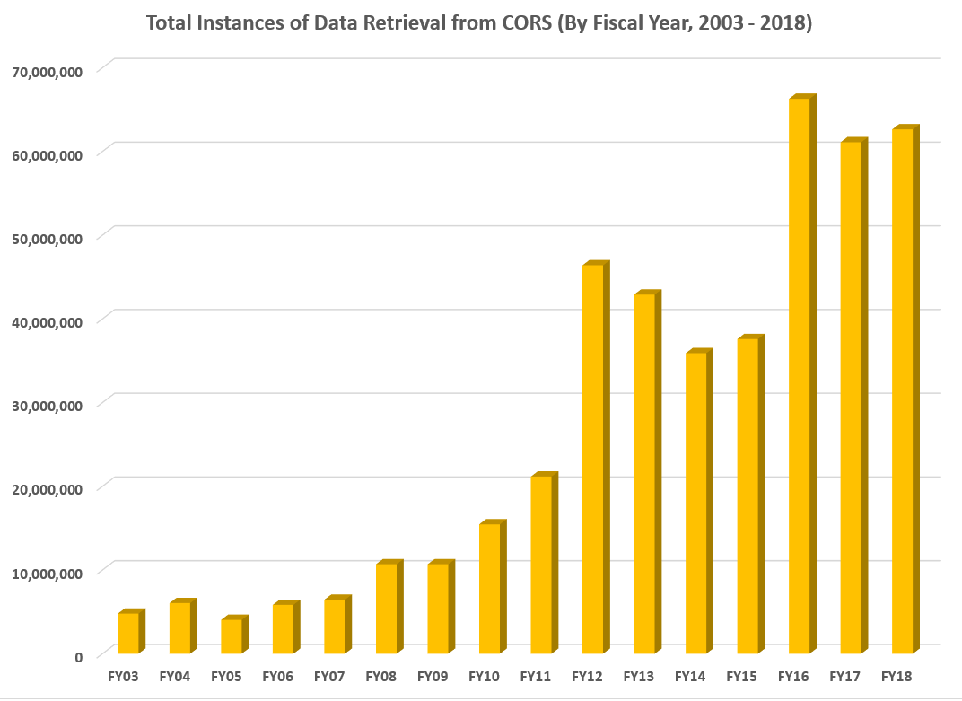
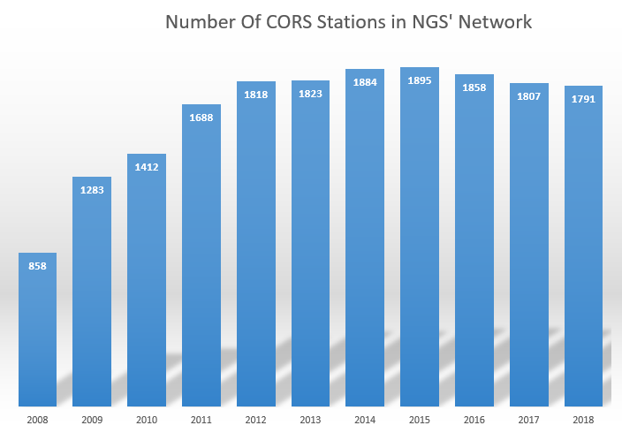
Socio-Economic Value
A 2008 economic benefit study valued CORS at $583 million
A new NGS-estimated update to that study values CORS at $2.61 billion
Despite an increase in demand, the number of CORS has been near the limit that NGS can support for 7 yrs.

Slide 7
New CORS Coordinates/Velocities
The NGS CORS Network has two sets of coordinates and velocities for each station- in the national and international reference frames
Multi-Year CORS Solution 2 (MYCS2)
NAD83 (2012) epoch 2010 and ITRF 2014 epoch 2010
1994-2017, ~ 3050 stations: All active CORS, decommissioned CORS, and International GNSS Service (IGS) stations.
Improvements over MYCS1 (completed in 2011)
~1800 active + ~800 decommissioned CORS stations (~450 more than 2011)
7 more years of data
Nearly 1000 more CORS have official computed coordinates and velocities
~240 new CORS (<3 yrs old) with approximate “modeled” coordinates and velocities
On BETA now
Upcoming NGS Webinar in June!
Notes:
2324 stations had > 3 years of data, nearly 987 more than MYCS1 (in 2011)
241 stations had < 3 years of data- none of which were in MYCS1 (in 2011)

Slide 8
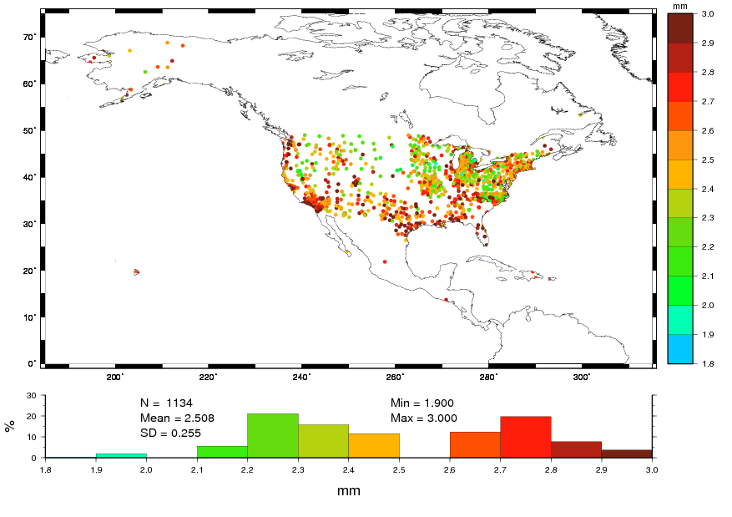
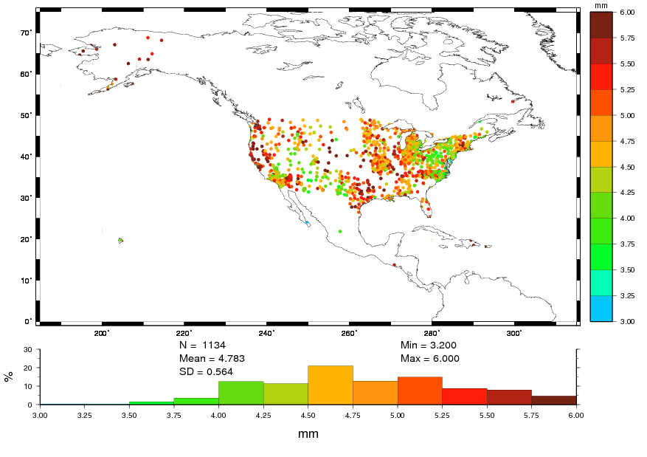
NOAA CORS Network Quality
% of Stations | # of Stations | Horizontal Motion | Vertical Motion
64% | 1139 | <= 3 mm | <= 6 mm
35% | 623 | <= 5 mm | <= 10 mm
1% | 16 | > 5 mm | > 10 mm
AND
AND
OR

Slide 9
Modernizing the NOAA CORS Network
Provide access to the National Spatial Reference System (NSRS)
Maintain quality of: 5 mm horizontal, 10 mm vertical (0.2”, 0.4”)
That’s nearly 75% BETTER than before; all but 16 CORS will meet standard
CORS Comprehensive Plan (Fall 2020)
Automate CORS network management and metrics (quality, availability, etc.)
Increase CORS partner communications
Better models of motion, for both plate rotation and regional motion (IFVM)
Provide an RTN-alignment service (RAS)
Improvements to OPUS for selection of CORS
CORS website redesign

