Slide 1



Update on GRAV-D and
Progress toward a new vertical Datum
New Hampshire Land Surveyors Association
December 05, 2014
Dan Martin
NGS Vermont State Geodetic Advisor
Dan.martin@noaa.gov
802-828-2952
www.aot.state.vt.us/geodetic/Advisor/advisorpresent.htm

Slide 2
U.S. Department of Commerce
National Oceanic & Atmospheric Administration
National Geodetic Survey
Mission: To define, maintain & provide access to the
National Spatial Reference System (NSRS)
to meet our Nation’s economic, social & environmental needs
National Spatial Reference System
& their time variations
      Latitude
      Longitude
      Height
  Scale
  Gravity
  Orientation
Notes:
- NSRS benefit to the nation = $2.5B/year
est. 300K precision GPS users worldwide (2008); ¼ in US
- Very exciting to us at NGS to see how it has evolved over the years – now cm-accuracy capability / tracking with time

Slide 3

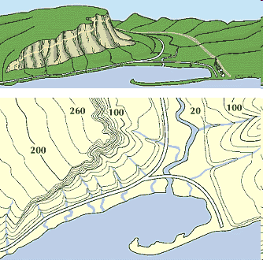
What is a Vertical Datum?
Strictly speaking, a vertical datum is a surface representing zero elevation
Traditionally, a vertical datum is a system for the determination of heights above a zero elevation surface
Vertical datum comprised of:
  Its definition: Parameters and other descriptors
  Its realization: Its physical method of accessibility
"topographic map." Online Art.
Britannica Student Encyclopædia.
17 Dec. 2008
<http://student.britannica.com/ebi/art-53199>

Slide 4
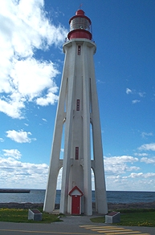
Current Vertical Datum in the USA
NAVD 88: North American Vertical Datum of 1988
Definition: The surface of equal gravity potential to which orthometric heights shall refer in North America*, and which is 6.271 meters (along the plumb line) below the geodetic mark at “Father Point/Rimouski” (NGSIDB PID TY5255).
Realization: Over 500,000 geodetic marks across North America with published Helmert orthometric heights, most of which were originally computed from a minimally constrained adjustment of leveling and gravity data, holding the geopotential value at “Father Point/Rimouski” fixed.
Father Point Lighthouse, Quebec
*Not adopted in Canada
Notes:
By fixing the geopotential value at the origin point, it was possible to ensure that the origins of IGLD 85 and NAVD 88 aligned.
*It should be pointed out that while the datum was defined in such a way as to be usable on the North American continent, it was never actually adopted in Canada. It can be used there, but it’s not their official civilian datum.
Note that the designation of the vertical control point at Father Point is “1250 G=NAVD 88 DATUM POINT” for PID# TY5255 and is not available from the publicly accessible NGSIDB.

Slide 5
History of vertical datums in the USA
NGVD 29
  National Geodetic Vertical Datum of 1929
  Original name: “Sea Level Datum of 1929”
  “Zero height” held fixed at 26 tide gauges
    Not all on the same tidal datum epoch (~ 19 yrs)
  Did not account for Local Mean Sea Level variations from the geoid
    Thus, not truly a “geoid based” datum

Slide 6
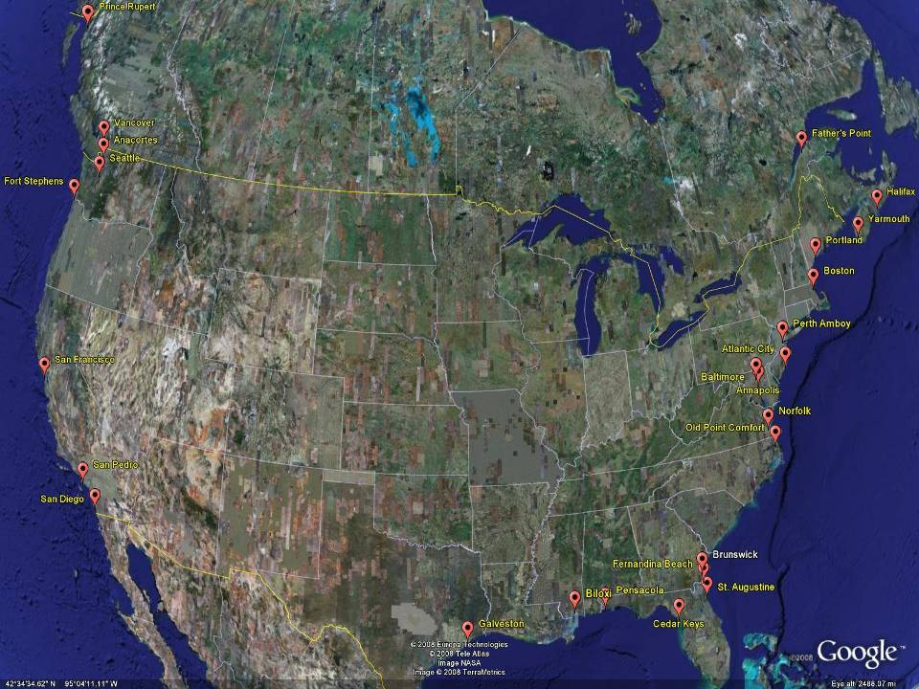
NGVD29
The National Geodetic Vertical Datum of 1929 is referenced to 26 tide gauges in the US and Canada
Notes:
It turns out that MSL is a close approximation to another surface, defined by gravity, called the geoid, which is the true zero surface for measuring elevations. Because we cannot directly see the geoid surface, we cannot actually measure the heights above or below the geoid surface. We must infer where this surface is by making gravity measurements and by modeling it mathematically. For practical purposes, we assume that at the coastline the geoid and the MSL surfaces are essentially the same. Nevertheless, as we move inland we measure heights relative to the zero height at the coast, which in effect means relative to MSL.
Definition: NGVD29 – The National Geodetic Vertical Datum of 1929…
The Sea Level Datum of 1929 was the vertical control datum established for vertical control surveying in the United States of America by the General Adjustment of 1929. The datum was used to measure elevation or altitude above, and depression or depth below, mean sea level (MSL).
Mean sea level was measured at 26 tide gauges: 21 in the United States and 5 in Canada. The datum was defined by the observed heights of mean sea level at the 26 tide gauges and by the set of elevations of all bench marks resulting from the adjustment. The adjustment required a total of 66,315 miles (106,724 km) of leveling with 246 closed circuits and 25 circuits at sea level.
Since the Sea Level Datum of 1929 was a hybrid model, it was not a pure model of mean sea level, the geoid, or any other equipotential surface. Therefore, it was renamed the National Geodetic Vertical Datum of 1929 (NGVD 29) in 1973. The NGVD 29 was subsequently replaced by the North American Vertical Datum of 1988 (NAVD 88) based upon the General Adjustment of the North American Datum of 1988.

Slide 7
History of vertical datums in the USA
NAVD 88
  North American Vertical Datum of 1988
  One height held fixed at “Father Point” (Rimouski, Canada)
  …height chosen was to minimize 1929/1988 differences on USGS topo maps in the eastern U.S.
  Thus, the “zero height surface” of NAVD 88 wasn’t chosen for its closeness to the geoid (but it was close…few decimeters)

Slide 8
History of vertical datums in the USA
NAVD 88 (continued)
  Use of one fixed height removed local sea level variation problem of NGVD 29
  Use of one fixed height did open the possibility of unconstrained cross-continent error build up
  But the H=0 surface of NAVD 88 was supposed to be parallel to the geoid…(close again)

Slide 9
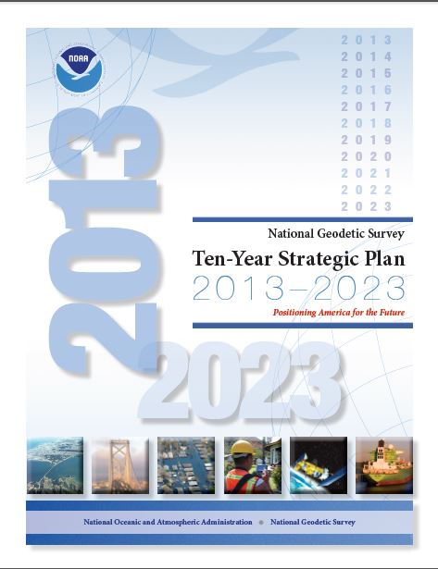
The National Geodetic Survey 10 year plan
Mission, Vision and Strategy
2008 – 2018
http://www.ngs.noaa.gov/INFO/NGS10yearplan.pdf
Official NGS policy as of Jan 9, 2008
  Modernized agency
  Attention to accuracy
  Attention to time-changes
  Improved products and services
  Integration with other fed missions
2022 Targets:
  NAD 83 and NAVD 88 re-defined
  Cm-accuracy access to all coordinates
  Customer-focused agency
  Global scientific leadership
Notes:
Realization and unification of NAD83 in Canada and the U.S. via the ITRF.
http://www.geod.nrcan.gc.ca > Geodetic Survey Division > Publications > Papers

Slide 10
Future Geopotential (Vertical) Datum
replace NAVD88 with new geopotential datum – by 2022
gravimetric geoid-based, in combination with GNSS
monitor time-varying nature of gravity field
develop transformation tools to relate to NAVD88
build most accurate ever continental gravimetric geoid model (GRAV-D)
determine gravity with accuracy of 10 microGals, anytime
support both orthometric and dynamic heights
Height Modernization is fully supported

Slide 11
Why New Datum?
NAVD 88
  cross-country build up of errors (“tilt” or “slope”) from geodetic leveling
  passive marks inconveniently located and vulnerable to disturbance and destruction
  0.5 m bias in the NAVD 88 reference surface from the (best) geoid surface approximating global mean sea level
  subsidence, uplift, freeze/thaw, and other crustal motions invalidate heights of passive marks, and can make it difficult to detect such motions
  marks lacking adequate geophysical models - complicate sea level change detection
  changes to Earth’s gravity field cause changes in orthometric heights, but NAVD 88 does not account for those changes (NAVD88 based on a static gravity model)
  gravity model and modeling techniques used to determine NAVD 88 are not consistent with those currently used for geoid modeling

Slide 12
Problems using traditional leveling (to define a National Vertical Datum)
Leveling the country can not be done again
  Too costly in time and money (Estimated ~ $1B)
Leveling yields cross-country error build-up; problems in the mountains
Leveling requires leaving behind passive marks
  Bulldozers and crustal motion do their worst

Slide 13
Why isn’t NAVD 88 good
enough anymore
NAVD 88 suffers from use of bench marks that:
  Are almost never re-checked for movement
  Disappear by the thousands every year
  Are not funded for replacement
  Are not necessarily in convenient places
  Don’t exist in most of Alaska
  Weren’t adopted in Canada
  Were determined by leveling from a single point, allowing cross-country error build up
Notes:
Clarification on the word “convenient” – this is used to mean “there isn’t always a bench mark around when you need one – sometimes you have to find one far away and level from it to your site of interest”

Slide 14
Subsidence and Bench Mark Height
1954: Leveling Performed
to bench mark
House
1954-1991: Subsidence
House
BM
BM
1991: Original 1954 leveling data is used to compute the NAVD 88 height which is then published for this BM
H₈₈(published)
H₈₈(true)
NAVD 88 zero height surface
Obviously the true height relative to the NAVD 88
zero surface is not the published NAVD 88 height

Slide 15
Error in NAVD 88 Orthometric Height (H)
The distance along the plumb line from the geoid up to the point of interest
Earth’s
Surface
H (NAVD 88)
H
NAVD 88 reference level
The Geoid
Errors in NAVD 88 : ~50 cm average,
100 cm CONUS tilt,
1-2 meters average in Alaska
NO tracking

Slide 16
Why isn’t NAVD 88 good
enough anymore?
NAVD 88 suffers from:
A zero height surface that:
  Has been proven to be ~50 cm biased from the latest, best geoid models (GRACE satellite)
  Has been proven to be ~ 1 meter tilted across CONUS (again, based on the independently computed geoid from the GRACE satellite)

Slide 17
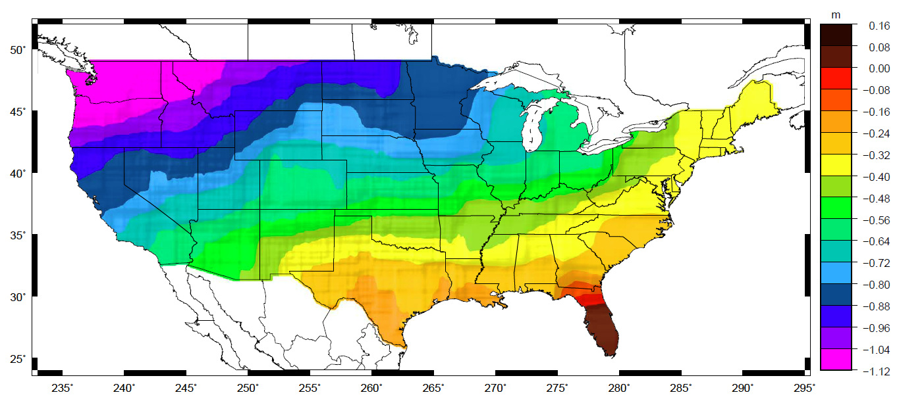
Problems with NAVD 88 Definition
Approximate level of geoid mismatch known to exist in the NAVD 88 zero surface, which was an estimate of the geoid
Notes:
This map reflects the sort of height changes that users could expect if NAVD 88 were replaced with a geoid-based vertical datum. This is only a large scale approximation and should not be used as an absolute guide.

Slide 18
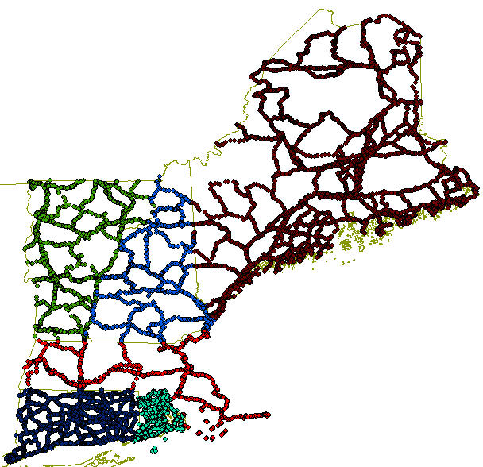
NGSIDB BM Status (1st, 2nd order)
 | CT | MA | ME | NH | RI | VT
In NGSIDB | 2599 | 1125 | 5401 | 1092 | 1380 | 2158
Poor | 31 | 24 | 118 | 20 | 19 | 17
Not Found | 281 | 150 | 1048 | 218 | 196 | 363
Not Rec since Monumented | 533 | 254 | 1659 | 216 | 160 | 461
Last Rec ≤ 1990 | 1570 | 584 | 4475 | 689 | 857 | 374
Last Rec ≤ 1980 | 160 | 499 | 3434 | 531 | 277 | 331

Slide 19
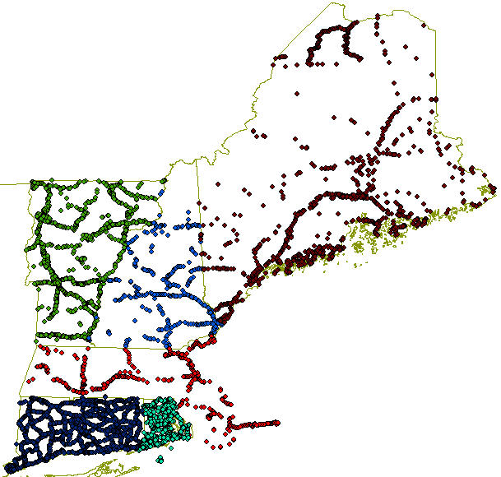
NE Vertical Control

Slide 20
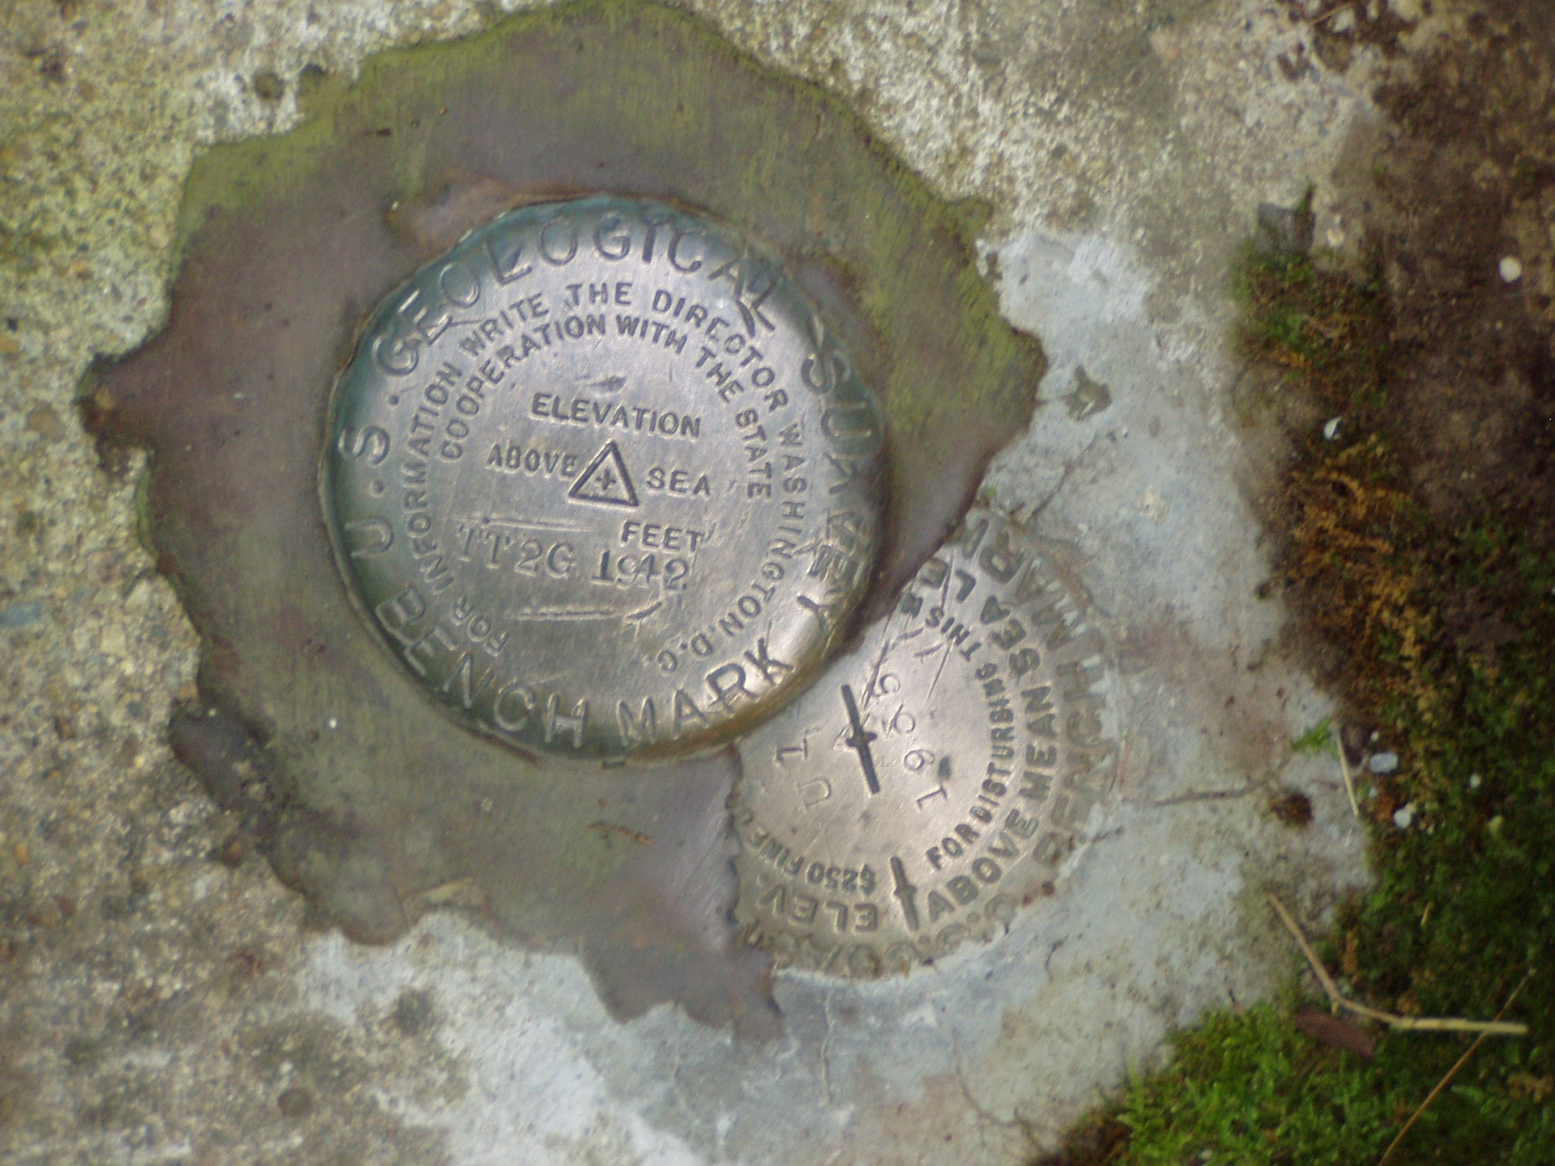
Height-Mod means More Marks?

Slide 21
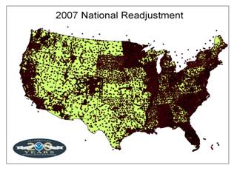

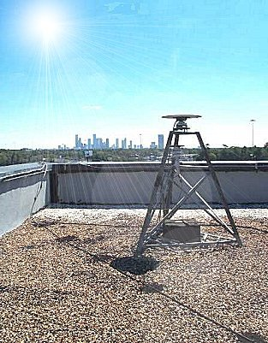
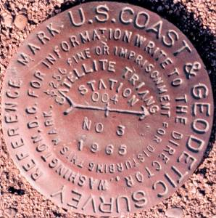
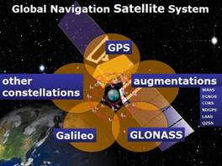
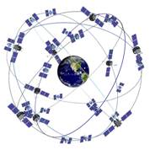
The NSRS has evolved
Evolving from passive to active to real-time augmentations
1 Million Monuments
(Separate Horizontal and Vertical Systems)
70,000
Passive Marks
(3-Dimensional)
→
Passive Marks
(Limited Knowledge of Stability)
1,320 CORS
(Time Dependent System Possible;
4-Dimensional)
→
GPS CORS → GNSS CORS
Notes:
This is what we will talk about – how you can access this data and use it for your projects and what tools we have available to assist you to ensure you are accurate.
ACCURATE -- cm accuracy on a global scale
MULTIPURPOSE -- Supports Geodesy, Geophysics, Land Surveying, Navigation, Mapping, Charting and GIS activities
ACTIVE -- Accessible through Continuously Operating Reference Stations (CORS) and derived products
INTEGRATED -- Related to International services and standards (e.g. International Earth Rotation and Reference Systems Service, International GNSS Service etc.)

Slide 22
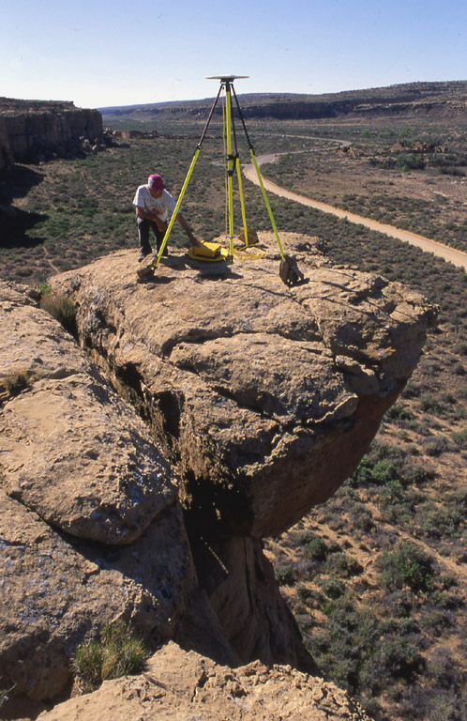
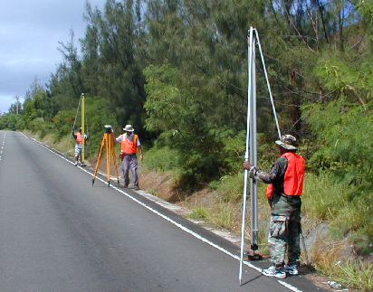
Height Modernization
Height
Modernization
-faster
-cheaper
Differential Leveling
GNSS + …

Slide 23
Geodetic Datums
  Horizontal
  2-D (Latitude and Longitude) (e.g. NAD 27, NAD 83 (1986))
  Vertical/Geopotential
  1-D (Orthometric/Dynamic Height) (e.g. NGVD 29, NAVD 88, IGLD 85)
  Geometric
  3-D (Latitude, Longitude and Ellipsoid Height)
  Fixed and Stable(?) - Coordinates seldom change
  (e.g. NAD 83 (1993), NAD 83 (2007), NAD 83 (2011))
  also
  4-D (Latitude, Longitude, Ellipsoid Height, Velocities)
  Coordinates change with time
  (e.g. NAD 83, ITRF00, ITRF05)
Notes:
Geodetic Datums
A set of constants specifying the coordinate system used for geodetic control, i.e., for calculating coordinates of points on the Earth. Specific geodetic datums are usually given distinctive names. (e.g., North American Datum of 1983, European Datum 1950, North American Vertical Datum of 1988)
Characterized by:
A set of physical monuments, related by survey measurements and resulting coordinates (horizontal and/or vertical) for those monuments

Slide 24






The National Spatial Reference System supports
Nautical charts, among many other geospatial applications
National Oceanic and Atmospheric Administration
Emergency Response Imagery,
Flood zones for the National Flood Insurance Program
Federal Emergency Management Agency
Levee Safety Program to determine levee heights & positions
United States Army Corps of Engineers
Topographic Maps and interior water data for the nation
United States Geological Survey
NSRS gravity data for the geospatial mission of NGA
National Geospatial-Intelligence Agency
Aeronautical Data Quality Assurance
Federal Aviation Administration

Slide 25
Vertical Datum
(Status)
United States Gravimetric Geoid 2012 (USGG12)
Hybrid Geoid 2012 (Geoid12a)
2022 Definition of the Vertical Reference Surface

Slide 26
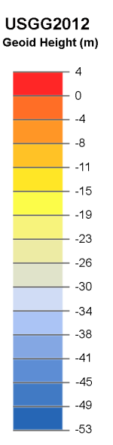
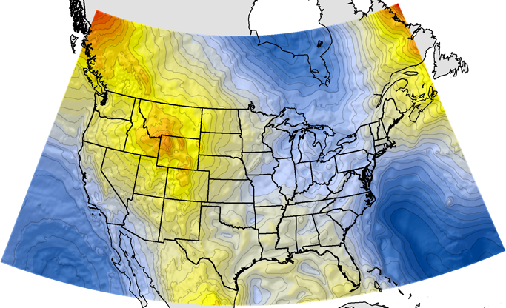
Best NGS Geoid: USGG2012
GOCO02S + EGM2008 + 3”-5’ RTM + ~ two million surface gravity
\||/
\/
One-arcminute (1’) nodes
IGS08-based reference
GRS-80 ellipsoid shell
W₀ = 62,636,855.69 m²/s²
Note: this is not the value adopted with Canada
Min =-52.53 m Max = 3.47 m Ave = -29.84 m SD = 10.35 m
GOCO02S is a combination of
GRACE, GOCE, CHAMP and SLR
Goiginger H., Rieser D., Mayer-Guerr T., Pail R., Schuh W.-D., Jäggi A.,
Maier A., GOCO Consortium (2011): The combined satellite-only global
gravity field model GOCO02S. European Geosciences Union General
Assembly 2011, Wien, 04.04.2011.

Slide 27
NEW VERTICAL DATUM
(Rationale)
  A move away from differentially leveled passive control as the defining mechanism of the reference surface
  To be consistent with the shift in the geometric reference frame/ellipsoid (2022)
  Improvement in our technical abilities in reference surface realization (geopotential gravimetric reference surface - 1cm accuracy of geoid (GNSS/GRAV-D))
  The new geopotential reference surface will be aligned with the geometric reference frame/ellipsoid (i.e., no hybrid geoid)

Slide 28
NEW VERTICAL DATUM
(Rationale)
  The technology to make accurate vertical heights measurements with GNSS technology
  To provide vertical access to formerly prohibitive places
  To allow monitoring of physical or geophysical datum deformation

Slide 29
Earth model: Ellipsoid of revolution
Best-fit ellipsoid
(e.g., GRS-80, WGS-84)
a = 6,378,137.000 m ≈ 3963 mi
b = 6,356,752.314 m ≈ 3950 mi
Ellipsoid flattening
f = (a – b)/a ≈ 0.335%
1/f ≈ 298.25722
San Diego
b = semi-minor axis
(polar radius)
Earth mass center
a = semi-major axis
(radius of equatorial plane)
Equatorial plane
Geoid
the best fit
equipotential surface
for “mean sea level”
Ellipsoid fits geoid to
within about ±100 m worldwide

Slide 30
Geoid
Geopotential
surfaces
Ellipsoid
surface
Gravity vector
(aka “plumbline”),
pointing “up”
The relationships between the ellipsoid surface (solid red), various geopotential surfaces (dashed blue), and the geoid (solid blue). The geoid exists approximately at mean sea level (MSL). Not shown is the actual surface of the earth, which coincides with MSL but is generally above the geoid.
Notes:
Looking at a side view of the irregular shaped Earth and the relationships between surfaces of equal potential (equipotential or geopotential surfaces), perpendicular to the attraction of gravity at that point. Note these geopotential surfaces are not geometrically parallel due to the variations in the earth’s irregular gravity field. Also, the geopotential surfaces converge (become closer together) at the poles due in large part to Earth’s rotation.
As you run levels across theses surfaces the equipment is plumbed per the attraction of gravity at that point. Our assumption is that our horizontal field of view can be corrected for a nice consistent Earth curvature when in fact a correction for conditions affecting us at a particular point must be accounted for.
Running levels north and south require more correction for the convergence of the geopotential surfaces than when running levels east and west.
The red oval illustrates the reference ellipsoid for our space based coordinate system and, though a close approximation of the size and shape of the Earth, is an entire, unrelated reference surface when determining GPS-derived ellipsoid heights.

Slide 31
The ellipsoid, the geoid, and you
Deflection of the vertical
You are here
Earth surface
Ellipsoid height, h
Orthometric height, H
Alaska
Mean
sea level
Geoid height, N_{G}
Ellipsoid
Geoid
h ≈ H + N_{G}
h = H + N_{G}
Note: Geoid height is negative everywhere in the coterminous US
(but it is positive in most of Alaska)

Slide 32
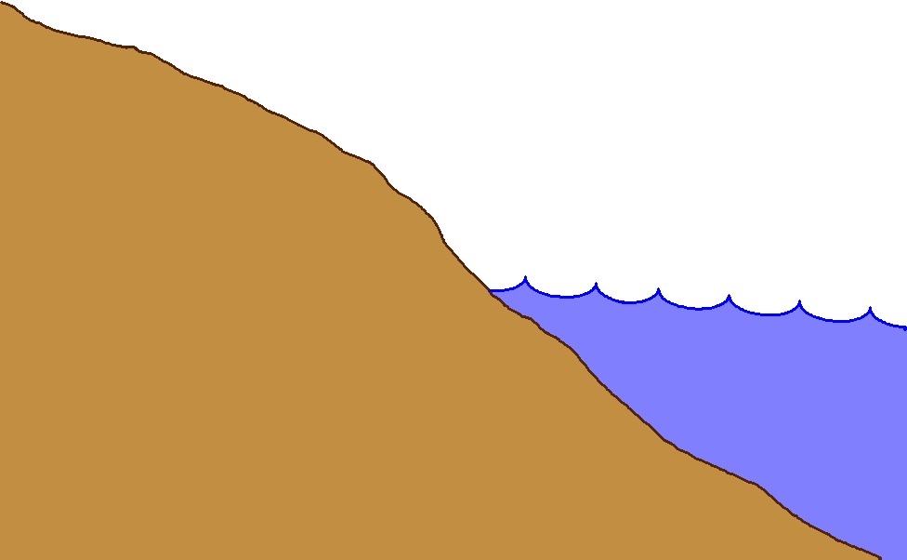
Gravity measurements help answer two big questions…
How “high above
‘sea level’ ” am I?
(FEMA, USACE,
Surveying and
Mapping)
How large are
hydrodynamic processes?
(Coast Survey, CSC,
CZM)
Earth’s
Surface
Geoid
Coast
Ocean
Surface
Ellipsoid
From
Gravity
From
GPS
From
Satellite Altimetry
Notes:
This slide is an idealized situation demonstrating the usefulness of near-shore gravity, specifically the use of such gravity to accurately compute a gravimetric geoid model. (The geoid is the one unique equipotential surface of the Earth’s gravity field which best fits, in a least-squares sense, global mean sea level).
On land, the use of the Global Positioning System (GPS) for fast, accurate surveying is well documented. However the height determined by GPS refers to a highly idealized, mathematically simple surface known as the ellipsoid. Thus GPS heights are “ellipsoid heights”. Unfortunately, ellipsoid heights are non-intuitive in many ways. First, they can be dozens of meters different from heights above the geoid (known as orthometric heights, or more colloquially, but less correctly as “heights above sea level”). Secondly, ellipsoid heights do not give an accurate portrayal of how water will flow, due to their complete disconnect from the gravity field of the Earth. If one has an accurate model of geoid undulations (the separation between the geoid and ellipsoid), then one can take the GPS-derived ellipsoid heights, remove the geoid undulation, and arrive at your orthometric height (a.k.a. “height above sea level”). This is a significantly faster method of determining orthometric heights compared to traditional surveying methods of spirit leveling.
On the ocean, satellite altimetry is used to monitor sea level. However, because the satellite orbits are known relative to the ellipsoid, and the altimetric measurement is from satellite to sea surface, the resulting information is the height of the sea surface above the ellipsoid, often called the “sea surface height” or SSH. If one is interested, however, in the impact of winds, heating, currents and other phenomena on the ocean surface, then one must remove the gravitational impact on the ocean surface. That is, one must know the separation between the ellipsoid and the geoid over the ocean in order to remove this signal, and arrive at the residual value. This residual, the distance from the geoid up to the sea surface, is known by many names, the most common being “sea surface topography” (SST) or “dynamic ocean topography”.
Coastal areas prone to flooding would benefit both by knowing accurate land elevations (to aid in construction planning, floodplain mapping, etc) as well as knowing accurately how the near shore ocean processes work (to better model responses to hurricanes and other dynamic ocean phenomena). It is an unfortunate fact that the largest areas missing accurate gravity measurements are those areas immediately offshore. This is because ships with gravimeters can not get into these shallows, altimetrically derived gravity models are unreliable due to the inability to accurately compute near-shore tides, and terrestrial gravimeters can not measure in the water. The only practical option to collecting the near-shore ocean gravity data is through airborne based technologies.
Dr. Dru A. Smith
Chief Geodesist
NOAA, National Geodetic Survey
Dru.Smith@noaa.gov
1/11/2006

Slide 33

Gravity Field Metaphor
Orbit View
Continent-Scale
Features:
Mountain
Ranges
Deserts
Large Rivers
Coastlines
Large Islands
Not detailed;
Continental
Courtesy of NASA

Slide 34

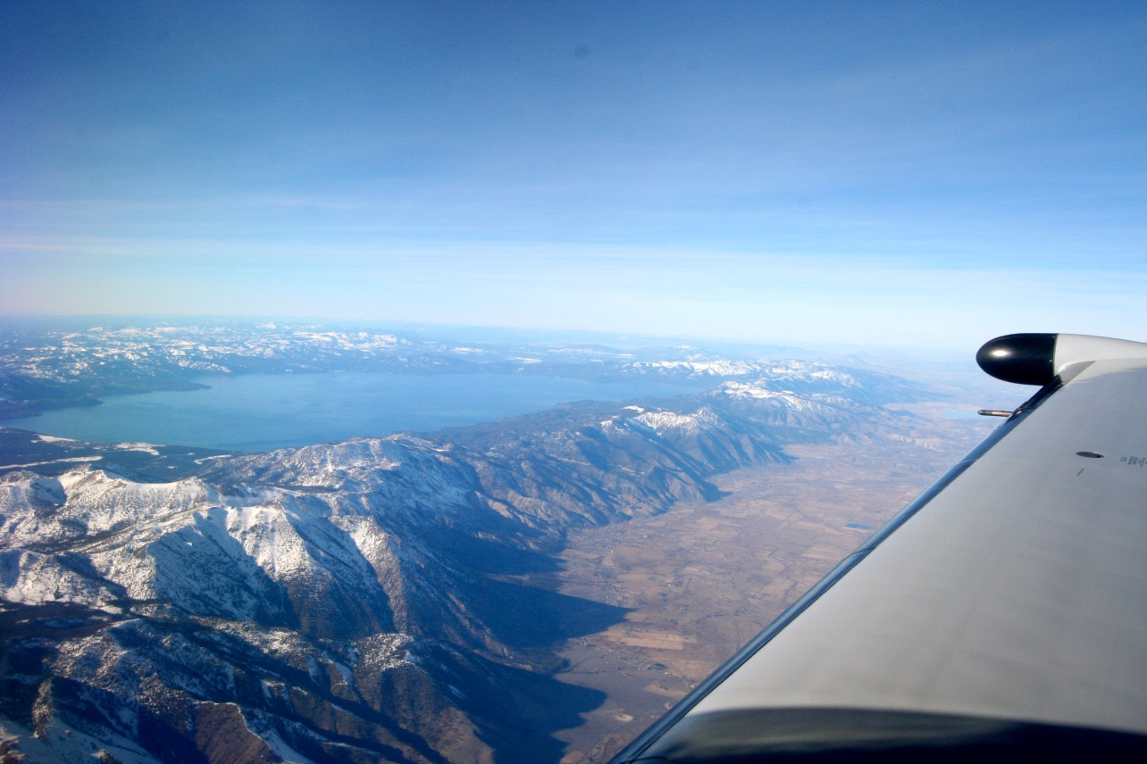
Gravity Field Metaphor
Airplane View
Individual Peaks
Large Lakes
Human Activity
Mountain Ranges
Regional
Denali (Mt. McKinley), AK
Lake Tahoe (CA/NV)

Slide 35
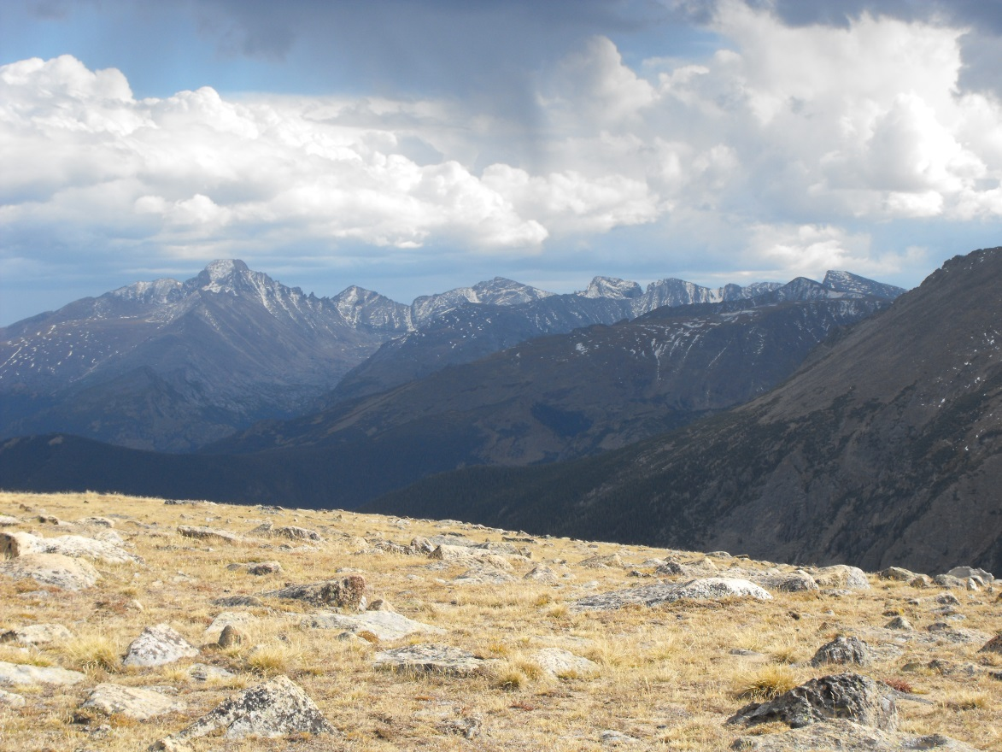
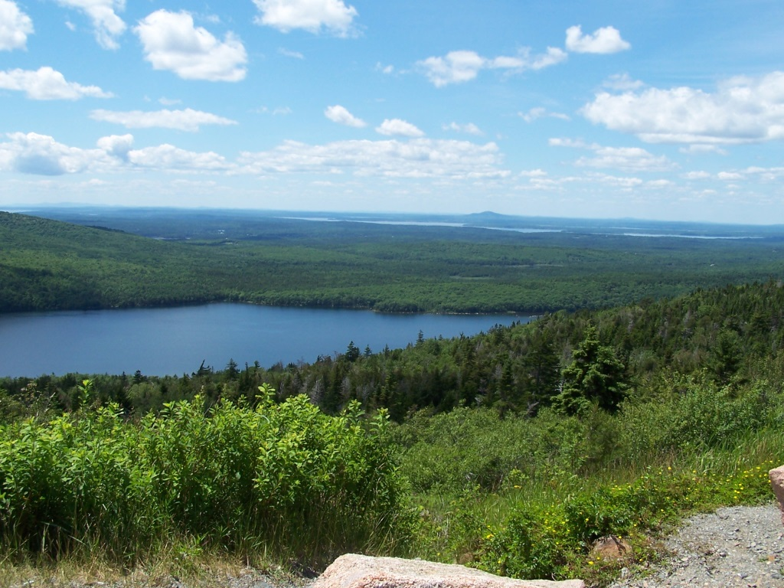
Gravity Field Metaphor
Ground View
Rocks/Boulders
Plants
Mountains, Valleys, Lakes, etc
Local
Rocky Mountain National Park, Colorado
Acadia National Park, Maine

Slide 36
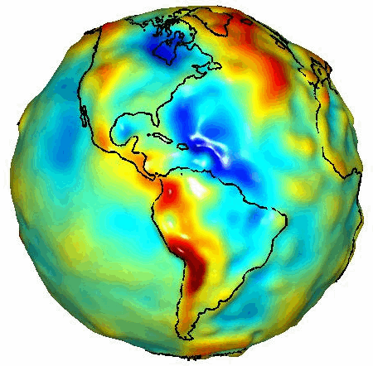
GRACE Gravity Model 01
- Released July 2003
Image credit:
University of Texas Center
for Space Research and NASA
Notes:
To fully appreciate the reasoning for many of strict requirements for geodetic leveling we must begin with understanding what are orthometric heights.
A realistic “view” of our very irregular shaped Earth as depicted in this gravity model determined from space borne gravity measurements by GRACE, gravity recovery and climate experiment.
Every time we set up and plumb our level equipment we are then determining our horizon through the optics of the instrument perpendicular to the attraction of gravity at that point. Now, envision about 26 setups per mile and hundreds and thousands of setups over distances covering a County, each perpendicular to the attraction at that point on our irregular shaped, curved Earth and you can begin to get the feeling that leveling must be much more than a “simple” routine of backsights minus foresights.

Slide 37
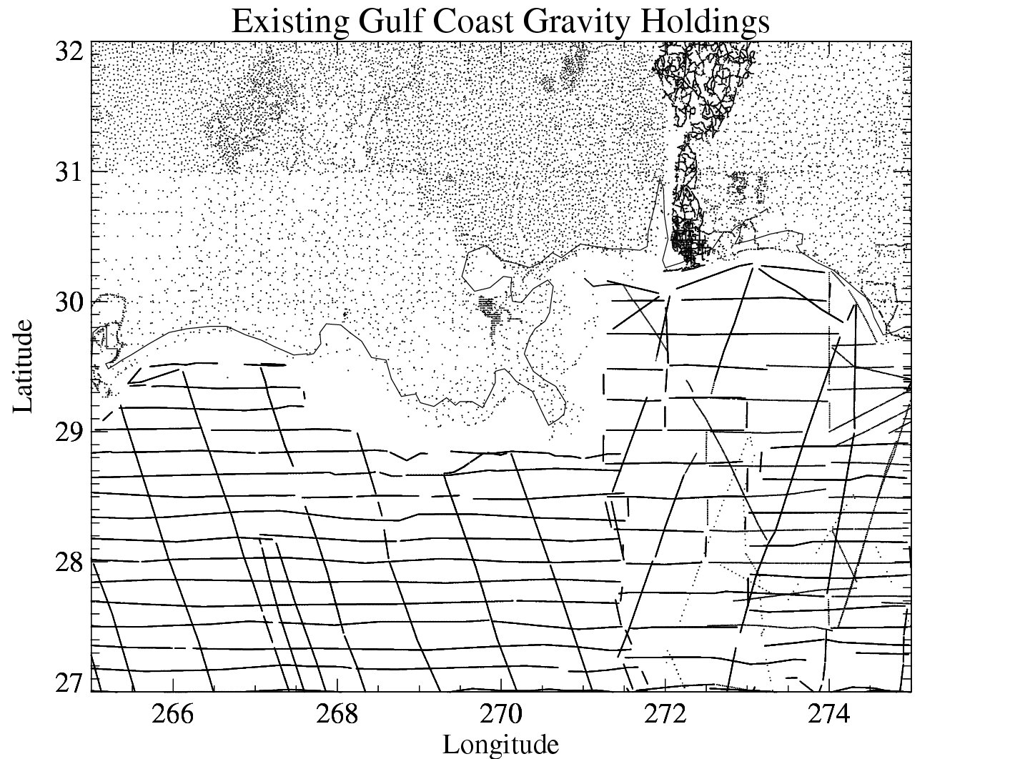
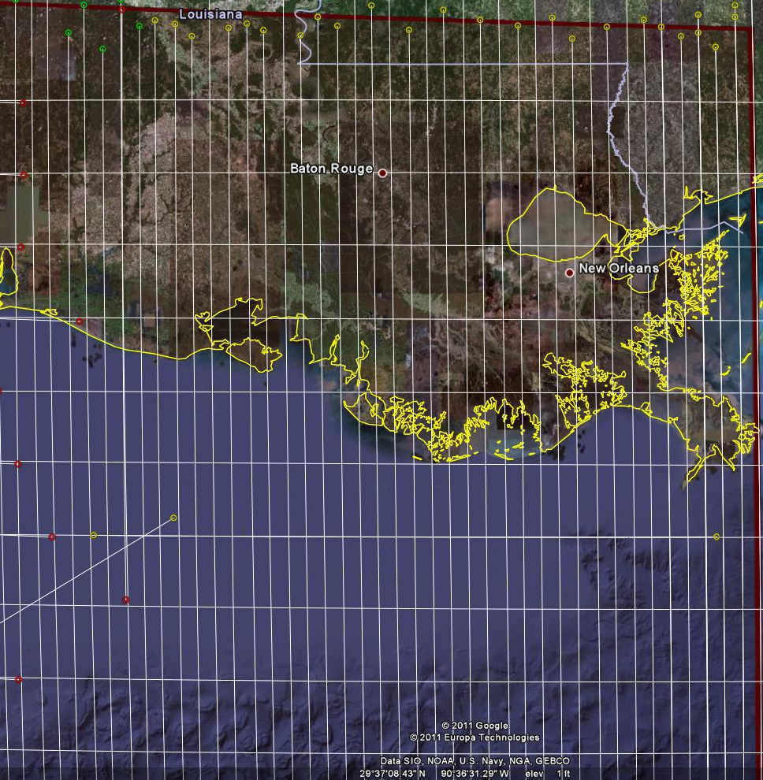
Problems with Gravity Holdings
Terrestrial gravity
20-100 km gravity gaps along coast
Field is not sampled uniformly
Data range in age and quality, some w/o metadata
Some surveys have systematic errors
Data gaps in littoral areas
Ship gravity
New Orleans

Slide 38
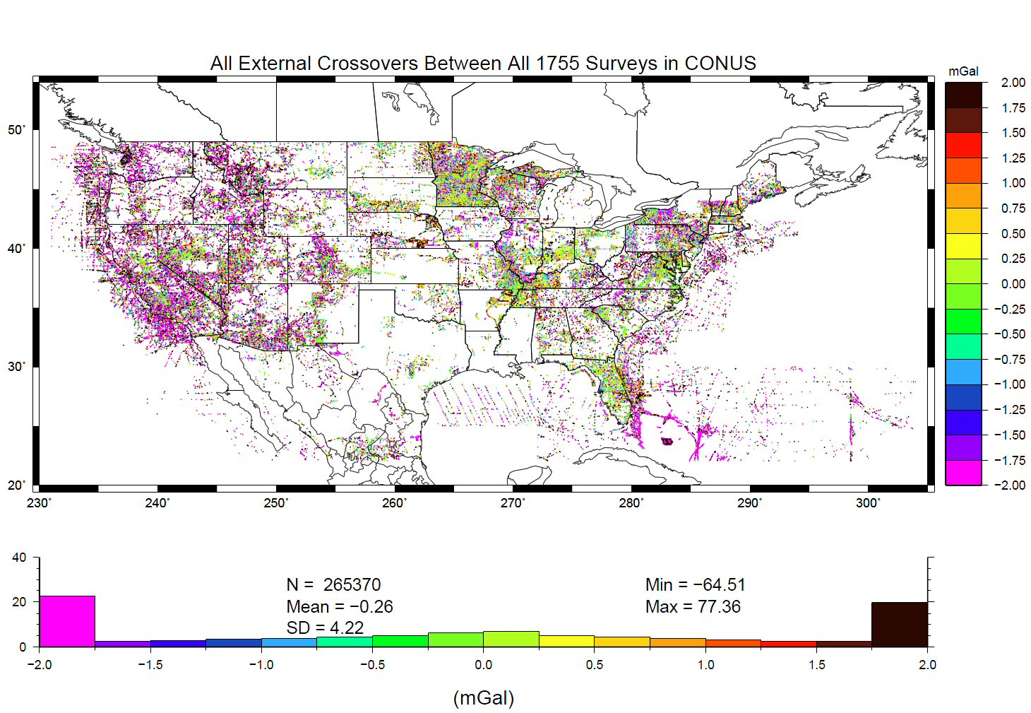
Problems with Gravity Holdings
Decades of gravity surveys are inconsistent with one another
Airborne gravity will provide a baseline for removing these inconsistencies
%
Notes:
This slide shows “crossovers” between any of the 1755 terrestrial gravity surveys which NGS holds in its database. These are
basically mismatches between surveys that overlap one another, plotted at the point of overlap. Note that the color bar
is +/- 2 mGals, and how many surveys disagree with one another at that level. GRAV-D flights should yield about 2 mGal
accuracy surveys, and help reduce the level of disagreement to that range.
The vertical axis of the lower plot is “Percent of points with this level of crossover error” So while it is bell-shaped around -0.26 mGals, the “wings” at the >+2 or <-2 range contain a good 45-50% of all crossovers.
Added October 2010.

Slide 39
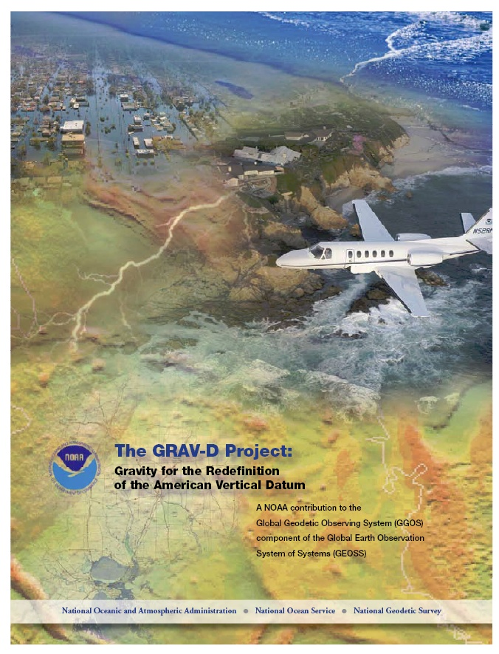
Gravity for the Redefinition of the American Vertical Datum (GRAV-D)
Replace the Vertical Datum of the USA by 2022 (at today’s funding) with a gravimetric geoid accurate to 1 cm
Orthometric heights accessed via GNSS accurate to 2 cm
Three thrusts of project:
  Airborne gravity survey of entire country and its holdings
  Long-term monitoring of geoid change
  Partnership surveys
Working to launch a collaborative effort with the USGS for simultaneous magnetic measurement
Gravity and Heights are
inseparably connected
Notes:
GRAV-D is the NGS project designed to replace NAVD88 with a vertical datum based upon a gravimetric geoid accurate to 1 cm. Heights above this datum will be accessed via GNSS measurements. Three thrusts of project. Launch USGS collaboration for simultaneous mag measurement.

Slide 40
What is GRAV-D?
GRAV-D will mean:
  As the H=0 surface, the geoid will be tracked over time to keep the datum up to date
  The reliance on passive marks will dwindle to:
    Secondary access to the datum
    Minimal NGS involvement
      Maintenance/checking in the hands of users
    Use at your own risk

Slide 41
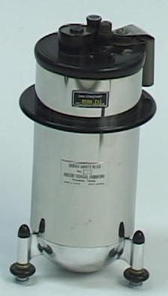
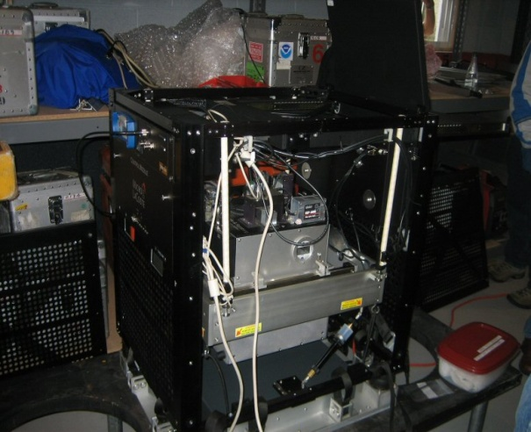
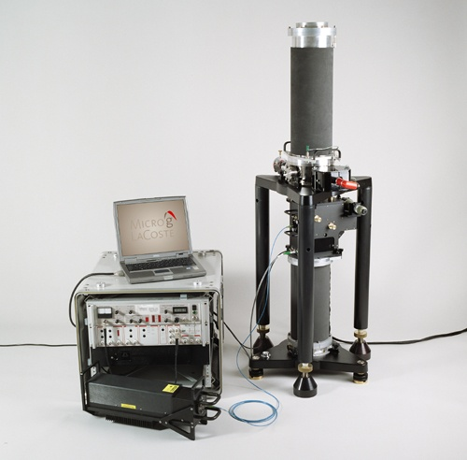
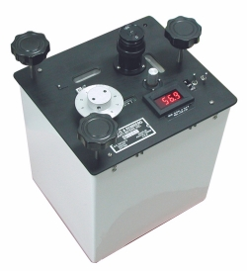
Gravity Survey Plan
National Scale Part 1
  Predominantly through airborne gravity
  With Absolute Gravity for ties and checks
  Relative Gravity for expanding local regions where airborne shows significant mismatch with existing terrestrial

Slide 42
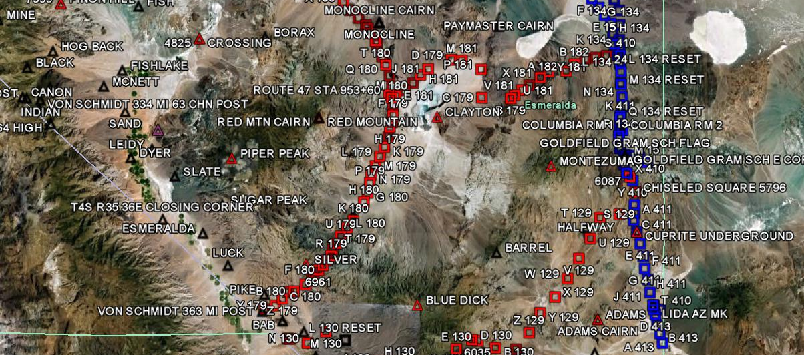
GRAV-D Goals
2 cm accuracy orthometric heights -
  from GNSS (1 cm) + geoid model (1 cm)
fast, accurate, consistent orthometric heights -
everywhere in the USA

Slide 43
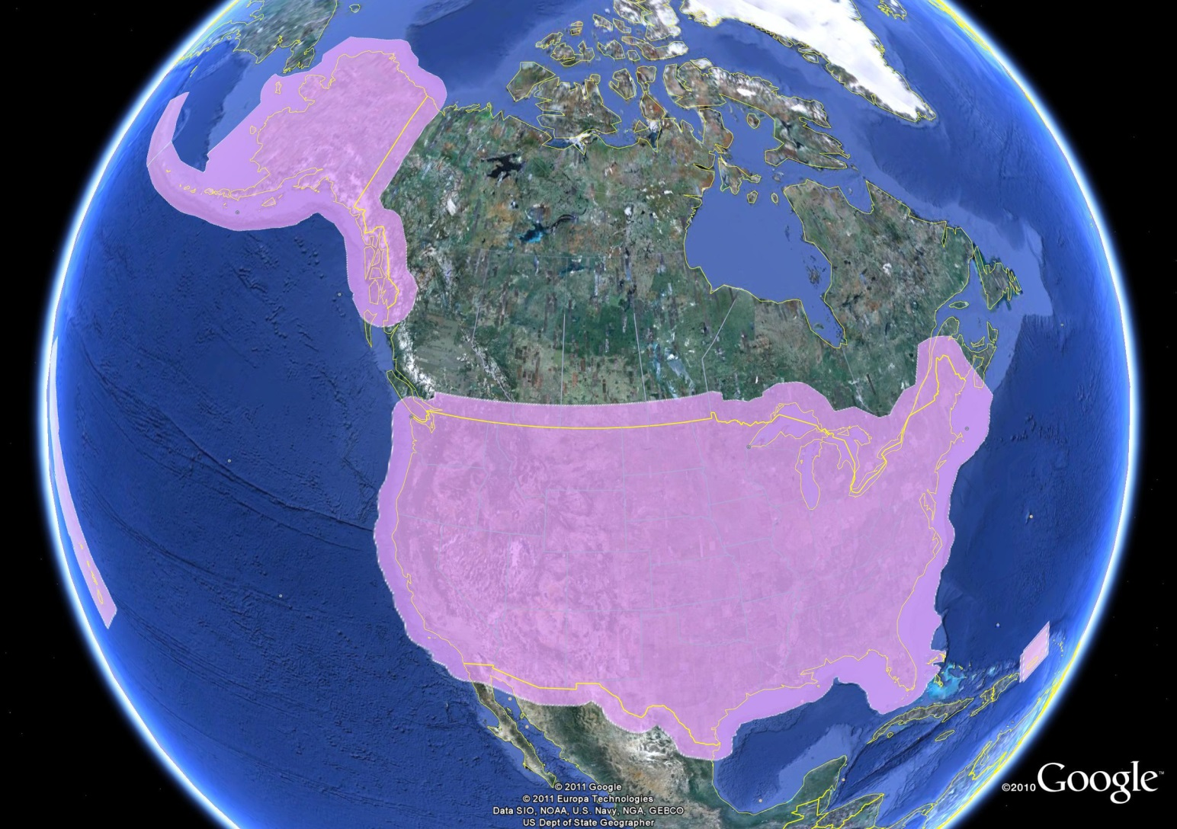
GRAV-D Expected Coverage
Puerto Rico
US Virgin Is.

Slide 44
Priority- Greatest Datum Need
Alaska
Puerto Rico/US Virgin Islands (PRVI)
Coastal US and Great Lakes
  Great Lakes
  Gulf of Mexico & FL
  Eastern Seaboard
  Western Seaboard
Hawaii and Pacific Islands
Aleutian Islands
Interior CONUS
  Mountainous areas first

Slide 45
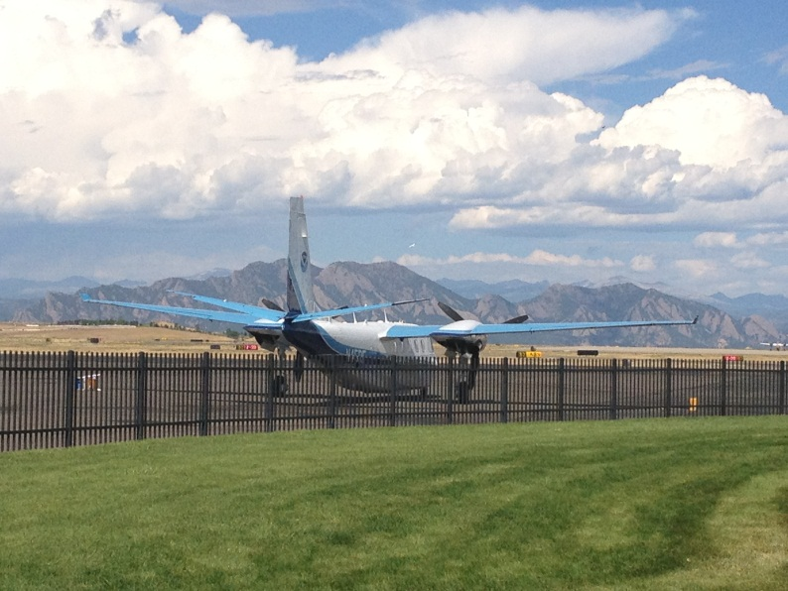
Other Variables to Consider
Time of Year, Need Smooth Air
  Likelihood of Turbulence: Hurricanes, Tornados
  Prevailing winds and weather patterns, especially wintery conditions and
  thunderstorms
Aircraft Available
  Differing Capabilities
Funding
Areas already completed
GPRA
NOAA TurboCommander at
Denver Rocky Mountain Airport
September 2012
*GPRA = Government Performance and Results Act of 1993

Slide 46
GPRA* Performance Metric
For Airborne Surveys
FY09 Baseline | Targets vs Actual
 | FY10 | FY11 | FY12 | FY13 | FY14 | FY15 | FY16 | FY17 | FY18 | FY19 | FY20 | FY21 | FY22
6.14% | 7.5% | 12% | 20% | 28% | 36% | 44% | 52% | 60% | 68% | 76% | 84% | 92% | 100% and Implement
6.14 | 7.8 | 14.7 | 23.9 | 31.0 | 38.1 | 39.4
Oct. 2014 through Dec. 2014
Measure: Percentage of the U.S. and its territories with GRAV-D data available
to support a 1 cm geoid supporting 2 cm orthometric heights.
*GPRA = Government Performance and Results Act of 1993
Notes:
We’ve set up a basic GIS GPRA monitoring in the War Room. We will report the coordinates of our survey monthly and they will calculate our percentages.

Slide 47
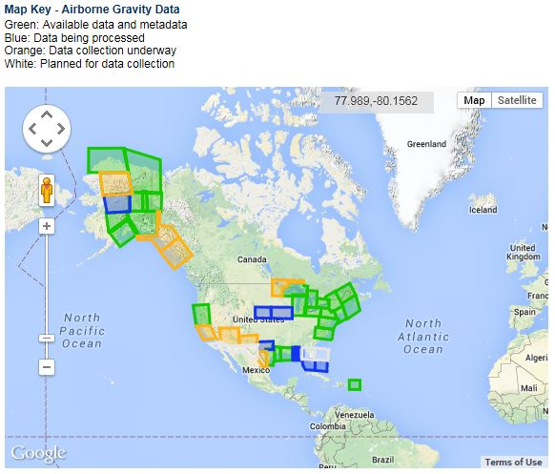
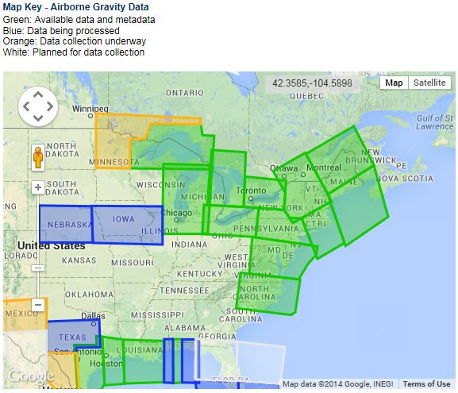
Airborne Gravity Current Coverage
Data Block Status
Complete
Processing
Collecting
Planned
As of Dec, 2014
http://www.ngs.noaa.gov/GRAV-D/data_products.shtml

Slide 48
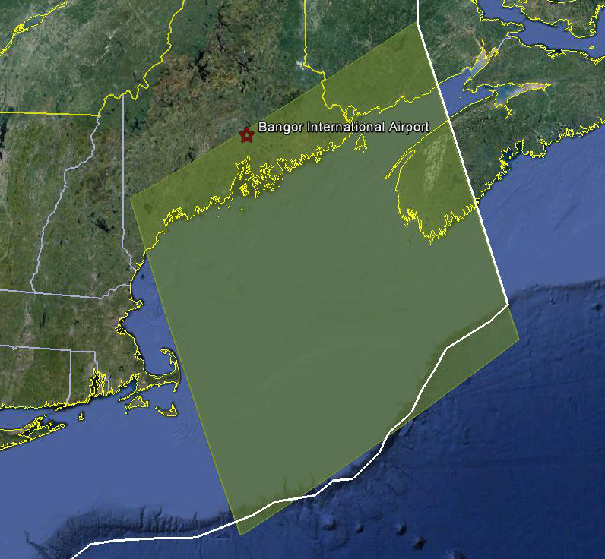
Survey and Block Plans
Layout rectangular survey 400 x 500 km
Extends beyond the shelf break
Block size will reflect the endurance of the aircraft
Notes:
Size of survey based on aircraft legs (how far it can go)
Location dependent on aircraft (over water?), in this case only a 2 engine aircraft

Slide 49
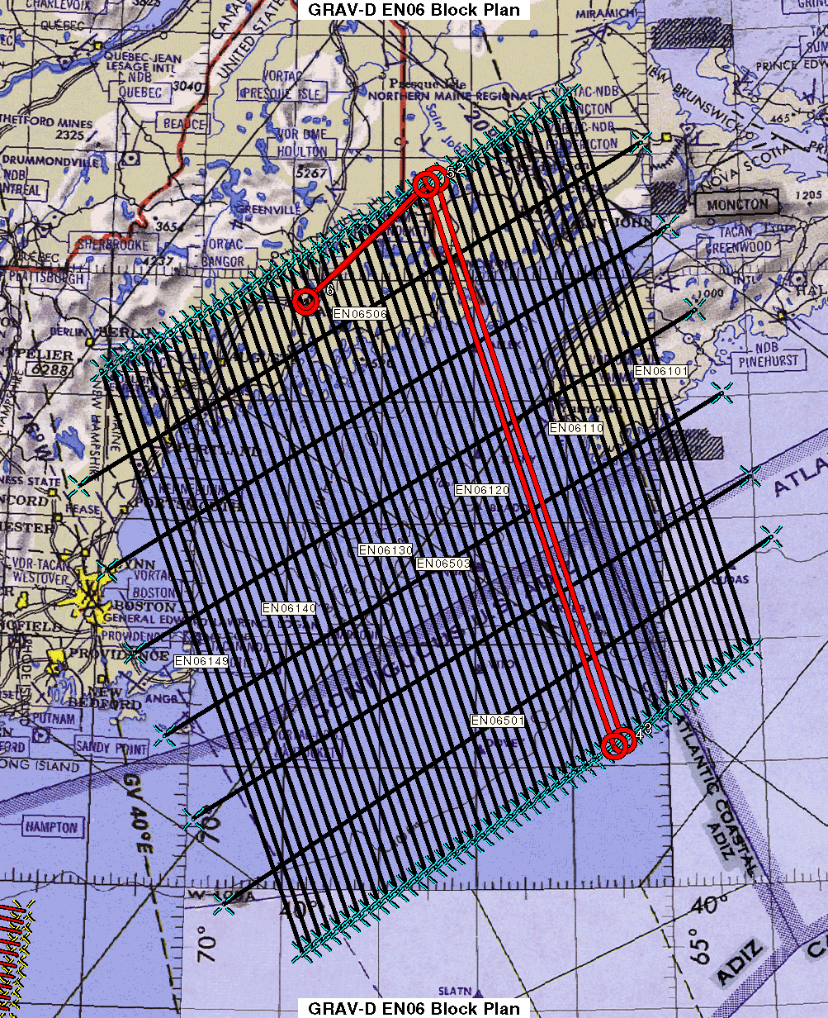
Survey and Block Plans
Data lines spaced 10 km apart
Cross lines spaced 60-80 km apart
Flight altitude 20,000 ft
Nominal speed 220-250 kts
Notes:
Block layout based on aircraft, adjust size of block if needed

Slide 50
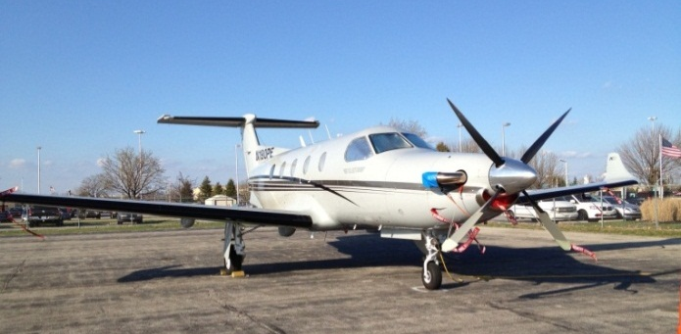

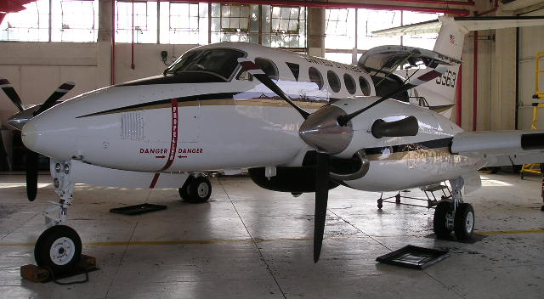

GRAV-D Aircraft
DOI Bureau of Land Management
  Pilatus PC-12
Fugro
  King Air E-90A
Naval Research Lab
  King Air RC-12
NOAA
  Gulfstream Jet Prop
  NOAA P-3 Hurricane Hunter
Pilatus PC-12
King Air E-90A
King Air RC-12
Notes:
GRAV-D surveys have been operating on a number of aircraft. In order to accomplish our objectives within budget, we utilize a “portfolio” of aircraft of both government and contract origin. We’ve used the NOAA Jet Prop and the P-3, although little opportunity exists for further use of these aircraft. We operate about five months/year aboard the BLM Pilatus PC-12 aircraft. This aircraft is used for fire-spotting during warmer weather months in AK and the western US. This year we began working with Fugro to provide us aircraft services. We plan also to work this year with the Naval Research Lab and the VXS-1 Navy Squadron aboard their RC-12 King Air aircraft.

Slide 51
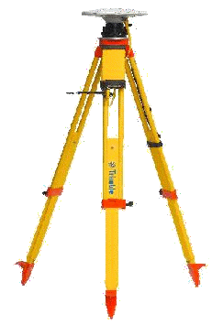
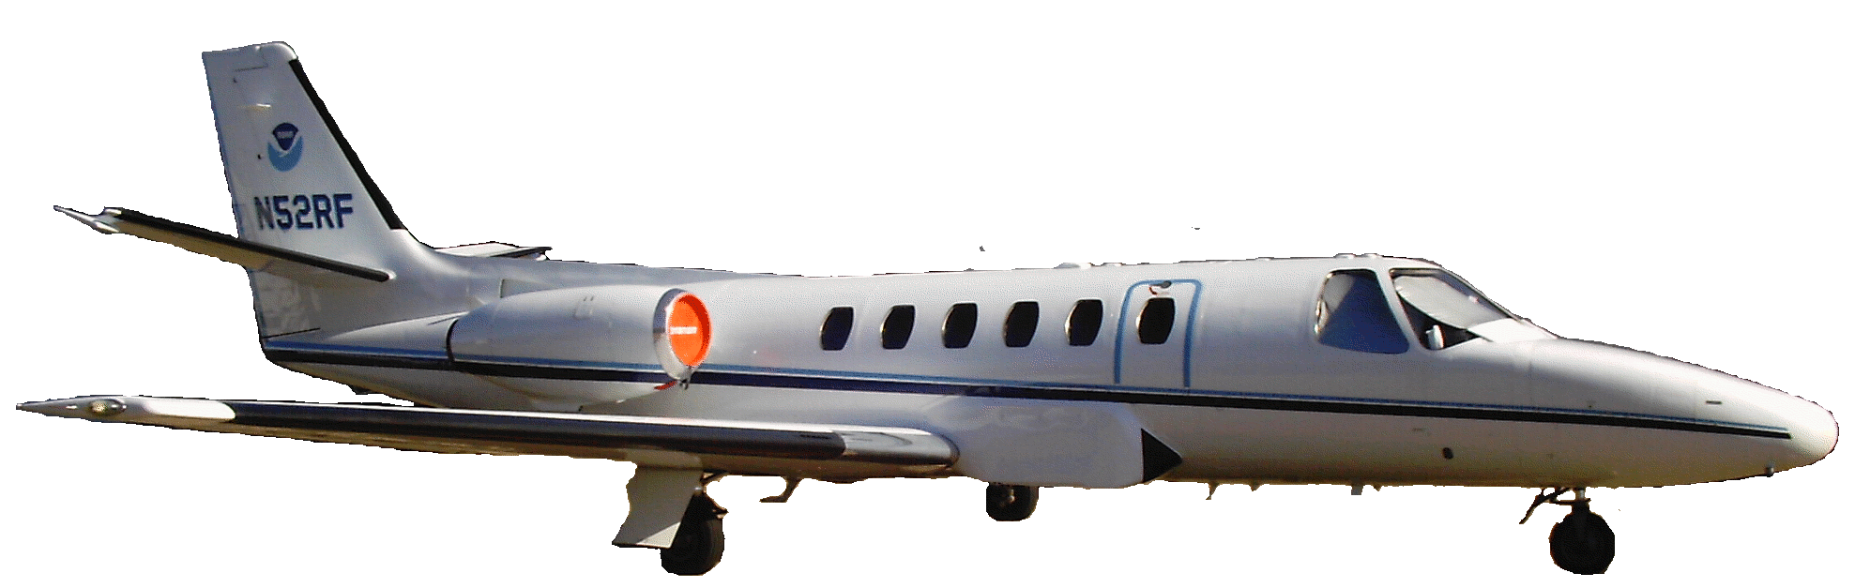
Requirements
Geodetic quality results require accurate aircraft positions, velocities, and accelerations
High-altitude, high-speed, long baseline flights for gravimetry
INS
GPS Antenna
Gravimeter
Absolute Gravity Tie

Slide 52
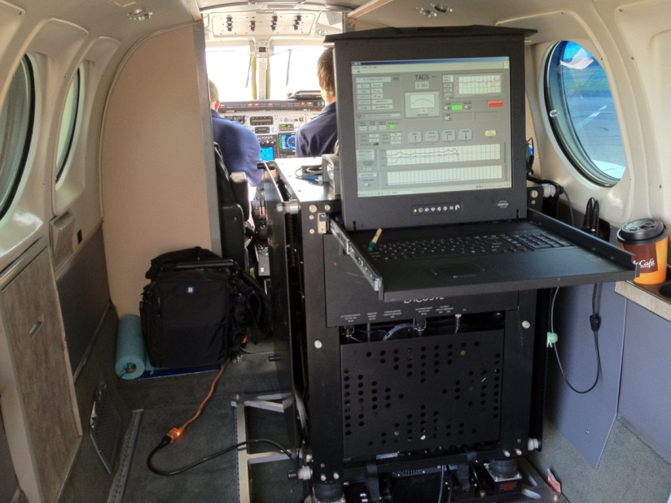
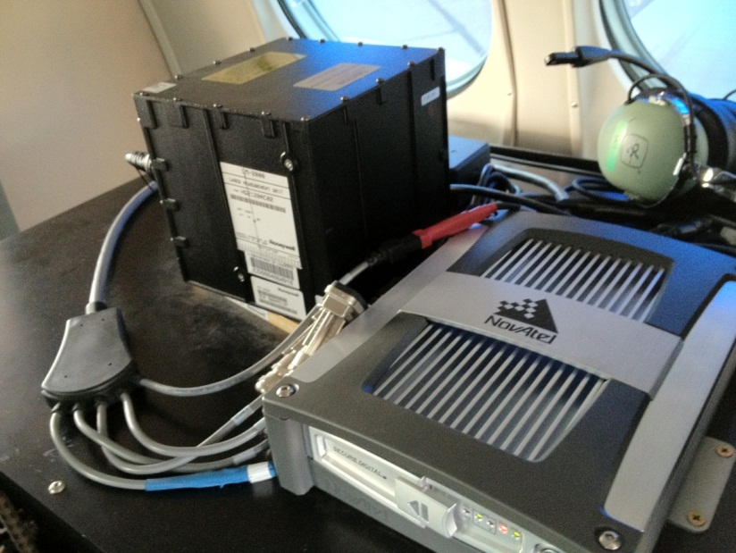
GRAV-D Instrumentation
Micro-g LaCoste
TAGS Gravimeter
NovAtel SPAN-SE
w/ Honeywell µIRS IMU
Both instruments include GNSS receivers
SPAN system allows for tightly coupled GPS/IMU solutions

Slide 53
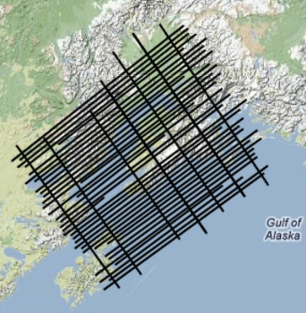
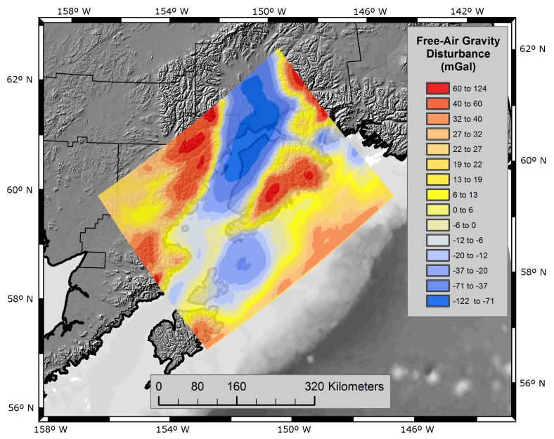
From Measurement to Product
Airborne Gravity Collection
GPS and Gravity Data Processing
  Kinematic positioning is critical
  NGS-developed software
More info: http://www.ngs.noaa.gov/corbin/class_description/GRAVD_0213.shtml
Gravity Data Release to Public
Inclusion in Yearly Experimental
Gravimetric Geoid Models

Slide 54
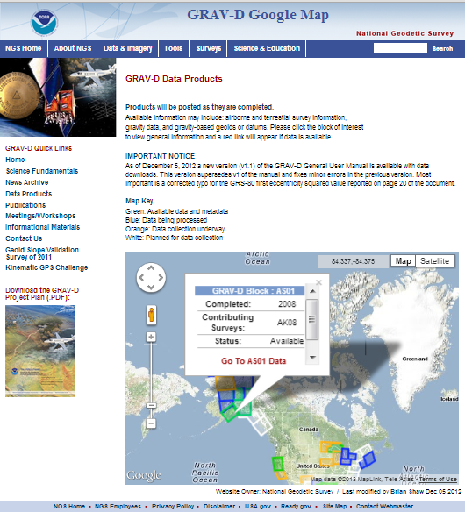
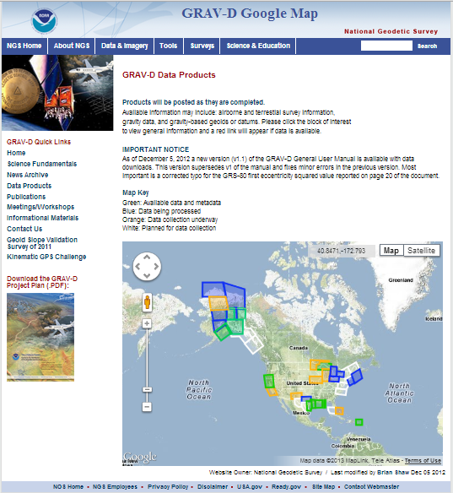
Online Data Portal http://www.ngs.noaa.gov/GRAV-D/data_products.shtml
Interactive Google Map:
  Up-to-date info on all blocks
  20 blocks released (as of Jan. 2014)
  Clicking a block pops up basic info and a link to the block’s page if data is available

Slide 55
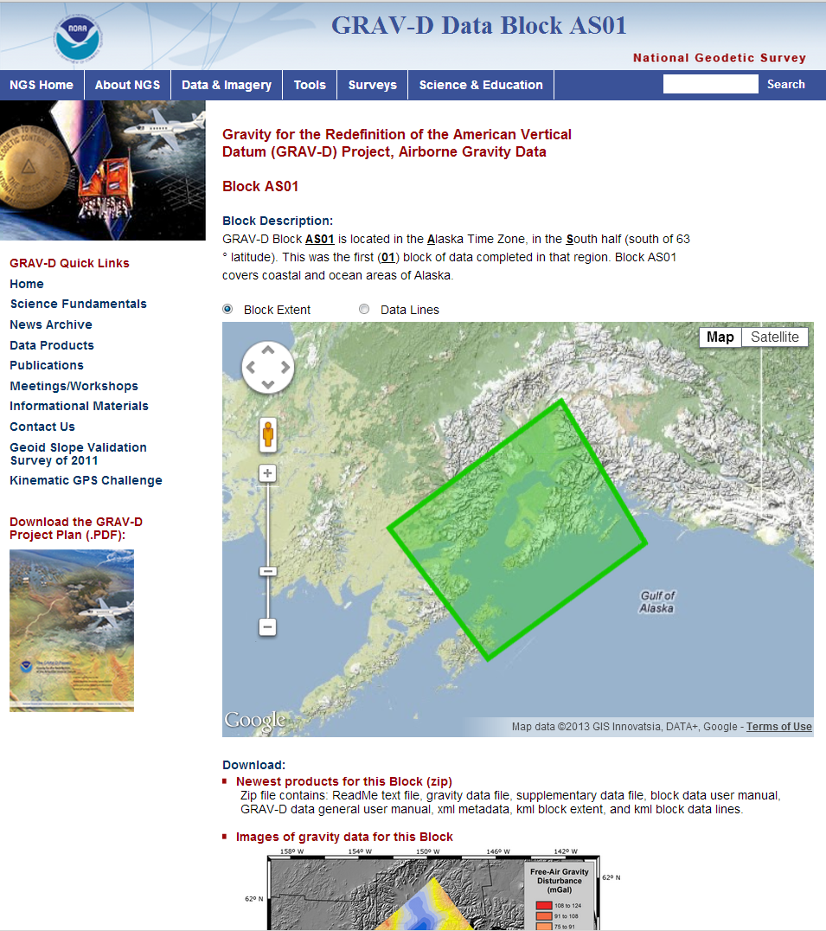
Online Data Portal
Example Block Site: http://www.ngs.noaa.gov/GRAV-D/data_as01.shtml
Data Available Now:
  Airborne gravity at altitude
  GIS Images
  .kmls of block extent and data lines
  Two user manuals (one general, one specific to block)
  FGDC metadata
Future Data:
  Experimental geoid products, similar to USGG official products
  Will incorporate GRAV-D data

Slide 56
Validating Geoid Accuracy (1 of 2)
“...the gravimetric geoid used in defining
the future vertical datum of the United States should have an absolute accuracy of 1 centimeter at any place and at any time.”
-- The NGS 10 year plan (2008-2018)
Admirable!...Achievable?
Notes:
The above quote refers to one of many ambitious goals in the NGS 10 year plan. While admirable, its achievability remains an open question. In order to begin addressing the actual achievable accuracy of a gravimetric geoid model, NGS will engage in a variety of testing methods prior to the 2022 date when the gravimetric geoid will serve as the reference surface for a new vertical datum. The first such testing method took place in the summer of 2011 and is known as the Geoid Slope Validation Survey of 2011, or GSVS11. As its name implies, this survey tested the accuracy of differential geoid undulations between points ("geoid slopes") from NGS's gravimetric geoid models. The baseline for comparison will be independently computed geoid slopes from two methods, GPS and leveling as well as Deflections of the Vertical.

Slide 57
Validating Geoid Accuracy (2 of 2)
NGS plans up to 3 surveys to validate the accuracy of the gravimetric geoid model
  GSVS11
    2011; Low/Flat/Simple: Texas; Done; Success!
  GSVS14
    2014; High/Flat/Complicated: Iowa; Field work Complete
  GSVS1x
    2017?; High/Rugged: Colorado? Wyoming?

Slide 58
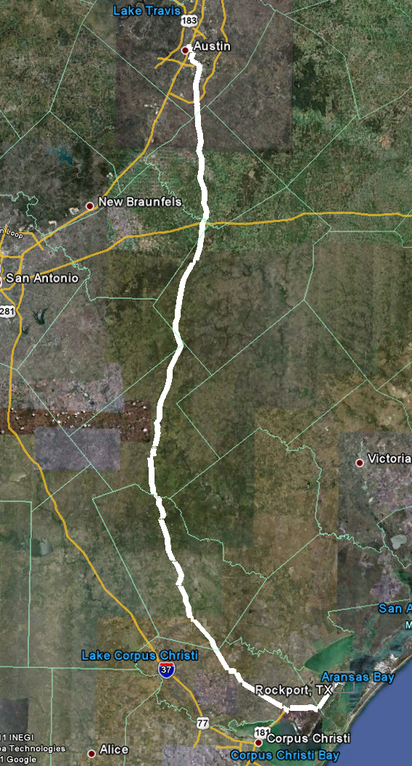
Geoid Slope Validation Survey
Austin
Observe geoid shape (slope) using multiple independent terrestrial survey methods
  GPS + Leveling
  Deflections of the Vertical
Compare observed slopes (from terrestrial surveys) to modeled slopes (from gravimetry or satellites)
  With / Without new GRAV-D airborne gravity
325 km
218 points
1.5 km apart
Rockport
Notes:
But will this method produce a sufficiently accurate geoid?
This summer, we conducted an experiment to determine the accuracy of our geoid. We selected a line that extended 325 km from downtown Austin, Texas (North end) to Rockport, Texas (South end). There were 218 official survey points along the line, with an average spacing of 1.5 km between them. We compared the slope of the geoid along the line determined with GPS + leveling with deflections of the vertical as measured by the ETH Zurich DIADEM zenith camera. We also compared the observed geoid slope with slopes calculated from various geoid models to evaluate the their quality. As for NGS models, we tested geoids that both included and didn’t include new GRAV-D airborne gravity.

Slide 59
Surveys Performed
GPS: 20 identical units, 10/day leapfrog, 40 hrs ea.
Leveling: 1st order, class II, digital barcode leveling
Gravity: FG-5 and A-10 anchors, 4 L/R in 2 teams
DoV: ETH Zurich DIADEM GPS & camera system
LIDAR: Riegl Q680i-D, 2 pt/m² spacing, 0.5 km width
Imagery: Applanix 439 RGB DualCam, 5000’ AGL
Other: RTN, short-session GPS, extra gravity marks around Austin, gravity gradients

Slide 60
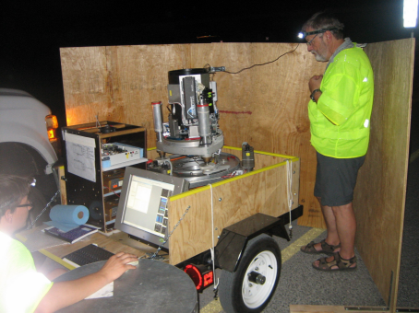




GPS
LIDAR/
Imagery
DoV
Gravity
Leveling
Notes:
These are just a small sampling of the field crews in action. Not shown are the RTN, FG-5, short-session GPS, relative gravity and mark setting crews.

Slide 61

Geoid Slope Survey Conclusions
Including airborne gravity data improves geoid slope accuracy at nearly all distances <325 km
The NGS geoid in the TX survey meets the 1 cm accuracy objective only if airborne data are included
  No other model achieved 1 cm accuracy
Gravimetric geoid models and GPS are a viable alternative to long-line leveling
Notes:
The Survey verified that the inclusion of the GRAV-D airborne survey improved the geoid slope accuracies at all distances measured by the survey.

Slide 62

GSVS14 Line
Goal: Same as GSVS11
Region: Moderate terrain
More complex gravity
Data: Same as GSVS11
Timeline: Starting in fiscal year 2014
Cedar Rapids to Denison

Slide 63
NEW VERTICAL DATUM
(Components)
Design and adopt new geometric reference frame (Geometric Datum Project)
Realize new geometric datum with existing passive/active control, i.e., a horizontal (geometric) adjustment
Definition of the W₀ surface as the new datum reference surface
Build a gravimetric geoid with an overall accuracy of 1 cm (GRAV-D Project)
Make orthometric heights easily available

Slide 64


Agreement on W₀ Value

Slide 65

Orthometric Heights from OPUS
Make geoid-based orthometric heights available via OPUS (NGS’ Online Positioning User Service)
  Done, in extended output

Slide 66
Experimental Models
Annually update an experimental gravimetric geoid with GRAV-D data
  Evolution as we move
    from USGG2012 (last non-GRAV-D gravimetric geoid)
    through xGG201? (annual experimental geoid)
    to USGG2022 (the final geoid with GRAV-D)
  Starting 2014: National Ocean Service Requirement

Slide 67


xGeoid2014
  First experimental geoid model released June 30, 2014
  Online tools for accessing it (GRAV-D website)

Slide 68

The effect airborne gravity

Slide 69
How much will heights change?
How much will NSRS ellipsoid height change?
  Geometric Datum will be aligned to ITRF
  Approx -1.9 m (Puerto Rico) to +2.0 m (Guam)
How much will NSRS CONUS orthometric height change?
  Approx +0.1 m (Florida) to -1.3 m (Washington)
  More than 2 meters of change in Alaska

Slide 70
NEW VERTICAL DATUM
(Components)
Prepare a forward and backward vertical datum conversion strategy - points and maps/charts (ref: NC Pilot Project)
Work with FGCS for adoption of new/updated (FGCS Vertical Working Group):
  Standards of Accuracy
  Specifications
  Procedures, and
  Guidelines
Outreach

Slide 71
Metadata is Critical
Your positional metadata should include:
  datum
  epoch
  source
These will facilitate transforming from current to new datum
Maintaining your original survey data will provide more accurate results

Slide 72
How to Plan for the Future
Move to newest realizations
  NAD 83(2011) epoch 2010.00
  USGG12 (gravimetric geoid) / GEOID12A (hybrid geoid)
Obtain precise ellipsoid heights on NAVD 88 bench marks (OPUS-DB, contact NGS Geodetic Advisor)
  Improves hybrid geoid models and provides “hard points” in new vertical datum
  Follow new NGS Guidelines when released
Move off of NGVD 29 to NAVD 88
  Understand the accuracy of VERTCON in your area
Move away from passive marks to GNSS
  Especially move off of classical passive control
Require/provide complete metadata for all mapping contracts
  How did they get the positions/heights? Document it!!

Slide 73
GNSS-Derived Height Guidelines
Current Technical Memorandum:
- Guidelines for Establishing GPS-Derived Ellipsoid Heights - NOAA TM NOS NGS-58 Nov 1997
- Guidelines for Establishing GPS-derived Orthometric Heights (Standards: 2 cm and 5 cm) NOAA TM NOS NGS-59 Mar 26, 2008
- Available: http://www.ngs.noaa.gov/PUBS_LIB/pub_GPS.shtml
12/02/2013 - Field Campaign Begins in South Carolina to Update NOAA Height Guidelines
Beginning December 2, NOAA and surveying and engineering firm, Gustin, Cothern & Tucker, Inc., (GCT), will begin a field campaign to collect Global Navigation Satellite System (GNSS) observations in South Carolina. Working in collaboration with the South Carolina Geodetic Survey, this effort is part of a larger study to update and improve existing NOAA guidelines to establish GNSS-derived heights. Since the original guidelines were published, many advances in science and technology have prompted a re-examination of how GNSS may be most effectively used to determine elevations.
STAY TUNED: http://www.ngs.noaa.gov/heightmod/

