Slide 1
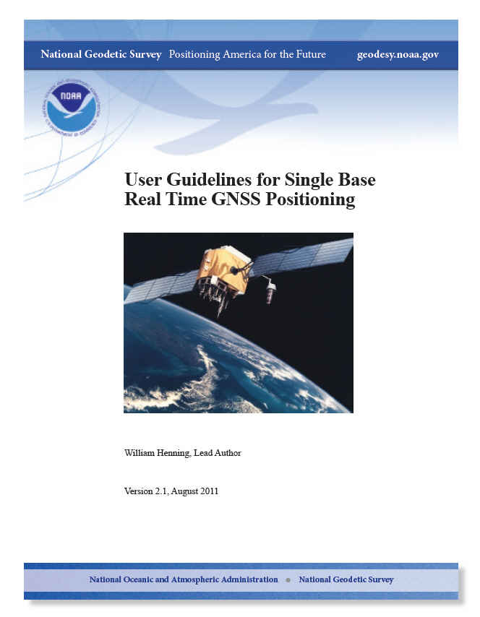
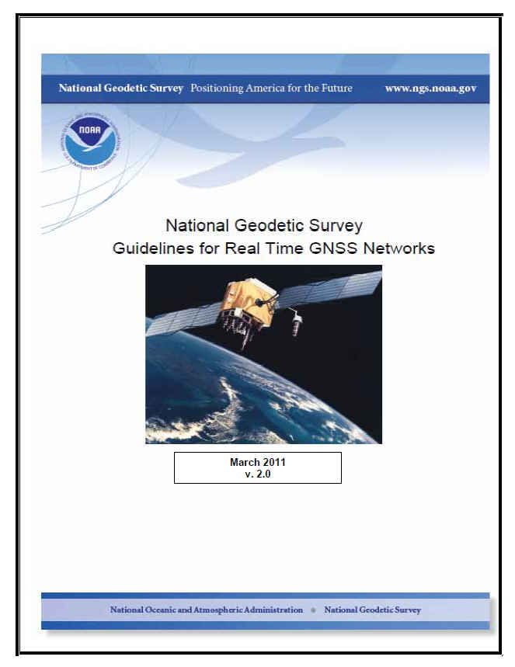


PSLS CONFERENCE
HERSHEY, PENNSYLVANIA
JANUARY 24, 2012
REAL TIME GNSS
POSITIONING
GUIDELINES
Bill Henning
Geodesist, Prof. LS.

Slide 2
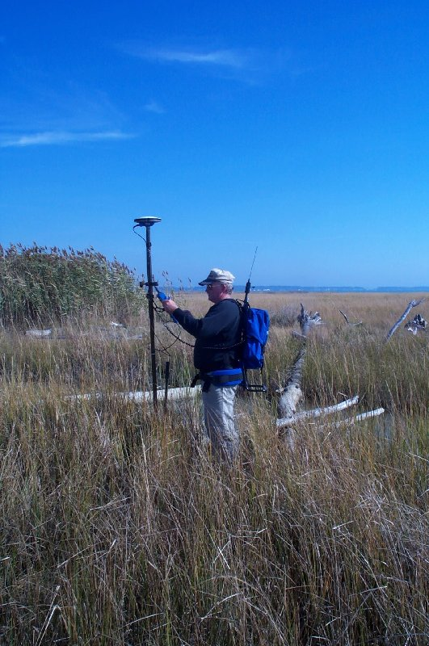
THE IMPORTANCE OF INTELLIGENT RT FIELD WORK
- Multipath
- Position Dilution of Precision (PDOP)
- Baseline Root Mean Square (RMS)
- Number of satellites
- Elevation mask (or cut-off angle)
- Base accuracy- datum level, local level
- Base security
- Redundancy, redundancy, redundancy
- Part(s) Per Million Error (ppm) – iono, tropo models, orbit errors
- Space weather- sunspot numbers, solar maximum
- Geoid quality
- Site calibrations (a.k.a. Localizations)
- Bubble adjustment
- Latency, update rate
- Fixed and float solutions
- Accuracy versus Precision
- Signal to Noise Ratio (S/N or C/N0)
- Carrier phase solution
- Code phase solution
- VHF/UHF radio communication
- CDMA/SIM/Cellular TCP/IP communication
WGS 84/ITRF00/IGS08/NAD 83, & Local datums
GPS, GLONASS, Galileo, Compass Constellations
THE CONTROL IS AT THE POLE!

Slide 3
WORKSHOP PLAN
BACKGROUND- NEW & CURRENT DATUMS,
RTN ADVANTAGES/DISADVANTAGES
GEOMETRICAL & DISPERSIVE EFFECTS ON THE GNSS SIGNAL
BEST METHODS FOR GNSS REAL TIME POSITIONING- A FIELD GUIDE
REVIEW OF HOW RT GNSS POSITIONING (RT) WORKS
INTRODUCTION-THE CONSTANCY OF CHANGE

Slide 4
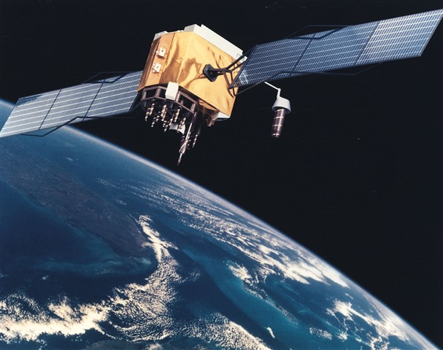
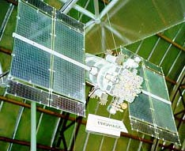
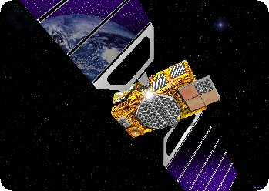
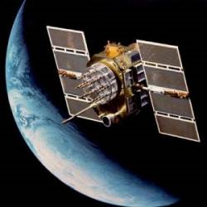
GNSS POSITIONING TECHNOLOGY-
WHERE WE STAND NOW
AND WHERE WE ARE HEADED
GPS
GALILEO
GLONASS
COMPASS (BEIDOU-2)

Slide 5
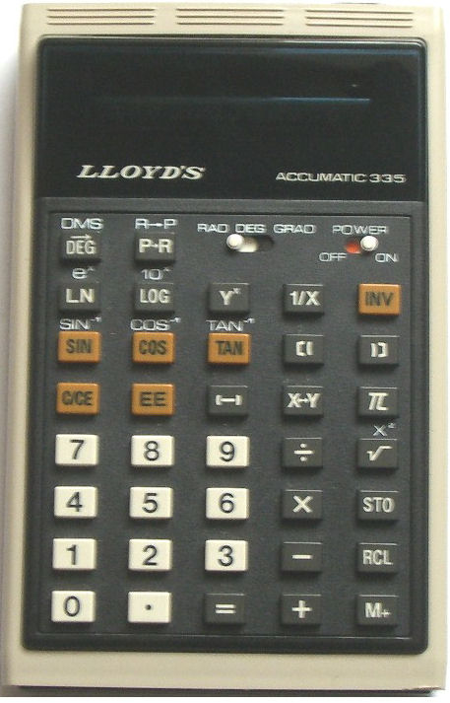
“Human knowledge is doubling every 10 years. The scientific knowledge produced between 1987 and 1997 is greater than that produced in all mankind’s history”.
Michio Kaku- renowned theoretical physicist
THE CHANGE FROM LABOR INTENSIVE TO TECHNOLOGY!

Slide 6
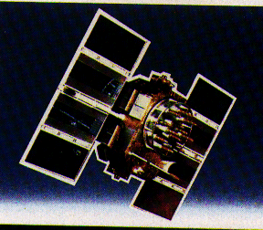

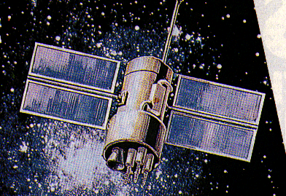

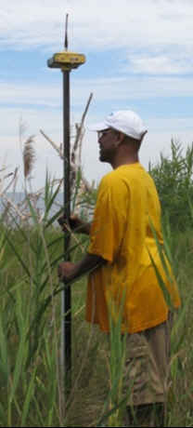
CHANGES IN GNSS
GPS:
L2C
L5 CARRIER
New Code on L5
L1C
10-15 cm???
GLONASS- FULL OPERATIONAL CAPABILITY
2011
EUROPEAN UNION - GALILEO
CHINA – COMPASS/BEIDOU
REGIONAL:
(JAPAN- QZSS FIRST LAUNCH 2010)
(INDIA – GAGAN)
1-3 m
BETTER RESISTANCE TO INTERFERENCE
FASTER AMBIGUITY RESOLUTION
AUGMENTED CODE APPLICATIONS
= 115 SATELLITES?

Slide 7
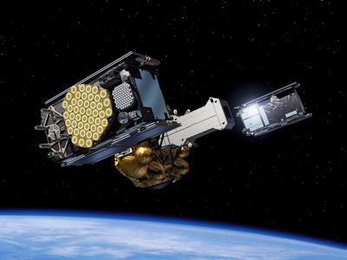
GALILEO- OFF THE GROUND
OCTOBER 21, 2011
2 IOV SATELLITES, EUROPEAN SPACEPORT, FRENCH GUIANA, RUSSIAN SOYEZ ROCKET (SPUTNIK, YURI GREGARIN)

Slide 8
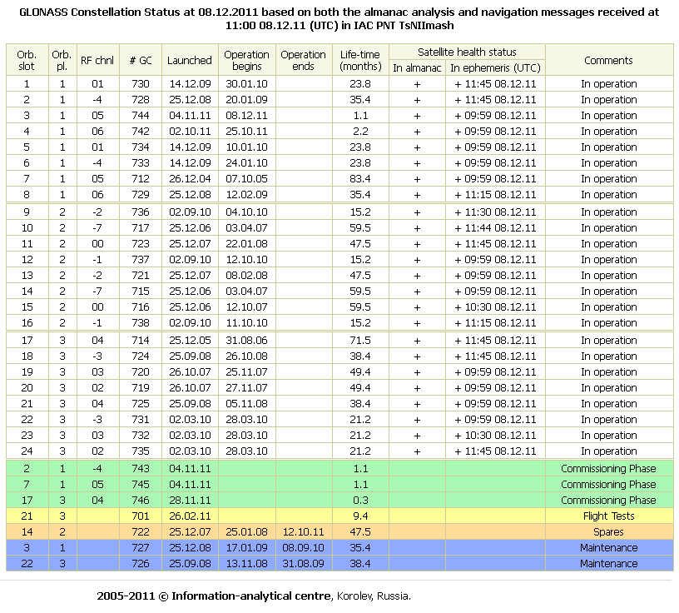
GLONASS STATUS

Slide 9
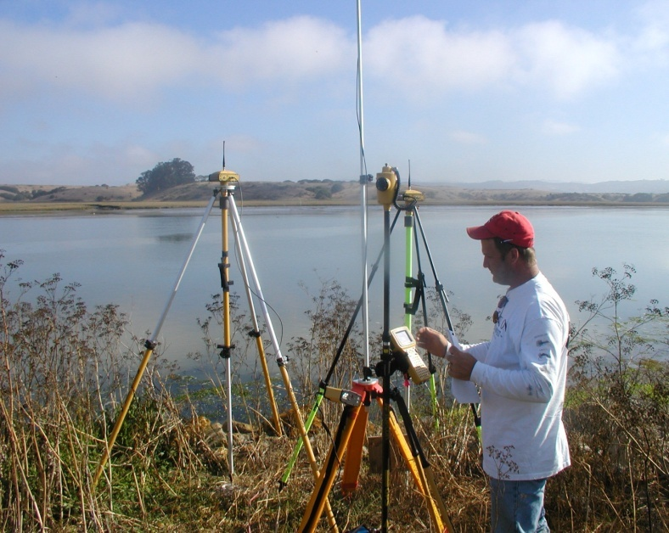
THE USE OF RTK- A CONFLUENCE OF TECHNOLOGY
INTERNET DATA VIA CELL TECHNOLOGY
SOFTWARE/FIRMWARE ALGORITHMS
GNSS HARDWARE
SATELLITE CONSTELLATIONS
SATELLITE CODES/FREQUENCIES

Slide 10
GNSS
TECHNOLOGY
GEODESY
SURVEYING
REMOTE SENSING
ENGINEERING
CM LEVEL PRECISION/ACCURACY
MAPPING
AROUND 2020 AUTONOMOUS GNSS POSITIONING MAY BE BETTER THAN 2-DM

Slide 11
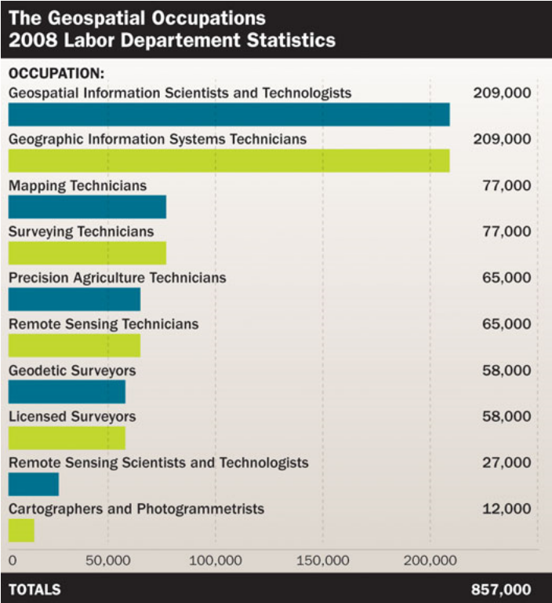
GEOSPATIAL PROFESSIONALS
Graphic:
Jeffery N. Lucas, PLS, Esq.
POB Magazine
On-Line Article
September 28, 2011
www.POBonline.com

Slide 12
COMMON DATUM DEFINITIONS IN THE USA
HORIZONTAL/ GEOMETRIC:
VERTICAL/GEOPOTENTIAL:
NAD 83
ITRS
WGS 84
NRS 22 (?)
NGVD 29
NAVD 88
NAVD 22 (?)
PROJECTIONS FROM DATUMS:
SPC
UTM
LDP

Slide 13
NAD 83, NAVD 88
  HORIZONTAL
  2 D (Latitude and Longitude) [e.g. NAD 27, NAD 83 (1986)]
  VERTICAL
  1 D (Orthometric Height) (e.g. NGVD 29, NAVD 88, Local Tidal)
  GEOMETRIC
  3 D (Latitude, Longitude and Ellipsoid Height)
  Fixed and Stable - Coordinates seldom change
  (e.g. NAD 83 (1991, 1999), NAD 83 (2007))
  also
  4 D (Latitude, Longitude, Ellipsoid Height, Velocities) Coordinates change with time
  NAD 83(CORS96) Epoch 2002 to: NAD 83(2011) Epoch 2010.0
  (around July 2011). Better orbits & velocities, uses absolute antenna calibrations

Slide 14
MULTI-YEAR CORS SOLUTION (MYCS)
= NAD 83 (2011):
BETTER ORBITS
MORE TRUE VELOCITIES KNOWN (1200 STATIONS +/- WITH >2.5 YEARS OF DATA-OTHERS MODELED WITH HTDP)
ABSOLUTE ANTENNA CALIBRATIONS
BROUGHT TO A MORE CURRENT EPOCH (2002 to 2010)
IMPLEMENTED SEPT 2011
http://geodesy.noaa.gov/CORS/coords.shtml
PASSIVE CONTROL ADJUSTMENT TO MYCS:
ORIGINAL OBSERVATIONS!!
NO VELOCITIES KNOWN (MODELED ONLY)
NO RIGOROUS ADJUSTMENT
5000 GPS PROJECTS SIMULTANEOUSLY VIA “NETSTAT” TO 95% CONFIDENCE
IMPLEMENTED EARLY CALENDAR YEAR 2012+/-
WILL HAVE NETWORK & LOCAL ACCURACIES

Slide 15
MD/PA NAD 83 POSITIONAL CHANGES
NAD 27 to NAD 83 (1986) ~ 30 m
NAD 83 (1986) to NAD 83 (1991, 1999 HARN) ~ 0.25 m
NAD 83 (1991, 1999 HARN) to NAD 83 (2007) ~ 0.01 m horiz., 0.015 h
NAD 83 (2007) to NAD 83 (CORS 96) epoch 2002 ~ 0.01 m horiz., 0.015 m h
NAD 83 (COR 96) epoch 2002 to
NAD 83 (2011) epoch 2010 ~ <0.01 m horiz.,
maybe 2 cm h (mostly from change in datum epoch)
[NAD 83 (2011) to NRS 22 ~ 1 m! horiz., 1 m h]

Slide 16
DATUMS
WHAT IS A GEODETIC DATUM?
WHAT IS A GEOMETRIC DATUM?
WHAT IS A GEOPOTENTIAL DATUM?
WHAT DOES GPS USE?
WHAT DOES GLONASS USE?
WHAT IS OUR NATIONAL DATUM?
WILL THERE BE ANOTHER NAD 83 ADJUSTMENT?
WILL THERE BE NEW DATUMS IN THE USA?

Slide 17
Z
DATUM=
SURFACE
ORIENTATION
SCALE
ORIGIN
+ GRAVITY
Zero
Meridian
-X
-Y
-
AUTONOMOUSGNSS POSITIONS ARE ECEF, XYZ
IN WGS 84 (~ITRF)
X
Y
Mean Equatorial Plane
-Z
Notes:
GPS Coordinate System - works with X, Y, Z coordinate frame based on center of mass Earth-Centered-Earth-Fixed (ECEF) coordinate system; changed into ellipsoidal latitude, longitude, and height through transformation.
Cartesian Coordinate System.

Slide 18
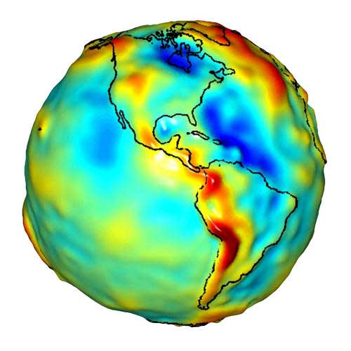
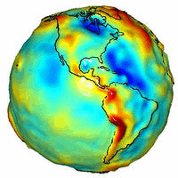
An ellipsoid of revolution is the figure which would be obtained by rotating an ellipse about its shorter axis. An ellipsoid of revolution describing the figure of the Earth is called a reference ellipsoid.
Earth
GRS80
Used for
NAD83
ITRS
  b = 6,356,752.31414 m
WGS 84
Used for
WGS 84
NOTE DIFFERENCE BETWEEN DATUM DEFINITION AND DATUM REALIZATION!
GRS 80 = AN OBLATE SPHEROID
Squash the sphere to fit at the poles
  a= 637813.000007 meters
  b= 6356752.31414 meters
  f= 1/((a-b)/a) = 298.2572220972
  a = 6,378,137.00000 m
Notes:
This shape is what we reference NAD83 and the GPS system to.
Both the horizontal and vertical coordinates originate with this surface.
The Pythagorean concept of a spherical Earth offers a simple surface which is mathematically easy to deal with. Many astronomical and navigational computations use it as a surface representing the Earth. While the sphere is a close approximation of the true figure of the Earth and satisfactory for many purposes, to the geodesists interested in the measurement of long distances—spanning continents and oceans—a more exact figure is necessary. Closer approximations range from modelling the shape of the entire Earth as an oblate spheroid or an oblate ellipsoid to the use of spherical harmonics or local approximations in terms of local reference ellipsoids. The idea of a planar or flat surface for Earth, however, is still acceptable for surveys of small areas as local topography is more important than the curvature. Plane-table surveys are made for relatively small areas and no account is taken of the curvature of the Earth. A survey of a city would likely be computed as though the Earth were a plane surface the size of the city. For such small areas, exact positions can be determined relative to each other without considering the size and shape of the total Earth.
Earth - Lumpy Bumpy rock that is difficult if not impossible to describe with an equation.
Click
Let's take a sphere and put its center at the earth's center of mass
Then resize the sphere to best fit the earth - radius of 6,378137.0 meters (later to become the semi-major axis)
This is a pretty good fit but we are out a little at the poles.
Click
Now we can squash the sphere at the poles for a better fit. This creates an oblate spheroid.
Now the diameter along the polar (semi-minor) axis is 6,356,752 meters.
We can now describe the earth's shape with an equation.
a= 637813.000007 meters
b= 6356752.31414 meters
f= 1/(a-b)/a = 298.2572220972
Click
We now have an ellipsoid - Since the Earth is in fact flattened slightly at the poles and bulges somewhat at the equator, the geometrical figure used in geodesy to most nearly approximate the shape of the Earth is an ellipsoid of revolution.
The ellipsoid of revolution is the figure which would be obtained by rotating an ellipse about its shorter axis. An ellipsoid of revolution describing the figure of the Earth is called a reference ellipsoid.
Definition:
NAD83 – The North American Datum of 1983 – the earth centered, earth fixed reference system that uses the GRS80 ellipsoid
The rotation of the Earth creates the equatorial bulge so that the equatorial diameter is 43 km larger than the pole to pole diameter.[37] The largest local deviations in the rocky surface of the Earth are Mount Everest (8,848 m above local sea level) and the Mariana Trench (10,911 m below local sea level). Hence compared to a perfect ellipsoid, the Earth has a tolerance of about one part in about 584, or 0.17%, which is less than the 0.22% tolerance allowed in billiard balls.[38] Because of the bulge, the feature farthest from the center of the Earth is actually Mount Chimborazo in Ecuador.[39]

Slide 19
UNITED STATES ELLIPSOID DEFINITIONS
(MORE THAN 60 HAVE BEEN USED AROUND THE WORLD)
BESSEL 1841
(1848 – 1879)
a = 6,377,397.155 m 1/f = 299.1528128
CLARKE 1866
(1879 – 1986)
a = 6,378,206.4 m 1/f = 294.97869821
GEODETIC REFERENCE SYSTEM 1980 - (GRS 80)
(1986 - Present)
a = 6,378,137 m 1/f = 298.257222101
WORLD GEODETIC SYSTEM 1984 - (WGS 84)
a = 6,378,137 m 1/f = 298.257223563
Notes:
There have been several different ellipsoids used for the horizontal datums of the United States. The Bessell 1841 ellipse was used from approximately 1845 until 1879. Clarke 1866, developed by the English Geodesist A. R. Clarke was adopted in 1879 following the completion of the great Transcontinental Arc of Triangulation as it most closely approximates the size and shape of North America. As part of the activity to complete the North American Datum of 1983 (NAD 83), In 1979, the National Geodetic Survey decided to adopt the Geodetic Reference System 1980 (GRS 80) as recommended by the International Association of Geodesy, as it most closely reflects the size and shape of the entire globe. It should be noted that GRS80 is for all practical purposes, the same size and shape as the World Geodetic System of 1984 (WGS 84) ellipsoid used with the Global Positioning System (GPS). The small numerical differences in the flattening (1/f) amount to less than 0.1 millimeter from the most northern part of Alaska to the southern tip of Florida!!

Slide 20
Earth-Centered-Earth-Fixed Coordinates
Conventional
Z Axis
Terrestrial
Pole
P
(X,Y,Z)
Earth’s
Surface
Zero
Meridian
Z
Origin
Y Axis
(0,0,0)
Center of Mass
X
Y
X Axis
Mean Equatorial Plane
Notes:
Point on the Earth’s surface positionally defined with an X, Y, Z coordinate.
The distance along the Z axis is not a height.
Height information is not apparent in this system.

Slide 21
X,Y,Z TO φ,λ,h
Z Axis
P
(X,Y,Z) = P (φ,λ,h)
h
Earth’s
Surface
Ellipsoid height component produced from GPS
Zero
Meridian
Reference Ellipsoid
Y Axis
φ
λ
X Axis
Mean Equatorial Plane
Notes:
Curvilinear Coordinate System
Same point on Earth’s surface positionally defined by latitude, longitude and ellipsoid height.
Ellipsoid height is the height of the point relative to the reference ellipsoid surface.
Same point can be positionally defined as and X, Y, Z or latitude, longitude, ellipsoid height.

Slide 22
THE REALIZATION OF NAD 83 HAS ITS ORIGIN 2.2 M FROM THE SCIENTIFIC ITRS DATUM REALIZED AS ITRF XX
h₈₃
h₀₀
Earth’s
Surface
ITRF 00 ORIGIN
(WGS 84 IS WITHIN A COUPLE OF CENTIMETERS IN REALIZATION)
2.2 meters
NAD 83
Origin
Notes:
ITRF (International Terrestrial Reference Frame) just has an origin; take NAD83 shaped ellipsoid centered at the ITRF origin to derive ITRF97 ellipsoid heights.
Ellipsoid heights NAD83 vs. ITRF97 - Defined origins are best estimate of the center of mass; NAD83 is not geocentric. Move origin; move ellipsoid surface as illustrated.
Ellipsoid height differences reflect the non-geocentricity of NAD83.

Slide 23
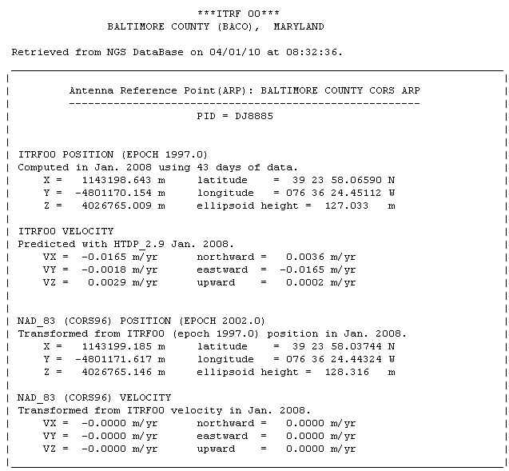

Slide 24
International Earth Rotation and
Reference System Service
(IERS)
(http://www.iers.org)
The International Terrestrial Reference System (ITRS) constitutes a set of prescriptions and conventions together with the modeling required to define origin, scale, orientation and time evolution
ITRS is realized by the International Terrestrial Reference Frame (ITRF) based upon estimated coordinates and velocities of a set of stations observed by Very Long Baseline Interferometry (VLBI), Satellite Laser Ranging ( SLR), Global Positioning System and GLONASS (GNSS), and Doppler Orbitography and Radio- positioning Integrated by Satellite ( DORIS).
ITRF89, ITRF90, ITRF91, ITRF92, ITRF93, ITRF94, ITRF95, ITRF96, ITRF97, ITRF2000, ITRF2005, ITRF2008

Slide 25
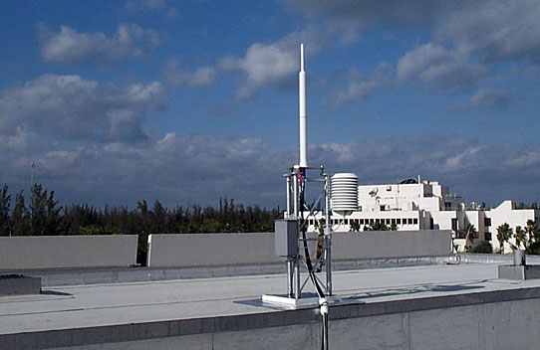
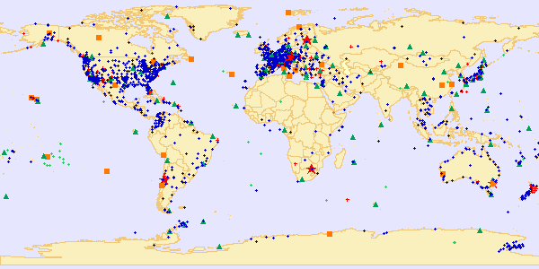
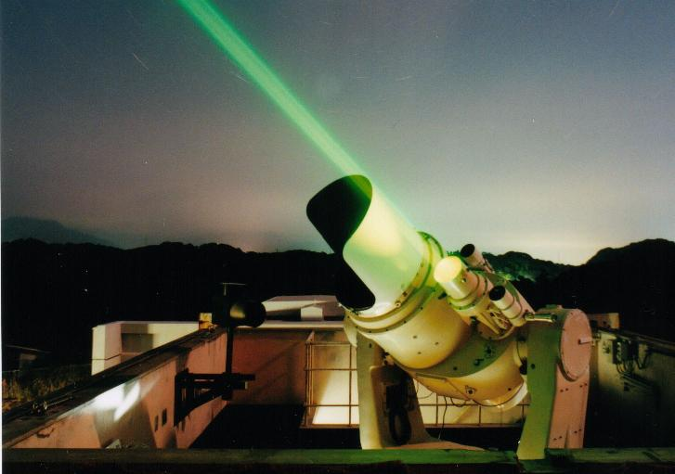
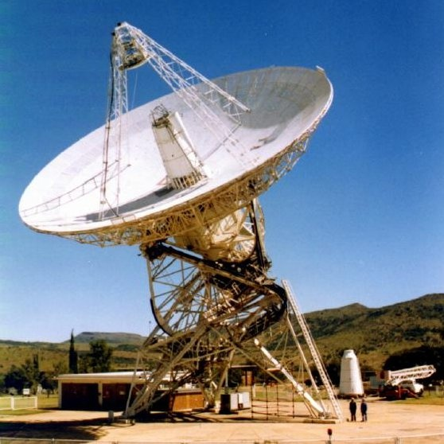
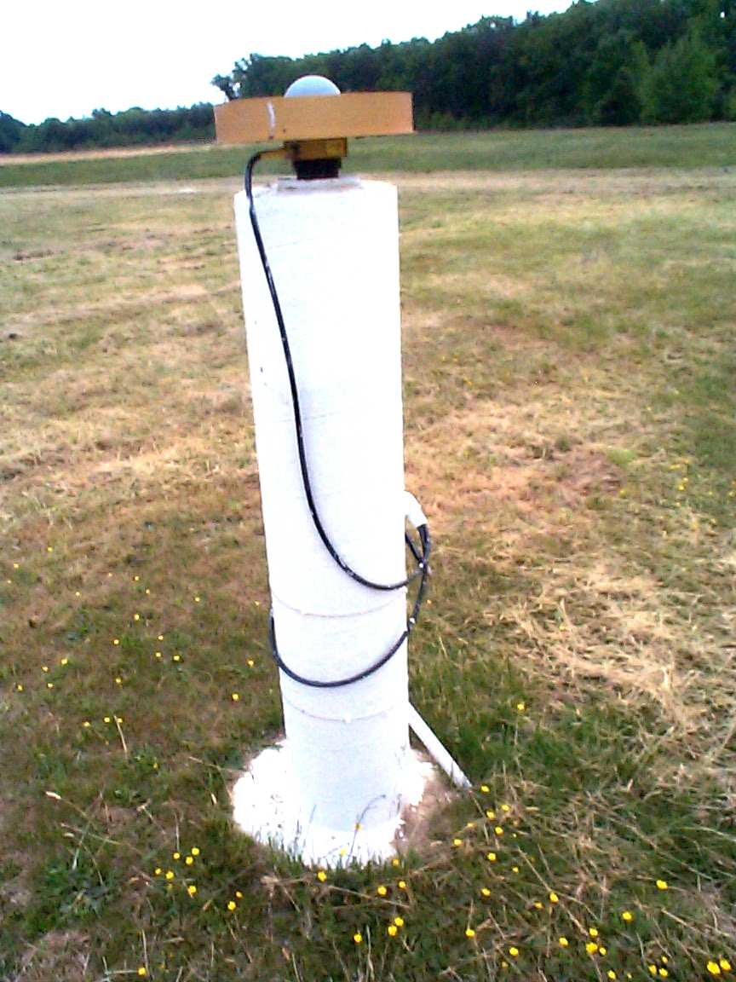
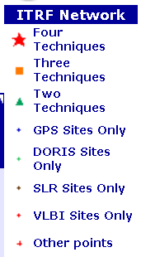
International Terrestrial Reference Frame
4 Global Independent Positioning Technologies
International Global Navigation Satellite Systems Service (IGS)
International Laser Ranging Service (ILRS)
International Very Long Baseline Service (IVS)
International DORIS Service (IDS)

Slide 26
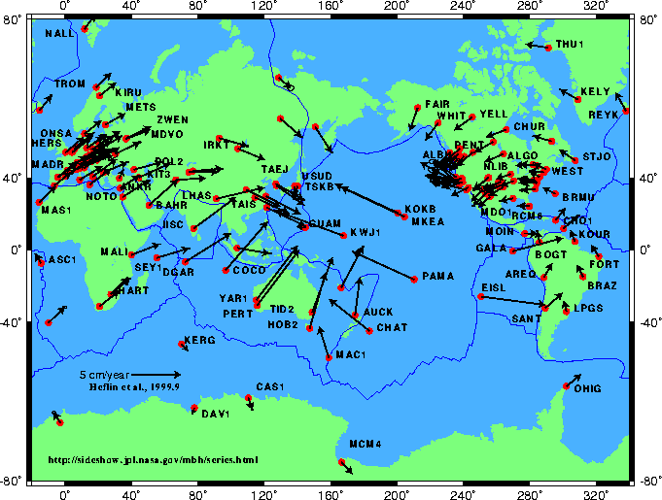
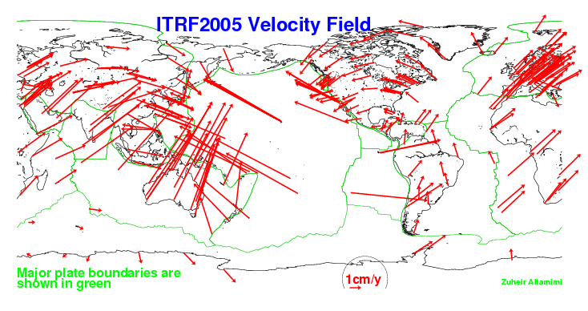
TECTONIC MOTIONS

Slide 27
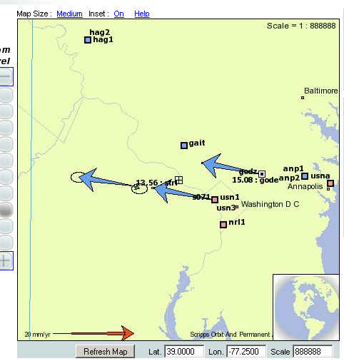
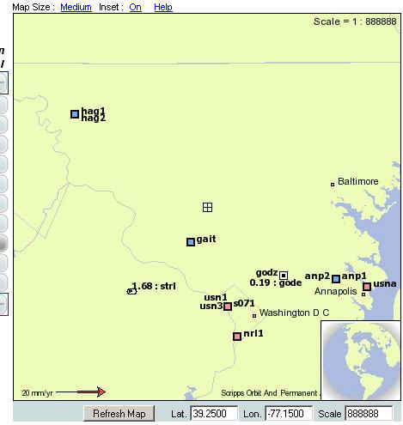
SILVER SPRING, MD
ITRF 2000
NAD 83

Slide 28
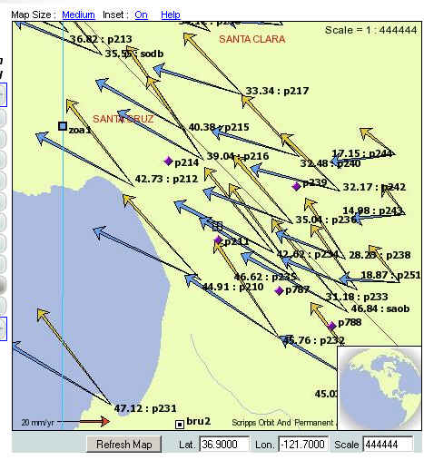
SANTA CRUZ, CA
NAD 83 VELOCITIES
(GOLD)
ITRF 2000
VELOCITIES
(BLUE)

Slide 29
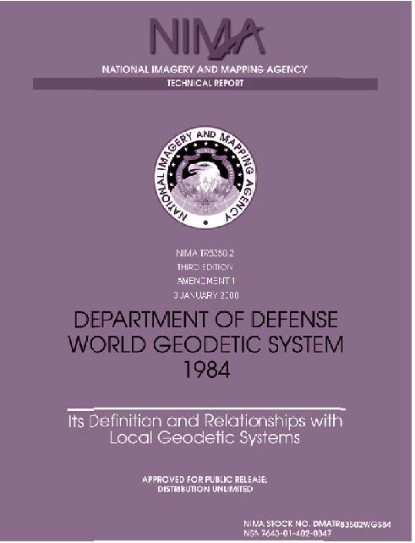
WORLD GEODETIC SYSTEM 1984
http://earth-info.nga.mil/GandG/publications/tr8350.2/tr8350_2.html
DATUM = WGS 84(G873)
5 USAF GPS Tracking Stations
7 NIMA Evaluation Stations
Datum redefined with respect to the International Terrestrial Reference Frame of 1994 (ITRF94) +/- 10 cm in each component
(Proceedings of the ION GPS-97 pgs 841-850)
DATUM = WGS 84(G730)
5 USAF GPS Tracking Stations
5 DMA Evaluation Stations
Datum redefined with respect to the International Terrestrial Reference Frame of 1992 (ITRF92) +/- 20 cm in each component
(Proceedings of the ION GPS-94 pgs 285-292)
DATUM = WGS 84(G1150)
Datum redefined with respect to the International
Terrestrial Reference Frame of 2000 (ITRF00)
+/- 2 cm in each component
(Proceedings of the ION GPS-02)
http://earth-info.nga.mil/GandG/sathtml/IONReport8-20-02.pdf
HOW MANY WGS 84s
HAVE THERE BEEN????
DATUM = WGS 84
RELEASED - SEPTEMBER 1987
BASED ON OBSERVATIONS AT MORE THAN 1900 DOPPLER STATIONS

Slide 30
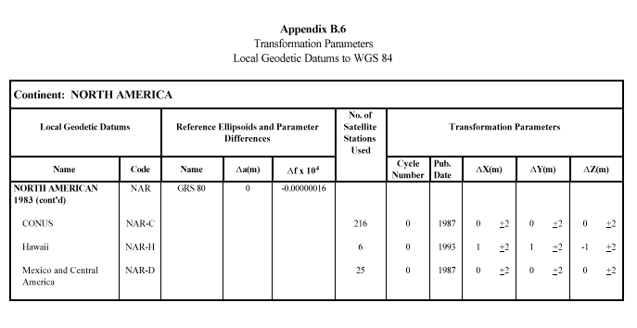
Federal Register Notice: Vol. 60, No. 157, August 15, 1995, pg. 42146
“Use of NAD 83/WGS 84 Datum Tag on Mapping Products”

Slide 31
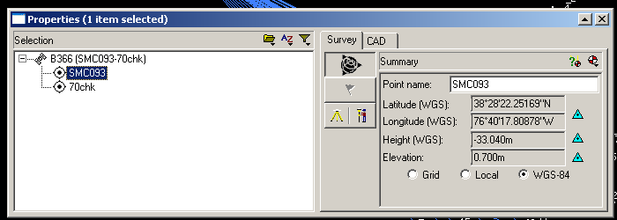
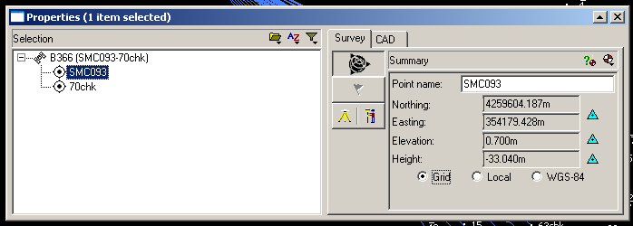
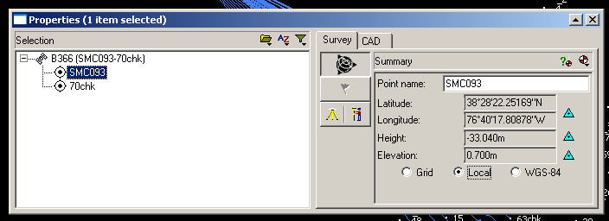
“WGS84” OR IS IT?
Unless you’re doing autonomous point positioning, or you’re tied to ITRF, you’re probably not in WGS 84

Slide 32
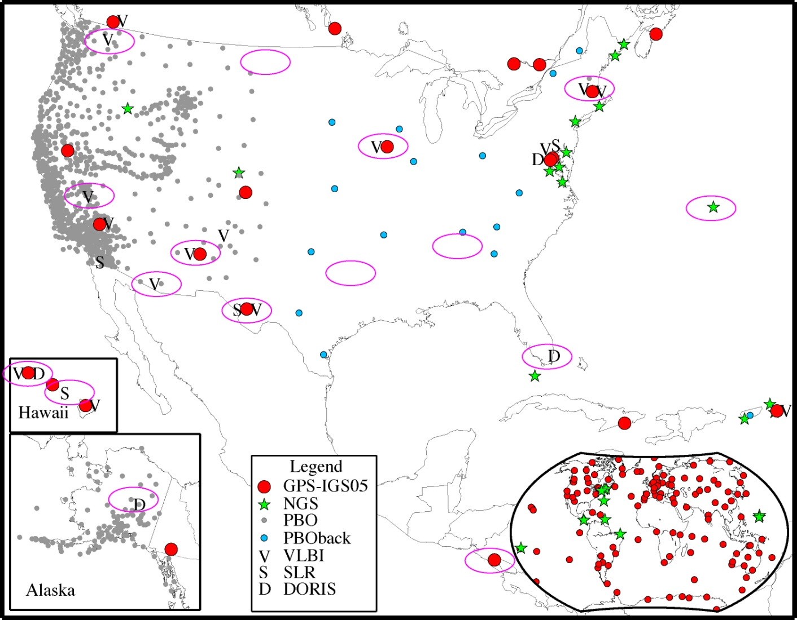
FOUNDATION
CORS
NEW GEOMETRICAL DATUM 2022 +/-
FEDERALLY OWNED/OPERATED BASE NETWORK = ULTIMATE TRUTH
Link to ITRF at sites co-located with VLBI, SLR, DORIS, then fill geographic gaps
Possible sites = magenta ovals

Slide 33
NEW NATIONAL VERTICAL DATUM 2022?
A PURELY GRAVIMETRIC SURFACE
BASED ON A HIGH RESOLUTION, 1 CM GEOID FROM GRAV-D PROGRAM
✪ ACCURATE TO 2 CM (ALLOWING FOR GNSS ERROR)
ACCESSABILITY: BROUGHT TO A PROJECT SITE VIA ACTIVE REFERENCE STATIONS (NATIONAL CORS), DENSIFIED TO PROJECT ACCURACY NEEDS. (ALTERNATIVE: USE BMs PREVIOUSLY TIED TO THE DATUM-CAVEAT EMPTOR)

Slide 34
WHAT ABOUT THE PASSIVE MARKS?
SECONDARY ACCESS (USE AT YOUR OWN RISK)
  PASSIVE MARKS THAT HAVE BEEN TIED TO THE NEW VERTICAL DATUM
  NGS WILL PROVIDE A “DATA SHARING” SERVICE FOR THESE POINTS, BUT THEIR ACCURACY (DUE TO EITHER THE QUALITY OF THE SURVEY OR THE AGE OF THE DATA) WILL NOT BE A RESPONSIBILITY OF NGS
  A CONVERSION WILL BE PROVIDED BETWEEN NAVD 88 AND THE NEW DATUM WHERE RECENT GNSS ELLIPSOID HEIGHTS EXIST TO PROVIDE MODERN HEIGHTS IN THE NEW DATUM
Notes:
NGS will eventually stop making the claim that we “know” the heights of bench marks as the method of providing access to the vertical datum. What NGS will do is provide the orthometric height to a user on the day of their survey (and with the disclaimer that this height should not be taken as “known” for very long, due to the dynamic nature of the Earth). If possible, height changes (velocities) will be computed and provided to
assist in predicting heights in the future.
Updated October 2010.

Slide 35
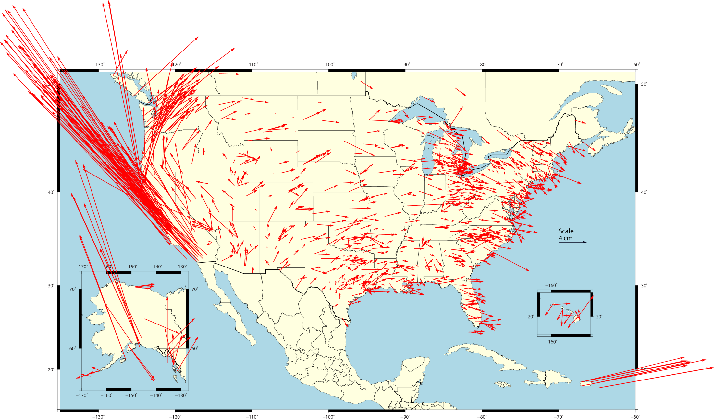
Changes in Horizontal NAD 83 Positions
NAD 83(2011) epoch 2010.0 – NAD 83(CORS96) epoch 2002.0
approx. 2 cm error expected @ 2005.0 (based on σ in old solution)
avg. horizontal shifts: ΔE = 0.09 (± 5.84) cm ΔN = 2.03 (± 5.98) cm
  combination of position and velocity differences
  due mostly to updated velocities (including up to 8 more years of data)
~1270
CORS w/ suff. data and linear velocities

Slide 36
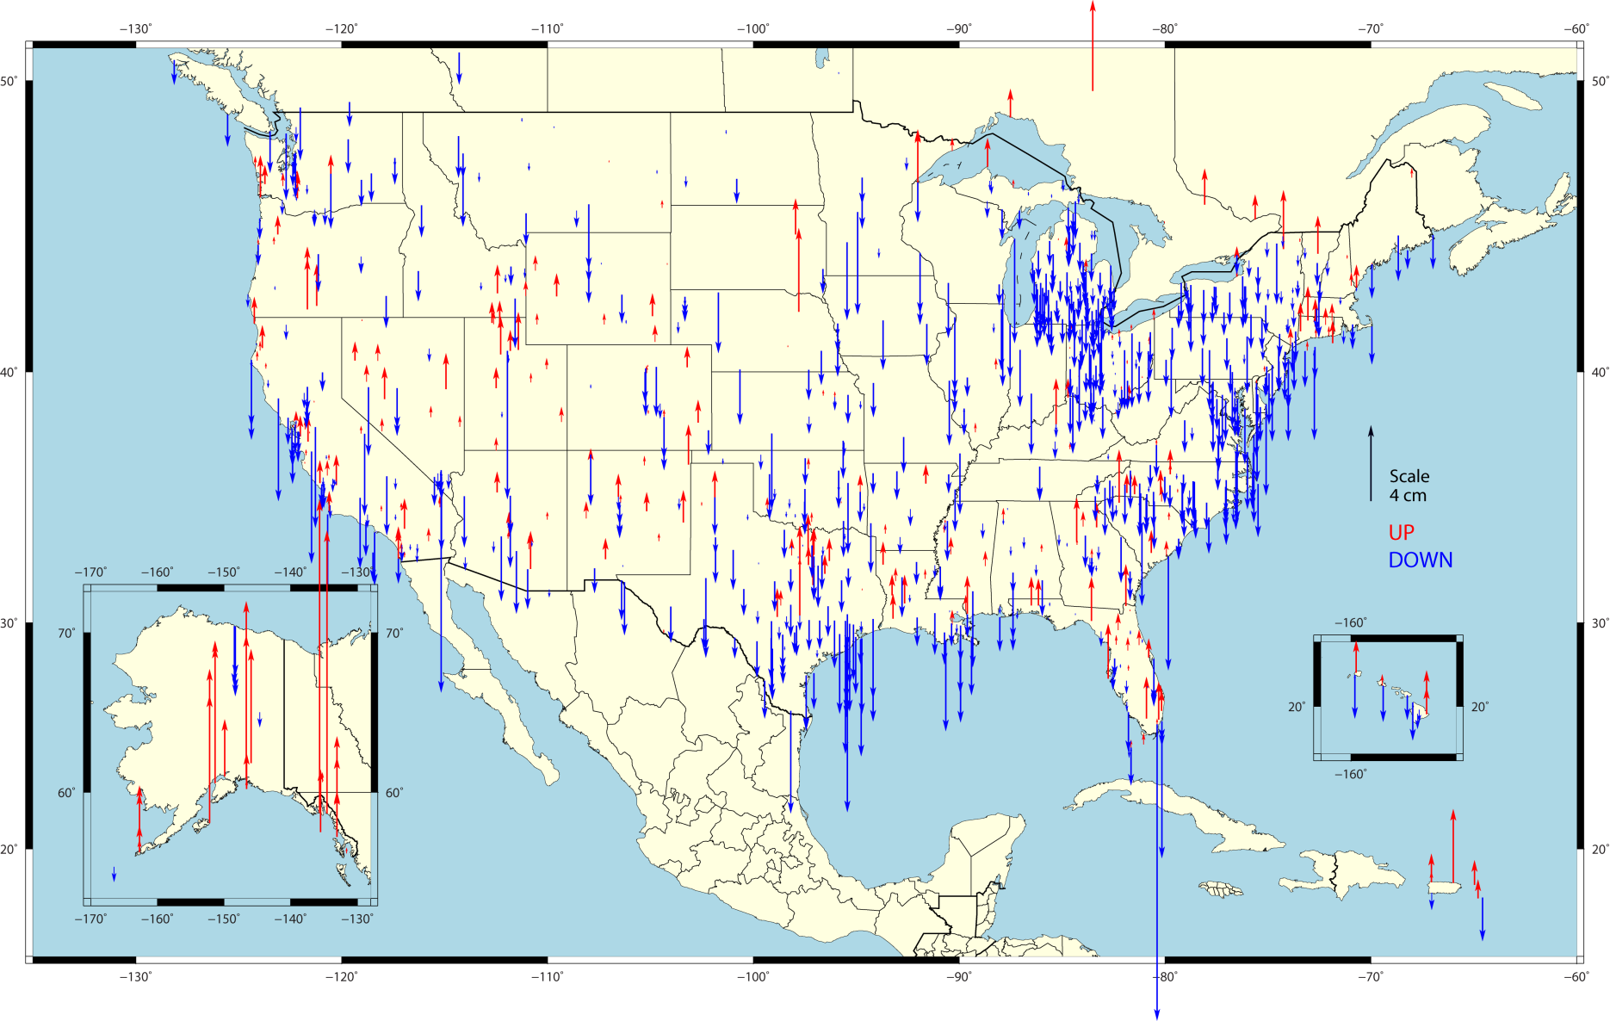
Changes in Vertical NAD 83 Positions
NAD 83(2011) epoch 2010.0 – NAD 83(CORS96) epoch 2002.0
NAD 83(2011) epoch 2010.0 – NAD 83(CORS96) epoch 2002.0
avg. vertical shifts: ΔU = -0.79 (± 2.09) cm
  combination of position and velocity differences from additional data, tectonics
  assuming vertical velocity ≈ 0.00 in NAD 83(CORS96)
~1270
CORS w/ suff. data and linear velocities

Slide 37
THE ROLE OF NGS INTO THE FUTURE
“NOAA’s National Geodetic Survey provides the framework for all positioning activities in the Nation. The foundational elements – latitude, longitude, elevation, and shoreline information – contribute to informed decision making and impact a wide range of important activities including mapping and charting, flood risk determination, transportation, land use and ecosystem management. NGS’ authoritative spatial data, models, and tools are vital for the protection and management of natural and manmade resources and support the economic prosperity and environmental health of the Nation.”
This means that the geodetic latitude, longitude and height of points used in defining the NSRS should have an absolute accuracy of 1 millimeter at any time. Obviously, such points will be actively monitored points, not passive monuments.

Slide 38

2022 NEW PROJECT CONTROL – ACCESS TO NSRS
RTN ALIGNED TO CORS AT 1 CM IN EACH COMPONENT (X,Y,Z) & 2 CM ORTHOMETRIC
100 KM (NOT TO SCALE)
20 KM
NEW PROJECT CONTROL
EXISTING PASSIVE MARKS- HORIZONTAL WITH OR WITHOUT VERTICAL
EXISTING PASSIVE BENCH MARKS
70 KM (NOT TO SCALE)
NATIONAL CORS = GEOMETRICAL & GEOPOTENTIAL TRUTH

Slide 39
NECESSARY BACKGROUND
(BUT KNOWLEDGE DOES ≠ WISDOM)
KNOW YOUR DATUM/ADJUSTMENT/EPOCH

Slide 40
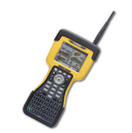
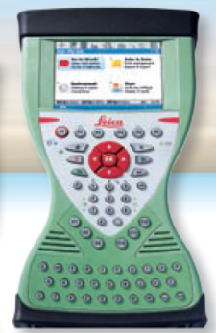

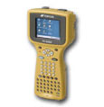
GNSS TO ANY DATUM
GNSS ECEF X,Y,Z (WGS 84 & PZ90)
NAD 83 (φ,λ,h) SPC N,E,h
+ GEOID XX = SPC N,E,H
OR
CALIBRATE TO 4-5 SITE POINTS IN THE DESIRED DATUM. THIS IS USED TO LOCK TO PASSIVE MONUMENTATION IN THE PROJECT AREA.

Slide 41
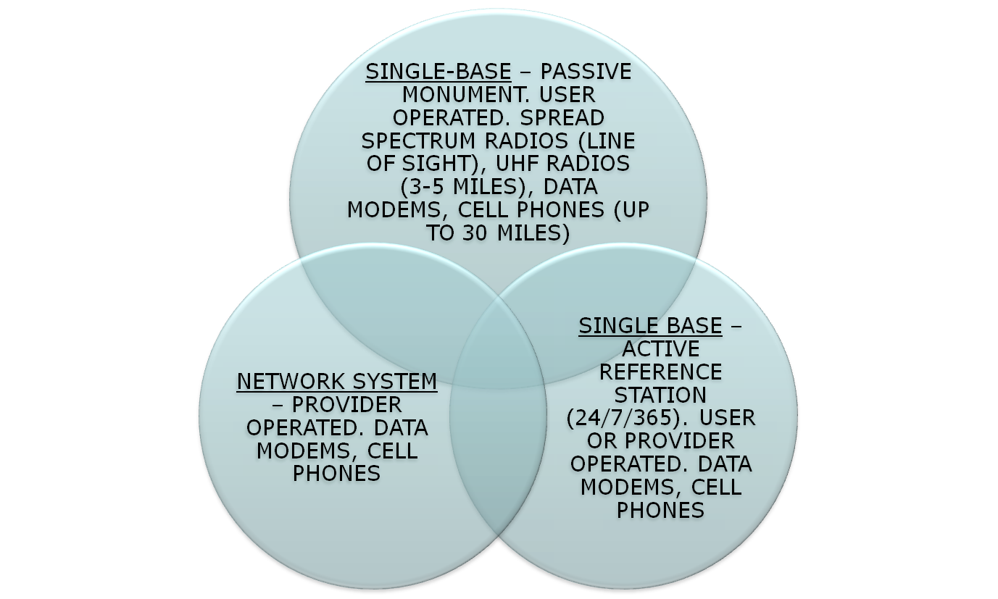
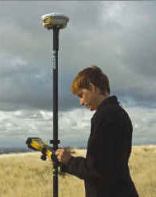
THE THREE BASE STATION OPTIONS FOR RT

Slide 42
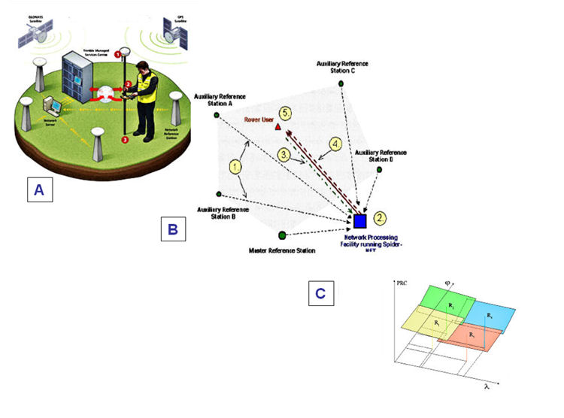
USING REAL TIME GNSS NETWORKS FOR POSITIONING

Slide 43
THE TECHNOLOGY SWEET SPOT
SBAS: 2 M H, 6 M V, 0.3 M SMOOTHED H, CHEAP
COMMERCIAL DGPS: FEW DM, $$
USCG BEACON: METER+, CHEAP
STATIC GNSS: SUB CM H, 2 CM V, TIME, PROCESSING INTENSIVE
DIFFERENTIAL LEVELING: 2-4 CM, LABOR/TIME INTENSIVE, $$$
GEODETIC LEVELING: mm, LABOR/TIME INTENSIVE, $$$$$
USER BASE RTK: 2-4 CM H, 3-5 CM V, REQUIRES INITIAL INVESTMENT
RTN: 3-4 CM H, 5-7 CM V, REQUIRES INITIAL INVESTMENT(BUT ½ OF RTK)
AERIAL MAPPING: .10 M H, .20 M V, $$$
LIDAR: 0.10 – 0.3 M V, $$$
SATELLITE IMAGERY: 0.5 METER H RESOLUTION, 3 M LOCATION, $$$
LOW ALTITUDE AERIAL IMAGERY: 2-4 CM H, 3-5 CM V, $$$
TERRESTRIAL LASER SCANNING: PROJECT SITES ONLY, 0.015 M H,
0.02 M V, REQUIRES $$$ INITIAL INVESTMENT
MOBILE MAPPING YSTEMS: 2-4 CM H, 3-5 CM V, $$$$$$$

Slide 44
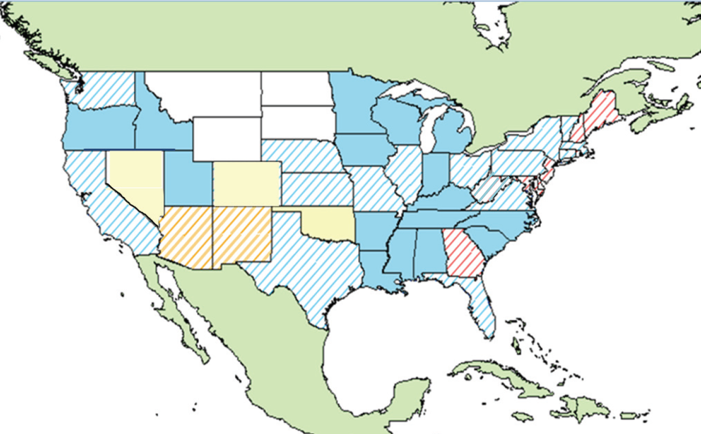
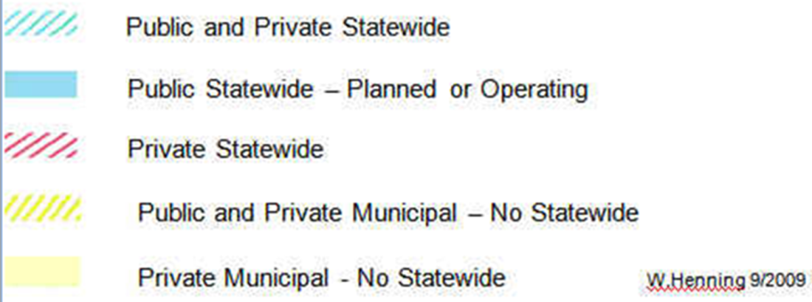
≥200 RTN WORLDWIDE
≥107 RTN USA
≈35 DOT
MAJOR RTN IN THE USA
(DECEMBER 2011)
ACADEMIC/SCIENTIFIC
SPATIAL REFERENCE CENTERS
VARIOUS DOTS + MACHINE GUIDANCE
COUNTY
CITY
GEODETICSURVEYS(NC,SC)
MANUFACTURERS
VENDOR NETWORKS
AGRICULTURE
MA & PA NETWORKS

Slide 45
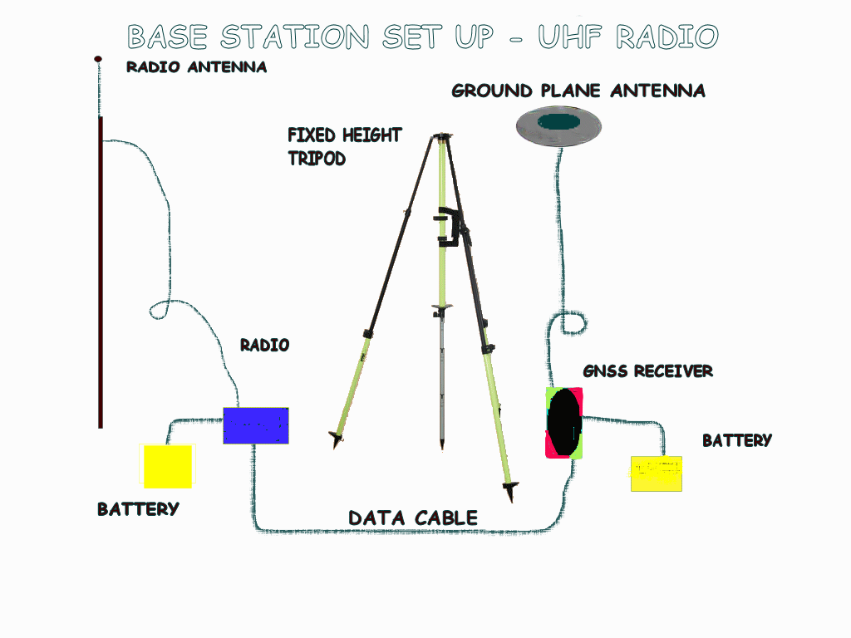
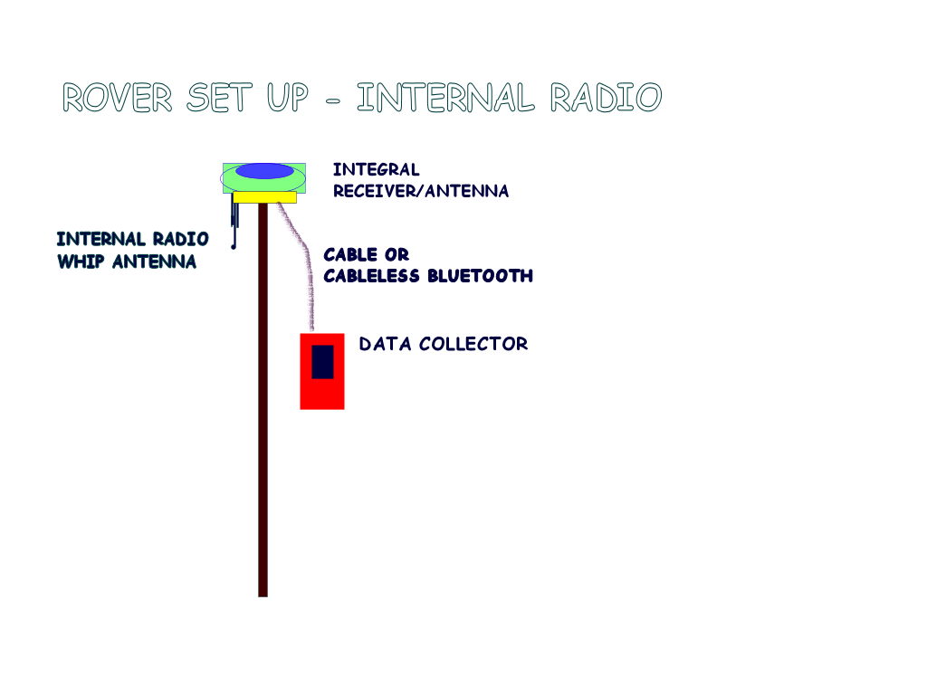


RTK VS. RTN
Cell technology
-Half the equipment or double the production
-No monument reconnaissance/
recovery
- No set/break down time
-No base baby sitting
RTN
Plus:
Easy alignment to the NSRS
No ppm (1ST ORDER) ERROR
Extended range
Homogeneous Data
Easy datum updates
RTK

Slide 46
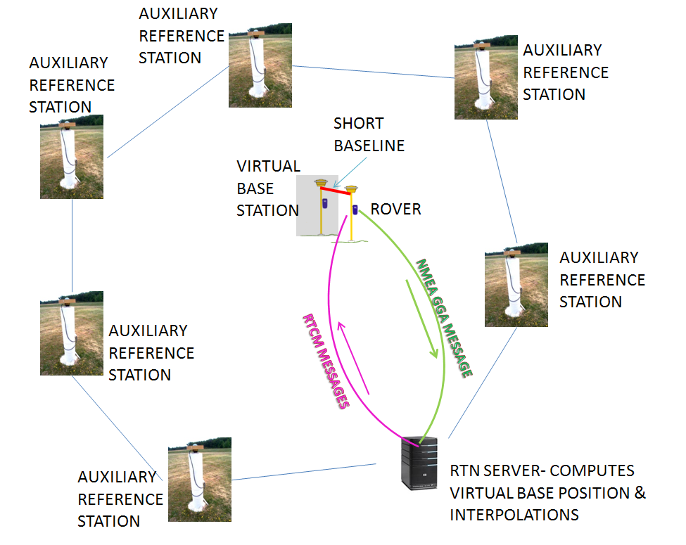
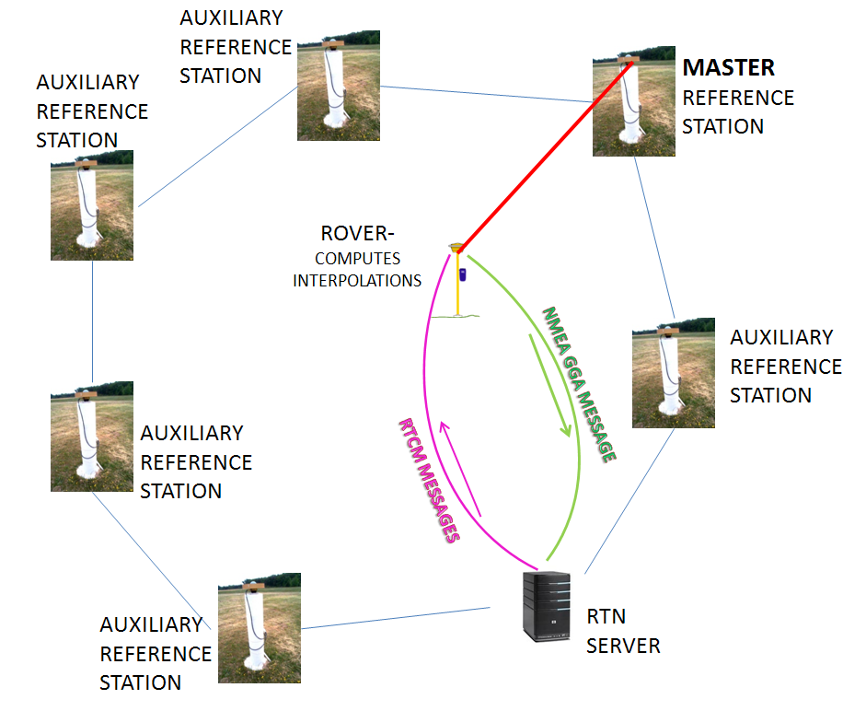
DIFFERENT RTN METHODOLOGIES
NON-PHYSICAL REFERENCE STATION
MASTER-AUXILLIARY CONCEPT
(DUPLEX COMMUNICATION)

Slide 47
SO – WHAT CAN I EXPECT FROM An RTN?
MOST RTN PRODUCE “GOOD” HORIZONTAL VALUES – TO A FEW CM. OUR HORIZONTAL SYSTEM IS BASED ON ACTIVE REFERENCE STATIONS (NGS CORS), AS ARE THE RTN STATIONS.
BECAUSE ORTHOMETRIC HEIGHTS (‘ELEVATIONS’) ARE BASED ON PASSIVE MONUMENTS WITH NAVD 88, THE RTN USER SHOULD, FOR THE MOST PART, CONSTRAIN THE PASSIVE MARK VALUES IN A LOCALIZATION.
CHOOSE THE RTN WITH A BUSINESS MODEL THAT BEST FITS YOUR NEEDS.

Slide 48
SOME RTN ADMINISTRATOR CONCERNS
$$$$$$$$$$$$$$$/ Business Model
Seasonal movement
Integrity Monitoring
Spacing
Communication
OPUS vs. CORS RTN adjustment
Upgrade? GNSS?
Velocity models for RTN stations (not CORS)
Velocity for CORS-HTDP, monthly CORS or wait till tolerance exceeded?
Orthos?
Datum/adjustment
Weather sensors ($2K) for tropo (humidity) modeling (not upper atmosphere)

Slide 49
USERS CONCERNS WITH RTN
What Datum is the RTN using?
What adjustment of the Datum is the RTN using?
What epoch of the Datum adjustment is the RTN using?
How Does The RTN Align To The NSRS?
Can Users Use Any Manufacturers’ Equipment In The RTN?
Do Overlapping Networks Give The Same Coordinates?
What Are The Field Accuracies?

Slide 50
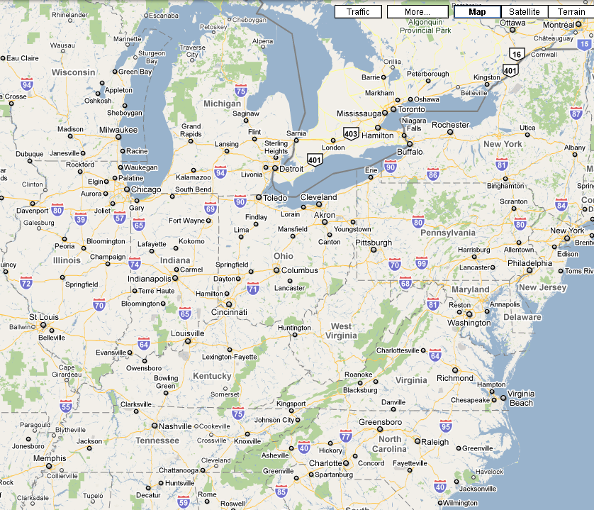
OVERLAPPING RTN-
NSRS?, HOMOGENEOUS?, USES ALL GNSS GEAR?
TRIMBLE
TRIMBLE
LEICA
LEICA
LEICA
TOPCON
TRIMBLE
TRIMBLE
LEICA
TRIMBLE
TOPCON
LEICA
TRIMBLE
TOPCON
TRIMBLE

Slide 51

REFERENCE STATION COORDINATE DERIVATION:
ALL CORS FIXED
ALL CORS WEIGHTED
OPUS (Average of 10 days of 24 hour data sets)
OPUS + HARN
BEST FIT TO ONE MASTER STATION
THE NGS RECOMMENDATION: Process at least 10 days of GPS data from all RTN stations using a simultaneous network adjustment while “constraining” several CORS coordinates with weights of 1 cm in each horizontal dimension and 2 cm in the vertical dimension. USE OF OPUS-PROJECTS?

Slide 52
NATIONAL SPATIAL REFERENCE SYSTEM
(NSRS)
Consistent National Coordinate System
Latitude
Longitude
Height
Scale
Gravity
Orientation
and how these values change with time
Notes:
NSRS is a consistent national coordinate system that defines
latitude,
longitude,
height,
scale,
gravity, and
orientation
throughout the Nation, and how these values change with time.

Slide 53

RTN GUIDELINES FOR GNSS POSITIONING–
WILL NOT SPECIFY OR DEFINE A STANDARD, BUT WILL HELP ADMINISTRATORS AND USERS TO BE AWARE OF ALL THE ISSUES INVOLVED WITH THIS NEW TECHNOLOGY
60+ CONTRIBUTORS:
NGS ADVISORS
DOT
STATE GEODETIC SURVEYS
GNSS MANUFACTURERS
SRCs
BLM, NPS
http://www.ngs.noaa.gov/PUBS_LIB/NGS.RTN.Public.v2.0.pdf

Slide 54



Slide 55
HOW WILL NGS HELP THE USER OF RTN?
“Develop guidelines for both the administration and use of real-time GNSS networks and especially for ensuring that these networks are compatible with the NSRS.”
1. TOP DOWN: OPUS POSITIONS ON RTN REFERENCE STATIONS AT APPROPRIATE INTERVALS COULD PRODUCE GRAPHICS THAT WOULD SHOW BIASES AT A GLANCE.
RTN
2. USER UP: PHYSICAL MONUMENTATION, ESTABLISHED WITH BEST TECHNOLOGY, COULD BE USED AS FIDUCIAL STATIONS TO HELP THE USER VERIFY THAT RTN ARE PRODUCING ACCURATE COORDINATES,

Slide 56
(NEAR) REAL TIME GNSS POSITIONING –
AMAZING WORK FROM YOUR ROVER
28

Slide 57
HOW DOES RT WORK?
∆ X,Y,Z FROM BASE (REMEMBER “GIGO” FOR SINGLE BASE)
MULTILATERATION - TIME (SEC.) · C (SPEED OF LIGHT) (M/SEC.)= DISTANCE from satellite
MUST RESOLVE CARRIER CYCLE INTEGER COUNT AMBIGUITIES (# cycles · wave length + partial cycle = distance)
MUST ACCOUNT FOR FACTORS AFFECTING THE PATH OF THE SIGNAL
DUAL FREQUENCY ENABLES “ON THE FLY” RESOLUTION OF THE AMBIGUITIES & EASIER CYCLE SLIP DETECTION
THAN L1 ONLY
FREQUENCY COMBINATIONS AND DIFFERENCING CONTRIBUTE TO MITIGATING THE ERROR BUDGET
GNSS ECEF X,Y,Z (WGS 84 & PZ90)
NAD 83 (φ,λ,h) SPC N,E,h
+ GEOID XX = SPC N,E,H
20

Slide 58
THE INTEGER AMBIGUITY
WGS 84
X,Y,Z
Resolving the integer ambiguity allows phase
measurements to be related to distances
Nλ
Δλ = First Partial Wavelength
Nλ = Integer Ambiguity
Distance
Δλ
Distance = Nλ + Δλ
RESOLUTION TO ROUGHLY 2 mm
λ1 = 19.03 cm
λ2 = 24.42 cm
λ5 = 25.48 cm

Slide 59
THE AMBIGUITY SEARCH….
The ambiguity is an integer number (a multiple of the carrier wavelength).
The integer is different for the L1 and L2 phase observations.
The integer ambiguity is different for each satellite-receiver pair.
The integer ambiguity is a constant for a particular satellite-receiver pair for all epochs of continuous tracking (that is, as long as no cycle slips occur)
The carrier phase measurement from one observation epoch to another is a measure of the change in satellite-receiver range.
The determination of the cycle ambiguity integer is known as ambiguity resolution, and is generally not an easy task because of the presence of other biases and errors in the carrier phase measurement.

Slide 60





8400 MPH
8400 MPH
SVN 31
SVN 8
SVN 14
8400 MPH
SVN 23
EVERY EPOCH OF OBSERVATION MUST COMPUTE CHANGE IN POSITION DUE TO EARTH ROTATION, SATELLITE ORBIT CHANGE AND RELATIVITY!
8400 MPH
800 MPH +/-
AT “C”, 1 NANOSECOND = 30 CM!
CORRECTIONS TO SVN’S before launch:
S.R.= +7 μ sec., G.R = -45.9 μ sec. = -38 μ sec./ day!

Slide 61




EFFECTS ON THE SIGNAL

Slide 62

IONO & TROPO LAYERS AND THEIR EFFECT ON THE GNSS SIGNAL

Slide 63

IONOSPHERIC EFFECTS ON POSITIONING
AVERAGE IONO- NO NETWORK
HIGH IONO- NO NETWORK
2D PRECISION/ACCURACY (CM)
SINGLE BASE
RTK @ 10 KM
(2000-2002)
(1994-1995)
NETWORK SOLUTION
@ 30 KM
WITH NETWORK
DISTANCE TO REFERENCE STATION (KM)
(SOURCE-BKG- GERMANY)

Slide 64




SUNSPOT CYCLE
Sunspots follow a regular 11 year cycle
We are just past the low point of the current cycle
Sunspots increase the radiation hitting the earth's upper atmosphere and produce an active and unstable ionosphere
2013
http://www.swpc.noaa.gov/

Slide 65

Official Space Weather Advisory issued by NOAA Space Weather Prediction Center Boulder, Colorado, USA SPACE WEATHER ADVISORY BULLETIN #10- 1 2010 April 05 at 12:13 p.m. MST (2010 April 05 1213 UTC) **** STRONG GEOMAGNETIC STORM IN PROGRESS **** A geomagnetic storm began at 05:55 AM EST Monday, April 5, 2010. Space weather storm levels reached Strong (G3) levels on the Geomagnetic Storms Space Weather Scale. The source of the storming is an Earth-directed Coronal Mass Ejection associated with a weak solar flare that occurred in Active Region 1059 on April 3 at 05:54 AM EST. This is expected to be an isolated storm that should subside quickly. Other than the flare and CME erupting on April 3, this active region has not produced any significant activity. Systems that can be affected include electric power systems, spacecraft operations, high-frequency communications, GPS, and other navigation systems. Data used to provide space weather services are contributed by NOAA, USAF, NASA, NSF, USGS, the International Space Environment Services and other observatories, universities, and institutions. More information is available at SWPC's Web site http://swpc.noaa.gov
SINGLE FREQUENCY USERS USE A MODEL FOR IONO CORRECTIONS, SO DURING GEOMAGNETIC STORMS, THEY WILL EXPERIENCEMORE DRAMATIC ERROR AND NOISE THAN DUAL+ FREQUENCY USERS WHO MAY USE THE DISPERSIVE CHARACTER OF THE IONOSPHERE TO CALCULATE THE ACTUAL ERROR.

Slide 66
TROPOSPHERE DELAY
  The more air molecules, the slower the signal (dry delay)
    High pressure, Low temperature
    90% of total delay
    relatively constant and EASY TO CORRECT FOR
  The more water vapor in the atmosphere the slower the signal (wet delay)
    High humidity
    10% of total delay
    Highly variable and HARD TO CORRECT FOR
Ionosphere
troposphere
10 KM
GREATER THAN 10 KM

Slide 67

ORBITAL ERRORS CONTRIBUTING TO PPM ERRORS
1 cm!
2-5 m
(See user guidelines
references for
Graphic: Ahn, 2005)

Slide 68

IONO, TROPO, ORBIT CONTRIBUTE TO PPM ERROR
REMEMBER GNSS EQUIPMENT MANUFACTURERS’ SPECS!

Slide 69

THE UNDIFFERENCED CARRIER PHASE OBSERVABLE IN CYCLES

Slide 70
THE CYCLE COUNT COOKBOOK-
USING DIFFERENCING TO ELIMINATE OR REDUCE COMMON ERRORS IN THE RECEIVER AND SATELLITE
RECEIVER HARDWARE DELAYS
SATELLITE HARDWARE DELAYS
RECEIVER CLOCK BIAS
SATELLITE CLOCK BIAS
ELIMINATED WITH DIFFERENCING
IONO DELAY
TROPO DELAY
SAME AS BASE WITH SINGLE BASE
INTERPOLATED WITH RTN
MEASUREMENT NOISE (HIGHER GRADE RECEIVERS = LESS NOISE)
MULTIPATH
NOT ELIMINATED WITH DIFFERENCING

Slide 71

OR MODELED BY RTN

Slide 72

CARRIER PHASE PROCESSING FLOW
REFERENCE:
“Parameterization of DGPS Carrier Phase Errors Over
a Regional Network of Reference Stations”
(URL: http://www.geomatics.ucalgary.ca/GradTheses.html)
by
Georgia Fotopoulos
August 2000

Slide 73
BEST METHODS FOR
REAL TIME POSITIONING
40

Slide 74
REAL-TIME CHOICES - BIG PICTURE ISSUES FOR INTELLIGENT FIELD WORK
PASSIVE / ACTIVE – WHAT IS ‘TRUTH’?
GEOID + ELLIPSOID / LOCALIZE –
QUALITY OF GEOID MODELS LOCALLY. ORTHOMETRIC HEIGHTS ON CORS?
GRID / GROUND –
LOW DISTORTION PROJECTIONS- SHOULD NGS PLAY?
ACCURACY / PRECISION- IMPORTANCE OF METADATA
SINGLE SHOT / REDUNDANCY
RTK / RTN
NATIONAL DATUMS / LOCAL DATUMS / ADJUSTMENTS- DIFFERENT WAYS RTN GET THEIR COORDINATES-VARIOUS OPUS, OPUS-DB, CORS ADJUSTED, PASSIVE MARKS. VELOCITIES - NEW DATUMS, “4 -D” POSITIONS
GNSS / GPS

Slide 75
FOUR CARDINAL RULES FOR RT POSITIONING
COMMUNICATIONS: THE KEY TO SUCCESS
CHECK SHOT: FIRST BEFORE NEW WORK
REDUNDANCY: FOR CONFIDENCE
MULTIPATH: AVOID UNSUITABLE CONDITIONS

Slide 76

NGS SINGLE BASE GUIDELINES
LEGACY EQUIPMENT
NO CELL COVERAGE
NEW RT CLOSEST BASE NETWORKS
MACHINE GUIDANCE AND PRECISION AGRICULTURE USE
http://www.ngs.noaa.gov/PUBS_LIB/NGSRealTimeUserGuidelines.v2.1.pdf

Slide 77

RT USER GUIDELINES

Slide 78

DRAFT GUIDELINES- 95% CONFIDENCE

Slide 79
“CONFIDENCE” IN YOUR POSITION INCREASES WITH:
MORE SATELLITES
SHORTER BASELINES
LOWER ‘DOP’
MORE OPEN SKY
LOWER RMS
CONTINUOUS COMMUNICATION
REDUNDANCY, REDUNDANCY, REDUNDANCY
(THE BEST OF ALL SINGLE BASE WORLDS = 8 GPS SATELLITES, GDOP 1.5, 2 KM BASELINE, RMS ≤ 0.01 M, OPEN SKY, NO WEATHER ELEMENTS, SOLID COMMUNICATION)

Slide 80
PRECISION VS. ACCURACY
“PRECISION” IS A COMPUTED STATISTICAL QUANTITY TO THE SOURCE OF THE MEASUREMENT - ALIGNMENT TO THE RTN OR PASSIVE MARK SHOWS PRECISION OF THE OBSERVATION (PER THE DATA COLLECTOR).
“ACCURACY” IS A COMPUTED STATISTICAL QUANTITY TO THE REALIZATION OF THE DATUM - ALIGNMENT OF THE RTN OR PASSIVE MARK TO THE NSRS SHOWS ACCURACY (PER ESTABLISHED METHODOLGY)

Slide 81
PRECISION vs. ACCURACY
NOTE: SPREAD OF SOLUTION REFLECTED IN THE “RMS”. HIGH RMS DOES NOT NECESSARILY MEAN A BAD RESULT
PRECISE – NOT ACCURATE
ACCURATE – NOT PRECISE
KEY
“TRUTH”
ACCURATE AND PRECISE

Slide 82
BEST METHODS FROM THE GUIDELINES:
THE 7 “C’s”
CHECK EQUIPMENT
COMMUNICATION
CONDITIONS
CONSTRAINTS(OR NOT)
COORDINATES
COLLECTION
CONFIDENCE
THE CONTROL IS AT THE POLE

Slide 83
FROM NGS SINGLE BASE GUIDELINES CHAPTER 5 - FIELD PROCEDURES, AND “USERS” CHAPTER OF RTN GUIDELINES:
RT = single base, either active or passive
B = Both Single base and RTN
ACHIEVING ACCURATE, RELIABLE POSITIONS USING GNSS REAL TIME TECHNIQUES
3

Slide 84
CHECK EQUIPMENT
B BUBBLE- ADJUSTED? (OR USE 180° ROTATION)
RT BATTERY- BASE FULLY CHARGED 12V?
B BATTERY – ROVER SPARES?
RT USE PROPER RADIO CABLE (REDUCE SIGNAL LOSS)
RT RADIO MAST HIGH AS POSSIBLE? (5’ = 5 MILES, 20’ = 11 MILES, DOUBLE HEIGHT=40% RANGE INCREASE). LOW LOSS CABLE FOR >25’.
RT DIPOLE (DIRECTIONAL) ANTENNA NEEDED?
RT REPEATER?
RT CABLE CONNECTIONS SEATED AND TIGHT?
B“FIXED HEIGHT” CHECKED?
RT BASE SECURE?
45

Slide 85

COMMUNICATION
RT UHF FREQUENCY CLEAR?
B CDMA/CELL - STATIC IP FOR COMMS?
B CONSTANT COMMS WHILE LOCATING
RT BATTERY STRENGTH OK?
B CELL COVERAGE?
B KEEP FIRMWARE UPDATED!

Slide 86
CONDITIONS
RT WEATHER CONSISTENT BASE & ROVER?
B CHECK SPACE WEATHER?
B CHECK PDOP/SATS FOR THE DAY?
RT OPEN SKY AT BASE?
RT MULTIPATH AT BASE?
B MULTIPATH AT ROVER?
B USE BIPOD?

Slide 87

Dilution Of Precision - DOP

Slide 88



NHUN – SATELLITES/ WITH OBSTRUCTIONS

Slide 89


NHUN – DOP / WITH OBSTRUCTIONS
55

Slide 90

GPS AND GLN
DUAL CONSTELLATION RT POSSIBILITIES:
GPS ≥ 5, GLN = 0
GPS = 4, GLN = 2
GPS = 3, GLN = 3
GPS = 2, GLN = 4
(Can't initialize with only GLN Sats.)

Slide 91


URBAN CANYONS
GNSS vs GPS – MIGHT HELP

Slide 92

HIGHWAY CORRIDORS
GNSS vs GPS – MIGHT HELP

Slide 93

ROUTE OBSTRUCTIONS
GNSS vs GPS – MIGHT HELP

Slide 94
COORDINATES
B TRUSTED SOURCE?
B WHAT DATUM/EPOCH ARE NEEDED?
RT GIGO⬇
B ALWAYS CHECK KNOWN POINTS.
B PRECISION VS. ACCURACY
B GROUND/PROJECT VS. GRID/GEODETIC
B GEOID MODEL QUALITY
B LOG METADATA
⬇ AUTONOMOUS LOCAL BASE STATION POSITION ARE OK IF CORRECT COORDINATES ARE INTRODUCED IN THE PROJECT FIRMWARE/SOFTWARE LATER

Slide 95

CONSTRAINTS (OR NOT)
B ≥ 4 H & V, KNOWN & TRUSTED POINTS?
B LOCALIZATION RESIDUALS-OUTLIERS?
B DO ANY PASSIVE MARKS NEED TO BE HELD?
RT BASE WITHIN CALIBRATION (QUALITY TIE TO NEAREST CALIBRATION POINT)?
B SAME OFFICE & FIELD CALIBRATION USED?
FYI: GNSS CAN PROVIDE GOOD RELATIVE POSITIONS IN A PROJECT WHILE STILL NOT CHECKING TO KNOWNS IN AN ABSOLUTE SENSE
TWO POINT CALIBRATION

Slide 96
PASSIVE/ACTIVE
NAD 83 REALIZED THROUGH NATIONAL CORS
NAVD 88 REALIZED FROM PASSIVE MARKS
NGSIDB HAS 1,000,000 PASSIVE MARKS
PASSIVE MARKS IN STATES HAVE MANY CAMPAIGNS OVER MANY YEARS WITH MANY ACCURACIES IN MANY SEPARATE ADJUSTMENTS. RTN MAY NOT AGREE WITH THESE REQUIRING CONSTRAINTS TO THE MONUMENTS FOR PROJECT WORK.
PASSIVE MARKS COORDINATES ARE A SNAPSHOT IN TIME AND CAN BE RELIED ON TO BE ACCURATE ONLY AT THE RECORDED OBSERVATION TIME.
2022+/- = NEW GEOMETRIC DATUM / 1 CM GRAVIMETRIC GEOID, VELOCITIES ON A GEOCENTRIC DATUM
THE METHOD OF CHOICE TO ACCESS THE NSRS IS ACTIVE MONUMENTATION (CORS, OPUS, RTN)

Slide 97


POSITIONAL ACCURACY
REPLACING DISTANCE CORRELATED ACCURACY

Slide 98
NEW DATASHEET FORMAT - 2012

Slide 99


Monumented Points
Deterioration
Disturbed Geodetic Control
Coordinates/Elevations
Questionable!
Destroyed Geodetic Control
No Coordinates/Elevation

Slide 100
RT DERIVED ORTHO HEIGHTS - LOCALIZE OR NOT?
PASSIVE MARKS ARE A SNAP SHOT OF WHEN THEY WERE LEVELED OR DERIVED FROM GPS
IF YOU BUILD FROM A MONUMENTED BM AND THE DESIGN WAS DONE REFERENCED TO IT, IT IS “THE TRUTH”, UNLESS IN GROSS ERROR.
CONSTRAINING TO PASSIVE BMs IS A GOOD WAY TO NOT ONLY LOCK TO THE SURROUNDING PASSIVE MARKS, BUT ALSO TO EVALUATE HOW THE CONTROL FITS TOGETHER.
HOW GOOD IS THE NGS HYBRID GEOID MODEL IN YOUR AREA? (SIDE NOTE: GEOID 09 IS THE CURRENT MODEL USED BY OPUS)

Slide 101

USING RTN ELLIPSOID HEIGHTS WITH THE HYBRID GEOID FOR ORTHO HEIGHTS
H₈₈ = h₈₃ – N₀₉
NAD 83 (HARN) USE GEOID O3
NAD 83 (CORS 96) USE GEOID 09
NAD 83 (2007) USE GEOID 09
ITRF USE SCIENTIFIC GEOID (USGG)
NAD 83 (2011) USE GEOID 12

Slide 102


CALIBRATIONS/VERTICAL LOCALIZATIONS

Slide 103

GRID/GROUND ISSUE
"GROUND"
Normal to ellipsoid
"GEODETIC"
"GRID"
SCALE FACTOR:
GRID DISTANCE >
ELLIPSOID DISTANCE
SCALE FACTOR:
GRID DISTANCE<
ELLIPSOID DISTANCE

Slide 104
PROJECT SURFACE VS. GRID PROJECTION SURFACE
IS YOUR DATA COLLECTOR CONFIGURED TO HANDLE THE TRANSFORMATION?
FEATURES AND WORK ARE REFERENCED TO THE GROUND
CONTROL MONUMENTATION IS USUALLY REFERENCED TO THE GRID
THERE ARE DIFFERENT WAYS TO RESOLVE THIS:
1. MODIFIED SPC
2. LDP
3. LOCALIZATION TO PASSIVE MONUMENTATION
4. ASSUMED (TANGENT PLANE)
RTN CAN ENCOMPASS LARGE REGIONS COMPOSSED OF MANY STATES!


Slide 105
COLLECTION
B CHECK ON KNOWN POINTS!
B SET ELEVATION MASK
B ANTENNA TYPES ENTERED OK?
B SET COVARIANCE MATRICES ON (IF NECESSARY).
B RMS SHOWN IS TYPICALLY 68% CONFIDENCE (BRAND DEPENDENT)
B H & V PRECISION SHOWN IS TYPICALLY 68% CONFIDENCE
B TIME ON POINT? QA/QC OF INTEGER FIX
B MULTIPATH? DISCRETE/DIFFUSE
B BUBBLE LEVELED? (OR 180° SHOTS)
B PDOP? (SET CUT OFF IN DATA COLLECTOR)
B FIXED SOLUTION?
B USE BIPOD? (3 MINUTE OCCUPATIONS)
B COMMS CONTINUOUS DURING LOCATION?
B BLUNDER CHECK LOCATION ON IMPORTANT POINTS.

Slide 106
COLLECTION ENVIRONMENT
WHAT ABOUT TREE CANOPY?
(SNEAK UP ON OBSCURED POINTS)
WHAT ABOUT HIGH POWER TRANSMISSION LINES?
(HIGH POWER CAN ADD NOISE OR PREVENT COMMUNICATION)
WHAT ABOUT SNOW AND RAIN?
(OK-BUT KEEP RADIO/MODEM CONNECTIONS DRY)
WHAT ABOUT KINEMATIC PP WHERE COMMUNICATION IS LOST FOR A SHORT TIME?
(NEED ≈ 20 MINUTES OF CONTINUOUS DATA)
WHAT ABOUT LASER RANGE FINDERS?
(SURE-GOOD FOR WETLANDS/CLEARING/BUFFERS)
WHAT ABOUT INCLINOMETERS?
(OK- MUST CALIBRATE, BUT NOT REALLY CONSISTENTLY ACCURATE)
CAN’T INITIALIZE? BAD CHECKS? PLENTY OF SATS? TRY:
TURN OFF GLONASS IF YOU HAVE ≥6 COMMON GPS SATS
REININTIALIZE
CHECK FOR “NOISY” SATS IN DATA COLLECTOR
LOOK FOR MULTIPATH NEARBY

Slide 107




MULTIPATH
θ
θ
= EXTRA DISTANCE

Slide 108




MULTIPATH = NOISE
SPECULAR(DISCRETE) & DIFFUSE
INSIDE GNSS
NOVEMBER-DECEMBER 2008
“MULTIATH-MITIGATION TECHNIQUES USING MAXIMUM-LIKELIHOOD PRINCIPLE”
MOHAMED SAHMOUDI AND
RENE JR. LANDRY
WWW.INSIDEGNSS.COM
NOTE:
Newer antennas have better multipath mitigation/rejection than legacy antennas

Slide 109
CONFIDENCE
B CHECK KNOWN BEFORE, DURING, AFTER SESSION.
B NECESSARY REDUNDANCY? (U. of Newcastle)
B WHAT ACCURACY IS NEEDED?
RT REMEMBER PPM
RT BASE PRECISION TO NEAREST CALIBRATION POINT
B AVERAGE REDUNDANT SHOTS – PRECISION DIFFERENCE WITHIN NEEDS OF SURVEY
B BE AWARE OF POTENTIAL INTERFERENCE (E.G., HIGH TENSION TOWER LINES)

Slide 110

BLUNDER/MISMATCH CHECKING

Slide 111
FURTHER CHECKS IN THE OFFICE
Antenna heights (height blunders are unacceptable and can even produce horizontal error - Meyer, et.al, 2005).
Antenna types
RMS values
Redundant observations
Horizontal & vertical precision
PDOP
Base station coordinates
Number of satellites
Calibration (if any) residuals

Slide 112






VECTOR & EQUIPMENT REVIEW

Slide 113
METADATA !
BESIDES ATTRIBUTE FIELDS, THE RT PRACTICIONER MUST KEEP RECORDS OF ITEMS NOT RECORDED IN THE FIELD, FOR INSTANCE:
WHAT IS THE SOURCE OF THE DATA?
WHAT WAS THE DATUM/ADJUSTMENT/EPOCH?
WHAT WERE THE FIELD CONDITIONS?
WHAT EQUIPMENT WAS USED, ESPECIALLY- WHAT ANTENNA?
WAS COMMUNICATION SOLID?
WHAT FIRMWARE WAS IN THE RECEIVER & COLLECTOR?
WERE ANY GUIDELINES USED FOR COLLECTION?
WHAT REDUNDANCY, IF ANY, WAS USED?
WERE ANY PASSIVE MARKS CONSTRAINED?
(GOOD IDEA TO CREATE A TABLULAR CHECK LIST FORM)

Slide 114

KNOW YOUR METADATA
ALL THESE COME INTO PLAY TO ENABLE THE STRUCTURE TO CLEAR THE BRIDGE!
LMSL
NAD 83
NAVD 88
BATHYMETRY
CHART DATUM
BRIDGE DYNAMICS
BRIDGE DIMENSIONS
SHIP SQUAT
SHIP DIMENSIONS

Slide 115
QUICK FIELD SUMMARY:
Set the base at a wide open site
Set rover elevation mask between 10° & 15°
The more satellites the better
The lower the PDOP the better
The more redundancy the better
Beware multipath
Beware long initialization times
Beware antenna height blunders
Survey with “fixed” solutions only
Always check known points before, during and after new location sessions
Keep equipment adjusted for highest accuracy
Communication should be continuous while locating a point
Precision displayed in the data collector can be at the 68 percent level (or 1σ), which is only about half the error spread to get 95 percent confidence
Have back up batteries & cables
RT doesn’t like tree canopy or tall buildings

Slide 116
FOUR CARDINAL RULES FOR RT POSITIONING
COMMUNICATIONS: THE KEY TO SUCCESS
CHECK SHOT: FIRST BEFORE NEW WORK
REDUNDANCY: FOR CONFIDENCE
MULTIPATH: AVOID UNSUITABLE CONDITIONS

Slide 117


CRADLE TO GRAVE GNSS!
Instead of looking for a traditional tombstone to mark the final resting place of a loved one, friends and relatives will be able to find the location of the deceased using a GPS device or mobile phone.
"The park will look very natural, just grass and trees. There will be no headstones and instead people will be buried in the park and a GPS locator placed in the coffin,” Michael McMahon chief executive of the Catholic Cemeteries Board told ABC News.
GPS Helps Track Babies in Nurseries
Hospitals all over the world are starting to use GPS to track newborns in their nurseries as a security measure.

