Slide 1

NGS
WEBINAR
NOVEMBER 9, 2011
REAL TIME GNSS POSITIONING
BEST METHODS FOR THE FIELD
Bill Henning
Geodesist, Prof.LS.

Slide 2
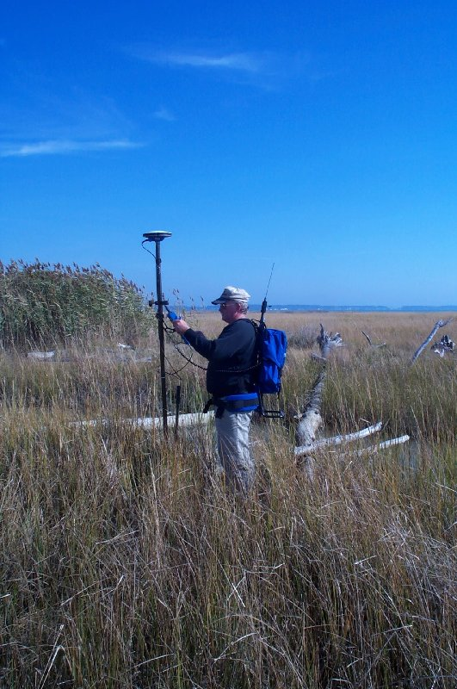
THE IMPORTANCE OF INTELLIGENT RT FIELD WORK
- Multipath
- Position Dilution of Precision (PDOP)
- Baseline Root Mean Square (RMS)
- Number of satellites
- Elevation mask (or cut-off angle)
- Base accuracy- datum level, local level
- Base security
- Redundancy, redundancy, redundancy
- Part(s) Per Million Error (ppm) – iono, tropo models, orbit errors
- Space weather- sunspot numbers, solar maximum
- Geoid quality
- Site calibrations (a.k.a. Localizations)
- Bubble adjustment
- Latency, update rate
- Fixed and float solutions
- Accuracy versus Precision
- Signal to Noise Ratio (S/N or C/N0)
- Carrier phase solution
- Code phase solution
- VHF/UHF radio communication
- CDMA/SIM/Cellular TCP/IP communication
WGS 84 versus NAD 83, or other local datums
GPS, GLONASS, Galileo, Compass Constellations
THE CONTROL IS AT THE POLE!

Slide 3
WORKSHOP PLAN
BACKGROUND- DATUMS, RTN vs SINGLE BASE
GEOMETRICAL & DISPERSIVE EFFECTS ON THE GNSS SIGNAL
BEST METHODS FOR GNSS REAL TIME POSITIONING- A FIELD GUIDE
HOW RT GNSS POSITIONING (RT) WORKS- BEYOND THE BLACK BOX
INRODUCTION-CHANGE AS A WAY OF LIFE

Slide 4
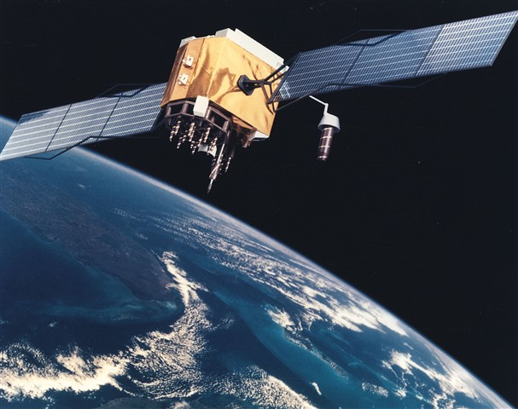
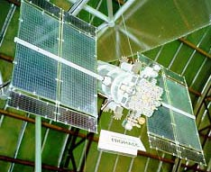
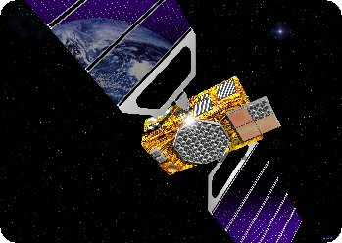
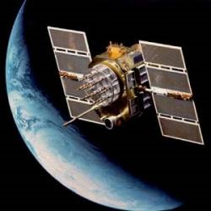
GNSS POSITIONING TECHNOLOGY-
WHERE WE STAND NOW
AND WHERE WE ARE HEADED
GPS
GALILEO
GLONASS
COMPASS (BEIDOU-2)

Slide 5
“Human knowledge is doubling every 10 years. The scientific knowledge produced between 1987 and 1997 is greater than that produced in all mankind’s history”.
Michio Kaku- renowned theoretical physicist
THE CHANGE FROM LABOR INTENSIVE TO TECHNOLOGY!

Slide 6
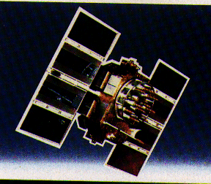

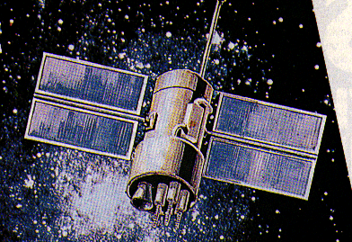

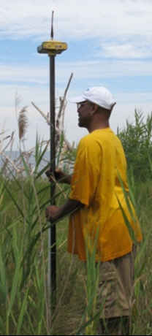
CHANGES IN GNSS
GPS:
L2C
L5 CARRIER
New Code on L5
L1C
10-15 cm???
GLONASS- FULL OPERATIONAL CAPABILITY
2011
EUROPEAN UNION - GALILEO
CHINA – COMPASS/BEIDOU
REGIONAL:
(JAPAN- QZSS FIRST LAUNCH 2010)
(INDIA – GAGAN)
1-3 m
BETTER RESISTANCE TO INTERFERENCE
FASTER AMBIGUITY RESOLUTION
AUGMENTED CODE APPLICATIONS
= 115 SATELLITES?

Slide 7
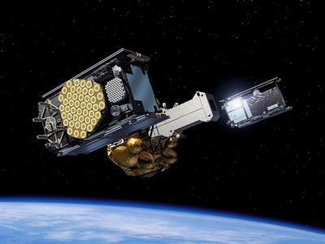
GALILEO- OFF THE GROUND
OCTOBER 21, 2011
2 IOV SATELLITES, EUROPEAN SPACEPORT, FRENCH GUIANA, RUSSIAN SOYEZ ROCKET (SPUTNIK, YURI GREGARIN)

Slide 8
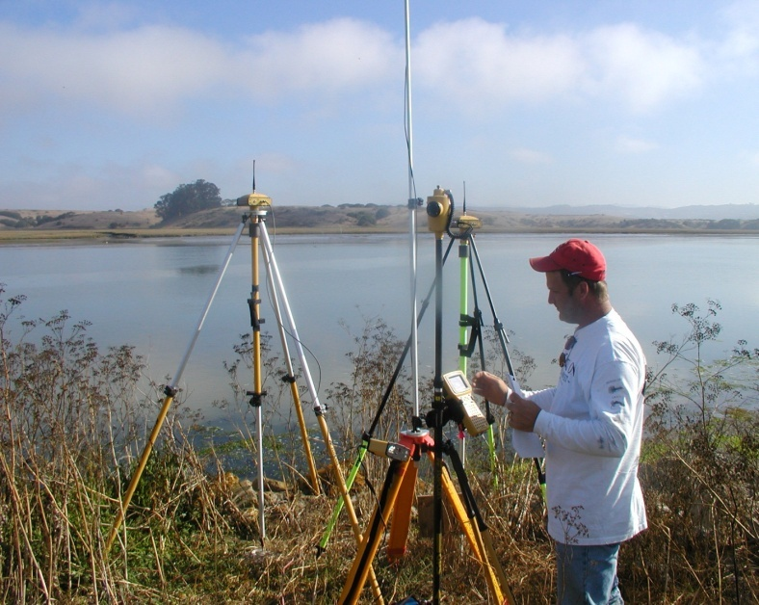
THE USE OF RTK- A CONFLUENCE OF TECHNOLOGY
INTERNET DATA VIA CELL TECHNOLOGY
SOFTWARE/FIRMWARE ALGORITHMS
GNSS HARDWARE
SATELLITE CONSTELLATIONS
SATELLITE CODES/FREQUENCIES

Slide 9
GNSS
TECHNOLOGY
GEODESY
SURVEYING
REMOTE SENSING
ENGINEERING
CM LEVEL PRECISION/ACCURACY
MAPPING
AROUND 2020 AUTONOMOUS GNSS POSITIONING MAY BE BETTER THAN 2-DM

Slide 10
GEOSPATIAL PROFESSIONALS
Graphic:
Jeffery N. Lucas, PLS, Esq.
POB Magazine
On-Line Article
September 28, 2011
www.POBonline.com

Slide 11
MULTI-YEAR CORS SOLUTION (MYCS)
= NAD 83 (2011):
BETTER ORBITS
MORE TRUE VELOCITIES KNOWN (1200 STATIONS +/- WITH >2.5 YEARS OF DATA-OTHERS MODELED WITH HTDP)
ABSOLUTE ANTENNA CALIBRATIONS
BROUGHT TO A MORE CURRENT EPOCH (2002 to 2010)
IMPLEMENTED SEPT 2011
http://geodesy.noaa.gov/CORS/coords.shtml
PASSIVE CONTROL ADJUSTMENT TO MYCS:
ORIGINAL OBSERVATIONS!!
NO VELOCITIES KNOWN (MODELED ONLY)
NO RIGOROUS ADJUSTMENT
5000 GPS PROJECTS SIMULTANEOUSLY VIA “NETSTAT” TO 95% CONFIDENCE
IMPLEMENTED EARLY CALENDAR YEAR 2012+/-
WILL HAVE NETWORK & LOCAL ACCURACIES

Slide 12
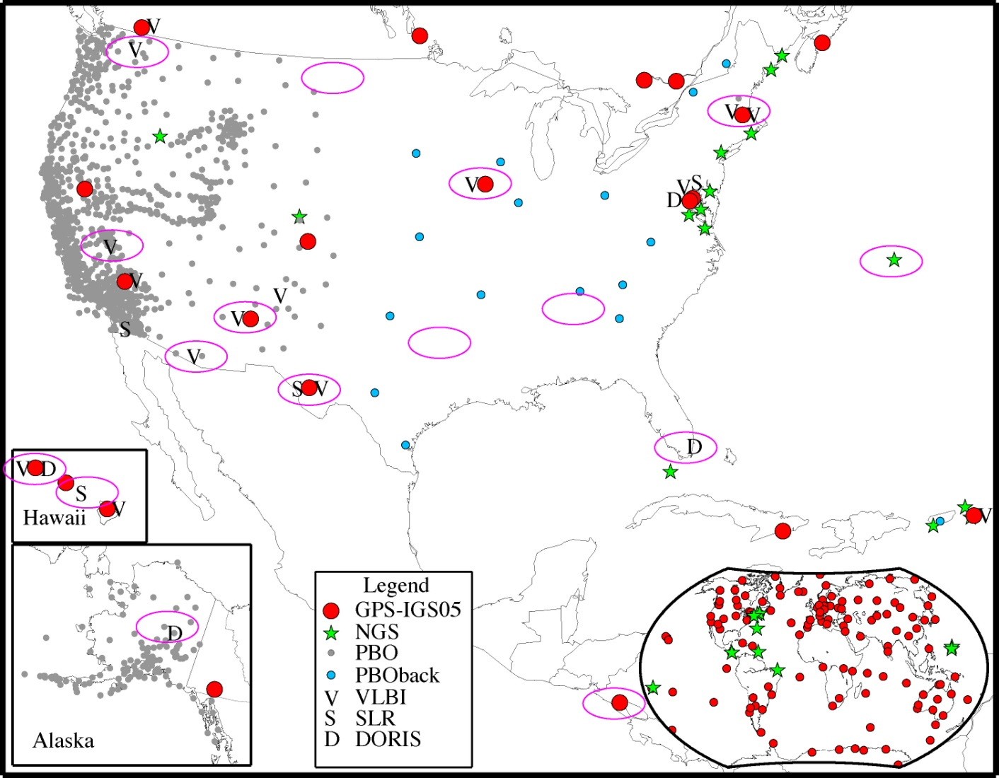
FOUNDATION
CORS
NEW GEOMETRICAL DATUM 2022 +/-
FEDERALLY OWNED/OPERATED BASE NETWORK = ULTIMATE TRUTH
Link to ITRF at sites co-located with VLBI, SLR, DORIS, then fill geographic gaps
Possible sites = magenta ovals

Slide 13
NEW NATIONAL VERTICAL DATUM 2022?
A PURELY GRAVIMETRIC SURFACE
BASED ON A HIGH RESOLUTION, 1 CM GEOID FROM GRAV-D PROGRAM
ACCURATE TO 2 CM (ALLOWING FOR GNSS ERROR)
ACCESSABILITY: BROUGHT TO A PROJECT SITE VIA ACTIVE REFERENCE STATIONS (NATIONAL CORS), DENSIFIED TO PROJECT ACCURACY NEEDS. (ALTERNATIVE: USE BMs PREVIOUSLY TIED TO THE DATUM-CAVEAT EMPTOR)

Slide 14
WHAT ABOUT THE PASSIVE MARKS?
SECONDARY ACCESS (USE AT YOUR OWN RISK)
  PASSIVE MARKS THAT HAVE BEEN TIED TO THE NEW VERTICAL DATUM
  NGS WILL PROVIDE A “DATA SHARING” SERVICE FOR THESE POINTS, BUT THEIR ACCURACY (DUE TO EITHER THE QUALITY OF THE SURVEY OR THE AGE OF THE DATA) WILL NOT BE A RESPONSIBILITY OF NGS
  A CONVERSION WILL BE PROVIDED BETWEEN NAVD 88 AND THE NEW DATUM WHERE RECENT GNSS ELLIPSOID HEIGHTS EXIST TO PROVIDE MODERN HEIGHTS IN THE NEW DATUM
Notes:
NGS will eventually stop making the claim that we “know” the heights of bench marks as the method of providing access to the vertical datum. What NGS will do is provide the orthometric height to a user on the day of their survey (and with the disclaimer that this height should not be taken as “known” for very long, due to the dynamic nature of the Earth). If possible, height changes (velocities) will be computed and provided to
assist in predicting heights in the future.
Updated October 2010.

Slide 15

2022 NEW PROJECT CONTROL – ACCESS TO NSRS
RTN ALIGNED TO CORS AT 1 CM IN EACH COMPONENT (X,Y,Z) & 2 CM ORTHOMETRIC
100 KM (NOT TO SCALE)
20 KM
NEW PROJECT CONTROL
EXISTING PASSIVE MARKS- HORIZONTAL WITH OR WITHOUT VERTICAL
EXISTING PASSIVE BENCH MARKS
70 KM (NOT TO SCALE)
NATIONAL CORS = GEOMETRICAL & GEOPOTENTIAL TRUTH

Slide 16
NECESSARY BACKGROUND
(BUT KNOWLEDGE DOES ≠ WISDOM)
KNOW YOUR DATUM/ADJUSTMENT/EPOCH

Slide 17
Z
DATUM=
SURFACE
ORIENTATION
SCALE
ORIGIN
+ GRAVITY
Zero
Meridian
-X
-Y
-
GPS POSITIONS ARE ECEF, XYZ IN THE WGS 84 DATUM (NOT NAD 83)
X
Y
Mean Equatorial Plane
-Z
Notes:
GPS Coordinate System - works with X, Y, Z coordinate frame based on center of mass Earth-Centered-Earth-Fixed (ECEF) coordinate system; changed into ellipsoidal latitude, longitude, and height through transformation.
Cartesian Coordinate System.

Slide 18
Earth-Centered-Earth-Fixed Coordinates
Conventional
Z Axis
Terrestrial
Pole
P
(X,Y,Z)
Earth’s
Surface
Zero
Meridian
Z
Origin
Y Axis
(0,0,0)
Center of Mass
X
Y
X Axis
Mean Equatorial Plane
Notes:
Point on the Earth’s surface positionally defined with an X, Y, Z coordinate.
The distance along the Z axis is not a height.
Height information is not apparent in this system.

Slide 19
X,Y,Z TO φ,λ,h
Z Axis
P
(X,Y,Z) = P (φ,λ,h)
h
Earth’s
Surface
Zero
Meridian
Reference Ellipsoid
Y Axis
φ
λ
X Axis
Mean Equatorial Plane
Notes:
Curvilinear Coordinate System
Same point on Earth’s surface positionally defined by latitude, longitude and ellipsoid height.
Ellipsoid height is the height of the point relative to the reference ellipsoid surface.
Same point can be positionally defined as and X, Y, Z or latitude, longitude, ellipsoid height.

Slide 20
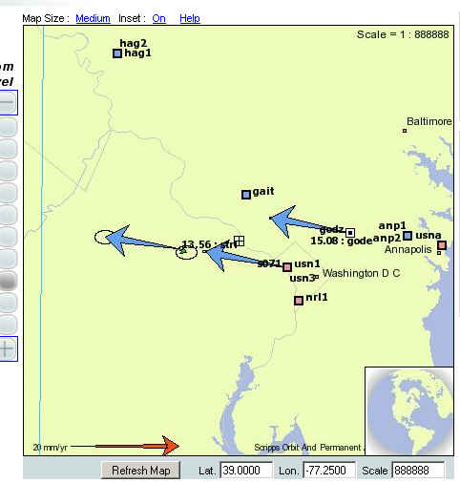
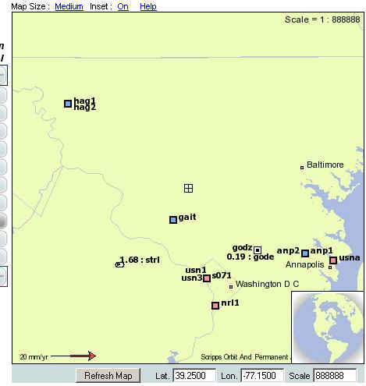
SILVER SPRING, MD
ITRF 2000
NAD 83

Slide 21
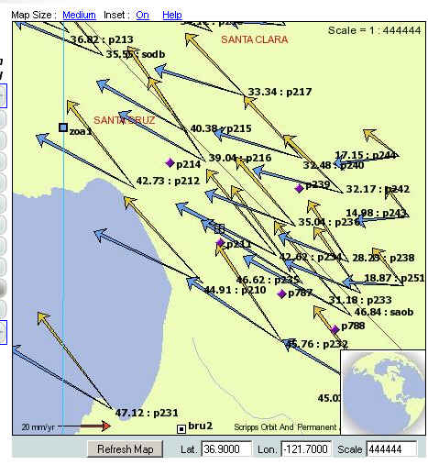
SANTA CRUZ, CA
NAD 83 VELOCITIES
(GOLD)
ITRF 2000
VELOCITIES
(BLUE)

Slide 22
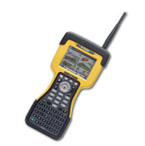
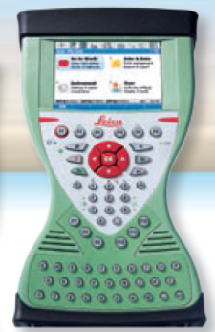

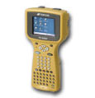
GNSS TO ANY DATUM
GNSS ECEF X,Y,Z (WGS 84 & PZ90)
NAD 83 (φ,λ,h) SPC N,E,h
+ GEOID XX = SPC N,E,H
OR
CALIBRATE TO 4-5 SITE POINTS IN THE DESIRED DATUM. THIS IS USED TO LOCK TO PASSIVE MONUMENTATION IN THE PROJECT AREA.

Slide 23
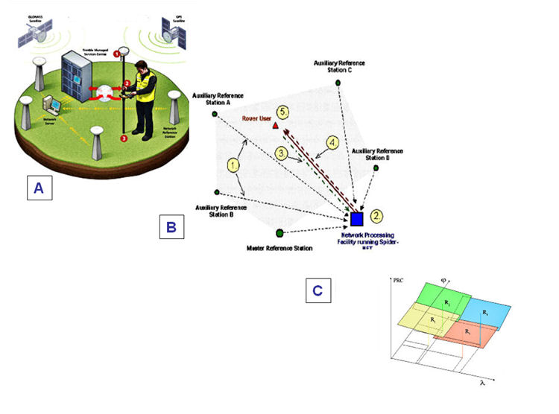
USING REAL TIME GNSS NETWORKS FOR POSITIONING

Slide 24
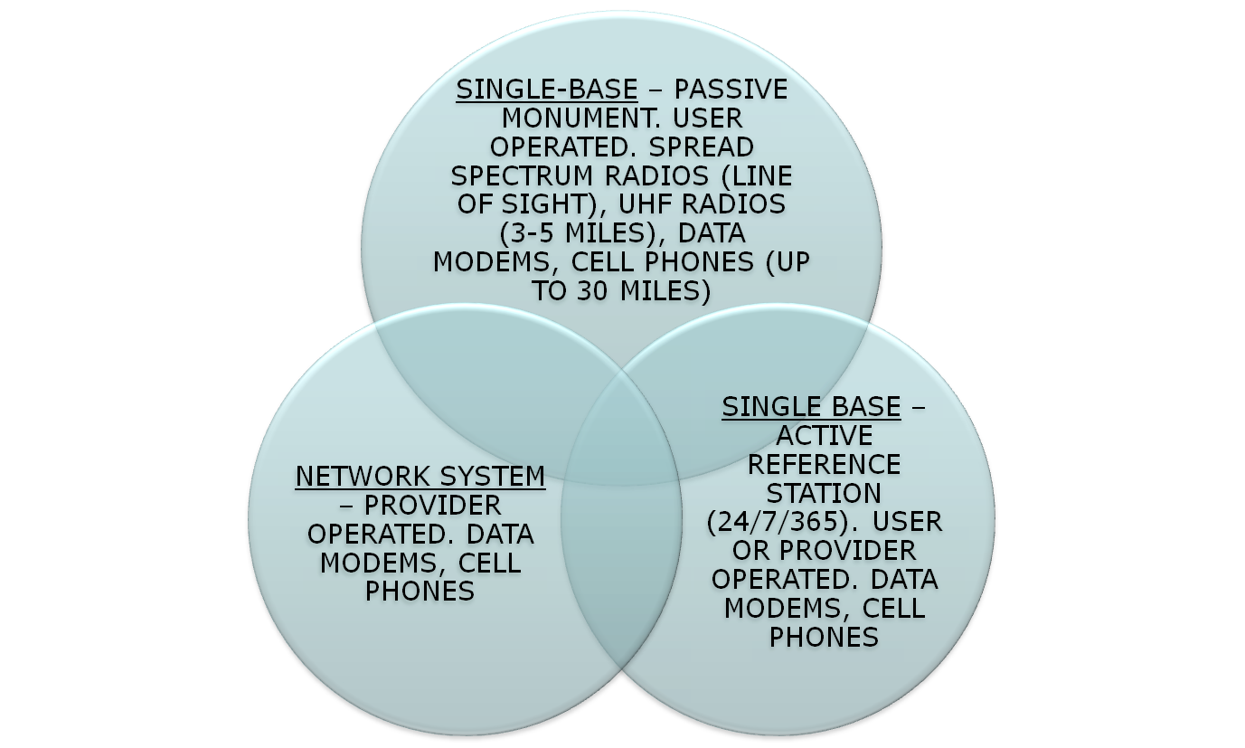
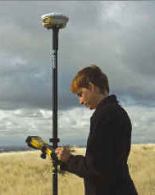
THE THREE BASE STATION OPTIONS FOR RT

Slide 25
THE TECHNOLOGY SWEET SPOT
SBAS: 2 M H, 6 M V, 0.3 M SMOOTHED H, CHEAP
COMMERCIAL DGPS: FEW DM, $$
USCG BEACON: METER+, CHEAP
DIFFERENTIAL LEVELING: 2-4 CM, LABOR/TIME INTENSIVE, $$$
GEODETIC LEVELING: mm, LABOR/TIME INTENSIVE, $$$$$
USER BASE RTK: 2-4 CM H, 3-5 CM V, REQUIRES INITIAL INVESTMENT
RTN: 3-4 CM H, 5-7 CM V, REQUIRES INITIAL INVESTMENT(BUT ½ OF RTK)
AERIAL MAPPING: .10 M H, .20 M V, $$$
LIDAR: 0.10 – 0.3 M V
SATELLITE IMAGERY: 0.5 METER H RESOLUTION, 3 M LOCATION, $$$
LOW ALTITUDE AERIAL IMAGERY: 2-4 CM H, 3-5 CM V, $$$
TERRESTRIAL LASER SCANNING: PROJECT SITES ONLY, 0.015 M H,
0.02 M V, REQUIRES INITIAL INVESTMENT

Slide 26
≥200 RTN WORLDWIDE
≥107 RTN USA
≥37 DOT
MAJOR RTN IN THE USA
(MARCH 2011)
ACADEMIC/SCIENTIFIC
SPATIAL REFERENCE CENTERS
VARIOUS DOTS + MACHINE GUIDANCE
COUNTY
CITY
GEODETICSURVEYS(NC,SC)
MANUFACTURERS
VENDOR NETWORKS
AGRICULTURE
MA & PA NETWORKS

Slide 27
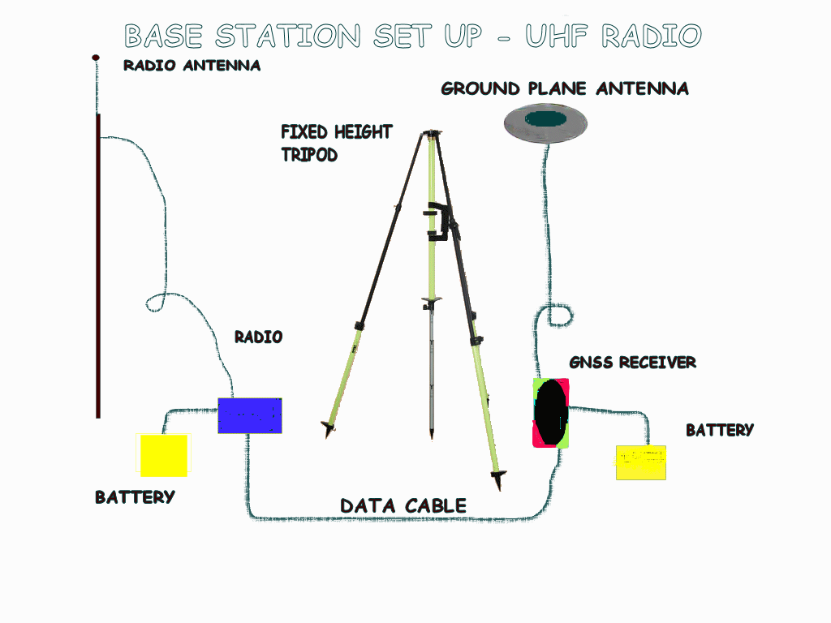
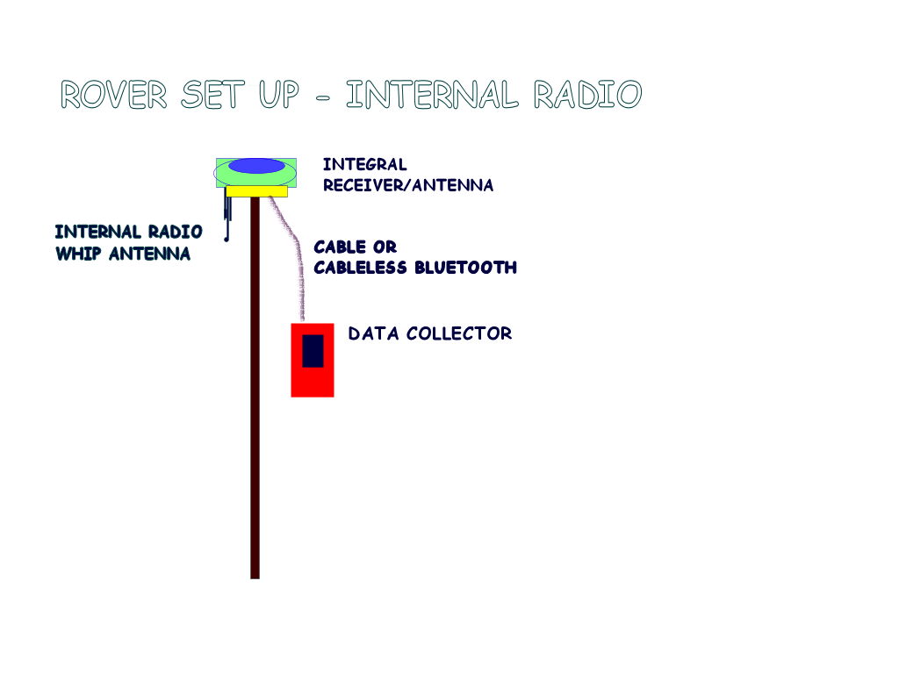


RTK vs. RTN
Cell technology
-Half the equipment or double the production
-No monument reconnaissance/
recovery
- No set/break down time
-No base baby sitting
RTN
Plus:
Easy alignment to the NSRS
No ppm (1ST ORDER) ERROR
Extended range
Homogeneous Data
Easy datum updates
RTK

Slide 28
SO – WHAT CAN I EXPECT FROM An RTN?
MOST RTN PRODUCE “GOOD” HORIZONTAL VALUES – TO A FEW CM. OUR HORIZONTAL SYSTEM IS BASED ON ACTIVE REFERENCE STATIONS (NGS CORS), AS ARE THE RTN STATIONS.
BECAUSE ORTHOMETRIC HEIGHTS (‘ELEVATIONS’) ARE BASED ON PASSIVE MONUMENTS WITH NAVD 88, THE RTN USER SHOULD, FOR THE MOST PART, CONSTRAIN THE PASSIVE MARK VALUES IN A LOCALIZATION.
CHOOSE THE RTN WITH A BUSINESS MODEL THAT BEST FITS YOUR NEEDS.

Slide 29
USERS CONCERNS WITH RTN
What Datum is the RTN using?
What adjustment of the Datum is the RTN using?
What epoch of the Datum adjustment is the RTN using?
How Does The RTN Align To The NSRS?
Can Users Use Any Manufacturers’ Equipment In The RTN?
Do Overlapping Networks Give The Same Coordinates?
What Are The Field Accuracies?

Slide 30
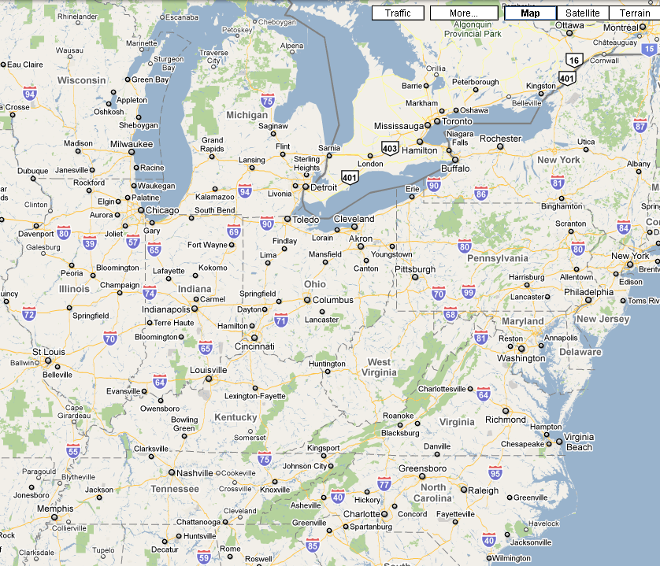
OVERLAPPING RTN-
NSRS?, HOMOGENEOUS?, USES ALL GNSS GEAR?
TRIMBLE
TRIMBLE
LEICA
LEICA
LEICA
TOPCON
TRIMBLE
TRIMBLE
LEICA
TRIMBLE
TOPCON
LEICA
TRIMBLE
TOPCON
TRIMBLE

Slide 31
NATIONAL SPATIAL REFERENCE SYSTEM
(NSRS)
Consistent National Coordinate System
Latitude
Longitude
Height
Scale
Gravity
Orientation
and how these values change with time
Notes:
NSRS is a consistent national coordinate system that defines
latitude,
longitude,
height,
scale,
gravity, and
orientation
throughout the Nation, and how these values change with time.

Slide 32
HOW WILL NGS HELP THE USER OF RTN?
“Develop guidelines for both the administration and use of real-time GNSS networks and especially for ensuring that these networks are compatible with the NSRS.”
1. TOP DOWN: OPUS POSITIONS ON RTN REFERENCE STATIONS AT APPROPRIATE INTERVALS COULD PRODUCE GRAPHICS THAT WOULD SHOW BIASES AT A GLANCE.
RTN
2. USER UP: PHYSICAL MONUMENTATION, ESTABLISHED WITH BEST TECHNOLOGY, COULD BE USED AS FIDUCIAL STATIONS TO HELP THE USER VERIFY THAT RTN ARE PRODUCING ACCURATE COORDINATES,

Slide 33
(NEAR) REAL TIME GNSS POSITIONING –
BEYOND THE BLACK BOX

Slide 34
HOW DOES RT WORK?
∆ X,Y,Z FROM BASE (REMEMBER “GIGO”)
MULTILATERATION - TIME (SEC.) · C (SPEED OF LIGHT) (M/SEC.)= DISTANCE from satellite
MUST RESOLVE CARRIER CYCLE INTEGER COUNT AMBIGUITIES (# cycles · wave length + partial cycle = distance)
MUST ACCOUNT FOR FACTORS AFFECTING THE PATH OF THE SIGNAL
DUAL FREQUENCY ENABLES “ON THE FLY” RESOLUTION OF THE AMBIGUITIES & EASIER CYCLE SLIP DETECTION
THAN L1 ONLY
FREQUENCY COMBINATIONS AND DIFFERENCING CONTRIBUTE TO MITIGATING THE ERROR BUDGET

Slide 35
THE INTEGER AMBIGUITY
WGS 84
X,Y,Z
Resolving the integer ambiguity allows phase
measurements to be related to distances
Nλ
Δλ = First Partial Wavelength
Nλ = Integer Ambiguity
Distance
Δλ
Distance = Nλ + Δλ

Slide 36
THE AMBIGUITY SEARCH….
The ambiguity is an integer number (a multiple of the carrier wavelength).
The integer is different for the L1 and L2 phase observations.
The integer ambiguity is different for each satellite-receiver pair.
The integer ambiguity is a constant for a particular satellite-receiver pair for all epochs of continuous tracking (that is, as long as no cycle slips occur)
The carrier phase measurement from one observation epoch to another is a measure of the change in satellite-receiver range.
The determination of the cycle ambiguity integer is known as ambiguity resolution, and is generally not an easy task because of the presence of other biases and errors in the carrier phase measurement.

Slide 37
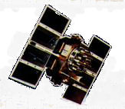
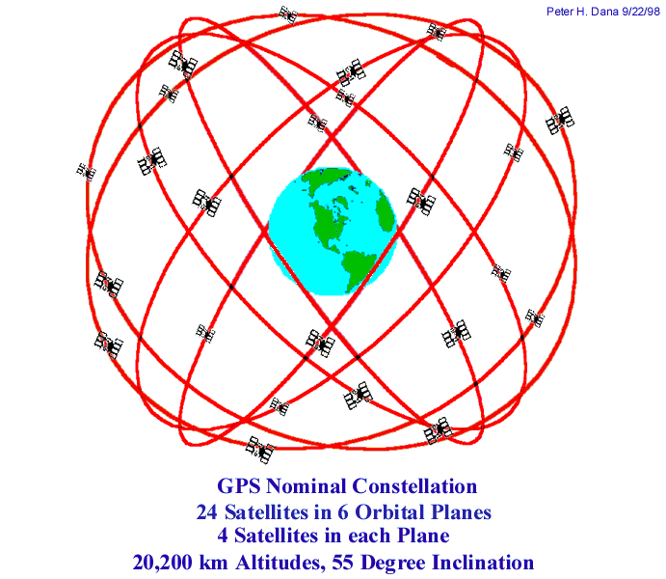
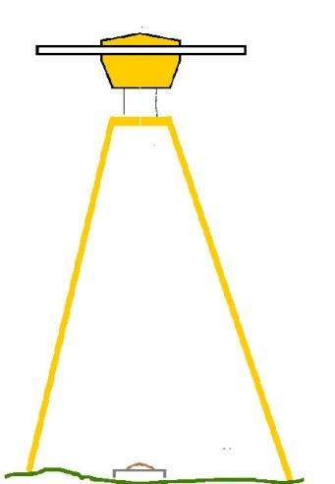
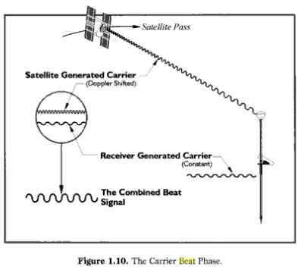
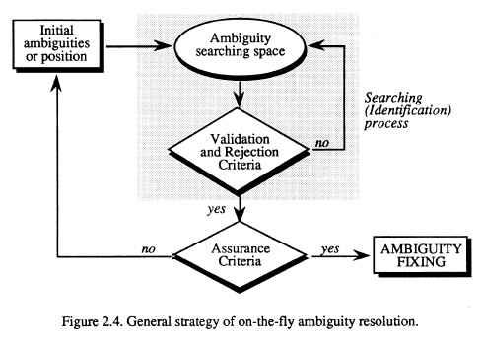
8400 MPH
8400 MPH
SVN 31
SVN 8
SVN 14
8400 MPH
SVN 23
EVERY EPOCH OF OBSERVATION MUST COMPUTE CHANGE IN POSITION DUE TO EARTH ROTATION, SATELLITE ORBIT CHANGE AND RELATIVITY!
8400 MPH
800 MPH +/-
AT “C”, 1 NANOSECOND = 30 CM!

Slide 38

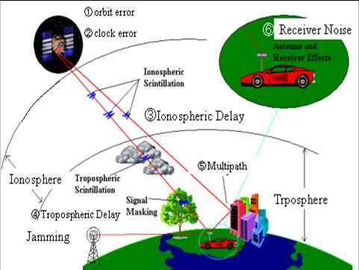
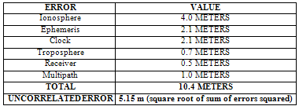
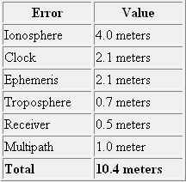
RT PROCESSING IN YOUR ROVER

Slide 39
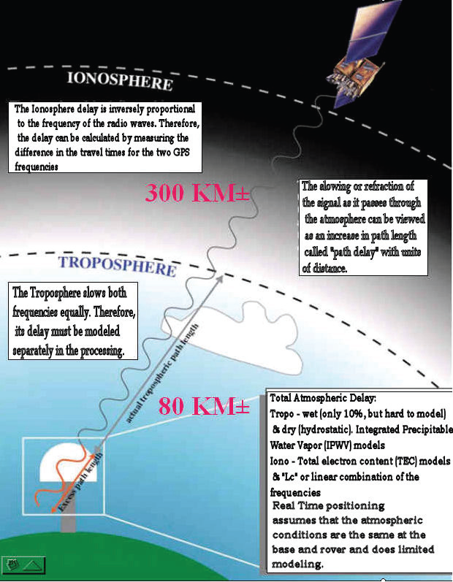
IONO & TROPO LAYERS AND THEIR EFFECT ON THE GNSS SIGNAL

Slide 40
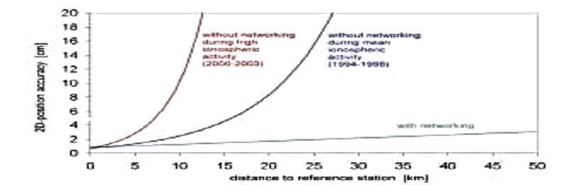
IONOSPHERIC EFFECTS ON POSITIONING
AVERAGE IONO- NO NETWORK
HIGH IONO- NO NETWORK
2D PRECISION/ACCURACY (CM)
SINGLE BASE
RTK @ 10 KM
(2000-2002)
(1994-1995)
NETWORK SOLUTION
@ 30 KM
WITH NETWORK
DISTANCE TO REFERENCE STATION (KM)
(SOURCE-BKG- GERMANY)

Slide 41
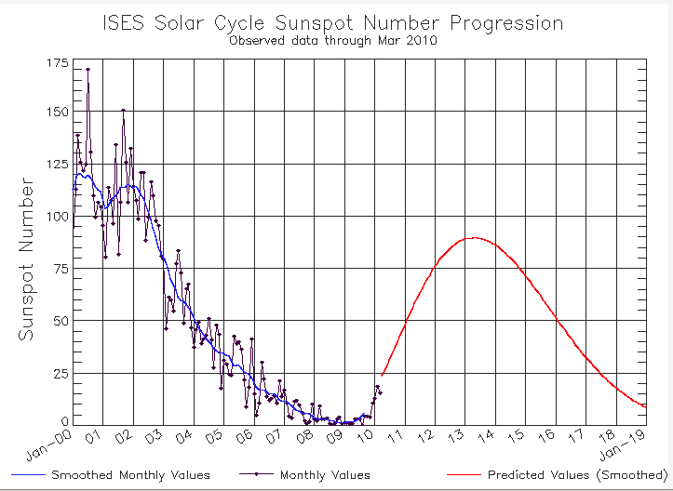
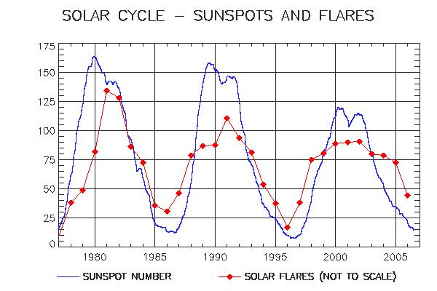
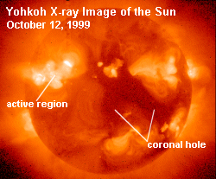
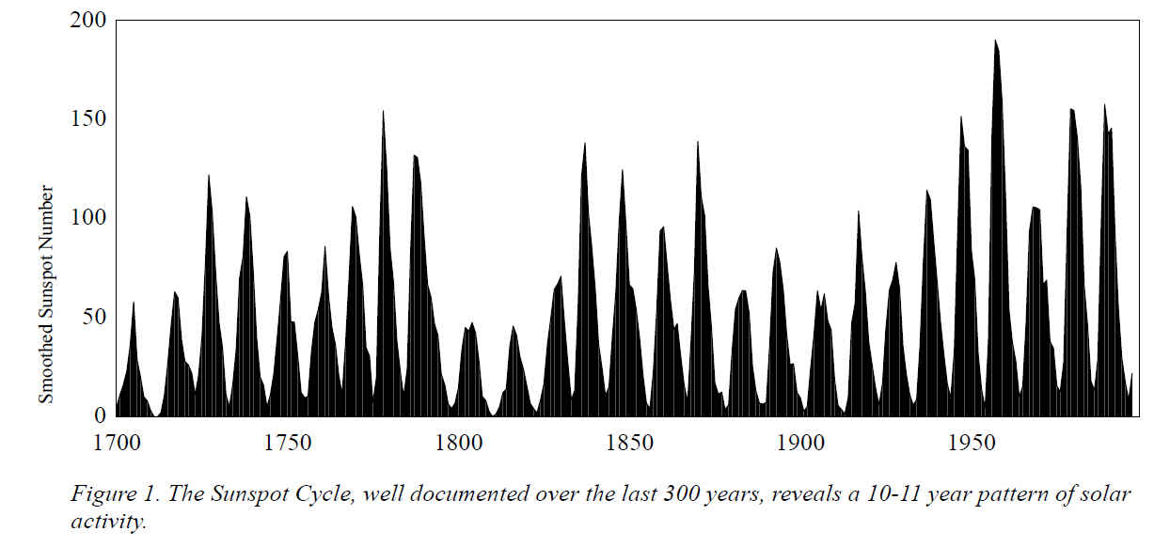
SUNSPOT CYCLE
Sunspots follow a regular 11 year cycle
We are just past the low point of the current cycle
Sunspots increase the radiation hitting the earth's upper atmosphere and produce an active and unstable ionosphere
2013
http://www.swpc.noaa.gov/

Slide 42
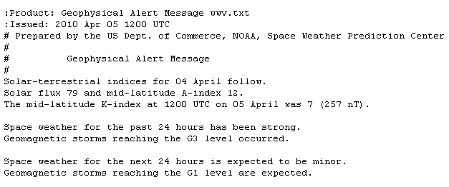
Official Space Weather Advisory issued by NOAA Space Weather Prediction Center Boulder, Colorado, USA SPACE WEATHER ADVISORY BULLETIN #10- 1 2010 April 05 at 12:13 p.m. MST (2010 April 05 1213 UTC) **** STRONG GEOMAGNETIC STORM IN PROGRESS **** A geomagnetic storm began at 05:55 AM EST Monday, April 5, 2010. Space weather storm levels reached Strong (G3) levels on the Geomagnetic Storms Space Weather Scale. The source of the storming is an Earth-directed Coronal Mass Ejection associated with a weak solar flare that occurred in Active Region 1059 on April 3 at 05:54 AM EST. This is expected to be an isolated storm that should subside quickly. Other than the flare and CME erupting on April 3, this active region has not produced any significant activity. Systems that can be affected include electric power systems, spacecraft operations, high-frequency communications, GPS, and other navigation systems. Data used to provide space weather services are contributed by NOAA, USAF, NASA, NSF, USGS, the International Space Environment Services and other observatories, universities, and institutions. More information is available at SWPC's Web site http://swpc.noaa.gov
SINGLE FREQUENCY USERS USE A MODEL FOR IONO CORRECTIONS, SO DURING GEOMAGNETIC STORMS, THEY WILL EXPERIENCEMORE DRAMATIC ERROR AND NOISE THAN DUAL+ FREQUENCY USERS WHO MAY USE THE DISPERSIVE CHARACTER OF THE IONOSPHERE TO CALCULATE THE ACTUAL ERROR.

Slide 43
TROPOSPHERE DELAY
  The more air molecules, the slower the signal (dry delay)
    High pressure, Low temperature
    90% of total delay
    relatively constant and EASY TO CORRECT FOR
  The more water vapor in the atmosphere the slower the signal (wet delay)
    High humidity
    10% of total delay
    Highly variable and HARD TO CORRECT FOR
Ionosphere
troposphere
10 KM
GREATER THAN 10 KM

Slide 44
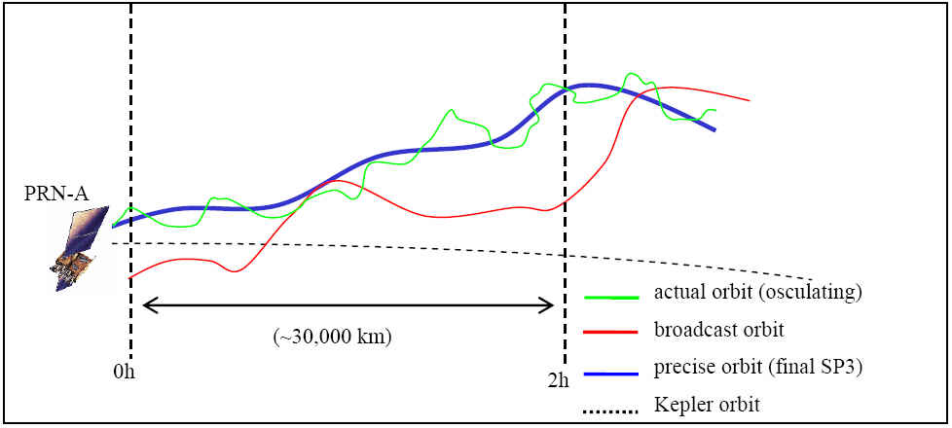
ORBITAL ERRORS CONTRIBUTING TO PPM ERRORS
1 cm!
2-5 m
(See user guidelines
references for
Graphic: Ahn, 2005)

Slide 45
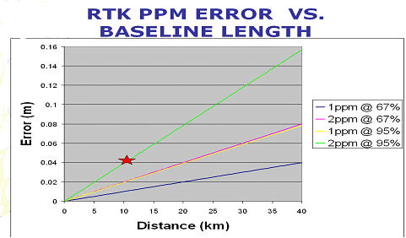
IONO, TROPO, ORBIT CONTRIBUTE TO PPM ERROR
REMEMBER GNSS EQUIPMENT MANUFACTURERS’ SPECS!

Slide 46
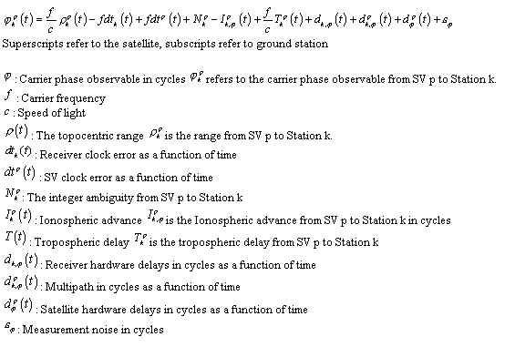
THE UNDIFFERENCE CARRIER PHASE OBSERVABLE IN CYCLES

Slide 47
THE CYCLE COUNT COOKBOOK-
USING DIFFERENCING TO ELIMINATE OR REDUCE COMMON ERRORS IN THE RECEIVER AND SATELLITE
RECEIVER HARDWARE DELAYS
SATELLITE HARDWARE DELAYS
RECEIVER CLOCK BIAS
SATELLITE CLOCK BIAS
ELIMINATED WITH DIFFERENCING
IONO DELAY
TROPO DELAY
SAME AS BASE WITH SINGLE BASE
INTERPOLATED WITH RTN
MEASUREMENT NOISE (HIGHER GRADE RECEIVERS = LESS NOISE)
MULTIPATH
NOT ELIMINATED WITH DIFFERENCING

Slide 48
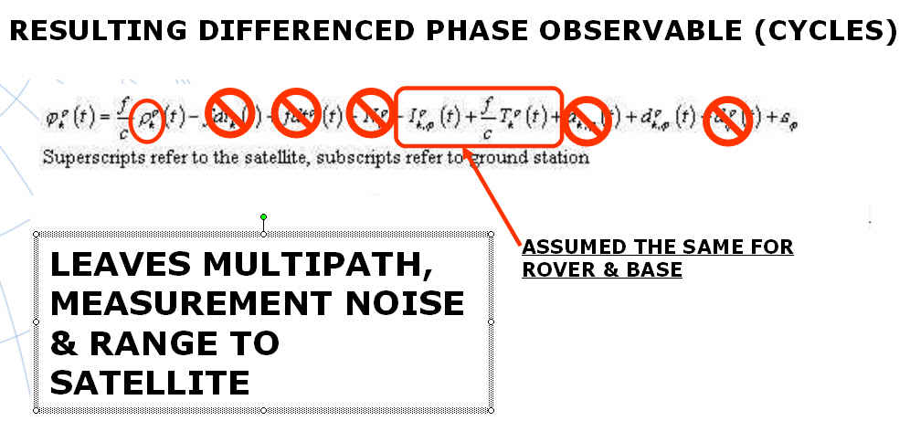
OR MODELED BY RTN

Slide 49
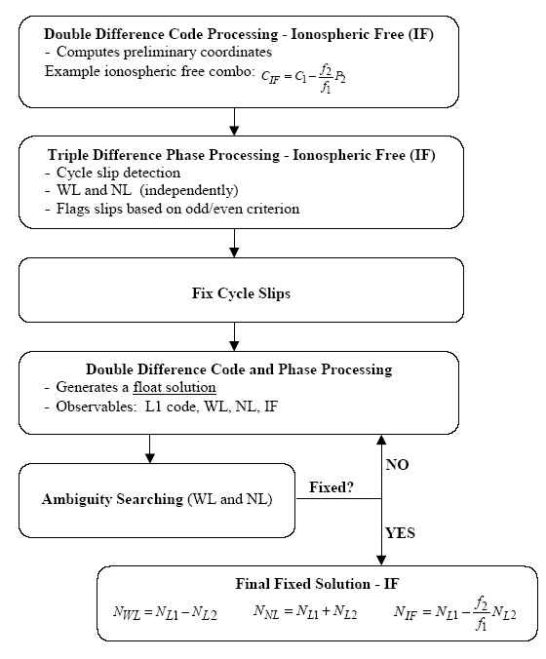
CARRIER PHASE PROCESSING FLOW
REFERENCE:
“Parameterization of DGPS Carrier Phase Errors Over
a Regional Network of Reference Stations”
(URL: http://www.geomatics.ucalgary.ca/GradTheses.html)
by
Georgia Fotopoulos
August 2000

Slide 50
BEST METHODS FOR
REAL TIME POSITIONING

Slide 51
REAL-TIME CHOICES - BIG PICTURE ISSUES
PASSIVE / ACTIVE – WHAT IS ‘TRUTH’?
GEOID + ELLIPSOID / LOCALIZE –
QUALITY OF GEOID MODELS LOCALLY. ORTHOMETRIC HEIGHTS ON CORS?
GRID / GROUND –
LOW DISTORTION PROJECTIONS- SHOULD NGS PLAY?
ACCURACY / PRECISION- IMPORTANCE OF METADATA
SINGLE SHOT / REDUNDANCY
RTK / RTN
NATIONAL DATUMS / LOCAL DATUMS / ADJUSTMENTS- DIFFERENT WAYS RTN GET THEIR COORDINATES-VARIOUS OPUS, OPUS-DB, CORS ADJUSTED, PASSIVE MARKS.
VELOCITIES - NEW DATUMS, “4 -D” POSITIONS
GNSS / GPS

Slide 52
FOUR CARDINAL RULES FOR RT POSITIONING
COMMUNICATIONS: THE KEY TO SUCCESS
CHECK SHOT: FIRST BEFORE NEW WORK
REDUNDANCY: FOR CONFIDENCE
MULTIPATH: AVOID UNSUITABLE CONDITIONS

Slide 53
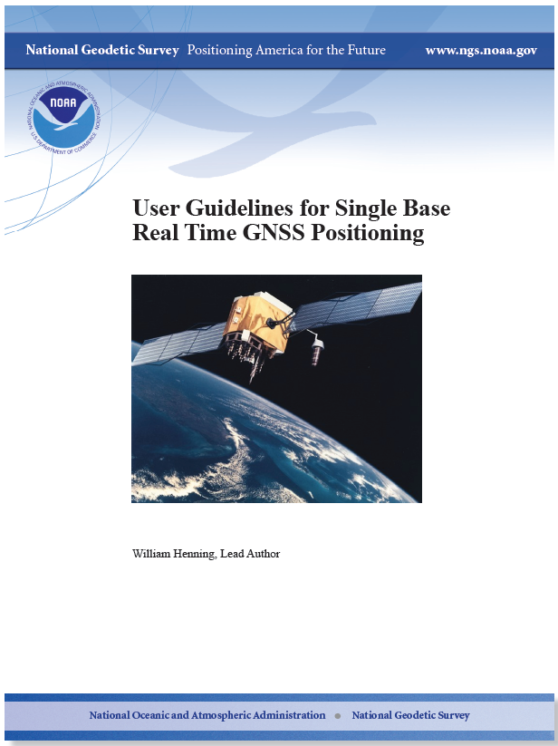
NGS SINGLE BASE GUIDELINES
LEGACY EQUIPMENT
NO CELL COVERAGE
NEW RT CLOSEST BASE NETWORKS
MACHINE GUIDANCE AND PRECISION AGRICULTURE USE
http://www.ngs.noaa.gov/PUBS_LIB/NGSRealTimeUserGuidelines.v2.1.pdf

Slide 54
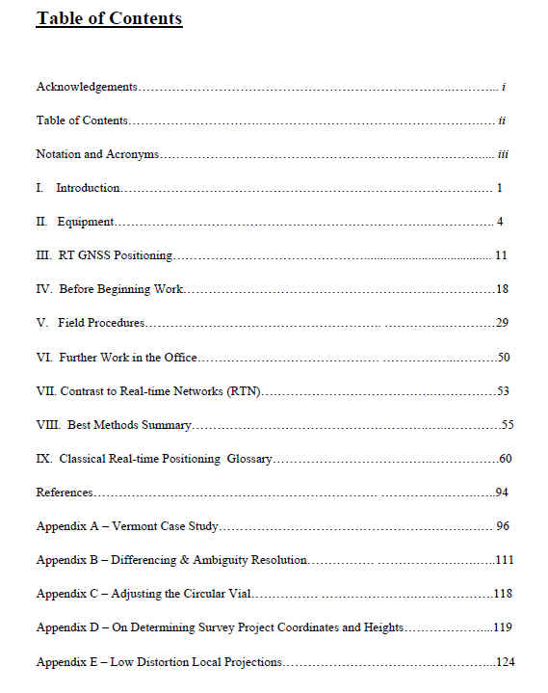
RT USER GUIDELINES

Slide 55
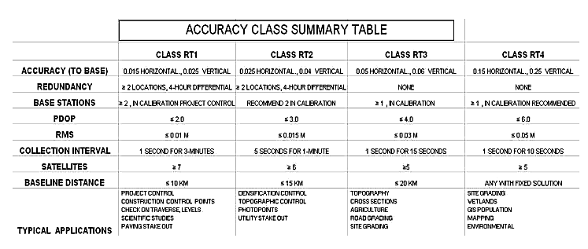
DRAFT GUIDELINES- 95% CONFIDENCE

Slide 56
RTN GUIDELINES FOR GNSS POSITIONING–
WILL NOT SPECIFY OR DEFINE A STANDARD, BUT WILL HELP ADMINISTRATORS AND USERS TO BE AWARE OF ALL THE ISSUES INVOLVED WITH THIS NEW TECHNOLOGY
60+ CONTRIBUTORS:
NGS ADVISORS
DOT
STATE GEODETIC SURVEYS
GNSS MANUFACTURERS
SRCs
BLM, NPS
http://www.ngs.noaa.gov/PUBS_LIB/NGS.RTN.Public.v2.0.pdf

Slide 57
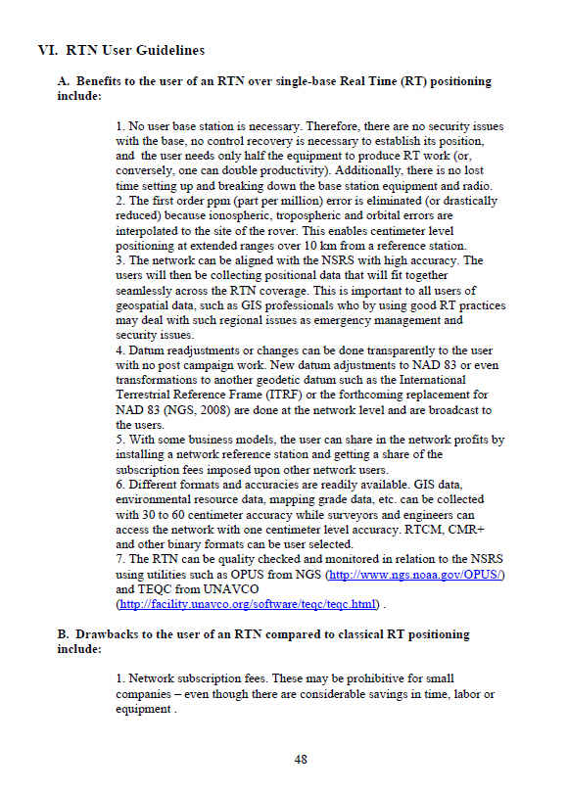

Slide 58
“CONFIDENCE” IN YOUR POSITION INCREASES WITH:
MORE SATELLITES
SHORTER BASELINES
LOWER ‘DOP’
MORE OPEN SKY
LOWER RMS
CONTINUOUS COMMUNICATION
REDUNDANCY, REDUNDANCY, REDUNDANCY
(THE BEST OF ALL SINGLE BASE WORLDS = 8 GPS SATELLITES, GDOP 1.5, 2 KM BASELINE, RMS ≤ 0.01 M, OPEN SKY, NO WEATHER ELEMENTS, SOLID COMMUNICATION)

Slide 59
PRECISION VS. ACCURACY
“PRECISION” IS A COMPUTED STATISTICAL QUANTITY TO THE SOURCE OF THE MEASUREMENT - ALIGNMENT TO THE RTN OR PASSIVE MARK SHOWS PRECISION OF THE OBSERVATION (PER THE DATA COLLECTOR).
“ACCURACY” IS A COMPUTED STATISTICAL QUANTITY TO THE REALIZATION OF THE DATUM - ALIGNMENT OF THE RTN OR PASSIVE MARK TO THE NSRS SHOWS ACCURACY (PER ESTABLISHED METHODOLGY)

Slide 60
PRECISION vs. ACCURACY
NOTE: SPREAD OF SOLUTION REFLECTED IN THE “RMS”. HIGH RMS DOES NOT NECESSARILY MEAN A BAD RESULT
PRECISE – NOT ACCURATE
ACCURATE – NOT PRECISE
KEY
“TRUTH”
ACCURATE AND PRECISE

Slide 61
BEST METHODS FROM THE GUIDELINES:
THE 7 “C’s”
CHECK EQUIPMENT
COMMUNICATION
CONDITIONS
CONSTRAINTS(OR NOT)
COORDINATES
COLLECTION
CONFIDENCE
THE CONTROL IS AT THE POLE

Slide 62
FROM NGS SINGLE BASE GUIDELINES CHAPTER 5 - FIELD PROCEDURES, AND “USERS” CHAPTER OF RTN GUIDELINES:
RT = single base, either active or passive
B = Both Single base and RTN
ACHIEVING ACCURATE, RELIABLE POSITIONS USING GNSS REAL TIME TECHNIQUES
3

Slide 63
CHECK EQUIPMENT
B BUBBLE- ADJUSTED?
RT BATTERY- BASE FULLY CHARGED 12V?
B BATTERY – ROVER SPARES?
RT USE PROPER RADIO CABLE (REDUCE SIGNAL LOSS)
RT RADIO MAST HIGH AS POSSIBLE? (5’ = 5 MILES, 20’ = 11 MILES, DOUBLE HEIGHT=40% RANGE INCREASE). LOW LOSS CABLE FOR >25’.
RT DIPOLE (DIRECTIONAL) ANTENNA NEEDED?
RT REPEATER?
RT CABLE CONNECTIONS SEATED AND TIGHT?
B“FIXED HEIGHT” CHECKED?
RT BASE SECURE?

Slide 64
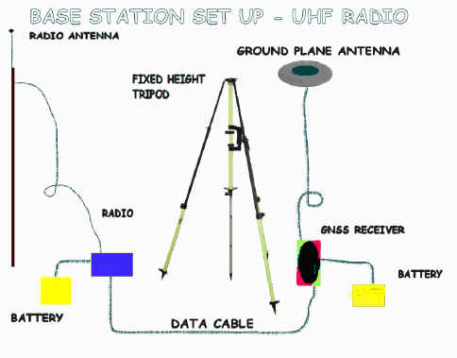
COMMUNICATION
RT UHF FREQUENCY CLEAR?
B CDMA/CELL - STATIC IP FOR COMMS?
B CONSTANT COMMS WHILE LOCATING
RT BATTERY STRENGTH OK?
B CELL COVERAGE?
B KEEP FIRMWARE UPDATED!

Slide 65
CONDITIONS
RT WEATHER CONSISTENT BASE & ROVER?
B CHECK SPACE WEATHER?
B CHECK PDOP/SATS FOR THE DAY?
RT OPEN SKY AT BASE?
RT MULTIPATH AT BASE?
B MULTIPATH AT ROVER?
B USE BIPOD?
3

Slide 66
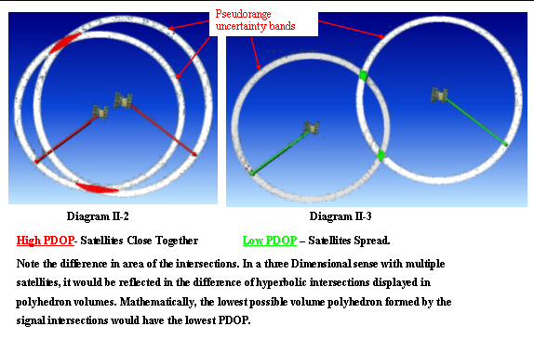
Dilution Of Precision - DOP

Slide 67
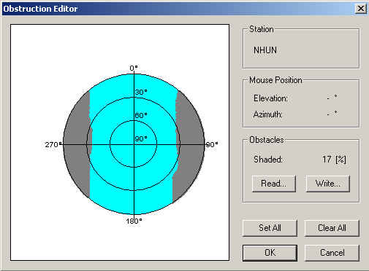


NHUN – SATELLITES/ WITH OBSTRUCTIONS

Slide 68


NHUN – DOP / WITH OBSTRUCTIONS

Slide 69

GPS AND GLN
DUAL CONSTELLATION RT POSSIBILITIES:
GPS ≥ 5, GLN = 0
GPS = 4, GLN = 2
GPS = 3, GLN = 3
GPS = 2, GLN = 4
(Can't initialize with only GLN Sats.)

Slide 70


URBAN CANYONS
GNSS vs GPS – MIGHT HELP

Slide 71

HIGHWAY CORRIDORS
GNSS vs GPS – MIGHT HELP

Slide 72

ROUTE OBSTRUCTIONS
GNSS vs GPS – MIGHT HELP

Slide 73
COORDINATES
B TRUSTED SOURCE?
B WHAT DATUM/EPOCH ARE NEEDED?
RT GIGO⬇
B ALWAYS CHECK KNOWN POINTS.
B PRECISION VS. ACCURACY
B GROUND/PROJECT VS. GRID/GEODETIC
B GEOID MODEL QUALITY
B LOG METADATA
⬇ AUTONOMOUS LOCAL BASE STATION POSITION ARE OK IF CORRECT COORDINATES ARE INTRODUCED IN THE PROJECT FIRMWARE/SOFTWARE LATER

Slide 74

CONSTRAINTS (OR NOT)
B ≥ 4 H & V, KNOWN & TRUSTED POINTS?
B LOCALIZATION RESIDUALS-OUTLIERS?
B DO ANY PASSIVE MARKS NEED TO BE HELD?
RT BASE WITHIN CALIBRATION (QUALITY TIE TO NEAREST CALIBRATION POINT)?
B SAME OFFICE & FIELD CALIBRATION USED?
FYI: GNSS CAN PROVIDE GOOD RELATIVE POSITIONS IN A PROJECT WHILE STILL NOT CHECKING TO KNOWNS IN AN ABSOLUTE SENSE
TWO POINT CALIBRATION

Slide 75
PASSIVE/ACTIVE
NAD 83 REALIZED THROUGH NATIONAL CORS
NAVD 88 REALIZED FROM PASSIVE MARKS
NGSIDB HAS 1,000,000 PASSIVE MARKS
PASSIVE MARKS IN STATES HAVE MANY CAMPAIGNS OVER MANY YEARS WITH MANY ACCURACIES IN MANY SEPARATE ADJUSTMENTS. RTN MAY NOT AGREE WITH THESE REQUIRING CONSTRAINTS TO THE MONUMENTS FOR PROJECT WORK.
PASSIVE MARKS COORDINATES ARE A SNAPSHOT IN TIME AND CAN BE RELIED ON TO BE ACCURATE ONLY AT THE RECORDED OBSERVATION TIME.
2020+ = NEW GEOMETRIC DATUM / 1 CM GRAVIMETRIC GEOID, VELOCITIES ON A GEOCENTRIC DATUM
THE METHOD OF CHOICE TO ACCESS THE NSRS IS ACTIVE MONUMENTATION (CORS, OPUS, RTN)

Slide 76


POSITIONAL ACCURACY
REPLACING DISTANCE CORRELATED ACCURACY

Slide 77


Monumented Points
Deterioration
Disturbed Geodetic Control
Coordinates/Elevations
Questionable!
Destroyed Geodetic Control
No Coordinates/Elevation

Slide 78
RT DERIVED ORTHO HEIGHTS - LOCALIZE OR NOT?
PASSIVE MARKS ARE A SNAP SHOT OF WHEN THEY WERE LEVELED OR DERIVED FROM GPS
IF YOU BUILD FROM A MONUMENTED BM AND THE DESIGN WAS DONE REFERENCED TO IT, IT IS “THE TRUTH”, UNLESS IN GROSS ERROR.
CONSTRAINING TO PASSIVE BMs IS A GOOD WAY TO NOT ONLY LOCK TO THE SURROUNDING PASSIVE MARKS, BUT ALSO TO EVALUATE HOW THE CONTROL FITS TOGETHER.
HOW GOOD IS THE NGS HYBRID GEOID MODEL IN YOUR AREA? (SIDE NOTE: GEOID 09 IS THE CURRENT MODEL USED BY OPUS)

Slide 79

USING RTN ELLIPSOID HEIGHTS WITH THE HYBRID GEOID FOR ORTHO HEIGHTS
H₈₈ = h₈₃ – N₀₉
NAD 83 (HARN) USE GEOID O3
NAD 83 (CORS 96) USE GEOID 09
NAD 83 (2007) USE GEOID 09
ITRF USE SCIENTIFIC GEOID (USGG)
NAD 83 (2011) USE GEOID 12

Slide 80


CALIBRATIONS/VERTICAL LOCALIZATIONS

Slide 81

GRID/GROUND ISSUE
"GROUND"
Normal to ellipsoid
"GEODETIC"
"GRID"
SCALE FACTOR:
GRID DISTANCE >
ELLIPSOID DISTANCE
SCALE FACTOR:
GRID DISTANCE<
ELLIPSOID DISTANCE

Slide 82
PROJECT SURFACE VS. GRID PROJECTION SURFACE
IS YOUR DATA COLLECTOR CONFIGURED TO HANDLE THE TRANSFORMATION?
FEATURES AND WORK ARE REFERENCED TO THE GROUND
CONTROL MONUMENTATION IS USUALLY REFERENCED TO THE GRID
THERE ARE DIFFERENT WAYS TO RESOLVE THIS:
1. MODIFIED SPC
2. LDP
3. LOCALIZATION TO PASSIVE MONUMENTATION
4. ASSUMED (TANGENT PLANE)
RTN CAN ENCOMPASS LARGE REGIONS COMPOSSED OF MANY STATES!


Slide 83
COLLECTION
B CHECK ON KNOWN POINTS!
B SET ELEVATION MASK
B ANTENNA TYPES ENTERED OK?
B SET COVARIANCE MATRICES ON (IF NECESSARY).
B RMS SHOWN IS TYPICALLY 68% CONFIDENCE (BRAND DEPENDENT)
B H & V PRECISION SHOWN IS TYPICALLY 68% CONFIDENCE
B TIME ON POINT? QA/QC OF INTEGER FIX
B MULTIPATH? DISCRETE/DIFFUSE
B BUBBLE LEVELED?
B PDOP?
B FIXED SOLUTION?
B USE BIPOD?
B COMMS CONTINUOUS DURING LOCATION?
B BLUNDER CHECK LOCATION ON IMPORTANT POINTS.

Slide 84
COLLECTION ENVIRONMENT
WHAT ABOUT TREE CANOPY?
WHAT ABOUT HIGH POWER TRANSMISSION LINES?
WHAT ABOUT SNOW AND RAIN?
WHAT ABOUT KINEMATIC PP WHERE COMMUNICATION IS LOST FOR A SHORT TIME?
WHAT ABOUT LASER RANGE FINDERS?
WHAT ABOUT INCLINOMETERS?

Slide 85




MULTIPATH
θ
θ
= EXTRA DISTANCE

Slide 86



MULTIPATH = NOISE
SPECULAR(DISCRETE) & DIFFUSE
INSIDE GNSS
NOVEMBER-DECEMBER 2008
“MULTIATH-MITIGATION TECHNIQUES USING MAXIMUM-LIKELIHOOD PRINCIPLE”
MOHAMED SAHMOUDI AND
RENE JR. LANDRY
WWW.INSIDEGNSS.COM
NOTE:
Newer antennas have much better multipath mitigation/rejection than legacy antennas

Slide 87
CONFIDENCE
B CHECK KNOWN BEFORE, DURING, AFTER SESSION.
B NECESSARY REDUNDANCY? (U. of Newcastle)
B WHAT ACCURACY IS NEEDED?
RT REMEMBER PPM
RT BASE PRECISION TO NEAREST CALIBRATION POINT
B AVERAGE REDUNDANT SHOTS – PRECISION DIFFERENCE WITHIN NEEDS OF SURVEY
B BE AWARE OF POTENTIAL INTERFERENCE (E.G., HIGH TENSION TOWER LINES)
CAN’T INITIALIZE? BAD CHECKS? PLENTY OF SATS? TRY:
TURN OFF GLONASS IF YOU HAVE ≥6 COMMON GPS SATS
REININTIALIZE
CHECK FOR “NOISY” SATS IN DATA COLLECTOR
LOOK FOR MULTIPATH NEARBY

Slide 88

BLUNDER/MISMATCH CHECKING

Slide 89
FURTHER CHECKS IN THE OFFICE
Antenna heights (height blunders are unacceptable and can even produce horizontal error - Meyer, et.al, 2005).
Antenna types
RMS values
Redundant observations
Horizontal & vertical precision
PDOP
Base station coordinates
Number of satellites
Calibration (if any) residuals

Slide 90






VECTOR & EQUIPMENT REVIEW

Slide 91
METADATA !
BESIDES ATTRIBUTE FIELDS, THE RT PRACTICIONER MUST KEEP RECORDS OF ITEMS NOT RECORDED IN THE FIELD, FOR INSTANCE:
WHAT IS THE SOURCE OF THE DATA?
WHAT WAS THE DATUM/ADJUSTMENT/EPOCH?
WHAT WERE THE FIELD CONDITIONS?
WHAT EQUIPMENT WAS USED, ESPECIALLY- WHAT ANTENNA?
WAS COMMUNICATION SOLID?
WHAT FIRMWARE WAS IN THE RECEIVER & COLLECTOR?
WERE ANY GUIDELINES USED FOR COLLECTION?
WHAT REDUNDANCY, IF ANY, WAS USED?
WERE ANY PASSIVE MARKS CONSTRAINED?
(GOOD IDEA TO CREATE A TABLULAR CHECK LIST FORM)

Slide 92

KNOW YOUR METADATA
ALL THESE COME INTO PLAY TO ENABLE THE STRUCTURE TO CLEAR THE BRIDGE!
LMSL
NAD 83
NAVD 88
BATHYMETRY
CHART DATUM
BRIDGE DYNAMICS
BRIDGE DIMENSIONS
SHIP SQUAT
SHIP DIMENSIONS

Slide 93
QUICK FIELD SUMMARY:
Set the base at a wide open site
Set rover elevation mask between 10° & 15°
The more satellites the better
The lower the PDOP the better
The more redundancy the better
Beware multipath
Beware long initialization times
Beware antenna height blunders
Survey with “fixed” solutions only
Always check known points before, during and after new location sessions
Keep equipment adjusted for highest accuracy
Communication should be continuous while locating a point
Precision displayed in the data collector can be at the 68 percent level (or 1σ), which is only about half the error spread to get 95 percent confidence
Have back up batteries & cables
RT doesn’t like tree canopy or tall buildings

Slide 94
FOUR CARDINAL RULES FOR RT POSITIONING
COMMUNICATIONS: THE KEY TO SUCCESS
CHECK SHOT: FIRST BEFORE NEW WORK
REDUNDANCY: FOR CONFIDENCE
MULTIPATH: AVOID UNSUITABLE CONDITIONS

Slide 95


CRADLE TO GRAVE GNSS!
Instead of looking for a traditional tombstone to mark the final resting place of a loved one, friends and relatives will be able to find the location of the deceased using a GPS device or mobile phone.
"The park will look very natural, just grass and trees. There will be no headstones and instead people will be buried in the park and a GPS locator placed in the coffin,” Michael McMahon chief executive of the Catholic Cemeteries Board told ABC News.
GPS Helps Track Babies in Nurseries
Hospitals all over the world are starting to use GPS to track newborns in their nurseries as a security measure.

