Slide 1
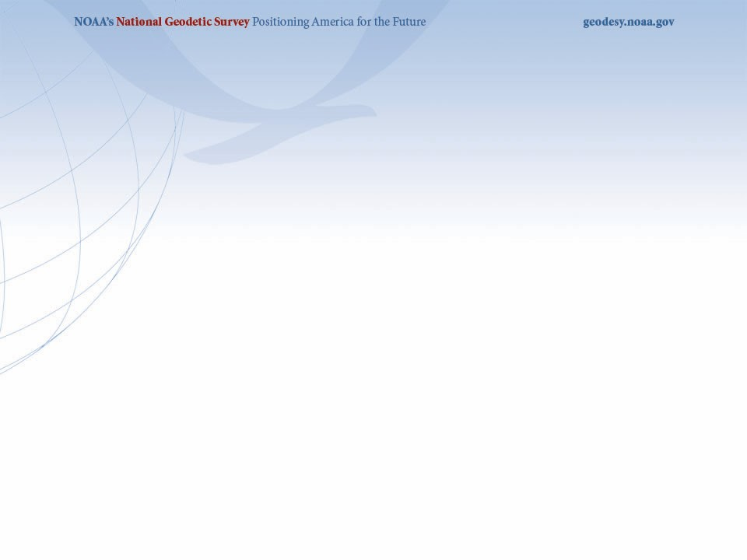


The New 2022 U.S. Datums and
Related Products
University of Florida Geomatics Students Association
March Meeting
March 4, 2021
Denis Riordan, PSM
NOAA, National Geodetic Survey
denis.riordan@noaa.gov

Slide 2
Presentation Topics
1. New 2022 Datums for the U.S.
2. Recent Announcements for NSRS Modernization
3. Coordinate transformations - NCAT
4. State Plane Coordinate System 2022 Project

Slide 3
New 2022 U.S. Geometric Datum

Slide 4
National Spatial Reference System(NSRS)
Improvements in the Horizontal Datums
TIME NETWORK METHOD
NETWORK SPAN ACCURACY OF REFERENCE
NAD 27 1927-1986 10 meter
NAD83(86) 1986-1990 1 meter
NAD83(199x)* 1990-2007 0.1 meter
HARN
NAD83(2007) 2007 - 2011 0.01 meter
(CORS)
NAD83(2011) 2011 - 2022 0.01 meter
(CORS)
TRAVERSE & TRIANGULATION -
GROUND MARKS USED FOR REFERENCING THE NSRS.
TERRESTRIAL BASED
REFERENCE SYSTEM
FOR NSRS
GPS BECOMES MEANS OF POSITIONING – STILL GRND MARKS.
TERRESTRIAL BASED REFERENCED
SYSTEM FOR NSRS
GPS – CORS STATIONS ARE MEANS OF REFERENCE FOR THE NSRS.
SPACE BASED
REFERENCE SYSTEM
FOR NSRS

Slide 5
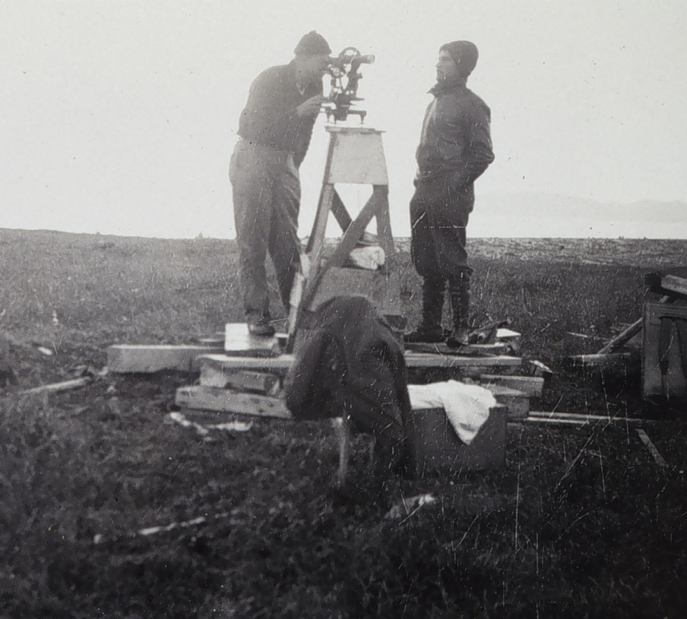
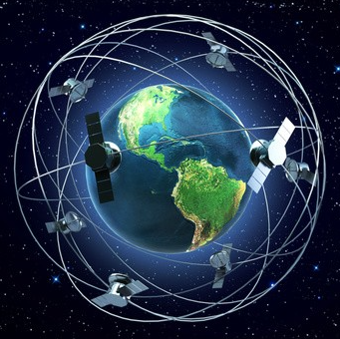
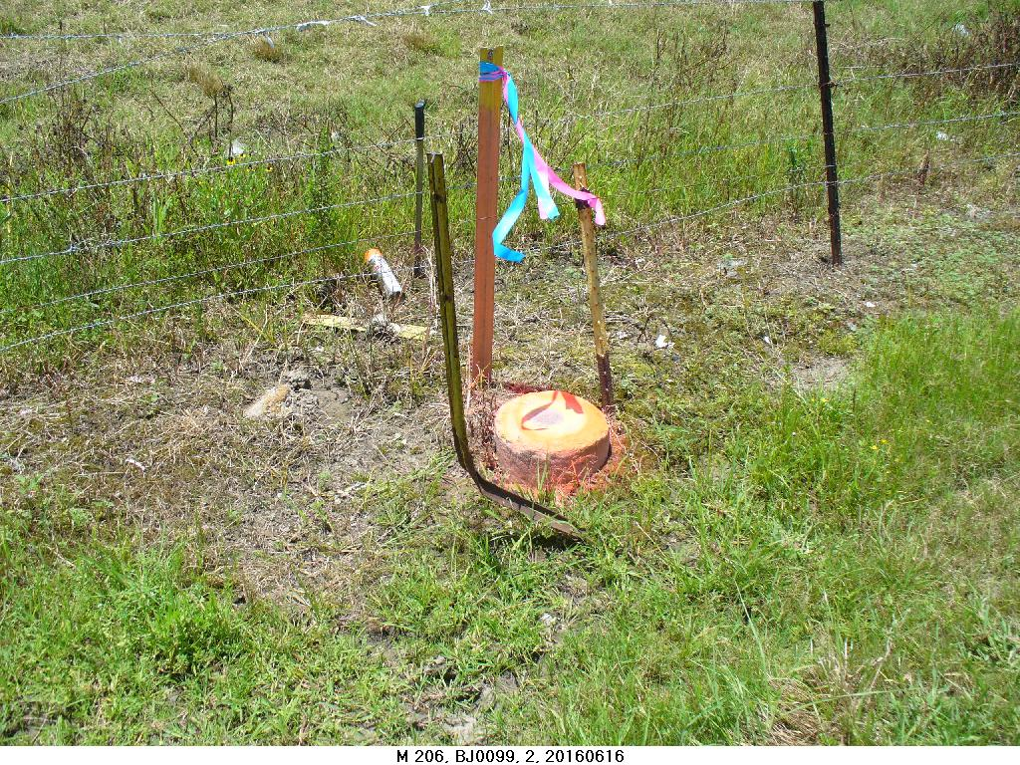
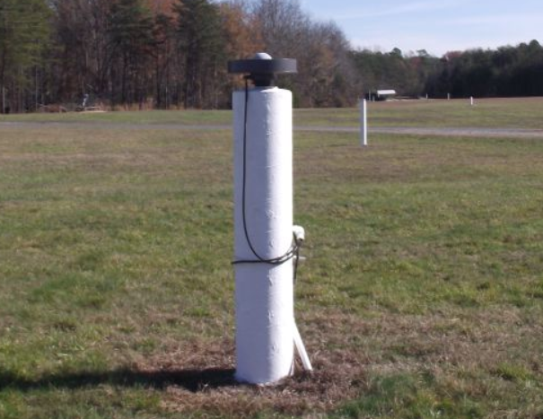
NSRS Reference Basis
Old NSRS Basis - Ground Marks
New NSRS Basis – GPS CORS
Passive Control
Active Control

Slide 6
Why Replace NAD83?
Datum based on best known information about the earth’s size and shape from the early 1980’s (≈40 years old), and the terrestrial survey data of the time.
NAD83 is NON-geocentric & hence inconsistent w/GNSS .
NAD83 is now ≈2.2 m. off from currently know mass center of earth
Replacement is necessary for agreement with current / future capabilities of GNSS positioning.

Slide 7
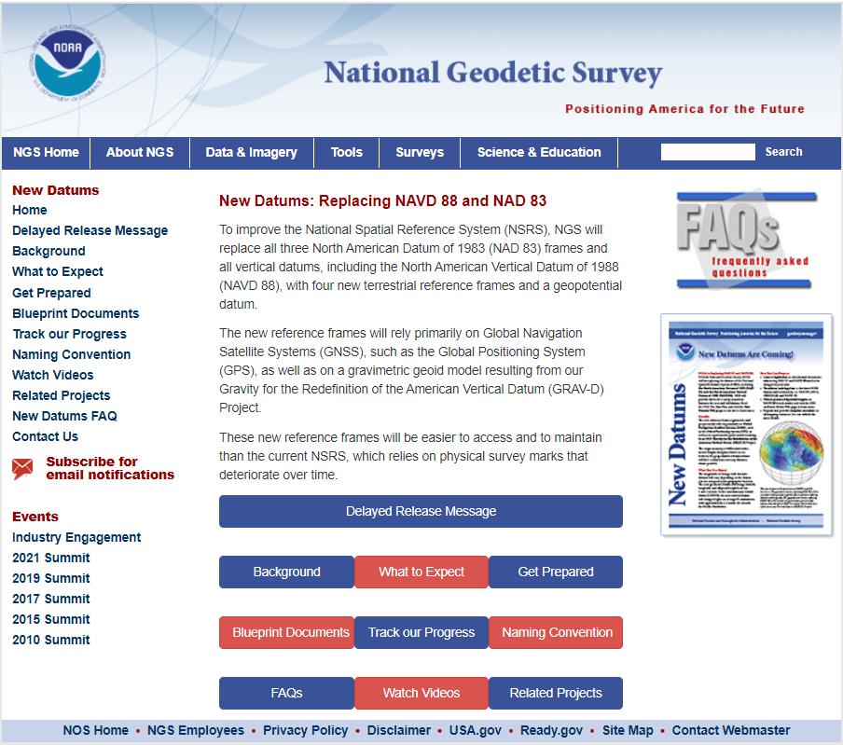
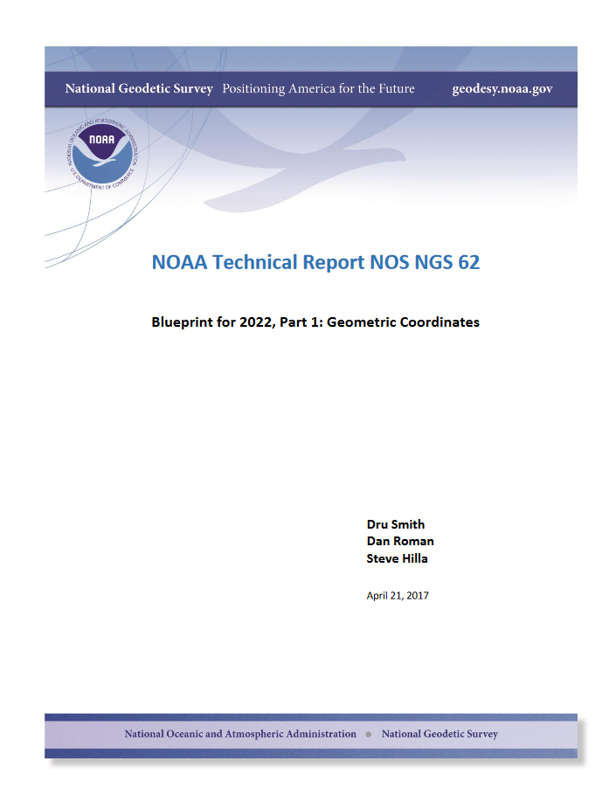
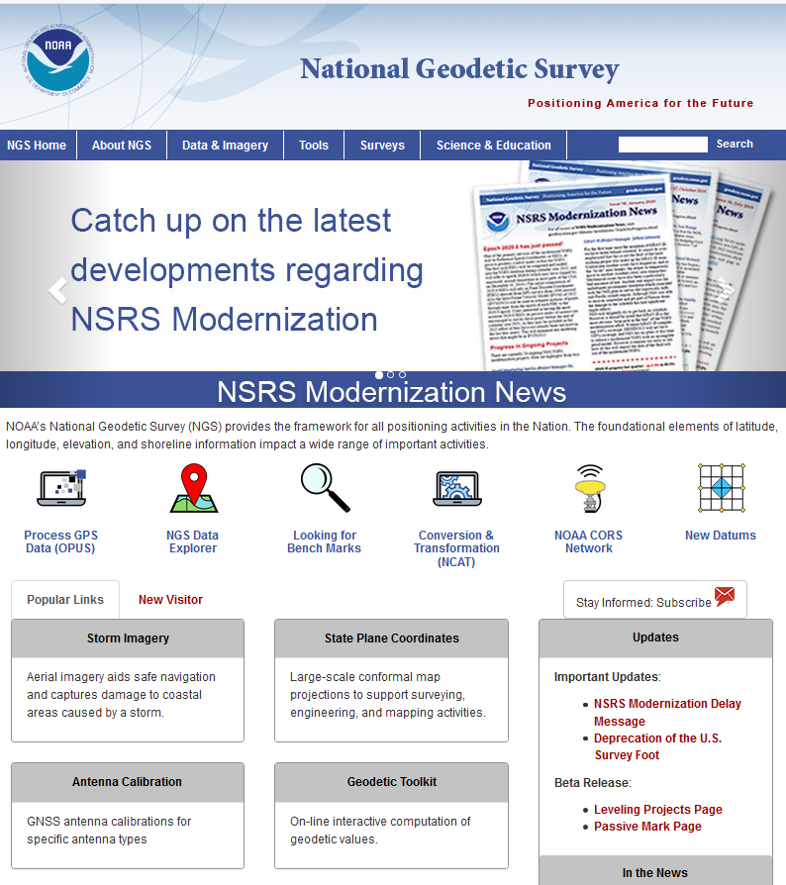

Slide 8
Future Geometric (3-D) Reference Frame
Blueprint for 2022: Part 1 – Geometric Datum
Replace NAD83 with new geometric reference frame.
CORS-based, accessed via GNSS observations.
Coordinates & velocities in ITRF (IGS) & new US reference frame.
      (coordinates in time) (stable coordinates)
  Transformation tools will relate NAD83 to new US reference frame (NCAT with 2022 transformation).

Slide 9
Names and Reference Frames
The Old:
NAD 83(2011)
NAD 83(PA11)
NAD 83(MA11)
The New:
The North American Terrestrial Reference Frame of 2022
(NATRF2022)
The Caribbean Terrestrial Reference Frame of 2022
(CATRF2022)
The Pacific Terrestrial Reference Frame of 2022
(PATRF2022)
The Mariana Terrestrial Reference Frame of 2022
(MATRF2022)

Slide 10
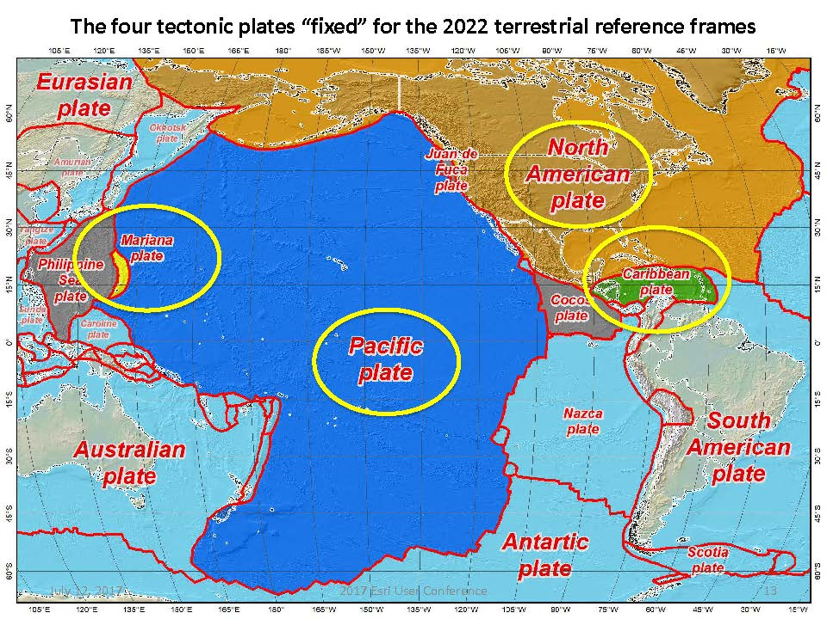
Drift…

Slide 11
NSRS Plate Rotation Modeling
Each frame will get 3 parameters
Euler Pole Latitude
Euler Pole Longitude
Rotation rate (radians / year)
This will be used to compute
time-dependent TRF2022
coordinates from time-dependent
IGS coordinates.
EULER Pole
11

Slide 12
ITRF2020 + EPP2022 = TRF2022
Rotation of the
North American Plate
NATRF2022
CATRF2022
PATRF2022
MATRF2022
Rotation of the
Caribbean Plate
ITRF2020
Rotation of the
Pacific Plate
Rotation of the
Mariana Plate
EPP2022
EPP for “Euler Pole Parameters”
(a way of describing a plate’s rotation)

Slide 13
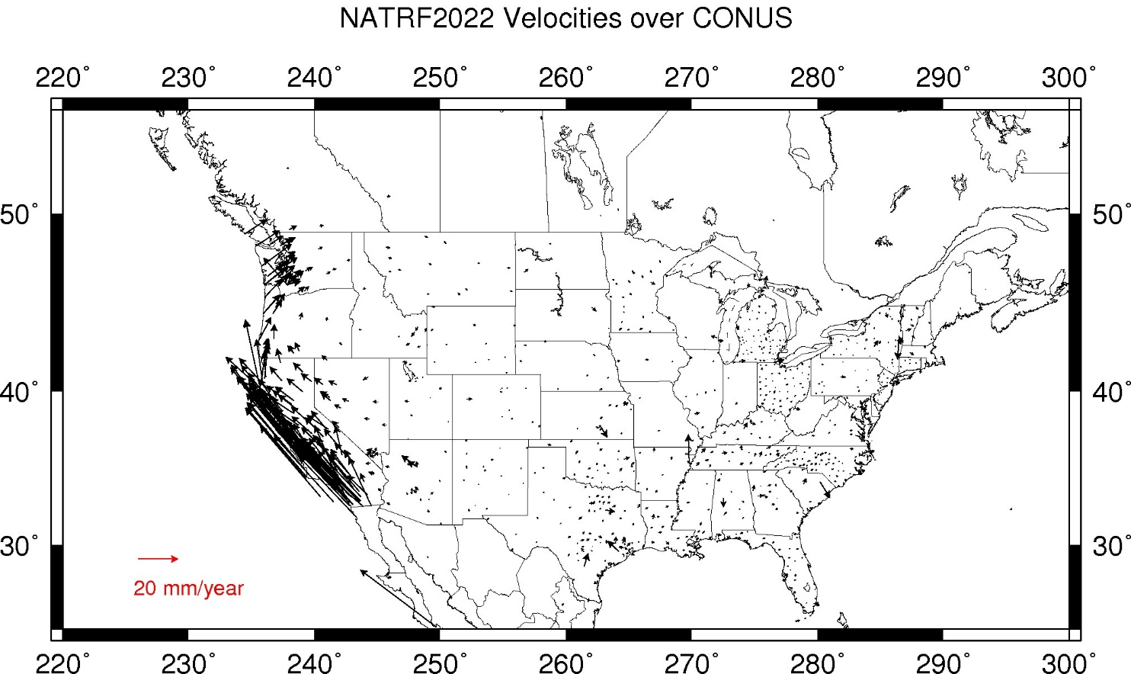
CORS Velocities – IGS08
Crustal motion to be removed by Intra Frame Velocity Models for each TRF.
Notes:
These velocities were arrived at by taking IGS08 velocities and removing the 3 parameter Euler Pole rotation of the North American plate as currently known (ITRF08 plate motion model).
These residual velocities will then be modeled into the IFVM for NATRF2022

Slide 14
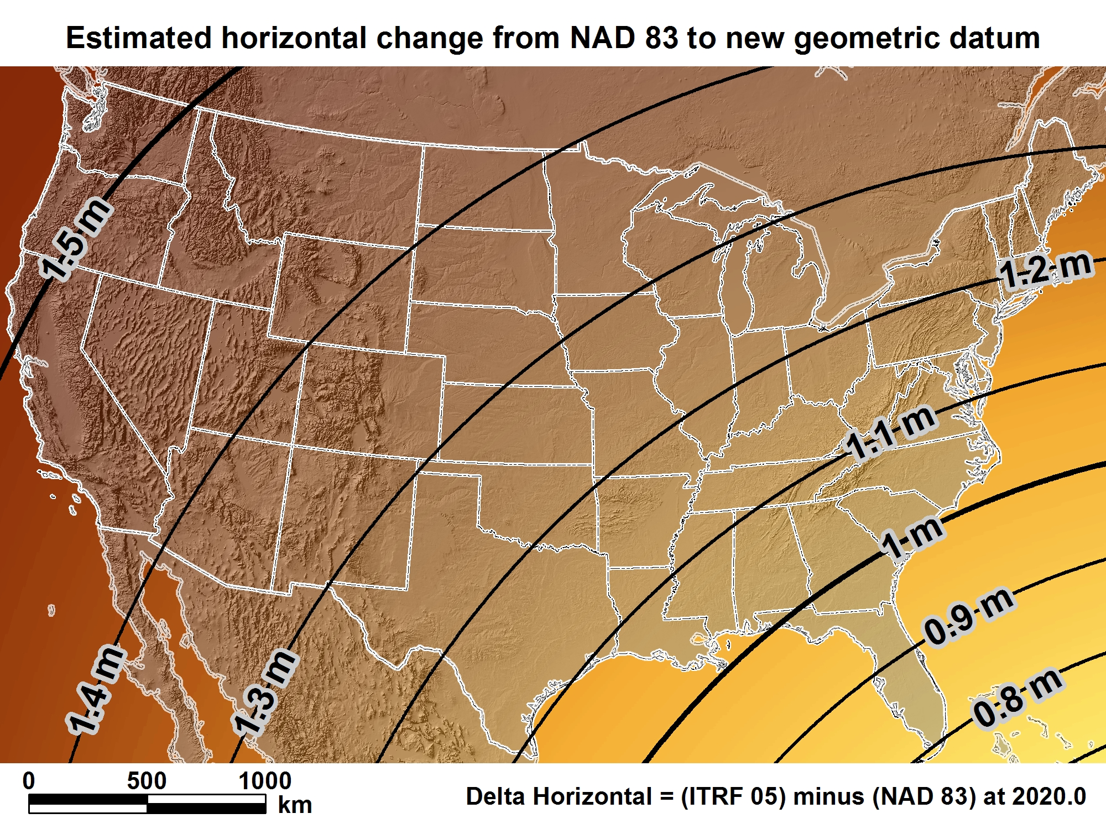
NATRF2022
New geometric datum minus NAD 83 (horizontal)
For Florida = 0.8 > 1.02 m (2.6 > 3.3 ft.)

Slide 15
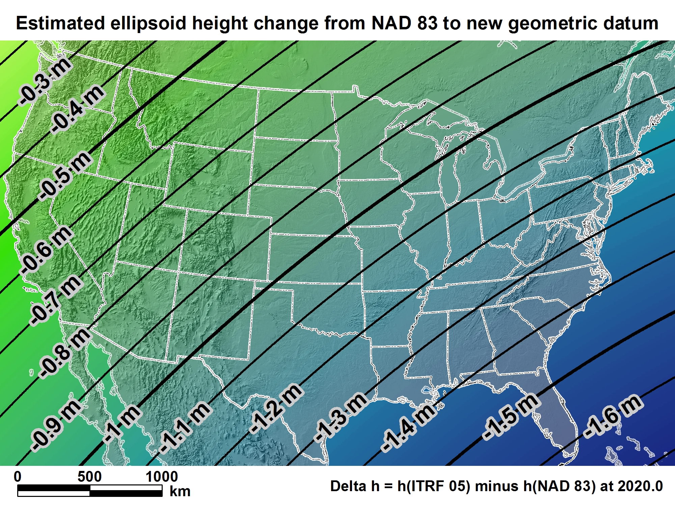
NATRF2022
For Florida = -1.39 > -1.62 m (-4.5 > -5.3 ft.)

Slide 16
New 2022 U.S. Vertical Datum

Slide 17

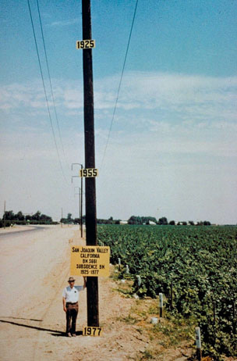
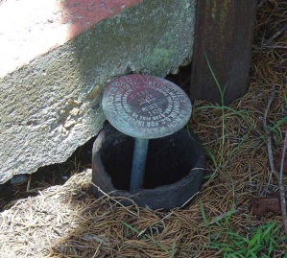
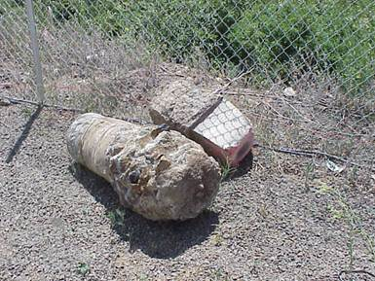
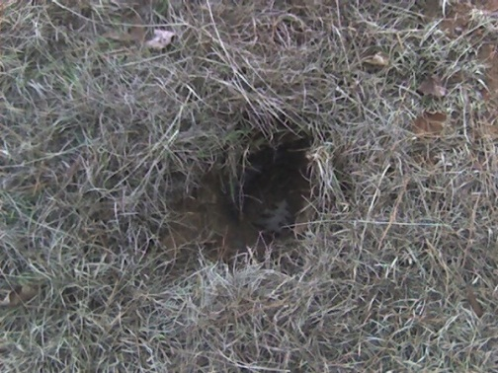
Why isn’t NAVD 88 good enough anymore?
* NAVD 88 is a terrestrial based vertical datum that changes as the land changes.
NAVD 88 suffers from use of bench marks that:
  Are almost never re-checked for movement
  Disappear by the thousands every year
  Are not funded for replacement
  Are not necessarily in convenient places
  Don’t exist in most of Alaska
  Were determined by leveling from a single point, allowing cross-country error build up

Slide 18
Can NAVD 88 be fixed?
Long term fix: Re-level some/all of NAVD 88
  81,500 km of 1st order leveling at least
  625,000 km of mixed 1st and 2nd order leveling
Re-leveling NAVD 88 estimated to cost between
  $200 Million and $2 Billion
Time factor in that amount of leveling
Still would have problems related to passive control
Notes:
Re-leveling NAVD 88 won’t fix:
Sparseness of the bench marks
Continued subsidence or uplift of bench marks
Destruction of bench marks
Canada’s decision not to adopt NAVD 88
Whatever errors caused a continent-wide 1 meter build up in the leveling the first time around

Slide 19
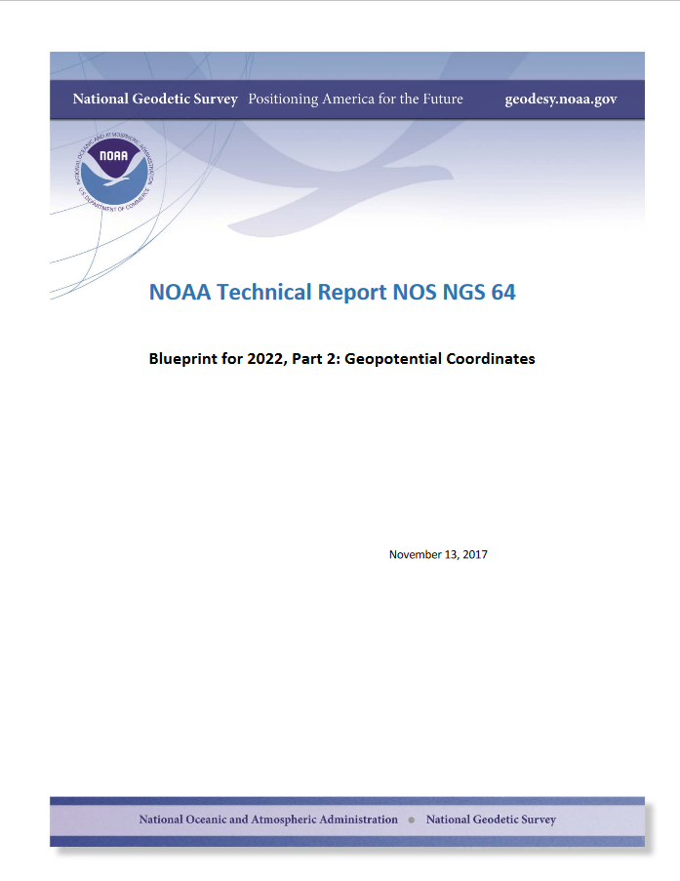

Slide 20
NEW VERTICAL DATUM (Rationale)
  A move away from differentially leveled passive control as the defining mechanism of the reference surface
  To be consistent with the shift in the geometric reference frame/ellipsoid (2022)
  Improvement in our technical abilities in reference surface realization (geopotential gravimetric reference surface - 1cm accuracy of the geoid (GNSS/GRAV-D))
  Goal - ability to establish 2cm orthometric height anywhere in U.S. using a minimum of 15 min. of GNSS data.
  The new geopotential reference surface will be aligned with the geometric reference frame/ellipsoid (i.e., no hybrid geoid)

Slide 21
Names
  The Old:
  NAVD 88
  PRVD 02
  VIVD09
  ASVD02
  NMVD03
  GUVD04
  IGLD 85
  IGSN71
  GEOID12B
  DEFLEC12B
Orthometric
Heights
  The New:
  The North American-Pacific Geopotential Datum of 2022 (NAPGD2022)
  * A gravity based datum.
Normal
Orthometric
Heights
Dynamic
Heights
Gravity
Geoid
Undulations
Deflections of
the Vertical

Slide 22

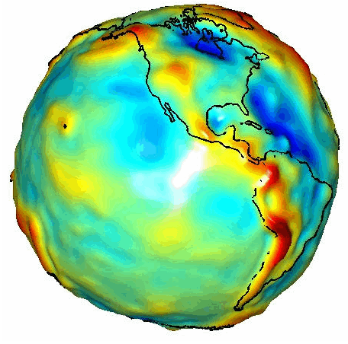
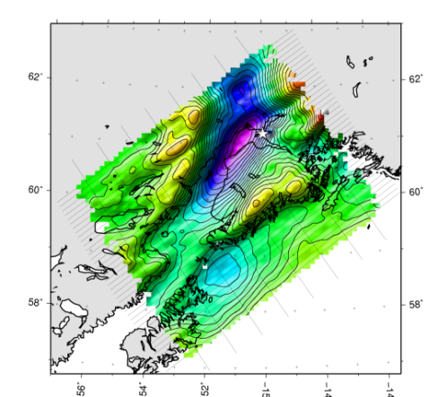

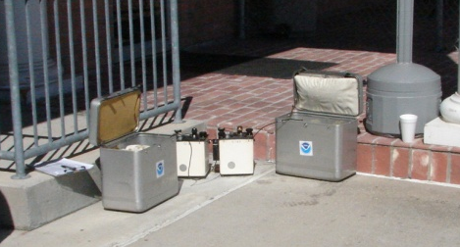
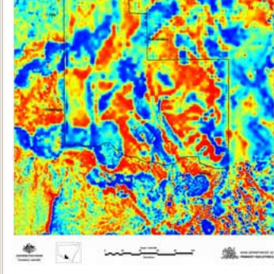
Building a Gravity Field
Long Wavelengths
(≥ 250 km)
GRACE/GOCE/Satellite Altimetry
+
Intermediate Wavelengths
(500 km to 20 km)
Airborne Measurement
+
Short Wavelengths
(< 100 km)
Surface Measurement and
Predicted Gravity from Topography
Notes:
Give example of how short wavelength information is like low altitude aerial photos (1/2” pixel accuracy) in that it provides very accurate and detailed information. The long wavelength gravity can be likened to the old LANDSAT imagery (3 meter pixel accuracy) in that it was good over large areas, but didn’t give much detail for local areas. The intermediate wavelength gravity data gives us a connection between the two (the short and long), allowing the NGS gravity team to use all available gravity information in working toward the production of a 1 cm accurate gravitational surface.

Slide 23
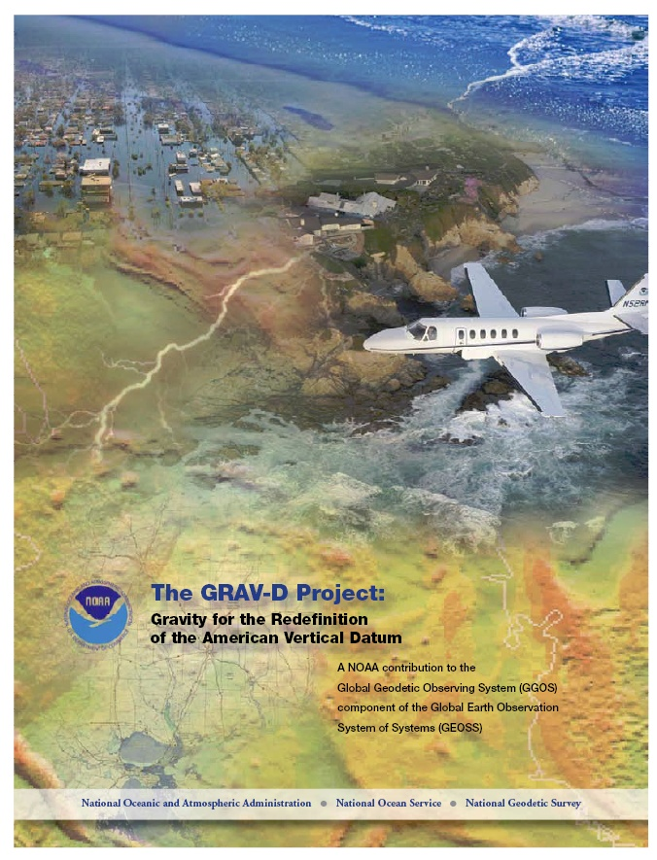
Gravity for the Redefinition of the American Vertical Datum (GRAV-D)
Replace the Vertical Datum of the USA by 2022 (at today’s funding)
GRAV-D is:
  An airborne gravity survey of the entire country and its holdings
  A 2022 gravimetric geoid accurate to 1 cm
  Long-term monitoring of geoid change over time
  Partnership surveys
Working to launch a collaborative effort with the USGS for simultaneous magnetic measurement
Acting Proj. Manager: Jeffery Johnson
Jeffery.Johnson@noaa.gov
Gravity and Heights are
inseparably connected
Notes:
GRAV-D is the NGS project designed to replace NAVD88 with a vertical datum based upon a gravimetric geoid accurate to 1 cm. Heights above this datum will be accessed via GNSS measurements. Three thrusts of project. Launch USGS collaboration for simultaneous mag measurement.

Slide 24
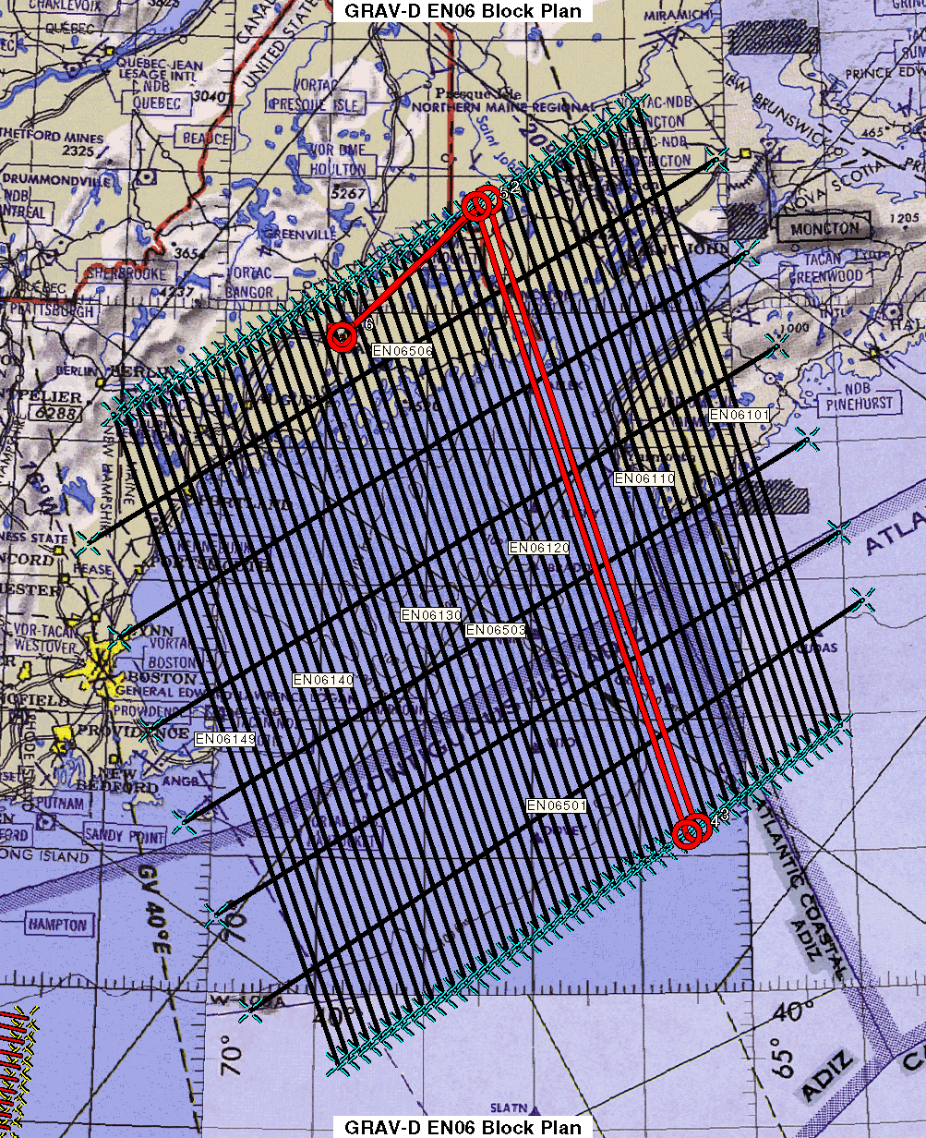
Survey and Block Plans
Data lines spaced 10 km apart.
Cross lines spaced 60-80 km apart.
Flight lines run 100-150 km offshore.
Flight altitude 20,000 ft.
Notes:
Block layout based on aircraft, adjust size of block if needed

Slide 25
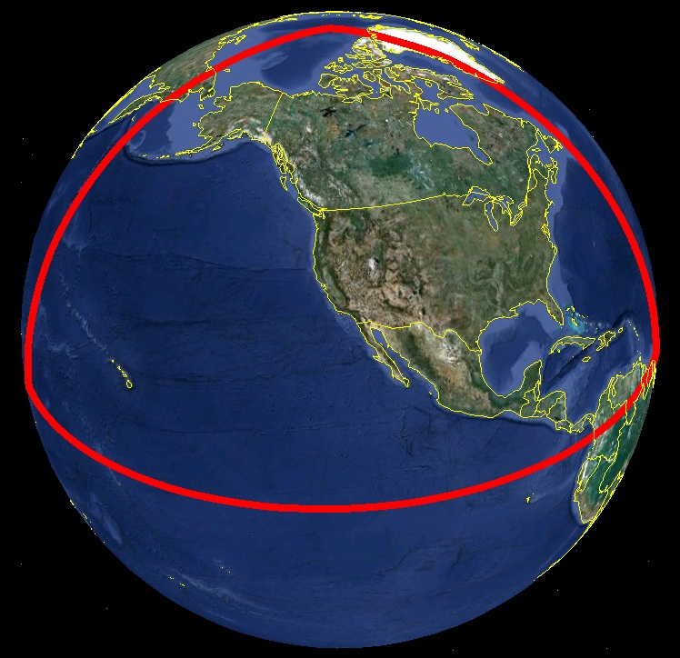
Extent of 2022 gravimetric geoid model used for NAPGD2022

Slide 26
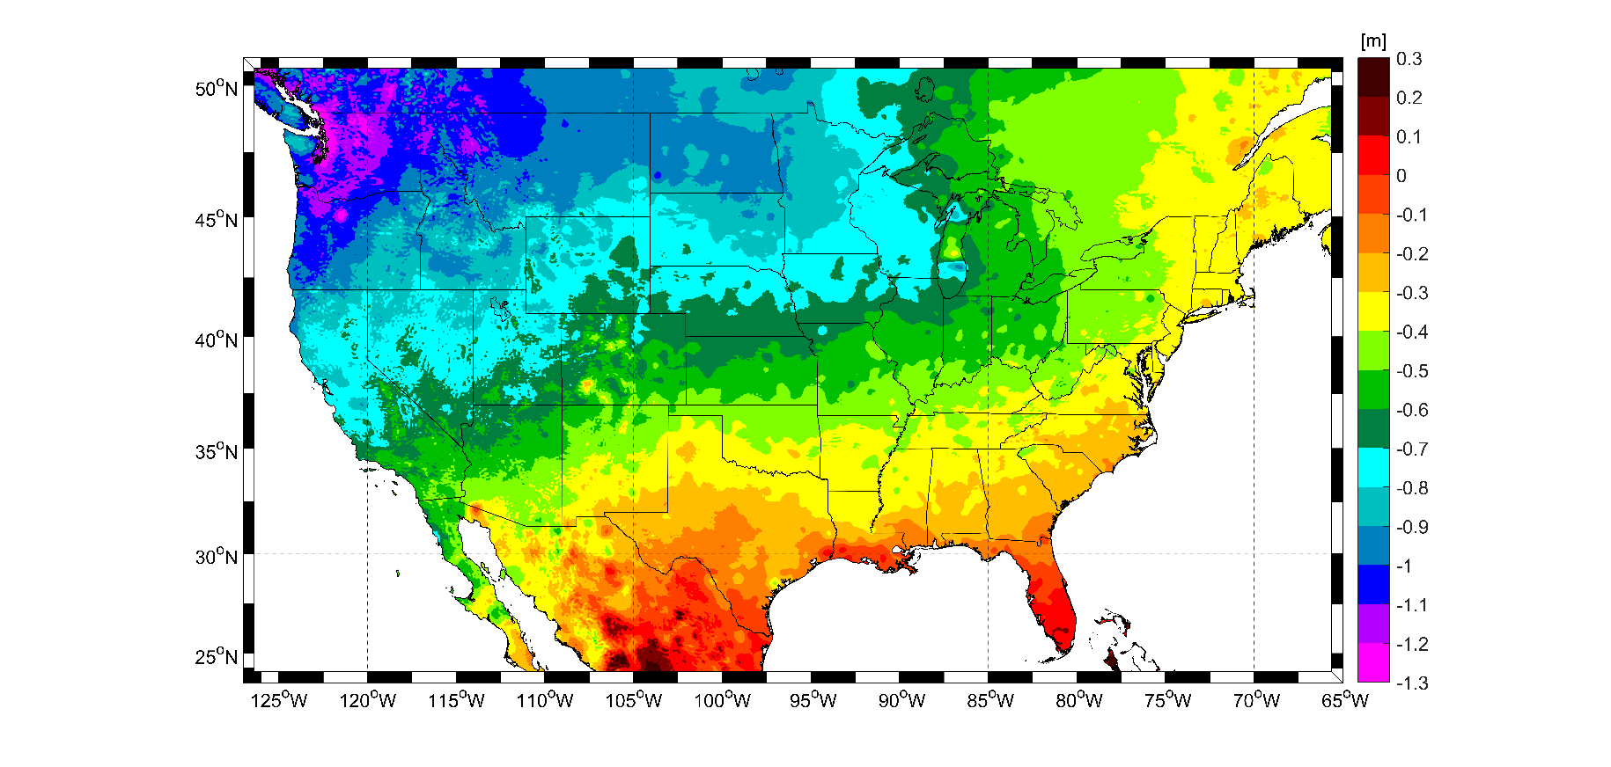
Expected changes to orthometric heights – NAVD88 to NAPGD2022
For Florida = 0.1 > -0.3 m (4 > -11 in.)

Slide 27
Geoid Monitoring Service (GeMS)
Goal: Track all changes to the geoid which would prevent 1 cm accuracy
Aspects included:
  Shape, Secular: e.g. Hudson Bay
  Shape, Episodic: e.g. Massive Earthquakes
  W0, Secular: Global Sea Level Change (see next slides)
Examples of things excluded:
  Size, Secular: Mass quantity of Earth is effectively static
  Shape, Periodic: Seasonal glacier cycle
Bottom Line: An accurate, up-to-date, and maintainable vertical datum.

Slide 28
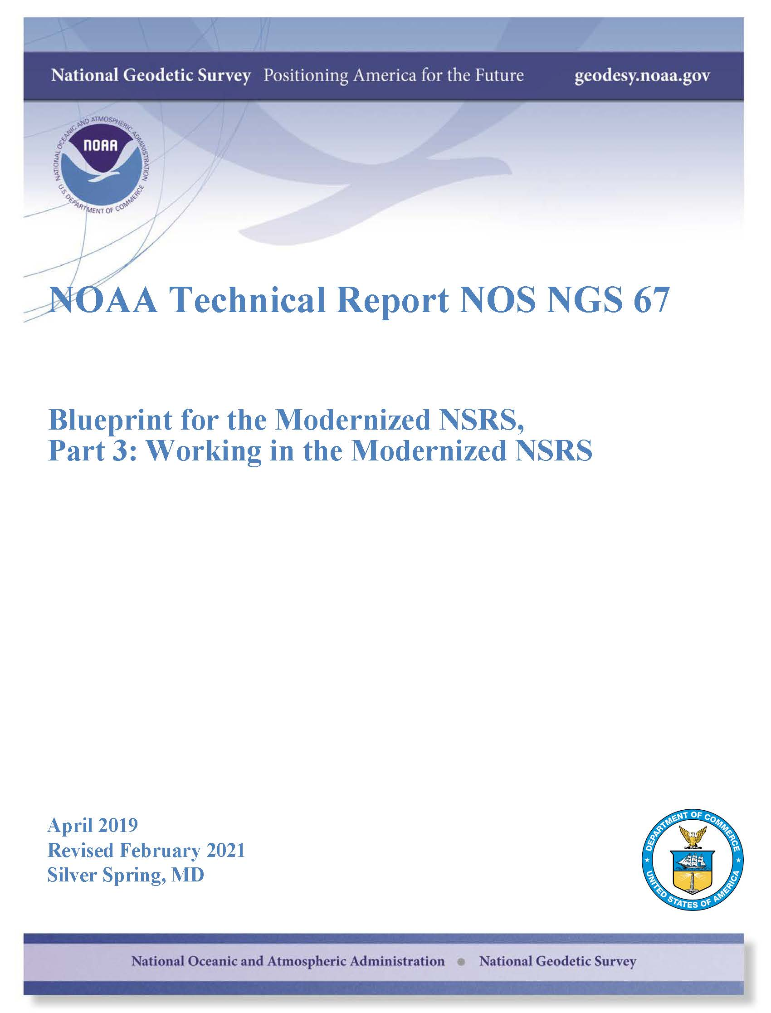

Slide 29
Delayed Release of Modernized NSRS

Slide 30
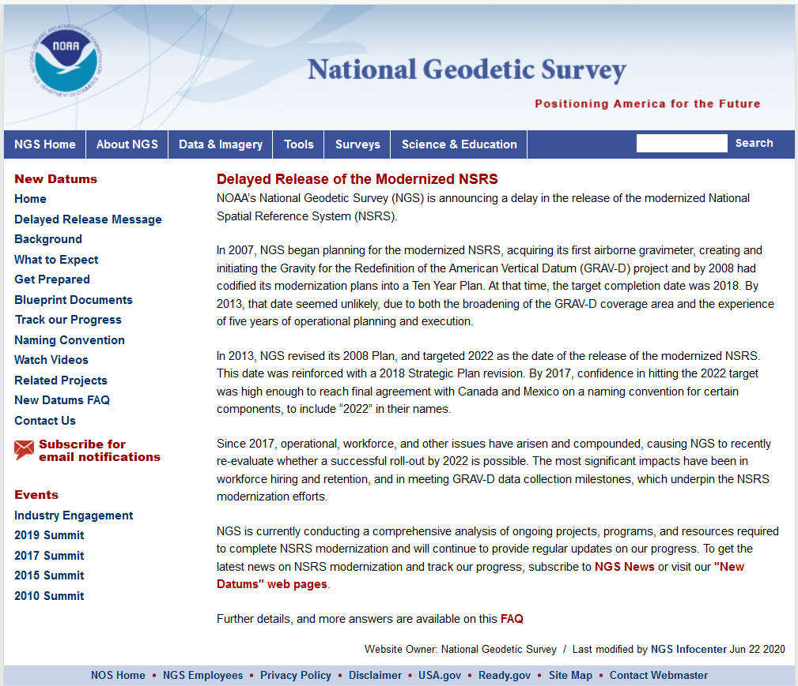

Slide 31
Conclusion
The modernized NSRS is delayed beyond 2022
  Most likely into the 2024-2025 timeframe
There is no way to accelerate this
  Can’t make people work faster or harder when they are already at maximum capacity
  Can’t make the troubles of 2020 go away
Want release of modernized NSRS to be correct, to support related NGS Products, and to enable / support the Geospatial community.

Slide 32
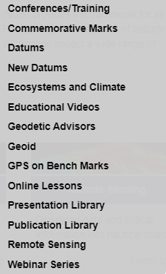
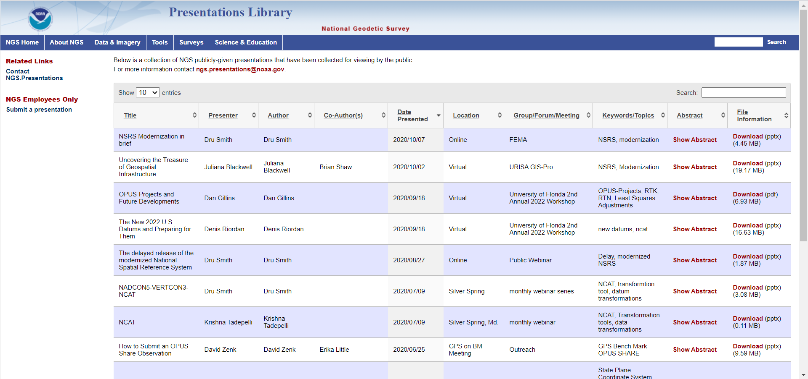
For More 2022 Datums Information, See..

Slide 33
NGS Products Update
Coordinate Conversion and Transformation Tool – NCAT using NADCON v5.0

Slide 34
Conversion or Transformation?
Historically NGS has been a little inconsistent about these two words. Going forward, we will use them as:
  Conversion: Changing the type of coordinate without changing the datum or frame
    e.g. change NAD 83(1986) latitude and longitude to NAD 83(1986) State Plane Coordinates
  Transformation: Changing the datum or frame, without changing the type of coordinate
    e.g. changing an NAD 27 latitude & longitude to an NAD 83(1986) latitude & longitude

Slide 35
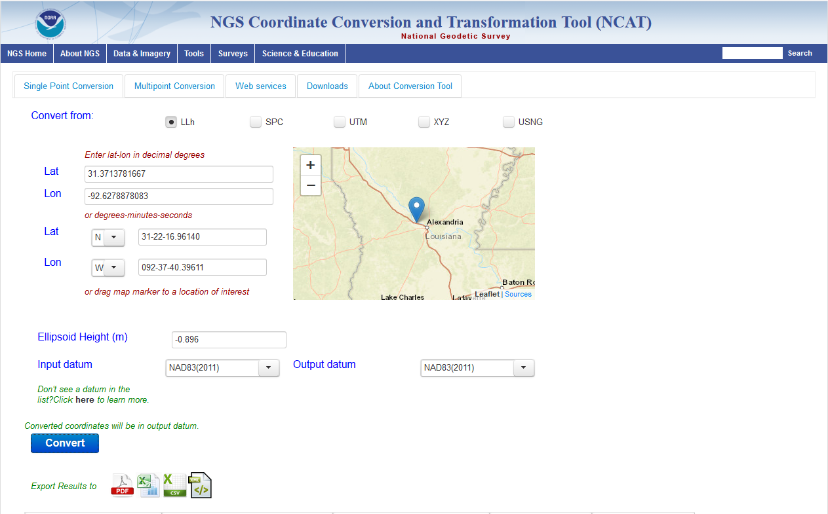
NCAT - Updated coordinate transformation program - NAD27 -> NAD83 (2011), also ready for 2022.

Slide 36
X, Y, Z
φ, λ, h
Region: CONUS
φ, λ, h
2022
X, Y, Z
SPC
UTM
USSD
USNG
UTM
φ, λ, h
GEOCON 11
φ, λ, h
NAD 27
NAD 83 (2011)
X, Y, Z
SPC
X, Y, Z
SPC
USNG
UTM
NADCON
GEOCON
USNG
UTM
NAD 83 (NSRS2007)
φ, λ, h
NAD 83 (1986)
φ, λ, h
NAD 83 (FBN)
NAD 83 (HARN)
φ, λ, h
X, Y, Z
SPC
X, Y, Z
SPC
φ, λ, h
USNG
UTM
USNG
UTM
X, Y, Z
SPC
X, Y, Z
SPC
USNG
UTM
USNG
UTM

Slide 37
X, Y, Z
φ, λ, h
Region: CONUS
NADCON 5 connections in RED
φ, λ, h
2022
X, Y, Z
SPC
UTM
USSD
NCAT (NADCON 5)
USNG
UTM
φ, λ, h
φ, λ, h
NAD 27
NAD 83 (2011)
X, Y, Z
SPC
X, Y, Z
SPC
USNG
UTM
USNG
UTM
NAD 83 (NSRS2007)
φ, λ, h
NAD 83 (1986)
φ, λ, h
NAD 83 (FBN)
NAD 83 (HARN)
φ, λ, h
X, Y, Z
SPC
X, Y, Z
SPC
φ, λ, h
USNG
UTM
USNG
UTM
X, Y, Z
SPC
X, Y, Z
SPC
USNG
UTM
USNG
UTM

Slide 38
NGS State Plane Coordinates System -
2022 Project

Slide 39
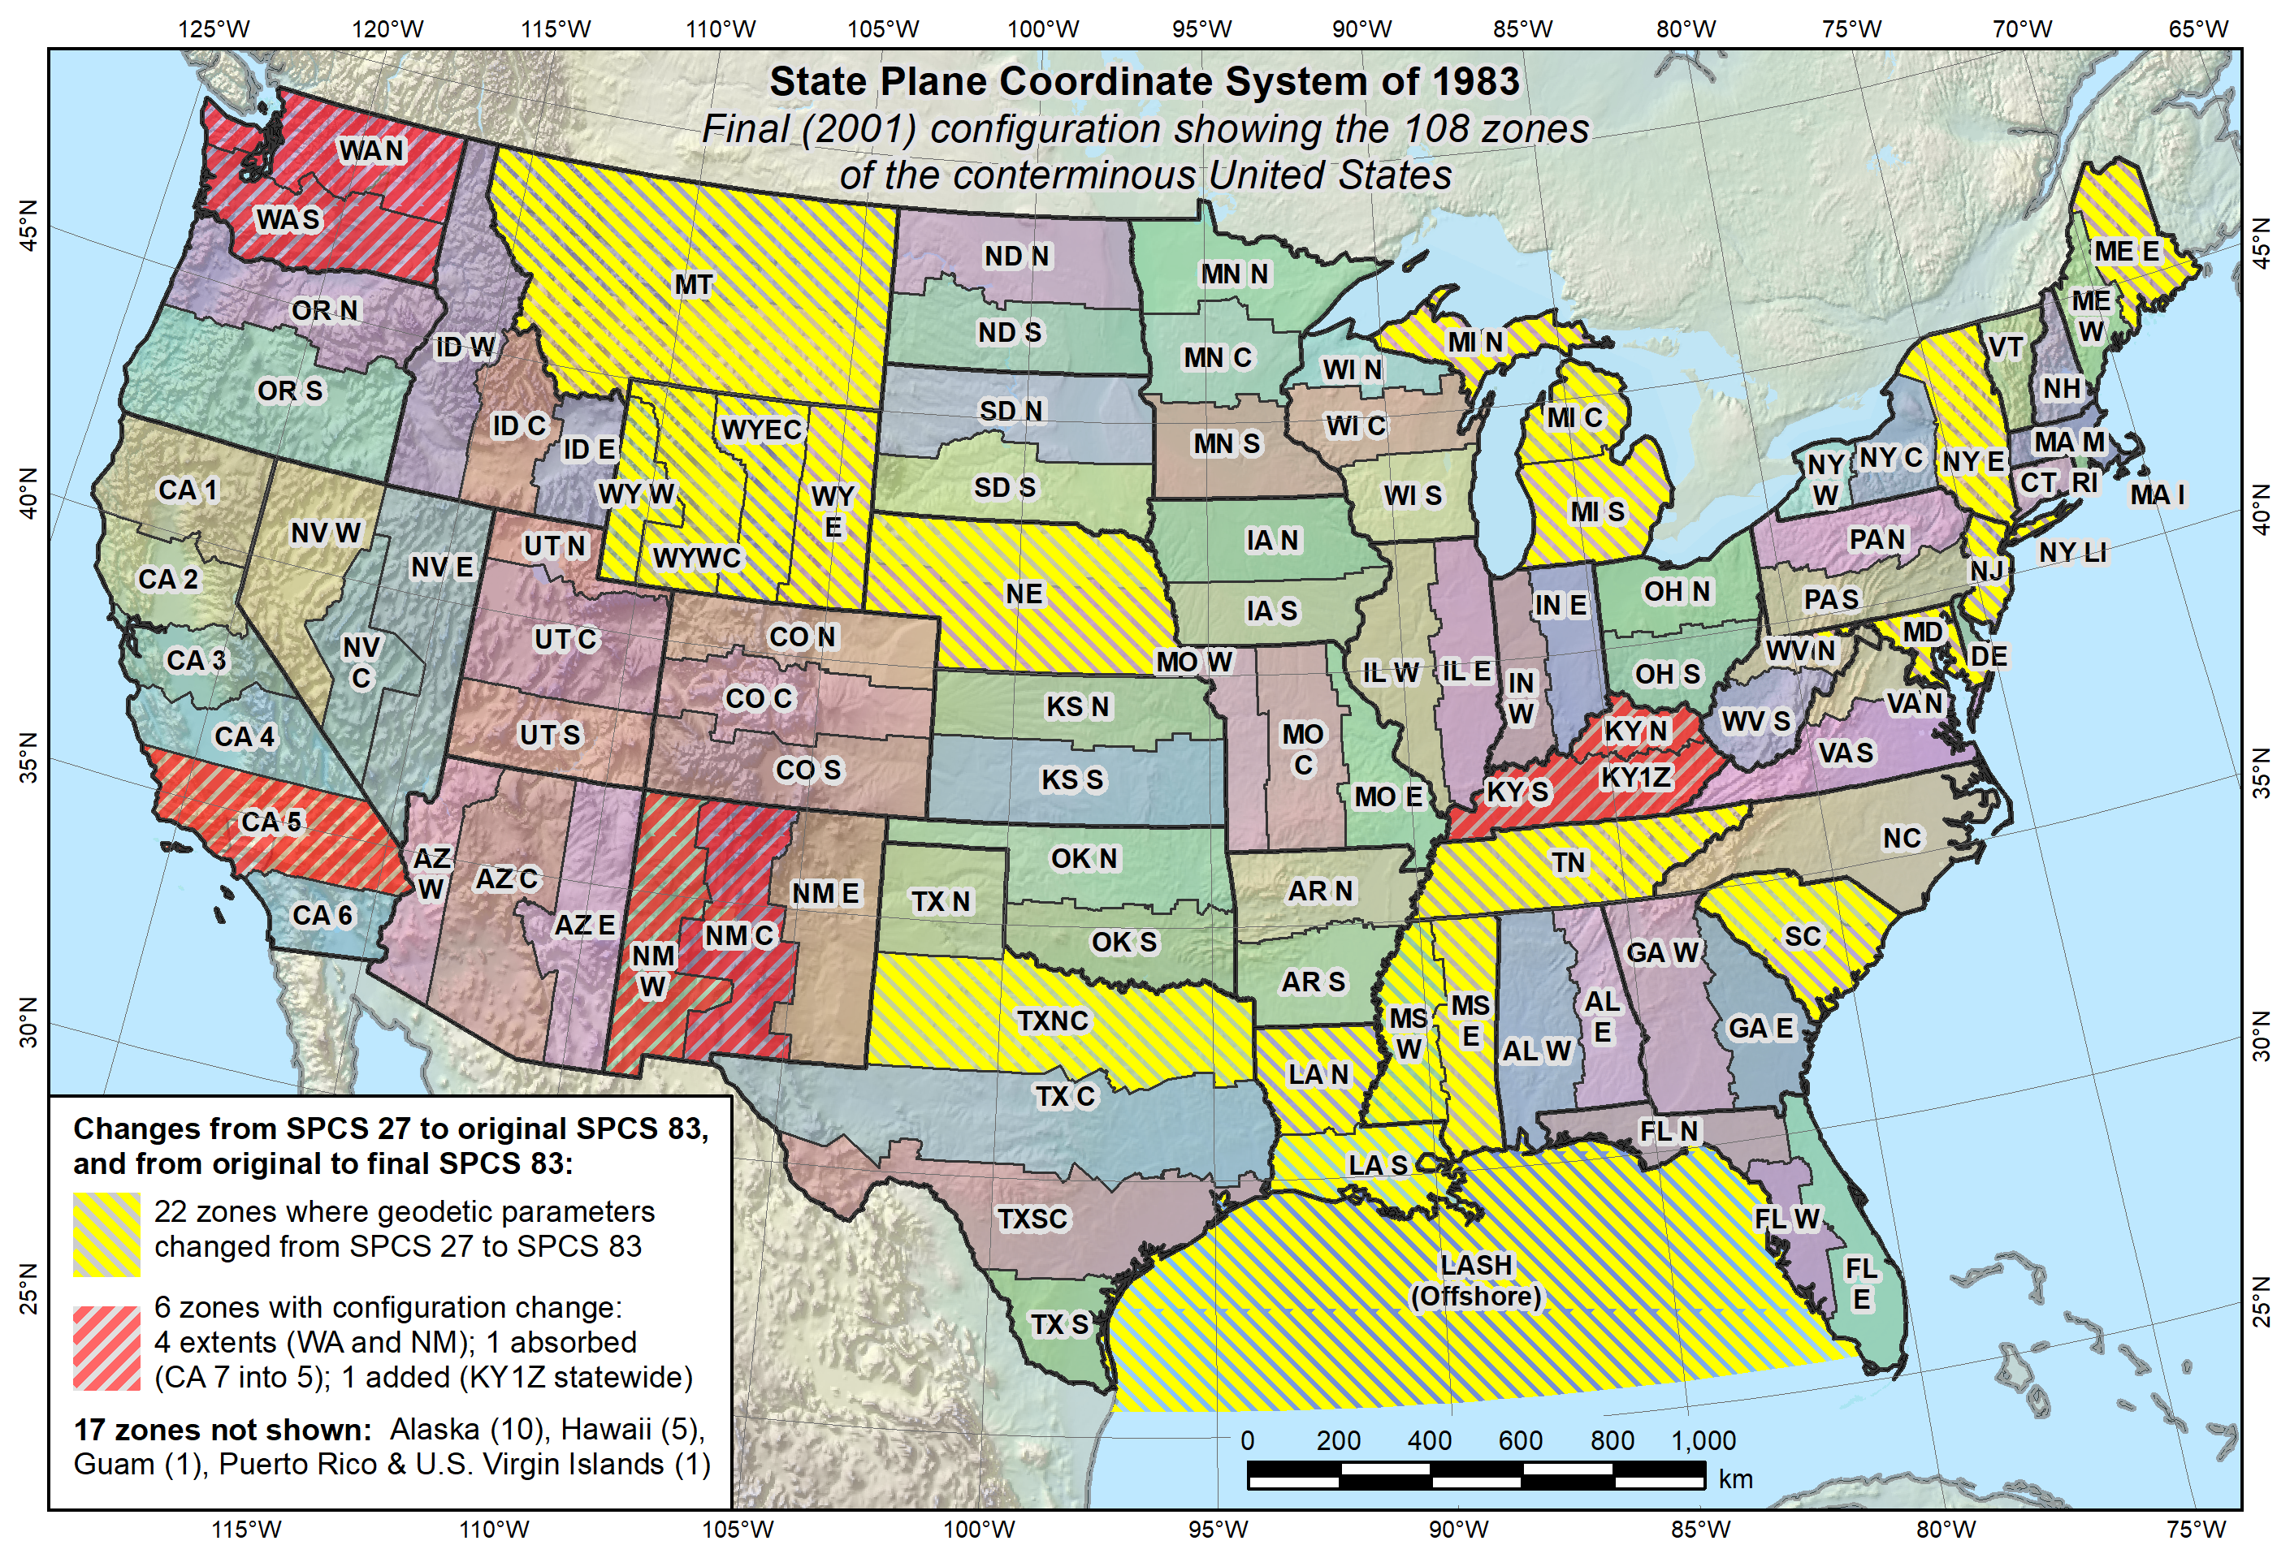
Final SPC 83 State Systems - 2001

Slide 40
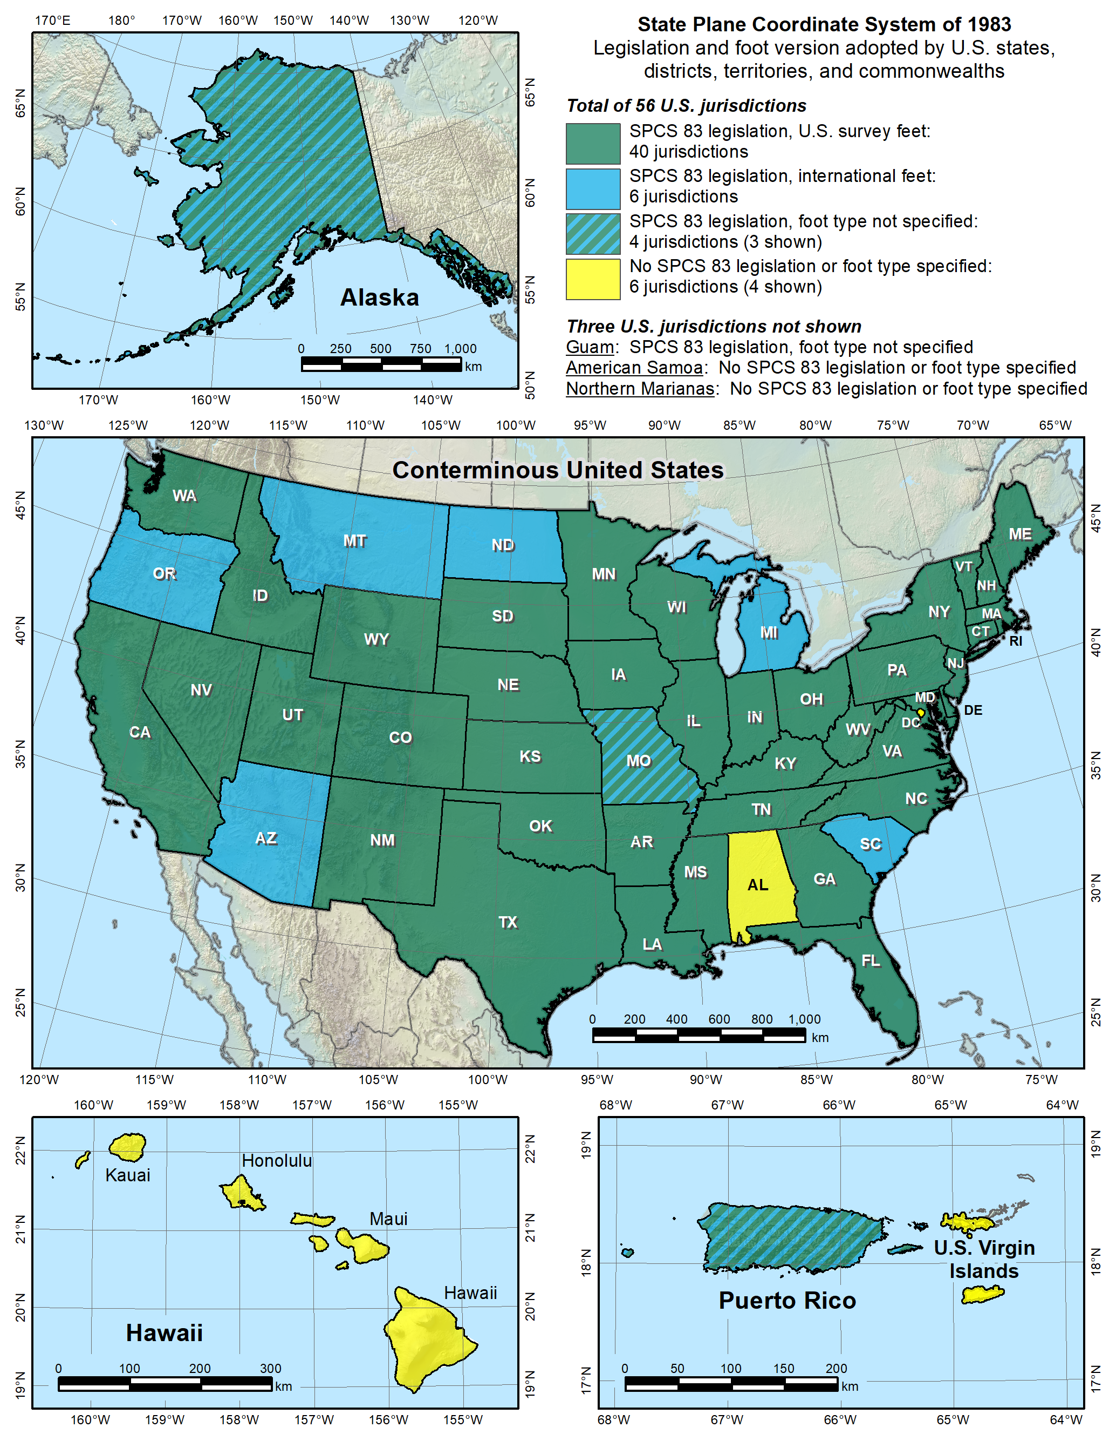
SPC 83 – Legislation & Foot Version

Slide 41

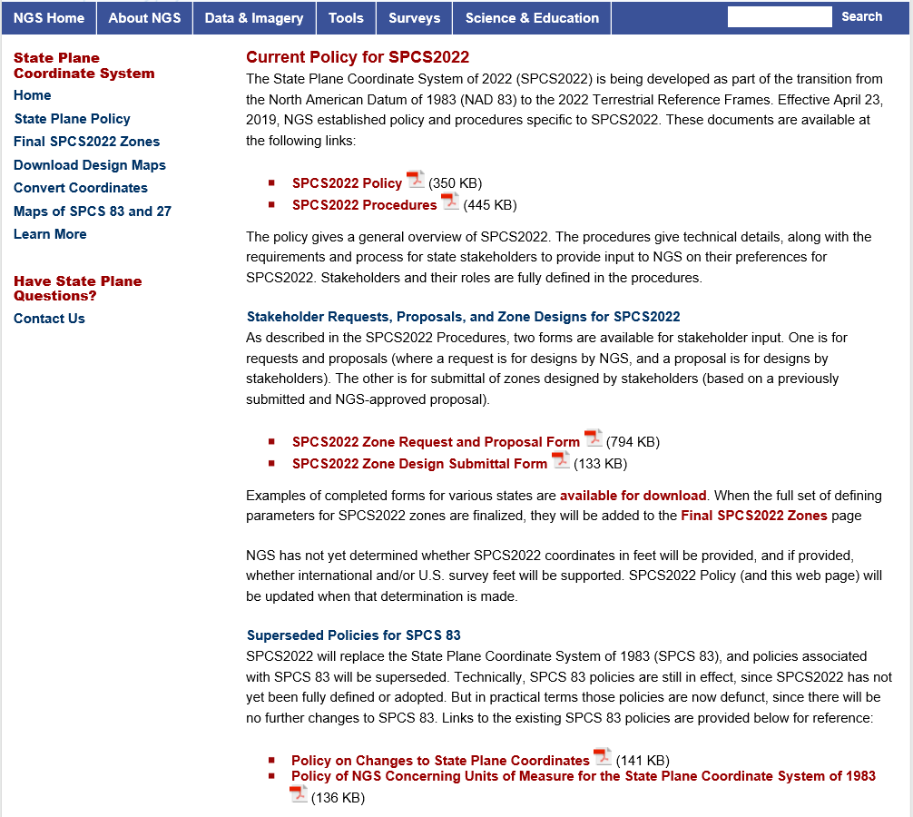

Slide 42
New State Plane Coordinate System (SPCS)
SPCS2022 characteristics different from SPCS 83:
  Minimize distortion at topo surface, not ellipsoid
  Up to 3 zone “layers” allowed (including an LDP layer)
  Coordinate changes of at least 10,000 m everywhere
  Longitudes defined as positive east (0°->360°)
    (Gainesville = 360° - 82° = 278° E)
Notes:
SPCS2022 is referenced to 2022 TRFs and thus part of new “datums”, and will replace existing SPCS 83 (referenced to NAD 83)
Similar to SPCS 83 in some ways:
Designed by state, using same reference ellipsoid and same projection types
Differs from SPCS 83 in other ways:
Designs minimize distortion at topographic surface rather than ellipsoid surface (reduces distortion where system is actual used)
NGS will design default zones for every state, and default zones corresponding to existing SPCS 83 zones for states that do not request or propose something different
Can have up to 3 zone layers (where one layer must be a statewide zone). The other layers can be default zones and/or LDP zones (but not designed by NGS). Only one layer can be discontinuous (i.e., zones do not completely cover a state); it is expected that discontinuous layers will always be LDP zones.
“Special use” zones are for major urban areas, American Indian reservations, or federal jurisdictions/applications that fall in more than one state. These must eb approved by the NGS Director on a case-by-case basis.
The stakeholder role is vitally important for states that want something other than default zones. But all requests and proposals from stakeholders must be unanimous to become part of SPCS2022.

Slide 43
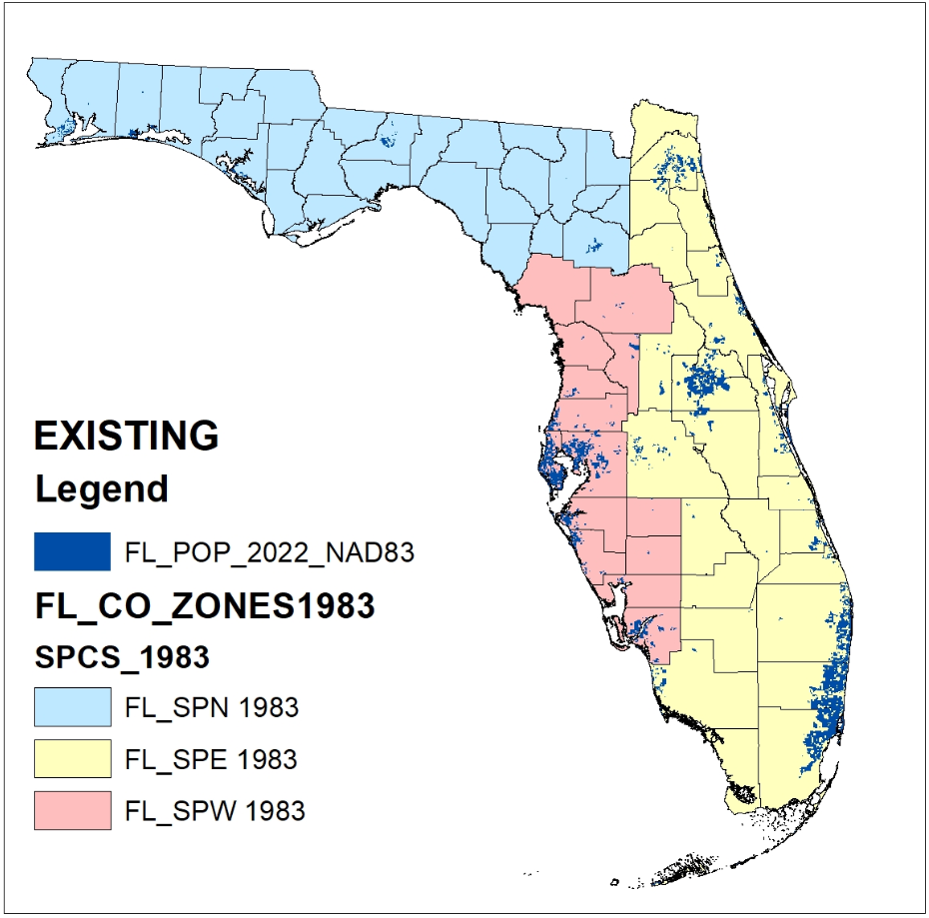
EXISTING FL
NAD83 SPCS

Slide 44
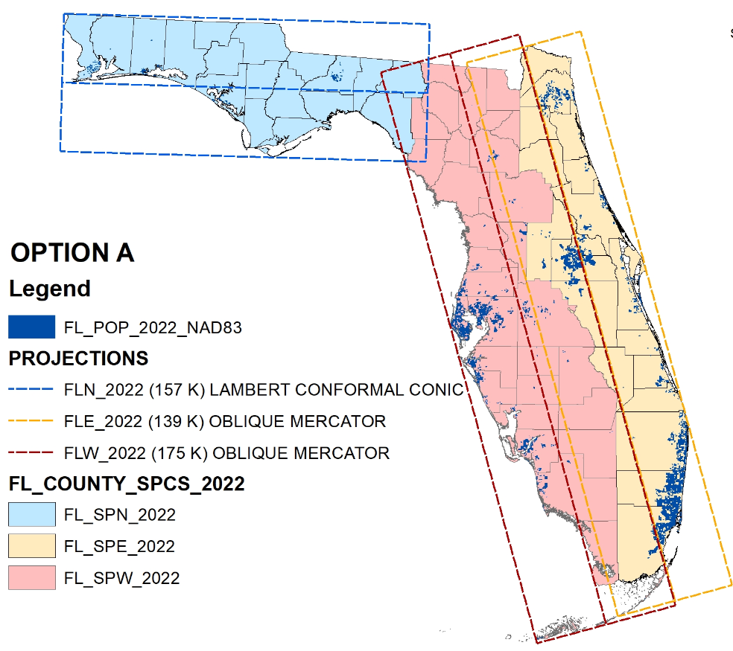
FL 2022 SPCS
MULTI-ZONE LAYER

Slide 45
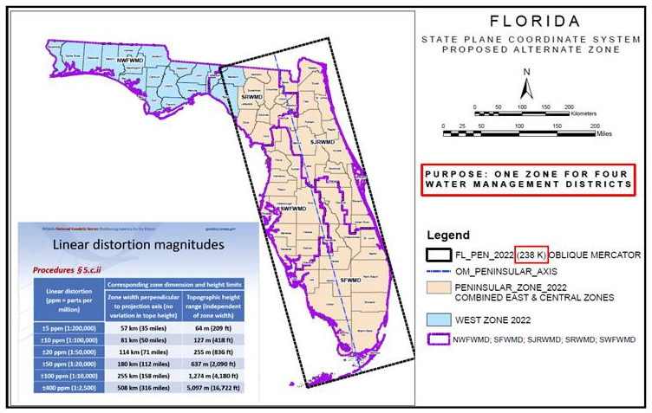
FL 2022 SPCS
PENINSULA ZONE
LAYER

Slide 46
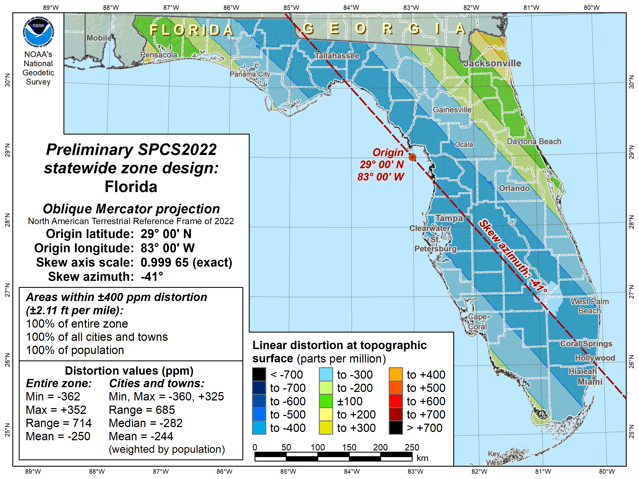

Slide 47
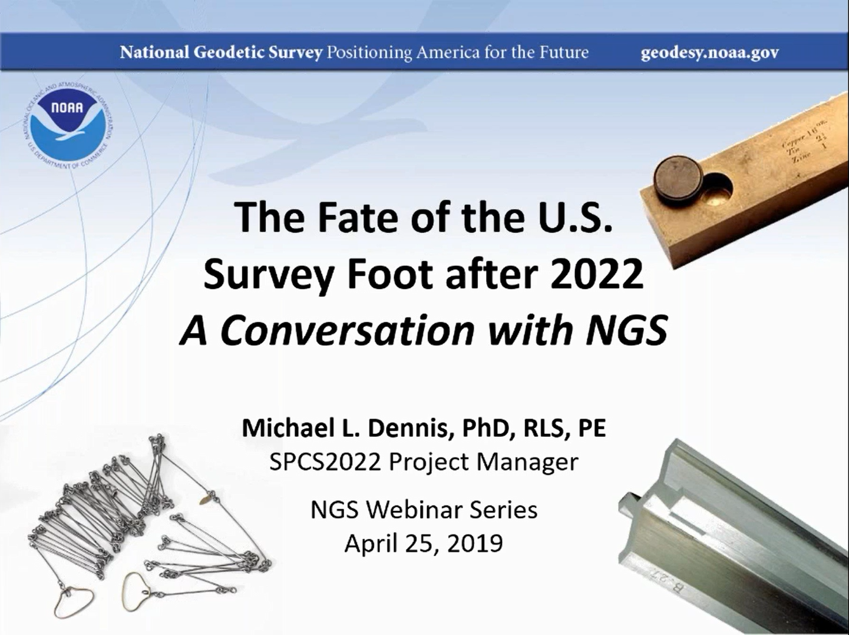

Slide 48
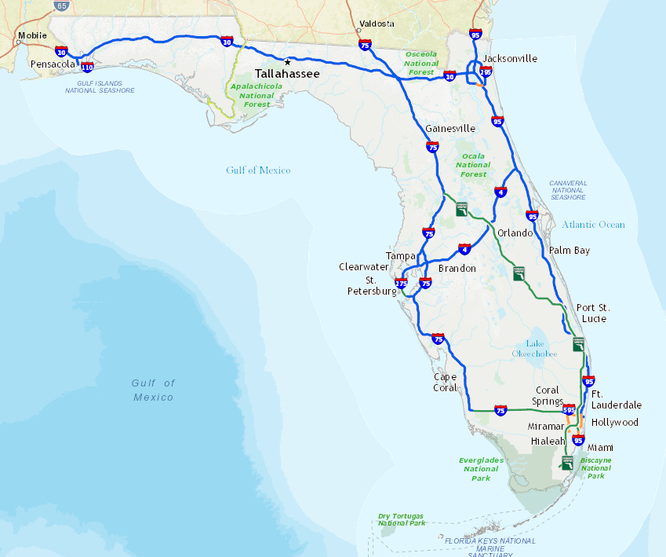
Pensacola
Jacksonville
≈ 534.700 Km
534,700 meters
= 1,754,265.1 iFt.
= 1,754,261.6 sFt.
Diff. = 3.5 ft.
≈ 2 ± ppm
1.0 sFt = 0.3048006096… m
vs.
Will be called just “foot”
after 2022.
1.0 iFt = 0.3048 m

Slide 49
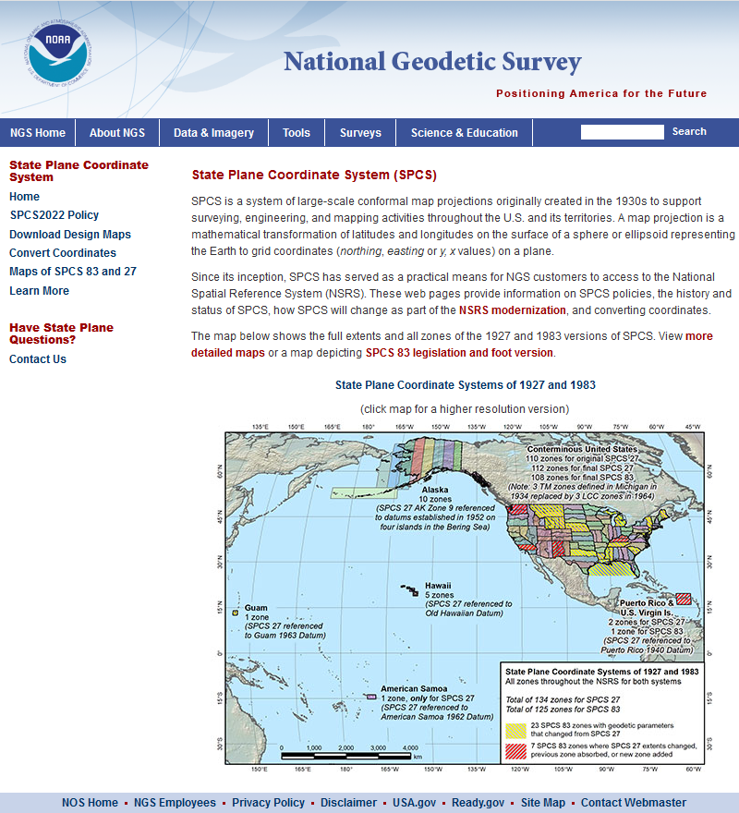
Also can find more information in the NGS presentation library or through viewing recordings of past webinars from the NGS Webinar Series.

Slide 50

? ? QUESTIONS ? ?
Denis.Riordan@noaa.gov

